Slide 1
Superheating field in superconductors with nanostructured surfaces
Pathirana and Gurevich, Front. Electr. Mat. 3, 1246016 (2023)
Alex Gurevich
Old Dominion University, Norfolk VA, USA
Supported by DOE DE-SC 100387-020

Slide 2
What are the SRF field limits and how could they be raised?
The widely used GL theory of dc superheating field H_{s}(T) is applicable near T_{c} but not at T << T_{c}.
Only H_{s}(0) = 0.84H_{c} at in the clean limit (Galaiko 1966, Catelani and Sethna, 2008)
and for arbitrary impurity concentration (Lin and Gurevich, 2012) have been calculated.
How different can the dynamic superheating field H_{d}(T,f) be from the static H_{s}(T) at GHz frequencies?
(Sheikhzada and Gurevich, 2020)
Increase of H_{s} by surface nanostructuring: dirty layers, SIS or SNS multilayers for which H_{s} has only been calculated in the limit of
We report GL numerical calculations of H_{s} at realistic finite for:
  Dirty surface layers
  SIS structures: dirty Nb-I-clean Nb, Nb₃Sn-I-Nb and others
A significant boost of H_{s} can be achieved by optimizing SIS parameters.

Slide 3
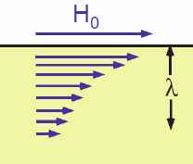

Superfluid pairbreaking velocity
1
100 nm
2-3 mm
RF field induces supercurrent density carried by Cooper pairs
Depairing current density at the surface:
J_{d} = env_{c} = 500 MA/cm²
Superfluid velocity v_{s} cannot exceed the critical value v_{c} above which the superconducting state breaks down. In the clean limit:
Thermodynamic critical field
H_{c} = 200 mT, λ = 40 nm. In Nb cavities
the dc depairing limit at 2 GHz and 2K
has been achieved on “industrial scale”
At for Nb the moving condensate of Cooper pairs
becomes unstable but the density of Cooper pairs does not vanish.
Bardeen, Rev. Mod. Phys. 34, 667 (1962), deGennes, 1968

Slide 4
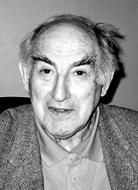
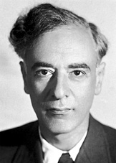
Ginzburg-Landau equations
Phenomenological Ginzburg-Landau theory (1950, Nobel prize 2003)
Coupled nonlinear PDEs for the pair wave function and magnetic vector-potential A(r).
Coherence length ξ and magnetic penetration depth λ
Thermodynamic critical field:
Boundary condition between a superconductor and vacuum J_{s} = 0:

Slide 5
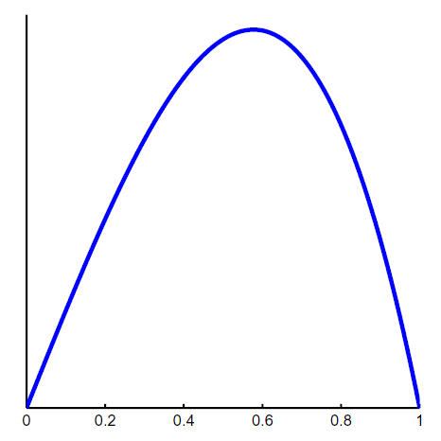
GL depairing current density
Uniform current-carrying state with ψ = ψ₀exp (-iqx), where q is proportional to the velocity of the Cooper pairs.
The GL equations give:
J = J_{d}
Current density as a function of q:
J < J_{d}
Suppression
of n_{s} by current
Maximum J at q = 1/ξ√3 defines the GL depairing current density:
ξq
At J = J_{d} the superfluid density
n_{c}(J_d) = (2/3)n_{s} does not vanish

Slide 6
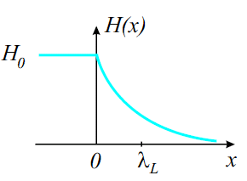
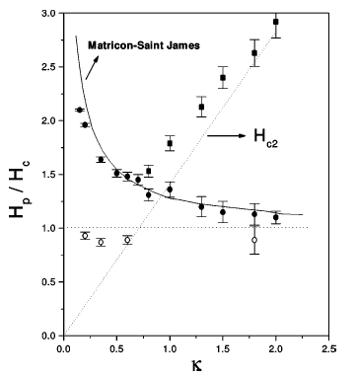
DC superheating field
Meissner state becomes unstable above the superheating field H > H_{s} as the
velocity of Cooper pairs exceed the critical velocity
GL region, T ≈ T_{c}: (Matricon and Saint-James, 1967, Chapman 1995)
λ
B_{s} decreases as the GL parameter κ = λ/ξ increases and
the material gets dirtier.
No theory of H_{s}(T) at low T and
Why?
Nb
Extrapolation of GL results to T << T_{c} underestimates H_{s}(0) = 0.84H_{c}
at κ >> 1 in the clean limit (Galaiko 1966, Catelani and Sethna, 2008)
and for arbitrary concentration of nonmagnetic and magnetic impurities (Lin and Gurevich, 2012)

Slide 7
Effect of on H_{s}
Nonlocal EM response
Local EM response
: Center of mass of Cooper pair reaches the critical velocity at J(0) > j_{d} at higher H at the surface. As a result,
Increases as decreases.
Spinning Cooper pair → vortices.
Large : Cooper pair reaches
the critical velocity at the surface, where
. This yields the
minimum superheating field at :

Slide 8
Vortices protect superconductivity at H > H_{s}
H < H_{s}
H > H_{s}
H₀
z
At H < H_{s} screening currents are not strong enough to break the Meissner state at J(0) < J_{d}
At H > H_{s} vortices reduce the current density at
the surface allowing SC at higher fields
Counterflow of vortex currents against the Meissner current reduces J(0) at the surface below J_{d} allowing
SC to survive up to high fields H_{c2} at which the vortex cores overlap
The SRF breakdown is limited by H_{s} but not H_{c2}
Vortices penetrate with supersonic velocities in
Embon et al Nat. Commun. 8, 85 (2017); Dobrovolskiy et al, Nat. Commun. 11, 3291 (2020)
Delay with penetration of vortices at H > H_{s} does not increase the SRF field limit but destroys SC

Slide 9
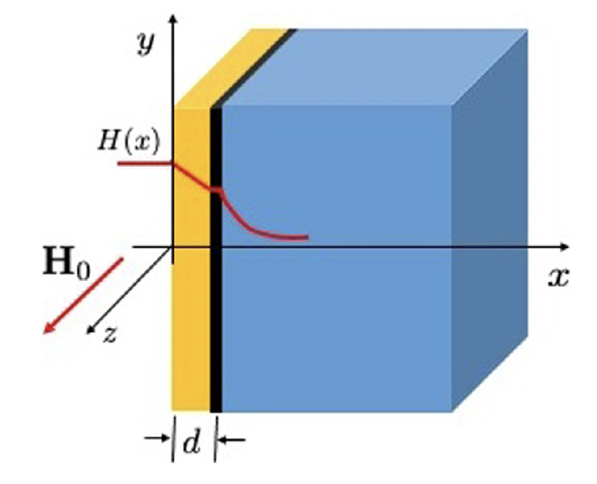
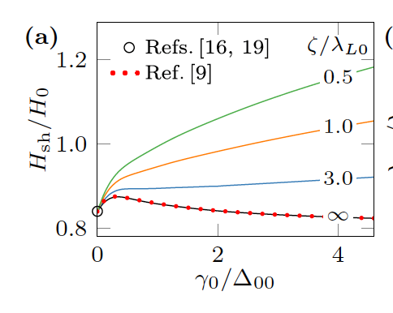
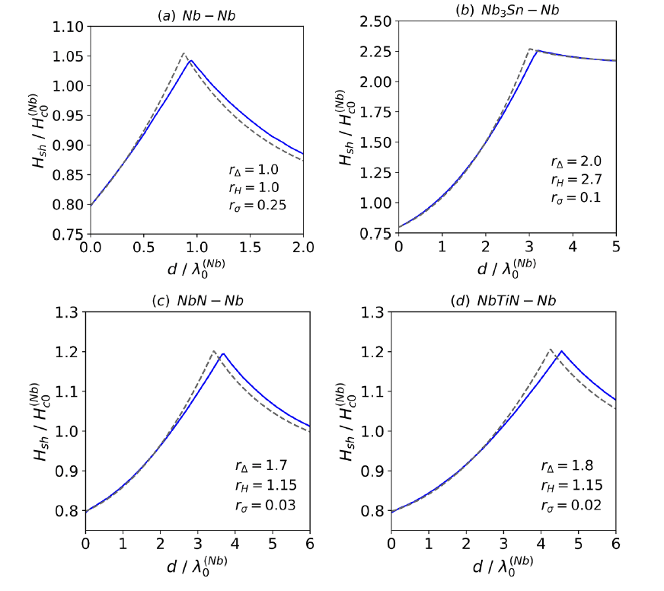
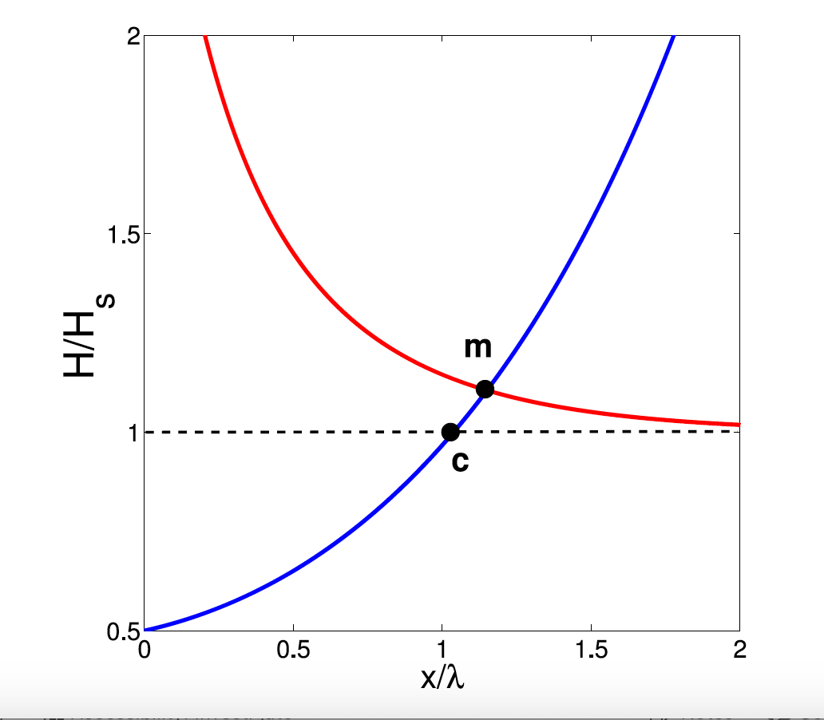
H_{s} for nanostructured surfaces in the limit of
SIS London model
Enhancement of H_{s} by current counterflow induced in the overlaayer
SIS, dirty limit, Usadel eqs
Dirty surface layer
Inhomogeneous impurity
scattering rate at the surface
Kubo, SUST 34, 045006 (2021)
Ngampruetikorn and Sauls,
Phys. Rev. Res. 1, 012015 (2019)
Gurevich, APL 88, 012511 (2006); AIP Adv. 5. 117112 (2015)
Kubo, Iwashita, Saeki, APL 104, 045006 (2014)

Slide 10
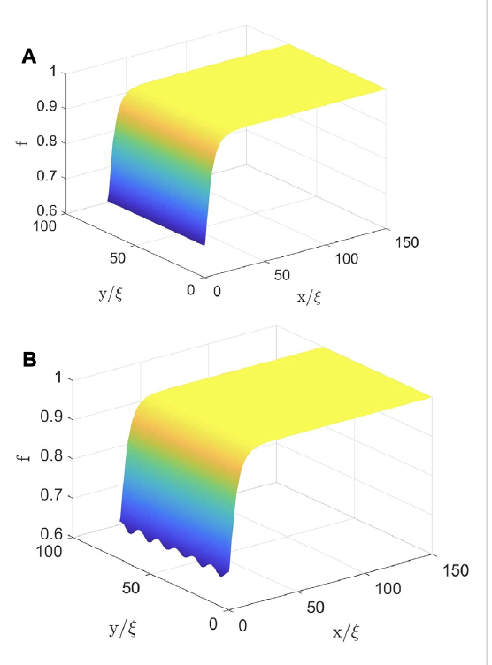
Instability of Meissner screening at H = H_{s} at finite
GL numerical simulations for Nb:
Pathirana and Gurevich, Front. Electr. Mat. 3, 1246016 (2023)
Christiansen, Solid Stat. Comm, 7, 727 (1969); Chapman
SIAM J. Appl. Math , 55, 1233 (1995); Transtrum et al, PRB
83, 094505 (2011), Liarte et al, SUST 30, 033002 (2017)
Partial suppression of
by
screening current at H < Hs
GL results for
Period along the surface
Growth of periodic perturbations
along the surface preceding
penetration of vortices at H > Hs
Decay length perpendicular to the surface
How can the instability lengths affect Hs
for nanostructured surfaces (SIS etc)?

Slide 11
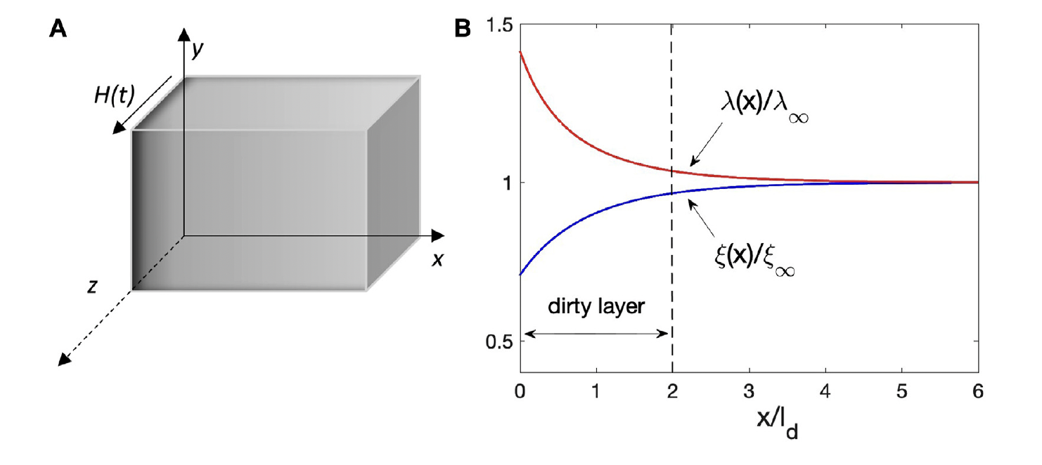
Dirty layer at the surface
Slowly ramping magnetic field:
instability

Slide 12
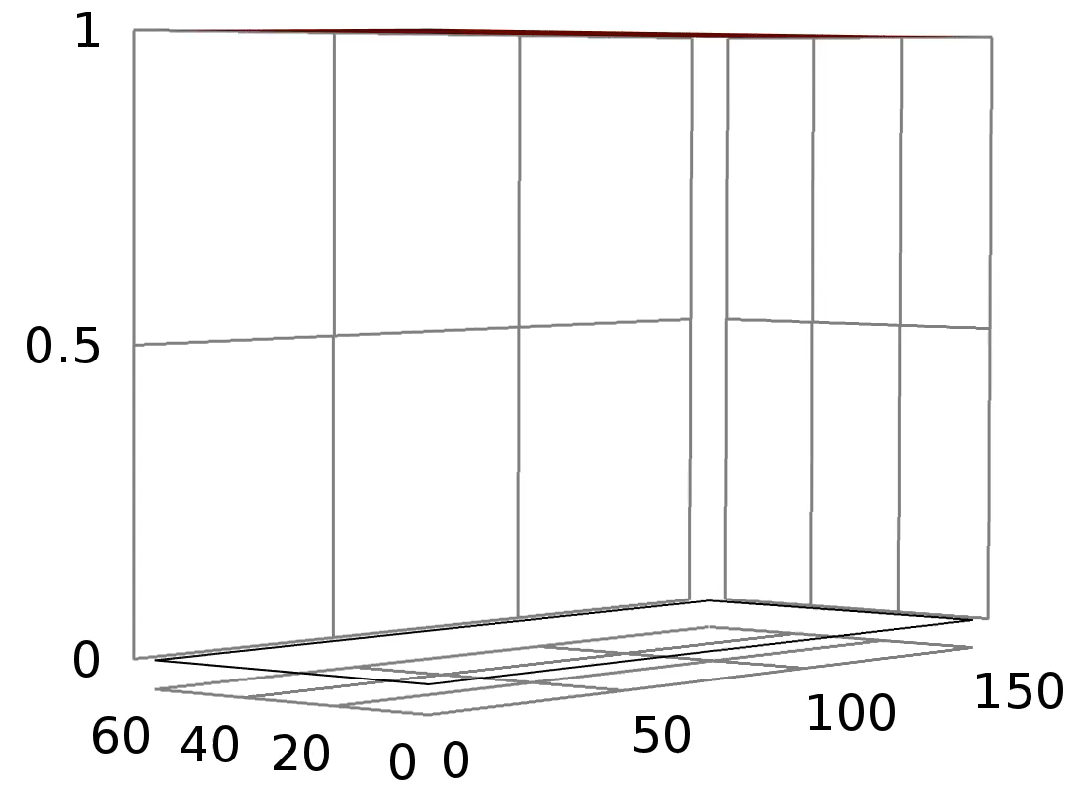
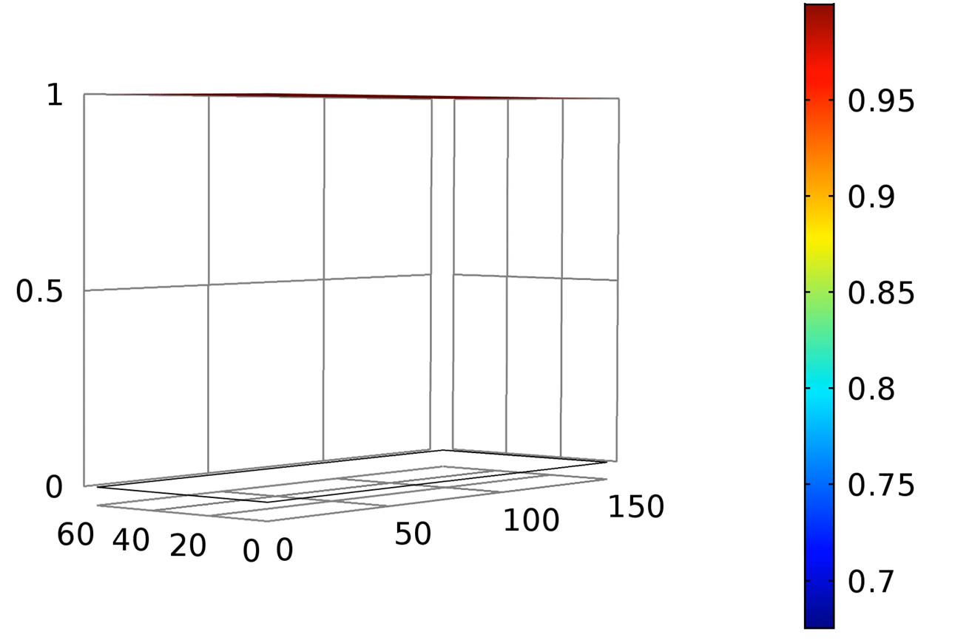
Detecting superheating field
Order Parameter (f)
x/ξ
y/ξ

Slide 13
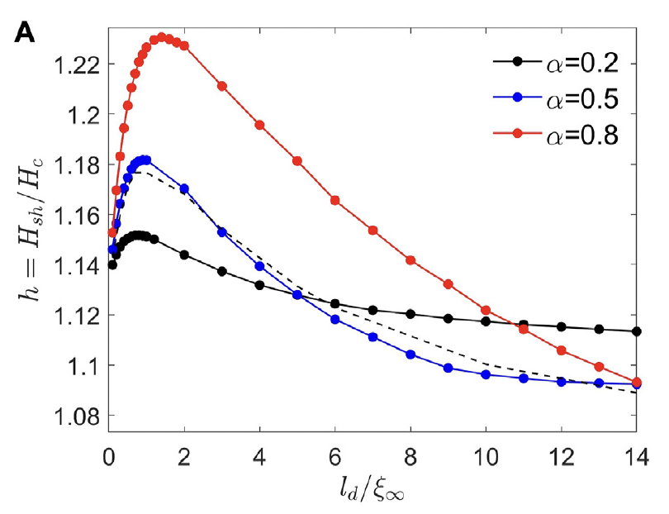
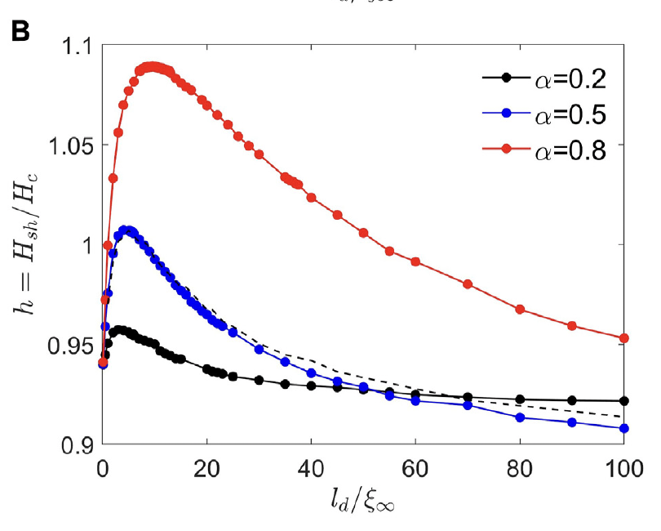
Dirty surface layer, results
Maximum in H_{s}(l_{d}) results from current counterflow induced in the dirty surface layer with larger
by the cleaner bulk with smaller , similar to that in SIS multilayers. Reduced Hs at larger ld is due to
larger GL parameter of the dirty layer,

Slide 14
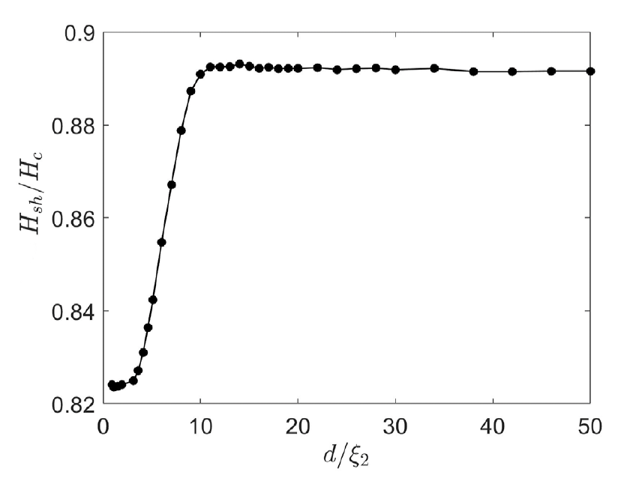
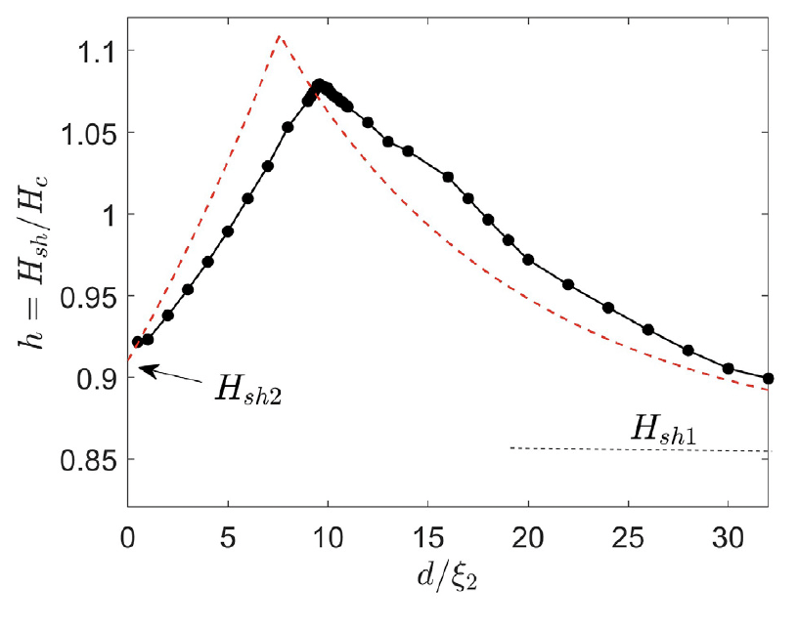
SIS with the same materials
SIS Nb₃Sn with the same
parameters of the overlayer
and the the bulk
SIS Nb₃Sn with dirtier overlayer
Dip in H_{s}(d) at small d results from suppression
of vortex perturbations by I layer over
perpendicular to the surface
Red dashed line shows H_{s}(d) calculated
in the London model

Slide 15
H_{s} of SIS in the London model
Gurevich, AIP Adv. 5. 117112 (2015)
Cusp-like maximum Hs caused by the current counterflow effect is at the optimum overlayer thickness:
Here H_{s1} and H_{s2} are the superheating fields for the bulk and overlayer materials

Slide 16
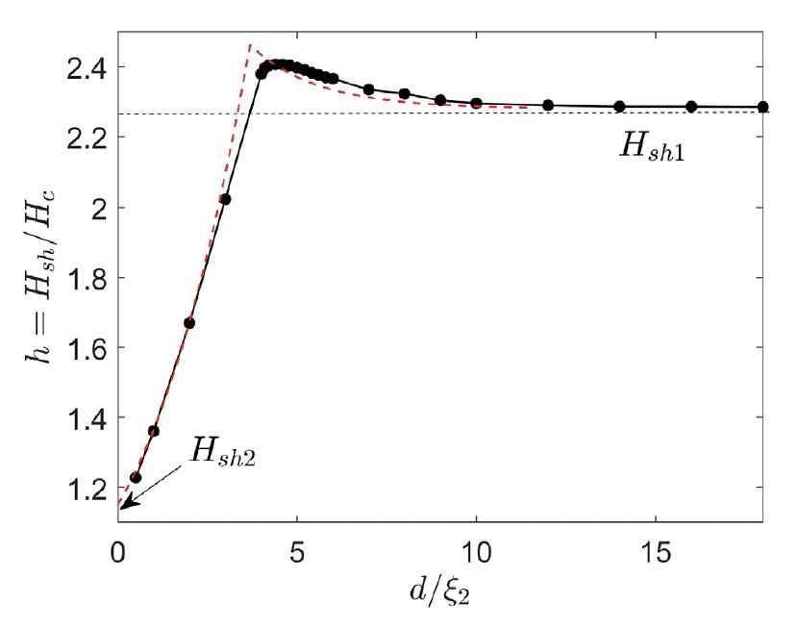
High-Tc overlayer in SIS
Thin Nb3Sn overlayer more
than doubles the dc
superheating field
London model works
surprisingly well
I interlayer is necessary to
prevent avalanche penetration
of vortices
Nb₃Sn - I - Nb

Slide 17
Nonequilibrium SRF
Sheikhzada and Gurevich, PRB 102, 104507 (2020)
Numerical simulations of equations of nonequilibrium superconductivity
Kinetic equations for quasiparticles and dynamic eqs for SC condensate
Time-dependent GL equations for a gapped dirty superconductor
Kramer and Watts-Tobin, PRL, 40. 1041 (1978)
Watts-Tobin, Krahenbuhl and Kramer, JLTP 42, 459 (1980)
Relaxation time of SC condensate:
Relaxation time constant of quasiparticles can be much larger than the RF period
Relaxation time of quasiparticles due to
inelastic electron-phonon collisions:
For Nb at 7K, we have:
Nearly instantaneous reaction of SC condensate to RF field.
Much slower relaxation of quasiparticles, which slows down greatly as T decreases

Slide 18
Dynamic SRF breakdown
SC breakdown field H_{d} (T,f) increases with up to the limit:
SC breakdown caused by the time
averaged squared RF field

Slide 19
Dynamic superheating field
High temperatures: enhancement of H_{d} due to slow qp relaxation:
Low temperatures: T < 0.5Tc: the relaxation time increases greatly but the density of quasiparticles decreases exponentially in the dirty limit.
No effect of quasiparticles on SC breakdown if
In the clean limit the quasiparticle gap vanishes at H < H_{s},
so the dynamic superheating field may be enhanced by slow relaxation of
quasiparticles
Sheikhzada and Gurevich, PRB 102, 104507 (2020)
Lin and Gurevich, PRB 85, 054513 (2012)

Slide 20
Conclusions
GL calculations of H_{s} for surface dirty layer and SIS structures were performed for arbitrary GL parameter.
In all cases we observed a maximum in H_{s} at optimal thickness for which H_{s} exceeds the superheating fields of both the overlayer and the bulk materials
Our GL results for H_{s}(d) at finite are qualitatively consistent with previous calculations in the London model
At GHz frequencies the dynamic superheating field in the dirty limit is close to the static H_{s} but in the clean limit the relation between H_{d} and H_{s} has not been investigated

