Slide 1



Thin Films SRF 2024
11th International Workshop on Thin Films
and New Ideas for Pushing the Limits of RF Superconductivity
Paris, September 16 – 20, 2024
Université Paris-Saclay, France
Nb₃Sn/Cu by Magnetron Sputtering for SRF cavities at INFN-LNL
Dorothea Fonnesu
17.09.2024
Work supported by INFN CSN5 experiment SAMARA and INFN CSN1 experiments SRF and RD_FCC
This project has received funding from the European Union’s Horizon-INFRA-2023-TECH-01 under GA No 101131435 – iSAS
and from the European Union’s Horizon 2020 Research and Innovation programme under GA No 101004730 – I.FAST

Slide 2
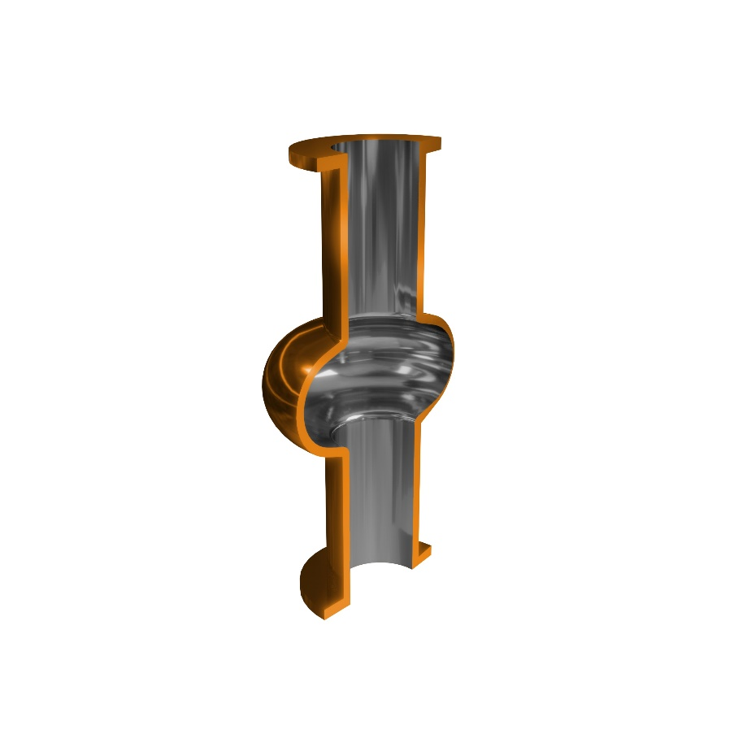
Outline
Nb₃Sn/Cu challenges
INFN-LNL goal
Deposition recipe optimization
Nb₃Sn R&D projects timeline
Conclusion

Slide 3
















Our partners
Lehrstuhl für
Oberflächen- und
Werkstofftechnologie

Slide 4
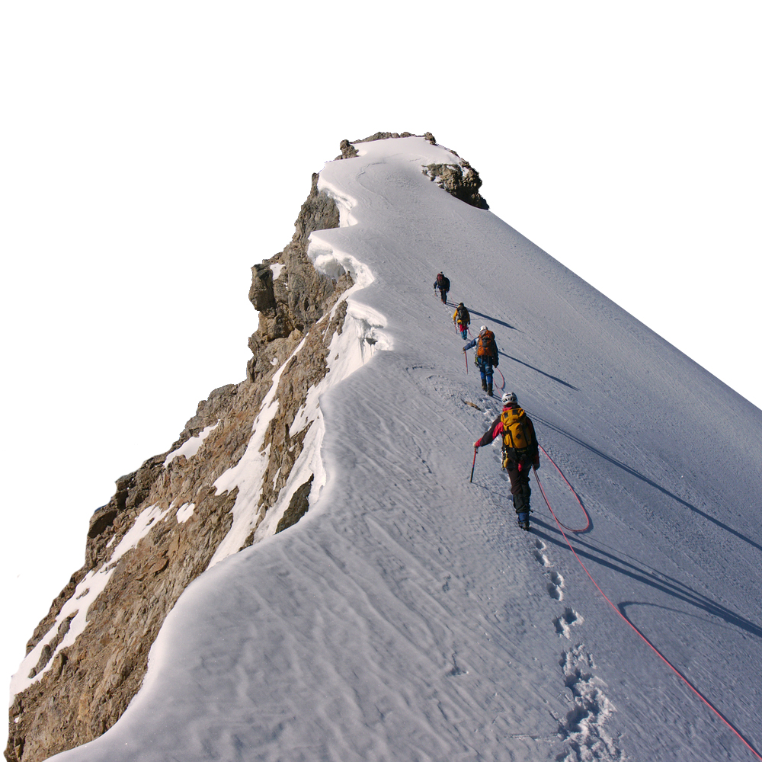



Nb₃Sn on Cu: multiple challenges
A15 are brittle materials
Complicated phase diagram
Low melting point substrate (Cu)
Interface diffusion
Tuning of coating parameters
Substrate preparation
Target production/magnetron design
Trapped flux
Cavity tuning
ESPP Accelerator R&D Roadmap

Slide 5
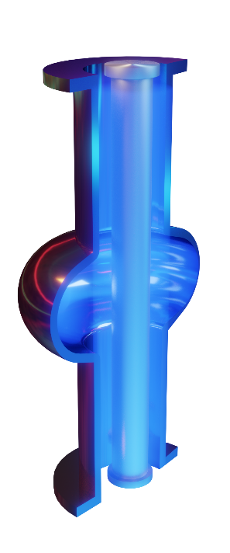
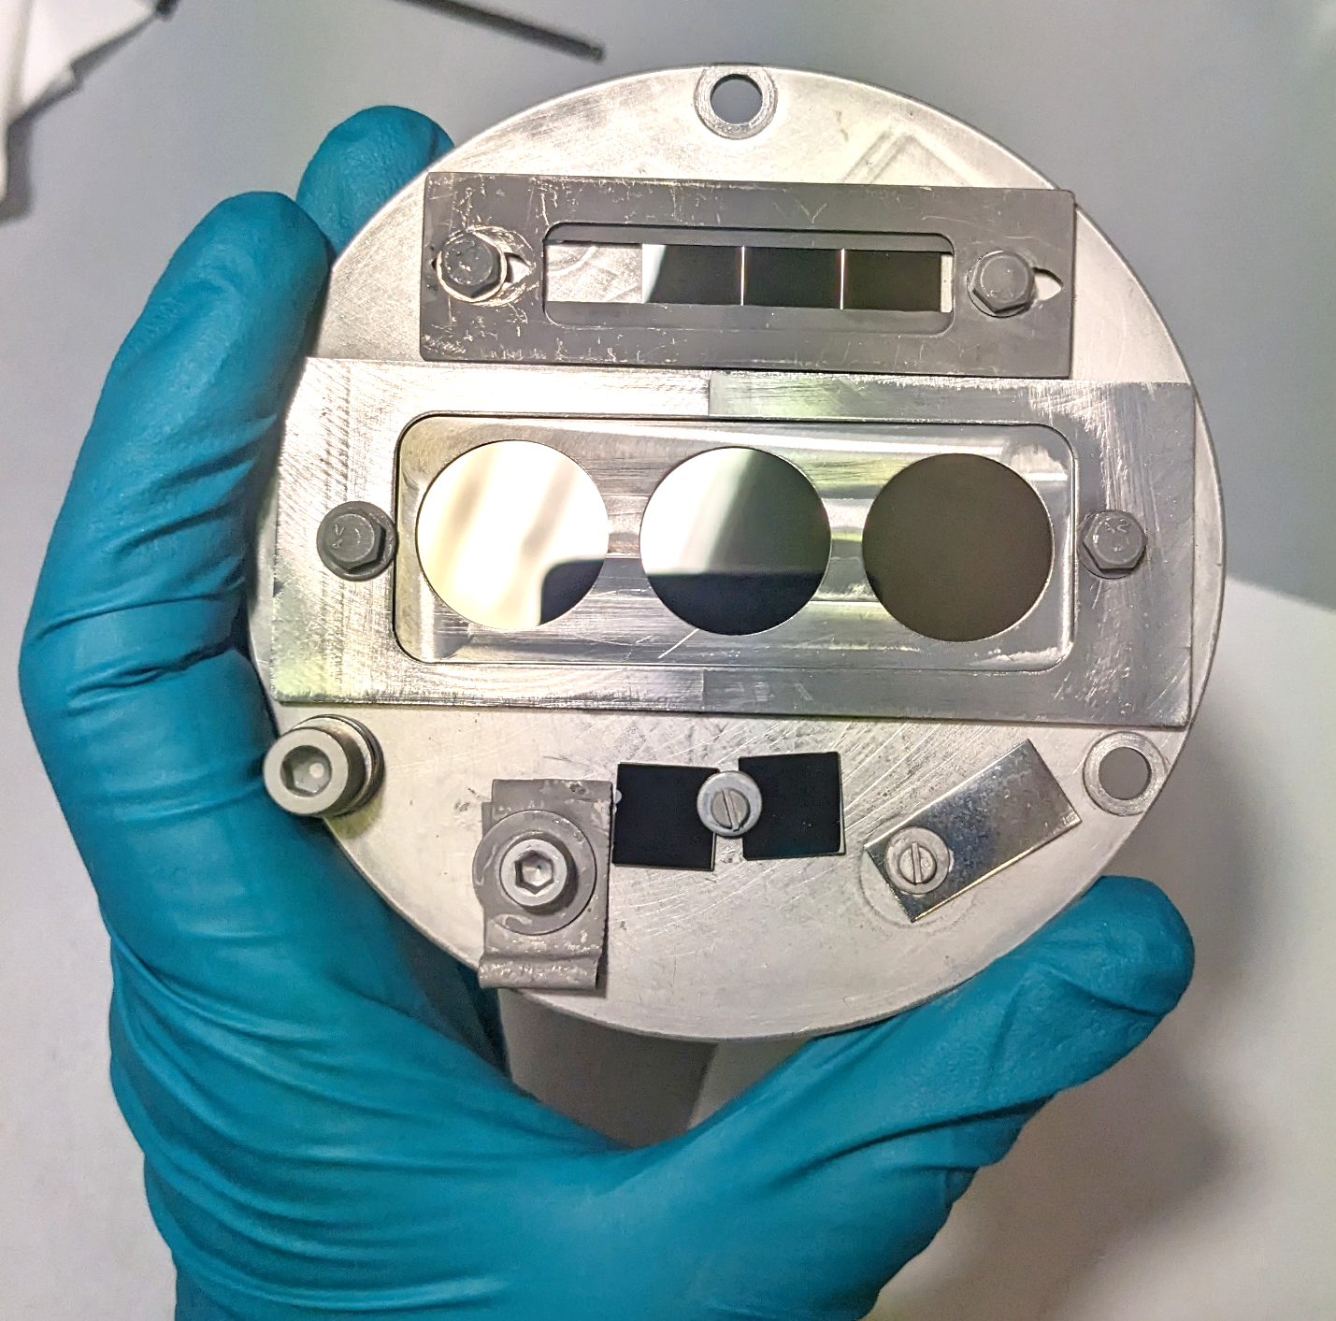
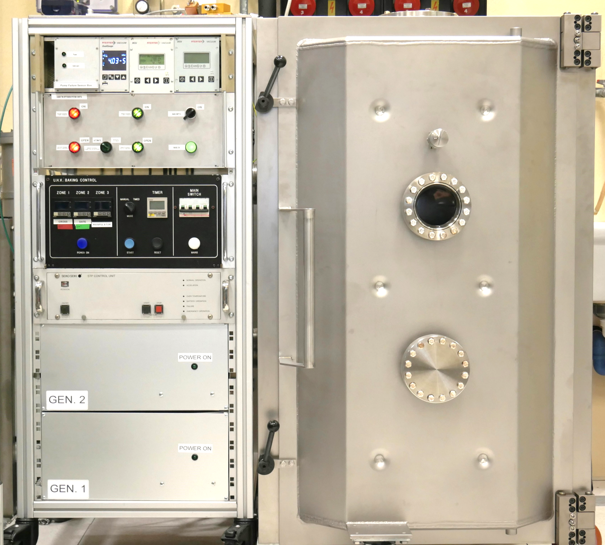
INFN-LNL goal
Main R&D activities
1.3 GHz elliptical Nb₃Sn/Cu prototype cavity
How?
Easy and validated
(e.g. LHC Nb/Cu)
DCMS with stoichiometric single target
(small samples)
cylindrical target production via LTD
(6 GHz cavities)
Deposition recipe must be optimised
DC Magnetron Sputtering
Liquid Tin Diffusion
Notes:
DCMS demonstrated for Nb/Cu (LEP-II, LHC, ALPI, ISOLDE)
easy to implement with single stoichiometric target for Nb₃Sn

Slide 6
Deposition recipe optimization
1
2
3
tuning of deposition parameters based on T_{c} of small film samples
production and RF test of quadrupole resonator (QPR) sample
apply 1&2 again for the deposition and RF test of 1.3 GHz prototype

Slide 7
1
T_{c}-driven parameter optimization

Slide 8
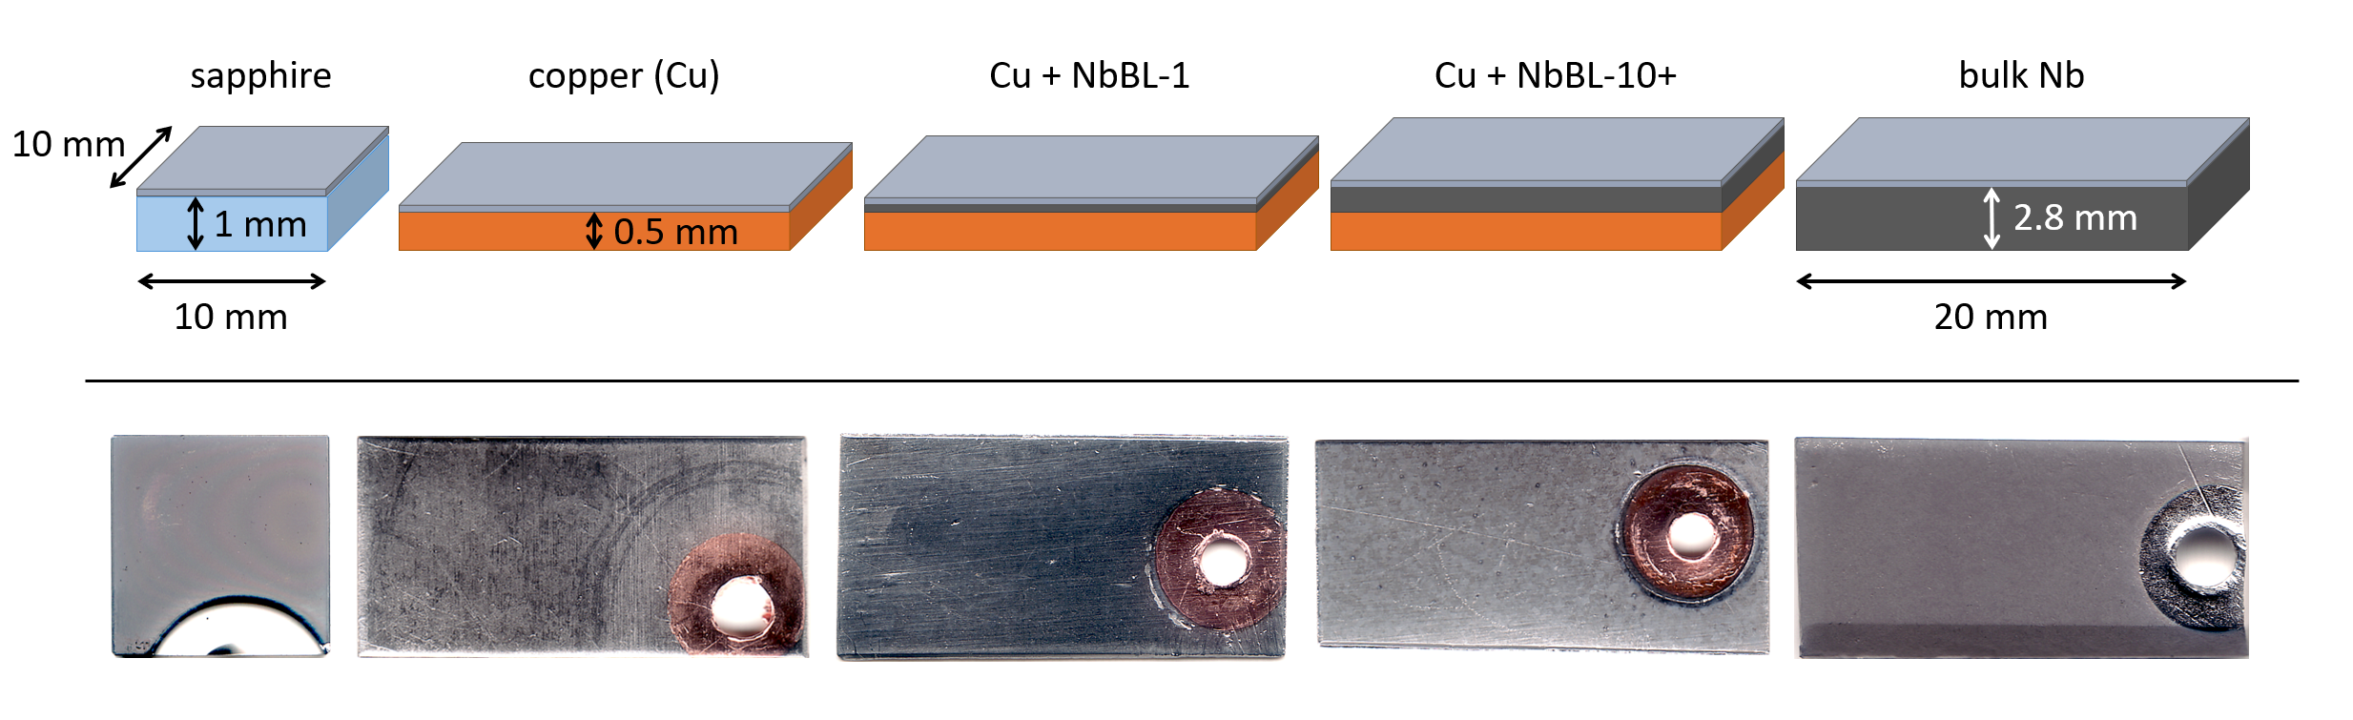
Sample production
Tight-feedback driven standardized process:
deposition > characterization > parameter adjustment
    Films are deposited on different substrates:
      sapphire for reference as substrate does not affect the film
      copper without and with a niobium buffer layer (NbBL) of variable thickness
      bulk Nb

Slide 9
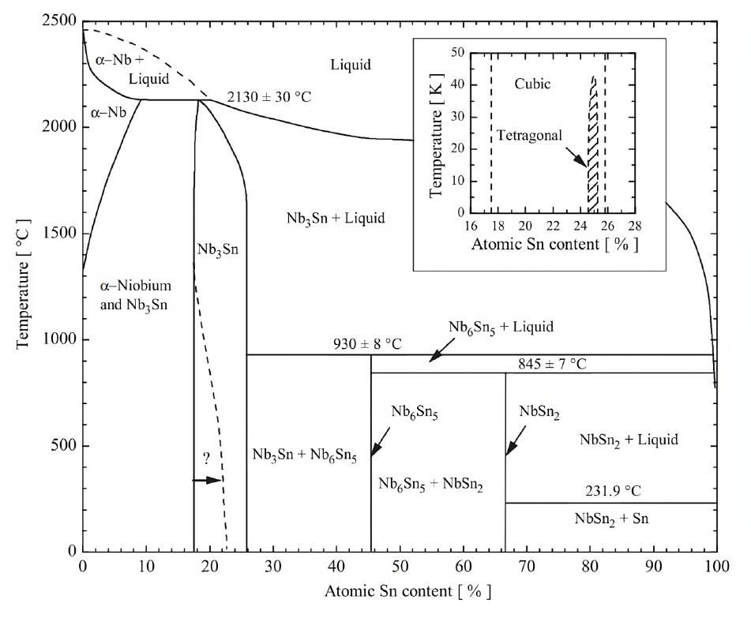
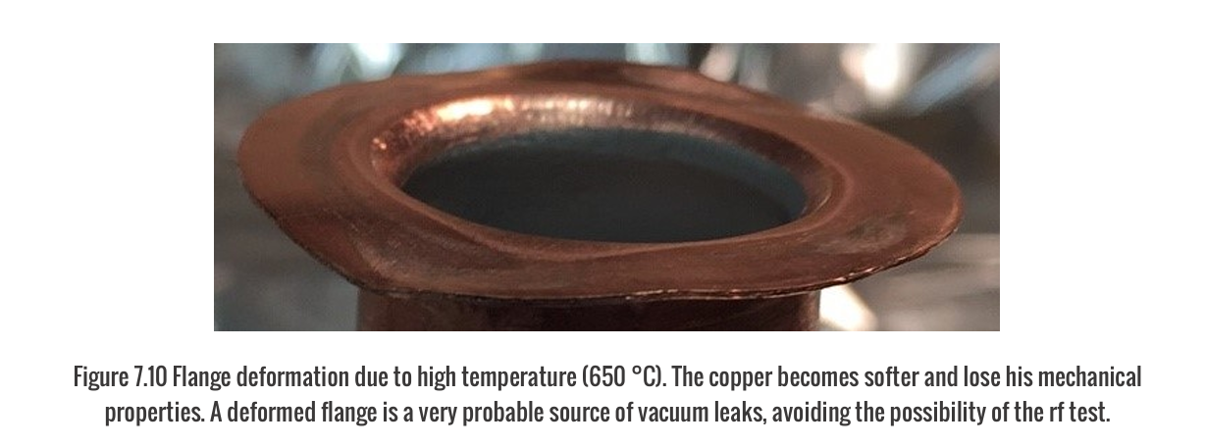
Deposition temperature limit
Limited by weakening point of copper
      Cu starts weakening at ~ 450 °C (Nb₃Sn requires > 930 °C)
      softening of 6 GHz cavity flanges observed at 650 °C

Slide 10
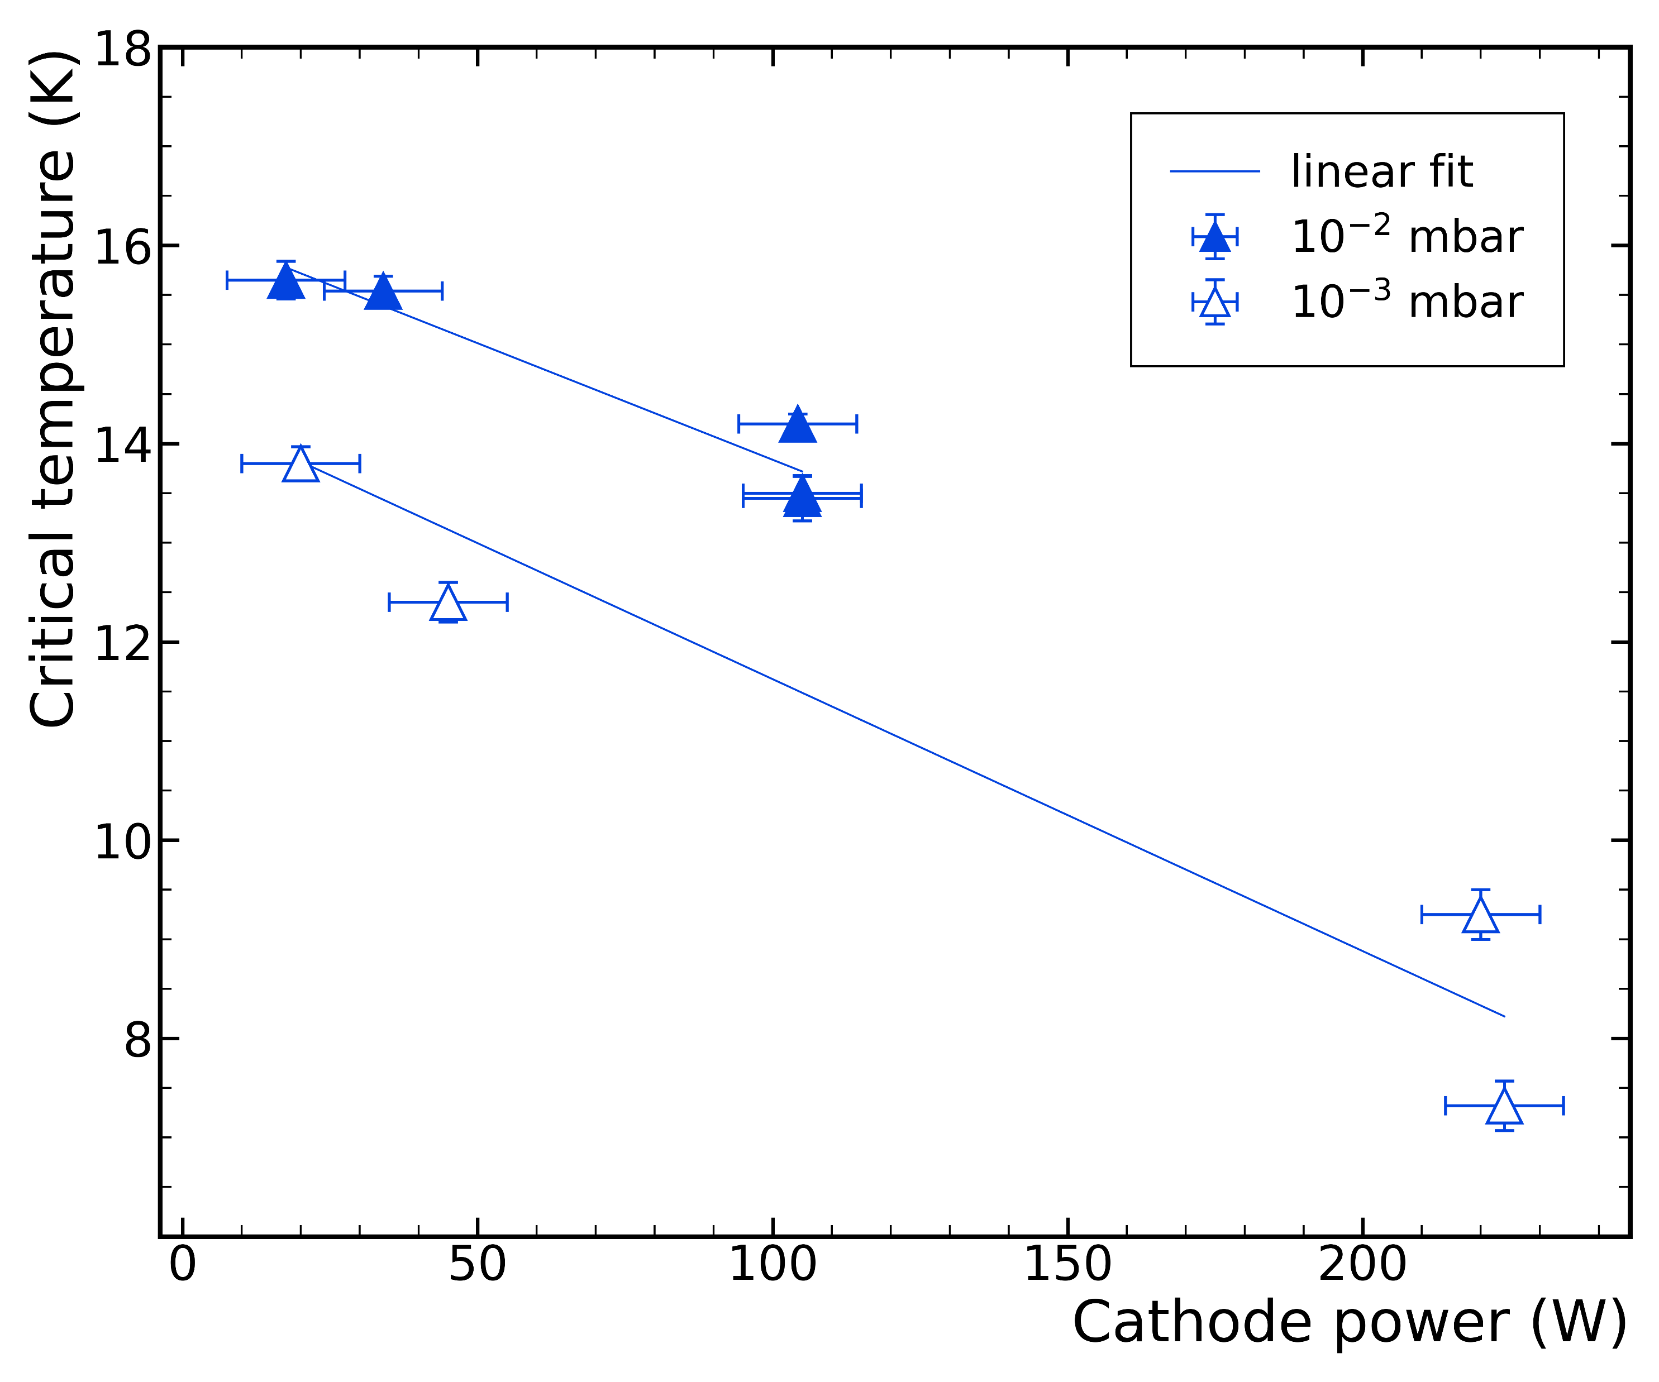
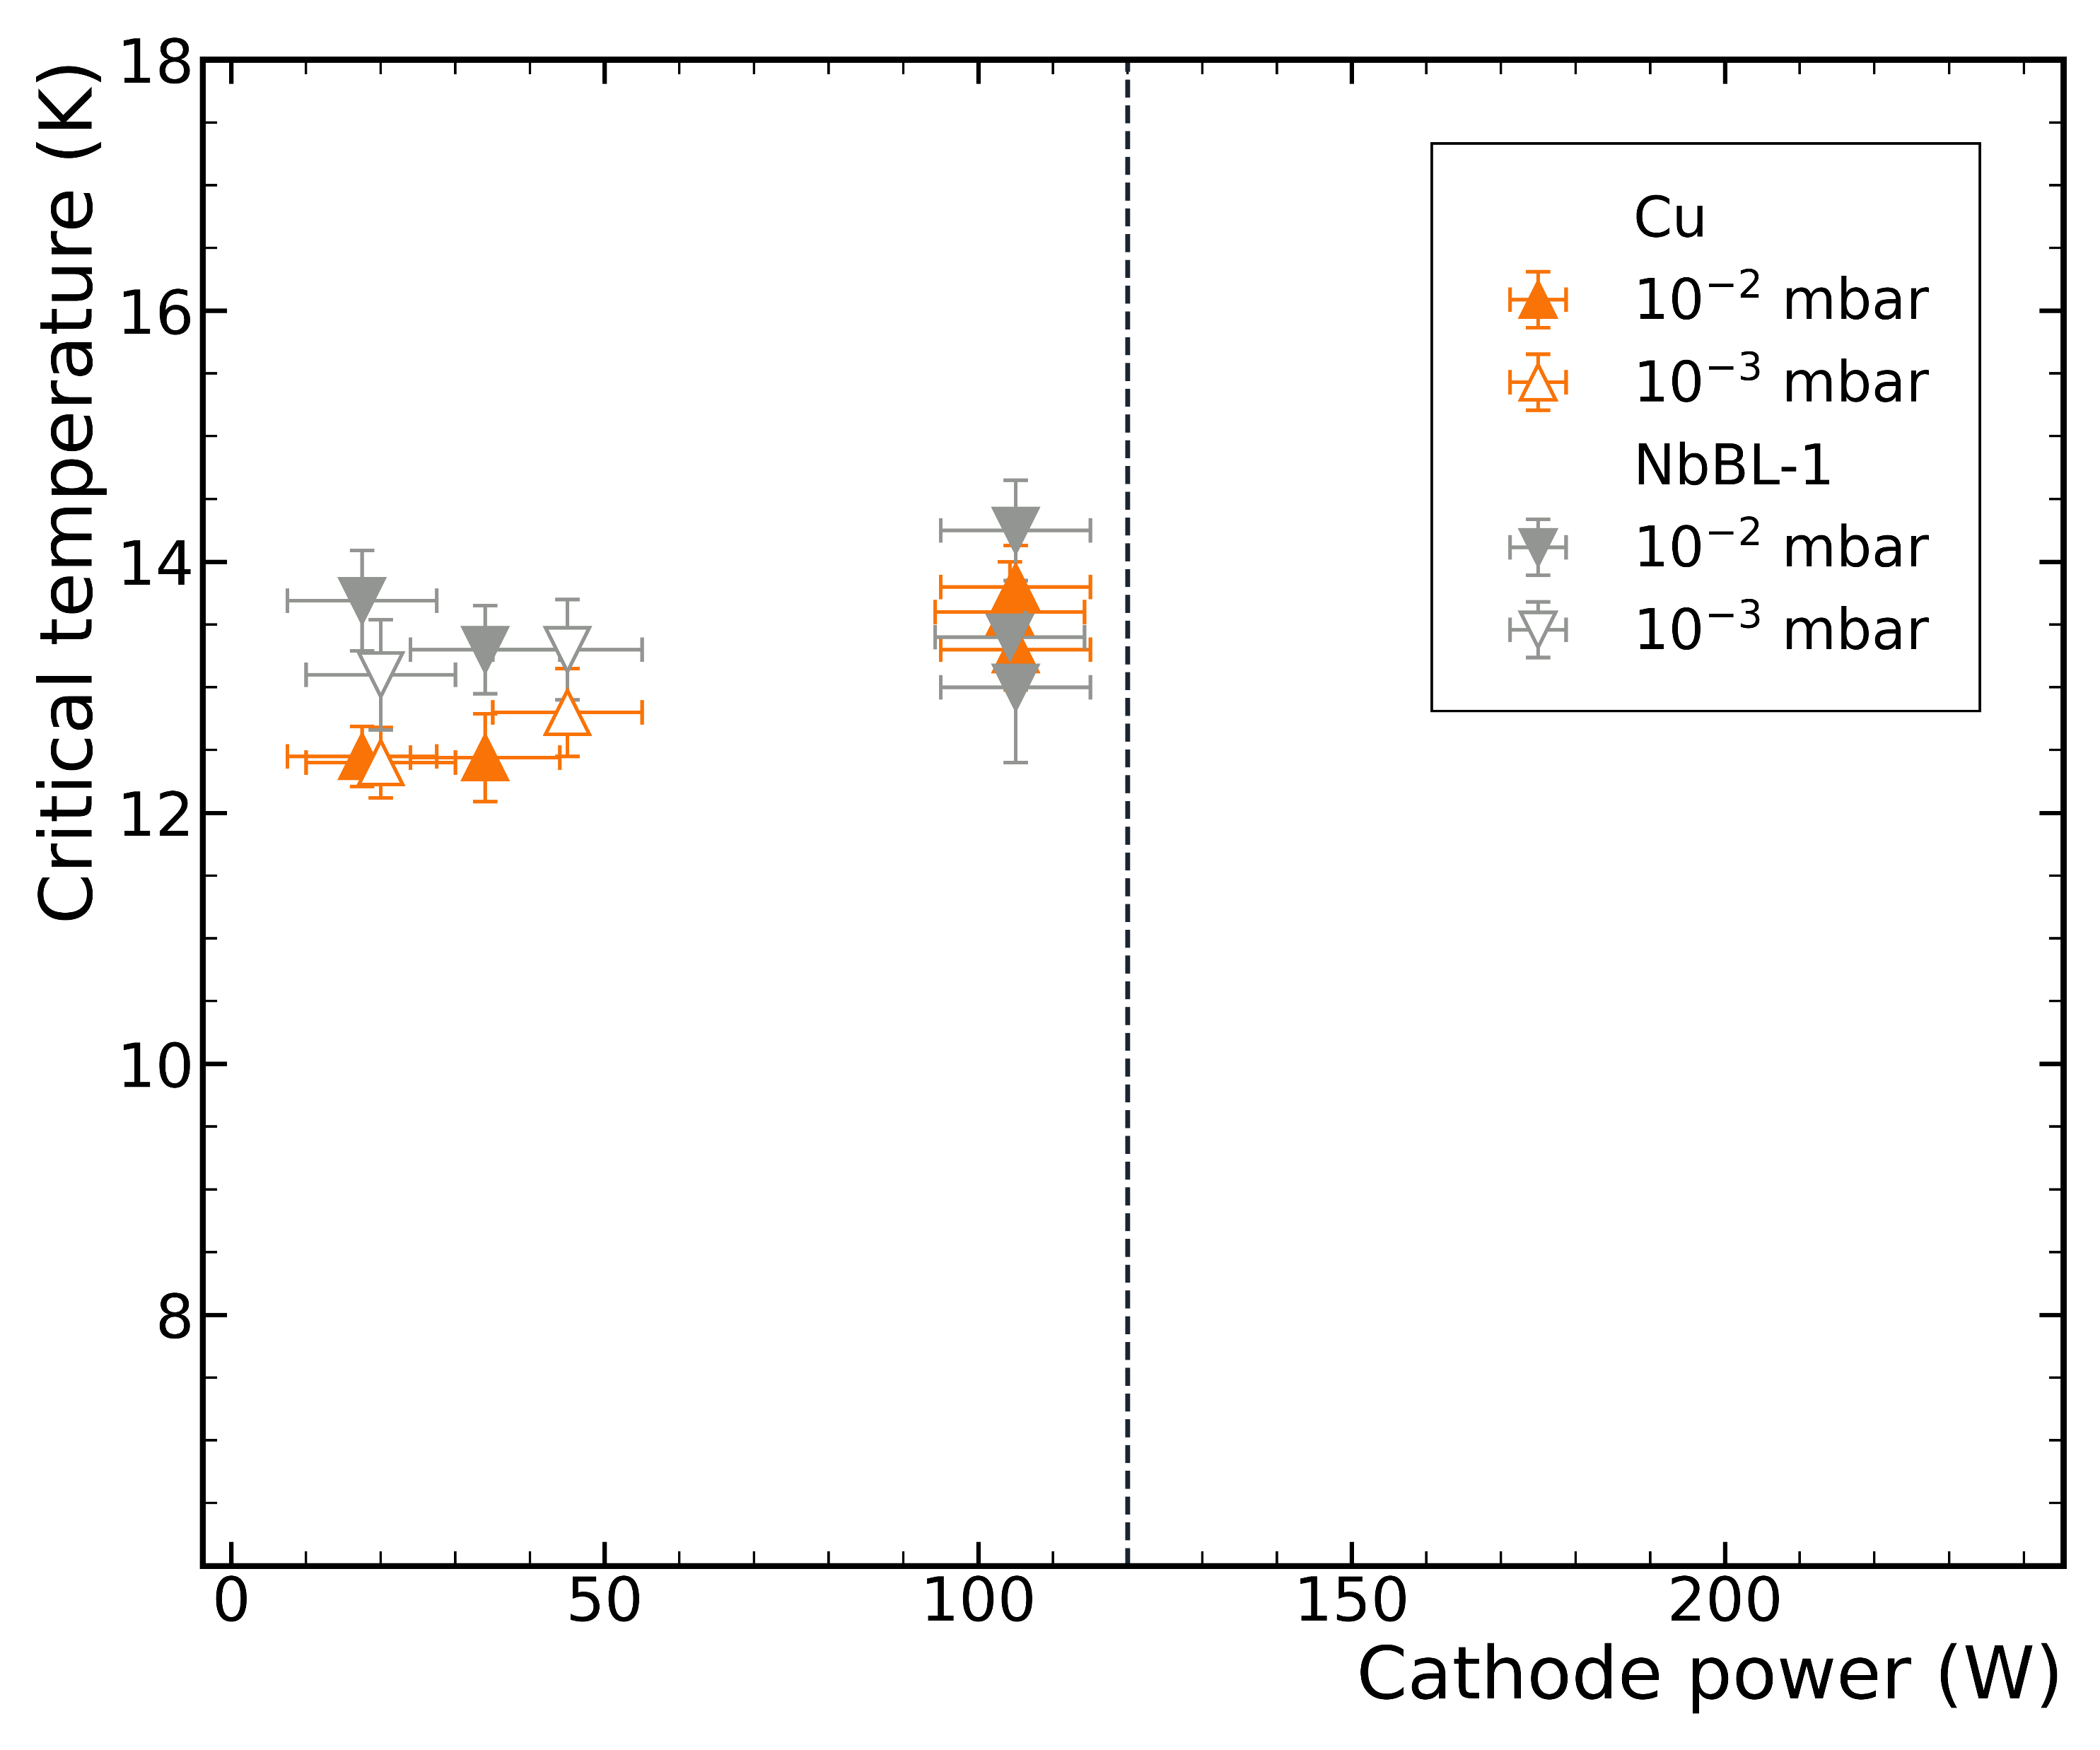
Pressure and cathode power
Deposition temperature = 630 ºC
sapphire substrate
copper and NbBL-1 substrate
T_{c}
pressure
power
not SC

Slide 11
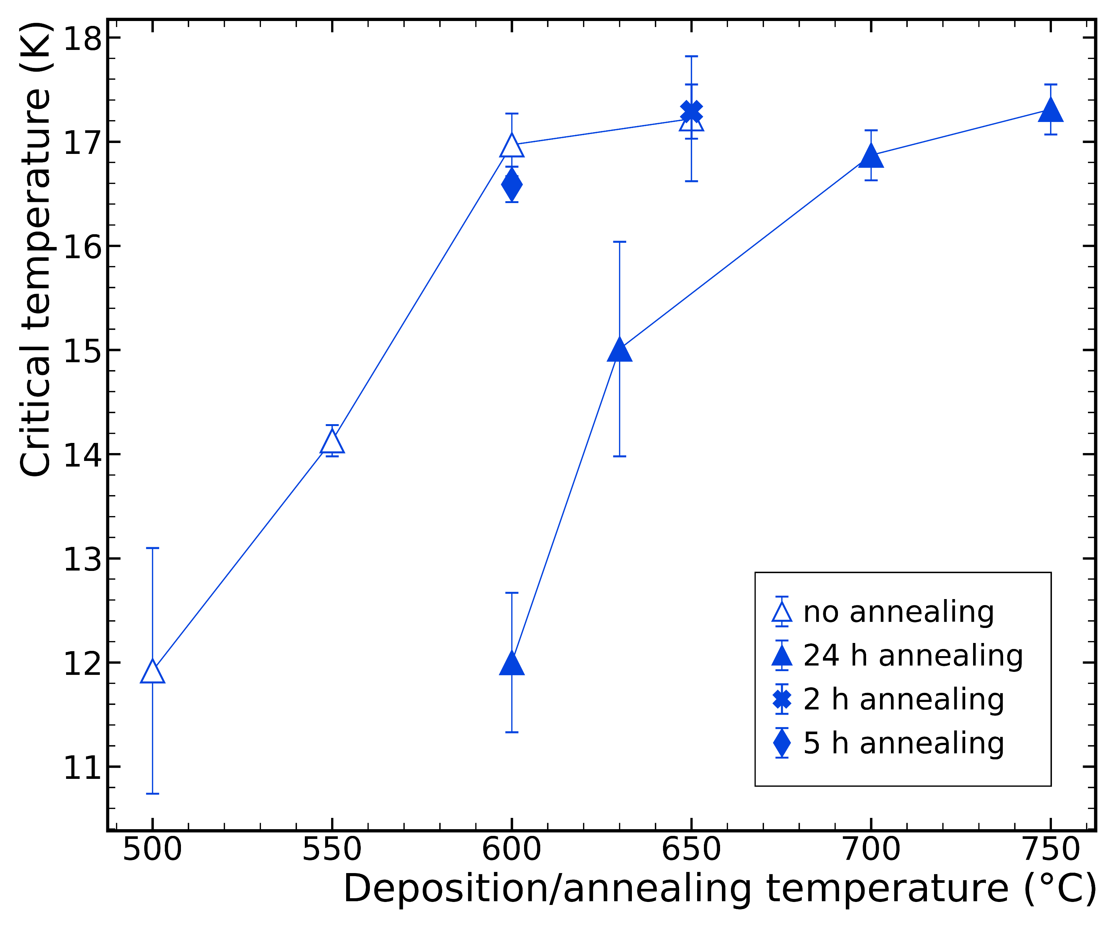
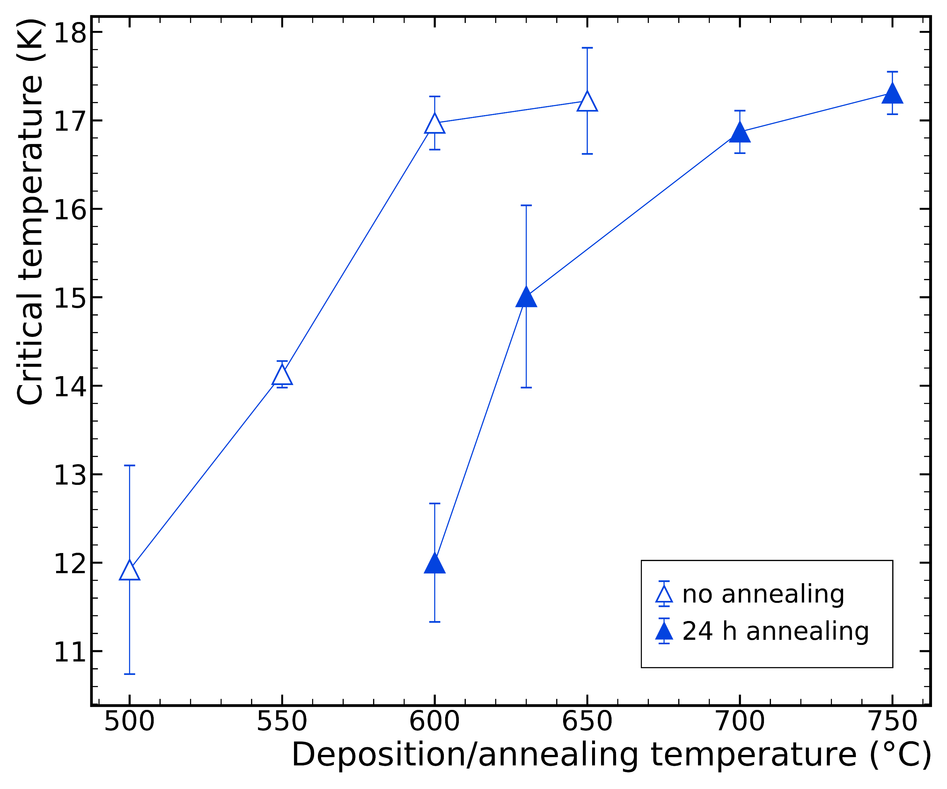
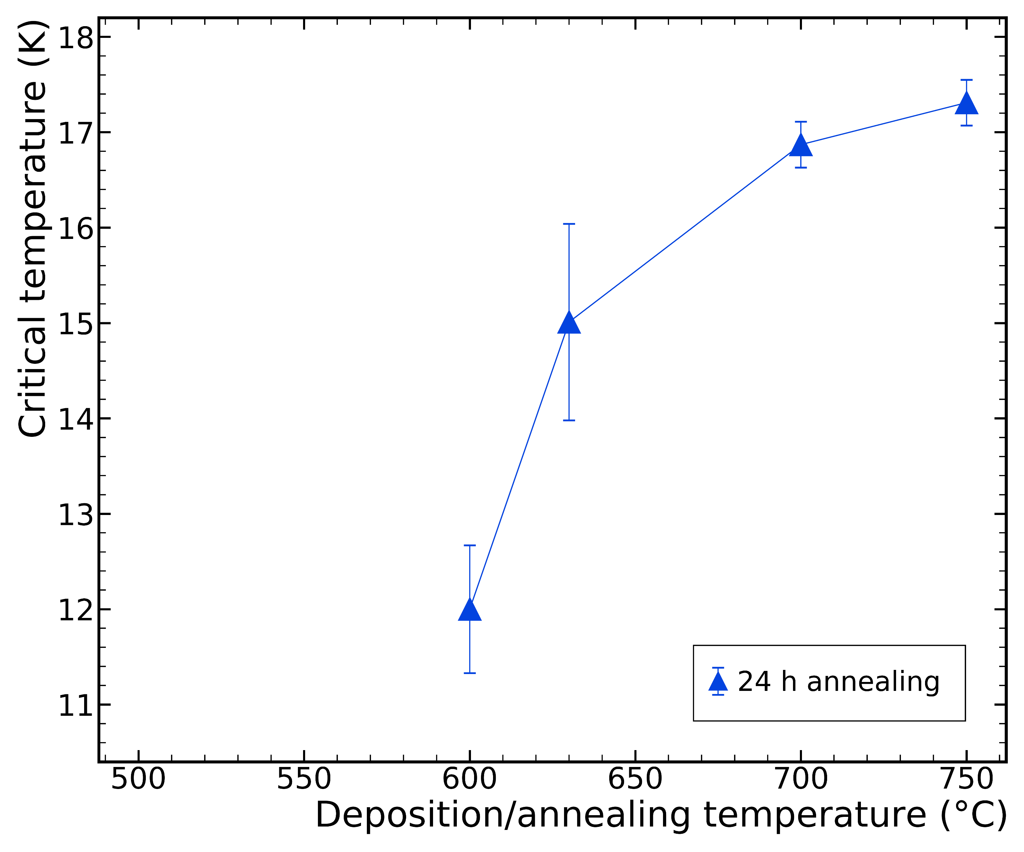
Temperature and annealing time
sapphire substrate
2 h
5 h
Annealing detrimental for T_{c}

Slide 12
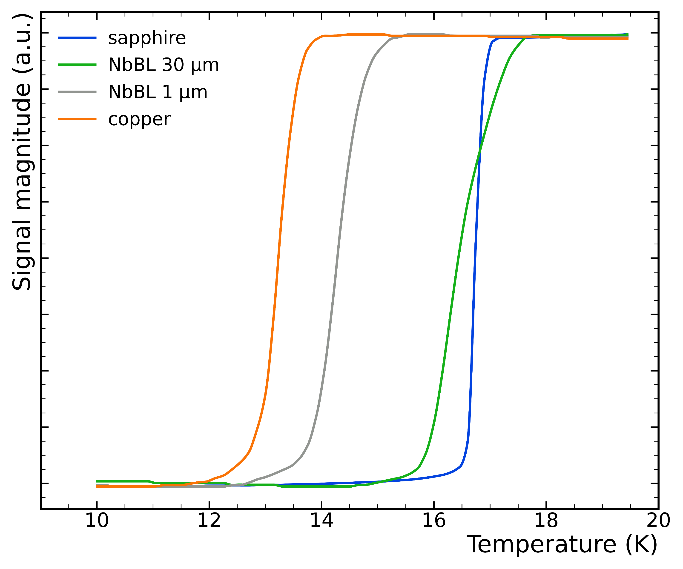
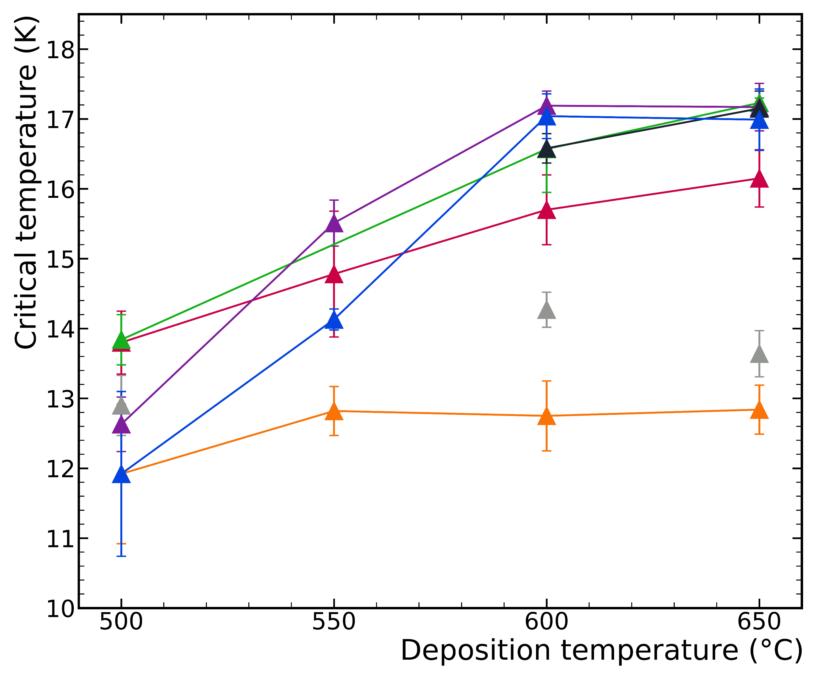
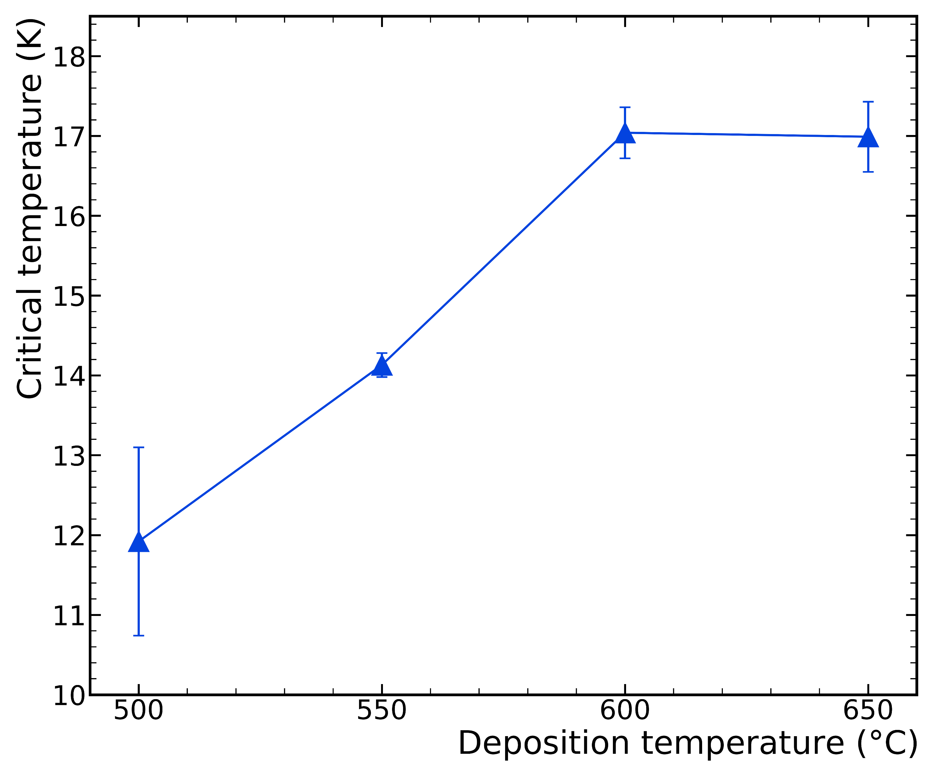
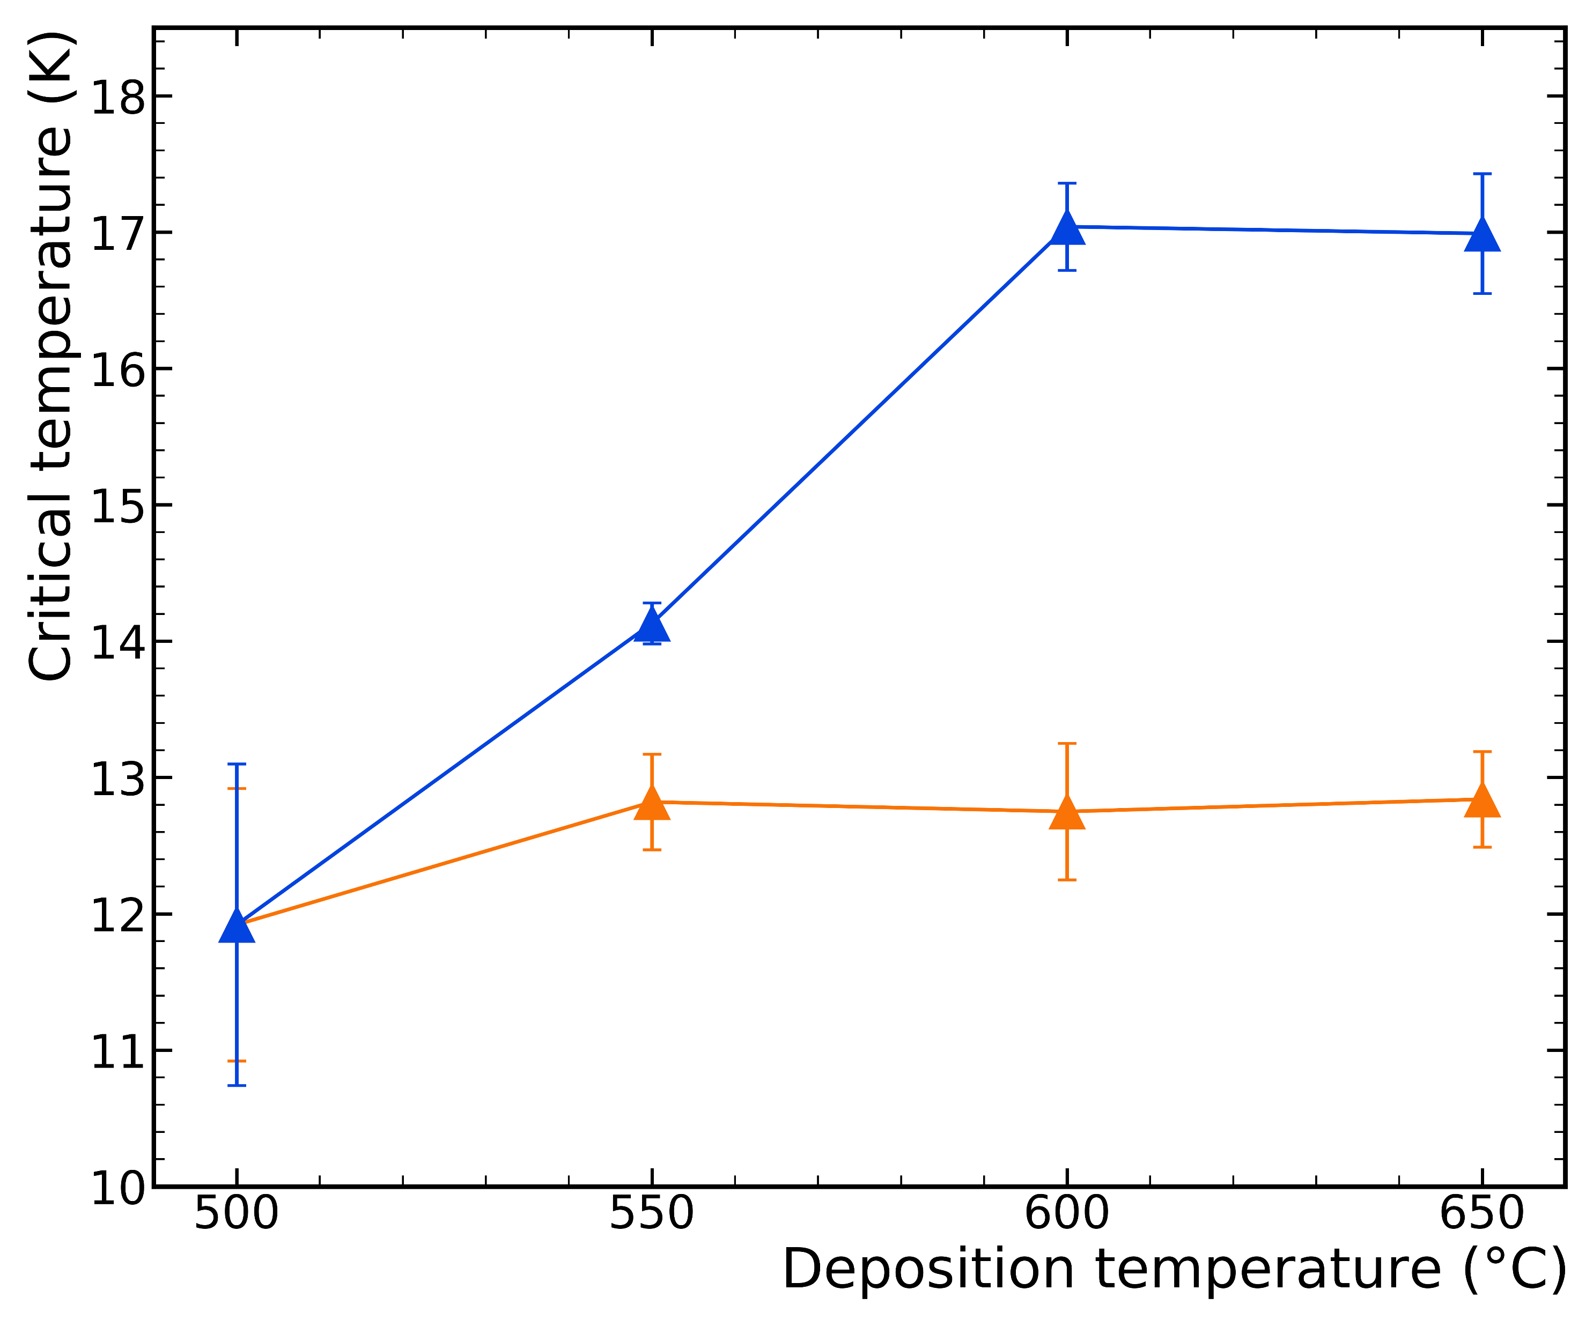
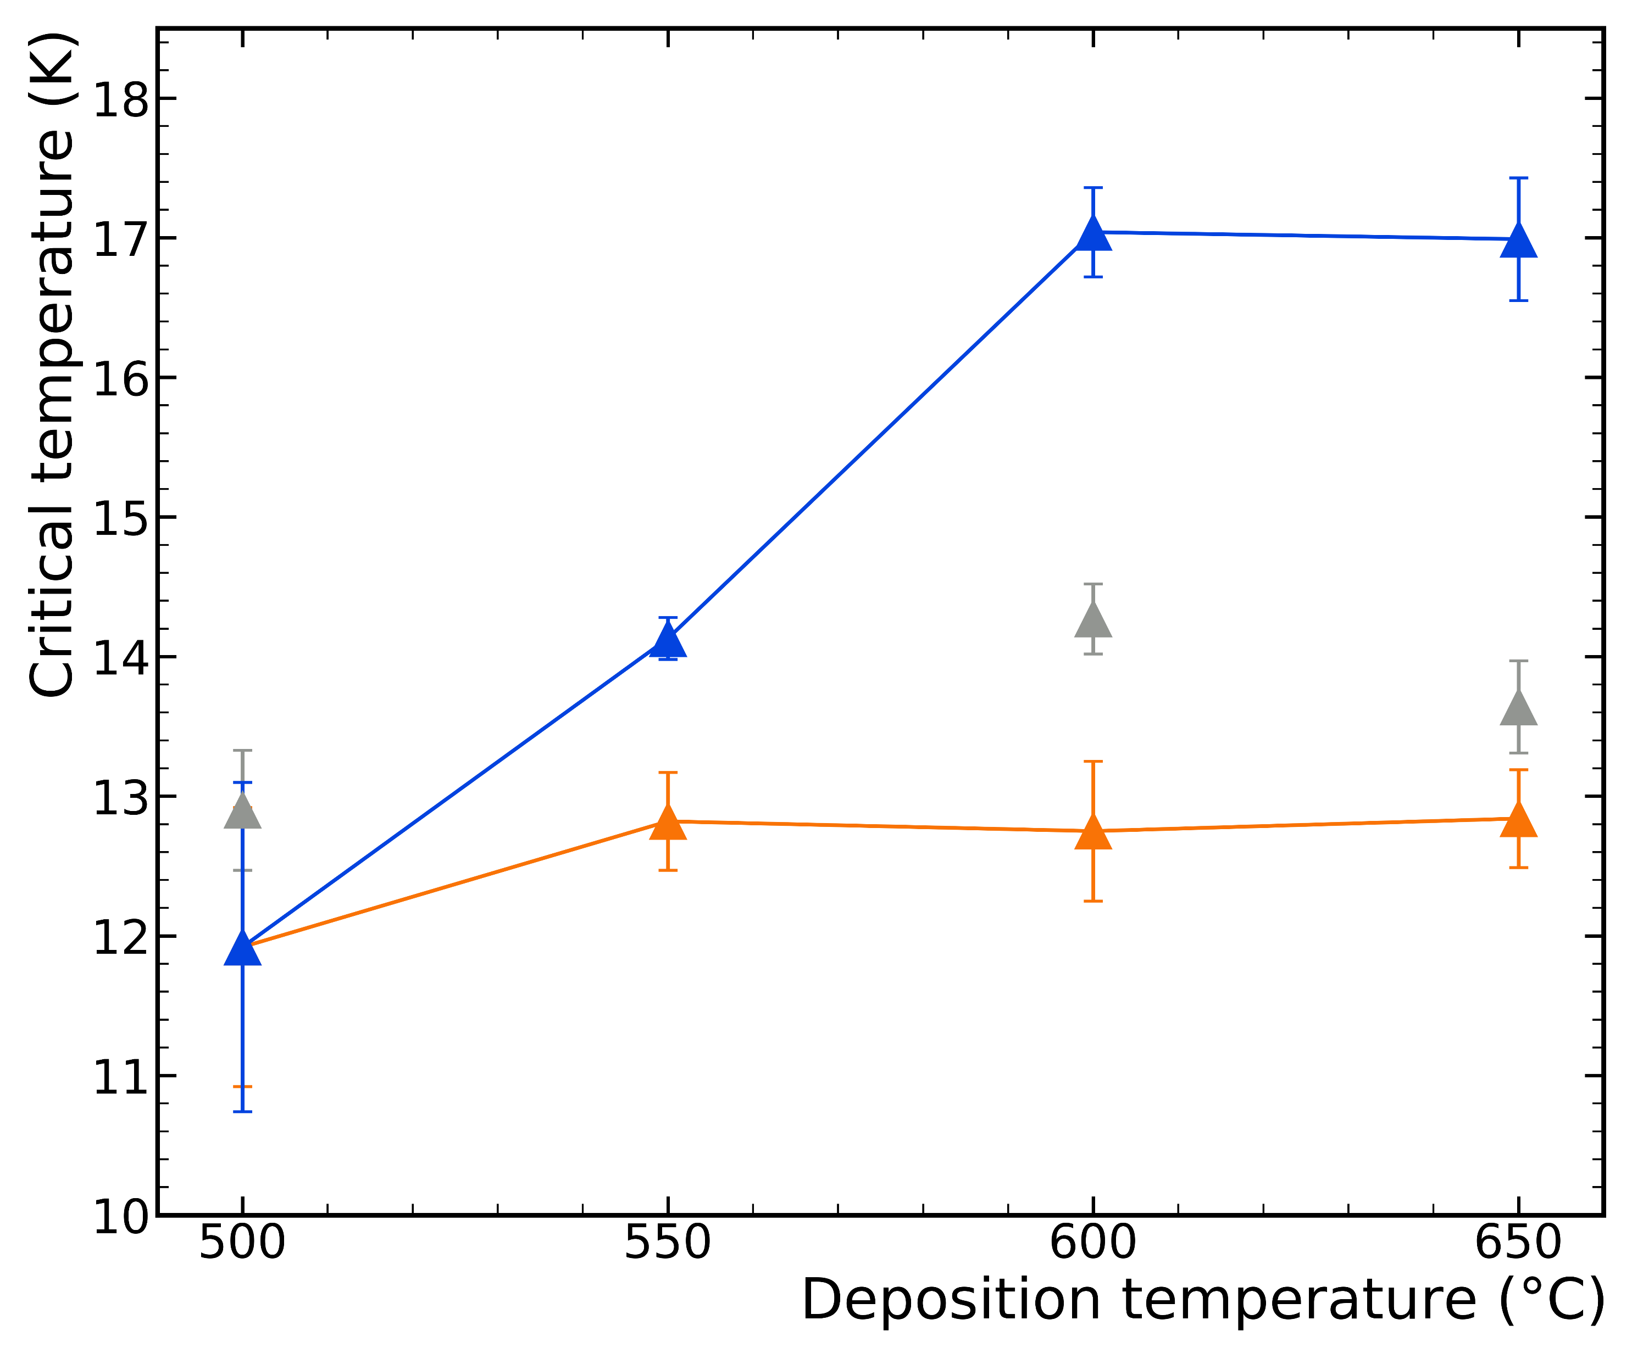
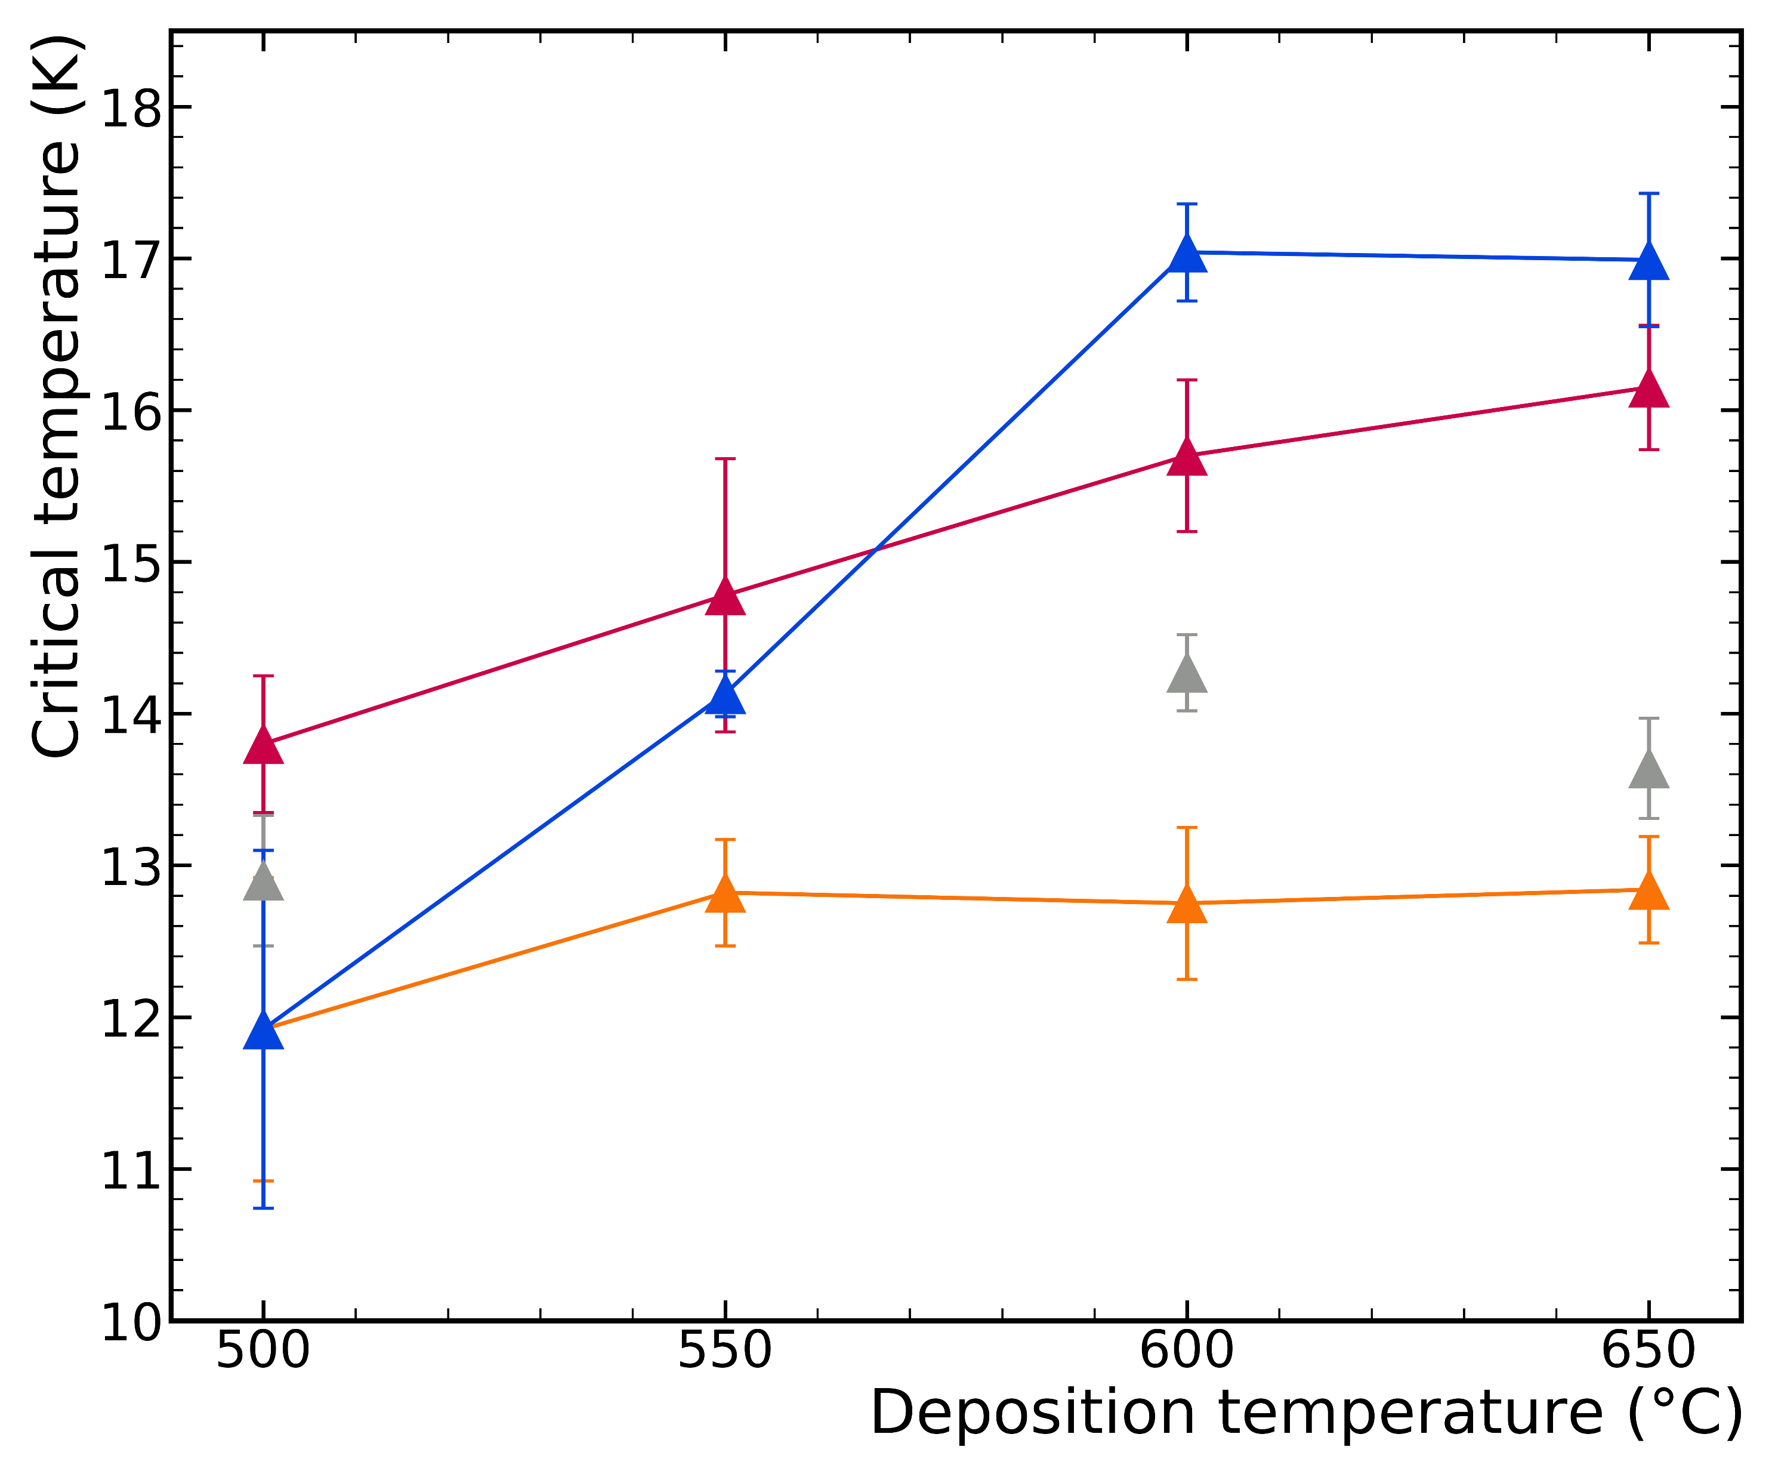
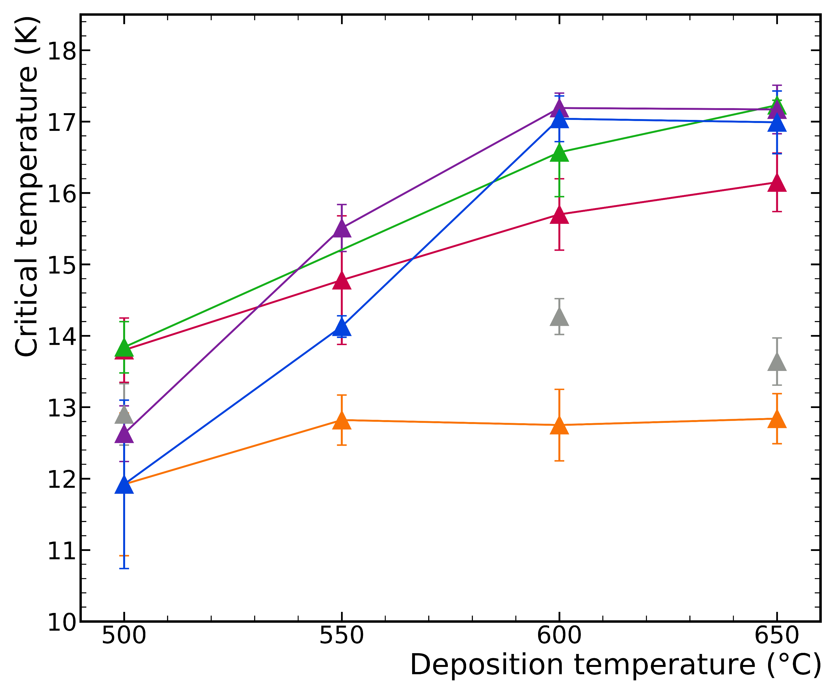
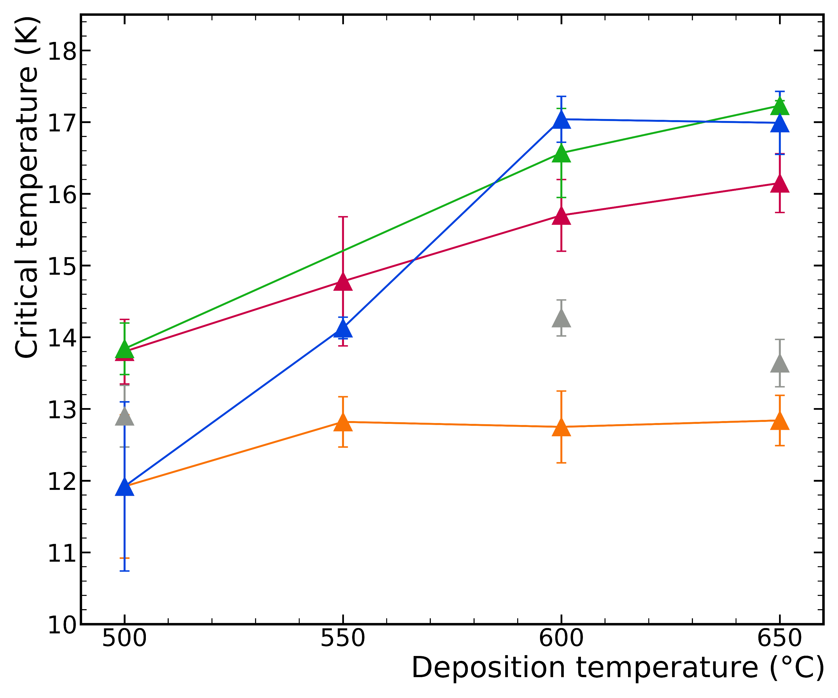
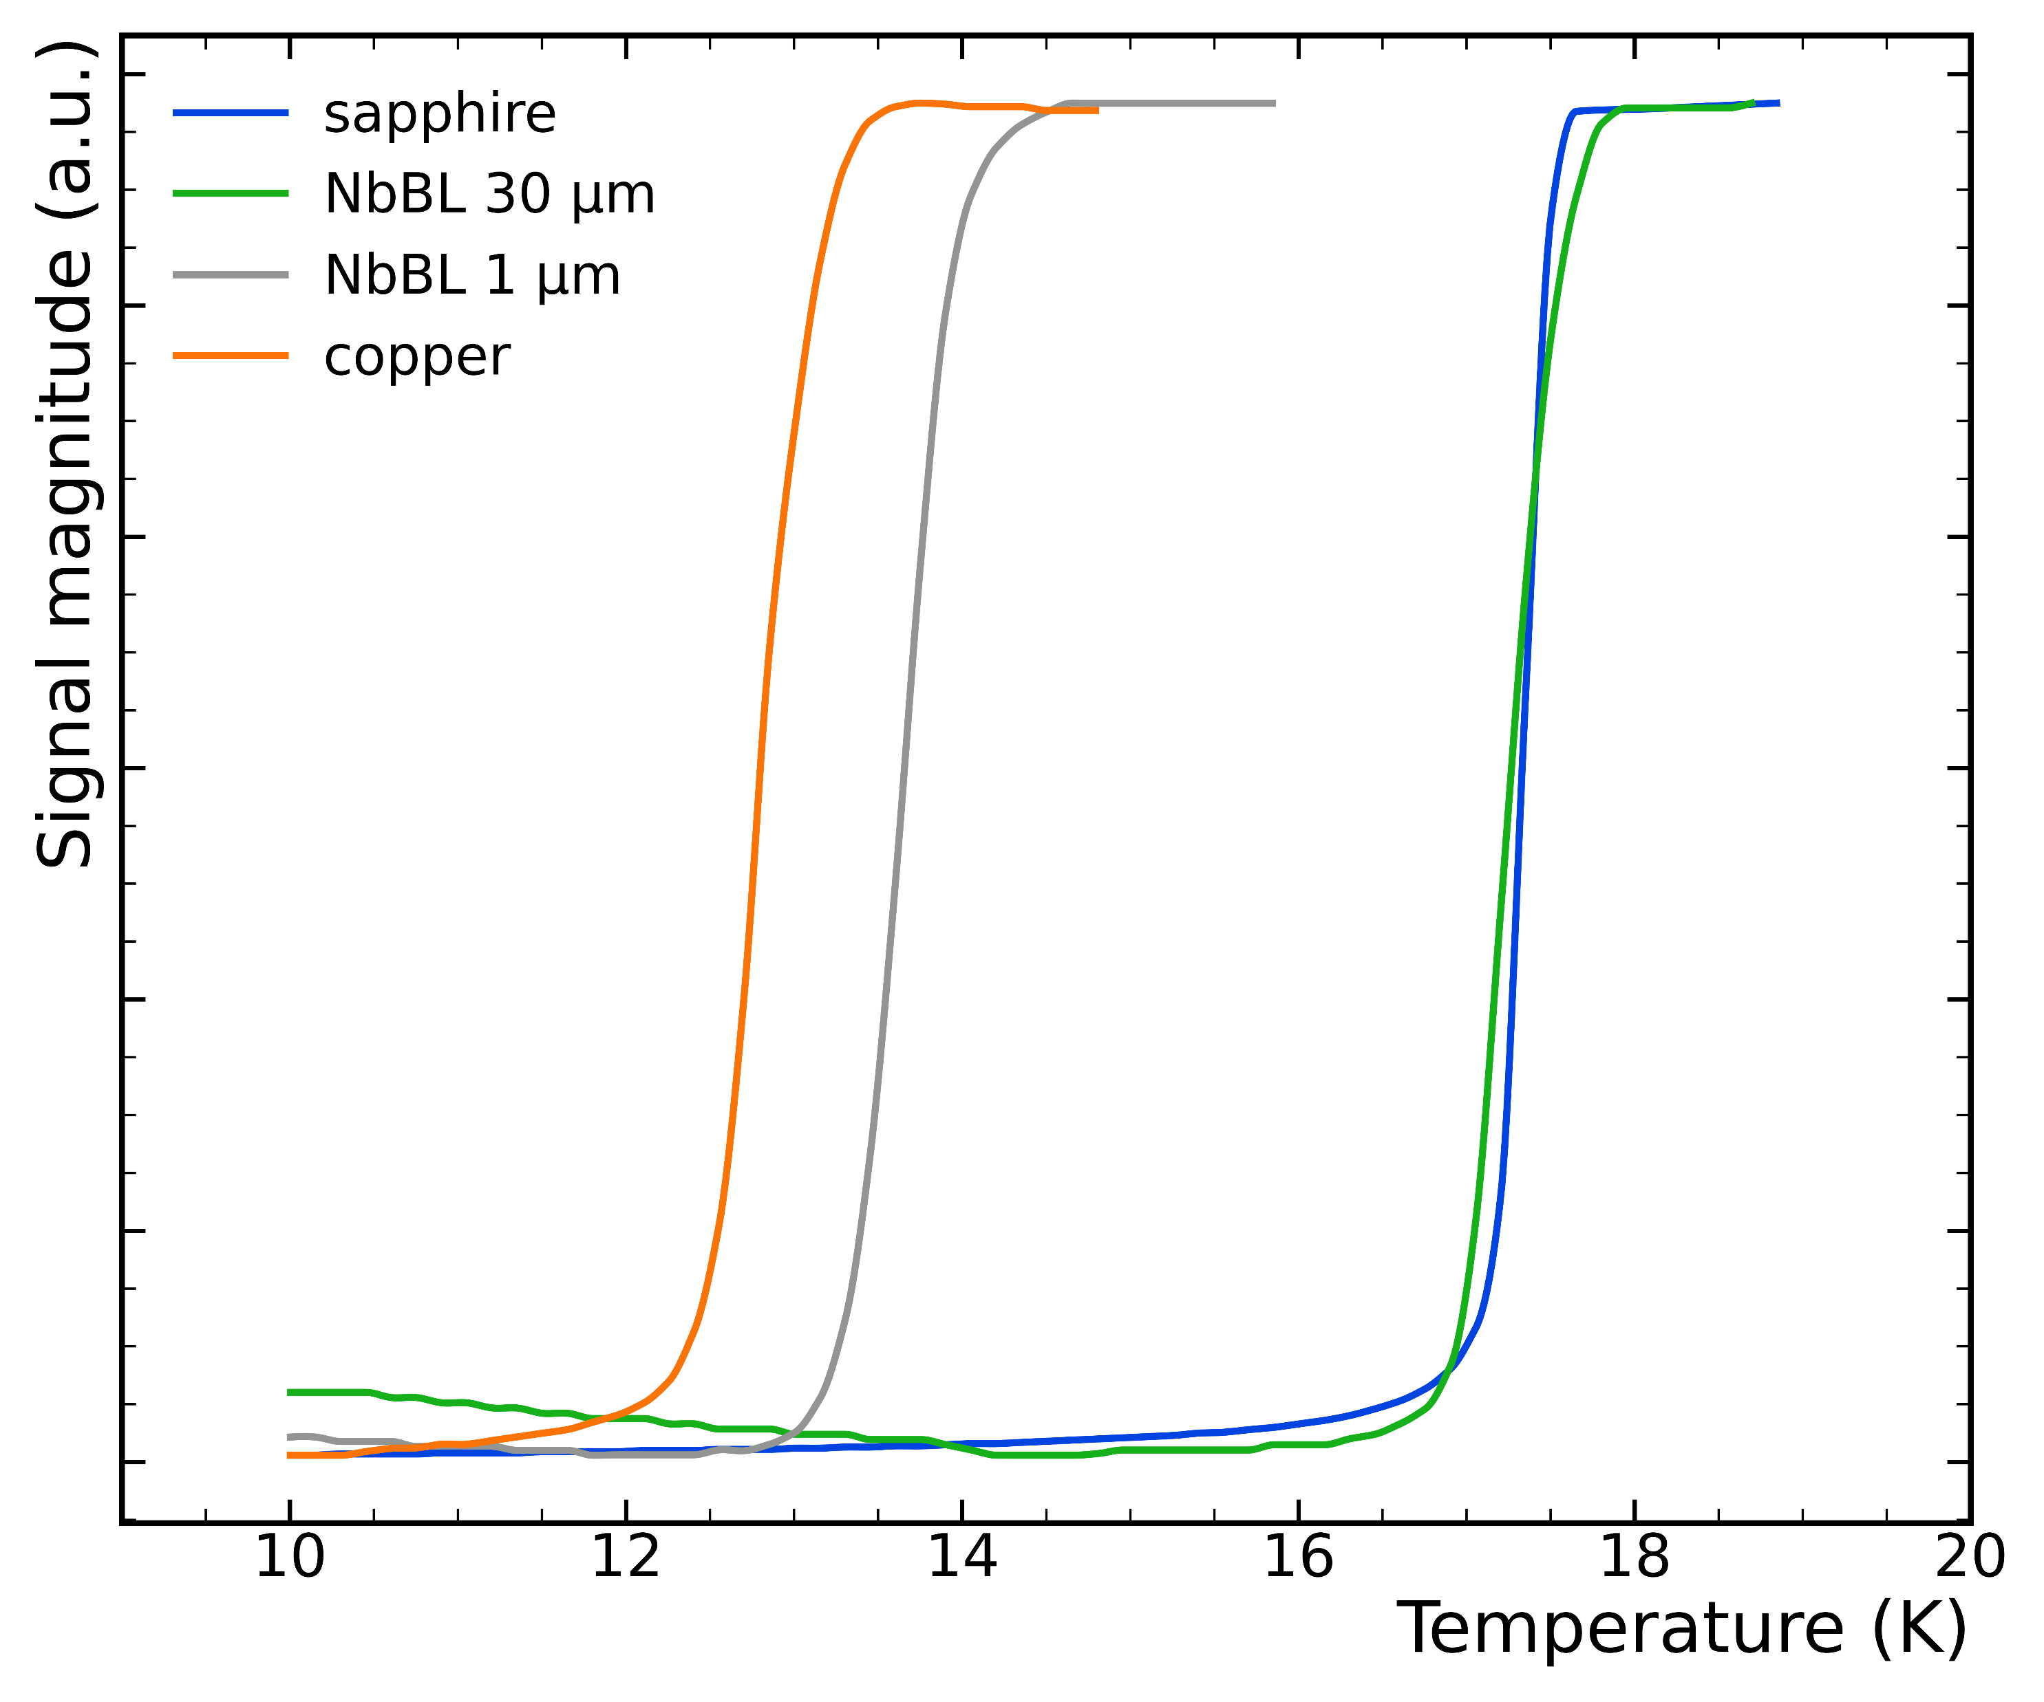
Role of the NbBL
Inductive measurement of SC transition
600 °C
No annealing
10 μm
10 μm
10 μm
10 μm
30 μm
30 μm
30 μm
40 μm
At 600+ ºC T_{c} converges at ~ 17 K for NbBL-30+ (sapphire and bulk Nb)
40 μm
bulk Nb
650 °C
1 μm
1 μm
1 μm
1 μm
1 μm
copper
copper
copper
copper
copper
copper
sapphire
sapphire
sapphire
sapphire
sapphire
sapphire
sapphire

Slide 13
Recap: Nb₃Sn base recipe
Based on the observed results
  Low cathode power < 20 W
  Deposition pressure 2 x 10⁻² mbar
  No annealing
  Deposition temperature 600 ºC – 650 ºC
NbBL thickness plays a major role

Slide 14
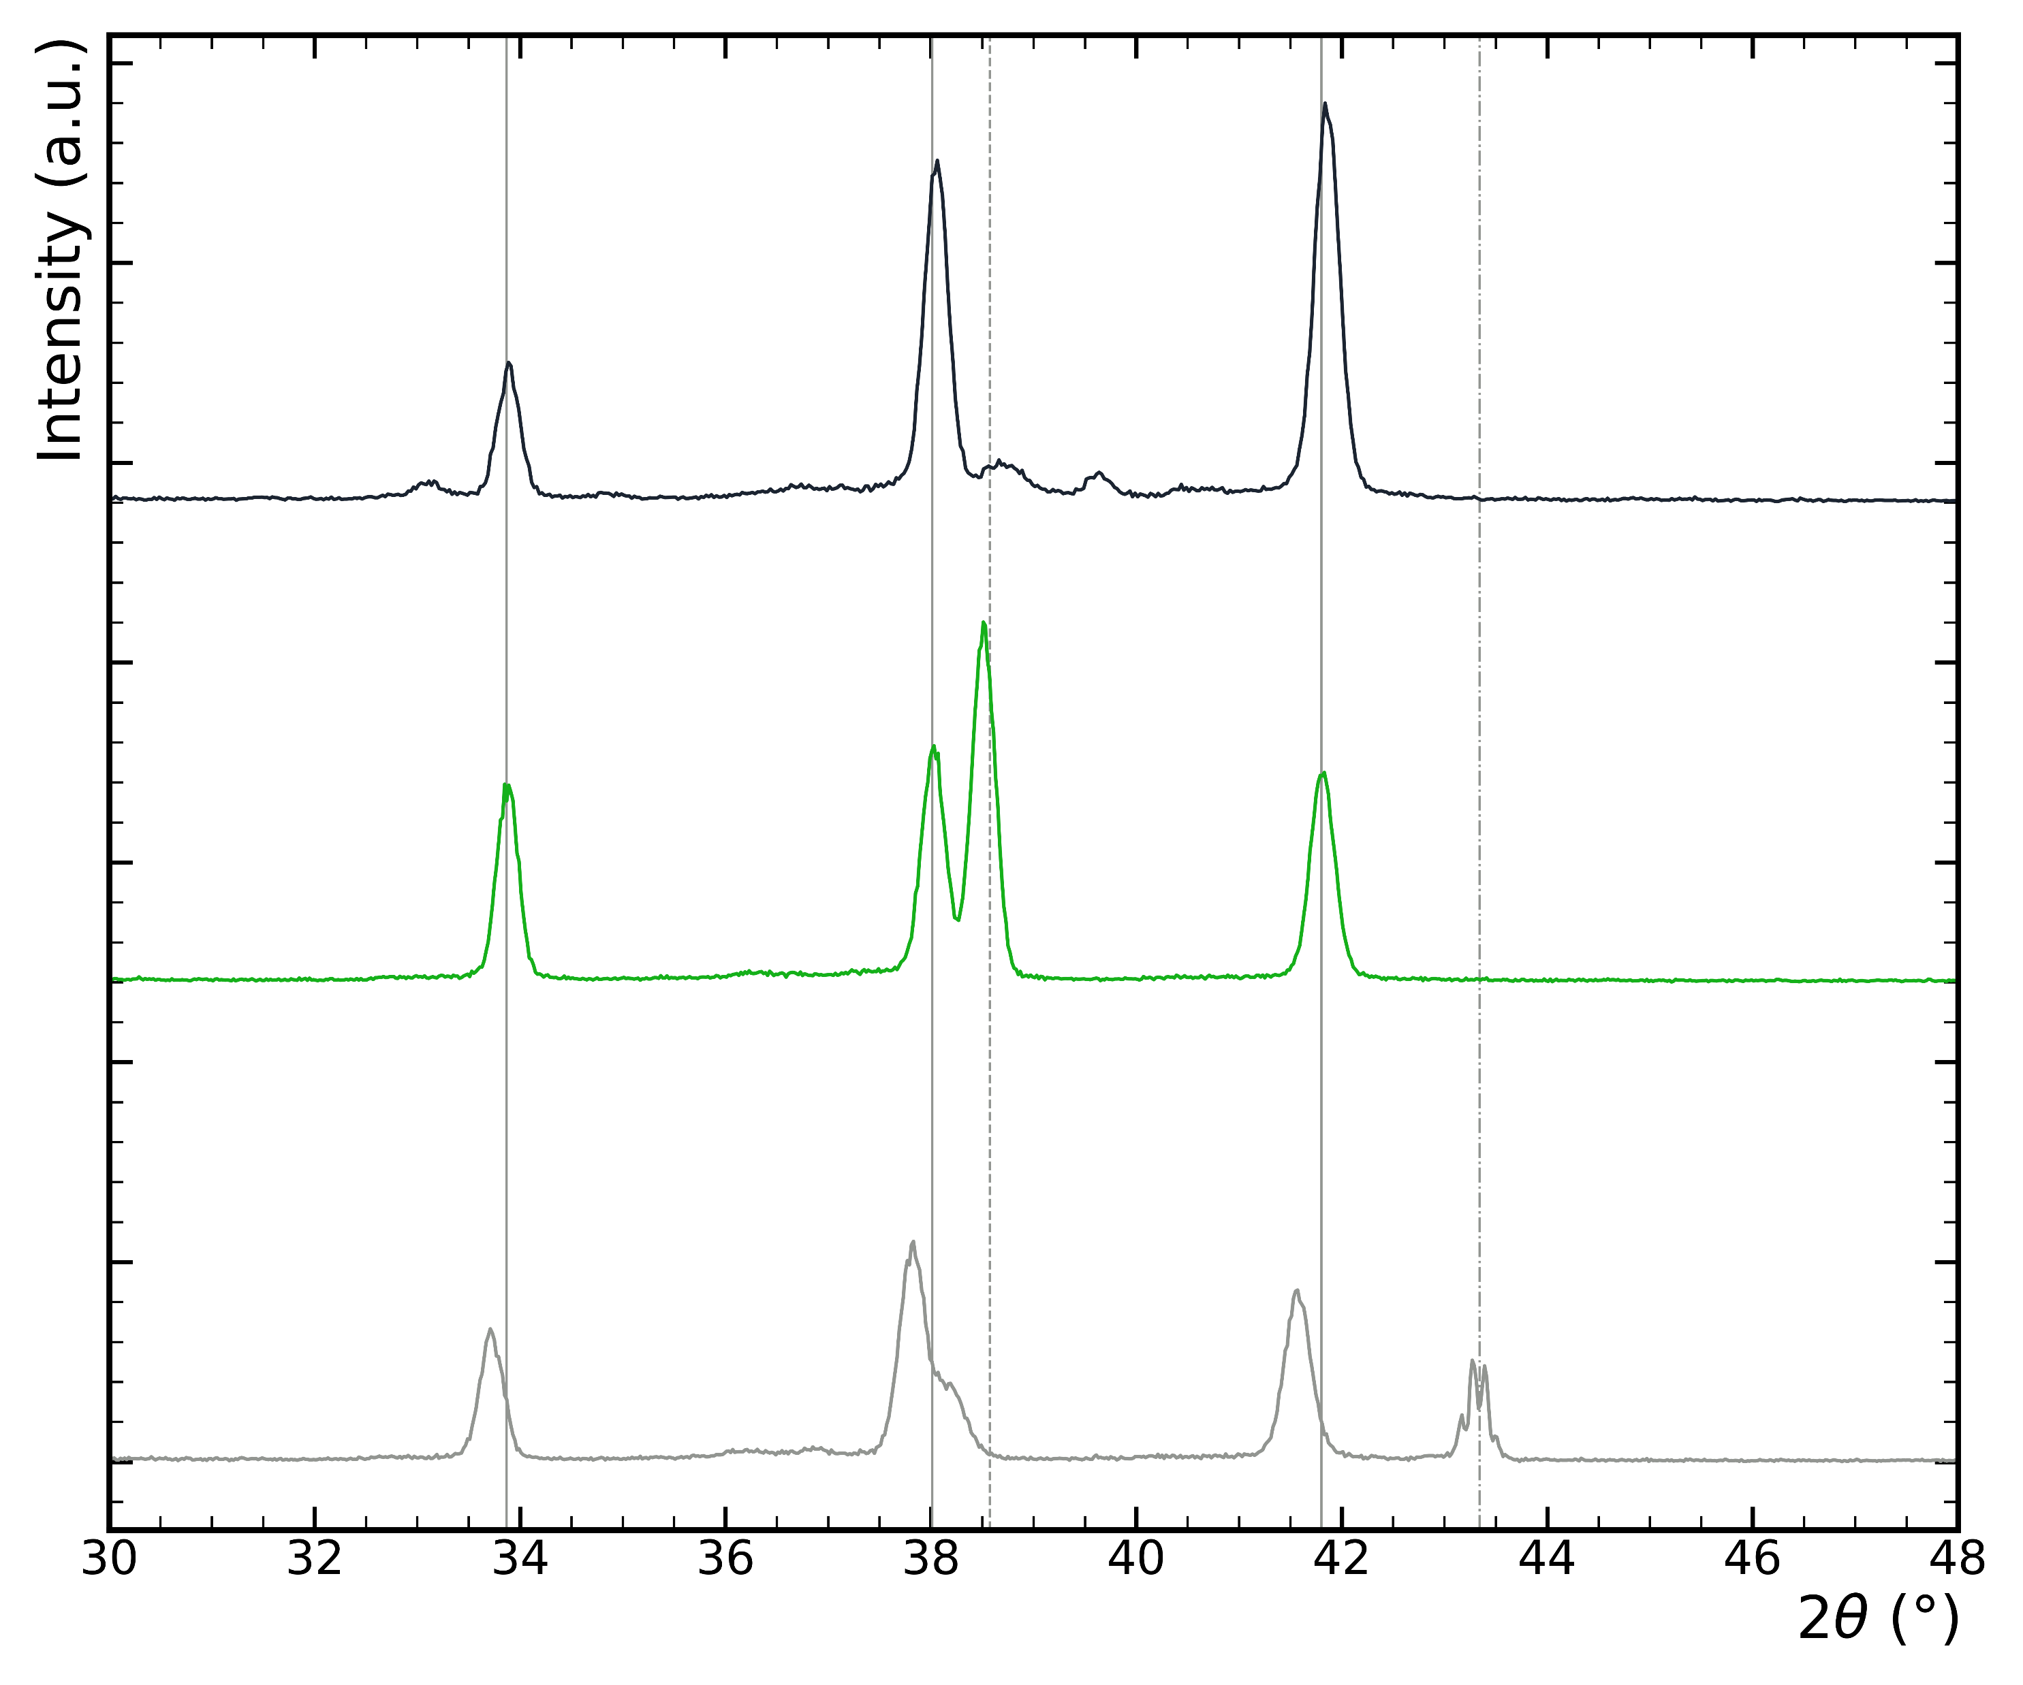
NbBL effect on lattice parameter
(002)
(012)
(011)
(112)
(111)
650 °C
bulk Nb
Peaks shift toward nominal values
X-Ray Diffraction spectroscopy (XRD)
30 μm
1 μm

Slide 15
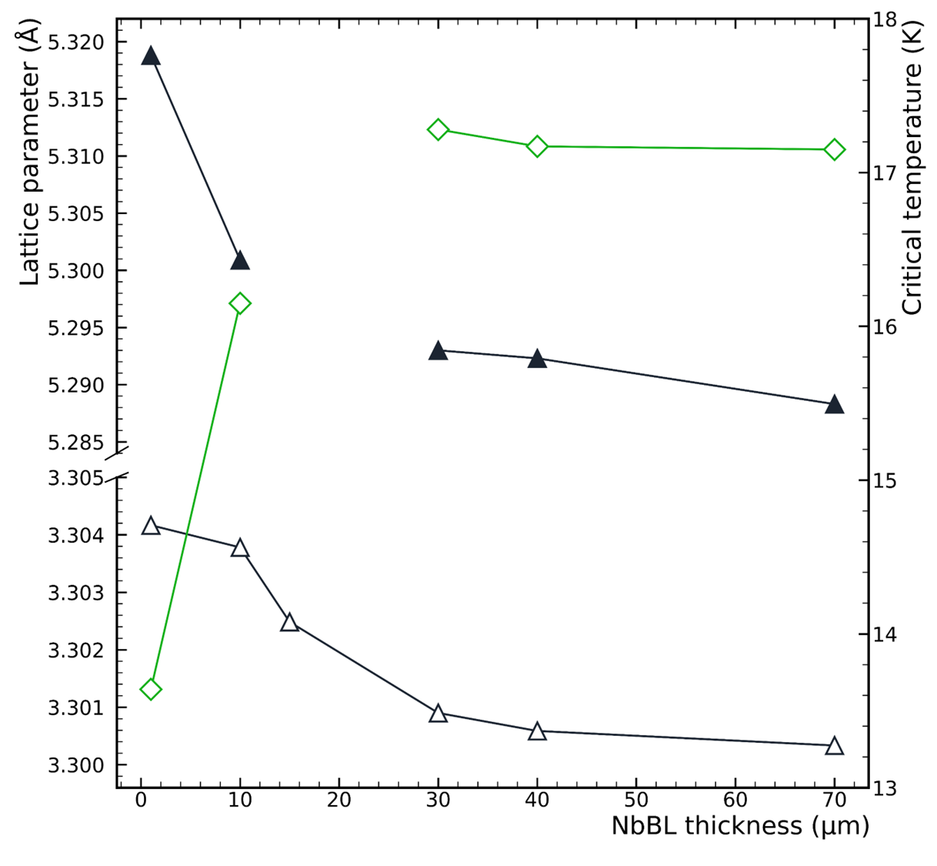

NbBL effect: accommodation
650 °C
A thicker NbBL promotes the formation of the A15 phase (see T_{c})
30+ µm is the “saturation” thickness
Nb₃Sn
NbBL
bulk

Slide 16
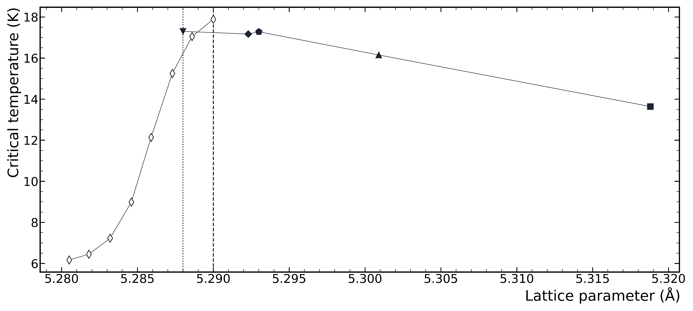
NbBL effect: accommodation
DCMS data comparison to literature data [A Godeke 2006 Supercond. Sci. Technol. 19 R68]
bulk Nb
30 μm
650 °C
10 μm
40 μm
1 μm
Increasing
Sn content
Increasing Sn content and NbBL thickness
25 At%

Slide 17
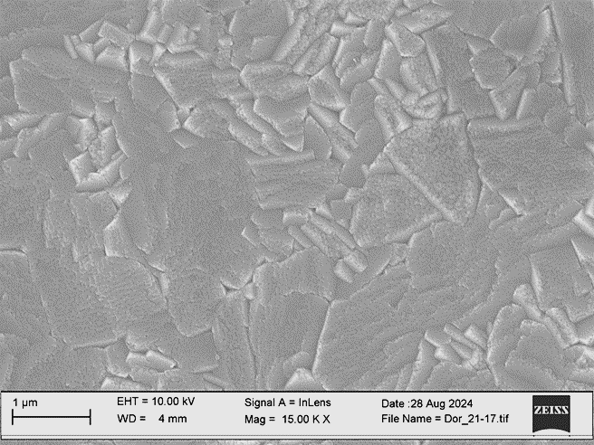
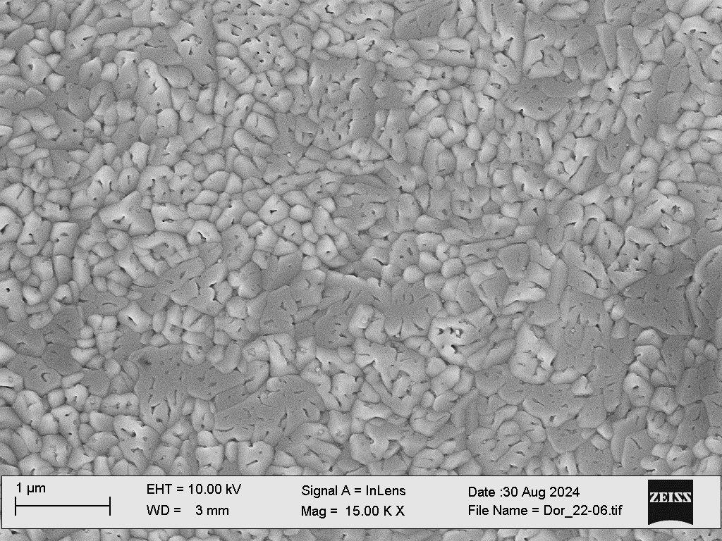
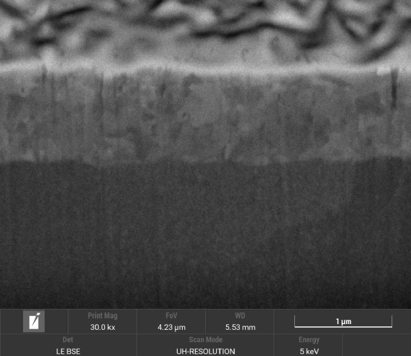

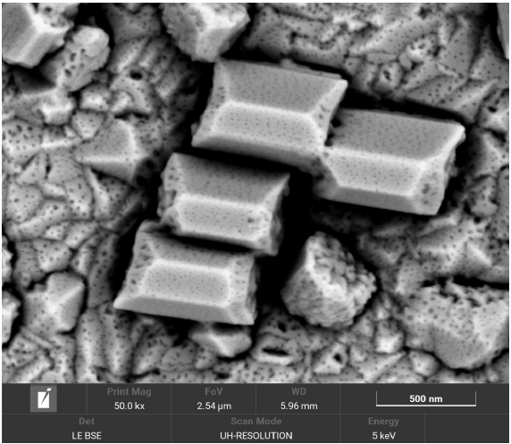
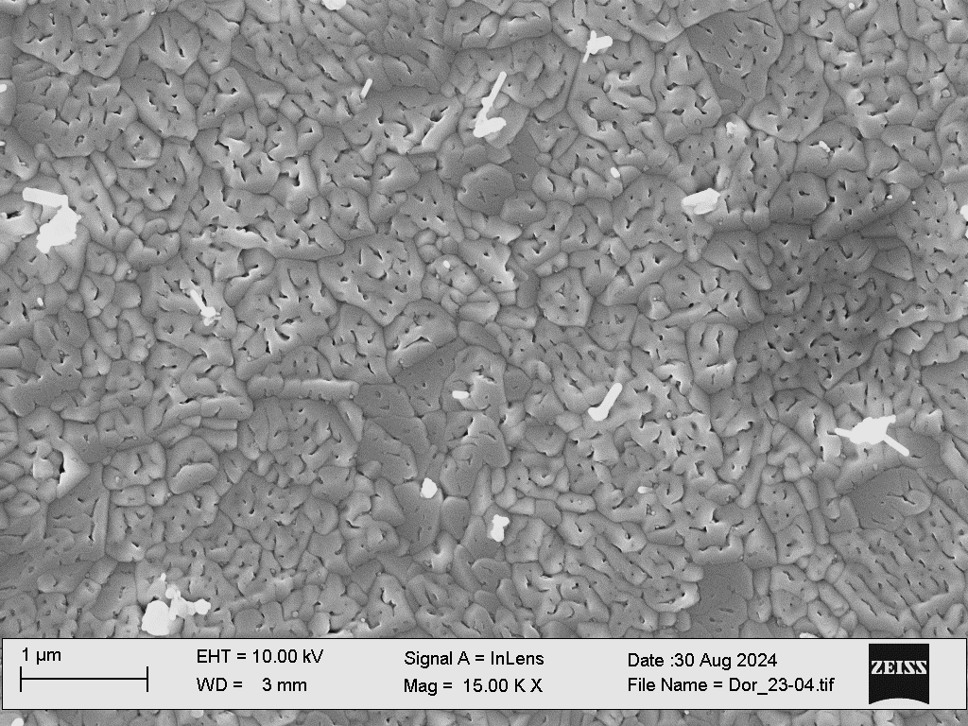
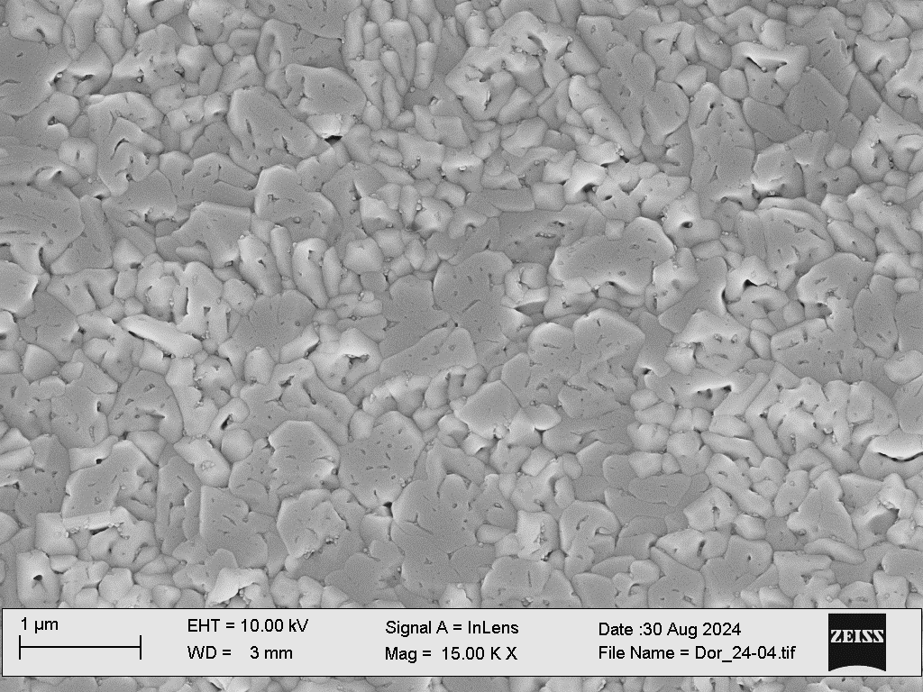
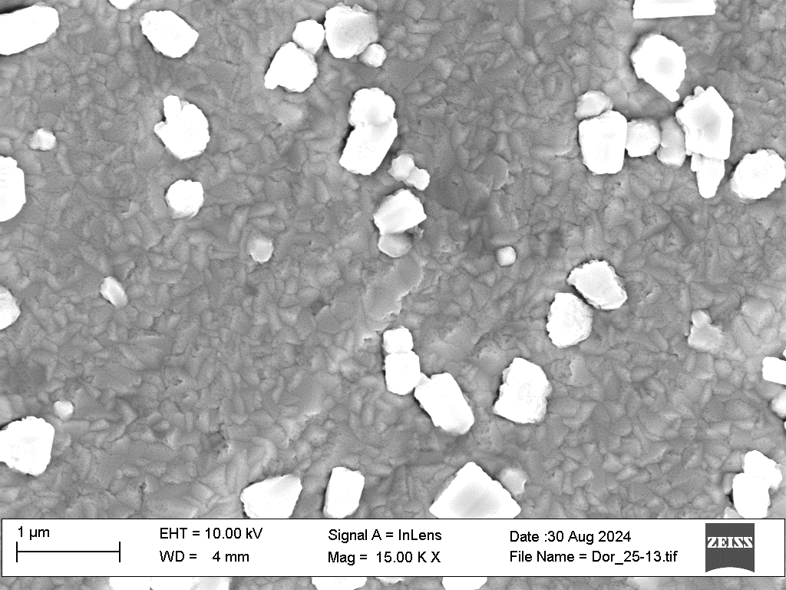
NbBL effect: morphology
Lehrstuhl für
Oberflächen- und
Werkstofftechnologie
Nb₃Sn/ Nb(1µm)/ Cu (650°C)
Nb₃Sn/ Nb(9µm)/ Cu (650°C)
1µm
Nb₃Sn/ Nb(40µm)/ Cu (650°C)
500 nm
Scanning Electron Microscopy (SEM)
Nb₃Sn/ Nb(30µm)/ Cu (650°C)
Nb₃Sn/ Nb(40µm)/ Cu (650°C)
Nb₃Sn/ bulk Nb (650°C)

Slide 18
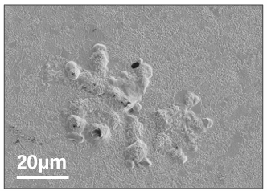
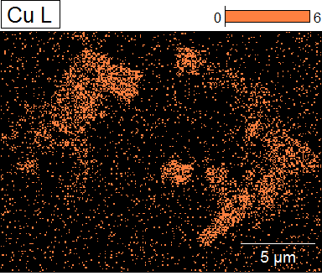

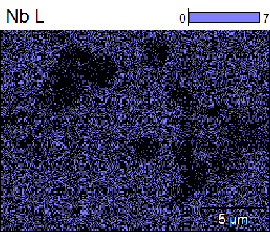
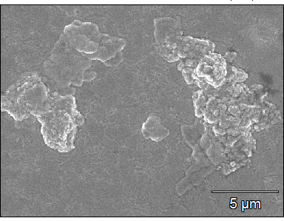
NbBL effect: morphology
S. Leith – CERN TE-VSC Seminar 15/11/2022
Copper inclusions on film deposited on 1 μm NbBL
Scanning Electron Microscopy (SEM) + Energy Dispersive X-ray spectroscopy (EDX)
Nb₃Sn/ Nb(1µm)/ Cu (650°C)

Slide 19
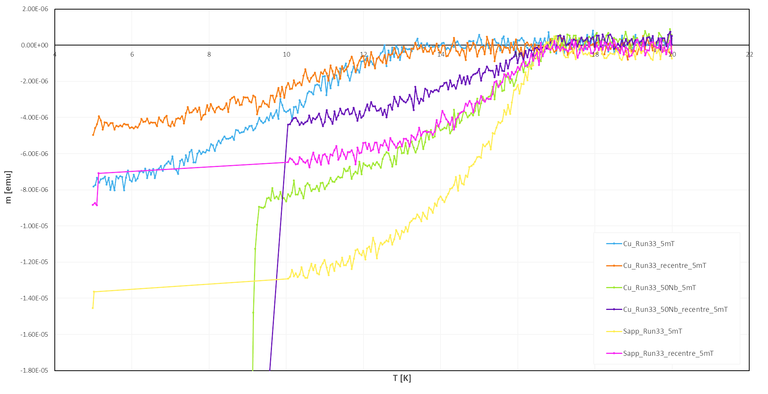
Additional studies
  P. Vidal Garcia’s talk later this morning!
  Magnetometry
  RF surface impedance in high/low DC magnetic field
  Superconducting gap
  Flash Lamp Annealing (FLA)
  laser treatment

Slide 20
2
RF test results

Slide 21
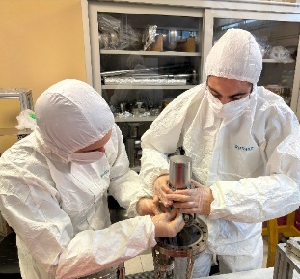
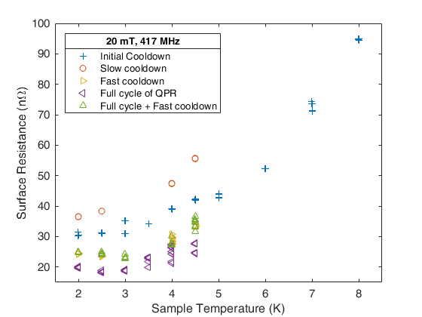
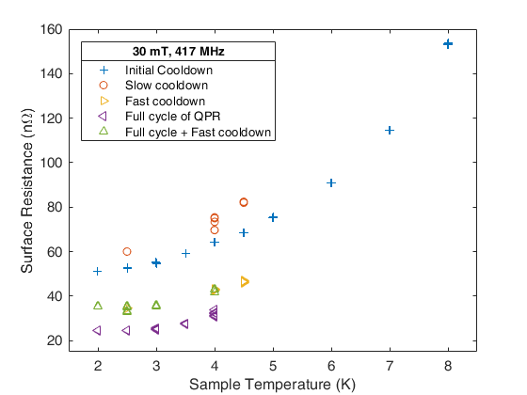
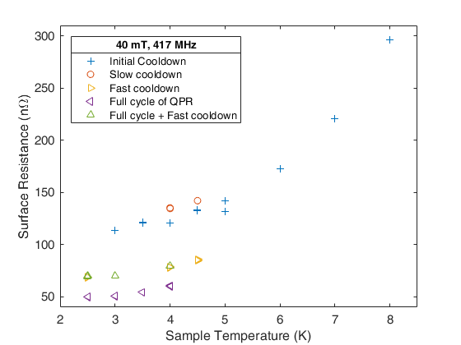
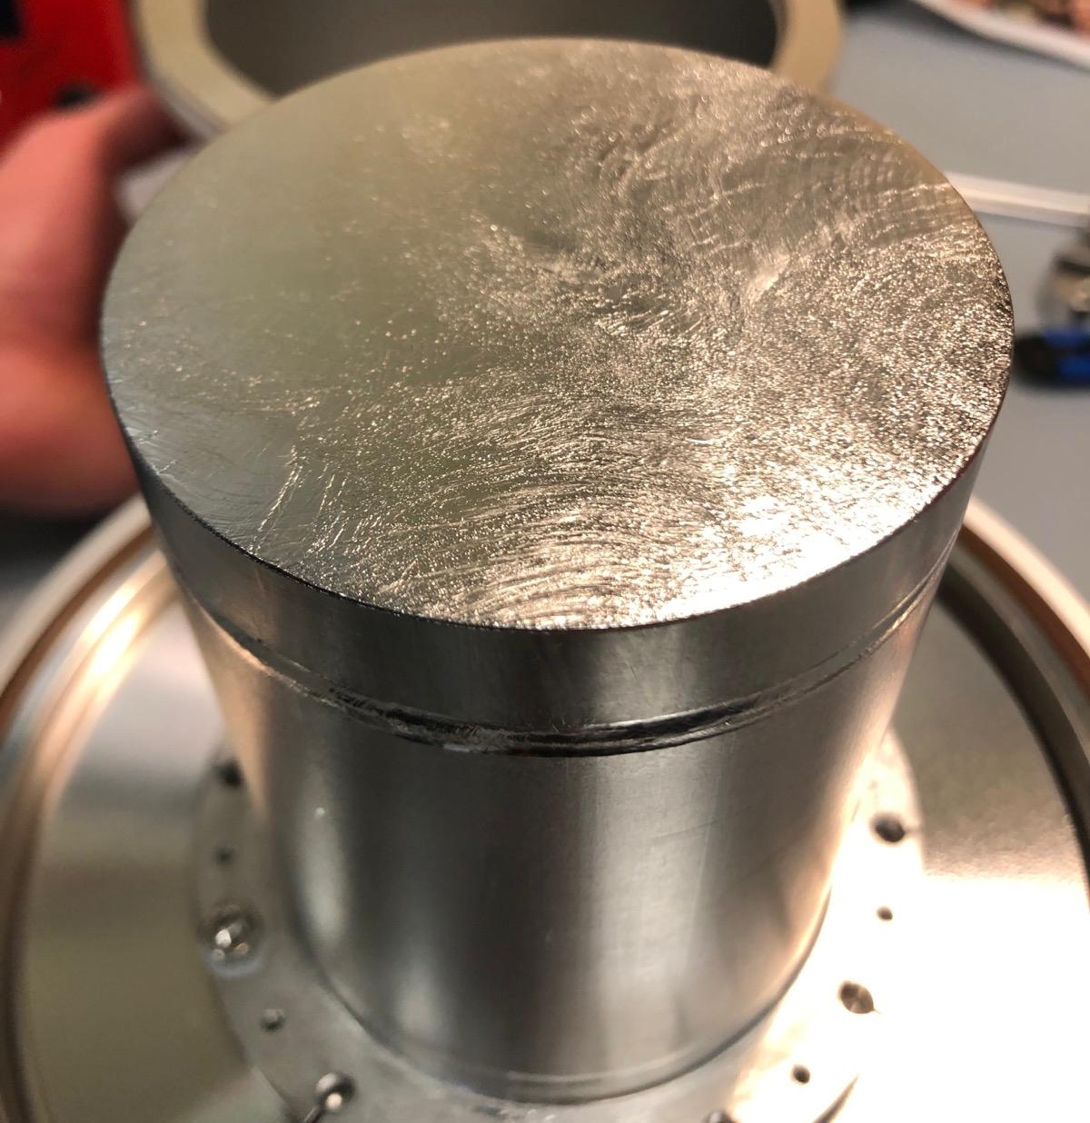
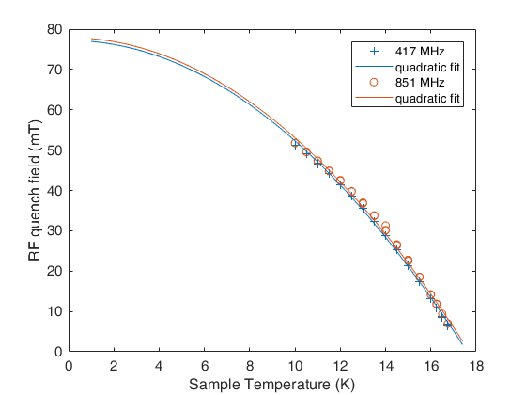
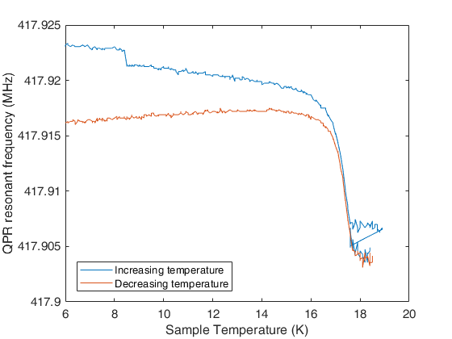
Nb₃Sn/bulk Nb QPR test
QPR = Quadrupole Resonator
Courtesy of O. Kugeler and S. Keckert
Slow cooldown
Fast cooldown
R_{s} ~ 23 nΩ
@ 4.5 K, 20 mT
Quench > 70 mT
@ 4.5 K
Nb₃Sn coating suffers from flux trapping
Cooldown procedure influence R_{s}

Slide 22
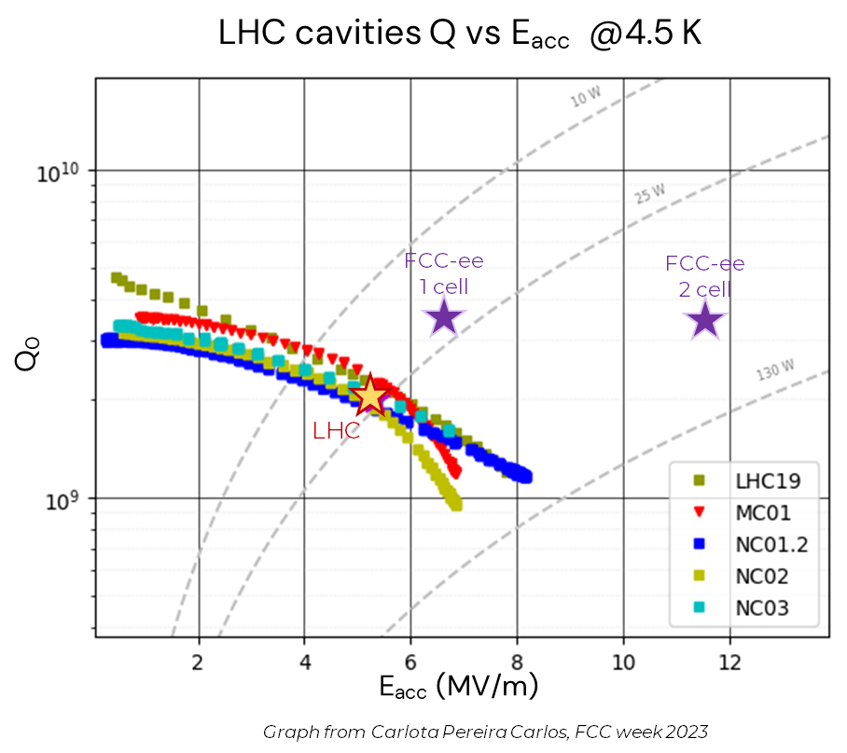
Nb₃Sn/bulk Nb QPR test
Comparison to LHC baseline: Q₀ vs. E_{acc} @ 4.5 K
G=216 Ω
QPR Nb₃Sn/Nb bulk
Equivalent to
Q₀ ~ 9 x 10⁹
@ 5 MV/m
@4.5 K
LHC cavities
Nb/Cu 400 MHz

Slide 23
3
Coating system for 1.3 GHz prototype

Slide 24
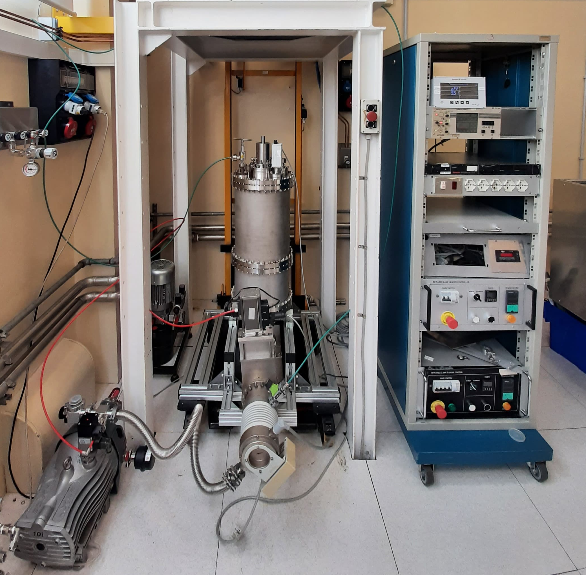
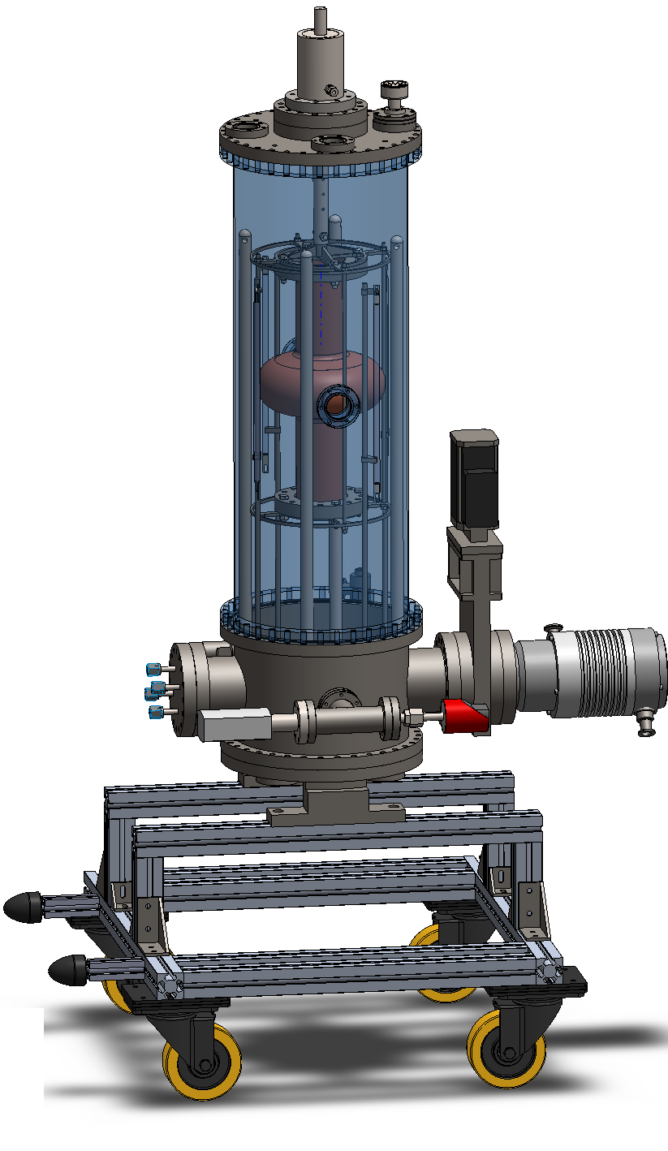
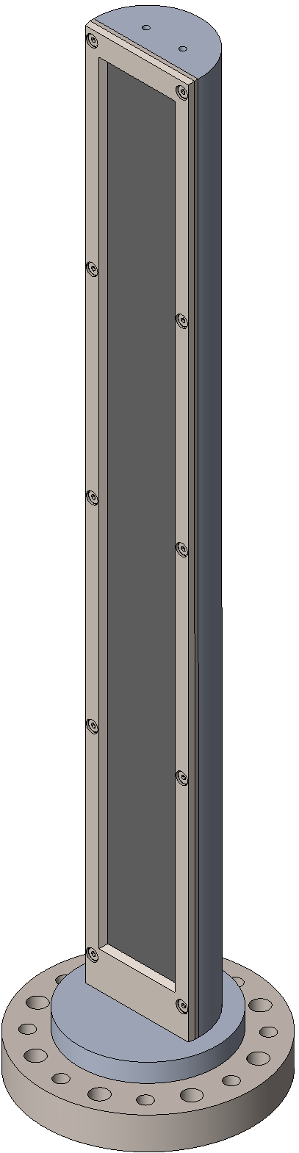
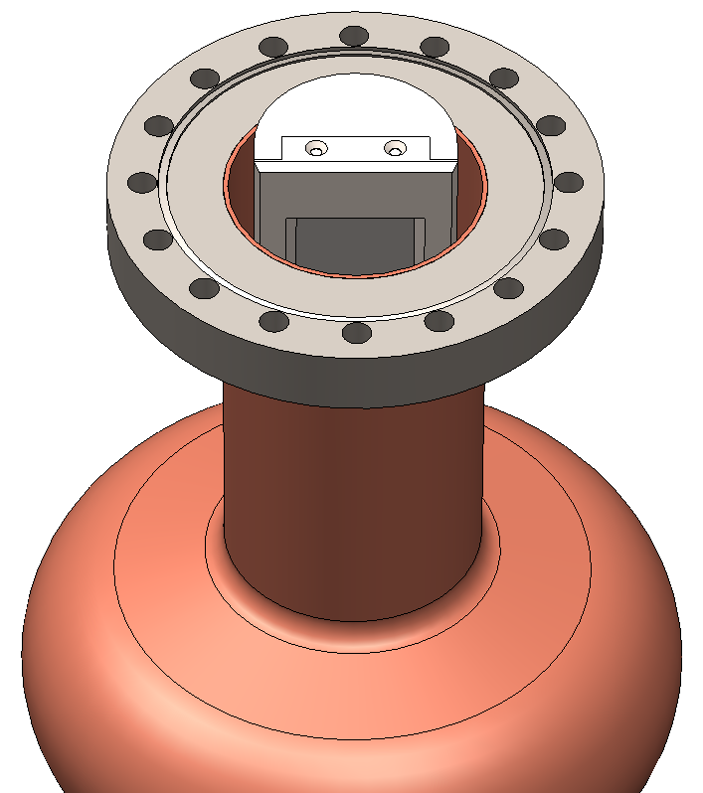
Nb₃Sn/Cu 1.3 GHz final prototype
Nb₃Sn on bulk Nb to validate coating performances on 1.3 GHz Elliptical Cavities (2025)
Develop Nb thick barrier/accommodation layer
on 1.3 GHz Elliptical Cavities (2025)
(proof of concept on 6 GHz cavities already done)
Nb₃Sn on Cu with thick Nb coating
on 1.3 GHz Elliptical Cavities (2026-2028)
In parallel:
Study on alternative buffer layer
Study on flux trapping
1.3 GHz vacuum system ready
Magnetron source commissioned

Slide 25

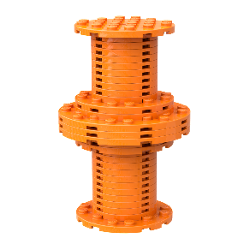




Timeline
TODAY
TeFeN
2021 | 2022 | 2023 | 2024 | 2025 | 2026 | 2027 | 2028
3/2024
First RF test on QPR
R_{s} ∼ 20nΩ @ 4.5 K, 400 MHz
6/2023
Thick Nb barrier layer → T_{c} > 17 K
1.3 GHz cavity
first RF test
(I.FAST)
1/2022
First test on planar samples → T_{c} ∼ 10 K
1.3 GHz cavity
optimized recipe for tuning
(ISAS)
4/2021
Nb₃Sn R&D started
Nb₃Sn

Slide 26
Conclusion
the optimization of Nb₃Sn deposition recipe via DCMS is at an advanced stage on small samples
  T_{c} ~ 17.5 K
  deposition temperature 600 ºC - 650 ºC
  thickness of NbBL 30+ µm → accomodation effect
first RF test for film deposited on bulk Nb on QPR sample: promising R_{s} ~ 23 nΩ @ 4.5 K, 20 mT
parallel work on coating system for 1.3 GHz with rectangular magnetron

Slide 27

Thank you!

Slide 28

Standard production process
(1)
Set parameters:
Cathode power P
Deposition pressure p_{dep}
Deposition temperature T_{dep}
(2)
(3)
Characterisation:
T_{c} measurement
SEM + EDS (Sn composition)
XRD
1 µm Nb₃Sn
Sapphire
Cu + 1 µm Nb buffer layer (BL)
Tune next parameters
based on trends (step 1)
small samples on holder plate
Cu
10 cm
+ 24 h annealing

Slide 29

Film properties
Field of first flux entry B_{en}

Slide 30

DC Magnetron Sputtering

Slide 31

Nb₃Sn deposition system

Slide 32

Nb₃Sn deposition system

Slide 33
Projects and partners:
SAMARA (INFN CSN5)
  INFN – LNL, INFN – TO, PoliTO, INFN – Roma3, INFN – LNF, Uni Roma 3, INFN – MI, INFN – LASA
I.FAST WP9 (EU’s Horizon 2020 Research and Innovation programme GA101004730)
  IEE – SAS, RTU, Piccoli S.R.L., Uni Siegen, LOT, HZB, HZDR, CEA, IJC, UKRI, Uni Lancaster, Uni Liverpool,
  UniPD; INFORMAL: CERN, DESY; ASSOCIATED: JLab
SRF (INFN Board for FCC R&D)
ISAS (EU’s Horizon Europe Research and Innovation programme GA101131435)
  IEE – SAS, RTU, Piccoli S.R.L., Uni Siegen, LOT, HZB, HZDR, CEA, IJC, UKRI, Uni Lancaster, Uni Liverpool,
  UniPD, CERN, DESY, JLab, Fermilab
SuperMAD (INFN CSN5)
  INFN – LNL, INFN – TO, PoliTO, INFN – Roma3, INFN – LNF, Uni Roma 3, ENEA

