Slide 1

Post doc – OCPC – Program (IMP, HZB)
Cu-based Nb₃Sn QPR sample preparation via ETS bronze route
Ming Lu
Institute of Modern Physics (IMP)
Helmholtz-Zentrum Berlin (HZB)
2024-09-17
Notes:
Hello, everyone. I’m very happy to make this presentation. I’m from the Institute of modern physics, Chinese academy of sciences. The topic of my report is Study on Nb3Sn coating technology for superconducting RF cavity by bronze method.

Slide 2
Outlines
1. Nb₃Sn And QPR background
2. Overall ETS bronze route progress
3. Cu-based Nb₃Sn QPR sample preparation
4. Nb/Cu QPR sample baseline RF test
5. Future work and Summary
Notes:
The Outlines include 3 parts: Background, Nb3Sn thin film activities and conclusion.

Slide 3
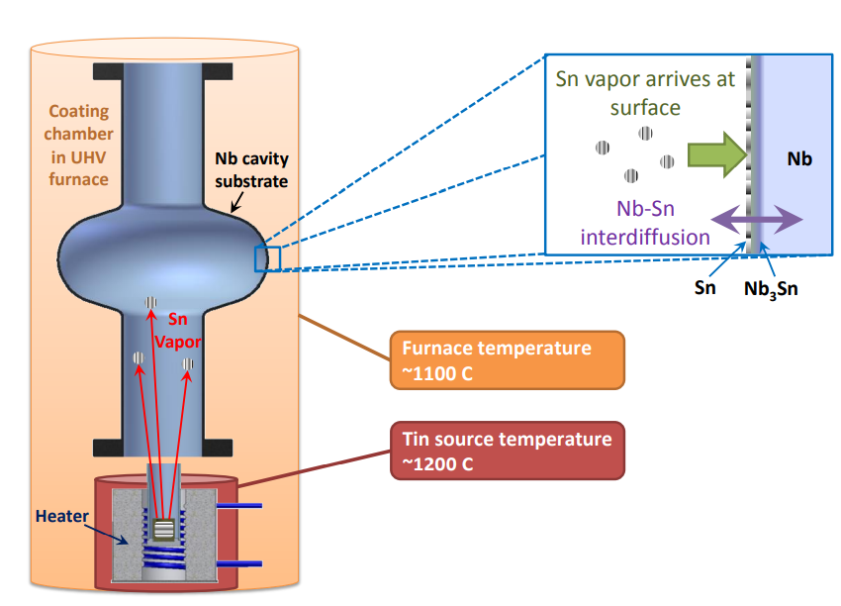
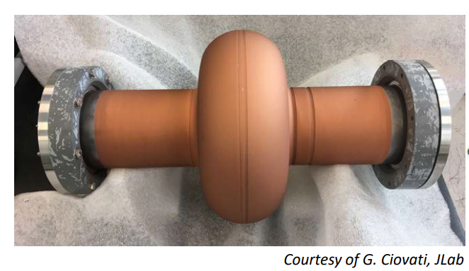
Background: Cu-based Nb₃Sn coating
Nb₃Sn thin film superconducting cavity is the key technology for next-generation accelerator, and its engineering application will lead to a technological revolution in the field of SRF.
Nb₃Sn film on Cu cavity:
Good thermal conductivity, better mechanical stability
High performance@4.2 K, cooled by cryocooler
Cu melting point: 1080℃
Diagram of the Tin Vapor Diffusion^{[1]}
[1] Posen, Sam. “Understanding And Overcoming Limitation Mechanisms In Nb3Sn Superconducting Rf Cavities.” (2015).

Slide 4
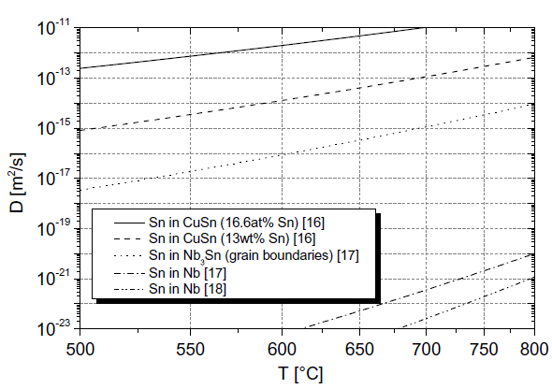
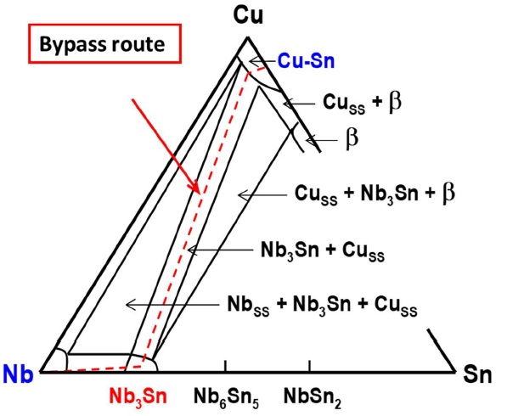
One achievable way : Nb₃Sn/Cu bronze route
Phase diagram of Nb-Cu-Sn ternary system [2] at 700℃
Bronze^{[1]}
Nb₃Sn
Nb^{[1]}
1. The copper can facilitate the interdiffusion between Nb and Sn by 7~10 magnitudes of orders.
2. The copper alloy will be excluded from the Nb₃Sn phase by itself.
[1] H. Müller and T. Schneider, "Heat treatment of Nb3Sn conductors," Cryogenics, vol. 48, pp. 323-330, 2008/07/01/ 2008.
[2] L Mei, Z Du, C Guo, & C Li. (2009). Thermodynamic optimization of the cu-sn and cu-nb-sn systems. Journal of Alloys & Compounds, 477(1-2), 104-117.
Notes:
As we know, it’s very difficult to form a single Nb3Sn phase in Nb-Sn binary phase below 900℃. However, in the Nb-Cu-Sn ternary phase diagram, a single Nb3Sn phase can be synthesized by a bypass route at 700℃. Besides, the copper can facilitate the interdiffusion between Nb and Sn by 7~10 magnitudes of orders. And the copper alloy will be excluded from the Nb₃Sn phase by itself, so Cu dose not affect the superconductivity of Nb3Sn film.

Slide 5
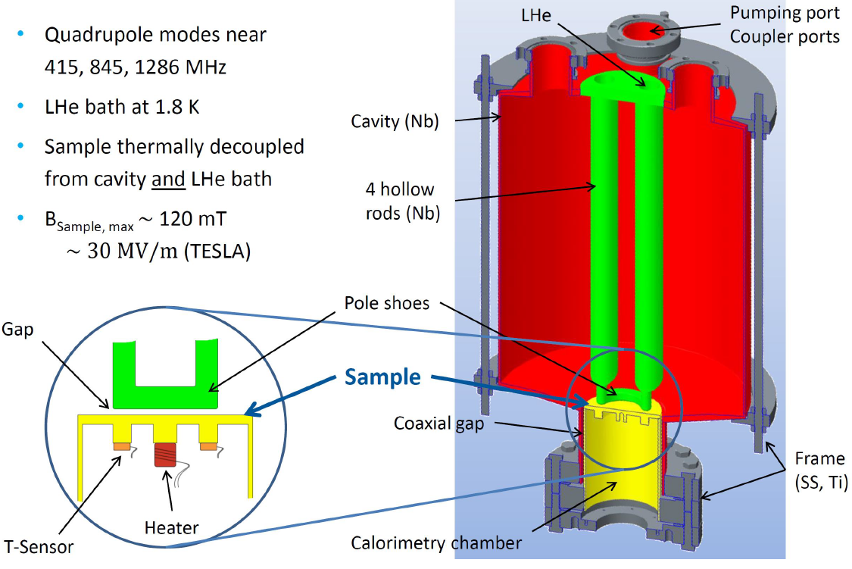
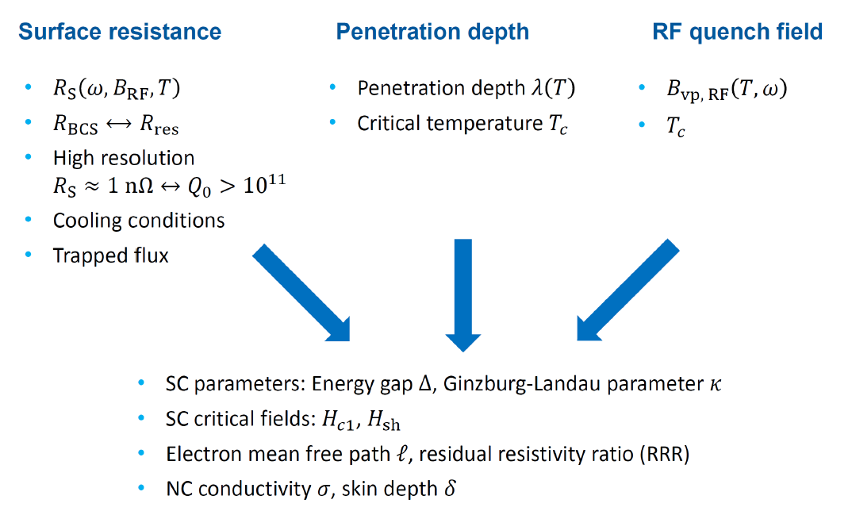
A powerful Tool: Quadrupole Resonator
Oliver Kugeler
Notes:
The QPR allows the RF characterization of superconducting samples over a wide range of frequencies, temperatures and magnetic field strengths, covering the operating parameters of a variety of particle accelerators.

Slide 6
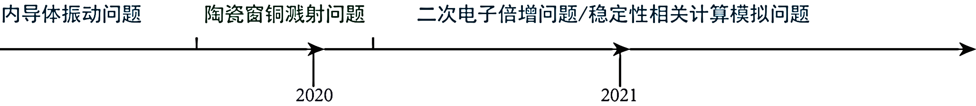
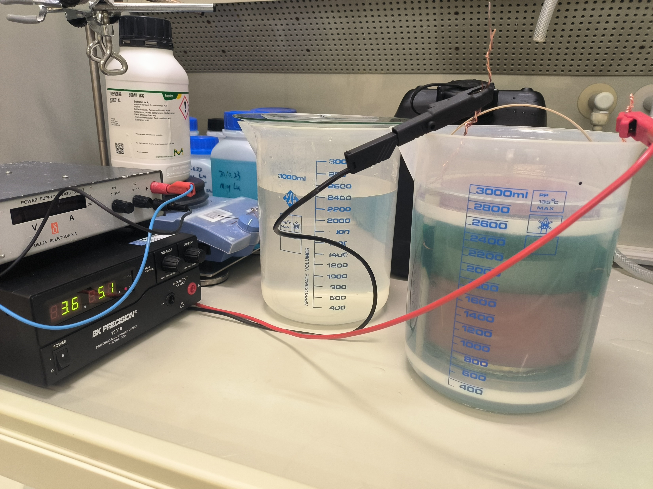
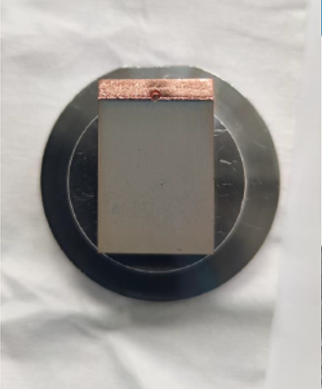
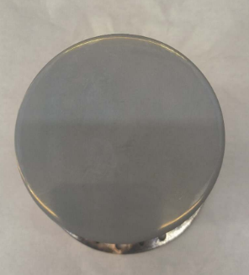
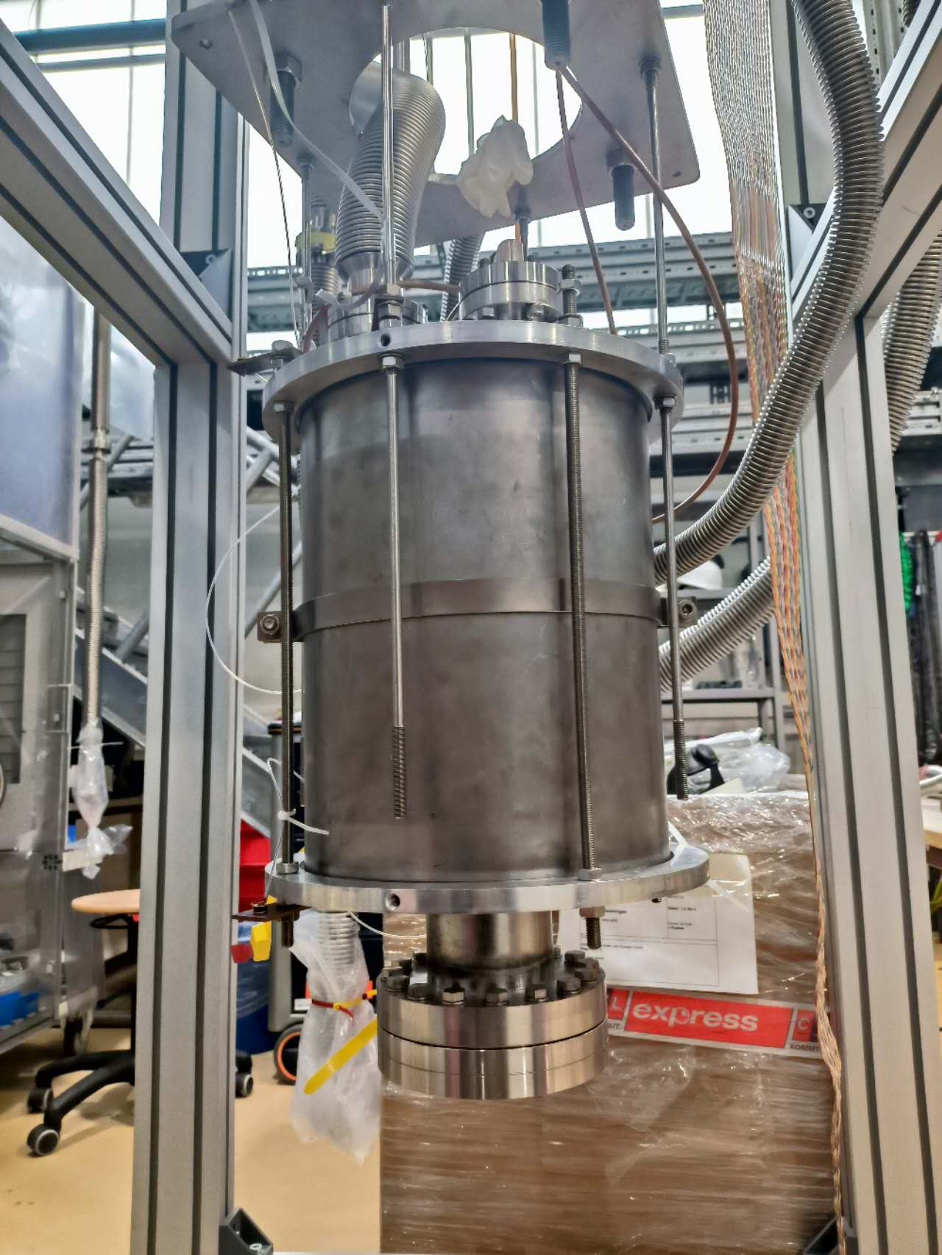
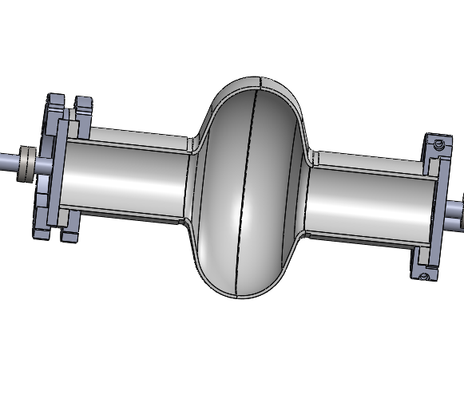
The bronze route work schedule at HZB
2023
2024
2025
2026
Study 1：Build an electrochemical platform√
Study 2：Optimized small Nb₃Sn samples√
Study 3：Optimized QPR Nb₃Sn samples√
Study 4 ：QPR sample RF iterative optimization×
Study 5 ：Cavity RF iterative optimization×

Slide 7
Outlines
1. Nb₃Sn background
2. Overall ETS bronze route progress
3. Cu-based Nb₃Sn QPR samples preparation
4. Nb/Cu QPR sample baseline RF test
5. Future work and summary
Notes:
The Outlines include 3 parts: Background, Nb3Sn thin film activities and conclusion.

Slide 8
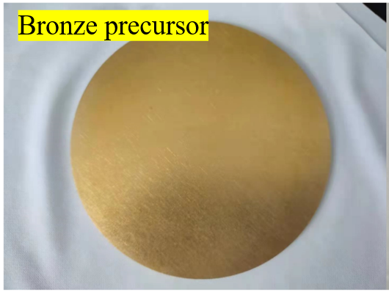
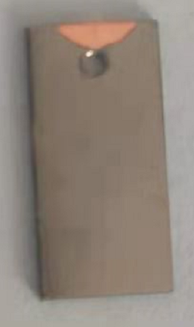
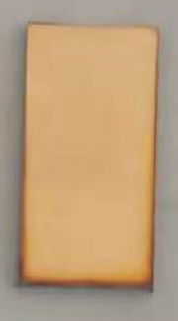
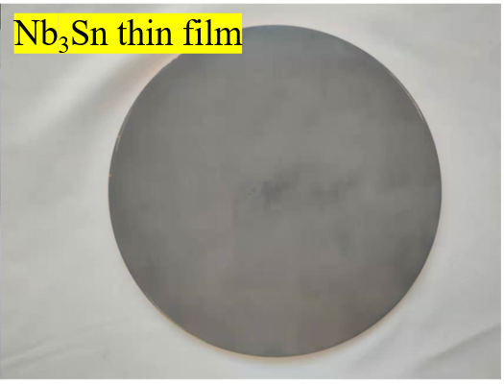
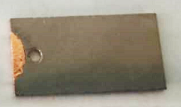
Previous work: Bronze/Nb/Cu flat samples
Nb₃Sn/Cu sample preparations: Electrochemical and Thermal Synthesis (ETS) bronze route
low cost, simple operation.
suitable for complex cavity types, mass production.
Bronze layer
Nb layer
Nb₃Sn layer
Nb₃Sn layer
Cu substrate
Cu substrate
Cu substrate
Φ=110 mm
Nb layer: magnetron sputtering
Φ=110 mm
Nb/Cu
Bronze/Nb₃Sn/Cu
Nb₃Sn/Cu
Notes:
Route 3 replaces the substrate with a copper substrate, first need to sputter a layer of niobium film on the copper substrate, and then implement the scheme according to route 2.
The images on the lower left showed a step by step coating process and annealing. The picture on the right shows the coating on a 110mm diameter large disc, and the copper-based Nb3Sn sample was successfully prepared, and the RF performance test will be carried out in the future.

Slide 9
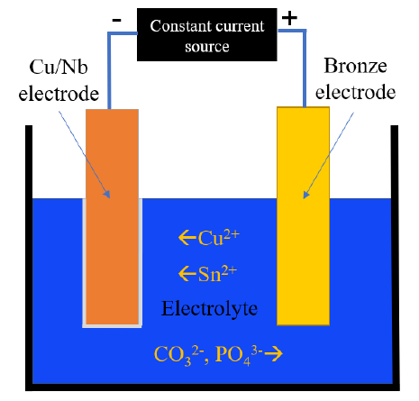
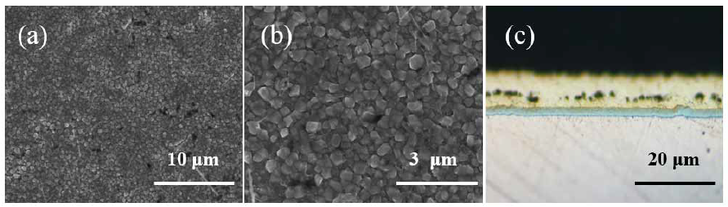
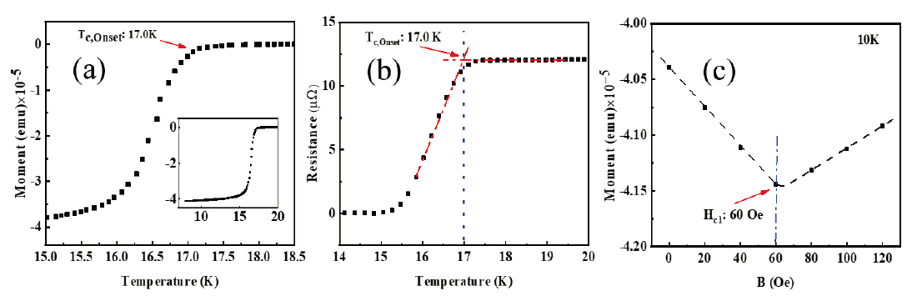
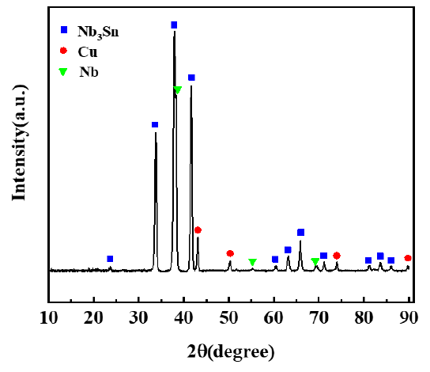
Small samples: Bronze/Nb/Cu multilayer films
Nb₃Sn/Cu sample properties:
(a)
(b)
10 μm
3 μm
Notes:
The surface morphology and superconducting properties of the copper-based Nb3Sn sample were tested, and the results showed that the film was complete, without cracks and bubbles, and the superconducting transition temperature could reach 17K.

Slide 10
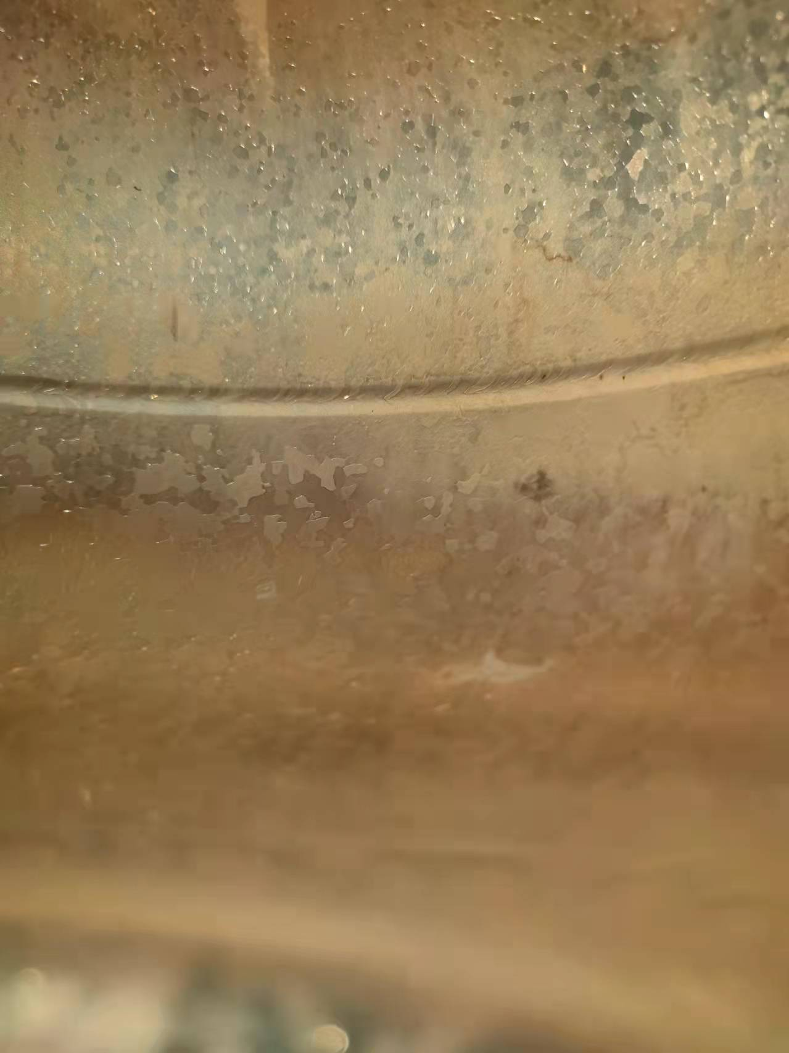
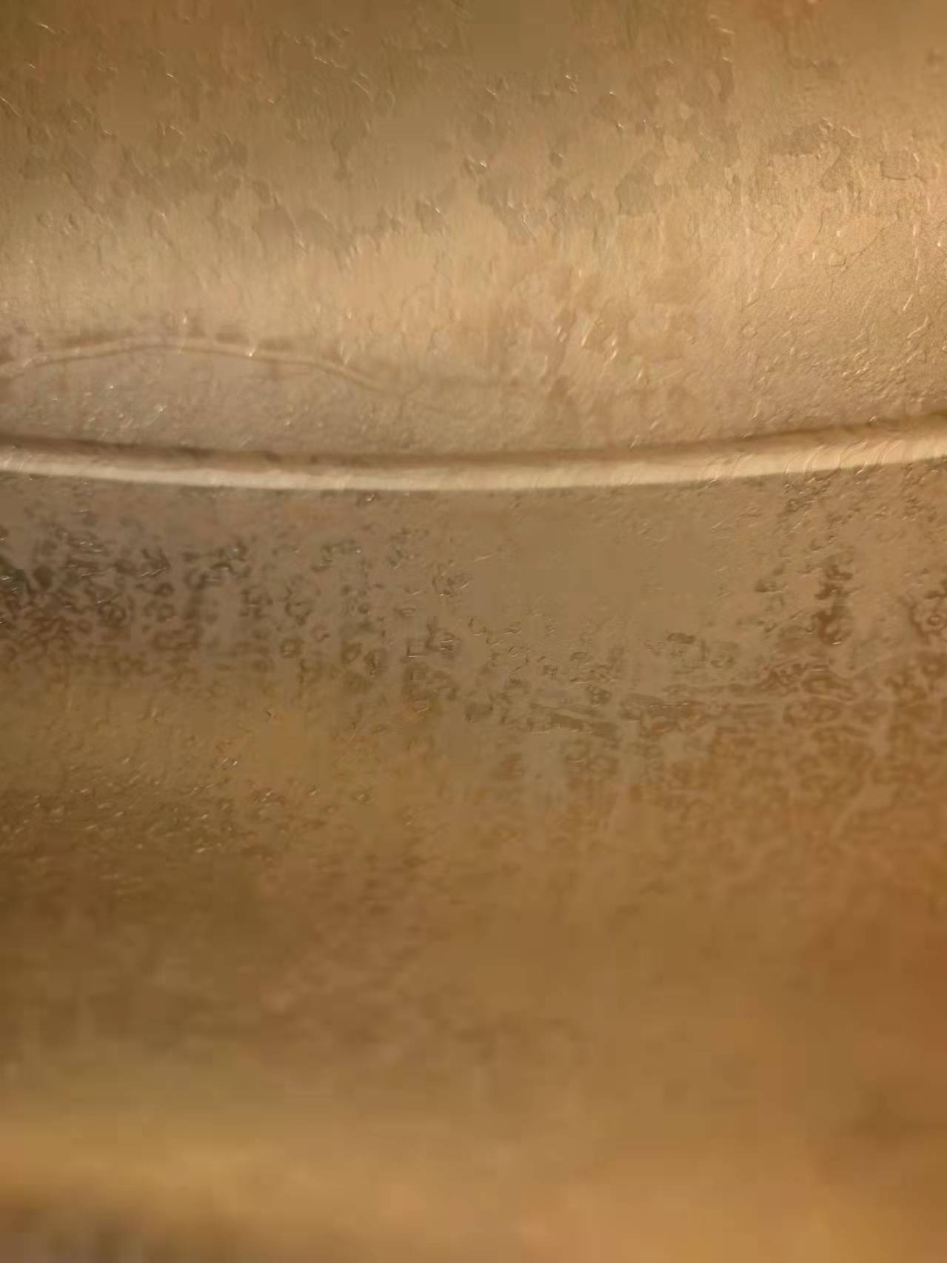
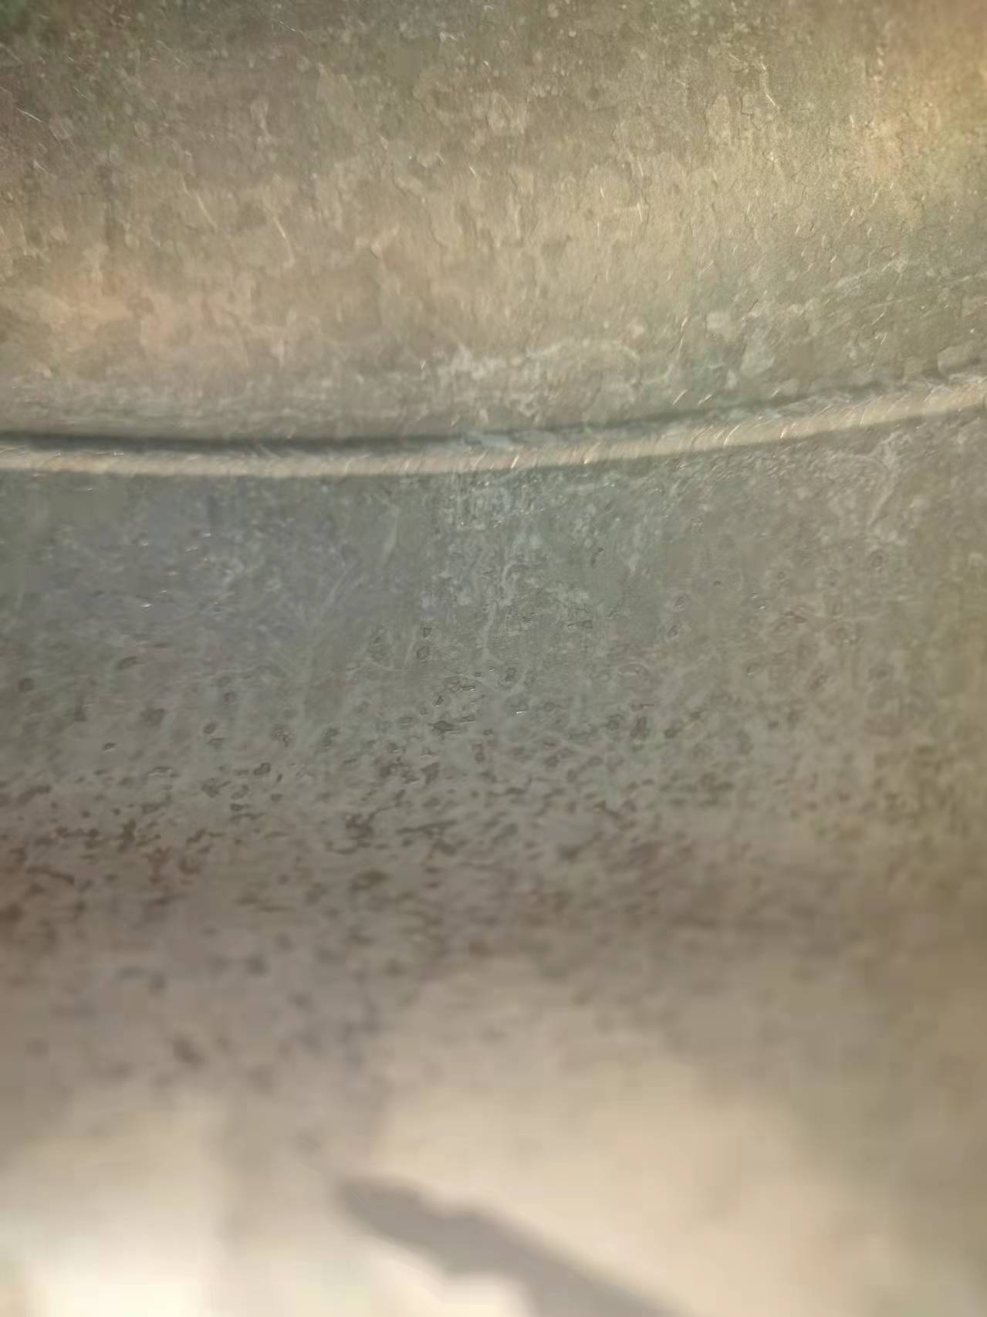
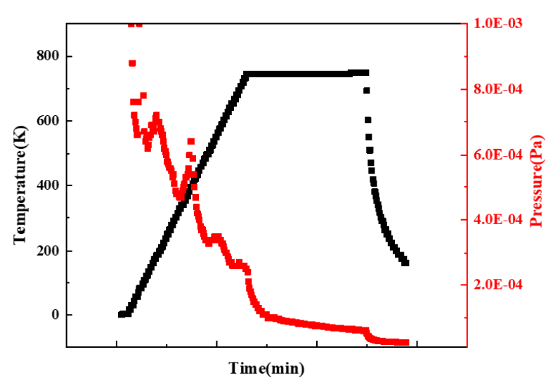
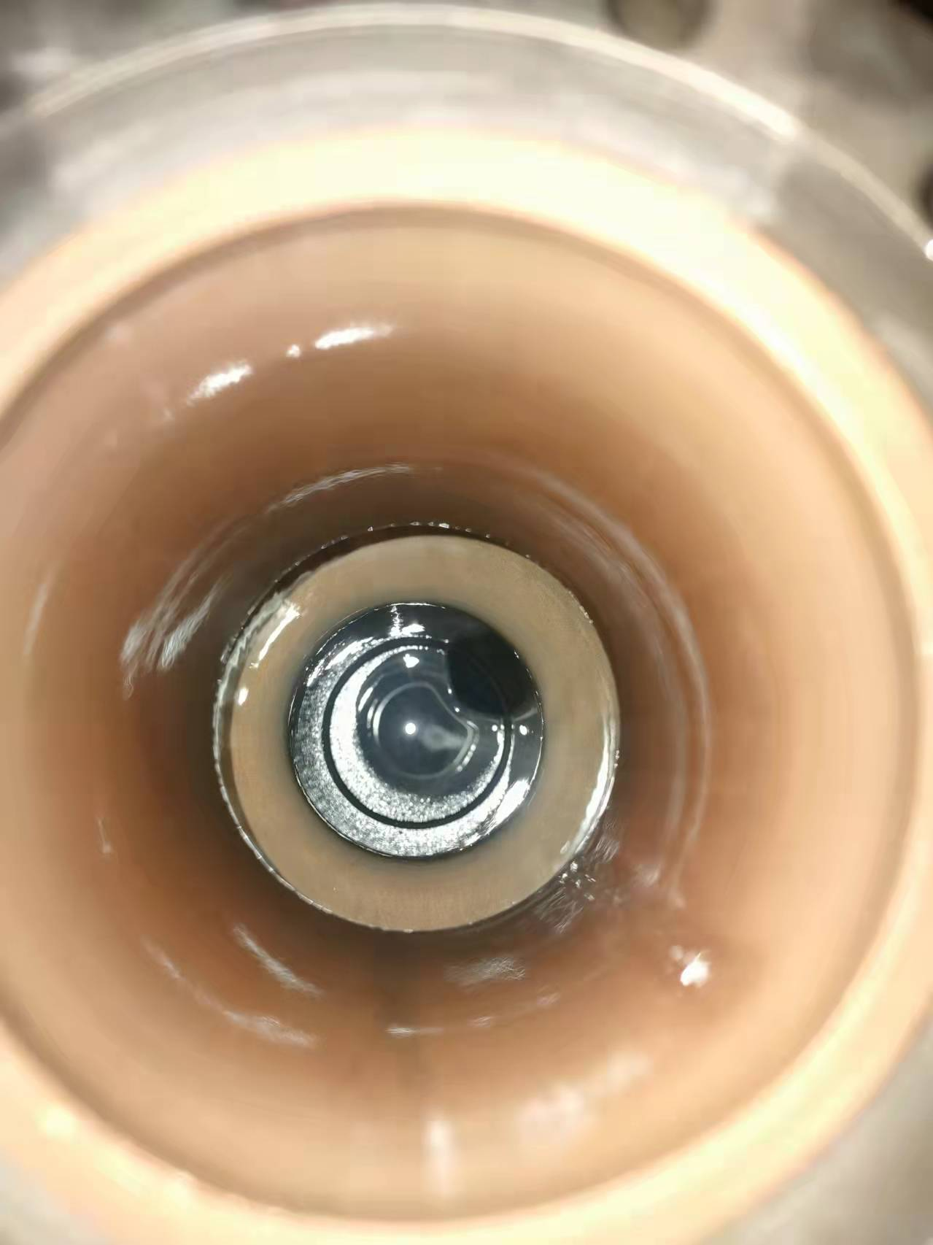
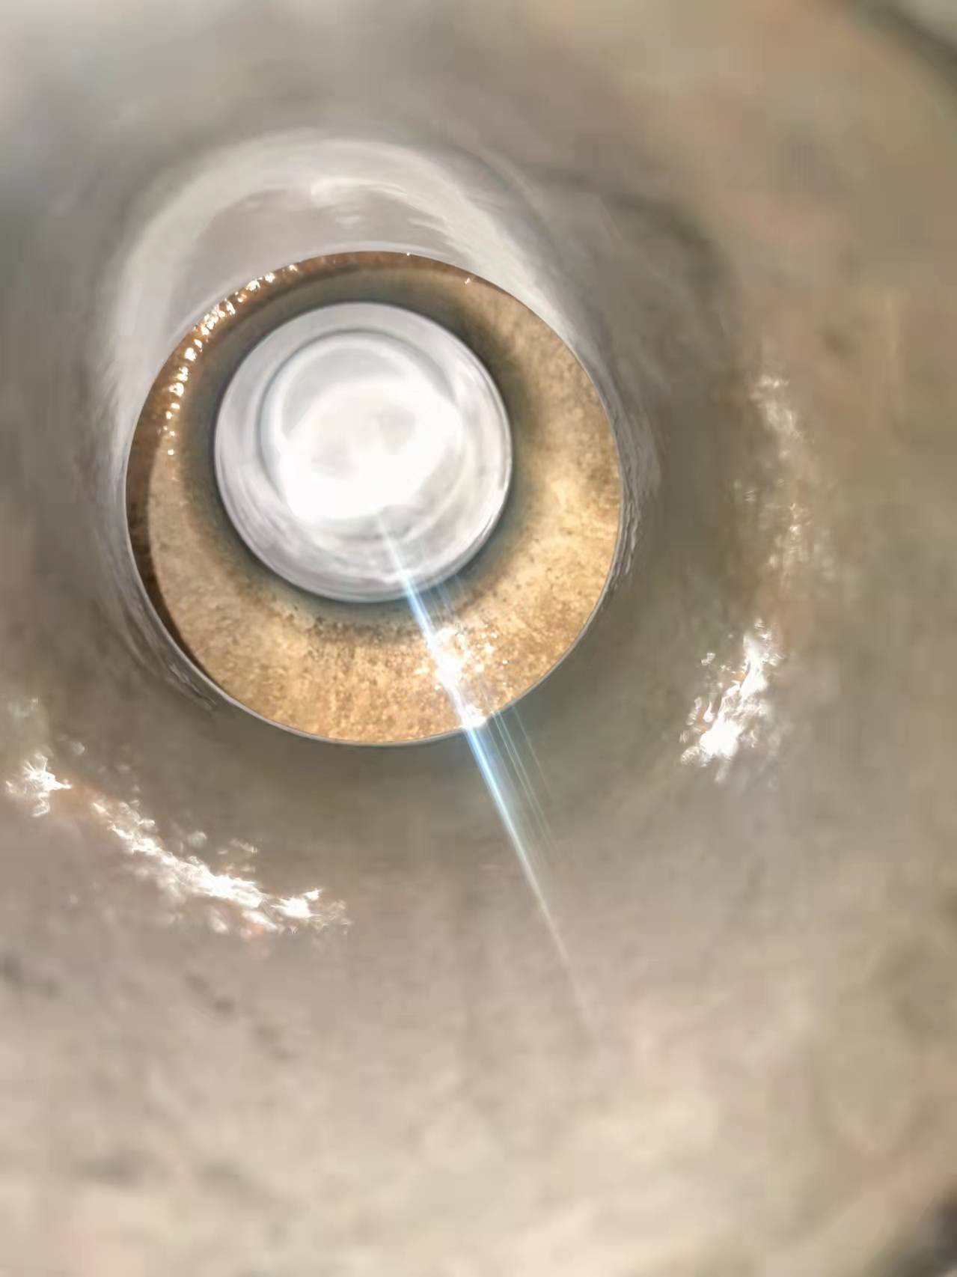
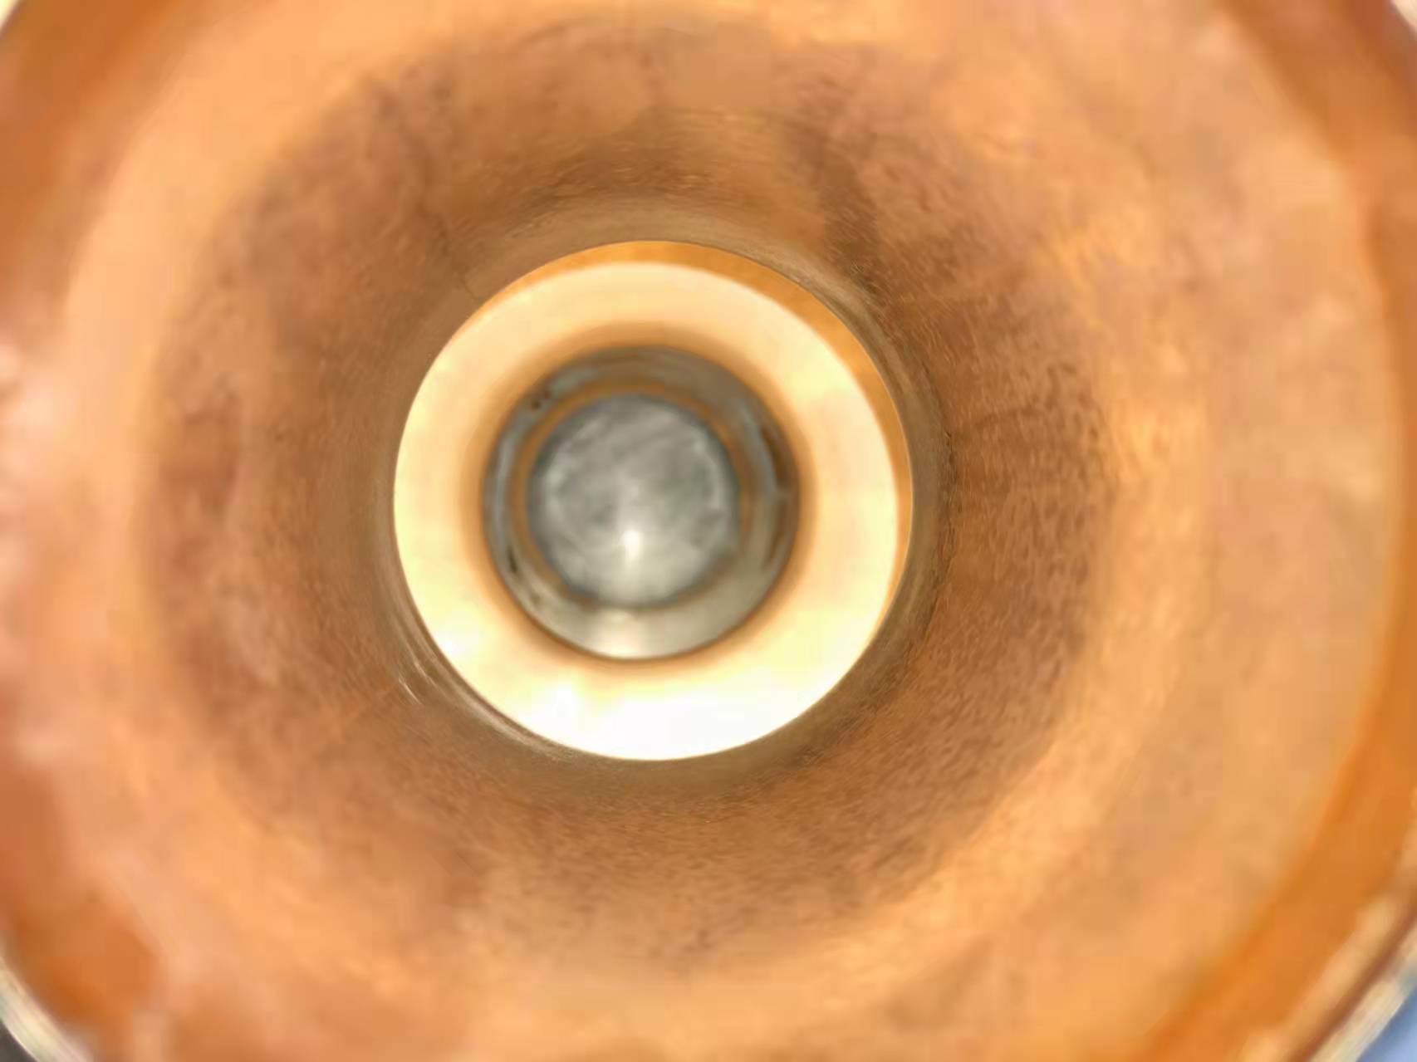
1.3 GHz Nb₃Sn/Nb cavity bronze route
The surface morphology of the different stages of the coating is shown in the figure below:
Before annealing
After annealing
After polishing
Before annealing
After annealing
After polishing
The relationship between annealing curve and air pressure with time.
Morphology analysis: The film is complete and the film-base bond is good, but there are differences in the optical area, and niobium oxide is suspected.
Notes:
Then a bronze Nb3Sn thin film cavity was prepared according to the standard coating operation process. The surface morphology of the different stages of the coating is shown in the figure below. Morphology analysis: The film is complete and the film-base bond is good, but there are differences in the optical area, and niobium oxide is suspected. The right picture showed the relationship between annealing curve and air pressure with time.

Slide 11
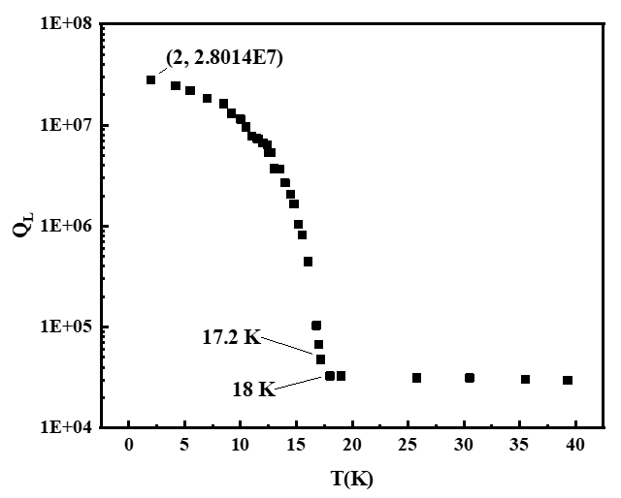
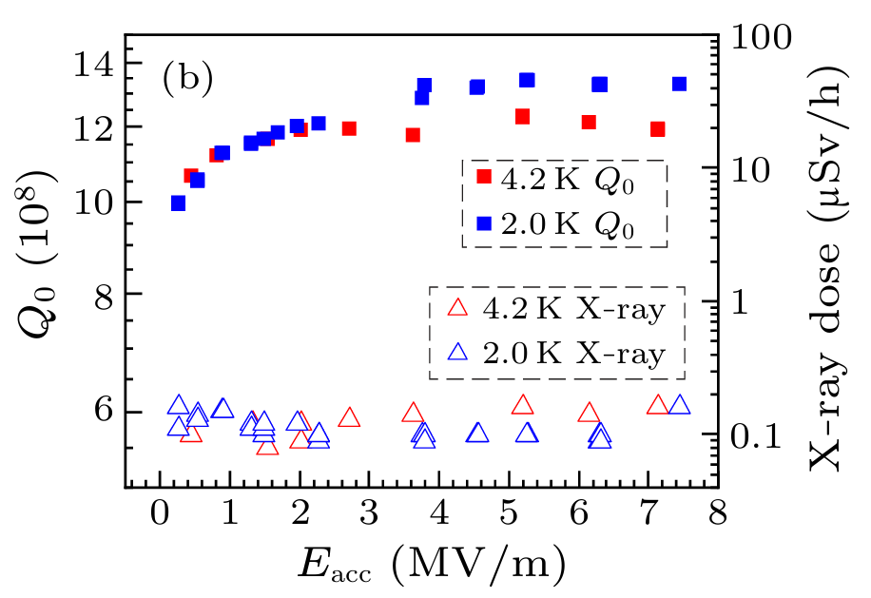
1.3 GHz Nb₃Sn/Nb cavity vertical test
Low temperature vertical test:
Q_{L}-T curve
Q₀-E_{acc} curve
The Q₀ of the thin-film cavity at 4.2 K is about 1.2E+9, which is better than that of the bulk niobium cavity under the same conditions.
Without Q-Slope and X-ray, it is inferred that the reason for limiting E_{acc} is thermal quench.
Notes:
The Q₀ of the thin-film cavity at 4.2 K is about 1.2E+9, which is better than that of the pure niobium cavity under the same conditions. Without Q-Slope and X-ray, it is inferred that the reason for limiting E_{pk} is thermal quench.

Slide 12
Outlines
1. Nb₃Sn and QPR background
2. Overall ETS bronze route progress
3. Cu-based Nb₃Sn QPR samples preparation
4. Nb/Cu QPR sample baseline RF test
5. Future work and summary
Notes:
The Outlines include 3 parts: Background, Nb3Sn thin film activities and conclusion.

Slide 13
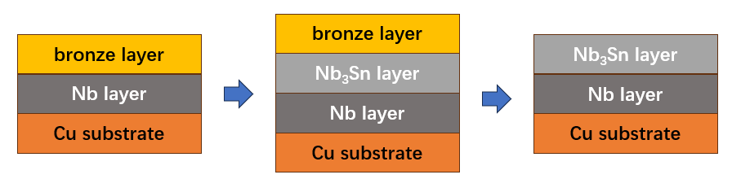
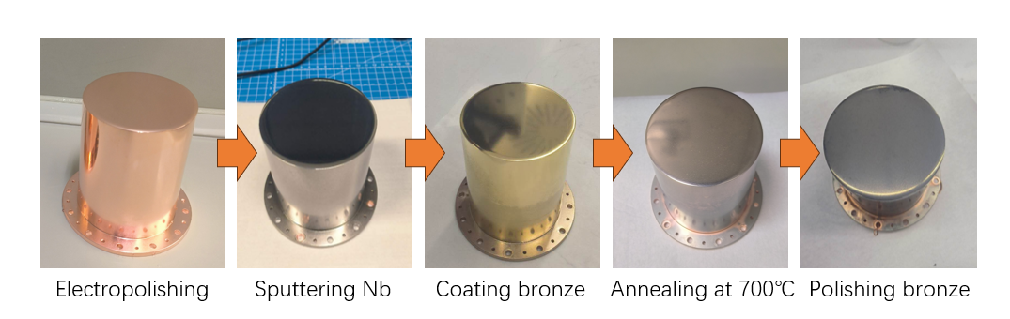
Nb₃Sn/Cu QPR sample prepare procedure
The Nb₃Sn/Cu QPR sample preparation process includes 6 steps:
Electro-polishing
Sputtering Nb
Electro-plating
Heat Treatment at 700℃
Post-chemical polishing
Mechanical polishing
Bulk copper QPR sample by turning, no braze or weld.
A new Cu-based Nb₃Sn QPR sample was successfully prepared.
The Nb₃Sn/Cu QPR sample RF properties will be tested at HZB soon.

Slide 14
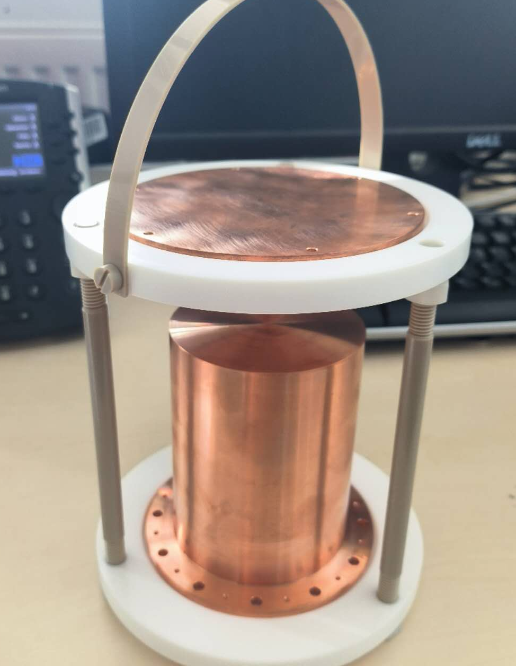
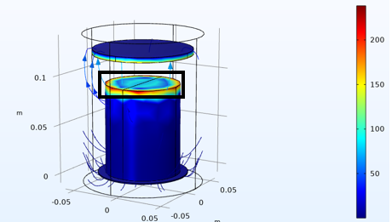
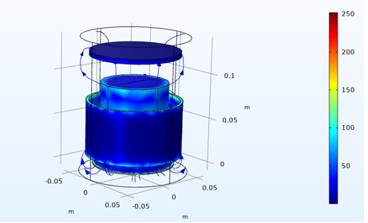
Step 2: Cu QPR sample electropolishing process
Optimized cathode structure and key parameters:
New cathode structure:
  1. Only disk cathode before
  2. Disk cathode and Round belt cathode
  COMSOL simulation:
  The difference in current density is reduced from 16 times to 2-3 times
Parameters:
  1. CV mode: 2.1 V
  2. Electrode distance: 20 mm
  3. Temperature: 15 ℃
  4. Stirring speed: 100 rpm
  5. Polishing time: 1 h (30 μm)

Slide 15
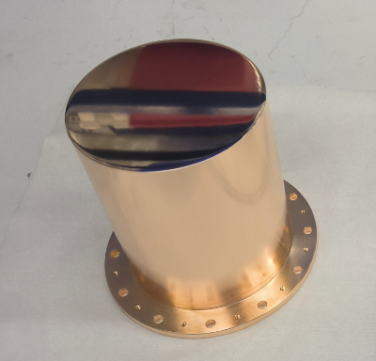
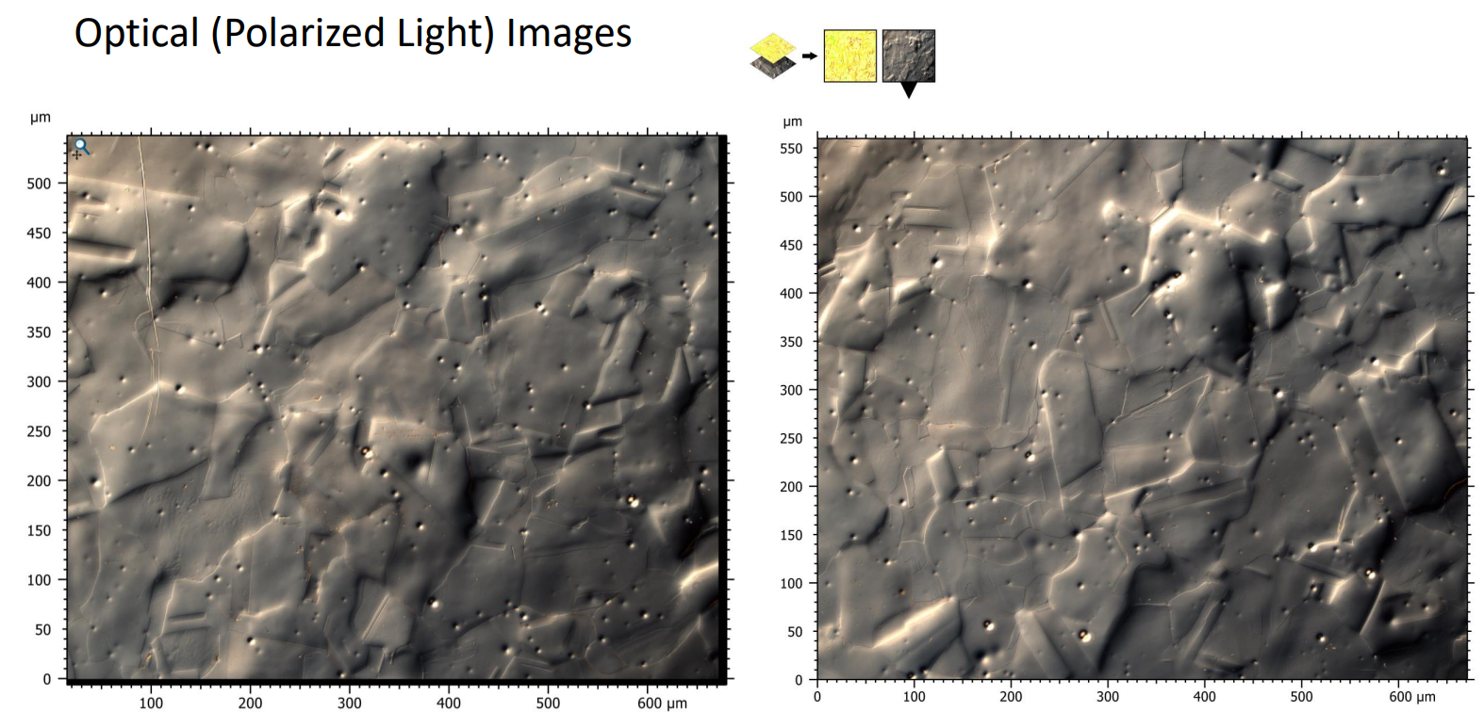
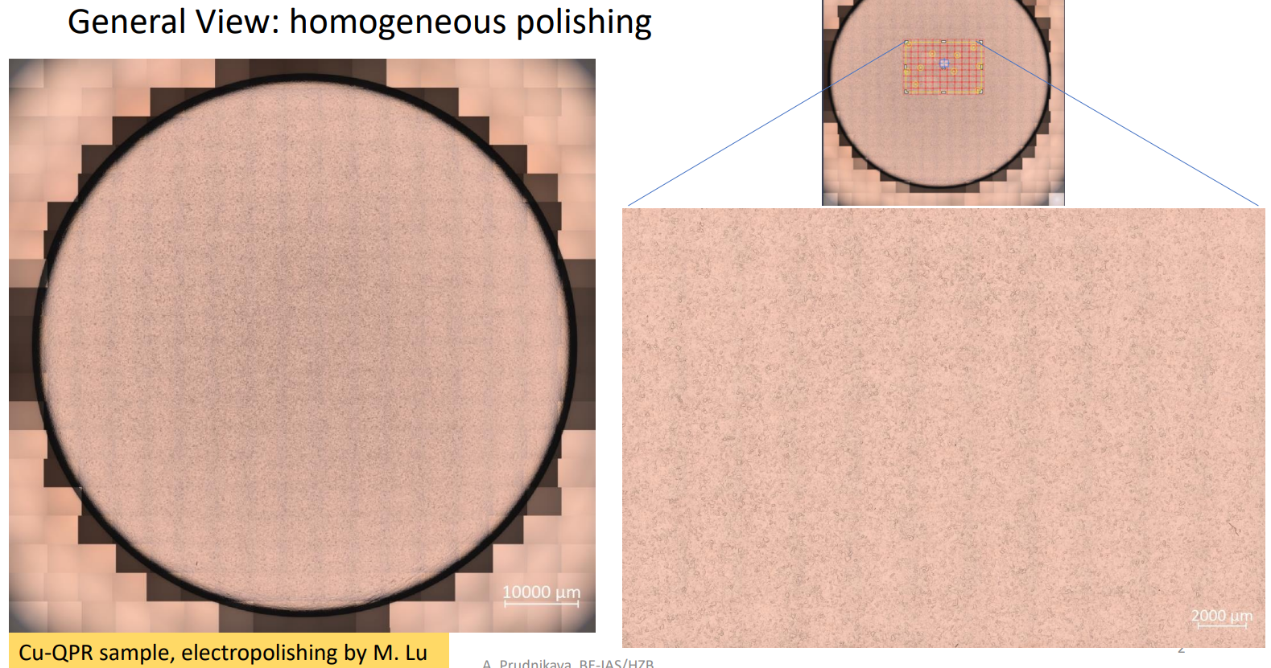
Surface Roughness test of EP QPR sample
Optimized electropolished Cu QPR sample:
Alena Prudnikava
Observing surface morphology using LSM and measuring surface roughness.
There are small pitting (1μm) and corrosion on the surface, difficult to completely remove.

Slide 16
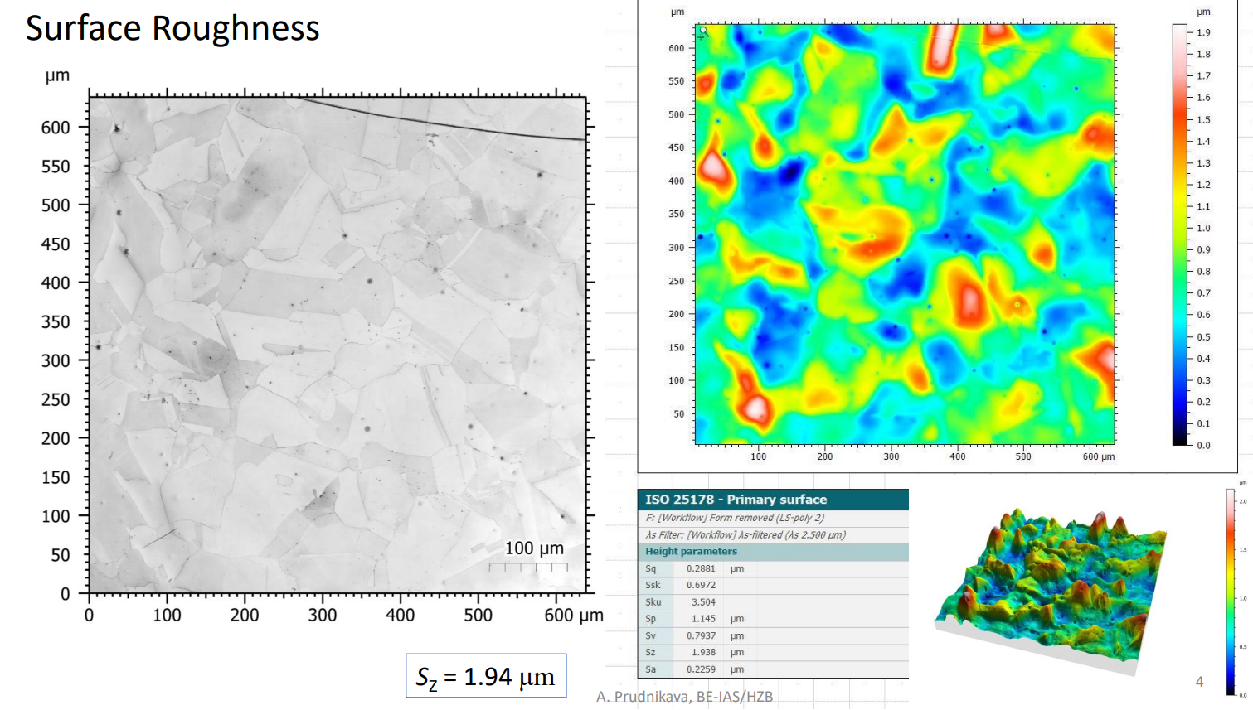
Alena Prudnikava

Slide 17
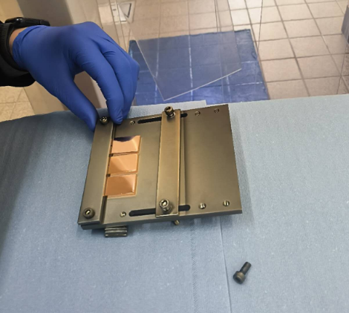
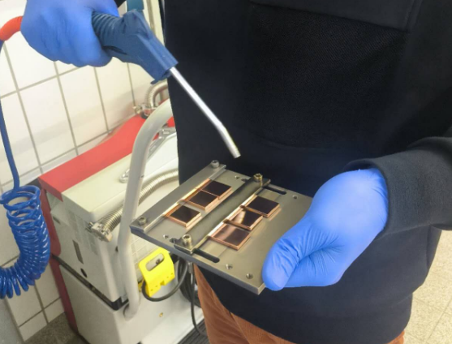
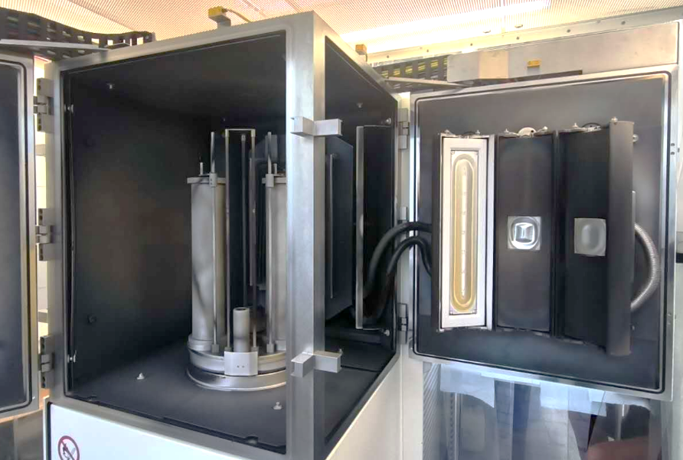
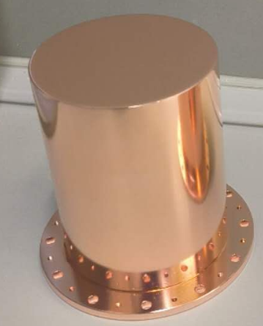
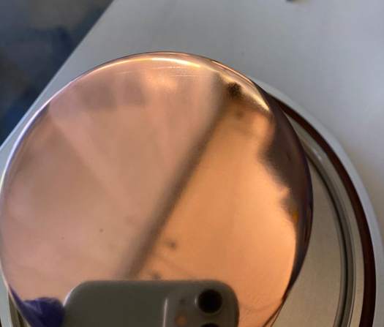
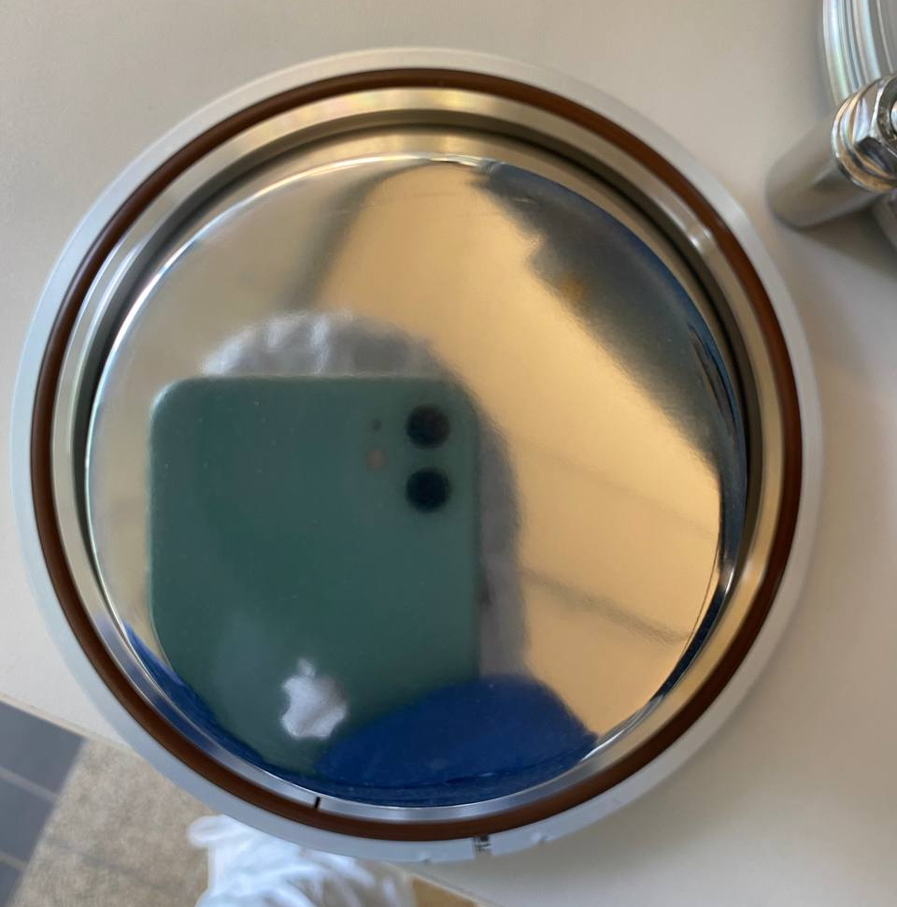
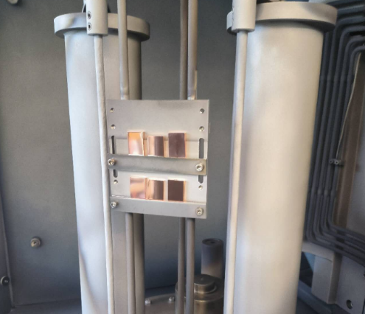
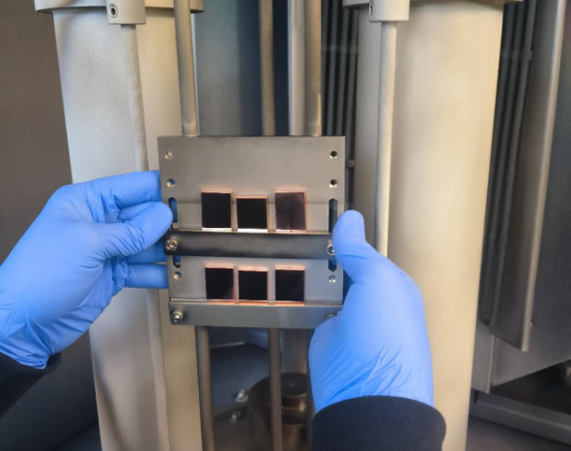
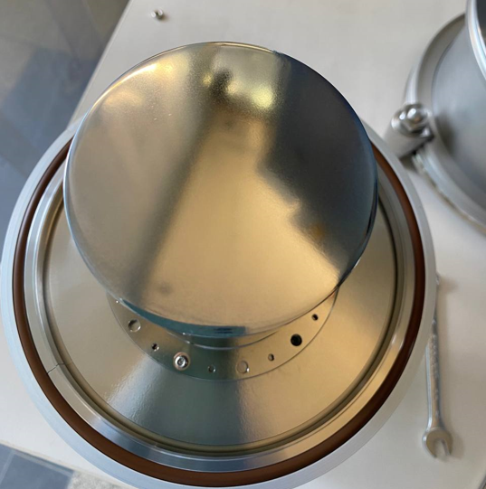
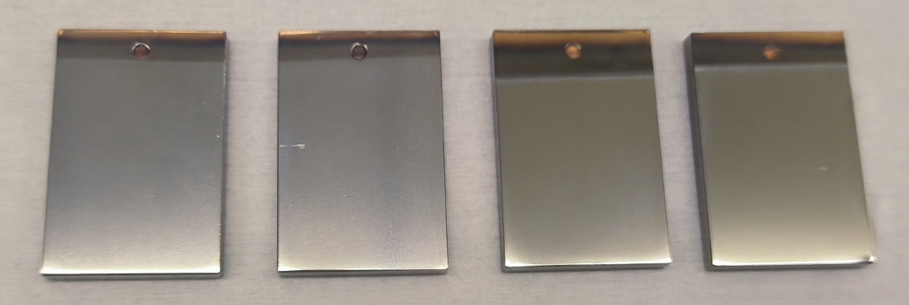
Step 3: Cu QPR sample sputtering Nb at Siegen
Sputtering Nb temperature: 180℃
Nb thin film thickness: 10 μm.
SUBU
EP
Dr. Aleksandr Zubtsovskii
Cu QPR samples were sputtered with Nb thin films about 10 μm using HiPIMS at Siegen.
The sputtering temperature is about 180℃, so annealing is required before bronze plating to eliminate thermal expansion mismatch problem.

Slide 18
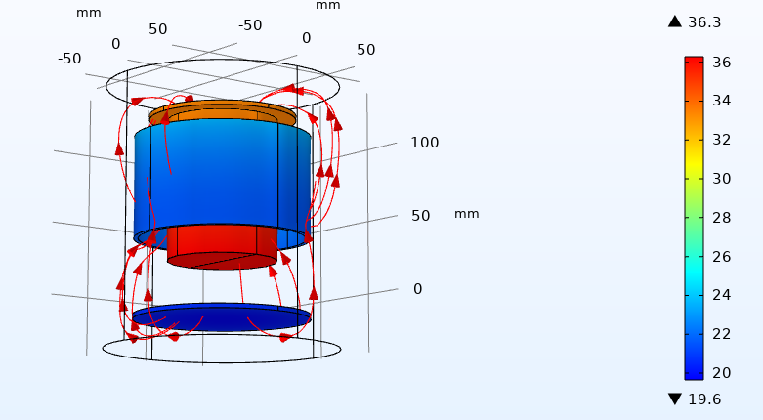

Step 4: Nb/Cu QPR sample electroplating process
Optimized anode structure and key parameters:
Anode structure:
  1. QPR samples are placed upside down to reduce the deposition of impurities from the anode
  2. Only disk anode
  COMSOL simulation:
  The difference in current density: 1-2 times
  Range: 3-4 mA/cm²
Parameters:
  1. CC mode: 0.3 A
  2. Electrode distance: 50 mm
  3. Temperature: 15 ℃
  4. Stirring speed: 100 rpm
  5. Electroplating time: 2 h (10 μm)

Slide 19



Step 5: The QPR sample Heat Treatment at 700℃
Optimized furnace structure and vacuum pressure:
Specific process:
  Placed vertically in a vacuum tube annealing furnace.
  QPR samples are placed vertically with glass sample holders at the bottom.
Parameters:
  Heat treatment curve: 600℃(30h)+700℃(30h).
  Heating and cooling rates:
  0.5℃/min and 9℃/min .
  Vacuum pressure:
  5E-9mbar (room temperature)
  6E-8mbar (at 700℃)
Before and after heat treatment

Slide 20




Step 6: The QPR sample polishing top impurity
HF and H₂SO₄ solution
Ultrasonic cleaning
Nitrogen drying
RF property test
H₃PO₄:
HNO₃=3:1
High-pressure rinsing
The thickness of the Nb film at the bottom of the QPR sample is too thin, causing the Nb₃Sn film to fall off after polishing, exposing the Cu substrate.
By removing impurities such as bronze, niobium oxide, and carbide on the surface, we obtained a clean Nb₃Sn/Cu QPR sample.

Slide 21







Small Nb₃Sn/Cu samples Heat Treatment at 700℃
After annealing
After sputtering
After polishing
I have prepared 6 small Nb₃Sn/Cu samples using the same process and characterized the Nb₃Sn coatings by LSM, SEM, EDX, XRD, PPMS, etc.

Slide 22





Small Nb₃Sn/Cu samples characterization
Zeiss LSM: total film thickness 9 μm (8 μm Nb+1 μm Nb₃Sn)
Alena Prudnikava

Slide 23










Small Nb₃Sn/Cu samples characterization
SEM and EDS: Nb₃Sn surface Sn content 22.35 at%, contains oxides and rare copper impurities.
Alena Prudnikava

Slide 24
Outlines
1. Nb₃Sn and QPR background
2. Overall ETS bronze route progress
3. Cu-based Nb₃Sn QPR samples preparation
4. Nb/Cu QPR sample baseline RF test
5. Future work and conclusion
Notes:
The Outlines include 3 parts: Background, Nb3Sn thin film activities and conclusion.

Slide 25




Nb/Cu QPR sample baseline test
Mount QPR sample
Mount sensor and heater
Check vacuum pressure
Move QPR to cryostat
The Nb/Cu QPR sample is not sealed with indium wire, but only connected with bolts, resulting in poor vacuum (resonator chamber: 7E-6 mbar, thermometry chamber: 2E-5 mbar).
Control the gap distance by selecting the flange with the appropriate height and vector network analyzer test. (a total of 7 flanges with different heights)
Sebastian Keckert

Slide 26

Nb/Cu baseline QPR sample test
413 MHz: R_{s} is measured to be about 33 nΩ at 2 K and 15 mT (R_{BCS} 1 nΩ +R_{res} 32 nΩ ) .
The Nb coating quality is average: Severe Q-slope and RF heat limit occur.
Performed multiple thermal cycles from 10-2K: 120-20 nΩ at 2K and 10mT, 240-60 nΩ at 4K and 15mT.
Nb/Cu QPR sample: When cooling through the critical temperature, the larger the rate, the less thermal current and less magnetic flux is trapped.

Slide 27
Nb/Cu baseline QPR sample test
From T-B_{quench} curve fitting (T/T_{c})², T>8K, we got B_{quench}(0K): 260mT and T_{c}: 9.24K (VNA data)

Slide 28



Future work: From sample to Nb₃Sn/Cu cavity
Aim:
  Nb₃Sn/Cu surface impurities optimization. (Cu, Oxides, Carbides).
  Nb₃Sn/Cu RF loss analysis and loss mechanism study.
  Nb₃Sn coating growth mechanism study and grain control.
Next:
  Nb₃Sn/Cu QPR sample test scheduled in Oct 2024.
  Trap flux study of Nb₃Sn coating on Cu substrate (TraMaFlu).
Future:
  Small samples -> larger samples -> QPR samples -> 1.3GHz cavities.
  1.3GHz copper cavity Nb sputtering + bronze route Nb₃Sn coating.
Felix Kramer
TU Darmstadt (TUD ) ?

Slide 29
Summary
Cu-based Nb₃Sn combines the excellent thermal conductivity of copper and the superior superconducting properties of Nb₃Sn in SRF field.
The ETS bronze route is one method to achieve Nb₃Sn coating on copper. Its advantages are low cost, simple operation, suitable for complex cavity types and mass production.
We provide a complete set of QPR sample preparation processes from copper electropolishing, Nb sputtering, electrodeposition and heat treatment to synthesize Nb₃Sn.
By optimizing the entire preparation process and key parameters, a new Cu-based Nb₃Sn QPR sample was successfully prepared, and its RF properties will be characterized by QPR testing system at HZB soon.
Notes:
Finally ,this is the conclusion.

Slide 30
Acknowledgement
Thanks to colleagues from the following institutes for providing help and information.
• Helmholtz-Zentrum Berlin (HZB), Germany
Alena Prudnikava, Sebastian Keckert, Felix Kramer, Oliver Kugeler, Jens Knobloch.
• Institute of Modern Physics (IMP), CAS, China
Jing Zhang, Bohao Zhang, Teng Tan.
• Universität Siegen, Germany
Dr. Aleksandr Zubtsovskii

Slide 31
Thanks for your attention.

