Slide 1


Enhancement of B_{c1} in Fe_{y}Se_{1-x}Te_{x} -coated Nb structures for SRF applications
Zefeng Lin
Institute of Physics, Chinese Academy of Sciences
CO： Institute of High Energy Physics, Chinese Academy of Sciences
Notes:
Good afternoon, everyone. This is Zefeng Lin from the Institute of Physics, CAS. First, I would like to thank the organizers for giving me this opportunity to share with you our recent work about FeSe coated Nb film and the enhanced Bc1 in this bilayer structure. Our work is primarily based on small samples and is still in the foundational research stage.

Slide 2
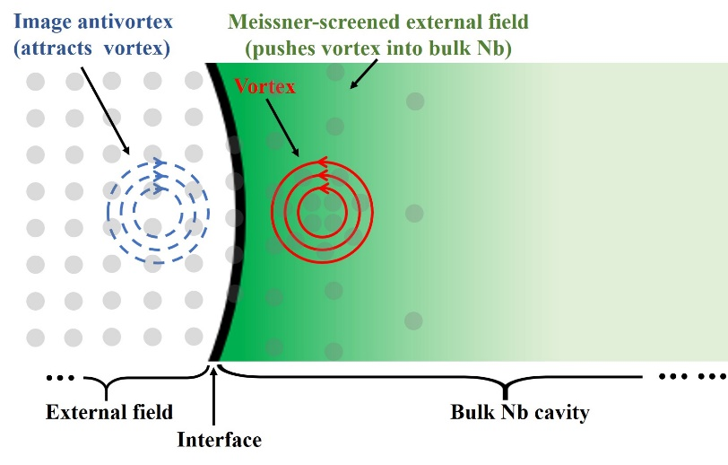
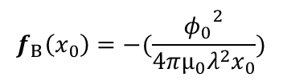


Superheating field B_{sh}
$$f_{M}\left(x_{0}\right)=φ_{0}J\left(x_{0}\right)$$
$$B_{s}=\frac{φ_{0}}{4πλξ}∝B_{c1}$$
$$f_{B}\left(x_{0}\right)=−(\frac{{φ_{0}}^{2}}{4πμ_{0}λ^{2}x_{0}})$$
C. P. Bean et al. Phys. Rev. Lett. 12, 14 (1964)
Notes:
Let's start with the superheating field of superconducting cavities, a topic which I believe many of you are familiar with. Here is the inner wall of a superconducting cavity. The surface induces an image vortex, which is attracted to vortices on the surface of the superconductor, thereby forming a surface barrier. This barrier increases the critical field that allows vortices to penetrate into the superconductor, thus higher than the lower critical field Bc1. A typical equation tells us that Bs is positively correlated with Bc1​. Whether the superconducting cavity parameter of interest is Bs or Bc1​, enhancing Bc1​ will improve the accelerating gradient.

Slide 3



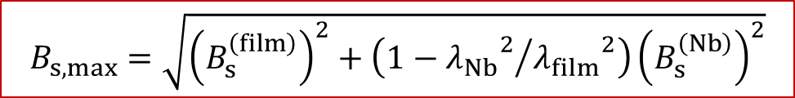
SS’ / SIS’ structure
$$B_{s,max}=\sqrt{{\left(B_{s}^{\left(film\right)}\right)}^{2}+\left(1−{{λ_{Nb}}^{2}}/{{λ_{film}}^{2}}\right){\left(B_{s}^{\left(Nb\right)}\right)}^{2}}$$
$$B_{s}^{\left(film\right)}$$
$$λ_{film}$$
$$B_{s,max}$$
A. Gurevich Appl. Phys. Lett. 88, 012511 (2006)
A. Gurevich Supercond. Sci. Technol. 30, 034004 (2017)
T. Kubo et al. Appl. Phys. Lett. 104, 032603 (2014)
Notes:
To further enhance the critical field, Gurevich proposed a multilayer structure consisting of a superconducting thin film, an insulating layer, and an Nb cavity. It is so call SIS structure or may be SS structure. By introducing more interfaces, both Bs and Bc1​ significantly increase. These paper calculate that, at the optimal film thickness, the Bs​ of this structure satisfies a particular equation. This equation requires the superconducting film to possess a high Bs​ and a large penetration depth λ, with the film thickness needing to be less than λ.

Slide 4
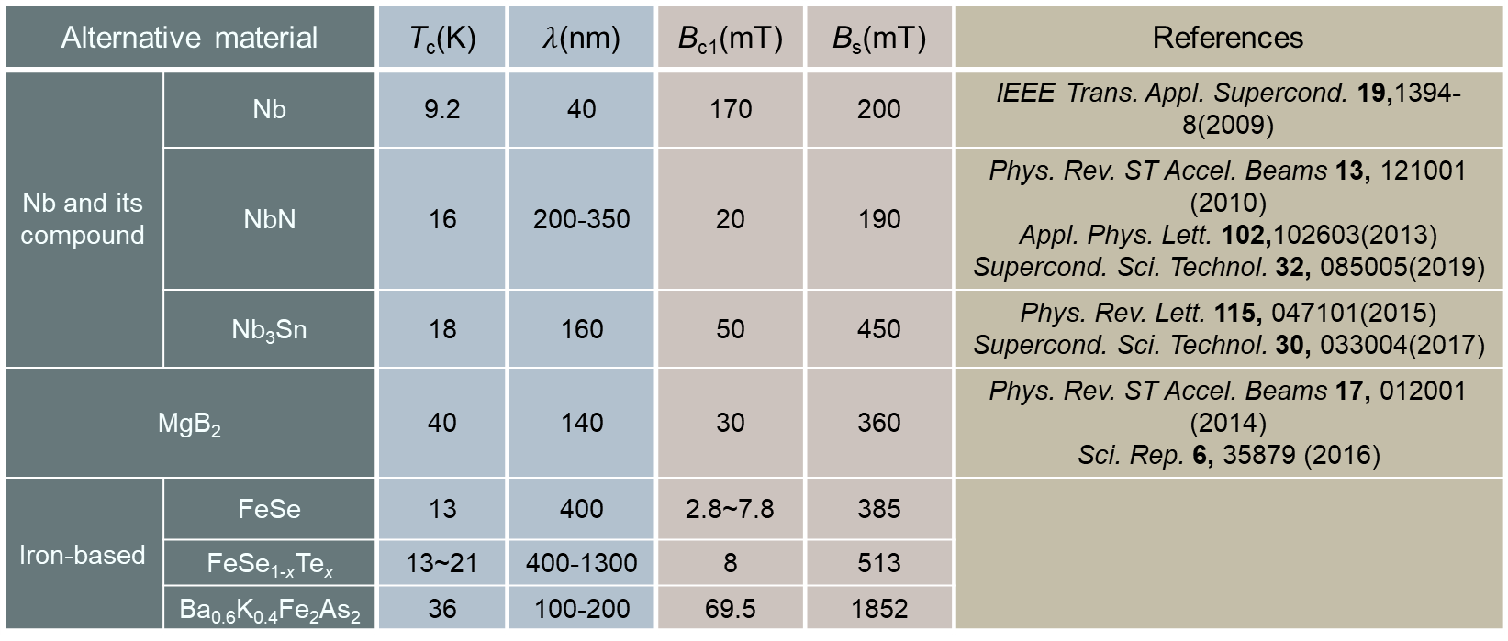
Alternative coating superconductor
Alternative material |  | T_{c}(K) | $λ$(nm) | B_{c1}(mT) | B_{s}(mT) | References
Nb and its compound | Nb | 9.2 | 40 | 170 | 200 | IEEE Trans. Appl. Supercond. 19,1394-8(2009)
 | NbN | 16 | 200-350 | 20 | 190 | Phys. Rev. ST Accel. Beams 13, 121001 (2010) Appl. Phys. Lett. 102,102603(2013) Supercond. Sci. Technol. 32, 085005(2019)
 | Nb₃Sn | 18 | 160 | 50 | 450 | Phys. Rev. Lett. 115, 047101(2015) Supercond. Sci. Technol. 30, 033004(2017)
MgB₂ |  | 40 | 140 | 30 | 360 | Phys. Rev. ST Accel. Beams 17, 012001 (2014) Sci. Rep. 6, 35879 (2016)
Iron-based | FeSe | 13 | 400 | 2.8~7.8 | 385
 | FeSe_{1-x}Te_{x} | 13~21 | 400-1300 | 8 | 513
 | Ba_{0.6}K_{0.4}Fe₂As₂ | 36 | 100-200 | 69.5 | 1852
A. Valente-Feliciano Supercond. Sci. Technol. 29, 113002 (2016)
A. Gurevich Supercond. Sci. Technol. 30, 034004 (2017)
Notes:
This table here presents some alternative film materials, including Nb and its compounds, MgB2, and iron-based superconductors. Considerable research has been done on Nb, its compounds, and MgB2. However, there are few experimental studies by using iron-based superconductors. Although they have a low Bc1​, they boast a large λ. The large λ enhances the critical field of the entire structure and allows us to grow thick films while ensuring the film thickness does not exceed λ. Thus, we attempt to prepare and measure small samples based on iron-based films, starting with FeSe due to its simple structure and lack of toxic elements.

Slide 5
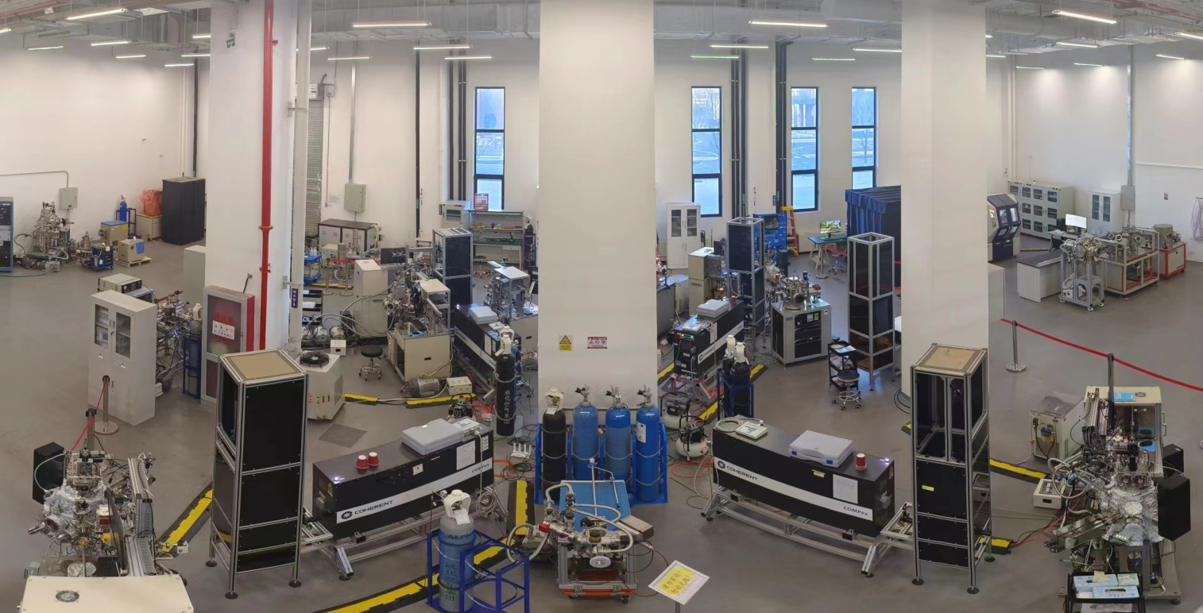
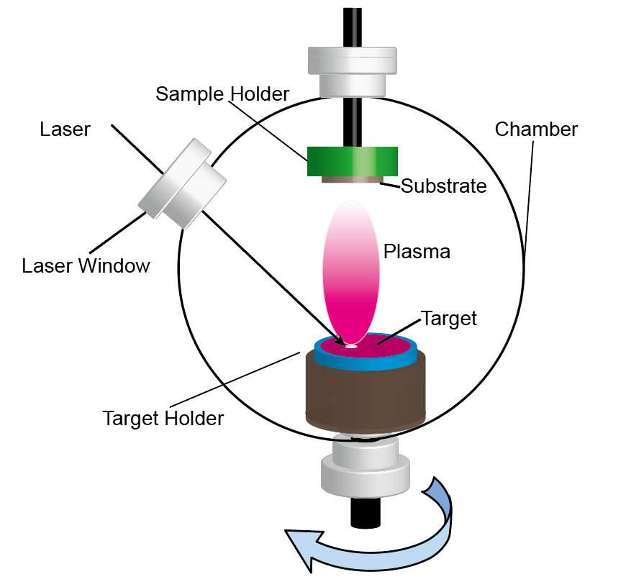
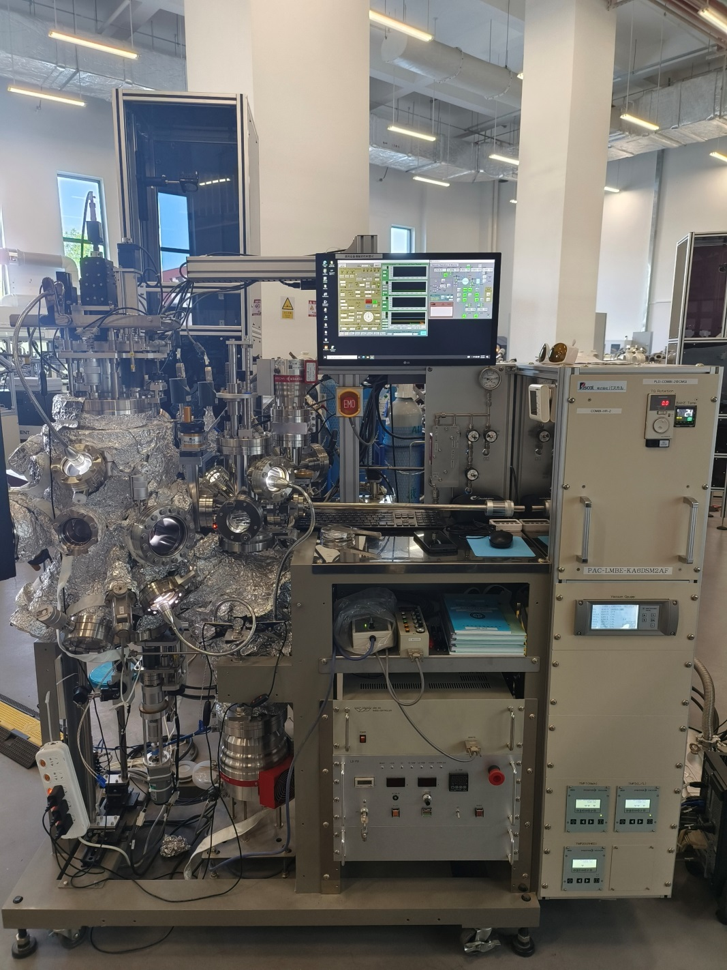
Single-crystalline film experimental station
Combinatorial laser molecular beam epitaxy (CLMBE): 4 sets
Pulsed laser deposition (PLD): 4 sets
XRD, AFM, Raman, PPMS……
@IOP, Beijing
CLMBE / PLD
Notes:
Our lab is constructed as a single-crystal film experimental station, including four combinatorial laser molecular beam epitaxy systems, which are capable of growing continuous composition films. I will introduce this technique later. Our lab is also equipped with four pulsed laser deposition (PLD) systems and some characterization tools. The principle of film preparation like laser molecular beam epitaxy or PLD is depicted as this picture. A high-energy laser enters the vacuum chamber through a focusing lens and focuses on an FeSe target—a polycrystalline bulk material. The laser ablates the target surface, creating a plasma plume, where molecules or atoms deposit on the substrate to form a film. We use this LMBE equipment to prepare FeSe films.

Slide 6
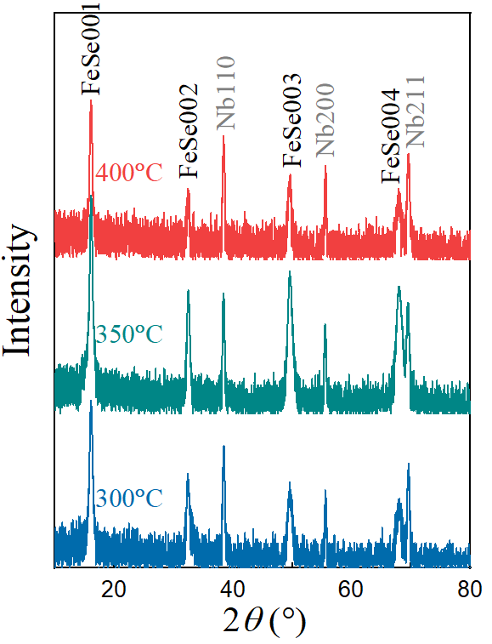
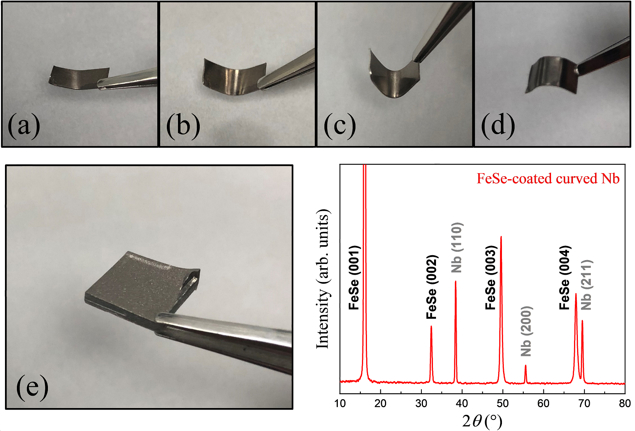
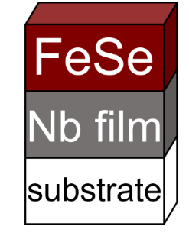
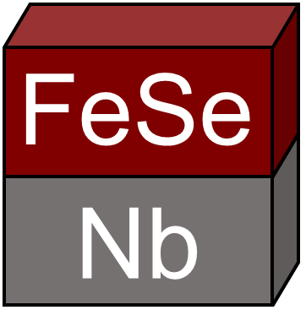
FeSe/Nb bilayer structure
XRD
Bending test
XRD
The out-of-plane alignment of the FeSe layer is good
The FeSe layer is capable of withstanding multi-angle bending
Z. Lin et al. Supercond. Sci. Technol. 34, 015001 (2021)
Notes:
We fabricated FeSe films on small Nb substrates, each less than 1 cm in length. Two types of Nb substrates are used: one is flexible Nb foil and the other is Nb slice cut from the inner wall of a superconducting cavity. Through optimization, we can prepare single-oriented FeSe films on polycrystalline Nb substrates. FeSe films on Nb foil can withstand bending at various angles without delamination, and maintain their physical properties. The measured signal of Nb slices often touch the test limits of our equipment; so in this case, we use Nb film as substrates instead of Nb slices.

Slide 7
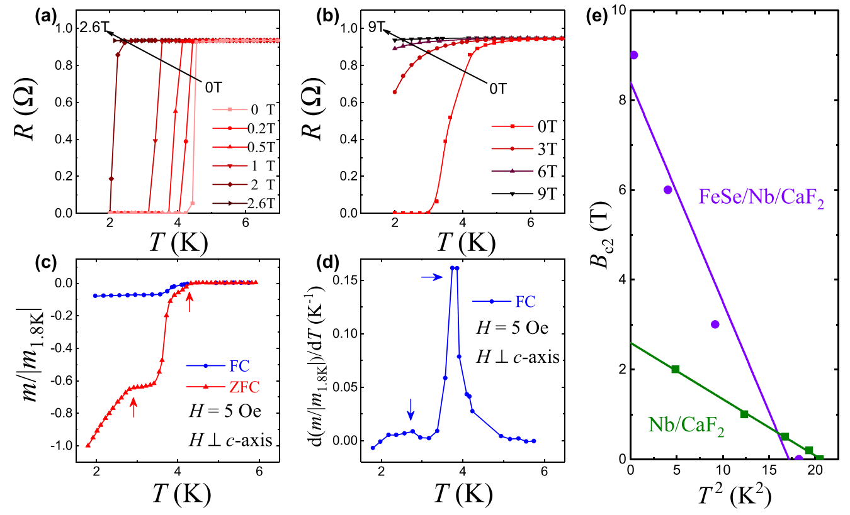
Verification of SS’ structure
Nb
FeSe/Nb
The high B_{c2} and two SC transitions in M-T confirm the existence of superconductor-superconductor (SS’) bilayer
R-T
FeSe/Nb
FeSe/Nb
M-T
Z. Lin et al. Supercond. Sci. Technol. 34, 015001 (2021)
Notes:
To verify the superconductivity of the FeSe layer, we conducted electrical transport (R-T) and magnetic (M-T) tests on the bilayer film. First, we measured R-T under different magnetic fields, and extracted the upper critical field Bc2​, which exceeds 8T for the bilayer film. In contrast, for the Nb film without FeSe layer, Bc2​ is less than 3T. Thus, we infer the FeSe layer is superconducting due to its high Bc2​. To distinguish the transition temperatures Tc​ of the FeSe and Nb layers, we performed magnetic measurements (M-T). The M-T curve and its derivative reveal two distinct superconducting transitions: one near 4K for the FeSe layer and another near 3K for the Nb layer, proving the sample is indeed an S-S structure.

Slide 8
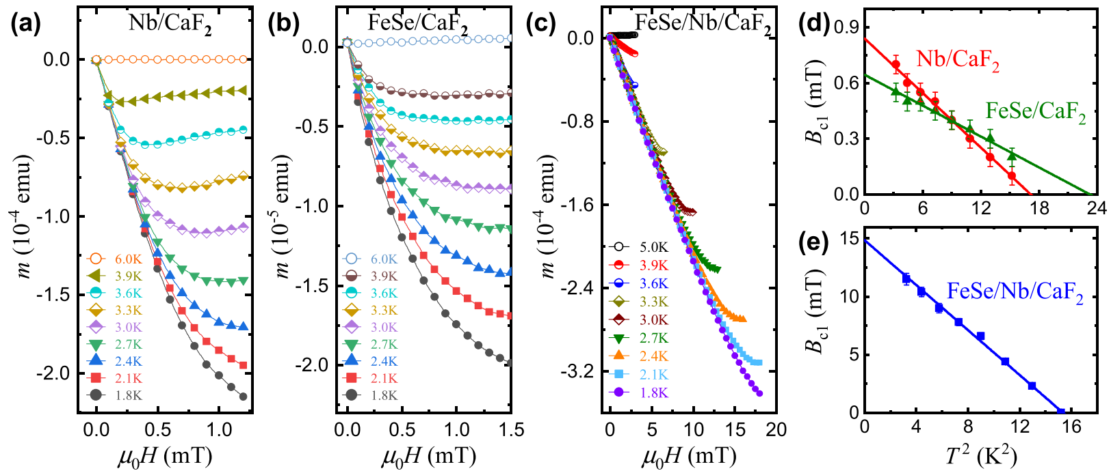
Enhanced B_{c1} in FeSe/Nb
M-H
M-H
M-H
FeSe
Nb
CaF₂
The B_{c1} of FeSe/Nb/CaF₂ is greatly enhanced compared with the single layers
Z. Lin et al. Supercond. Sci. Technol. 34, 015001 (2021)
Notes:
We then used MPMS to measure the magnetization curves of three samples: FeSe film, Nb film, and bilayer FeSe/Nb films, with the magnetic field parallel to the film surface. By extracting the field at which the M-H curve deviates from linearity, we obtained the Bc1​ values at different temperatures. We found the Bc1​ of the bilayer film is significantly higher than that of the single-layer films. It's noteworthy that the thickness of the FeSe and Nb films is consistent with the bilayer film, indicating that the film thickness is not the primary reason for Bc1​ enhancement. This work marks the preliminary investigation of FeSe on Nb, and observe Bc1​ enhancement in the FeSe bilayer structure. However, both Tc​ and Bc1 values​ are very low, and require further improvement.

Slide 9
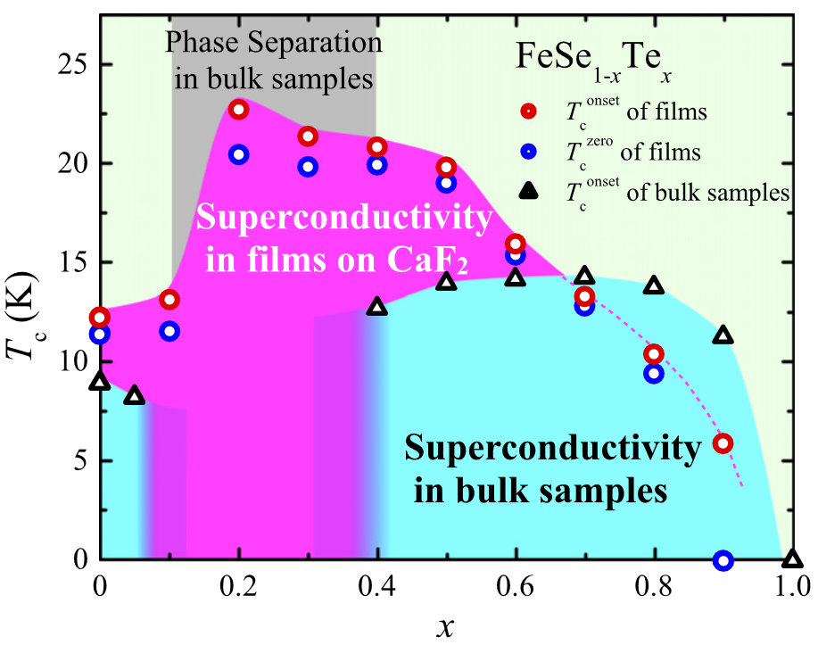
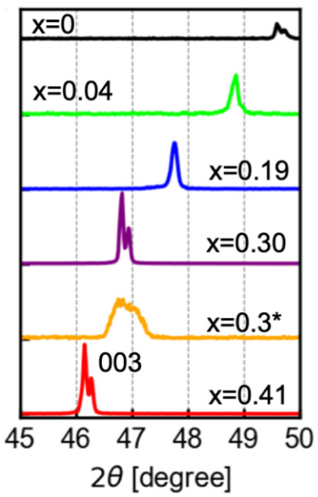
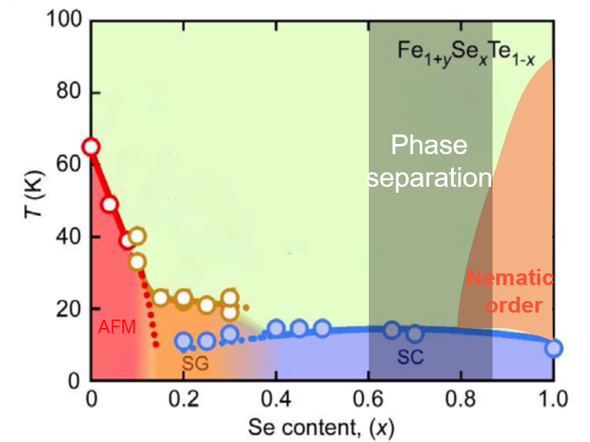
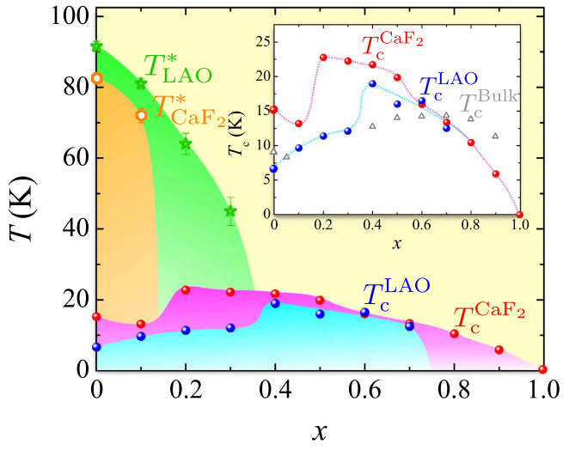
FeSe → Fe_{y}Se_{1-x}Te_{x}
Bulk
Film
Y. Imai et al., PNAS 112, 1937 (2015)
Y. Imai et al., Sci. Rep. 7, 46653 (2014)
Films can overcome phase separation, but different substrates lead to varying optimal Te dopings.
Phys. Rev. B 100, 224516 (2019）
Phase separation in bulk Fe_{y}Se_{1-x}Te_{x} (0.1＜x＜0.4)
Optimal Te doping on Nb?
Notes:
Compared to FeSe, FeSeTe is much easier to achieve a higher Tc​. This compound is fabricated by doping Te. For bulk materials, whether single crystal or polycrystalline, Tc can be raised to 15K with a Te doping level around 0.5. However, bulk materials face a big challenge that the phase separation usually occurs when the Te doping ranges from 0.1 to 0.4, for example, XRD peaks are splitting within this range. Fortunately, films can overcome phase separation, and on some substrates, such as CaF2, Tc​ can exceed 20K. The phase diagram of FeSeTe varies with the substrate, leading to different optimal Te doping. Therefore, when growing FeSeTe on Nb substrates, the first step is to determine the optimal Te doping, and this process would be time-consuming.

Slide 10
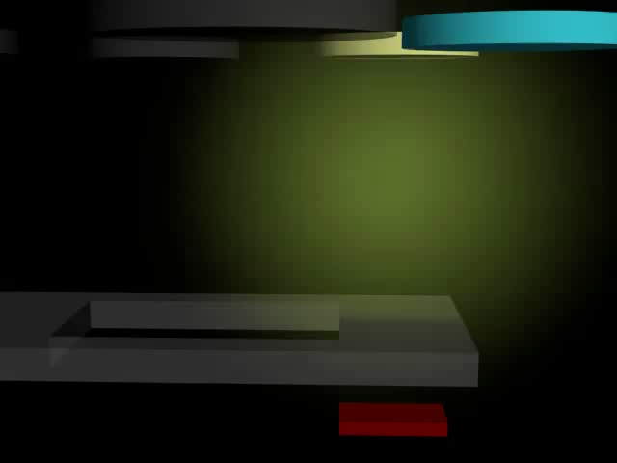
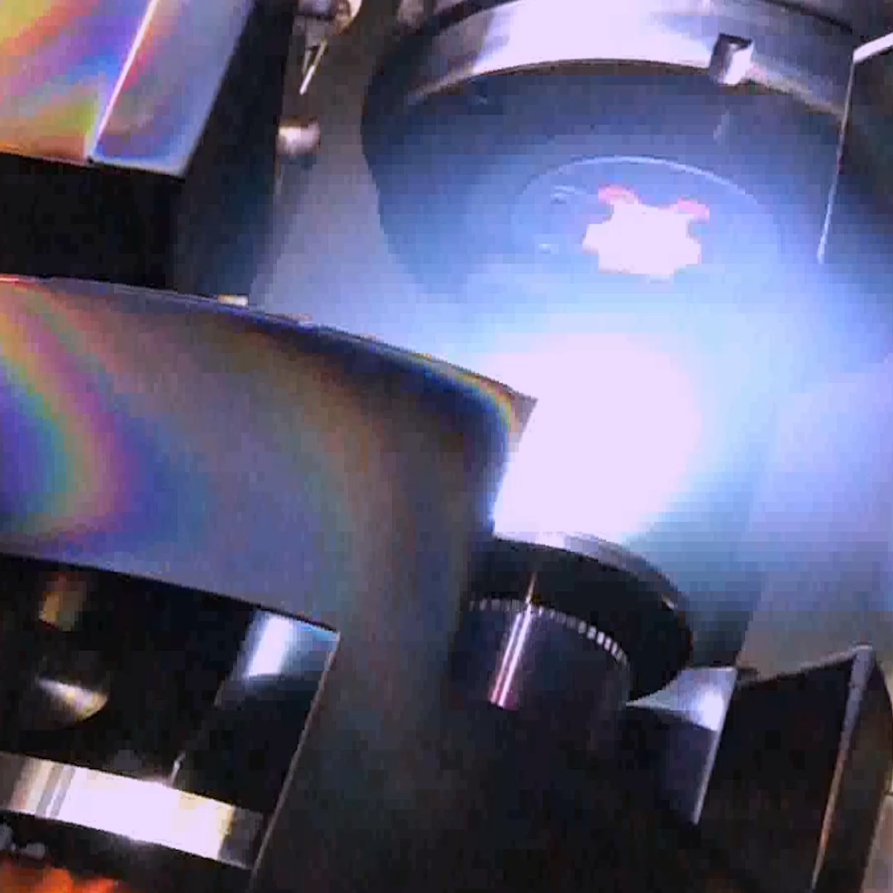
High-throughput composition-spread film
La_{2-x}Ce_{x}CuO₄ with continous composition 0.10≤x≤0.19 on one substrate
x = 0.10
x = 0.19
Top view
Side view
1 u.c.
SrTiO₃
substrate：1 cm²
Combinatorial single crystalline film Rather than superlattice
Combinatorial laser molecular beam epitaxy
H. Yu et al. Sci. China-Phys. Mech. Astron. 60, 087412 (2017)
J. Yuan et al. Nature 602,431 (2022)
Notes:
Let me introduce the advanced combinatorial laser MBE technique, which is another high-throughput film technique. For an example LCCO. It is a electron-doped cuprate superconductor, and we spent almost 4 years in fabricating combinatorial LCCO from the optimal doping x=0.10 to overdoped x=0.19 to optimize the technique. Here is the cartoon. You only need two targets, one is the x=0.10, the other is 0.19. Using excimer laser shoots those two targets alternatively equipped with moving mechanical mask. At the first half period, the laser ablates x=0.10 target and meanwhile the mask moves to the right side so you got such a gradient of thickness. In the second half period, change to the other target and move mask to opposite direction, we got a reverse thickness gradient of x=0.19. Repeat this process, you can get any thickness you need. But make sure that in one period only one unit cell is deposited, or else it is not combinatorial single crystalline film but superlattice. The latter has two sets of Bragg peaks in x-ray diffraction.

Slide 11
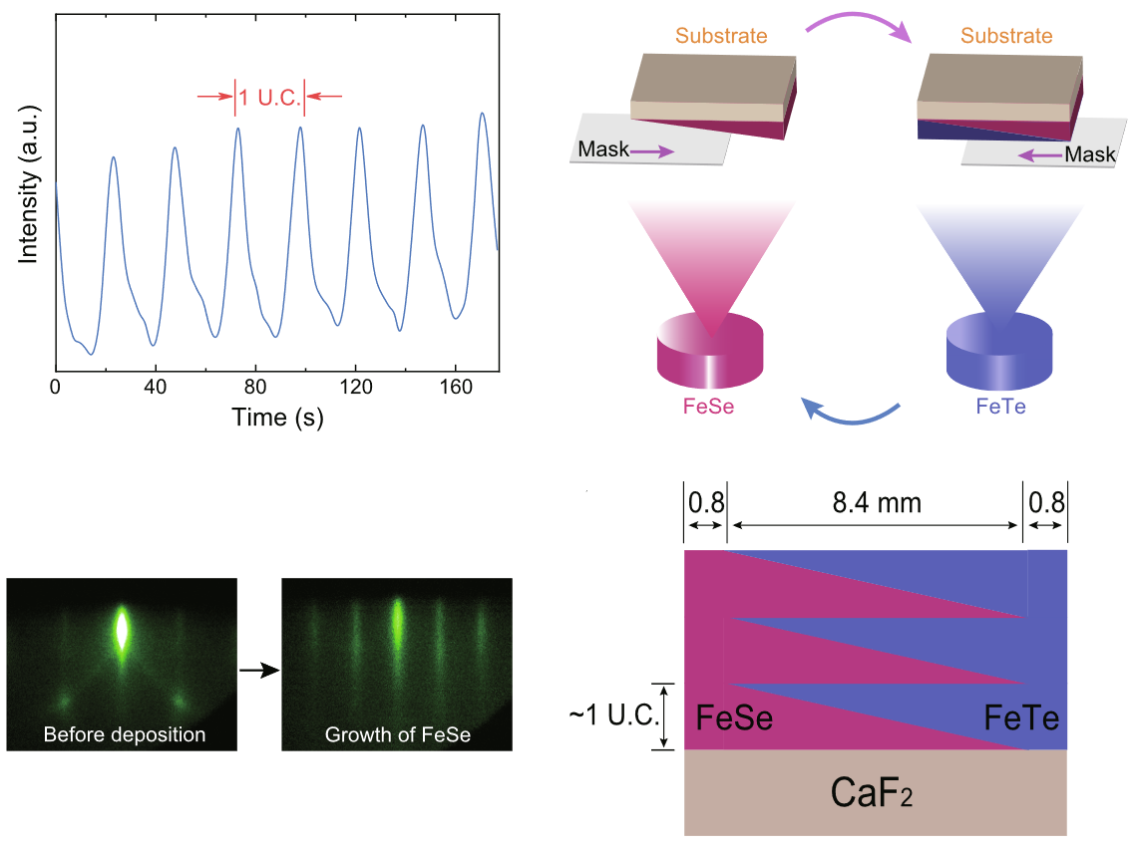
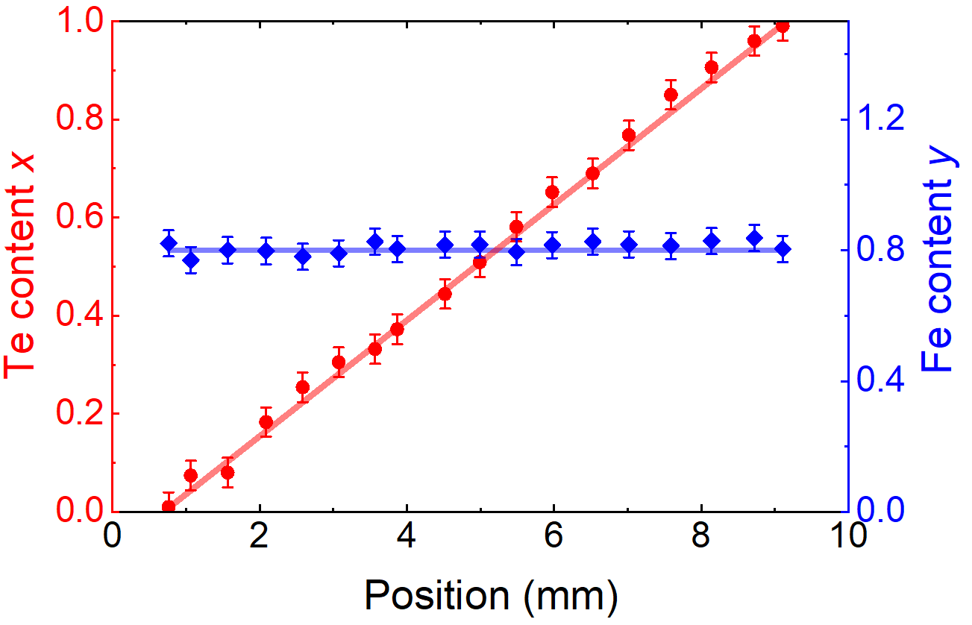
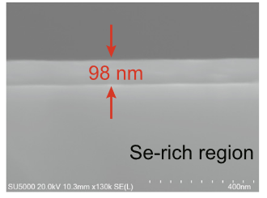
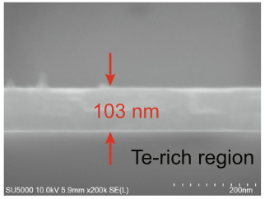
Composition-spread Fe_{y}Se_{1-x}Te_{x} films
EDX
RHEED
Te doping level vs. Position
SEM
We can fabricate an epitaxial composition-spread Fe_{y}Te_{1-x}Se_{x} film across the entire Te content x from 0 to 1 on a single piece of substrate
Thickness
Z. Lin et al. Sci. Bull. 67, 1443 (2022)
Notes:
Beyond cuprate, we bring the combi techniques to FeSeTe. It can be called FST for short. A good news is that we have succeeded in fabricating the combinatorial film from FeSe to FeTe on a CaF2 substrate. We utilized the reflection high-energy electron diffraction (RHEED) to monitor the deposition rate, so we can control the film thickness very well. RHEED oscillations and pattern indicates the film surface is flat during growth. The element ratio of film was mapped using EDX. The doping level varies linearly with position, from 0 to 1. And the thickness from SEM measurements indicates a uniform deposition rate of FeSe and FeTe. In a word, we succeeded in fabricating an epitaxial composition-spread Fe_{y}Te_{1-x}Se_{x} film across the entire Te content x from 0 to 1 on a single piece of substrate.

Slide 12
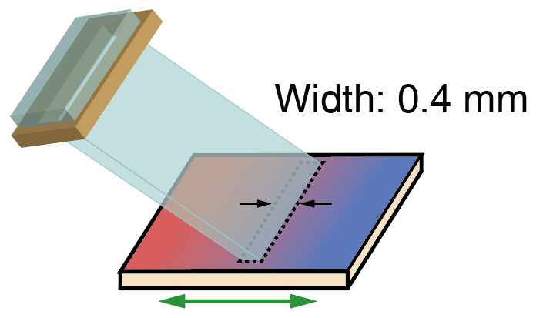
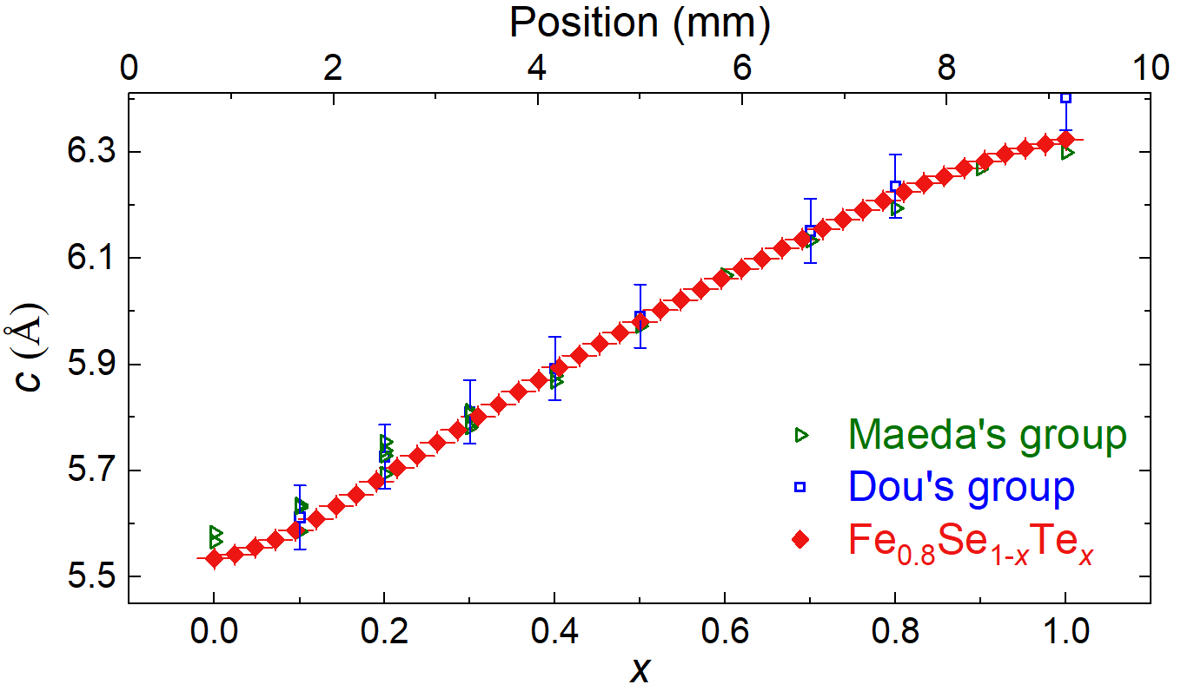
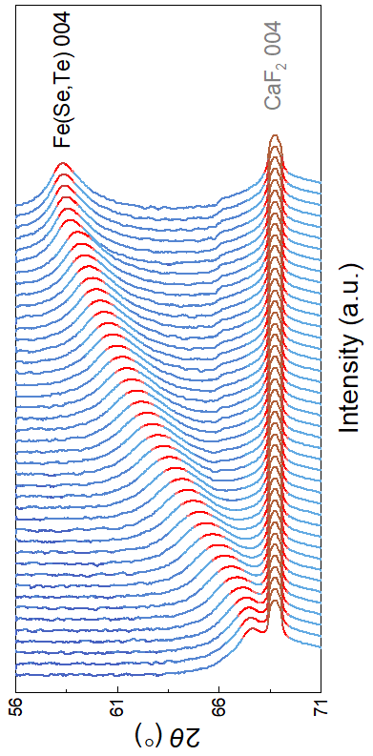
Micro-region XRD $θ−2θ$ scan
Micro-region XRD
x = 0
x = 1
c parameters vs. Te doping level
Good out-of-plane alignment across all compositions
The phase separation is suppressed
Z. Lin et al. Sci. Bull. 67, 1443 (2022)
Notes:
To gain more information at higher spatial resolution, the micro-region out-of-plane XRD with a beam size about 0.4 mm in width was performed on the composition-spread film. As the X-ray scans along the spread, The FeyTe1-xSex diffraction peak moves to higher angles as x increases while the CaF2 peak is fixed. There exist neither splitting nor broadening of the FeyTe1-xSex peaks even from x=0.1 to 0.4, where the phase separation usually occurs, indicating a good out-of-plane alignment at all positions. The c-axis lattice constant monotonically decreases with x, consistent with that for single component films from other groups.

Slide 13
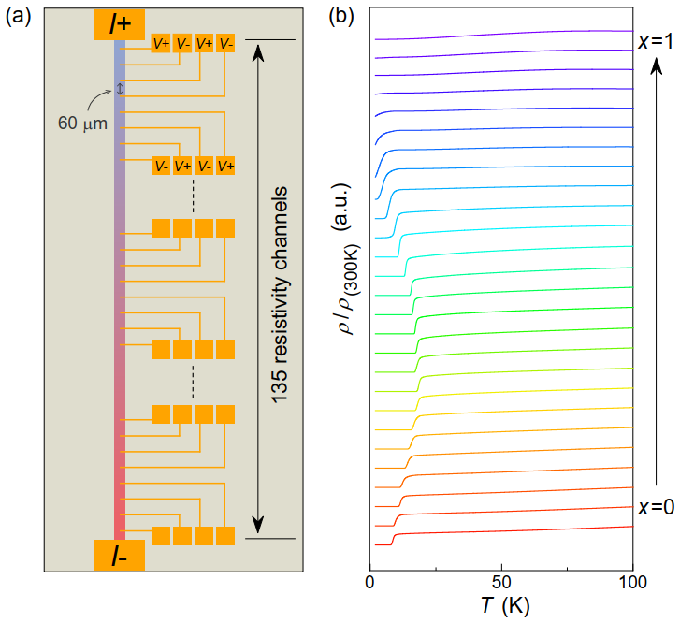
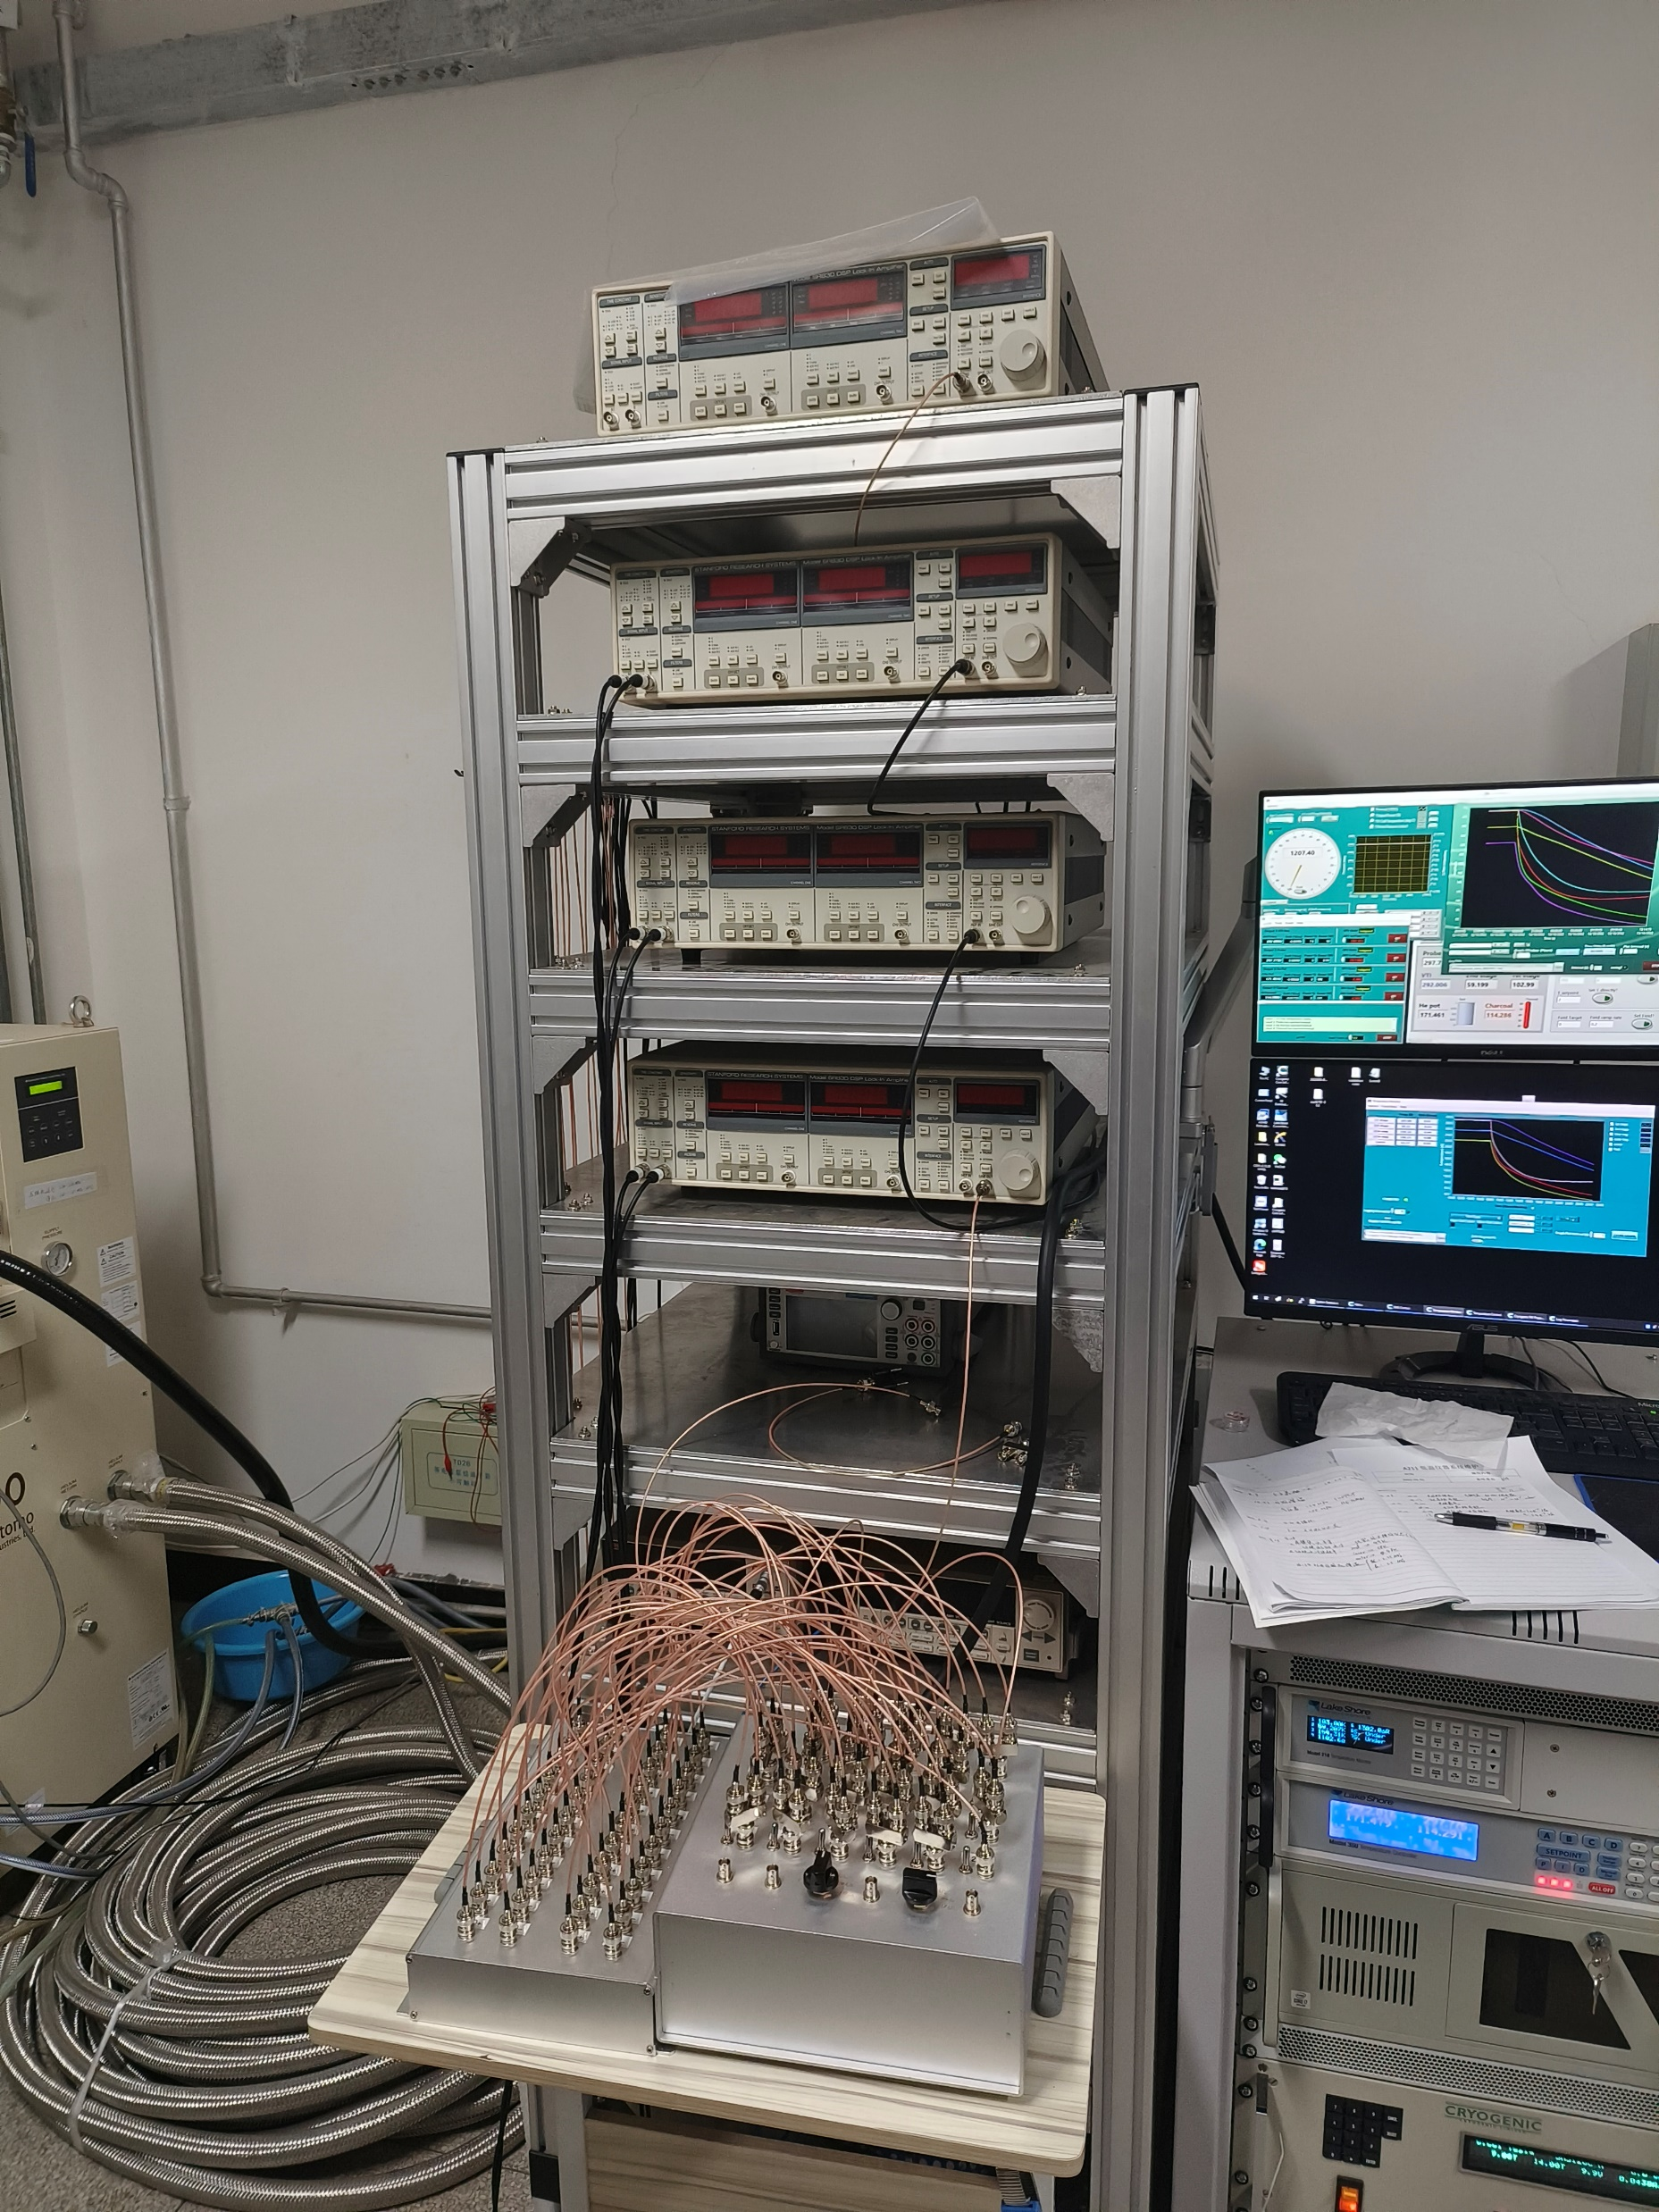
Micro-region electrical transport measurements
Patterned by lithography
Multi-channel R-T measurement
Composition resolution ＜1%
21 channels at a time
R-T data across the entire Te content
Notes:
Using lithography, we are able to pattern the composition-spread FeyTe1-xSex film to microbridge arrays including more than 100 resistivity channels along the spread, which achieved an x resolution of less than 1 %. Then we performed multi-channel R-T measurement in this system, which is able to measure 21 resistivity channels at a time. In this case, the temperature-dependent resistivity data from 100 to 2 K measured across the entire spread are shown in this figure. Only in one week we can obtain enough data points on such a combi sample.

Slide 14
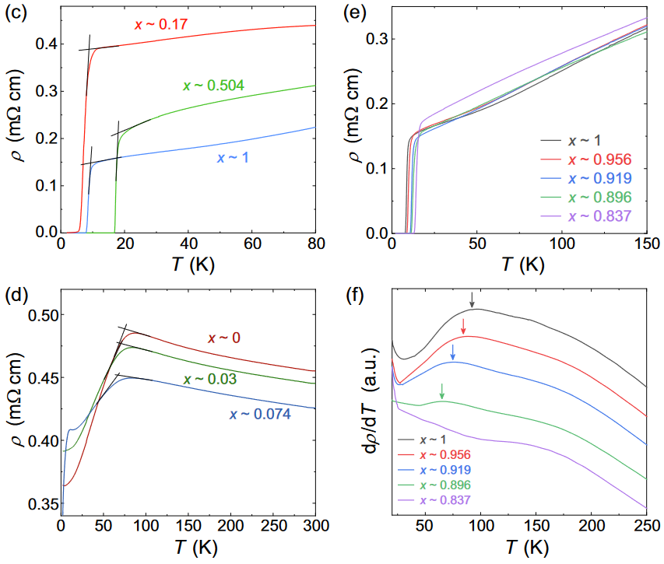
Phase diagram of Fe_{y}Se_{1-x}Te_{x} on CaF₂
Superconductivity
Structural transition
Antiferromagnetic state
ρ-T
A complete phase diagram from a piece of film
Z. Lin et al. Sci. Bull. 67, 1443 (2022)
Notes:
By analyzing the transport data, we can identify the superconducting states, antiferromagnetic order, and structural transitions across different compositions, and plot them on a phase diagram. This slice is not the main focus, so I won't go into detail. I want to highlight that this high-throughput film technology provides us with the opportunity to efficiently construct a complete doping phase diagram on a single sample.

Slide 15
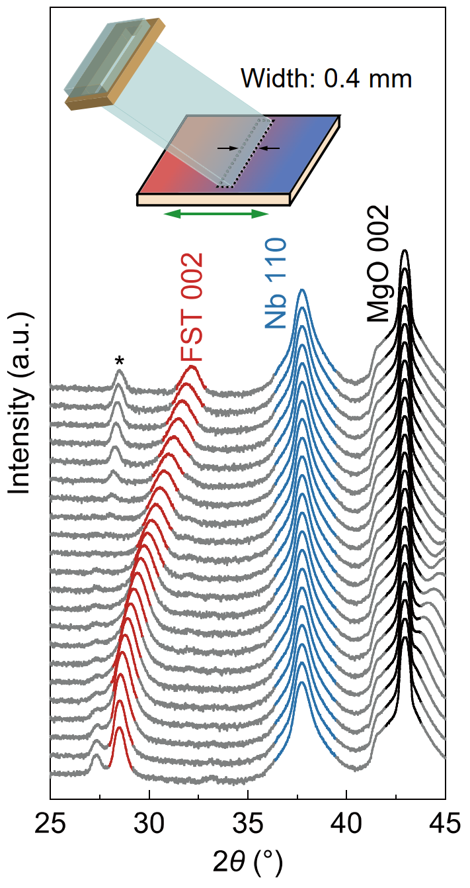
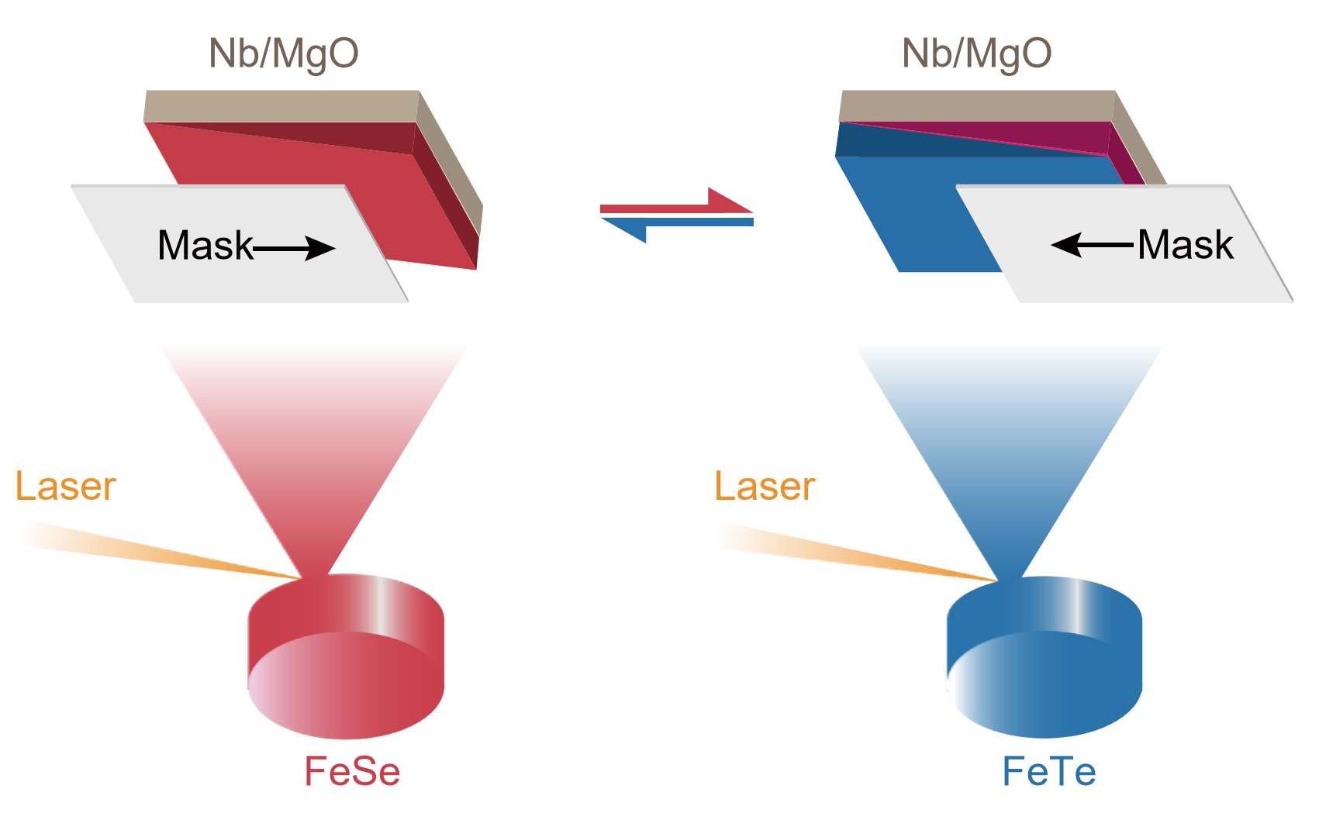
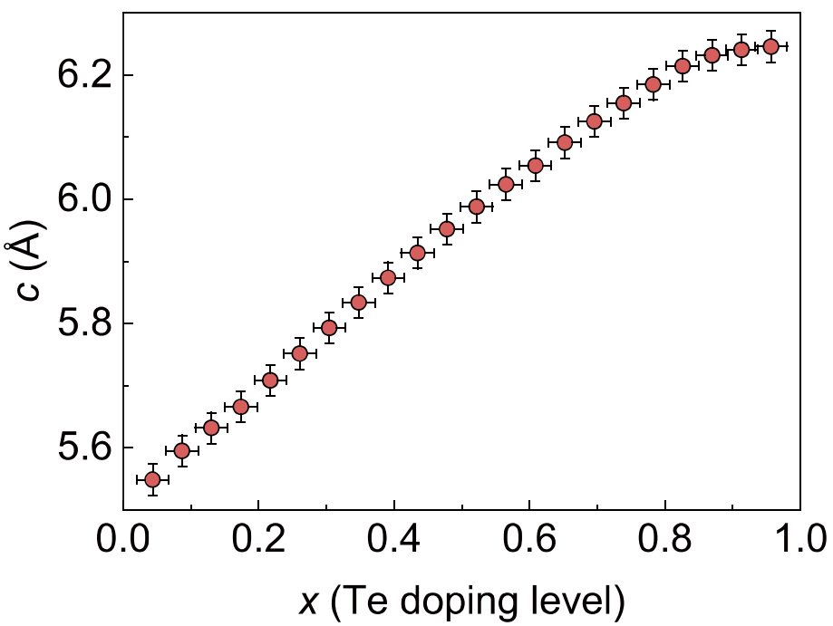
Composition-spread Fe_{y}Se_{1-x}Te_{x} films on Nb/MgO
Micro-region XRD
x = 0
x = 1
C. Dong †, Z. Lin † et al. (2024)
Notes:
Let's return to the main topic. Now we can switch the substrate to an Nb to prepare continuous-composition FeSeTe films. After 400 growth periods, a 250-nm-thickness combinatorial FeSe_{1-x}Te_{x} film with x ranging from 0 to 1 was fabricated at 300 °C. To examine the crystal quality, the micro-region XRD was performed on the film. Similar to the film on CaF₂ substrates, there is not splitting of the FeSe_{1-x}Te_{x} peaks across the spread, suggesting the absence of phase separation. The extracted c-axis lattice parameters in this figure monotonically increases with x, consistent with that on other substrates.

Slide 16
Composition-spread Fe_{y}Se_{1-x}Te_{x} films on Nb/MgO
Micro-region XRD
x = 0
Impurity phases
(NbSe_{x} or NbTe_{x})
Obvious NbSe_{x} or NbTe_{x} peaks in the FeSe or FeTe end
NbSe_{x} or NbTe_{x} phases are partially suppressed for 0.36 < x <0.55
x = 1
C. Dong †, Z. Lin † et al. (2024)
Notes:
However, there exist obvious NbSe_{x} or NbTe_{x} peaks in the two ends, respectively, due to the element diffusion into Nb layer. It means that these impurity phases may form at the interface between two layers. Interestingly, for medium doping, the intensity of NbSe_{x} or NbTe_{x} phases are partially suppressed.

Slide 17
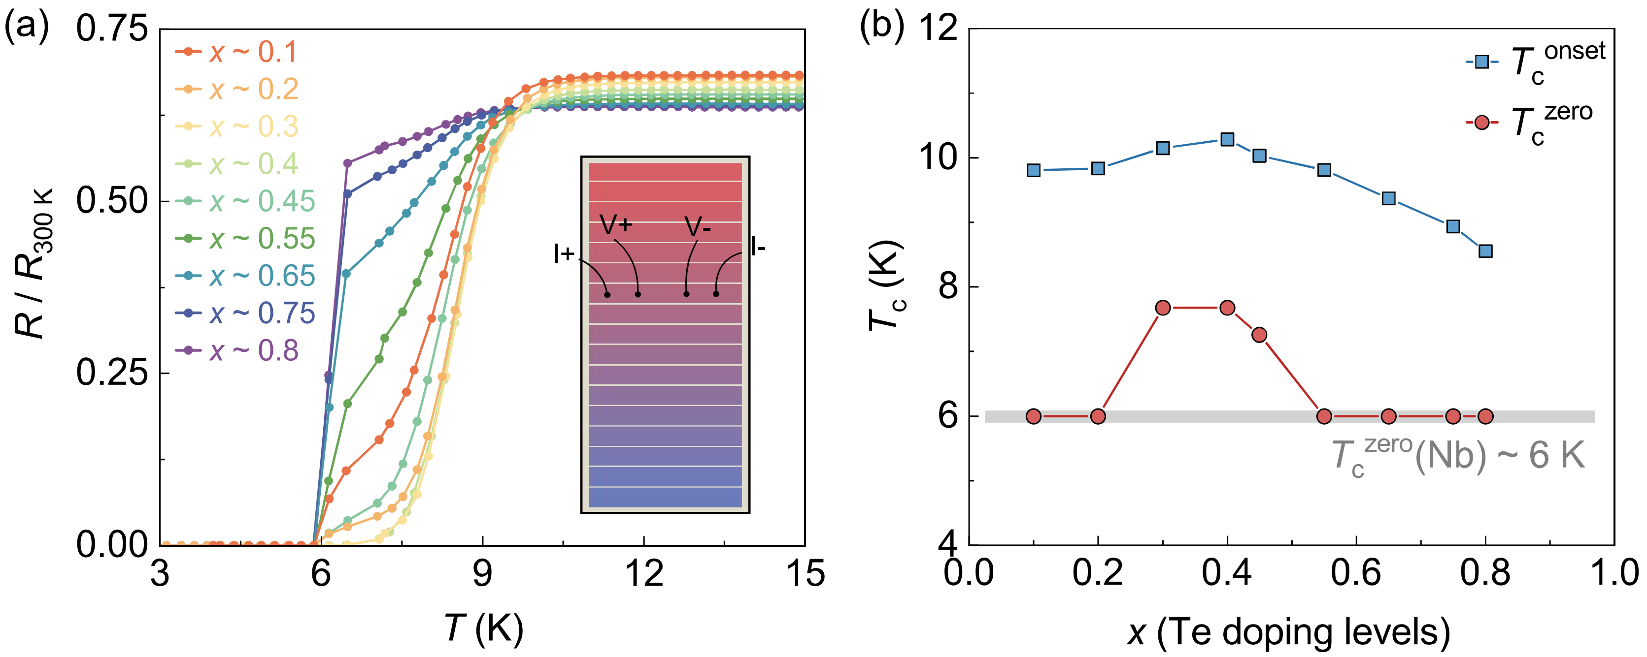
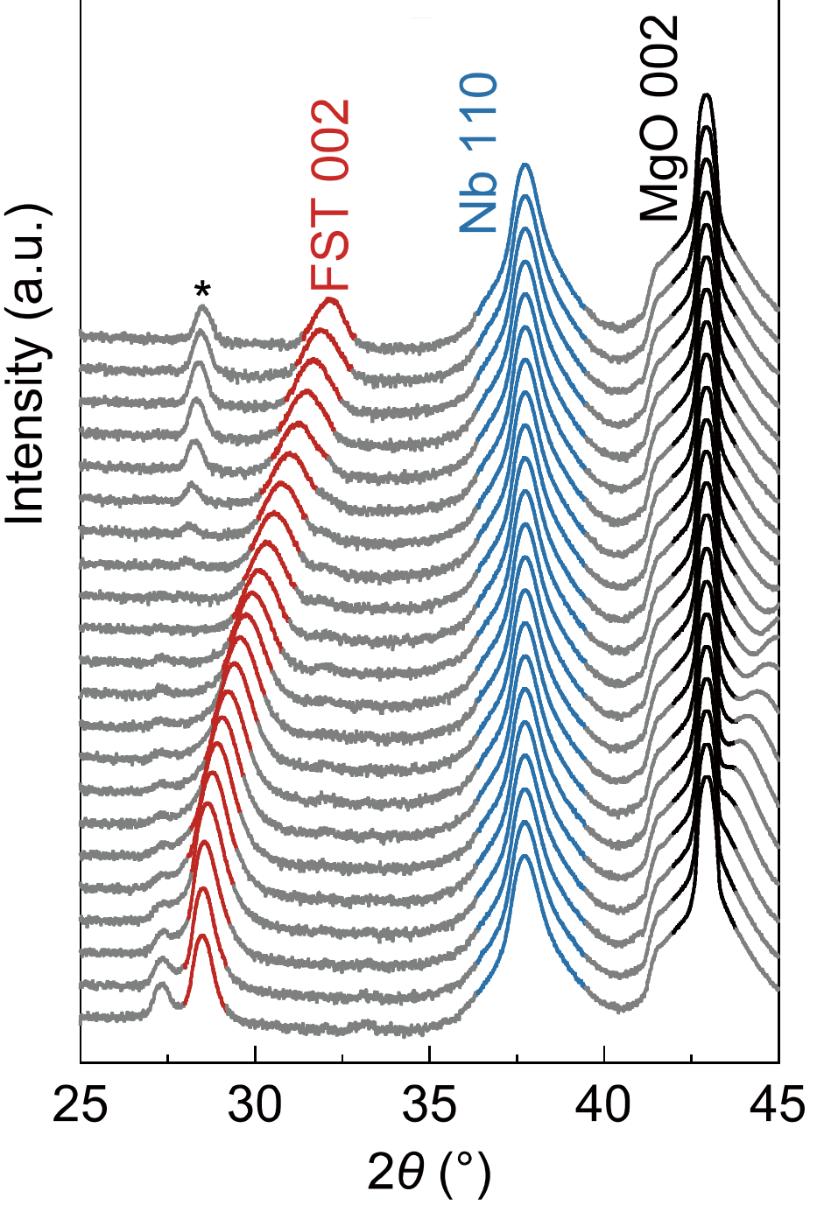
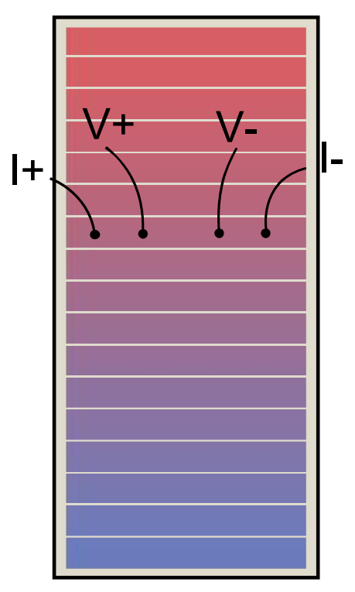
Micro-region transport measurements
x = 0
x = 0
R-T
x = 1
x = 1
Patterned by hand-made
From XRD data: optimal range 0.36 < x <0.55
From R-T data: optimal range 0.3 < x <0.5
C. Dong †, Z. Lin † et al. (2024)
Optimal Te doping x ~ 0.4
Notes:
The film was patterned into a series of stripes as resistivity channels along the spread by hand-made. we measured the RT data of some specific channels from 15 to 3 K using standard four-electrode method. Most of the R-T curves show two superconducting onset transitions (we defined it as T_{c}^{onset}), which originate from the contributions of FeSe_{1-x}Te_{x} and Nb layers. The extracted T_{c}^{onset} and T_{c}^{zero} of different channels are summarized in the T-x phase diagram. As x increases, the higher T_{c}^{onset} firstly increases and then decreases while the lower one are fixed, indicating the higher T_{c}^{onset} arises from the FeSe_{1-x}Te_{x} layer and the other from the Nb layer. The T_{c}^{onset} as a function of Te content exhibits the typical dome shape, of which the highest T_{c}^{onset} value occurs at x ~ 0.4, different from the film on CaF₂ substrates. As x < 0.2 and x > 0.55, The values of T_{c}^{zero} are constant 6 K corresponding to Nb layer, implying that in these Te content ranges T_{c}^{zero} of FeSe_{1-x}Te_{x} layer is lower than that of Nb layer. Recalling XRD result, we can infer that these impurities near the interface significantly suppress the volume of superconducting phase. So in total, the optimal Te doping is around 0.4 according to the XRD and RT data.

Slide 18
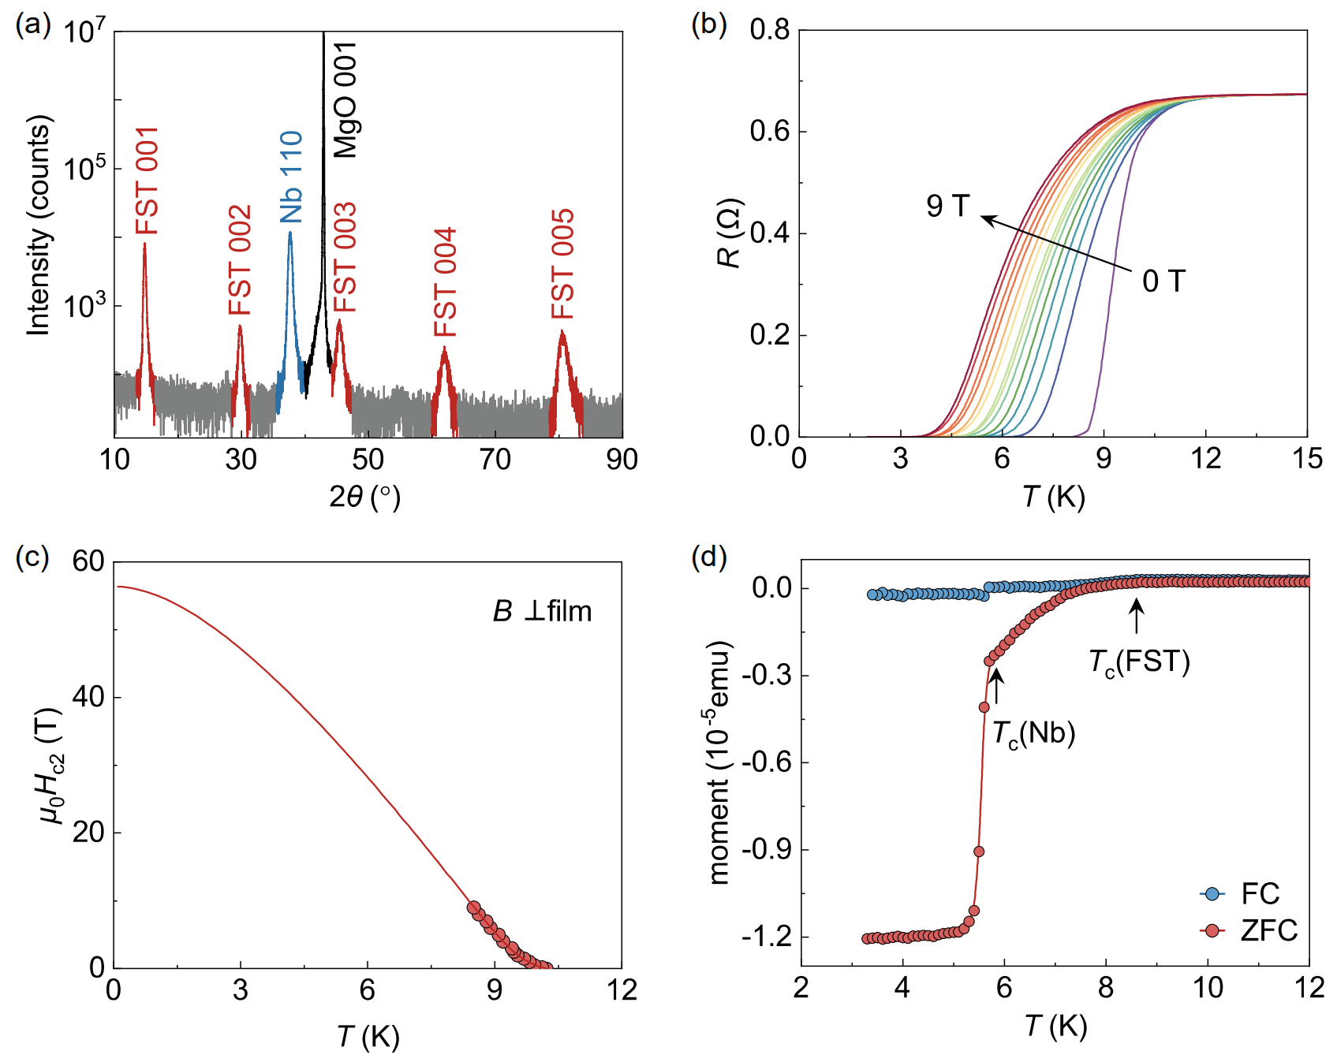
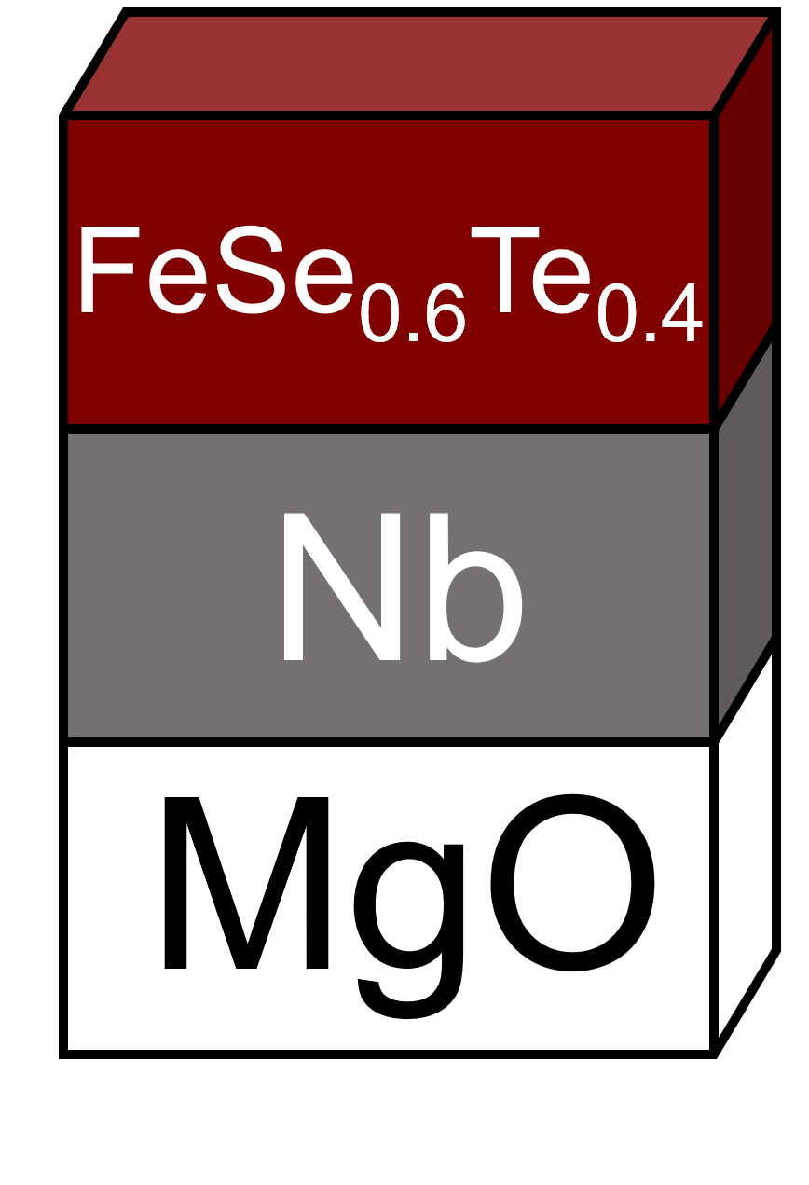
FeSe_{0.6}Te_{0.4} /Nb/MgO
XRD
R-T
T_{c} _{(FST)} ~ 8.5 K
T_{c(Nb)} ~ 6 K
Only the (00l) peaks of FeSe_{0.6}Te_{0.4} layer
T_{c} of FeSe_{0.6}Te_{0.4} layer can reach that of bulk Nb without any buffer layer
M-T
B_{c2} ~ 56 T
C. Dong †, Z. Lin † et al. (2024)
Notes:
Now the optimal doping is observed, we fabricated a single-component film with the doping level~ 0.4. This figure summarizes the structural, transport and magnetic measurements of the bilayer. The XRD still exhibits only the (00l) out-of-plane alignment for FeSe_{0.6}Te_{0.4} and weak impurity phase, very similar to the result of composition-spread film with same composition. The transport and magnetic data tell us the existence of two superconducting components from FeSe_{0.6}Te_{0.4} and Nb layer. Tc of FeSeTe layer is about 8.5K while Nb layer is 6 K. Based on above experiments, we demonstrate the possibility to fabricate a S-S bilayer structure containing iron-chalcogenide material of which T_{c} can reach that of bulk Nb without any buffer layer.

Slide 19
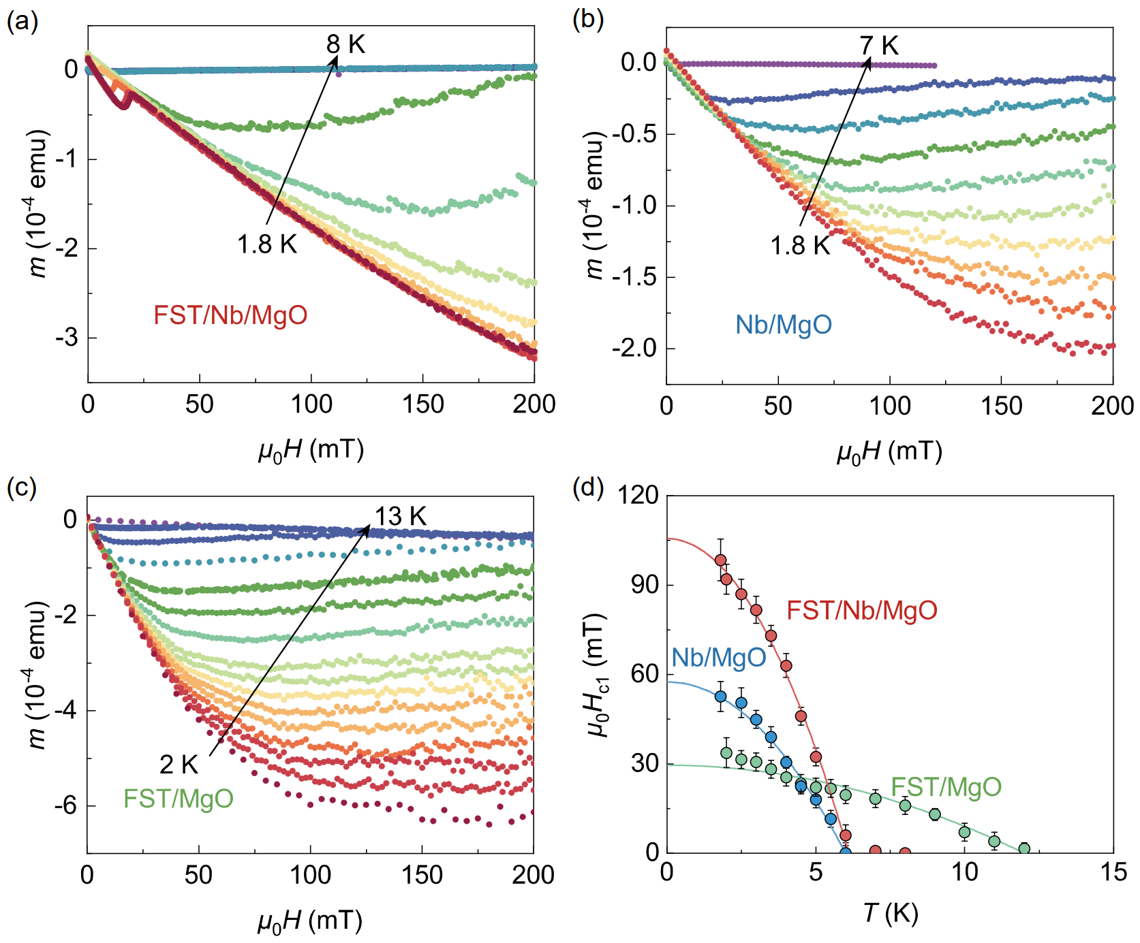
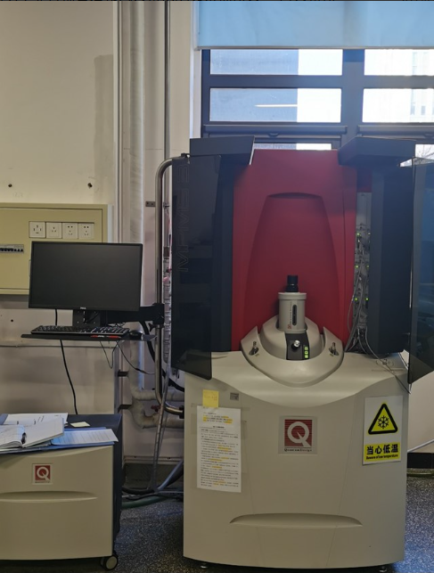
Enhanced B_{c1} in FeSe_{0.6}Te_{0.4} /Nb
MPMS
M-H
M-H
M-H
B_{c1} comparison:
B_{c1(Nb)}(0) ~ 57 mT
B_{c1(FST)}(0) ~ 30 mT
B_{c1(FST/Nb)}(0) ~ 105 mT
FeSe_{0.6}Te_{0.4}
Nb
MgO
H
C. Dong †, Z. Lin † et al. (2024)
Notes:
To obtain Bc1, we performed magnetic measurements on the FeSe_{0.6}Te_{0.4}/Nb/MgO film as well as two films Nb/MgO and FeSe_{0.6}Te_{0.4}/MgO using MPMS. For MPMS measurements, films were cut to less than 5 × 5 mm² and glued on a quartz rod in the configuration where samples’ surfaces parallel to the magnetic field. We got The in-plane field-dependent magnetization m(H) of three samples at various temperatures. For Nb/MgO and FeSe_{0.6}Te_{0.4}/MgO with only one superconducting layer, m(H) data exhibit linear behavior at low magnetic field and deviate from linearity at different field for different temperatures. Here the μ₀H_{c1} values are determined as the magnetic field where the deviation occurs. We used G-L equation to fit the Bc1 of three samples, and got their Bc1 value at 0 K. The enhancement of μ₀H_{c1} appeared obviously when the measured temperature below the T_{c} value of Nb layer (~ 6 K)

Slide 20
Enhanced B_{c1} in FeSe_{0.6}Te_{0.4} /Nb
MPMS
M-H
M-H
Flux penetration in FeSe_{0.6}Te_{0.4}/Nb
M-H
B_{c1} comparison:
B_{c1(Nb)}(0) ~ 57 mT
B_{c1(FST)}(0) ~ 30 mT
B_{c1(FST/Nb)}(0) ~ 105 mT
FeSe_{0.6}Te_{0.4}
Nb
MgO
H
C. Dong †, Z. Lin † et al. (2024)
Notes:
However, for the FeSe_{0.6}Te_{0.4}/Nb/MgO bilayer structure, the flux penetrating effect can be observed under low fields by the jump in the m(H) curves, which becomes more obvious at low temperatures. Interestingly, the m(H) curves restored the linearity after the jump, This may be because, although the magnetic flux lines penetrate the non-superconducting interface, the two superconducting layers continue to repel the flux lines once the flux distribution stabilizes.

Slide 21
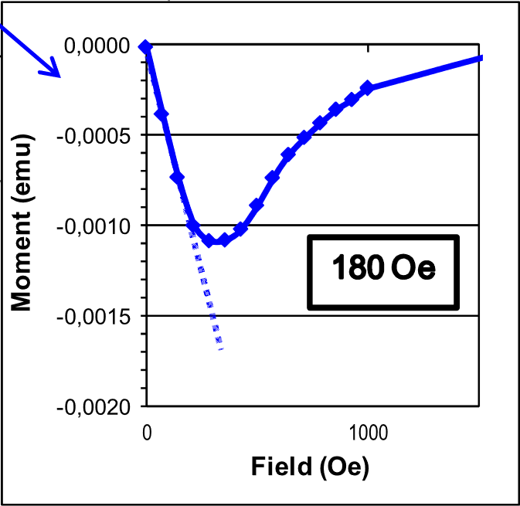
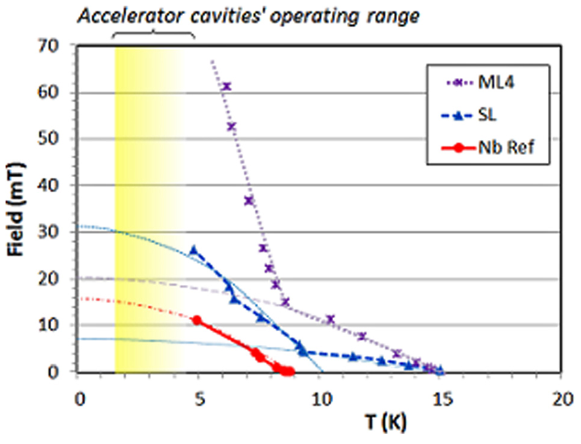
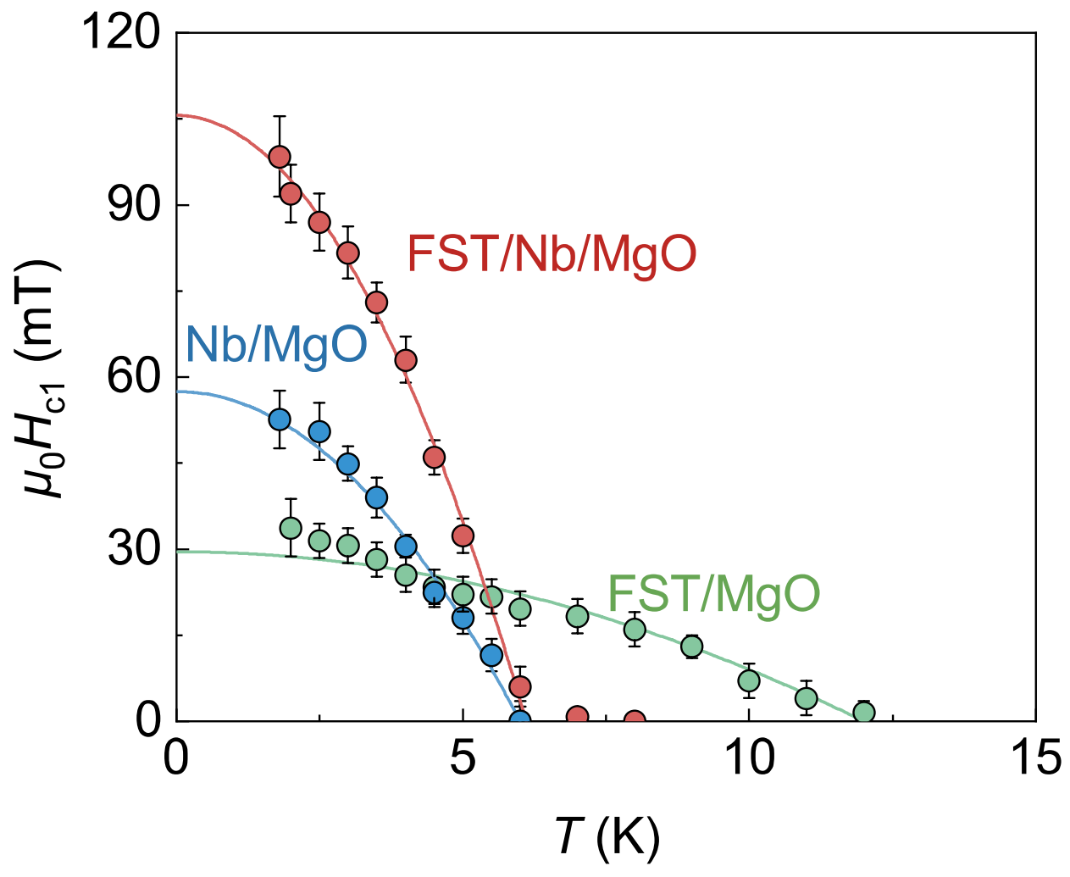
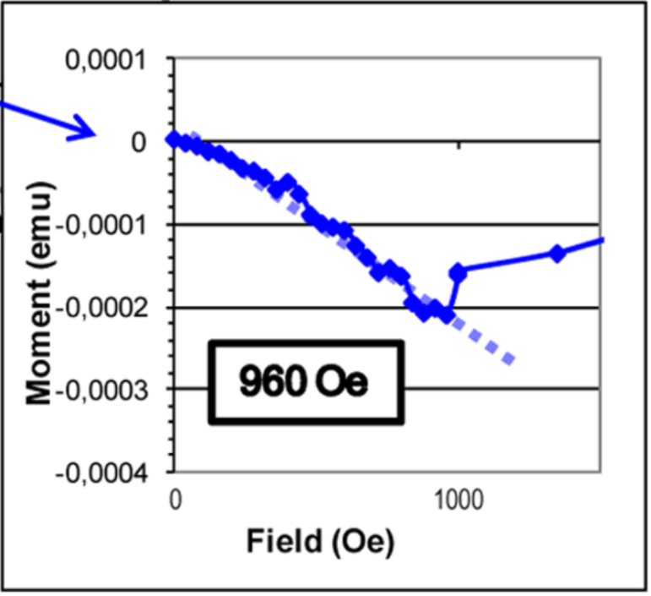
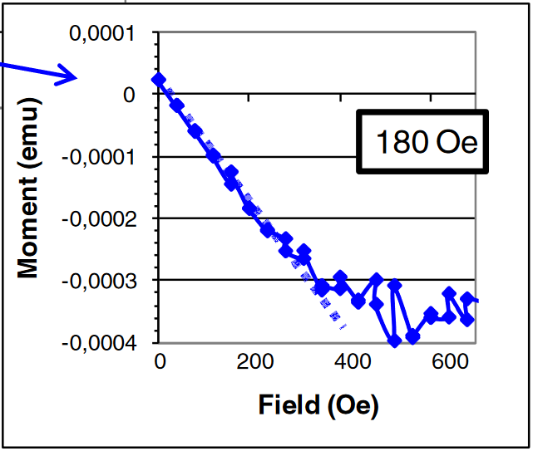
Enhanced B_{c1} in SS’ / SIS’ structure
C. Z. Antoine et al., Phys. Rev. ST Accel. Beams 13, 121001 (2010)
C. Z. Antoine et al., Appl. Phys. Lett. 102, 102603 (2013)
FeSe_{0.6}Te_{0.4}
NbN
MgO
Nb
NbN
MgO
Nb
Nb
MgO
H from both sides
H from both sides
H from one side
Notes:
It is worth mentioning that, In a real Nb cavity, the magnetic flux can only approach from one side. If fabricating a superconducting thin film on bulk Nb, which can be regarded as an ideal “S-S” model proposed by Kubo, the magnetic flux has to penetrate the thin protecting layer with enhanced μ₀H_{c1} before attacks the base material Nb. While in MPMS system, the magnetic field attacks the protecting layer FeSe_{0.6}Te_{0.4} from the front and also the base Nb from the back simultaneously. So, it is anomalous that our FeSe_{0.6}Te_{0.4}/Nb/MgO exhibits an enhanced μ₀H_{c1} at low temperatures. We notice Antoine and her cooperators utilized two different methods to measure Bc1 of NbN/MgO/Nb multilayer structures. No matter the magnetic field distribution was from both side, or from one side, the enhancement of Bc1 usually occurred.

Slide 22
Enhanced B_{c1} in SS’ / SIS’ structure
C. Z. Antoine et al., Phys. Rev. ST Accel. Beams 13, 121001 (2010)
C. Z. Antoine et al., Appl. Phys. Lett. 102, 102603 (2013)
NbSe_{x} or NbTe_{x} Impurity phases near the interface between FST and Nb
Flux penetration in FeSe_{0.6}Te_{0.4}/Nb in the m(H) under low fields
FeSe_{0.6}Te_{0.4}
NbN
MgO
Nb
NbN
MgO
Nb
Nb
MgO
H from both sides
H from both sides
H from one side
Notes:
When we looking back on the XRD and M-H data, there are two important information. One is that NbSe_{x} or NbTe_{x} Impurity phases near the interface between FST and Nb, the phase may be non-superconducting. The other is Flux penetration in FeSe_{0.6}Te_{0.4}/Nb in the m(H) under low fields.

Slide 23
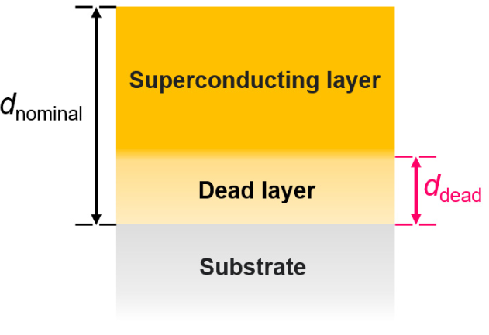
Enhanced B_{c1} in SS’ / SIS’ structure
C. Z. Antoine et al., Phys. Rev. ST Accel. Beams 13, 121001 (2010)
C. Z. Antoine et al., Appl. Phys. Lett. 102, 102603 (2013)
FeSe_{0.6}Te_{0.4}
NbN
MgO
Nb
NbN
MgO
Nb
Nb
MgO
R. Zhang et al., Phys. Rev. Applied 17, 054034 (2022)
H from both sides
A non SC “dead layer” usually exists near the interface.
H from both sides
H from one side
Notes:
Moreover, in the previous work in my group, we have discovered that there is always a non-superconducting layer at the interface between the FeSe superconducting film and the substrate, which we refer to as the "dead layer." The thickness of this dead layer can be several tens of nanometers.

Slide 24
Enhanced B_{c1} in SS’ / SIS’ structure
C. Z. Antoine et al., Phys. Rev. ST Accel. Beams 13, 121001 (2010)
C. Z. Antoine et al., Appl. Phys. Lett. 102, 102603 (2013)
FeSe_{0.6}Te_{0.4}
Non SC
NbN
MgO
Nb
NbN
MgO
Nb
Nb
MgO
FeSe_{0.6}Te_{0.4}
Nb
MgO
H from both sides
The flux inside dead layer may prevent the penetration of outside flux.
H from both sides
H from one side
Notes:
In this case, the FeSeTe/Nb bilayer structure is no longer an SS structure but rather an SIS structure. When a magnetic field is applied, the flux penetrate the interface between the two films, repelling the flux on either side of the films, thereby increasing Bc1​. This picture requires further simulation.

Slide 25
Summary and perspective
FeSe/Nb by PLD: It is experimentally possible to deposit a crystalline and superconducting FeSe layer with (00l)-oriented on Nb. The B_{c1} of FeSe/Nb can be greatly enhanced.
Fe_{y}Se_{1-x}Te_{x}/Nb by the composition-spread film technique: Efficiently obtain the T_{c}-x phase diagram and optimal Te doping x.
FeSe_{0.6}Te_{0.4}/Nb by PLD: The T_{c} value of FeSe_{0.6}Te_{0.4} layer can reach that of bulk Nb without any buffer layer. The non-SC interface may play an important role in the B_{c1} enhancement of FeSe_{0.6}Te_{0.4}/Nb.
Further work requires:
In theory: Vortex simulation to explain the B_{c1} enhancement .
In experiments: Improve T_{c};
Fabricate FeSe_{0.6}Te_{0.4} films on the inner wall of cavities.
Notes:
In summary, Firstly, we have experimentally demonstrated that FeSe superconducting films can be grown on Nb substrates, even on polycrystalline substrates, and Bc1​ can be enhanced. To more easily increase the Tc of iron-based films, we selected FeSeTe films as the coating and efficiently identified the optimal Te doping on Nb substrates using a high-throughput method. Finally, we fabricated FeSeTe/Nb bilayer films with the optimal Te composition, The T_{c} value of FeSe_{0.6}Te_{0.4} layer can reach that of bulk Nb without any buffer layer. We speculate that the non-superconducting interface may play a significant role in the enhancement of Bc1.
For a perspective, we need vortex simulation to explain the B_{c1} enhancement. Especially in experiments, future work requires us to further enhance Tc and fabricate FeSe_{0.6}Te_{0.4} films in superconducting cavities.

Slide 26
SI

Slide 27
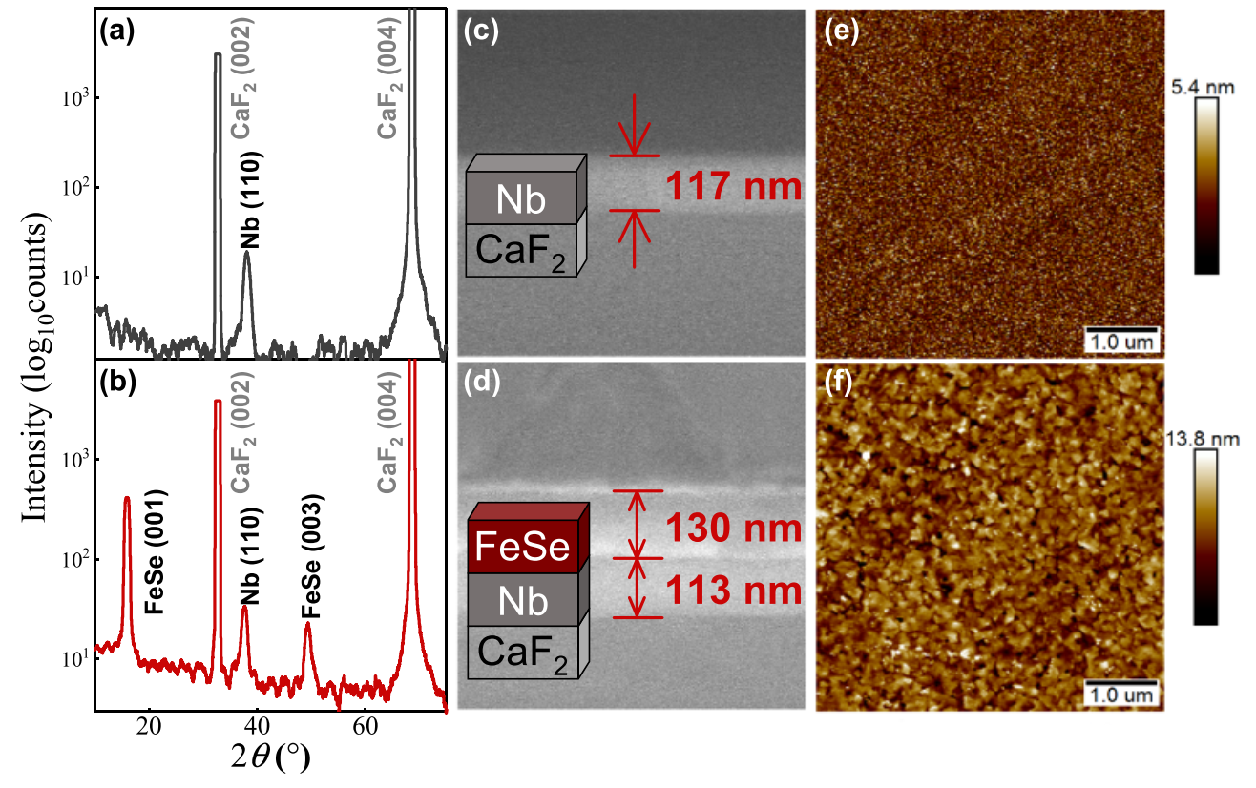
Structural charaterizations
A sharp interface between the FeSe and Nb layer
Small roughness
R_{q}~0.77 nm
R_{q}~1.89 nm
XRD
SEM
AFM
Z. Lin et al. Supercond. Sci. Technol. 34, 015001 (2021)
Notes:
FeSe films grown on Nb films maintain good out-of-plane orientation. Due to the smoother surface of the Nb film, the interface between the FeSe and Nb layers is well-defined. SEM measurements show that both film layers are about a hundred nanometers thick. A lower surface roughness promotes the formation of a surface barrier. However, the superconductivity of FeSe layer need to be verified because of the lattice mismatch with Nb.

Slide 28
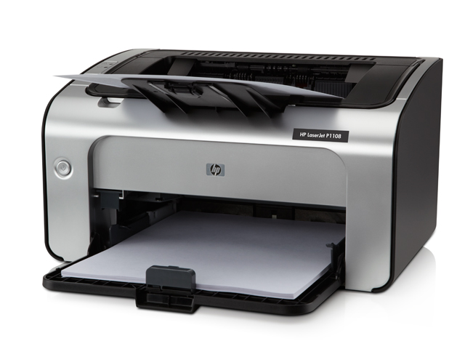
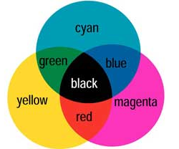
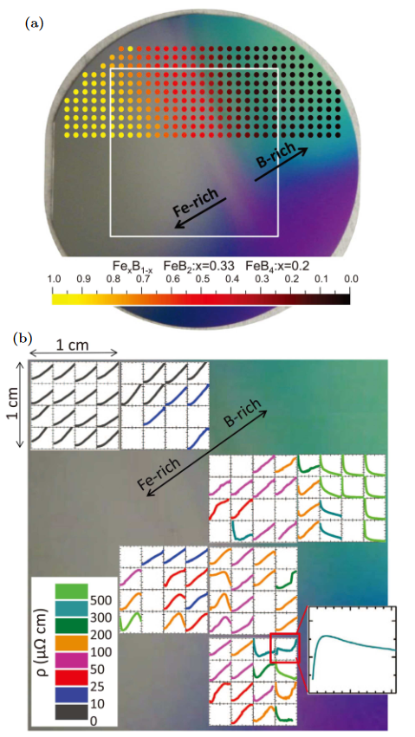


High-throughput film synthesis technology
Fe-B spread
Magnetron co-sputtering
Fe:B=1:60
Fe
High-throughput film techniques can speed up the optimization of material compositions
K.Jin et al. APL Mater. 1, 042101 (2013)
Notes:
In the past two decades, the high-throughput combinatorial thin-film synthesis technology, which can achieve a continuous change of single chemical composition, has been well developed for the growth of complex materials. For example, co-sputtering technique is like a color printer, three basic colors can give you all the colors you need. In principle, imaging you replace these toner cartridges with sputtering gun, you may get continuous doping. Kui Jin, now is our group leader, he and his cooperators succeeded in making a Fe-B spread on 3-inch wafer by sputtering Fe target and B target. Naturally, they got a library of Fe-B from pure Fe to a mixture of FeB60. Then they found the composition with superconductivity. This means such continuous composition spread may efficiently assist in searching the desired composition.

Slide 29



3-dimensional phase diagram
By changing the laser fluence and target composition, a two-dimensional phase diagram (T_{c}, x) can be expanded to a three-dimensional phase diagram (T_{c}, x, y) .
Notes:
Furthermore, by changing the laser fluence and target composition, we can change the Fe content in films, and expand the two-dimensional phase diagram to a three-dimensional phase diagram including Te doping level as x axis, and Fe content as y axis. Due to the sensitivity of Fe content to Tc, we increased the maximum Tc to more than 20K by changing the Fe content.

