Slide 1
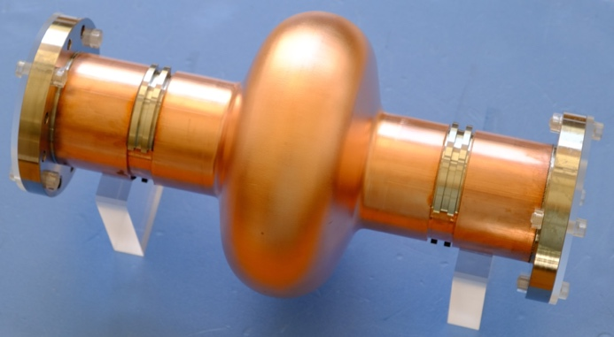


Copper full-seamless substrate cavity manufactured by hydroforming
11th International Workshop on Thin Films and New Ideas for Pushing the Limits of RF Superconductivity
TFSRF2024 16–20 Sept. 2024 Université Paris-Saclay, France
YAMANAKA Masashi, ARAKI Hayato,
Guillaume Jonathan Rosaz,
Said Atieh, Marco Garlasche, Joanna Sylwia Swieszek

Slide 2
Contents
Fabrication of full seamless cavity
Niobium coating
RF test
1.3 GHz one-cell full-seamless copper substrate cavity

Slide 3

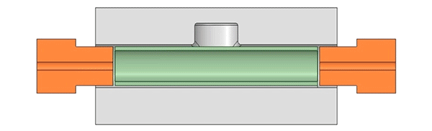
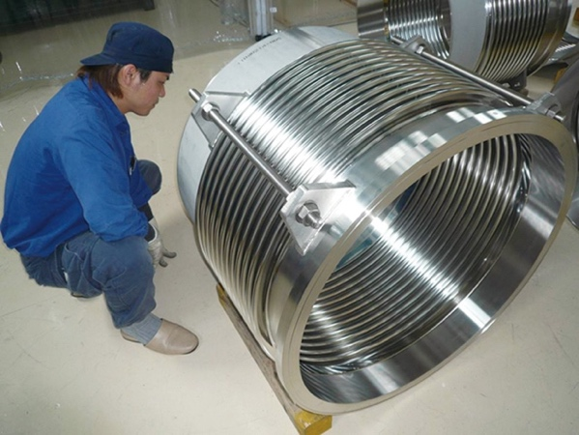
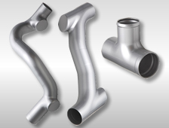
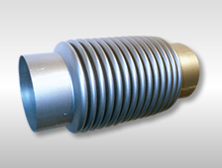
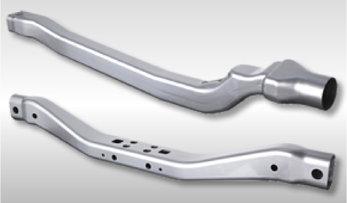
Tube hydroforming
Well-known plastic forming technique
Shijian Yuan, Springer
Principle of hydroforming
https://www.tube-forming.co.jp/bulge.html
Bellows
Automobile parts
Hydraulic joints
Flexible tubes
Hollow flame parts
Industrial applications
https://sango.jp/pipe.html

Slide 4
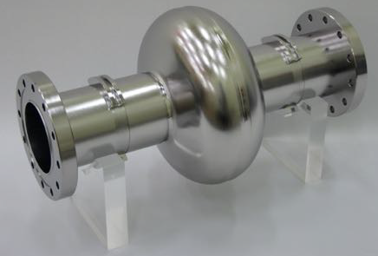
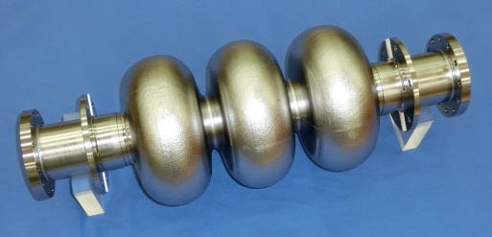

Full-seamless cavity concept
Conventional (4 pieces)
Cell part is manufactured by press-forming and EB welded with beam tubes
Cell part is manufactured by hydroforming from a seamless tube, then EB welded with beam tubes
KEK succeeded 3-cell bulk niobium cavity in this method.
Seamless (3 pieces)
Whole cavity is manufactures by hydroforming from one seamless tube.
There is no welding part (no bead).
Full seamless (1 piece)
This time, we try an OFE copper substrate cavity for niobium coating.
There is no welding bead on equator and iris parts so that inner surface is so smooth. It has a big merit for niobium coating.

Slide 5
1.3 GHz one-cell full-seamless copper cavity

Slide 6
1.3 GHz one-cell full-seamless copper cavity

Slide 7
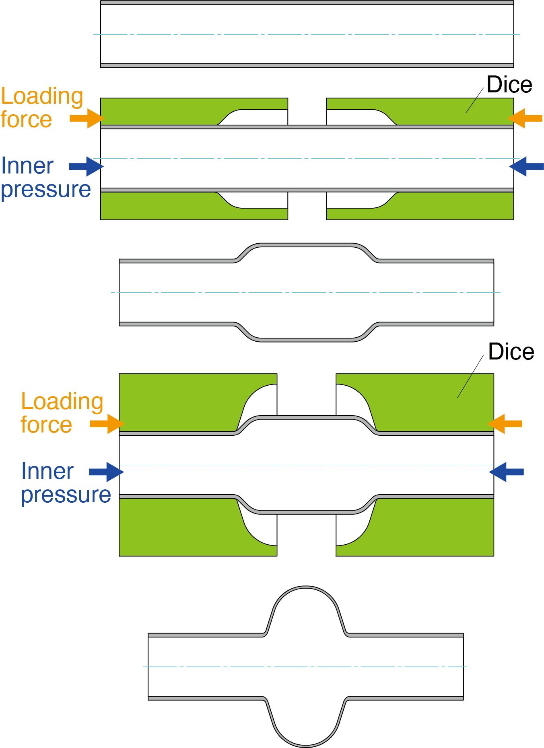
Optimized manufacturing process
Initial tube
Beam tube size
Hydroforming 1
(HF1)
Intermidiate
annealing
Hydroforming 2
(HF2)
Machining
Welding end flanges
Inner surface treatment
Nb coating
Finish

Slide 8
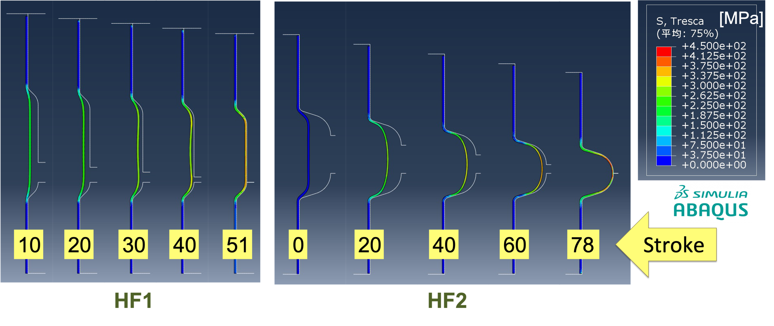
Simulation
Tresca stress distribution according to stroke
MAX. stresses are 381.5 and 424.1 MPa at HF1 and HF2, respectively
Hydroforming is held in vertical. Lower die is fixed, and upper die moves to the downward direction (see pic. next page).

Slide 9
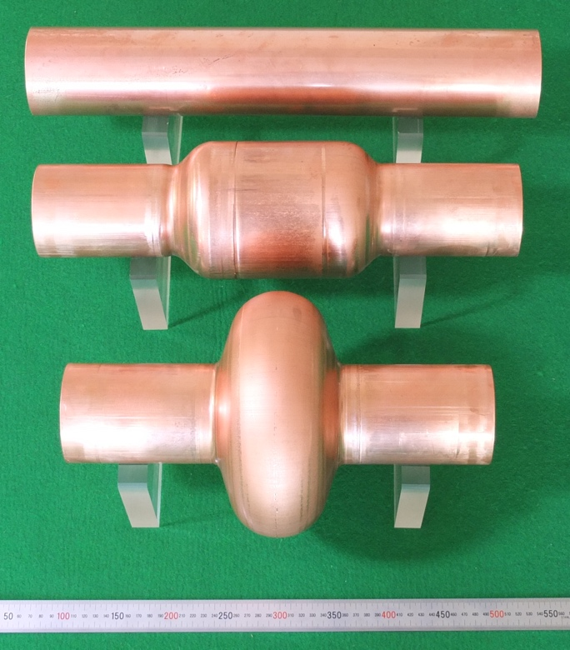
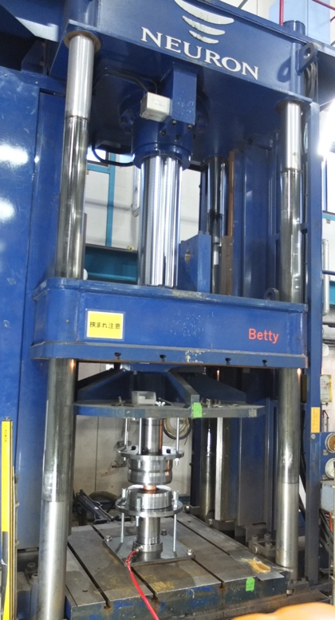
Successful hydroforming
HF1
Annealing
500℃ x 2h
HF2
Hydroformed copper tubes
Hydroforming machine
22
Both loading speeds: 1 mm/s
Pressure (MPa)
Pressure (MPa)
12.6
10
10
51
5
20
78
Stroke (mm)
Stroke (mm)
HF1 (1 pass)
HF2 (1 pass)

Slide 10
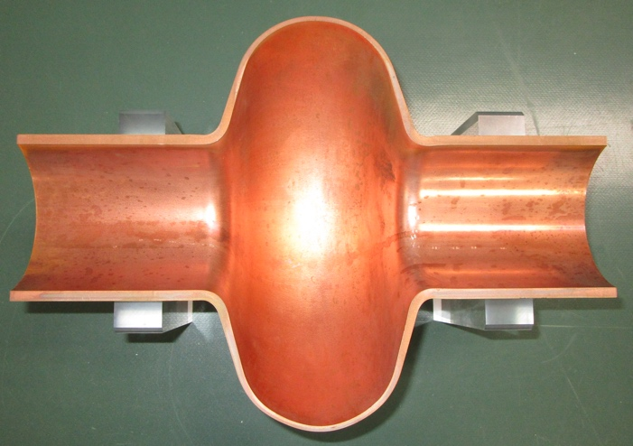
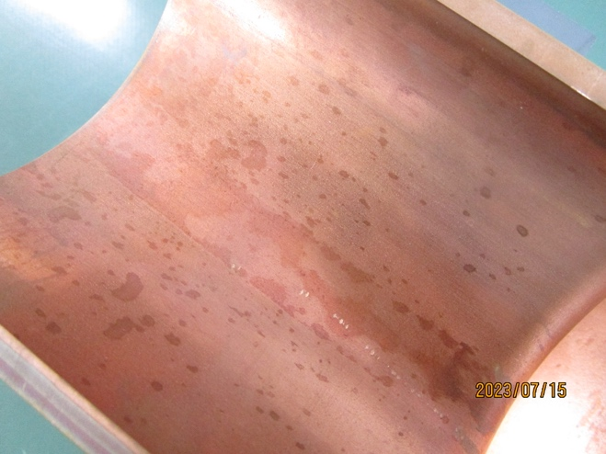
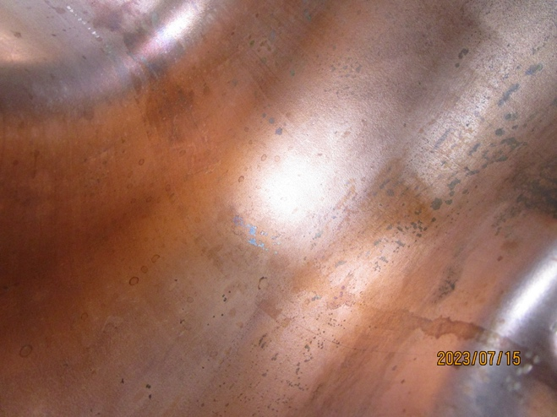
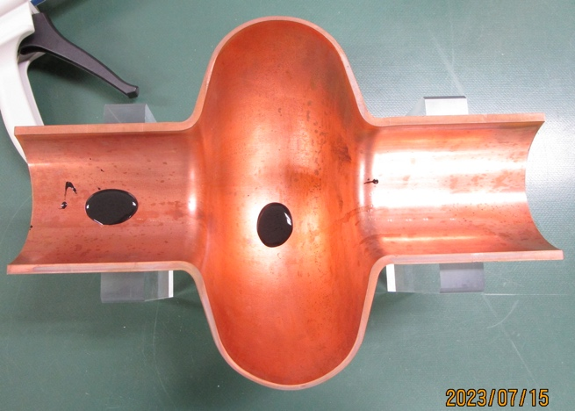
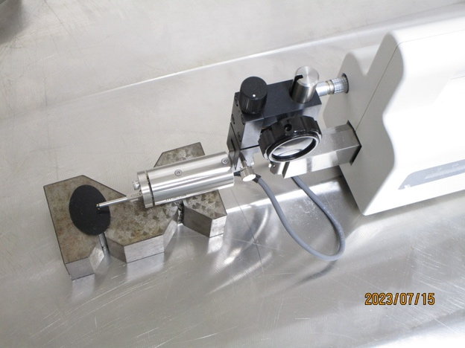
Measurement of roughness
Cut piece of cavity
Close up at beam tube
Close up at equator
Replica
Measured roughness [µmRa]
Plastic replica is used for roughness measurement
Direction | Beam tube | Equator
longitudinal | 1.0 | 2.9
circumferential | 0.8 | 2.6
circumferential
longitudinal

Slide 11
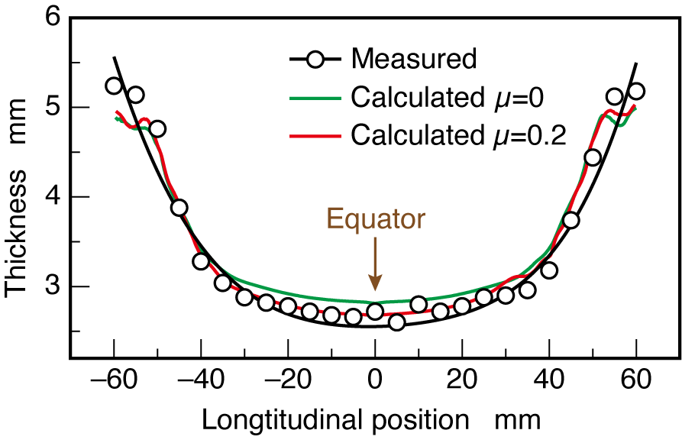
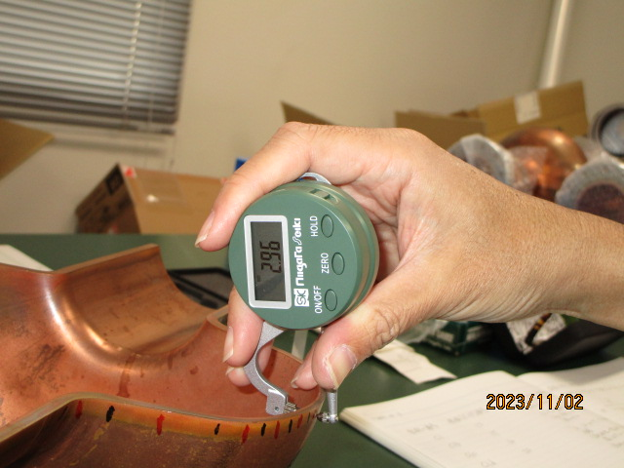
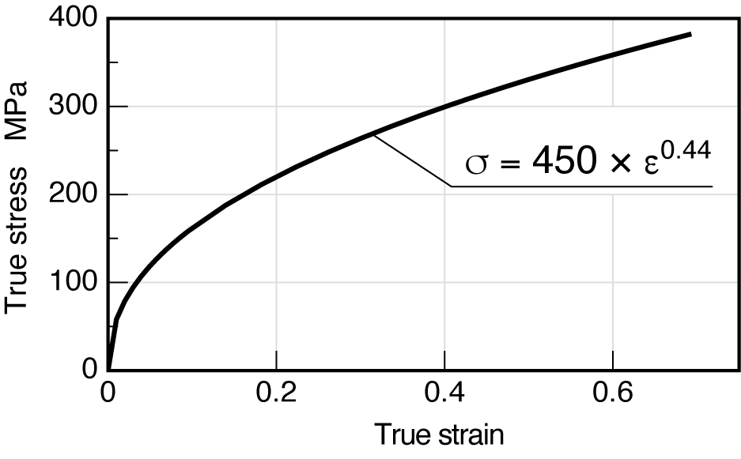
Thickness distribution
The wall at equator becomes thick
Comparison between measured and calculated thickness
In case of µ=0.2, measured and calculated results agreed well
We will apply to design of dice considering thickness distribution
Thickness was measured by caliper
Tensile test was achieved using the specimen from actual copper tube

Slide 12
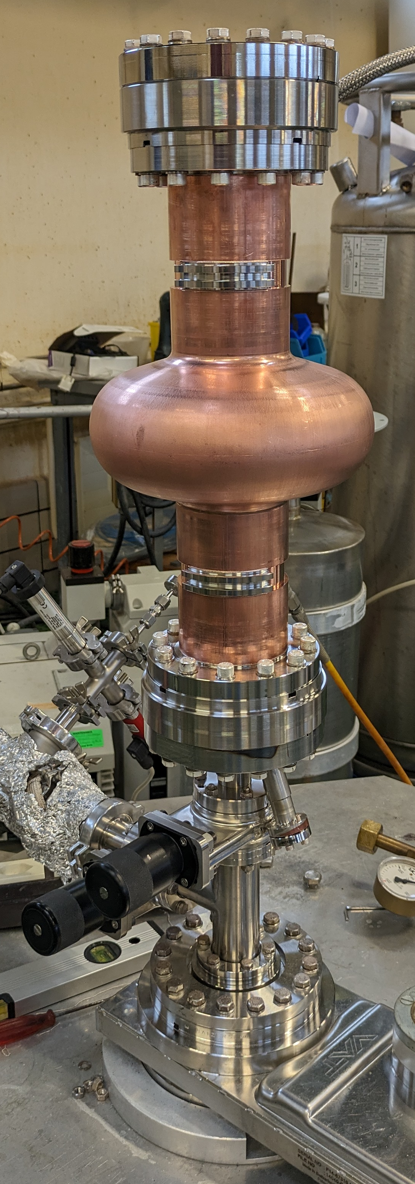
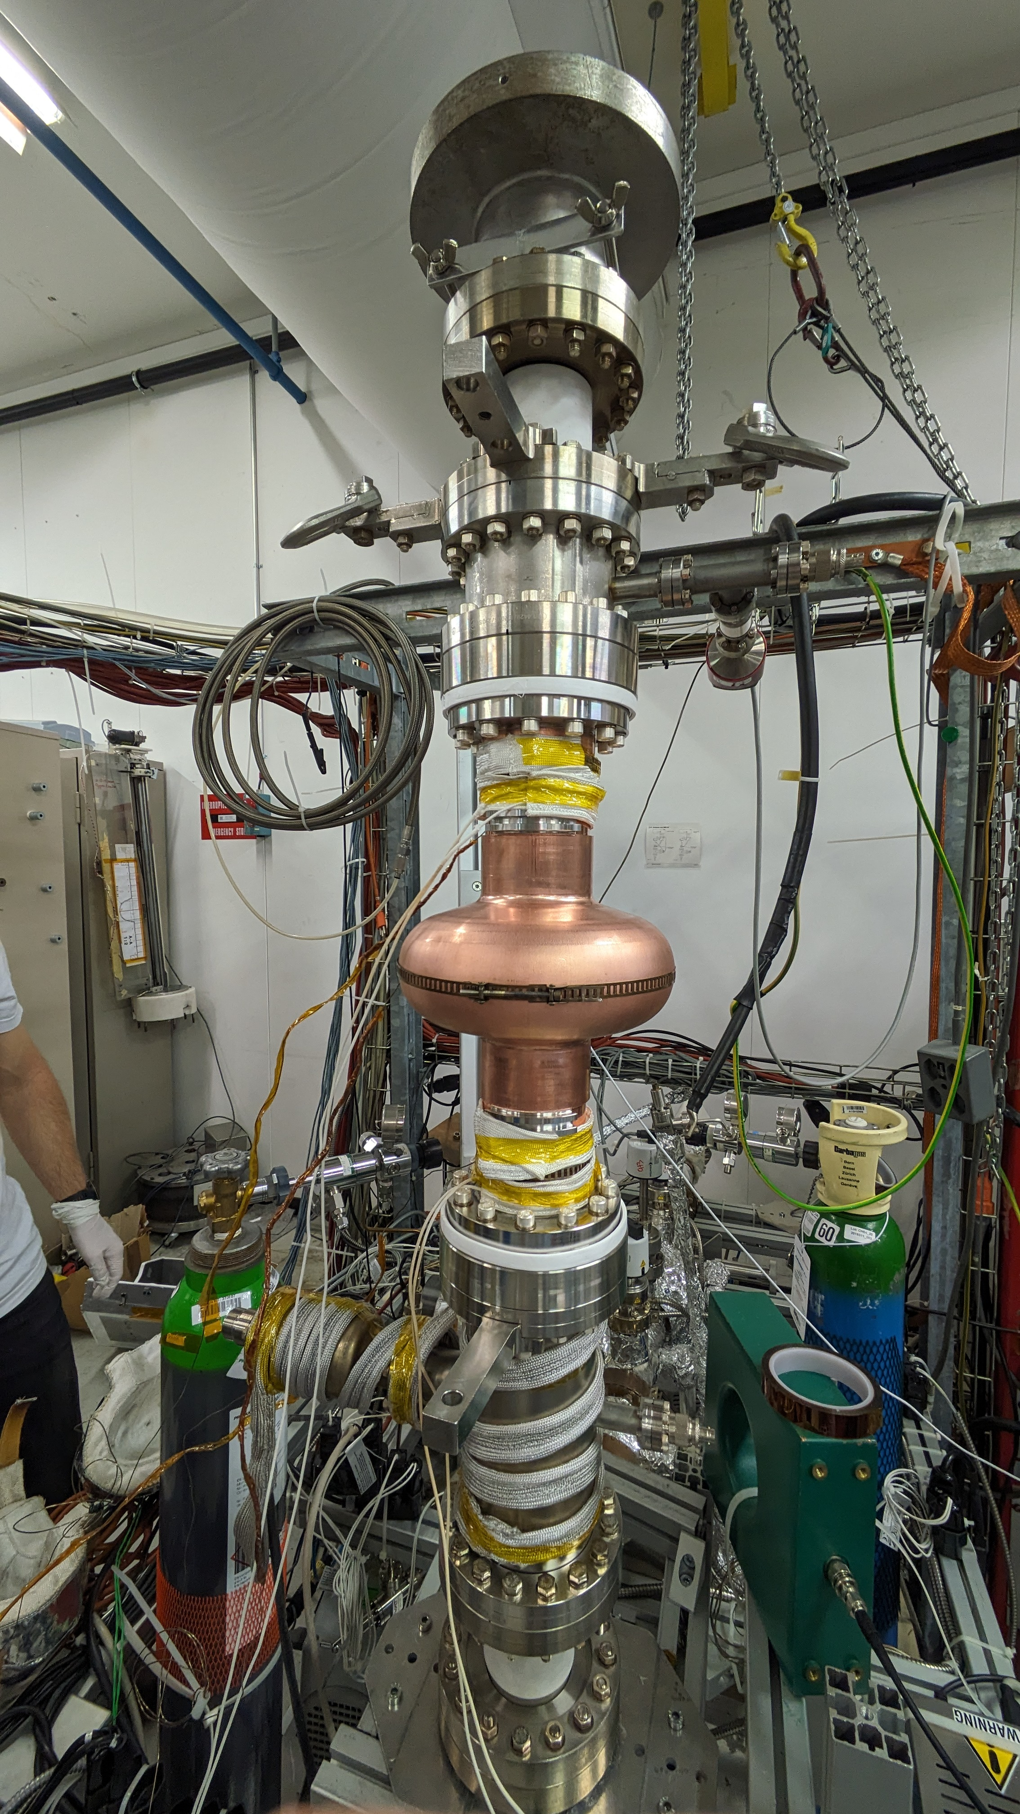
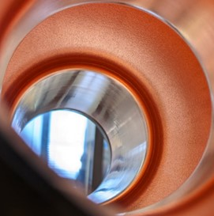
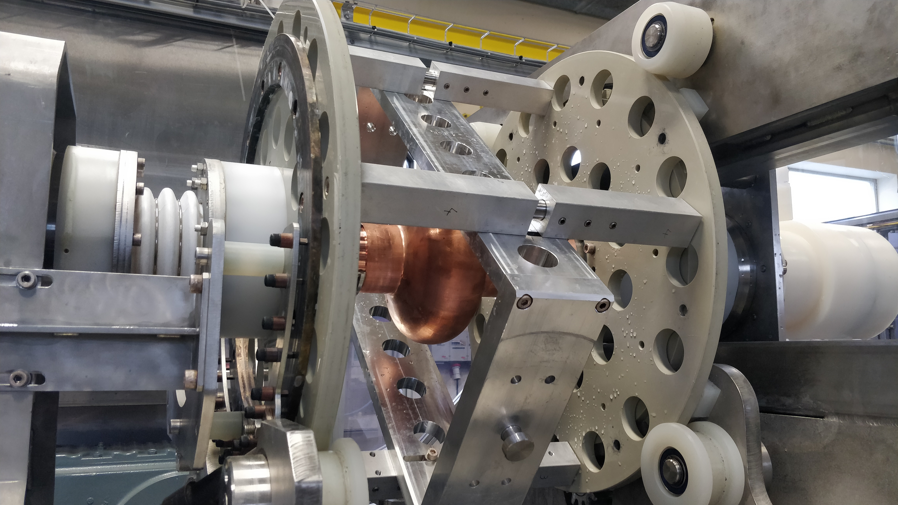
Nb thin film coating
Process flow
HPR (100bars)
ISO 5 Cleanroom assembly
Pump down
Bakeout
Coating
ISO Cleanroom disassembly
HPR (100 bars)
Shipping to KEK
Electropolishing
Cavity on the EP bench
Cavity’s cell surface during cleanroom assembly
Cavity on the HPR setup
Cavity on the coating bench

Slide 13
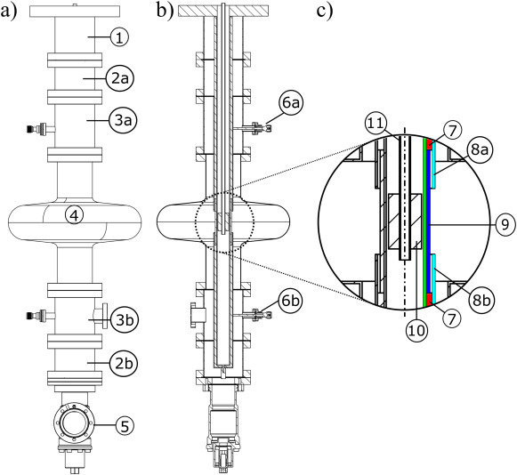
Nb thin film coating
Process parameters
EP: 40 minutes, target 12 μm removed material.
HPR: 100 bars, 3 hours, cavity dried under vacuum at 50°C.
Bakeout: 48h, 200 °C, base pressure ~ 2.10⁻¹⁰ mbar
Coating: HiPIMS
- cut-offs: 350W, 2.5.10⁻² mbar Kr, 6 positions/cut-off, 150 °C, unbiased.
- cell: 2 kW, 2.5.10⁻³ mbar Kr, 6 hours, 150 °C, -75V bias voltage
- Targeted thickness at the equator: 6 μm
Coating apparatus schematic
https://doi.org/10.1016/j.surfcoat.2022.128306

Slide 14
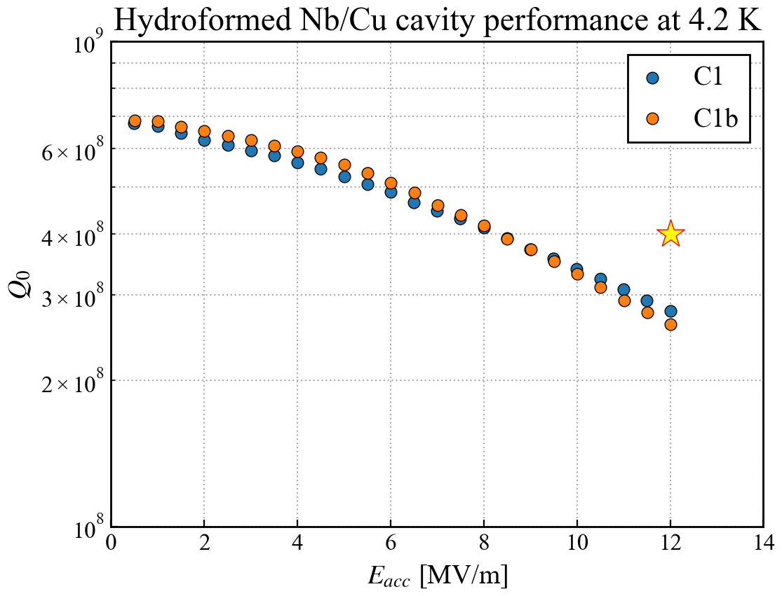
RF Measurement
4.2 K Measurement
Target: Q > 4×10⁸ at 12 MV/m
  Equivalent with Q > 3×10⁹ at 4.5 K, 400 MHz (FCC)
Result (at KEK, March 2024):
Could not reach Q requirement
  2.6-2.8 ×10⁸ at 12 MV/m
Stopped at 12 MV/m due to power limit
No field emission
No quench
Good reproducibility between the two cavities

Slide 15
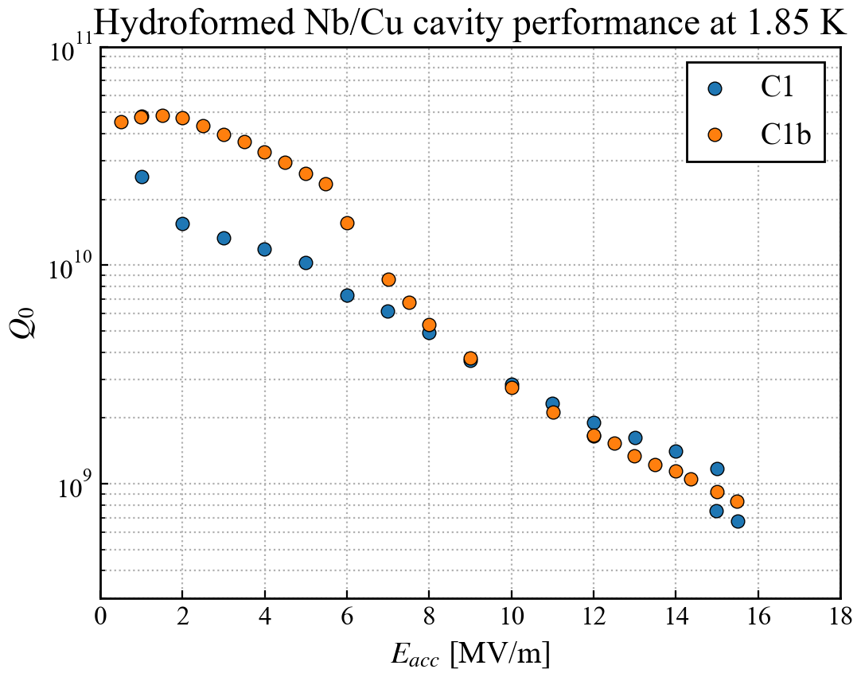
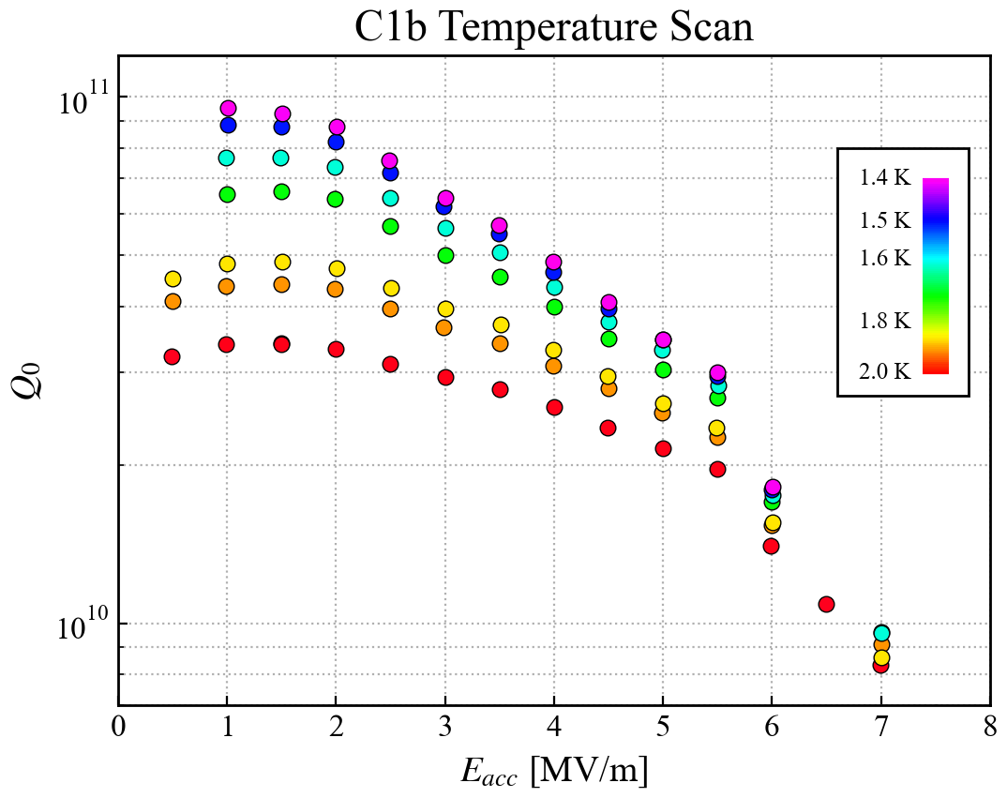
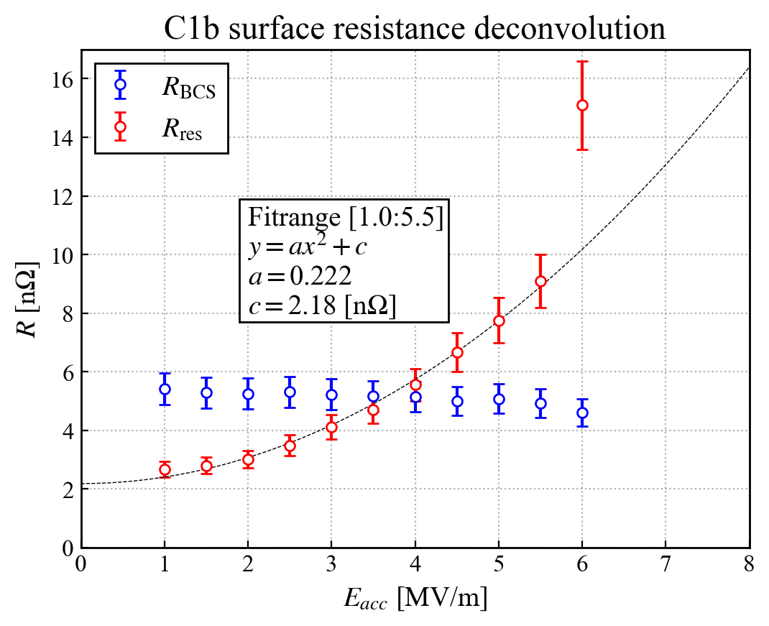
RF Measurement
Below 2.0 K
Max E_{acc}: 15.5/15.7 MV/m (C1/C1b, 1.85 K)
Max Q: 9.5 ×10¹⁰ (C1b: 1.40 K, 1.0 MV/m)
Quench field exceeded 12 MV/m without field emission
High quality factor in low field
Q slope was too steep in high field
  There is still room for improvement in surface treatment.
Minimizing temperature gradient on T_{c} is essential.

Slide 16



Summary
An optimized manufacturing method has been achieved, for the cavity without seam by hydroforming
We succeeded in manufacturing of a full seamless cavity by hydroforming. We thank the strong collaboration with NEURON (Japan) and CERN
Niobium thin film was coated with HiPIMS at CERN
RF performance was measured at KEK and confirmed to be close to FCC requirement
Acknowledgements
MEC, iCASA
Prof. emeritus A. Yamamoto
EN-MME, TE-VSC, SY-RF

