Slide 1


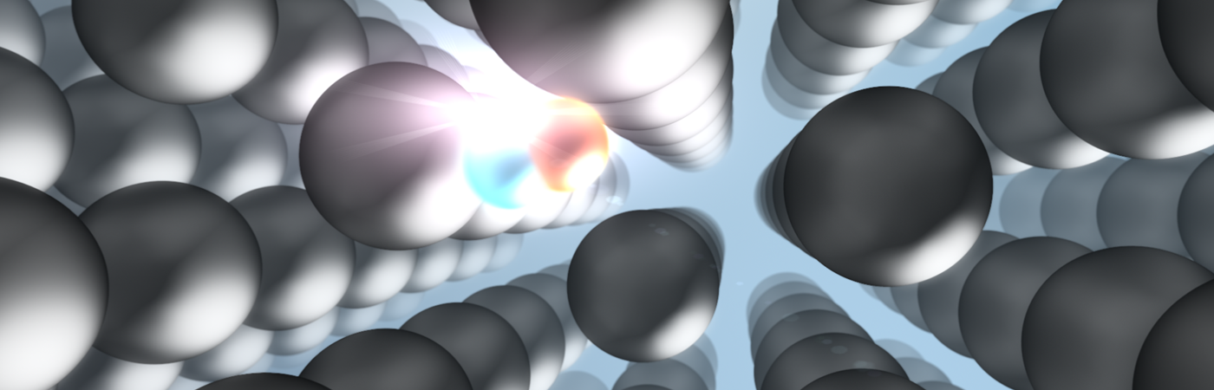
Positron annihilation spectroscopy:
11th International Workshop on Thin Films and New Ideas for Pushing the Limits of RF Superconductivity - TFSRF2024
pursuing point defects in superconducting film
Institute of Radiation Physics· Department of Nuclear Physics · Sebastian Klug · s.klug@hzdr.de · www.hzdr.de

Slide 2
Introduction
M. Sc. Sebastian Klug
Doctoral Student since May 2024
HZDR, Institute of Radiation Physics
    topics: Positron Annihilation Spectroscopy (PAS), SRF cavities, Magnetron Sputtering (DC-/HiPIMS)
  Ph.D. project
role of defects & defect development in superconducting thin films
    impact on superconducting properties
defects/voids/interfaces created during thin film creation
    in-situ investigations of defect dynamics with PAS
    materials: Nb, NbN, NbTiN, Nb₃Sn
    study of multilayer thin films (SIS structure)

Slide 3

Introduction
NOVALIS project (Novel accelerator technology for efficient light sources)
German research project (Federal Ministry of Education and Research of Germany)
Consortium of different German research institutions:
    Technical University of Darmstadt (TUDA)
    University of Hamburg (UHH)
    University of Siegen (USI)
    Helmholtz-Zentrum Berlin (HZB)
    University of Wuppertal (BUW)
    Helmholtz-Zentrum Dresden-Rossendorf (HZDR)
AIM: significant reducing of operational power losses of SRF cavities
    Beyond Niobium research, focus on thin films
    task of HZDR: providing facilities for positron annihilation spectroscopy of thin film samples

Slide 4
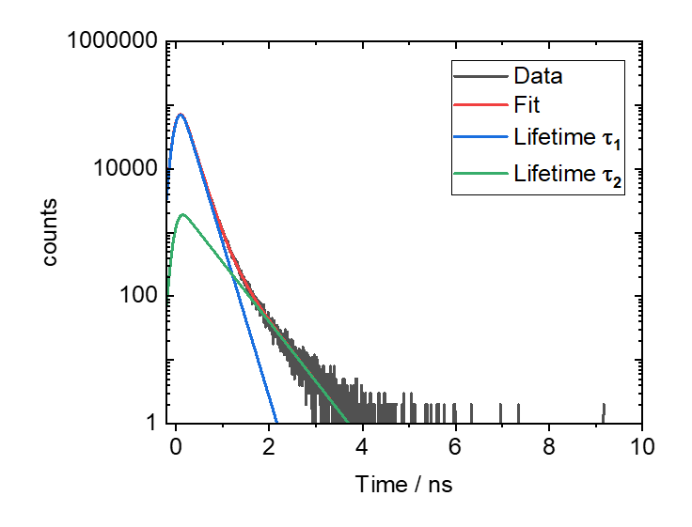
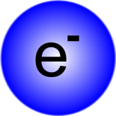

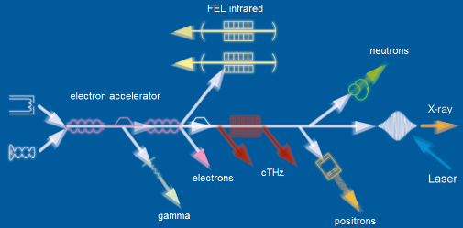
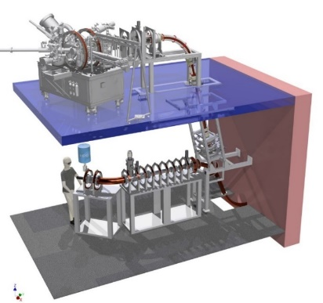
Outline
Positron Annihilation Spectroscopy
Recent research of point defects
Positron facilities at HZDR
Outlook: Magnetron Sputtering & in-situ PALS
Conclusion

Slide 5
Positron Annihilation Spectroscopy (PAS)
Positron / DBS / PALS

Slide 6
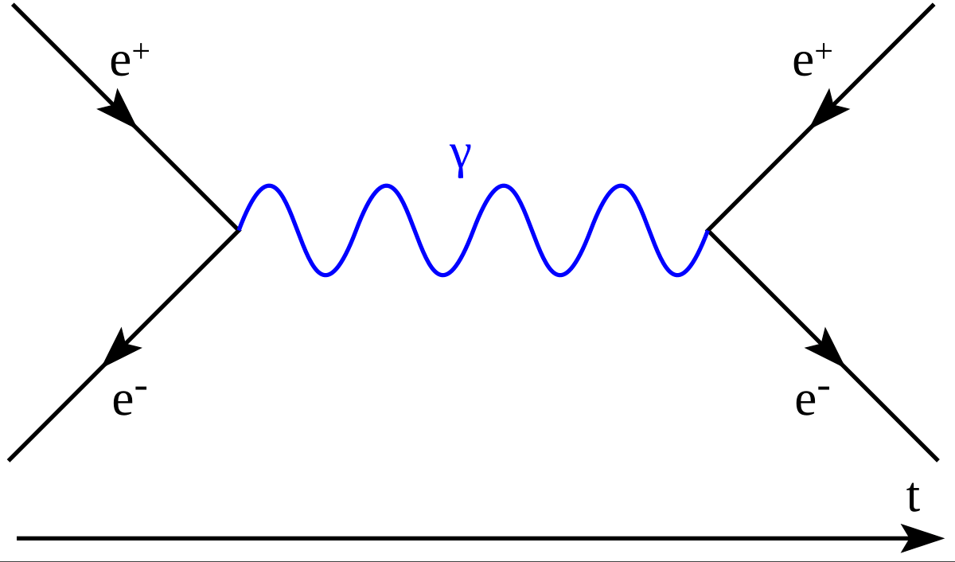
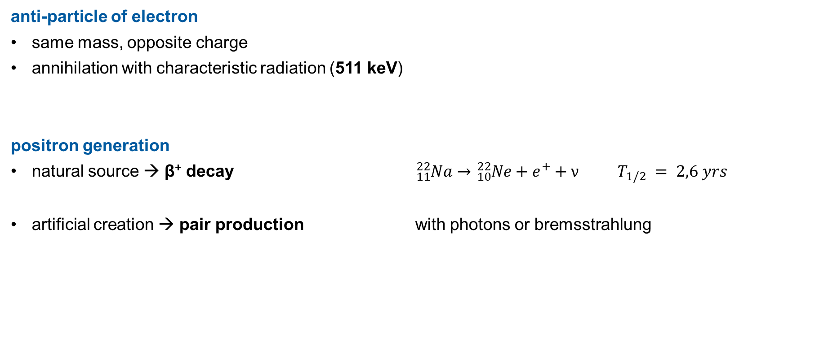
Positron Annihilation Spectroscopy (PAS)
Positron
anti-particle of electron
same mass, opposite charge
annihilation with characteristic radiation (511 keV)
positron generation
natural source → β⁺ decay ${}_{11}^{22}{Na→{}_{10}^{22}{Ne}+e^{+}+ν}$ $T_{1/2} = 2,6 yrs$
artificial creation → pair production with photons or bremsstrahlung

Slide 7
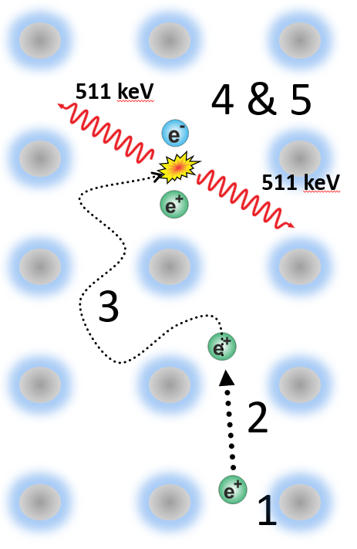
Positron Annihilation Spectroscopy (PAS)
Positron
Interaction mechanism positron (e⁺) ←→ matter
Generation & implantation of e⁺
    dependence on implantation energy
Thermalization
    <10 ps
    losing of kinetic energy
Diffusion through the lattice
    100 ps, up to 100 nm
Trapping in defects
    different electron densities
Annihilation with electron & Emission of photons
atomic lattice with one vacancy

Slide 8
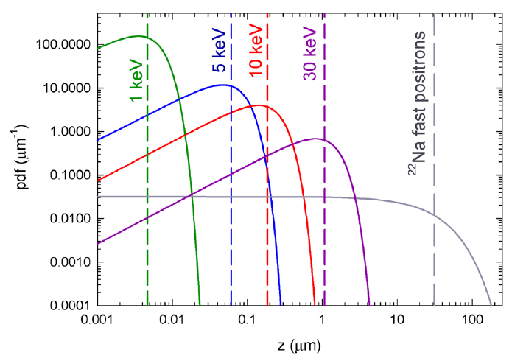


Positron Annihilation Spectroscopy (PAS)
Positron
Implantation (Makhov) profile
mean positron penetration depth $〈z〉$
dependent on E_{p} and ρ
low implantation energy E_{p}
    surface-near implantation
    sharp profile
high implantation energy E_{p}
    deeper implantation
    broadening of profile (positron scattering)
Optimal thickness of examination: 50 - 300 nm
$$〈z〉\text{[}\text{nm}\text{]}=\frac{36}{ρ\text{[}\text{g}{\text{cm}}^{−3}\text{]}}E_{p}^{1.62}\text{[}\text{keV}\text{]}$$
Makhov profile for Nb
Wenskat, M. et al. Scientific Reports 10(2020), 8300

Slide 9
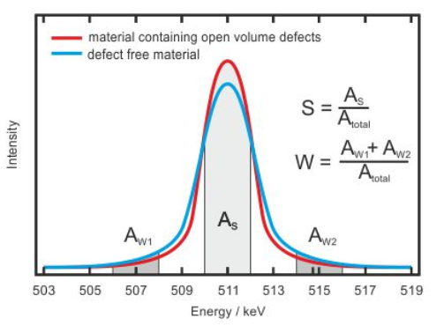
Positron Annihilation Spectroscopy (PAS)
Doppler-Broadening Spectroscopy (DBS)
Doppler broadening of annihilation line (511 keV)
electron momentum → energy shift
different fractions of electrons
low electron momentum (valence electrons)
    S (shape) parameter → defect concentration
high electron momentum (core electrons)
    W (wing) parameter → atomic environment of defects
annihilation line with S and W parameters

Slide 10
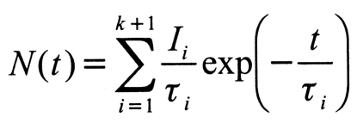

Positron Annihilation Spectroscopy (PAS)
Positron Annihilation Lifetime Spectroscopy (PALS)
Lifetime of positrons
time between generation and annihilation
of positrons
Spectrum of positron lifetime
nonlinear fitting process required
convolution with time resolution function
exponential decay terms (i ∈ ℕ)
    lifetime components $τ$_{i} (defect size)
    intensity $I$_{i} (defect density)
2 component fit for Nb sample (6 keV implantation energy)

Slide 11
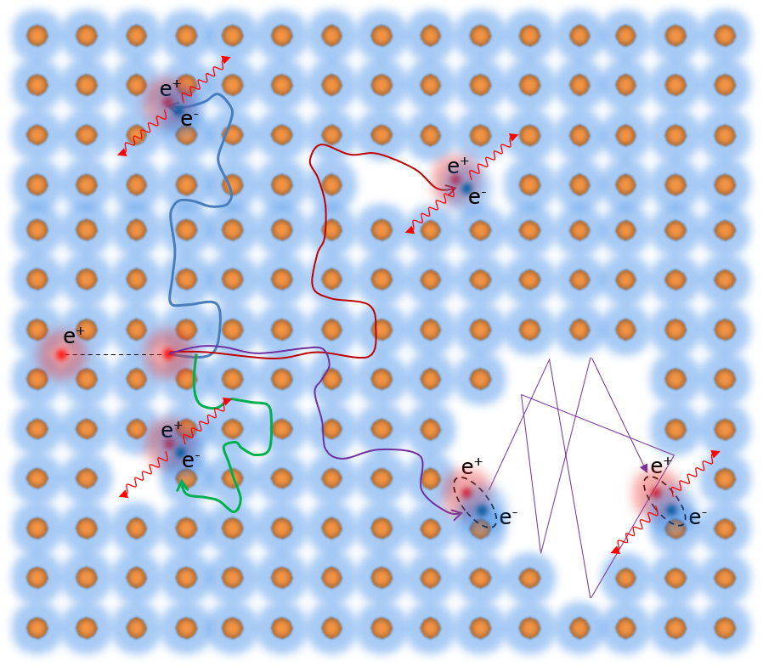
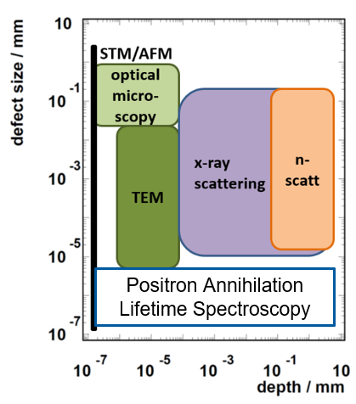
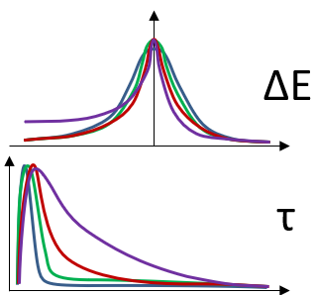
Positron Annihilation Spectroscopy (PAS)
Positron Annihilation Lifetime Spectroscopy (PALS)
Non-destructive and high-sensitivity to small defects (atomic scale)
bulk
mono-vacancy
vacancy agglomeration
void / pore

Slide 12
Recent research of point defects
Vacancy kinetics in Nb / Point defects of Nb-based thin films

Slide 13
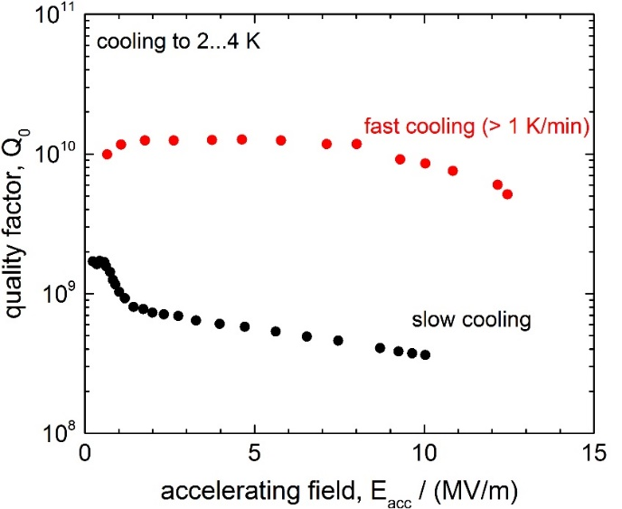
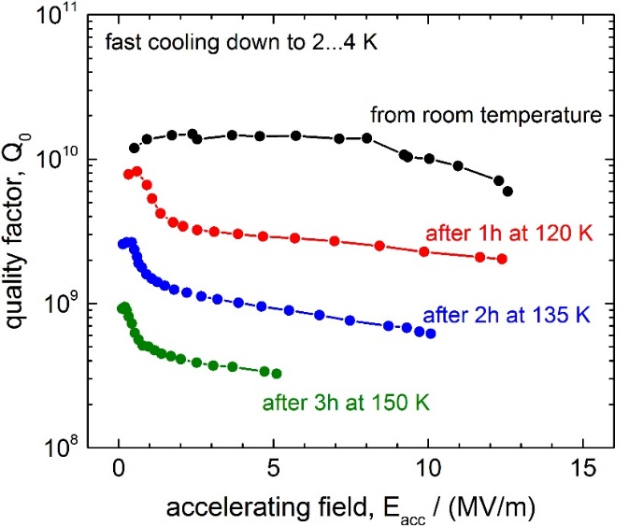
Vacancy kinetics in Nb
Q disease
Collaboration with M. Wenskat (DESY, DE) & J. Čižek (Prague, CZ)
Origin of Q disease
formation of niobium hydrides in the rf surface layer during cooling down
open volume lattice defects have high trapping potential for impurities,
especially hydrogen: vacancy-hydrogen complexes
Curing Q disease
mild bake: at 390 K for 48 h (< 1e−6 mbar)
to avoid high-field Q slope (accidentally found!)
low-T bake: only 350 K for first 2 h
Q losses reduced by factor 2
increased achievable accelerating field by >10%
RF layer
Q
standard
+ mild bake
+ low-T bake
E

Slide 14
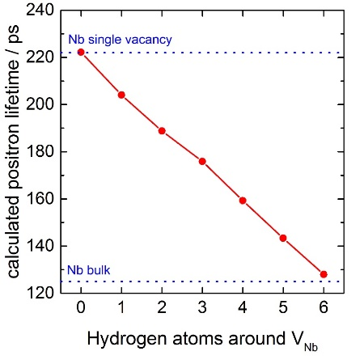
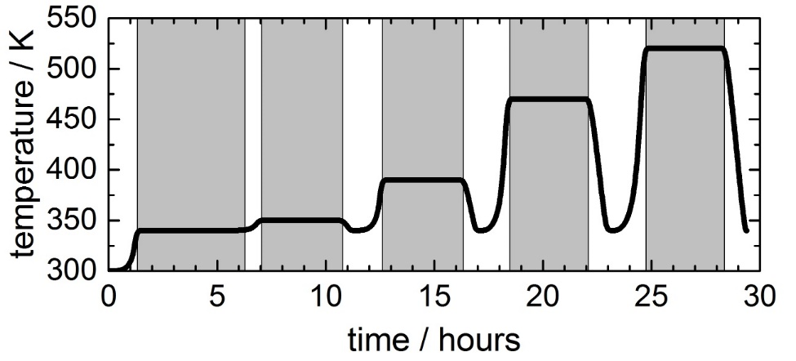
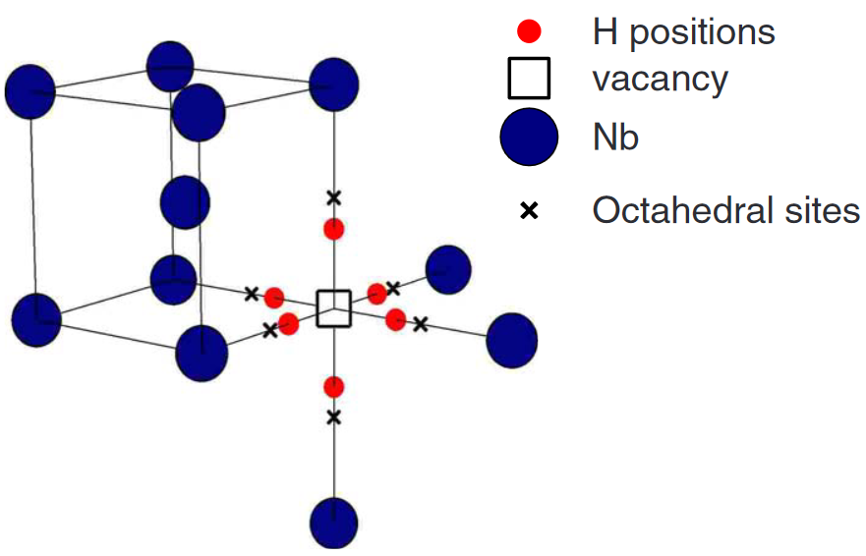
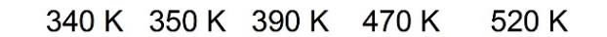
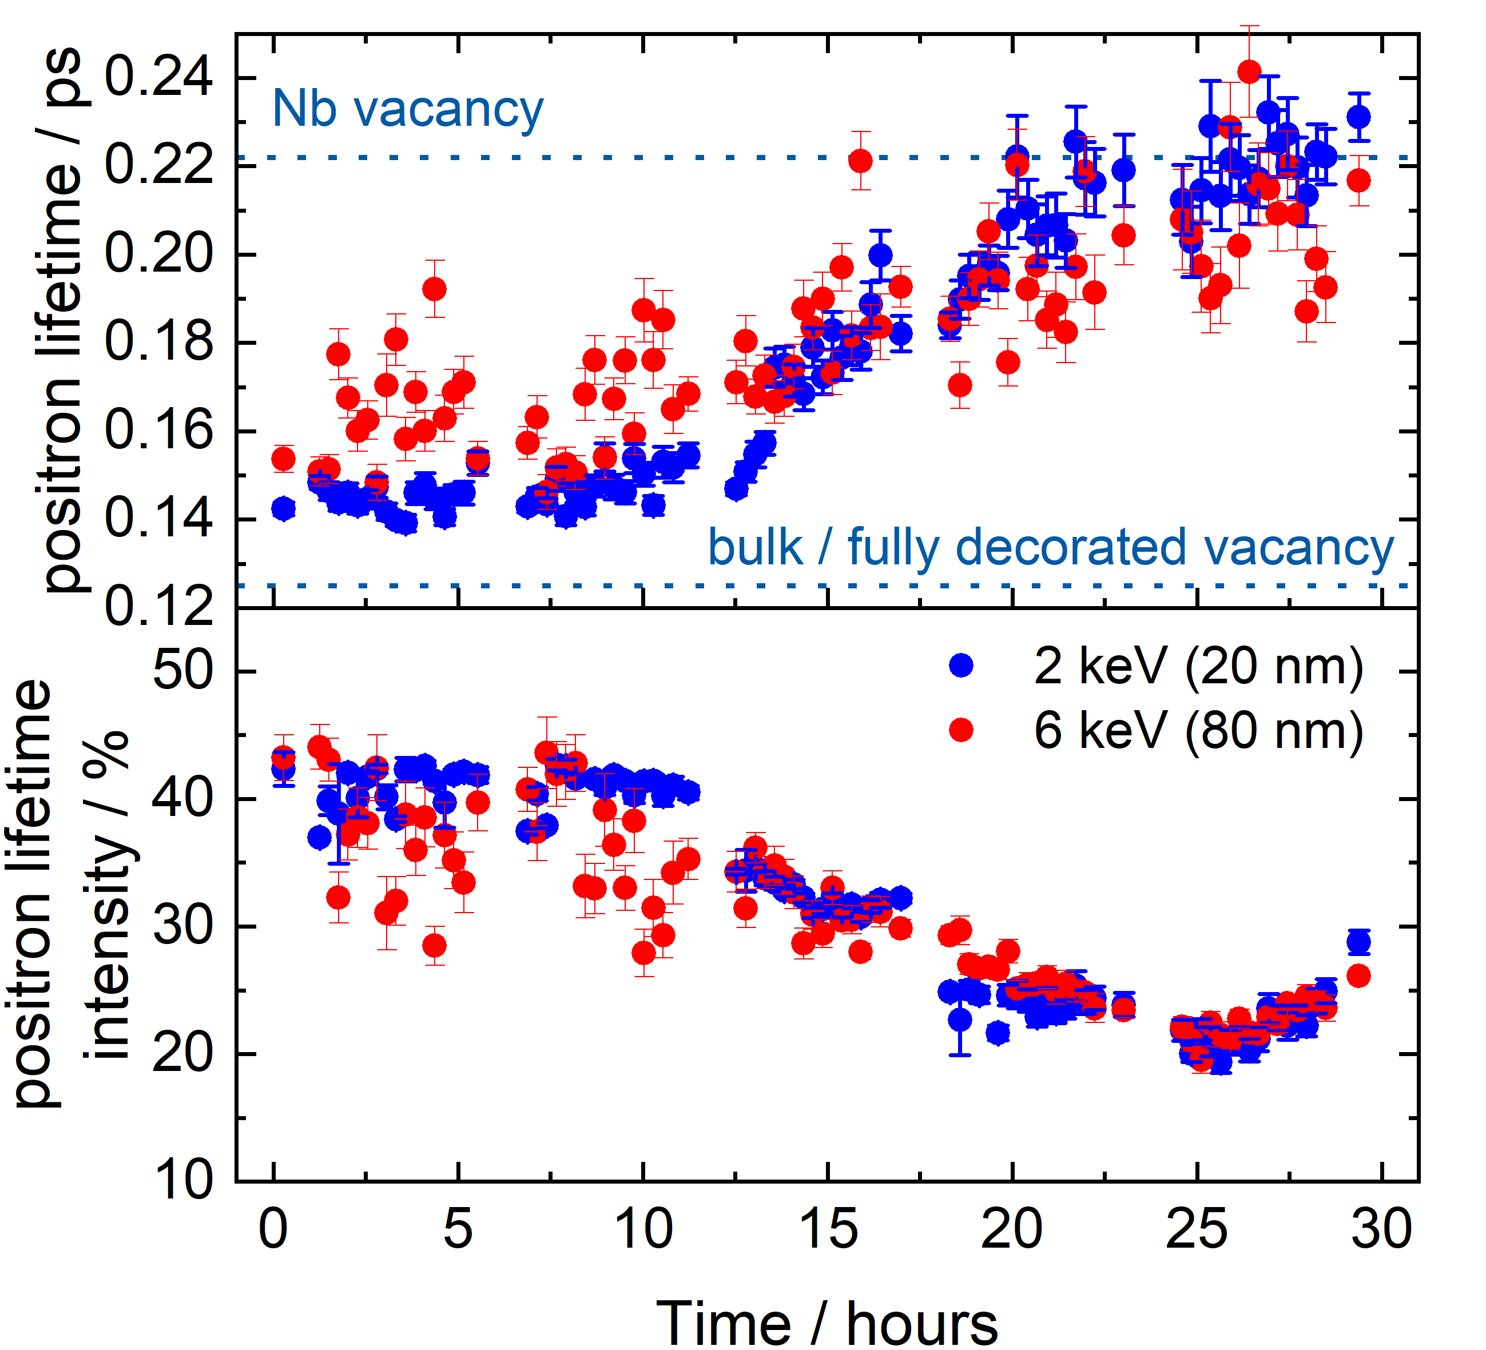
Vacancy kinetics in Nb
Collaboration with M. Wenskat (DESY, DE) & J. Čižek (Prague, CZ)
T = 390 K:
shows most significant changes
(already after short times)
T > 390 K:
hydrogen released from complexes (lifetime increases)
v+nH concentration decreases (intensities decrease)
Wenskat, M. et al. Phys. Rev. B 106(2022), 094516
Wenskat, M. et al. Scientific Reports 10(2020), 8300

Slide 15
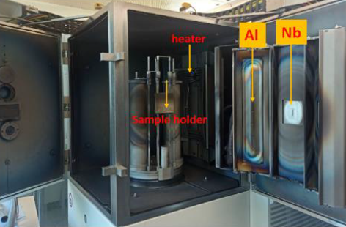
Point defects of Nb-based thin films
Magnetron sputtering
Thin film creation
cooperation with University of Siegen, Germany
    Prof. Dr. rer. nat. habil. Xin Jiang & Dr. Aleksandr Zubtsovskii
    NOVALIS project
knowledge transfer for new sputtering chamber @HZDR
reference samples for future sample series
Sample characterization @HZDR, Germany
XRD (θ - 2θ scan)
→ DBS & PALS
CemeCon CC800 at University of Siegen

Slide 16
Point defects of Nb-based thin films
Nb films on Si(100)
sample | cathode type | Power (W/cm²) | p_gas (mbar) | Ar flow (sccm) | N2 flow (sccm)
DCMS-Nb | DC | 4,54 | 0,00801 | 410,0 | 0,0
HiPIMS-Nb LP | HiPIMS | 4,54 | 0,00801 | 500,0 | 0,0
HiPIMS-Nb HP | HiPIMS | 6,82 | 0,02001 | 700,0 | 0,0

Slide 17
Point defects of Nb-based thin films
Nb films on Si(100)

Slide 18
Point defects of Nb-based thin films
NbN films on Si(100)
sample | cathode type | Power (W/cm²) | p_gas (mbar) | Ar flow (sccm) | N2 flow (sccm)
DCMS-NbN | DC | 5,68 | 0,01315 | 522,5 | 45,5
HiPIMS-NbN | HiPIMS | 4,54 | 0,02291 | 641,8 | 71,3

Slide 19
Point defects of Nb-based thin films
NbN films on Si(100)

Slide 20
Positron user facilities at the HZDR
ELBE / SPONSOR / MePS / Access for user

Slide 21

Positron user facilities at the HZDR
ELBE (Electron Linear accelerator with high Brilliance and low Emittance)
ELBE as User Facility
> 50 % of beamtime
for external user groups

Slide 22
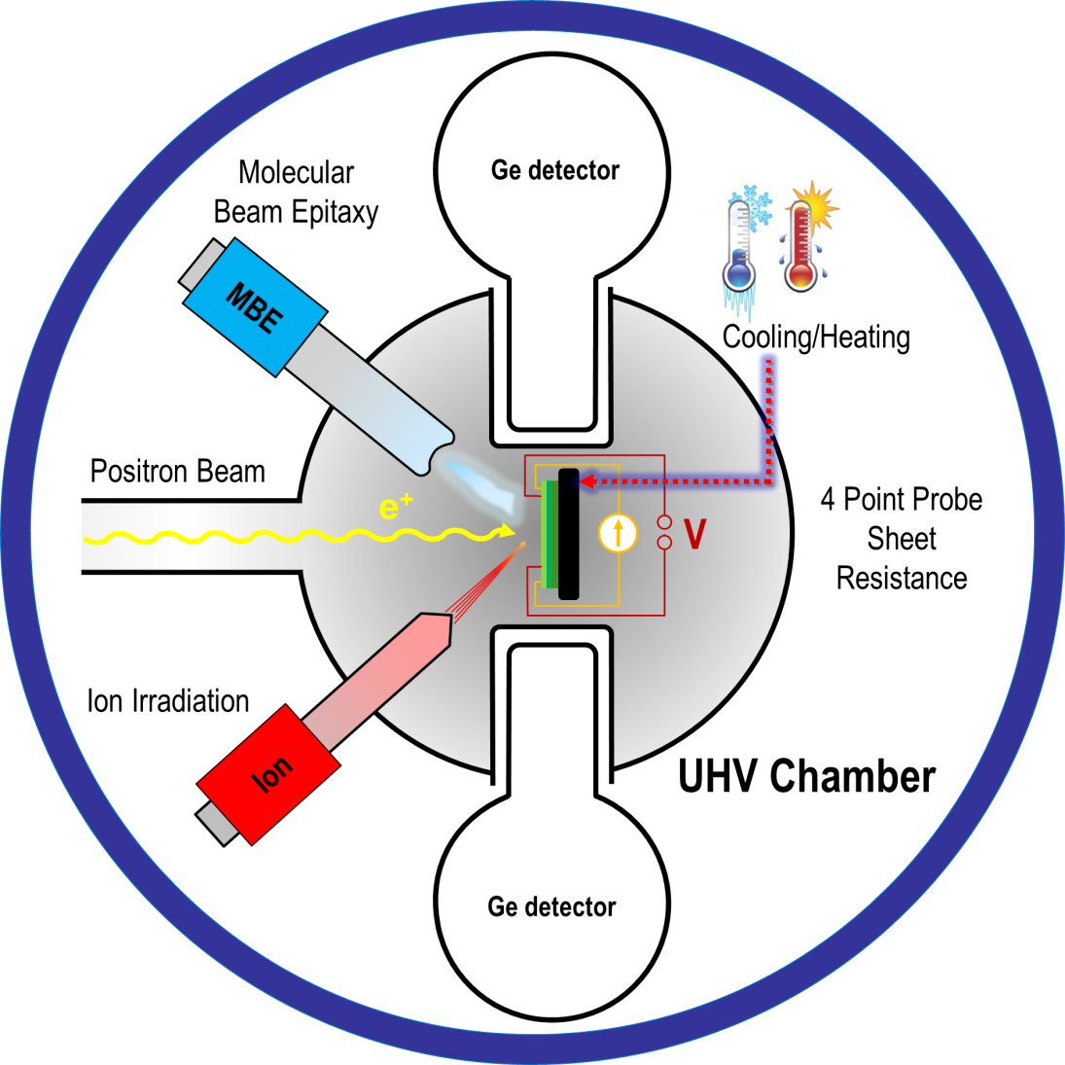
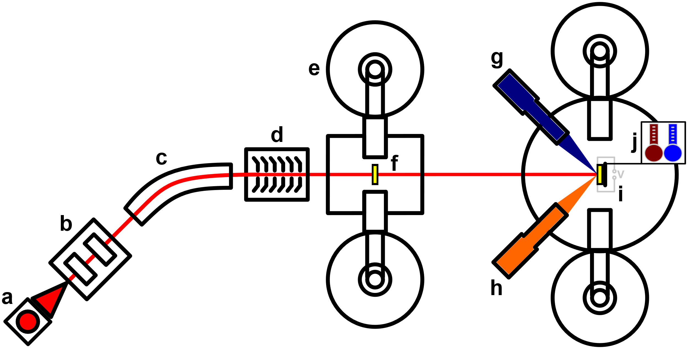
Positron user facilities at the HZDR
SPONSOR (The Slow-Positron System of Rossendorf)
Usage of ²²Na source
DBS (defect size, density and chemistry)
depth resolved measurements
implantation energy (E_{p}) 0…35 keV (depth ~20 nm to few µm)
Apparatus for in-situ defect analysis (AIDA I)
base pressure: 2e-9 mbar
temperature: 100 - 1200 K
Molecular Beam Epitaxy (MBE)
ion irradiation: E_{ion} = 0,5…5,0 keV
sheet resistance (4 point probe)
sample bias (± 1000 V)
AIDA I
light
SPONSOR

Slide 23
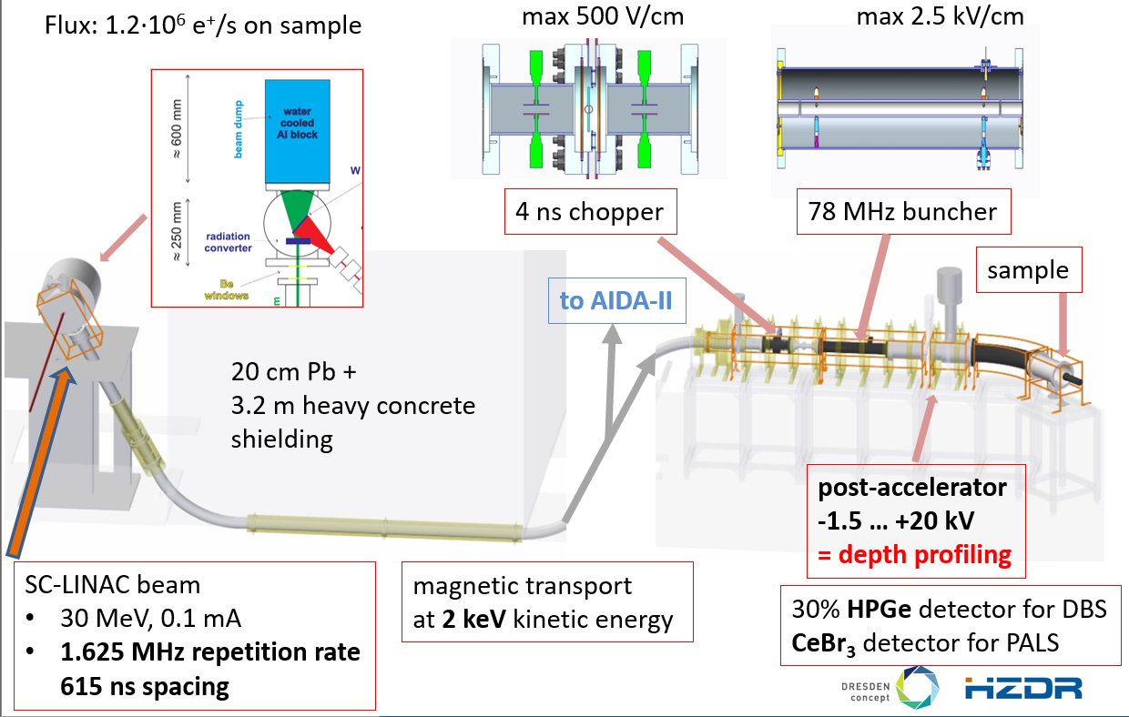
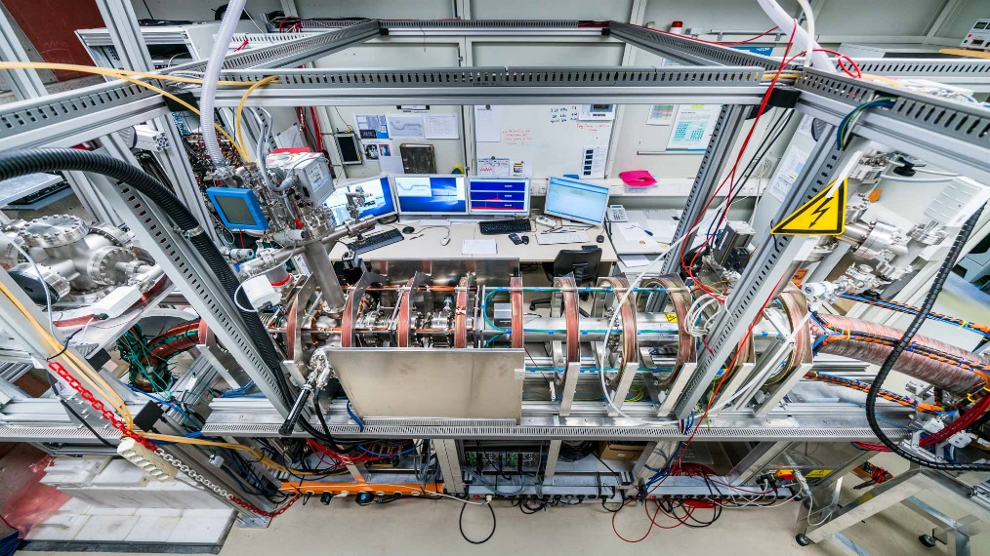
Positron user facilities at the HZDR
MePS (Mono-energetic Positron Spectroscopy)
Usage of Linac
PALS (defect size and density)
depth resolved measurements
implantation energy (E_{p}) 0…18 keV
temperature up to 800 K
planned implantation of cryostat (20 K)

Slide 24

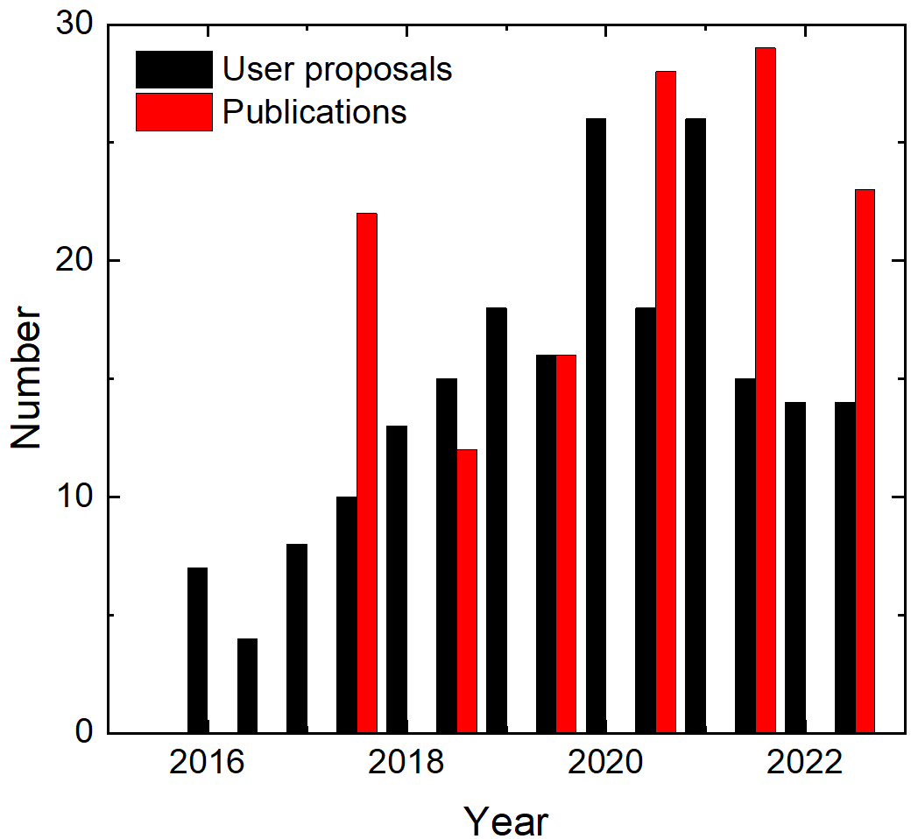
Positron user facilities at the HZDR
Access for user
Application with scientific user proposal
submitted through the user portal GATE
evaluation by international and interdisciplinary Scientific Advisory Committee
free of charge for all non-proprietary research
Website https://www.hzdr.de/db/Cms?pNid=1732
Deadline
twice a year
next call for 1st half 2025:
    September 23rd, 2024 (already next Monday!)
~ 30 proposals / year

Slide 25
Outlook: Magnetron Sputtering & in-situ PALS
AIDA II / future plans

Slide 26
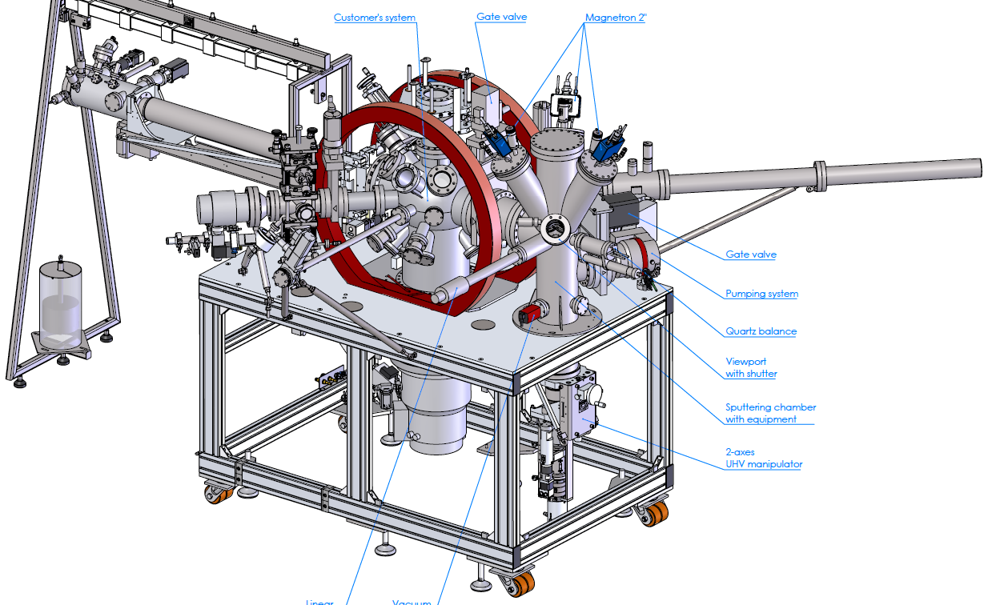
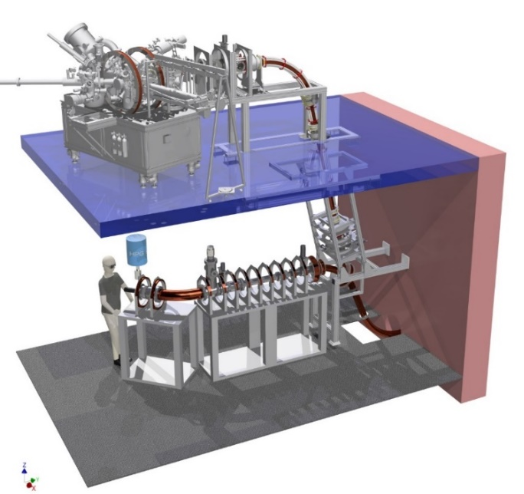
Outlook: Magnetron Sputtering & in-situ PALS
sputtering chamber
AIDA II
Magnetron sputter chamber
3 confocal magnetrons: 2x DC, 1x RF; 400 W
working gases: Ar, N₂, O₂
2-inch targets
base pressure < 1e-9 mbar
temperature range -180 to 800 °C
In-situ characterization (PALS)
Apparatus for in-situ defect analysis (AIDA II)
combination of MePS and magnetron sputtering
novelty: PALS during sputtering process
    tracking of development of point defects
AIDA II
MePS

Slide 27
Outlook: Magnetron Sputtering & in-situ PALS
future plans
next steps
finishing work on AIDA II
investigations of influence of magnetron sputtering process parameters
in-situ PALS of Nb and NbN thin films
ex-situ characterization with XRD, SEM, AFM
characterization of superconducting properties
later
Study of NbTiN, Nb₃Sn and final aim of SIS multilayers
Cu (interdiffusion studies)

Slide 28
Conclusion
Positron Annihilation Spectroscopy

Slide 29
Conclusion
Positron Annihilation Spectroscopy
non-destructive characterization of defects
vacancy-like defects down to atomic scale
depth profiling
combination with ATSUP calculations
Doppler-Broadening-Spectroscopy (DBS)
    defect concentration & atomic environment of defects
Positron Annihilation Lifetime Spectroscopy (PALS)
    defect typ, size & density

Slide 30
Acknowledgement
Contact:
Sebastian Klug
+49 351 260 3127
s.klug@hzdr.de
THANK YOU FOR
YOUR ATTENTION !
ELBE as user facility!
Institute of Radiation Physics,
HZDR, Germany
Dr. Andreas Wagner
Dr. Maciej Oskar Liedke
Dr. Ahmed Gamal Attallah Elsherif
Dr. Maik Butterling
Dr. Eric Hirschmann
and more…
Institute of Materials Engineering,
University of Siegen, Germany
Prof. Dr. rer. nat. habil. Xin Jiang
Dr. Aleksandr Zubtsovskii
M.Sc. Bharath Reddy Lakki Reddy Venkata
and more…

