Slide 1
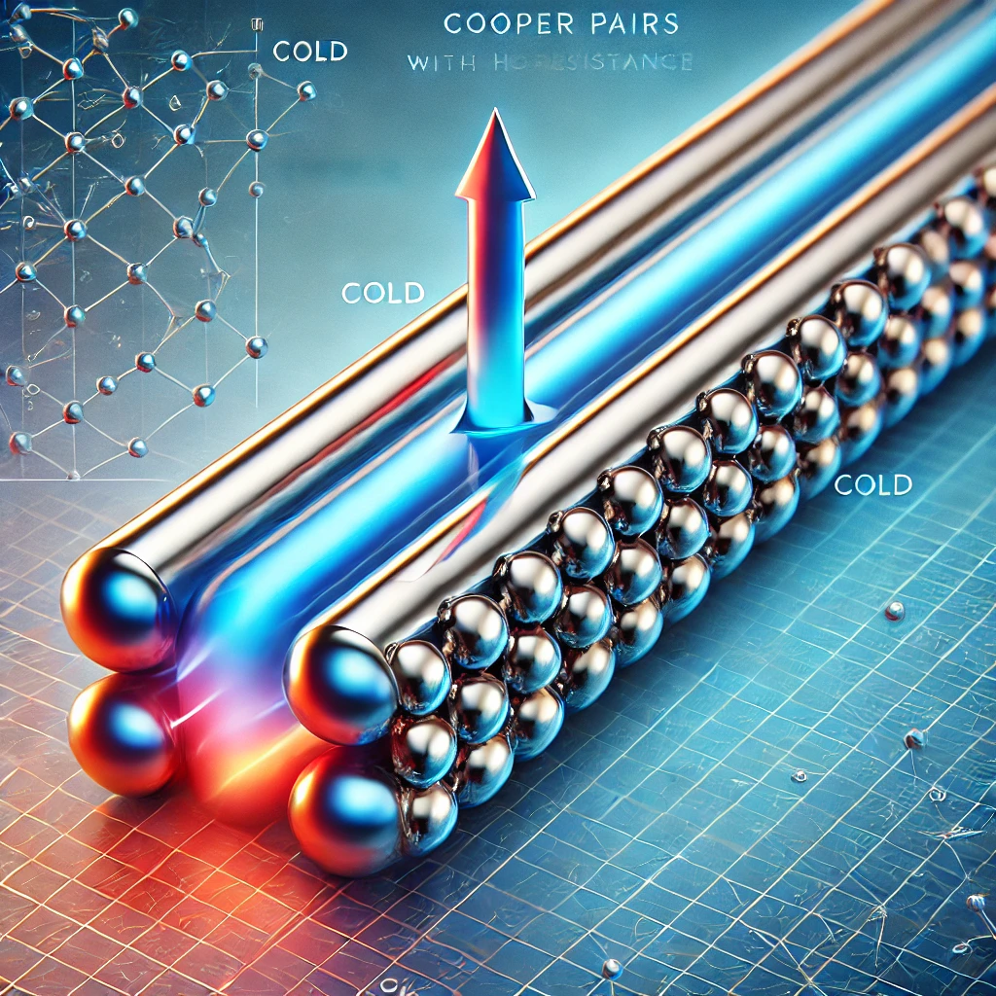


Thermal transmittance measurements of SIS & Nb₃Sn coated samples at cryogenic temperatures
Image generated by ChatGPT, an AI model by OpenAI.
“Draw me a picture illustrating thermal conduction in a metallic superconductor.”
19.09.2024
Marc Wenskat – on behalf SRF R&D Team
emphasis on Leon King, Anton Lorf, Cem Saribal

Slide 2

Thermal transmittance is crucial for stable operation
We need to dissipate RF losses / Joule heating away into the liquid He
If the heat is not dissipated away, we will have an unwanted thermal feedback increasing R_{s}
To achieve gradients >50 MV/m we need to study thermal transmittance K
Does overall thermal transmittance K deteriorate after coating of Nb?
  Is the thermal conductivity λ the culprit?
  The thermal interface resistance R_{th} between layer and substrate?
  What about the Kapitza-Resistance R_{K} of the coated layer?
$$={\left(\frac{d}{λ}+R_{K}\right)}^{−1}$$
S
λ_{Nb}
Nb
R_{th}
R_{K}
λ_{S}
lHe
λ_{S}

Slide 3
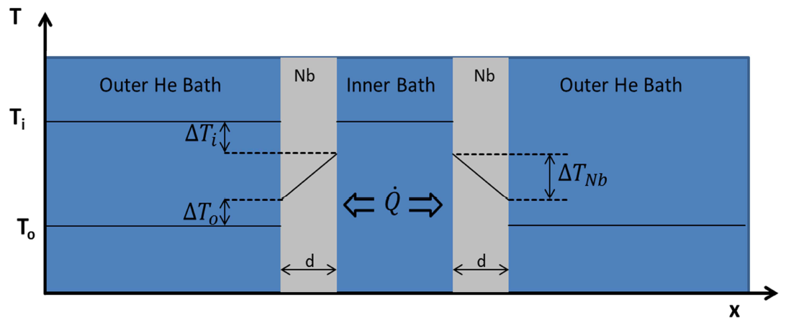
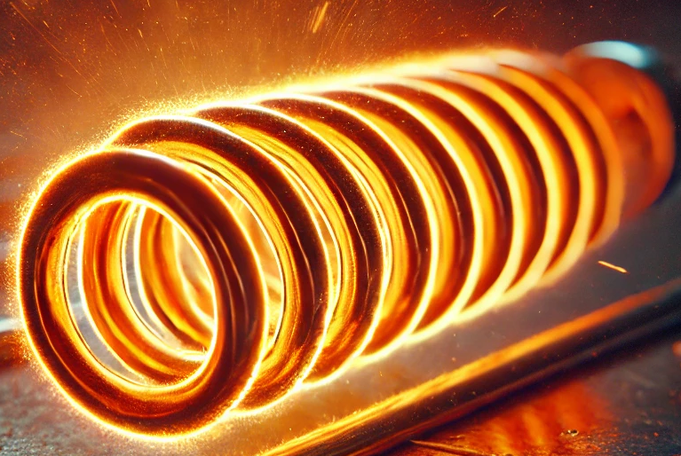


How can we measure K across films?
To enforce heat flow through the film, standard measurements used in SRF are not feasible
Remembered earlier works by J. Amrit and C. Antoine (Thank you!)
Amrit, J., and M. X. François. "Heat flow at the niobium-superfluid helium interface: Kapitza resistance and superconducting cavities." Journal of low temperature physics 119 (2000): 27-40.
We know A, control $\dot{Q}$ and measure $T_{i}$ and $T_{o}$
$\left(\frac{d}{λ}+R_{K}\right)\dot{Q}=A∙$ $(T_{i}−T_{o})$
1/K → This is what we obtain

Slide 4
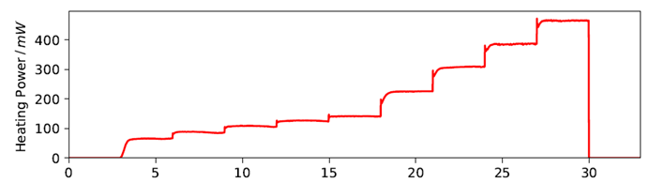
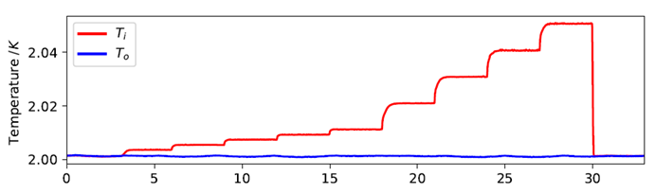
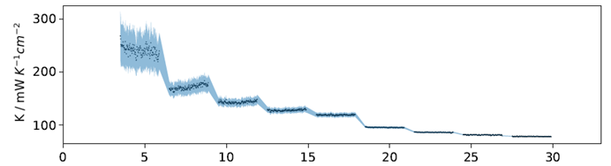


Measurement procedure
2K
$$\frac{σ_{P}}{P}=8\%$$
$$σ_{T}<10 mK$$

Slide 5
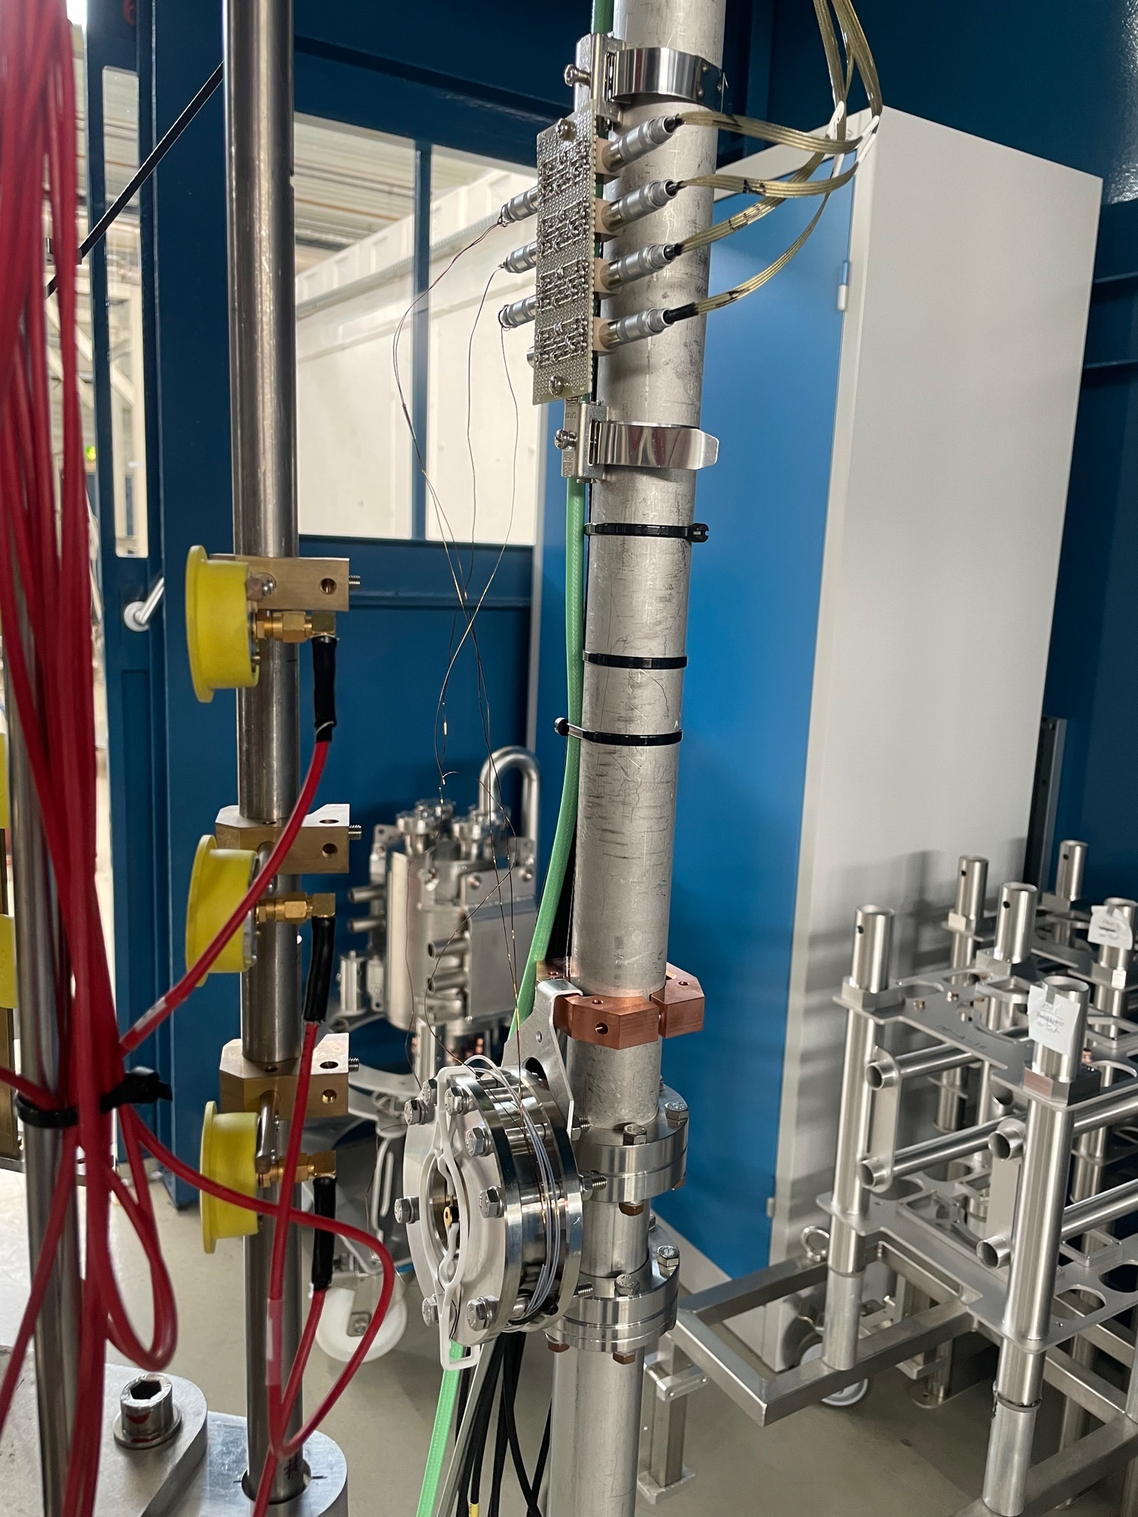
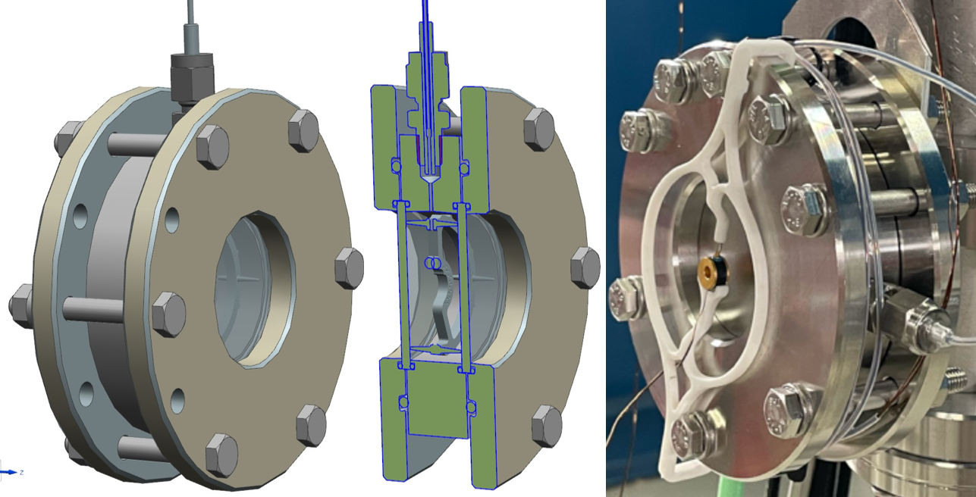
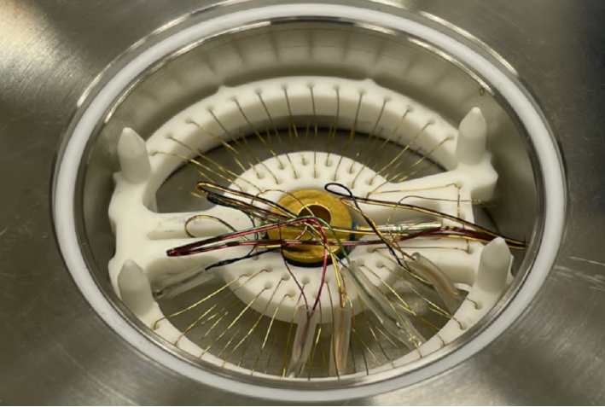
How does it look like?
Parasitically installed at cavity insert
Cell Ø=106mm
Sample Ø=45mm
T-sensor inside & outside
Manganin heating wire inside
Filling by 1m capillary with Ø=1mm to thermally decouple inside
Electrical wires go through there (heater & T-sensor)
Only glued / screwed → high chance of leaks
Notes:
PTFE Sealings

Slide 6
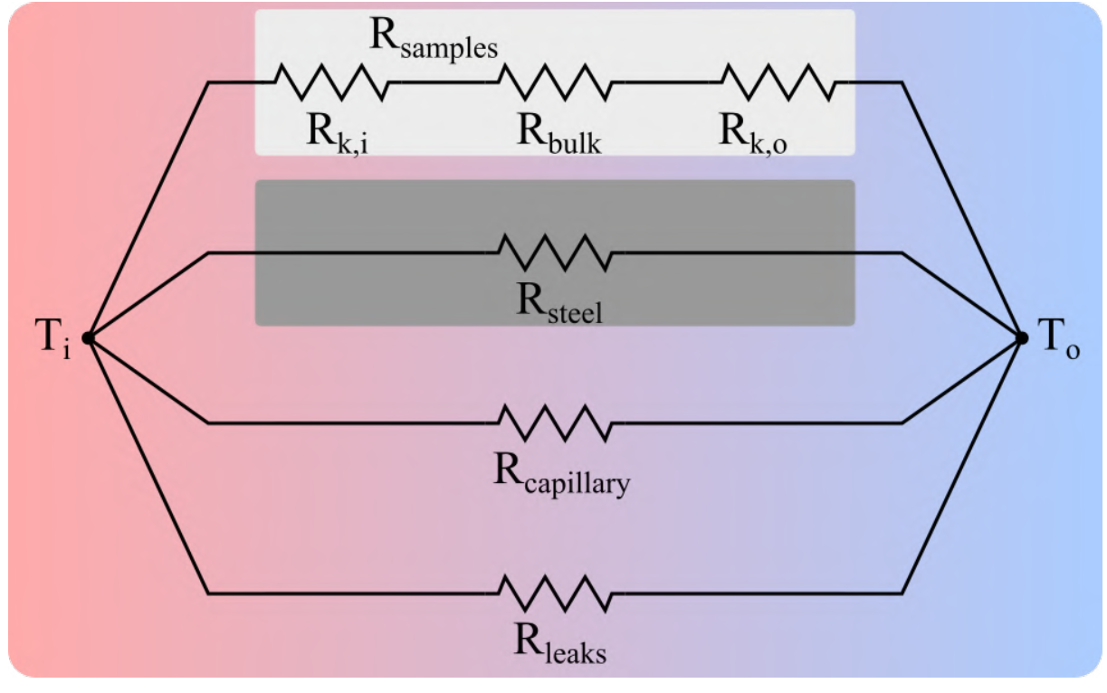
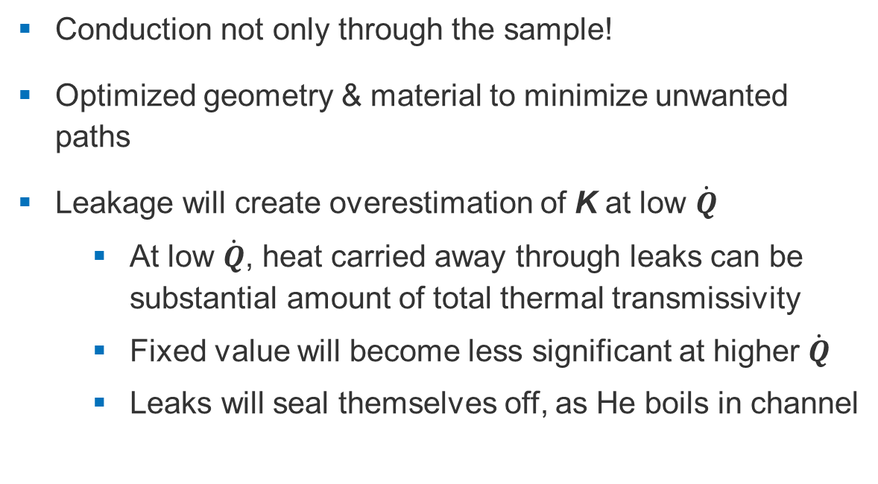
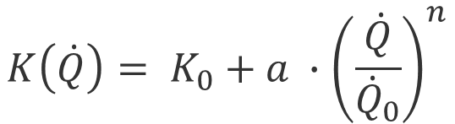
Systematic uncertainties?
≈94 %
Conduction not only through the sample!
Optimized geometry & material to minimize unwanted paths
Leakage will create overestimation of K at low $\dot{Q}$
  At low $\dot{Q}$, heat carried away through leaks can be substantial amount of total thermal transmissivity
  Fixed value will become less significant at higher $\dot{Q}$
  Leaks will seal themselves off, as He boils in channel
0.65 %
2-5 %
X %
$$K\left(\dot{Q}\right)= K_{0}+a ∙{\left(\frac{\dot{Q}}{{\dot{Q}}_{0}}\right)}^{n}$$

Slide 7
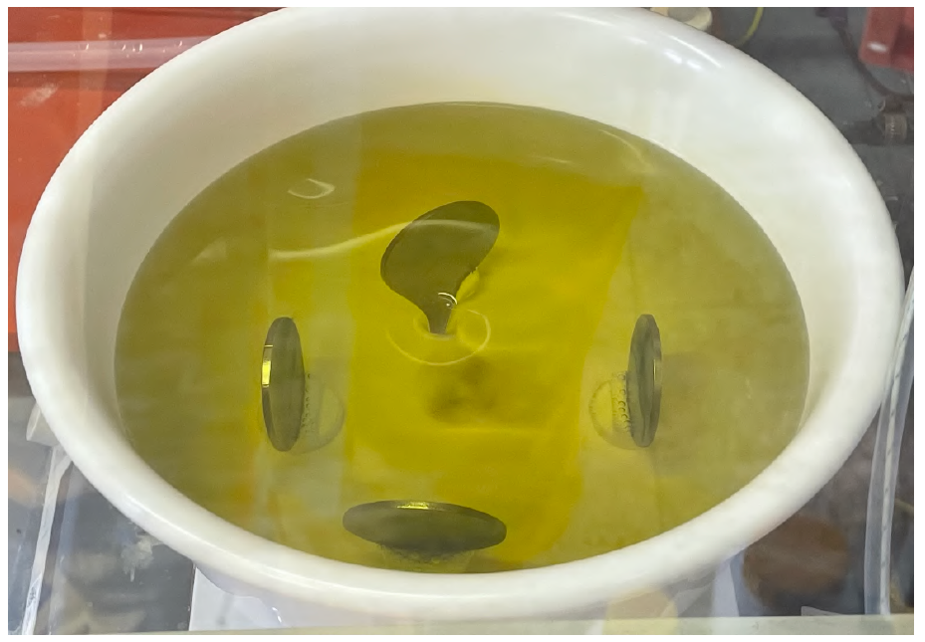
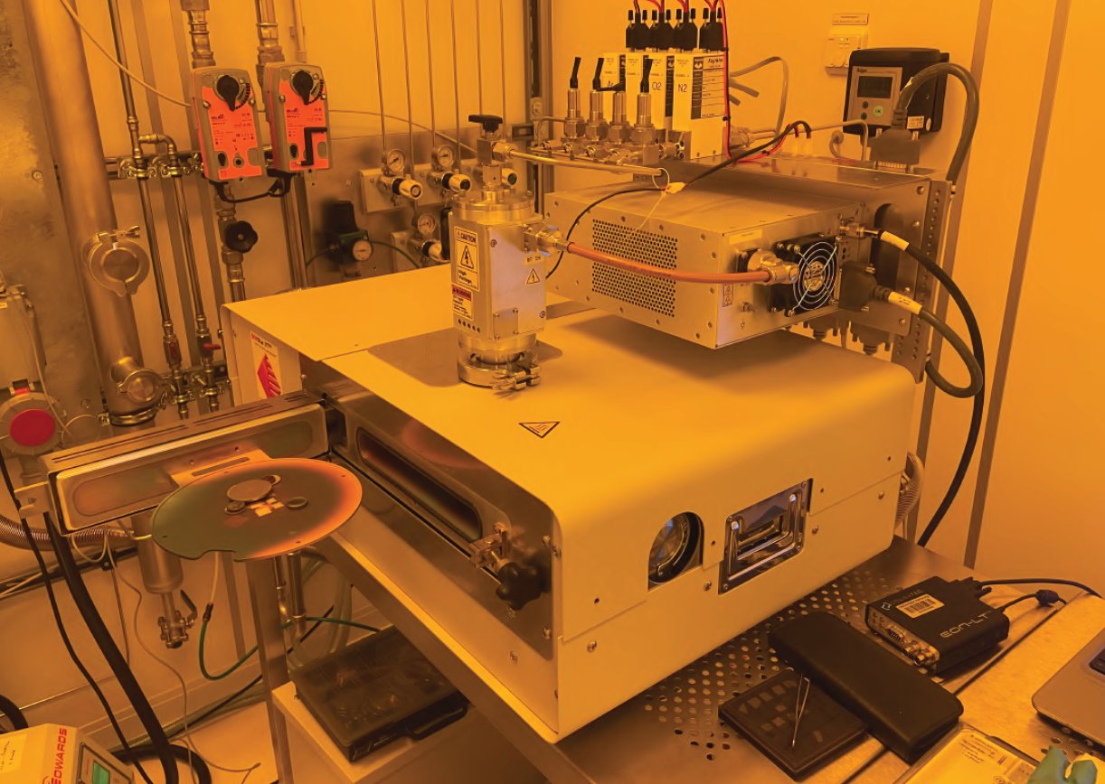
Samples
All samples cut from 1 EXFEL sheet
All samples underwent coarse BCP + 3h@800°C (Baseline)
1 pair was coated both sides with
  15nm/60nm AlN/NbTiN via PEALD (as-deposited)
  +1h@900°C to achieve high T_{c} ^{[1]} (annealed)
1 pair was coated with 200nm Nb₃Sn ^{[2]} twice (one side each) by TU Darmstadt (DCMS co-sputtering)
All measurements shown are at 2K
¹ González Díaz-Palacio, I., Wenskat, M., Deyu, G. K., Hillert, W., Blick, R. H., & Zierold, R. (2023). Thermal annealing of superconducting niobium titanium nitride thin films deposited by plasma-enhanced atomic layer deposition. Journal of Applied Physics, 134(3)
² Schäfer, N., Karabas, N., Palakkal, J. P., Petzold, S., Major, M., Pietralla, N., & Alff, L. (2020). Kinetically induced low-temperature synthesis of Nb3Sn thin films. Journal of Applied Physics, 128(13).

Slide 8
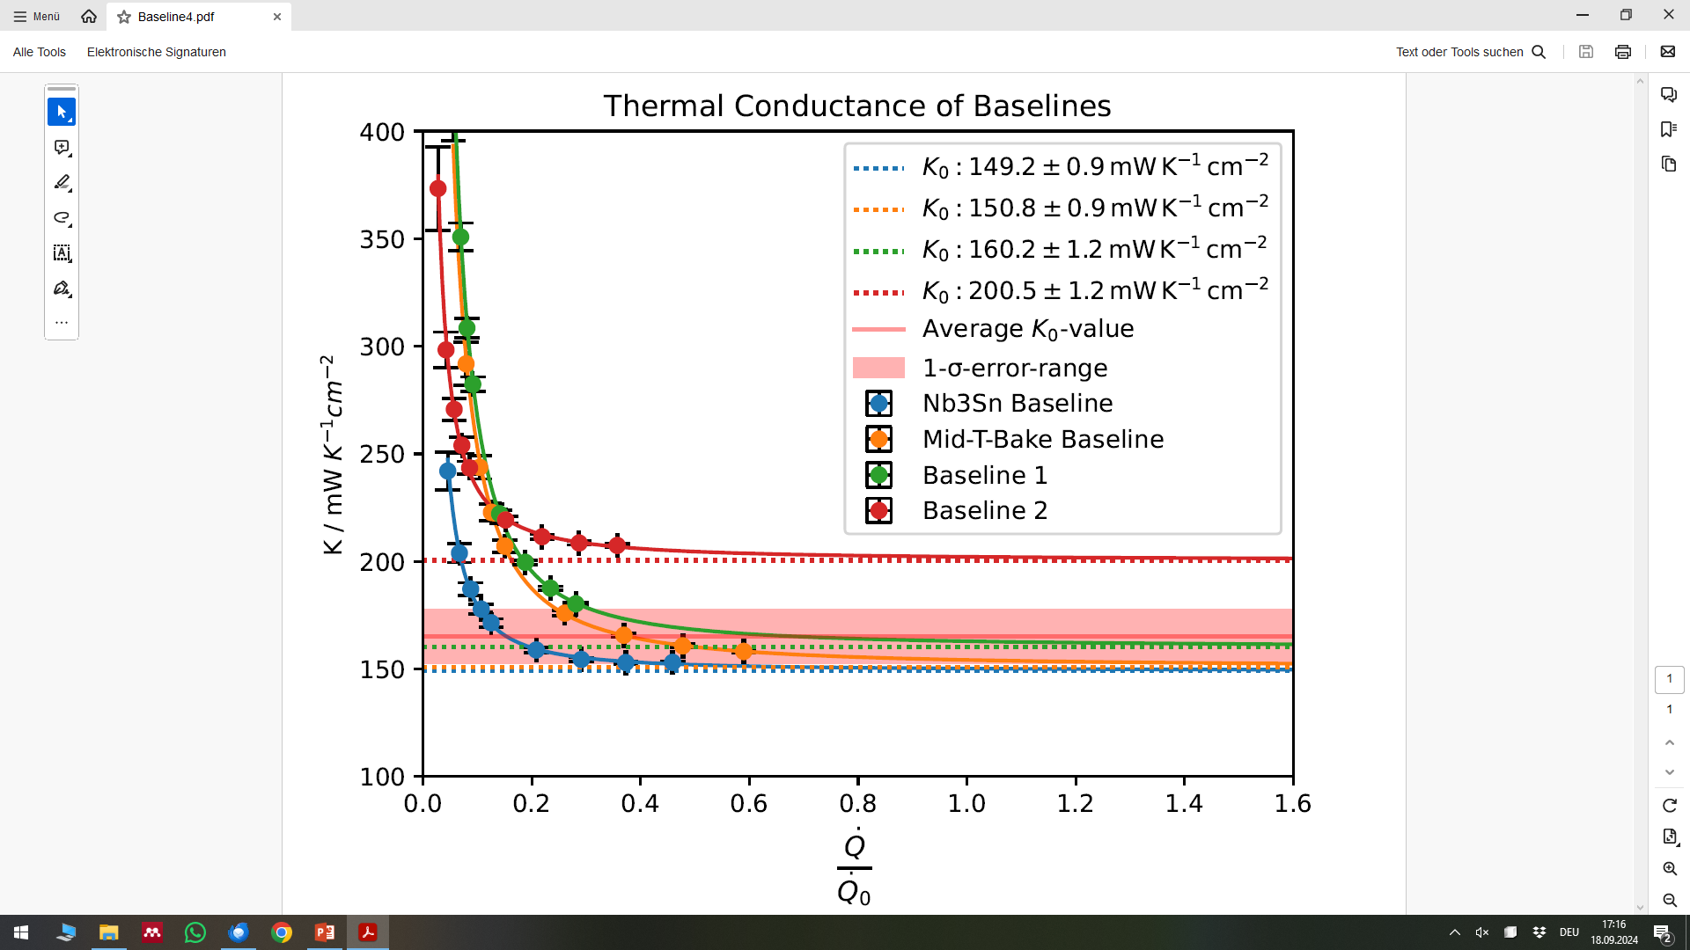
Can we trust the results? Yes, they are reasonable
Shows expected behavior with power law dependency
Values are well in agreement with literature
  K₀ = (150 – 200) mW cm⁻² K⁻¹
Measured as-fabricated (only water-jet cutting)
  K₀ = (307±46) mW cm⁻² K⁻¹
  K₀ = (332±31) mW cm⁻² K⁻¹
Higher K₀ also in agreement with literature

Slide 9
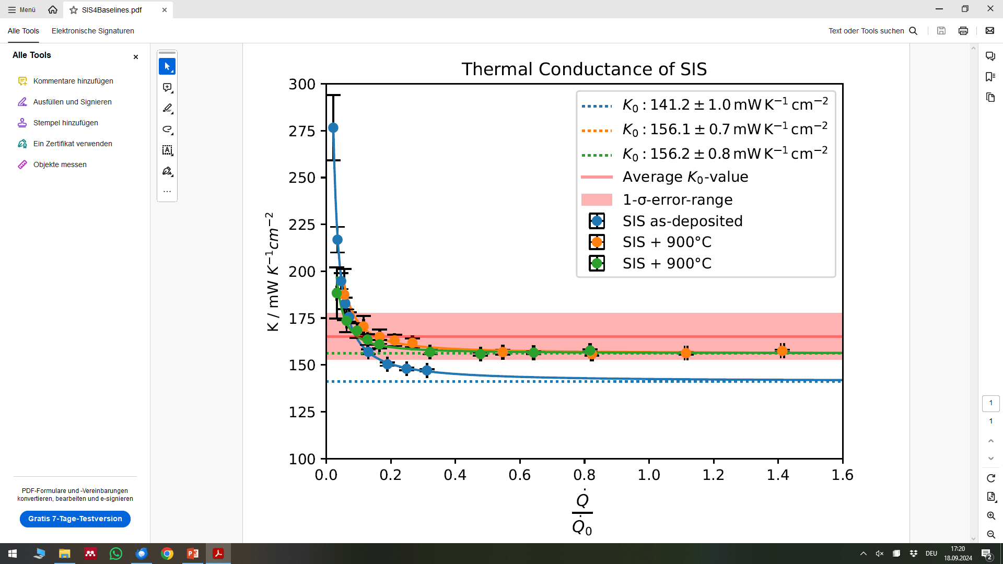
SIS does not reduce the thermal transmittance K
As-deposited K₀ = (141±13) mW cm⁻² K⁻¹
After annealing K₀ = (156±10) mW cm⁻² K⁻¹
SIS on both sides → many interfaces
Well within the baseline Nb value!

Slide 10
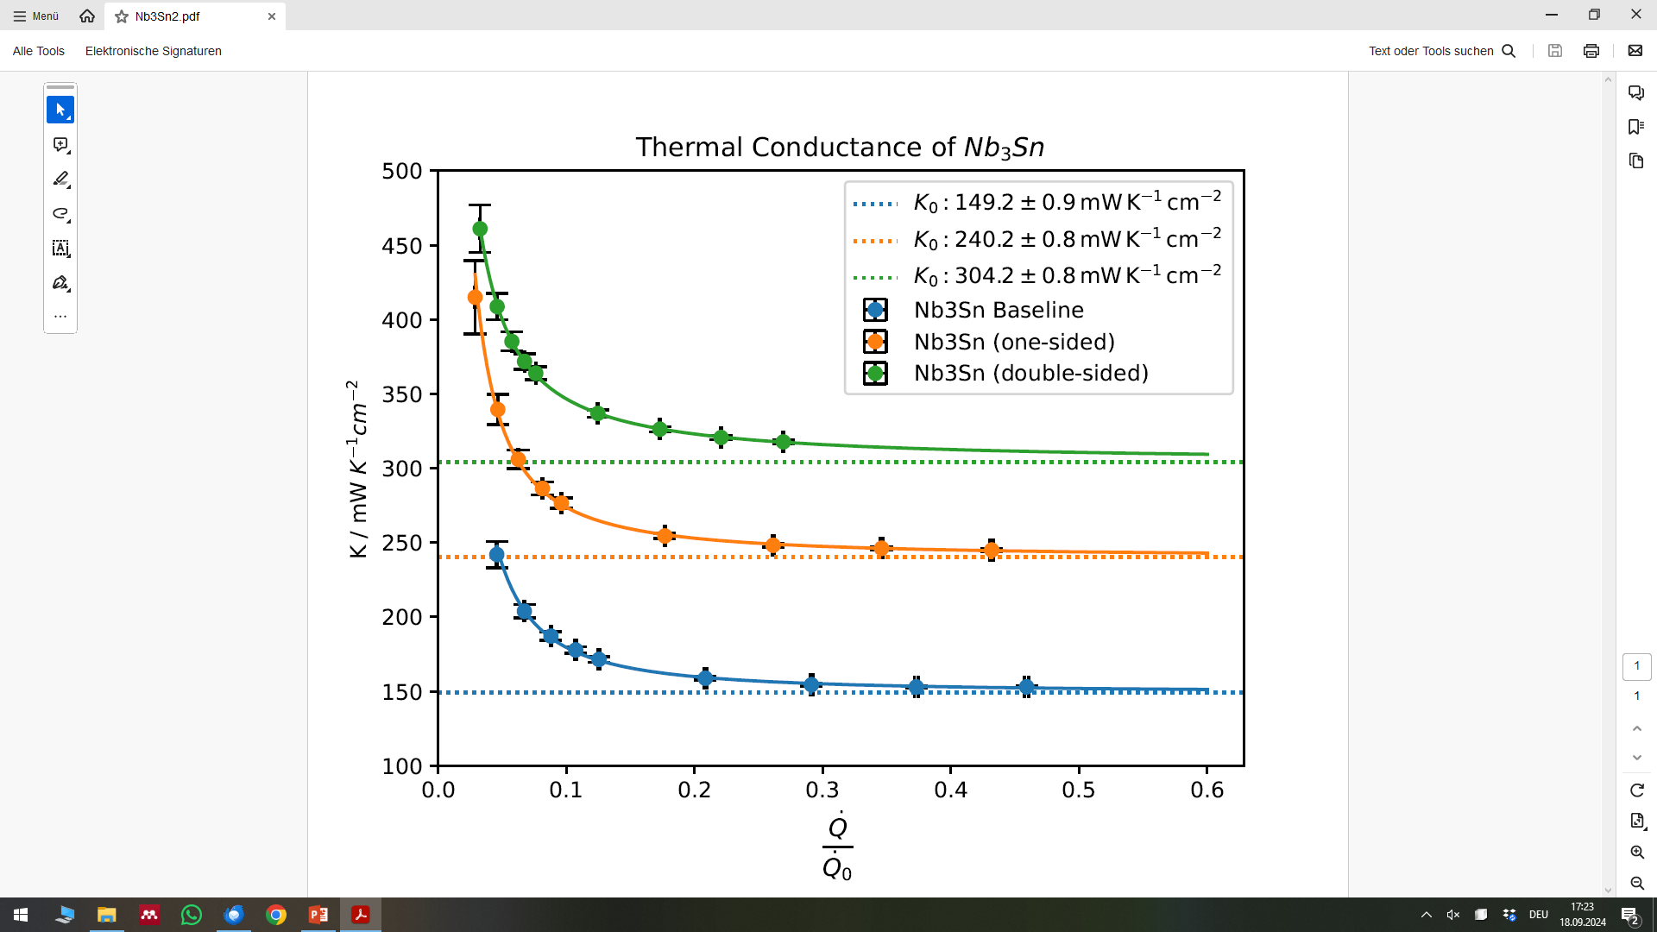

Nb₃Sn coating shows an unexpected behavior
Nb₃Sn shows increased K₀ after coating one side
Further increase after coating other side as well
It can‘t be thermal conductivity λ of Nb₃Sn
What about the Kapitza-Resistance R_{K}?
  Is R_{K,Nb3Sn} < R_{K,Nb} ?
  Is it the surface roughness?
    Surface area would have to increase by x2
    As-fabricated Nb had similar K₀
Next steps:
  Coat second sample pair, measure K₀
  Measure roughness before & after
  Compare to as-fabricated roughness

Slide 11
Summary
Thermal transmittance K is an important property of coated cavities
Yet, it remains unknown for most material / material combinations
We started measurements to assess impact of treatments & coatings
  SIS is comparable to bare Nb, despite many interfaces
  Nb₃Sn shows significant increase of K – material property or surface roughness?
Next-gen cell with soldered stainless steel capillary is currently fabricated

Slide 12

Thanks to…
Questions?
you for listening
the conveners for the opportunity to present this work
DESY for the measurement opportunities
BMBF for funding
Contact:
Marc Wenskat
MSL/DESY
E-Mail: marc.wenskat@desy.de
Swartzwelder, J. (Writer), & Reardon, J. (Director). (1994, January 6). Homer the Vigilante (Season 5, Episode 11) [TV series episode]. In D. Mirkin, J. L. Brooks, M. Groening, & S. Simon (Executive Producers), The Simpsons. Gracie Films; Twentieth Century Fox Film Corporation.

Slide 13
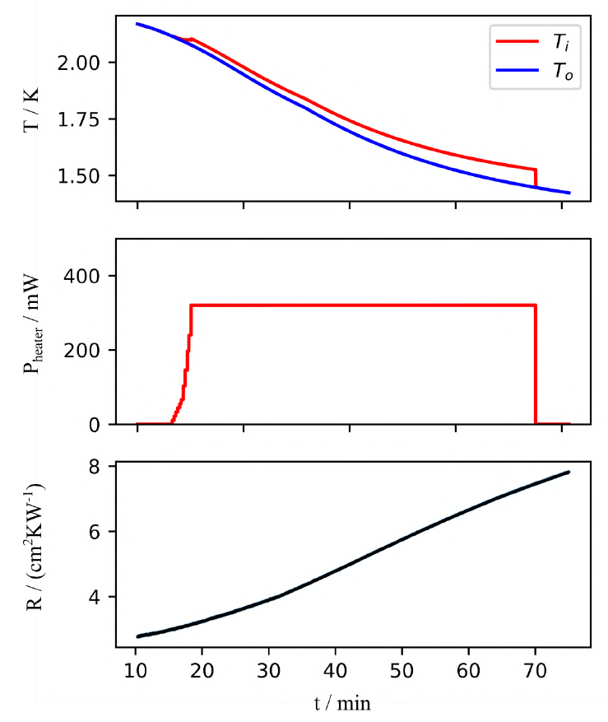
Temperature Scan
Started testing temperature scans while cooling down at QvT
High power to be close to K₀
Measurement starts at 2.1K

