Slide 1

Gallifa Terricabras
Tatiana Santos Maldonado
Tatiana Santos Maldonado
Tatiana Santos Maldonado
Enhancement of magnetic flux expulsion in multilayer structures
Daniel Turner, Alick Macpherson, Paul Schneider, Niall Stapley
University of Hamburg:
M. Wenskat, I. G. Díaz-Palacio, L. Preece
daniel.andrew.turner@cern.ch
Acknowledgements:
CERN
J. Bastard, S. Barriere, L. M. Bartolome, R. Betemps, M. Buzio, P. Borges De Sousa, C. P. Carlos, A. Gallifa Terricabras, T. Guillen Hernandez, R. Gerard,
A. Ivanov, T. Koettig, S. Leith, A. Moros, C. Pereira Carlos, S. Pfieffer, S. Prunet, G. Rosaz, D. Smakulska, C. Tatiana Santos Maldonado
Hamburg & DESY
Wolfgang Hillert, Robert Zierold
Appreciated ongoing support
TE-CRG: CERN Cryolab team and infrastructure support
EN-MME-MM: Material measurements support
EN-MME-EDS: Design office team
EN-MME-MMA: Main workshop fabrication support

Slide 2
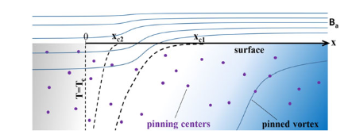
Why flux expulsion?
Magnetic flux can be trapped within a superconductor
  Manifest as normal conducting cone like structures
Trapped vortices increase surface resistance R_{s}
  Increased power loss in the cavity surface as heat
    Risk of localised quenches
  Reduced Q₀ and limits E_{acc}
Fast or slow cooldowns?
  Fast cooldowns = larger thermal gradient = more magnetic flux expulsion
  However, larger thermal gradients can increase the amount of trapped flux in Nb on Cu cavities
    Bi-metal junction and Seebeck effect produces B field
      Self generated B field is trapped
  Does this occur with other materials?
  Can we correlate flux trapping with cooldowns and RF performance?
  Small samples are faster to test than full size cavities
    Easier to deposit
Kubo, T., 2016. Flux trapping in superconducting accelerating cavities during cooling down with a spatial temperature gradient. Progress of Theoretical and Experimental Physics, 2016(5), p.053G01.
2

Slide 3
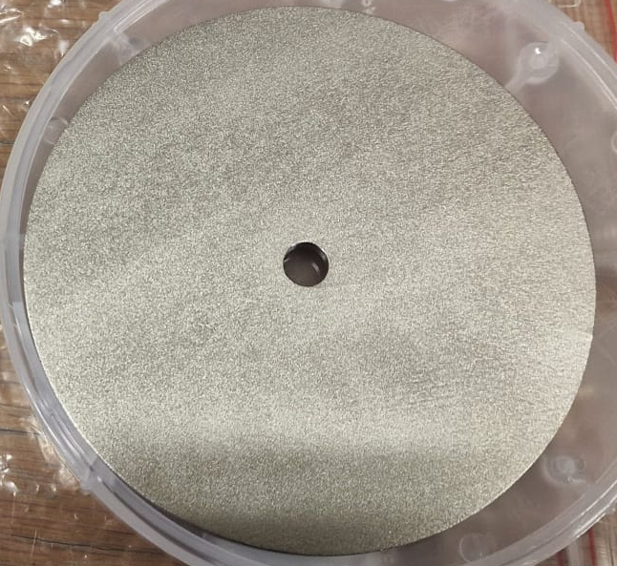
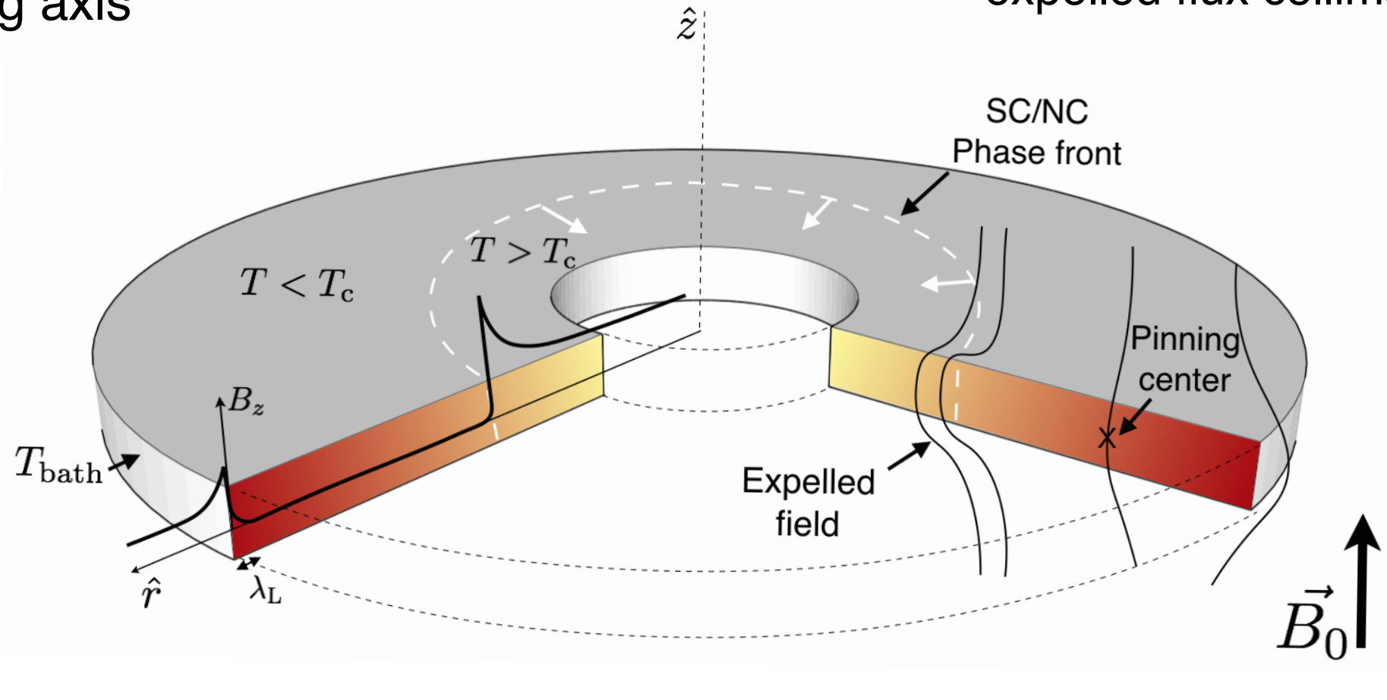
Flux expulsion lens – Conceptual overview
Aim:
Quantify flux expulsion during superconducting transition
Generate statistically significant expulsion measurements
Device:
Design based on closed topological cooling of material
Device designed for bulk Nb, adapting to thin film samples
Material investigated:
Bulk and 3D printed Nb
Nb on Cu (HiPIMS)
Multilayer films on Nb (PEALD)
6.7mm
90mm
*Courtesy of Anton Ivanov
3

Slide 4
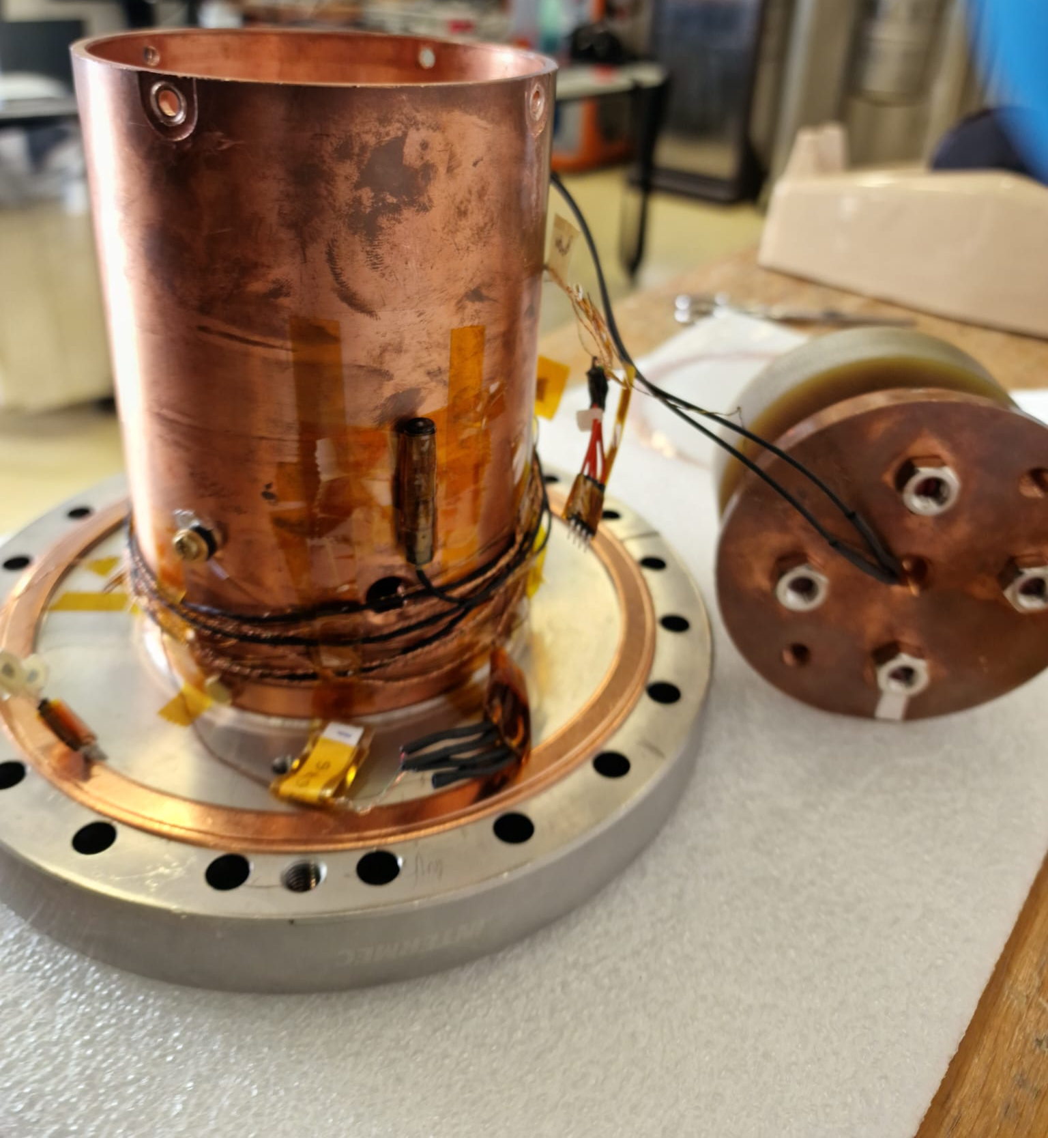
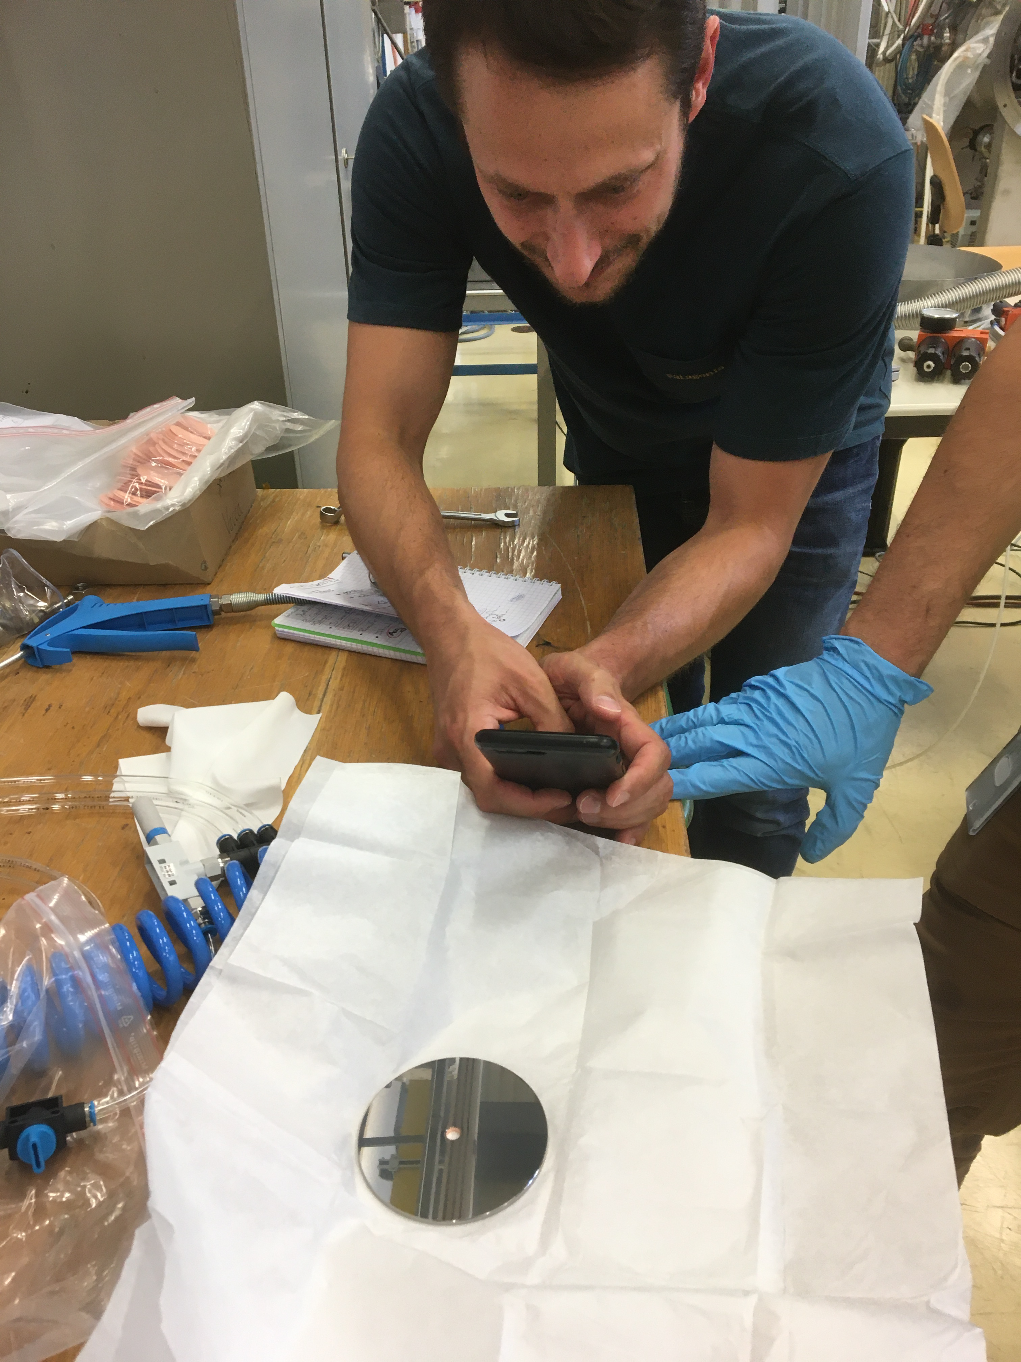
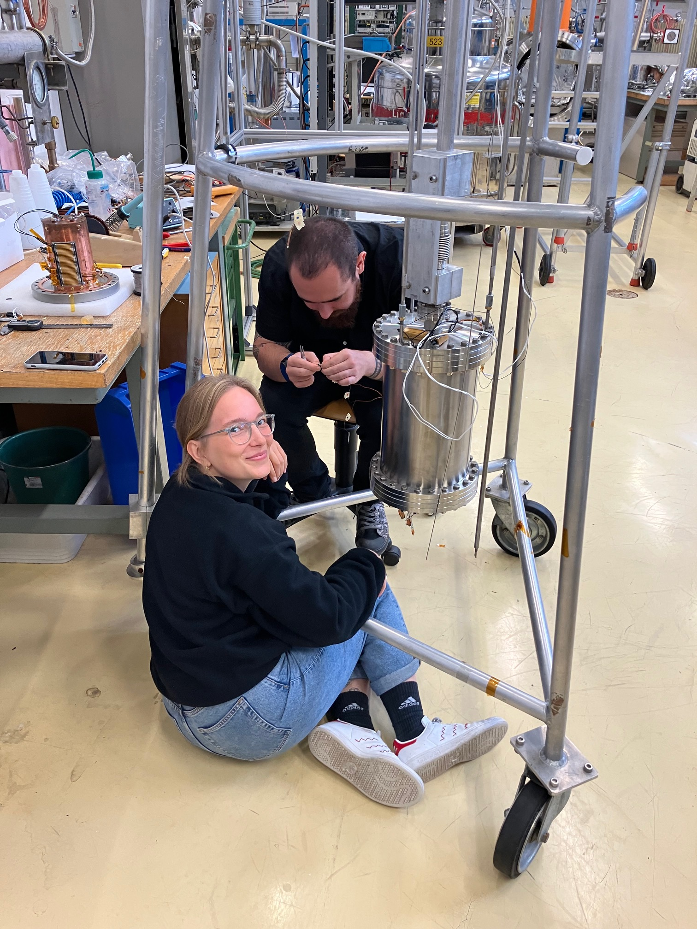
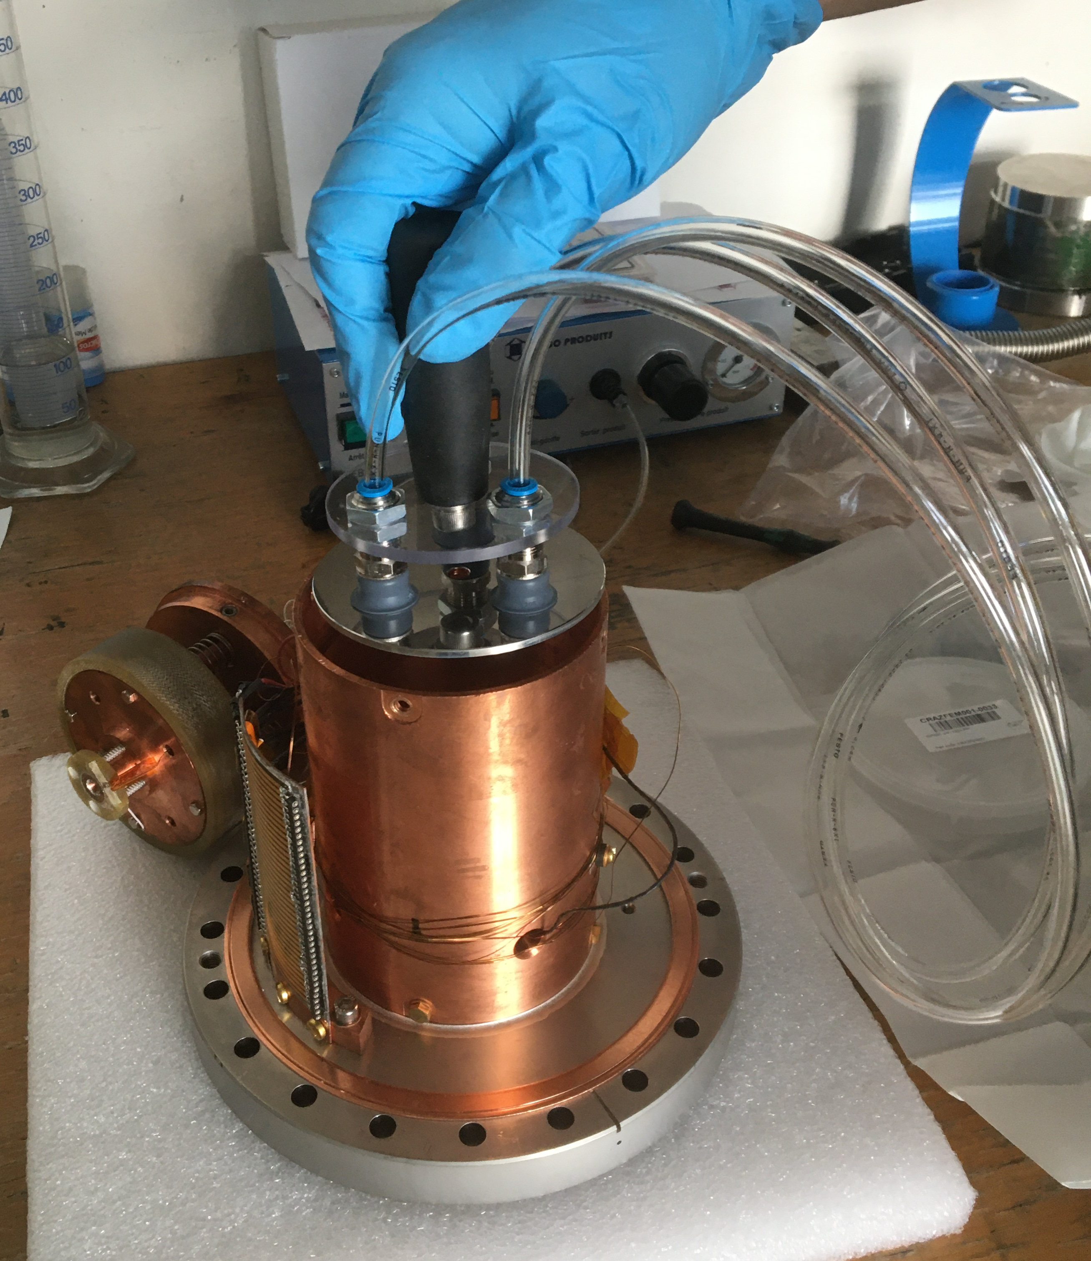
Facility photos

Slide 5
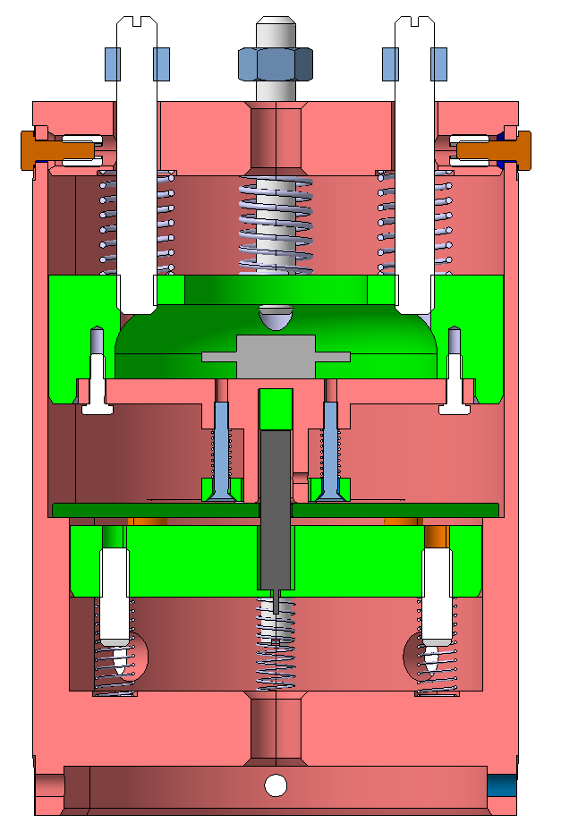
Flux expulsion lens – Design outline
Sample mounting:
  Spring loaded compression to ensure good thermal contact between the sample and the Cu housing
Conduction cooled:
  Flux Lens is connected to a cold bath by a conduction interface
  Cold source conduction path is at outer radius of sample
  Heat source is applied from the inner aperture to outer radius.
Flux lens design:
  Compatible with Cryocooler & LHe Cryostats.
  All 2022/23 measurements: Cryolab LHe Cryostat.
    Thermal gradients similar to cavity cooldowns.
Upgrades:
  Upgraded software allows an increased number of measurements (20Hz)
  Inner flux gate replaced for higher saturation sensor
  Previous sensor moved to the outside of the flux gate
Heater
Flux gate
Thermometer
Sample
Sample cold source
Heat path
Cold source
LHe or cryocooler

Slide 6
Flux expulsion lens – Design outline
Sample mounting:
  Spring loaded compression to ensure good thermal contact between the sample and the Cu housing
Conduction cooled:
  Flux Lens is connected to a cold bath by a conduction interface
  Cold source conduction path is at outer radius of sample
  Heat source is applied from the inner aperture to outer radius.
Flux lens design:
  Compatible with Cryocooler & LHe Cryostats.
  All 2022/23 measurements: Cryolab LHe Cryostat.
    Thermal gradients similar to cavity cooldowns.
Upgrades:
  Upgraded software allows an increased number of measurements (20Hz)
  Inner flux gate replaced for higher saturation sensor
  Previous sensor moved to the outside of the flux gate
Heat path
Cold source
LHe or cryocooler
6

Slide 7
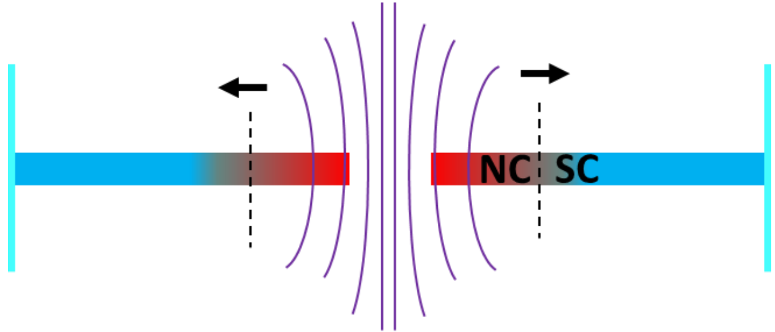
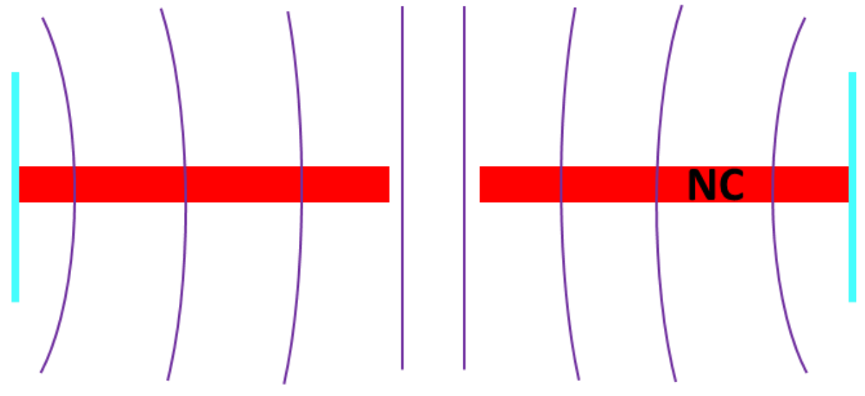
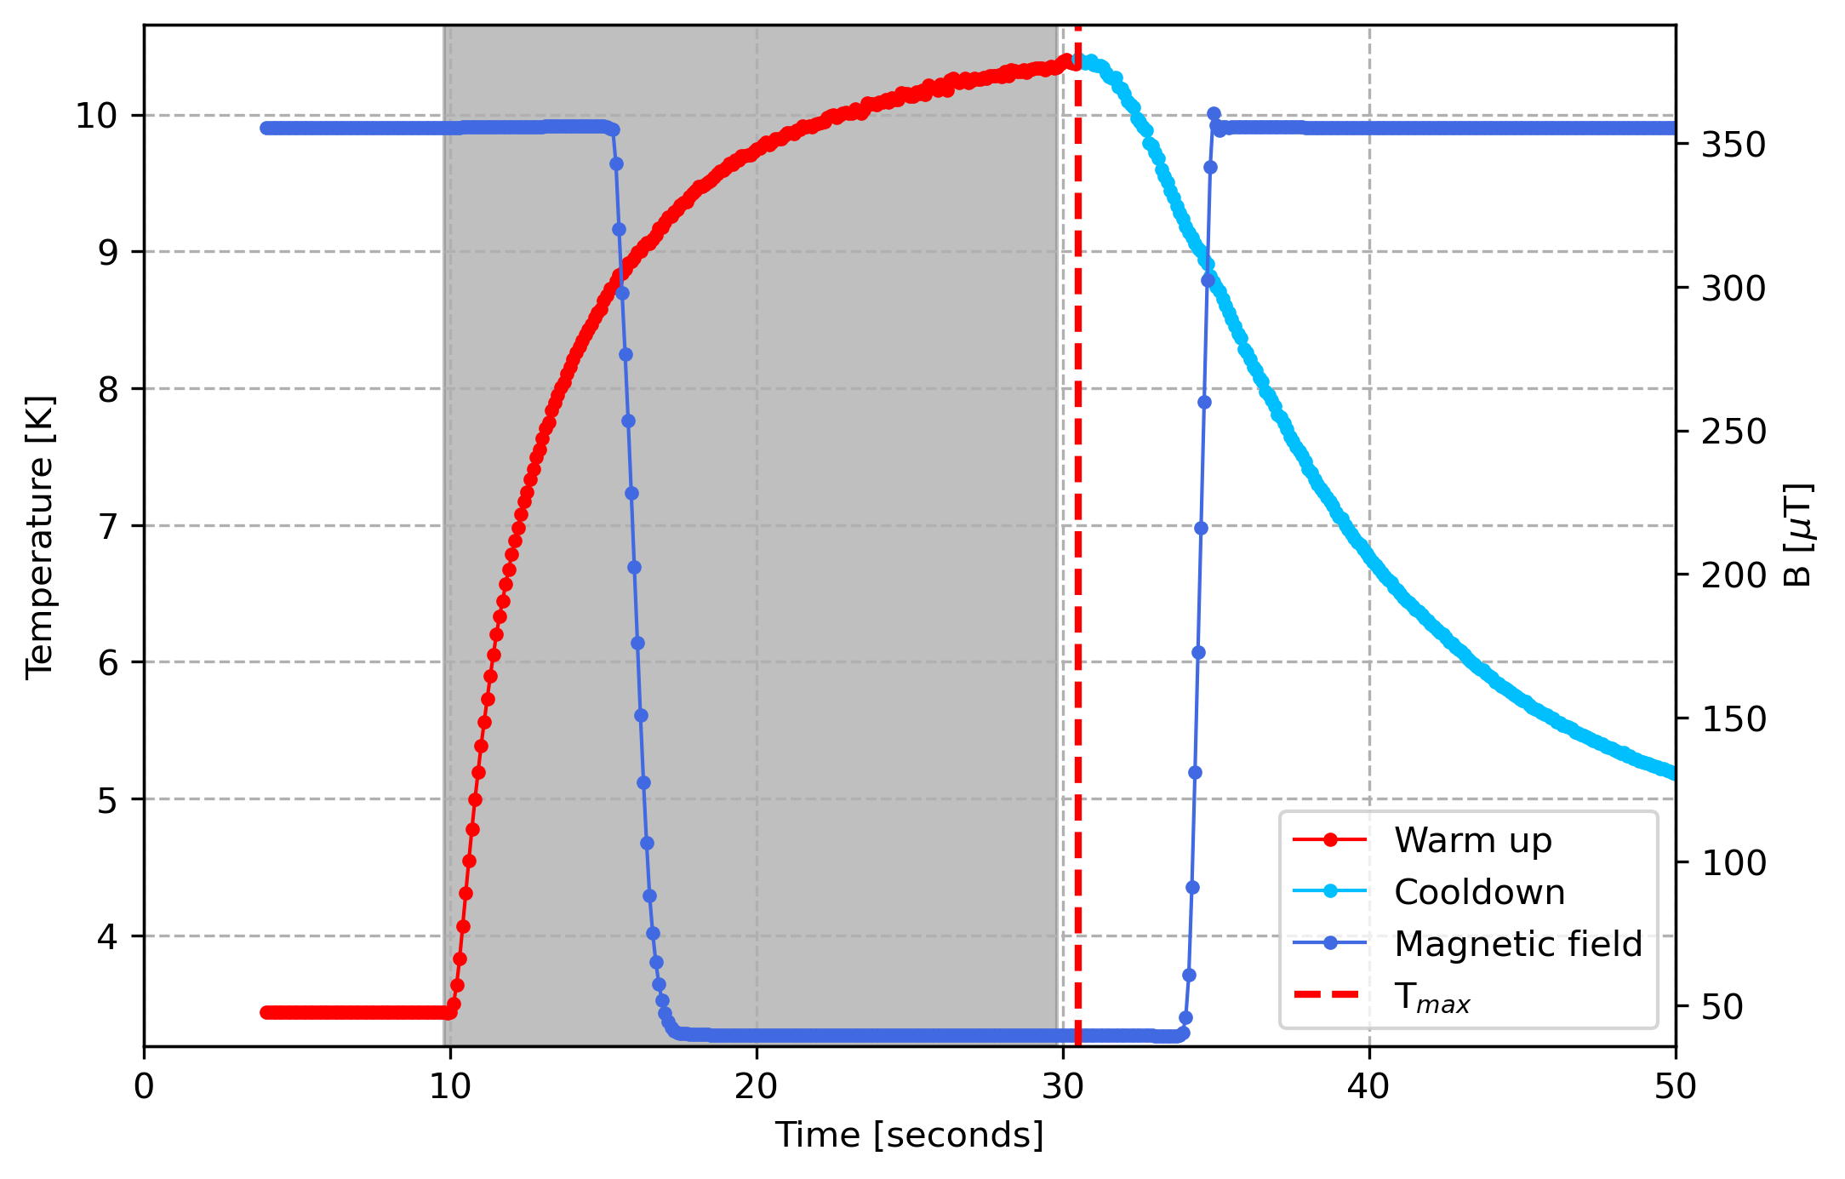
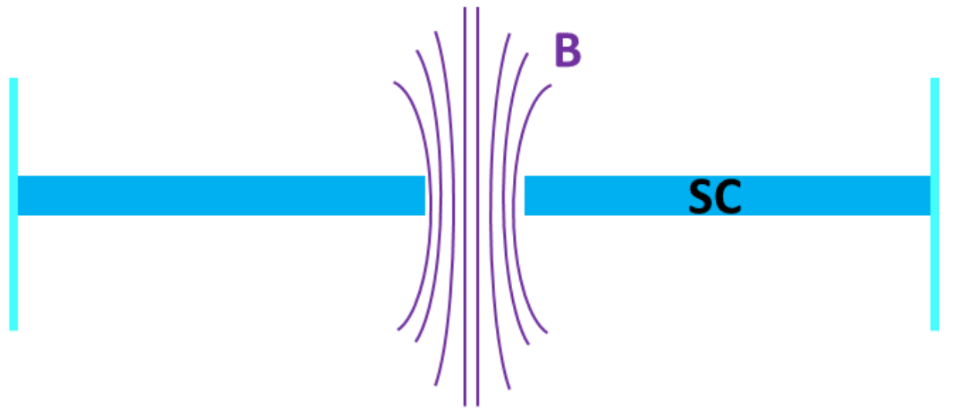
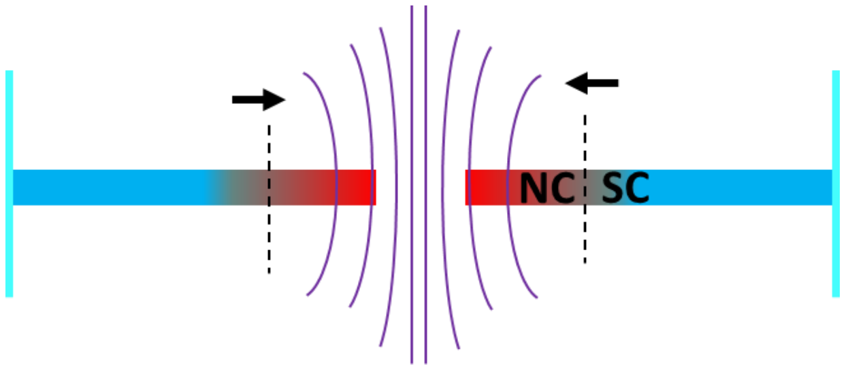
How does it work?
2
3
Heater is turned on
- SC/NC boundary expands outwards towards edge of disk
Full conversion to NC state
- As the NC area increases, the flux density in the magnetic flux gate decreases to ambient level
Heater on
4
2
4
1
5
Heater is turned off
- Sample re-cools with closed boundary topology, i.e.- SC/NC boundary contracts towards aperture
Sample in SC state
- B is confined to the disk aperture, measured by a magnetic flux gate
1
3
5
Thermalise and repeat
7

Slide 8
How does it work?
2
3
Heater is turned on
- SC/NC boundary expands outwards towards edge of disk
Full conversion to NC state
- As the NC area increases, the flux density in the magnetic flux gate decreases to ambient level
Heater on
This is repeated multiple times over a wide range of thermal gradients
The thermal gradient is altered by increasing the maximum temperature of the pulse and reducing the bath temperature
4
2
4
1
5
Heater is turned off
- Sample re-cools with closed boundary topology, i.e.- SC/NC boundary contracts towards aperture
Sample in SC state
- B is confined to the disk aperture, measured by a magnetic flux gate
1
3
5
Thermalise and repeat
8

Slide 9
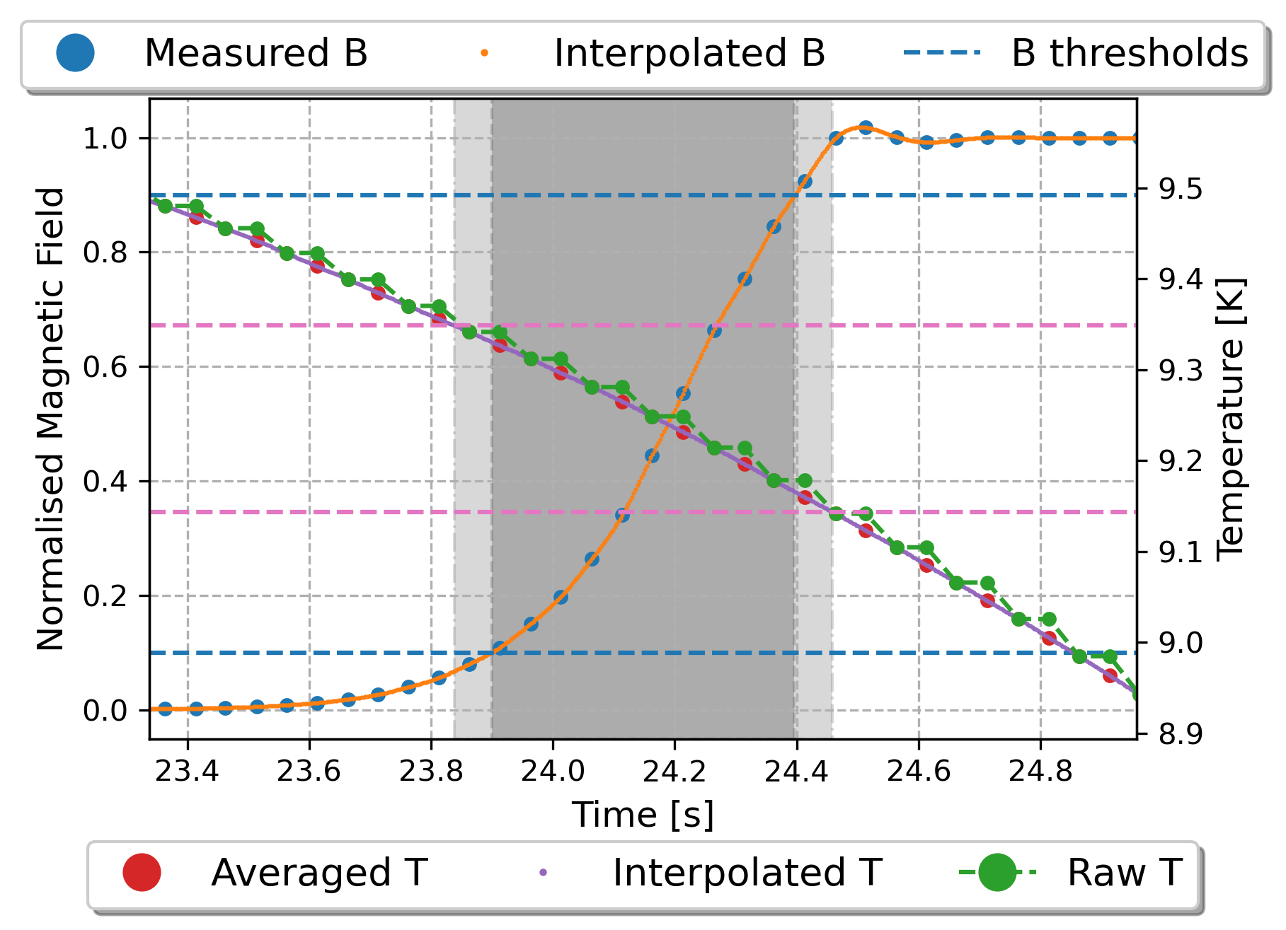
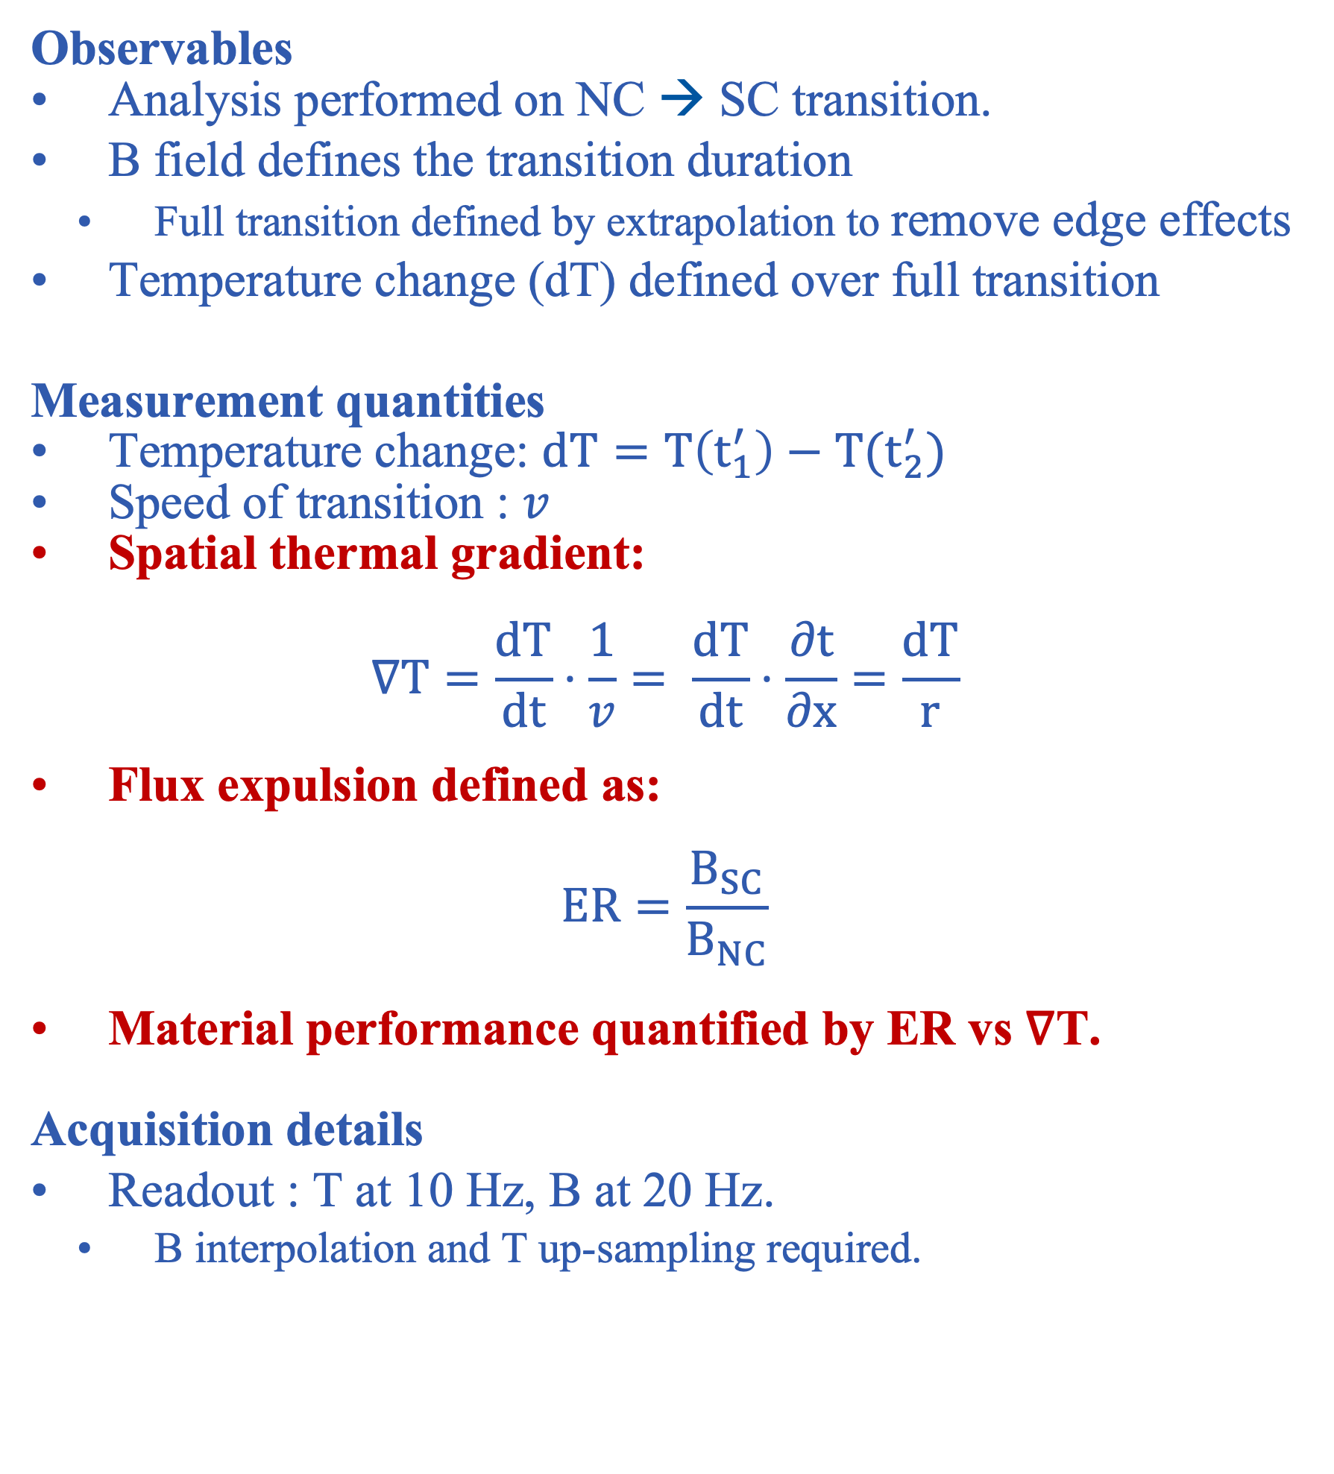
Pulse analysis – Extracting useful flux expulsion data
Observables
Analysis performed on NC → SC transition.
B field defines the transition duration
  Full transition defined by extrapolation to remove edge effects
Temperature change (dT) defined over full transition
Measurement quantities
Temperature change: $dT=T\left(t_{1}^{′}\right)−T(t_{2}^{′})$
Speed of transition : $v$
Spatial thermal gradient:
$$∇T=\frac{dT}{dt}⋅\frac{1}{v}= \frac{dT}{dt}⋅\frac{∂t}{∂x}=\frac{dT}{r}$$
Flux expulsion defined as:
$$ER=\frac{B_{SC}}{B_{NC}}$$
Material performance quantified by ER vs ∇T.
Acquisition details
Readout : T at 10 Hz, B at 20 Hz.
  B interpolation and T up-sampling required.
T(t₁’)
T(t₂’)
t₁
t₂
t₁’
t₂’

Slide 10
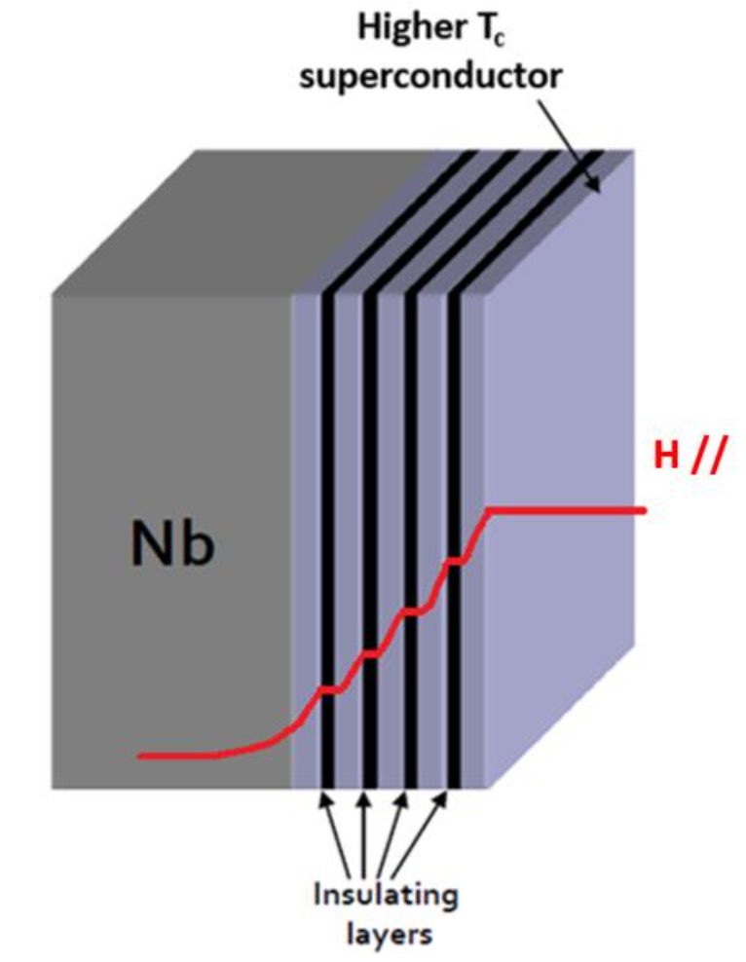
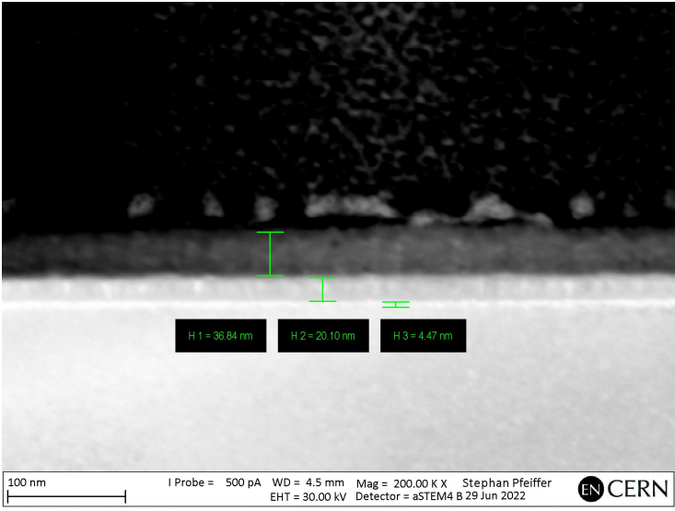
Multilayer thin films on Nb substrates
What?
Superconducting layers must be thinner than the London penetration depth, λ_{L}
  Superconductor-Insulator-Superconductor (SIS) structures
  Superconductor-Superconductor (SS) bi-layers
Why?
S-layers: Thin films screen B field
  SC substrate witness to smaller B than on surface
  Losses in the thin film less than substrate
I-layers: Possible to localize vortex propagation to the thin films
Where?
University of Hamburg using Plasma-enhanced atomic layer deposition (PEALD)
  Fine control and consistent film thickness
    I: AlN (insulating layer) of 15 nm
    S: NbTiN or NbN (superconducting layers) of 60nm
Objective
  Assess multilayer samples for indications of shielding
  Establish sensitivity to multilayer samples on Nb substrates
Please see Lea Preece’s talk, “Characterization of PEALD Coated Thin Films for SRF Cavity Research” – This afternoon!
*Courtesy of Steffan Pfeiffer, EN_MME, CERN
36.8 nm
20.1 nm
4.5 nm
10

Slide 11
Multilayer films on Nb substrates
Nb Substrate:
  Set 1: BCP+800°C (3 hours) + BCP
  Set 2: BCP+900°C (3 hours) + BCP
Films
  SS bilayer – Nb/NbTiN → 3mm/60nm
  SIS multilayer – Nb/AlN/NbTiN → 3mm/15nm/60nm
  SIS multilayer – Nb/AlN/NbNTi → 3mm/15nm/60nm
Sample preparation
Known: Thin films have a low T_{c} as deposited (≈ 8K)
Post deposition anneal increases T_{c} (≈ 16K): 900°C for 1 hr
  Isabel Gonzalez Dıaz-Palacio et al. “Thermal annealing of superconducting niobium titanium nitride thin films deposited by plasma-enhanced atomic layer deposition”. In: Journal of Applied Physics 134.3 (2023)
Measurement strategy
Flux Lens samples tested before and after the post deposition anneal
Witness samples tested to determine the T_{c} of the materials
STEM
X-Ray Reflectometry
Layer | Aim | Nb/AlN/NbTiN | Nb/AlN/NbN
AlN | 15 | 16 | 20.1
NbTiN | 60 | 47 | 36.8
*Courtesy of Alice Moros, EN-MME, CERN
44.7 nm
45.8 nm
43.6 nm
48.0 nm
14.6 nm
11
Notes:
STEM = Scanning transmission electron microscopy

Slide 12
Results

Slide 13
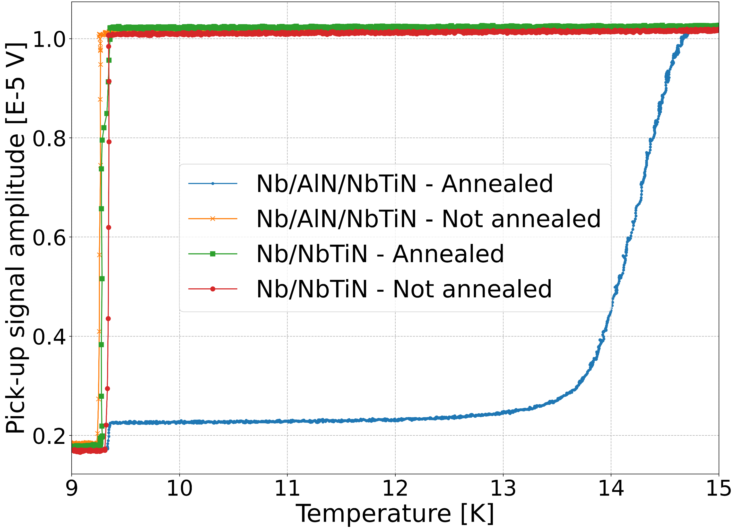
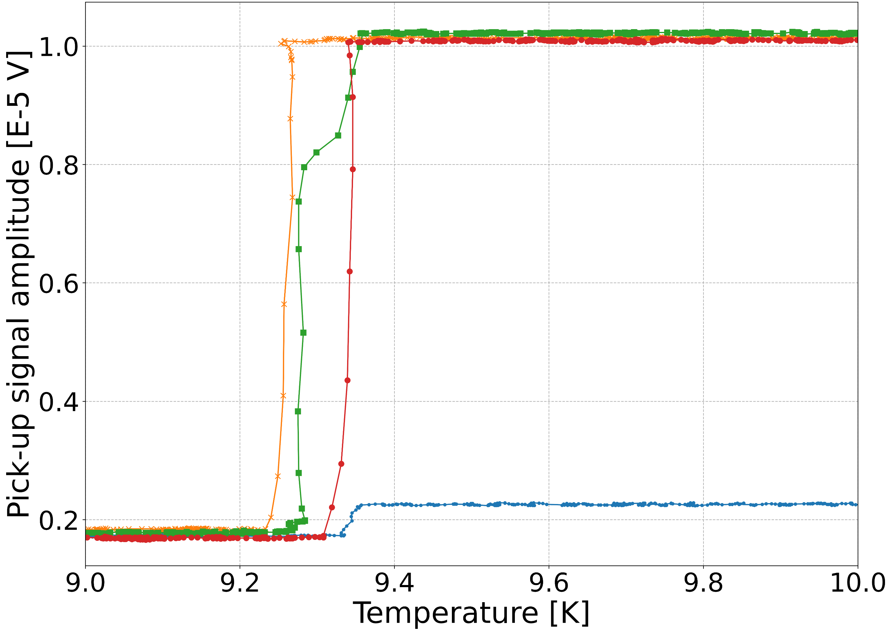
Multilayer films: T_{c}
4 witness samples made by PEALD
  2 SS, 2 SIS
  One of each set tested as deposited
  One of each set was annealed after deposition
Results
Without an anneal, samples behave like only Nb
Only SIS showed the expected increase in T_{c}
Annealed SS shows different behaviour pre/post anneal
  Structured transition smears out T_{c} determination
*Measurements courtesy of Erwan Reches, CERN cryolab
Dorothea Fonnesu et al. “CERN Based Tc Measurement Station for Thin-Film Coated Copper Samples and Results on Related Studies”, doi: 10.18429/JACoW-SRF2021-SUPFDV018..
13

Slide 14
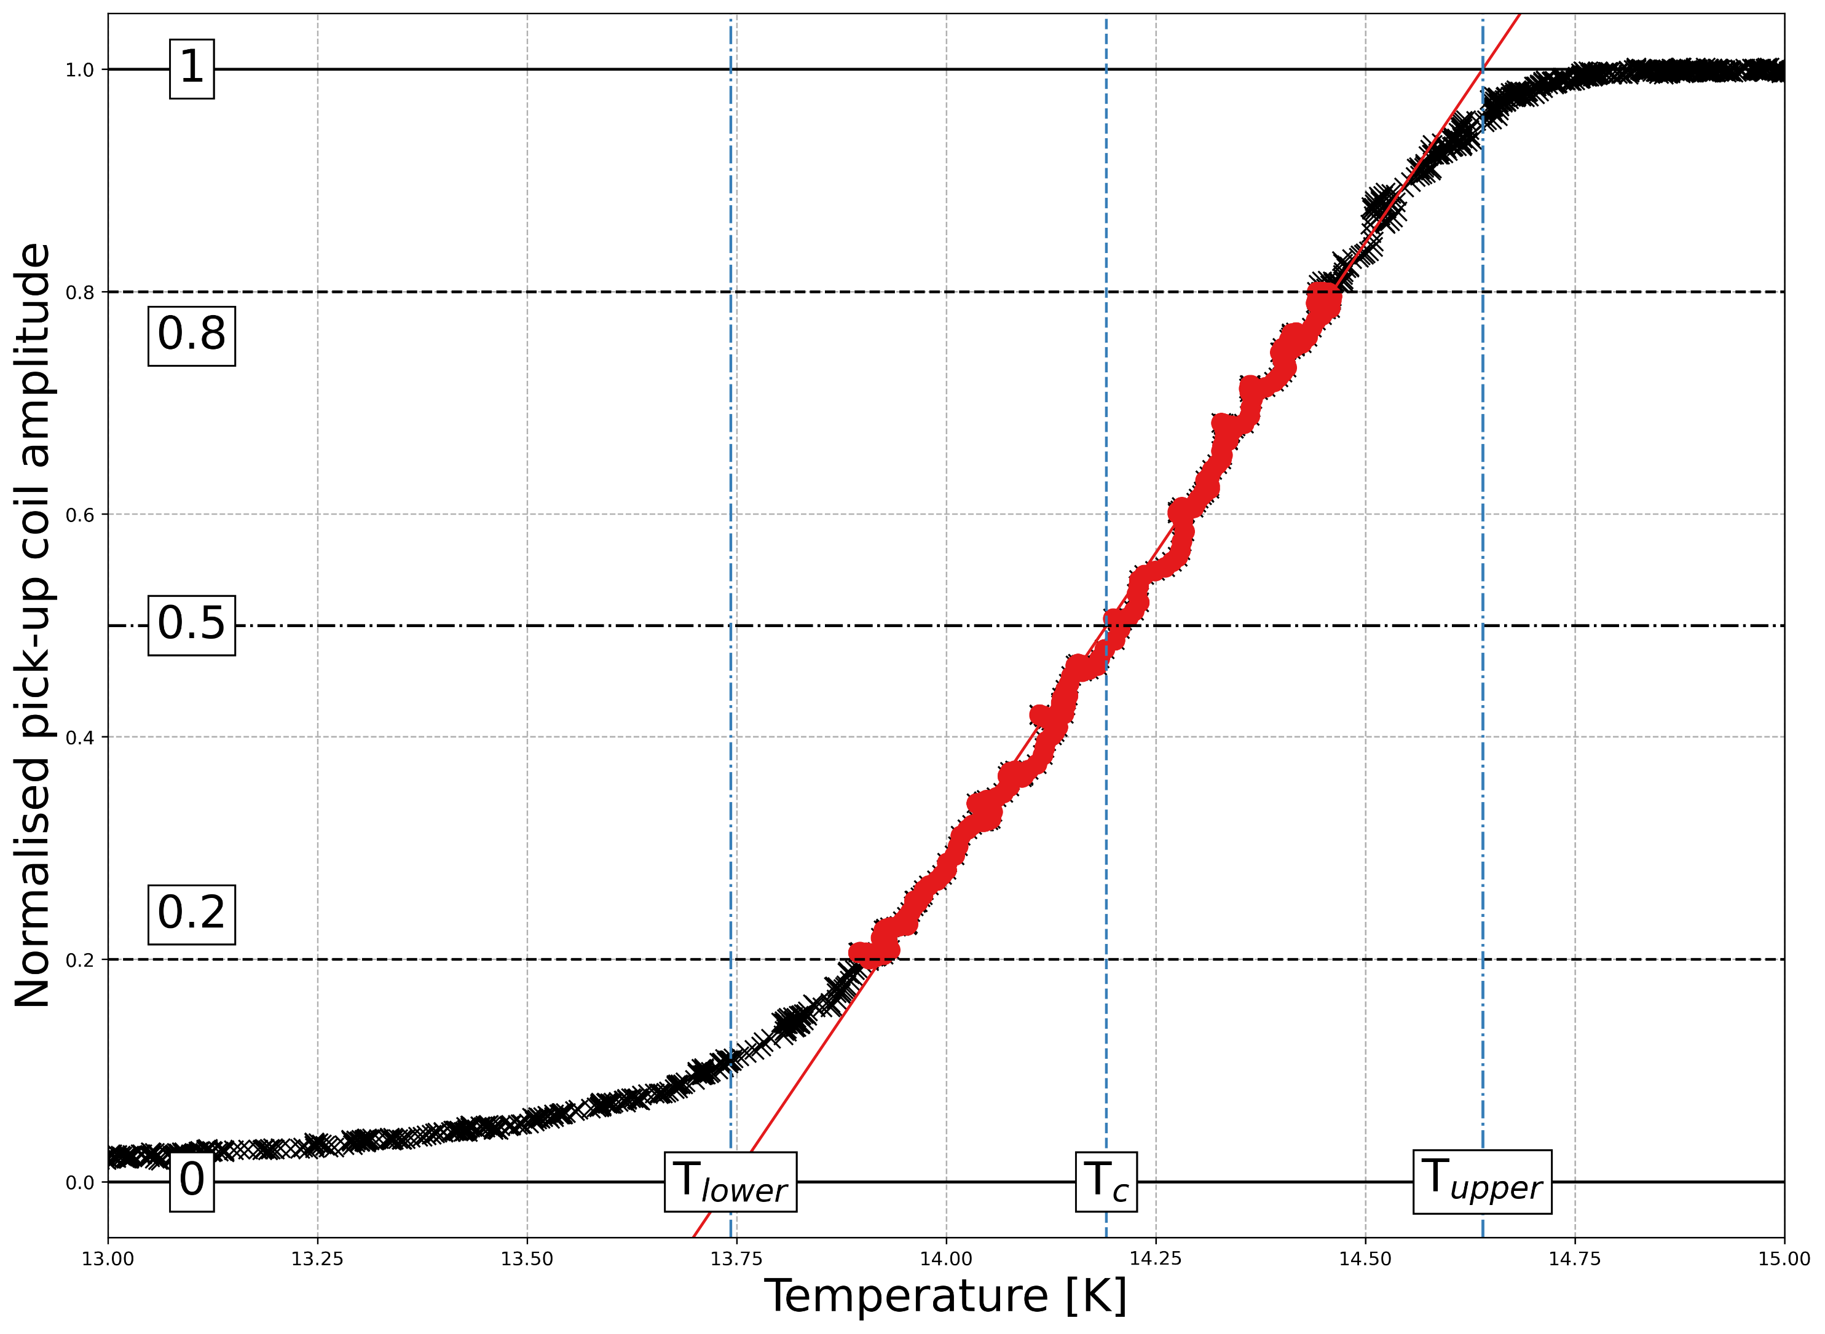
Multilayer films: Detailed T_{c} measurements
4 witness samples made by PEALD
  2 SS, 2 SIS
  One of each set tested as deposited
  One of each set was annealed after deposition
Results
Without an anneal, samples behave like only Nb
Only SIS showed the expected increase in T_{c}
Annealed SS shows different behaviour pre/post anneal
  Structured transition smears out T_{c} determination
T_{c} reported as the transition midpoint
Reported error: linear fit extended to 0/100% (see left)
This may not be the film but a measurement effect
T_{c,NbTiN} = 14.2 K, not as high as expected (15.9 K)
Take away:
SS does not show an increased T_{c}
SIS does show an increased T_{c}
Structure | Post deposition anneal? | T_{c,Nb} [K] | T_{c,NbTiN} [K]
Nb/AlN/NbTiN | N | 9.259 ± 0.013 | -
Nb/AlN/NbTiN | Y | 9.343 ± 0.014 | 14.191 ± 0.449
Nb/NbTiN | N | 9.339 ± 0.018 | -
Nb/NbTiN | Y | 9.277 ± 0.017 | 9.341 ± 0.018

Slide 15
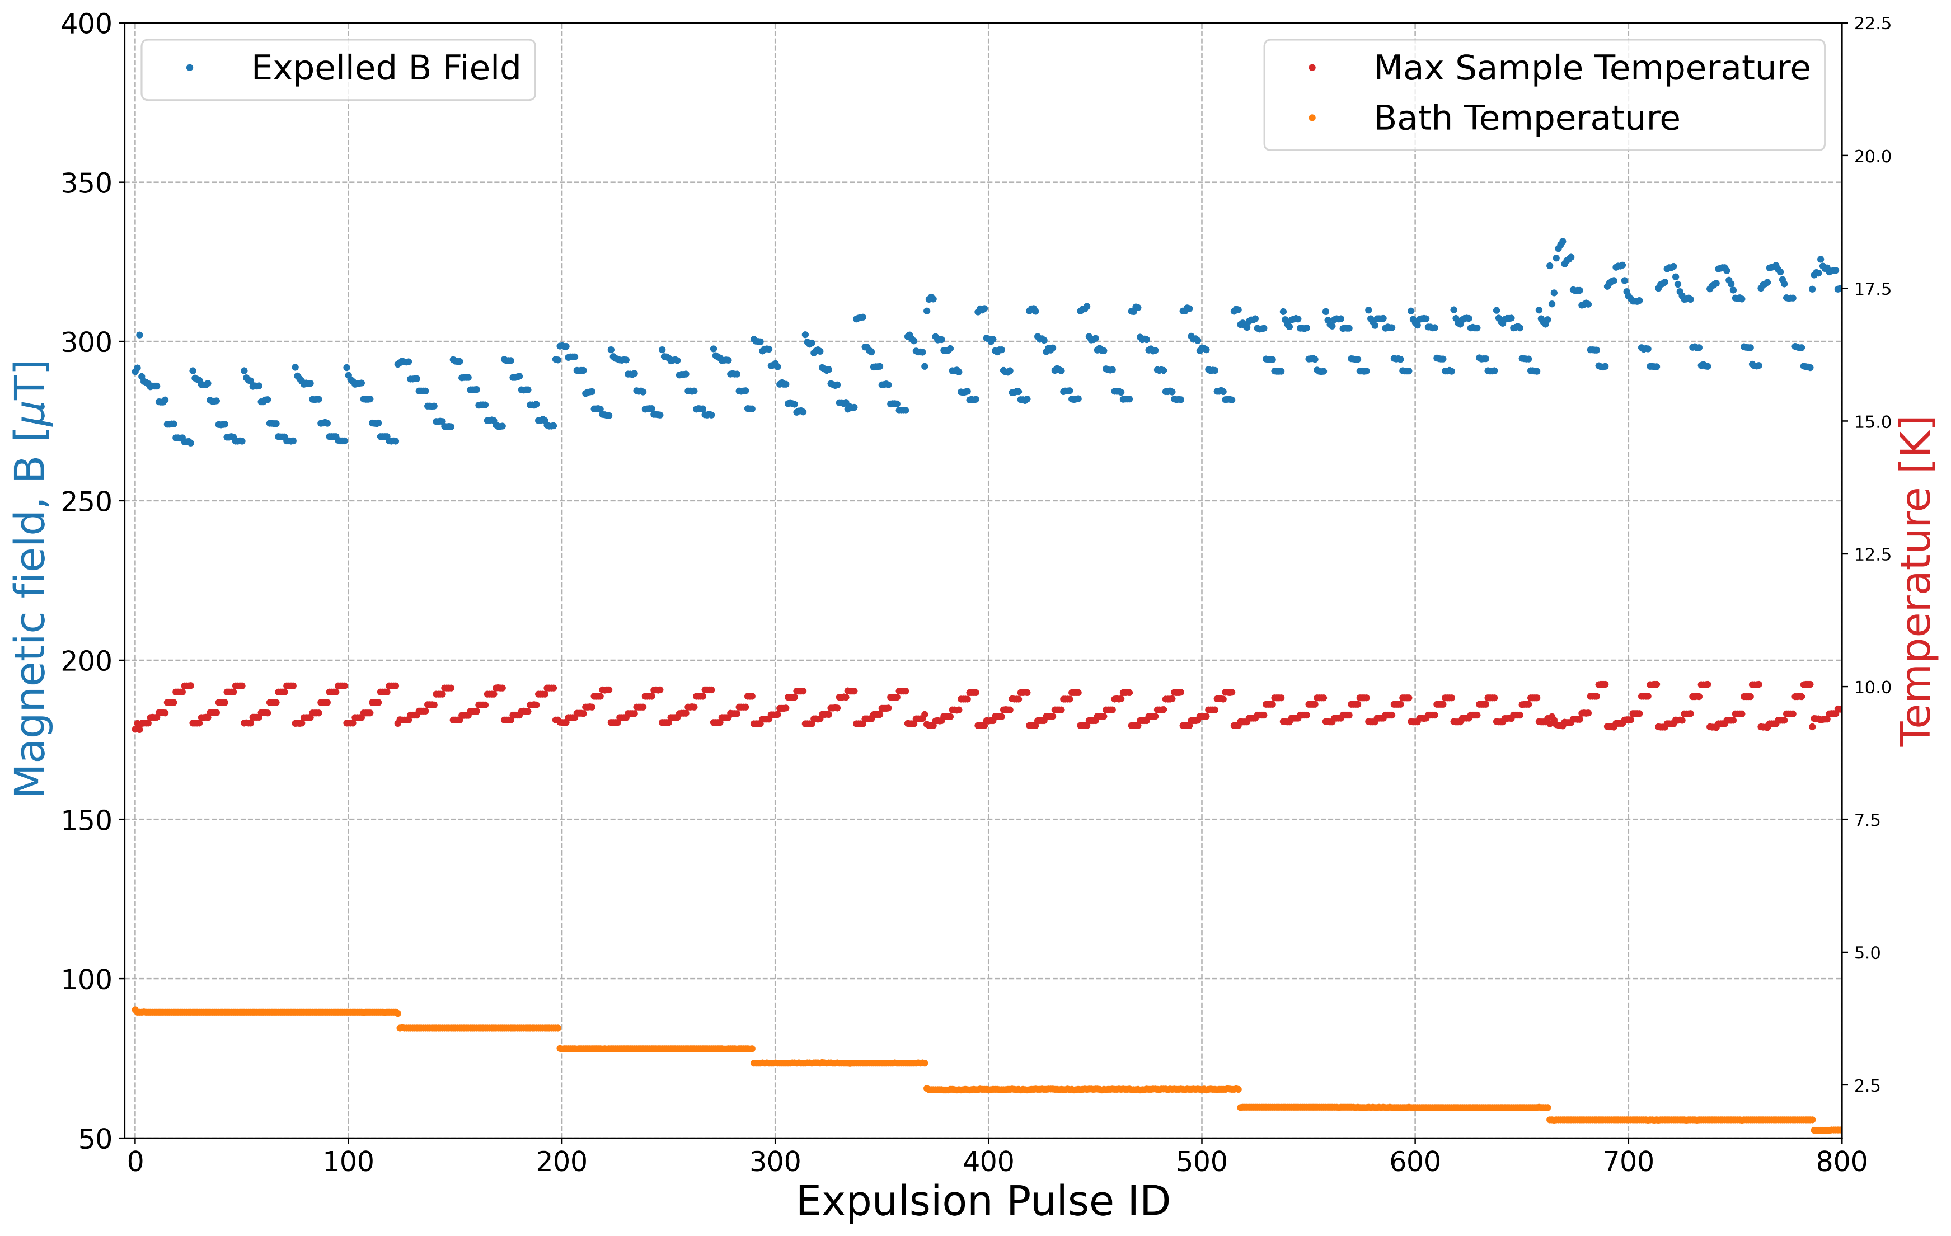
Multilayers: 1 measurement campaign
A heat pulse is applied to drive the sample normal conducting
Transition taken on re-cooling
Heat pulse: Requires T_{max} > T_{c}
  Sample fully transitioned
Measurements performed multiple times for statistics
Each group = 1 measurement set
  Set: Fixed heat pulse power
Nb/AlN/NbTiN pre anneal, expulsion is only due to Nb
1 group
1 point is 1 flux expulsion cycle
  This plot = 800 measurements
Time
15
Notes:
Spatial thermal gradient is altered by:
Changing the time of the applied heat pulse
Reducing the T of the LHe bath

Slide 16
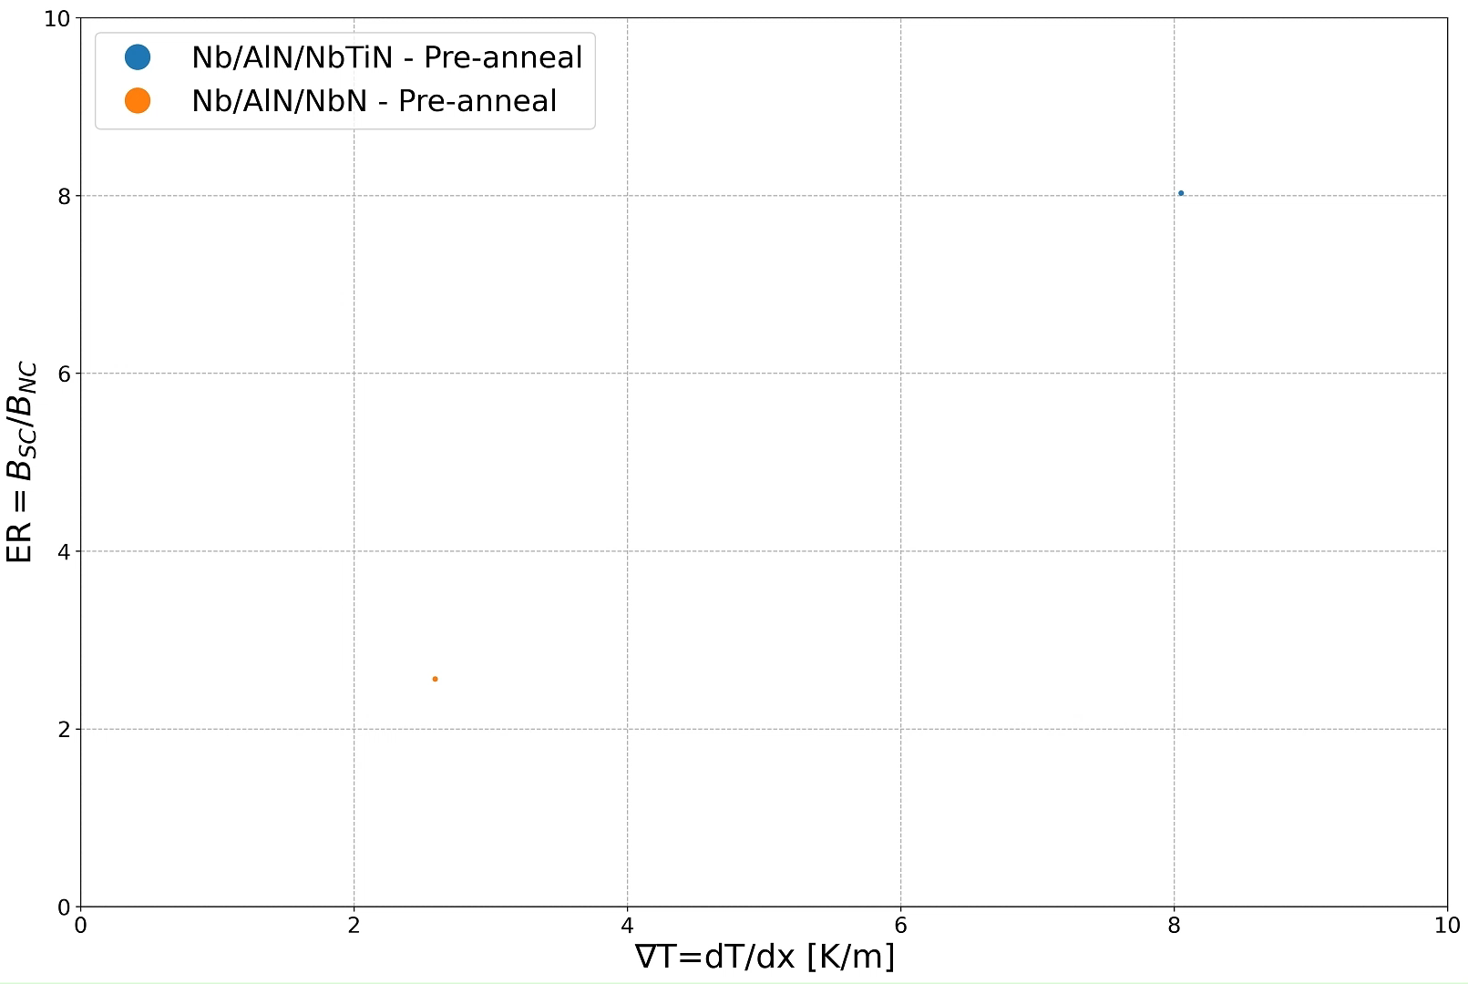
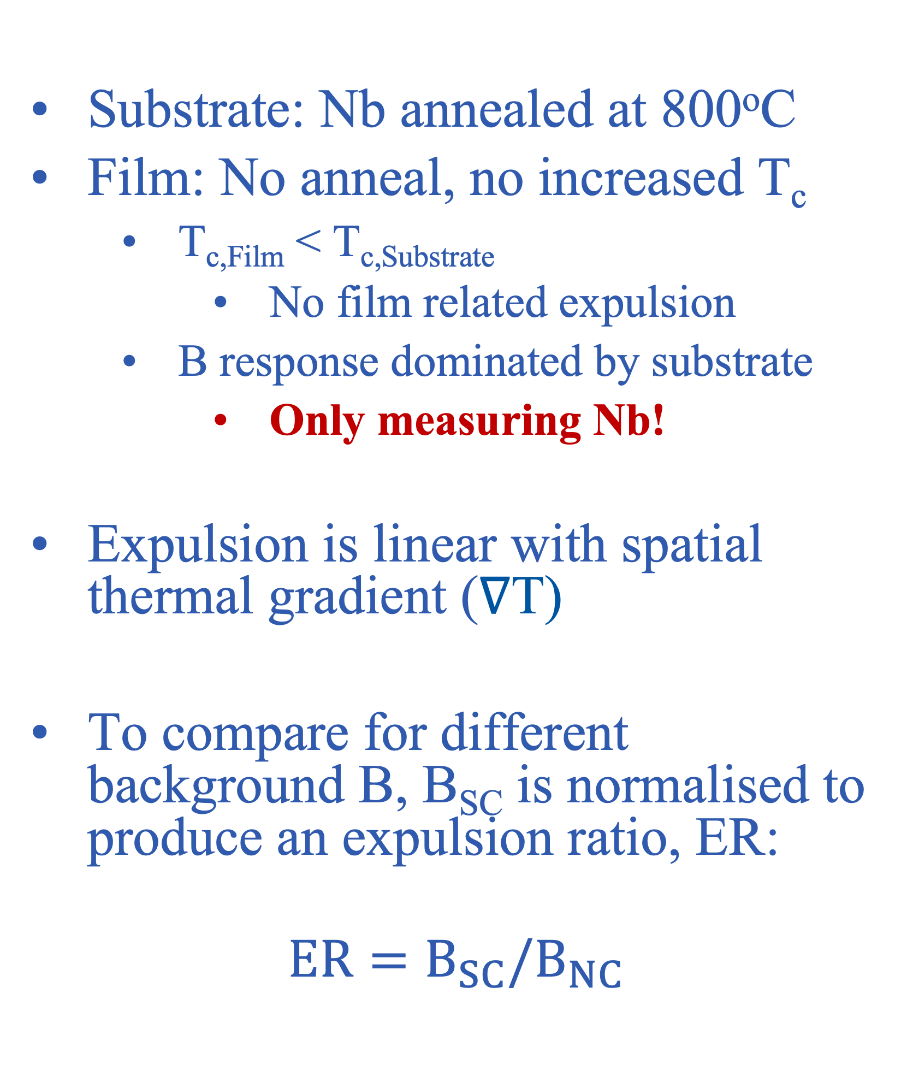
Multilayers: As deposited
Substrate: Nb annealed at 800ºC
Film: No anneal, no increased T_{c}
  T_{c,Film} < T_{c,Substrate}
    No film related expulsion
  B response dominated by substrate
    Only measuring Nb!
Expulsion is linear with spatial thermal gradient (∇T)
To compare for different background B, B_{SC} is normalised to produce an expulsion ratio, ER:
$$ER=B_{SC}/B_{NC}$$
16

Slide 17
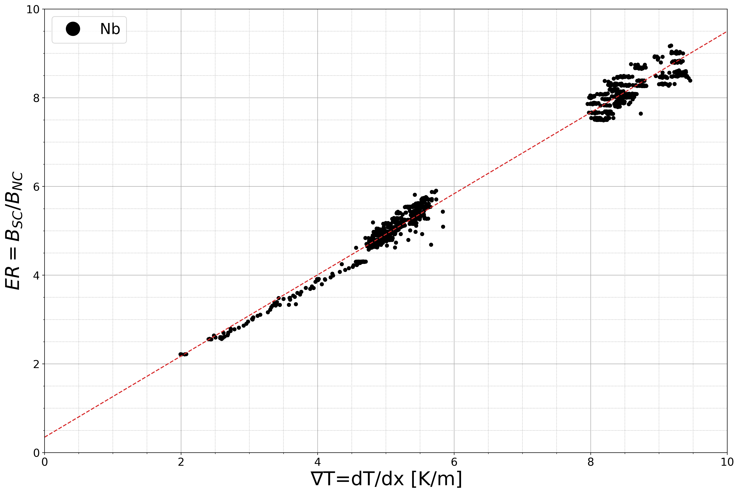
Multilayers: As deposited
Substrate: Nb annealed at 800ºC
Film: No anneal, no increased T_{c}
  T_{c,Film} < T_{c,Substrate}
    No film related expulsion
  B response dominated by substrate
    Only measuring Nb!
Expulsion is linear with spatial thermal gradient (∇T)
To compare for different background B, B_{SC} is normalised to produce an expulsion ratio, ER:
$$ER=B_{SC}/B_{NC}$$
17

Slide 18
Annealed SS bilayers
18

Slide 19
Multilayers: As deposited
Take the Nb sample as baseline
2 SS bilayer samples
  Nb/NbTiN
  d_{NbTiN} = 60nm
Anneal treatment (substrate/film):
  800/900°C anneal
  900/900°C anneal
Flux lens heat pulse:
  Requires T_{max} > T_{c,Nb}
    No sign of T_{c,NbTiN}
Expulsion ratio larger than Nb
Sign of saturation at large ∇T
T_{max} does not influence behaviour
  Each pulse is full expulsion
19

Slide 20
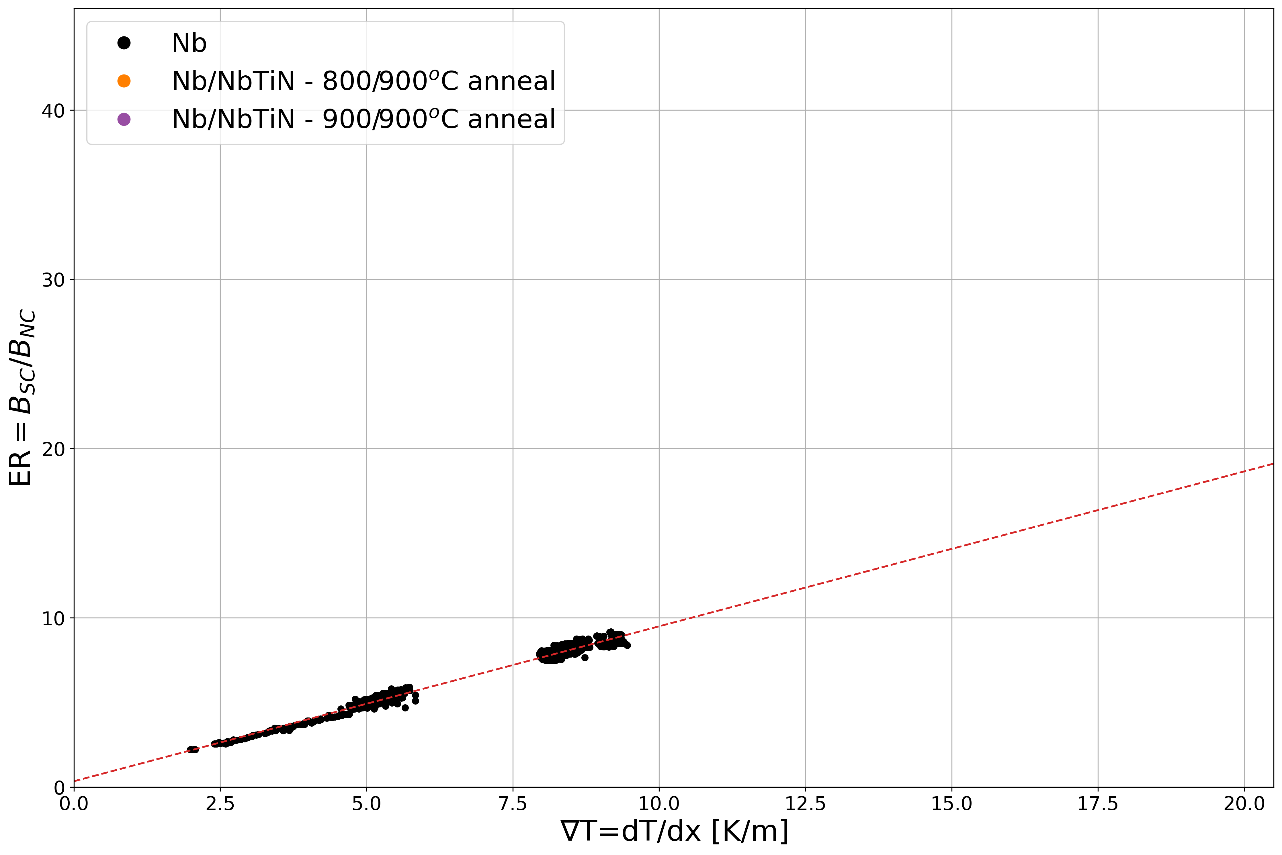
Multilayers: As deposited
Take the Nb sample as baseline
2 SS bilayer samples
  Nb/NbTiN
  d_{NbTiN} = 60nm
Anneal treatment (substrate/film):
  800/900°C anneal
  900/900°C anneal
Flux lens heat pulse:
  Requires T_{max} > T_{c,Nb}
    No sign of T_{c,NbTiN}
Expulsion ratio larger than Nb
Sign of saturation at large ∇T
T_{max} does not influence behaviour
  Each pulse is full expulsion
20

Slide 21
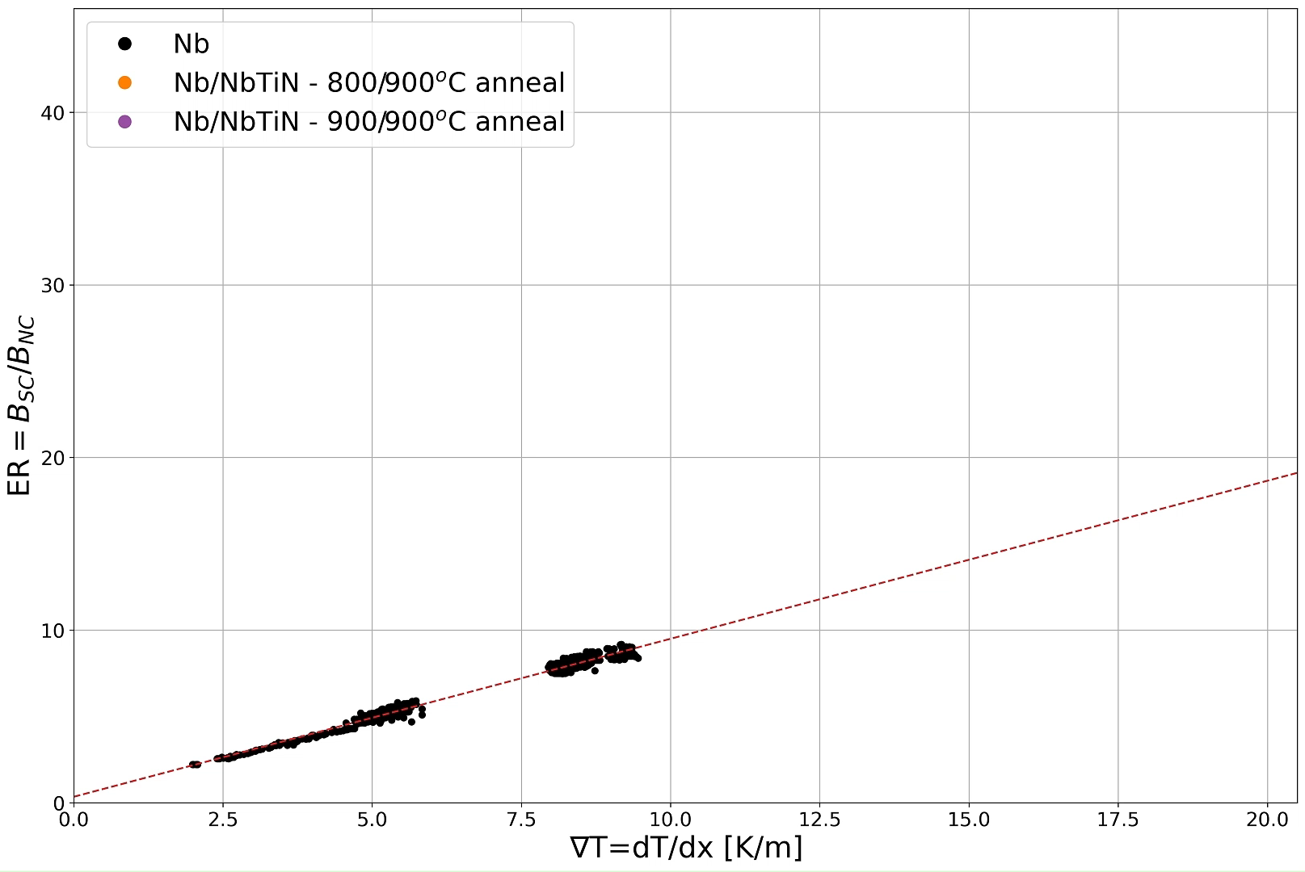
Multilayers: As deposited
Take the Nb sample as baseline
2 SS bilayer samples
  Nb/NbTiN
  d_{NbTiN} = 60nm
Anneal treatment (substrate/film):
  800/900°C anneal
  900/900°C anneal
Flux lens heat pulse:
  Requires T_{max} > T_{c,Nb}
    No sign of T_{c,NbTiN}
Expulsion ratio larger than Nb
Sign of saturation at large ∇T
T_{max} does not influence behaviour
  Each pulse is full expulsion
21

Slide 22
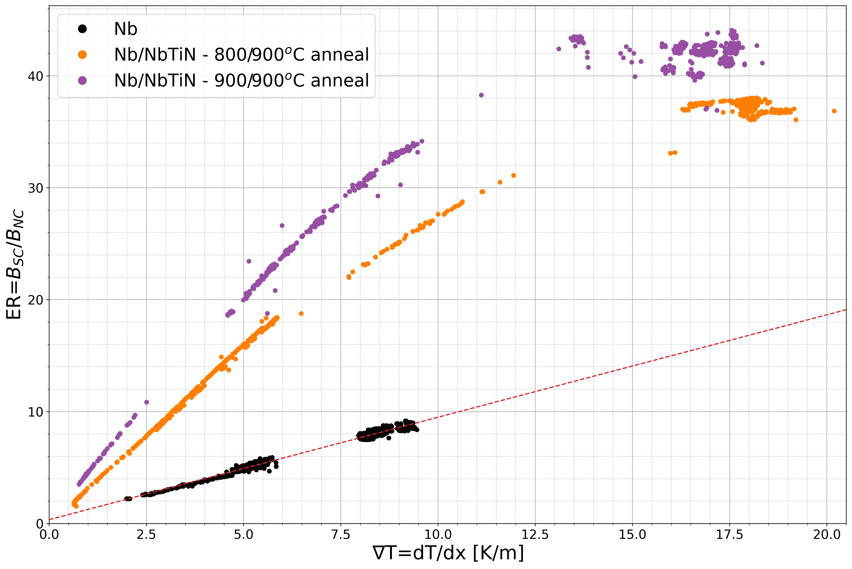
Multilayers: As deposited
Take the Nb sample as baseline
2 SS bilayer samples
  Nb/NbTiN
  d_{NbTiN} = 60nm
Anneal treatment (substrate/film):
  800/900°C anneal
  900/900°C anneal
Flux lens heat pulse:
  Requires T_{max} > T_{c,Nb}
    No sign of T_{c,NbTiN}
Expulsion ratio larger than Nb
Sign of saturation at large ∇T
T_{max} does not influence behaviour
  Each pulse is full expulsion
22

Slide 23
Annealed SIS multilayers
Enter Flux Ratcheting
23

Slide 24
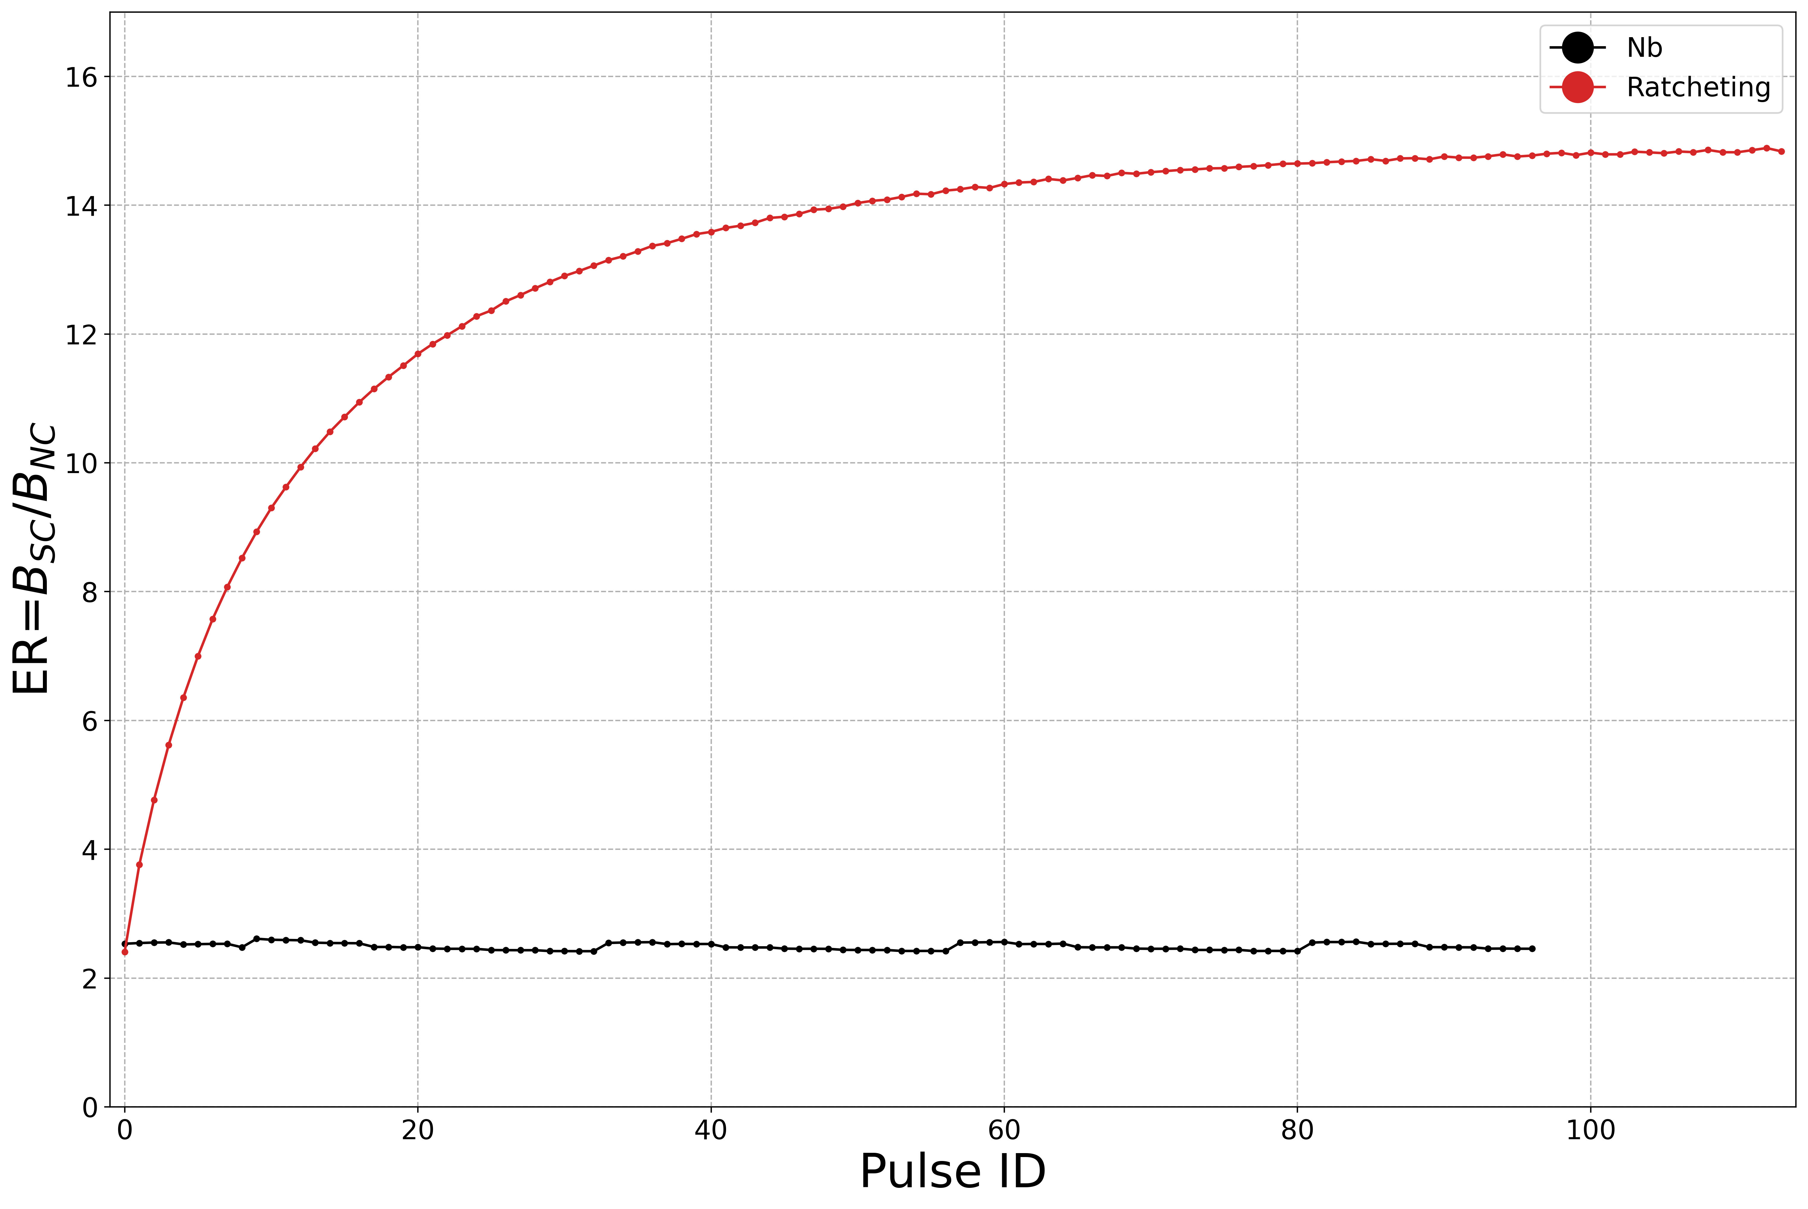
Multilayers: Ratcheting - Introduction
Concept:
  Controlled incremental expulsion of flux → Exceeds that of Nb baseline
    Sequential process to enhance magnetic hygiene of RF surface
    First report of flux ratcheting – terminology introduced by CERN
Observation
  To date: Only observed in SIS multilayer with high T_{c,film}
24

Slide 25
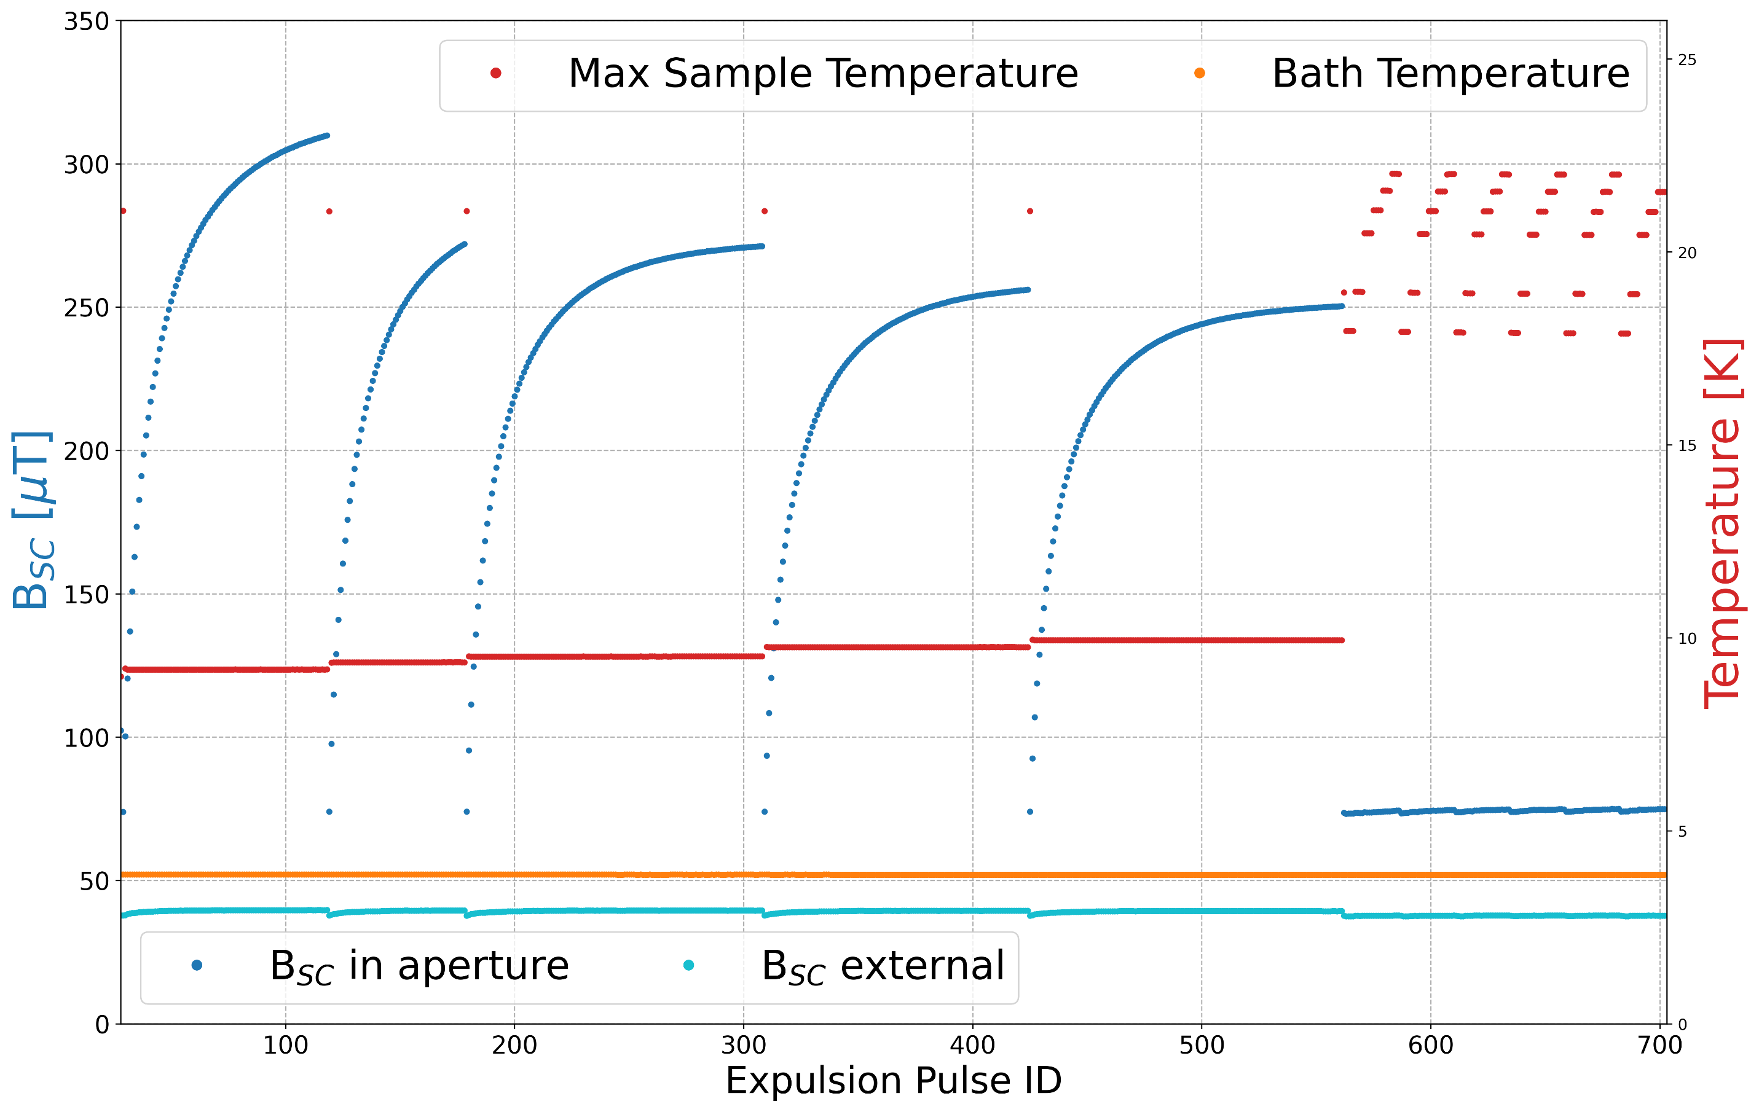
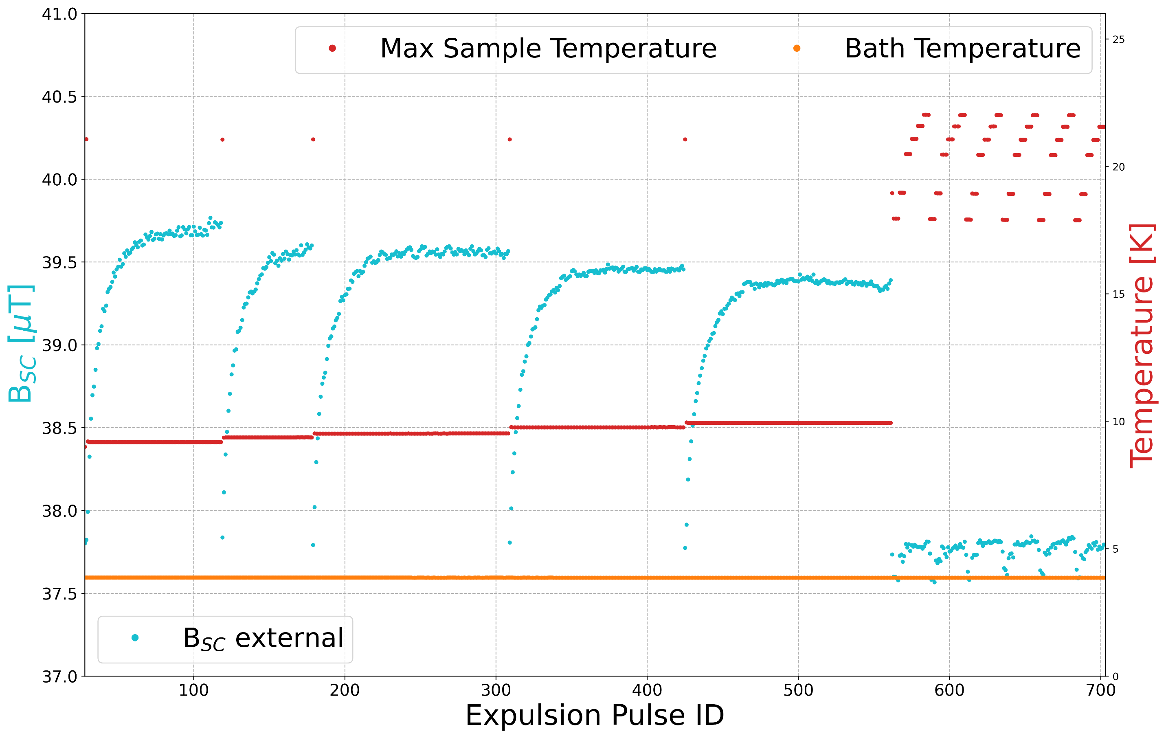
Multilayers: Ratcheting – Example Nb/AlN/NbTiN
Ratcheting:
  Every subsequent pulse increases the B expelled from the sample T_{c,Nb} < T_{max} < T_{c,film}
  Dubbed ratcheting as subsequent pulses increase the amount of expelled B
Magnetic Reset
  The expelled B is ‘reset’ when T_{c,film} < T_{max}
No ‘flux pumping’: shown by outer B field not reducing → No B entering sample from outside
Outer B probe
3
1
2
25

Slide 26
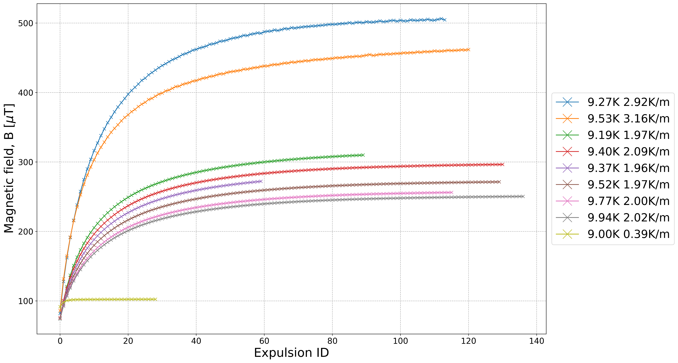
Multilayers: Ratcheting dependencies
Necessary: T_{c,Nb} < T_{max} < T_{c,film}
Magnitude of flux ratcheting depends on:
  Maximum Temperature and Spatial thermal gradient
Strongest ratcheting
  T_{max} → T_{c,Nb}
  Large ∇T
Measured ER=B_{sc}/B_{NC} ~ 30
  Best case for Nb ER < 10
T_{max} ∇𝑇
26

Slide 27
Multilayers: Ratcheting dependencies
Necessary: T_{c,Nb} < T_{max} < T_{c,film}
Magnitude of flux ratcheting depends on:
  Maximum Temperature and Spatial thermal gradient
Strongest ratcheting
  T_{max} → T_{c,Nb}
  Large ∇T
Measured ER=B_{sc}/B_{NC} ~ 30
  Best case for Nb ER < 10
T_{max} ∇𝑇
27

Slide 28
Multilayers: Ratcheting dependencies
Necessary: T_{c,Nb} < T_{max} < T_{c,film}
Magnitude of flux ratcheting depends on:
  Maximum Temperature and Spatial thermal gradient
Strongest ratcheting
  T_{max} → T_{c,Nb}
  Large ∇T
Measured ER=B_{sc}/B_{NC} ~ 30
  Best case for Nb ER < 10
T_{max} ∇𝑇
28

Slide 29
Multilayers: As deposited
How does flux ratcheting compare to Nb?
Take the Nb dominated response (as before) before the post deposition anneal as a baseline.
Full expulsion: T_{max} > T_{c,film}
Same trend as Nb
Only SIS with an initial 900ºC anneal behaves slightly differently
29

Slide 30
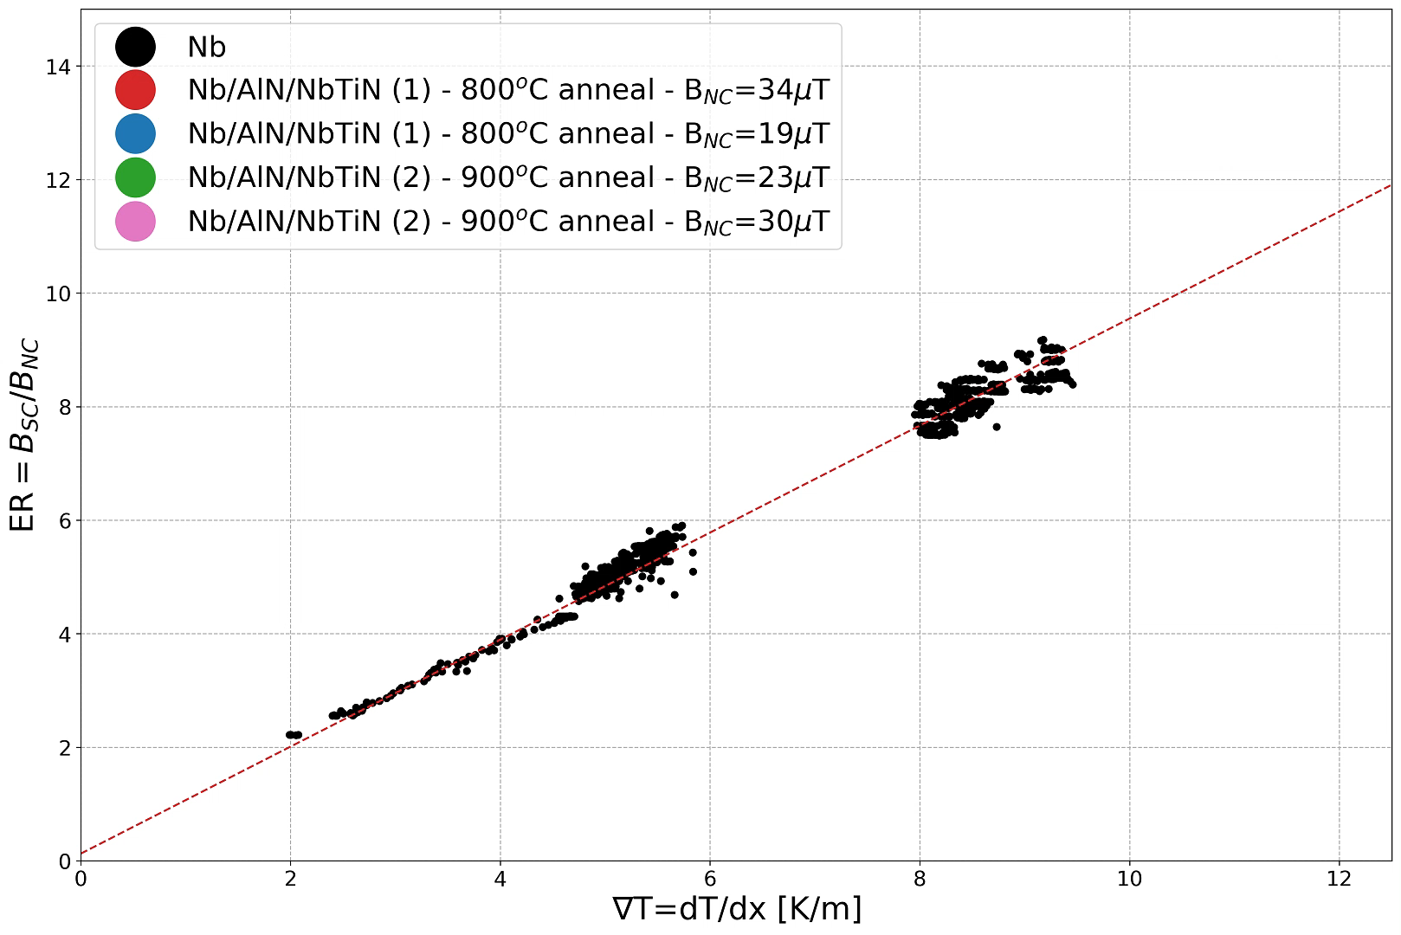
Multilayers: Compare the SIS with full expulsion
How does flux ratcheting compare to Nb?
Take the Nb dominated response (as before) before the post deposition anneal as a baseline.
Full expulsion: T_{max} > T_{c,film}
Same trend as Nb
Only SIS with an initial 900ºC anneal behaves slightly differently
30

Slide 31
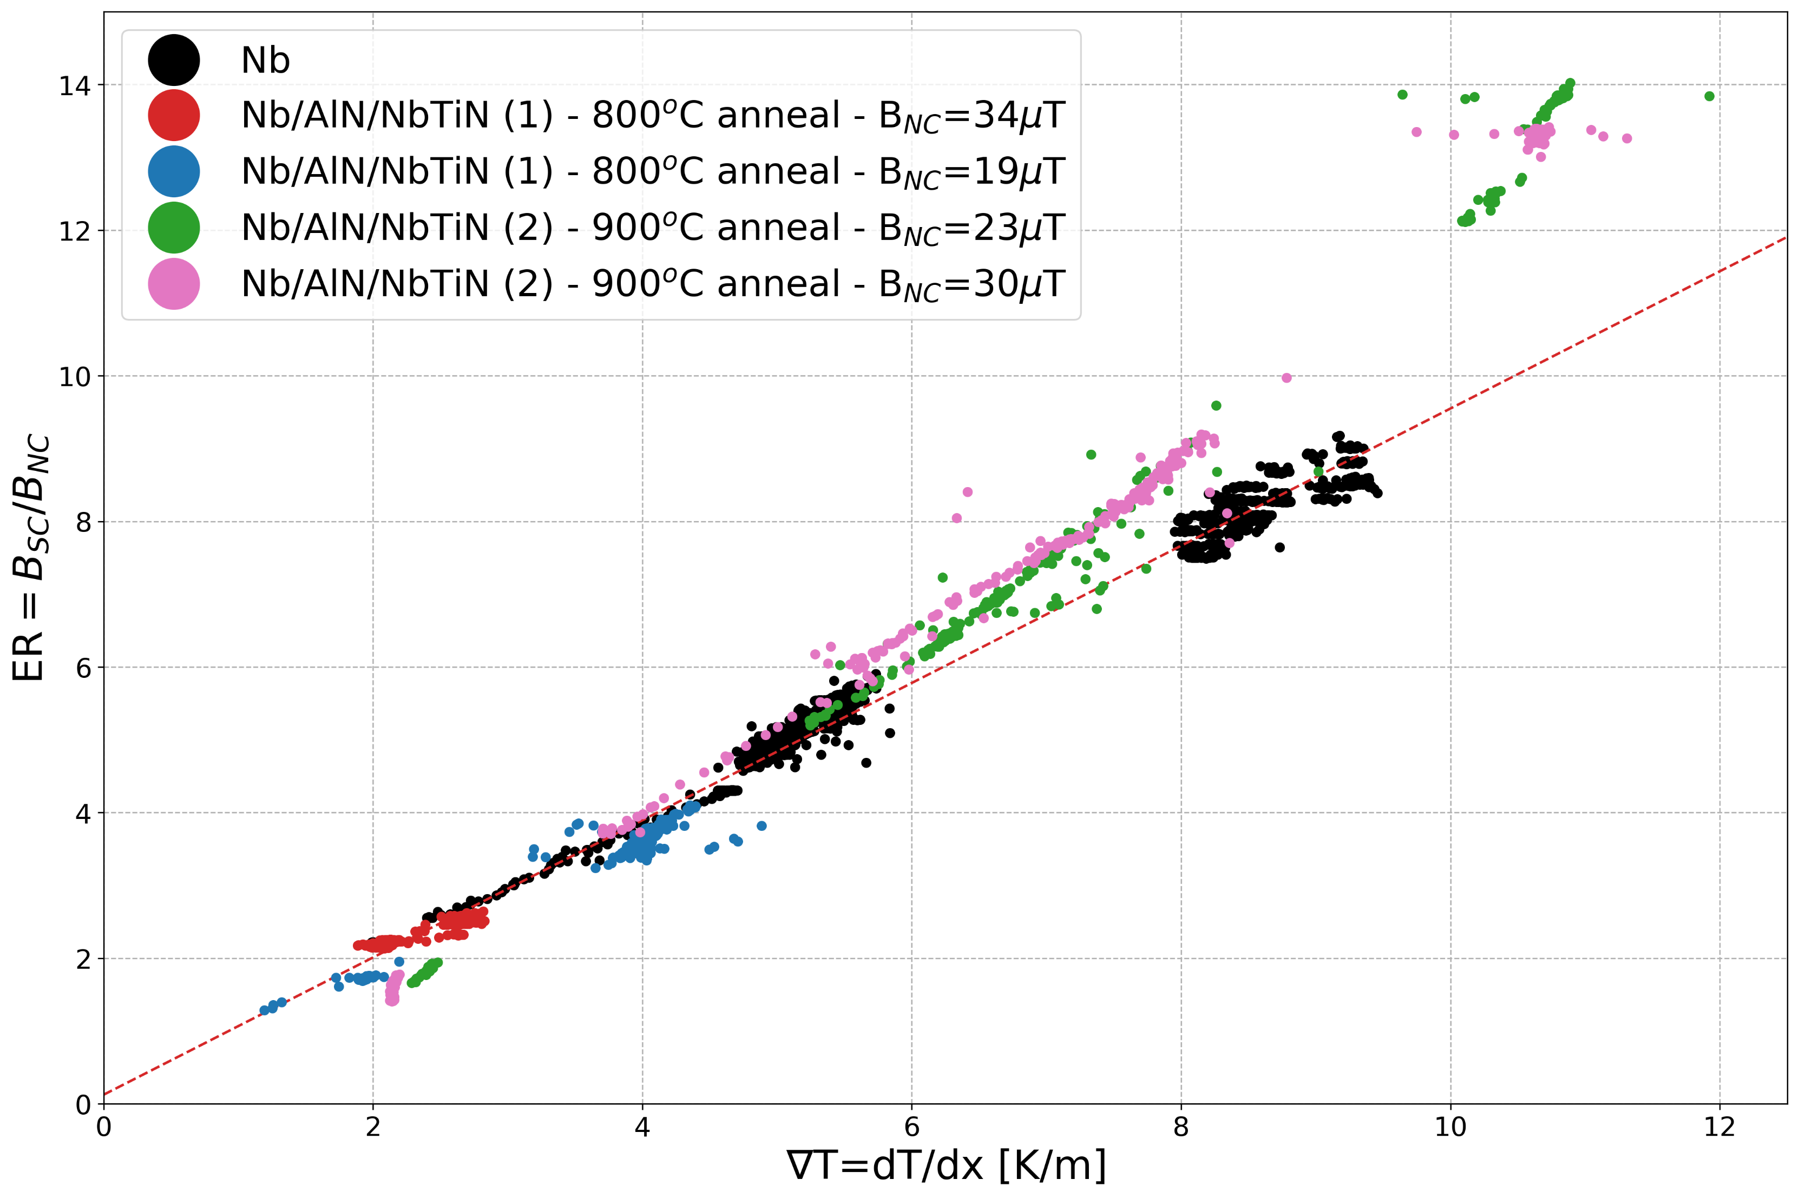
Multilayers: Compare the SIS with full expulsion
How does flux ratcheting compare to Nb?
Take the Nb dominated response (as before) before the post deposition anneal as a baseline.
Full expulsion: T_{max} > T_{c,film}
Same trend as Nb
Only SIS with an initial 900ºC anneal behaves slightly differently
31

Slide 32
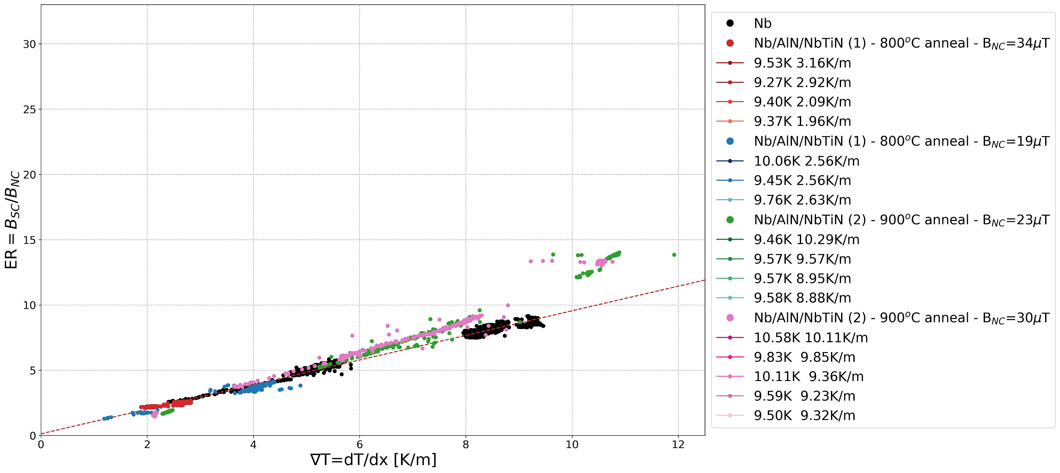
Multilayers: Compare the SIS with full expulsion
Initial ‘reset’ pulse: Reset to Nb substrate
  Full expulsion with T_{max} > T_{c,film}
Heat pulse requirement: T_{c,Nb} < T_{max} < T_{c,film}
Observations
  Clear and significant increase in ER
  Incremental ER improvement → Ratcheting
32

Slide 33
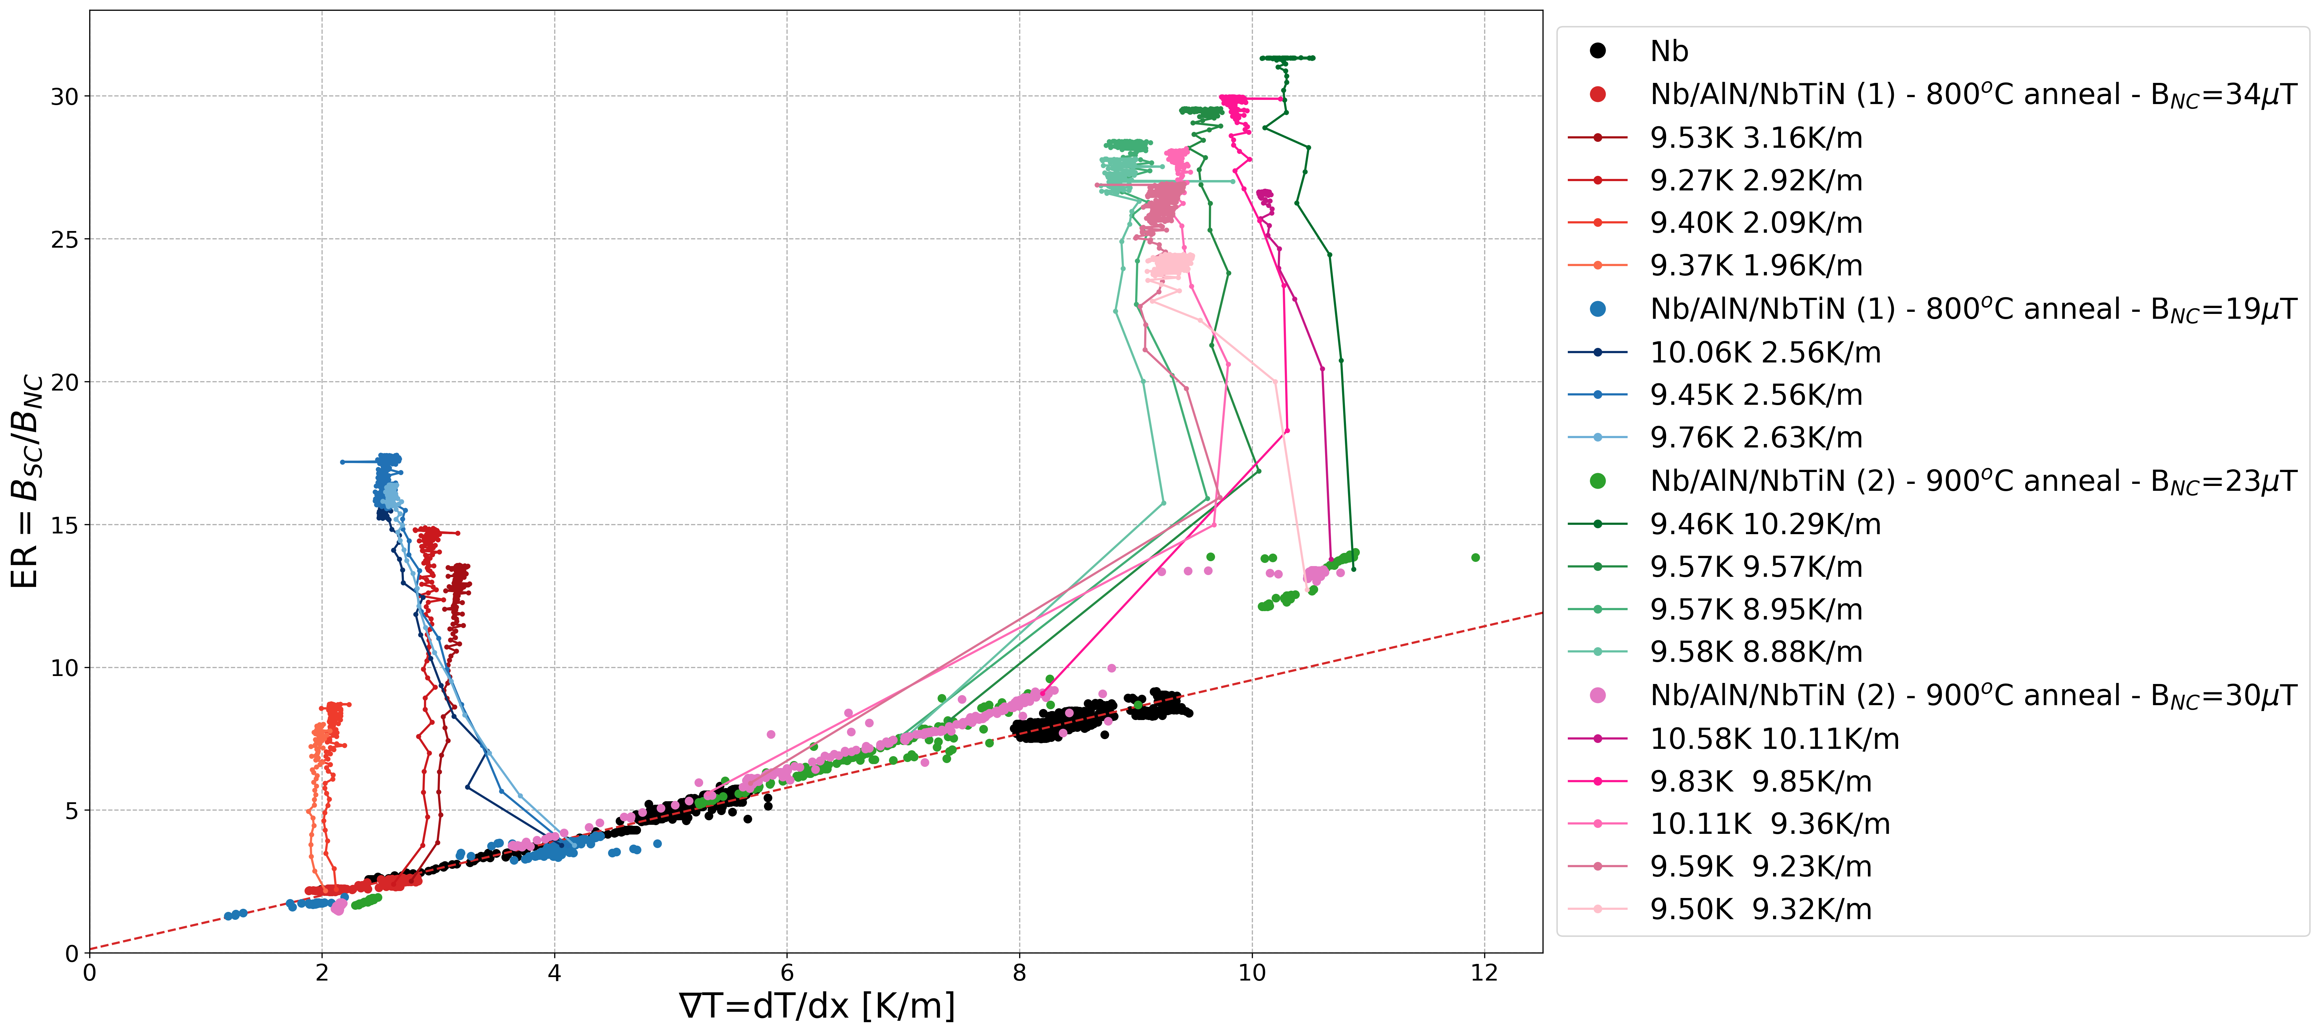
Multilayers: Compare the SIS with full expulsion
Initial ‘reset’ pulse: Reset to Nb substrate
  Full expulsion with T_{max} > T_{c,film}
Heat pulse requirement: T_{c,Nb} < T_{max} < T_{c,film}
Observations
  Clear and significant increase in ER
  Incremental ER improvement → Ratcheting
33

Slide 34
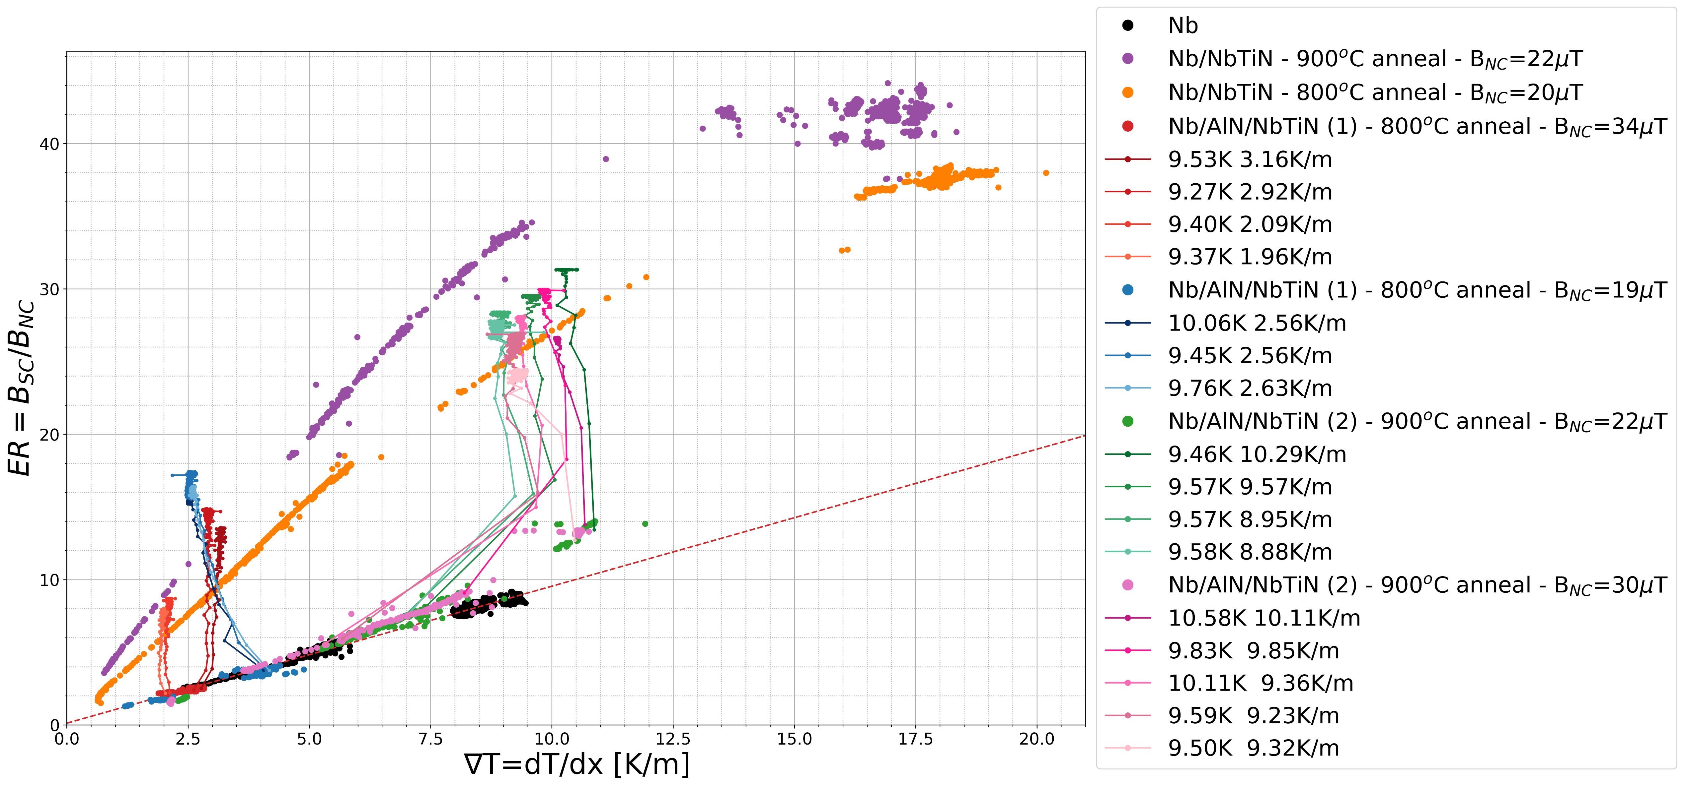
Multilayers: Compare SS bilayers
Comparing SIS to SS using ER
  Low ∇T, ratcheting produces more relative expulsion
  High ∇T, SS produces more relative expulsion
34

Slide 35
Flux pumping investigation
35

Slide 36
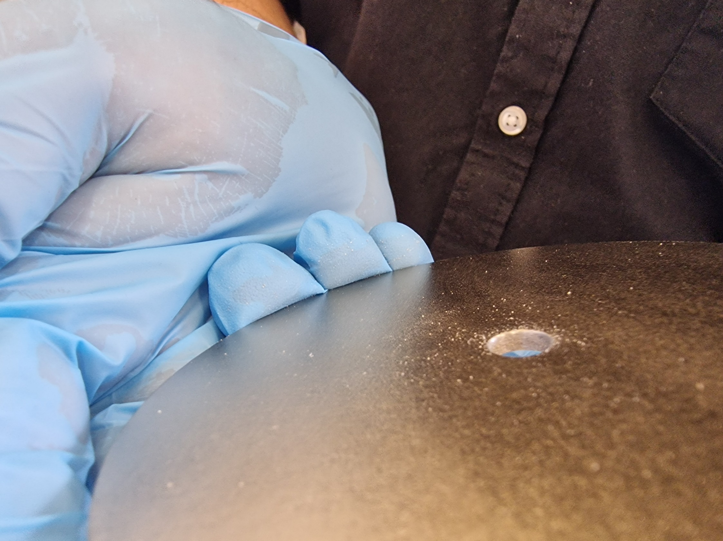
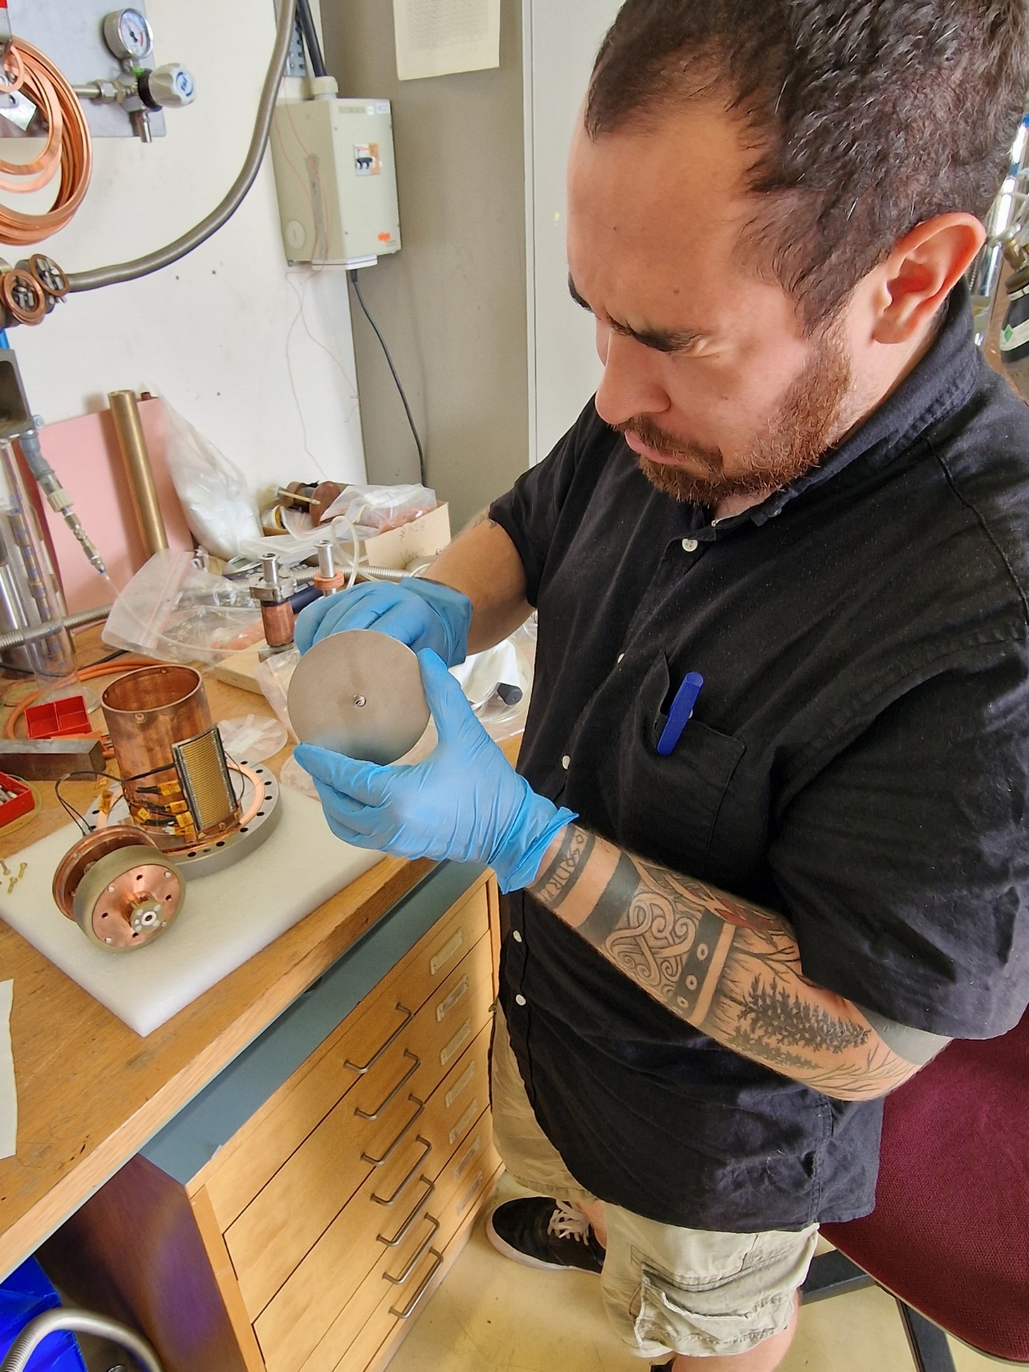
Flux pumping investigation
Sanity cross check:
Can ratcheting be mistaken for flux pumping?
  Flux pumping: Magnetic flux pulled into the closed topology from outside the sample
Nb
Nb/AlN/NbTiN
Strategy
The thin films are also coated on the edges of the sample
Remove outer edge with sandpaper
  Outer edge acting as a SC barrier
Retest on ratcheting samples
  Look for evidence for flux pumping on outer probe
Expectation:
  If pumping, ratcheting doesn’t saturate
  Outer B should reduce as B is moved into the sample
Nb/AlN/NbTiN
Edges removed

Slide 37
Flux pumping investigation:
Full sample – Un-damaged
Outer B probe
37

Slide 38
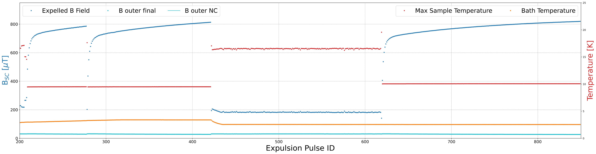
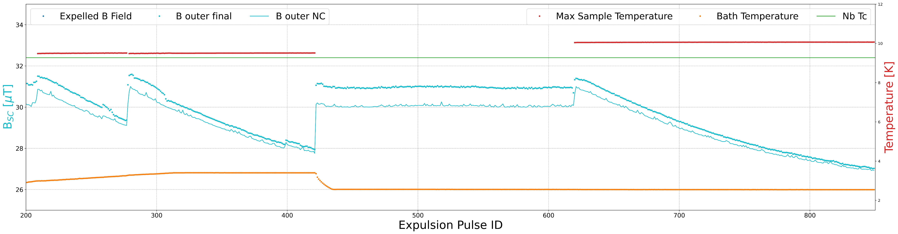
Flux pumping investigation
Full sample – Damaged
No Saturation!
Pumping!
38

Slide 39
Flux pumping investigation
Full sample – Damaged
Removing the edges now allows B to enter from outside the sample
  No SC barrier to keep the ambient B outside the sample
  Parrallel B no longer screened by the thin film at the outer radius
Pulse sequence
  Each ‘ratcheting’ pulse reduces B in the sample
  Sample now has a lower B than B_{ambient} → energetically favourable for B to enter the sample
  Subsequent ratcheting pushes more B into the aperture
No Saturation!
Pumping!
39

Slide 40
Summary
Multilayers deposited by PEALD at DESY
  As deposited, T_{c,films} are lower than T_{c,Nb}. Response only due to Nb → Increased by a post deposition anneal
Results
  Magnetic Flux lens is operational with a full R&D program → demonstrates systematic expulsion of flux
  Enhanced flux expulsion has observed on multilayer samples
  Controlled, enhanced flux expulsion achieved → ‘Magnetic flux ratcheting’
    To date ratcheting only observed in SIS samples → T_{c,Nb} < T_{max} < T_{c,film}
  Film topology is relevant to control flux movement → input for ratcheting cavity designs
Future work
  Objective: Demonstrate flux ratcheting on a 1.3 GHz Nb cavity and assess RF performance
    Preparation (ongoing): HiPIMS Nb film on Nb 1.3 GHz cavity for multilayer trial coating
      Please see Kristoff Brunner’s talk, “Status of HIPIMs developments at CERN”, 16/09/2024 – 15:16
    Dedicated 1.3 GHz bulk Nb cavities under fabrication → Target: ready for SS/SIS treatment in Q1 2025
  Investigation of thin film flux trapping mechanisms:
    Surface characterisation: TEM measurements with EN-MME at EPFL Lausanne → Ongoing
    Vacancy population measurements: Positron Annihilation Lifetime Spectroscopy (PALS at Dresden)
40
Notes:
SS samples show increased expulsion
Not controllable - it is a single cooldown, similar to Nb
Magnitude depends on; background B, maximum T and 𝛻𝑇

Slide 41
Thank you for your attention
41

Slide 42
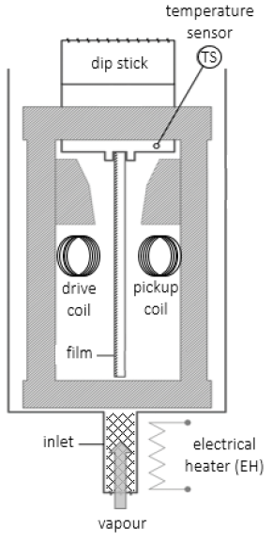
Multilayer films: T_{c}
T_{c} tests performed in the Cryolab using an AC field
  Sample is placed in between a drive and a pickup coil
  Sample in the Meissner state screens the alternating B field
  At T_{c} the sample stops screening, and the B is measured by the pickup coil
  Dorothea Fonnesu et al. “CERN Based Tc Measurement Station for Thin-Film Coated Copper Samples and Results on Related Studies”. In: JACoW SRF2021 (2022), pp. 105–108. doi: 10.18429/JACoW-SRF2021-SUPFDV018..
42

Slide 43
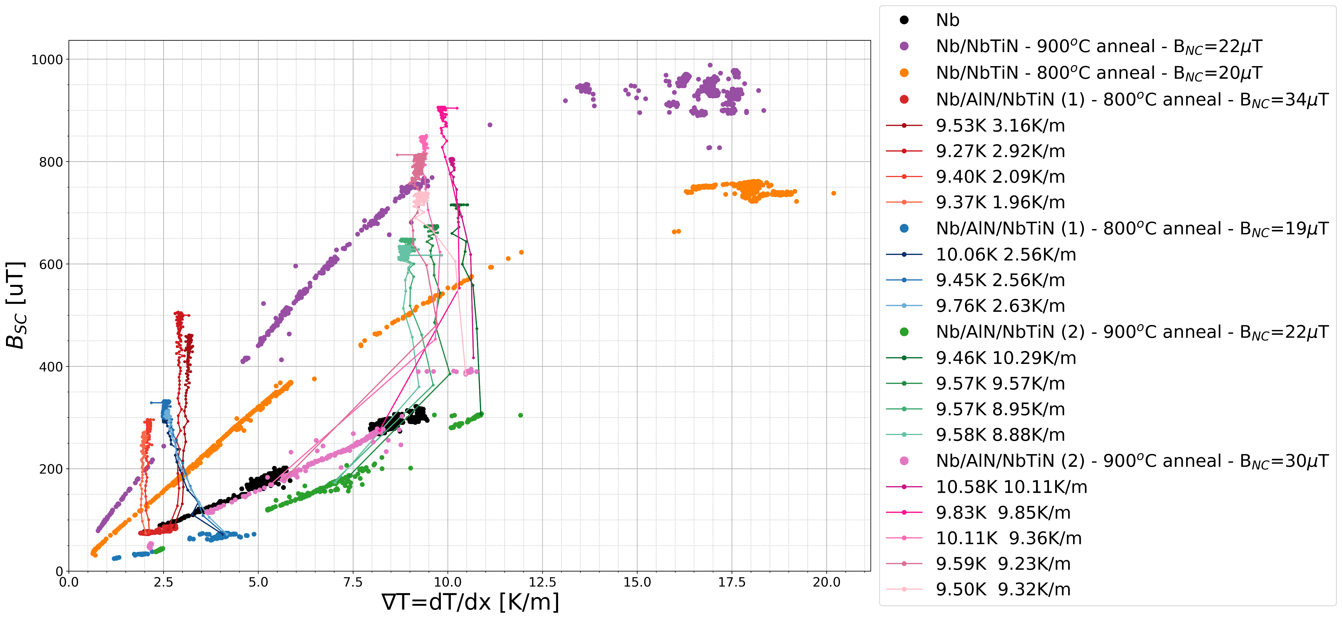
Multilayers: Compare SS bilayers
Comparing SIS to SS using ER
  Low ∇T, ratcheting produces more absolute expulsion
  High ∇T, SIS produces can produce more absolute expulsion
43

