Slide 1
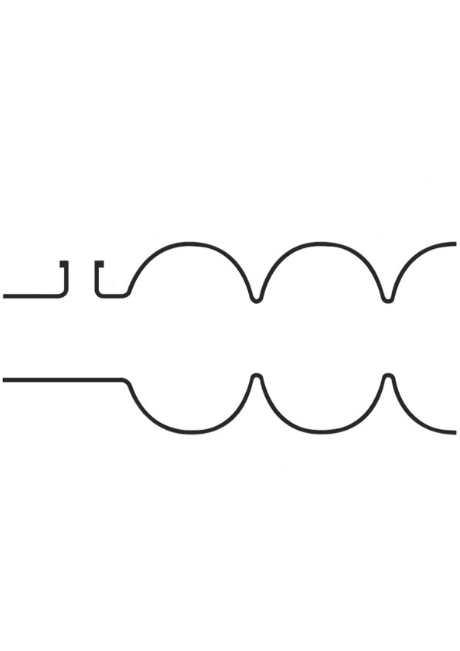
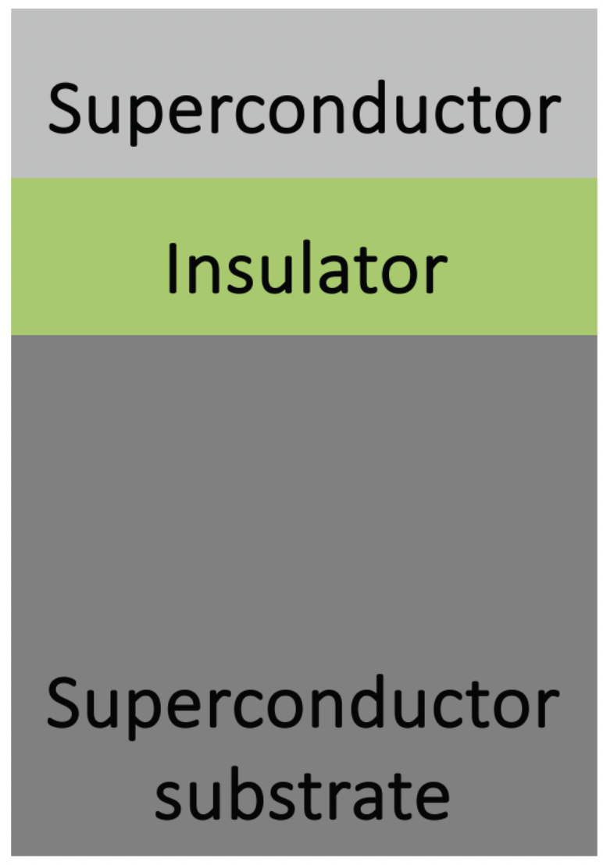
Characterization of PEALD Coated Thin Films for SRF Cavity Research
Lea Preece - on behalf of the SRF R&D Team Hamburg
11th International Workshop on Thin Films and and New Ideas for Pushing
the Limits of RF Superconductivity – TFSRF2024 – Sept. 19, 2024
Notes:
Not like other characterization as for Siegen Talk -> AFM, XPS, EBSD, TEM, etc but MAGNETIC characterization

Slide 2
Motivation
Magnetic Characterization Study
➾ comprehensively investigate the magnetic properties of SIS layers
SRF cavities approach thermodynamic limit of niobium
Superconductor-Insulator-Superconductor (SIS)
multilayers
  Theory shows potential to enhance E_{acc} and achieve lower rf losses
SIS coating of cavities creates new challenges
  Experimental realization
  Material properties of thin multilayer systems
~ 45 MV/m
Notes:
High Tc!!!
SIS = potential to enhance Eacc and achieve lower rf losses, new geometries comes with challenges that have to be investigated, eg. Flux pinning, has to be comprehensively investigated to understand magnetic properzies

Slide 3
Motivation
~ 45 MV/m
SRF cavities approach thermodynamic limit of niobium
Superconductor-Insulator-Superconductor (SIS)
multilayers
  Theory shows potential to enhance E_{acc} and achieve lower rf losses
SIS coating of cavities creates new challenges
  Experimental realization
  Material properties of thin multilayer systems
~ 70 MV/m
Magnetic Characterization Study
➾ comprehensively investigate the magnetic properties of SIS layers
Notes:
SRF cavities = key component for acceleration in state-of-the-art particle accelerators
SIS = potential to enhance Eacc and achieve lower rf losses, new geometries comes with challenges that have to be investigated, eg. Flux pinning, has to be comprehensively investigated to understand magnetic properzies

Slide 4
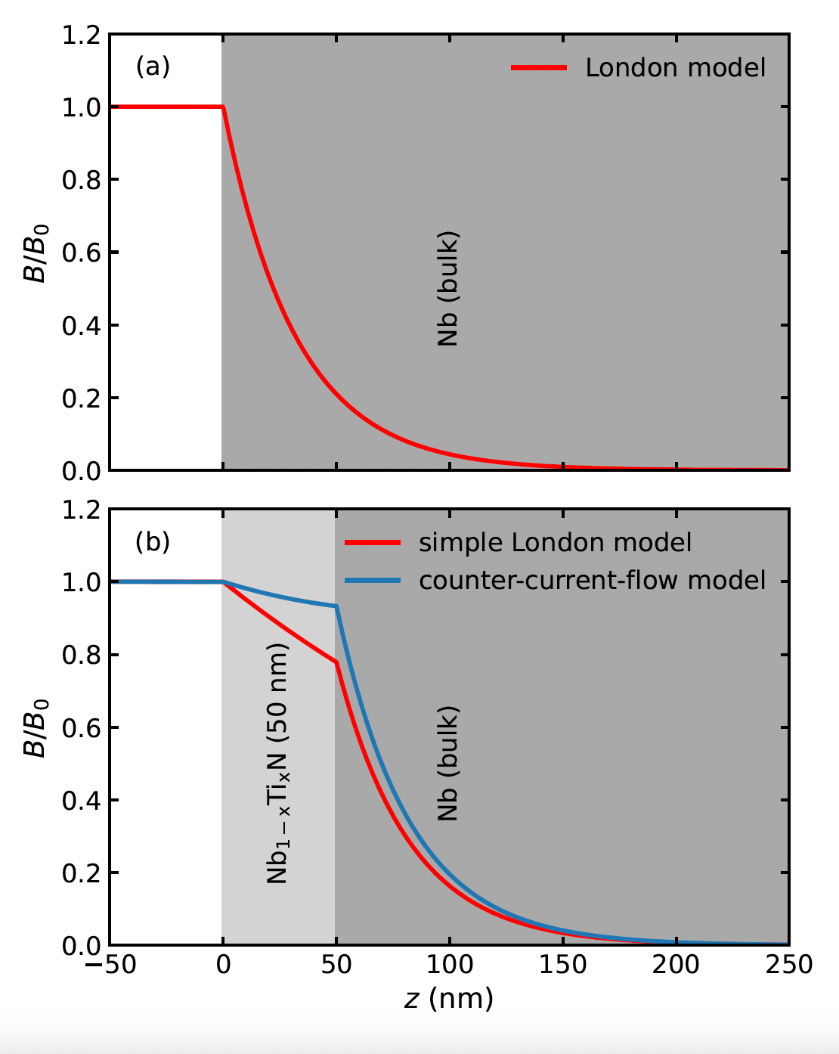
Thin Films and Screening Currents
References:
A. Gurevich, APL 88 (2006),
T. Kubo, SUST 30 (2017)
Gurevich: Vortices are energetically supressed in SC thin films for d < λ_{L}
Insulator as vortex barrier so that global vortex penetration is prevented
Kubo: Vortex penetration shifts to H_{sh}>H_{C1} through “counter current” at interfaces
‘Pancake’ Vortex
Vortex dissipation becomes energetically unfavourable
[Asaduzzaman M. et al., Direct measurement of the Meissner screening profile in
superconductor-superconductor bilayers using low-energy muon spin rotation (2023)]
Notes:
Hier noch anschauliche Abb zu pancake vortices

Slide 5
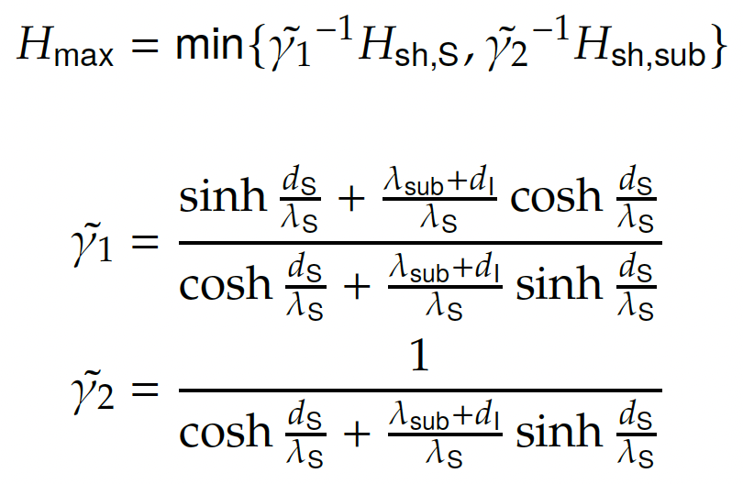
SIS Multilayer Theory
Reference:
T. Kubo, SUST 30 (2017)
Top superconductor sees majority of rf field
→ Surface resistance improves
Insulating layer creates more interfaces
→ More counter currents
Layers must be thinner than λ_{L,Top}
→ RF field is affected by counter currents
→ Optimal layer thickness d_{S} depends on λ_{L} and H_{C1} of the used bulk and layer materials
Theoretical maximum surface field a SIS coated cavity can withstand:
Literature values
Niobium
(9.27 K)
cubic high-T_{c} superconductors NbN (17.3 K) and NbTiN (17.8 K)
AlN as insulator
Notes:
Hier SS ohne d_I

Slide 6
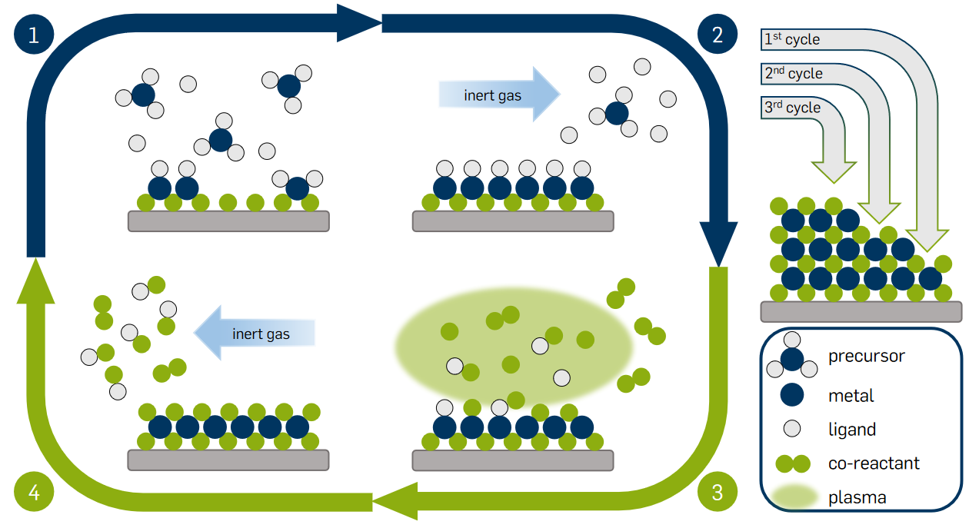
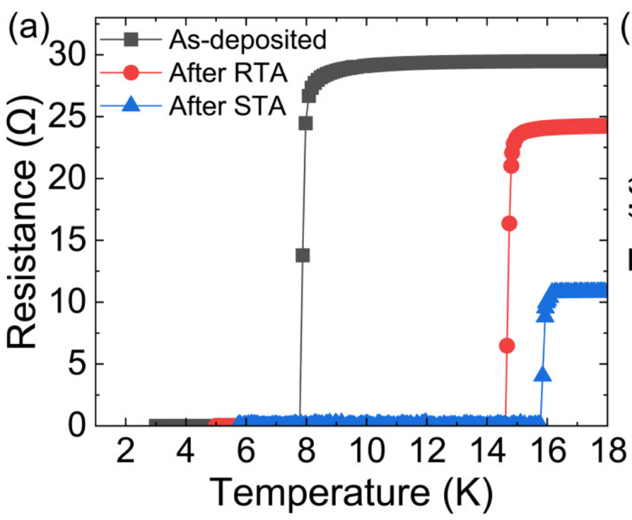
Sample Preparation
Plasma-Enhanced Atomic Layer Deposition (PEALD)
Post-Deposition Annealing to improve
T_{C} and H_{C1}
Precursors:
TMA (AlN),TDMAT (TiN), TBTDEN (NbN)
Recrystallisation and degas of impurities
μ₀H_{C1} = 15 mT
μ₀H_{C1} = 81 mT
μ₀H_{C1} = 98 mT
μ₀H_{C1,bulk} ≈ 33 mT
NbTiN
250 °C
[Gonzalez.I. et al., J. Appl. Phys. 134, 159902 (2023), 035301 (2023)]
900 °C annealing for 1 hour with controlled heating and cooling rates
Plasma mix of H₂ and N₂
[L. Mai, DOI: 10.13154/294-7658 (2020)]

Slide 7
Characterization Measurements on SIS & SS samples
X-Ray Reflectivity (XRR) measurement
  Determine the PEALD growth per cycle (GPC)
Low Energy Muon Spin Rotation (LE-μSR) measurement
  Determine the London penetration depth λ_{L}
T_{C} measurements
  Contactless Inductive T_{c} measurement on Nb
  Physical properties measurements on Si (electrical transport, VSM)
Magnetic Flux Lens (MFL) measurement
  Measure flux expulsion (and T_{C})
See also Md Asaduzzaman‘s talk on „Depth-resolved characterization of superconductor-superconductor bilayer properties beneficial for SRF applications “ ealier today
See also Daniel Turner‘s talk on „Enhancement of magnetic flux expulsion in multilayer structures“ ealier today

Slide 8
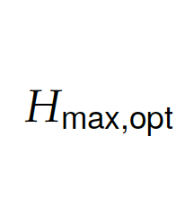
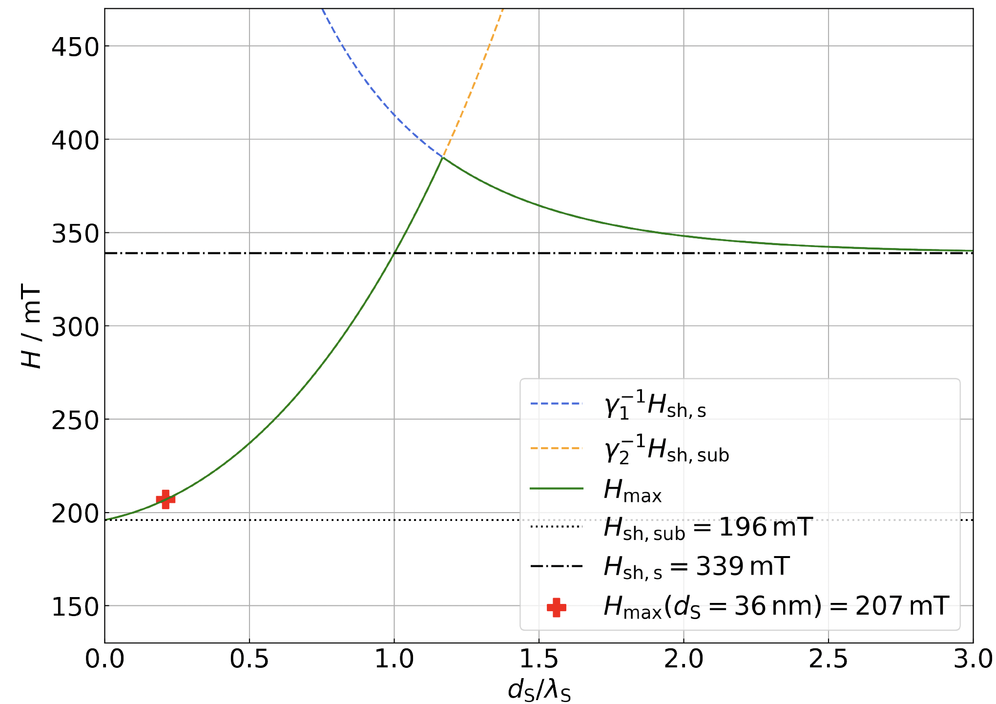
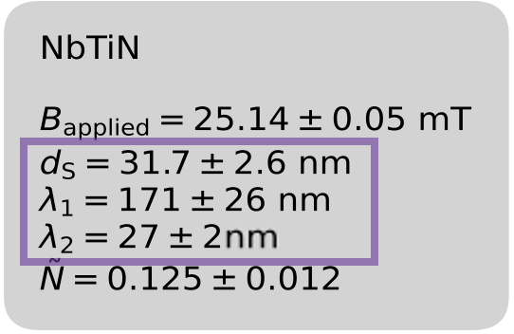
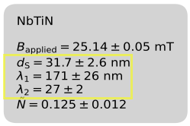
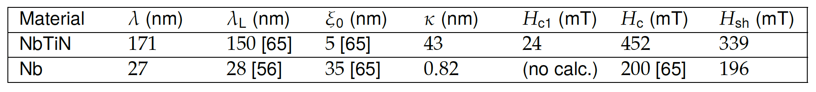
λ_{L} and the Estimation of H_{sh}
Meissner Screening Profile
SS bi-layer Nb/NbTiN
(d ~ 36 nm)
Expected decrease in B with increasing E and z
Kubo’s counter current model used for fit
H_{max} estimated for Nb/NbTiN SS bi-layer
Normal state (20 K)
Meissner state (2.7 K)
Fit
Literature
Calculated
[Credits to Ryan McFadden]
Clean limit of λ_{L}
Notes:
Meissner profile shows two decrease rates -> Nb and NbTiN contribution
N accounts for sample size and shape, here simplified and does not include any sample properties, had to be fixed because of constraints while fitting
Layer thickness as expected within two standard deviations, lambdas in agreement with literature values (clean limit for Nb otherwise kappa out of SC Type II limit!)
Lambda Nb probably between fit value and 40nm
Hsh reasonable in cpmparison with Nb3Sn -> 450mT
Bunch of assumptions made before and after Meissner profile fit → influence the interpretation of the results
λ_{Nb} (λ_{sub}) and λ_{NbTiN} (λ_{S}) used to calculate H_{sh,sub} and H_{sh,S} -> used to calculate H_{max}

Slide 9
Discussion on Meissner Profile and H_{max}
Meissner Screening Profile
H_{max} estimate visualizes Kubo’s prediction
  H_{max} > H_{sh,Nb}
  SIS multilayers needed!
Kubo’s counter current model suitable to determine λ_{L}
Normal state (20 K)
Meissner state (2.7 K)
Estimate based on Meissner Fit → improvable!
Illustrates principle of field enhancement in an SS bi-layer
[Credits to Ryan McFadden]
Notes:
In the range where dS is thicker than lambda S, the Meissner state can only be preserved if phase transition is prevented by an energy barrier as a Bean Livingston barrier, see section 2.3.2. Consequently, multilayer coatings with multiple interfaces between the layers, i.e. more suppression by counter currents

Slide 10
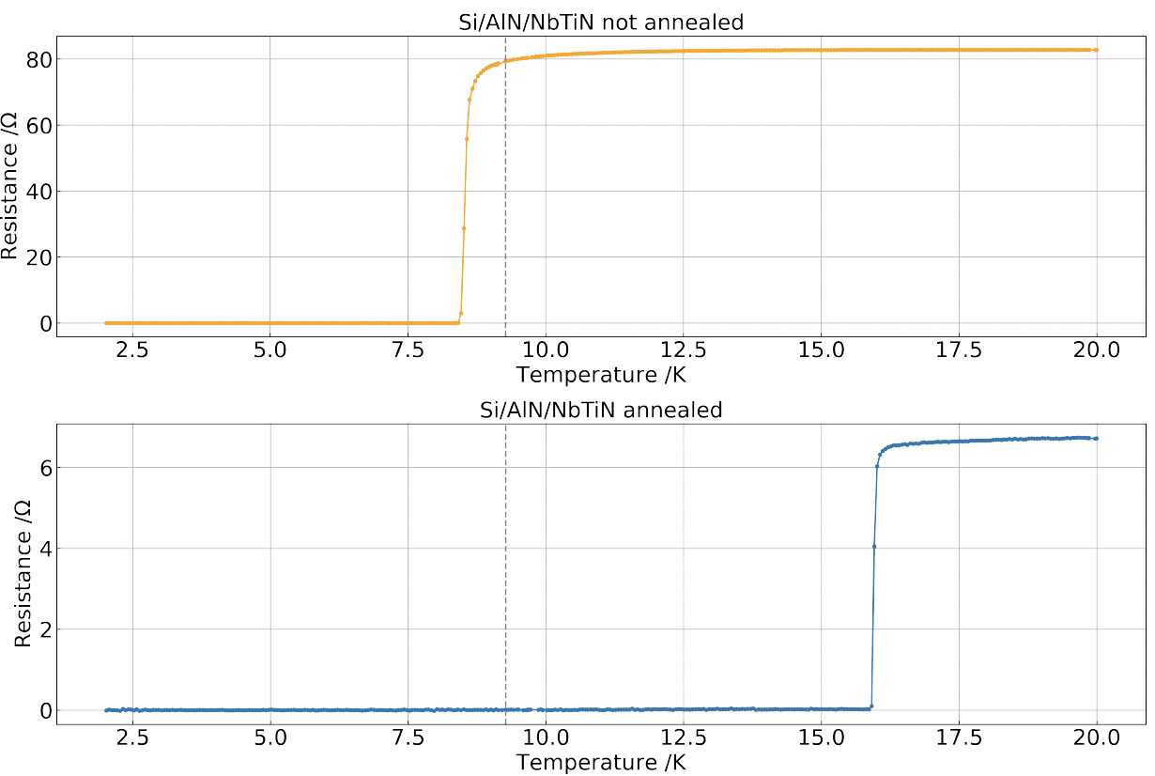
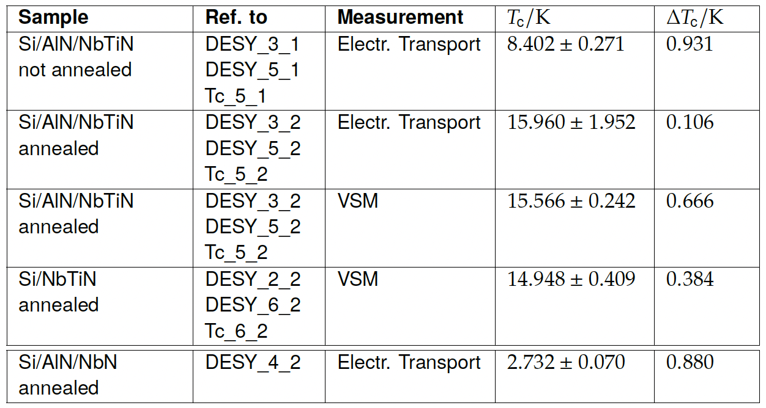

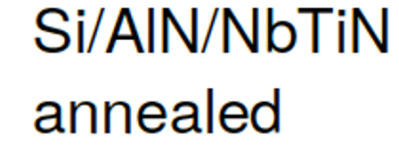
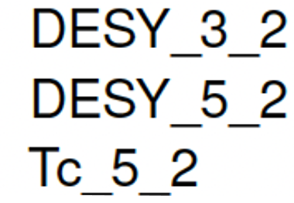

T_{C} Measurements on Si Substrate
Highest value measured
Not the same for Nb substrate!
T_{C} can be clearly assigned to the SC thin film
Highest T_{C} for Si/AlN/NbTiN in both measurement modes
Measurement of an SIS Si/AlN/NbN sample → very low T_{C}
Notes:
Tc clearly assigned to thin film because of nc Si substrate

Slide 11
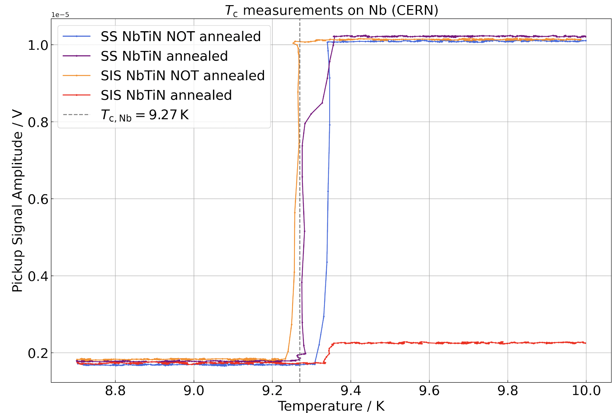
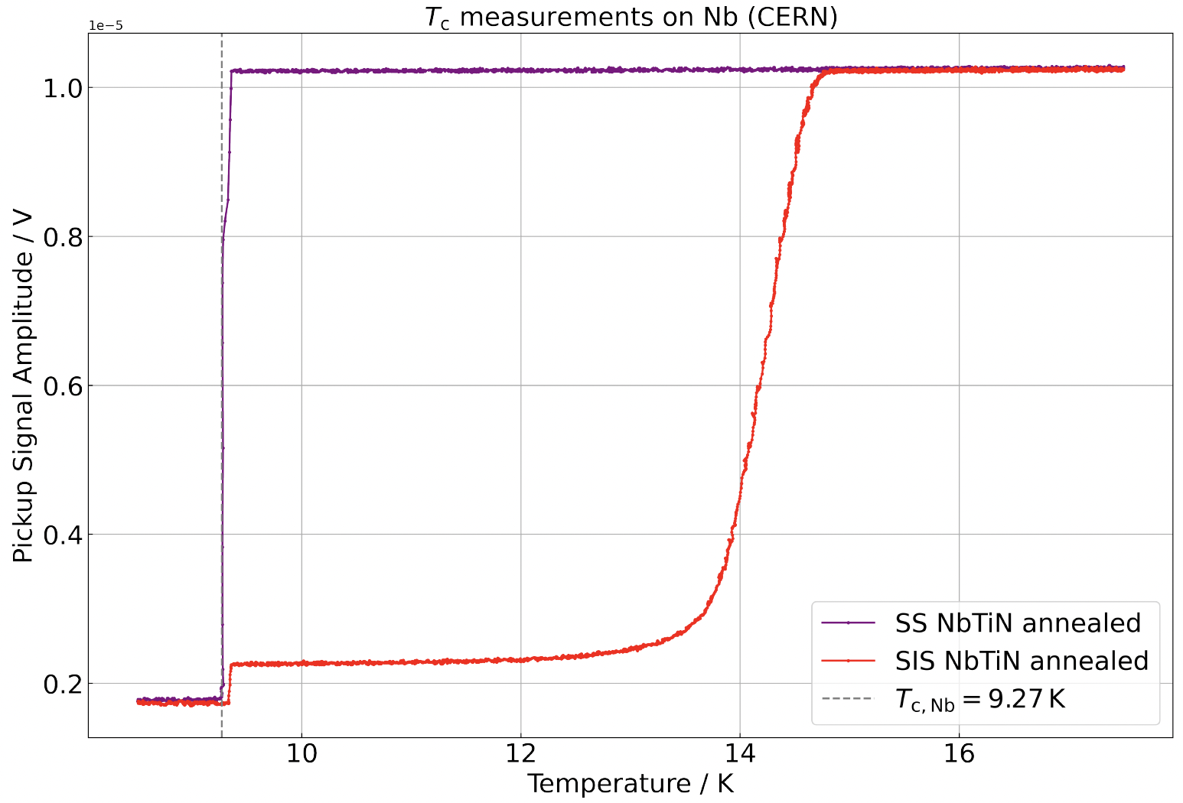
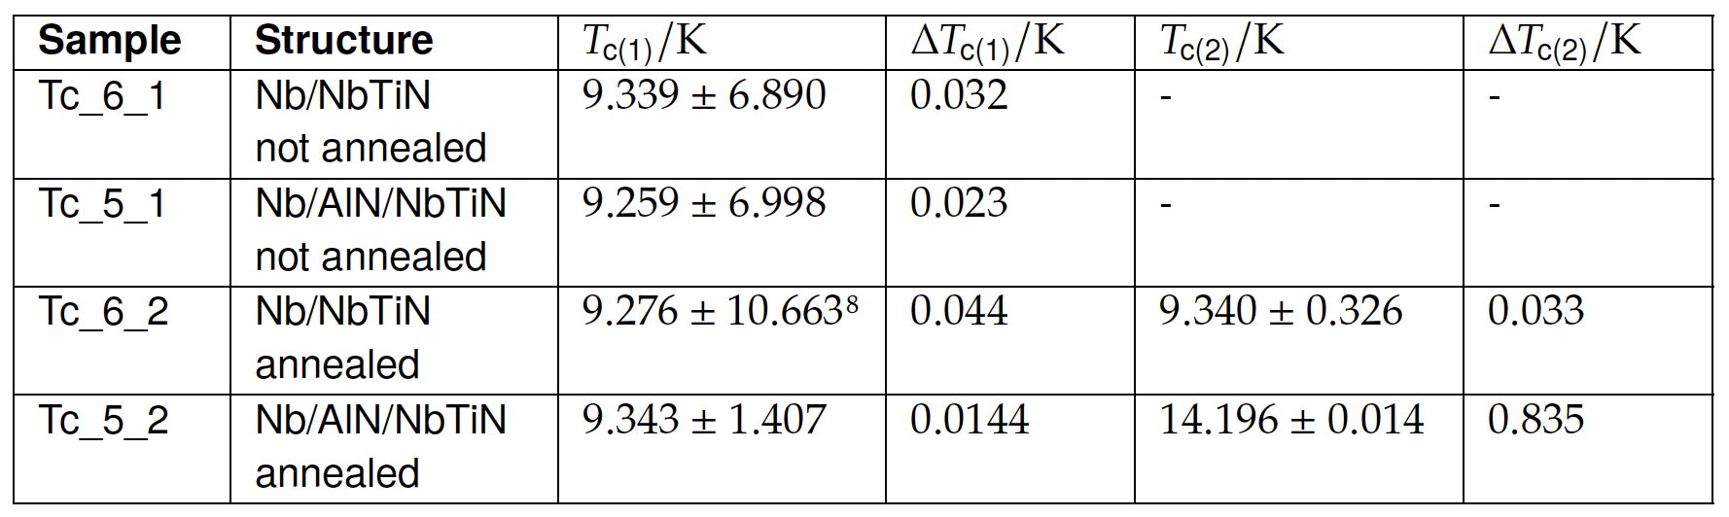

T_{C} Measurements on Nb Substrate
As-deposited: T_{C} not
higher than 7 to 8 K
Annealed SS with NbTiN behaves similar as unannealed samples
  T_{C} ~ T_{C,Nb}
  Two transitions?
Only annealed SIS with NbTiN
→ shows clear stepwise
transition
→ reaches high T_{c}
(Zoomed out)
[Measurement Courtesy of Erwan Reches, CERN cryolab]
See also Daniel Turner‘s talk on „Enhancement of magnetic flux expulsion in multilayer structures“ ealier today

Slide 12
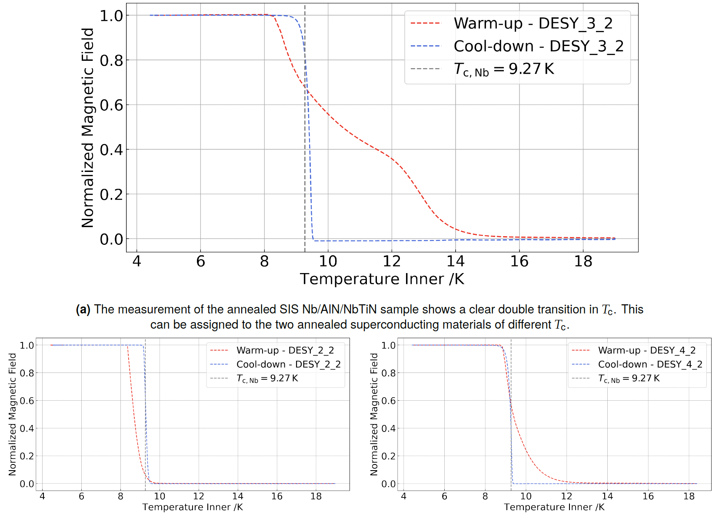
T_{C} Measurements with MFL
Annealed Nb SIS and SS samples
Only SIS with NbTiN
→ shows stepwise transition
→ reaches high T_{c}
No double transition or
significant increase in T_{c} for
→ SS Nb/NbTiN
→ SIS Nb/AlN/NbN
All T_{c} measurements deliver matching results!
SIS
Nb/AlN/NbTiN
Stepwise Transition
[Credits to Daniel Turner]
SS
Nb/NbTiN
Continuous transition
SIS
Nb/AlN/NbN
Notes:
With polycrystallinity and a rising number of material defects, the transition width becomes broader [33, 68]. As presented in [69] for PEALD coated NbN thin films of high quality compared to e.g. sputtered films, Tc is in a range below 1 K. This is in good agreement with the measurements carried out in this study.

Slide 13
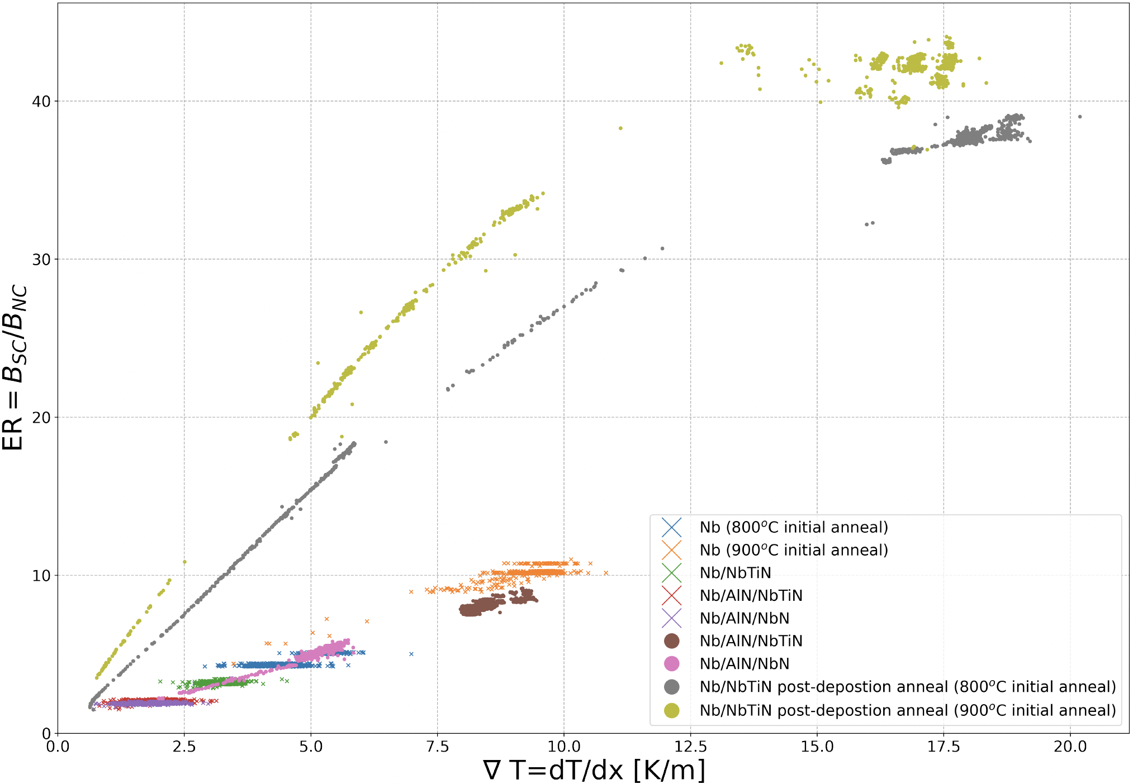
Magnetic Flux Expulsion
See also Daniel Turner‘s talk on „Enhancement of magnetic flux expulsion in multilayer structures“ ealier today
As-deposited SIS and SS thin films
ER(Nb@900 °C) > ER(Nb@800 °C)
Limited spatial thermal gradient
Annealed SS thin films
Much higher flux expulsion
Greater expulsion for 900 °C initial anneal
Annealed SS samples
As-deposited and bare samples
800 °C initial anneal
[Credits to Daniel Turner]
Notes:
Without annealing no influence of AlN layer

Slide 14
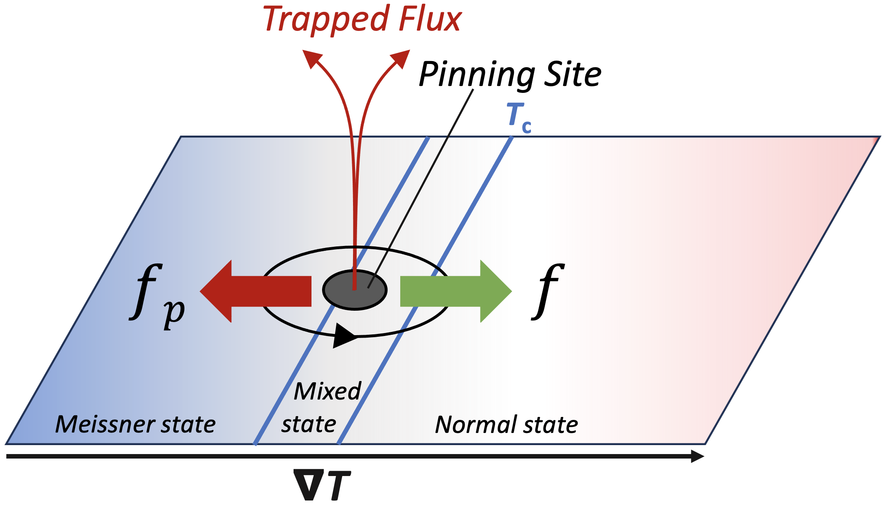
Discussion on T_{C} and Flux Expulsion
Better flux expulsion for 900 °C initial anneal (also observed in other labs)
  Increase in grain size with higher T_{anneal}
  Reduction in pinning sites
Post-deposition annealing enhances flux expulsion
  Even for SS Nb/NbTiN if no high T_{C} is achieved
  Assumption: Pancake effect adding additional force
  that counteracts pinning force

Slide 15
Discussion on T_{C} and Flux Expulsion
High-T annealing required to activate the thin film and achieve high T_{C}
Insulating layer on Nb required to ensure increase in T_{C}
  Barrier layer prevents oxygen from diffusing into NbTiN layer
  XRD of NbTiN on Si confirm high-T_{C} 𝛿-phase formation for SS sample
  Electron Microscopy probably shows oxygen-enriched phase with varying
  stoichiometry (Ongoing TEM studies with EPFL)
Intermediate oxygen layer

Slide 16
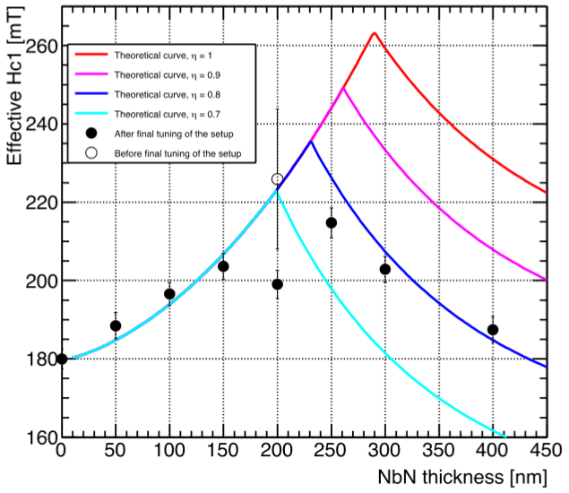
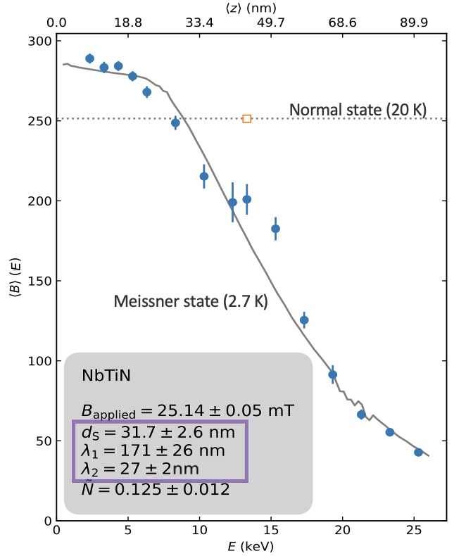
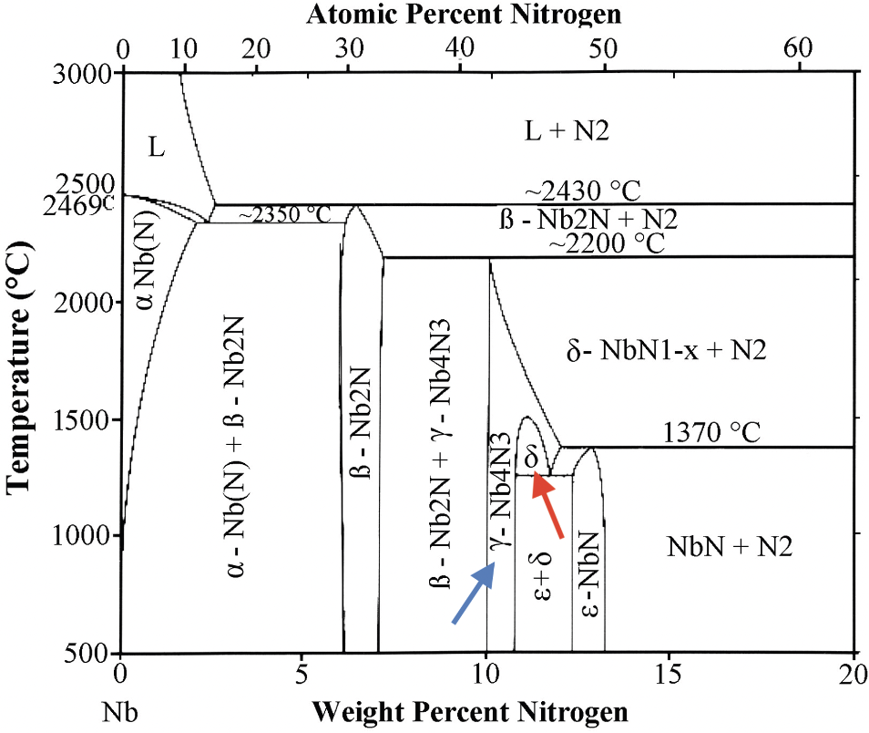
Conclusion
Soon: NbTiN H_{C1} measurement @ KEK!
Unclear if reduction of T_{C} implies reduction of H_{C}
  Experimental determination required
  Useful comparison with estimation of H_{max} following Kubo’s model
Findings on oxygen diffusion allow new considerations on μSR data analysis
  Intermediate layer in the SS bi-layer Nb/NbTiN?
900 °C annealing of SIS Nb/AlN/NbN
  Does not form intended high-T_{C} 𝛿-phase
  Ti as stabiliser of the cubic high-T_{C} 𝛿-phase
  NbN excluded from SIS studies
Ito, H. et al. [arXiv: 1907.03410] (2019)
?

Slide 17
Summary
Further improvement of Nb SRF cavity performance neccessary... and possible with PEALD coated SIS multilayer!
  Coating thin high-T_{C} superconducting and insulating layers
  Pushing the field of first flux penetration H_{ffp}
Further characterization and experimental testing of the SIS theory required
SIS is a promising approach towards new technologies and improved future applications in SRF research!
Contact
Lea Preece
PhD Student
Universität Hamburg
Institute for
Experimental Physics
Luruper Chaussee 149
22761 Hamburg
Room 045, Bldg. 30
+49 40 8998-2394
lea.preece@desy.de

Slide 18
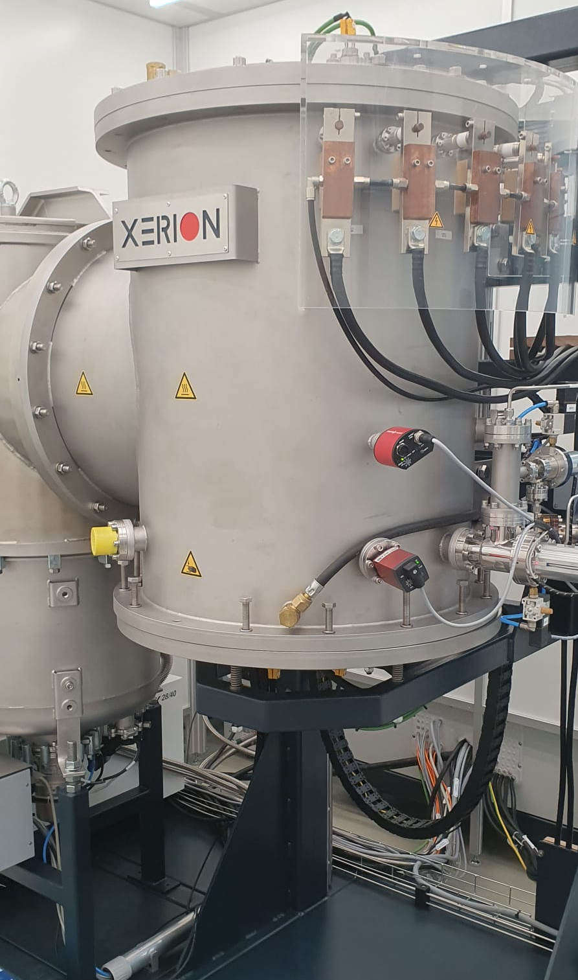
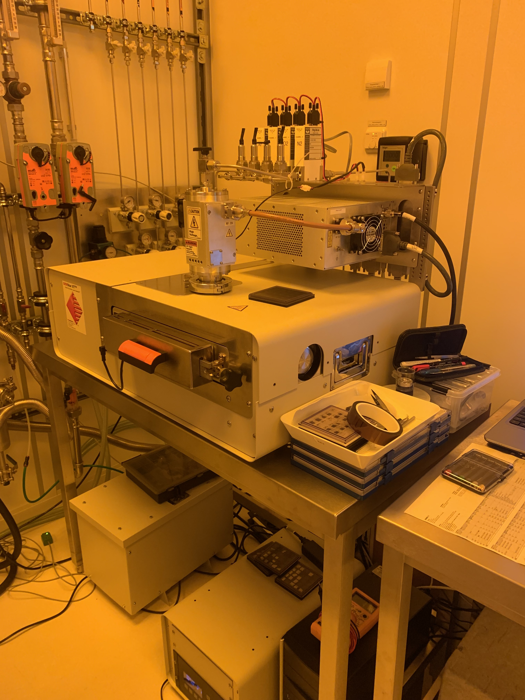
Backup
PEALD System at Universität Hamburg
UHV Furnace at Universität Hamburg

Slide 19
Sample Preparation
Plasma-Enhanced Atomic Layer Deposition (PEALD)
Uniform layer-by-layer thin film coatings
Various advantages
(compared to e.g. thermal ALD)
  Low-temperature deposition
  High quality, high conformality
  Vast choice of precursors
Self-regulating process
Convenient for coating complex structures, e.g. inside of an SRF cavity
[L. Mai, DOI: 10.13154/294-7658 (2020)]

Slide 20
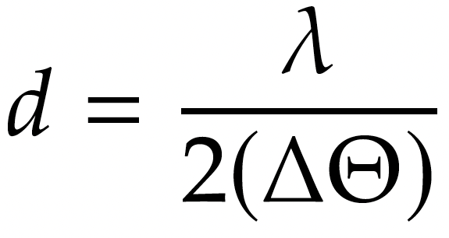
Characterization Measurements
X-Ray Reflectivity (XRR)
Low Energy-μ Spin Rotation (μSR)
Determine thin film thickness
Reflectivity curve shows interference oscillations
→ periodicity related to layer thickness
Depth-resolved near-surface magnetic properties measurement → λ_{L}
Spin polarised muon beam with energy of 0.5 to 30 keV
Resolves up to 150 nm below sample surface
Oscillation width
Notes:
NbTiN no elementary superconductor!!!
Lamor precession = the precession of the angular momentum of a particle with a magnetic dipole moment about the direction of an external magnetic field
Precession = the change in direction that the rotation axis of a rotating body (gyroscope) performs when an external force exerts a torque (Drehmoment) perpendicular to this axis

Slide 21
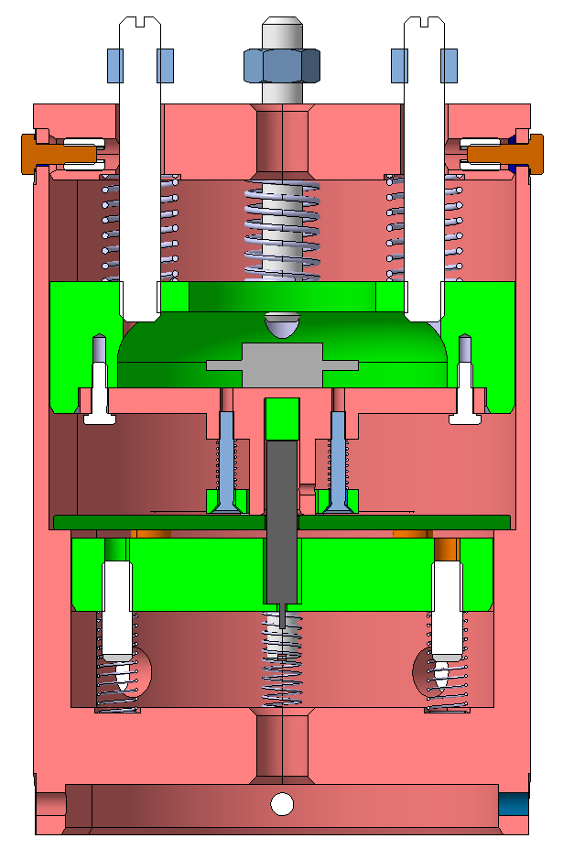
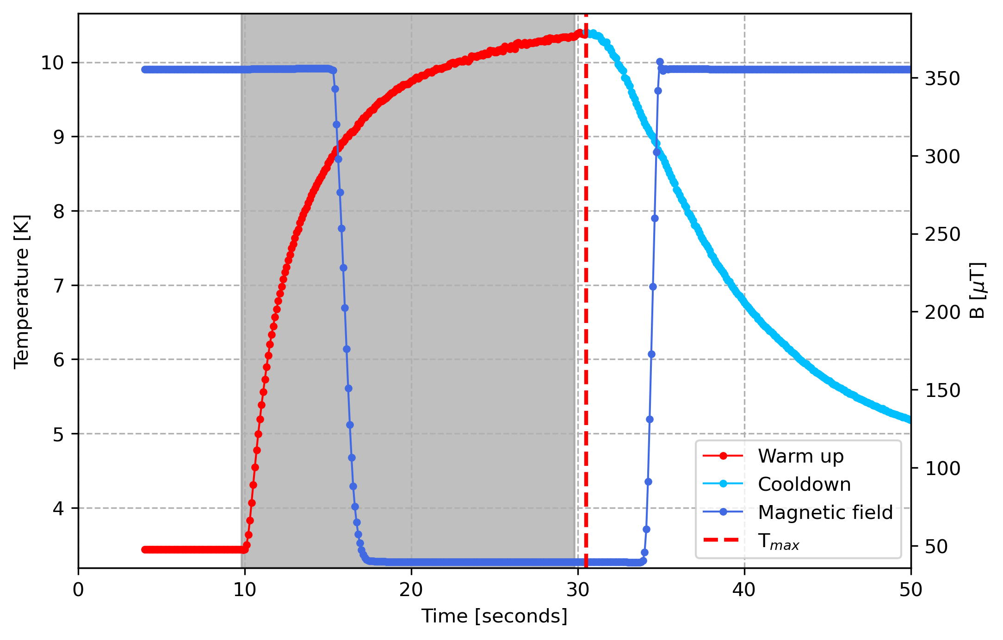
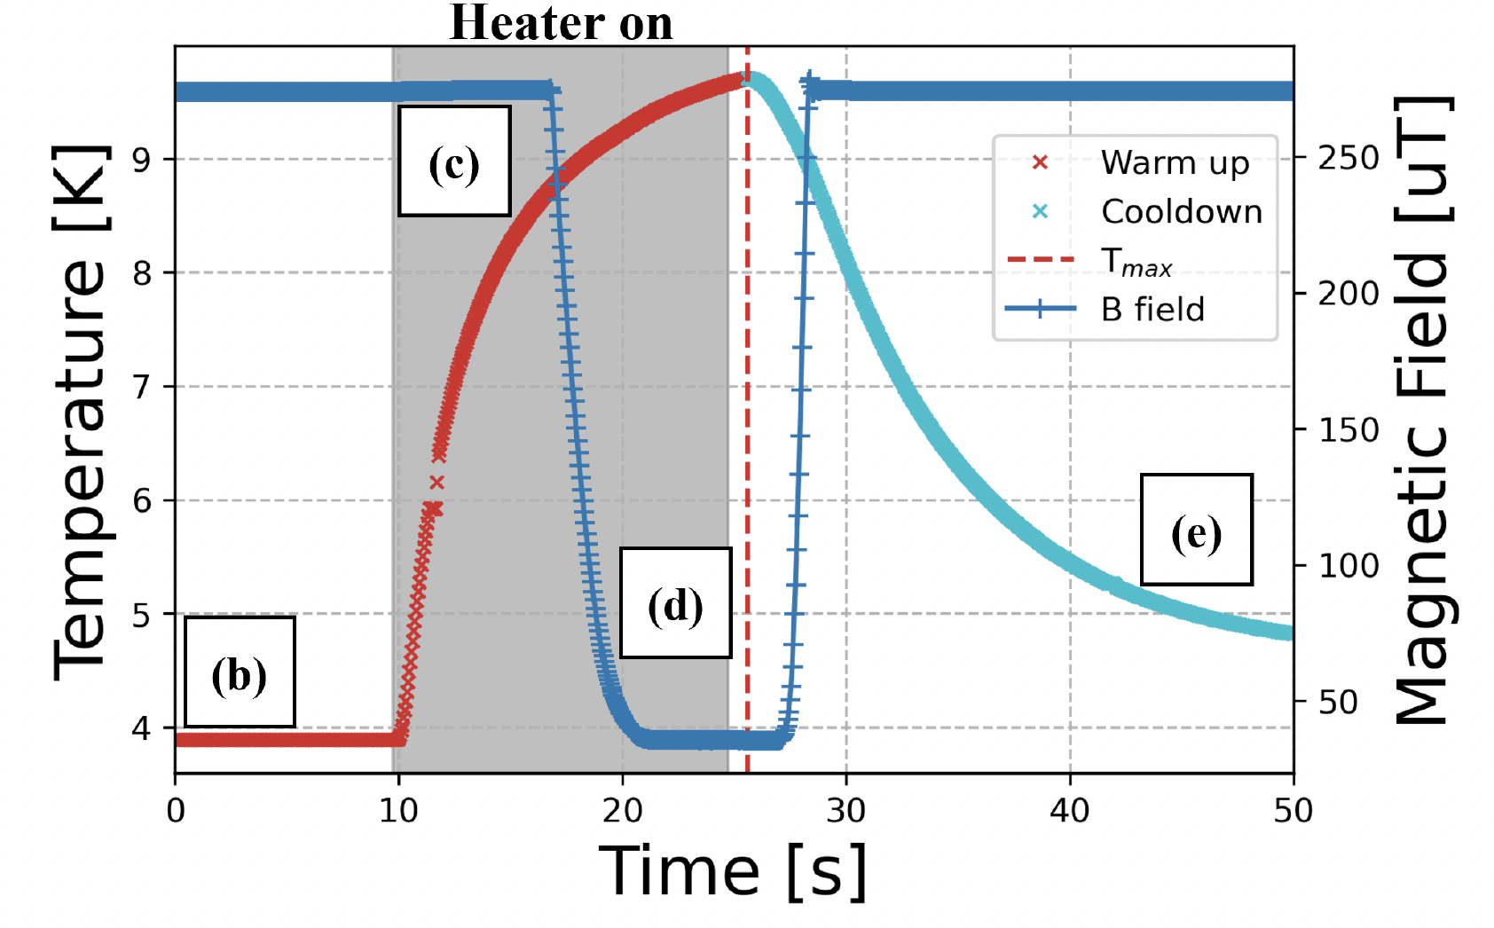
Characterization Measurements
Magnetic Flux Lens (MFL)
T_{C} Measurements
SC/NC sample transition with pulsed heating under controlled cooling conditions
Contactless Inductive T_{c} Measurement on Nb
Ramping-up T until SC state breaks down
T_{c} Measurements on Si (with PPMS)
Electrical-transport mode
→ measure electrical resistance R vs. T
Vibrating sample magnetometry (VSM)
→ measure DC magnetic moment vs. T
See also Daniel Turner‘s talk on „Enhancement of magnetic flux expulsion in multilayer structures“ ealier today
[Credits to Daniel Turner]

Slide 22
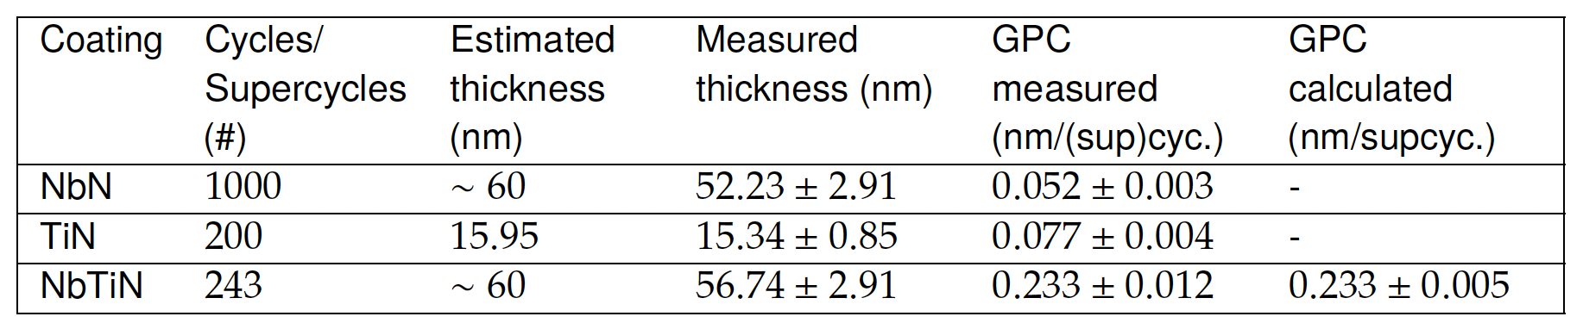
PEALD Growth per Cycle for NbN, TiN and NbTiN
1 supercycle NbTiN = 3 x NbN + 1 x TiN
Two-fold results for NbTiN:
Growth per Cycle calculated from measured XRR NbTiN thickness
Growth per Cycle calculated from individual GPCs of NbN and TiN
Results within the
expected range
XRR results
matching NbTiN GPCs

Slide 23
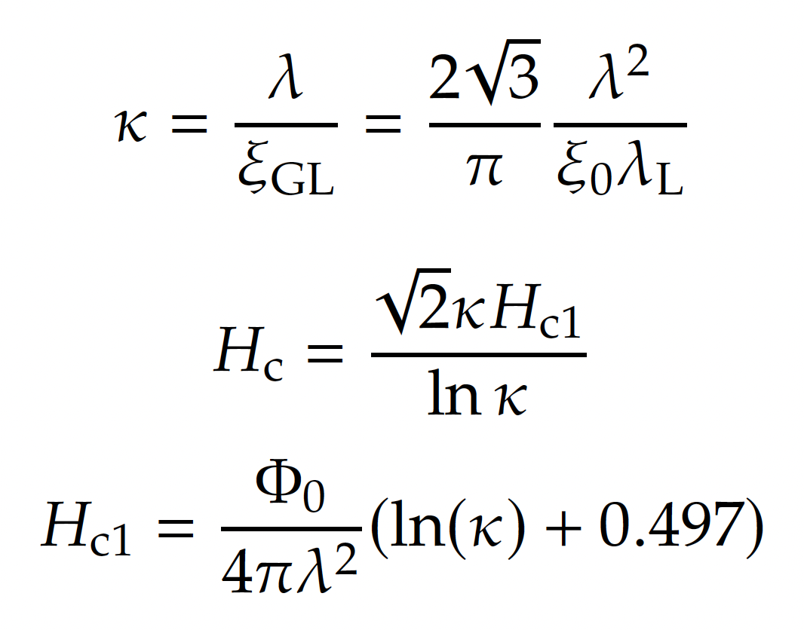
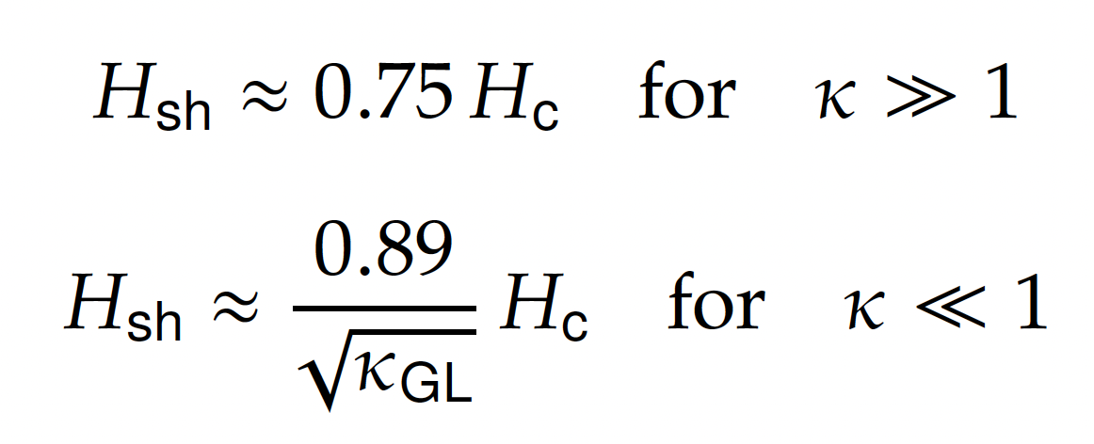
Prediction of maximum surface field H_{max}
Clean limit of λ_{L}

Slide 24
Post-Deposition Annealing
1
Theory & Methods
→ Improvement of T_{C} and H_{C1}
μ₀H_{C1} = 15 mT
μ₀H_{C1} = 81 mT
μ₀H_{C1} = 98 mT
μ₀H_{C1,bulk} ≈ 33 mT
900 °C annealing for 1 hour
→ heating rate 3 °C/min
→ controlled cooling rate ~ 1.45 °C/min
for 8 hours to 200 °C
[Gonzalez.I. et al., J. Appl. Phys. 134, 159902 (2023)]
[Gonzalez.I. et al., J. Appl. Phys. 134, 035301 (2023)]

Slide 25
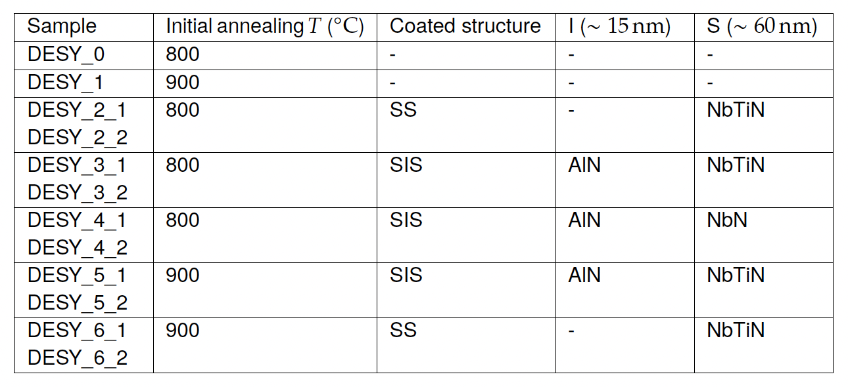
Flux Expulsion Measurement

Slide 26
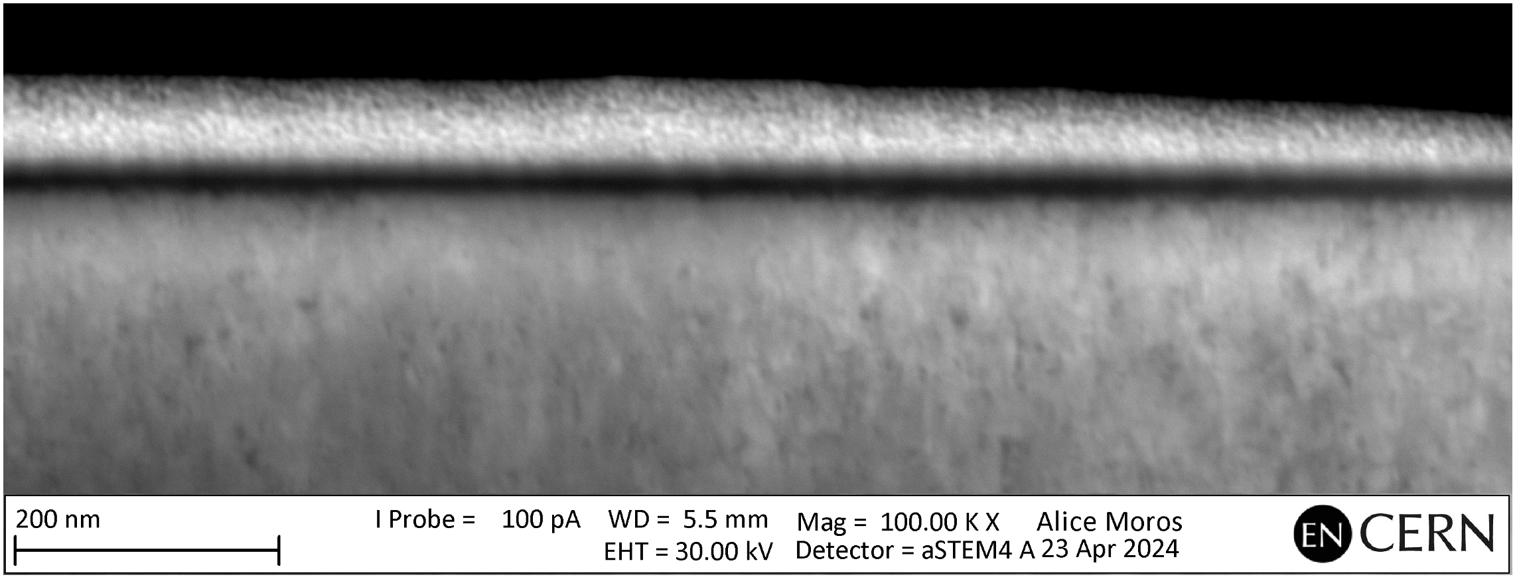
STEM Measurements at CERN
Scanning transmission electron microscopy of Tc_6_2 Nb/NbTiN

Slide 27
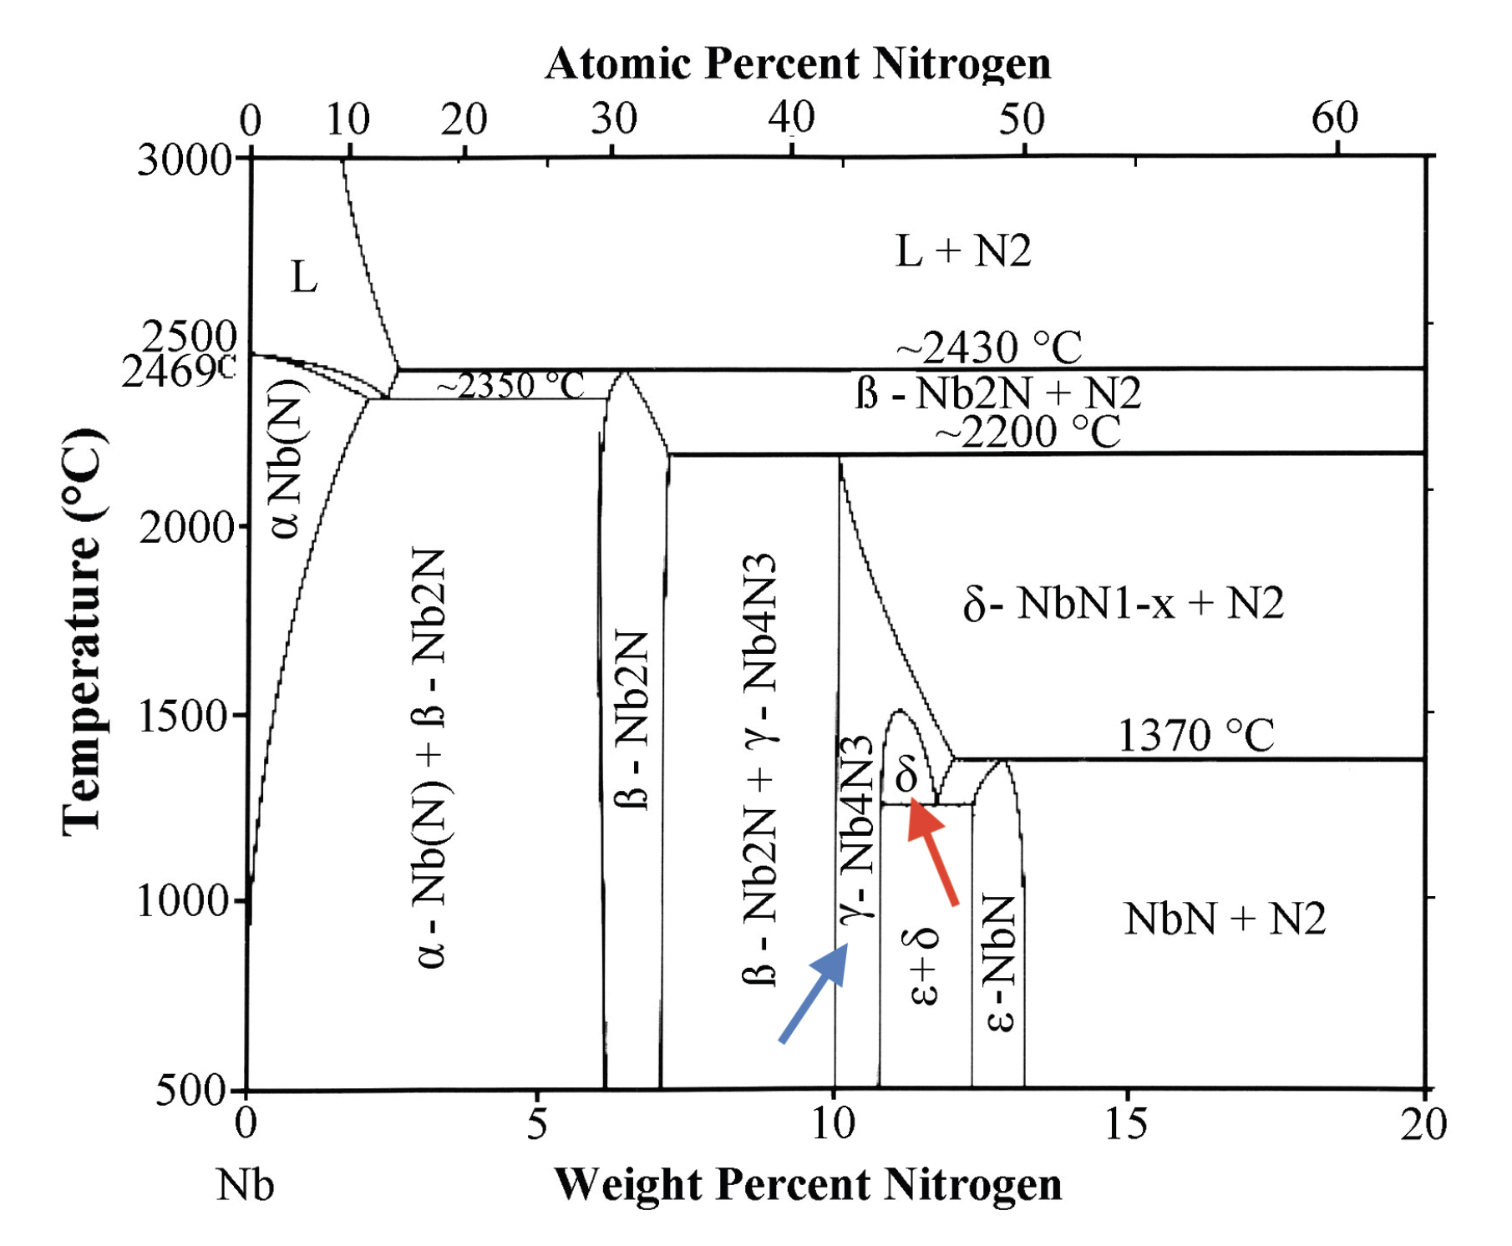
NbN Phase Diagram

Slide 28
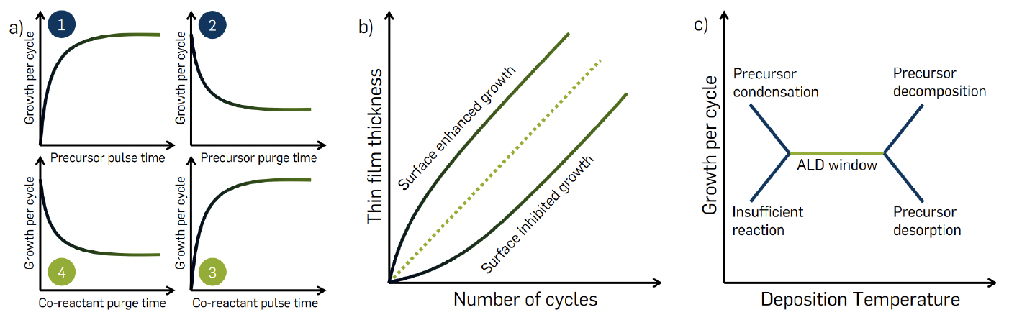
PEALD

Slide 29
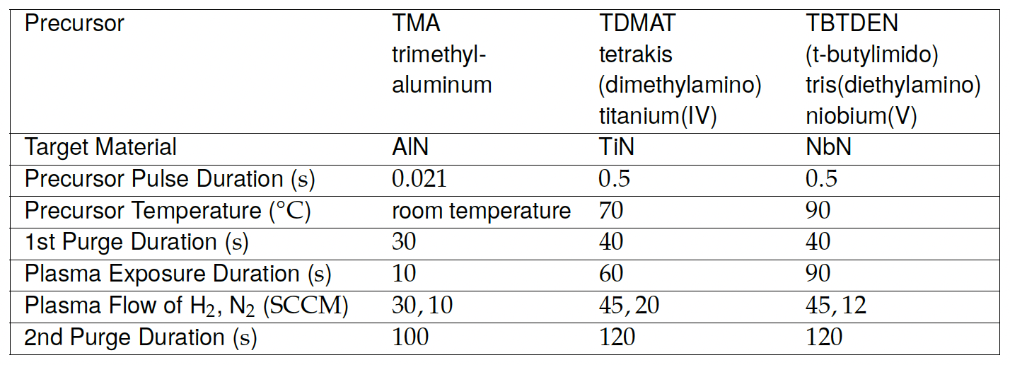
Deposition specifications

Slide 30
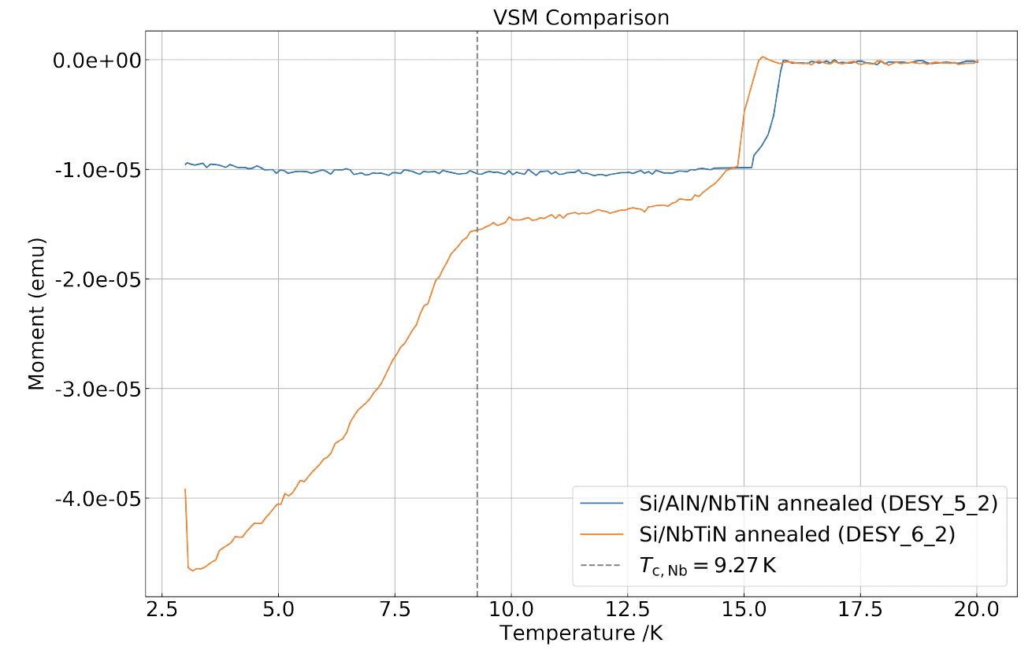
VSM T_{c} Measurements Results
text

Slide 31
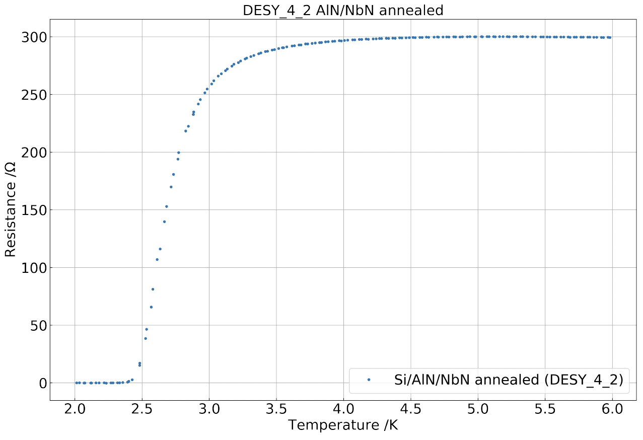
Electrical-transport T_{c} Measurement Result for NbN
900 °C annealing of SIS Nb/AlN/NbN
  intended high-T_{C} 𝛿-phase is not formed
  Ti as stabiliser of the cubic high-T_{C} 𝛿-phase
  NbN excluded from SIS studies

Slide 32
H_{C1} measurement at KEK
Measured HC1 of Nb/SiO2/NbN samples vs. NbN thickness:
Determination of H_{C1}(d) for SIS mandatory
Third-harmonic voltage measurement with
local magnetometry at KEK in Japan
  SIS coated Nb samples with varying sc layer thicknesses
Compare results with theory!
H_{C1} of bulk Nb
Ito, H. et al. [arXiv: 1907.03410] (2019)

