Slide 1
Point contact tunneling spectroscopy for SRF cavities and Qubits
Ivana Curci
CEA/IRFU

Slide 2
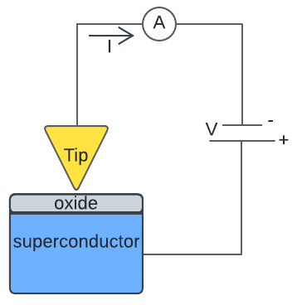
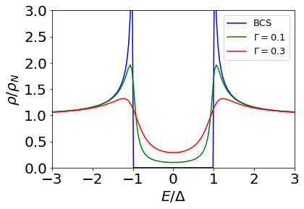
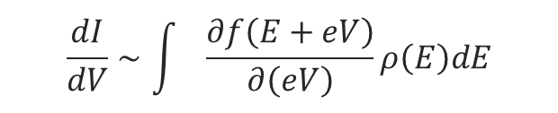

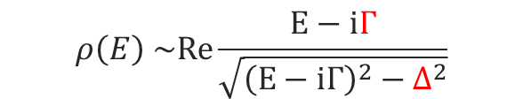
Principle of tunneling spectroscopy
$$∆$$
SIN junction
Dynes formula
$$ρ\left(E\right) \sim Re\frac{E−iΓ}{\sqrt{{{\left(E−iΓ\right)}^{2}−∆}^{2}}}$$
$$\frac{dI}{dV}∼\int{\frac{∂f\left(E+eV\right)}{∂\left(eV\right)}}ρ\left(E\right)dE$$
Other models:
Shiba (magnetic impurities)
Arnold
McMillan
N
Fermi function
Superconducting DOS
proximity effect
S
Our PCT instrument has mapping capability with ~µm resolution statistics of the superconducting parameters spatial distribution

Slide 3
Outline
ALD- coated Nb.
Nb-HPR-annealed.
Nb₃Sn-Cu.
Nb, Ta, Ta/Nb for 2D Qubits.
SRF cavities

Slide 4
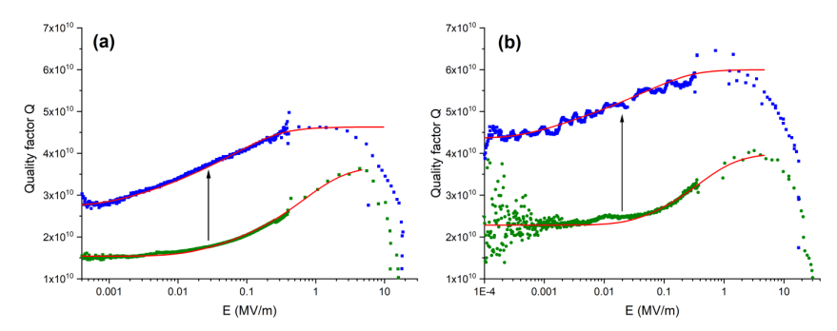
ALD Al₂O₃-Nb
ALD + heat treatment decreases TLS losses and increases the quality factor at low fields.
First experiment
Second experiment
650°C 4 h
650°C 10 h

Slide 5
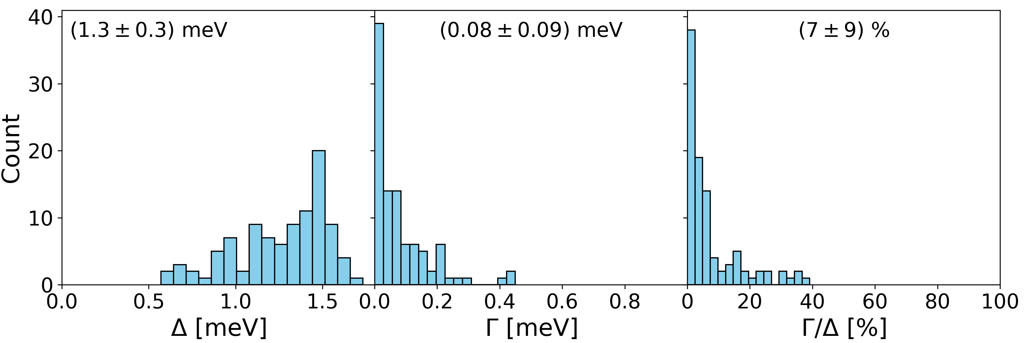
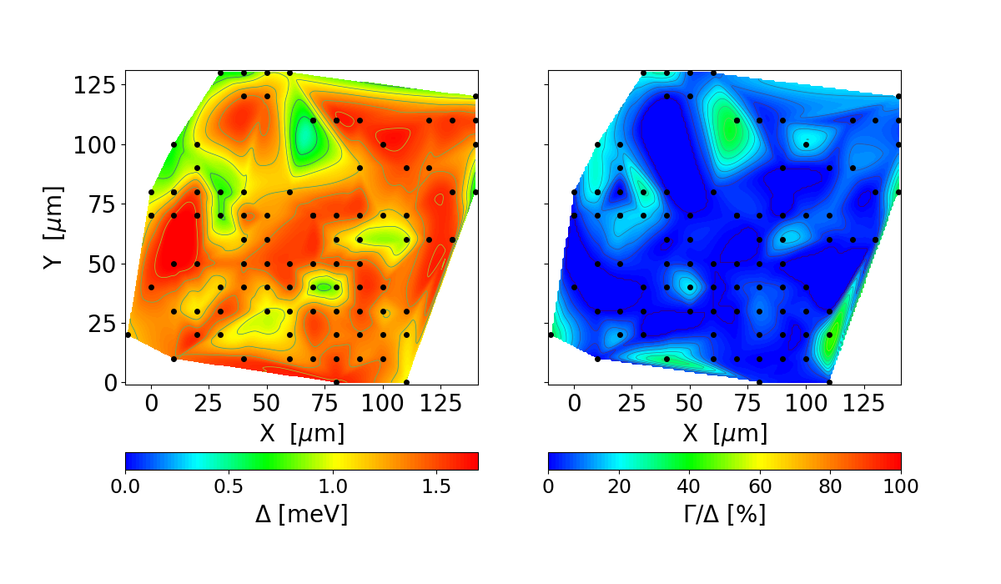
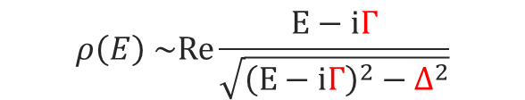
ALD Al₂O₃-Nb
Dynes formula
$$ρ\left(E\right) \sim Re\frac{E−iΓ}{\sqrt{{{\left(E−iΓ\right)}^{2}−∆}^{2}}}$$
bulk
Reminder!!
Small Δ and Γ might reveal a proximity effect.
Non- homogeneous spatial distribution of Δ and Γ.

Slide 6
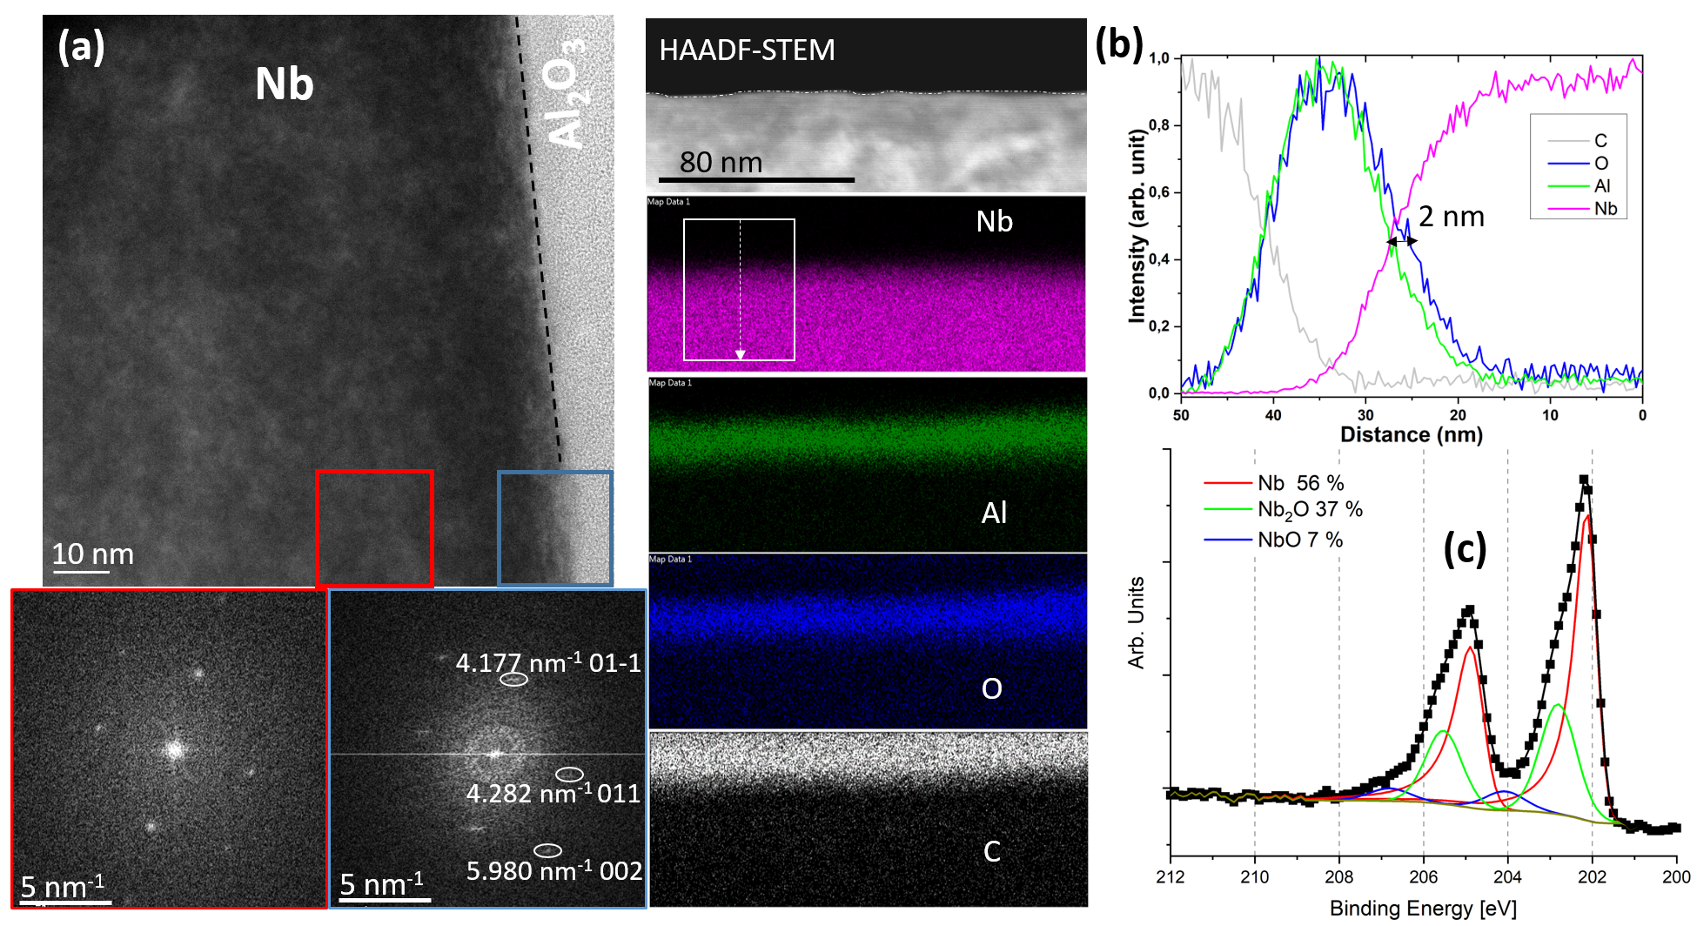
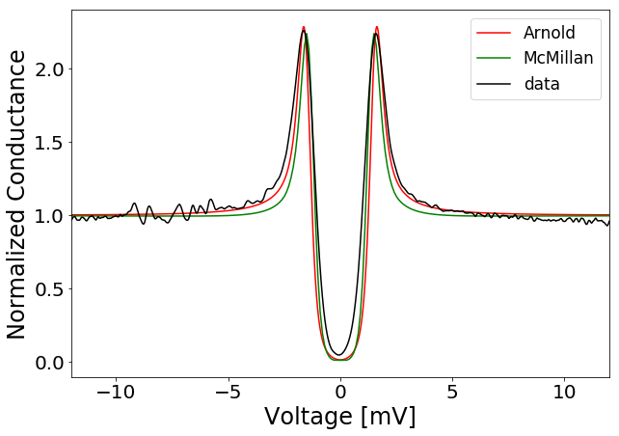
Correlation between PCT, XPS and TEM
T=1.8 K
N
Δn
See Y. Kalboussi talk…
McMillan:
Δn=0, Δs=1.55, g1=5, g2=0.1, Γ =0.01
d ≤ 2.3 nm
S
Δs
TEM and XPS reveal a 2 nm Nb oxide that might be responsible for the proximity effect.

Slide 7
Outline
ALD- coated Nb
Nb-HPR-annealed
Nb₃Sn-Cu
Nb, Ta, Ta/Nb for 2D Qubits.
SRF cavities

Slide 8
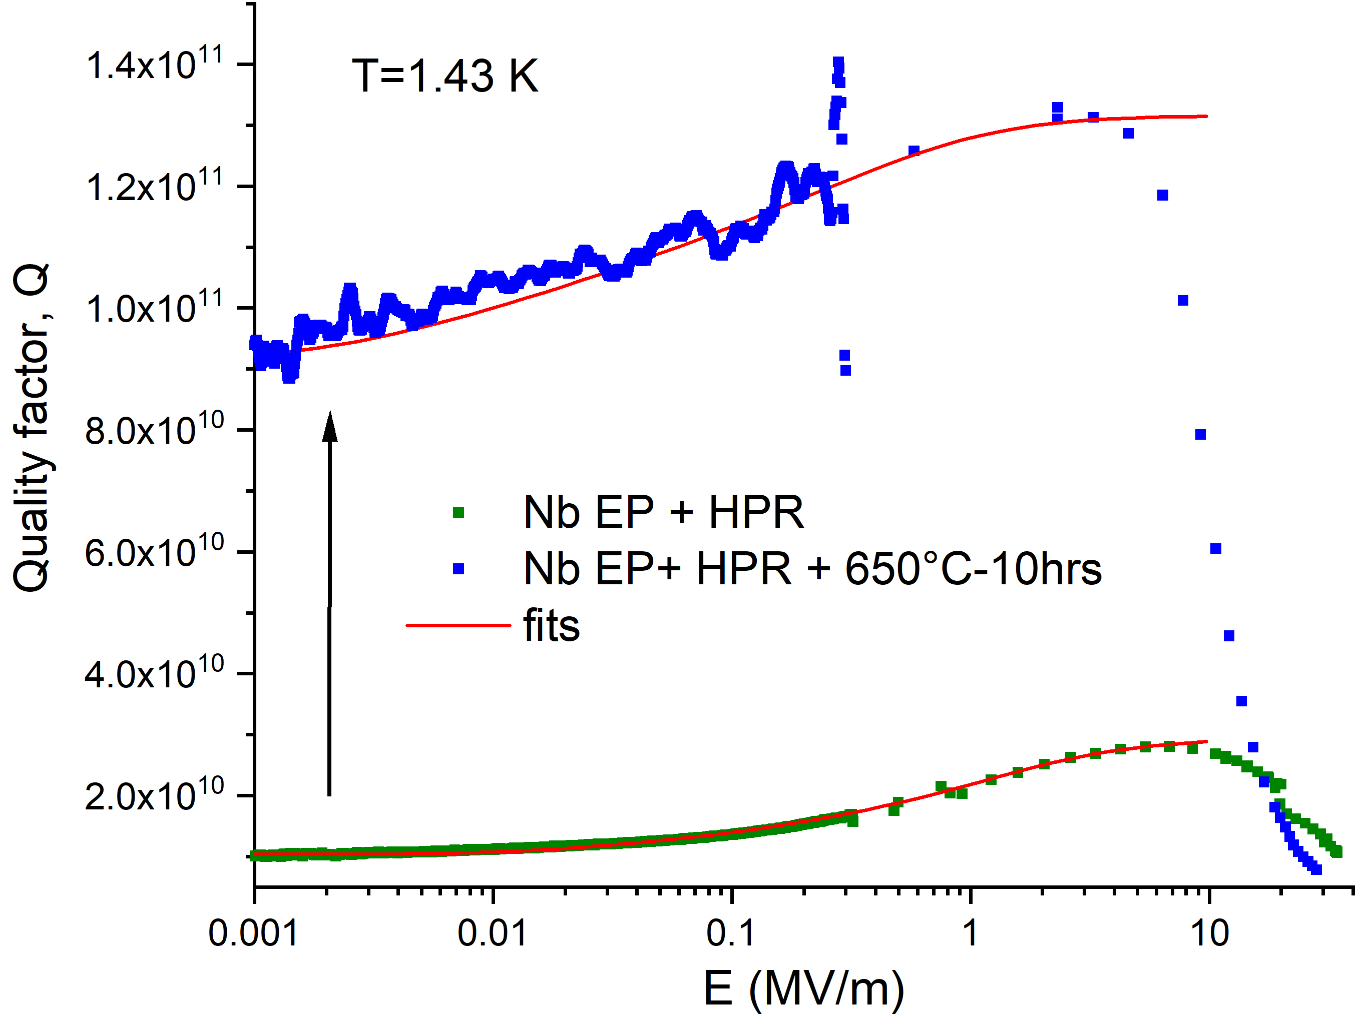
Nb-HPR-annealed
(Nb EP + HPR + 650°C-10hrs + HPR)
SRF cavities show Q factors ~10 times higher than Nb EP + HPR
σ_{TLS} and tan(δ_{TLS}) decreased by a factor 10.

Slide 9
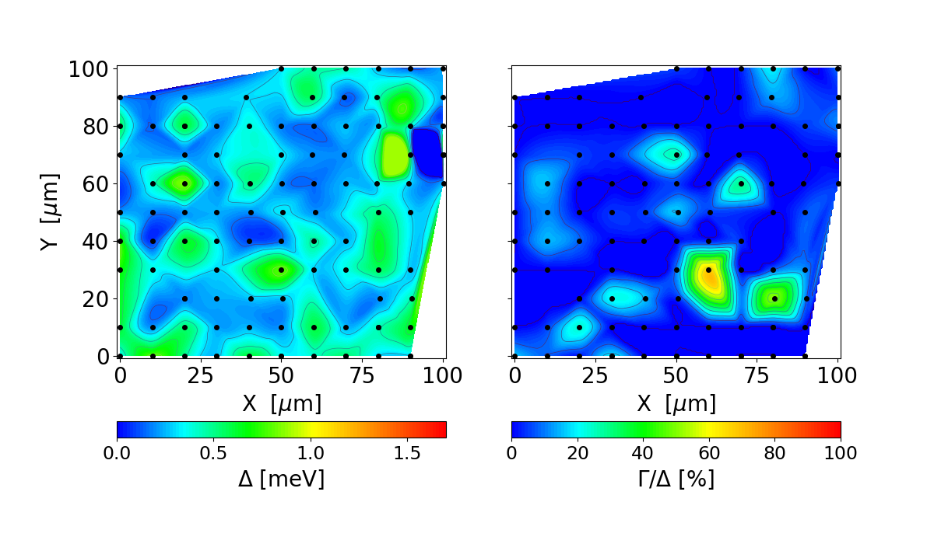
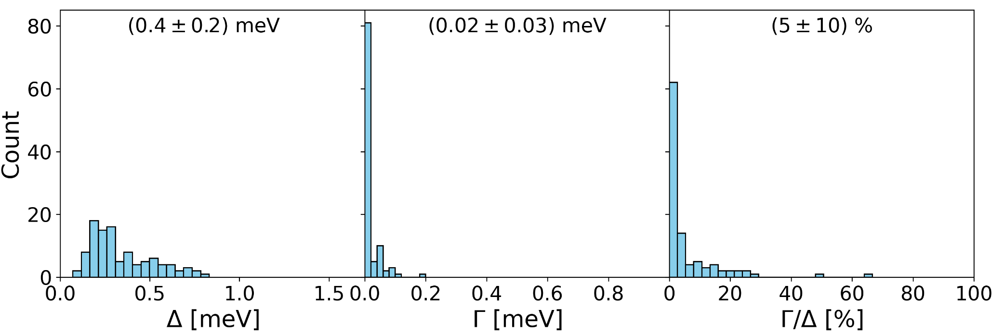
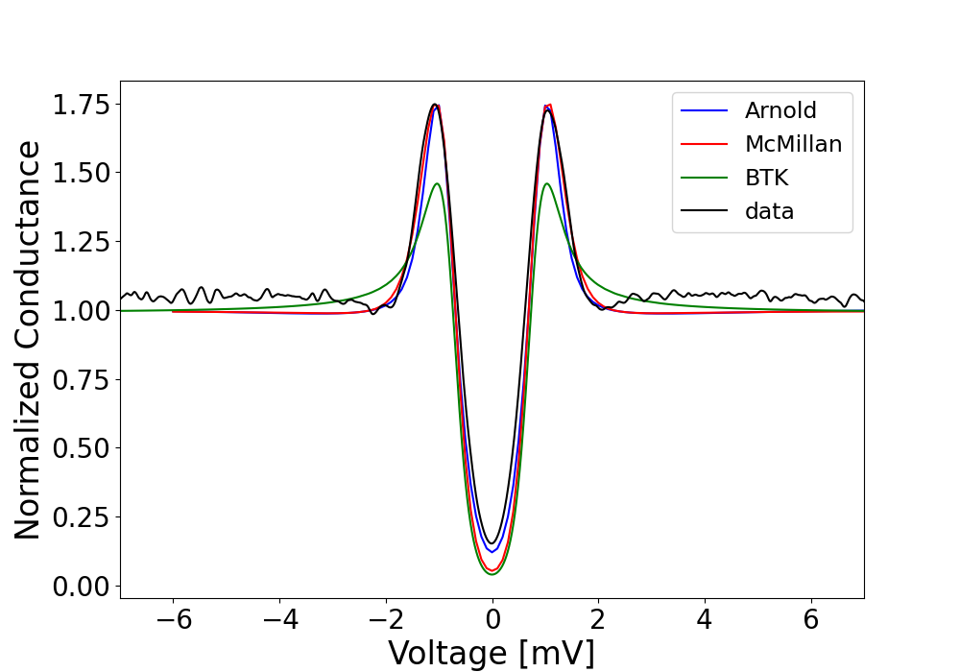
Nb-HPR-annealed
bulk
T=1.85 K
Dynes
Very small Δ and Γ reveal a proximity effect. Non-homogeneus spatial variation.
McMillan predicts d ≤ 6 nm, consistent with TEM (~ 5 nm).
However, for various junctions we did not obtain good fits with McMillan/Arnold.
We want to test a new proximity effect model (Usadel).
McMillan:
Δn=0, Δs=1.2,
g1=2, g2=0.1,
Γ =0.01
d ≤ 6 nm

Slide 10
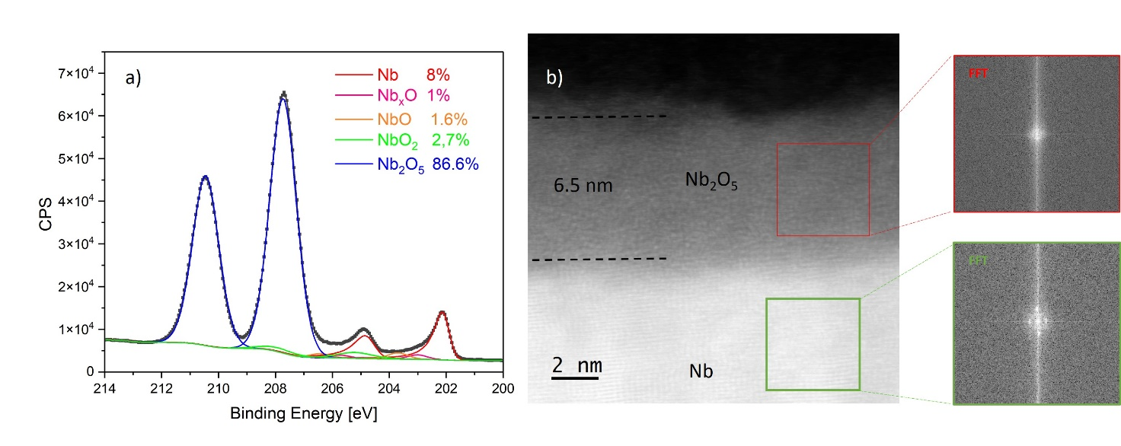
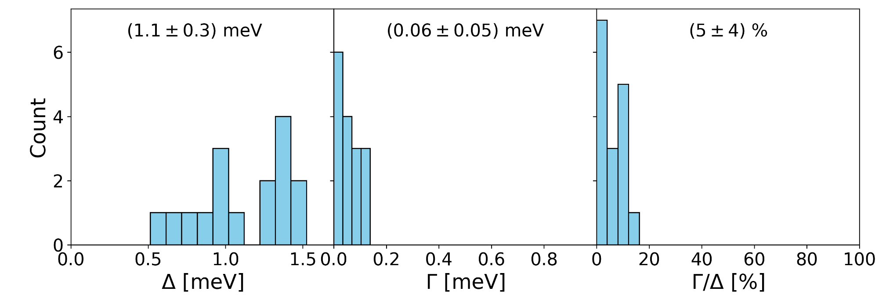
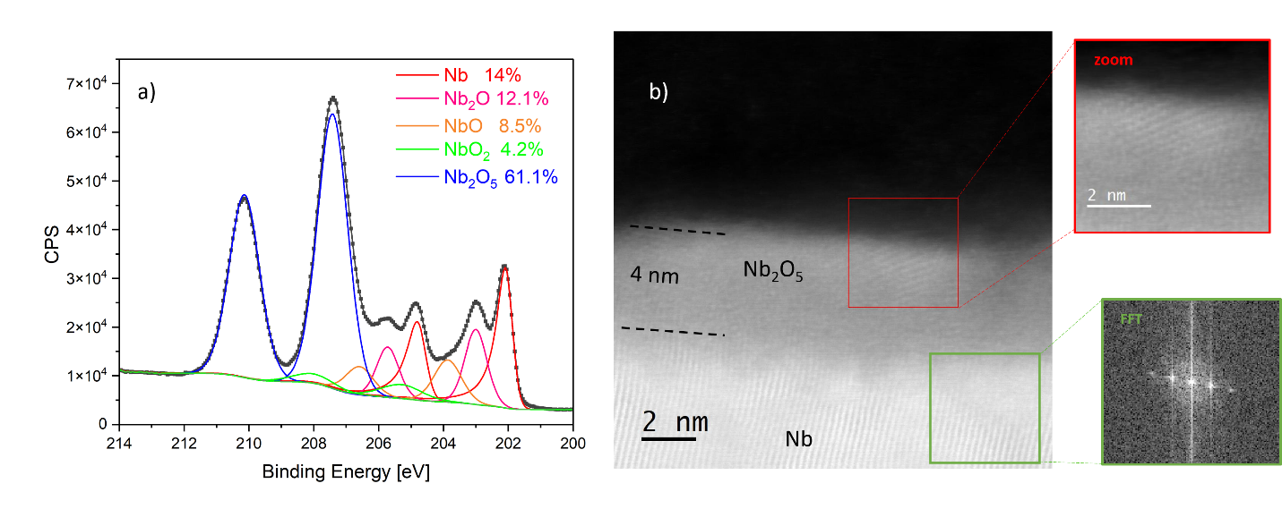
Nb+HPR+annealed vs Nb+HPR
Nb EP + HPR
bulk
7.5 nm
7.5 nm
Nb EP + HPR + 650°C-10hrs + HPR
bulk
4.5 nm
4.5 nm
4.5 nm
4.5 nm
See Y. Kalboussi talk…
Nb +HPR shows higher Δ and Γ than Nb+HPR+annealed.
TEM and XPS show NbOx partially crystalline which explains the proximity effect in PCT.
At low field, the increase in the Q factor can be explained by the thinner and more cristalline oxide (less defects, less TLS).
And at higher field?

Slide 11
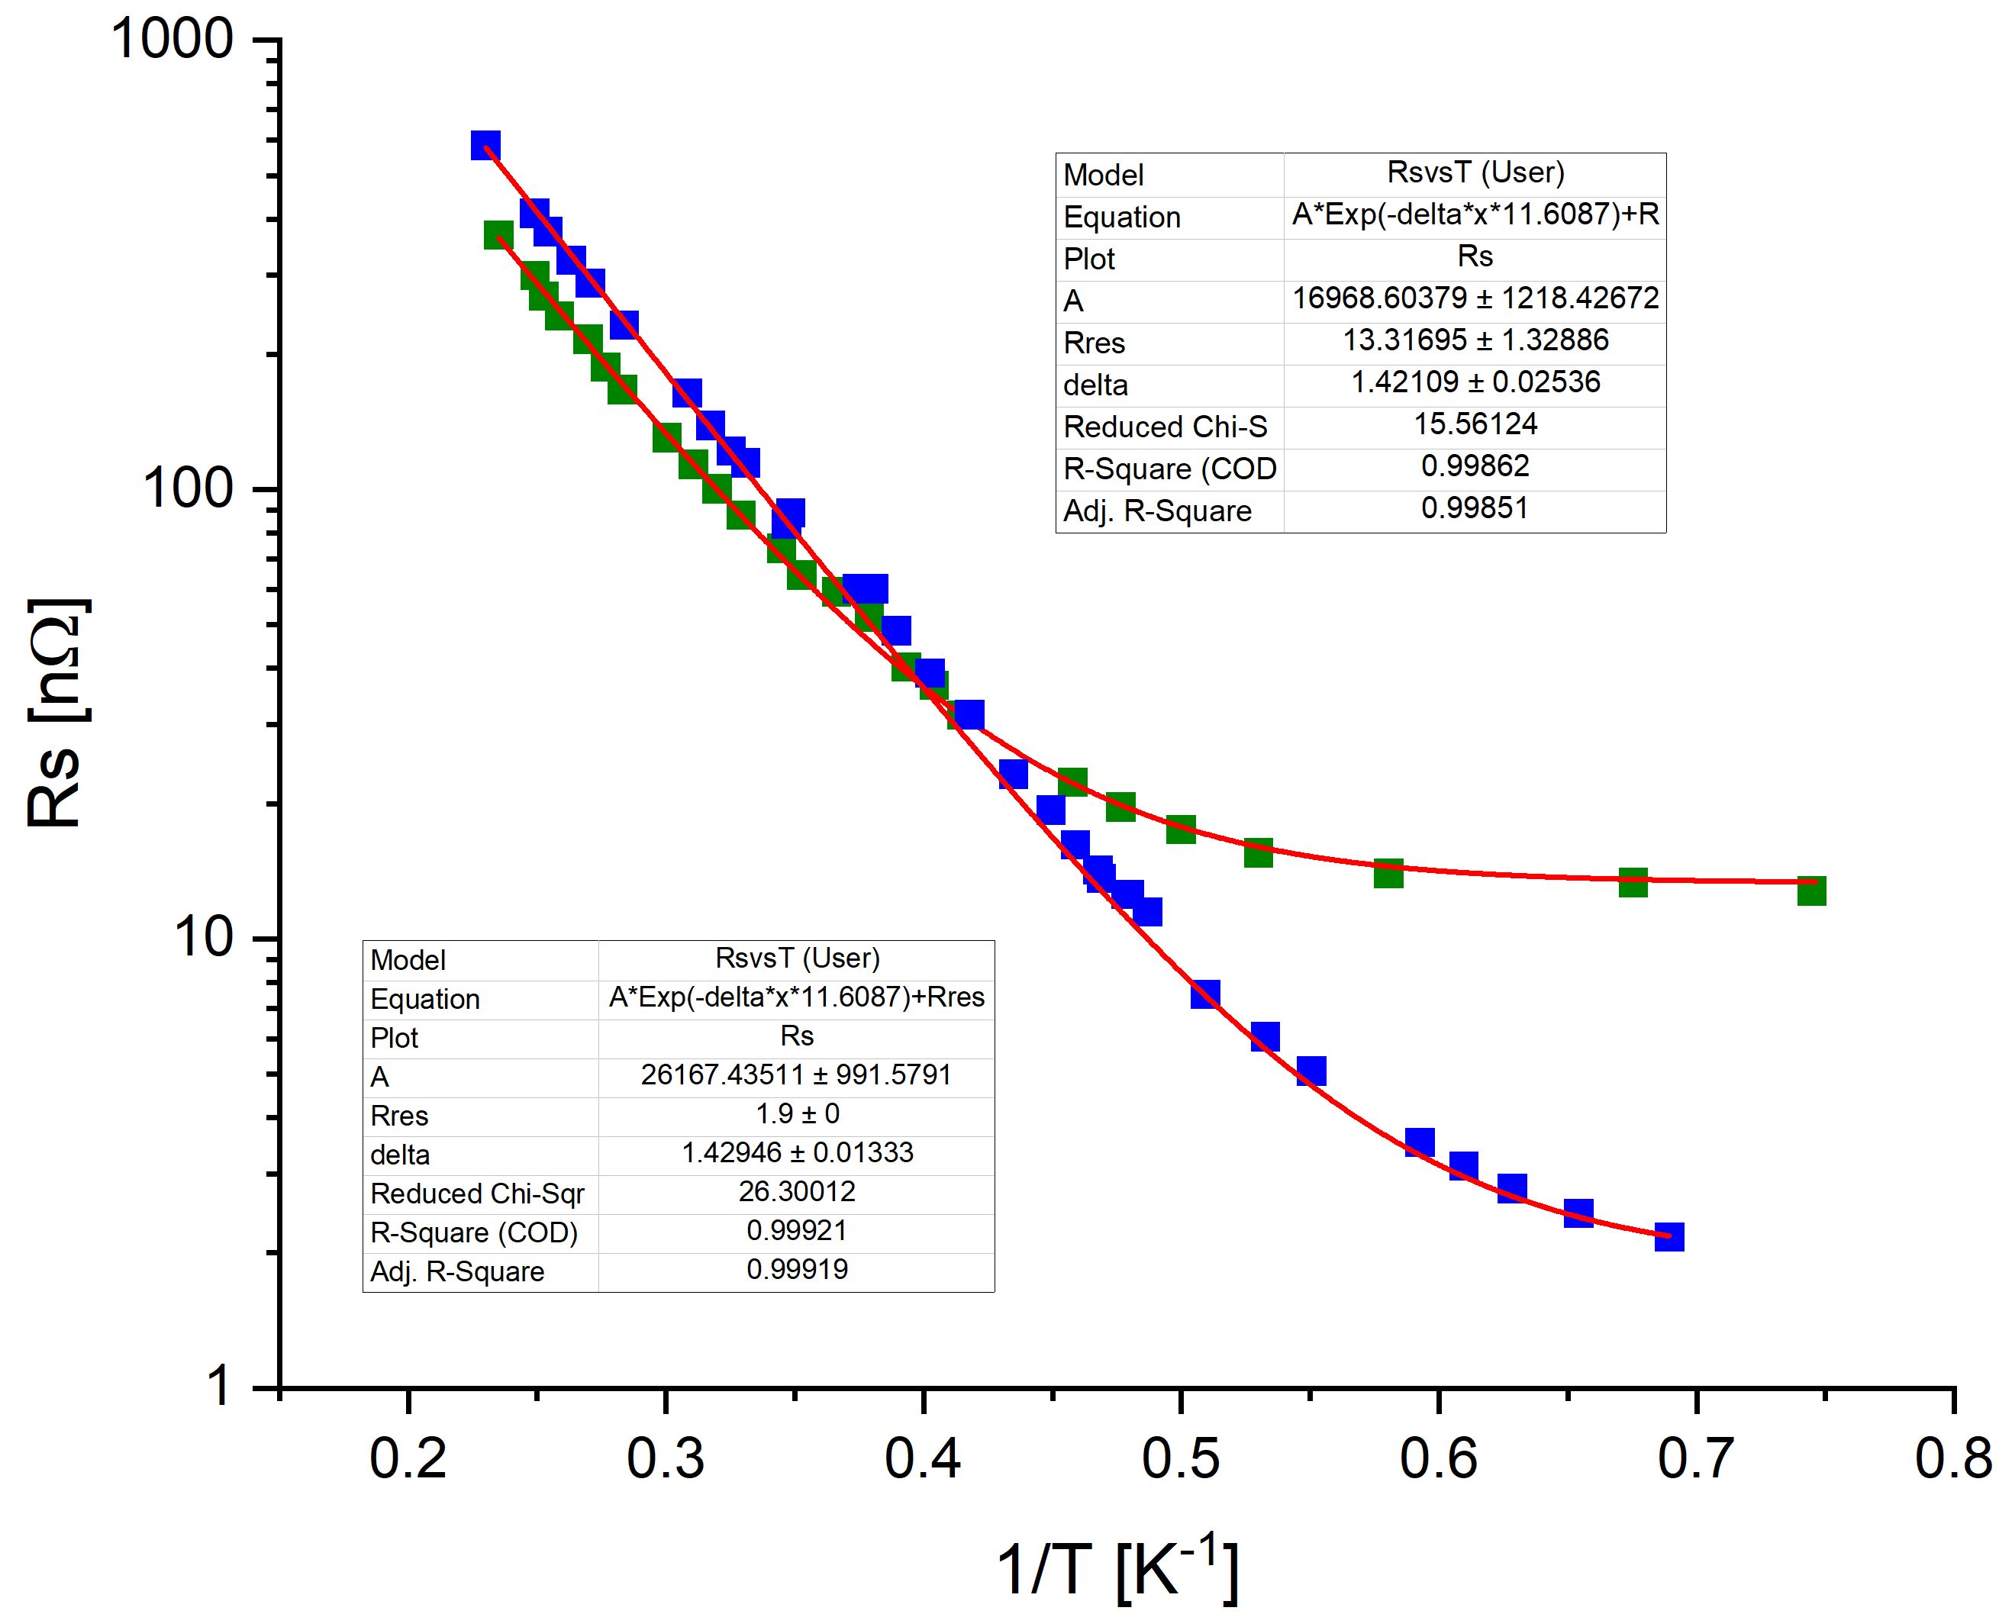
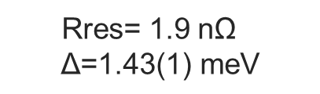
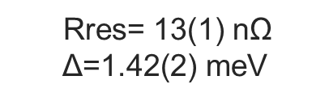
RS
Nb+HPR+annealed vs Nb+HPR
Rres= 13(1) nΩ
$$\text{Δ}\text{=}\text{1}\text{.}\text{42}\text{(}\text{2}\text{) }\text{meV}$$
Rres= 1.9 nΩ
$$\text{Δ}\text{=}\text{1}\text{.}\text{43}\text{(}\text{1}\text{) }\text{meV}$$
Same Δ but ${\text{R}}_{Residual}$is higher for the reference. ${\text{R}}_{Residual}$ Γ ? Analysis on process
PCT reveal a reduction in Δ due to a proximity effect. How can we explain the difference in ${\text{Δ}}_{PCT }$ vs ${\text{Δ}}_{Rs }$ ??

Slide 12
Outline
ALD- coated Nb
Nb-HPR-annealed
Nb₃Sn-Cu
Nb, Ta, Ta/Nb for 2D Qubits.
SRF cavities

Slide 13
Nb₃Sn-Cu for SRF cavities:
There are current efforts aimed at obtaining cavities with high quality factors using Nb3Sn on Cu.
.
Nb3Sn
Nb3Sn
Nb3Sn
Nb3Sn
Barrier to reduce Cu diffusion.
Y₂O₃
Ta
Cu
Cu
CERN samples

Slide 14
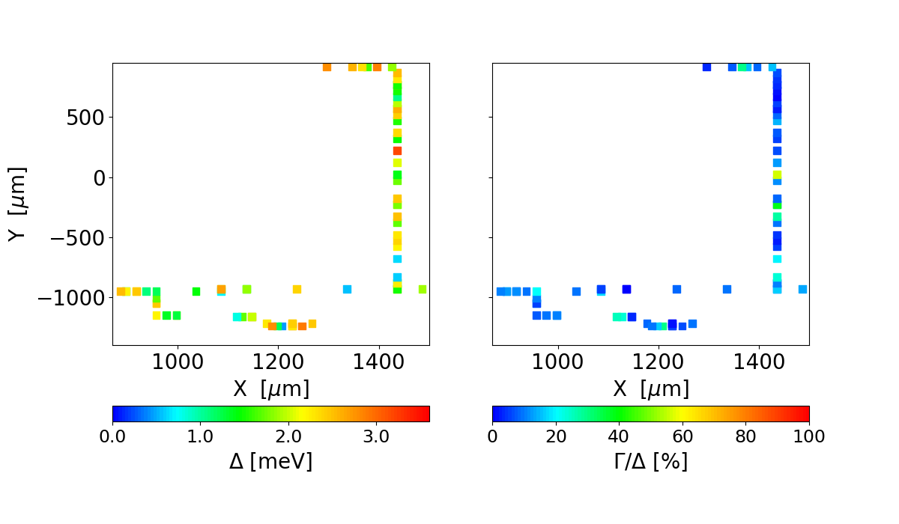
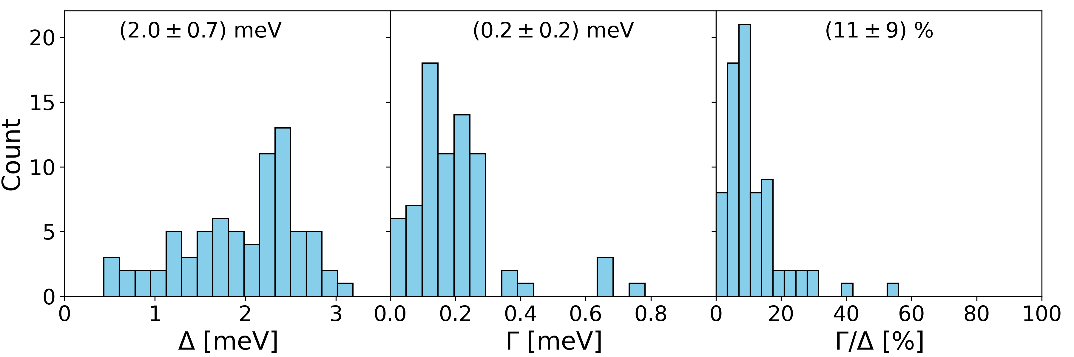
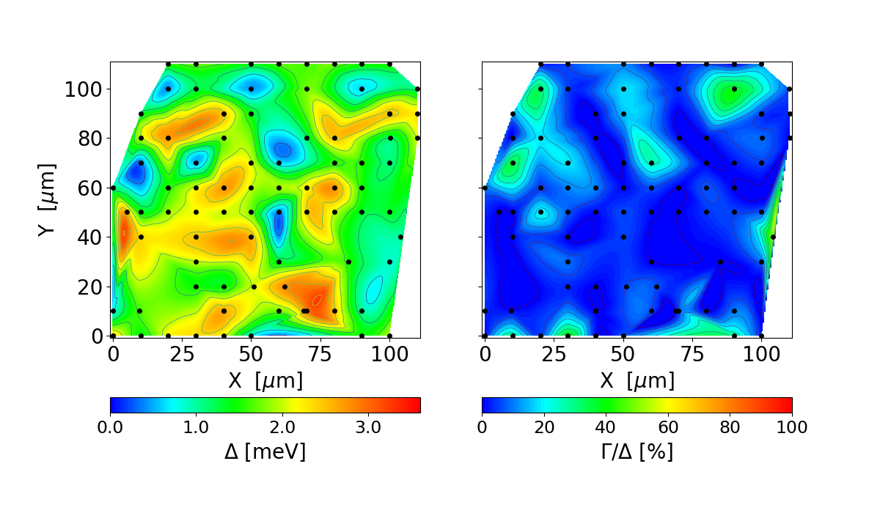
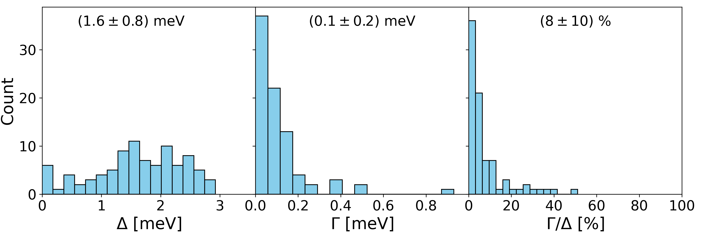
Nb₃Sn-Ta-Cu and Nb₃Sn-Y₂O₃-Cu
Nb₃Sn-Ta-Cu
bulk
Nb₃Sn-Y₂O₃-Cu
bulk
Small Δ and Γ (smaller values for Nb₃Sn-Y₂O₃-Cu) Proximity effect? Nb? Cu?
Non-homogeneous spatial distribution of Δ and Γ.

Slide 15
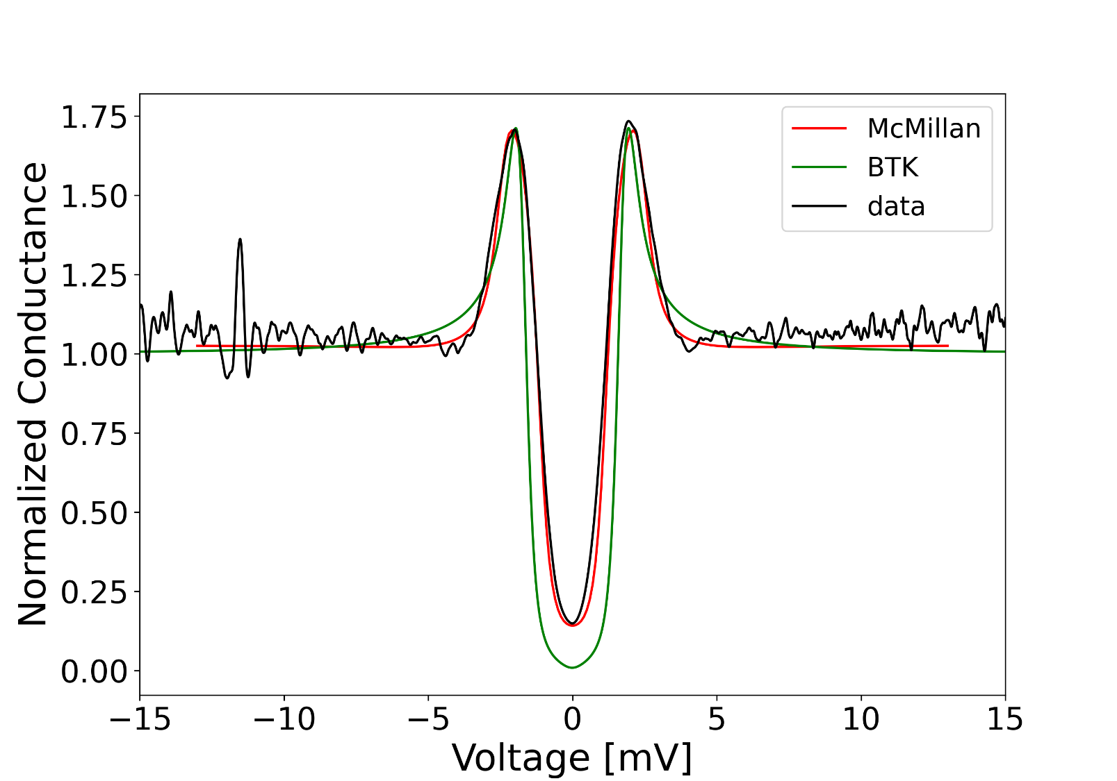
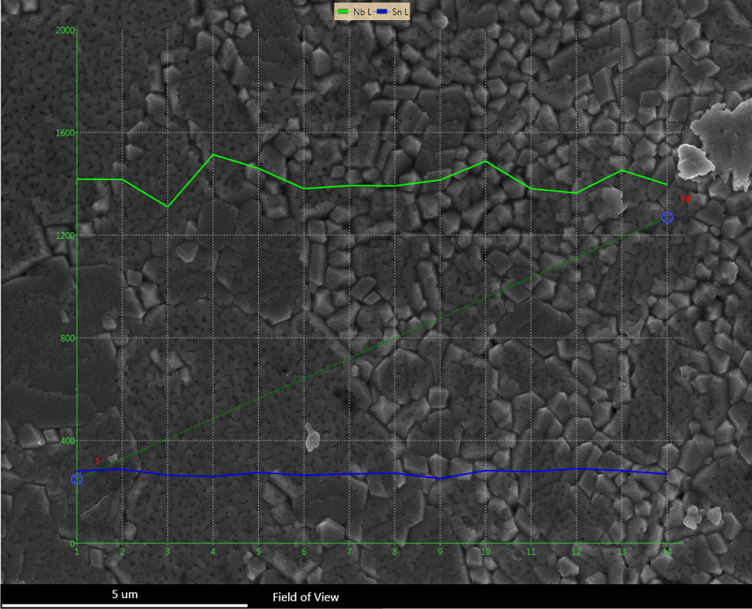
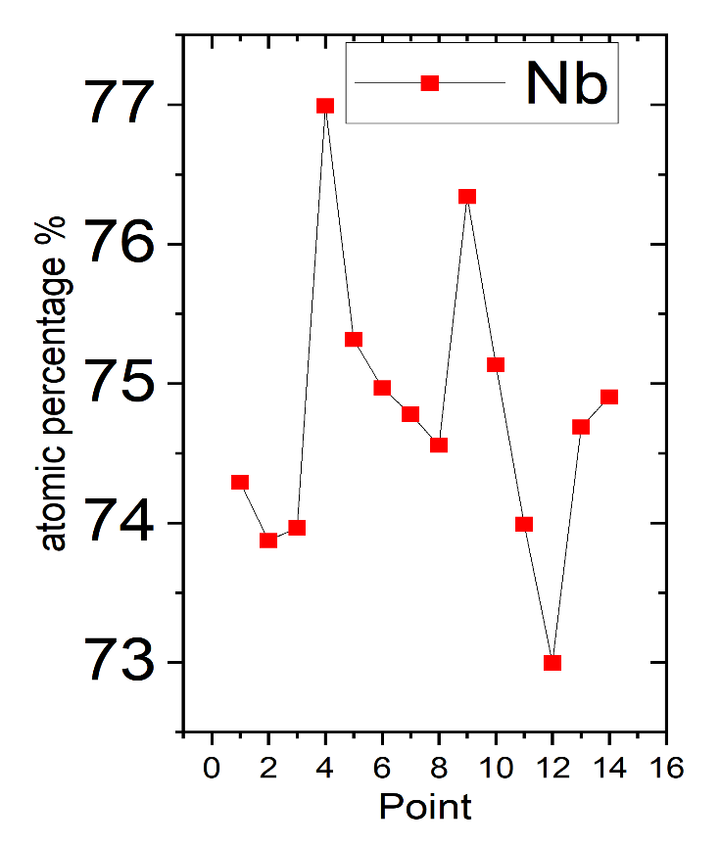
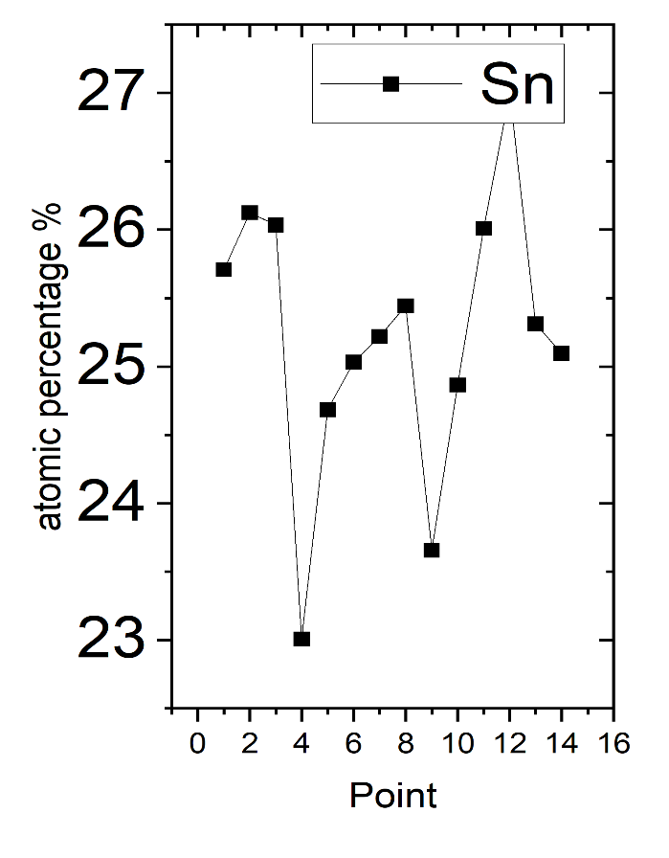
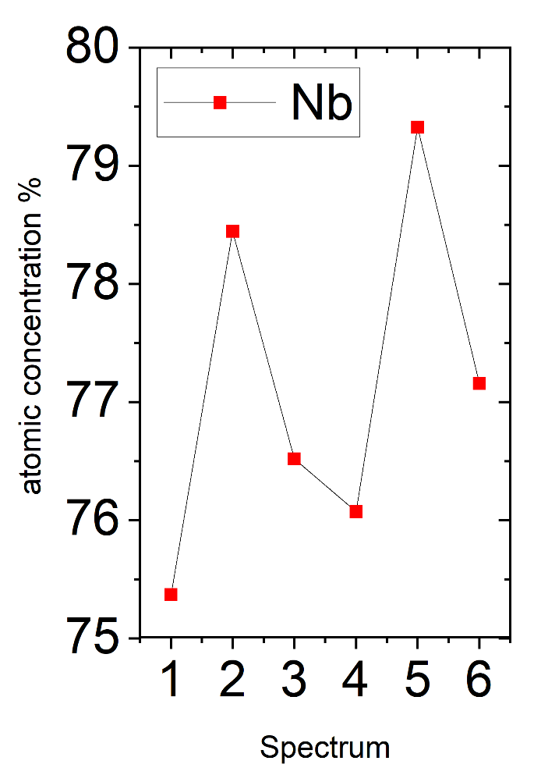
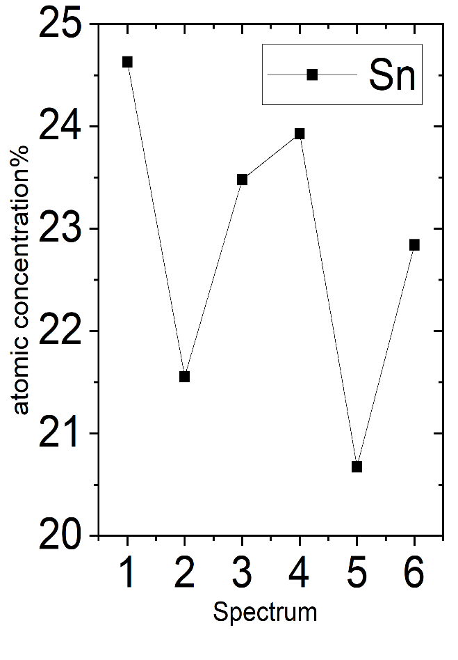
EDS/SEM for Nb₃Sn-Cu samples (CERN)
Nb₃Sn-Ta-Cu
Nb₃Sn-Y₂O₃-Cu
Dynes
scan
McMillan:
Δn=0, Δs=2.45,
g1=3.5, g2=0.7,
Γ =0.17
Nb₃Sn-Y₂O₃-Cu
EDS shows 73-77 %Nb variation for
Nb₃-Sn-Ta-Cu sample and 75-79% for
Nb₃Sn-Y₂O₃-Cu.
For Nb₃Sn-Y₂O₃-Cu, some junctions fit
with McMillan. It predicts d~3-7 nm.
EDS does not show Cu on the surface.
Not enough resolution?
XPS?
Tuesday’s presentations!!

Slide 16
Outline
ALD- coated Nb.
Nb-HPR-annealed.
Nb₃Sn-Cu.
Nb, Ta, Ta/Nb for 2D Qubits.
SRF cavities

Slide 17
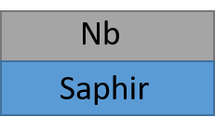
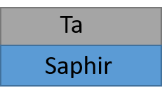
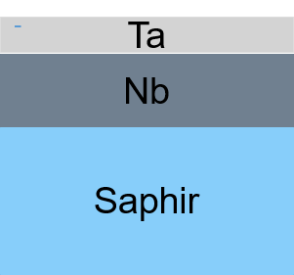
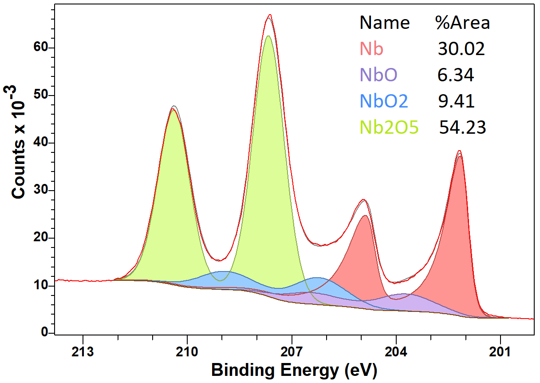
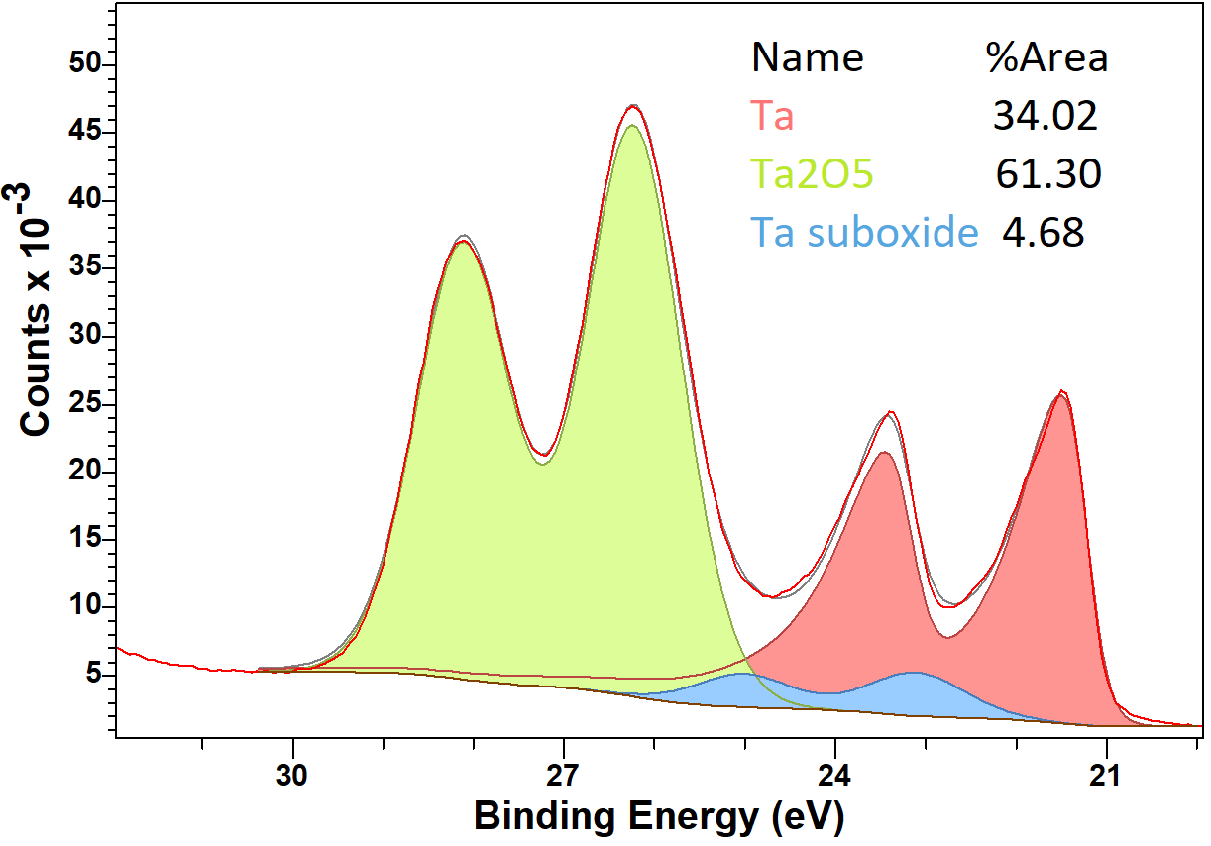
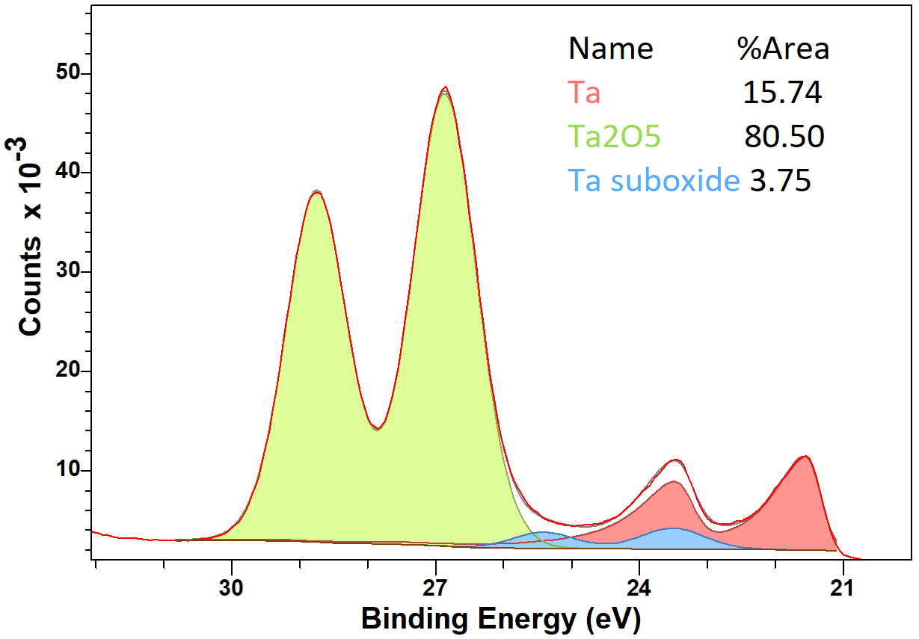

Qubits coherence time (literature):
T1~200-300 μs
T1~ 400- 500 μs
T1~100 μs
${\text{T}\text{1}}_{Ta−Nb}$ >${\text{T}\text{1}}_{Ta}$ > ${\text{T}\text{1}}_{Nb }$Why? Oxides?
SPEC sample
SPEC sample
FNAL/SQMS sample
Nb-Sapphire
Ta-Sapphire
Ta-Nb-Sapphire
What can PCT reveal to understand the difference between Ta and Nb Qubits?

Slide 18
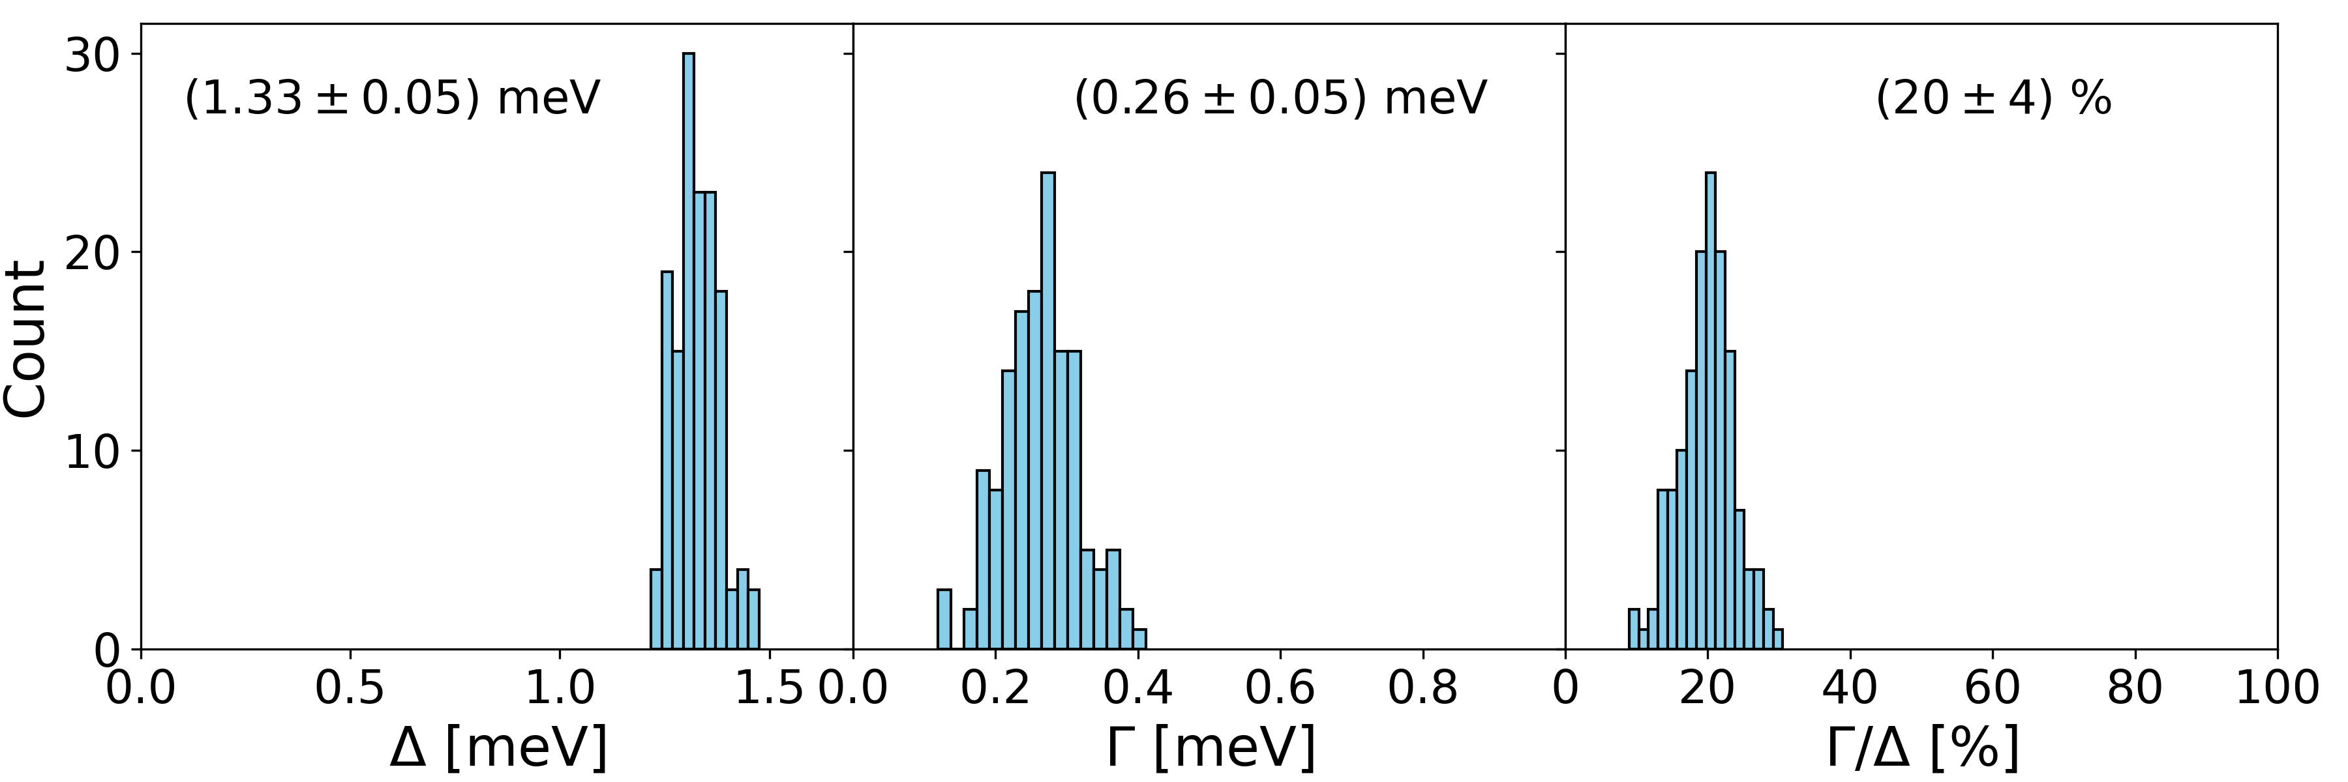
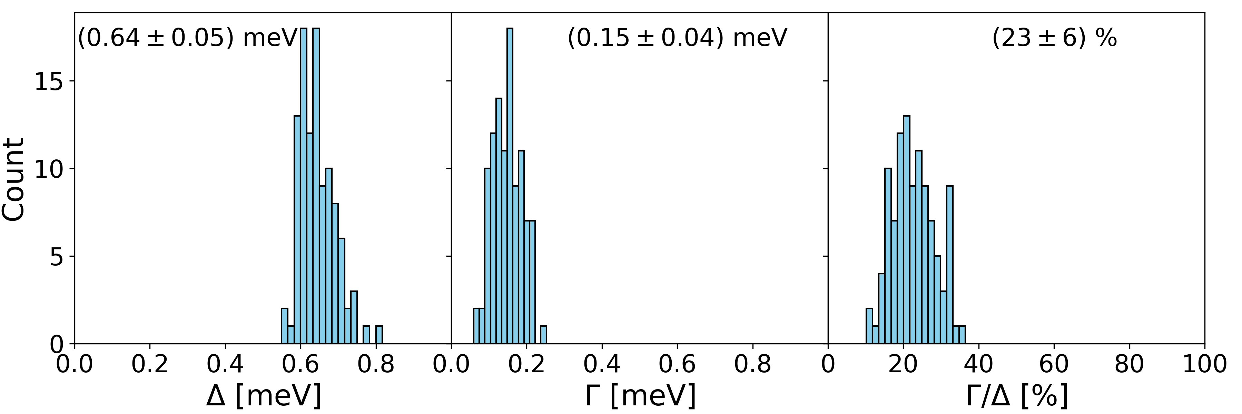
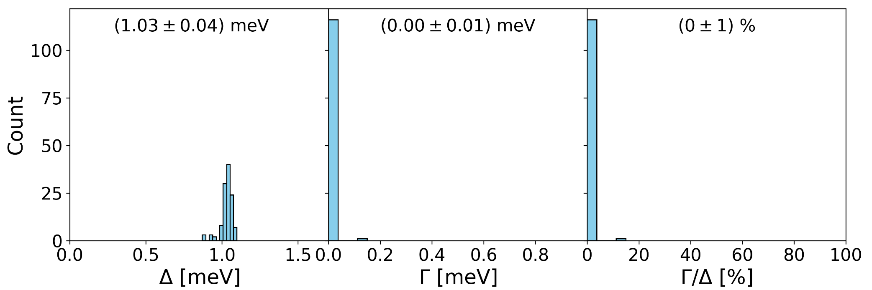


PCT for Nb, Ta and Ta/Nb
Nb-Sapphire
bulk
T1~100 μs
Losses are not dominated by Δ in Qubits.
Γ T1 ? How?
T=1.85 K
${{\text{Γ}}_{Ta−Sapphire }=\text{0.15 }\text{< }\text{Γ}}_{Nb−Sapphire}$=0.26. Correlation with ${\text{T}\text{1}}_{Ta}$ >${\text{T}\text{1}}_{Nb}$ ?
${\text{T}\text{1}}_{Ta−Sapphire}$ for our sample vs literature?
XRD reveal both α (wanted) and β (unwanted) phases.
Ta-Sapphire
T1~200-300 μs
bulk
T = 1.33 K
Small Δ and Γ on Ta/Nb proximity effect between Ta and Nb.
McMillan gives good fits for Ta/Nb. It predicts
d ≤ 10 nm and Γ ~ 0.01.
${\text{Γ}}_{Ta−Nb}$=0.01 < ${\text{Γ}}_{Ta}$= 0.15.
Correlation with ${\text{T}\text{1}}_{Ta−Nb}$ >${\text{T}\text{1}}_{Ta}$ ?
Ta-Nb-Sapphire
T1~ 400- 500 μs
bulk
More PCT on Ta and Nb is needed!!
T= 1.85 K

Slide 19
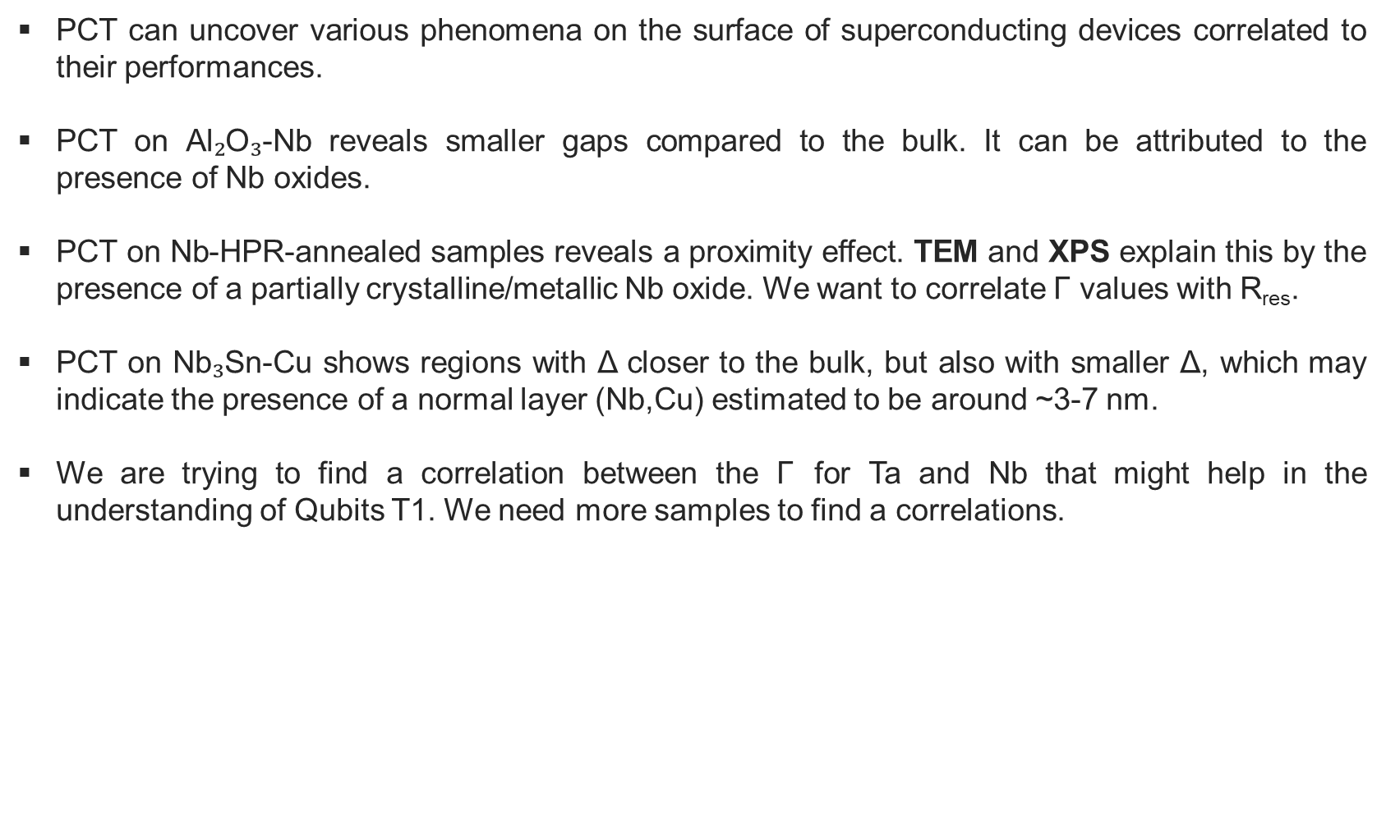
Conclusions
PCT can uncover various phenomena on the surface of superconducting devices correlated to their performances.
PCT on Al₂O₃-Nb reveals smaller gaps compared to the bulk. It can be attributed to the presence of Nb oxides.
PCT on Nb-HPR-annealed samples reveals a proximity effect. TEM and XPS explain this by the presence of a partially crystalline/metallic Nb oxide. We want to correlate $\text{Γ}$ values with R_{res}.
PCT on Nb₃Sn-Cu shows regions with Δ closer to the bulk, but also with smaller Δ, which may indicate the presence of a normal layer (Nb,Cu) estimated to be around ~3-7 nm.
We are trying to find a correlation between the $\text{Γ}$ for Ta and Nb that might help in the understanding of Qubits T1. We need more samples to find a correlations.

Slide 20
References
Proslier, T., Zasadzinski, J., Moore, J., Pellin, M., Elam, J., Cooley, L., ... & Gray, K. E. (2008). Improvement and protection of niobium surface superconductivity by atomic layer deposition and heat treatment. Applied Physics Letters, 93(19).
Kalboussi, Y., Delatte, B., Bira, S., Dembele, K., Li, X., Miserque, F., ... & Proslier, T. (2024). Reducing two-level system dissipations in 3D superconducting Niobium resonators by atomic layer deposition and high temperature heat treatment. arXiv preprint arXiv:2402.04137.

Slide 21
Thank you

