Slide 1
Applications of Compact SRF Linacs
Prof Graeme Burt
Cockcroft Institute/ Lancaster University

Slide 2
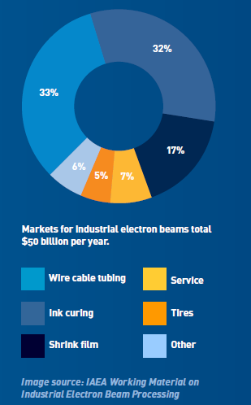
5 Main Industrial Applications
Processing of Polymers (cross-linking, curing, gemstone colouring) – To make them stronger, heat resistance, heat shrinkable, dry faster or change the colour (10,000)
Sterilisation – Use of electrons or X-rays to kill pathogens or prevent undesirable changes.
Non-destructive testing (NDT) – Inspection of components for flaws or hidden features. High energy X-rays are need for thick components.
Ion implanting in chip fabrication – To dope semiconductors to alter near surface properties by placing ions at specific locations and depths.
Watewater and Flue gas treatment – To remove contaminants or bye products of other processes.

Slide 3
Where is there a gap that we can fill?
10 MeV
Rhodotron
At high current, intermediate voltage we are beam power dominated so RF losses are less of an issue until we get to very high voltages.
At low current the power demands are low so SRF only good if capital costs are competitive.
At high voltage intermediate to high current there are good solutions at present but could SRF be better?
Also any application at low current that needs CW
Thin film SRF???
UHF multi cells
Pulsed TW linacs
Beam Voltage
UHF single cells
DC accelerators
100 kW
1000 kW
Beam Power

Slide 4
Where is there a gap that we can fill?
10 MeV
Radiotherapy
Medical Sterilization
Clearly thin film SRF is best aimed at high energy (10 MeV), high beam power (1 MW) applications.
Efficiency would need to be greater than 50% and costs less that $7M to be competitive
Medical sterilization and water treatment seem the best options.
Thin film SRF???
Water treatment
Non-destructive testing
Beam Voltage
Ion Implanting
Polymer Crosslinking for thick samples
Polymer Crosslinking
Flue gas treatment
100 kW
1000 kW
Beam Power

Slide 5
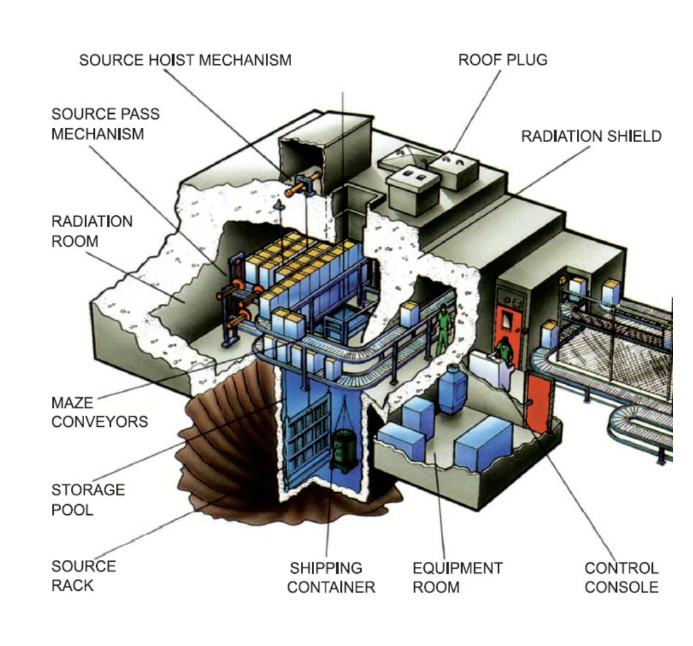
Application: Medical sterilization
50% of single use medical equipment is sterilized by ionizing radiation, to create microbial inactivation.
Gamma/X-rays or electrons can be used to sterilize, commonly Co60 sources (80%) used, but there is a shortage and there are security concerns with transport and disposal.
X-ray replacements have been increasing in the past few years as lower doses are needed.
Aim is to treat pallets not individual items (syringes, plastic containers, bottles, bandages). Also implants.
5-7 MeV is ideal energy for X-rays for a standard pallet.
E-beam treatment is also possible (3-10 MeV) but this is more focused on boxes rather than pallets. It can treat much faster so better for sensitive products.

Slide 6
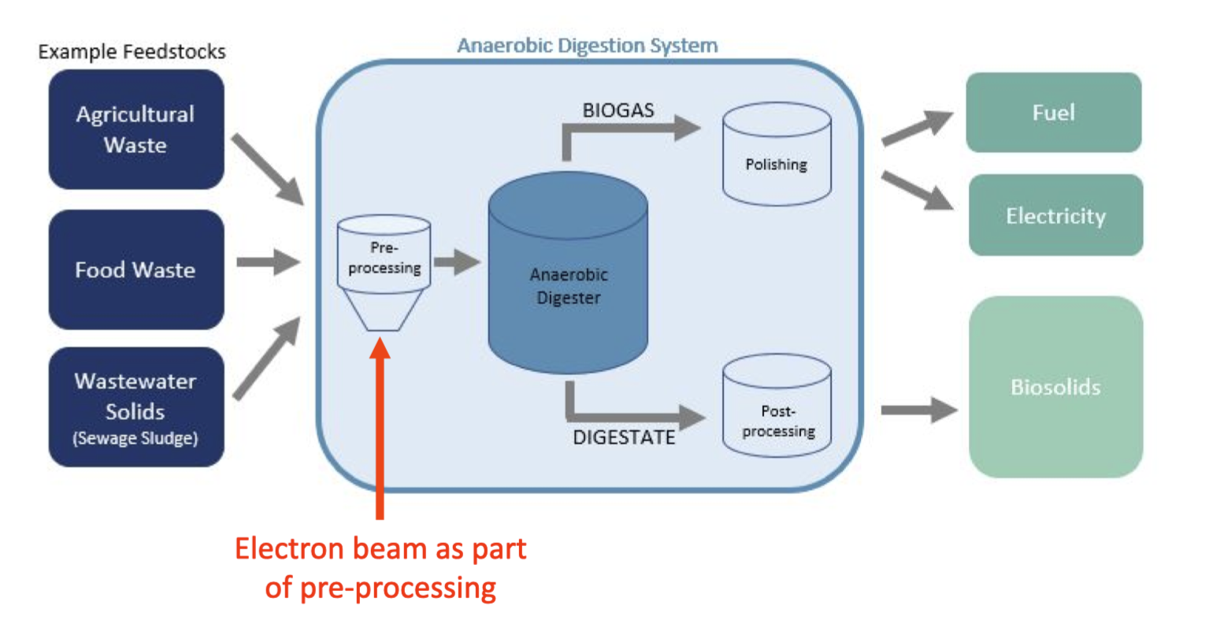
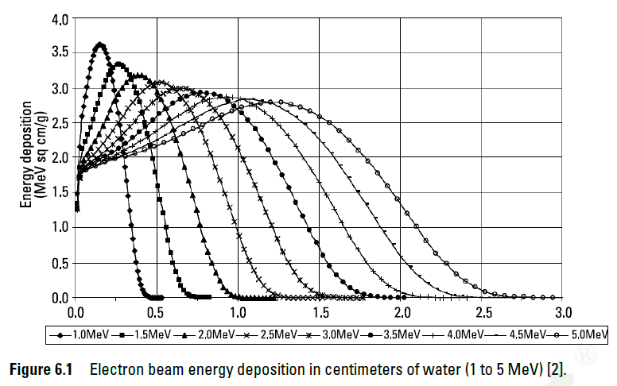
Application: Wastewater treatment
Uses e-beams on either drinking water (polyfluoroalkyl substances (PFAS)) or industrial sludge pre-processing.
Uses radiolysis of water to create short lived reactive species
China has operated the worlds largest water treatment plant at 10 MeV, 100 kW using a Rhodotron
  It is able to treat 30 M litres of industrial wastewater per day saving 4.5 Billion litres of fresh water annually
Fermilab determined the requirements for 10 MeV e-beam power at the Metropolitan Water Reclamation District (MWRD) of Greater Chicago,
  1 MW needed for dewatered biosolid sludge or the pre-anaerobic digester thickened waste activated sludge (WAS) at 8 million litres per day.

Slide 7
What other potential applications need CW low to intermediate currents
Single photon counting for cargo scanning
  5-10 MeV sub-1kW but CW
Nuclear Resonance Fluorescence
  Security irradiation of cargo that you don’t want heavily irradiated but need high dose (17 MeV)
FLASH radiotherapy (maybe?)
  10 MeV for X-rays but target is the limitation, ideal operating parameters not yet known, SRF not ideal for VHEE due to high energy required (150 MeV)
Leather irradiation.
  1 MeV, 100+ kW
Medical Isotopes (Mo⁹⁹) from photonuclear reactions
  20-55 MeV beams at 30 kW, not so compact
Biofuel pretreatment to enhance enzymatic digestion
  1.5 MeV electrons 10kGy doses
Remediation of petroleum-affected soil
  3 MeV electrons (100 kW per 4 m^3 per hour)

Slide 8
Competing technology: Electron accelerators
DC- Transformer types: Simple but size grows sharply with energy (not linear). Very efficient.
Single cavity types – Can use very high power RF sources that exist at low frequency (UHF). This means the power transferred to the beam is higher hence fairly efficient. Large transverse size.
Linacs – Sizes scales linearly with energy. Smaller transverse size as higher RF frequency. Less power is available at higher frequencies (at least not at affordable prices) so proportionally more of the power goes into RF losses and less to the beam.

Slide 9

Efficiency of NC Linacs
$Efficiency=\frac{Beam Power}{RF input power}=\frac{V_{beam}I}{\frac{{V_{beam}}^{2}}{R_{s}}+V_{beam}I}$ $=\frac{I}{\frac{V_{beam}}{R_{s}}+I}$
As can be seen above the efficiency increases with increasing beam current or shunt impedance and decreasing beam energy.
However most RF sources have a fixed power available hence we can also give efficiency as
Hence efficiency is also limited by the difference in the power required to drive the cavity and the available power.
Normal conducting linacs operating with high beam currents at low voltage can achieve beam efficiencies of 80-90% rivalling SRF linacs
$$Efficiency=\frac{Beam Power}{RF input power}=\frac{{P_{rf}−\frac{{V_{beam}}^{2}}{R_{s}}}_{}}{P_{rf}}$$

Slide 10
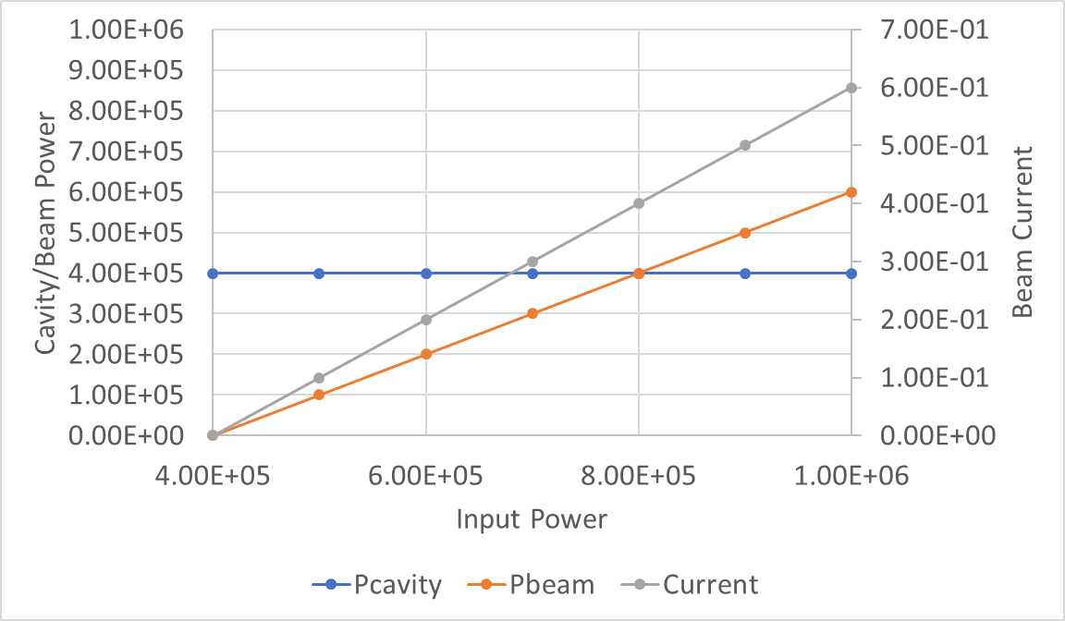
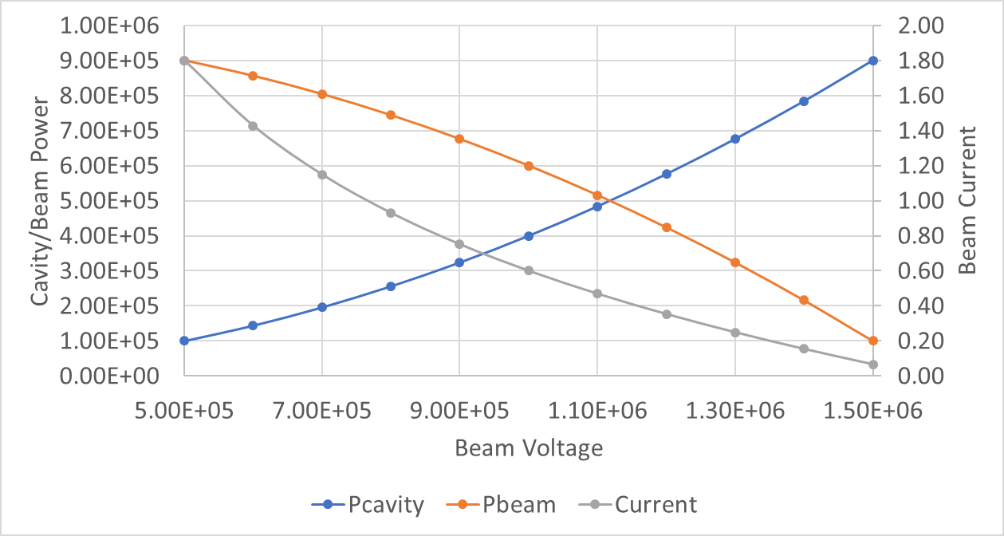
Efficiency
Shown on the right is an example of the 100 MHz cavity
Higher beam power gives higher efficiency for a given beam voltage
As can be seen lower voltages lead to higher efficiencies as the cavity absorbs less power.
Higher RF powers deliver higher efficiency but average power is limited by heat
V= 1 MV
Pin= 1 MW

Slide 11
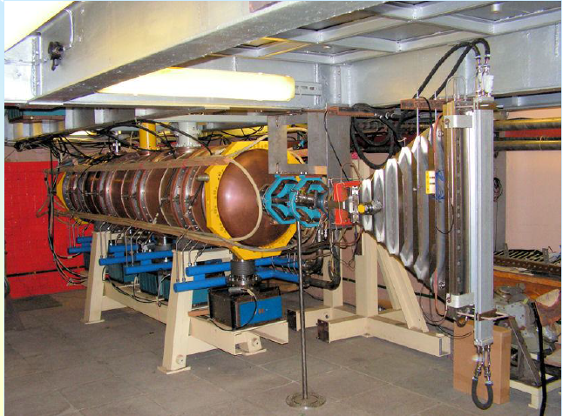
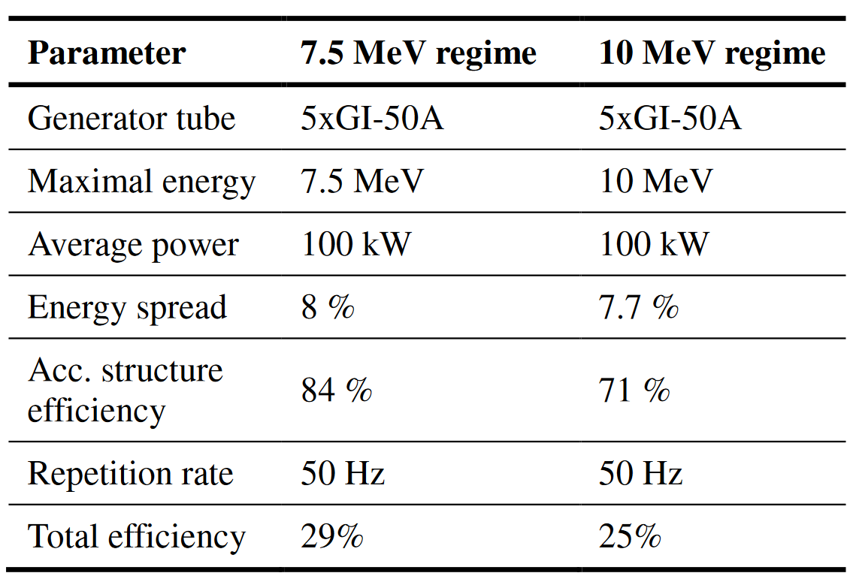
Normal conducting competitors
Budker INP has developed ILU-14 radio-frequency pulsed linear accelerator capable of providing 100 kW beam at 7.5–10 MeV.
The accelerator has fast removable X-ray converter and can operate both in e-beam and X- ray processing modes.
The machine utilizes a low frequency (176 MHz) SW accelerating structure

Slide 12
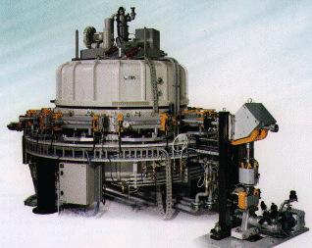
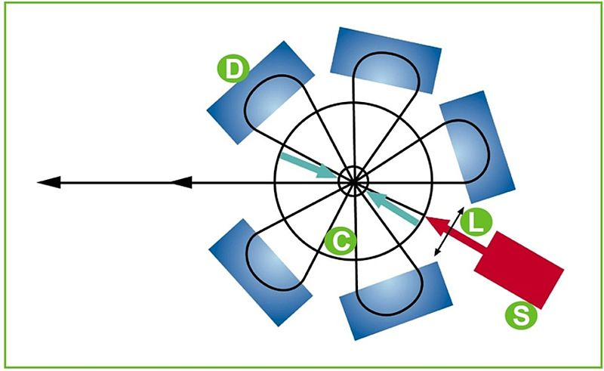
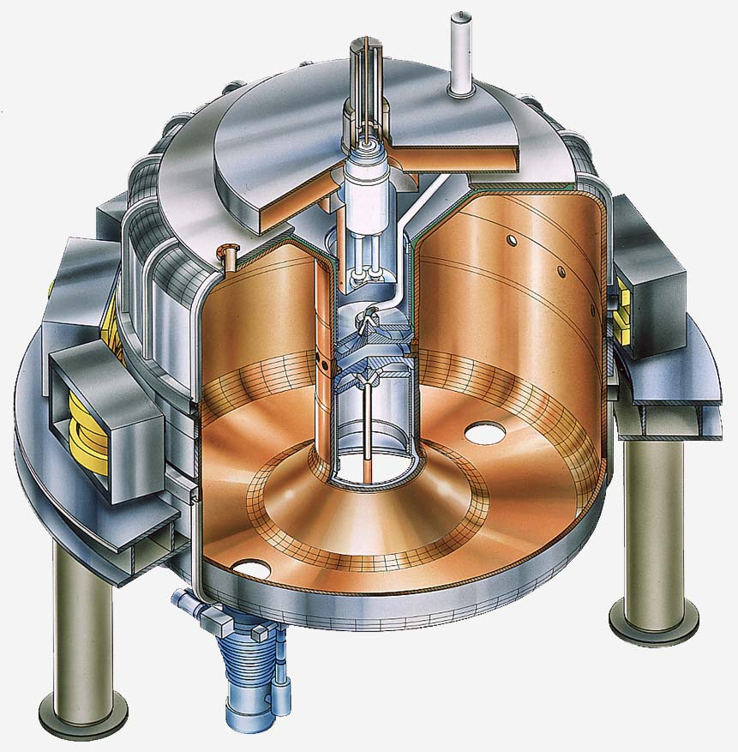
Rhodotron
There is also the option of a Rhodotron (IBA) which is less common.
Can reach 200-700 kW, 5-10 MeV at an efficiency of 40-50%.
RF is 100-200 MHz Tetrodes
Despite what it looks like it is quite simple to maintain (according to IBA)
Costs ~$7M

Slide 13
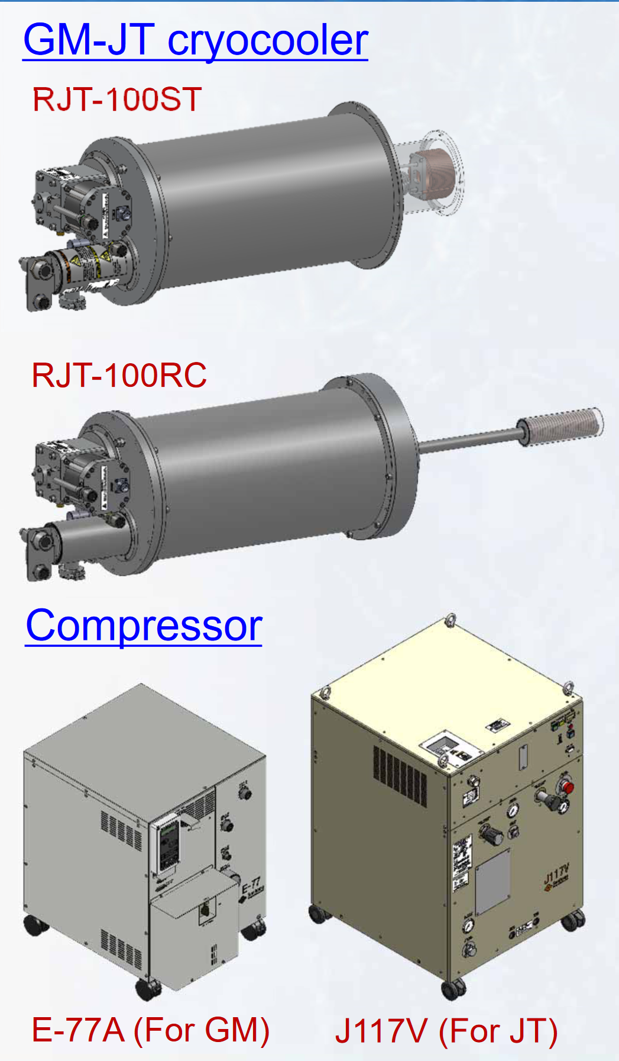
What limits competitiveness?
1. Cryocoolers
A LHe system at 4.2 K with 7.2 Watts of power, needs a wall plug power of 2.5 kW
A cryocooler at 7.2 K at 4 Watts of power needs a wall plug power of 12.5 kW.
SHI RJT-100 delivers 9 watts at 4.2 K needs 14 kW
For a 1000 kW beam power 14 kW 1.4% of the power but if multiple are needed can reduce efficiency.
Also expensive could be a large part of capital cost and have long cooldown times.
Courtesy Andrew Blackett-May, STFC

Slide 14
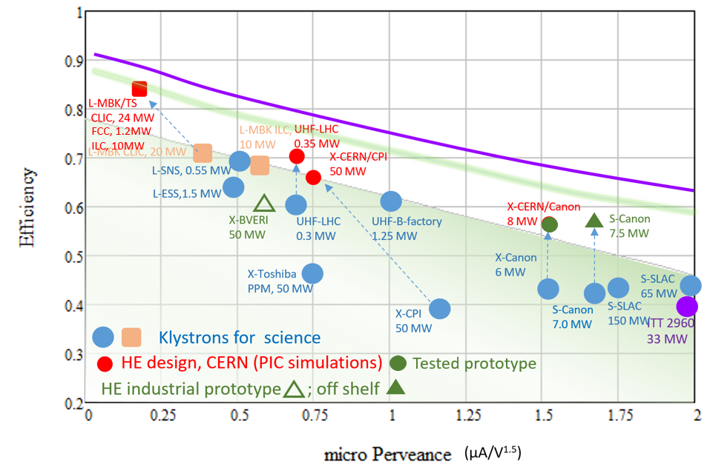
What limits competitiveness?
2. RF Amplifiers
Need > 1MW CW at 400-1300 MHz
Klystrons are a good possibility here
Stability isn’t required so can run at saturation (60% efficiency) but this would immediately put the linac at the same efficiency as a Rhodotron
New high efficiency klystrons may achieve 80-90% efficiency.
Example FCC: 400 MHz, 1 MW, 86% efficiency
Phase-locked magnetrons at 800 MHz also 80-90% efficiency but <100 kW

Slide 15
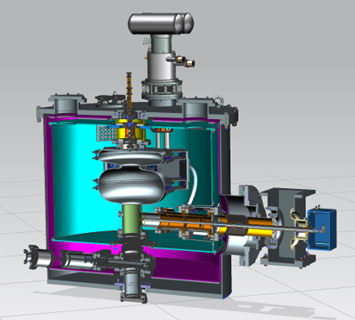
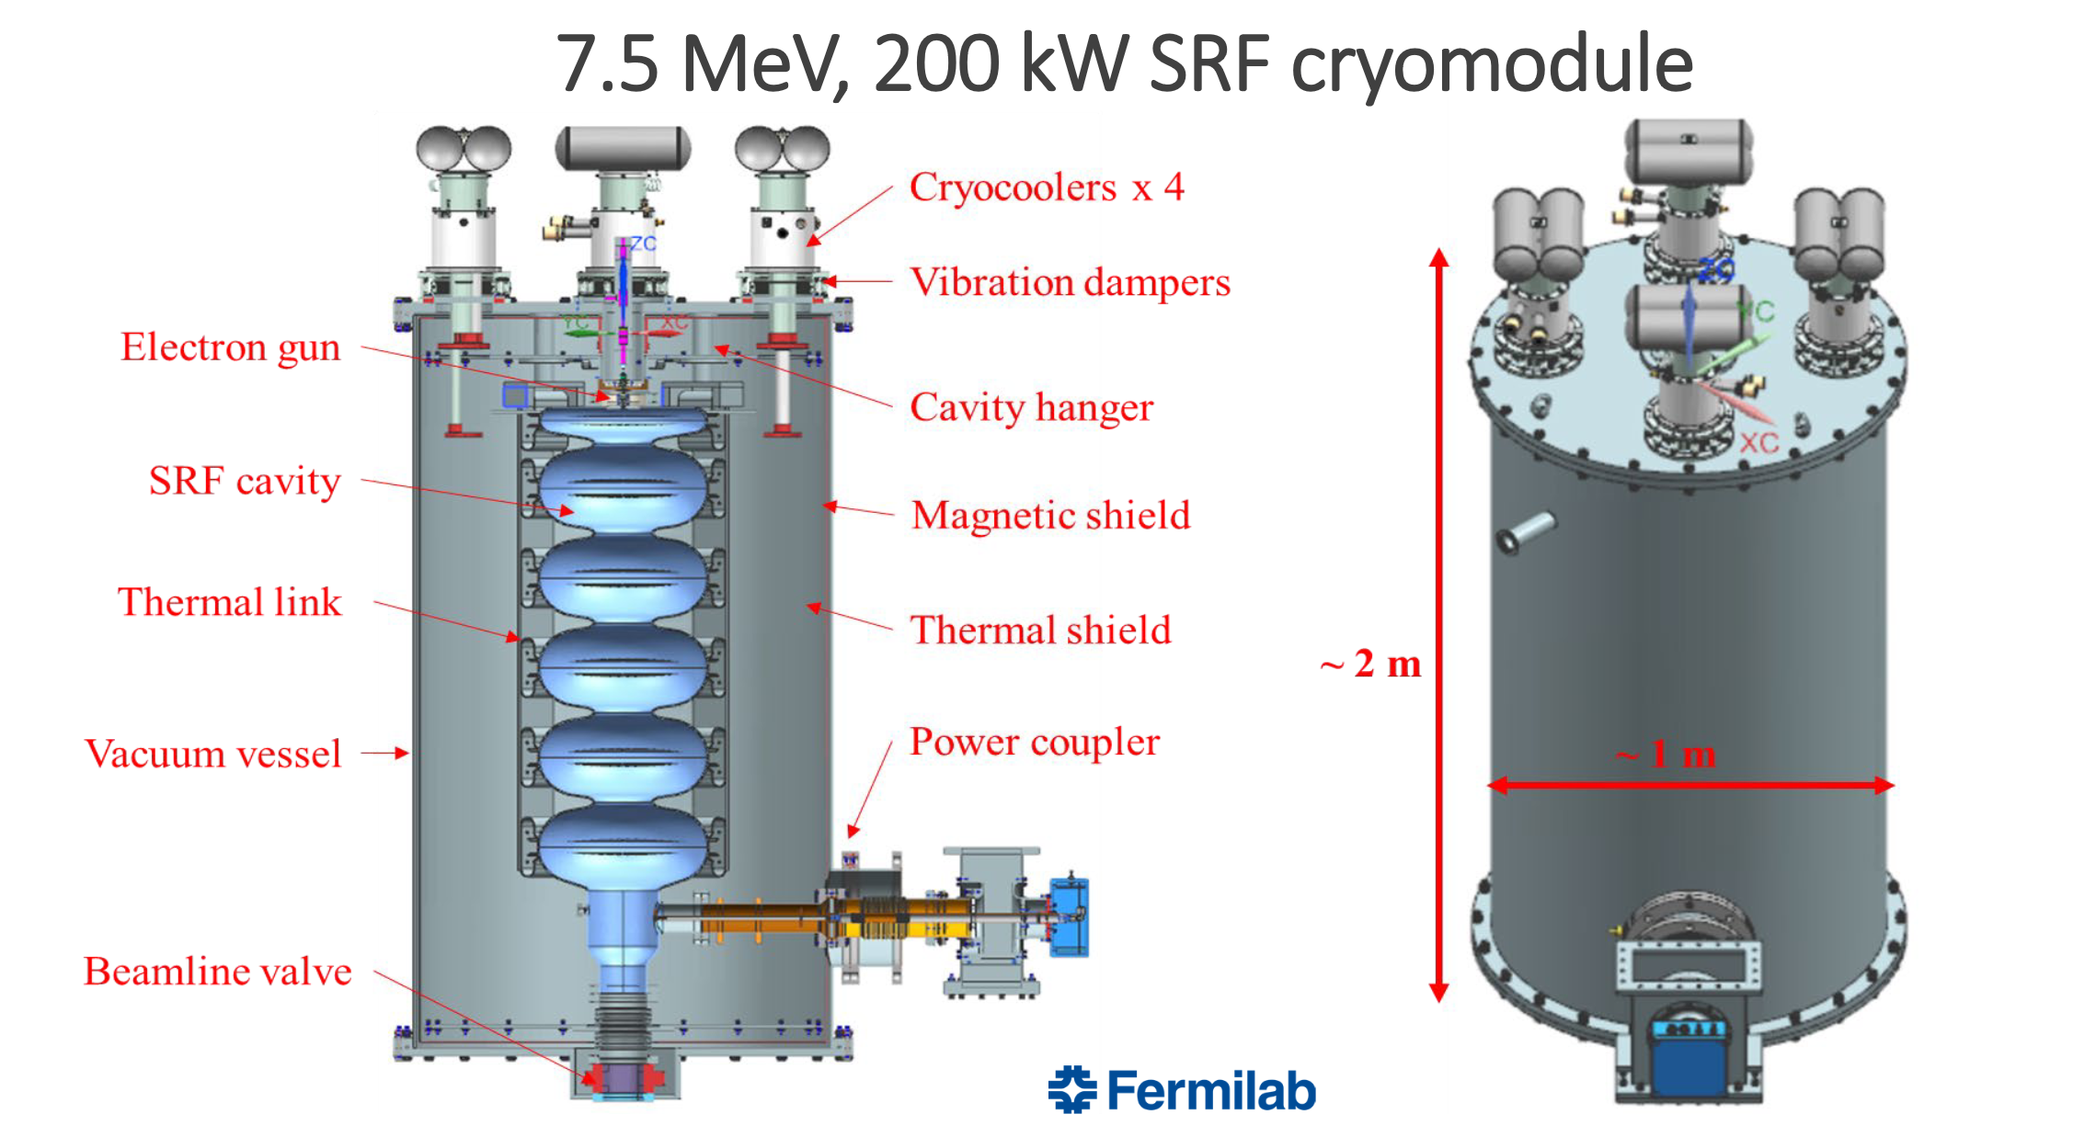
Fermilab: Medical waste sterilization
The final goal is an accelerator with 7.5 MeV beam energy and 200 kW beam power, which would be a valid alternative to large cobalt-60 facilities.
Initial design is a 1.6 MeV, 20 kW, 650 MHz demonstrator
Would be used to generate X-rays
2 Cryocoolers at 1.6 MeV, 4 at 7.5 MeV
1.5/5.5 cell Nb3Sn cavities

Slide 16
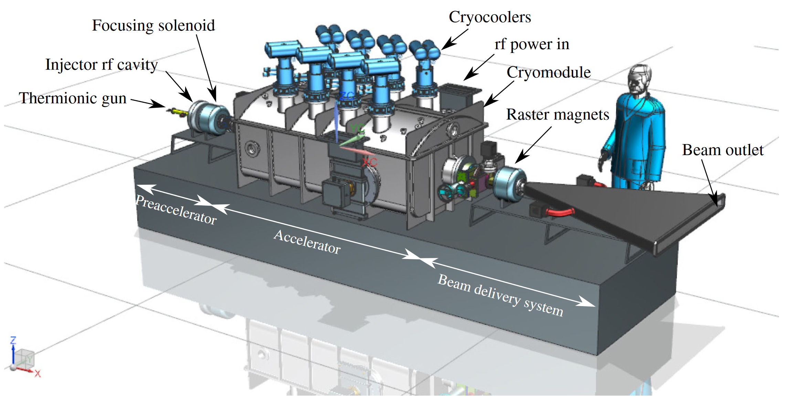
Jlab: Waste Water treatment
10 MeV, 1000 kW
Nb3Sn 650 MHz 5-cell
90% RF to beam efficiency, 40% wall plug efficiency
8x PT425 Cryocoolers at 4.45 K with 20 Watts capacity
Klystron powered (assumed 50% efficiency so can be improved)
~$8M
Note this delivers twice the power of the Rhodotron so price per MW is almost halved.

Slide 17
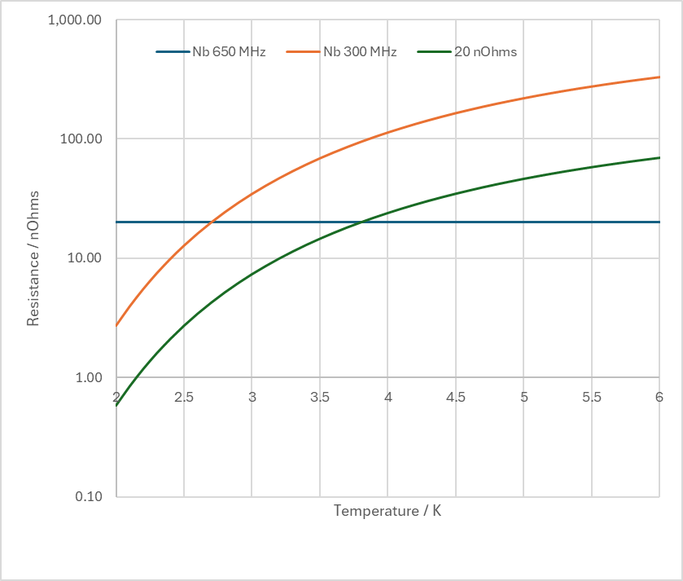
Nb vs Nb₃Sn
Barrier to using Nb is the number of cryocoolers needed to reach the same beam energy.
J-lab design assumes 20 nOhm resistance at 650 MHz for Nb3Sn, R_{BCS} for Nb at 4.5 K at 650 MHz is 160 nOhm, 8 times more!
Operating instead at 300 MHz drops the BCS resistance to 47 nOhms
Dropping to 4K operation & 300 MHz takes us to 24 nOhms

Slide 18
Conclusion
SRF could corner the market in intermediate voltage (10-20 MV) medium-high power applications (water treatment, medical sterilization)
Can deliver twice the power of conventional solutions so price per MW is better if customer needs higher power
Currently less efficient than a Rhodotron (dominated by the RF source) but high-efficiency klystrons will bring major improvements

