Slide 1

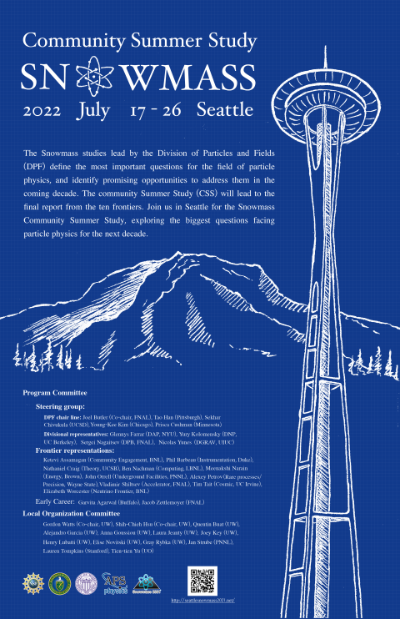
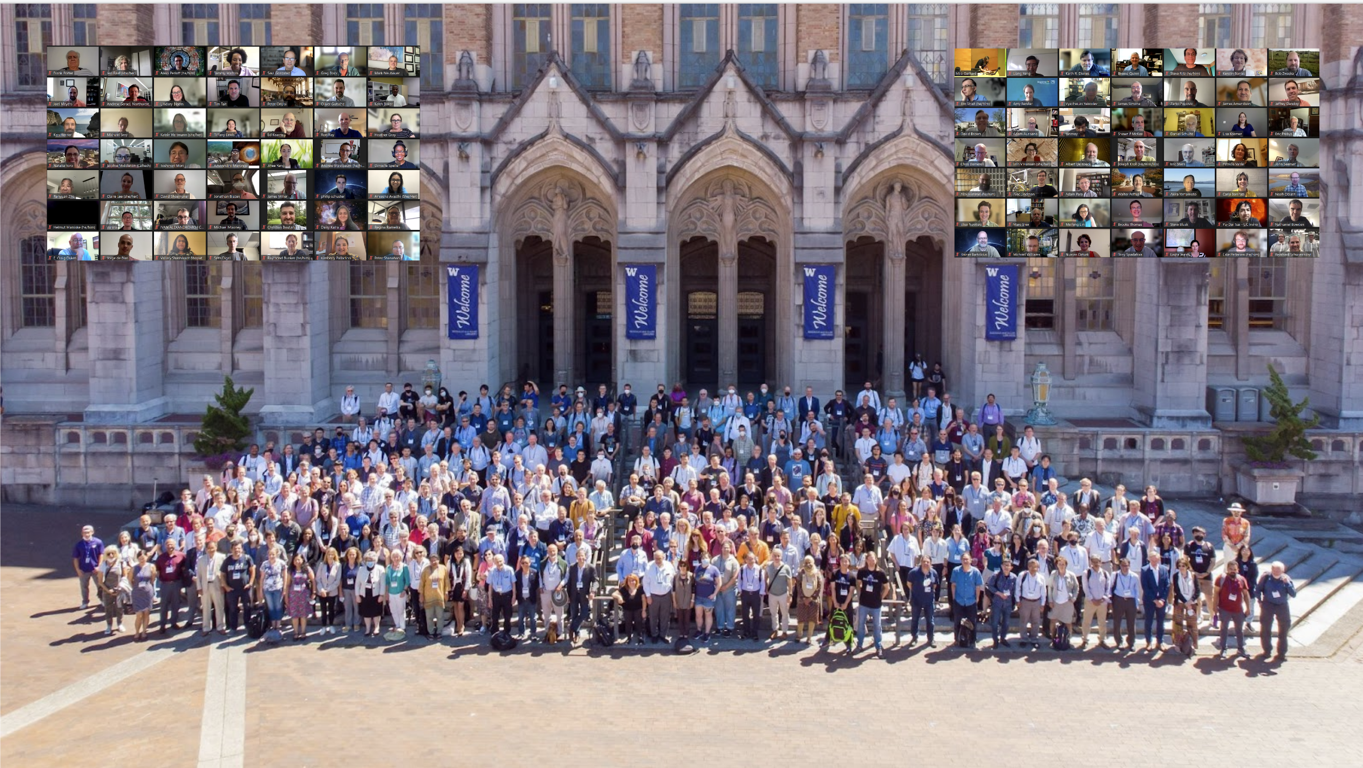
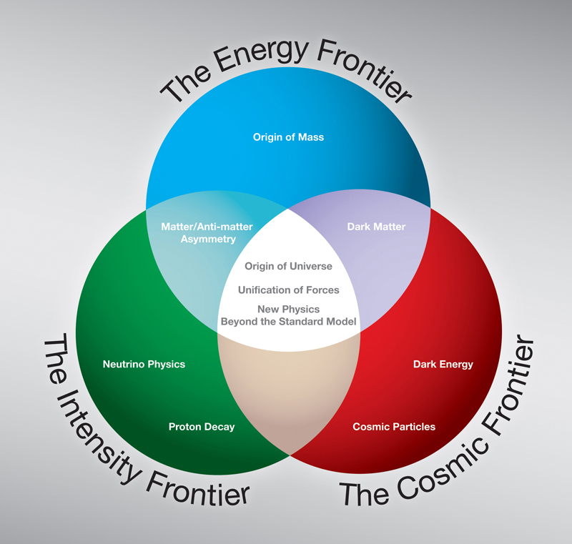
The TFSRF program in the SNOWMASS 20213 strategy
A.-M. Valente-Feliciano
On behalf of the SRF community

Slide 2
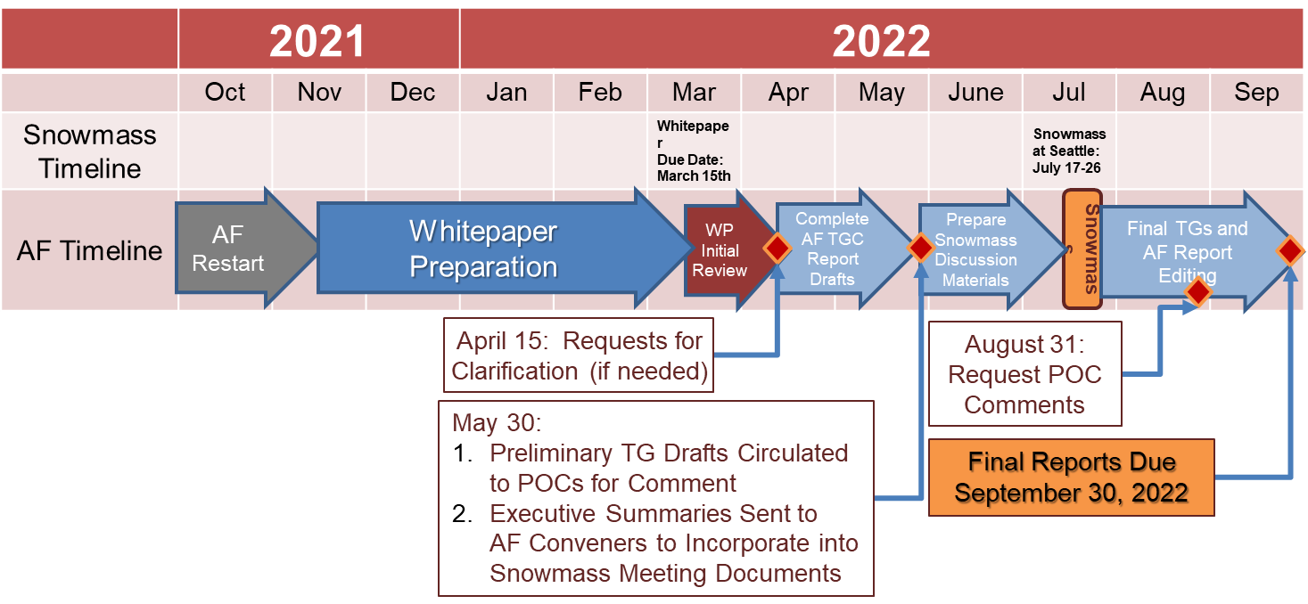

SNOWMASS 2021
Snowmass is a particle physics community study
Sponsored by APS DPF, DPB…
Define the most important questions in the field of particle physics and identify promising opportunities to address them.
Assess the future of elementary particle physics, to explore the limits of our technological capabilities, and to consider the nature of future major facilities for particle physics in the US. https://www.snowmass21.org/
Provides scientific input to DOE’s P5 (Particle Physics Project Prioritization Panel) that develops a strategy for the US HEP program that can be executed over a 10 year timescale, in the context of a 20-year global vision for the field.
Planning for 2025-2035 with a view toward 2050
    Accelerator subpanel deliberations during last P5 made a significant impact on resources for R&D
Contributions provide important input that influences future projects and scientific programs
The Start of the Snowmass Process
1st exercise in 1982 at Snowmass, Colorado provided a model for the community summer studies open to all active particle physicists in the United States, joined by representatives of the European physics community, the DOE, and the NSF.
Followed by 1990, 2001, 2013, …

Slide 3



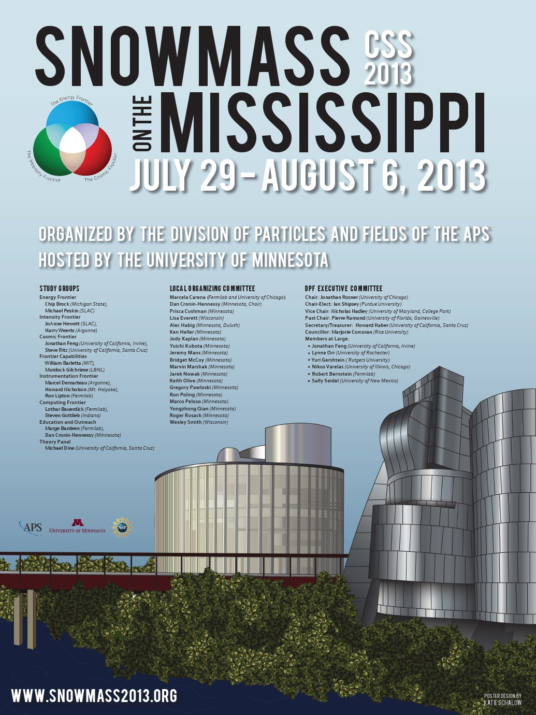
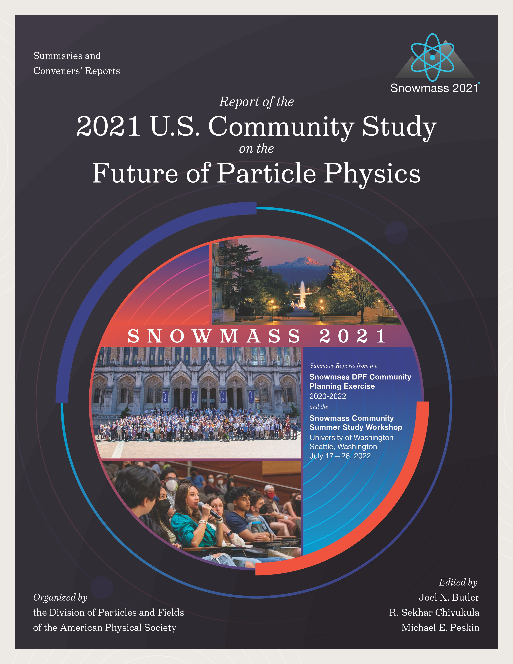
U.S. Particle Physics Strategic Planning Process
2008
2014
2023
https://www.usparticlephysics.org/2023-p5-report/index.html

Slide 4
Snowmass Accelerator Frontier
The Accelerator Frontier activities include discussions on high-energy hadron and lepton colliders, high-intensity beams for neutrino research and for the “Physics Beyond Colliders”, accelerator technologies, science, education and outreach as well as the progress of core accelerator technology, including RF, magnets, targets and sources.
Participants submitted Letters of Intent, contributed papers, took part in corresponding workshops and events, contributed to writing summaries and took part in the general Snowmass'21 events
1. What is needed to advance the physics?
2. What is currently available (state of the art) around the world?
3. What new accelerator facilities could be available on the next decade (or next next decade)?
4. What R&D would enable these future opportunities?
5. What are the time and cost scales of the R&D and associated test facilities as well as the time and cost scale of the facilities?
4

Slide 5
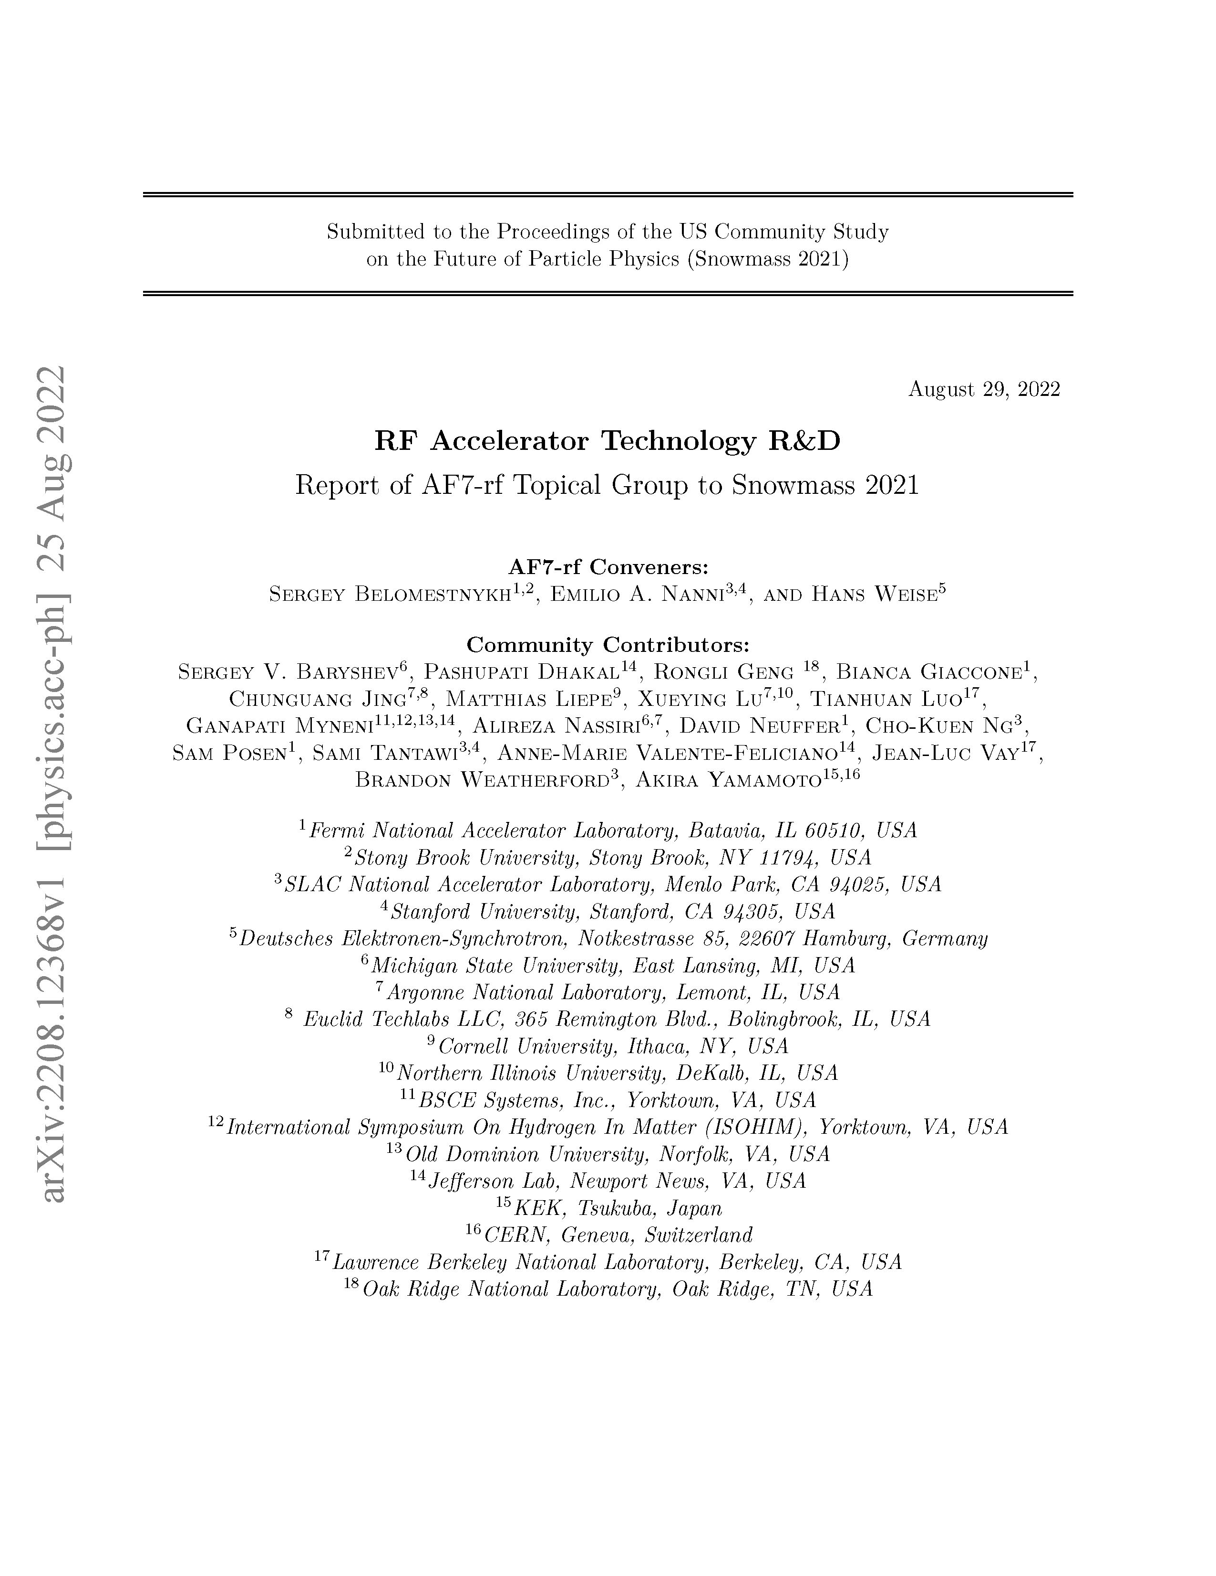
AF07: Accelerator technology R&D - RF systems
Sergey Belomestnykh, Emilio Nanni, Hans Weise
  78 LOIs submitted
  18 WP submitted to AF-RF (additional 9 relevant; probably more)
  https://snowmass21.org/submissions/start
  3 mini Workshops
AF7 - Subgroup RF – mini Workshop on RF Systems and Sources Follow-Up, https://indico.fnal.gov/event/52406/ , Jan. 11th, 2022
AF7 - Subgroup RF – mini Workshop on Innovative Design and Modeling Follow-Up, https://indico.fnal.gov/event/52407/ , Jan 18th, 2022
AF7 - Subgroup RF – mini Workshop on Cavity Performance Frontier Follow-Up, https://indico.fnal.gov/event/52408/, Feb. 1st, 2022
AF7-rf report presented at July Meting; structure informed from submissions & community events
5

Slide 6
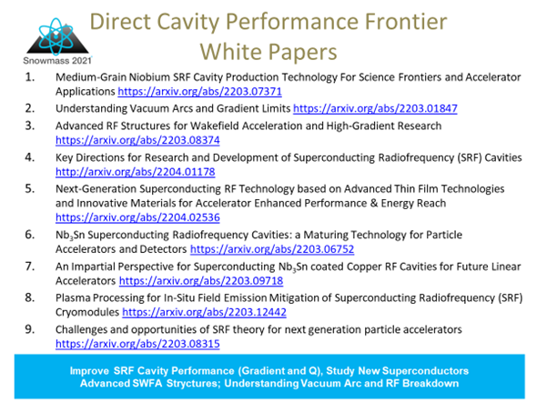
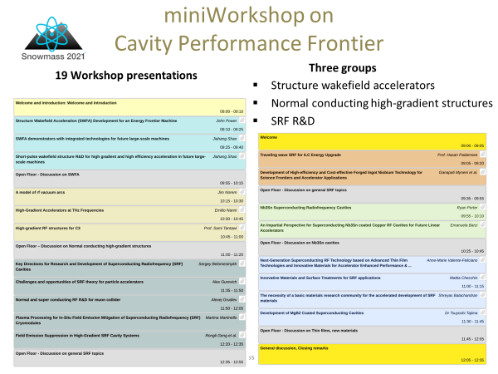
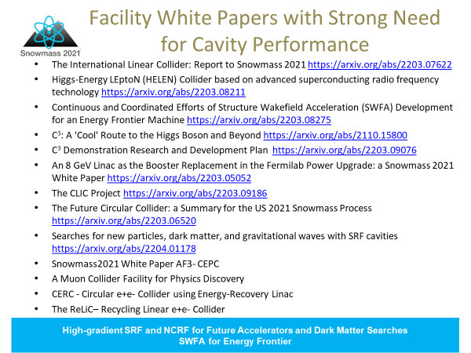
SRF Performance Frontier - Contributions
9 WP

Slide 7
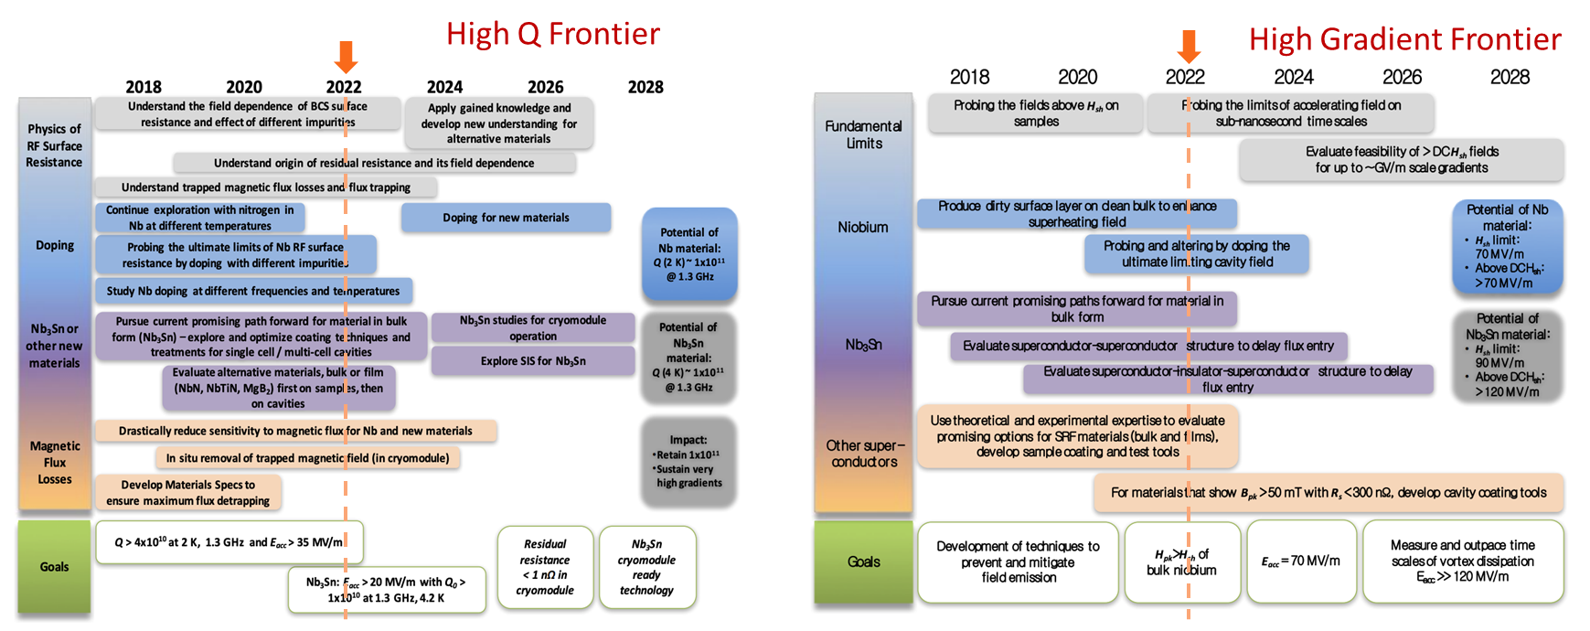
DOE GARD RF accelerator technology roadmap
https://doi.org/10.2172/1631119
DOE/HEP General Accelerator R&D (GARD) Program ten-year roadmap was developed by a team of leading researchers with input from the community (domestic and international) in 2017
It reflected the P5 strategy and the subsequent HEPAP Accelerator Subpanel recommendations
The roadmap incorporated the most promising research directions for advances that enable future experimental high energy physics programs
Anticipated that the roadmaps will be updated after SnowMass2021 and subsequent P5 process
General Accelerator R&D RF Research
Roadmap Workshop Report
https://www.osti.gov/servlets/purl/1631119/
Notes:
Structure some discussion around DOE RF Accelerator Roadmap
Does it capture the right topics / are we making progress?
In addition, explore new or overlooked concepts/topics

Slide 8
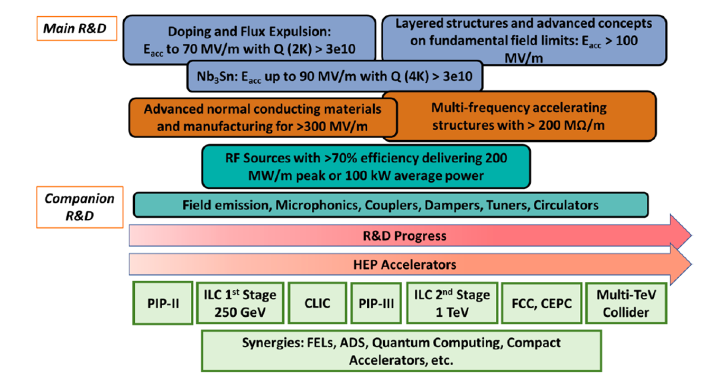
Key directions for R&D of SRF cavities
SRF is a critical technology for several accelerator-based frontier HEP facilities:
  HL-LHC (crab cavities)
  LBNF/DUNE/PIP-II
  Future linear (ILC) and circular (FCC-ee, CEPC) colliders
  Muon collider
Other potential applications:
  Next generation dark sector searches (axions, dark photons…)
  Quantum computing for HEP
  Compact accelerators for societal needs
Synergy with other fields: Nuclear Physics (EIC, FRIB, …), Light Sources / FELs (e.g., LCLS-II/LCLS-II HE), Spallation Sources (SNS upgrade, ESS, …)
Continued improvements in cavity performance enables new scientific applications when they would have otherwise been either unachievable or too expensive
S. Belomestnykh, S. Posen, D. Bafia, S. Balachandran, M. Bertucci, A. Burrill, et al.
”Key directions for research and development of superconducting radio frequency cavities”
https://arxiv.org/pdf/arXiv:2204.01178

Slide 9
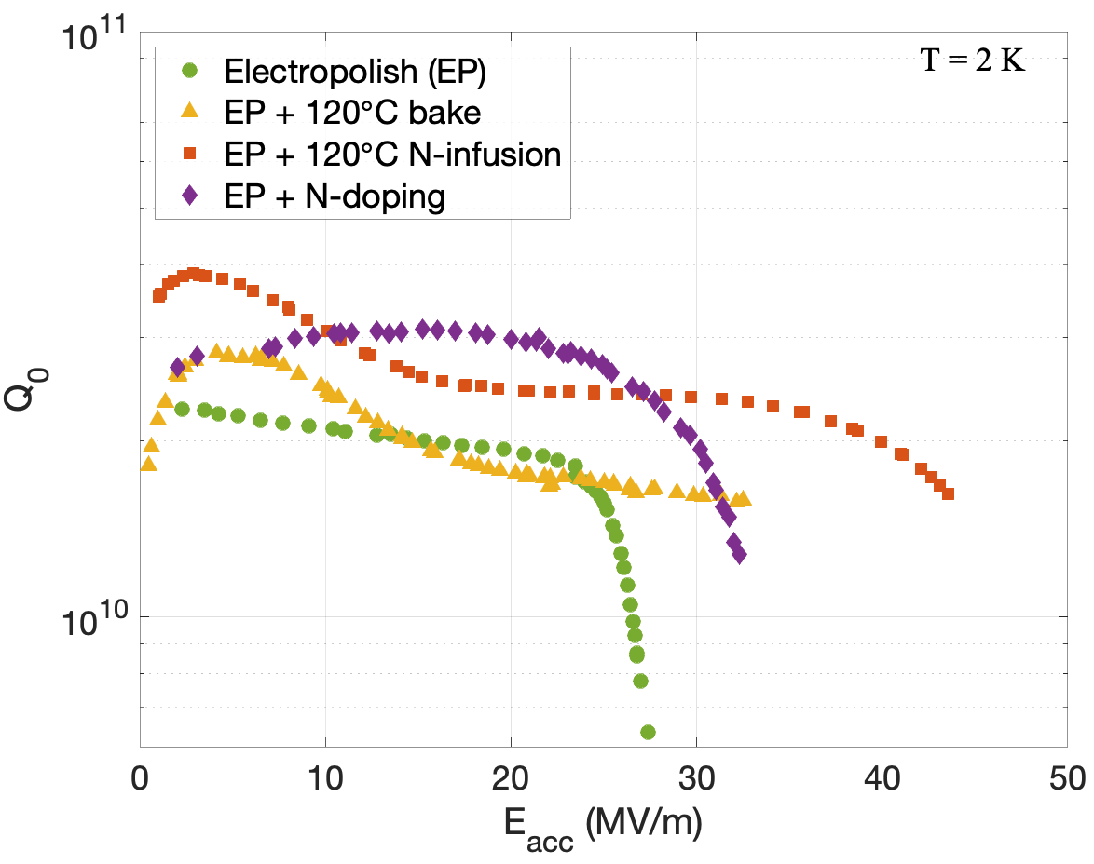
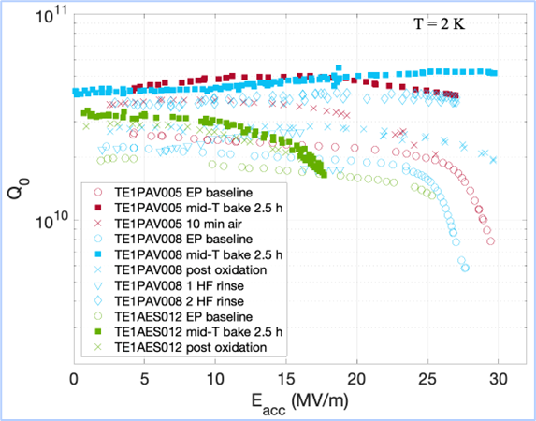
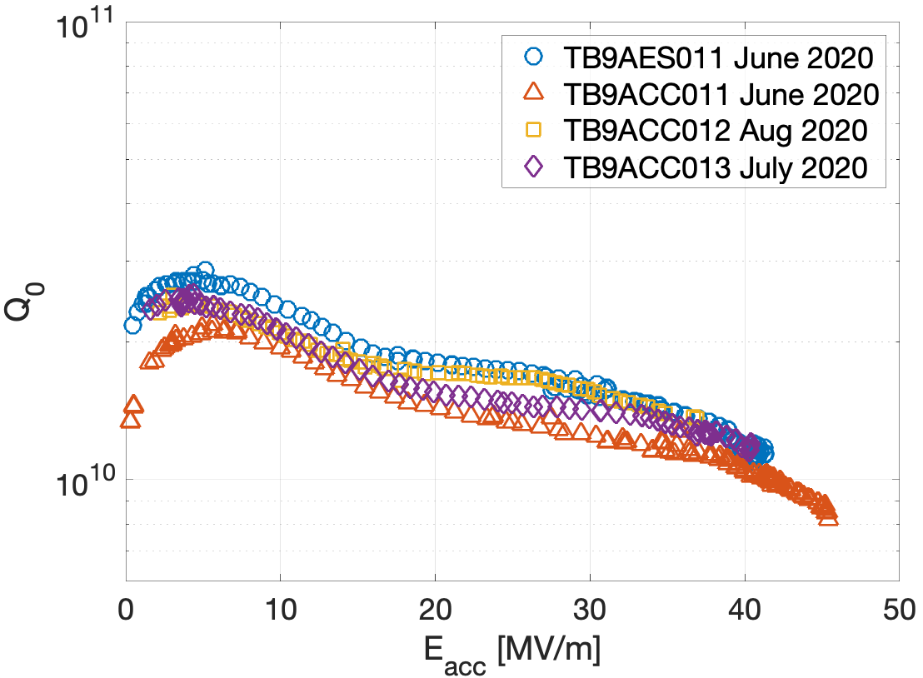
High Q & High Gradient SRF Frontier - Main Directions
Continue exploration of the effect of interstitial impurities on bulk Nb surface resistance
Study the effect of doping on Q of cavities at different frequencies (650 MHz – 3.9 GHz)
Develop fundamental understanding of the reverse field dependence of the BCS surface resistance and devise experiments towards validation of different theories
Develop understanding of mechanisms of trapping magnetic vortices and their contribution to the RF losses
Develop understanding of 'intrinsic' residual resistance and its field dependence
Ameliorate trapped vortices via innovative ideas
Develop Nb₃Sn coating on single and multi-cell cavities of different frequencies
Investigate feasibility of other materials for high Q
Mid-T bake
Furthering our understanding of RF losses and ultimate quench ﬁelds of niobium via experimental and theoretical investigations;
developing methods for nano-engineering the niobium surface layer and tailoring it for speciﬁc applications;
studying new SRF materials beyond niobium via advanced deposition techniques and bringing these materials to practical applications;
developing advanced cavity geometries to push accelerating gradients of bulk niobium cavities to ∼ 70 MV/m and pursuing R&D on companion RF technologies to mitigate ﬁeld emission, provide precise resonance control, etc.;
investigating application of SRF technology to dark sector searches.
N doping & infusion
High gradient cryomodule
~48-50 MV/m (~210 mT)

Slide 10
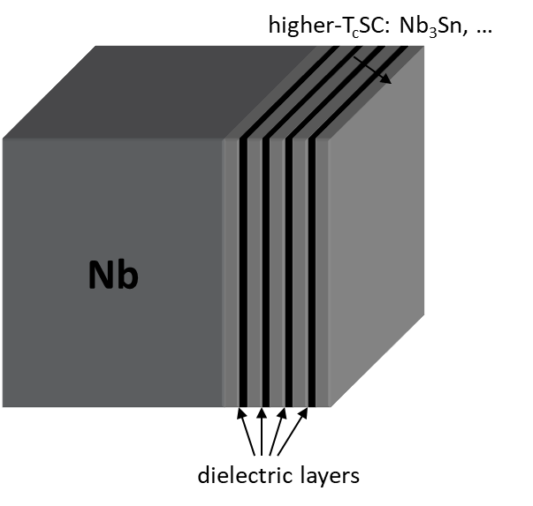
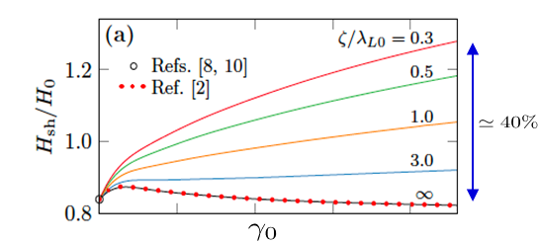
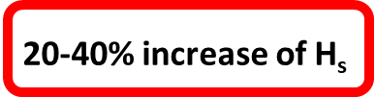
SRF theory for next generation particle accelerators
Field limit
The widely used GL theory of dc superheating field H_{s}(T) is applicable near T_{c} but not at T << T_{c}.
Only H_{s}(0) = 0.84H_{c} at was calculated (Galaiko 1966, Catelani and Sethna, 2008; Lin and Gurevich, 2012).
at T << T_{c} and arbitrary GL parameter has not yet been calculated.
Dynamic superheating field H_{d}(T,f). How different can it be from the static H_{s}(T) at GHz frequencies?
Recent result: (Sheikhzada and Gurevich, 2020)
Q limit
BCS surface resistance R_{s}(T) vanishes at T=0. How far can the residual resistance be decreased?
Trapped vortices, subgap quasiparticles and two-level states, proximity-coupled suboxide layers.
Nonequilibrium superconductivity
Nonlinear BCS surface resistance in a nonequilibrium SC under strong rf current. Negative Q(H) slope.
Extreme dynamics and nonlinear losses of trapped vortices driven by strong rf current
Pathirana and Gurevich, PRB 101, 064504 (2020)
and unpublished
Tuning SRF performance by surface nanostructuring
Increase of H_{s} and vortex penetration field by SIS multilayers and impurity gradients at the surface
Reduction of R_{s} by optimizing proximity-coupled layers and transparency of grain boundaries
Alex Gurevich, Takayuki Kubo, James A. Sauls
”Challenges and opportunities of SRF theory for next generation particle accelerators”
https://arxiv.org/pdf/2203.08315

Slide 11
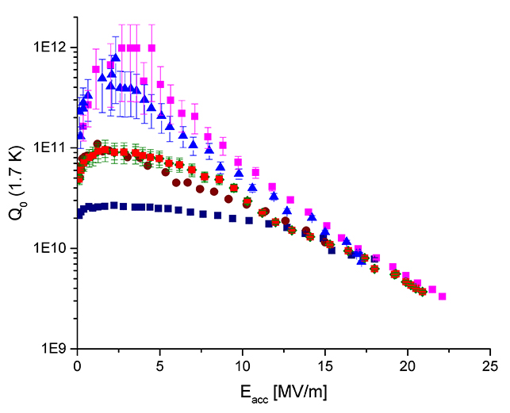
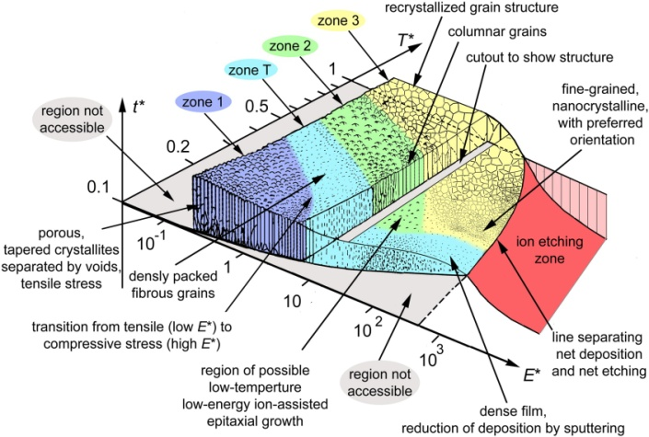
Next Generation Nb/Cu SRF Cavities Based on Advanced Coating Technology for CW Accelerators
Nb/Cu Technology proof of principle with LEP2, LHC, ALPI machines
Great potential for cost savings and operational advantages for machines operating at lower frequency and relatively modest gradients
high current storage ring colliders : FCC, EIC and CEPC
Increased temperature stability due to Cu substrate higher thermal conductivity
Operation at 4.5 K, generating capital and operational cost savings
Material cost saving, particularly for low frequency structures
Easily machinable and castable structures
Perspectives for significant cryomodule simplification.
Novel deposition techniques exploiting species energetics offer opportunities to improve and manipulate film structure and performance
Anders, André. "A structure zone diagram including plasma-based deposition and ion etching." Thin Solid Films 518.15 (2010): 4087-4090.

Slide 12
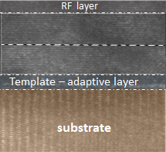





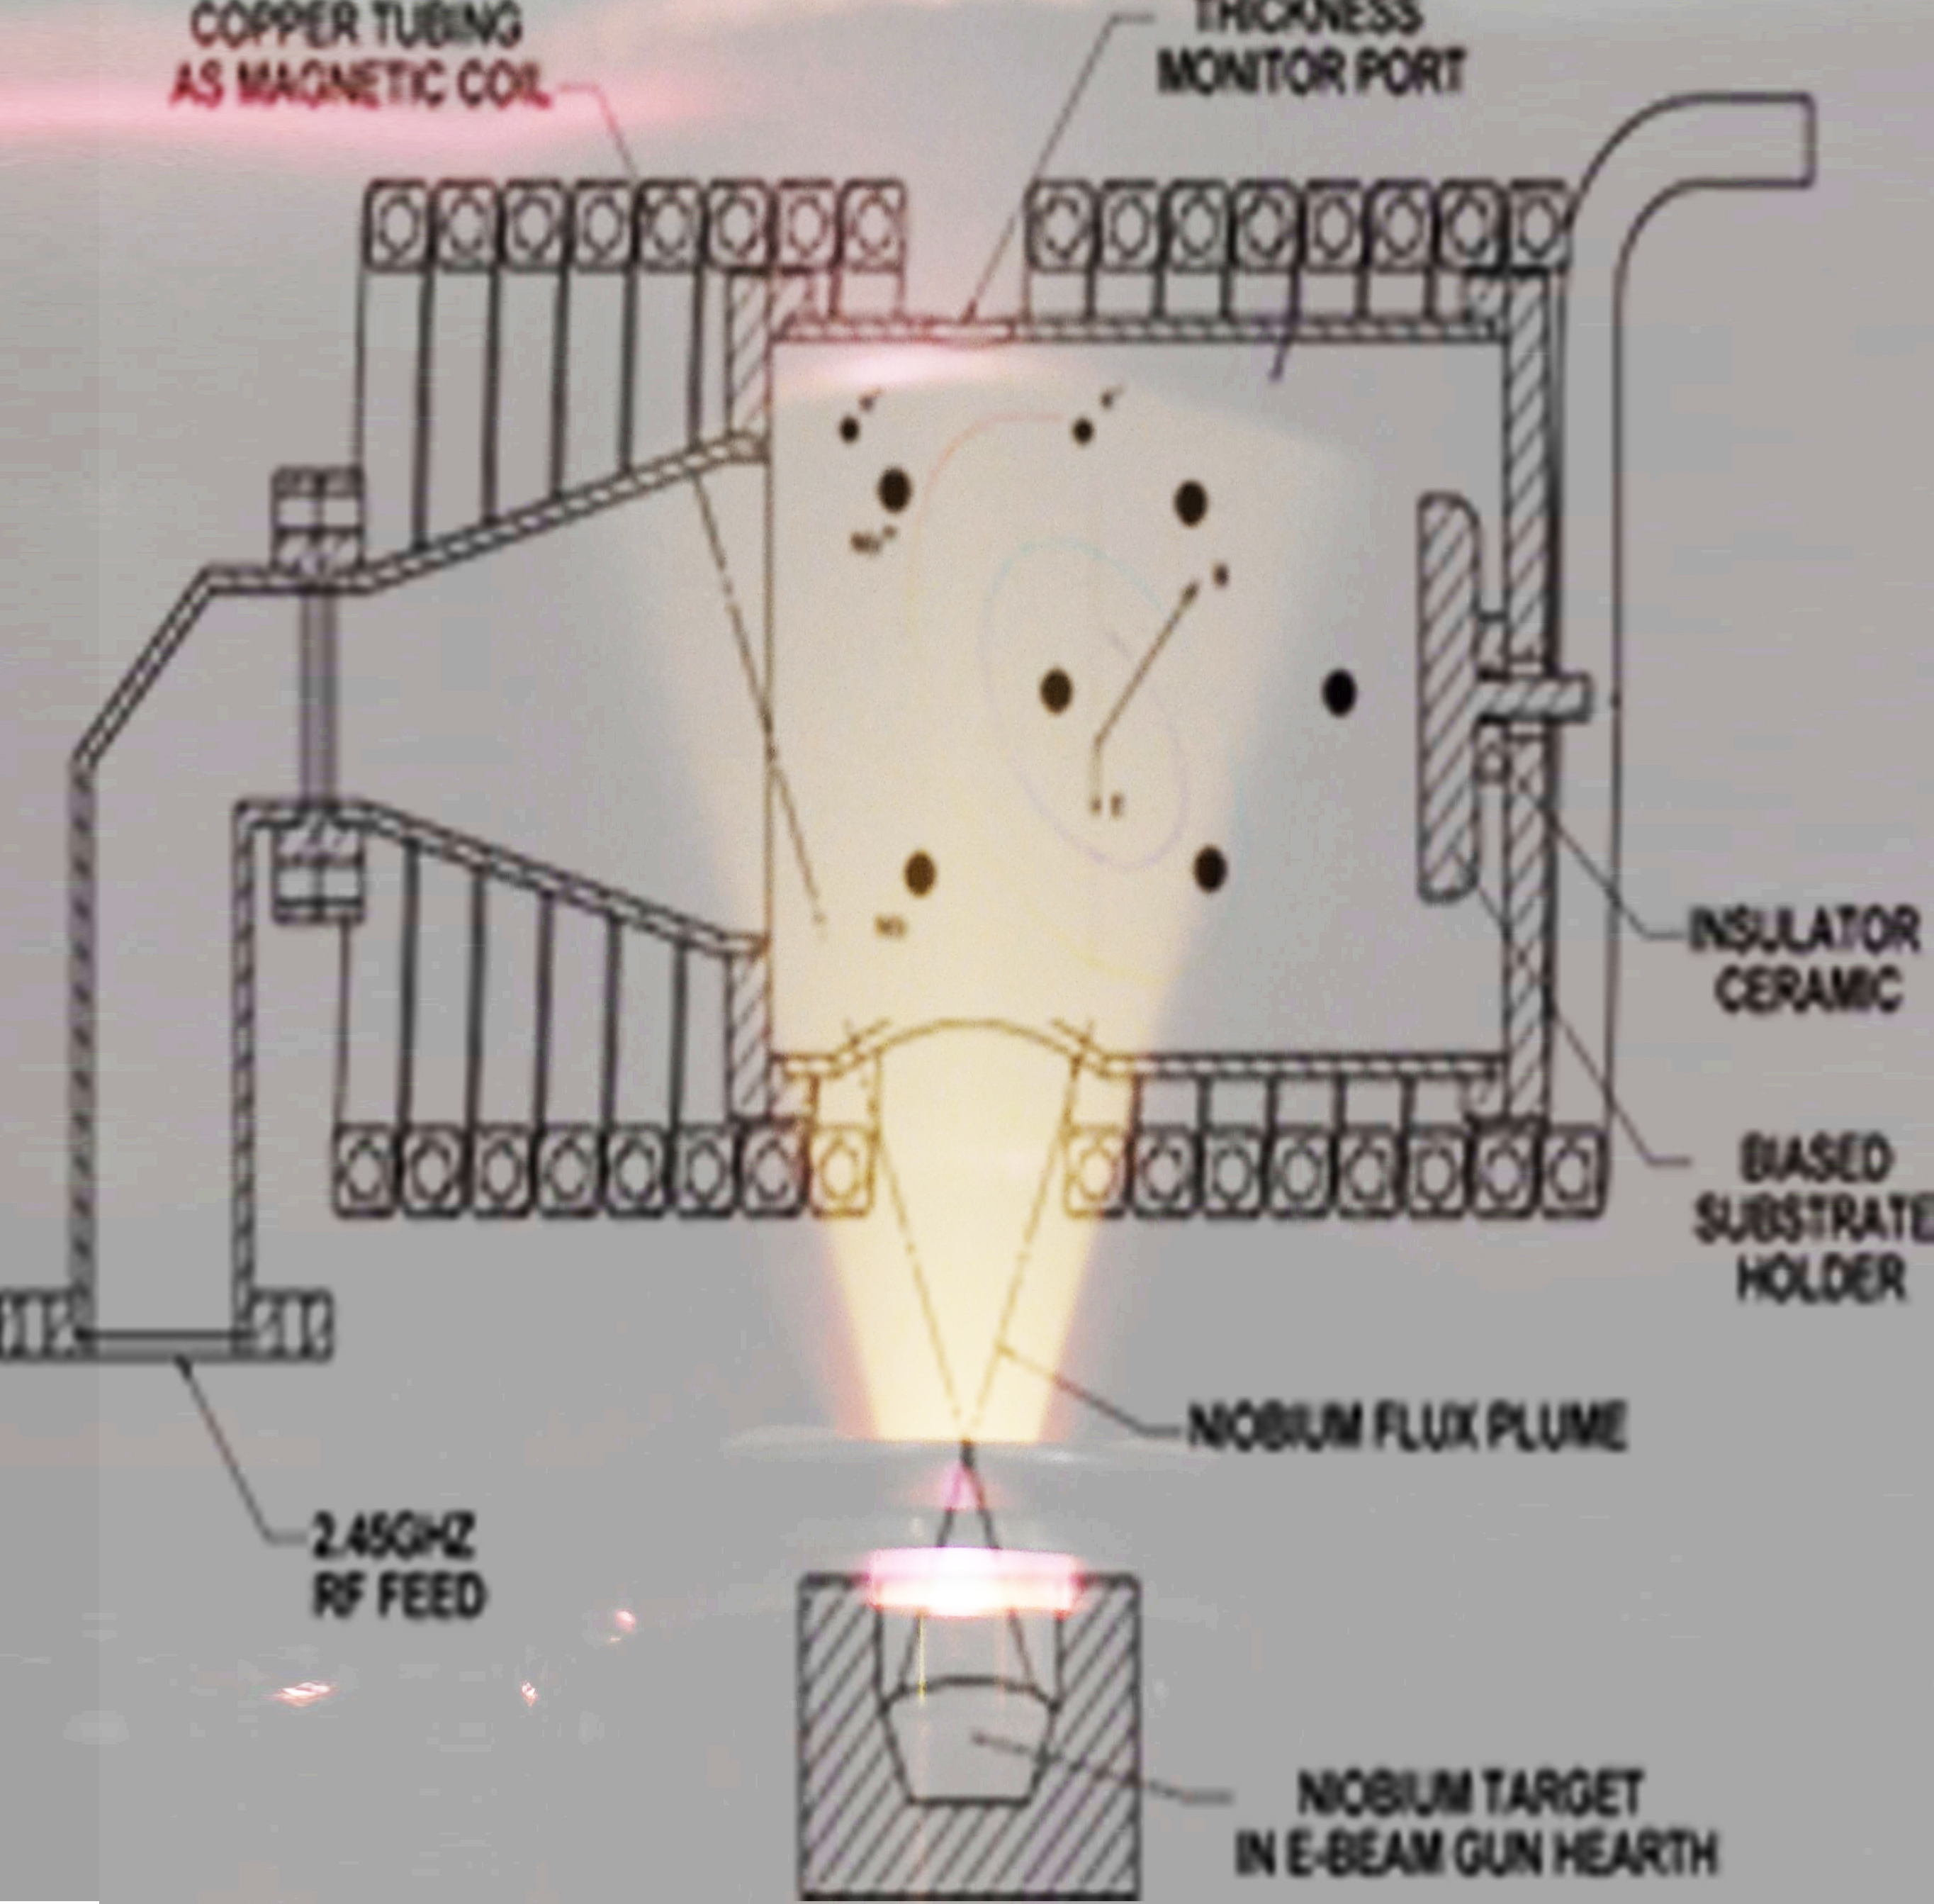
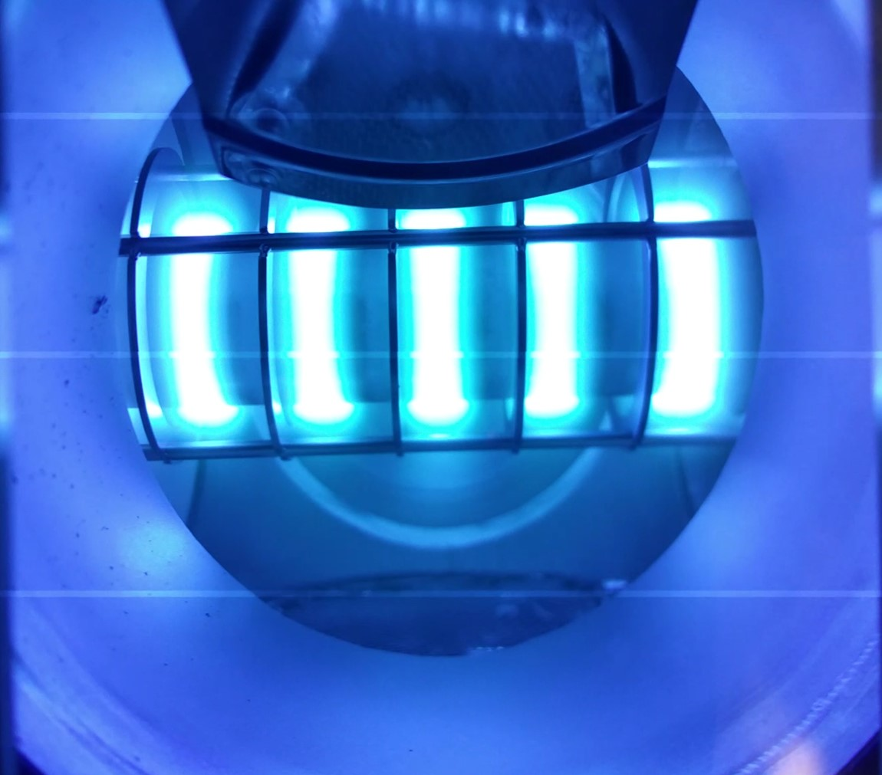
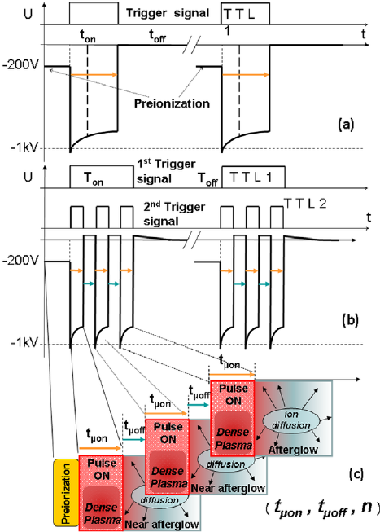
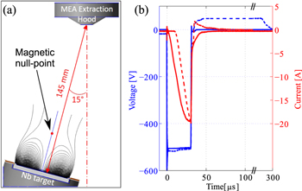
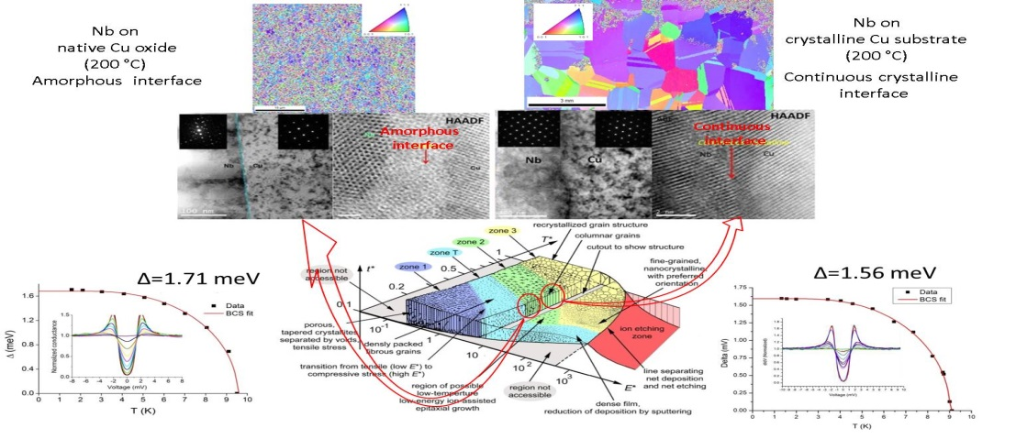
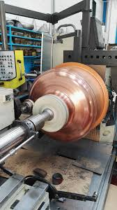
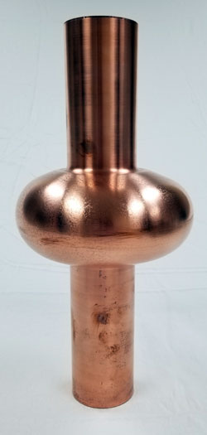


Advances in Thin Film Nb on Cu Technology
Energetic condensation
ECR
Cylindrical HiPIMS
F Avino et al 2019 Plasma Sources Sci. Technol. 28 01LT03
HiPIMS + kick pulse
Substrate Fabrication & Processing
Full control over final SRF performance with strict process protocols
Further tailoring opportunities:
N doping on films

Slide 13
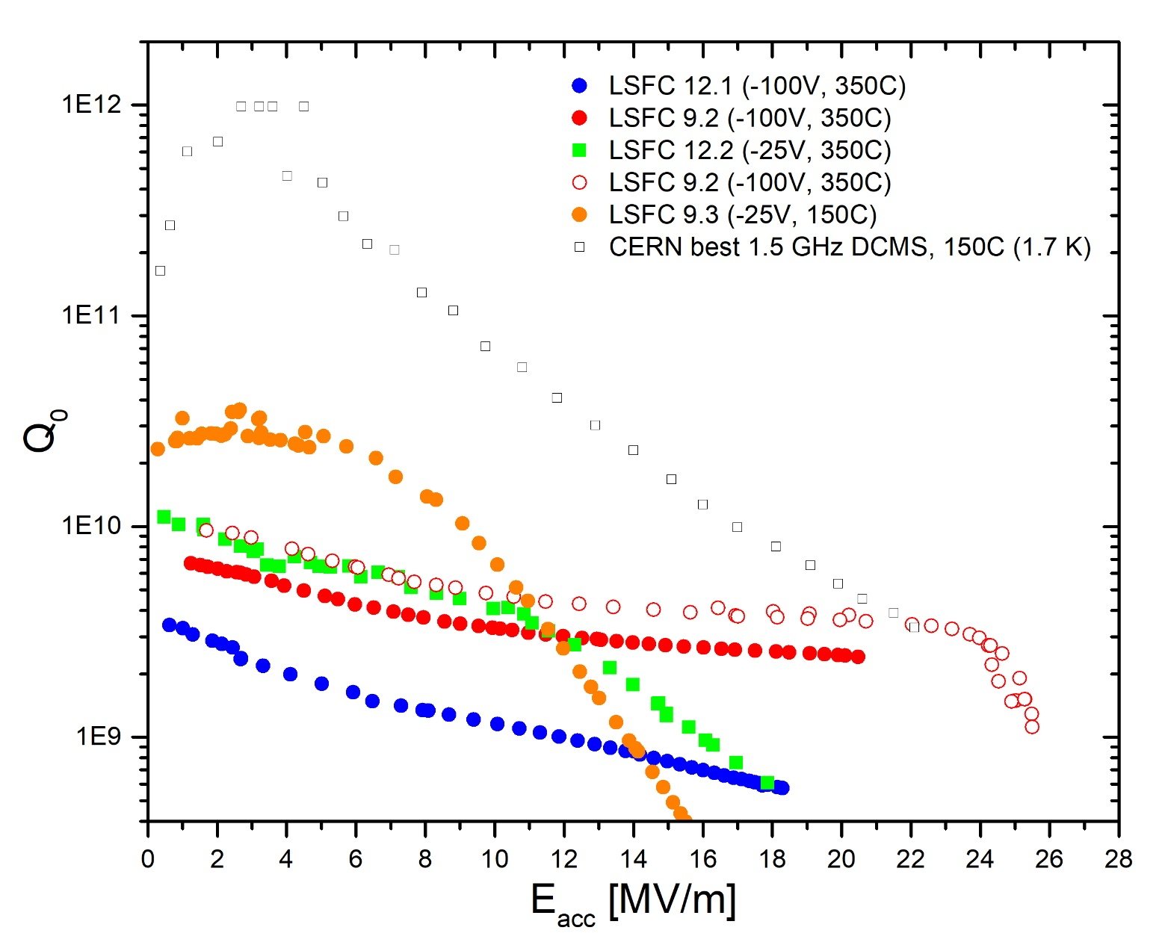
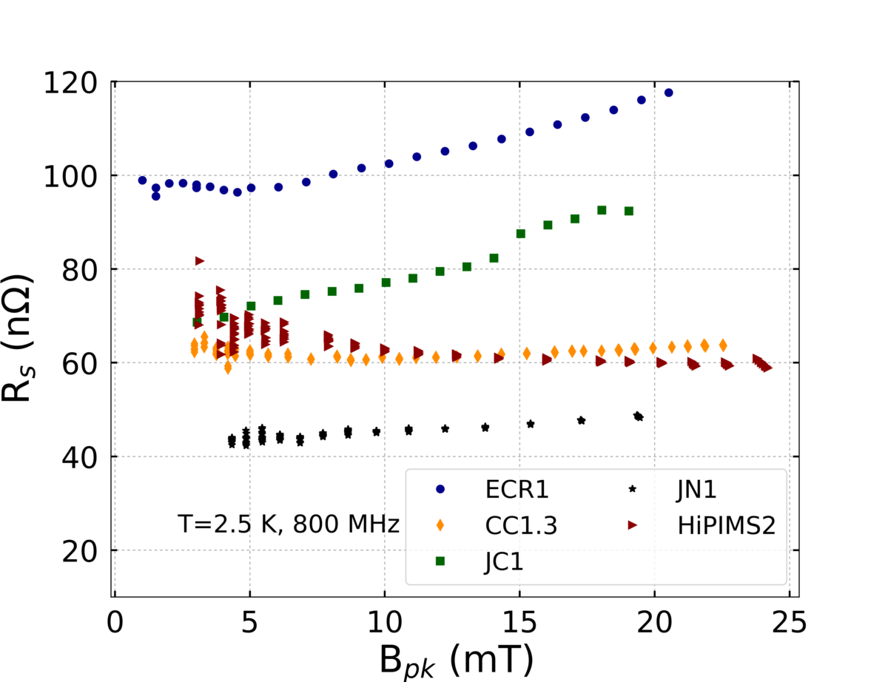
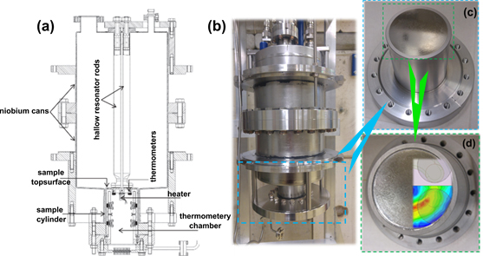

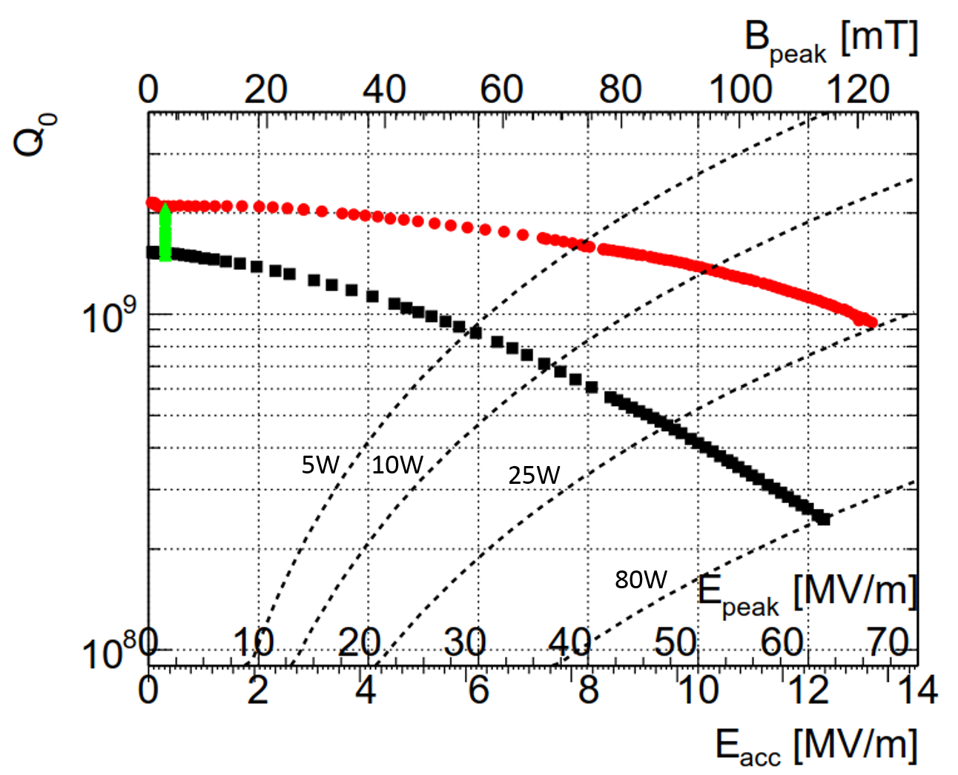
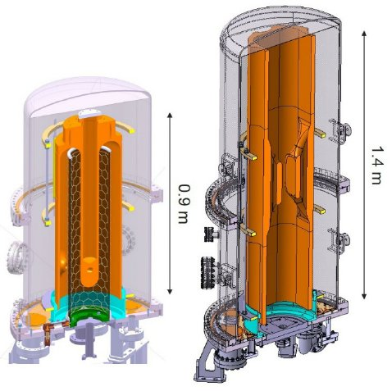
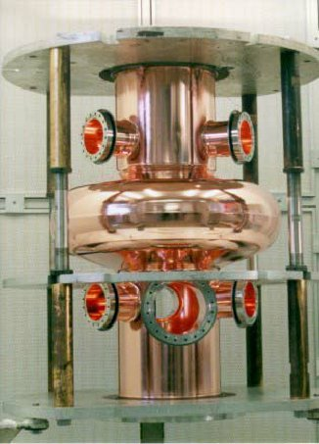
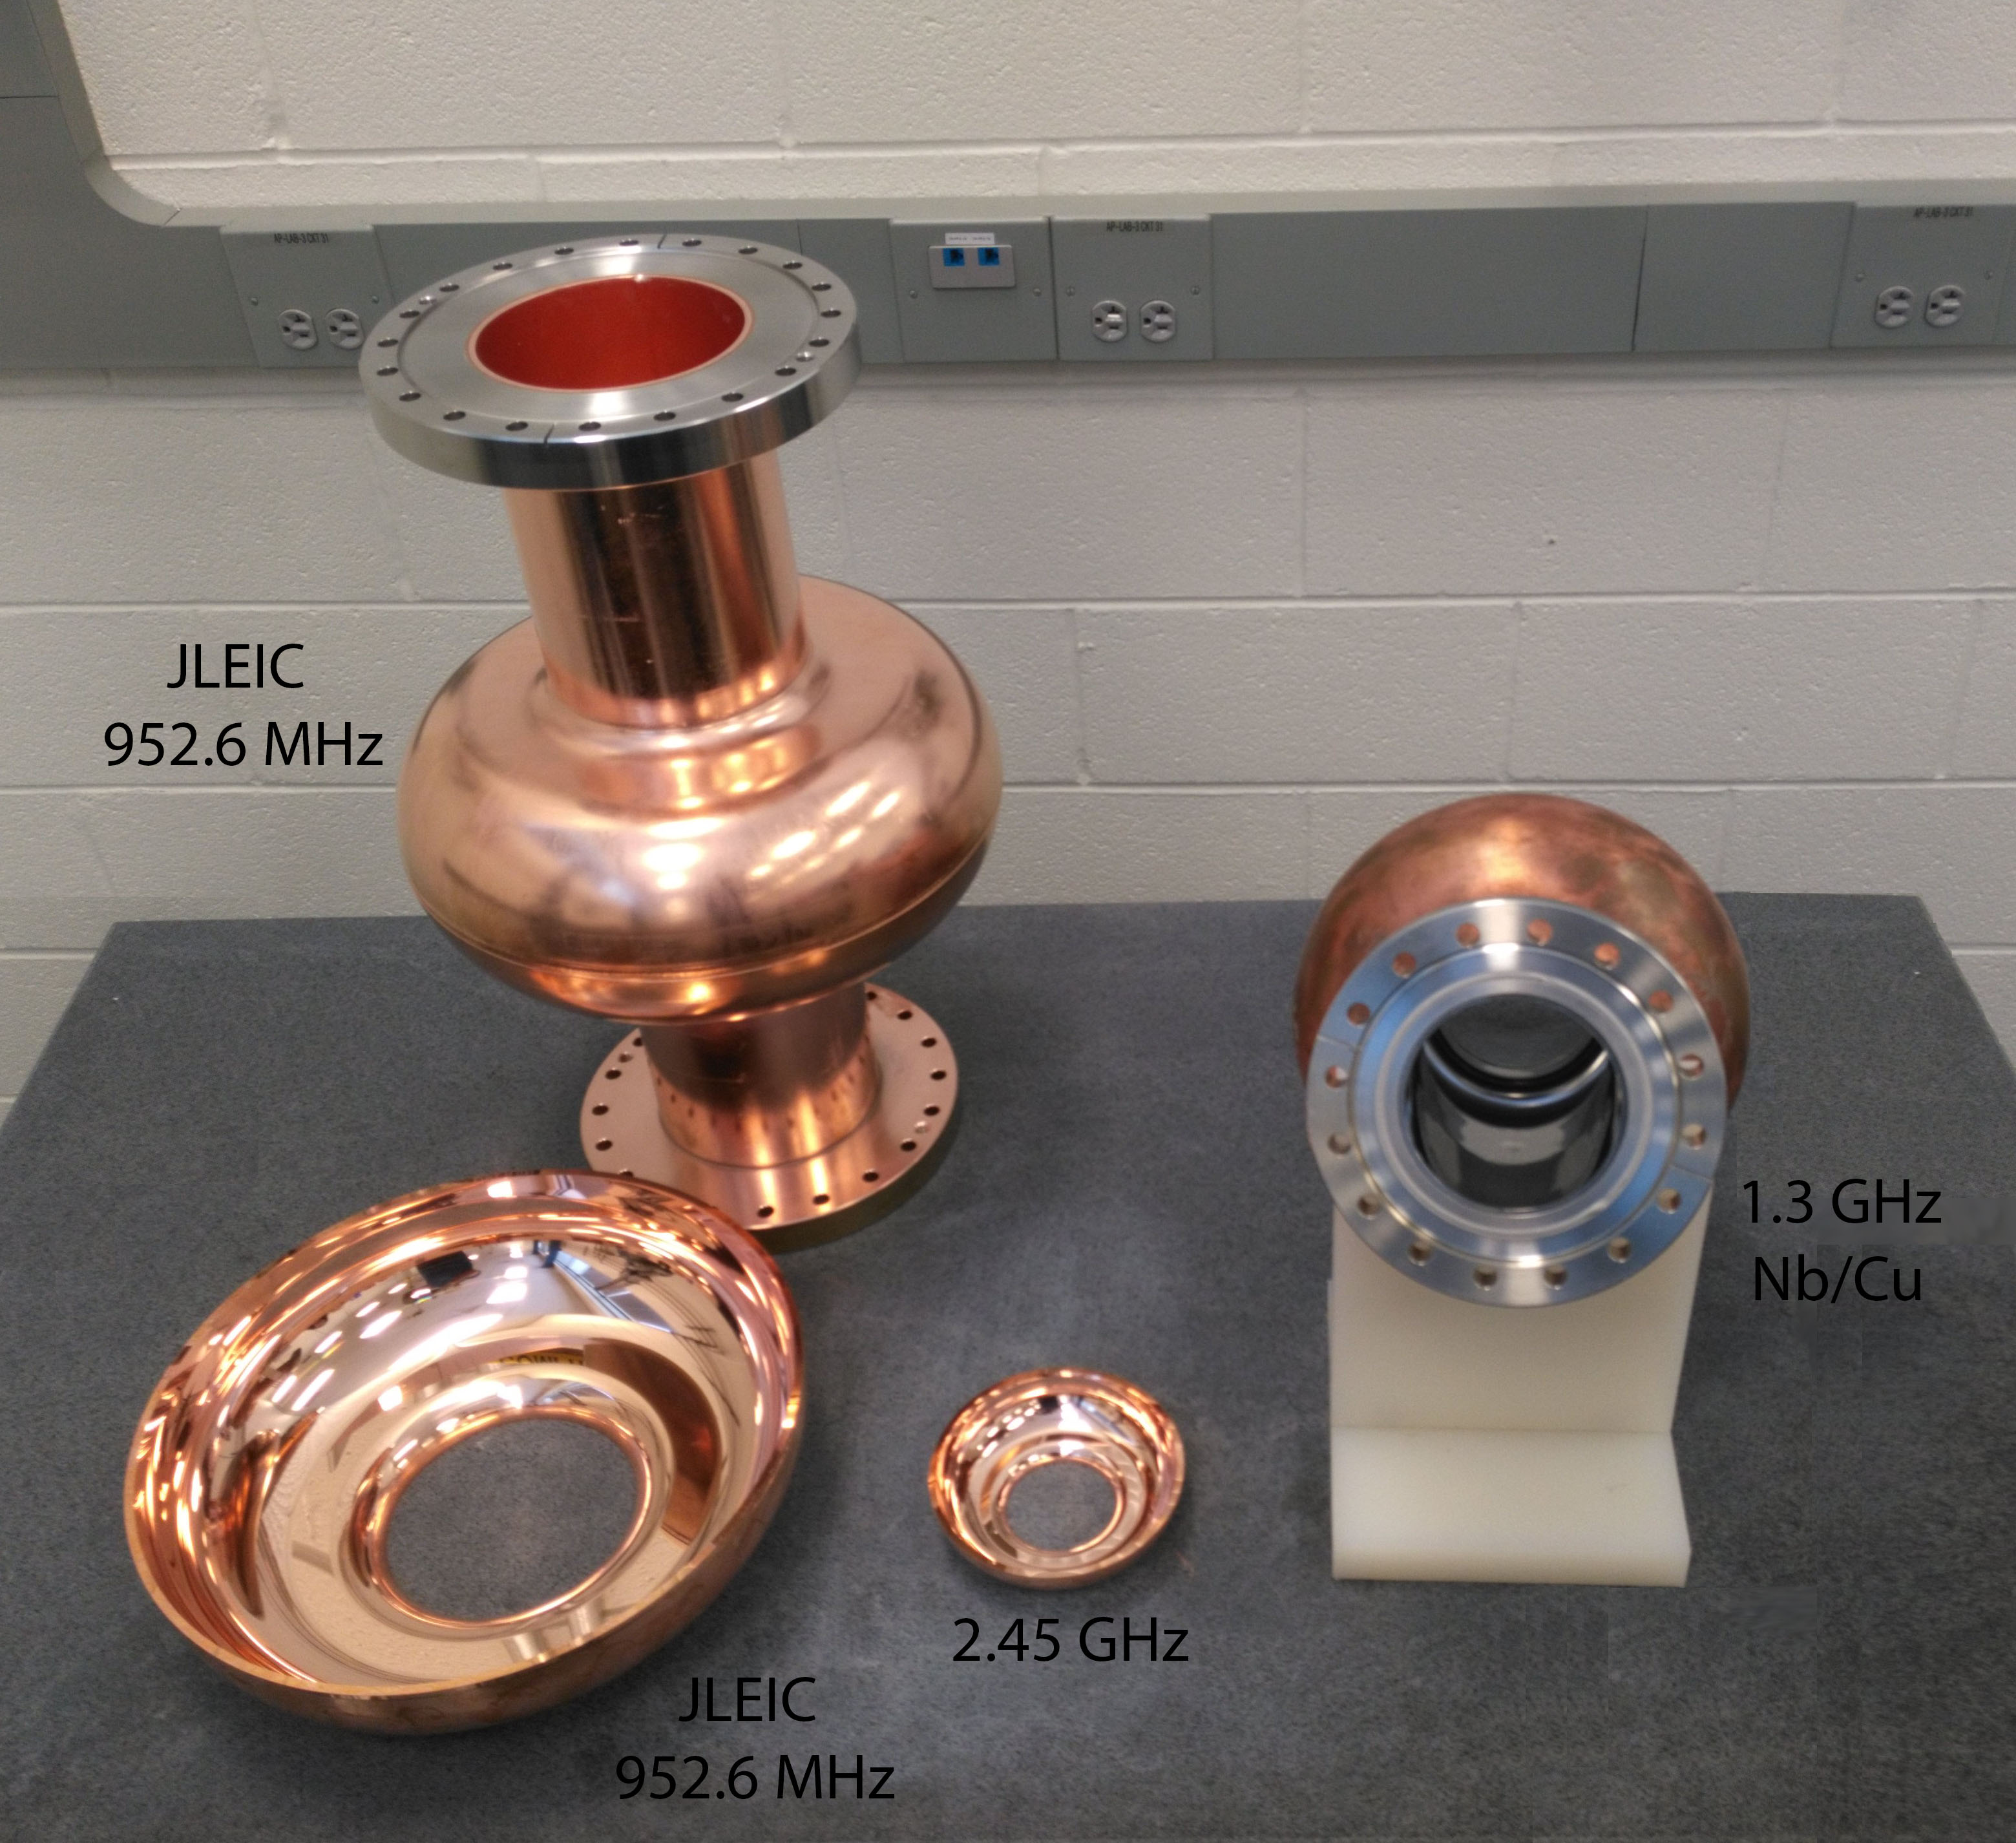
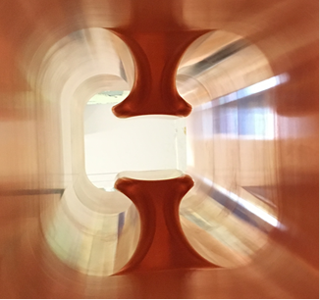
Advances in Thin Film Nb on Cu Technology
ECR
Cylindrical HiPIMS
B_{res}= 50 mG
T= 2.3 K
Developments across shapes & frequencies
LHC 400 MHz
FCC 800 MHz
956.2 MHz / 1.3 GHz
QWR 100 MHz

Slide 14
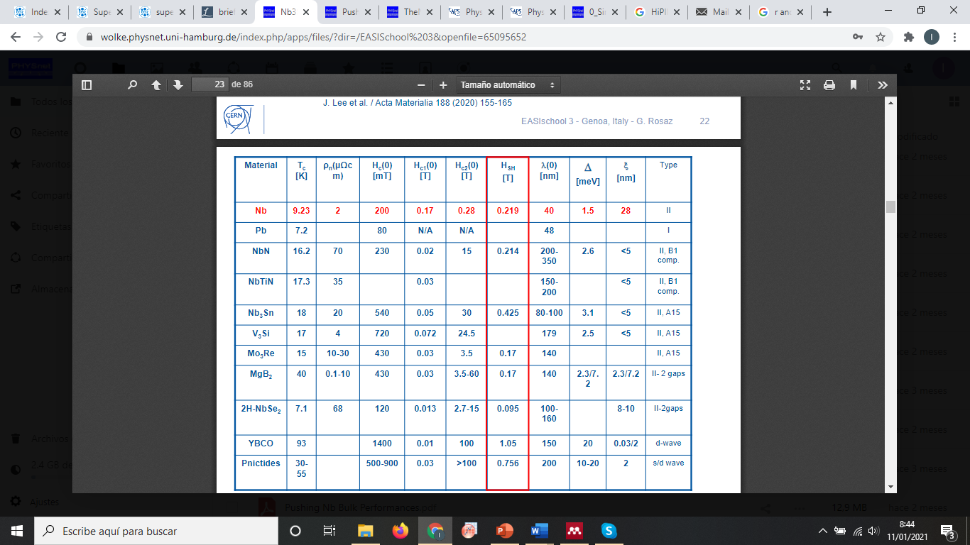
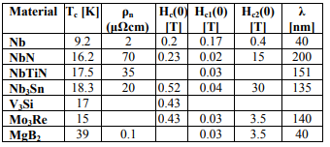
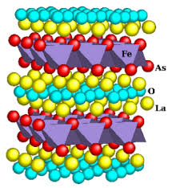
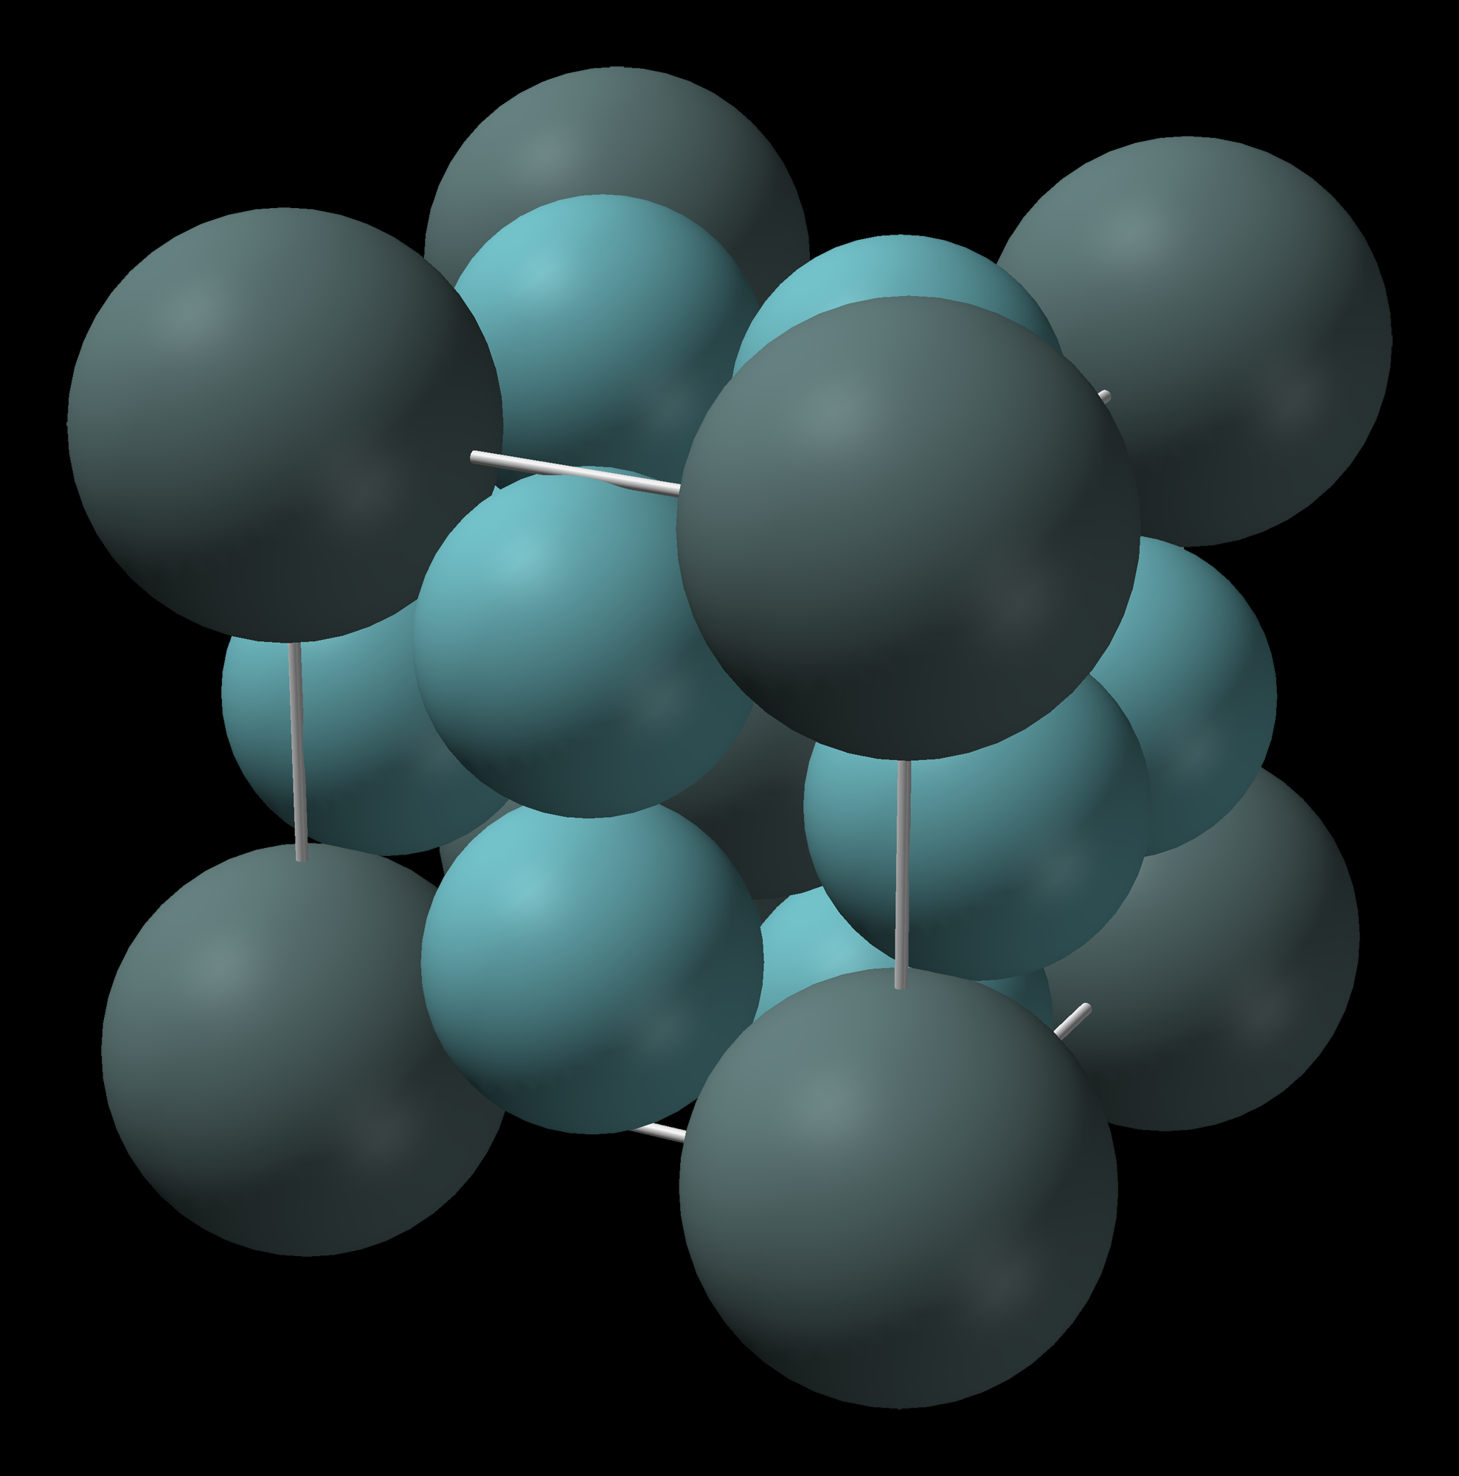
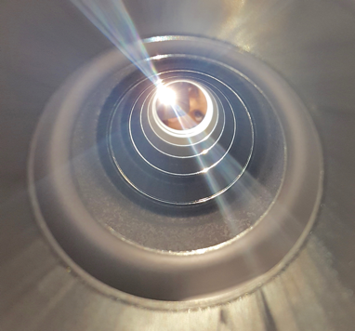
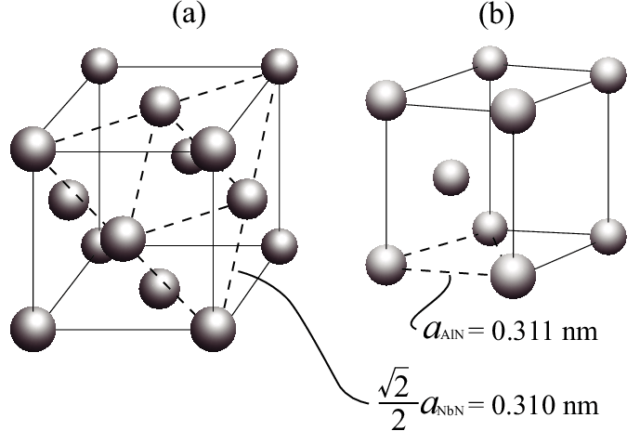
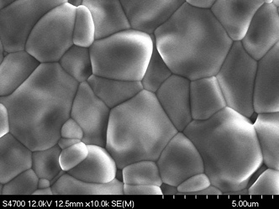
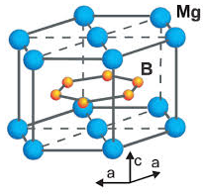
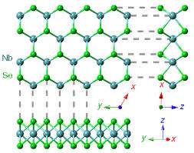
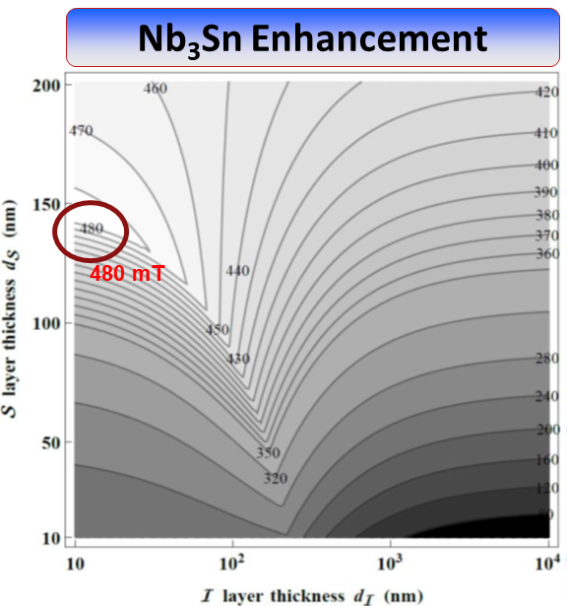
Explore alternative materials with higher critical temperature and critical fields
Alternate Materials and Advanced Structures for Higher Gradients and High Q
Alternative materials with higher critical temperature and critical field are the prime candidates to disrupt the established bulk Nb technology.
B1
Pnictides
A 15
MgB₂
2D-NbSe₂
Alex Gurevich, Appl. Phys. Lett. 88, 012511 (2006)
Alex Gurevich, AIP ADVANCES 5, 017112 (2015)
T. Kubo, Applied Physics Letters 104, 032603 (2014)

Slide 15
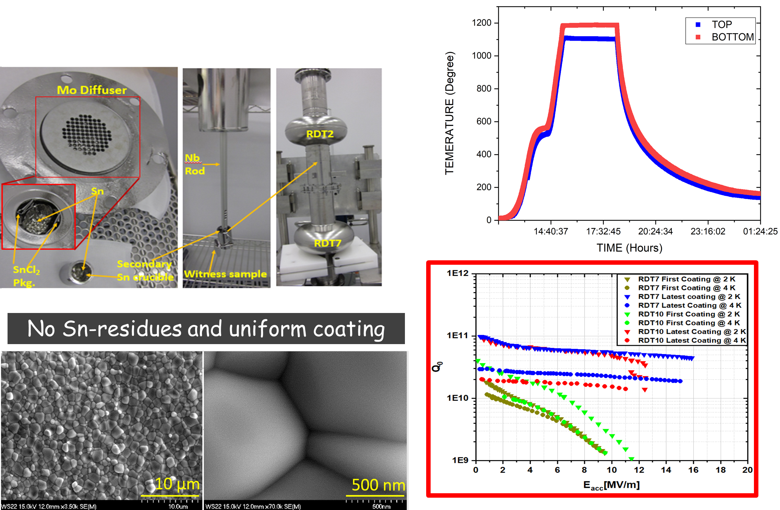
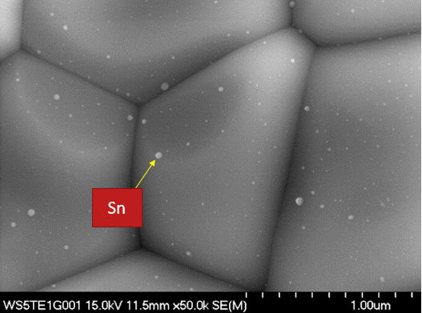
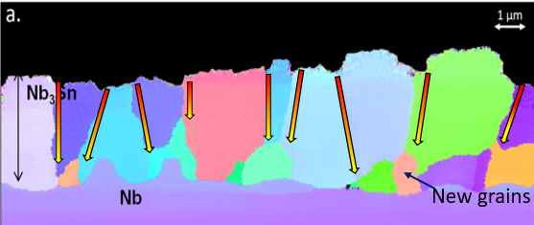
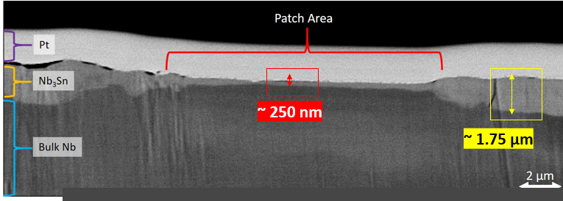







A15 Materials for SRF cavities - Nb₃Sn Development
Material studies to understand the fundamental growth mechanism linking with RF performance
Process Development
Materials such as Nb₃Sn offer order of magnitude improvements in operating efficiency, and a theoretical pathway to 100 MV/m gradient.
Recent R&D efforts have demonstrated that the persistent Q-slope and gradient limitation observed in the past are not fundamental but process induced and therefore amenable to improvement.
Alternative deposition approaches such as sputtering, energetic condensation and atomic layer deposition (ALD) should be fully explored for enhanced properties and conformality.
Early results with sequential and stoichiometric deposition both on Nb and on Cu are promising and could prove to push the Nb₃Sn technology further.
✗
✗
✗
Potential factors contributing to recurrent Q-slopes in Nb₃Sn cavities
✓
Grain-boundary diffusion primarily controls thin-film growth. Patchy regions lack grain boundaries resulting in RF-affecting thin regions.
Modification of coating process based on learnings from correlated material and RF studies of Nb₃Sn samples resulted in the removal of recurrent Q-slopes.
Multi-cell cavity coating for accelerator application
Despite early cavities suffered non-uniformity, enhanced substrate quality and continuously updated coating process resulted in notable improvement.
Multi-metallic conduction cooled Nb3Sn-coated cavity
G. Ciovati et al 2020 Supercond. Sci. Technol. 33 07LT01
These cavities progress to quarter cryomodule for the first-ever beam test.
Talk Title Here
15

Slide 16


A15 Materials for SRF cavities - Nb₃Sn Development
Alternative coating methods for Nb₃Sn/Cu or Nb/CuSn
S. Posen, M. Liepe, G. Eremeev, U. Pudasaini, C.E. Reece
”Nb3Sn Superconducting Radiofrequency Cavities: a Maturing
Technology for Particle Accelerators and Detectors”
https://arxiv.org/pdf/2203.06752
Electrodeposition, Nb/CuSn+annealing, magnetron sputtering
E. Barzi et al.
An Impartial Perspective on Superconducting Nb3Sn coated Cu RF Cavities for Future Accelerators
https://indico.cern.ch/event/656491/contributions/2932254/
Meter-scale prototype C³ structure
Notes:
Nb

Slide 17

















Alternative Materials to Nb & Multilayered Structures
Develop alternative materials such as NbTiN, NbN, Nb₃Sn Va₃Si, ... with advanced coating techniques.
Especially for low melting temperature substrates (Cu, CuSn, Al…)
Newly discovered high temperature superconducting (HTS) materials (pnictides …) would be particularly interesting if any of them turns out to have favorable microwave properties
Advanced coating techniques
Hauptmann, N., M. Becker, J. Kröger and R. Berndt. “Surface reconstruction and energy gap of superconducting V 3 Si ( 001 ).” Physical Review B 79 (2009): 144522.
High quality dense films
Improved conformality
Re-HiPIMS
Conformal, self-limiting
nm precision
Precursors difficult
ALD

Slide 18







Path Forward
Microscopy
Already well-established and fruitful international R&D collaborations
JLab, SLAC, ODU, CORNELL, FNAL, FSU, W&M, ANL, Temple U. …
&
CEA Saclay, CERN, DESY, HZB, INFN-LNL, KEK, STFC, TRIUMF and other institutions
should be fully supported and expanded in the following areas of R&D:
Diffraction
STEM, PCT
Magnetometry
Theoretical and material studies to gain in-depth understanding of the fundamental limitations of thin film superconductors under radio-frequency fields
Advanced coating technology for Nb/Cu and alternative materials, Nb₃Sn, V₃Si, NbTiN …
    Energetic condensation (electron cyclotron resonance (ECR), HiPIMS, kick positive pulse…)
    Atomic Layer Deposition (ALD)
    Hybrid deposition techniques
Cavity deposition techniques for development of superconductor-insulator-superconductor (SIS) nanometric layers to further enhance the performance of bulk Nb and Nb/Cu
Improved cavity fabrication & preparation techniques
  electroforming, spinning, hydroforming, electro-hydro forming, 3D additive manufacturing
  environmentally friendly electropolishing, diamond cutting, nano-polishing, plasma etching …)
Cryomodule design optimization
Improvement of accelerator ancillaries with advanced deposition techniques
  HiPIMS Cu coated bellows, power couplers…
ECR
ECR
HiPIMS
ALD
Substrates
Substrates
Cryomodule Design
Bellows

Slide 19

SRFTF Development
F. Marhauser, R. A. Rimmer et al.
SRF thin film technology based on advanced coating techniques offers many opportunities to fully engineer SRF surfaces :
  Deliberate creation of the most favorable interface or functional interlayer
  Tailoring of the most favorable film(s) structure
  Properties enhancement with doping/infusion
  Control over the final SRF surface with dry oxidation or cap layer protection.
Bulk-like performance Nb films, alternative material films and SIS multilayer structures open the possibility of major system simplifications and enhanced performance.
Developments transformative not only for future high energy physics machines but will also bring forth the opportunity to upgrade existing machines to higher performance in achievable energies and cryogenic & power consumption, within the same footprint.
Active community in the US and Internationally
A.- M. Valente-Feliciano, C. Antoine, S. Anlage, G. Ciovati, J. Delayen, et al.
”Next-Generation Superconducting RF Technology based on Advanced Thin Film Technologies and Innovative Materials for Accelerator Enhanced Performance and Energy Reach”
https://arxiv.org/pdf/arXiv:2204.02536

Slide 20

Compact SRF Accelerators for Societal Applications
Salime Boucher, Eric Esarey, Cameron Geddes, Carol Johnstone, Sergey Kutsaev, Billy W. Loo Jr et al
”Transformative Technology for FLASH Radiation Therapy”
https://arxiv.org/pdf/arXiv:2203.11047, also under CommF01
Compact cavity cooled by cryocoolers for environmental applications
The emergence of reliable, energy efficient high Q systems, based on highly performing SRF cavities along with transformative development with cryocoolers would impact societal applications ranging from medicine to industry.
Cost effective compact superconducting accelerators will reduce the footprint and capital investment of
  Medical machines - cancer therapy, medical radioisotope production
  environmental remediation
  accelerator-driven systems (ADS) -nuclear waste transmutation,power generation
  high-intensity proton accelerators for homeland security (nuclear weapons detection).
Most critical area of development
Energy efficiency
Ciovati, G., et al. “Design of a low-cost, compact SRF accelerator for flue gas and wastewater treatment.” (2017).
Ciovati, Gianluigi, et al. "Multi-metallic conduction cooled superconducting radio-frequency cavity with high thermal stability." Superconductor Science and Technology 33.7 (2020): 07LT01.
Stilin, Neil et al. “Stable CW Operation of Nb₃Sn SRF Cavity at 10 MV/m using Conduction Cooling.” arXiv: 2002.11755: Accelerator Physics (2020).
R C Dhuley et al 2020 Supercond. Sci. Technol. 33 06LT01

Slide 21

Advanced RF Structures
Cavities with sophisticated geometry and tuning mechanisms required to allow large volume experiments to be operated at high frequencies.
Microwave cavities for axion searches leverage new ideas from both accelerators and quantum information sciences.
Moving to higher frequencies cavity volumes run into rapidly degrading volumes and lower quality factors for ordinary metals. There are several methods to recover this:
    •Increase volume by coherently adding multiple cavities in phase at the same fre-quency to take advantage of the axion coherence
    •Increase search scan rate but building an array of cavities with complementary fre-quencies and small tuning range to perform a frequency comb search. Does not take advantage of axion coherence but may be simpler to implement
J. Jaeckel, G. Rybka, L. Winslow, for the Axion Prospects Collaboration
“Axion Dark Matter”
https://arxiv.org/pdf/arXiv:2203.14923(also under RF03, CF02, TF09, IF01)
Emilio A. Nanni, Martin Breidenbach, Caterina Vernieri, Sergey Belomestnykh, et al.
”C³ Demonstration Research and Development Plan”
https://arxiv.org/pdf/arXiv:2203.09076, also under CommF01)
Cool Copper Collider (C³) – Liquid N₂-cooled C-band distributed coupling linac
For compact Higgs Factory

Slide 22








What is needed?
Synergies between R&D programs, institutions along aligned path
Multiple RF test platforms (QPR, cavities…) for fundamental,
detailed materials study
    --Doping, Nb₃Sn, peak fields, multi-layers, other A15, MgB₂…
Material research instruments
Expanded distribution of funding (GARD…) for National Labs & Universities
Continued investments are needed in R&D, production and test facilities.
      Labor
      Existing facility upgrade
      New facilities
Training of young Scientists and Engineers
Fostering industrial partners in US

Slide 23


AF7 Recommendations

Slide 24
CONCLUSIONS
The next 5-40 years will be an exciting time in Accelerator Physics & SRF
The Snowmass process offers opportunities to advocate to
The scientific community
the public
our funding agencies and governments
Will lead to a comprehensive international program for US participation in future colliders that welcomes all with know-how and interest, and at all levels of innovation and R&D
New materials and thin film technologies made it into the Snowmass exercise for the 1st time
http://seattlesnowmass2021.net/

Slide 25
TFSRF Roadmap
2024
2026
2028
2030
2032
2034
Physics of RF Surface Resistance
Nb/Cu
Nb₃Sn or other new materials
Magnetic Flux Losses
Substrates
Understand the field dependence of BCS surface resistance and effect of different impurities
Apply gained knowledge and develop new understanding for alternative materials
Understand origin of residual resistance and its field dependence
Understand trapped magnetic flux losses and flux trapping
Establish Nb film baseline
@ 1.3 GHz (2 K) & @ 800- 400MHz (4.2 K)
Develop Nb film multi-cell cavities
Potential of Nb/Cu material:
Q (2 K) ~ 4x10¹⁰ @ 1.3 GHz
Integrate Nb/Cu with graded doping
Master Nb₃Sn film growth on bulk Nb single cell / multi-cell cavities
Integrate Nb, Nb₃Sn, other mat’l, doping in common deposition
Nb₃Sn studies for cryomodule operation
Potential of Nb₃Sn material:
Q (4 K) ~ 3x10¹⁰
@ 1.3 GHz
Explore SIS for Nb₃Sn
Explore SIS on cavities
Evaluate Nb₃Sn film growth on Cu
Scale to lower frequency cavities
Evaluate alternative film materials (NbN, NbTiN, MgB₂) first on samples, then on cavities
Impact:
Retain 1x10¹¹
Sustain very high gradients
Drastically reduce sensitivity to magnetic flux for Nb and new materials
In situ removal of trapped magnetic field (in cryomodule)
Develop adequate Cu substrate and preparation methods
Goals
Q > 4x10¹⁰ at 2 K, 1.3 GHz (800 MHz) and E_{acc} > 35 MV/m (25 MV/m)
Q > 3x10⁹ at 4.2 K, 400 MHz and E_{acc} > 13 MV/m
Nb₃Sn: E_{acc} > 20 MV/m with Q₀ > 1x10¹⁰ at 1.3 GHz, 4.2 K
Residual resistance < 1 nΩ in cryomodule
Nb₃Sn cryomodule ready technology
SIS structures
on Nb & Nb/Cu
30–50% E_{acc} increase and a factor of two in Q0.

Slide 26
MERCI
THANK YOU

Slide 27
Synergy with European Strategy
European Strategy for Particle Physics (ESPP) describes strategy for particle physics in Europe and their contributions world-wide (June 19, 2020)
European National Laboratories Directors Group (LDG) – July 2 (Chaired by Lenny Rivkin)
Immediate outcome àAccelerator R&D Task Forces reporting to Lab Directors Group(LDG) and CERN Council
Address the question of what are the most promising Accelerator R&D activities for HEP
Snowmass AF participants are active on all the LDG panels
Efforts in the United States for SRF research and development are in synergy with other regions, Europe and Asia
coherent with the European Strategy for particle physics document published January 2022

