Slide 1
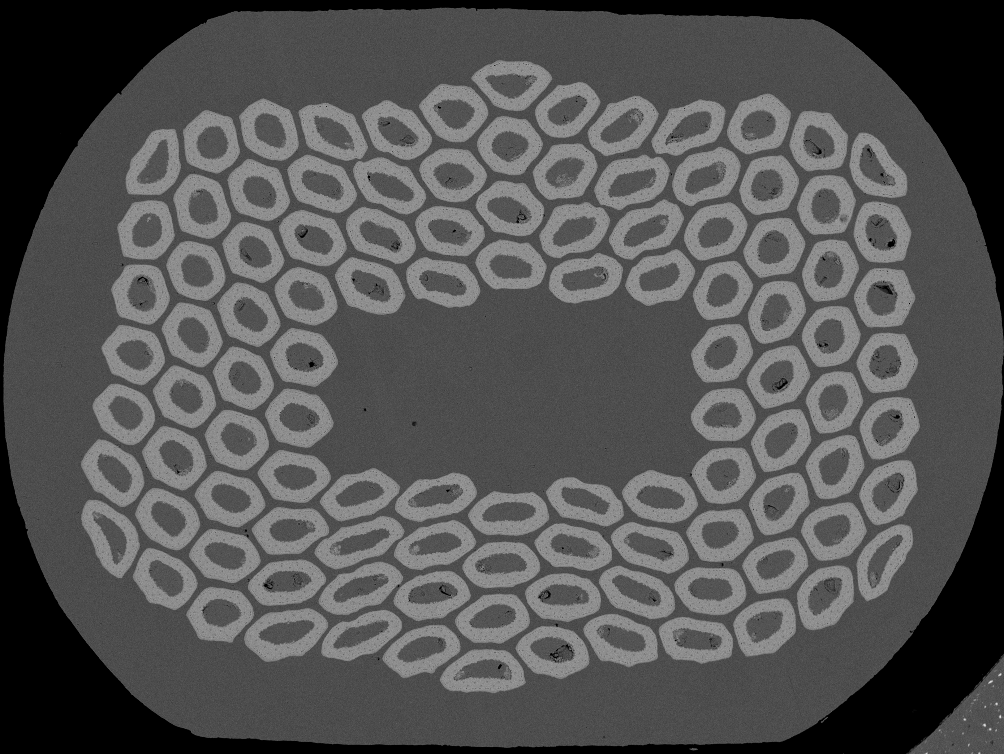
Variables
Type of wire
- Manufacturing method
- Wire layout
Wire deformation
- % of rolling compression
- Orientation of the compression
Round
20% rolling compression

Slide 2
Variables
Type of wire
- Manufacturing method
- Wire layout
Wire deformation
- % of rolling compression
- Orientation of the compression
Round
Manual location of points
One MQXF (108/127):
At least 756 points to describe subelement position and shape
20% rolling compression

Slide 3
Variables
Type of wire
- Manufacturing method
- Wire layout
Wire deformation
- % of rolling compression
- Orientation of the compression
Round
Manual location of points
One MQXF (108/127):
At least 756 points to describe subelement position and shape
Computer assisted location of key points?
20% rolling compression

Slide 4
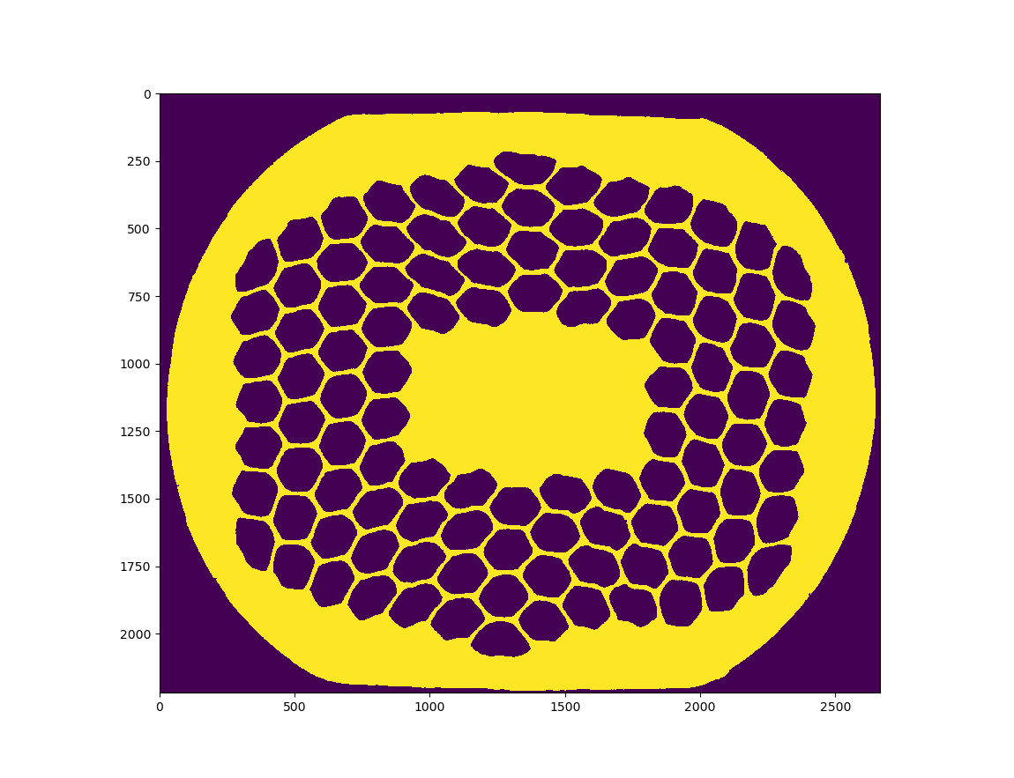
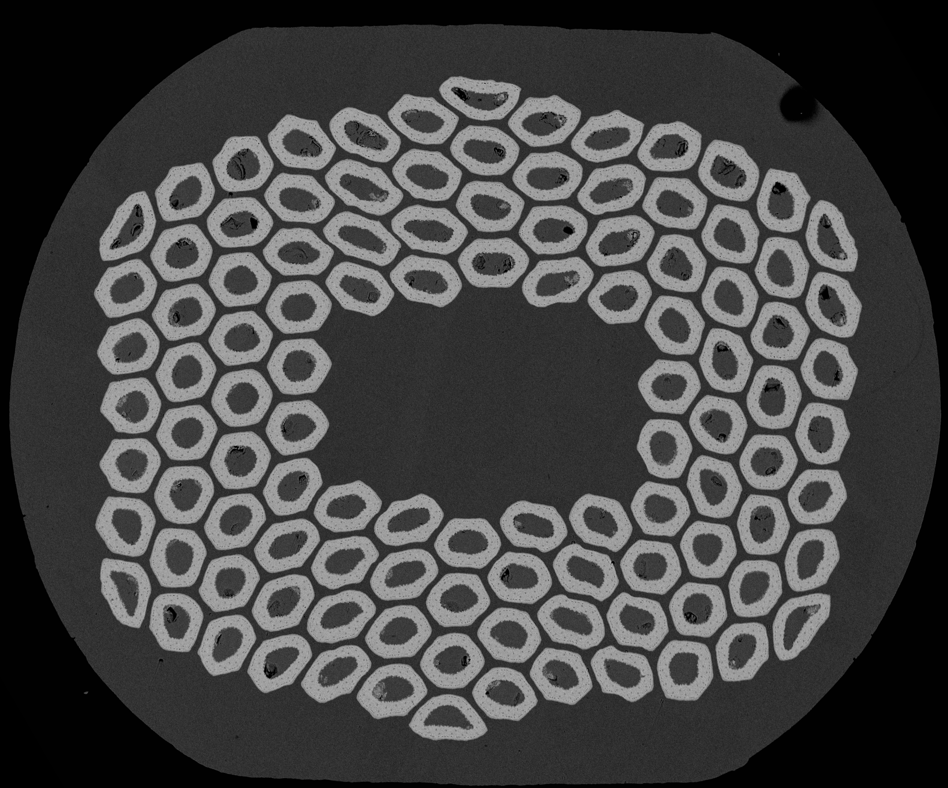
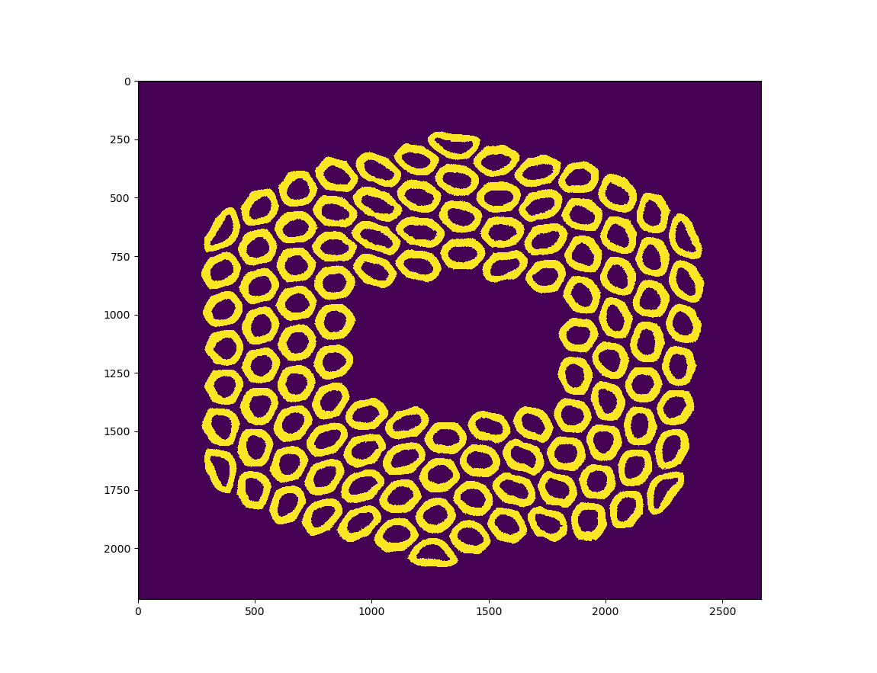
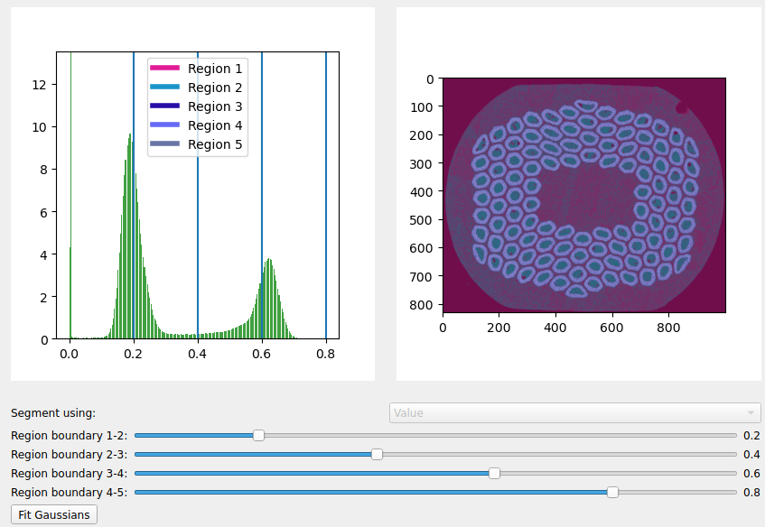
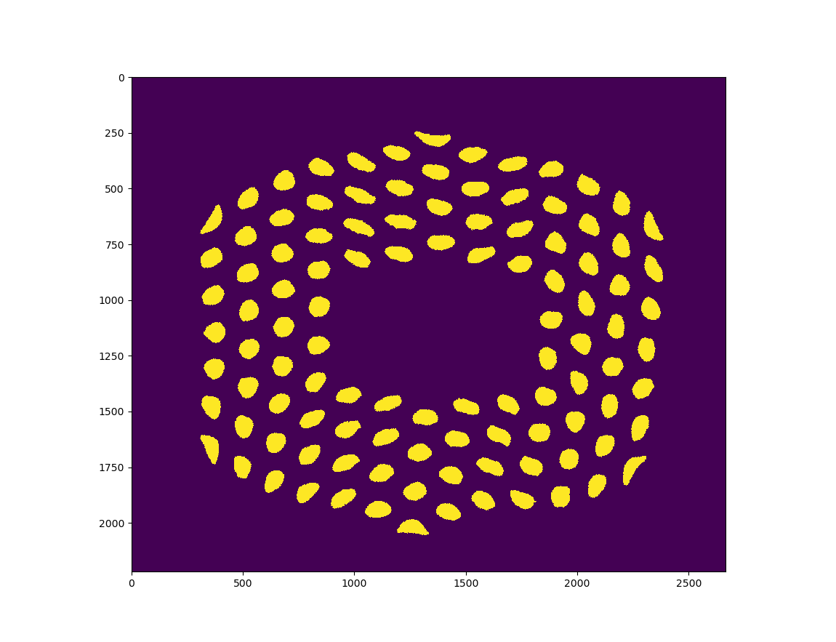
Segmentation
Cu
Nb3Sn
Cu-Sn

Slide 5
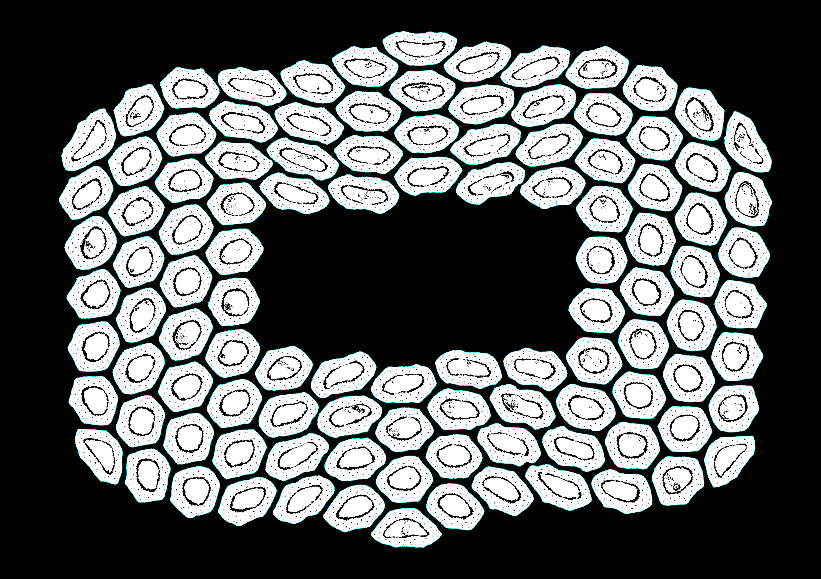
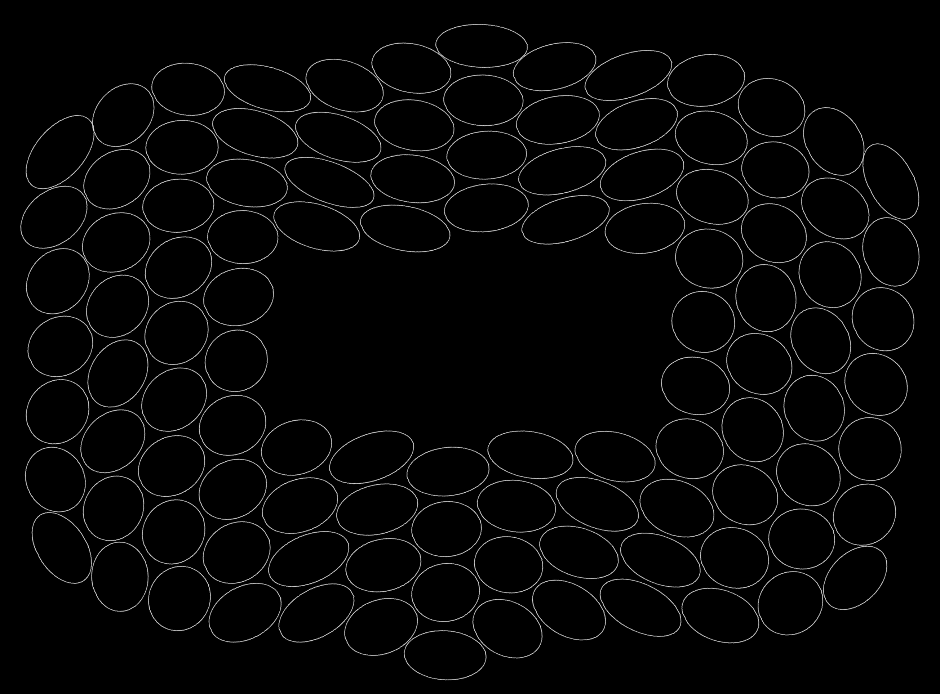

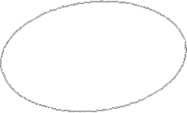
Elliptical description
Wire centre
Minor axis
SubElement centre
angle
Major axis

Slide 6
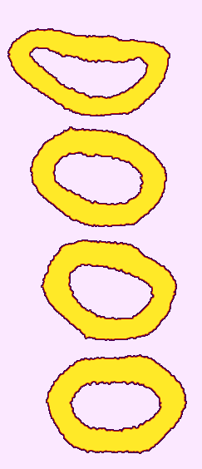
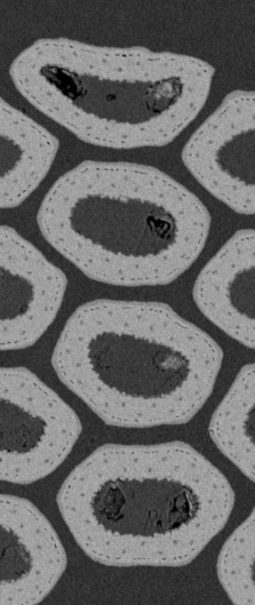
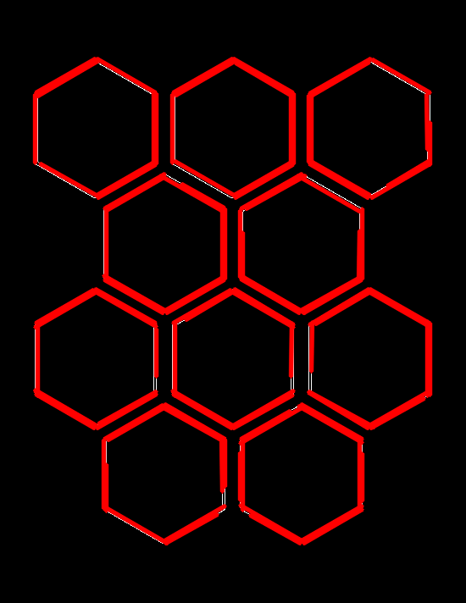
Polygonal description
Corners are Intersections of straight segments (Hough method)
Hexagons?
By Hough Transformation 0 corners detected

Slide 7
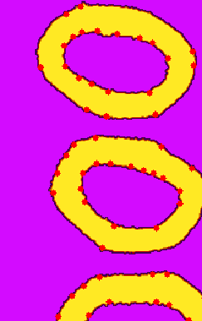
Harris Corner Detector: given a contour a function determines the corner quality measure at every source image pixel
Too many corners
Jianbo Shi and Carlo Tomasi. Good features to track. In Computer Vision and Pattern Recognition, 1994. Proceedings CVPR'94., 1994 IEEE Computer Society Conference on, pages 593–600. IEEE, 1994.

Slide 8


After some adjustments:
Harris Corner Detector: given a contour a function determines the corner quality measure at every source image pixel
Jianbo Shi and Carlo Tomasi. Good features to track. In Computer Vision and Pattern Recognition, 1994. Proceedings CVPR'94., 1994 IEEE Computer Society Conference on, pages 593–600. IEEE, 1994.

Slide 9
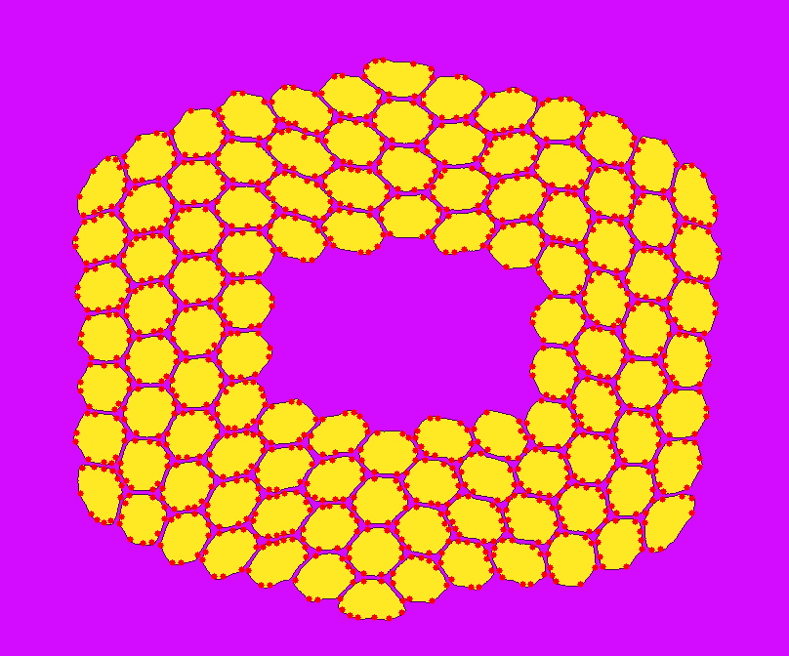
Segmentation
Still some adjustments needed
Harris Corner Detector: given a contour a function determines the corner quality measure at every source image pixel
Jianbo Shi and Carlo Tomasi. Good features to track. In Computer Vision and Pattern Recognition, 1994. Proceedings CVPR'94., 1994 IEEE Computer Society Conference on, pages 593–600. IEEE, 1994.

Slide 10




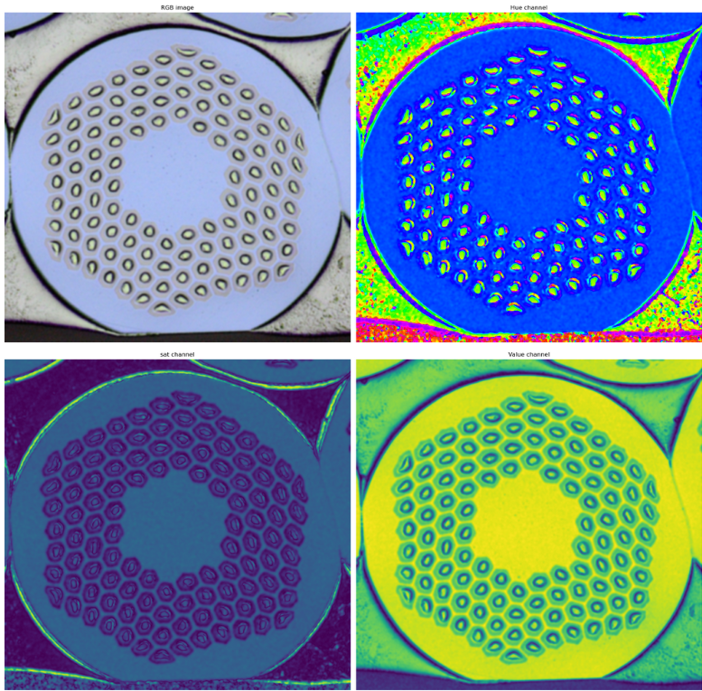
Further steps
Acquisition
Segmentation
Disassemble
Electron Microscopy
Optical Microscopy
Calculate Nb3Sn area
Establish sub-Element centroid and key points
Curvature optimisations (based on 3-points arc)

