Slide 1
Nb₃Sn Wire Cross-Sections, Image Analysis and Geometrical Descriptions
S. C. Hopkins
Geometry of strands and cables for simulations in FiQuS, 12 February 2024

Slide 2
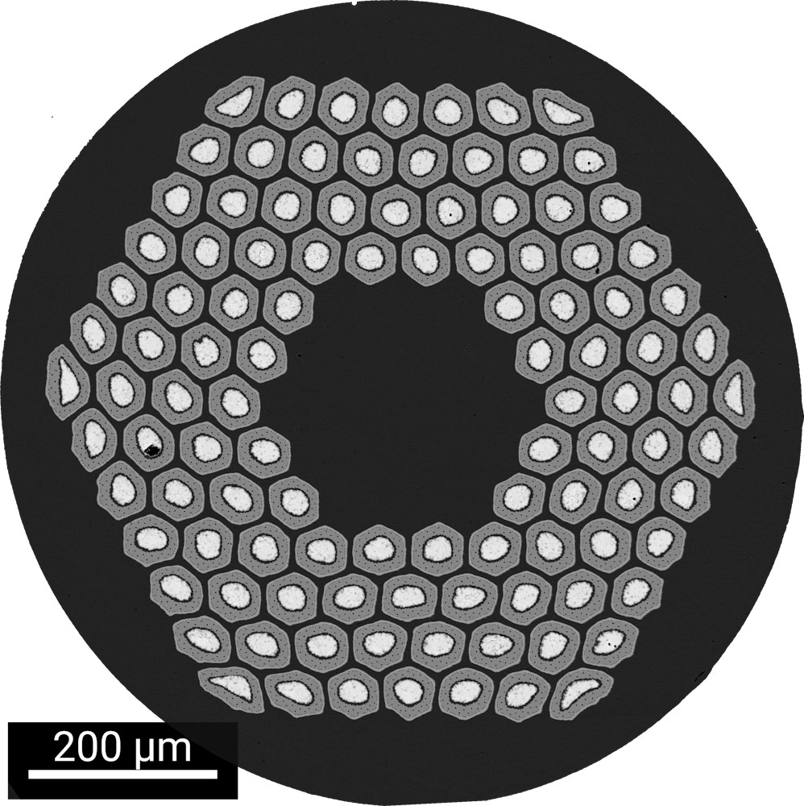
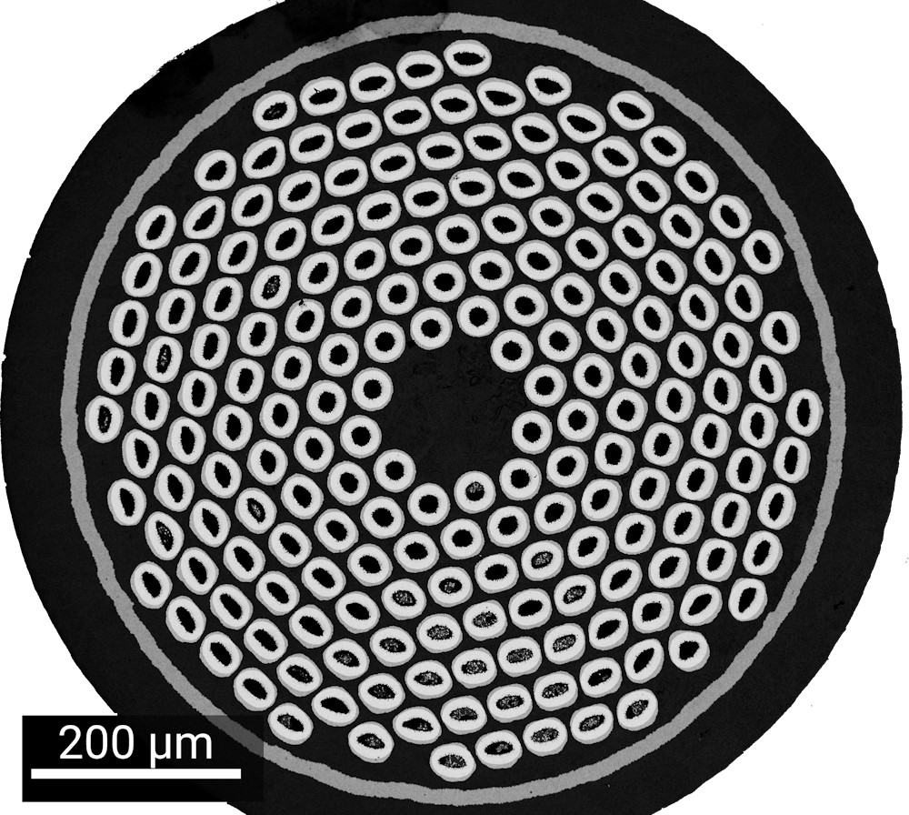
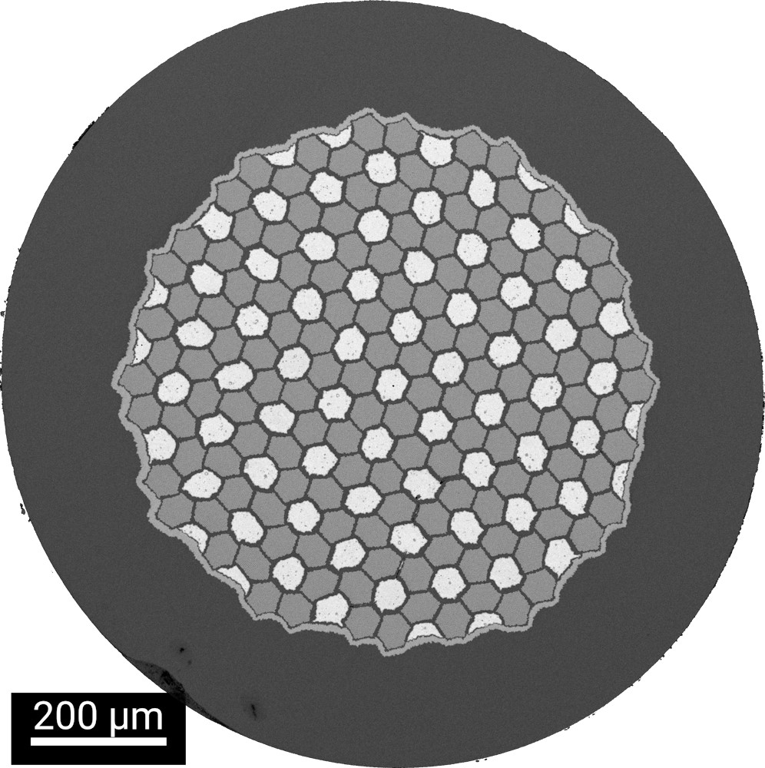
Nb₃Sn Wire Types
Currently, Nb₃Sn is processed by wind-and-react routes, so wires (as-received) are precursors with a mixture of Cu/Nb/Sn containing phases from which Nb₃Sn is formed on heat treatment
For high J_{c} applications, three types are of recent interest for magnet use at CERN:
  Internal tin – (almost) pure Sn and Nb in a Cu matrix, enclosed in a diffusion barrier
    Rod Restack Process (RRP®) – Bruker OST commercial wire
    Distributed tin (DT) – JASTEC and KAT R&D wires
  Powder in tube (PIT)
    Nb-Sn intermetallic in Nb-Ta tube – Bruker EAS commercial wire
  Other PIT formulations, tube-type designs etc., also exist
108/127
RRP®
162/169
PIT
DT

Slide 3
RRP® Wires
Hexagonal stack of hexagonal sub-elements
  A/B = A superconducting sub-elements in array of B modules (many different configurations possible)
  In principle, geometry defined by A/B, Cu/non-Cu, Cu spacing and elemental ratios
    We have a Python tool to build this geometry from input parameters
108/127 (MQXF) | 120/127 (ERMC#101) | 132/169 (FRESCA 2) | 150/169 (ERMC#102) | 162/169 (ERMC-1, DEM-1.1)
.

Slide 4
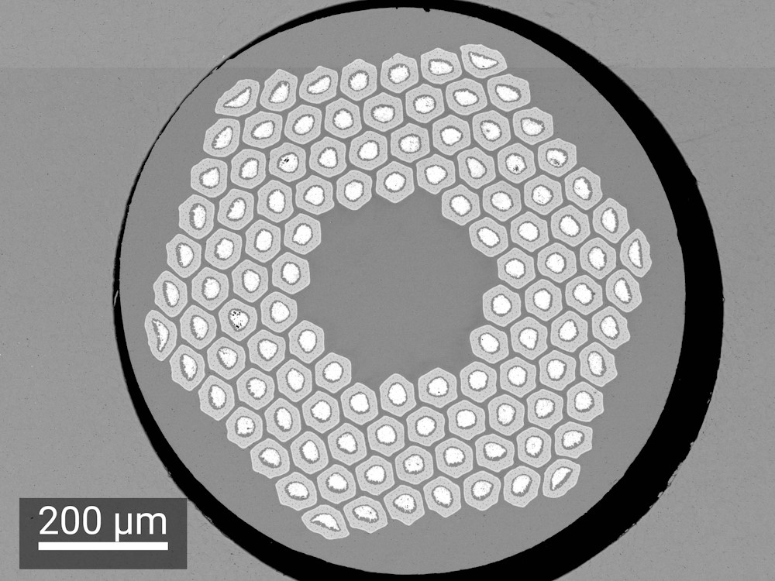
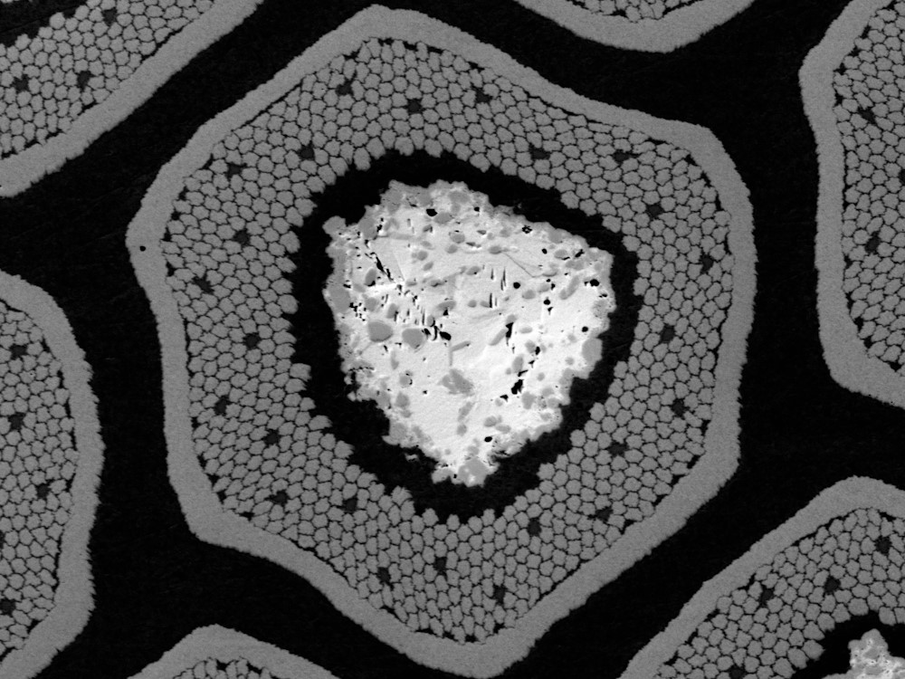
RRP® Wires (2)
Each sub-element consists of an array of Nb filaments inside a Nb diffusion barrier, surrounding a Sn core
In real wires, these are not perfectly hexagonal, and are particularly distorted in corner positions

Slide 5
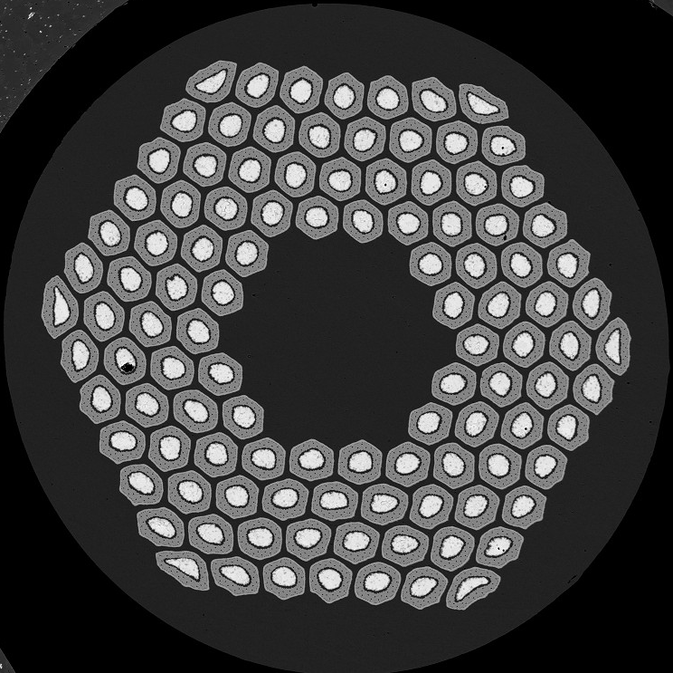
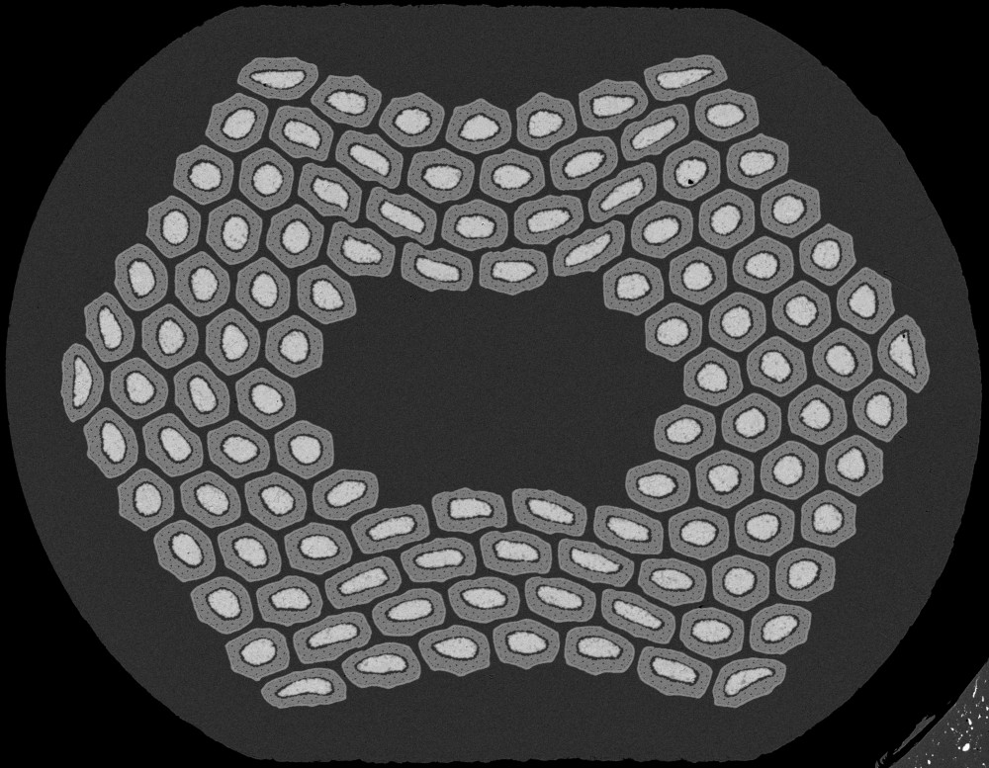
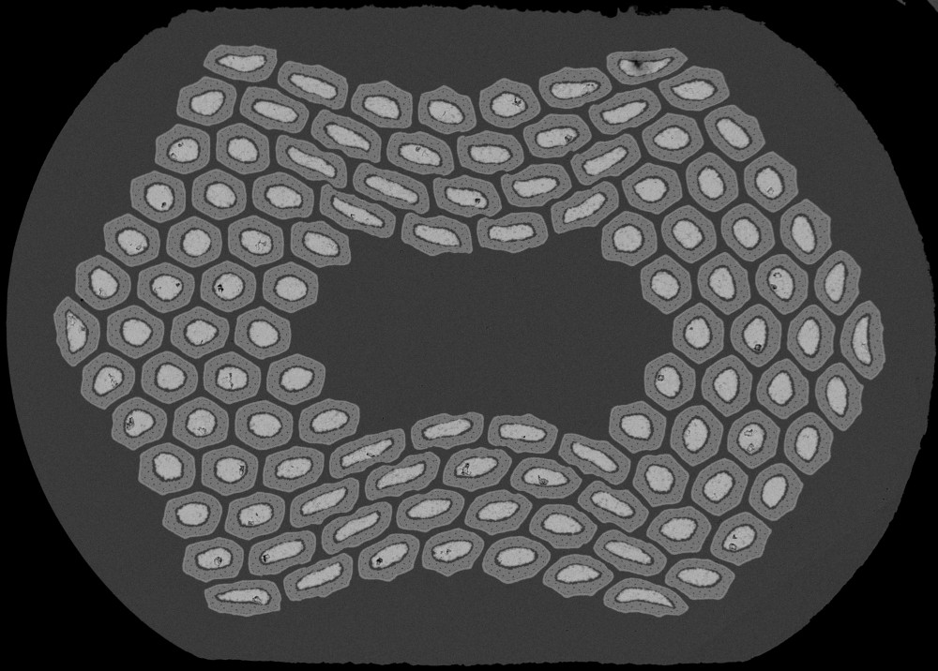
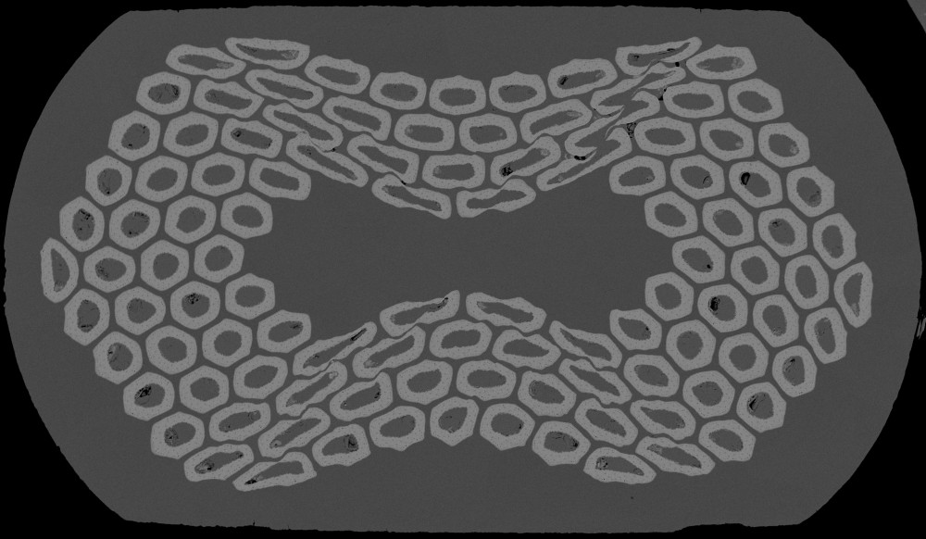
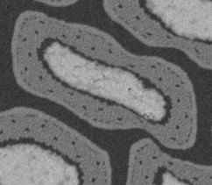
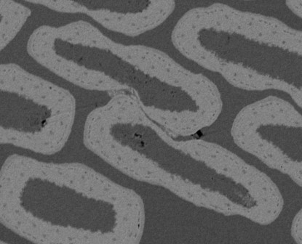
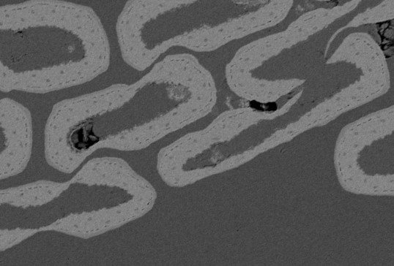
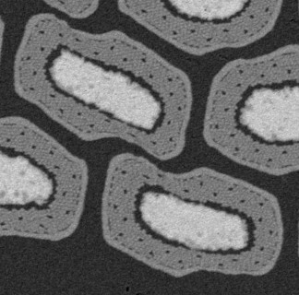
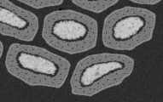
RRP® Rolling: Key Features
Visually apparent that progressive rolling:
  Increases subelement aspect ratios
  Locally reduces diffusion barrier (and Nb filament pack) thickness
  Shears or merges adjacent subelements
These observations can be quantified by image analysis:
  Performed for a set of adjacent samples from one spool reacted in a single heat treatment
Round
15 %
20 %
30 %
RRP® 108/127,
0.85 mm
Local barrier thinning, reduction of separation
Increasing subelement aspect ratio
Subelement merging, shearing and barrier thinning

Slide 6
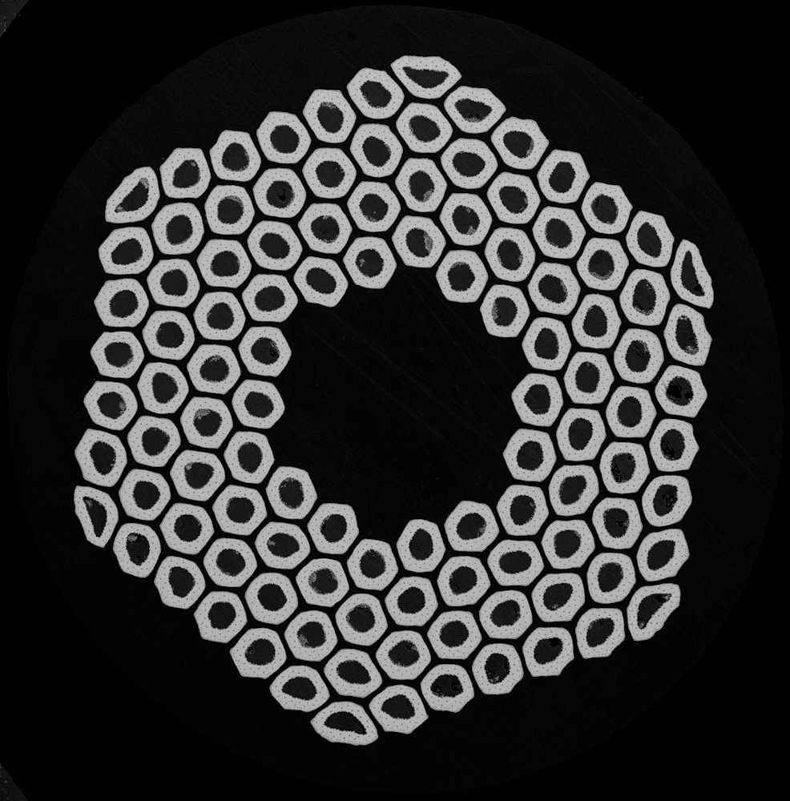
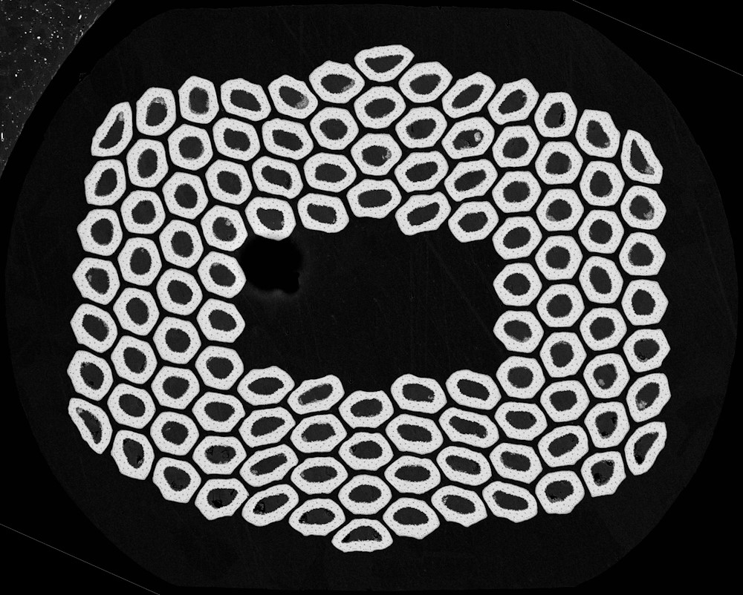
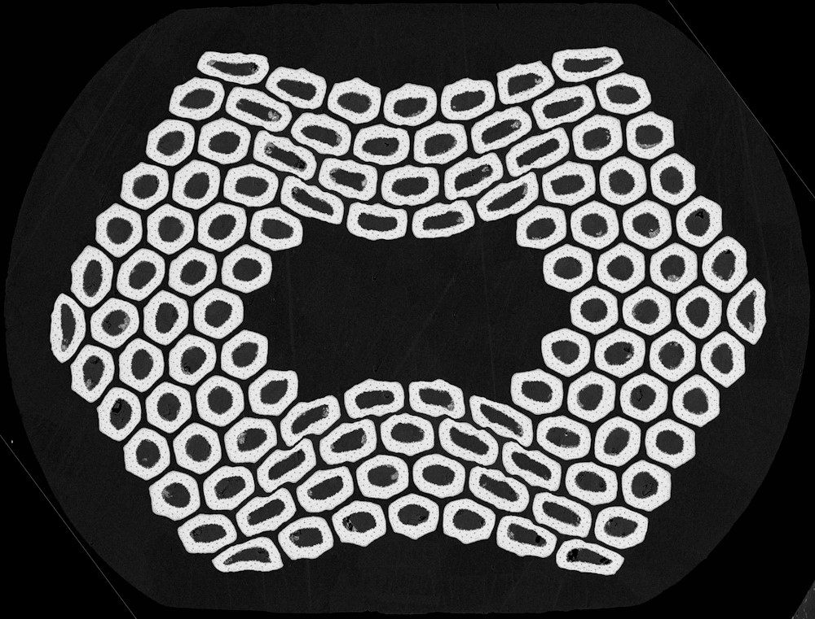
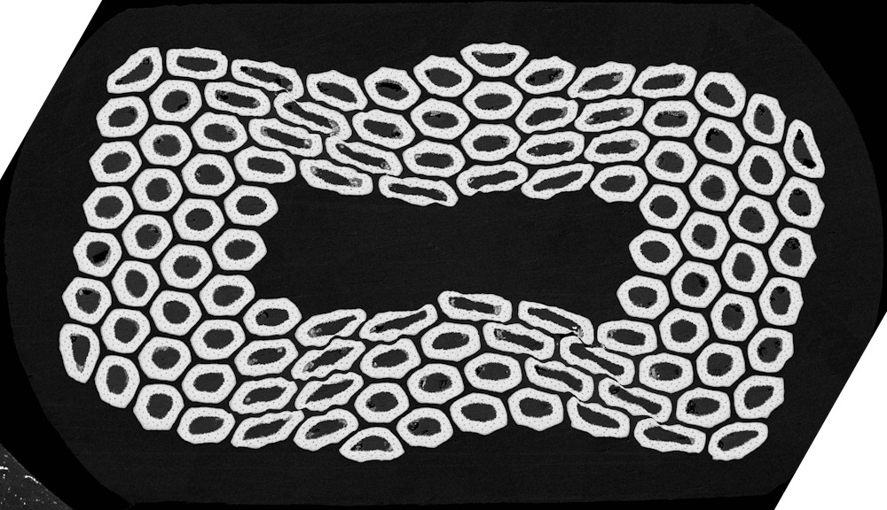
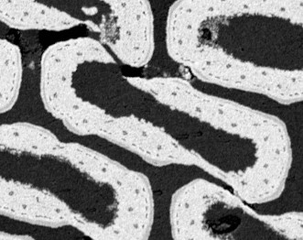
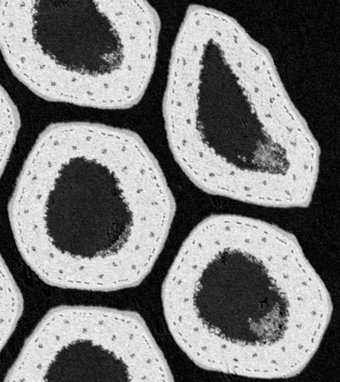
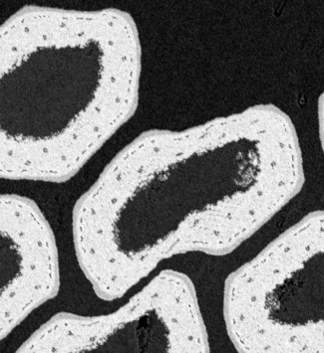
RRP® Rolling: After Reaction
After reaction, the aspect ratio distribution remains similar but areas expand (due to the expected volumetric expansion of Nb → Nb₃Sn)
At 20 % and 30 % rolling, local instances of complete barrier reaction and/or breaks due to shearing become more prevalent, resulting in increased Sn loss to the matrix, and intermittent discontinuities and contacts in Nb₃Sn subelements
Locally complete barrier reaction, variable Nb₃Sn thickness
Contact between, and discontinuities in, Nb₃Sn regions

Slide 7
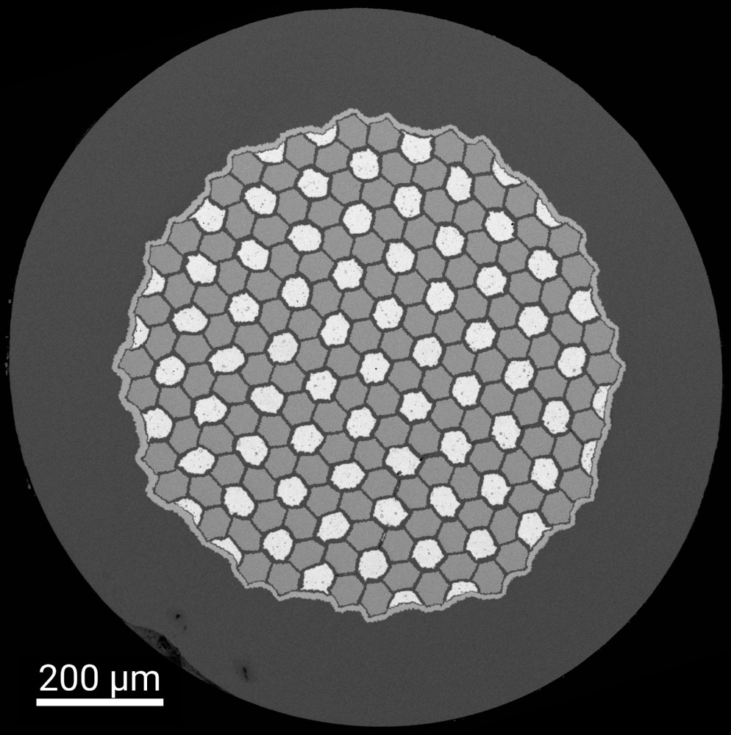
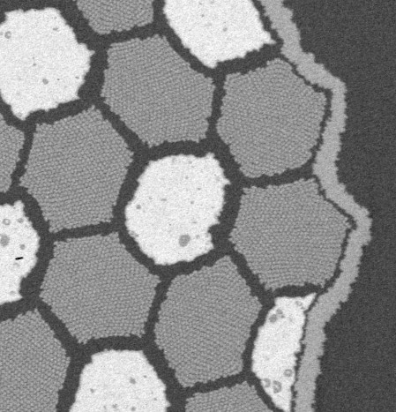
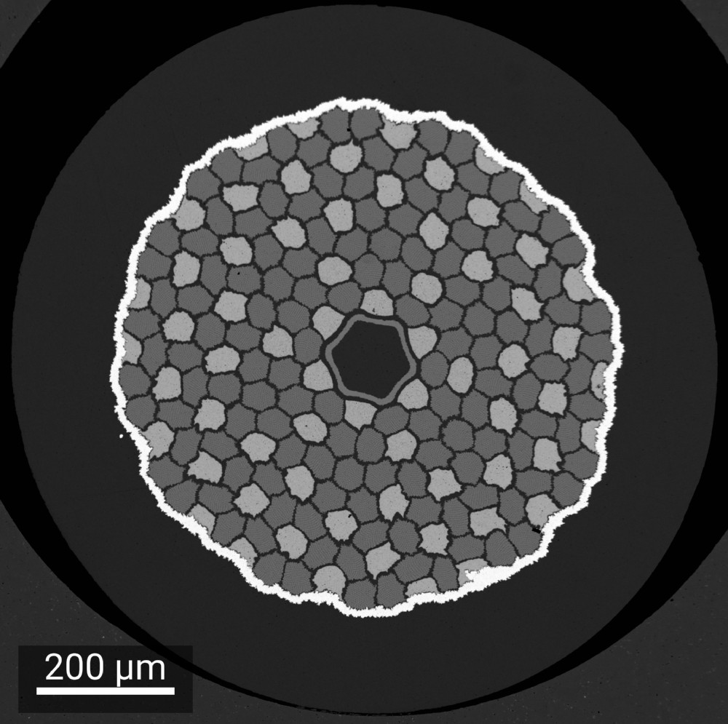
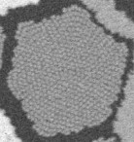
Distributed Tin Wires
Two manufacturers, JASTEC and KAT, have developed ‘distributed tin’ wires
  KAT wires currently have an internal Cu region protected by an additional diffusion barrier
Hexagonal arrays of Nb filaments and Sn modules are distributed on an hexagonal array inside a common diffusion barrier
JASTEC
Diffusion barrier
KAT
Cu
Sn(Ti)
Nb filaments
Cu

Slide 8
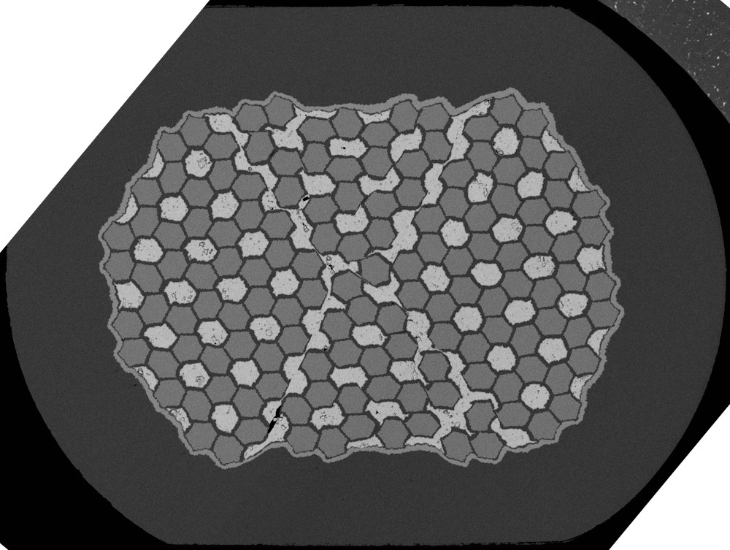
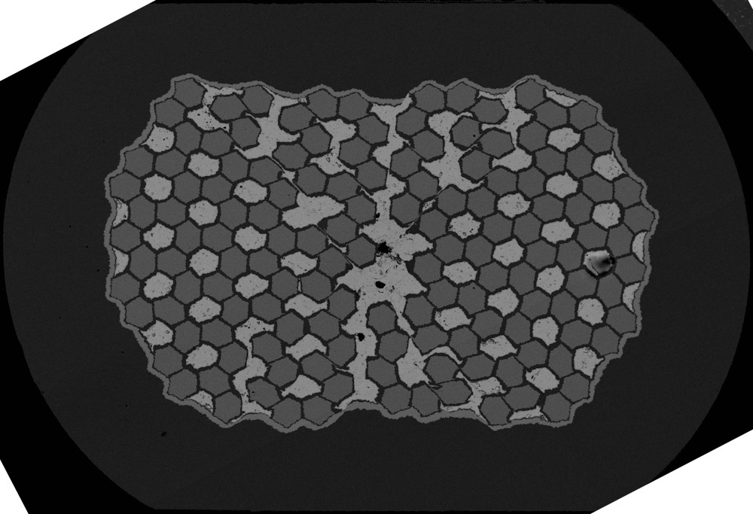
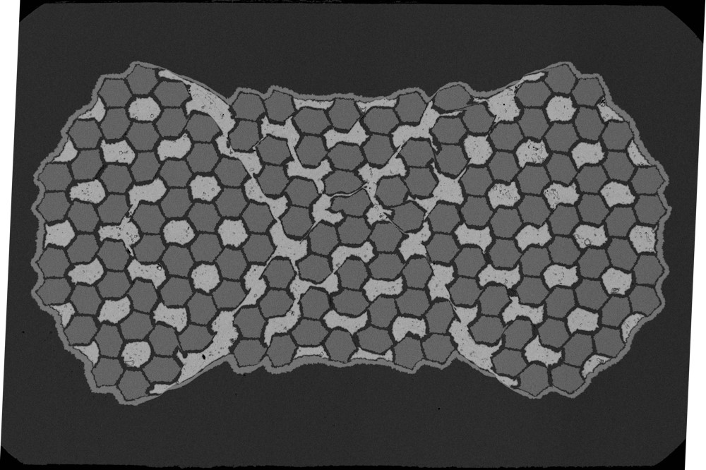
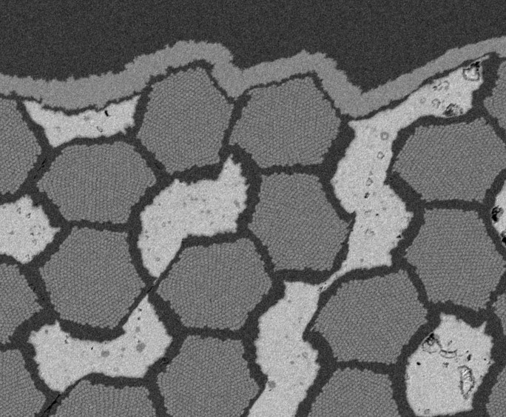
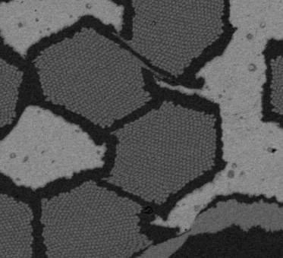
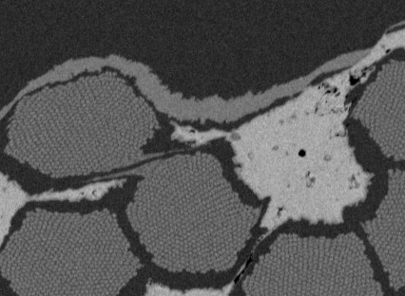
JASTEC Rolling: Key Features
As observed for previous DT wires, Sn regions deform and merge, whilst Nb modules are largely displaced intact
Round
15 %
20 %
30 %
Relative displacement of Nb modules; Sn core merging
Shearing at periphery of Nb modules; barrier thinning
Barrier breakage, extended Nb module shearing

Slide 9






JASTEC Rolling: Aspect Ratios
Aspect ratios do not show large increases, or form bands relative to the rolling direction:
  Unlike RRP® or PIT – see 3-MO-CS2-06S this afternoon
Large variation in Nb modules between longitudinal positions, as broad Sn regions can open up locally
15 %
20 %
30 %

Slide 10
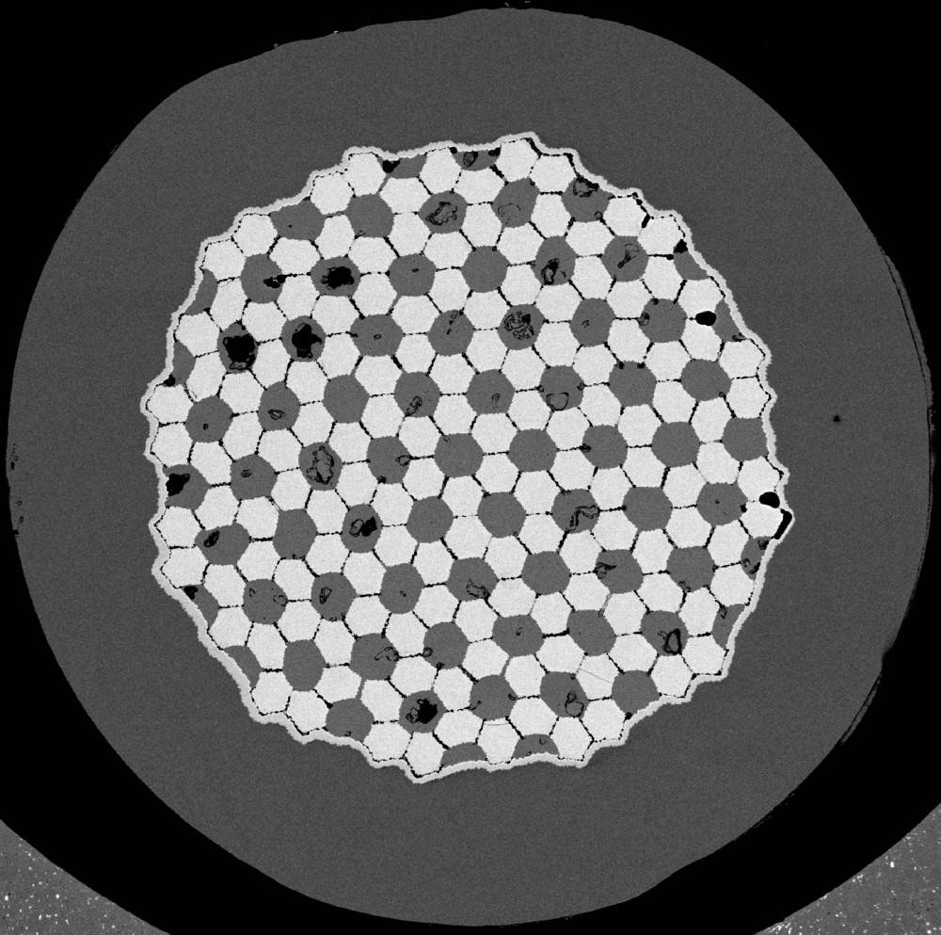
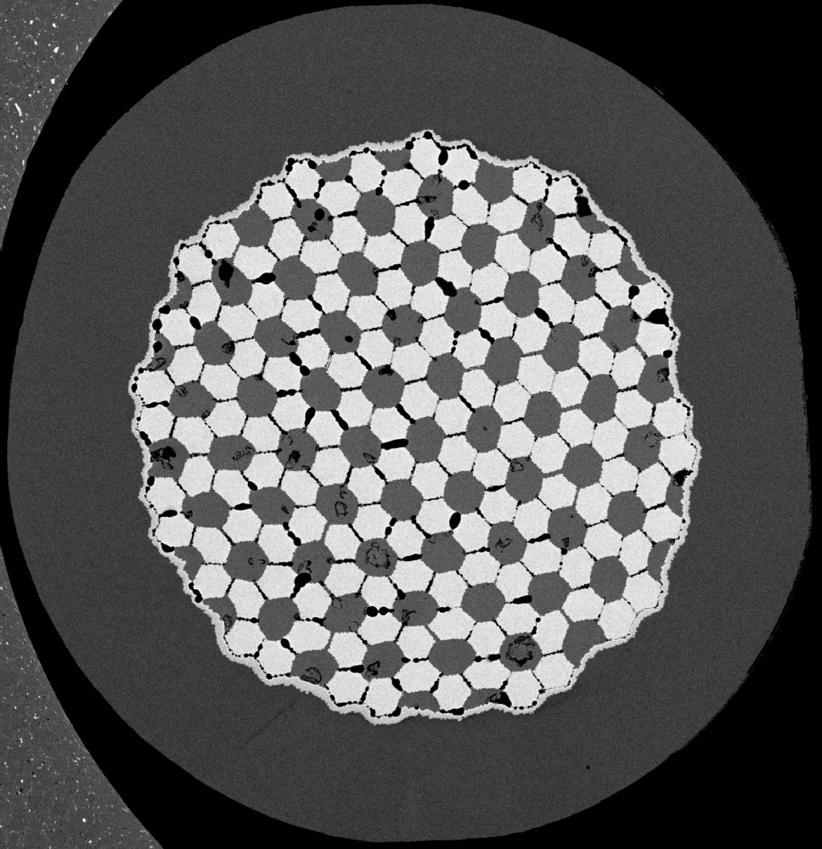
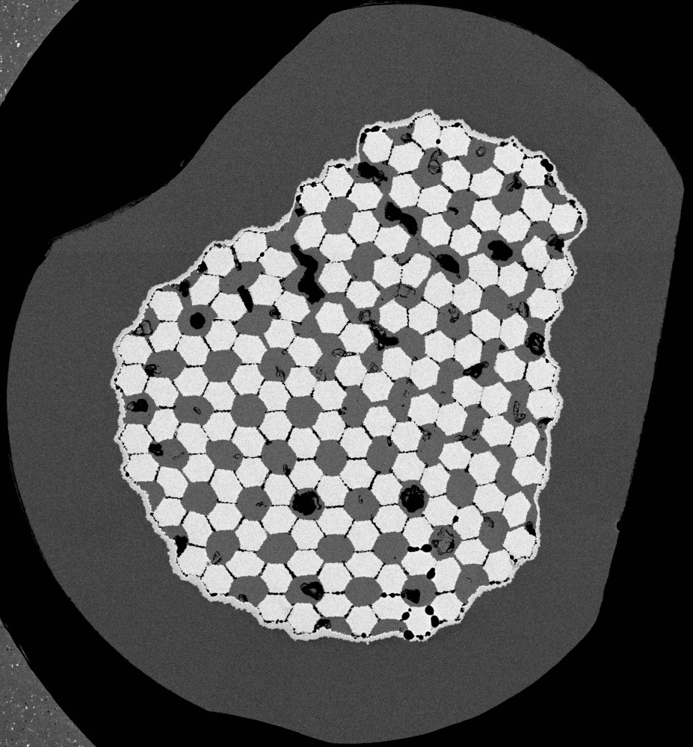
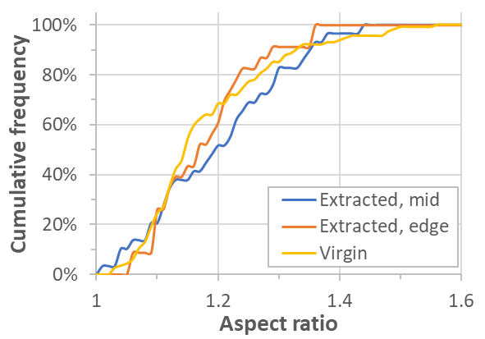
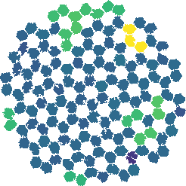


JASTEC: Reacted Strands
After heat treatment and the Nb → Nb₃Sn volume expansion, the separation of modules is locally small
  Difficult to be certain if modules are in contact: colour maps below show area, but can be considered to highlight potential clusters of different numbers of modules in contact
  As expected, the most distorted position at the cable edge exhibits larger clusters of modules potentially in contact → potential increase in d_{eff} and/or stability impact
Considering only well-separated modules, the distribution of aspect ratios remains comparable to unreacted samples
Virgin
Extracted, mid
Extracted, edge
Area
distributions
Aspect ratio distribution of well separated modules

Slide 11
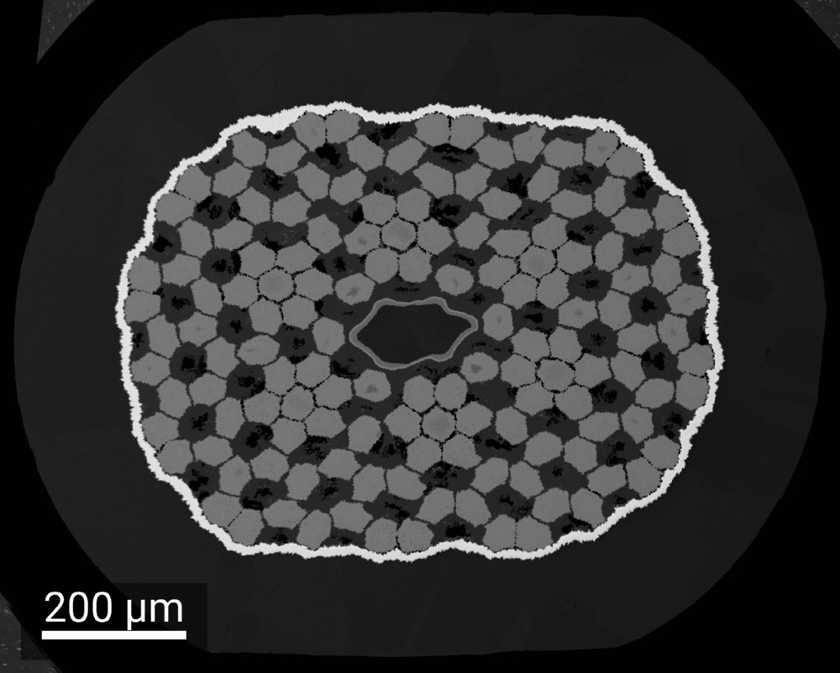
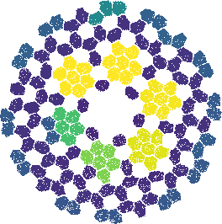
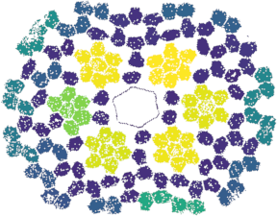
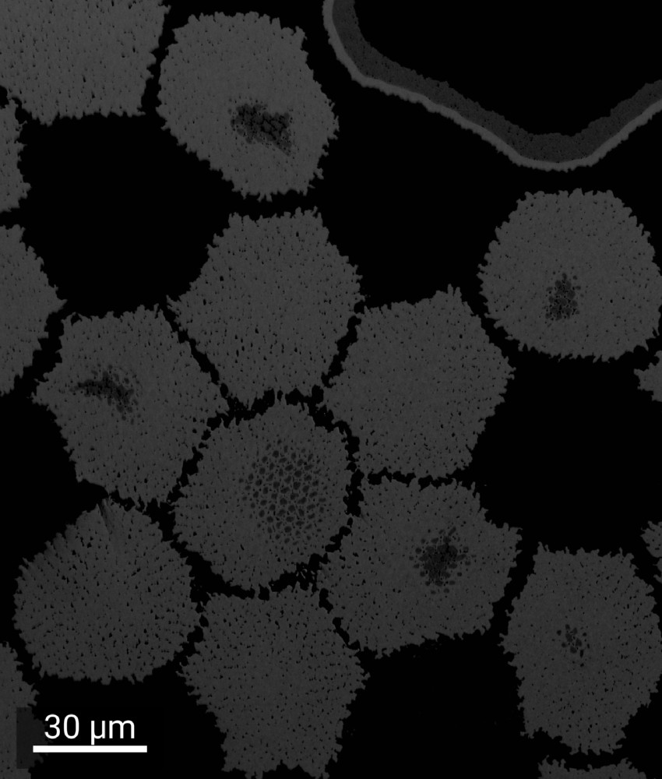
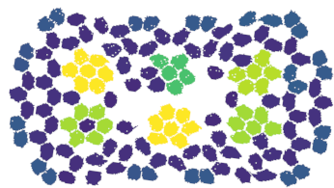
KAT: Reacted Strands
For KAT reacted strands, observations for subelement shape are similar to JASTEC
In addition:
  The area distribution plots highlight 6 clusters of Nb₃Sn regions in close proximity after reaction, which could contribute to increase d_{eff}
  For larger rolling reductions, the internal diffusion barrier is severely deformed
    The internal Cu volume is small, and not critical to Cu/non-Cu, but it may influence the deformation of neighbouring modules
  Unreacted Nb is evident in the centre of some Nb modules, indicating the potential for increase I_{c} if tin supply can be improved by design or heat treatment
0 %
15 %
Area
distributions
30 %

Slide 12
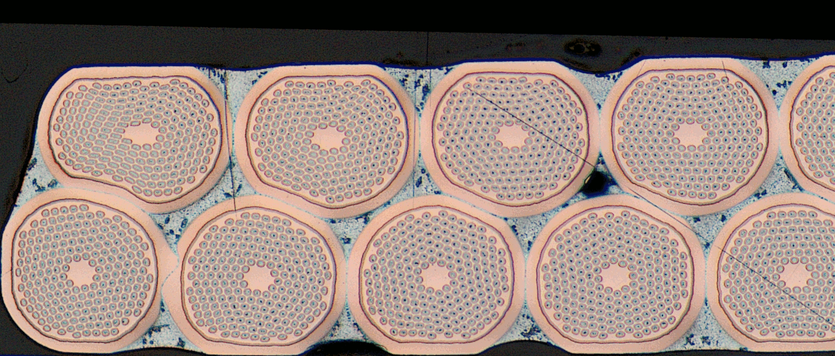
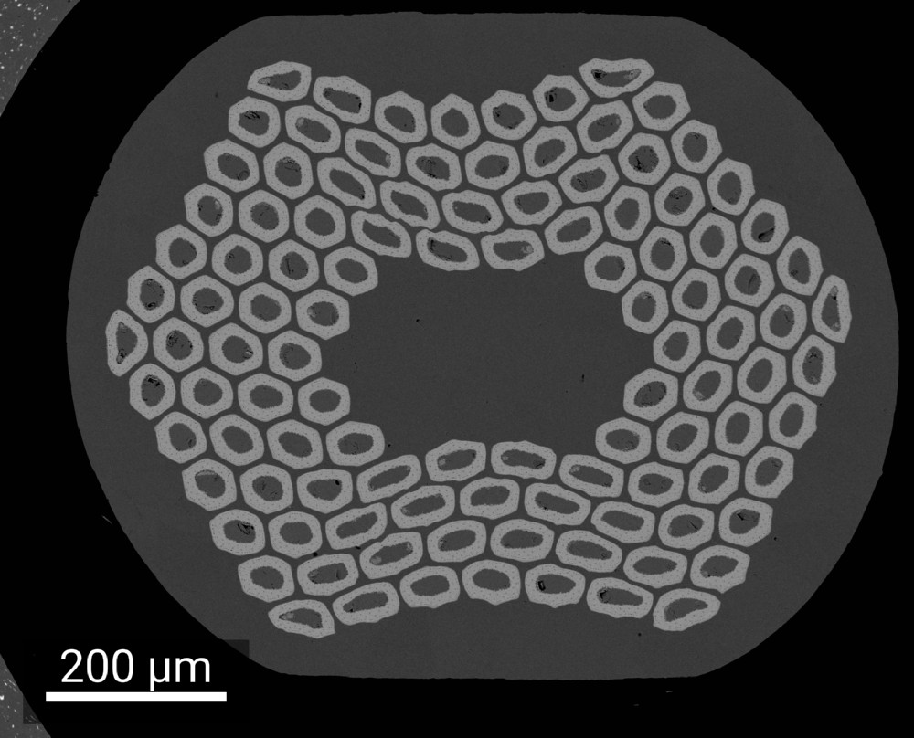
Rutherford Cable Deformation
Mid-thickness
Strands at the centre of the cable width typically have a nominal thickness reduction ~11 %
  Rolling studies typically performed for 10 % and/or 15 % uniaxial rolling reduction
The real deformation, especially at the (thin) edge, is more severe and not uniaxial
  All strands experience this periodically, at a transposition length typically much shorter than the lengths of samples used for I_{c} and RRR
Stresses align along shear planes, but the resulting deformation of sub-elements depends on the wire type and its local orientation [1]
Sub-element deformation affects performance via several mechanisms:
  Sub-element shearing and merging
  Changes in local barrier thickness and diffusion distances
Thin edge
Core
Thick edge
Keystone
Courtesy of Algirdas Baskys
[1] IEEE Trans Appl. Supercond. 33 (5) 4801605, 10.1109/TASC.2023.3265910

Slide 13
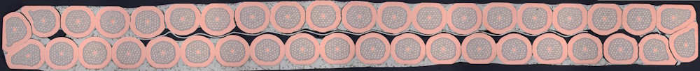
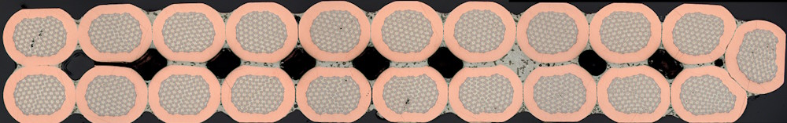
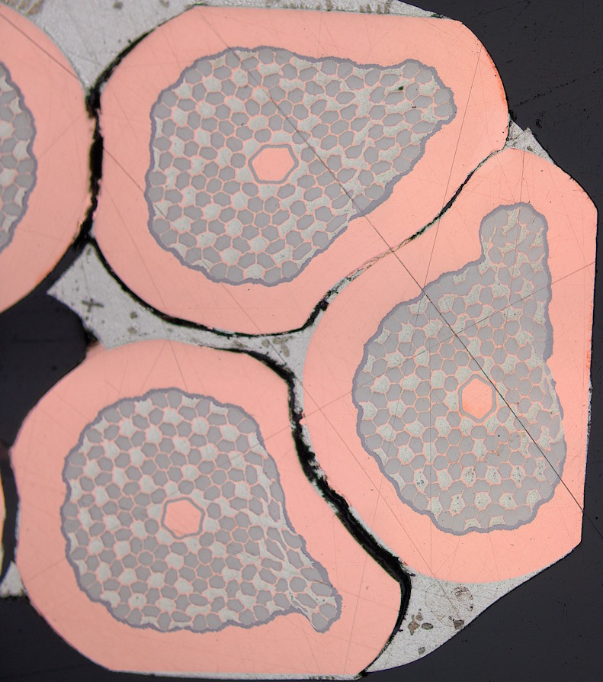
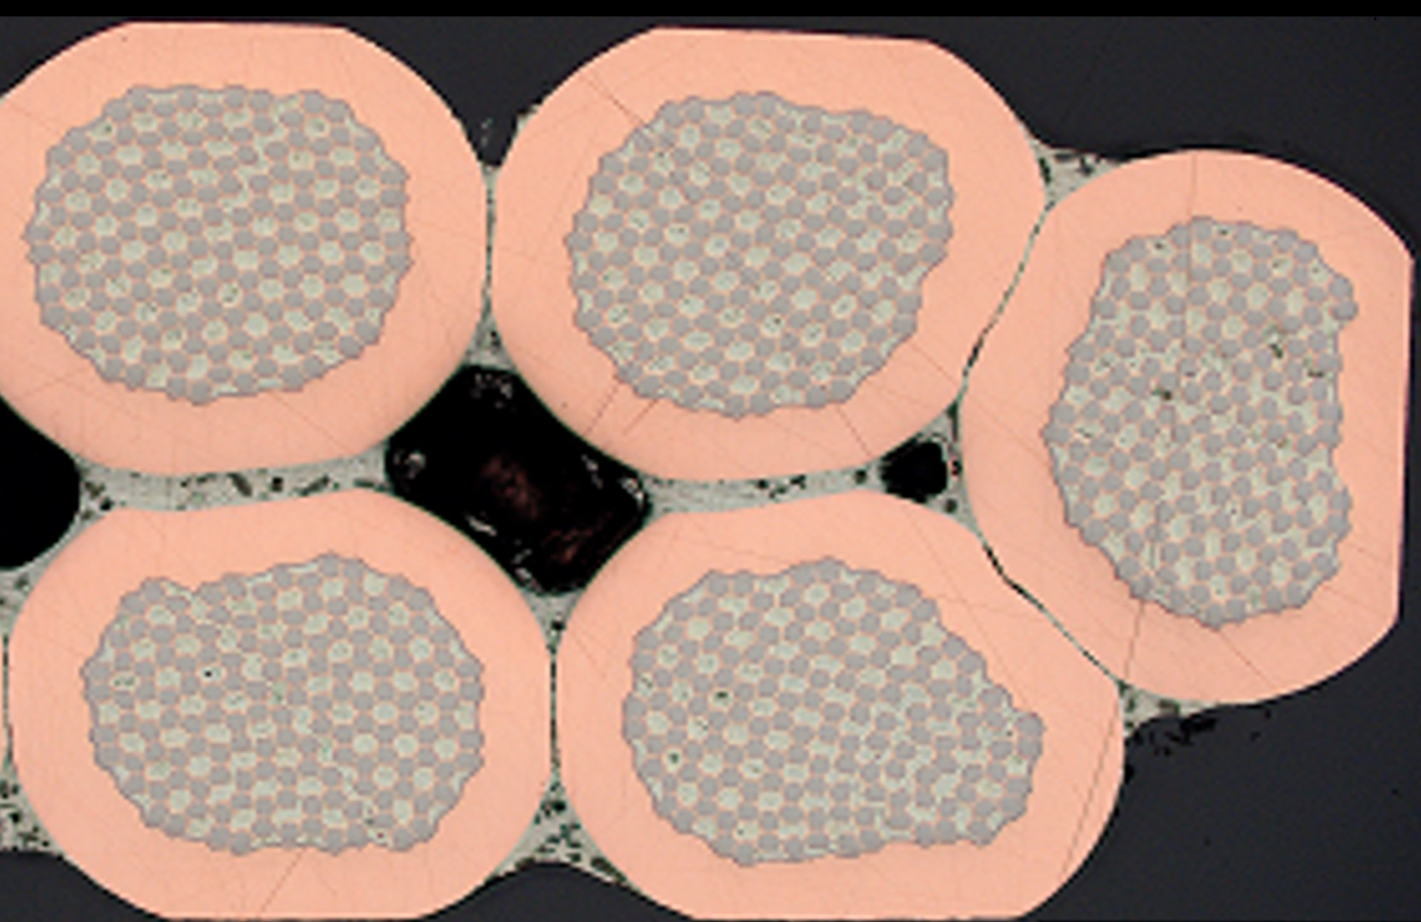
Cable Cross-Sections
Optical micrographs show, as expected:
  Uniform strand cross-sections in the middle of the cable width
  Significant distortion of module geometry and barrier thinning in the most deformed edge location
KAT
JASTEC

