Slide 1
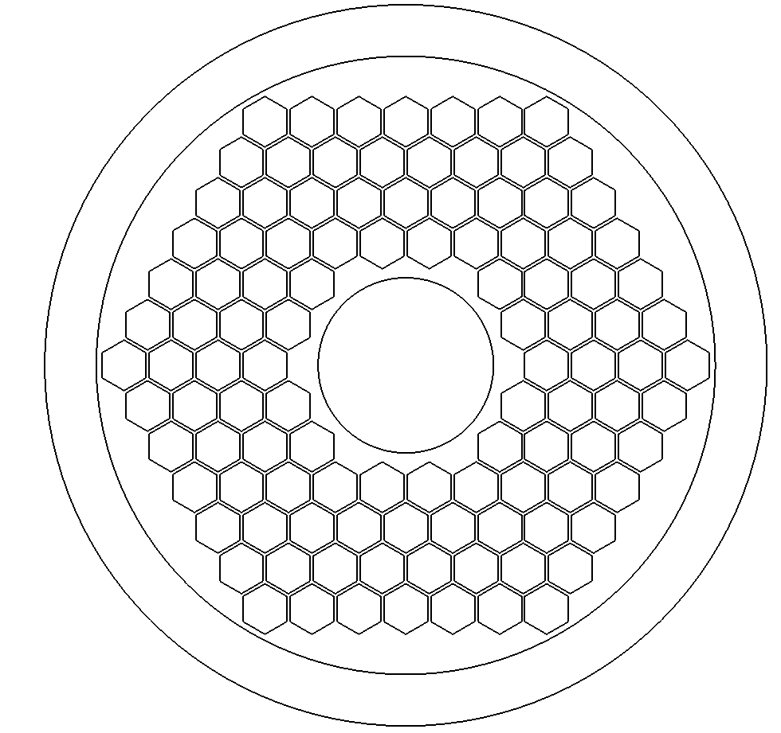
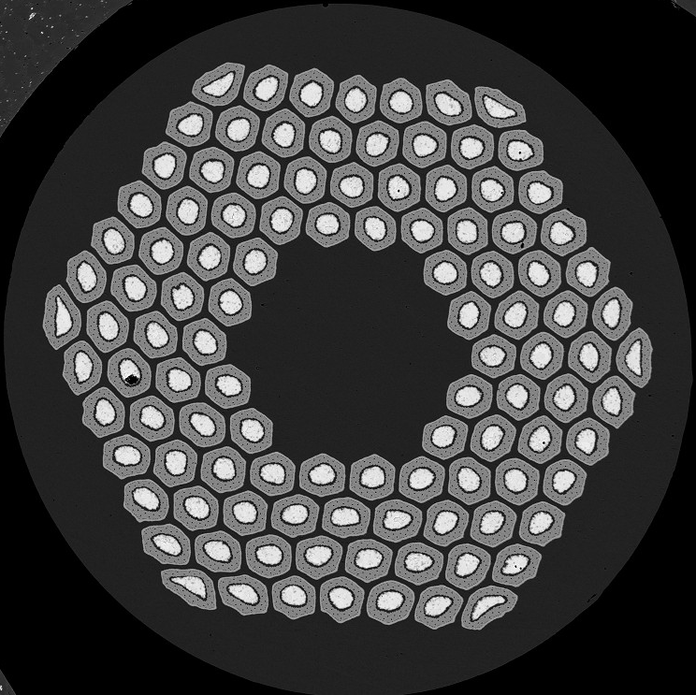
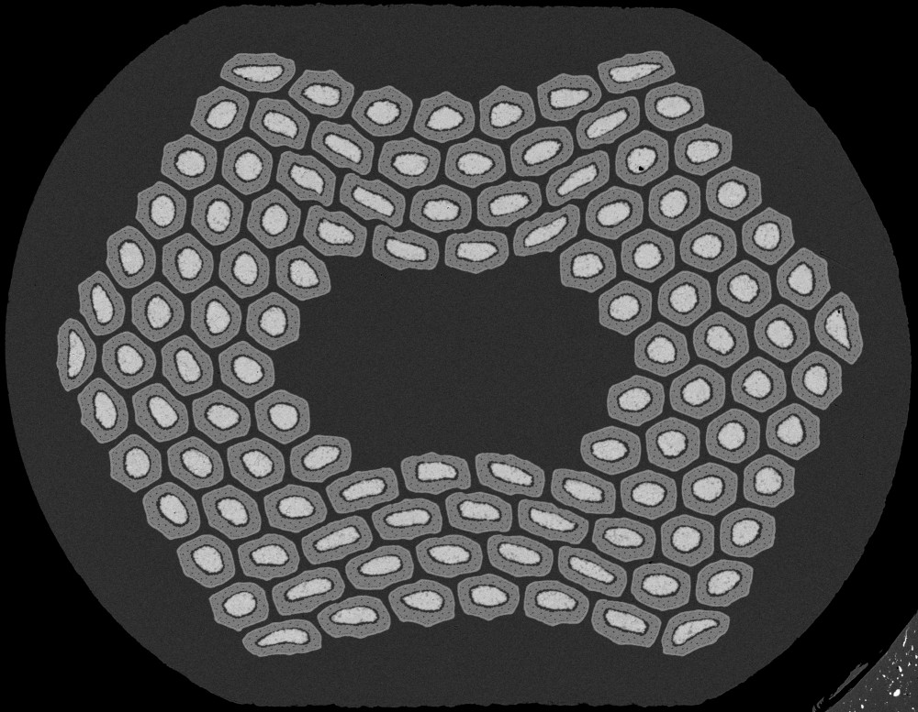
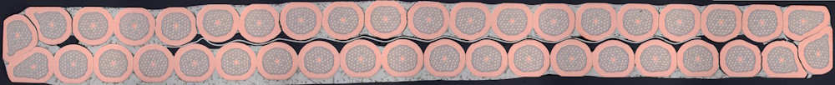
Geometries of strands and cables for simulations in FiQuS
Fredrik Magnus 12.02.2024
Fredrik Magnus 12.02.2024
Images courtesy of S. C. Hopkins – MSC Seminar 28.09.2023

Slide 2
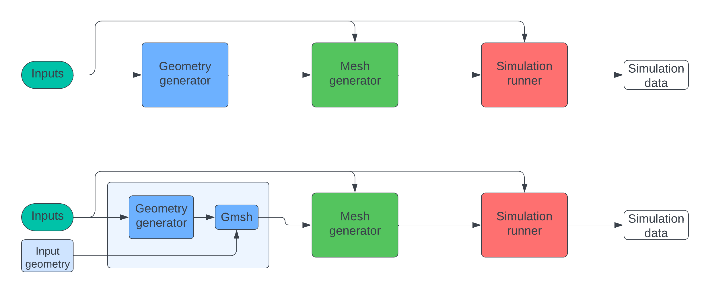
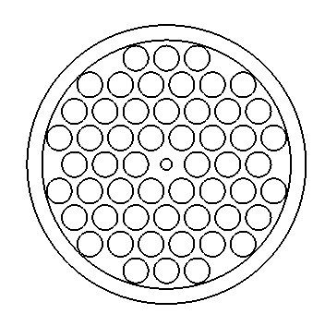
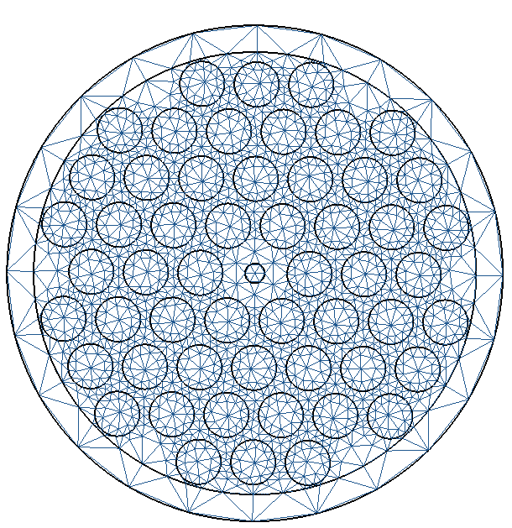
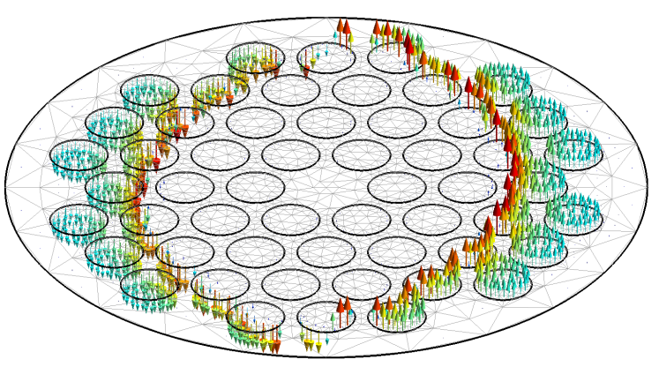
Program flow

Slide 3
Program flow
Criteria for input geometry:
  Compatibility with Gmsh
  Contains necessary information for simulations
  Can be properly meshed

Slide 4
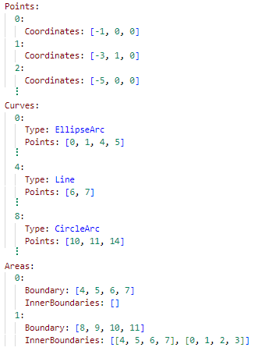
Geometry representation
YAML - format
The basic building blocks:
  Points
    Coordinates: [x,y,z]
  Curves
    Type: Line, CircleArc or EllipseArc *
    Points: List of point-IDs
  Surfaces
    Outer boundary: List of curve-IDs
    Inner boundaries: List of lists of curve-IDs
*Gmsh also supports curve types: Bezier, BSpline and Spline

Slide 5
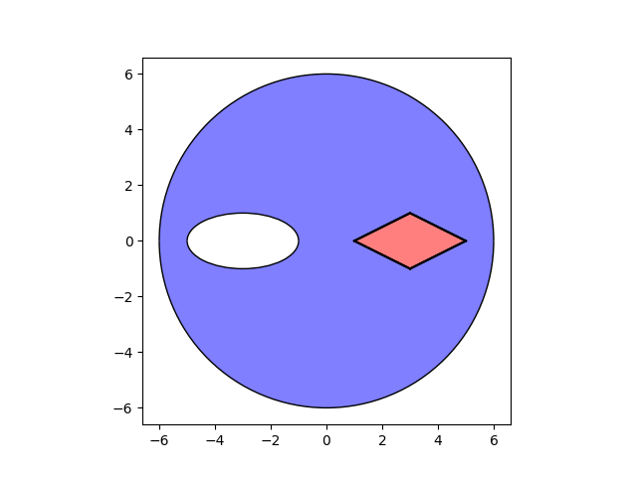
Geometry representation

Slide 6

Geometry representation

Slide 7

Geometry representation

Slide 8
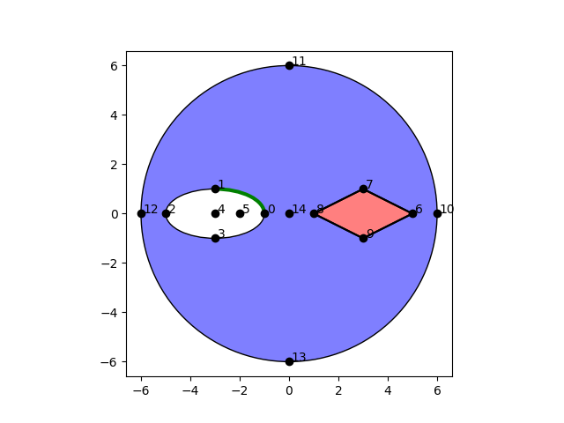
Geometry representation

Slide 9
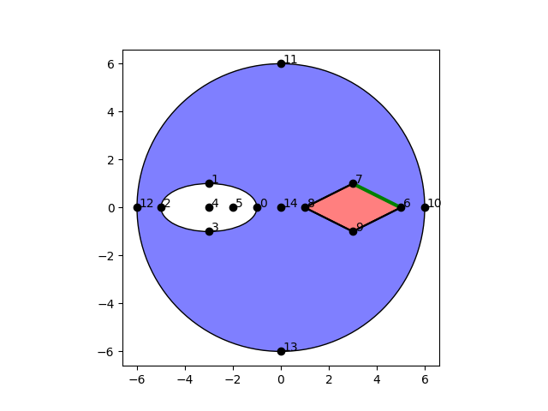
Geometry representation

Slide 10
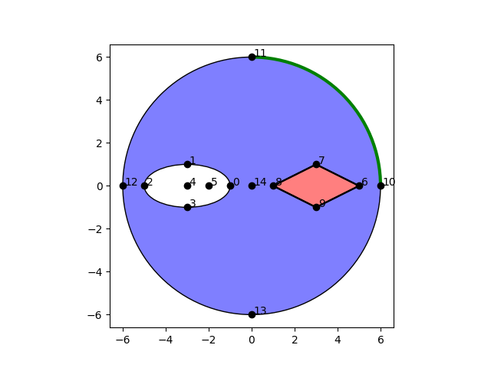
Geometry representation

Slide 11
Geometry representation

Slide 12
Additional information is necessary
Enough to specify the geometry – Additional information required for simulations
Strands:
  Area:
    Materials
    Diffusion barrier thickness -and material
    Filament layer -and index
Cables:
  Curve:
    Contact type
    Contact thickness
    Contact material

Slide 13
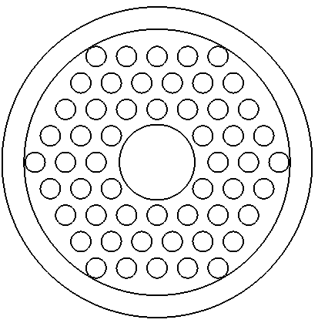
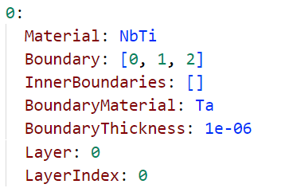
Additional necessary information - Strands
Material
Diffusion barrier thickness and material
Filament layer -and index

Slide 14
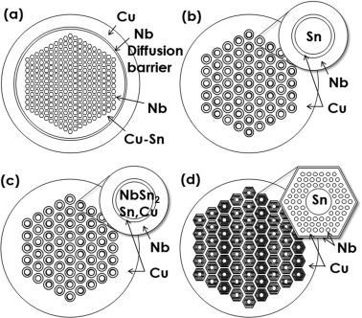
Additional necessary information - Strands
Material
Diffusion barrier thickness and material
Filament layer -and index
Image courtesy of Nobuya Banno – Low-temperature superconductors: Nb₃Sn, Nb₃Al, and NbTi

Slide 15
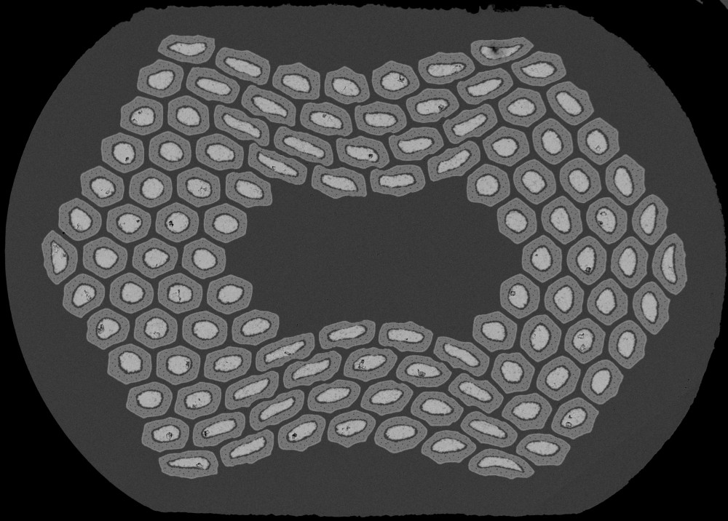
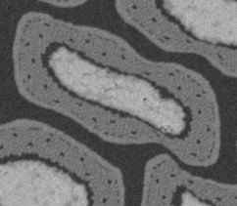
Additional necessary information - Strands
Material
Diffusion barrier thickness and material
Filament layer -and index
Images courtesy of S. C. Hopkins – MSC Seminar 28.09.2023

Slide 16
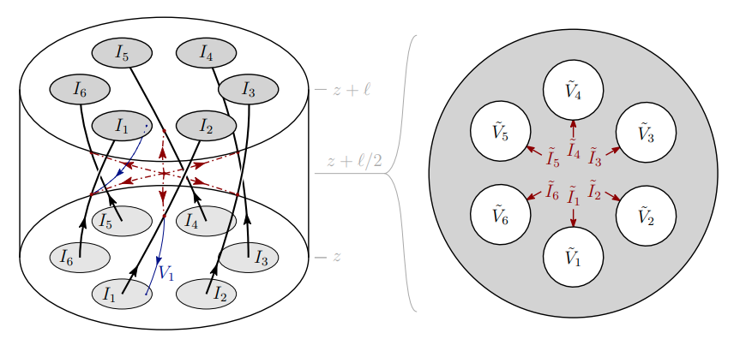
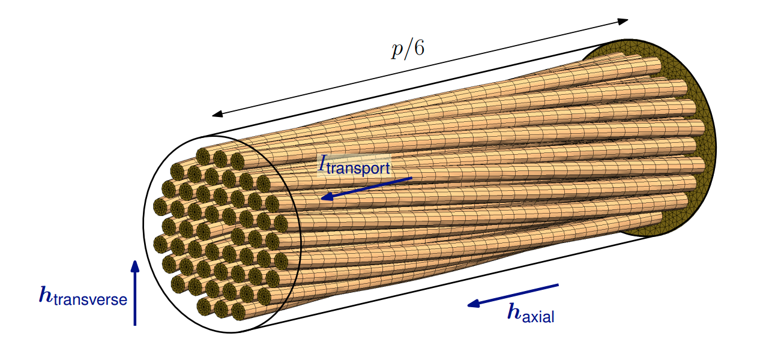
Additional necessary information - Strands
Material
Diffusion barrier thickness and material
Filament layer -and index
Images courtesy of J. Dular

Slide 17
Additional necessary information - Strands
Material
Diffusion barrier thickness and material
Filament layer -and index

Slide 18
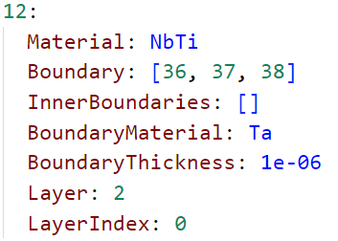
Additional necessary information - Strands
Material
Diffusion barrier thickness and material
Filament layer -and index

Slide 19
Additional necessary information - Strands
Material
Diffusion barrier thickness and material
Filament layer -and index

Slide 20

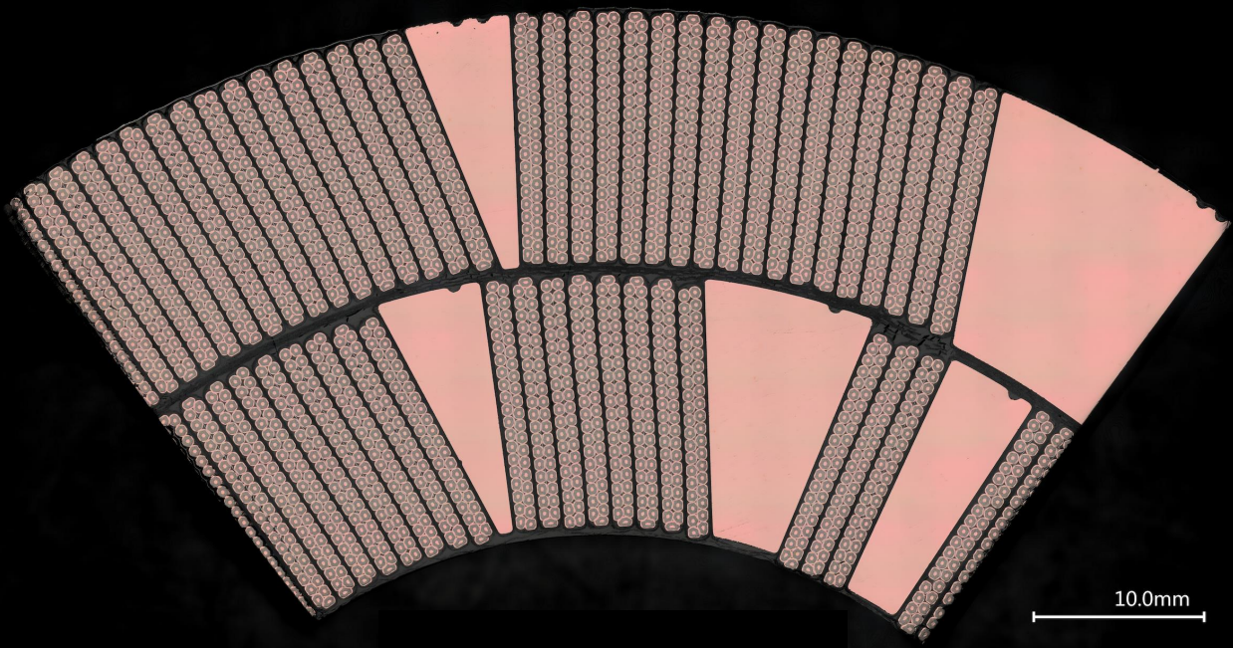
Additional necessary information - Cable
Index of strands
Contact between strands:
  Contact type
  Thickness
  Material
Images courtesy of M.D. Crouvizier EN-MME

Slide 21
Additional necessary information - Cable
Index of strands
Contact between strands:
  Contact type
  Thickness
  Material
39 38 37 36 35 34 33 32 31 30 29 28 27 26 25 24 23 22 21 20
0 1 2 3 4 5 6 7 8 9 10 11 12 13 14 15 16 17 18 19
Images courtesy of M.D. Crouvizier EN-MME

Slide 22
Additional necessary information - Cable
Index of strands
Contact between strands:
  Contact type
  Thickness
  Material
Images courtesy of M.D. Crouvizier EN-MME

Slide 23
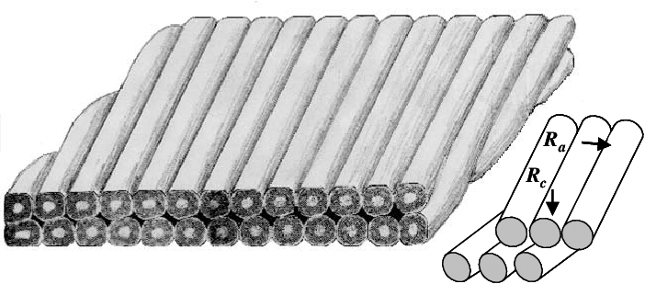
Additional necessary information - Cable
Index of strands
Contact between strands:
  Contact type
    Contact between parallel strands
    Contact between crossing strands
  Thickness
  Material
Image courtesy of Martin N. Wilson – ADVANCES IN LOW LOSS NBTI STRAND AND CABLE

Slide 24
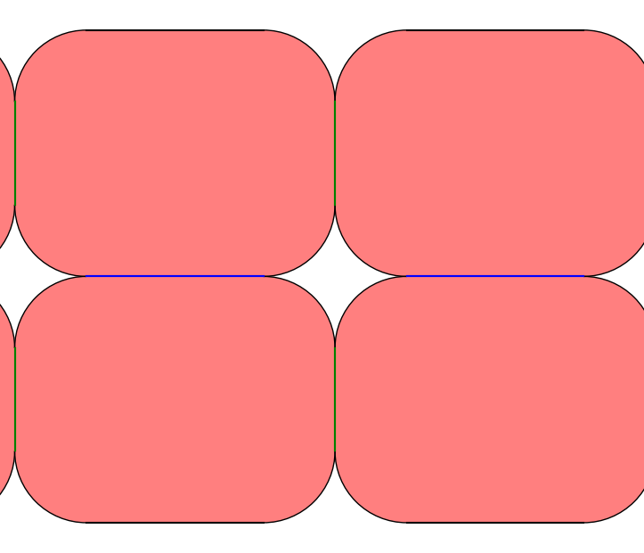
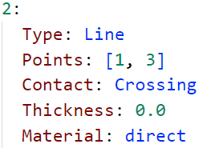
Additional necessary information - Cable
Index of strands
Contact between strands:
  Contact type
    Contact between parallel strands
    Contact between crossing strands
  Thickness
  Material

Slide 25
Additional necessary information - Cable
Index of strands
Contact between strands:
  Contact type
    Contact between parallel strands
    Contact between crossing strands
  Thickness
  Material

Slide 26
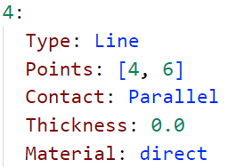
Additional necessary information - Cable
Index of strands
Contact between strands:
  Contact type
    Contact between parallel strands
    Contact between crossing strands
  Thickness
  Material

Slide 27
Additional necessary information - Cable
Index of strands
Contact between strands:
  Contact type
  Thickness
  Material

Slide 28
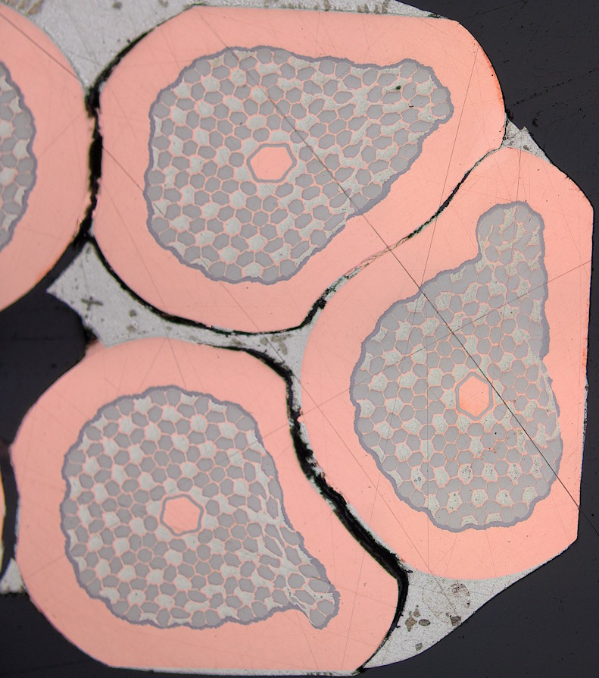
Additional necessary information - Cable
Index of strands
Contact between strands:
  Contact type
  Thickness
  Material
…
Want to avoid close curves – Single curve should represent the gap
…
Image courtesy of S. C. Hopkins – MSC Seminar 28.09.2023

Slide 29
Considerations for meshing
Avoid excessive number of curves
No overlapping curves
Avoid very close curves

Slide 30
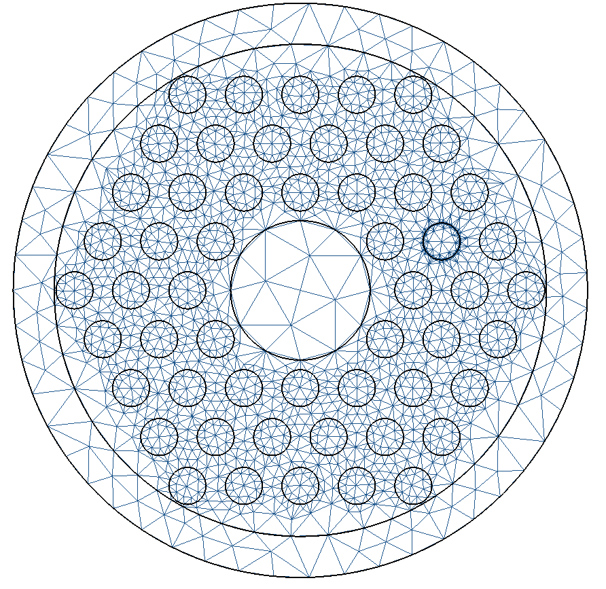
Considerations for meshing
Avoid excessive number of curves
No overlapping curves
Avoid very close curves

Slide 31
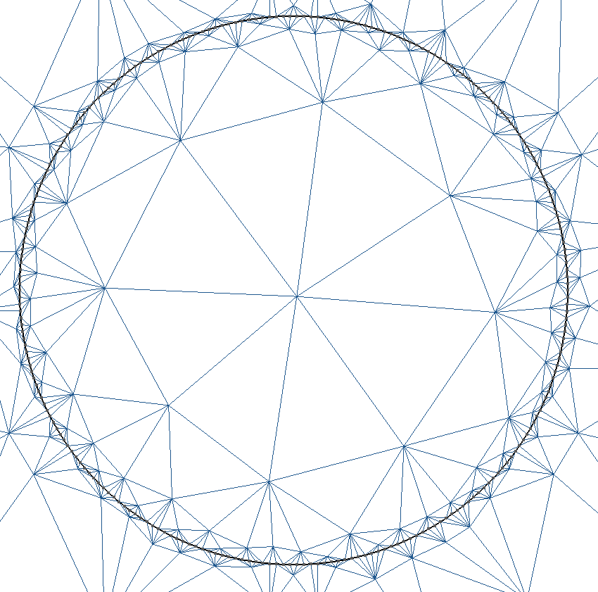
Considerations for meshing
Avoid excessive number of curves
No overlapping curves
Avoid very close curves
Filament created using 250 lines

Slide 32
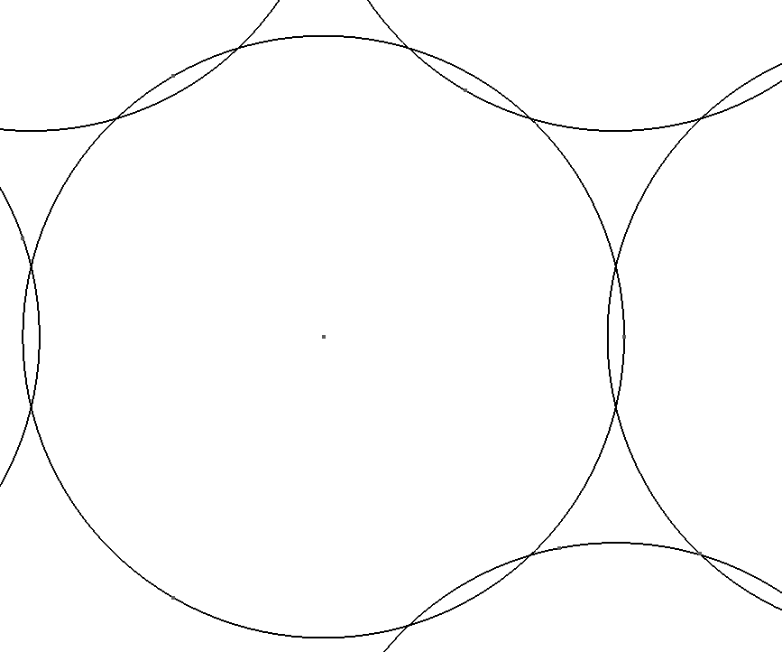
Considerations for meshing
Avoid excessive number of curves
No overlapping curves
Avoid very close curves

Slide 33
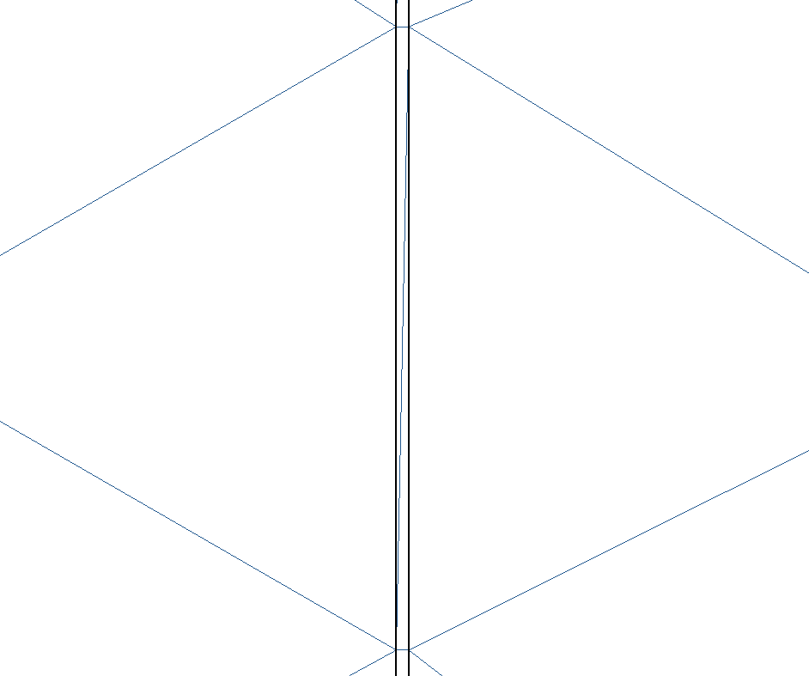
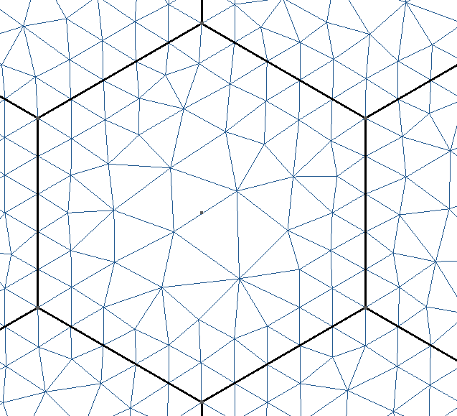
Considerations for meshing
Avoid excessive number of curves
No overlapping curves
Avoid very close curves

Slide 34
Summary
YAML-file for input geometry
  Representing the geometry
  Additional information required for simulations
  Considerations for meshing
Let’s discuss next steps – Working towards a first geometry

