Slide 1
CBG Work Programme and Objectives for 2024-2025
Chair Brigita Abakevičienė
Deputy Chair Kārlis Dreimanis
All representatives of CBG

Slide 2
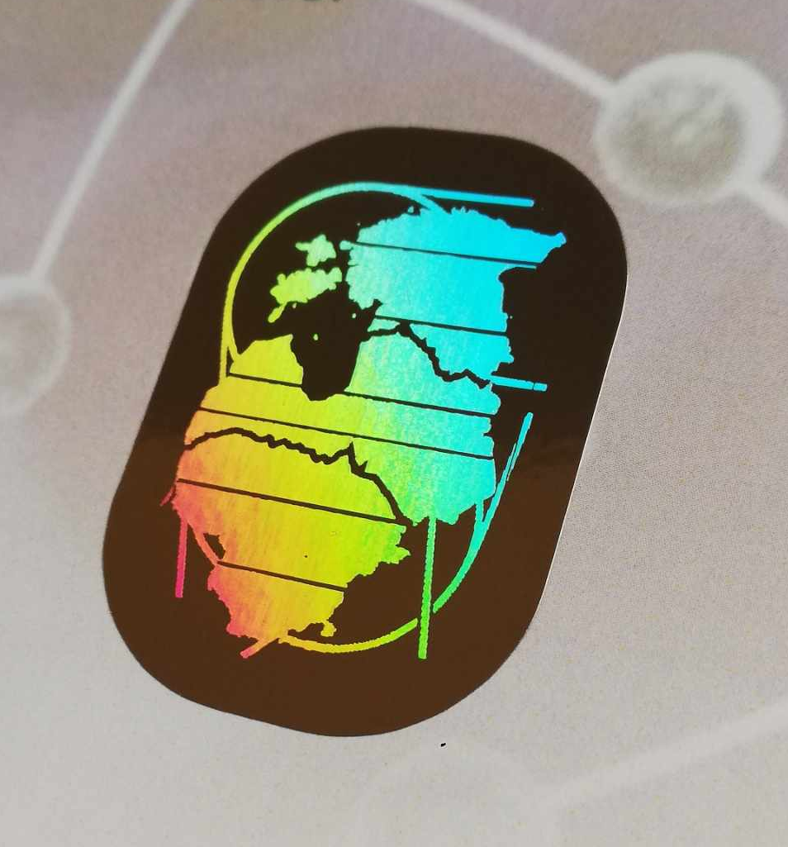

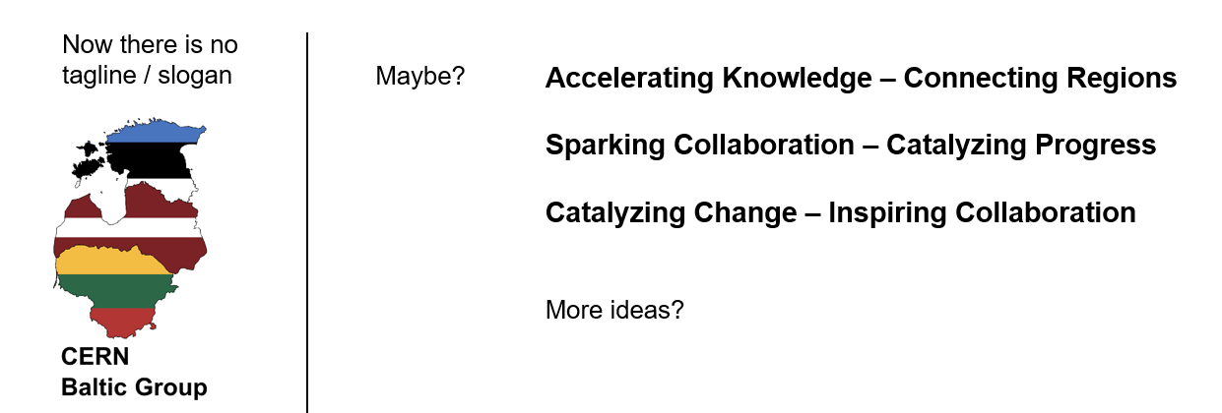
OBJECTIVES
To increase the visibility and recognisability of the CBG !
  Development of the visual identity;
  Creation of social media channels (linkedin, etc.);
  Creation of a motto / slogan / tagline.

Slide 3
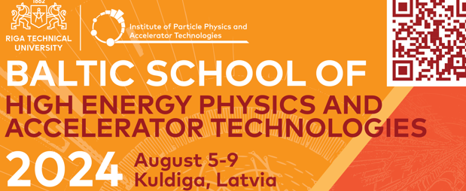
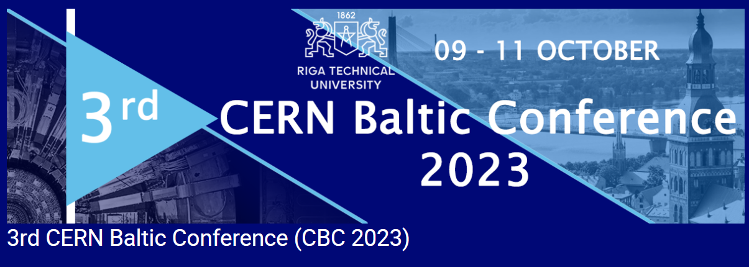

OBJECTIVES
To support the existing CBG events (School and Conference);
  Jointly looking for potential sponsors for the events;
To investigate developing other joint events (online colloquia for students ?)

Slide 4
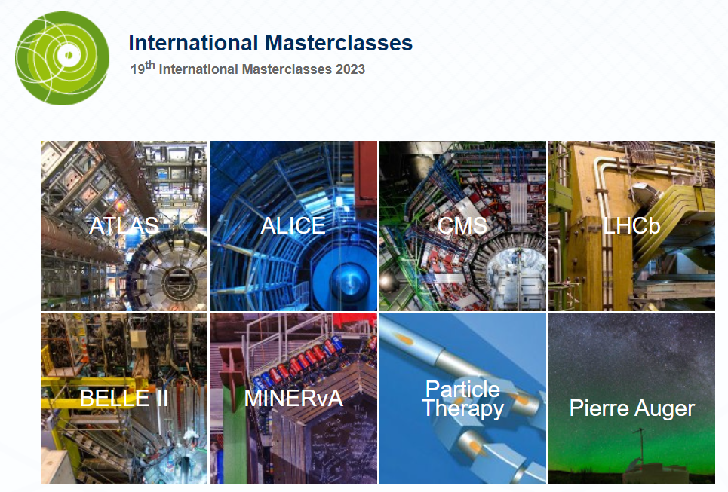
OBJECTIVES
To jointly organize the International Masterclasses in the Baltic States;
(International Particle, CMS, etc. masterclasses)

Slide 5
OBJECTIVES
Investigate the revitalization of the “Science and Technology” working group !
  No events taken place in 2023;
  Potentially using Masterclasses in HEP as a catalyst for activity ?
  Must increase the involvement of NICPB (KBFI) in CMS-related activities !
No panic yet ! We are confident that this WG can be revitalised
to become an integral part of CBG activities.

Slide 6

The active CBG Working Groups:
- Advanced Particle Therapy Center for the Baltic States;
- Study Programmes.

Slide 7

OBJECTIVES
To continue a periodic Coordination Team Meetings (CTM);
  Aim for ~4 short meetings per year;
  Predominantly online;
  Maybe 1 in-person CTM per year ?

Slide 8


OBJECTIVES
To review the existing CBG MoU and see if any ammendments are needed;
In particular, investigate establishing a small institutional
annual fee to cover minor expenses:
  Coffee breaks & snacks at GMs;
  Prizes for poster session winners @ CBCs;
  Webpage maintanence.
  etc. ...
Potentially to support the CBG events …

Slide 9
The next (14th) CERN Baltic Group General meeting;
(time, place)
The Coordination Team meeting;
(time, place)

Slide 10
The main objectives of the CERN Baltic Group are:
Coordination of the Baltic research institutions activities towards CERN and related Collaborations/Experiments;
Strengthening and development of Baltic High Energy Physics community;
Foster cooperation between CERN and local industry in the Baltic States and generate new opportunities via joint research projects and contacts;
Development of the Baltic international multidisciplinary masters/doctoral level study programme in High Energy Physics and Accelerator Technologies, and related areas.
The main principles of the CERN Baltic Group are: transparency, honesty, sharing, and collaboration.

Slide 11

We are strong together!

