Slide 1
“Advanced Particle therapy center in the Baltic States” initiative
Current status
Future outlooks and feasibility study
On behalf of the CERN Baltic group
“Advanced Particle therapy center for the Baltic States” working group
Toms TORIMS, Kristaps PALSKIS, Erika KOROBEINIKOVA, Sergei NAZARENKO

Slide 2
The overall proposed concept
Integration of helium synchrotron technology and all the capabilities into a modern clinical treatment center and large scale scientific research infrastructure
Clinical cancer treatment facility
Particle therapy and nuclear medicine
Industry involvement infrastructure
Research institution

Slide 3
The overall proposed concept
Clinical treatment with proton therapy
Clinical research and future treatment with helium ion beams
Novel delivery methods – FLASH, mini-beams. Possibilities of proton radiography
Possibility of parallel radioisotope production – diagnostics for radiotherapy treatment planning, theragnostics approaches and targeted alpha therapy
Pre-clinical and clinical research work necessary for novel therapy integration
Particle therapy research fields – medical physics, radiobiology, dosimetry, accelerator physics and technologies
Complementary research fields – material science, radiation chemistry, particle physics aspects . . .
Possibility of heavier ion research (carbon, oxygen)
Involvement of relevant industry sectors in delivery of center – capacity and “know-how” in accelerator technologies
Infrastructure provides possibilities of future R&D activities in particle therapy technology developments, addressing the global needs of the community

Slide 4
Milestones achieved
End of 2021
Idea and
first discussions
Aug 2022
Baltic Assembly support – letter to 3 prime ministers
Oct 2022
Resolution of Baltic Assembly
Presentations and discussions with relevant professional societies,
scientific universities and political stakeholders
Apr 2022
Conceptual design paper and working group establishment

Slide 5
In unison with medical community: professional societies
Oct 2022 Presentation at the 8th Baltic Radiology congress
Jan 2023 Presentation at Lithuanian Society of Radiation Therapy conference
Mar 2023 Presentation for Latvian Therapeutical Radiology Association
Spring 2023 Discussions on conceptual idea with Baltic Nuclear Medicine Association
Jun 2023 Presentation at 19th Nordic-Baltic Conference on Biomedical Engineering and Medical Physics
Jun 2023 Presentation at Educational course of International Stereotactic Radiotherapy Society held in Latvia

Slide 6
Milestones achieved
End of 2021
Idea and
first discussions
Aug 2022
Baltic Assembly support – letter to 3 prime ministers
Oct 2022
Resolution of Baltic Assembly
Presentations and discussions with relevant professional societies,
scientific universities and political stakeholders
Apr 2022
Conceptual design paper and working group establishment
Oct-Nov 2022
Bi-lateral discussions with stakeholders in all 3 Baltic States

Slide 7
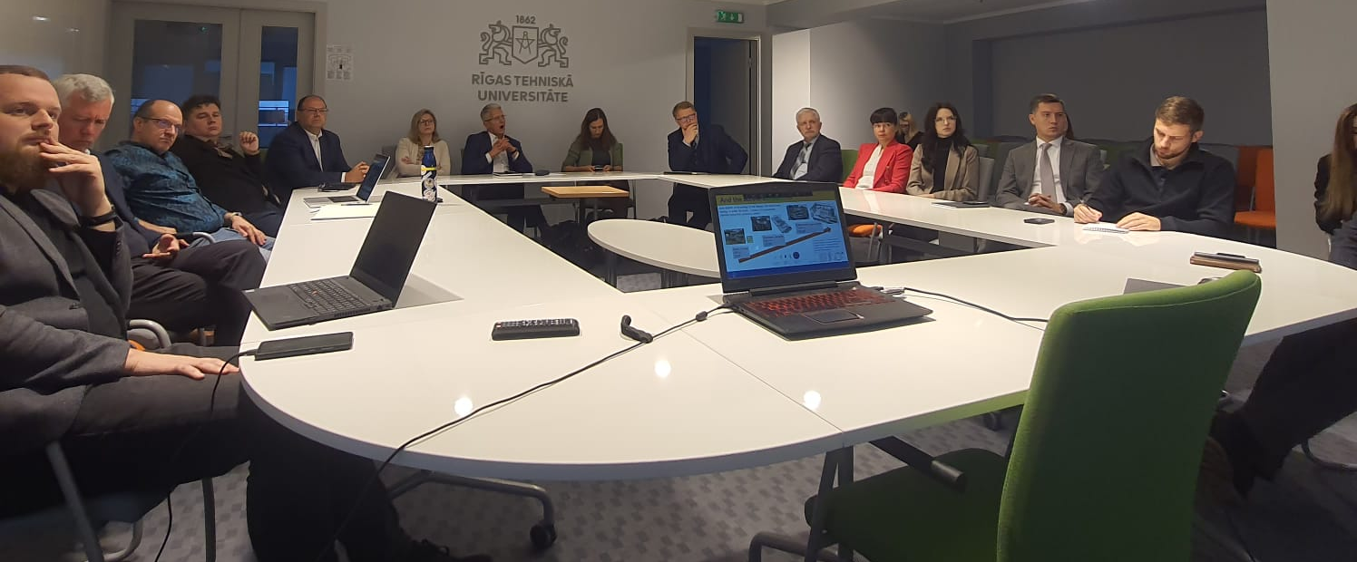
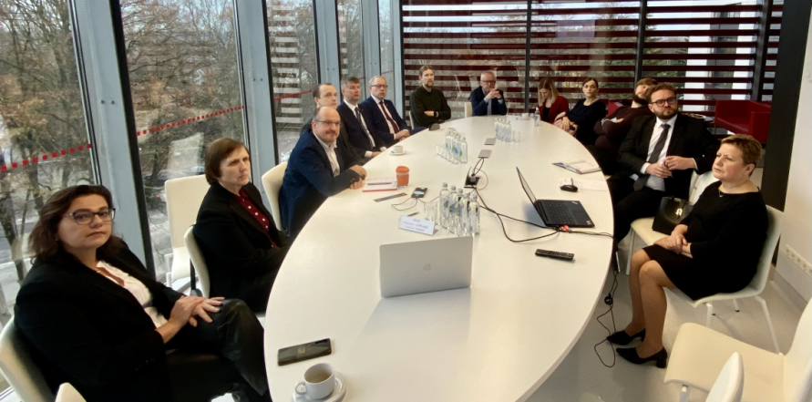
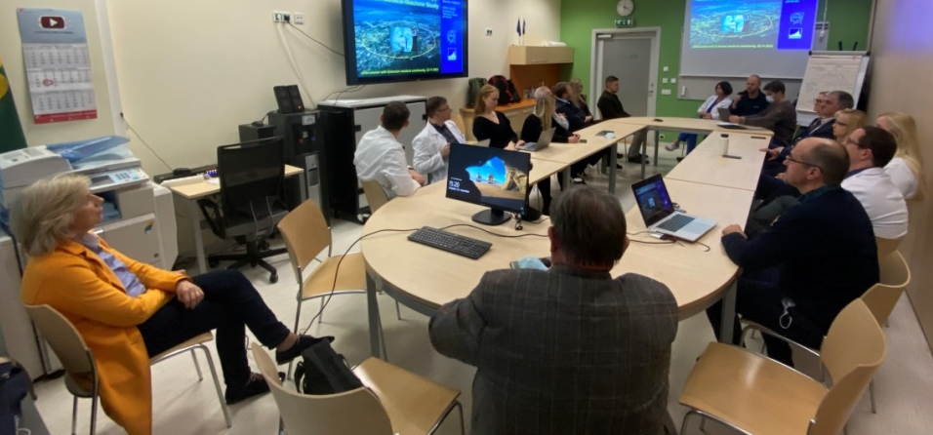



The bi-lateral meetings with medical and other stakeholders
Set-up of the events
Meeting relevant stakeholders in all 3 of the Baltic countries
Invitations to professional associations and societies of radiologists, nuclear medicine specialists, radiation oncologists and medical physicists as well as representatives of involved universities, research institutions and political bodies
Meetings were aimed to be in-person for maximum engagement
20 – 30 participants in each of the meetings
18th of October – Latvian stakeholders, Riga
16th of November – Lithuanian stakeholders, Kaunas
22nd of November – Estonian stakeholders, Tallinn

Slide 8
Milestones achieved
End of 2021
Idea and
first discussions
Aug 2022
Baltic Assembly support – letter to 3 prime ministers
May 2023
Baltic implementation – part of IPAC paper by NIMMS
Oct 2022
Resolution of Baltic Assembly
Presentations and discussions with relevant professional societies,
scientific universities and political stakeholders
Apr 2022
Conceptual design paper and working group establishment
Oct-Nov 2022
Bi-lateral discussions with stakeholders in all 3 Baltic States
25th of May 2023
Workshop at CERN
Particle therapy - future for the Baltic States? State-of-play, synergies and challenges

Slide 9
“Particle therapy - future for the Baltic States?”
A joint, dedicated workshop
“Particle therapy - future for the Baltic States? State-of-play, synergies and challenges”
Recap of the event
37 participants (mainly on site participants) – Baltic medical community representatives, CNAO radiation oncologist, CERN and NIMMS experts, members of political bodies – Baltic Assembly
5 sessions dedicated to each of the core discussion areas identified with reporters on subject matter and moderators of the session
Cancer statistics and indication profile in the Baltic States. Status of radiotherapy technologies in the Baltic States. | Cancer statistics in the Baltic States – number of patients diagnosed and treated with RT yearly Most common malignancies, with a correspondence to eligibility for particle therapy Technological level of currently used radiation therapy techniques, statistics of RT equipment
Clinical indications for proton and particle therapy. Existing clinical evidence and on-going clinical trials. | Main cancer types and oncological indications eligible On-going clinical trials for evidence-based medicine are to be discussed Existing consensus statements and alternative approaches for patient selection
The technology of helium synchrotron: technology readiness level and research needed. | Current status of the technology and technology readiness level Potential challenges in the development and construction stages Scientific research inputs necessary
Current status of nuclear medicine in the Baltic States. Trends and research pathways going into the future. | Current status of the nuclear medicine field within the Baltic States Insights gained from PRISMAP project - focus on novel radioisotopes Technical aspects and scientific research needed to develop production of such isotopes
Educational necessities and possible solution pathways for clinical and technical personnel training. | Key educational necessity areas International educational opportunities and collaborations Educational aspect implementation paths early-on within the project initiative

Slide 10
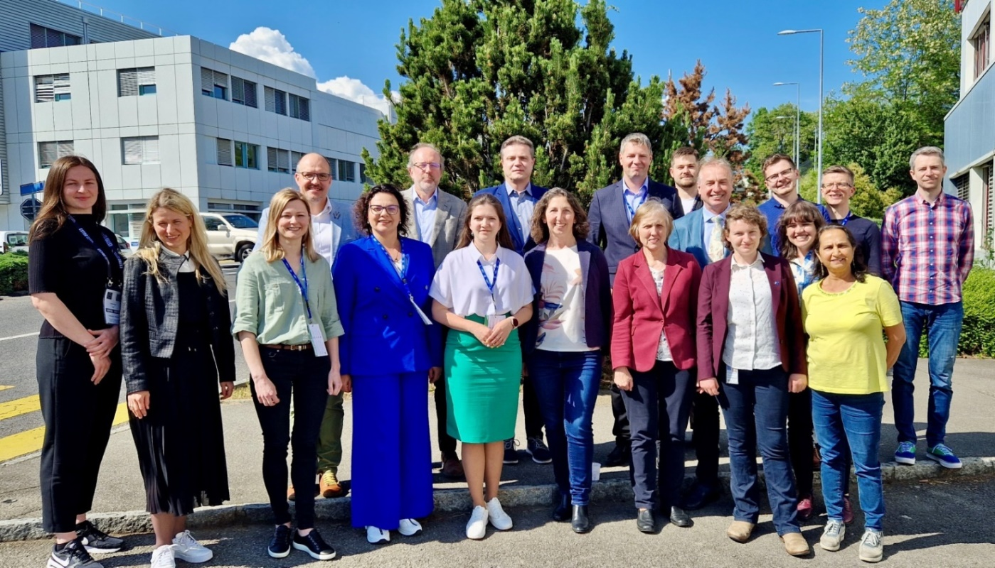
“Particle therapy - future for the Baltic States?”
A joint, dedicated workshop
“Particle therapy - future for the Baltic States? State-of-play, synergies and challenges”
Recap of the event
There would be no workshop without the reporters and moderators
Erika Korobeinikova (Lithuanian Society of Radiation Oncology, LSMU, Clinic of Kaunas)
Anna Maria Camarda (CNAO)
Dace Bogorada-Saukuma (Latvian Association of Therapeutic Radiology)
Maija Radziņa (Latvian Radiology Association, University of Latvia)
Andrejs Ērglis (University of Latvia)
Manjit Dosanjh (University of Oxford, CERN)
Maurizio Vretenar (CERN)
Elena Benedetto (SEEIIST Association, CERN)
Taylor Rebecca (Imperial College, CERN)
Edgars Mamis (University of Latvia, CERN)
Diana Adlienė (KTU, CERN Baltic Group)
Toms Torims (RTU, CERN Baltic Group)
Kristaps Palskis (RTU, CERN)

Slide 11
Recall on the clinical cancer statistics
Key information reported
  What is the cancer incidence and mortality in the Baltic States ?
Helium synchrotron
technology
 | Lithuania | Latvia | Estonia | TOTAL
Registered cancer cases | 17 073 | 12 051 | 8 907 | 38 031
Registered cancer deaths | 8 168 | 5 892 | 3 840 | 17 900
Cancer incidence rate (per 100 000 inhabitants) | 611 | 637 | 669 | 632
Cancer mortality (per 100 000 inhabitants) | 292 | 311 | 288 | 297
Patients receiving RT | 6343 (37.2 %) | 4146 (34.4 %) | 2556 (28.7 %) | 13045 (34.3 %)
Indications for particle therapy
Nuclear medicine
Educational pathways
Data as of 2020/2021
Cancer statistics in the Baltics
  Total population in the Baltic States - 6.02 million
  Crude, non age-specific corrected cancer incidence and mortality rates are 632 and 297 per 100 000 inhabitants, respectively
  in 2020 a total of about 13045 patients received conventional radiotherapy as cancer treatment procedure
What about specific data for particle therapy ?
For more details refer to: Workshop report

Slide 12
Recall on the clinical cancer statistics
Preliminary data are promising for further investigations . . .
Key information reported
How many PT eligible patients could we have in the Baltic States ?
  A literature review done by dr. Erika Korobeinikova:
Helium synchrotron
technology
Data of United States, 2021 | 2.2 % of all RT patients – eligible and treated
Data of United Kingdom, 2018 | 1.5 % of all RT patients – eligible and treated
Swedish study, 2005 | 14 – 15 % of all RT patients - therapeutic benefit to justify
United Kingdom study, 2022 | 4.3 % of all RT patients - therapeutic benefit to justify
Korean study, 2018 | 10 % of all RT patients – eligible and treated
Indications for particle therapy
Nuclear medicine
196 PT patients
13045 RT patients
in 2020
1.5 %
Educational pathways
1950 PT patients
Cancer statistics in the Baltics
15 %
European proton therapy center statistics show on average 223 adult and 150 pediatric patients receive proton therapy yearly per center ( data of 2020 )
For more details refer to: Workshop report

Slide 13
General conclusions of the workshop
Main conclusions
  Baltic region – state-of art conventional radiotherapy practices.
  Different studies generally indicate between 1.5 to 15 % patients receiving conventional radiation therapy would be eligible for particle therapy. In the Baltic States – corresponds to about 500 to 2000 patients annually. Promising starting point for further investigations.
  NIMMS helium synchrotron design would provide larger flexibility of the design, as well as training of personnel and vast scientific research programme. Helium synchrotron would allow proton therapy before commissioning and clinical trials of helium ion therapy. Most of technologies and components used in the helium synchrotron design are standard, so R&D risk is limited.
  New pathways in radioisotope production for nuclear medicine and associated research, though coordination with existing cyclotron facilities and research activities with current infrastructure should be considered.
  For capacity building and personnel training a Marie Curie Initial Training Network project proposal could be considered, as well as involvement in HITRIplus and ENLIGHT network activities – from which a clear support on the initiative has been shown
For more details refer to: Workshop report

Slide 14
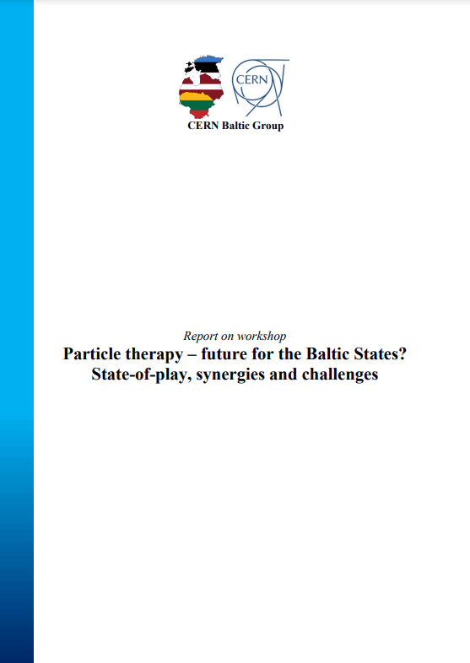
Report of the workshop
Overview report
Last information we reported . . .
A report on all findings within the “ Particle therapy - future for the Baltic States? ” workshop was created by the working group and approved
October 2023 by CERN Baltic Group
at 12th General meeting
Document serves as background for all future activities of the initiative
For more details refer to: Workshop report

Slide 15
Milestones achieved as of last report
End of 2021
Idea and
first discussions
Aug 2022
Baltic Assembly support – letter to 3 prime ministers
May 2023
Baltic implementation – part of IPAC paper by NIMMS
Oct 2023
Report on the workshop findings approved by CERN Baltic Group
Oct 2022
Resolution of Baltic Assembly
Presentations and discussions with relevant professional societies,
scientific universities and political stakeholders
Apr 2022
Conceptual design paper and working group establishment
Oct-Nov 2022
Bi-lateral discussions with stakeholders in all 3 Baltic States
25th of May 2023
Workshop at CERN
Particle therapy - future for the Baltic States? State-of-play, synergies and challenges

Slide 16
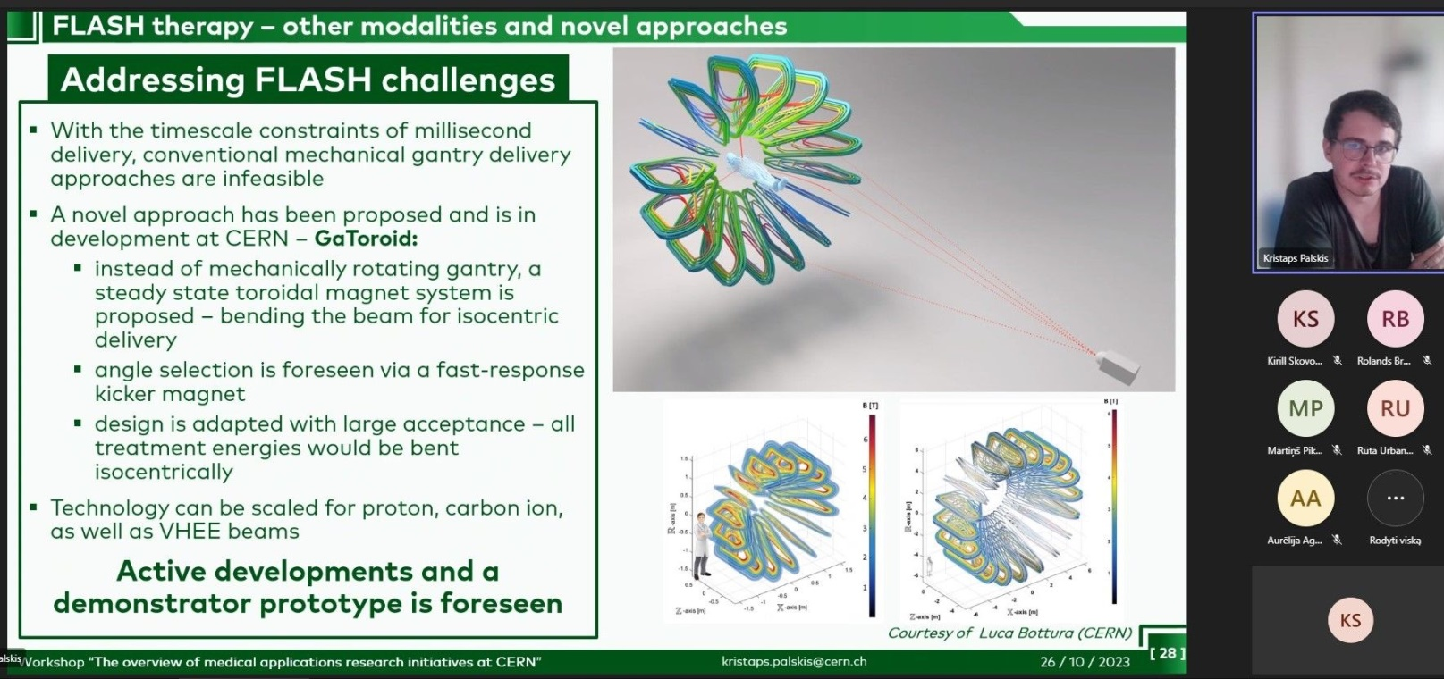
Further stakeholder engagement activities
Seminar with all 3 Baltic
medical physicist associations
on CERN medical
applications research
Oct 2023

Slide 17
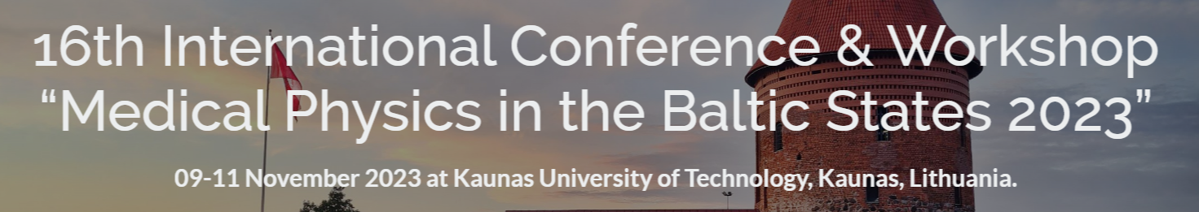
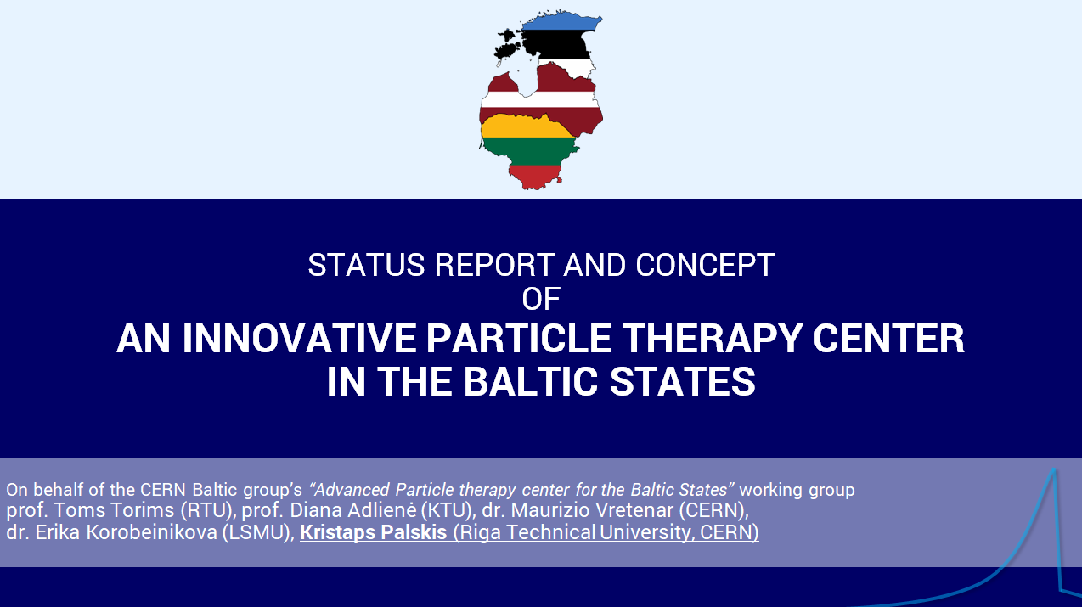
Further stakeholder engagement activities
Presentation at
16th International Conference
«Medical Physics in the
Baltic States 2023»
Oct 2023
Nov 2023

Slide 18
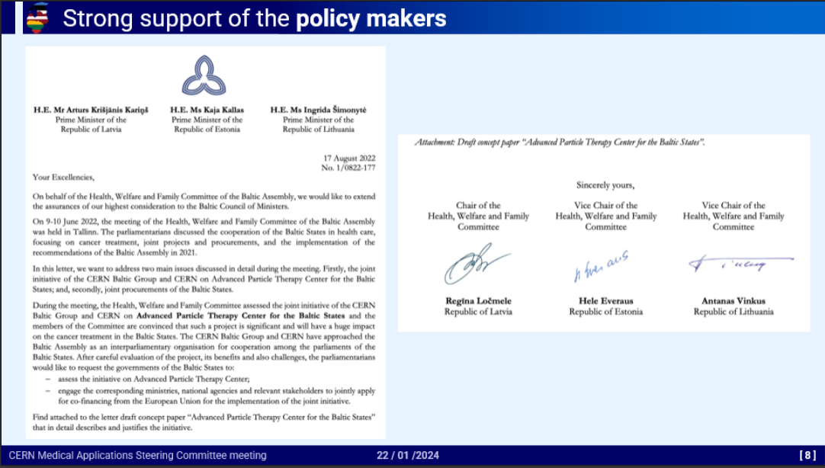
Further stakeholder engagement activities
Presentation at
CERN Medical Applications
Steering Commitee
Oct 2023
Nov 2023
Jan 2024

Slide 19
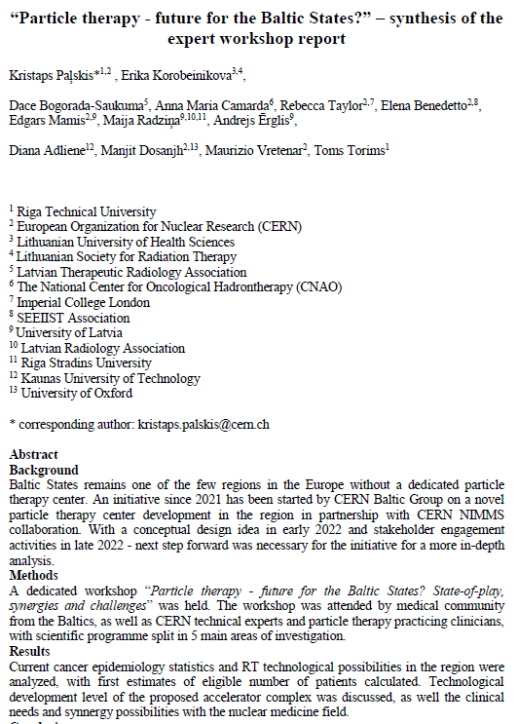
Further stakeholder engagement activities
Workshop overview and conclusions have been a prepared as
a publication in a dedicated issue
of «Health and Technology»
«Hadrontherapy and BNCT:
Current Status and
Future Trends»
Oct 2023
Nov 2023
Jan 2024
Feb 2024

Slide 20
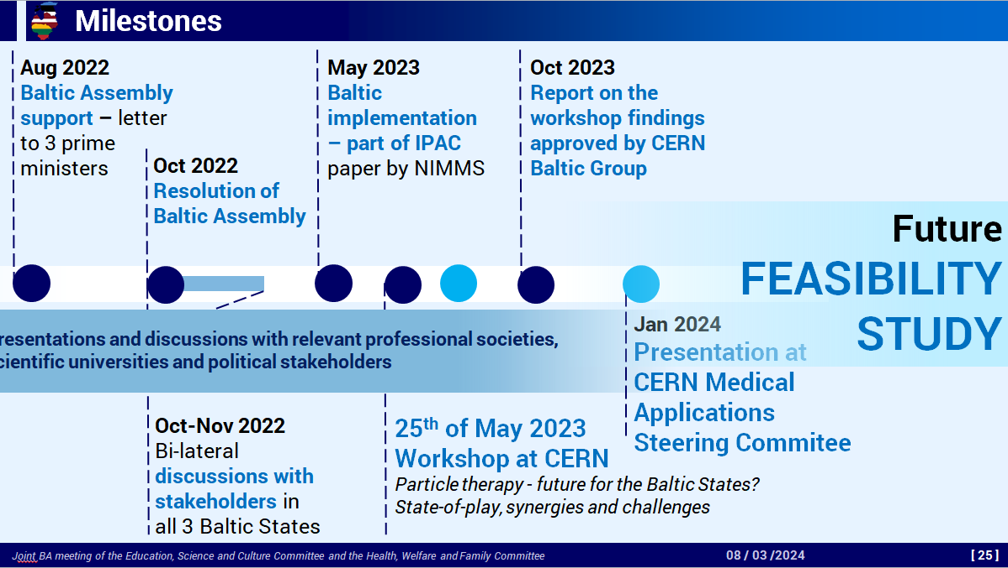
Further stakeholder engagement activities
Participation in
Joint Baltic Assembly meeting
of the Education, Science
and Culture Committee
and the Health, Welfare
and Family Committee
Oct 2023
Nov 2023
Jan 2024
Feb 2024
8th of March 2024

Slide 21
Further stakeholder engagement activities
Participation in
Joint Baltic Assembly meeting
of the Education, Science
and Culture Committee
and the Health, Welfare
and Family Committee
Future of the initiative
FEASIBILITY STUDY
and BEYOND
Oct 2023
Nov 2023
Jan 2024
Feb 2024
8th of March 2024

Slide 22
Future steps of the initiative
Future of the initiative
Feasibility study on implementation in the Baltics
EIC Pathfinder project application for prototyping of technology
Helium synchrotron technology is still in active development within CERN NIMMS collaboration – prototyping of the crucial technologies would be highly beneficial
A possible EIC Pathfinder project application is foreseen for this research with CERN as leading institution together with technical and medical university representatives from the Baltic States
Feasibility of a dedicated facility in the Baltic States – core focus of technology adaptation and integration for a specific facility, along with analysis on the epidemiological case in the region and treatment eligibility criteria

Slide 23




Initial outline of the feasibility study
A full-scale feasibility study of the project
Clinical case and epidemiology
Technical aspects
Business case
Within the framework of CERN

Slide 24
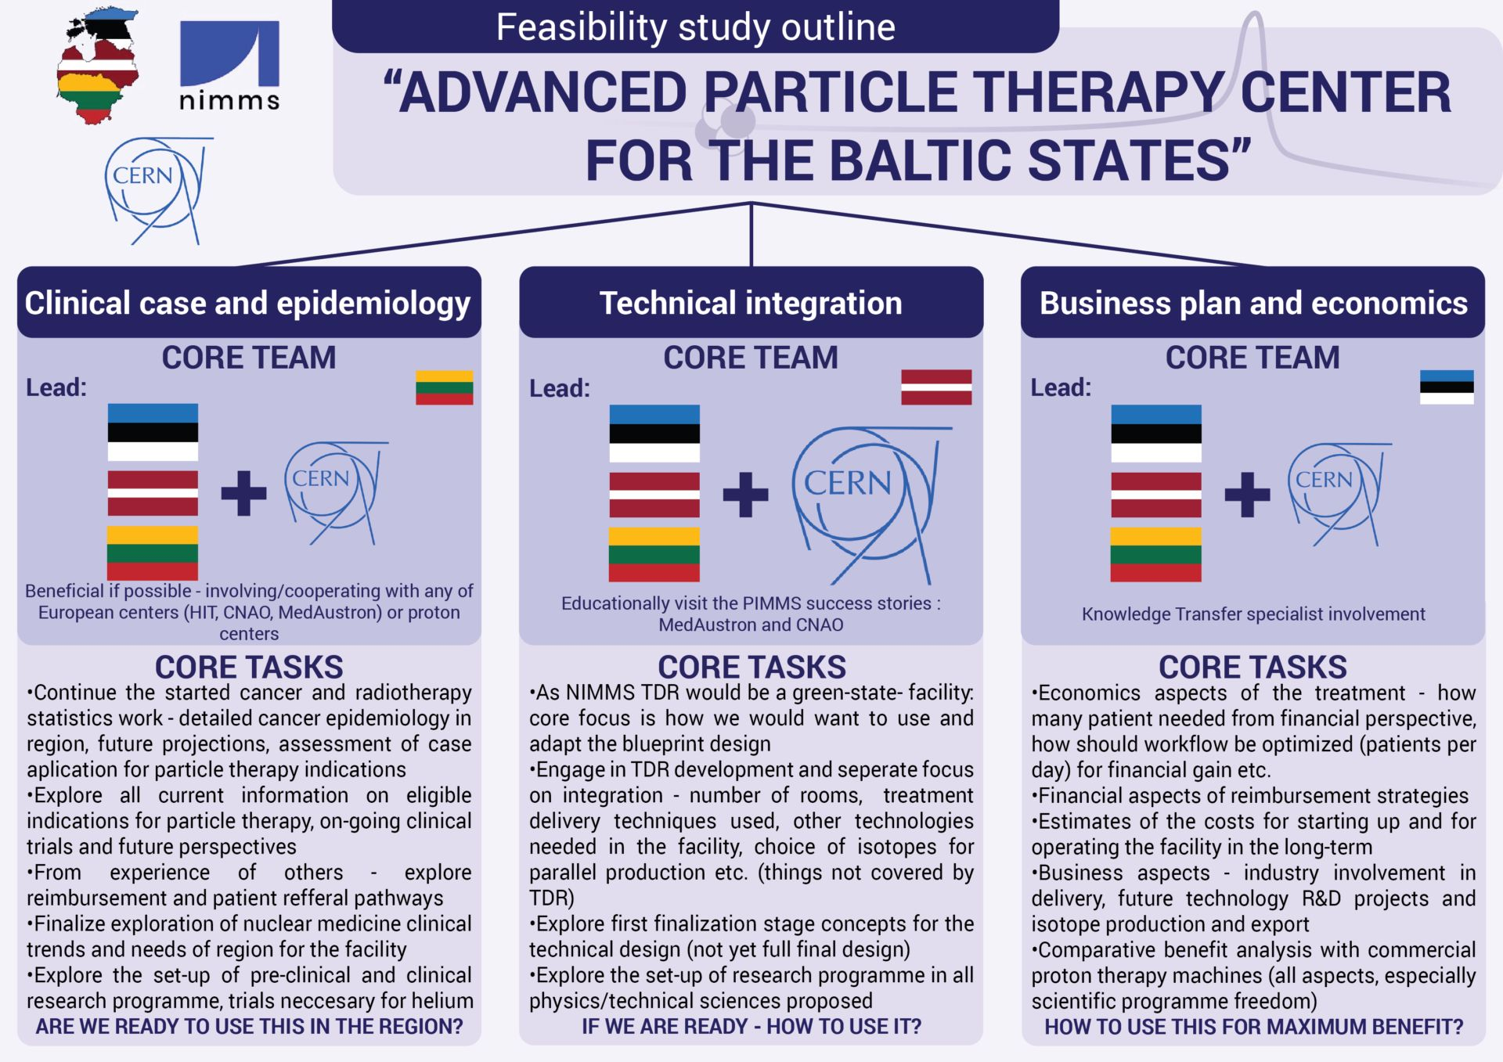
Initial outline of the feasibility study

Slide 25
Feasibility study preliminary overview: Clinical case and epidemiology
The Medical Case
„Cancer epidemiology in the Baltic States”
Core question for the working group:
ARE WE READY TO USE THIS TECHNLOGY – ARE THERE ENOUGH PATIENTS AND WHAT ARE THE TRENDS IN RADIATION THERAPY AND NUCLEAR MEDICINE IN THE BALTIC STATES?

Slide 26
Feasibility study preliminary overview: Clinical case and epidemiology
Task 1: Collection of statistics in the region
Continue the started cancer and radiotherapy statistics work - detailed cancer epidemiology in region, future projections, assessment of case aplication for particle therapy indications.
Statistics on the use of nuclear medicine (radioisotopes, patient statistics) in the region and future projections.

Slide 27
Feasibility study preliminary overview: Clinical case and epidemiology
Task 2: Literature analysis
Explore all current information on eligible indications, on-going clinical trials and future perspectives for particle therapy (protons, helium ions)
Analyse nuclear medicine clinical trends - „which isotopes would be of interest and benefit to produce in the Baltic region both for clinics and business”
Explore the set-up of pre-clinical and clinical research programme, trials necessary for helium ion therapy

Slide 28
Feasibility study preliminary overview: Clinical case and epidemiology
Task 3: Establishing connections
From experience of others - explore reimbursement and patient referral pathways
It would be highly beneficial to involve or/and cooperate with any of European ion therapy centres (HIT, MIT, CNAO, MedAustron) or even proton therapy centres could be considered, as proton therapy would be the first clinical modality to be used in the proposed facility:
    optimal clinical and research set-ups.

Slide 29
Feasibility study preliminary overview: Clinical case and epidemiology
Technological aspects
„Technological integration for a facility in the Baltic States”
Core question for the working group:
IF WE ARE READY, HOW DO WE WANT TO USE AND ADAPT THE HELIUM SYNCHROTRON TECHNOLOGY FOR A FACILITY IN THE BALTIC STATES?

Slide 30
Feasibility study preliminary overview: Clinical case and epidemiology
Direction of investigation Nr. 1: Design integration for the Baltic Sates
NIMMS Technical Design report (TDR) - green-state- facility
Overall core focus - how we would want to use and adapt the blueprint design developed by NIMMS collaboration for the facility proposed in the Baltic States
Main technical aspects: beam time operational plan (treatment-research ratio), number of rooms, treatment delivery techniques used, other technologies needed in the facility, choice of isotopes for parallel production etc. (essentially – things and aspects not covered by TDR itself)
Close collaboration with CERN NIMMS with tangible inputs for TDR development

Slide 31
Feasibility study preliminary overview: Clinical case and epidemiology
Direction of investigation Nr. 2: Additional infrastructure needed
The developed helium synchrotron by itself – technology not a facility
Multiple additional things need to be considered:
  additional technologies needed within the facility related to clinical and research activities:
    imaging units (CT, MRI, PET) etc. and choice of in-room imaging;
    related to radioisotope production: hot cells, clean room facilities, technologies for chemical preparation of radiopharmaceuticals etc.
Importantly: all the related support systems are not included in main design, need to be considered – IT infrastructure, power engineering, civil engineering aspects, radiation shielding etc.

Slide 32
Feasibility study preliminary overview: Clinical case and epidemiology
Direction of investigation Nr. 3: Research programme in «tech sciences»
Working Group #1 – clinical and pre-clinical research pathway and programme development
Explore the set-up of research programme and possible pathways in all the non-clinical and complementary science fields:
  Medical physics, accelerator physics
  Accelerator technologies
  Radiation chemistry, material science
  . . .
Educational visits to the PIMMS „success story” facilities: MedAustron and CNAO
Specifics of accelerator their accelerator complexes, supporting infrastructure and challenges faced from PIMMS integration into a clinical-research facility

Slide 33
Feasibility study preliminary overview: Economics and business plan
„Economical aspects and business plan”
Core question for the working group:
HOW TO USE THE FACILITY FOR MAXIMUM BENEFIT – NOT JUST FROM CLINICAL TREATMENT ECONOMICS, BUT ALSO INDUSTRY INVOLVEMENT AND FUTURE R&D AVENUES?
Some initial core ideas:
Economics aspects of the treatment - how many patient needed from financial perspective, how should workflow be optimized (patients per day) for financial gain etc.
Financial aspects of treatment reimbursement strategies
Estimates of the costs for starting up and for operating the facility in the long-term
Business aspects - industry involvement in delivery, future technology R&D projects and isotope production and export
Comparative benefit analysis with commercial proton therapy machines (all aspects, especially scientific programme freedom)
More from prof. Sergei Nazarenko

Slide 34
Feasibility study preliminary overview
Clinical case and epidemiology
Technical integration
Economics
aspects

Slide 35



Feasibility study: Team Composition
FS Leader (@CERN) + Project. Admin.+ Comm
Clinical and epidemiology
Technical
aspects
Economic
assessment
Pillar Leader - Senior Researcher with proven knowledge in the field
LUHS
Pillar Leader - Senior Researcher with proven knowledge in the field
Pillar Leader - Senior Researcher with proven knowledge in the field
RTU
TalTech
PhD student or researcher
PhD student or researcher
PhD student or researcher
NCI
KTU+LEI
VU
PhD student or researcher
RSU
PhD student or researcher
LU
PhD student or researcher
LU
PhD student or researcher
PhD student or researcher
PhD student or researcher
North Estonia Medical Centre
TalTech
TU
Criteria: commitment, competence, collaboration
+ associated partners of CBG member institutions

Slide 36
Feasibility study: Core principles
CERN Hosted Activity of CERN Baltic Group
Feasibility study personnel:
  to be employed by home institutions of CBG Members (USER, COAS, PJAS, VISC)
  or enrolled in CERN Doctoral Programme (DOCT)
  or enrolled in CERN Technical Student Programme (TECH)
To be paid subsitance (COLA) allowance (or renumeration if DOCT or TECH) in accordance with the CERN «Subsistance rates for associated members of the personnel»
To be directly supervised by an expert in the field at the home institution (competence)
Activity has to be integrated and aligned with the study or research process at the home institution
Opportunity to build expertise, capacity and strong collaboration
during the long-term attachment with CERN

Slide 37
Feasibility study: Estimated annual costs
Feasibility study leader: 124 000
Clinical and epidemiology
Technical
aspects
Economic
assessment
61 000
61 000
61 000
Pillar Leader
Pillar Leader
Pillar Leader
56 000
56 000
56 000
56 000
56 000
56 000
56 000
56 000
56 000
+ administrative costs: 40 550
+ travel: 9 500

Slide 38

Feasibility study: Estimated total costs
 | Year 1 | Year 2 | Total contribution
 | 287 016 | 287 016 | 574 033
 | 287 016 | 287 016 | 574 033
 | 287 016 | 287 016 | 574 033
Total | 861 050 | 861 050 | 1 722 100

Slide 39
Feasibility study: Stakeholders
Professional medical associations
  radiation oncologists
    Lithuanian Society for Radiation Therapy
    Latvian Society of Therapeutic Radiology
    Estonian Society for Clinical Oncology and Estonian Society of Oncology
  medical physicists
    Lithuanian Society of Medical Physicists
    Latvian Medical Engineering and Physics Society
    Estonian Society for Biomedical Engineering and Medical Physics
  radiologists
    Lithuanian Radiologists’ Association
    Latvian Society of Radiology
    Estonian Society of Radiology
  Baltic Nuclear Medicine Association

Slide 40
Feasibility study: Stakeholders
National Cancer Institutions in the 3 Baltic Countries
  National Cancer Institute (Vilnius)
  Tartu University Hospital and North Estonia Medical Centre
  To be National Cancer Centre in Latvia under Riga East Clinical University hospital

Slide 41
Feasibility study: Stakeholders
Baltic Assembly
The 3 Baltic ministries of science and research
The 3 Baltic ministries of healthcare
The 3 Baltic ministries of economy
The 3 Baltic research councils
European Commission
ENLIGHT network and partners
HITRIplus project community
PRISMAP project community
European ion therapy centers: HIT, CNAO, MedAustron, MIT

Slide 42
An exciting, unique and uniting opportunity not to be missed . . .

Slide 43
Thank you for your attention !

