Slide 1
















HOW TO LIMIT THE ENVIRONMENTAL IMPACT
Mar Capeans
EDMS 2735914

Slide 2

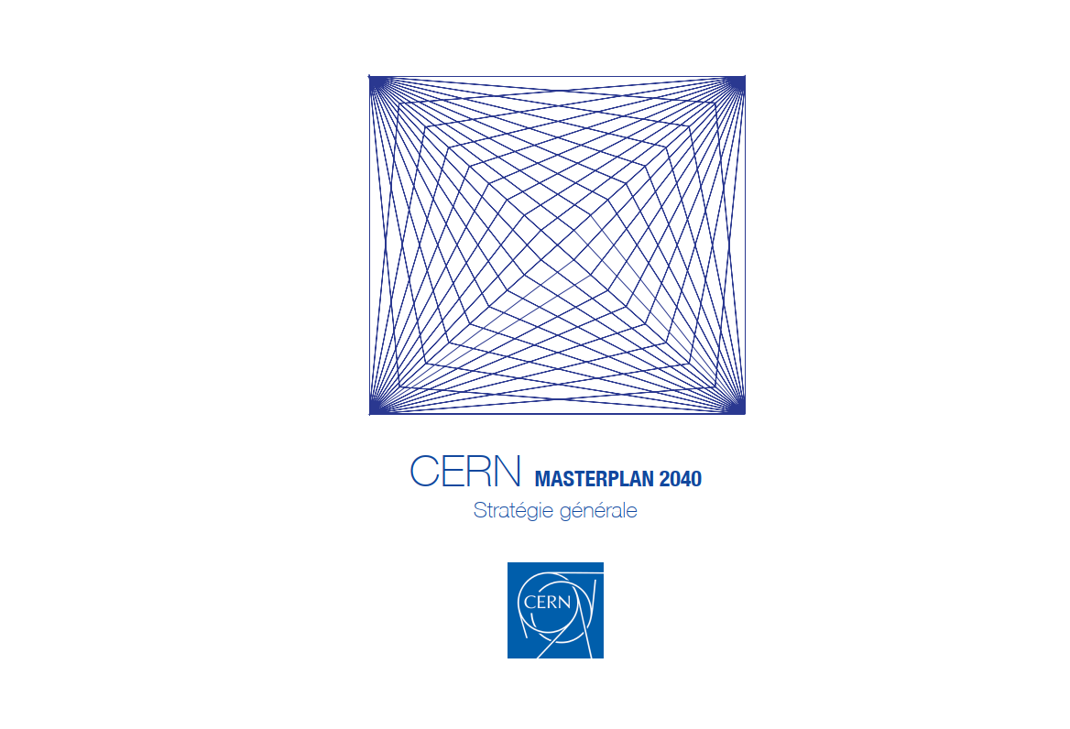
OUTLINE
Environmental protection at CERN
Reporting
Targets
Actions
CERN Environmental Reports
CERN Masterplan 2040
Site development
Future
Outlook
ACKNOWLEDGEMENTS
B. Delille and S. Kleiner, CERN Health, Safety and Environmental Unit, E. Cennini, CERN Industry, Procurement and Knowledge Transfer, N. Bellegarde and S. Claudet, CERN Accelerator & Technology Sector, FCC team, CLIC team, CERN Site and Civil Engineering Department team

Slide 3
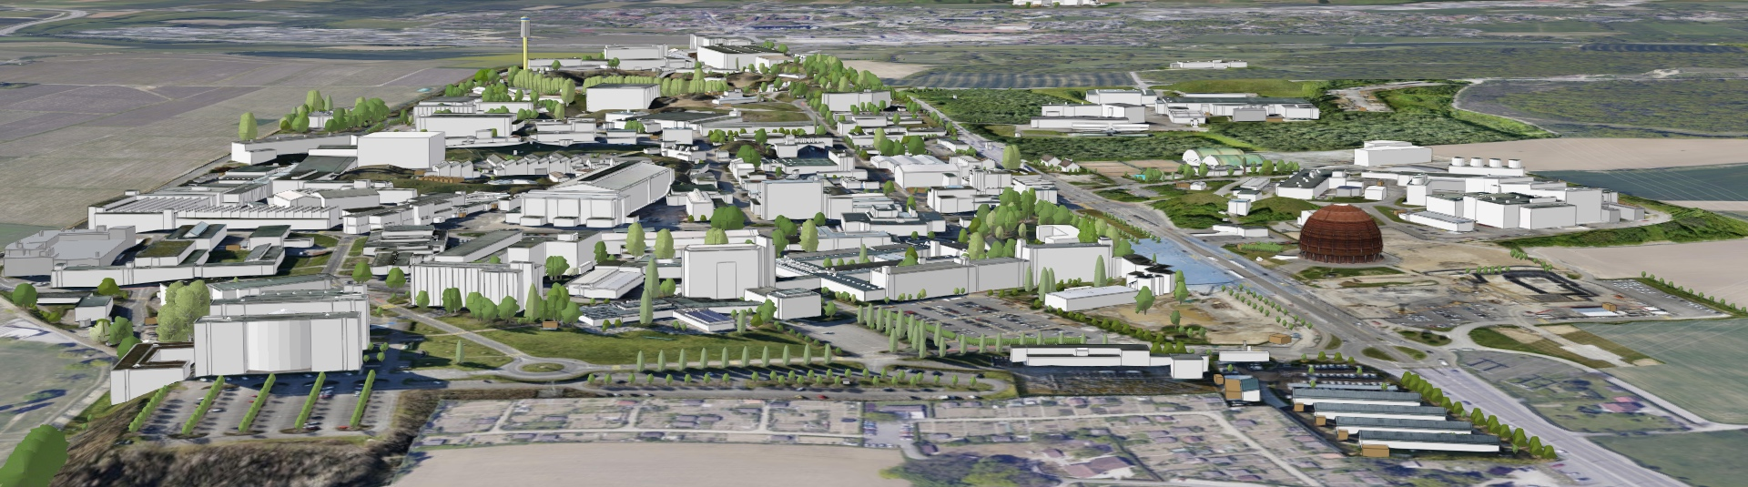
KEY FIGURES
590 ha (220 fenced)
2 main sites and 15 satellite sites
670 buildings from 10 m² to 20.000 m²
65% built before the 70’s
70 km tunnels and 80 caverns
30 km roads
1000 km technical galleries and trenches
9000 persons/daily
490 hostel rooms
8500 working places
4300 parking places in Meyrin, 1400 in Prévessin
25000 daily movements to- and inter-sites
Public transport links in CH, not in FR

Slide 4
STRATEGY
Involving the entire organization
  Environment included in CERN’s main objectives for 21-25
  Strong strategic direction from the DG, endorsed by Council and supported by enthusiastic efforts throughout the organization
  Increasing accountability and governance
Generating transparent and reliable reporting
  Materiality assessment and stakeholder review
  Reporting on GHG emissions since 2019, Global Reporting Guidelines (GRI)
Acting
  Setting targets
  Global strategy with objectives and measures that take up the framework objectives and translate them into operational prioritized measures

Slide 5

STRATEGIC ACTIONS
2016 | 2017 | 2018 | 2019 | 2020 | 2021 | 2022 | 2023 | 2024 | 2025
Energy Management Panel
Baseline year
2017-2018
Environment Report
2023-2024 Environment Report
Environmental Protection Steering Board
Materiality analysis
Environmental Noise policy
2021-2022 Environment Report
Environmentally Responsible Procurement Policy
2019-2020 Environment Report
Energy Performance plan
Environmental Responsible Procurement Policy Project
ISO50001 certification
Green Village
Innovation Programme on Environmental Applications
Masterplan2040

Slide 6
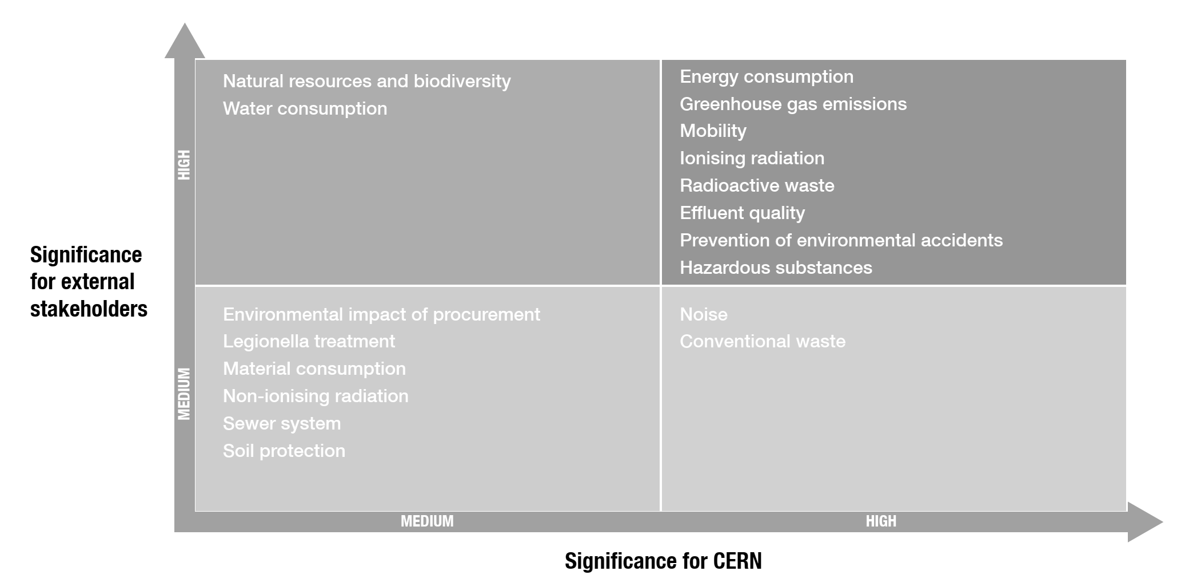
MATERIALITY

Slide 7











SCOPE 1
Direct
SCOPE 2
Indirect
SCOPE 3
Indirect
Particle Detectors
Accelerators
Purchased electricity
Waste treatment
Water purification
Business Travel
Vehicles
Employee Commuting
Catering
Procurement
Assets

Slide 8
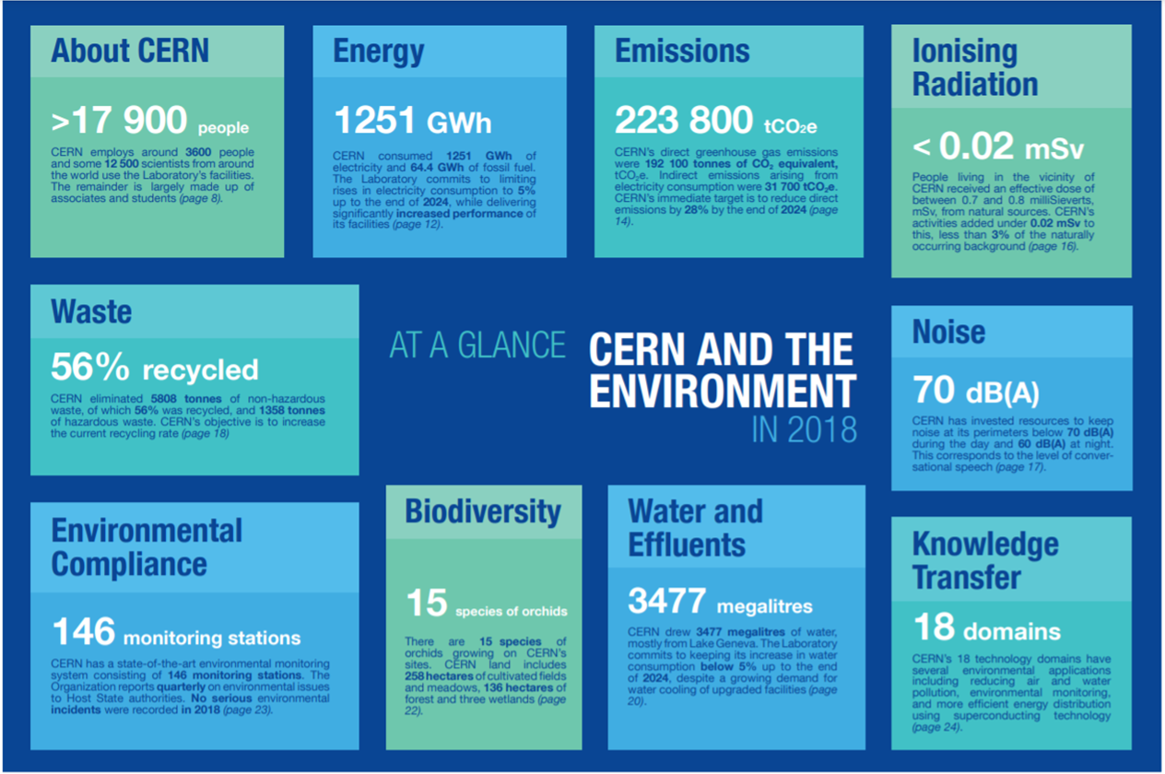

Slide 9
TARGETS 2025
ENGAGEMENTS
GHG Emissions
Reduction by 28%
Waste
Increase recycling rate
Noise
Restrict
Energy Consumption
Limit raise by 5%
Commuting
Constant
Water Consumption
Limit raise by 5%
Biodiversity
Protect

Slide 10
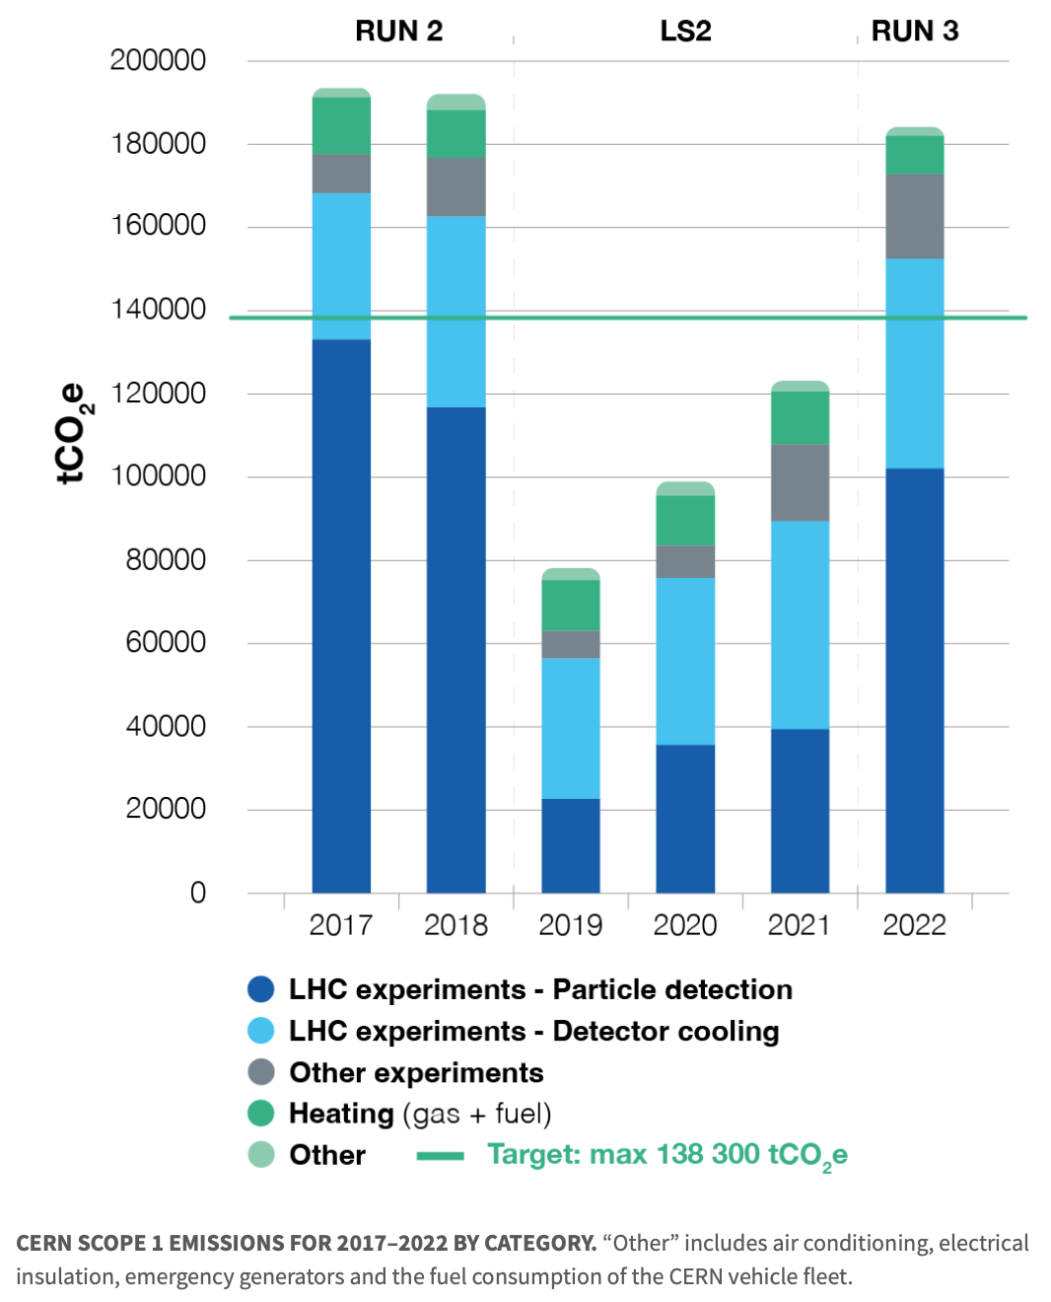
GHG EMISSIONS
Detector cooling
Systems using F-gases will be stopped by end of Run3 and replaced by CO₂ cooling for Run4
With forecasted reduction ~40’000 tCO₂e/year
Particle detection (gases)
Reduction target ~13’000 tCO₂e/year

Slide 11
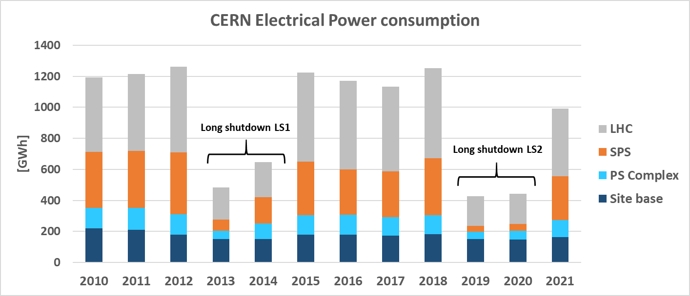
SCOPE 2: INDIRECT EMISSIONS

Slide 12
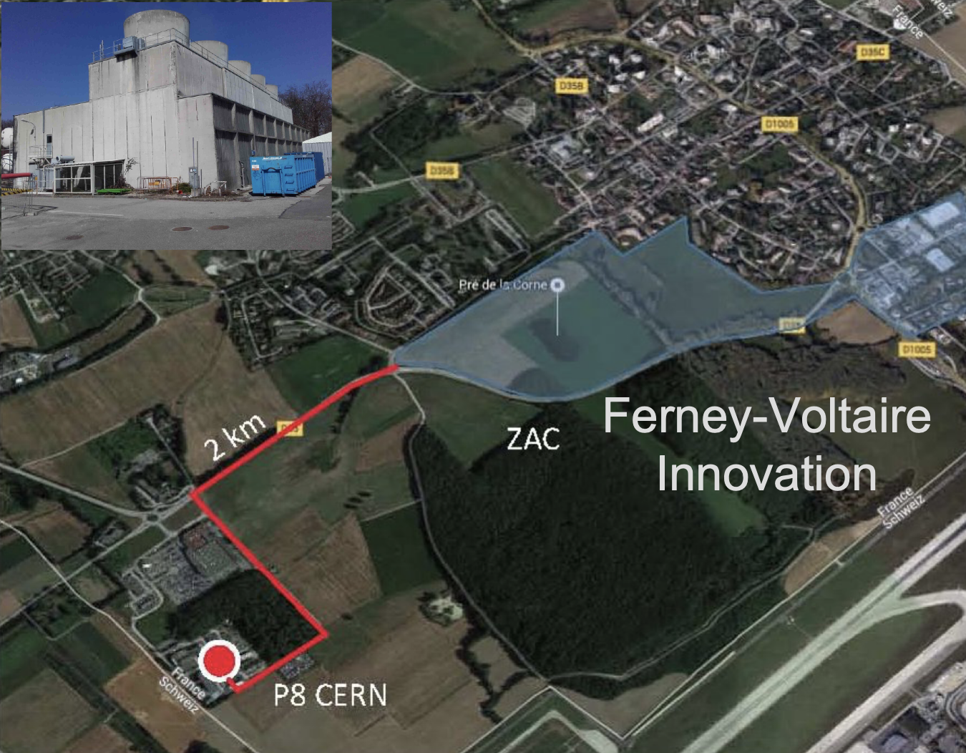
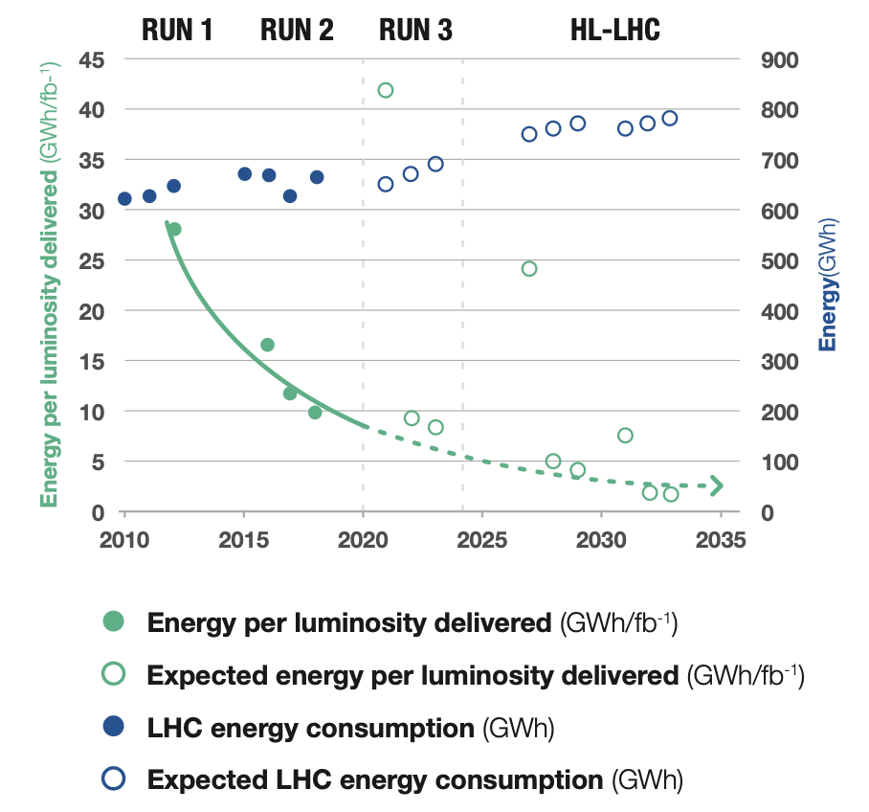
SCOPE 2: ACTIONS ON ENERGY CONSUMPTION
INCREASE EFFICIENCY
USE LESS
RECOVER
Savings up to ~100 GWh/y since 2010
LHC high availability at ~constant energy consumption
Technology: PS East area power converters designed to supply the magnets on a cyclical basis, with an energy-recovery stage between each cycle resulting into 90% electricity consumption reduction: (11 to 0.6 GWh/y)
Campus: Building Global renovations for reduction of losses (energy, water, gas, cooling), densifying occupation
Annual Virtual Energy Bills
Energy performance plan & ISO50001
Hot water from LHC cooling system (P8, 2 x 5 MW heat exchangers) to heat up a residential area (20 GWh/y at peak).
PCC to heat Prevessin CERN site (3-4 MW)
LHC Cooling towers at P1 to heat Meyrin CERN site (5-10 MW)

Slide 13
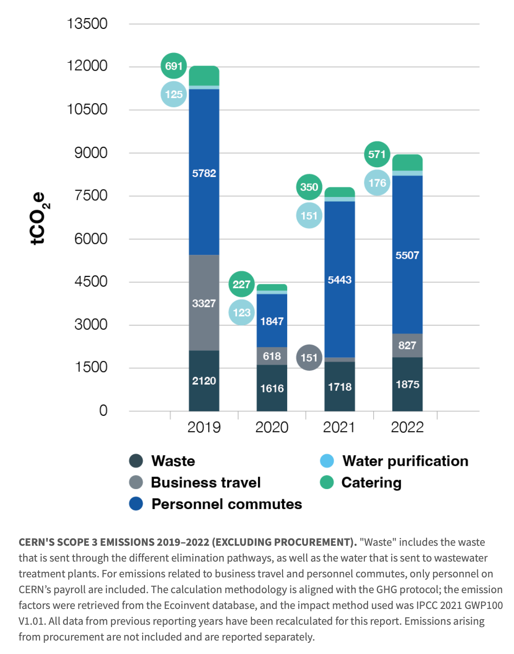
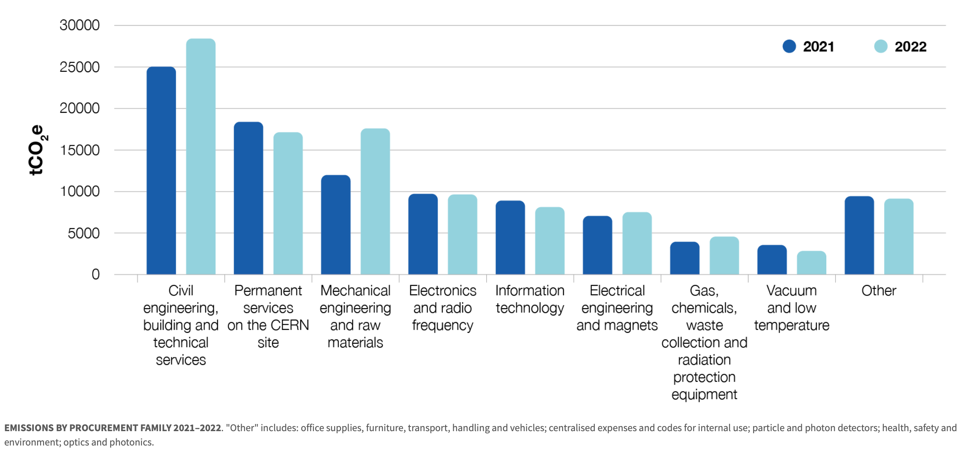
SCOPE 3: INDIRECT EMISSIONS
21/03/2022

Slide 14
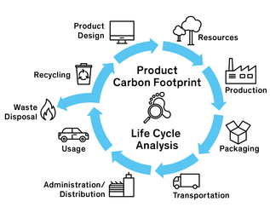

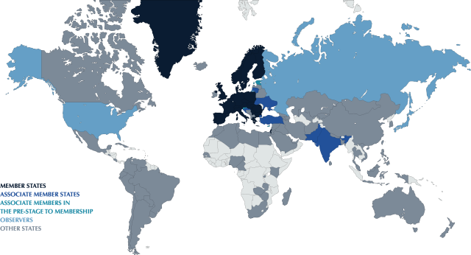
Challenge the need!
SCOPE 3: ACTIONS
As user/owner?
Functional approach
KPIs e.g. % recycled
Buy/Partner/Make
CERN Environmental Responsible Procurement Policy Project (2021)
Courtesy E. Cennini
WHY BUYING
HOW DO WE BUY
Fair competition
Payment deadline
WHAT DO WE BUY
Reasoned negotiation
Suppliers’ performance
Respect of commitments
Polluting materials?
Carbon footprint?
Social impact?
Eco-design/Life Cycle Analysis
Resource optimization (water/energy)
Total Cost of Ownership (TCO)
WHO WE BUY FROM
Countries/people exposed
Duty of vigilance/Compliance
(Very) Poorly balanced Countries
Labels/Certification
Local purchase/Diversity

Slide 15
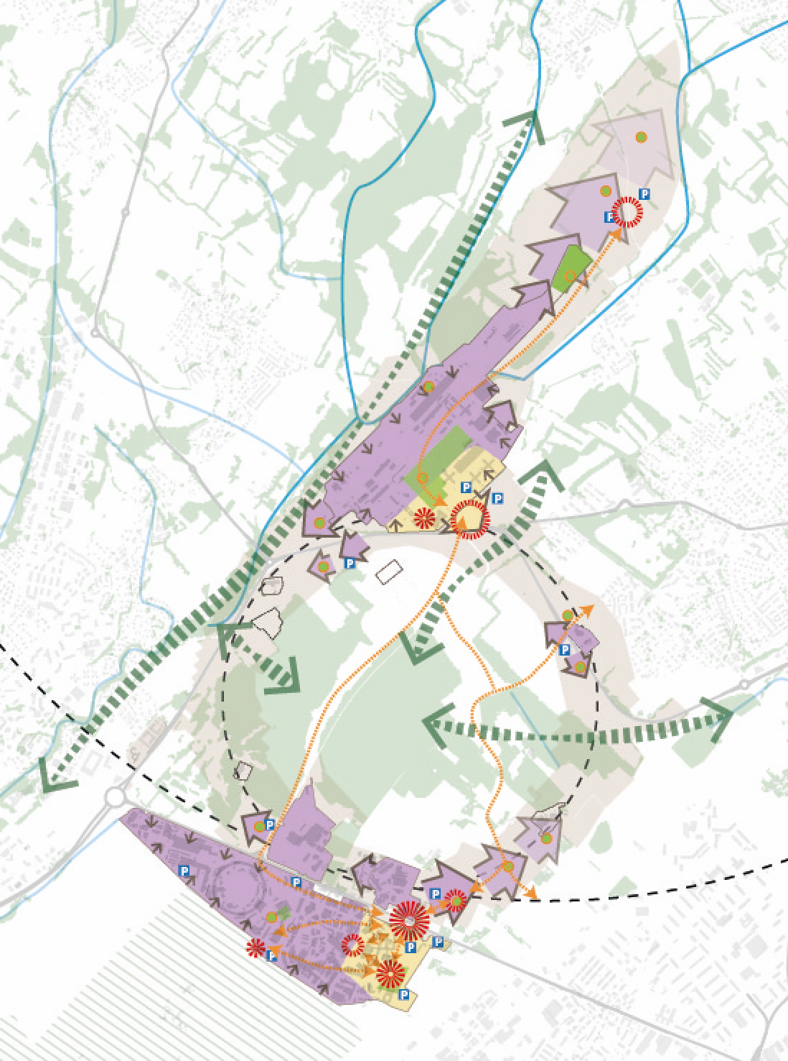
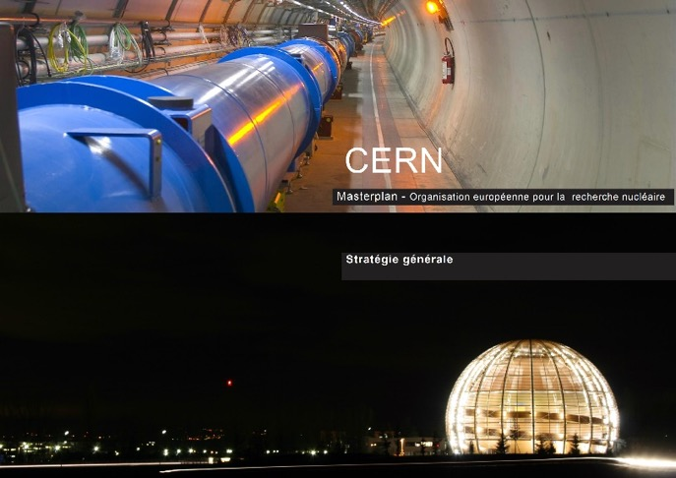

CERN MASTERPLAN2040
Integration of the latest projects
Integration of SPS land and LHC points
Integration of the Development Guide (CH)
Integration of sustainable development

Slide 16
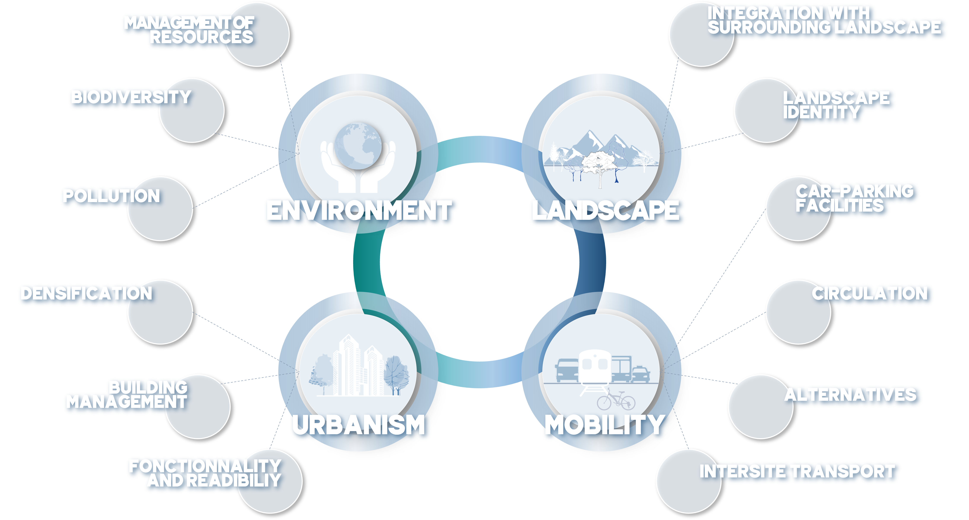

MASTERPLAN2040
Framework objectives and measures

Slide 17
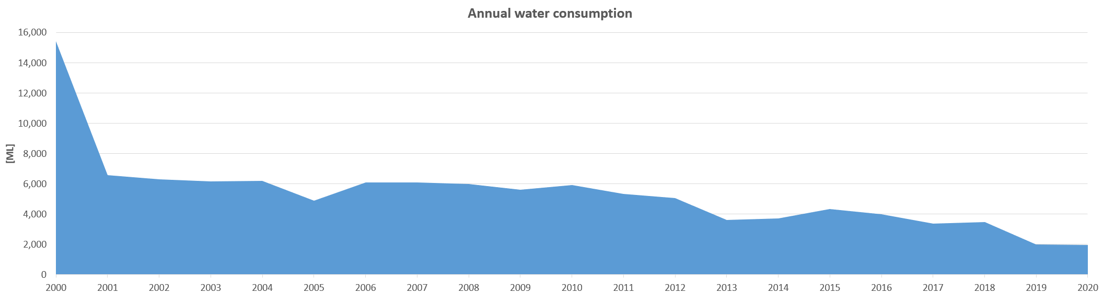
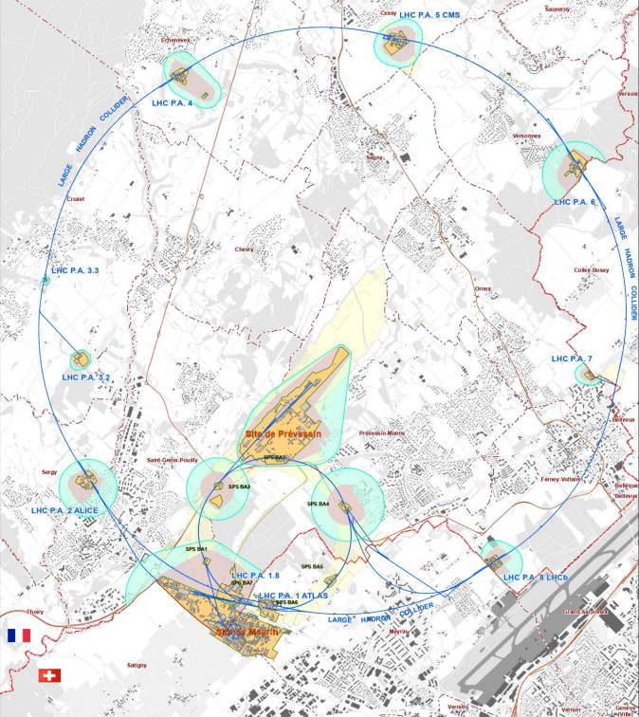
MASTERPLAN 2040: Environment
WATER
NOISE

Slide 18
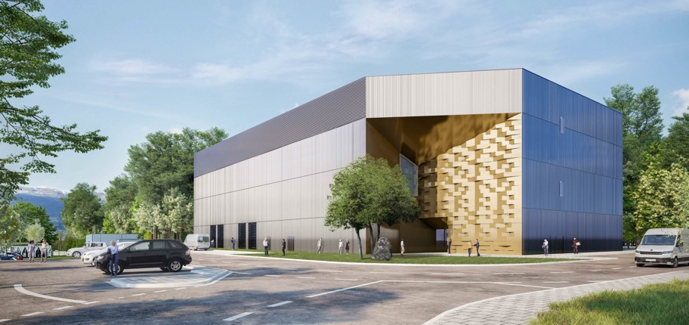
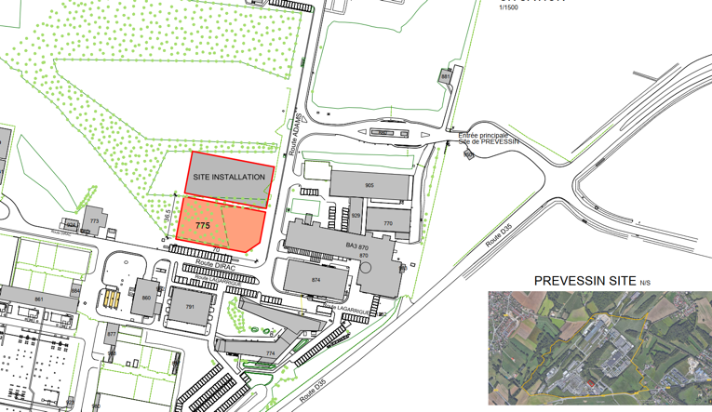
PREVESSIN COMPUTING CENTER
Initial capacity of 4 MW available for IT equipment with stepwise future increases to 12 MW.
To meet CERN's environmental goals the project incorporates the following considerations :
Designed to be energy efficient with a target PUE (Power Usage Efficiency) of 1.10 (1.15 contractual)
Optimised water consumption via a recirculation system lowering consumption in hot periods
All cleared vegetation will be reconsolidated
The acoustic study used for design of the building follows CERN commitments
A heat recovery system is foreseen for up to 25% of power produced to be recovered
Green terrace on the roof

Slide 19
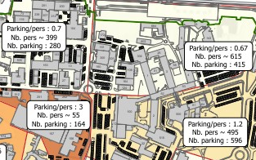
MOBILITY
STRATEGIC PRINCIPLES
ROADMAP
ACTIONS
Focus on people needs
Integrate transport modes
Adaptable to the future needs of the organization
Sustainable and eco-responsible
Communicate, cooperate with local actors, and involve the community
Data driven
Targets
KPIs
Eliminate abandoned vehicles (2021)
10 km Cycle paths (2020)
+40% Bike parkings (2022)
2 E-charging stations (2022)
80 E-bikes (2021)
Increased car-sharing (2022)
Optimization of the car fleet (2023)
Modal points at < 5min walk
Mobility Report (2022 and yearly)

Slide 20
TECHNOLOGY & ENVIRONMENT
INNOVATION PROGRAMME ON ENVIROMENTAL APPLICATIONS
GREEN
VILLAGE
FROM SOCIETY TO CERN TO SOCIETY
Enabling rapid access to CERN campus as a test site for technologies linked to environment and sustainability
Accelerating the commercialization of ideas, technologies and prototypes
Involving Young Innovators (new ideas for unforeseen applications)
Challenges: waste management, mobility, energy efficiency for tertiary activities on campus, space management, IoT, Zero-waste, urban analytics, …
FROM CERN TO SOCIETY
CIPEA: Developing advanced technologies linked to environment and sustainability
E.g. solar thermal panels derived from vacuum technology; CO₂ cooling technology; superconductive power transmission lines and current leads

Slide 21
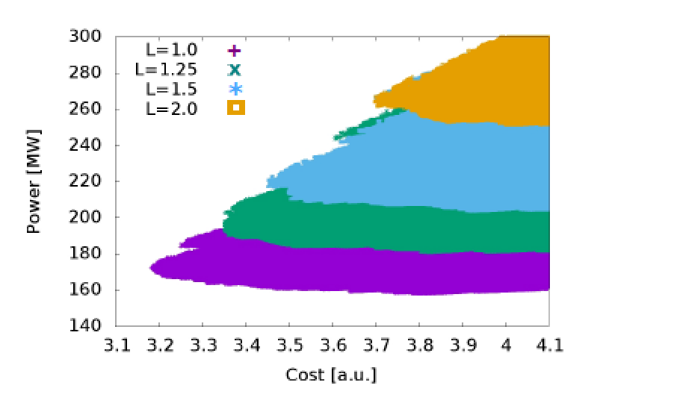
FUTURE STUDIES & ENVIRONMENT
FCC
CLIC
Integration of an “Eco-design” from the first conceptual design phase onwards, balancing Scientific excellence, Territorial compatibility, Implementation and operation
The environmental evaluation process follows “Avoid-Reduce-Compensate”; includes geology, urbanism, society health and safety, technical development and risks…
Iterative co-development with the Host State partners on high-priority topics such as:
  Consumption of resources: land, soil, water
  Limitation of impacts, e.g. re-use of excavated materials, reduction of surface footprints, energy efficient designs, reduction of traffic and nuisances during construction
  Creation of added value, e.g. supply of waste heat, sharing of technical infrastructures (e.g. electricity, telecommunications, water supply and treatment)
Approaches to increase sustainability:
Overall system design
  Compact (short) accelerator -> high gradient
  Energy efficient -> low losses
  Effective -> small beam sizes
Subsystem and component design, e.g.
  High-efficiency klystrons, permanent magnets
  Heat-recovery in tunnel linings
Sustainable operation concepts
  Recycle energy (heat recovery)
  Adapt to regenerative power availability, Exploit energy buffering potential

Slide 22










SUMMARIZED AMBITIONS
Reduce direct emissions by 28%
ENERGY: limiting rises in electricity consumption to 5%
WATER: increase in water consumption below 5%
Control water effluents (CH)
Closed/loop and recycling of cooling water from Cooling towers
2021
2022
2023
2024
2025
2026
2027
2028
2029
2030
Reduce professional travel
Control water effluents (FR)
100% Inventory of CERN areas of biological interests
40’000 m² new Green Space
40’000 m² Renovated buildings
CO2-based detector cooling
Potential reduction ~40’000 tCO₂e
Reduce car fleet
Potential reduction ~ 500 tCO2e/y
Sustainable heating plants
Heat recovery from data centre in Prévessin and cooling towers at LHC PA1
Potential reduction ~1’900 tCO₂e/y and ~6’000tCO₂e/y
Particle detection (gases)
Reduction target ~13’000 tCO₂e

Slide 23

OUTLOOK
CERN’s strategy with respect to environment and sustainability is based on three lines of action:
  Reduce the laboratory’s impact on the environment with comprehensive CO₂ footprint evaluation and commitment to decrease it,
  Reduce energy consumption and increase energy recovery,
  Develop technologies that can help society to preserve the planet.
Actions to reduce environmental impact require long planning, often long-lead execution
and RoI; ambition and long-term planning with short-term actions are crucial.
A selection of programs for improving existing infrastructures is a way to put into practice the good intentions, and to acquire expertise.
Scientific/research organizations are often ‘special’ but their environment and sustainability challenges are similar; knowledge exchange on carbon accountings and sharing experiences on reduction actions is important.
Future large-scale science projects will need to carefully address energy management and sustainability, e.g. energy efficiency, energy recovery and carbon accounting; at all levels, from design decisions through construction to operation and decommissioning plans.
23

