Slide 1
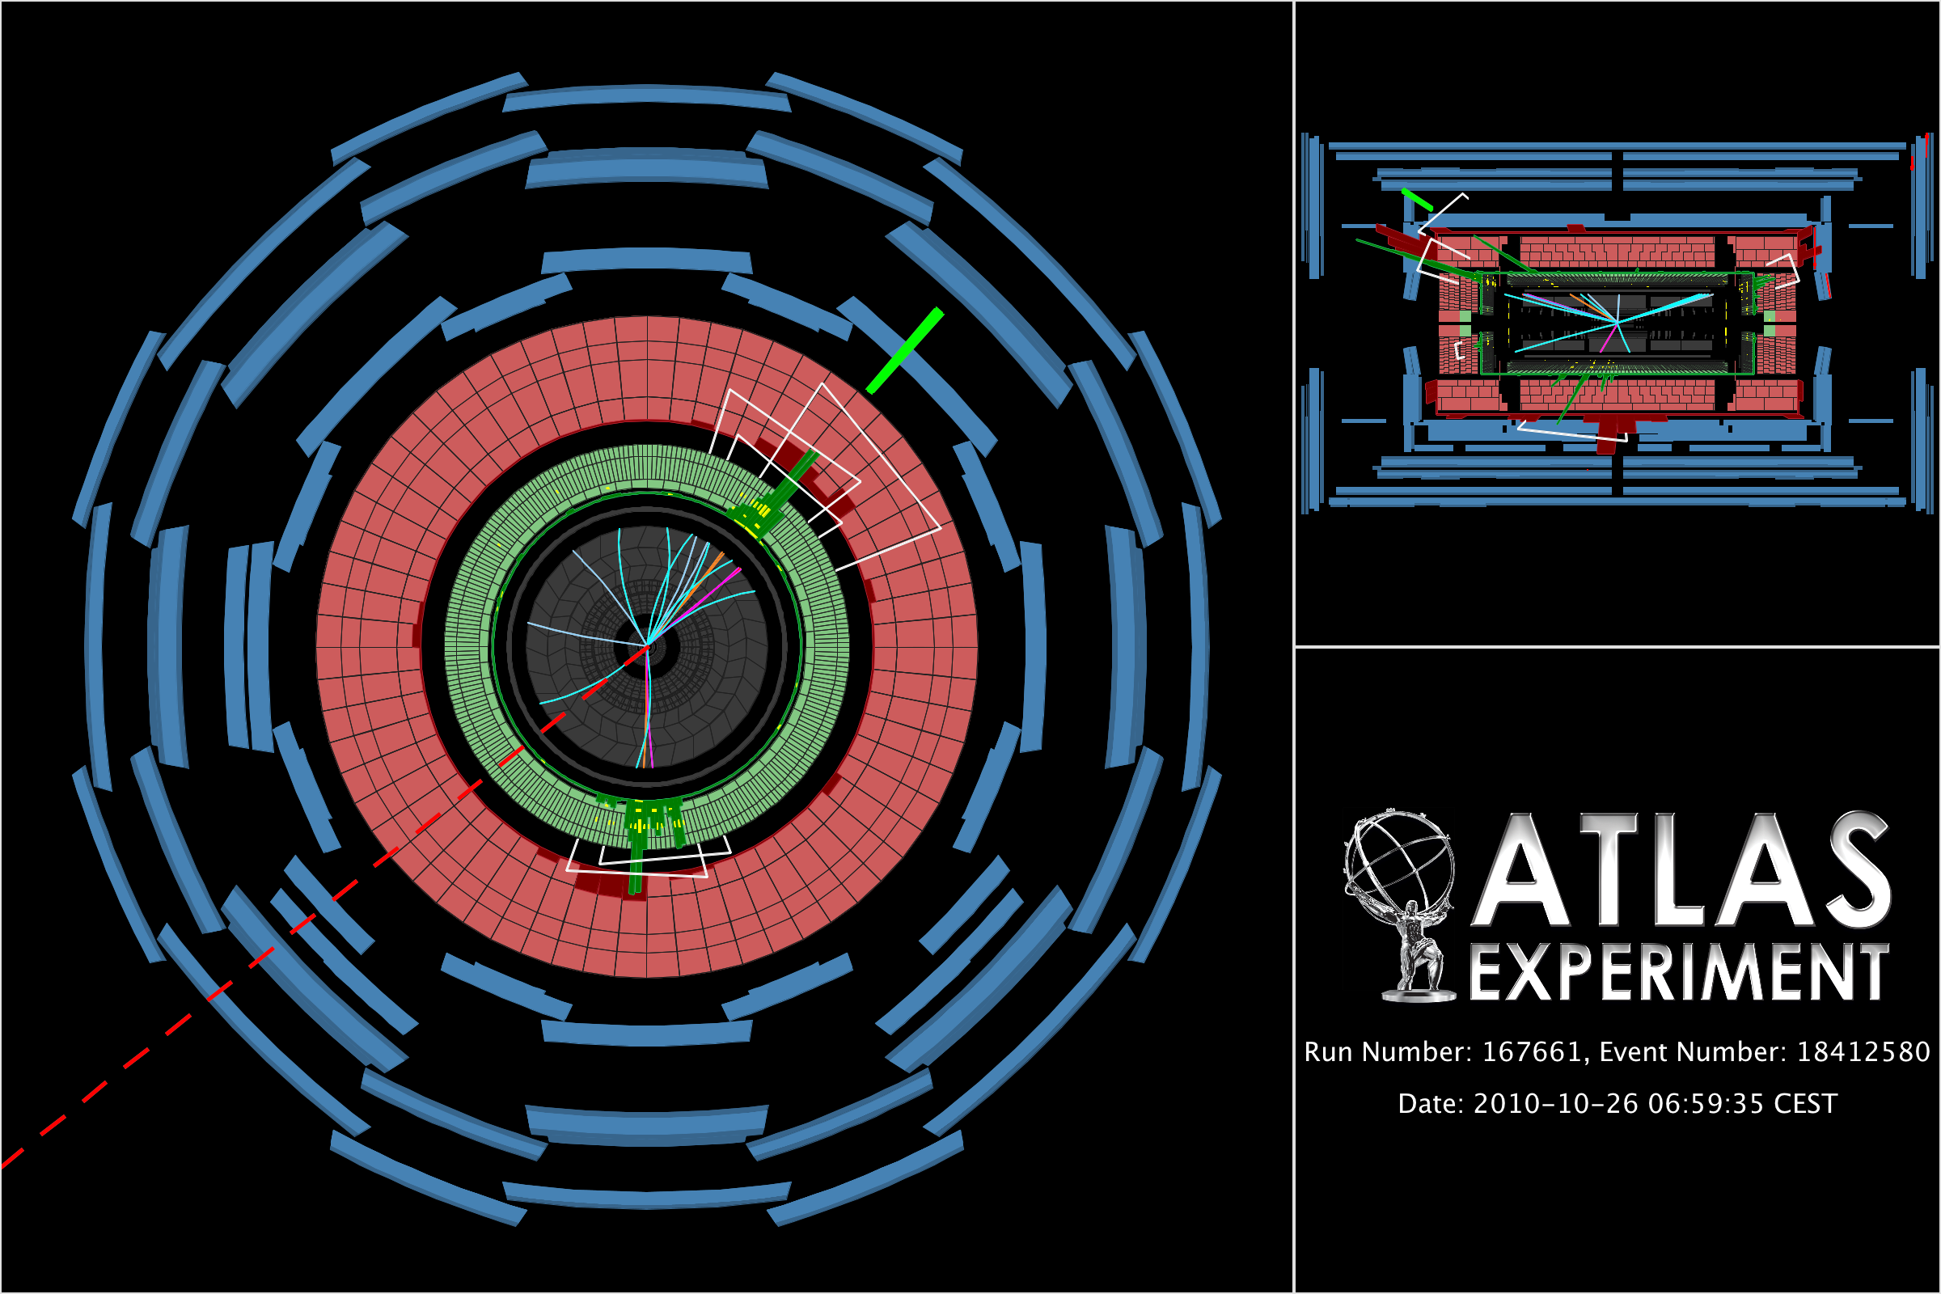



Background for SUSY searches in ATLAS
Background for SUSY searches in ATLAS
Monica D’Onofrio, University of Liverpool
West-coast ATLAS Forum
May 18th 2011
SLAC -from CERN via EVO☺

Slide 2
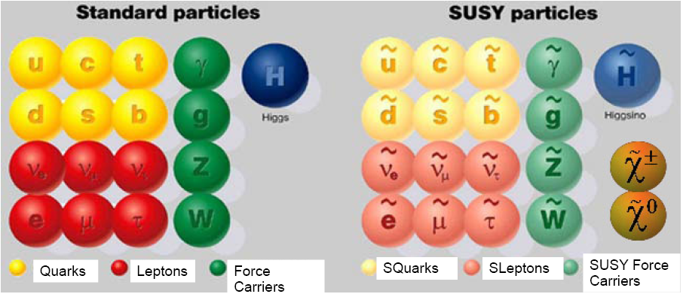
Supersymmetry
New spin-based symmetry relating fermions and bosons
Q|Boson> = Fermion
Q|Fermion> = Boson
Minimal SuperSymmetric SM (MSSM):
  Mirror spectrum of particles
  Enlarged Higgs sector: two doublets with 5 physical states
gaugino/higgsino mixing
Naturally solve the
hierarchy problem
Unification of forces possible
No SUSY particles found yet!
→ SUSY must be broken
Define R-parity = (-1)^{3(B-L)+2s}
  R = 1 for SM particles
  R = -1 for MSSM partners
If conserved, provides Dark Matter Candidate
(Lightest Supersymmetric Particle)

Slide 3
SUSY phenomenology
Breaking mechanism and R-parity determines
phenomenology and the search strategy
Generic MSSM
MSUGRA/CMSSM
GMSB, GGM
AMSB
Split-SUSY
RPV-scenarios
….
Exploit unbalanced momentum from LSP
In R-parity conserving scenarios, χ₁⁰(or ν) is LSP.
Signatures:
Missing E_{T} + jets (+ leptons)
~
~
Gravitino very light (<< MeV) → is the LSP. Neutralino can be NLSP:
Signatures (R-parity cons.):
Missing E_{T}+2γ (+lepton/jets)
Depending on the mass spectrum
if small χ± – χ₁⁰ mass difference, long-lived charginos expected
Signatures:
displaced vertex kinked tracks
~
~
Dedicated techniques
squarks/gluinos heavy
Typical signatures:
Long-Lived / quasi stable particles (R-hadrons)
If R-parity not conserved, search for resonances

Slide 4
Outline
Focus on searches for R-parity conserving SUSY:
Searches for SUSY in final state events with large E_{T}^{Miss}, high p_{T} jets (including b-jets) with and without leptons
  Data-driven or partially data-driven techniques for:
    QCD-multijet background
    W/Z+jets processes
    Top production
Summary and conclusions
Note: will show only publicly available material with the 2010 dataset (35 pb⁻¹). On-going update of analysis for PLHC (~170 pb⁻¹) and EPS (up to 500 pb⁻¹ ?)

Slide 5
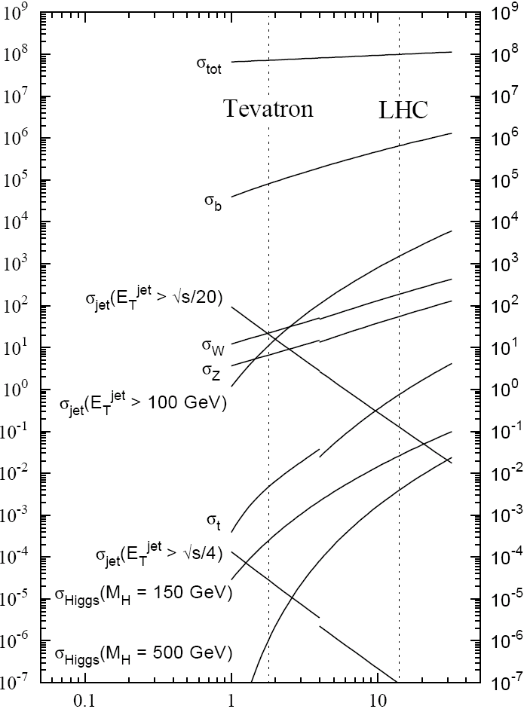
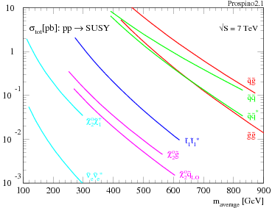

Production cross sections
1 mb
1 μb
1 nb
1 pb
` SUSY σ are several order of magnitude lower than SM processes

Slide 6
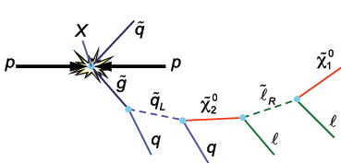
SUSY Event Topology
Complex (and model-dependent) squark/gluino cascades
Focus on signatures covering large classes of models while strongly rejecting SM background
  large Missing E_{T}
  High transverse momentum jets
  Leptons
    Perform separate analyses with and
    without lepton veto (0-lepton / 1-lepton / 2-leptons )
  B-jets: to enhance sensitivity to third generation squarks
Missing Transverse Energy
Jets

Slide 7
SM processes as background
SUSY events present same signature as:
  QCD events with mismeasured jets/semileptonic HF decay
  Z → νν + jets (MET+jets, irreducible background)
  W → lν + jets (MET+jets(+leptons) where l = e,μ,τ)
  Top production processes
Different approaches have been followed, depending on the analysis, with some common features:
  Whenever possible, use of data-driven techniques
    to estimate absolute normalization and/or shapes
    defining ‘control’ samples and making closure tests
  With 35 pb⁻¹ in several cases use Monte Carlo tools to model observable shapes
    Data-driven methods sometimes affected by large statistical uncertainties
    Goodness of Monte Carlo tools extensively tested!
q
Z/γ*
ν
ν
g
g
q
f.i.: Z+jets

Slide 8
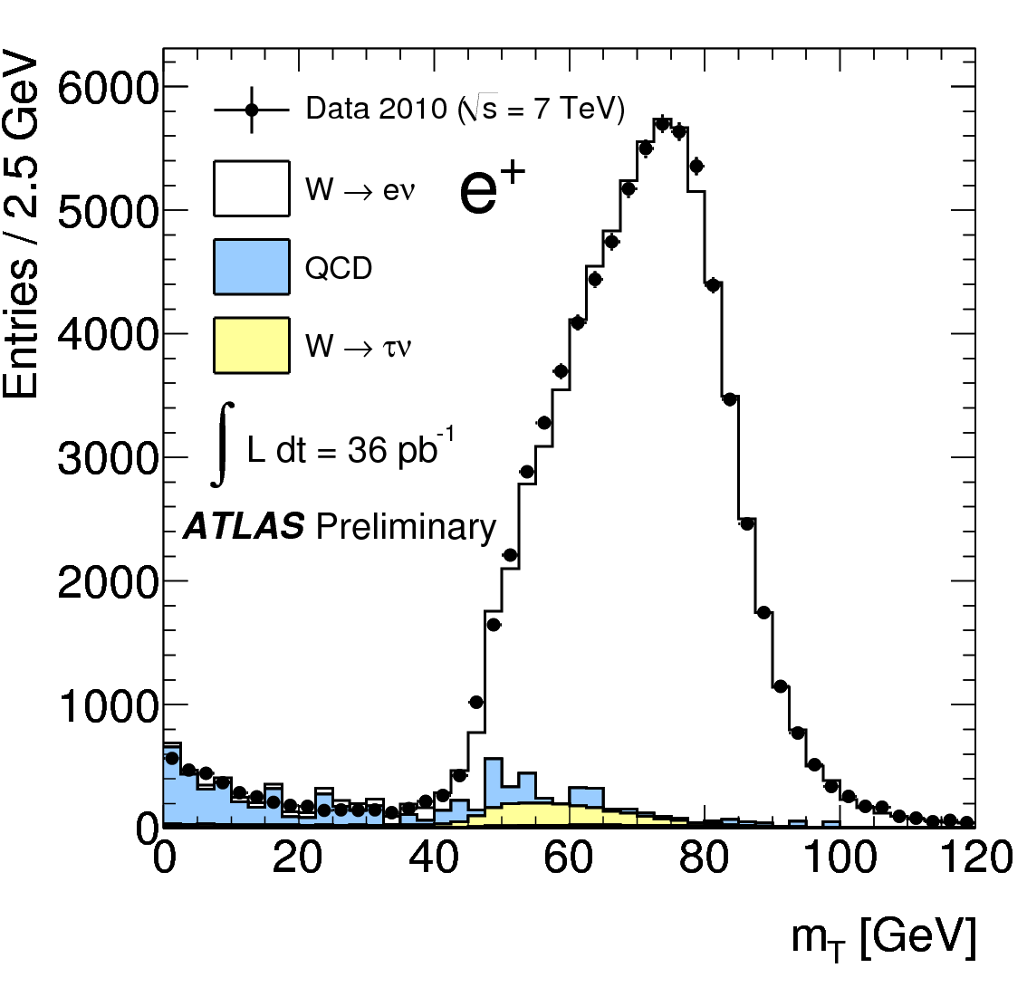
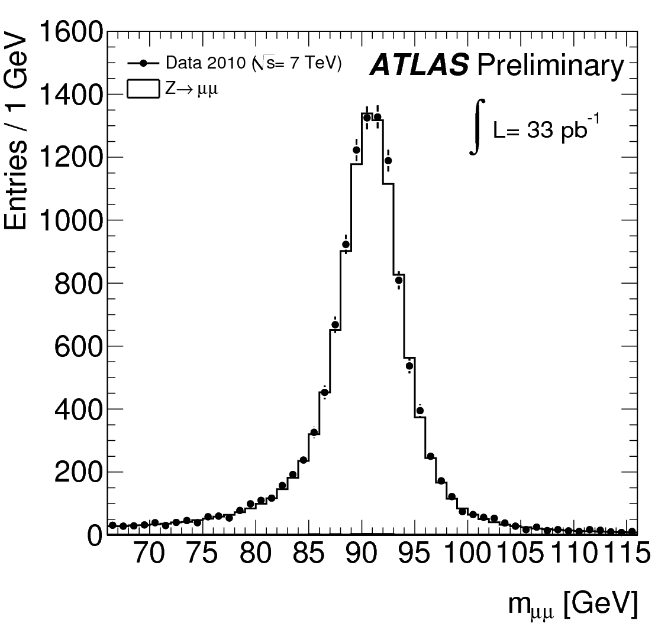
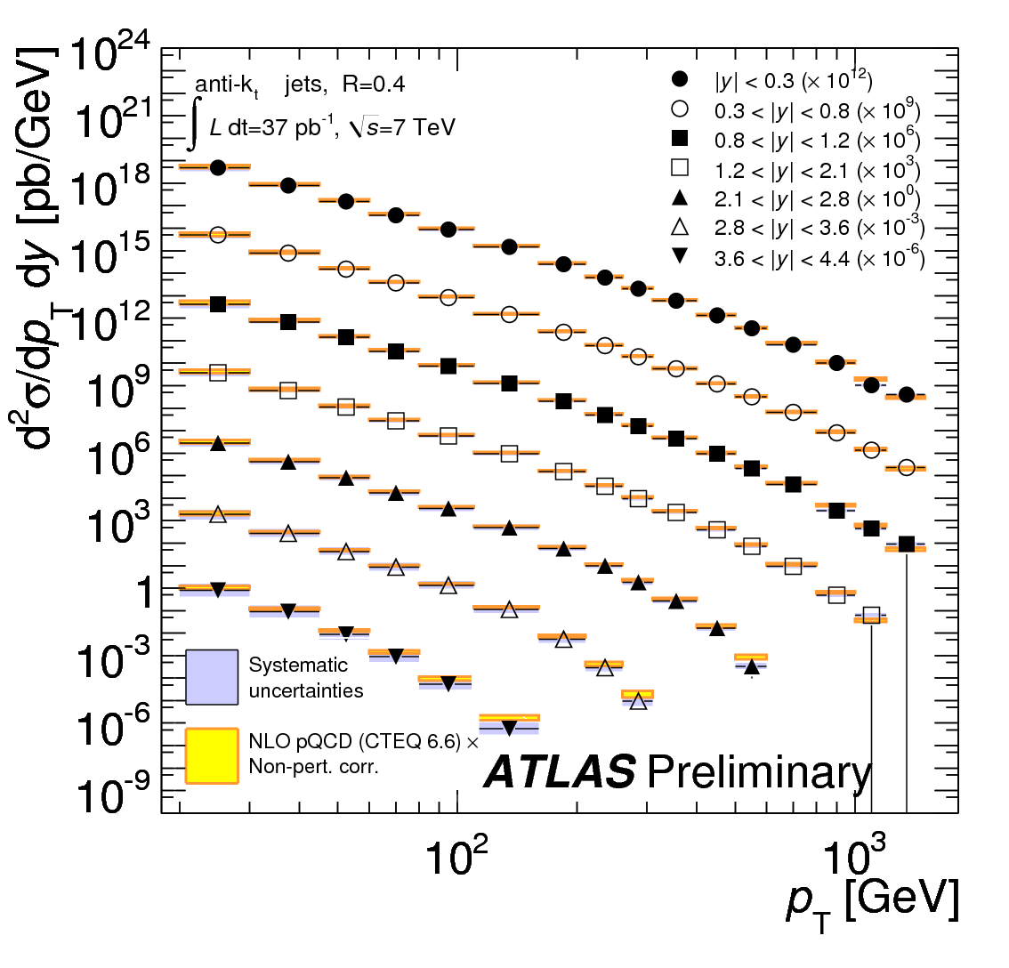
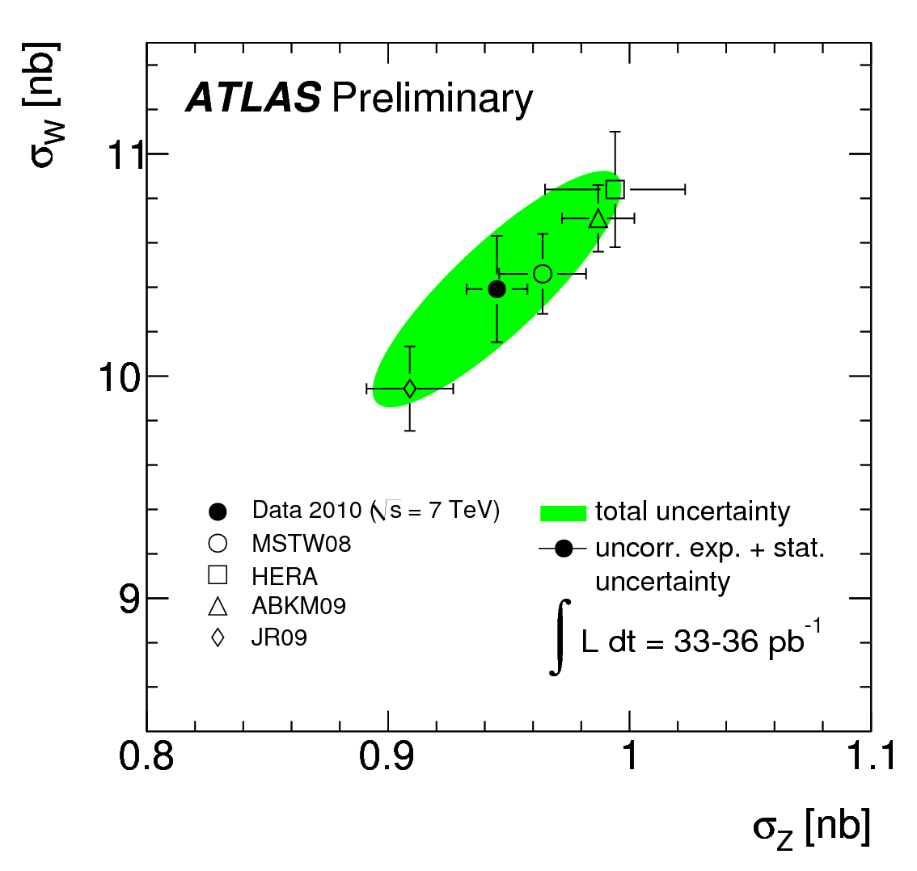
Knowledge of SM processes (I)
W/Z (in e/μ) cross sections with very first data
Excellent reconstruction and identification of e and μ
Inclusive jet (and dijet) cross sections
good understanding of jets and Jet Energy Scale

Slide 9
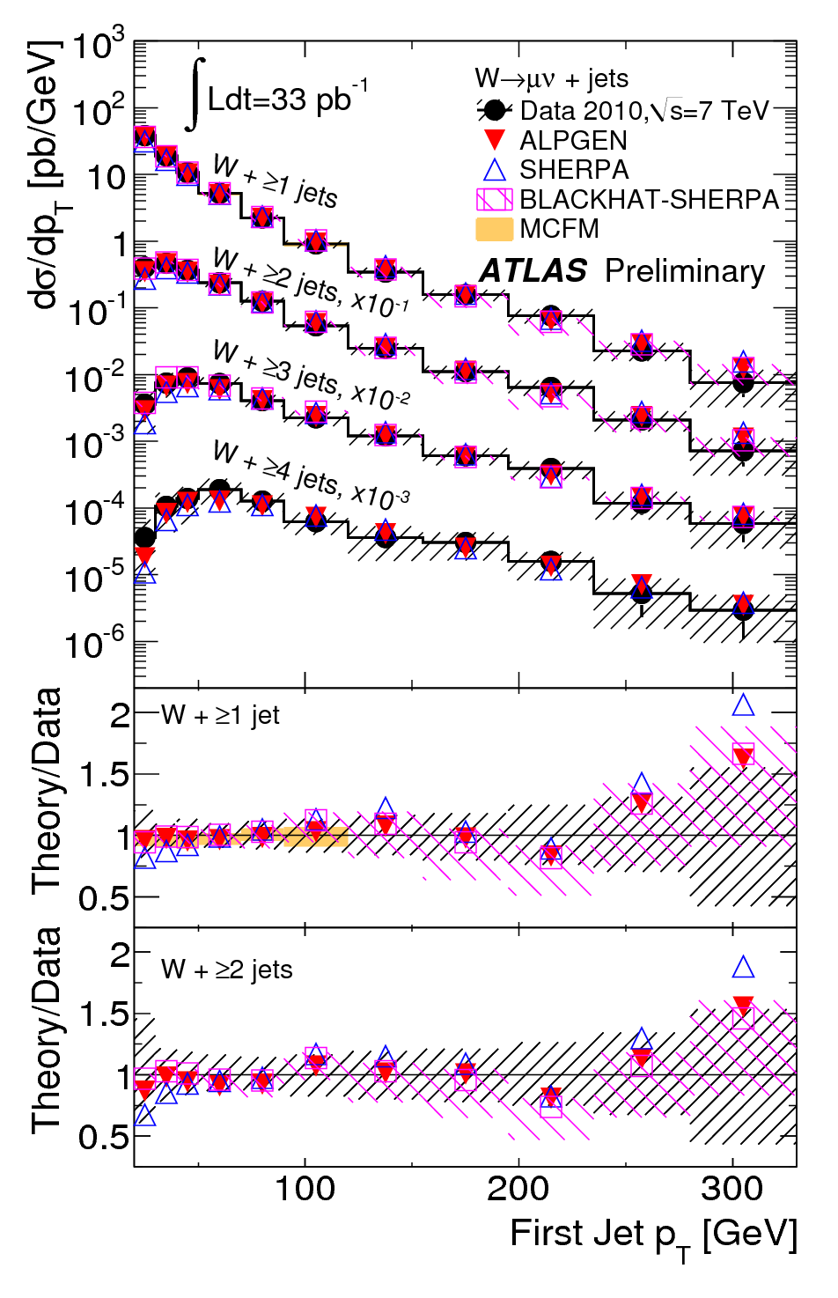
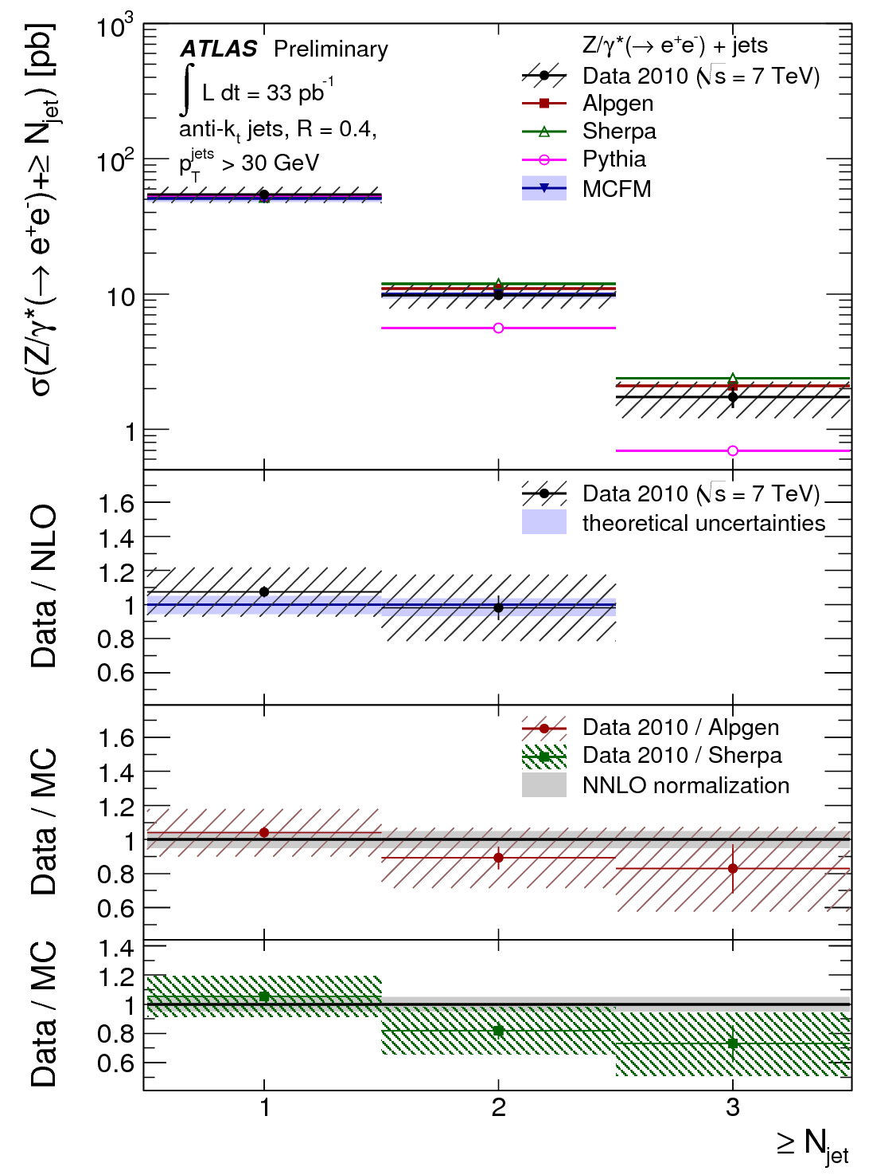
Knowledge of SM processes (II)
W / Z + jets cross sections
Z→ee + jets
W→μν + jets

Slide 10
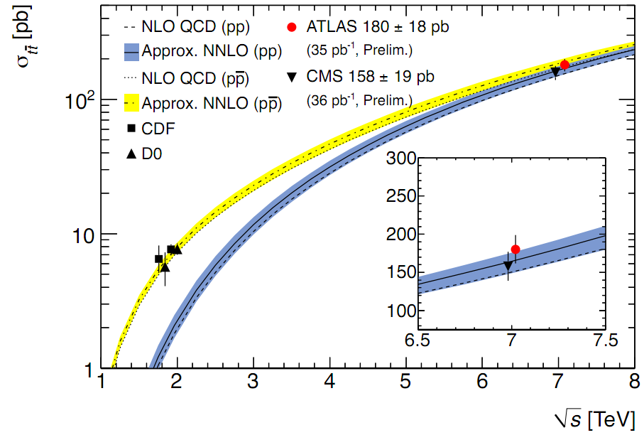
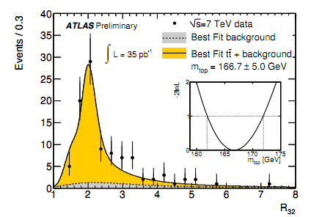
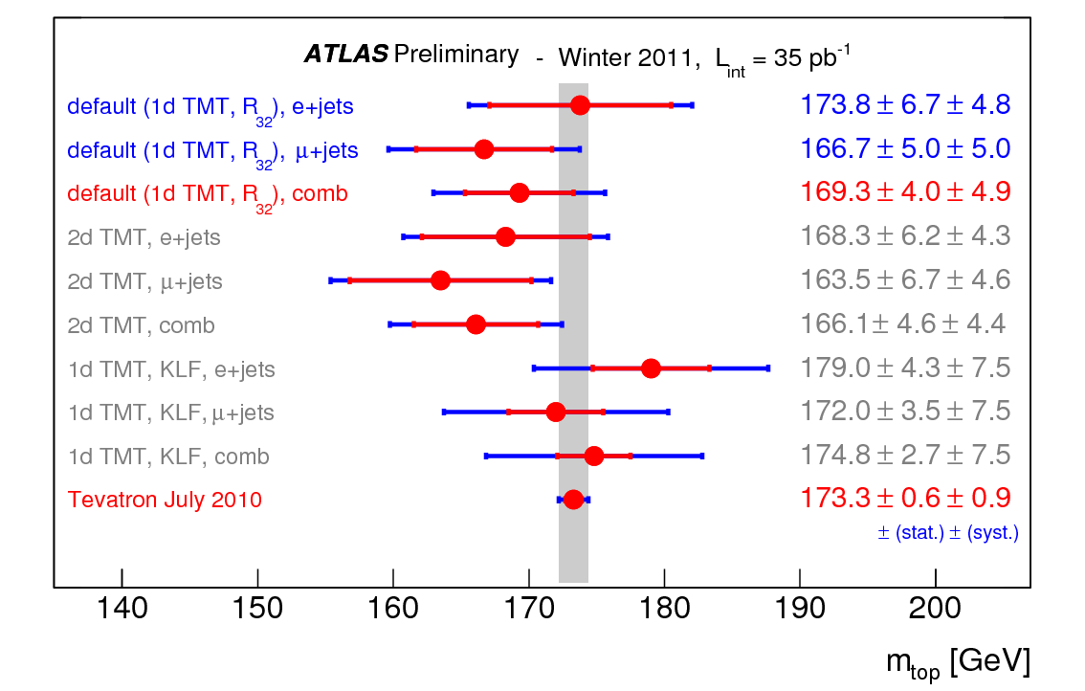
Knowledge of SM processes (III)
  Measured in e/μ+jets (with b-tag) and dilepton channels (combined)
  Measured in e/μ+jets channel
  Dominant uncertainty due to JES
  Employ the ratio of reconstructed top to W mass (R₃₂)
m(t) = 169.3 ± 4.0 ± 4.9 GeV
μ+jets channel
35 pb⁻¹
ATLAS-CONF-2011-033
ATLAS-CONF-2011-037
ATLAS-CONF-2011-023
ATLAS-CONF-2011-025
ATLAS-CONF-2011-034
ATLAS-CONF-2011-040
σ(tt) = 180 ± 9± 15 ± 6 pb
[ 10% total uncertainty ]

Slide 11
Searches for SUSY

Slide 12
Object identifications
Common tools and requirements for ‘good events’ are used
Primary vertex
At least 1 good vertex with N_{tracks}>4
Electrons
p_{T} > 20 GeV, |η|<2.47
reject events if electron candidates are in transition region (1.37<|η|<1.52)
Jets
anti-k_{T}, R=0.4
p_{T} > 20 or 30 GeV, |η| up to 2.8
Reject events compatible with noise or cosmics
Muons
p_{T} > 20 GeV, |η|<2.4
combined/extrapolated info from ID and Muon spectrometer
Sum p_{T} of tracks <1.8 GeV in ΔR<0.2
B-Jets
Exploit Secondary vertex reconstruction algorithm
Missing E_{T}
Calculated from objects and clusters
Remove overlapping objects
If ΔR(jet,e)<0.2, remove jet
If 0.2<ΔR(jet,e)<0.4, veto electron, if ΔR(jet,μ)<0.4, veto muon

Slide 13
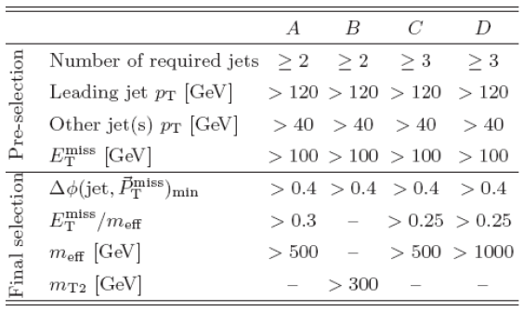
Search in no-lepton final states
arXiv:1102.5290 (Sub. PLB)
Select events with jets, missing E_{T} and no lepton (e/μ veto)
Signal regions definition on the basis of jet multiplicity
(n ≥2 jets or n≥3 jets), jet p_{T} and E_{T}^{Miss} thresholds and:
Scalar sum of objects p_{T}
Effective mass (m_{eff})
Stransverse mass (m_{T2})
Phys.Lett.B463:99-103,1999
J.Phys.G29:2343-2363,2003
4 signal regions
Due to trigger requirements
QCD-multijet rejection
Enhance sensitivity to SUSY

Slide 14
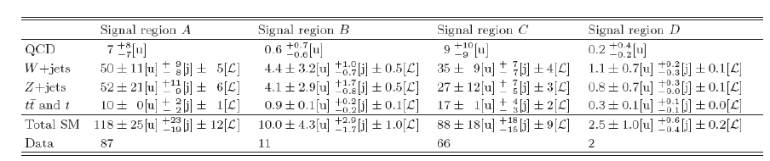
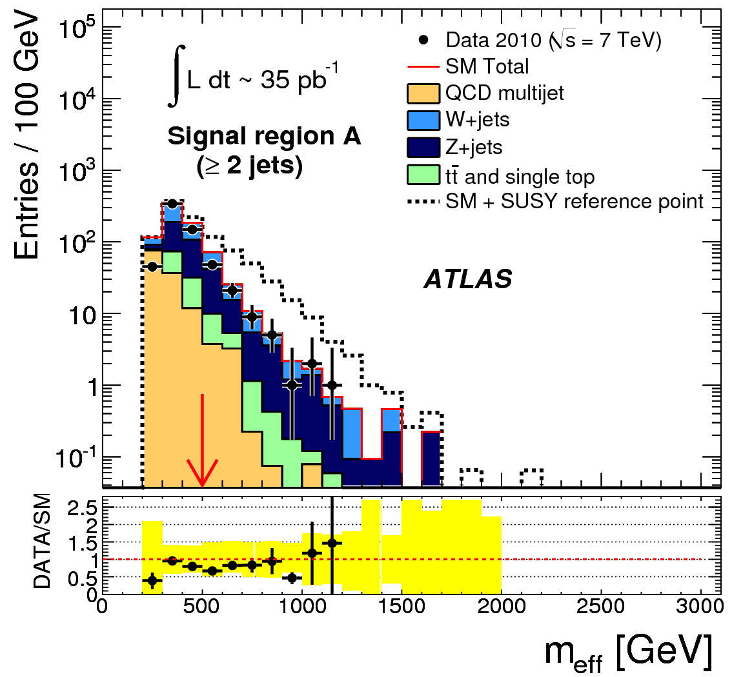
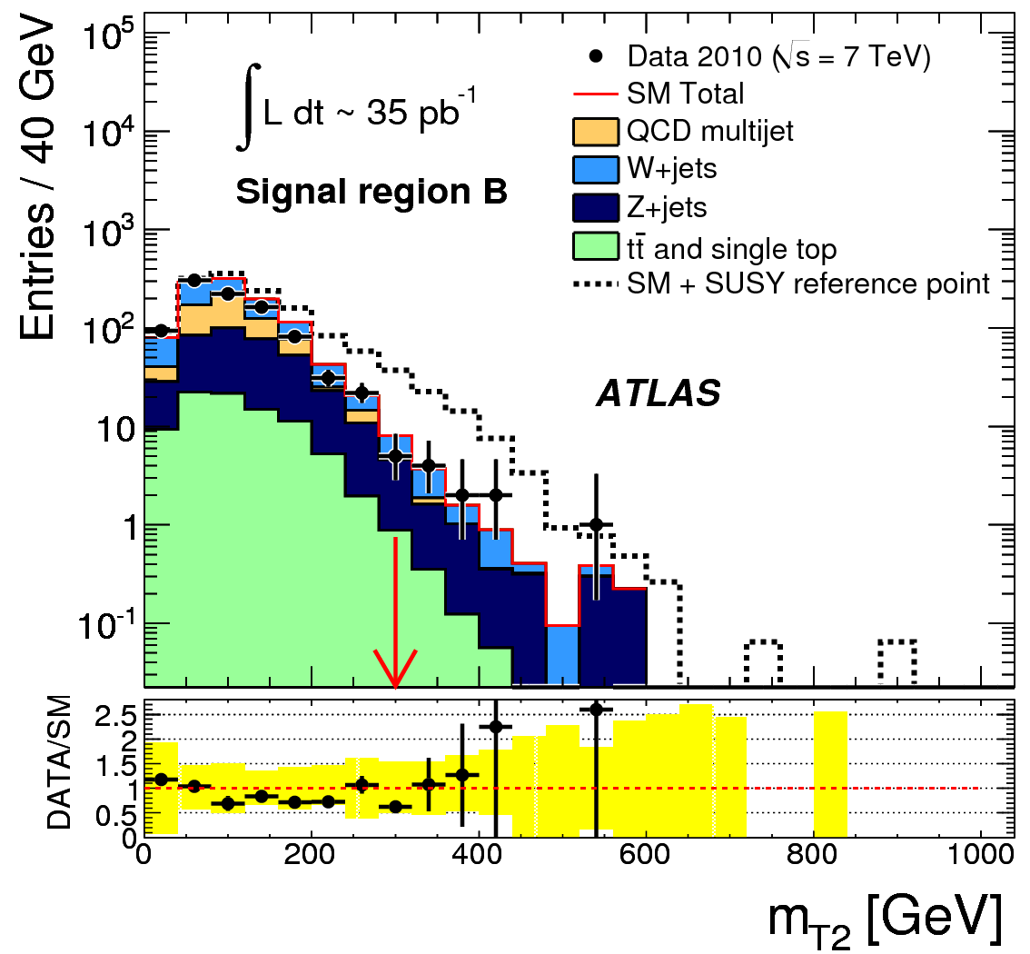
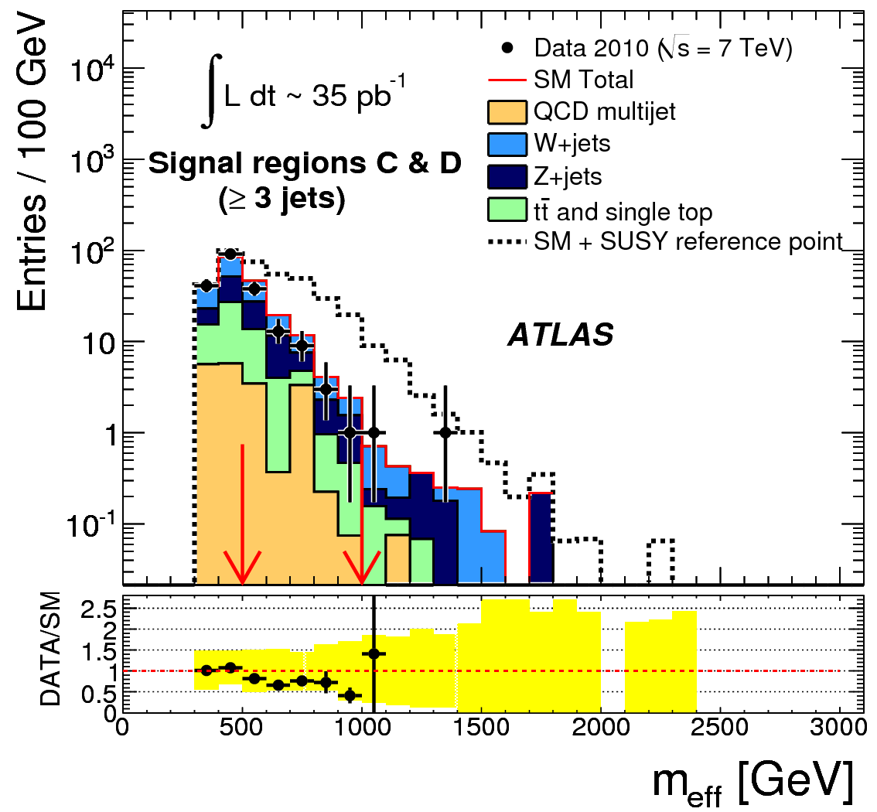
Results for SUSY in jets+MET
W/Z+jets bkg dominates
[u]=uncorrelated uncertainties (MC statistics, acceptance, jet energy resolutions..)
[j]=Jet Energy Scale (6%-10% as function of jet p_{T}), [L]=luminosity (11%)
Good agreement between data and SM predictions

Slide 15
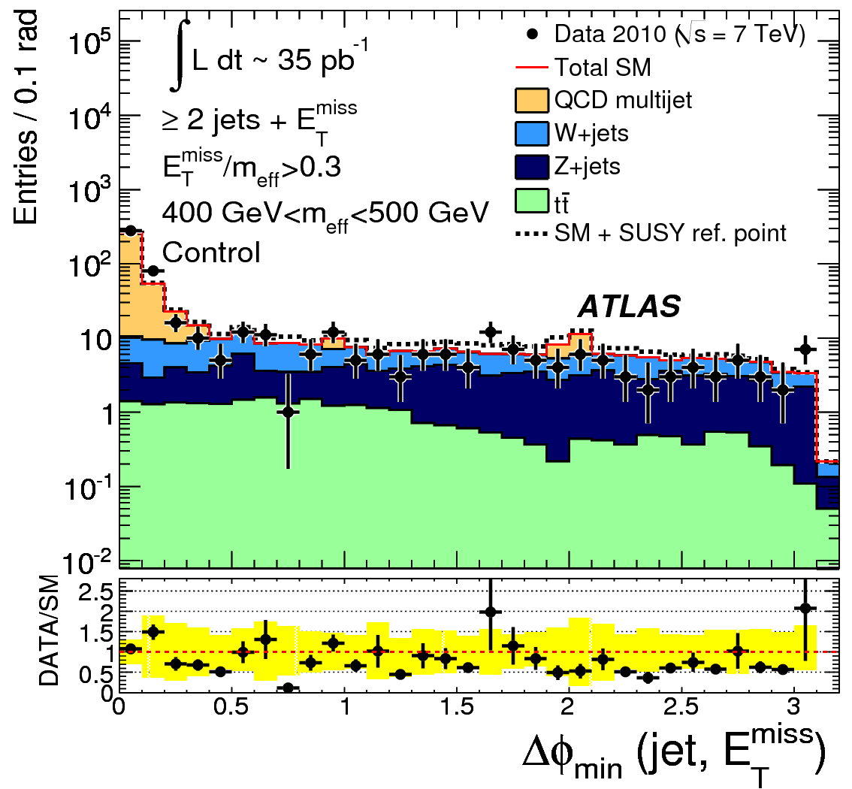
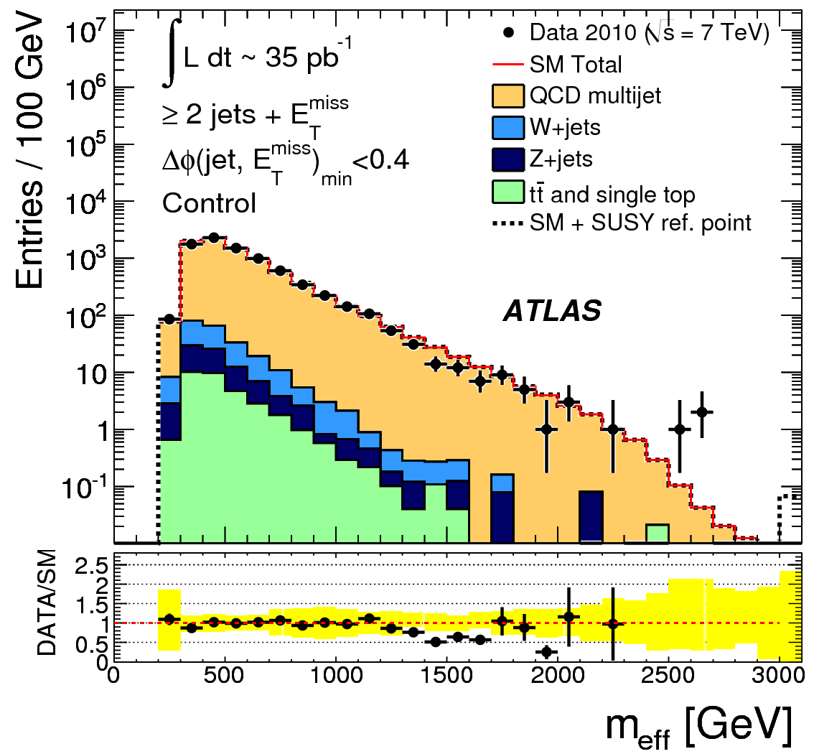
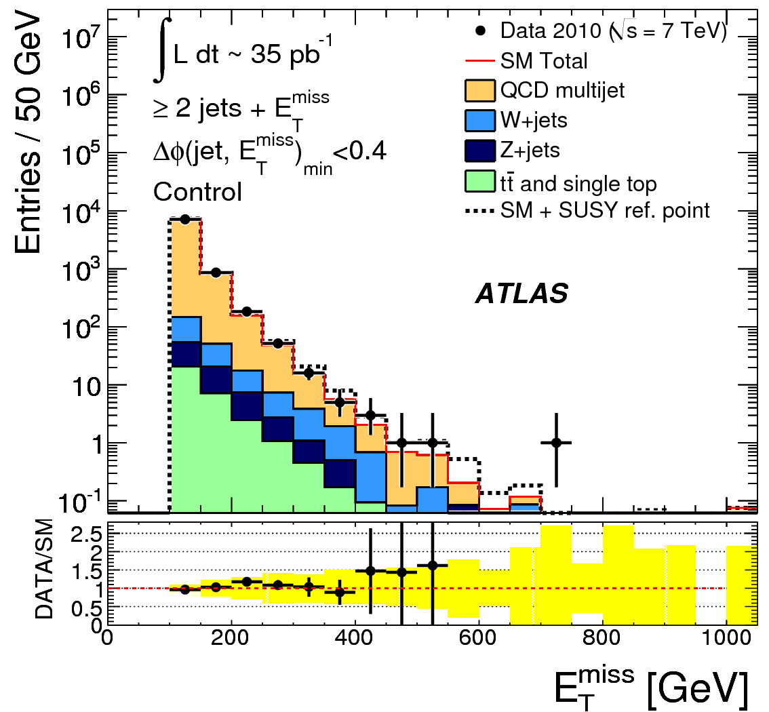
QCD for 0-lepton
QCD-multijet background due to mis-reconstructed jets and neutrinos from HF leptonic decays
  E_{T}^{Miss} expected to be aligned to one of the jets
Use partially data-driven estimate:
  Rescale MC samples (PYTHIA and ALPGEN)
  in control region → Δφ(jet, E_{T}^{Miss}) < 0.4
After rejection:
QCD ~5% of TOT Bkg
Cross-checked with
fully data-driven
techniques (Jet smearing)
→ Use control region
based on reversed
E_{T}^{Miss}/m_{eff} for rescaling

Slide 16
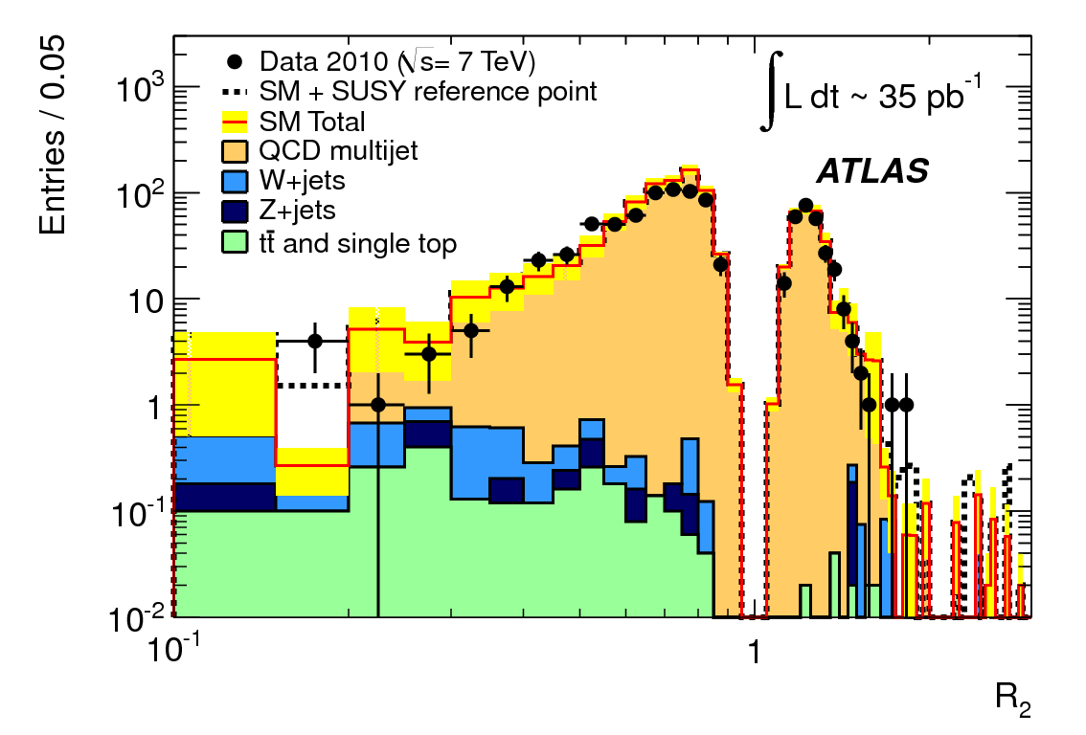
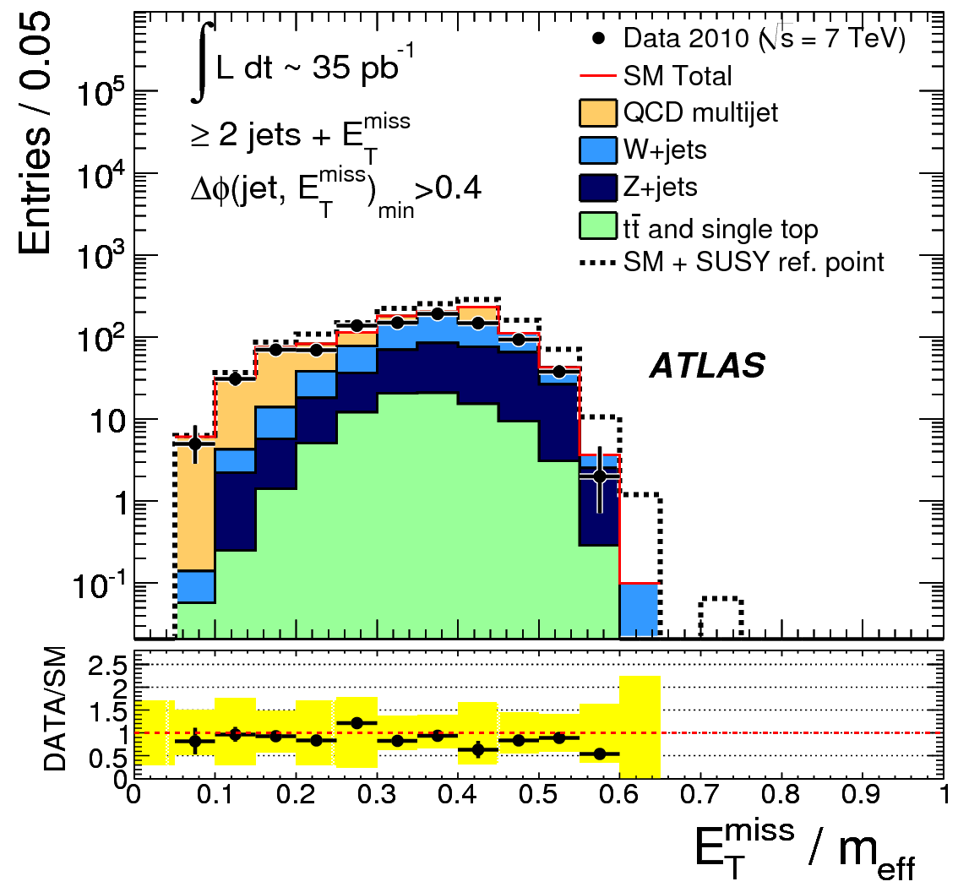
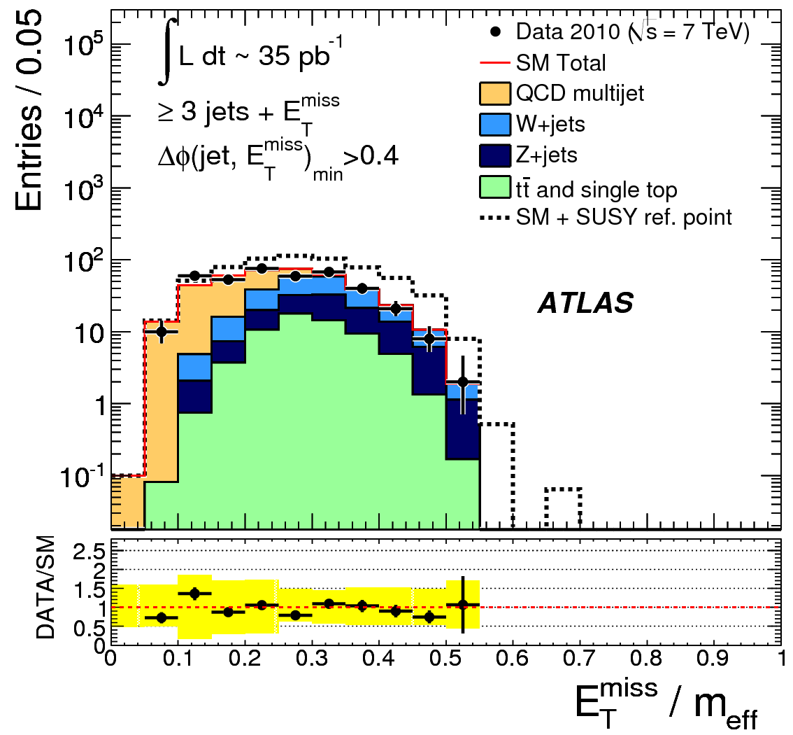
QCD for 0-lepton: cross checks
Non-Gaussian tail of jet response function
Baseline QCD estimation consistent with fully data-driven technique:
  High MET events ‘generated’ from data, smearing down low MET events on a jet-by-jet basis with measured jet energy resolution functions
  Assume source of E_{T}^{Miss} associated with jets only
(1)
p_{Tlead jet} >200 GeV
(2)
  -- Use additional control regions reversing E_{T}^{Miss/}m_{eff} requirements
Notes:
A measurement of the non-Gaussian tail of the jet response function. The quantity R_2 is defined by the vector equation R_2 = (p_T.(p_T+p_T^miss))/|p_T + p_T^miss|. It is shown for events in which requirements have been used to associate the source of the P_T^miss with only one of the jets. The example shown is for leading jet pT > 200 GeV. The Gaussian core of the jet response function is removed by the selection requirements on E_T^miss. For each p_T bin the tails at low R_2 are subsequently used, together with the central Gaussian part of the response function (measured separately), and a set of low-E_T^miss seed events to form the fully data-driven QCD determination.

Slide 17
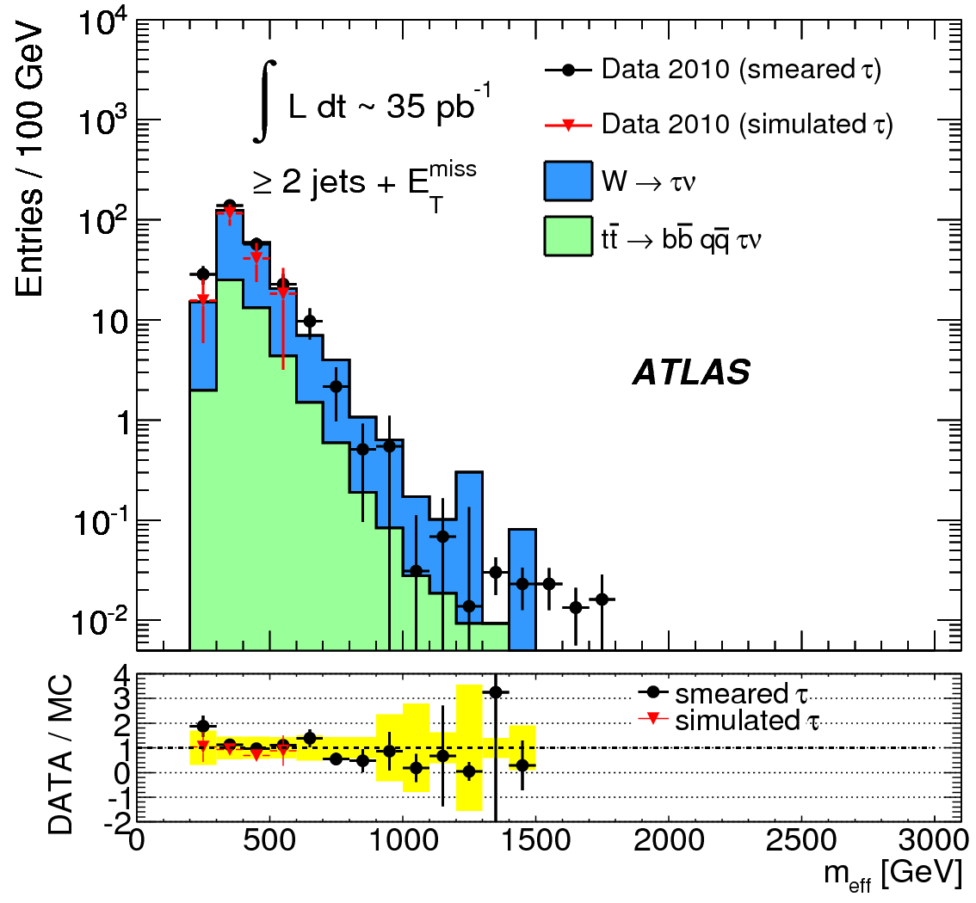
W+jets (and top background)
Non-QCD bkg dominated by
  W→τν, W→(missed)e/μ
  Top pair production (t → τ+jets)
Central value derived from MC:
  W+jets: ALPGEN normalized to NNLO
  Top: MC@NLO (+HERWIG and JIMMY),
  CTEQ6.6 PDF
Cross checks on data:
  Control regions with leptons removed from W data
    In-situ checks for τ background, derived from W→μν events
    2 ‘replacement’ methods:
      smeared resolution function: hadronic τ decay products considered as a single additional τ-jet → τ-jet smearing function calculated from W → τν MC
      full simulation (embedding)
Finally use MC → theoretical/modeling uncertainties comparable to statistical uncertainty from data-driven estimates
Notes:
derived from selected W --> mu nu events. The muon is removed from the event and replaced by a Monte Carlo tau lepton decay, which is either smeared using resolution functions to emulate the detector response (smeared tau) or processed using the full detector simulation (simulated tau). The yellow band shows the combined uncertainty from the jet energy scale, background subtraction and acceptance corrections.

Slide 18
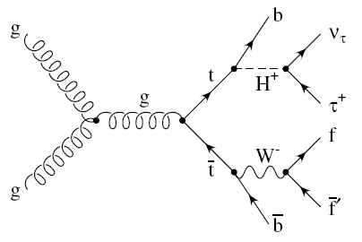
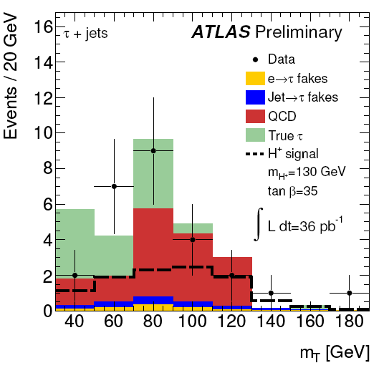
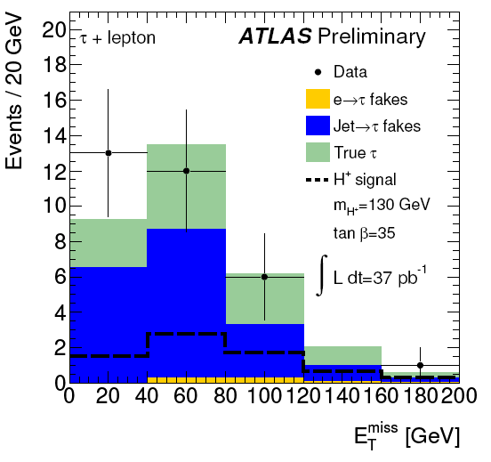
Embedding method for tau: an example
Method used for data-driven estimates in searches
for charged Higgs in τ-hadronic final states:
  τ+jets and τ+leptons
SM background estimated with data-driven techniques:
  Fake τ: e,μ or jets misidentified as τ jets → rate from data
    e,μ: matrix method; Jets: in γ+jet samples
  QCD-multijets: in control samples with loose-no-tight τ candidates
  Real τ (relevant for τ+jets): from top and W+jets with embedding method
ATLAS-CONF-2011-051

Slide 19
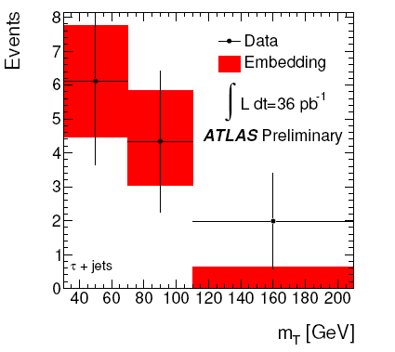
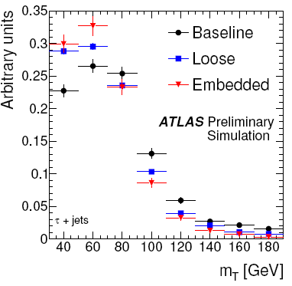
Estimate of true-τ background
Control samples with single and top pair production and W+jets events with muons:
  Replace muon with simulated τ lepton
  Re-reconstruct new hybrid events
  Use these events instead of simulation:
  → Advantage: whole event is taken from data including pile-up, HF jets etc.
μ+jets sample:
one isolated m, pT>20 GeV
at least 3 jets, pT>20 GeV
at least 1 b-tagged jet
m(jj) in [M_{W}± 20 GeV]
MET>30 GeV, Σ ET > 200 GeV
Method is statistically limited at the moment:
→ Use loose selection with respect to baseline

Slide 20
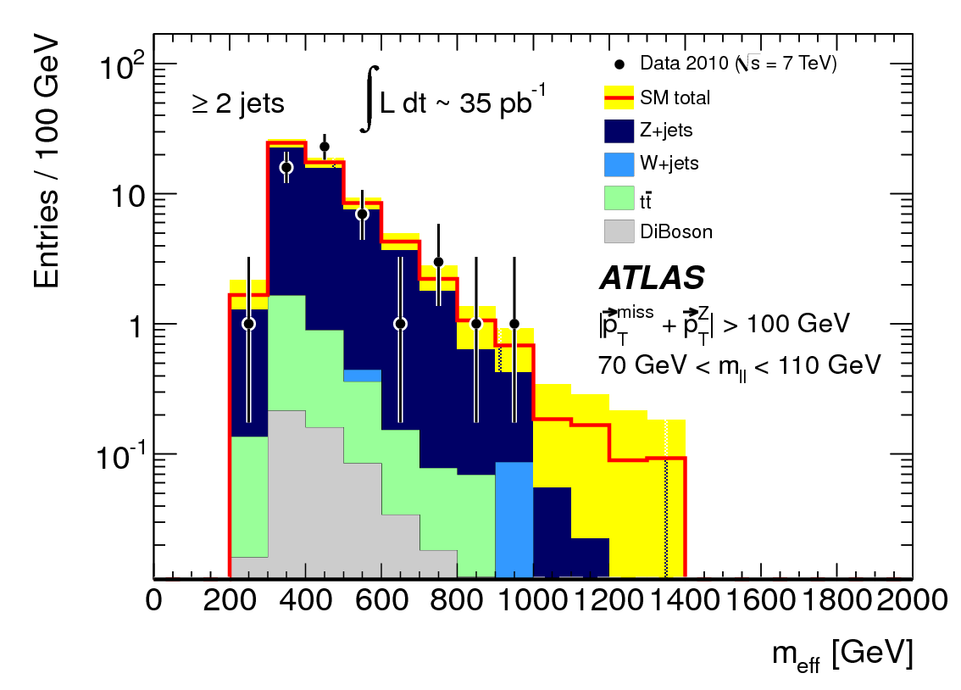
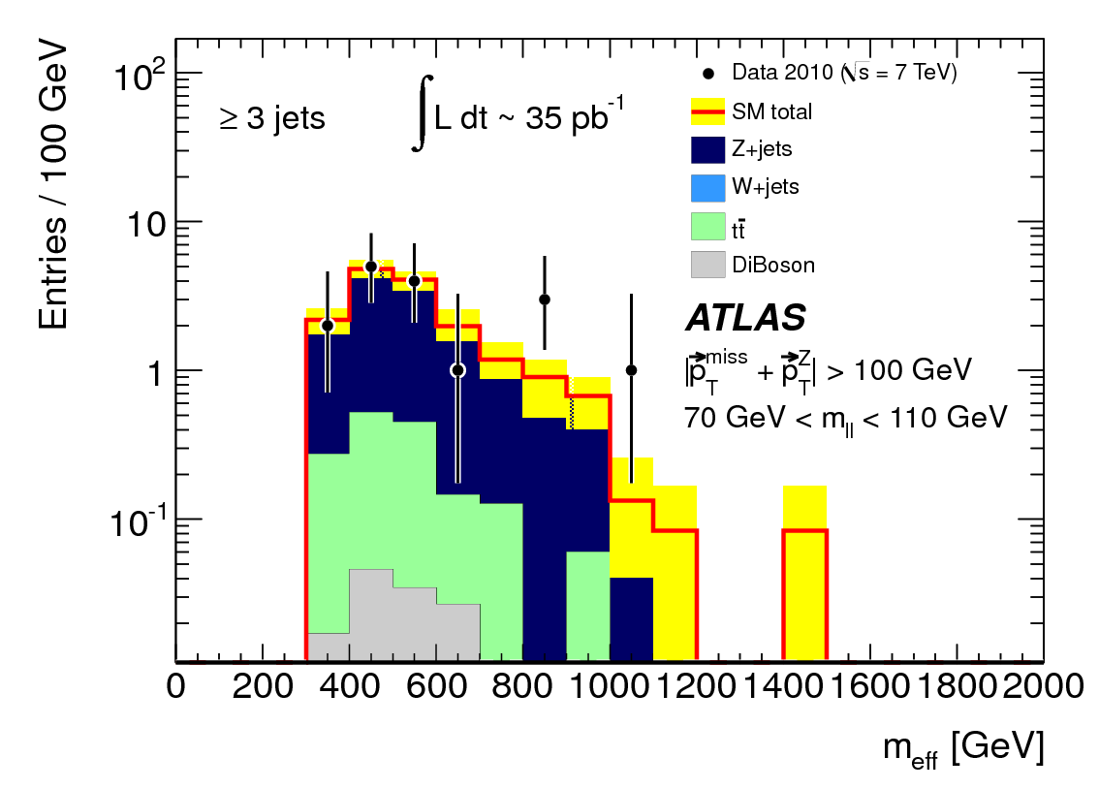
Z + jets in SUSY jets+MET
Z+jets background is dominated by the irreducible Z→νν + jets
Central value derived from MC:
  Z+jets: ALPGEN normalized to NNLO
Control regions with leptons removed from Z data
Z+jets control sample
MET recalculated for each event artificially removing the leptons from Z-decay. Corrections for μ vs ν coverage done with MC
Additional cross checks also performed in γ+jets samples:
→ generally poor statistics at medium/high MET, to be further investigated
Notes:
derived from selected W --> mu nu events. The muon is removed from the event and replaced by a Monte Carlo tau lepton decay, which is either smeared using resolution functions to emulate the detector response (smeared tau) or processed using the full detector simulation (simulated tau). The yellow band shows the combined uncertainty from the jet energy scale, background subtraction and acceptance corrections.

Slide 21
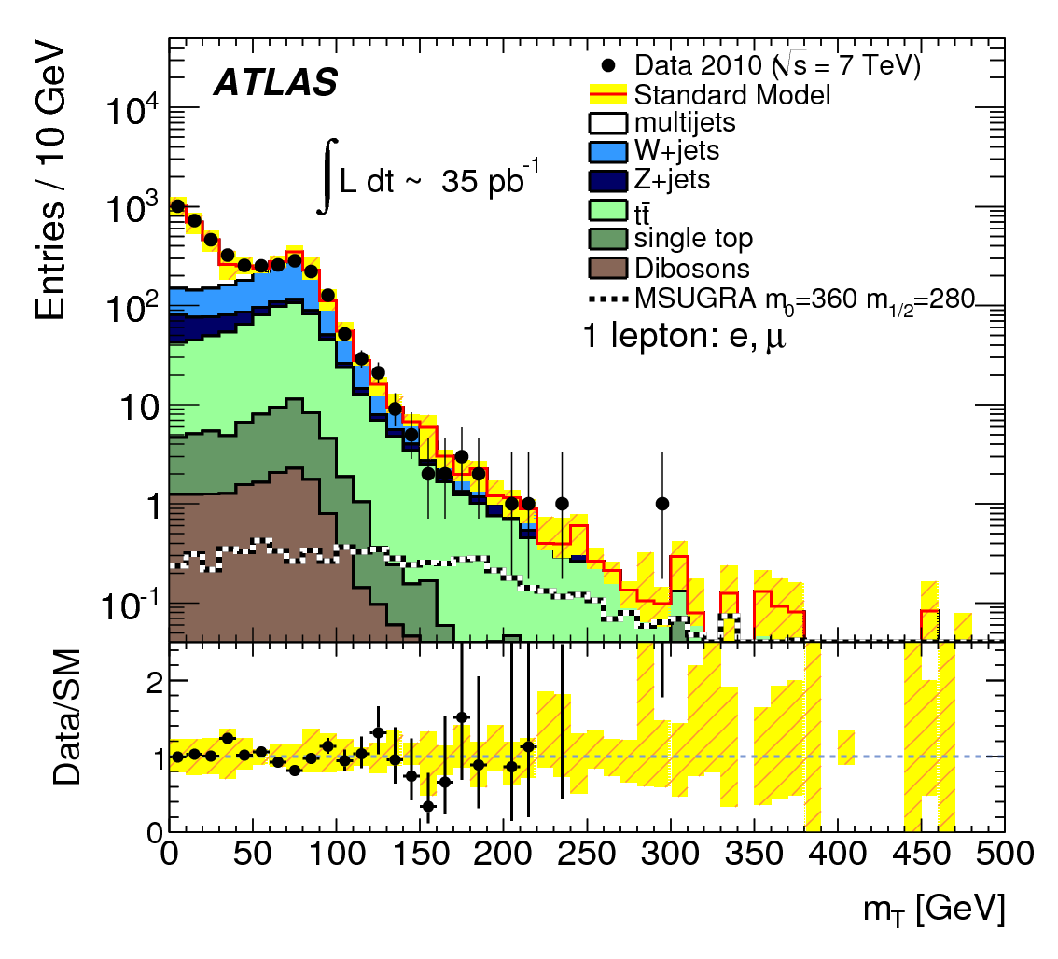
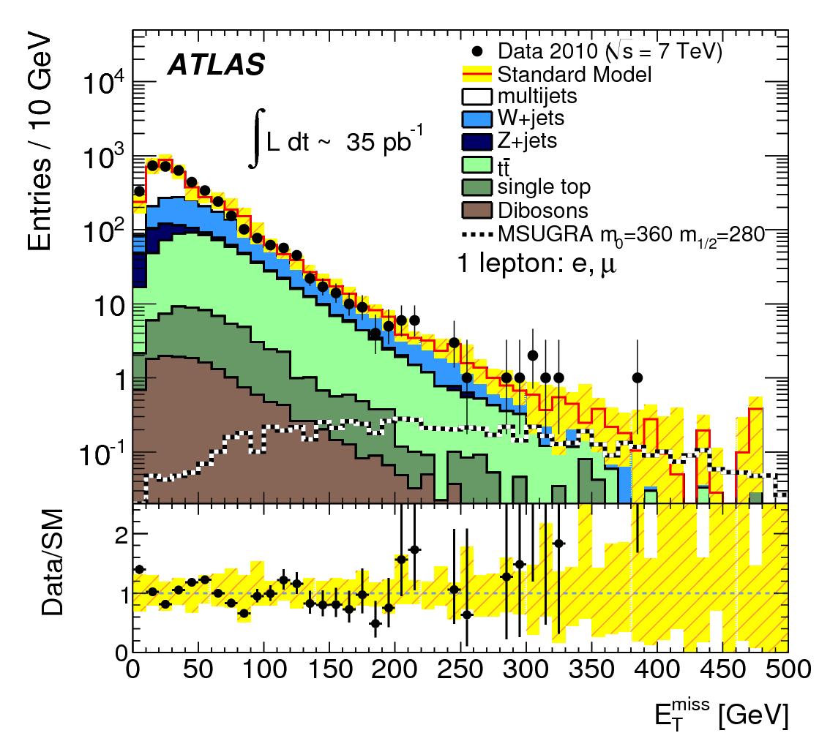
Search in 1-lepton final states
Phys. Rev. Lett. 106, 131802 (2011)
Require exactly 1 lepton (e or μ, p_{T}>20 GeV) + ≥3 jets [p_{T}> 60,30,30 GeV]
  Privilege signatures from gluino/squark cascade decays with intermediate steps
  Isolated lepton suppresses QCD multijet background and facilitates triggering
Use m_{T} as additional discriminating variable, Missing E_{T} and jets and leptons p_{T}

Slide 22
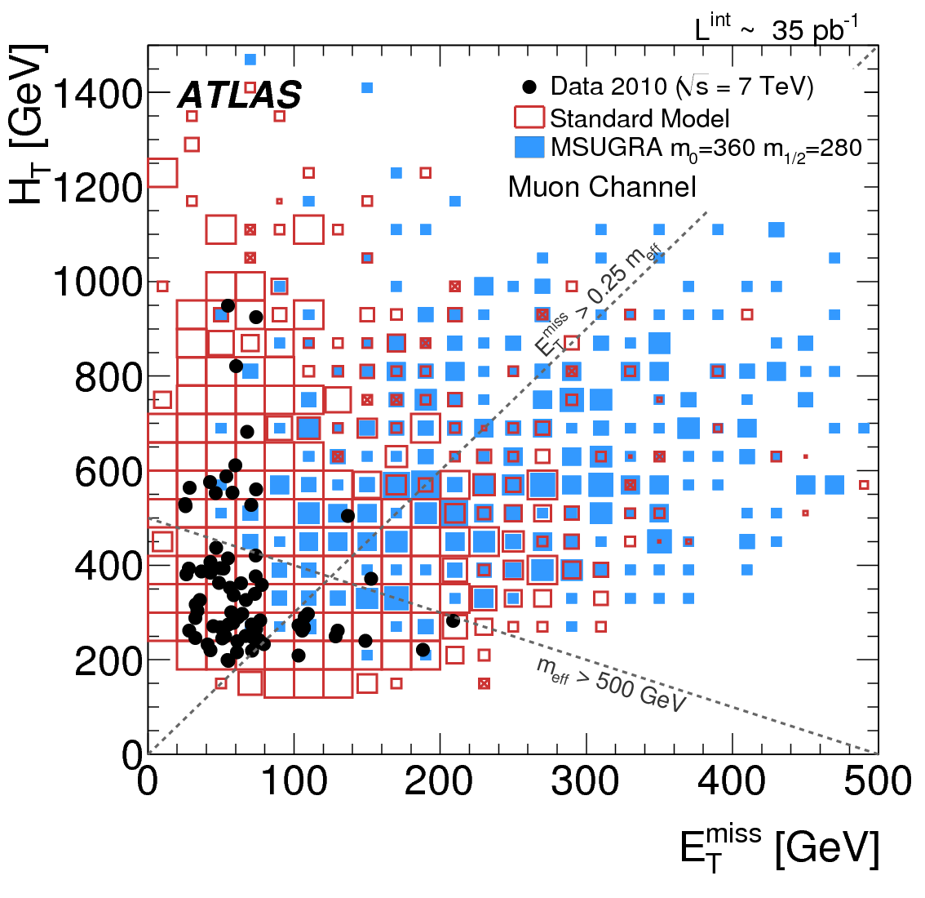
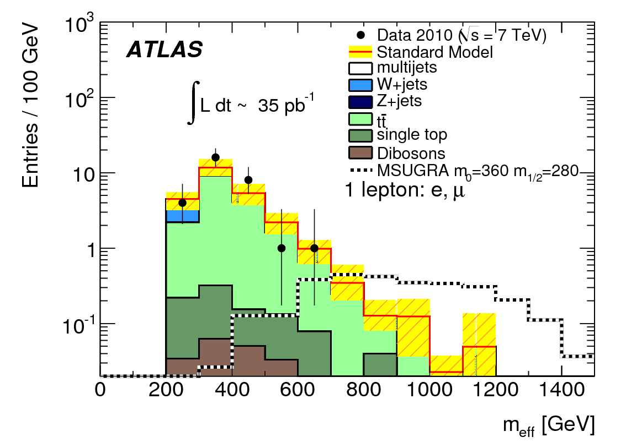
Signal region and results
Signal region:
  m_{T}>100 GeV → to suppress W+jets and top pair production
  MET/m_{eff} > 0.25 → to suppress QCD background
  m_{eff}>500 GeV → to enhance sensitivity to SUSY particles
+ Δφ(jet, E_{T}^{Miss}) > 0.2
for QCD rejection
After all cuts:
One event observed in each channel
Main background: top ~ 70%, rest = W+jets
Estimated with partially data-driven methods
(similar for the electron channel)

Slide 23
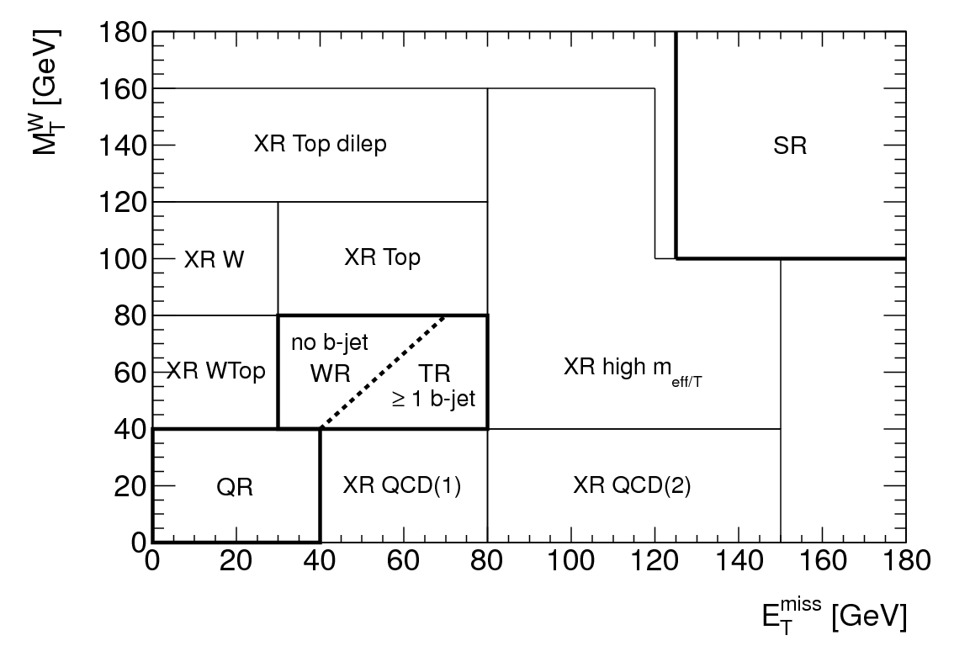
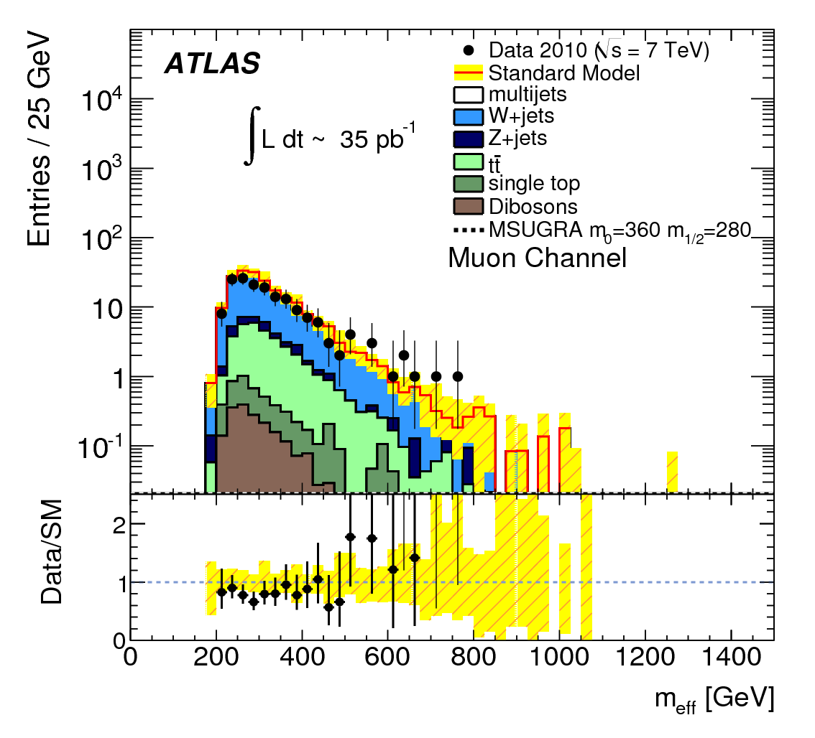
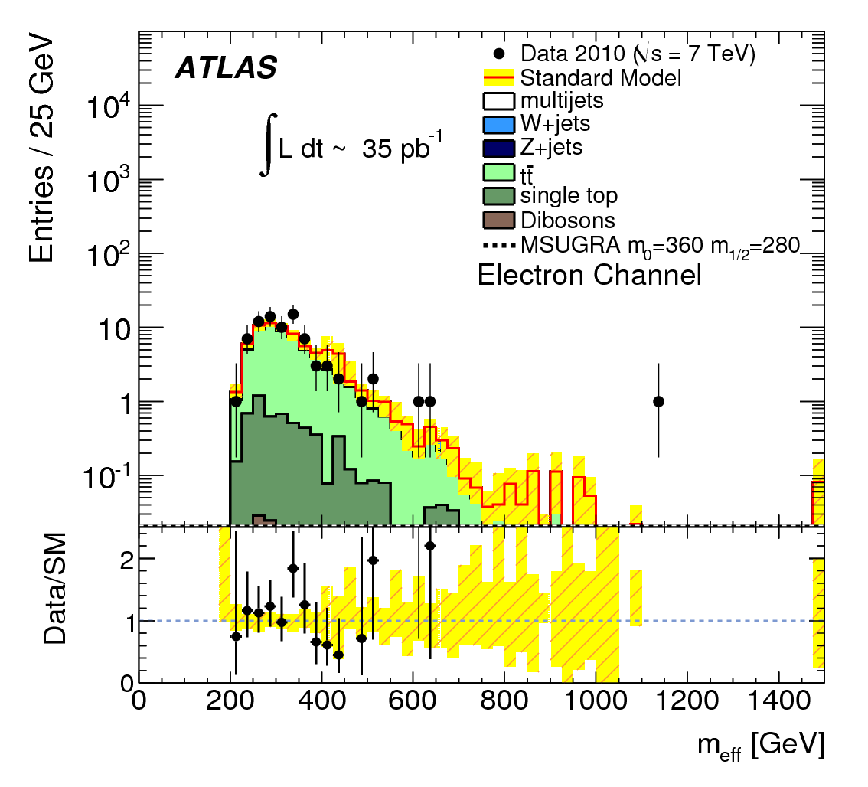
SM background estimation (I)
Exploit use of control regions:
  Based on E_{T}^{Miss} VS M_{T}
  Define samples enriched in a given process
  Constrain MC predictions to data in that region (rely on MC shapes)
  Extrapolate to other regions (with MC). Ex.:
  N^{tt} _{SR} (pred) =(N^{data}_{CR} –N^{BkgMC}_{CR})× (N^{tt} _{SR,MC} /N^{tt} _{CR,MC} )
  Systematic uncertainties on extrapolation factors
W-enriched sample(require < 1 b-tagged jet)
top-enriched sample
(require ≥ 1 b-tagged jet)

Slide 24
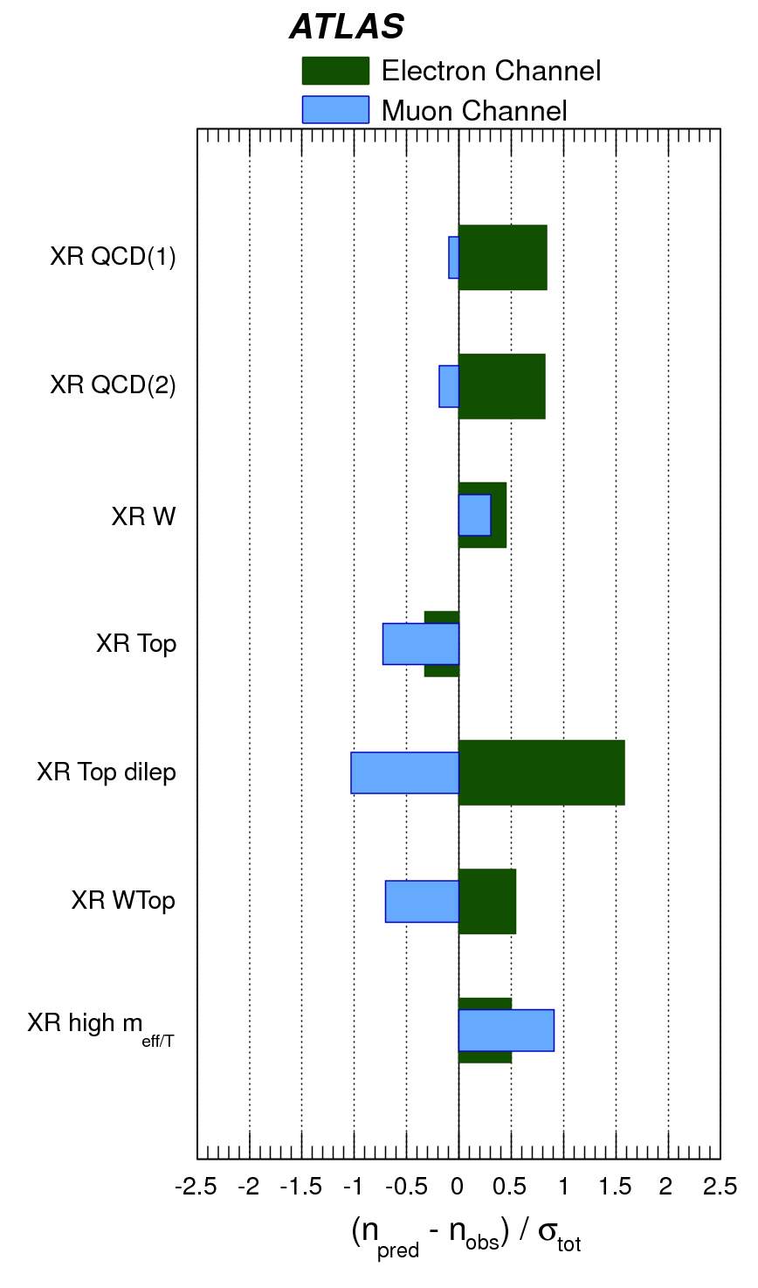
SM background estimation (II)
Exploit use of control regions:
  Based on E_{T}^{Miss} VS M_{T}
  Define samples enriched in a given process
  Constrain MC predictions to data in that region (rely on MC shapes)
  Extrapolate to other regions (with MC). Ex.:
  N^{tt} _{SR} (pred) =(N^{data}_{CR} –N^{BkgMC}_{CR})× (N^{tt} _{SR,MC} /N^{tt} _{CR,MC} )
  Systematic uncertainties on extrapolation factors
Additional control regions at low M_{T} or low Missing E_{T} used to validate the assumption on MC shape.
Pull:
Used to estimate QCD in other CR
Main uncertainties:
Theory/modeling: 50% W+jets (uncertainty on m_{eff} NLO shape), 25% top (comparison between generators)
B-tagging: ~ [10-25]%

Slide 25
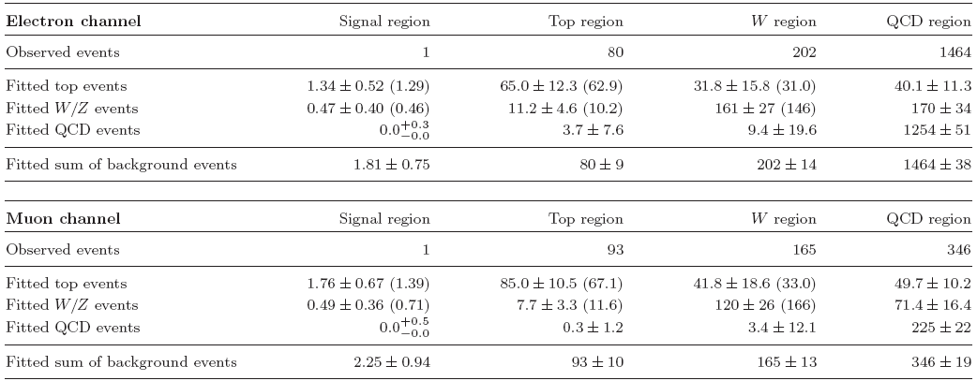
Likelihood method (1-lepton)
Fill all useful information into a likelihood => minimize to estimate bkgs
  One poisson for signal region and for each control region
  → simultaneous fit of all regions (signal and control)
  Systematic uncertainties treated as nuisance parameters
Fitted predictions in agreement with observation

Slide 26
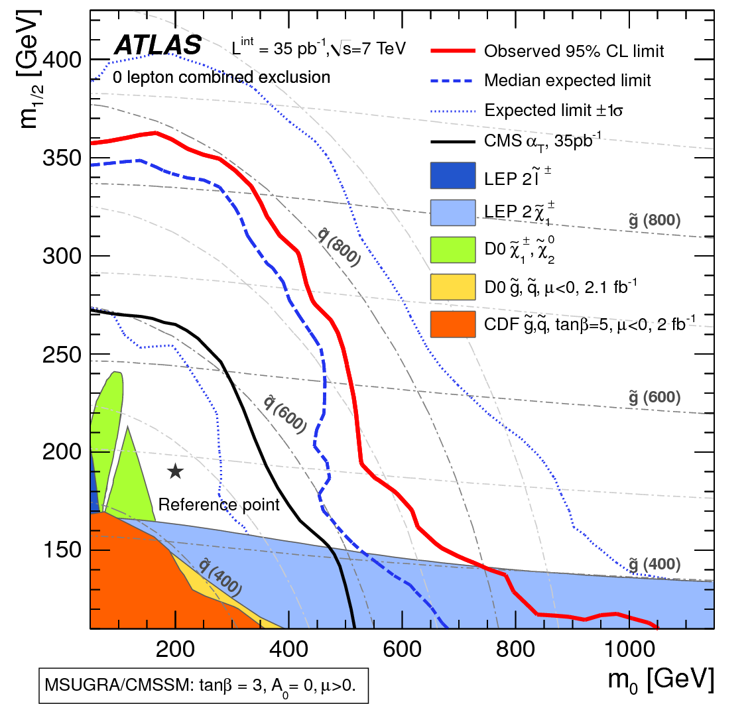
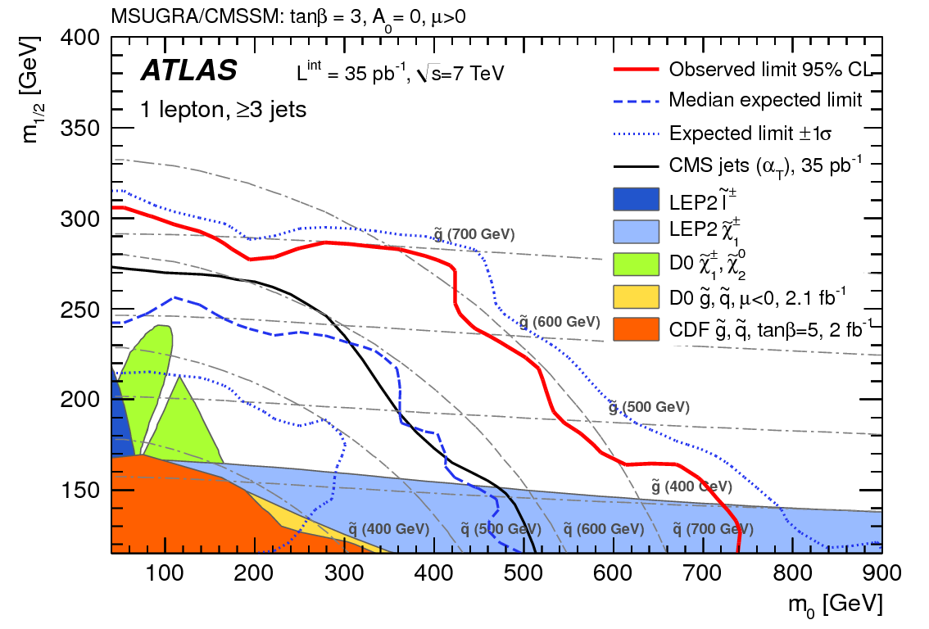
0 and 1-lepton results
Limit in mSUGRA
0-lepton
If m_{squark}=m_{gluino}
exclude < 775 GeV
1-lepton
If m_{squark}=m_{gluino}
exclude < 700 GeV

Slide 27
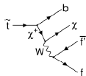
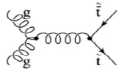
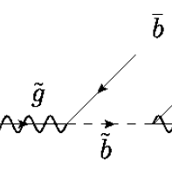
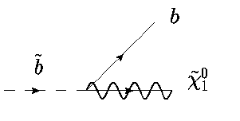
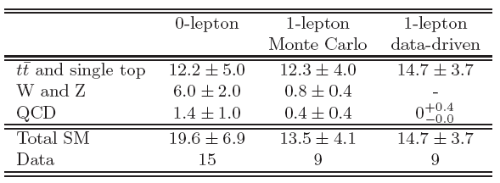
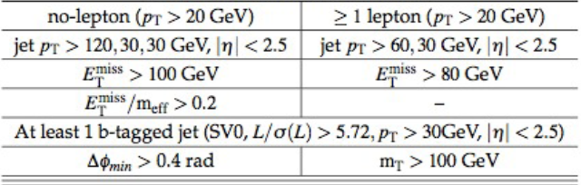


Searches in E_{T}^{Miss}+b-jets
arXiv:1103.4344
Submitted to PLB
Third generation squarks might be lighter than 1st, 2nd generation → possibly high cross sections:
  direct pair or gluino-mediated production
Final state enriched in b-jets → search in events with jets (≥1 b-jet) +E_{T}^{Miss} ( + 0/ ≥ 1) leptons
~
b/
/t
~
~
b/
/t
Event selection
Signal regions:
0-lepton: M_{eff} > 600 GeV 1-lepton: M_{eff} > 500 GeV
0-lepton
1-lepton

Slide 28


SM Background: 0-lepton
QCD: Partially data-driven
Top/Boson+jets: MC estimate
Revert Δφ_{min}<0.4
Take Meff shape from Δφ_{min} <0.4
Uncertainties (~60%) driven by statistics
From MC: take fraction of QCD events passing
Δφ_{min} >0.4

Slide 29



0-lepton bkg details (b-jets)
Breakdown of non-QCD SM-background contributions (from MC) for 0-lepton analysis at each stage of the selection (per pb⁻¹)
b-tagging

Slide 30



Systematic uncertainties
0-lepton analysis: theoretical uncertainties larger than JES at high meff values
Tails of relevant distributions
for SUSY event selection affected by
large theoretical uncertainties.
Meff: 600 GeV → 1 TeV
Meff: 600 GeV → 1 TeV

Slide 31






1 lepton bkg details (b-jets)
QCD estimation from a Matrix method relying on 2 data sets differing only in the lepton ID criteria: tight (standard) and loose (relaxed):
Breakdown of non-QCD SM-background contributions for 1-lepton analysis at each stage of the selection
ε_{real}=measured in Z-samples
ε_{fake}=measured QCD-enriched sample

Slide 32




SM Background: 1-lepton (II)
Data-driven techniques for all bkg
  QCD: “matrix-method” as in previous analyses
  Top/Boson+jets: exploit low correlation between M_{T} and M_{eff}
C
D (Signal Region)
100
M_{T} (GeV)
A
B
40
500
M_{eff} (GeV)
“Closure-test” with MC → good agreement with data

Slide 33


Interpretation in pheno-MSSM
~
~
Assume gluino decays in b₁b (BR=100%) and b₁→bχ⁰₁ (BR=100%)
m(χ⁰₁)=60 GeV
Assume gluino decays in t₁t (BR=100%) and t₁→bχ⁺₁ (BR=100%), χ⁺₁ →W*χ⁰₁
m(χ⁰₁)=60 GeV , m(χ₁) ≈2×m(χ⁰₁)
~
~
~
~
~
~
~
0-lepton analysis
1-lepton analysis
Gluino masses below 590 GeV excluded for sbottom masses below 500 GeV
Gluino masses below 520 GeV excluded for stop masses below 300 GeV

Slide 34


2-leptons analysis
Search for dilepton (e,μ) pairs from neutralino/chargino decays
Two search strategies, requiring opposite-sign (OS) and same-sign (SS) dileptons events
Event selection
exactly two leptons
M(ll) > 5 GeV
Signal regions
OS: E_{T}^{Miss} > 150 GeV
SS: E_{T}^{Miss} > 100 GeV
Main SM Background
OS: top pair (estimate in CR)
SS: misidentified leptons (fakes) → data-driven as in previous analyses
Opposite-Sign
Same-Sign
Notes:
Loose optimization on the sensitivity based on the study of MSSM models with squark and gluino mass at ~ 400 GeV

Slide 35


Top background for OS
Dileptonic top decays tt → l⁺νb l⁻νb
“Top tagging” algorithm based on contransverse mass (m_{CT})
Control Sample
E_{T}^{Miss} [60,80] GeV, ≥2 jets with p_{T}>20 GeV
Calculate m_{CT} from 4-vectors of leptons and jets → must be consistent with tt bounds
m(jet,l1) and m(jet,l2) consistent with top decays
Data CR: 15 top-tagged events
MC CR: 21.3±3.8 (18.8 from ttbar)
Estimation in Signal Region →
2.8+1.4-1.3

Slide 36




Results
Agreement between data and SM expectations within uncertainties:
  Use sum of ee,μμ,eμ channel for SS, combination of the three channels for OS
  95% C.L. upper limits on effective cross section σ ∙ A∙BR from new physics:
    SS: σ<0.07 pb
    ee: 0.09 pb, μμ: 0.21 pb, eμ: 0.22 pb
Interpretation in mSUGRA

Slide 37

Bkg estimate methods
Difficult to summarize, but let’s try …
MC based approach: MC based estimate where both the shape and the rate in the signal region (SR) are estimated from MC
Mixed data and MC based via overall corrections : estimate where the MC rate is constrained by data in a control sample (CS), but the MC is used to extrapolate from the control sample to the signal region.
→Pros: remove uncertainties on Lumi and total σ, factorize part of detector and theoretical uncertainties (if Control Sample CS ~ similar topology)
→Cons: central value possibly affected by large statistical fluctuation in CS. Theoretical uncertainties might be quite large.
Event based correction on data: A quasi data-driven approach, where both the number of events and the shape are taken from a data CS. In case correction factors must be applied to account for the acceptance and ID efficiency of the events in the CS → taken from data when possible, otherwise from Monte Carlo.

Slide 38
Conclusions
Several approaches followed to estimate SM background contributions in SUSY searches, depending on the analysis variables (jet multiplicity, explicit lepton requirement, with/without b-tagging)
  Common features:
    define control regions orthogonal to signal samples
    use MC tools to estimate shapes, data-driven techniques for normalization
  Only a few examples shown here
Larger use of data-driven techniques with more data:
  Analyzing already 170 pb⁻¹ of 2011 data
  in most cases, use of MC samples unavoidable (acceptance corrections, control sample-to-signal region corrections). → Reducing theoretical uncertainties might be the key-issue for kinematic regimes interesting for searches

Slide 39
Back-up
slides

Slide 40

The ATLAS detector
Spectrometer coverage up to |η|<2.7
Trigger and measurement for μ with momentum resolution < 10% up to E_{μ} ~ 1 TeV
Coverage up to |η|=4.9
EM calorimeter, e/γ trigger, ID, measurement
Resolution: σ/E ~ 10%/√E 0.007
HAD calorimeter (jets, MET)
Tiles(central), Cu/W-Lar (fwd)
E-resolution: σ/E ~ 50%/√E 0.03
Fwd cal: σ/E ~ 90%/√E 0.07
3-level trigger
rate to tape ~200 Hz
Inner Detector (|η|<2.5)
Tracks and Vertex reconstructions
σ/p_{T} ~ 3.8 x 10⁻⁴ p_{T} (GeV) 0.015
Length: ~45 m
Radius: ~12 m
Weight: ~7000 tons
2 T magnetic field

Slide 41



The 2010 ATLAS pp data
~ 35 pb-1 of data used in the analyses presented here
Profiting at best from the excellent LHC performance:
  Maximum values of 6 pb⁻¹ luminosity per day
  Instantaneous luminosity values up to 2 × 10³² cm⁻² s⁻¹
Detector efficiency above 90%

Slide 42




Electron Performance Results
forward-central Zs
electrons above the tracker acceptance
ATLAS-CONF-2011-041
Notes:
Figure right bottom: Control distributions for the forward Z to electrons analysis, Z rapidity distribution. The background is determined from a fit to the invariant mass distribution. The simulation is normalised to the data.

Slide 43



ID and Muon Combined Performance
Low p_{T} efficiency from J/ψ→μμ decays
High p_{T} efficiency from Z→μμ decays
Very good description of alignment in MC
ATLAS-CONF-2011-046
ATLAS-CONF-2011-021
Efficiency understood down to very low p_{T}
Present understanding of ID alignment
Smear MC hit uncertainties
ATLAS-COM-CONF-2011-003
Improved momentum scale and resolution
muon scale uncertainty is < 1%
dimuon mass resolution 1.8% barrel and 3% end-cap
Notes:
Figure bottom left:
Di-muon invariant mass distribution for oppositely charged muon pairs with transverse momentum above 20 GeV and the above track isolation.
The momentum vector is jointly reconstructed in the muon spectrometer and the inner tracking detector.
The measured di-muon mass is shown for the full pp data of 2010 in first-pass reconstruction using preliminary calibration and alignment constants and after the reprocessing of the data with improved calibration and alignment constants. The distribution is compared to MC prediction using Pythia-generated Z->µµ events and reconstructed with the same software version as the original data processing.
pull functions for TRT are smaller than 1, so no additional smearing needs to be added

Slide 44

Jet Energy Scale
ATLAS-CONF-2011-032
In-situ calibrations
barrel
3%
Improved by factor of 2 with respect to previous version
Evaluated up to 3.5 TeV in energy and |η|<4.5
Notes:
MPF: Missing Et Projection Fraction
Figure 1:
Fractional jet energy scale systematic uncertainty as a function of pjetT for jets in the pseudorapidity region 0.3 ≤ |h| < 0.8 in the calorimeter barrel. The total uncertainty is shown as the solid light blue area. The individual sources are also shown, with uncertainties from the fitting procedure if applicable.
Figure 2:
Figure 12: Jet energy scale uncertainty as a function of pjetT in the central barrel. This plot shows the data to Monte Carlo simulation ratios for several in-situ techniques that test the jet energy scale exploiting photon jet balance (direct balance or using the missing transverse momentum projection technique), the balance of a leading jet with a recoil system of two or more jets at lower transverse momentum (multijets) or using the momentum measurement of tracks in jets.

Slide 45
Jet Energy and Etmiss Resolutions
PbPb data only sample reaching this high in ∑E_{T}
14.5 TeV
Advanced calibrations → improve resolution by 10-30%
Monte Carlo agrees with data within 10%
Notes:
Exmiss and Eymiss resolution as a function of the total transverse energy (ΣET) for Pb+Pb and pp collision events. For Pb+Pb, due to low statistics, RMS values are plotted instead of sigma from the fit. The line represents independent fits to the resolution obtained in Pb+Pb data and in pp data at 7 TeV ( ATLAS-CONF-2010-057). Exmiss , Eymiss and ΣET are computed from cells with energy > 2σ(noise) calibrated with Global Cell Weighting (GCW). A logarithmic scale is used on the X axis

Slide 46
Interpretation of the results
Use profile likelihood ratio:
  include correlations of uncertainties where appropriate
→ Estimate upper limits at 95% C.L. on N signal events and effective cross sections independently of new physics models (background-only hypothesis)
Exclude non-SM: N events 43.9(A), 11.9(B), 37.6(C), 3.5(D)
σ of 1.3(A), 0.35(B), 1.1(C), 0.11 (D) pb
Best sensitivity
Region D
(3j, m_{eff} > 1 TeV)
Translate results in limits on MSUGRA/CMSSM
(m₀,m_{1/2})-plane
parameters at GUT scale
1. Unified gaugino(scalar) mass m_{1/2}(m₀)
3. Ratio of H₁, H₂ vevs tanβ
4. Trilinear coupling A₀
5. Higgs mass term sgn(μ)
Best sensitivity
Region C
(3j, m_{eff} > 500 GeV)
If m_{squark}=m_{gluino}
exclude < 775 GeV
Theoretical uncertainties on SUSY NLO cross sections included in limit calculation

Slide 47


Results (b-jets)
Good agreement between data and
SM predictions within systematic
uncertainties in both channels
0-lepton analysis
Interpret the results as 95%C.L. upper limits on N signal events independently of new physics models:
N(0-lepton) > 10.5
N(1-lepton)>4.7
Effective cross sections:
σ (0-lepton) > 0.32 pb
σ (1-lepton) > 0.13 pb
1-lepton analysis

Slide 48




Specific SUSY models
0- and 1-lepton analyses
0-lepton analysis
mSUGRA: large tan β or low A₀ values:
  For each (m₀,m_{1/2}) sbottom/stop masses lower than in low tan β scenarios
  Exclude gluino masses up to 500 GeV for m₀ < 1 TeV
SO(10) models: gluino pair production one of the dominant processes:
  Gluino → bbχ⁰₁ (DR3) or bbχ⁰₂ (HS)
  Exclude masses up to 500(420) GeV
HS-model
DR3-model

Slide 49


Top-tagger: m_{CT}
Tovey, JHEP 0804 (2008) 034
Polesello, Tovey, JHEP 1003 (2010) 030
In the decay of a two pair-produced heavy states which decay via δ◊αχ_{i}
m_{CT} distributions have endpoints defined by m(δ), m(α) and the vector sum of transverse momenta of the visible particles upstream of the system for which the contransverse mass is calculated (p_{b})
For the top-pair system m_{CT} (ll), m_{CT} (jj ), m_{CT} (j l, jl) can be constructed
Efficiency m_{CT} tagger = 85%
control region for ttbar:
  m_{CT}-tagged events
  60<E_{T}^{Miss}<80 GeV

Slide 50


Other backgrounds for 2-lepton
Electron charge-flip:
  Relevant for Same-Sign dilepton final states
  Background from dilepton top events:
    Hard bremsstrahlumng process
    Charge mis-identified rate taken from Zee MC samples as a function of |η|
    Validated in Z→ee data
Z+jets:
  Z→eμ from MC (low statistics in data)
  Semi-data driven estimation for Z→ee,μμ
  Control region:
    81<m(ll)<101 GeV
    E_{T}^{Miss} < 20 GeV
  Corrected for predicted number of W and top in control region
Cosmics:
  2 methods considered →
    matrix method based on impact parameter
    Trigger Lifetime
  Both consistent to zero
  Define an upper bound: Ncos < 1.32 at 68% CL, Ncos < 3.45 at 95% CL

Slide 51

Monte Carlo samples used
Analyses generally employ MC samples generated with:
  Alpgen associated with HERWIG (not ++) and JIMMY for W+jets and Z+jets (including Wbb, Zbb)
    MLM matching scheme to combine samples with different final state parton multiplicities (up to 5 for inclusive, up to 3 for Wbb/Zbb)
  PYTHIA used for low DY region and Z→ττ (τ-decays with TAUOLA)
  SHERPA samples used for cross check in some cases
    Large “production” on-going for 2011 analyses
V+jets predictions normalized to NNLO cross sections (FEWZ)
  CTEQ6L1 for ALPGEN and SHERPA samples
  MRST2007lomod (LO modified) for PYTHIA samples (for low mass DY)
Example from H→WW* analysis

Slide 52
Search on SM Higgs
H→ W*W

Slide 53





SM Higgs →W W*→lν lν (l = e, μ)
ATLAS-CONF-2011-005
Strong sensitivity in 120 < m(H_{SM}) < 200 GeV
Cut-based analysis
  combine H + 0 jet, H + 1 jet and H + 2 jet
Dominant backgrounds: DiBoson, tt,V+jets
(H+0/1j)
(H+2j)
0-jet final states
1-jet final states
2-jet final states
2 leptons, m(ll)<50(65) GeV
p_{T}(ll) > 30 GeV
0.75×m_{H} < m_{T} < m_{H}
2 leptons and exactly 1 jet
same as H+0j selection
p_{T}(jet)>25 GeV, |η|<2.5
B-jet veto (anti-tag)
|P_{T}^{TOT} | < 30 GeV (l1,l2,j,MET)
Z→ττ suppression
2 leptons and 2 jets
η_{j1}* η_{j2} < 0, Δη_{jj}>3.8, m_{jj}>500 GeV
m(ll)<80 GeV, p_{T}(ll) > 30 GeV
0.75×m_{H} < m_{T} < m_{H}
B-jet veto and Z→ττ suppression
|P_{T}^{TOT} | < 30 GeV (l1,l2,j1,j2MET)
Signal region
Notes:
Exclusion limits as function of MH has been presented in a mass range of 120 – 200 GeV. At 160 GeV a SM-like Higgs boson with a production rate of 1.2 times the SM value is excluded at 95% Confidence level using PCL.

Slide 54


W+jets background
Define control sample enriched in W+jets:
  One lepton must satisfy ID and isolation
  cuts of the analysis
  Require second lepton to satisfy loose
  set of cuts (fakeable)
  → W+jets expectations in signal region (SR):
dσ/dX (SR) = dσ/dX (CR) × f_{l}
f_{l} = fake factor = Prob(loose → ID )
  Good agreement data/MC in shape for kinematic distributions

Slide 55

Fake factor
  Control sample defined in multi-jets events with at least a fakeable lepton.
  Real lepton contamination (from W,Z) removed
  ~ 50% uncertainties, mostly dominated by sample and trigger selection dependence
Luminosity after prescale

Slide 56


W+jets estimates in H→WW*
H+0j
H+1j
H+2j: negligible

Slide 57



Z+jets (and low DY) background
Scaling the yield in MC by a E_{T}^{Miss} mis-modeling factor using control regions
Same method used independently on jet multiplicity
In H+2j selection, Z-->ll+jets expected to be dominant before m(ll) selection → checks on pre-selection events for several kinematic distributions:
  E_{T} and η jets (1,2,3)
  m(jj), Δη(jj), Δφ(jj)
Good agreement in shape and in absolute normalization (within 10%)
Notes:
Exclusion limits as function of MH has been presented in a mass range of 120 – 200 GeV. At 160 GeV a SM-like Higgs boson with a production rate of 1.2 times the SM value is excluded at 95% Confidence level using PCL.

Slide 58


Results for SM Higgs →W W*
Upper limit on σxBR(H→WW*)
m_{H}=120 GeV : 54 pb
m_{H}=160 GeV : 11 pb
m_{H}=200 GeV : 71 pb
Notes:
Exclusion limits as function of MH has been presented in a mass range of 120 – 200 GeV. At 160 GeV a SM-like Higgs boson with a production rate of 1.2 times the SM value is excluded at 95% Confidence level using PCL.

