Slide 1

Antinucleon-nucleus interactions
with
the INCL code
Jean-Christophe David
XSCRC2024: Cross sections for Cosmic Rays @ CERN
16-18 October 2024 - Cern

Slide 2
Plan
What is INCL?
INCL and CR
Antiprotons
Antineutrons
(light) Antinuclei
Antinucleon-nucleus interactions
with the INCL code
XSCRC2024: Cross sections for Cosmic Rays @ CERN

Slide 3
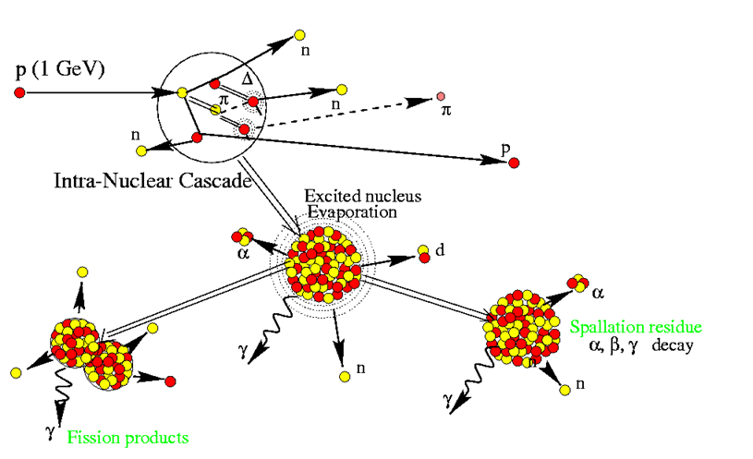
What is INCL?
Generalities
light particle + nucleus
(~20 MeV < E_{p} < ~20 GeV)
INCL: IntraNuclear Cascade of Liège
INCL
After the cascade follows a deexcitation (usually we use ABLA)
INCL (and ABLA) implemented in Geant4
ABLA
Antinucleon-nucleus interactions
with the INCL code
XSCRC2024: Cross sections for Cosmic Rays @ CERN

Slide 4








What is INCL?
Capabilities
Produced particles
n
p
π
Cluster A $≤$ 4
Cluster A $≤$ 8
η
ω
K
Λ
Σ
10-20 GeV
2009-2011
2014
2-3 GeV
2017-2018
2016
2023
2024…
2002
2004
2013
2014
~150 MeV
2003 (npπ) 2013 (A $≤$4)
Tens of MeV
n
p
π
K
Λ
Σ
$$\overline{p}$$
$$\overline{n}$$
Anticluster
$(\overline{d}$, …)
Cluster A $≤$ 18
Projectile particles
Cluster A $≤$ 4
ν
Antinucleon-nucleus interactions
with the INCL code
XSCRC2024: Cross sections for Cosmic Rays @ CERN

Slide 5
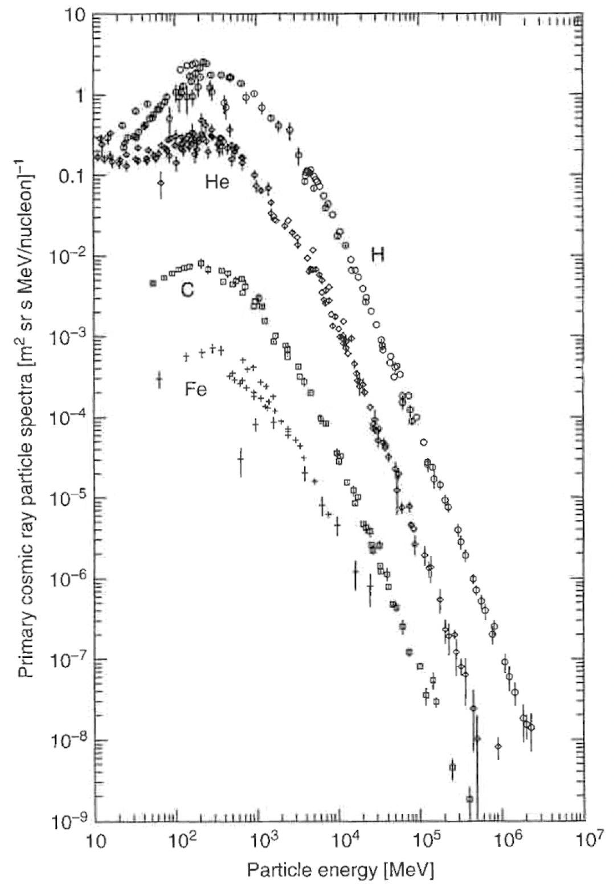
INCL and Cosmic Rays
INCL energy range matches CR’s spectra
Antinucleon-nucleus interactions
with the INCL code
XSCRC2024: Cross sections for Cosmic Rays @ CERN

Slide 6
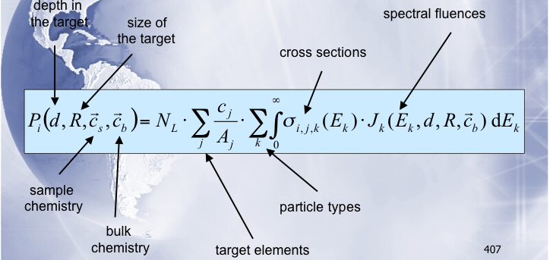
INCL and Cosmic Rays
meas. & calc.
exp. data. & calc.
INCL energy range matches CR’s spectra
Main work/collaboration: Meteorite studies with I. Leya (Bern U.)
(p, n, α)
(Fe, Ni, O, …)
Antinucleon-nucleus interactions
with the INCL code
XSCRC2024: Cross sections for Cosmic Rays @ CERN

Slide 7
INCL and Cosmic Rays
INCL energy range matches CR’s spectra
Main work/collaboration: Meteorite studies with I. Leya (Bern U.
      A review paper Spallation, cosmic rays, meteorites, and planetology
      J.-C. David and I. Leya / Prog. Part. Nucl. Phys. 109 (2019) 103711
conclusions: models more useful/accurate than ever
but era of precision…
Antinucleon-nucleus interactions
with the INCL code
XSCRC2024: Cross sections for Cosmic Rays @ CERN

Slide 8
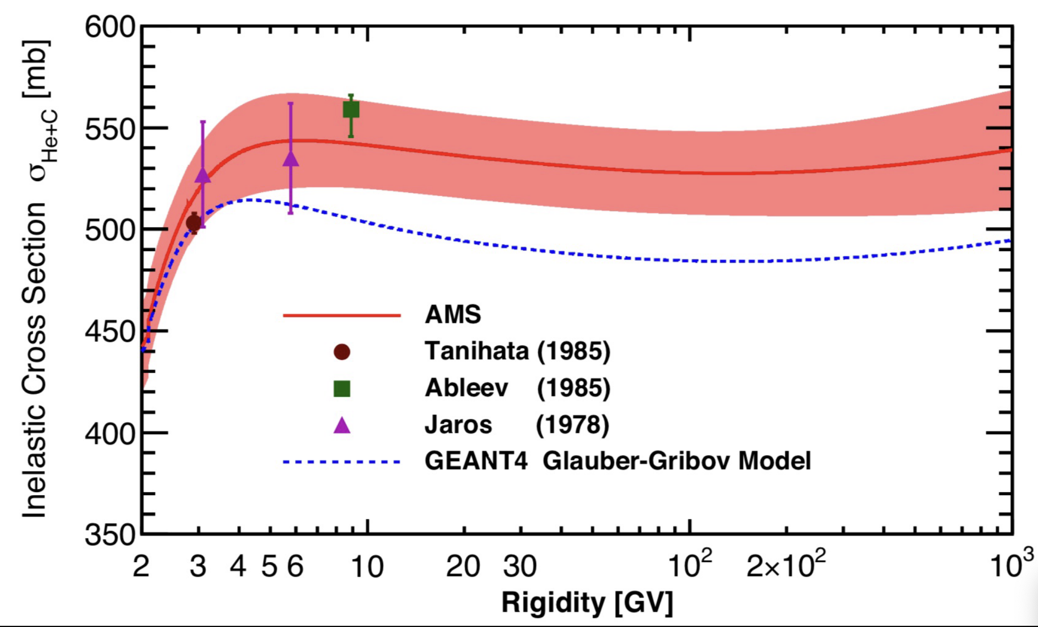
INCL and Cosmic Rays
INCL energy range matches CR’s spectra
Main work/collaboration: Meteorite studies with I. Leya (Bern U.
      A review paper Spallation, cosmic rays, meteorites, and planetology
      J.-C. David and I. Leya / Prog. Part. Nucl. Phys. 109 (2019) 103711
conclusions: models more useful/accurate than ever
but era of precision…
Example:
rare exp. data for He4-induced reaction
Plot shown on Monday (M. Paniccia)
Antinucleon-nucleus interactions
with the INCL code
XSCRC2024: Cross sections for Cosmic Rays @ CERN

Slide 9
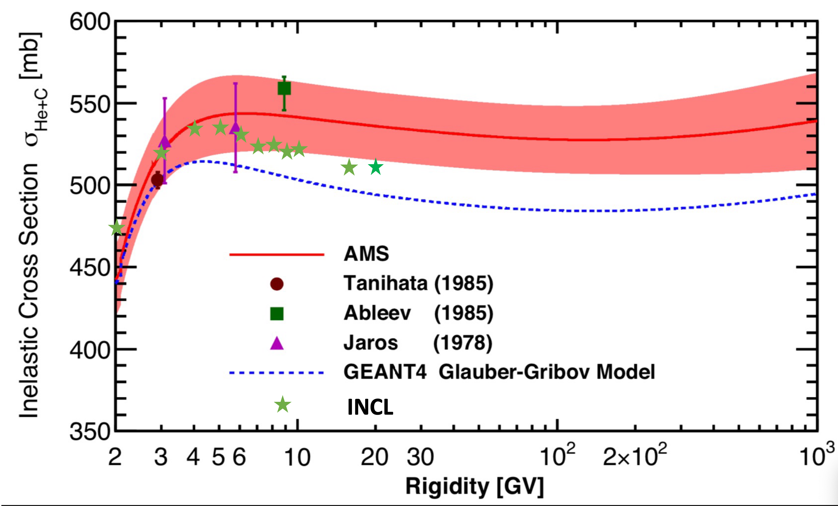
INCL and Cosmic Rays
INCL energy range matches CR’s spectra
Main work/collaboration: Meteorite studies with I. Leya (Bern U.
      A review paper Spallation, cosmic rays, meteorites, and planetology
      J.-C. David and I. Leya / Prog. Part. Nucl. Phys. 109 (2019) 103711
conclusions: models more useful/accurate than ever
but era of precision…
Example:
rare exp. data for He4-induced reaction
Plot shown on Monday (M. Paniccia)
+ INCL
Antinucleon-nucleus interactions
with the INCL code
XSCRC2024: Cross sections for Cosmic Rays @ CERN

Slide 10
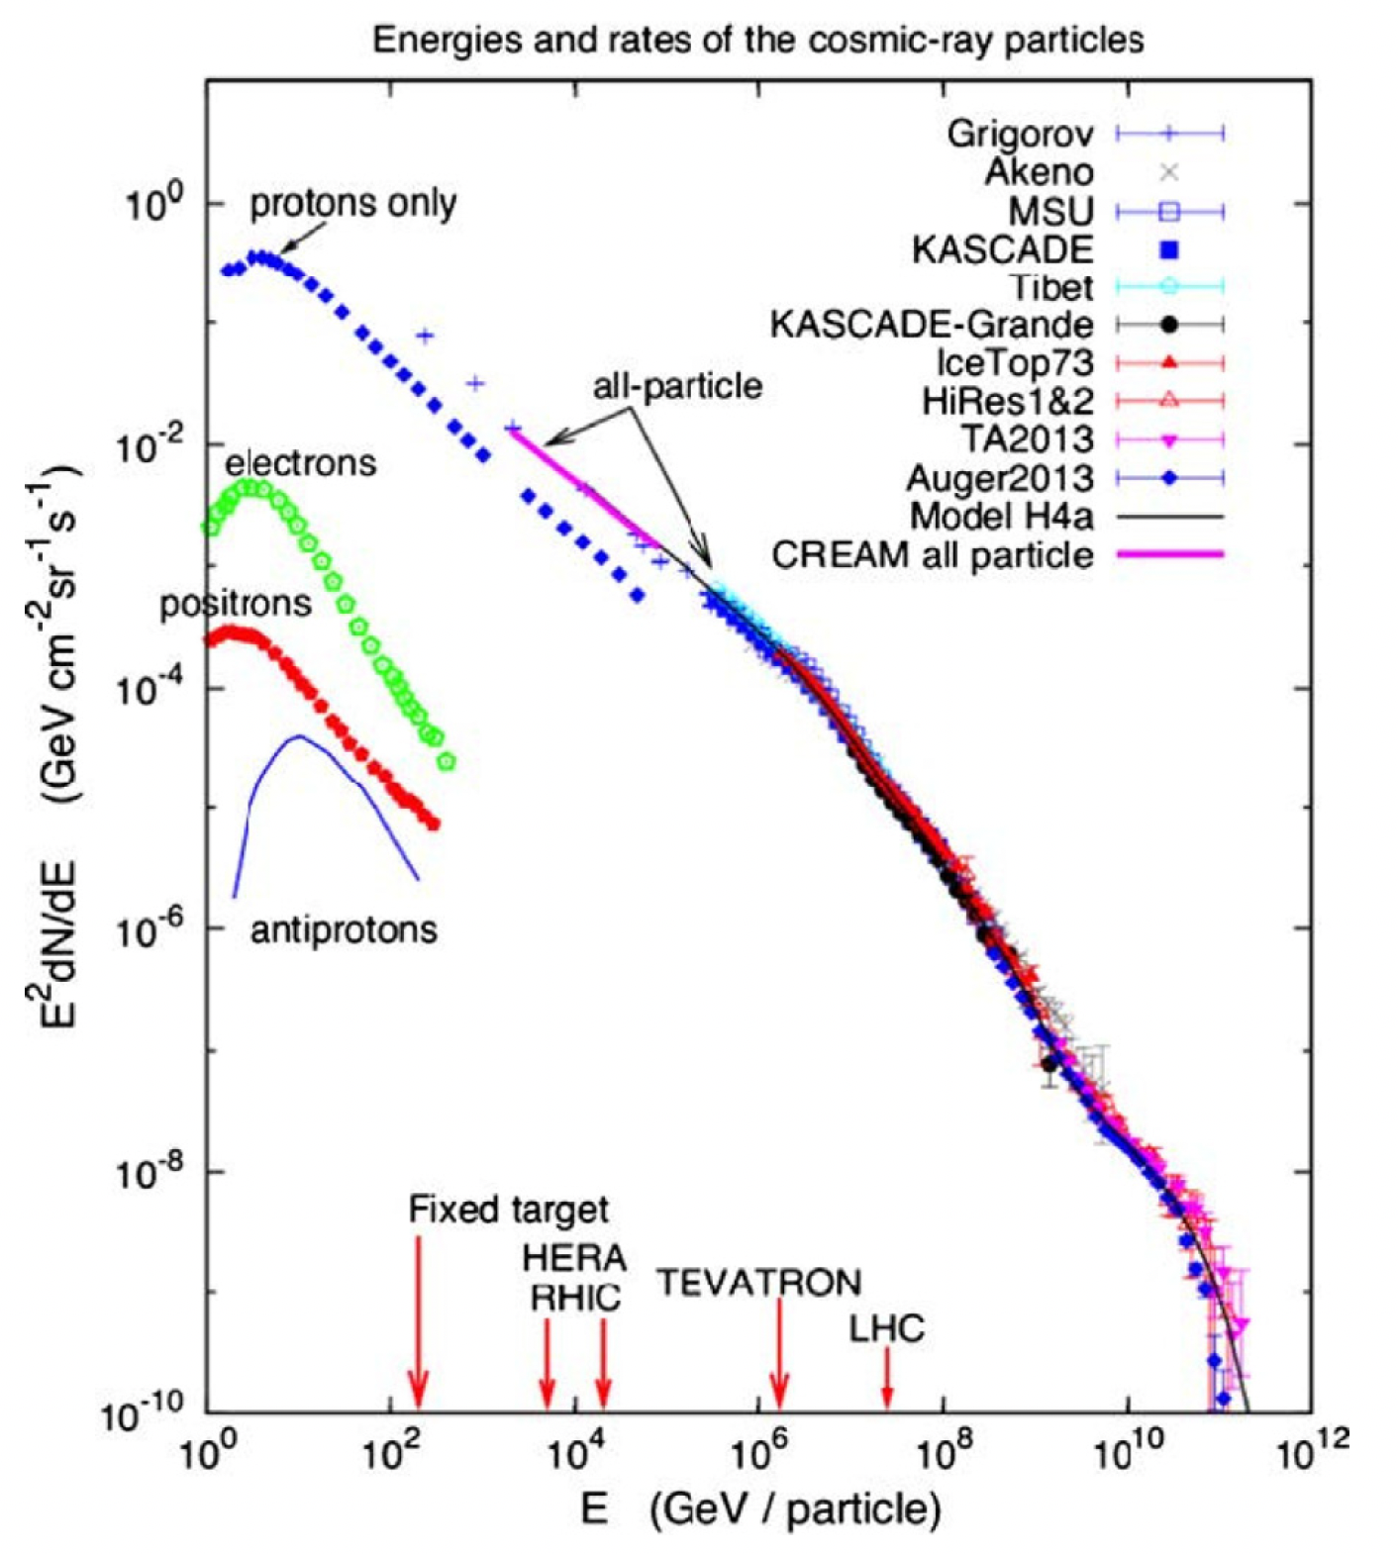
INCL and Cosmic Rays
INCL energy range matches CR’s spectra
Main work/collaboration: Meteorite studies with I. Leya (Bern U.
      A review paper Spallation, cosmic rays, meteorites, and planetology
      J.-C. David and I. Leya / Prog. Part. Nucl. Phys. 109 (2019) 103711
conclusions: models more useful/accurate than ever
but era of precision…
Recently have been asked to put pbar (AD, FAIR)
So if pbar, why not nbar?
for DM experiments…
Then antideuteron, anti-³He
Antinucleon-nucleus interactions
with the INCL code
XSCRC2024: Cross sections for Cosmic Rays @ CERN

Slide 11
Antiprotons
In-flight
E_{at rest}=200 MeV < E < 10 GeV
At rest
E < E_{at rest}= 200 MeV
p
p
b
e⁻
Main ingredients
  Cross sections
    Elastic
    Annihilation
    Production
    Charge exchange
  Final products (types; momenta)
  Potential ( )
Main ingredients
  Annihilation nucleon (p or n)
  Position of the Annihilation
  Final products (types; momenta)
p
Antinucleon-nucleus interactions
with the INCL code
XSCRC2024: Cross sections for Cosmic Rays @ CERN

Slide 12
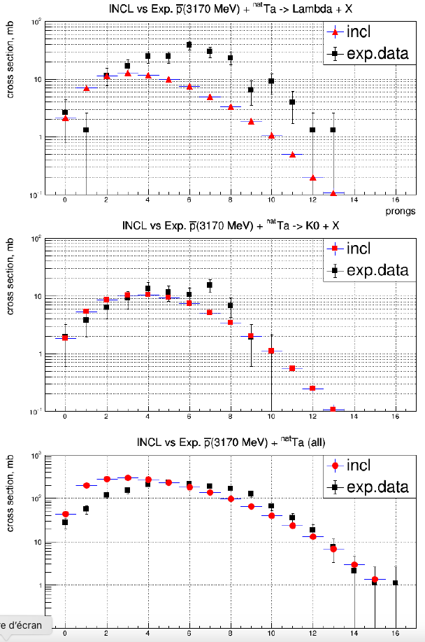
In-flight
Antiprotons
Results
Charged particles
production
Underestimate
(4 GeV/c) + Ta
p
OK (low multiplicity a little high)
OK
Antinucleon-nucleus interactions
with the INCL code
XSCRC2024: Cross sections for Cosmic Rays @ CERN

Slide 13
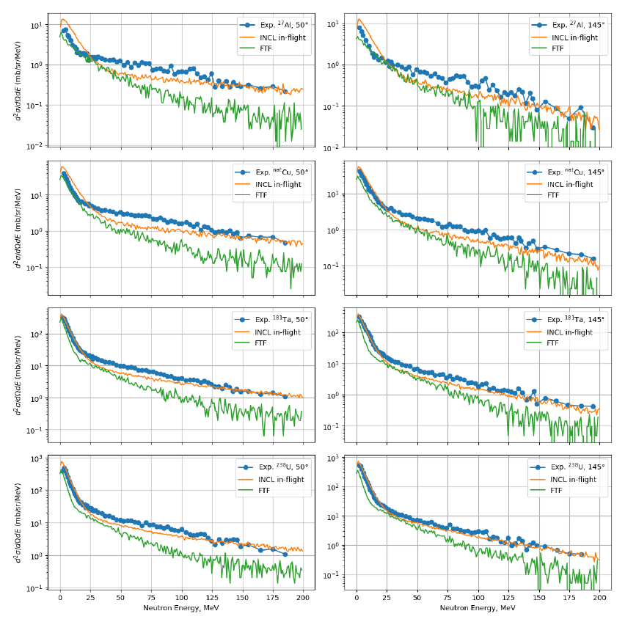
In-flight
Antiprotons
Results
Spectra
(neutron)
(1.22 GeV) + ²⁷Al
p
OK (medium energy a bit low)
(1.22 GeV) + ²³⁸U
p
OK
Antinucleon-nucleus interactions
with the INCL code
XSCRC2024: Cross sections for Cosmic Rays @ CERN

Slide 14
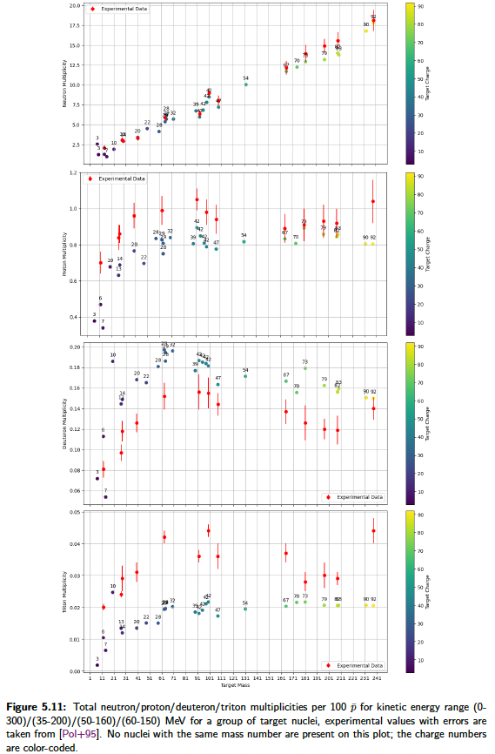
At rest
Antiprotons
Results
Multiplicities n & p
n
n: ~perfect
p: little underestimation (< 20%)
p
D. Polster et al.
Phys. Rev. C51 (1995), 1167–1180.
Antinucleon-nucleus interactions
with the INCL code
XSCRC2024: Cross sections for Cosmic Rays @ CERN

Slide 15
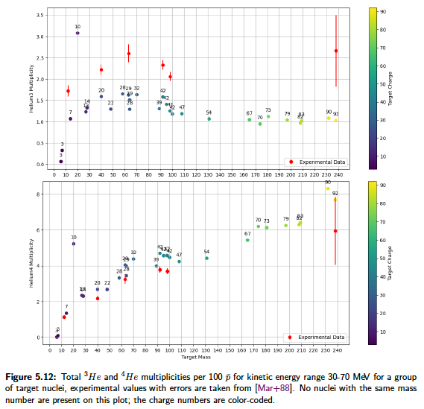
At rest
Antiprotons
Results
Multiplicities ³He & ⁴He
³He: underestimation (< x1.5)
⁴He: rather good
³He
⁴He
W. Markiel et al. Nuclear Physics A 485.3 (1988), 445–460.
Antinucleon-nucleus interactions
with the INCL code
XSCRC2024: Cross sections for Cosmic Rays @ CERN

Slide 16
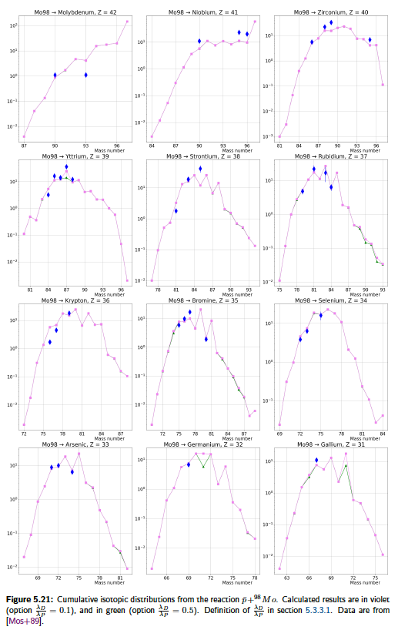
At rest
Antiprotons
Results
Residue production
Here, cumulative production (progenitors accounted for)
Not bad at all, is it?
(same reliabilty as in p + A)
Mass distributions
E. F. Moser et al.,
Z. Phys.A –
AtomicNuclei 333, 89-105 (1989)
+ ⁹⁸Mo → Z
p
Antinucleon-nucleus interactions
with the INCL code
XSCRC2024: Cross sections for Cosmic Rays @ CERN

Slide 17
Antineutrons
In-flight
E_{at rest}=14 MeV < E < 10 GeV
« At rest »
E < E_{at rest}= 14 MeV
n
n
b
Main ingredients
  Cross sections
    Elastic
    Annihilation
    Production
    Charge exchange
  Final products (types; momenta)
  Potential ( )
Main ingredients
  Annihilation nucleon (p or n)
  Position of the Annihilation
  Final products (types; momenta)
n
Antinucleon-nucleus interactions
with the INCL code
XSCRC2024: Cross sections for Cosmic Rays @ CERN

Slide 18
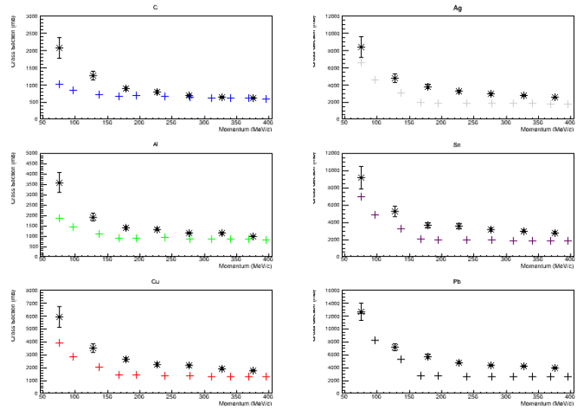
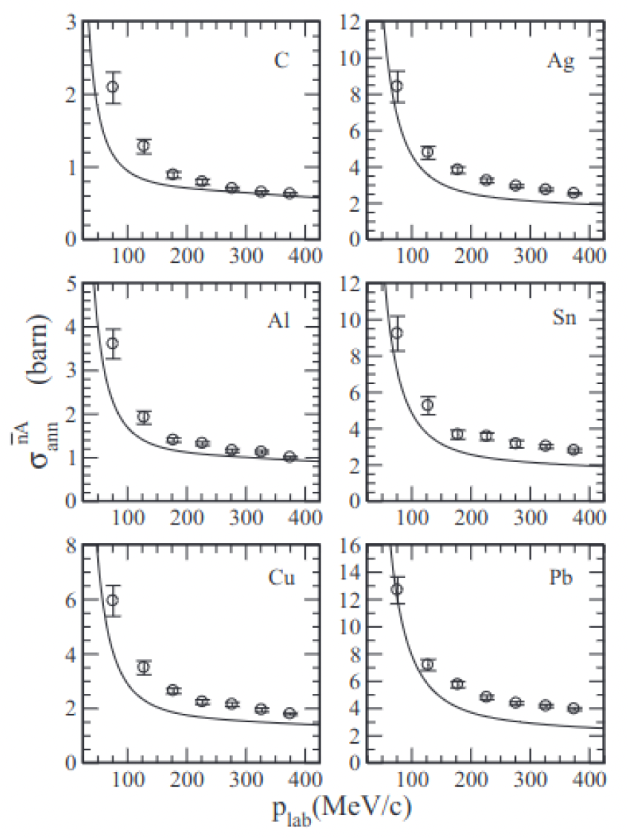
Antineutrons
Results
Annihilation σ
Underestimation
Depending on
  the target
  the energy
But encouraging
…and similar to other model
Lee and Wong. Phys. Rev. C 93, p. 014616 (2016)
Antinucleon-nucleus interactions
with the INCL code
XSCRC2024: Cross sections for Cosmic Rays @ CERN

Slide 19
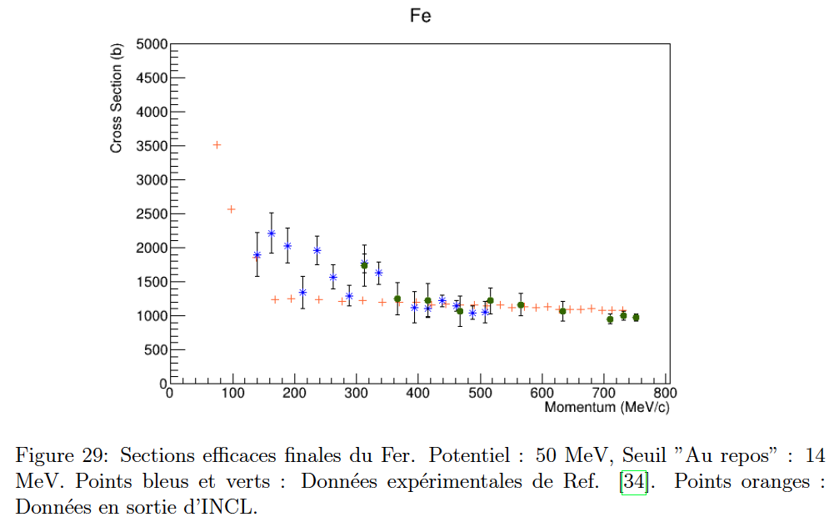
Antineutrons
Results
Annihilation σ
Underestimation
Depending on
  the target
  the energy
But encouraging
…and even better at higher energy
Antinucleon-nucleus interactions
with the INCL code
XSCRC2024: Cross sections for Cosmic Rays @ CERN

Slide 20
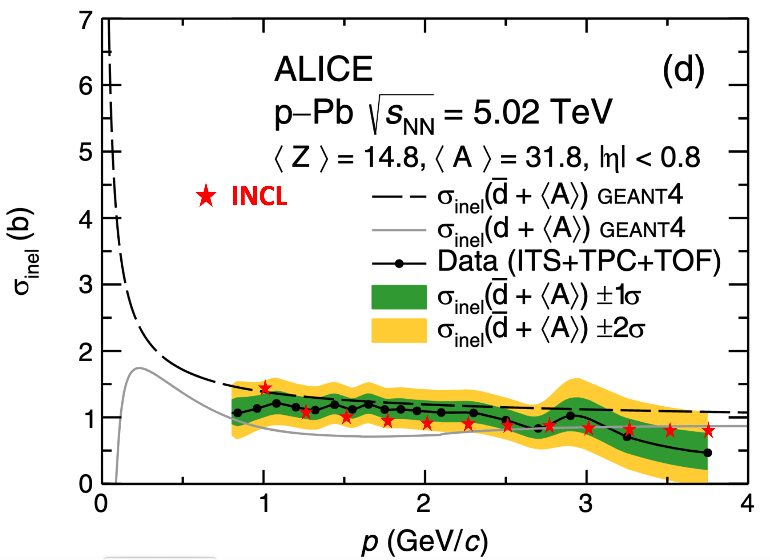
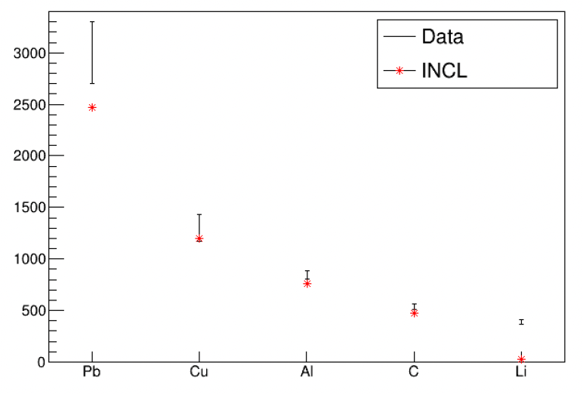










$\overline{d}$,
$\overline{t}$,
$\overline{3He}$,
$$\overline{4He}$$
INCL treats d, t, ³He, ⁴He-induced reactions (and more)
Now and -induced reactions available
So, why not -induced reactions?
It’s in progress… but at an (very) early stage with antideuteron!
First results are encouranging.
$$\overline{n}$$
$$\overline{p}$$
$\overline{d}$,
$\overline{t}$,
$\overline{3He}$,
$$\overline{4He}$$
Original paper: ALICE,
Phys. Rev. Lett. 125, 162001
preliminary results with
dbar + ³²P
$$\overline{d} (13.3 GeV/c)$$
preliminary results
cross section (mb)
S.P. Denisov et al.,
Nuclear Physics B 31.2 (1971), pp. 253–260.
Antinucleon-nucleus interactions
with the INCL code
XSCRC2024: Cross sections for Cosmic Rays @ CERN

Slide 21
A project (NuRBS: Nuclear Reaction model improvement with Bayesian Statistics) has been funded (2024->2027) – CEA & Bern U. (and IAEA+Coruña U.)
Goals: Building tools for biasing and parameter optimisation
Applying them to INCL and ABLA for several cases
Conclusions
pbar in INCL and Geant4 (since Geant4-11.2)
nbar almost in INCL (some checks) and planned for next year in Geant4
light antinuclei in progress…
Rather good results,
but place for improvements
π high multiplicities (refinement)
p ~underestiamted
d overestimated; t and ³He underestimated
K K⁰ ~OK
K^{+/-} underestimated
Λ underestimated
Some not-so-well-known ingredients …
(potential, position of the annihilation, on which nucleon (n? p?) the annihilation…)
Antinucleon-nucleus interactions
with the INCL code
XSCRC2024: Cross sections for Cosmic Rays @ CERN

Slide 22

Thanks for your attention!
And thanks to the students
          D. Zharenov (antiprotons + antineutrons)
          O. Lourgo (antineutrons + antideuterons)
and
J. Hirtz who gave advices
Antinucleon-nucleus interactions
with the INCL code
XSCRC2024: Cross sections for Cosmic Rays @ CERN

Slide 23
backup

Slide 24
What is INCL?
Capabilities
Produced particles
n
p
π
Cluster A $≤$ 4
Cluster A $≤$ 8
η
ω
K
Λ
Σ
10-20 GeV
2009-2011
2014
2-3 GeV
2017-2018
2016
2023
2024…
2002
2004
2013
2014
~150 MeV
2003 (npπ) 2013 (A $≤$4)
Tens of MeV
n
p
π
K
Λ
Σ
$$\overline{p}$$
$$\overline{n}$$
Anticluster
$(\overline{d}$, …)
Cluster A $≤$ 18
Projectile particles
Cluster A $≤$ 4
ν
Antinucleon-nucleus interactions
with the INCL code
XSCRC2024: Cross sections for Cosmic Rays @ CERN

Slide 25
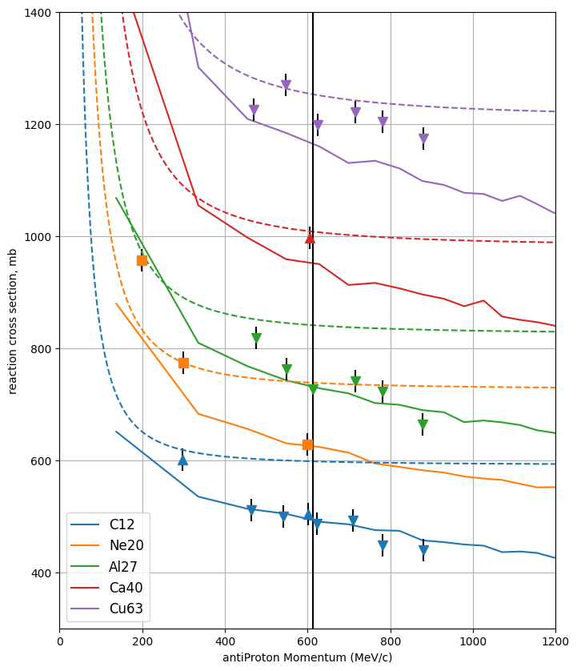
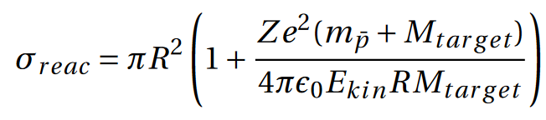
In-flight
Antiprotons
Results
Reaction Cross section
Solid lines: INCL calculations
Dashed curves: at rest normalization
Antinucleon-nucleus interactions
with the INCL code
XSCRC2024: Cross sections for Cosmic Rays @ CERN
Antinucleon-nucleus interactions
with the INCL code
XSCRC2024: Cross sections for Cosmic Rays @ CERN

Slide 26
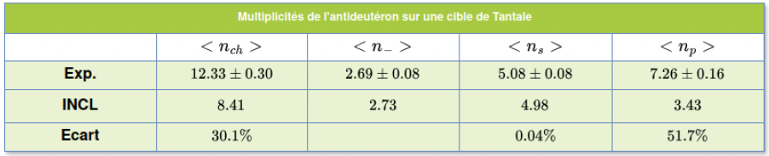

$\overline{d}$,
$\overline{t}$,
$\overline{3He}$,
$$\overline{4He}$$
INCL treats d, t, ³He, ⁴He-induced reactions (and more)
Now and -induced reactions available
So, why not -induced reactions?
It’s in progress… but at an (very) early stage with antideuteron!
First results are encouranging.
$$\overline{n}$$
$$\overline{p}$$
$\overline{d}$,
$\overline{t}$,
$\overline{3He}$,
$$\overline{4He}$$
preliminary results
$$\overline{d}\left(\text{6.1 }\text{GeV}\text{/}\text{c} \text{per} \text{nucleon} \right)+Ta$$
multiplicity
$$\overline{d} (13.3 GeV/c)$$
π⁺/π⁻
p
preliminary results
cross section (mb)
bias
V. F. Andreyev et al.,
Il Nuovo Cimento A 103.8 (1990), pp. 1163–1176
S.P. Denisov et al., Nuclear Physics B 31.2 (1971), pp. 253–260.
Antinucleon-nucleus interactions
with the INCL code
XSCRC2024: Cross sections for Cosmic Rays @ CERN

