Slide 1

Using deep learning to investigate QCD phase transitions
or
The unexpected virtue of ignorance
Ahmed Abuali
Advisor : Prof. Claudia Ratti
Collaborators: Dr. David Clarke, Prof. Ricardo Vilalta, Prof. Morten Hjorth-Jensen
Natural Sciences and Mathematics
Notes:
Hello everyone, my name is Ahmed Abuali,
I am working in the theoretical nuclear physics group with Dr. Ratti,
my talk today is about “using deep learning to investigate QCD phase transitions”
Or
“the unexpected virtue of ignorance”
we will see soon what do I mean by the word ignorance

Slide 2
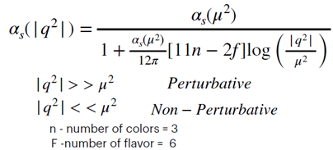
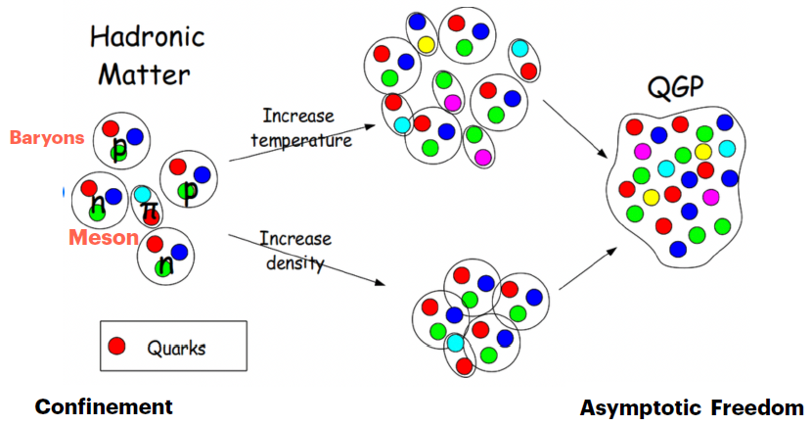
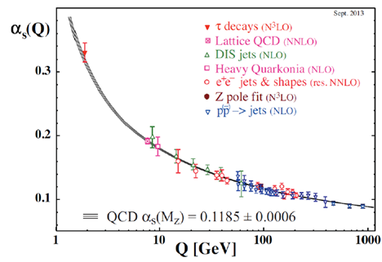
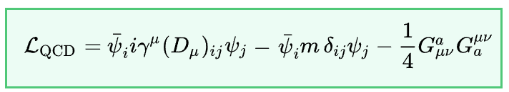
Natural Sciences and Mathematics
What is QCD?
The theory of strong interactions
QCD Lagrangian & gauge group
The gauge group for QCD is SU(3)
Natural Sciences and Mathematics
Notes:
First thing first, what is QCD?
QCD is theory that describe the strong interaction between nuclear matter
We know that hadronic matter which is baryons and mesons consist of quarks and gluons confined inside
But quarks can be deconfined if we increase the temperature or increase the density in a phenomena, we call asymptotic freedom
The gauge group of QCD is SU(3) , and the Lagrangian of QCD shown here resemble the quark-gluon interaction term, the gluon-gluon interaction term and the mass term
QCD is also characterized by running coupling constant, where the strength of the interaction get lower when we increase the momentum transfer.
Due to this phenomena QCD is not in general a perturbative theory (where we can apply perturbation theory o solve the system), QCD is perturbative in the low momentum transfer region, which it is the region that we are interested in

Slide 3
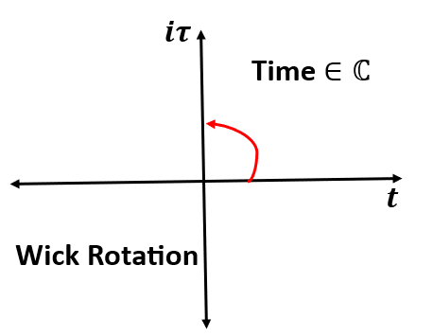
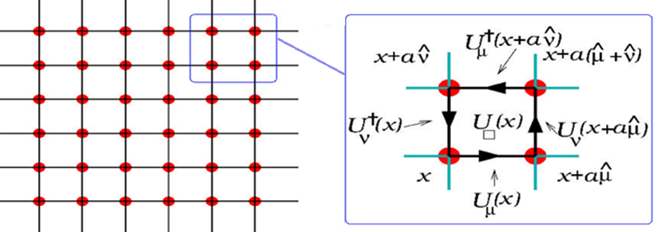



Natural Sciences and Mathematics
Introducing Lattice QCD
We go from 4D Minkowski spacetime to 4D Euclidean spacetime
$$t→iτ$$
Introduce complex time
Do Wick rotation $t→iτ$
Interpreting the denominator of the propagator as a partition function
This can be interpreted as partition function $𝓩$
Space-time discretization
Monte-Carlo Simulation
Natural Sciences and Mathematics
3 of 11
Notes:
One way to solve the QCD in the non perturbative region is using what is called Lattice QCD
In Lattice QCD we introduce time as an imaginary value, by doing wick rotation from the real axis to the imaginary axis in the complex plan
This process will convert the space from 4D Minkowski spacetime to 4D Euclidean space
Doing that allow us to interpret the denominator of the propagator as a partition function
Then we can discretize spacetime to be in the form of a lattice where quark are the vertices and gluons are the sides, each side is an SU(3) matrix
finally we can do Monte Carlo simulation to calculate thermodynamical variables and generate configurations

Slide 4
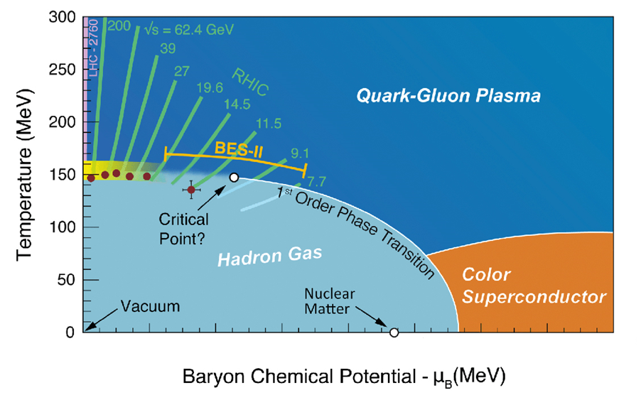
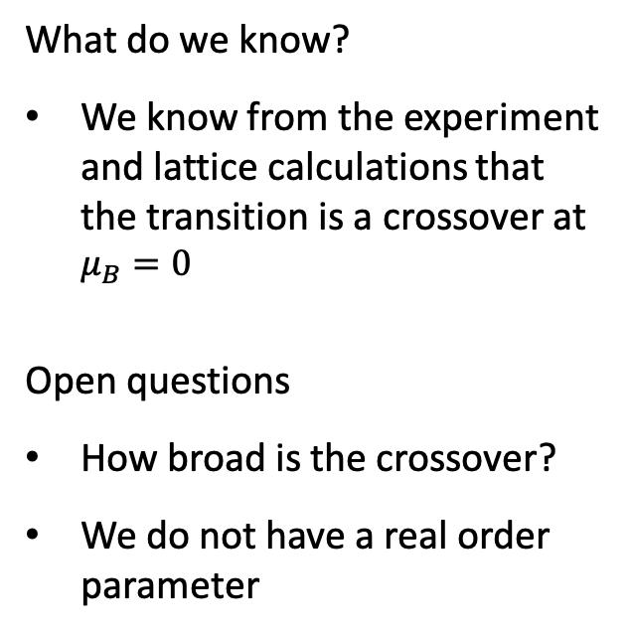
Natural Sciences and Mathematics
QCD Phase Diagram
What do we know?
We know from the experiment and lattice calculations that the transition is a crossover at $μ_{B}=0$
Open questions
How broad is the crossover?
We do not have a real order parameter
crossover
Natural Sciences and Mathematics
Notes:
Now we can talk about QCD phase diagram, this diagram showing the phases of QCD for different values of baryon chemical potential and temperature
in this diagram we are sure from the experiment and from lattice calculations at mu_B =0 that we have a smooth crossover
but we do not know how broad is the crossover, and we do not have a real order parameter

Slide 5
Natural Sciences and Mathematics
Problem Statement
Q: Is Deep Learning able to tell us how broad the crossover is? Can it do that using only the lattice configurations and with complete ignorance of the physics behind, doing it without imposing our preconceived notion of a pseudo-order parameter?
A: Probably yes.
Q: How will we use Deep Learning to solve the problem?
A: learn from simple, well-known statistical models, then move to complex models:
2D/3D Ising and Heisenberg models
Transfer our knowledge to pure gauge lattice QCD configurations
Build a deep learning model to study system with quarks
Natural Sciences and Mathematics

Slide 6
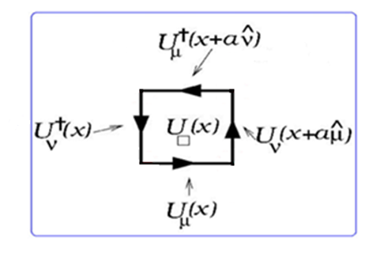
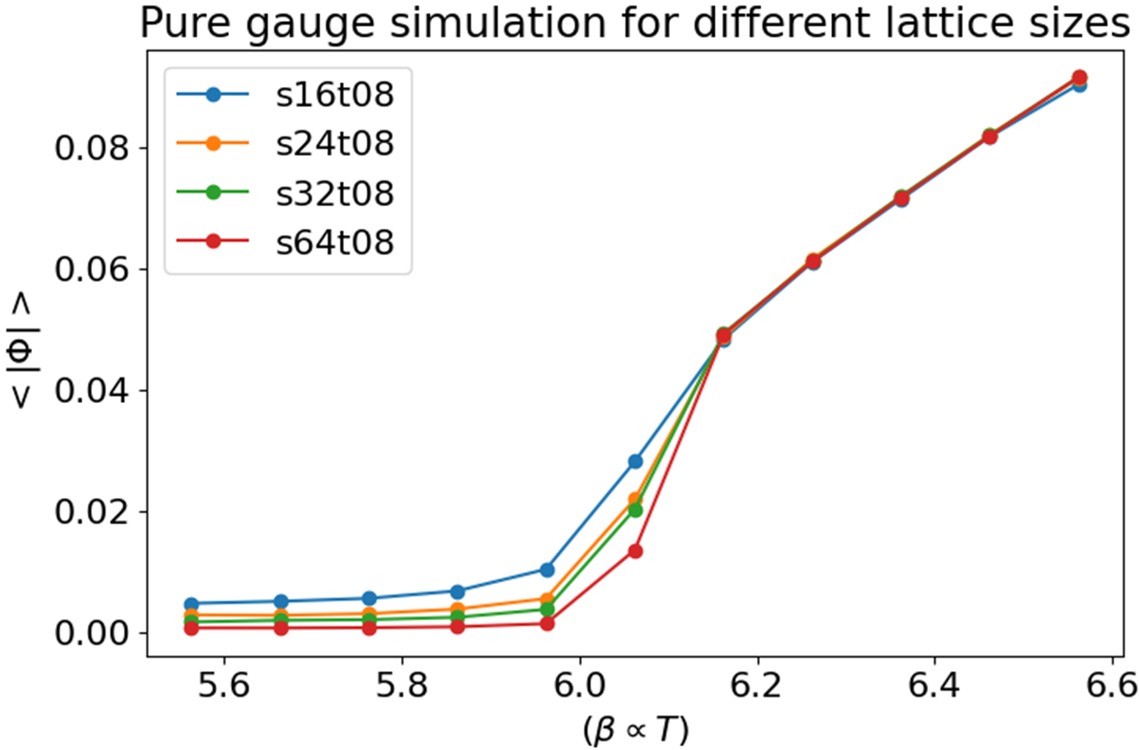
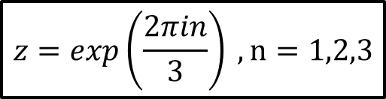
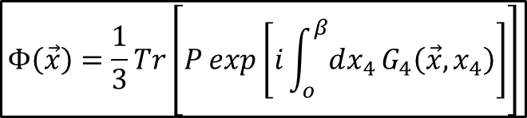
Natural Sciences and Mathematics
Understand pure-gauge critical behavior
Z(3) Symmetry
$$z=exp\left(\frac{2πin}{3}\right) , n=1,2,3$$
The Polyakov Loop (order parameter)
$$Φ\left(\vec{x}\right)=\frac{1}{3}Tr\left[P exp\left[i\int_{o}^{β}{dx_{4}}G_{4}\left(\vec{x},x_{4}\right)\right]\right]$$
Natural Sciences and Mathematics
6 of 11

Slide 7
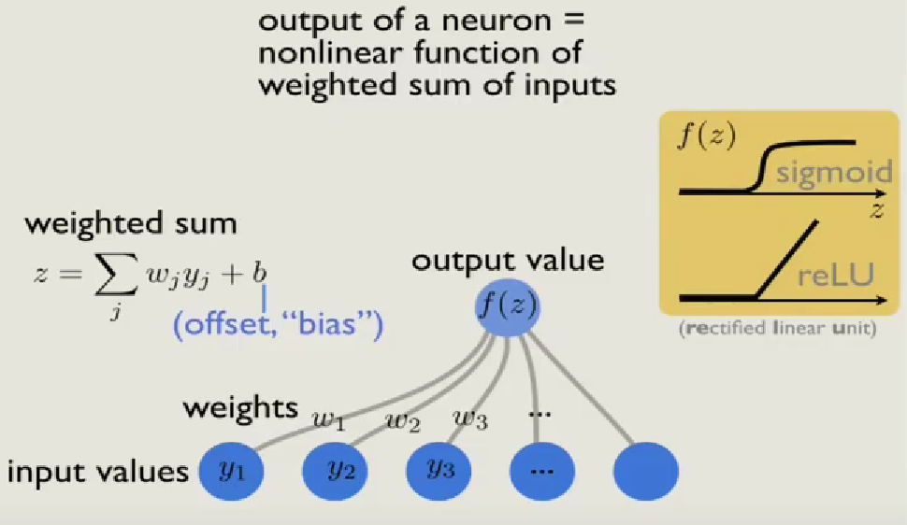
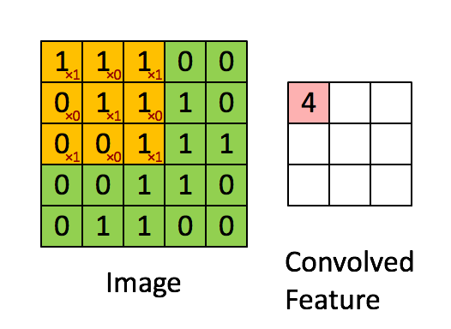
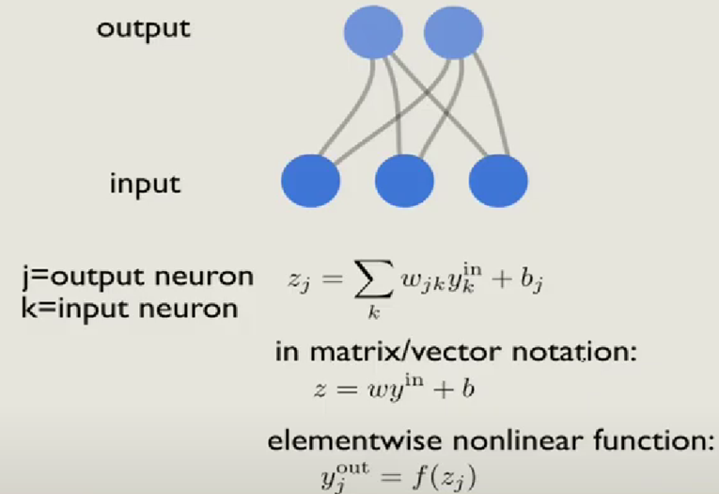
Natural Sciences and Mathematics
What is Deep Learning ?
How does the CNN work?
Natural Sciences and Mathematics

Slide 8
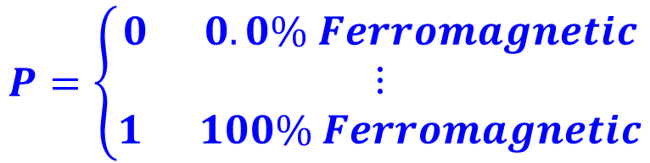
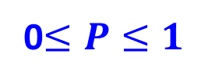
Natural Sciences and Mathematics
Implementation for 2D/3D Ising and Heisenberg Models
Generating configuration files: Monte Carlo simulation for different statistical models
Supervised training
Build DL model
Feed conf files to the model
Train the model
Test the model
Use the trained model to predict the phase of a different set of configurations, for example one thousand configuration files per temperature
Model prediction per configuration :
0$≤P≤1$
Doing statistics on the 1000 predictions
$$P=\left\{\begin{aligned}0 0.0\% Ferromagnetic \\ ⋮ \\ 1 100\% Ferromagnetic\end{aligned}\right.$$
Average prediction per configuration <P>
Standard deviation prediction (error bars)
Variance in prediction σ²
Natural Sciences and Mathematics
8 of 11

Slide 9
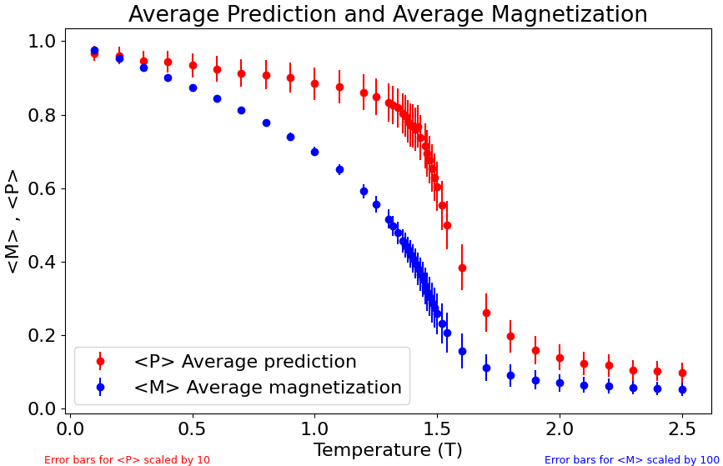
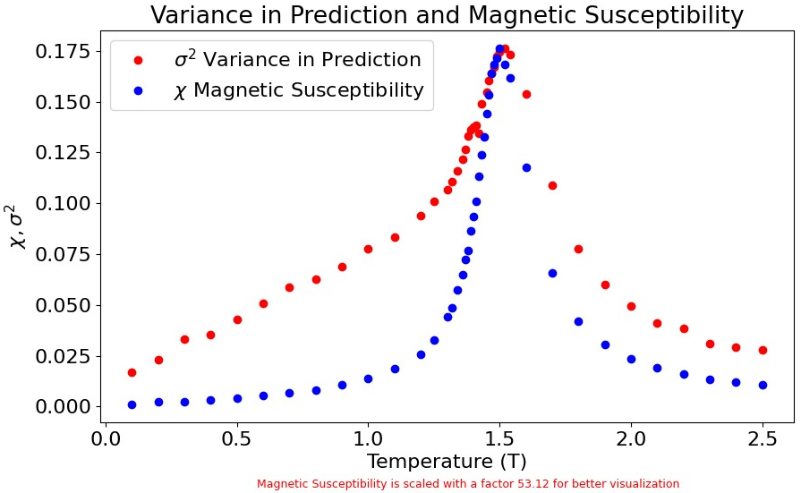

Natural Sciences and Mathematics
Classical 3D-Heisenberg Model Results X-Component Only
We got very good results for:
2D/3D Ising Model
3D Heisenberg Model
✓
✓
Natural Sciences and Mathematics
9 of 11
9

Slide 10
Natural Sciences and Mathematics
Conclusions and future work
Conclusions:
The classification tasks for complex statistical models needs building CNN networks
The average prediction mimics the behavior of an order parameter
  we can use it to get insight in systems for which we don’t have a real order parameters
The variance in prediction is a very good indicator for the location of the phase transition
  we can use it in systems for which we do not know the value of the transition temperature
Future work:
Build a model to do classification tasks the in the pure gauge sector
Build a model to do the classification task in a QCD system that includes fermions
Natural Sciences and Mathematics
10 of 11

Slide 11
Natural Sciences and Mathematics
Thank You
Natural Sciences and Mathematics
11 of 11

