Slide 1

Improving Calibration Methods for NOVA
Dat Tran
Lisa Koerner

Slide 2
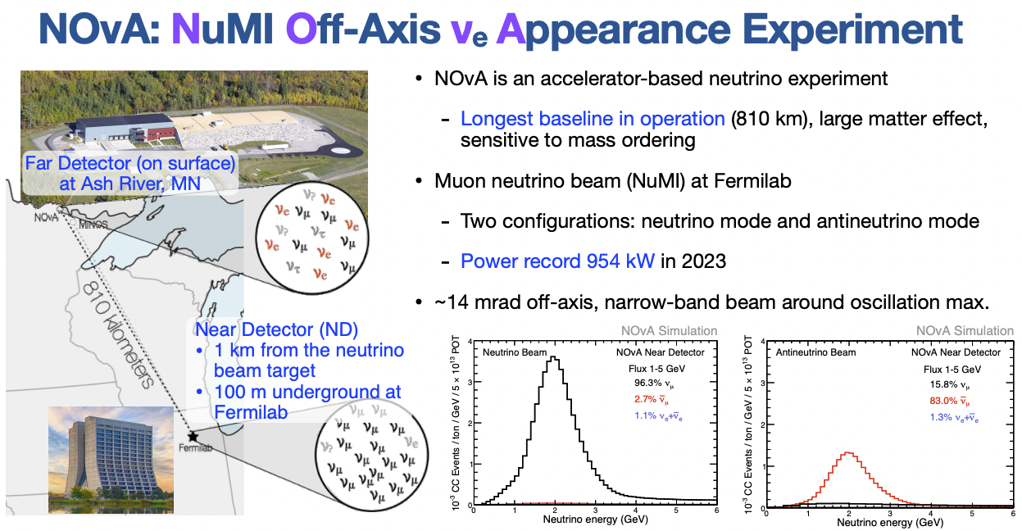

Slide 3
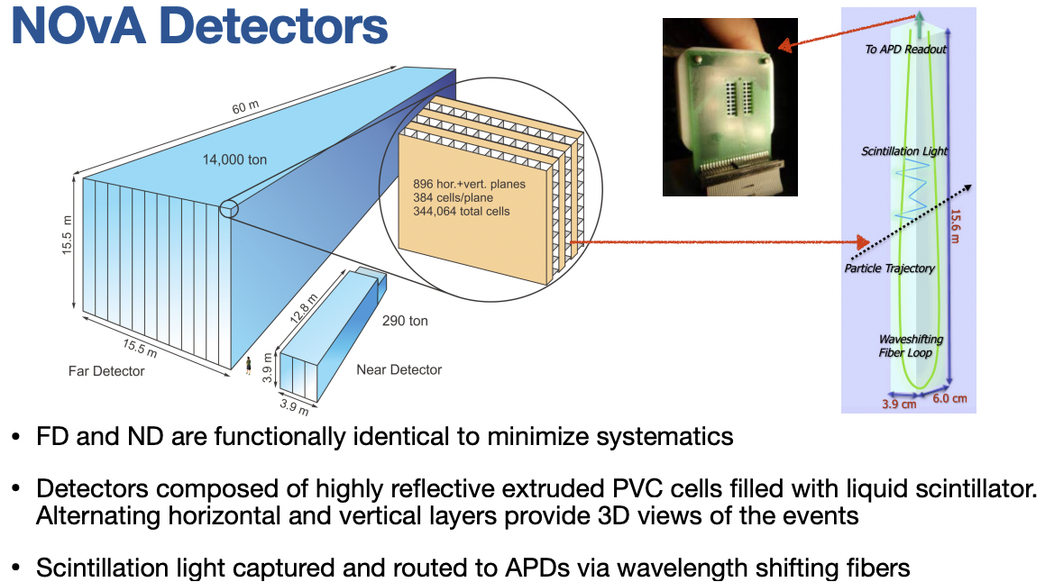

Slide 4
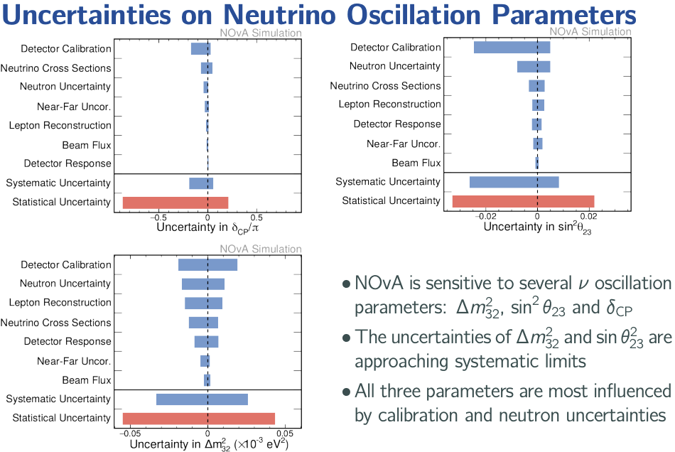

Slide 5
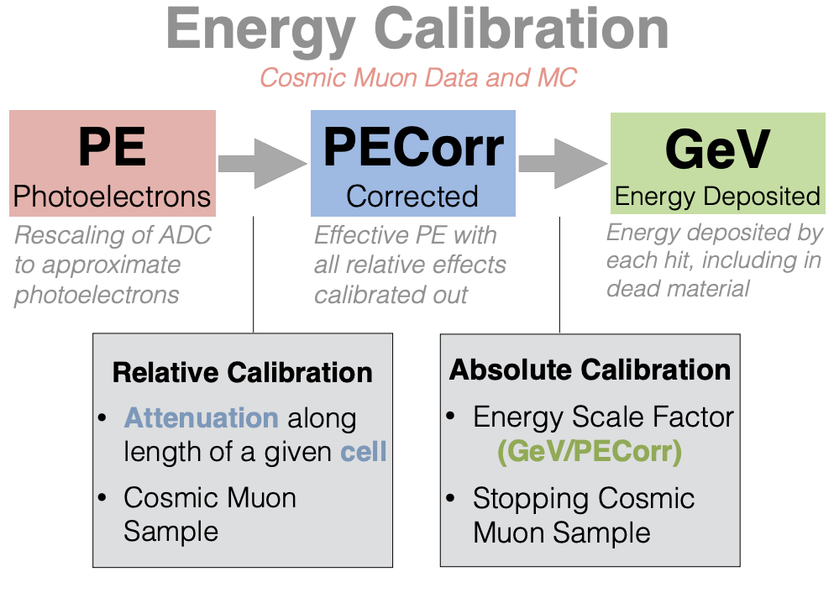
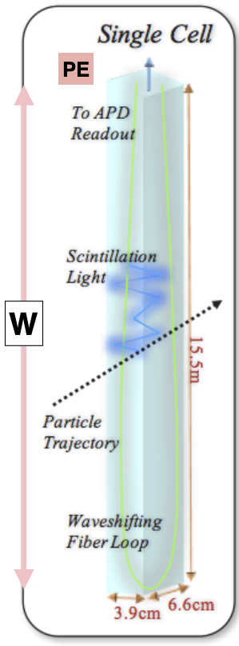

Slide 6
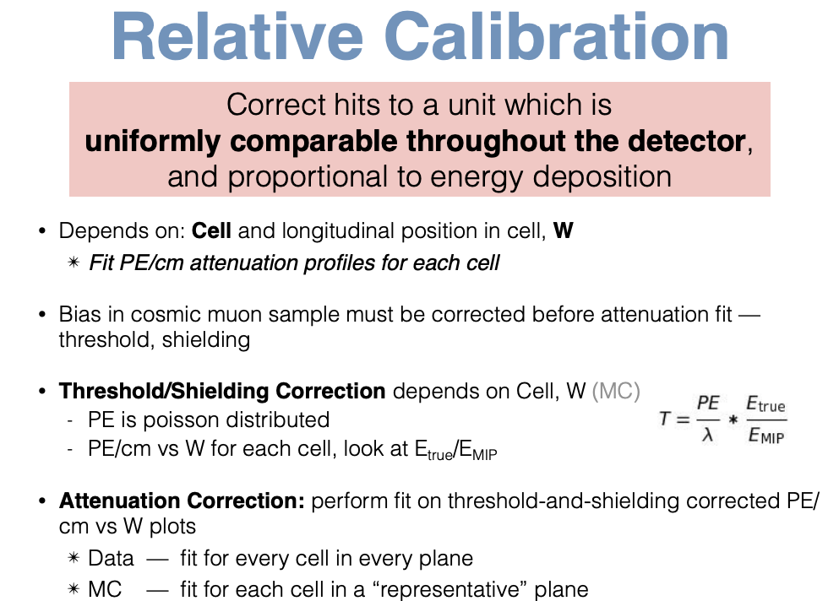
Threshold/Shielding Correction depends on Cell, W (MC)
Threshold Effect: Hits < 25 PE not seen by readout
Shielding Effect: Energy deposition is not uniform throughout the detector

Slide 7
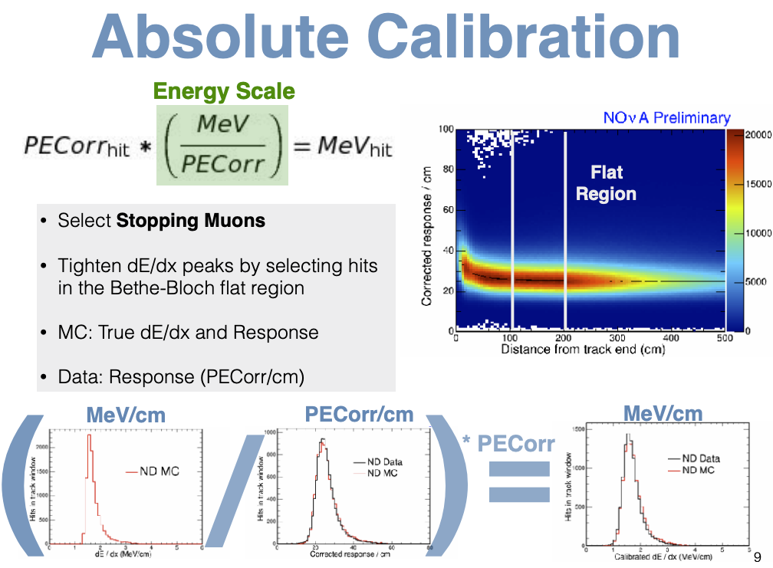

Slide 8
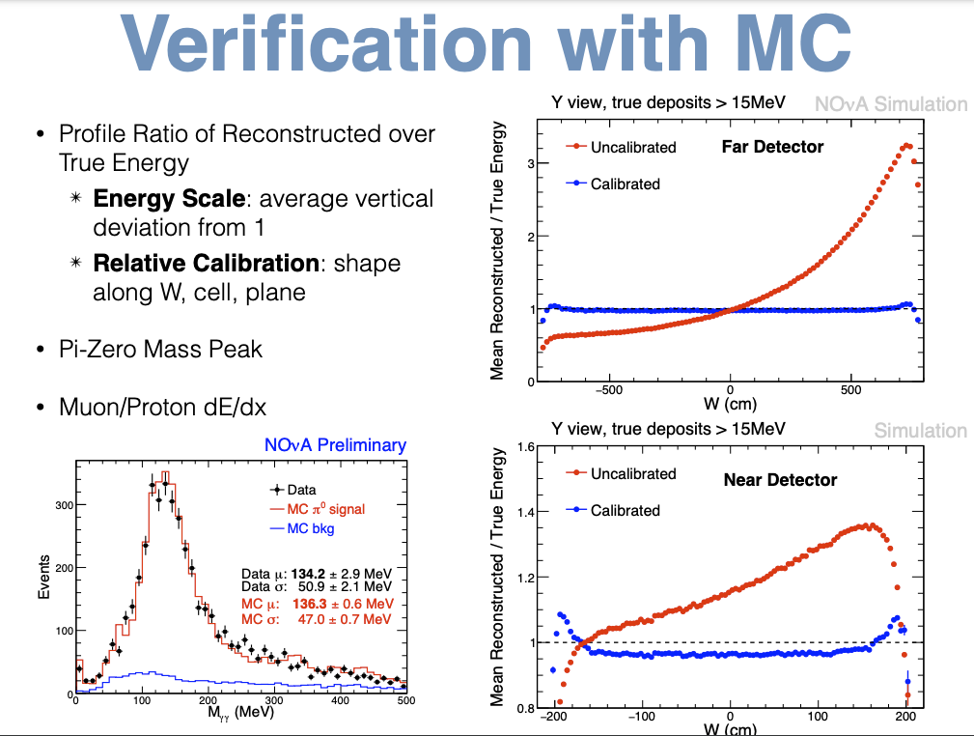

Slide 9
Challenges of calibration
The calibration code is convoluted, not beginner friendly. It tries to process the samples, calculate constants, make plots, and create a tex file at the same time.
It is very manual and takes a long time to run, leaving us at risk of running out of memory (and patience) if when processing large samples.
It’s not easy to redo calibration for a certain sample. One would have to go through the entire workflow again.
=> Goal is to automate the process and make it more approachable for beginners.

Slide 10
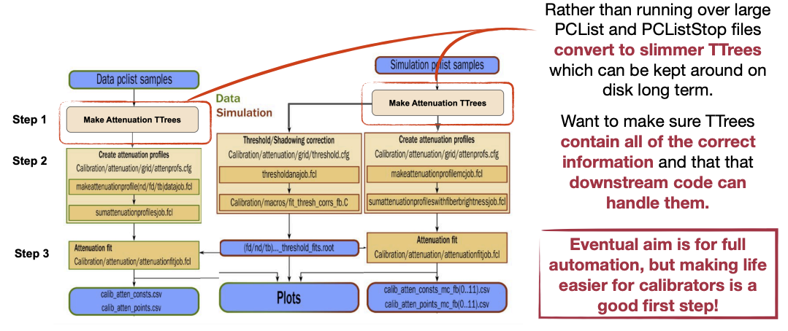
Relative Calibration Improvement

Slide 11
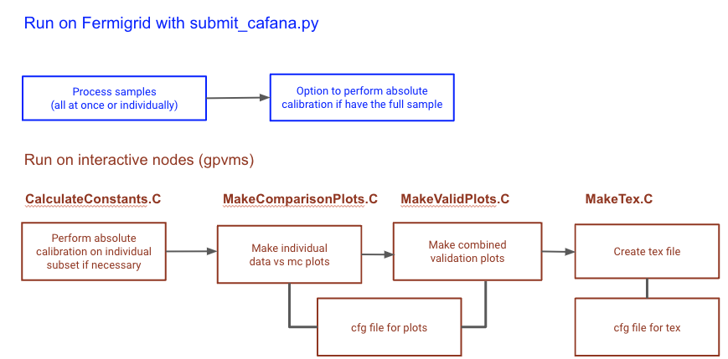
Absolute Calibration Improvement

Slide 12
Future Goals
Absolute calibration new software is finished.
Relative calibration: validation between old and new version at each step of the process.
Automation (or close to automation) of the entire process.
Train new people to take charge of calibration for future data.
Technotes, wiki guides >>> calibration paper.

