Slide 1


Replication and study of anomalies in LK-99, the alleged ambient-pressure, room-temperature superconductor
Thacien Habamahoro
Advisor: Prof. Paul Ching Wu Chu
HABAMAHORO, Thacien¹, BONTKE, Trevor¹, CHIROM, Meiraba², WU, Zheng¹, BAO, Jiming³, DENG, Liangzi¹, CHU, Ching Wu¹
¹ Department of Physics and Texas Center for Superconductivity at UH
² Department of Electrical Engineering and Texas Center for Superconductivity at UH
³ Department of Chemistry and Texas Center for Superconductivity at UH

Slide 2
Outline
Introduction to superconductivity
Applications & Motivation
Evidence for Superconductivity in LK-99 by Lee et al./ Our comments
Replication of LK-99
Our evidence against superconductivity in LK-99
Summary

Slide 3

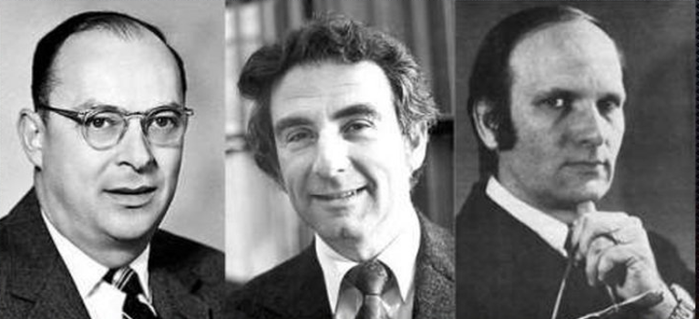
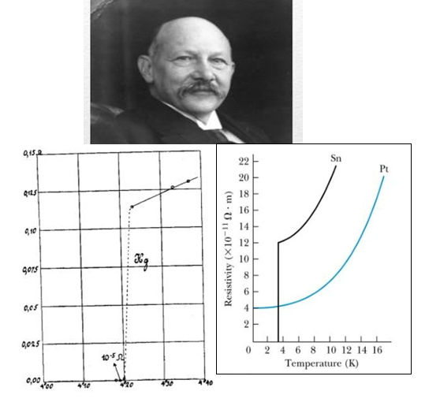
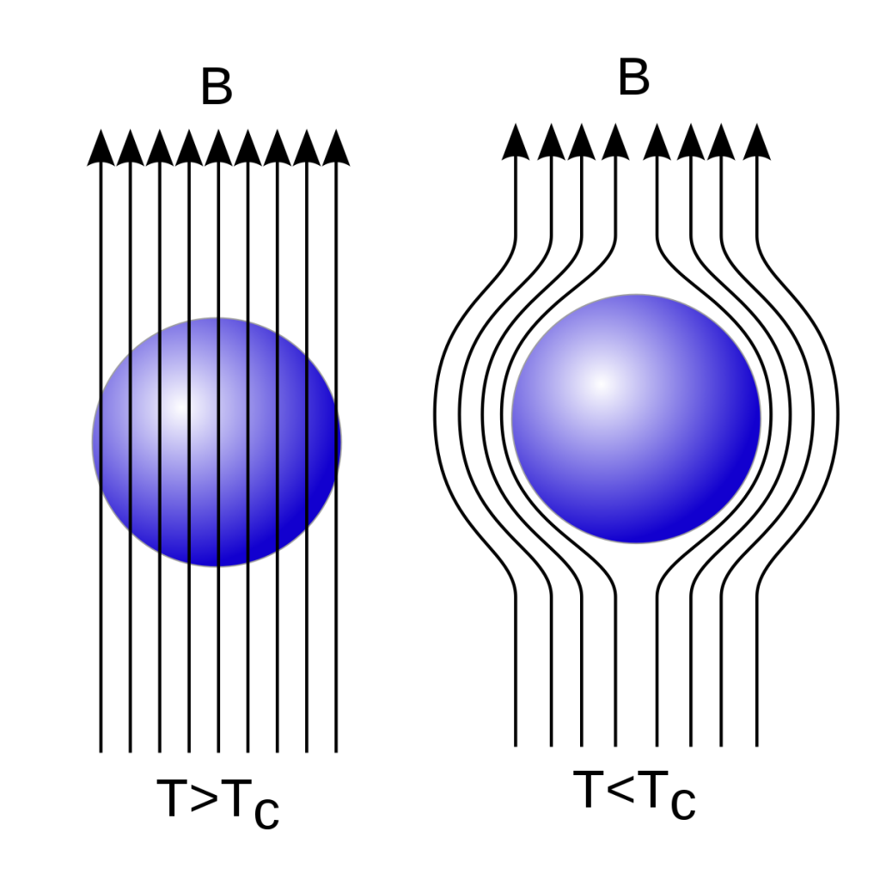
Introduction to superconductivity
1957 - BCS theory
1900 - Drude’s theory for metals
1911 – Heike K. Onnes,
Discovered Superconductivity
Describes Superconductivity as macroscopic effect caused by condensation of Cooper pairs
Low Temperature superconductivity: Early predicted max Tc was 23 K
High Temperature superconductivity
35 K in LBCO (Müller & Bednorz, 1986)
93 K in YBCO (Chu et al. 1987)
164 K in HgBa₂Ca₂Cu₃O_{8+δ} at 32 GPa (Chu et al. 1994)
203 K in H₃S at 150 GPa (Eremets et al. 2015)
260 K in LaH₁₀ at 190 GPa (Hemley et al. 2019)
1933 – Meissner & Oschenfeld,
The Meissner effect
Expulsion of magnetic flux from the interior at T<T_{C}

Slide 4
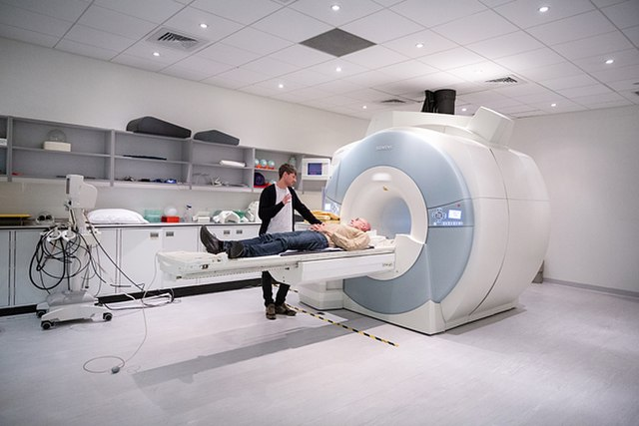
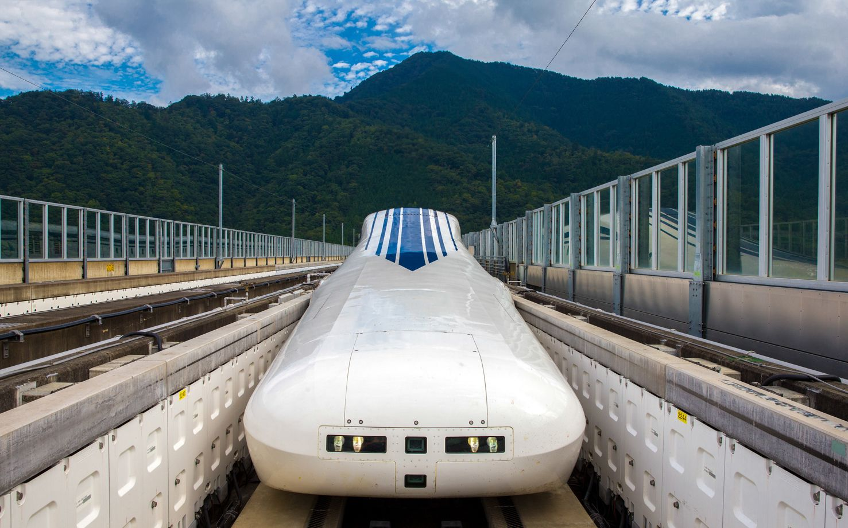
Applications/Motivation
Efficient electric power transmission
Smaller but powerful magnets
Magnetic levitation
High-speed computing, etc.
MRI
Maglev train
The need of low temperature or extreme high-pressure limit the applications
Example: H₃S needs 203 K (-90 ºC) and 150 GPa (1.5$×$10⁶ Atmospheres)
Do we have a superconducting material under ambient conditions?

Slide 5
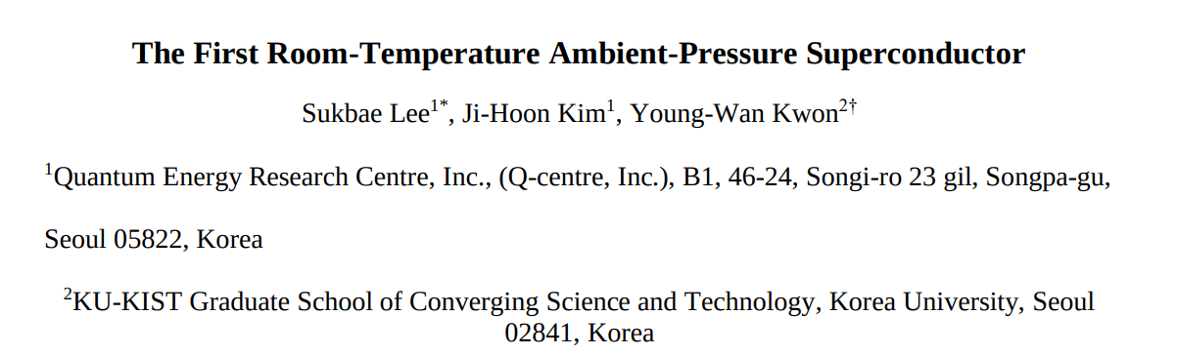
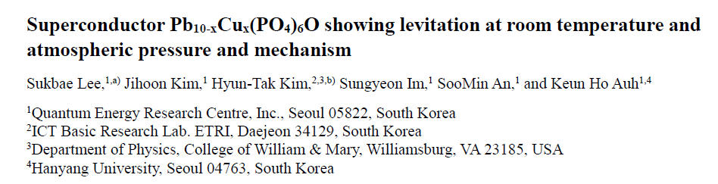
Motivation
S. Lee et al., arXiv preprint arXiv:2307.12008 (2023).
July 22,2023
S.Lee at al., arXiv preprint arXiv:2307.12037 (2023).
July 22,2023

Slide 6
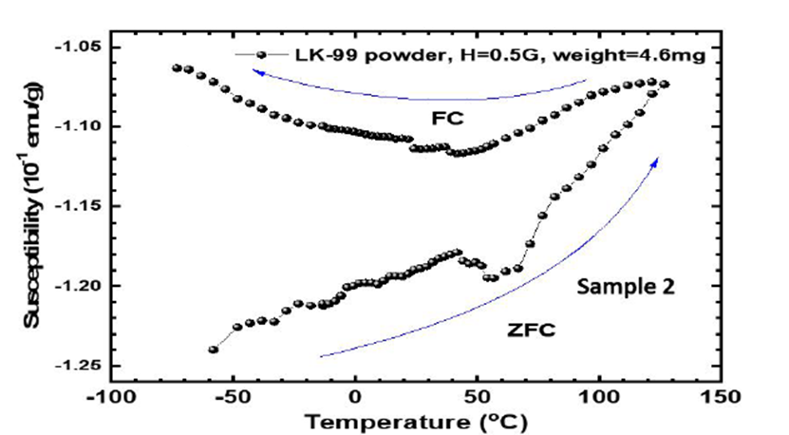
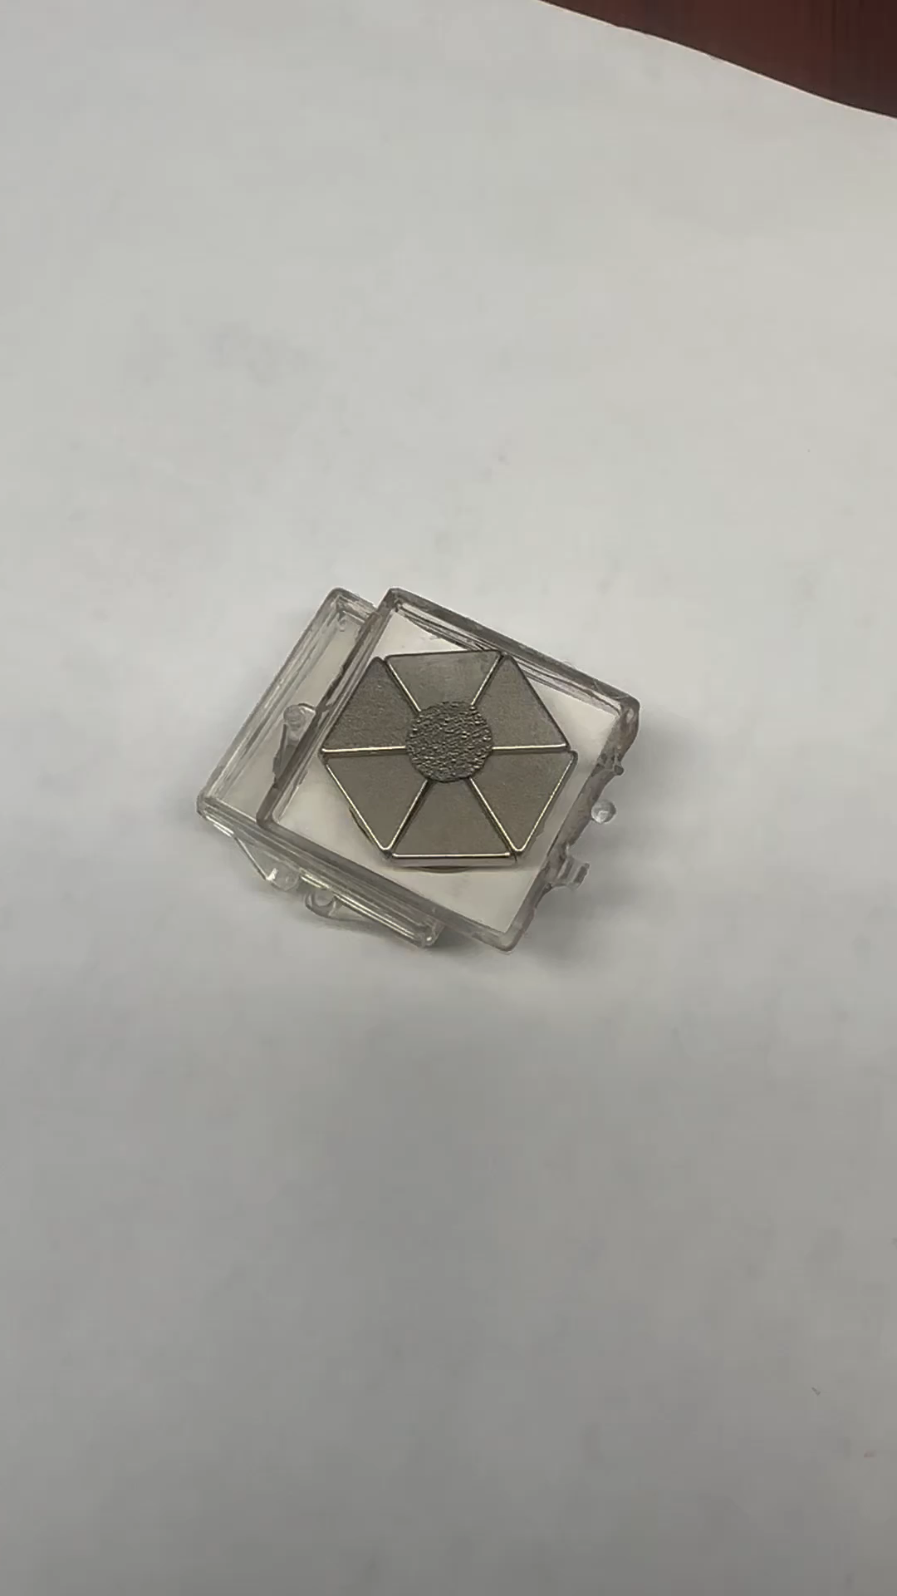
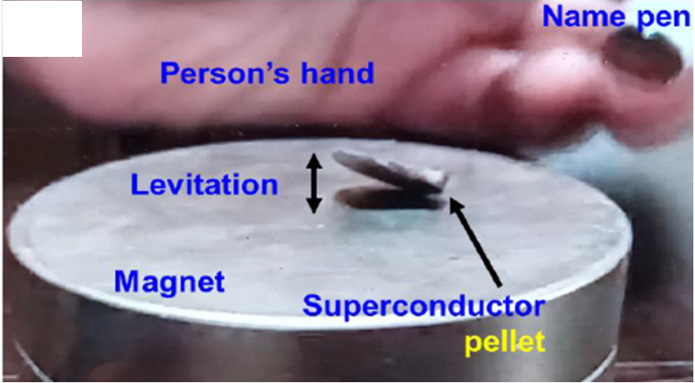
Lee et al. evidence for Superconductivity in LK-99: Our comments
Unphysical large magnetic susceptibility
One edge touching the magnet
Superconductor Pb_{10-x}Cu_{x}(PO₄)₆O showing levitation at room temperature and atmospheric pressure and mechanism
Stable magnetic levitation of a thin slab of graphite over an assembly of magnets

Slide 7
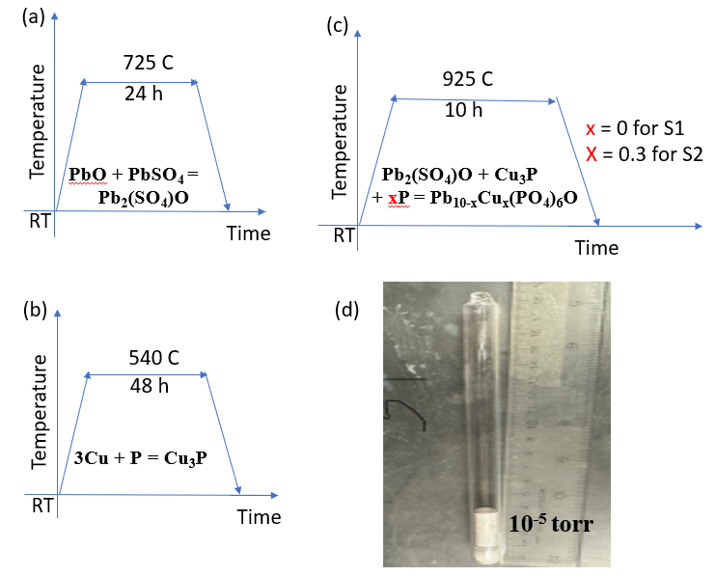
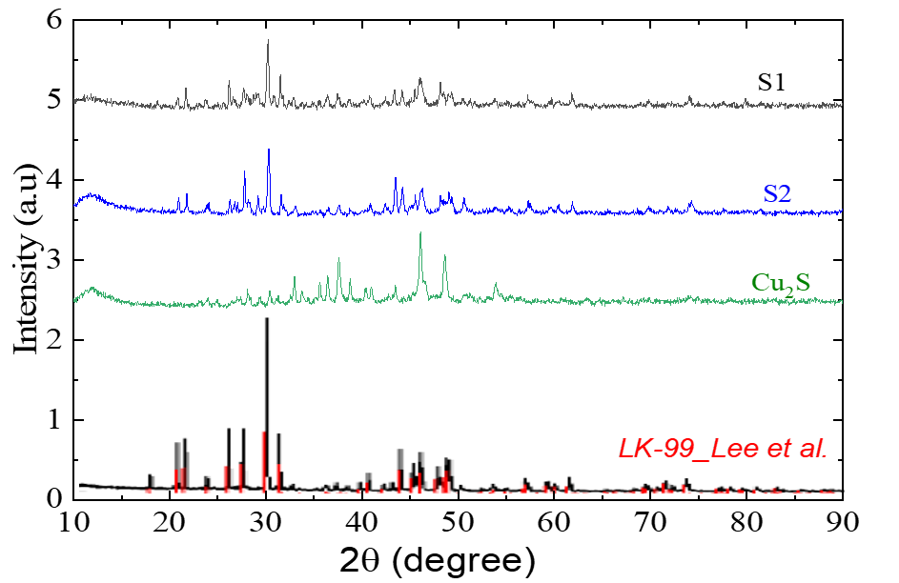
Synthesis: LK-99 Samples/Replication
XRD of Samples obtained via Lee et. al synthesis recipe

Slide 8
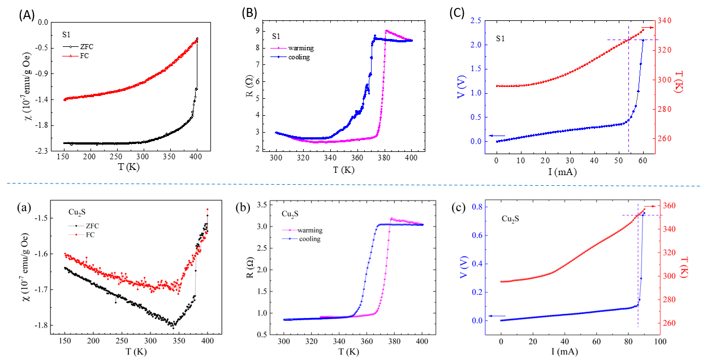
Our evidence against superconductivity in LK-99

Slide 9
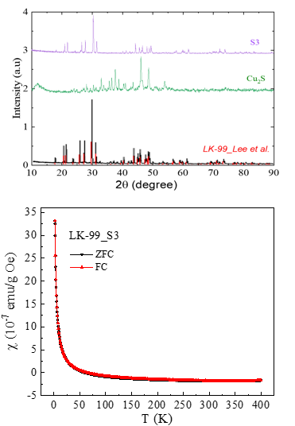
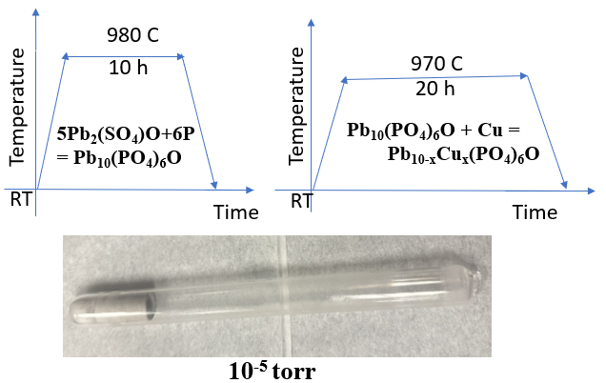
Our evidence against superconductivity in LK-99:
LK-99 sample without Cu₂S impurity
(a)
(b)
(c)
S3 is insulating and shows no magnetic anomaly anywhere close to 400 K

Slide 10
Summary
Demonstrated levitation possibility in non-superconducting materials using a graphite slab on magnets.
Replicated LK-99 sample: Produced sample mirroring Lee et al.'s synthesis, showing anomalies close to 400 K, attributed to Cu2S impurity.
Pure Cu₂S study: Identified a structural phase transition close to 400 K, from monoclinic to hexagonal, indicating impurity-related anomalies.
Cu₂S-free LK-99 synthesis: Developed a sample without Cu₂S impurity, exhibiting no anomalies and high electrical insulation, concluding impurity's role in observed anomalies, not superconductivity.

Slide 11
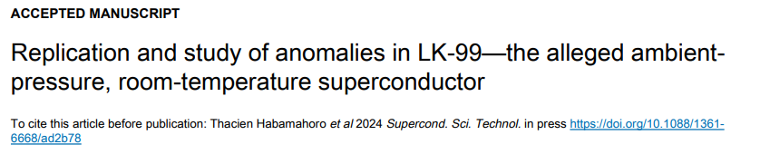
Publication

Slide 12
Acknowledgements
This work is supported by the Enterprise Science Fund of Intellectual Ventures Management, LLC; U.S. Air Force Office of Scientific Research Grants FA9550-15-1-0236 and FA9550-20-1-0068; the T. L. L. Temple Foundation; the John J. and Rebecca Moores Endowment; and the State of Texas through the Texas Center for Superconductivity at the University of Houston.
Thank you

Slide 14
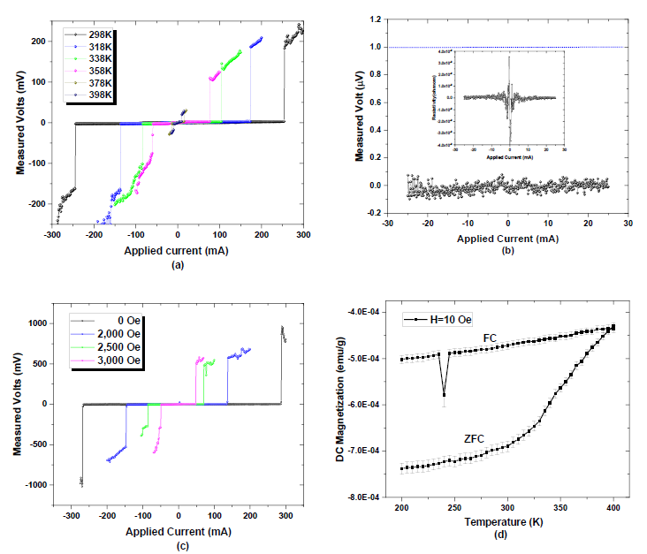
Lee et al. evidence for Superconductivity in LK-99
The First Room-Temperature Ambient-Pressure Superconductor

Slide 15
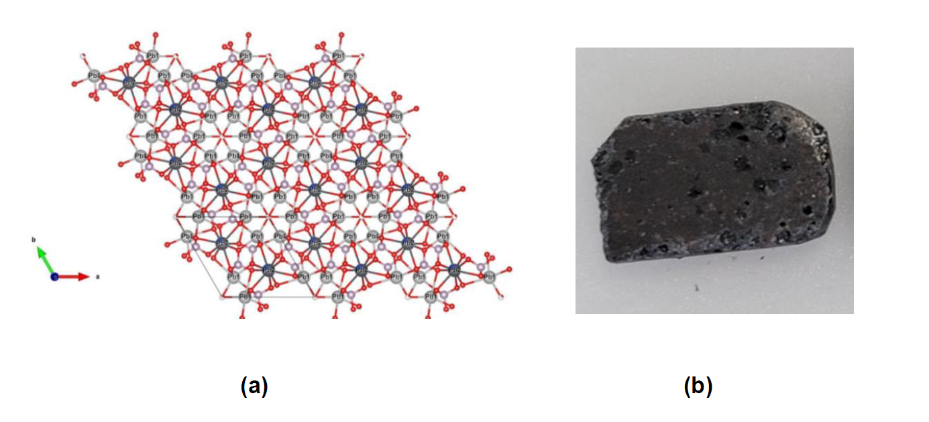
Supplementary slides
Lee et al. LK-99 crystal structure and their bulk sample image

Slide 16
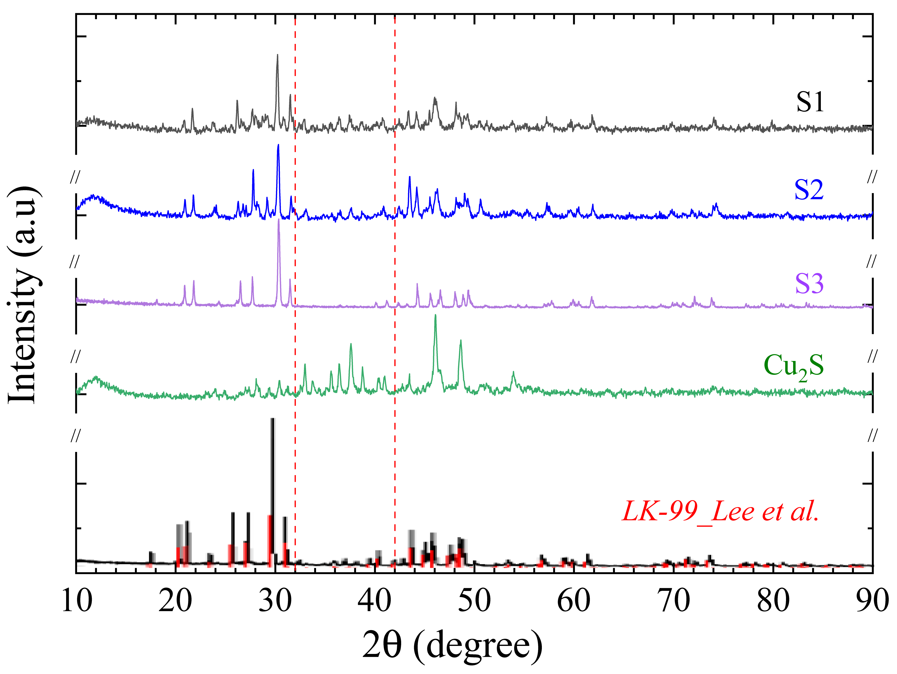
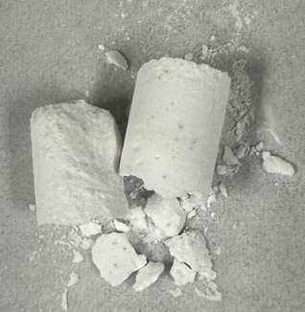
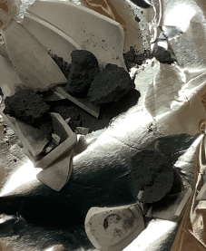
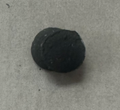
Cu₃P
LK-99

Slide 17
Summary/Conclusion
With a video of a thin slab of graphite on top of magnets set up, we discussed the possibility of having a levitating non-superconducting material.
We successively replicated LK-99 sample following closely Lee et al. synthesis recipe. Our samples have very close XRD data to Lee’s LK-99 sample including Cu₂S impurity. These samples (S1 and S2) show anomaly in magnetic and resistive data at around 380 K, but not related to superconductivity.
We studied pure Cu₂S and found a first order phase transition at around 380 K related to the structural phase change from low-temperature monoclinic to high-temperature hexagonal structure.
We then synthetized LK-99 sample free of Cu₂S impurity following a slightly different route. This sample does not exhibit any of the above anomaly and it’s highly insulating.
We conclude that all anomalies studied are associated with the structural transition of the Cu₂S impurity in their sample and not with superconductivity.

Slide 18
