Slide 1




Dual-Phase TPC Separation Grid Development and Production in Darkside-20k Prototypes
By Daniel Huff
PI: Dr. Andrew Renshaw
University of Houston – Dept. of Physics
01/17

Slide 2
Presentation Focal Points
Workings and advantages of dual-phase TPCs
Objectives and methods of separation grid assembly
02/17

Slide 3
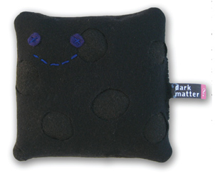
A Profile of Dark Matter
Theorized from strong astrophysical evidence (gravitational)
Slow, stable, massive particles without EM interactions
No direct detection … yet!
Particle Zoo’s Dark Matter Plush
03/17

Slide 4
To Detect the Undetected
Liquid scintillator target (noble liquids common)
Nuclear and/or electron recoils
? + Ar -> Ar*
Ar* -> Ar + γ + e⁻
Many prior detectors only utilized the light signal
γ
Ar
e-
04/17

Slide 5
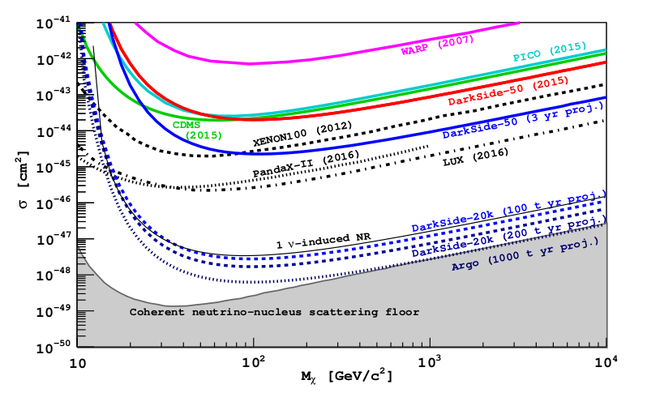
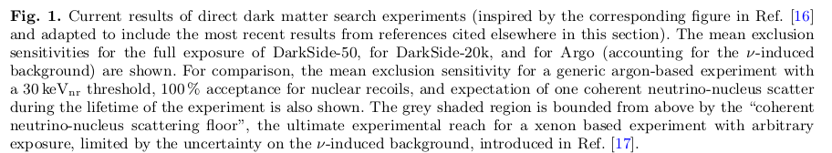
(Aalseth, 2018)
05/17

Slide 6
Darkside-20k and Dual-Phase TPCs
Eliminating backgrounds is the key to success and sensitivity
-Passive vetos, active vetos, and signal shape (PSD)
Even more powerful: coincidence signals (S1 and S2)
Second phase allows for creation of S2 signal using ionization electrons
(Aalseth, 2018)
06/17

Slide 7
Gaseous Argon
S2
Liquid Argon
Electric Field
WIMP
e⁻
S1
07/17

Slide 8
The Electric Fields of DS-20k
Both a "drift" and "extraction" field are needed
Elements inside of detector volume!
Uniformity of fields and transparency of
extraction/separation grid
08/17

Slide 9
Presentation Focal Points
Workings and advantages of dual-phase TPCs
Objectives and methods of separation grid assembly
09/17

Slide 10
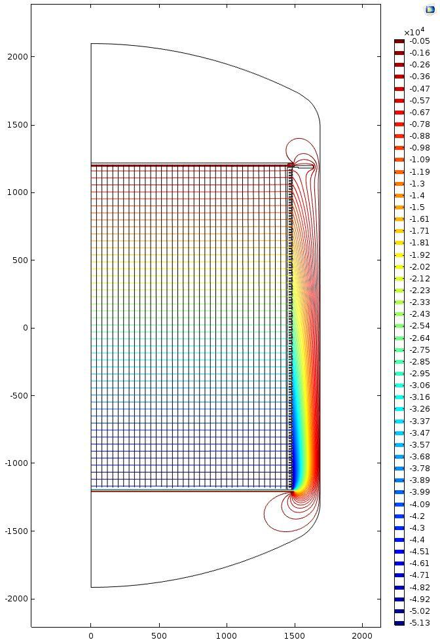
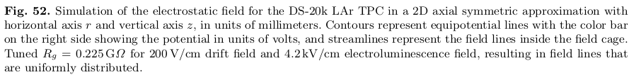
d
General grid shape, wire pitch "d"
DS Mockup = 231 wires
(Aalseth, 2018)
10/17

Slide 11
An Effective Grid: Uniform and Transparent
For cylindrical wires, separated by pitch d, it turns out that "deviations from uniformity in the field are therefore small even when |x| is of the same magnitude as d“
Shielding inefficiency σ is:
where p is the grid-to-anode distance, so to minimize σ we want p > d
We don't want to do this with r ~ d, because of the condition for low grid interception:
where ρ = 2πr/d
σ ≈ (d/2πp) * log(d/2πr)
ΔVa/ΔVc > (p + pρ + 2lp) / (a - aρ - 2lp)
11/17
(Quote and formulae: Bunemann, 1949)

Slide 12
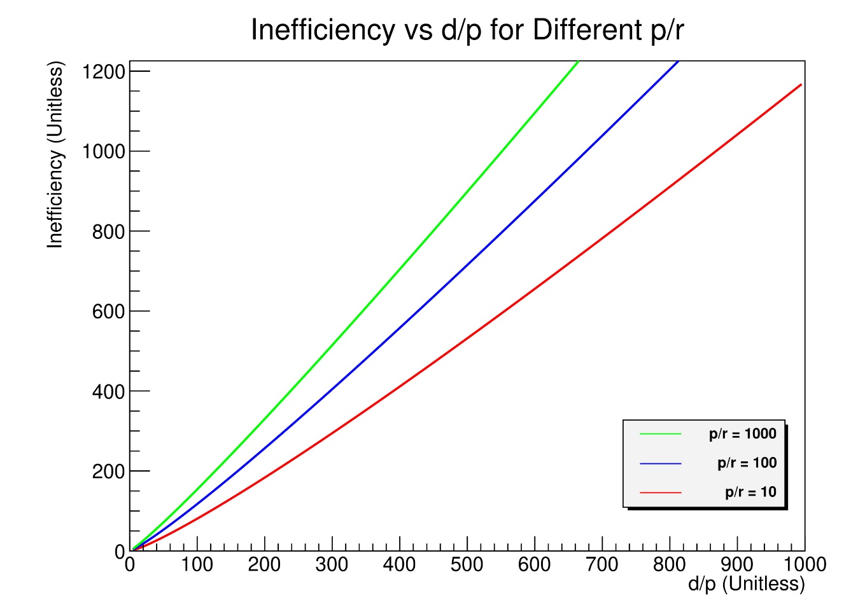
…to minimize σ we want p > d
σ ≈ (d/2πp) * log(d/2πr)
ΔVa/ΔVc > (p + pρ + 2lp) / (a - aρ - 2lp)
Grid Specifications:
3mm pitch
200µm wire
12/17
(Quote and formulae: Bunemann, 1949)

Slide 13
An Effective Grid: In One Piece
Inside the TPC the temperature is < 87K -> thermal stress
The wires repel one another -> EM force
The wires are suspended in liquid -> buoyant force
For grid uniformity, shape is essential, thus tension is needed
2-3N is sufficient and not excessive
13/17

Slide 14
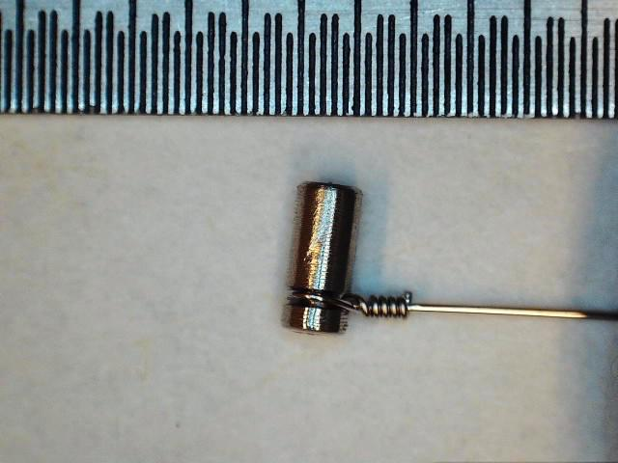
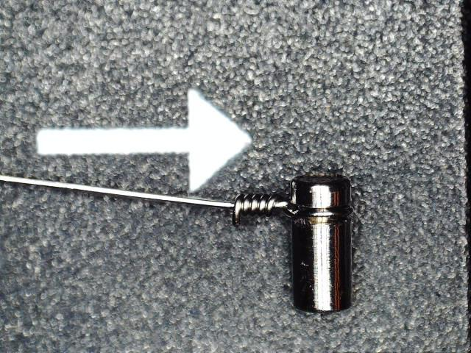
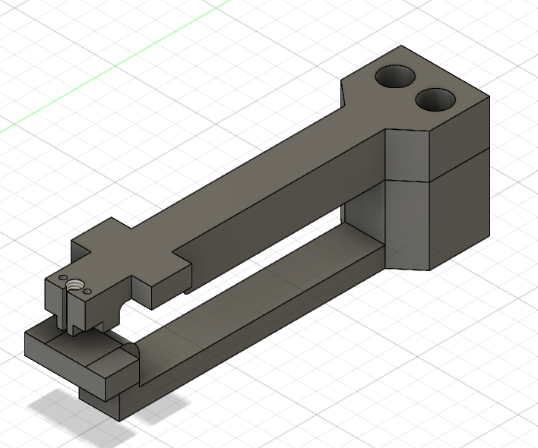
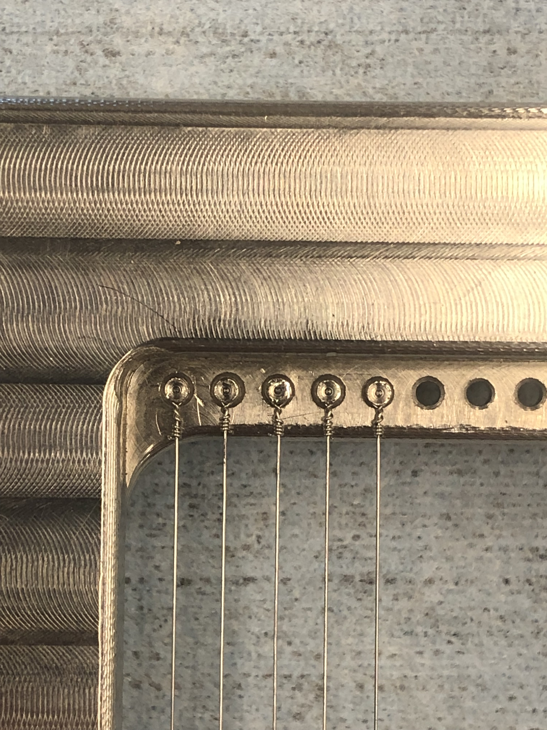
Interchangeable Wires
Wires are made to various lengths/tensions from SS-316 (r = 200µm)
Fastened to SS-316 pins using twisted end design
Pins are inserted into holes in the frame using custom tools
14/17

Slide 15
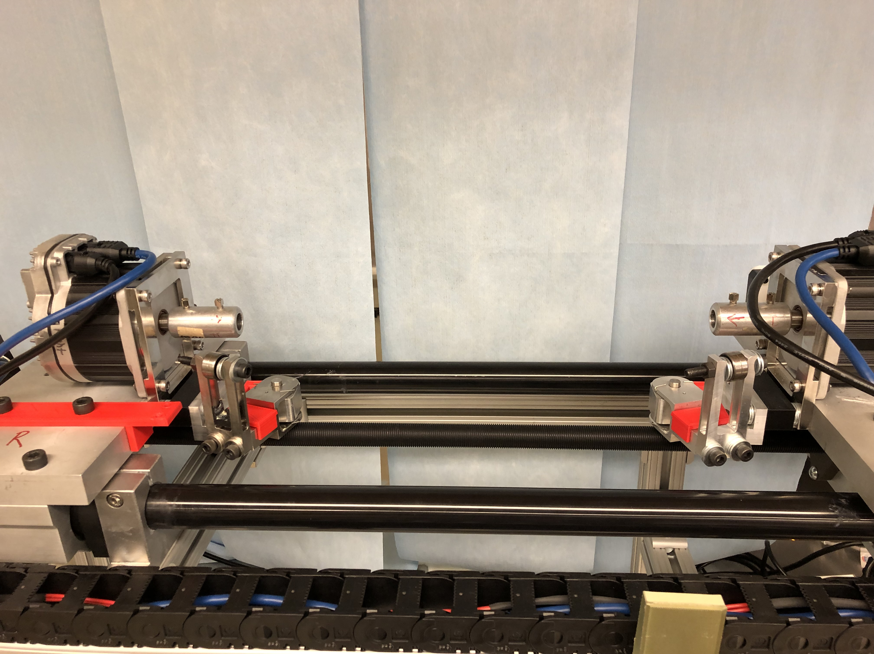
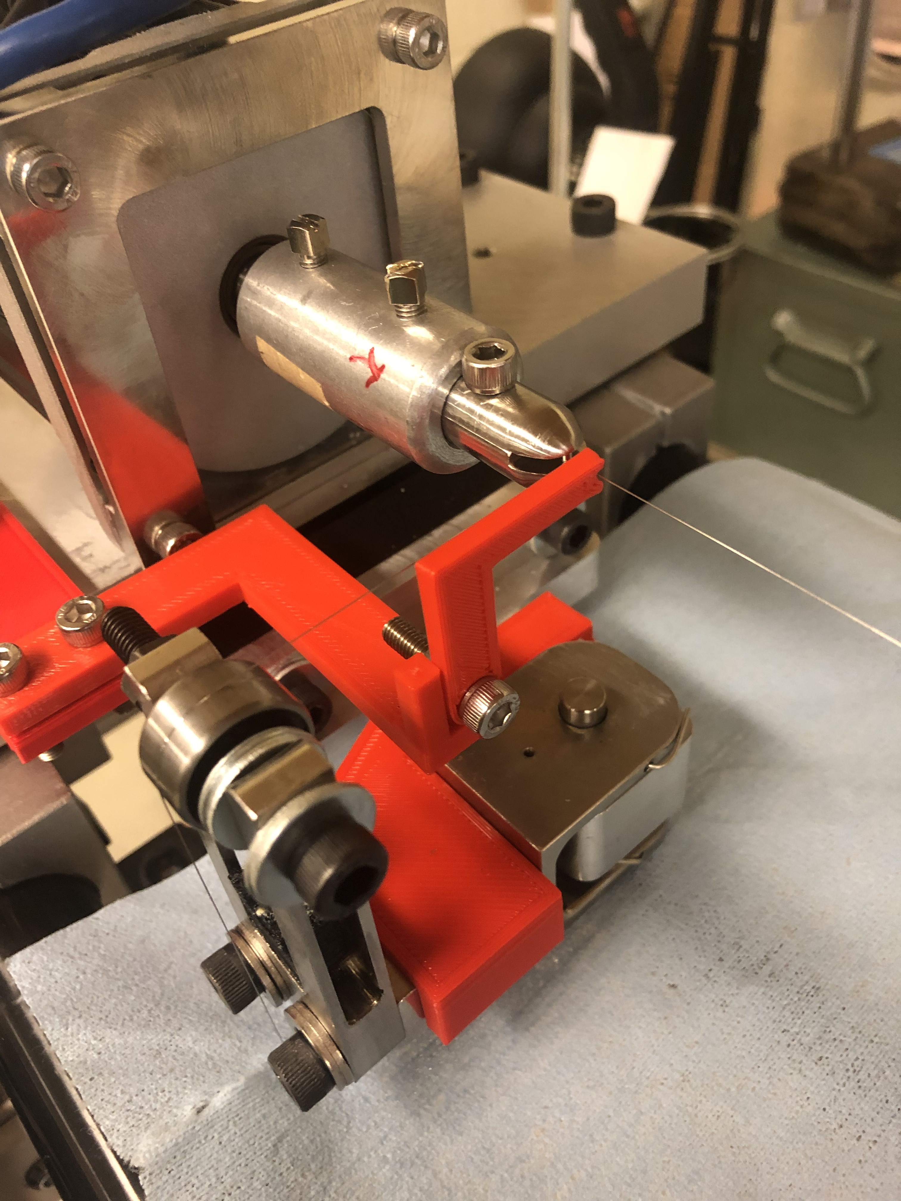
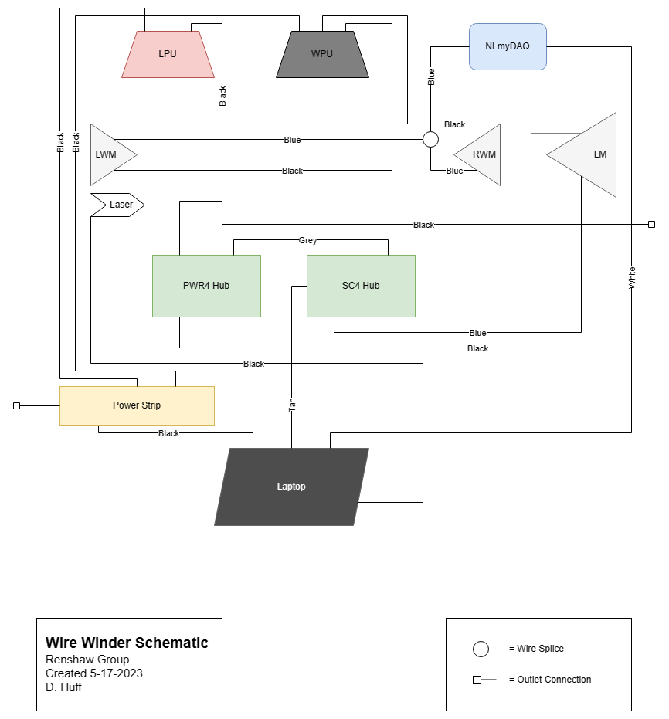
15/17

Slide 16
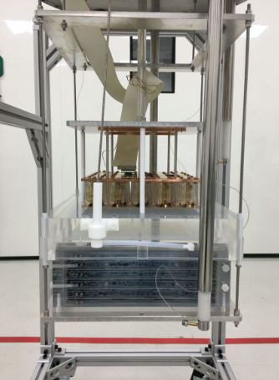
Performance of Wires
Structure holds up to 15N tension – failure mode is unravelling
Low radioactivity in materials
High production consistency from QA measurements
Proto-0 running already
Mockup (or Proto-1T) wire production underway
Courtesy: Michael Poehlmann
16/17

Slide 17
Thank You!
Special thanks to:
Dr. Dan Cherdack
Dr. Ed Hungerford
Dr. Stephen Pordes
Future Dr. Alejandro Ramirez
Future Dr. Sebastian Torres-Lara
The DS-20k Collaboration, including the ID Working Group
17/17

Slide 18
References
Aalseth, Craig E., et al. "DarkSide-20k: A 20 tonne two-phase LAr TPC for direct dark matter detection at LNGS." The European Physical Journal Plus 133 (2018): 1-129.
O. Bunemann, T. E. Cranshaw, and J. A. Harvey. 1949. DESIGN OF GRID IONIZATION CHAMBERS. Canadian Journal of Research. 27a(5): 191-206.
Ref.

