Slide 1


PTFE reinforced electrolyte membrane for high performance and durability in Proton Exchange Membrane Fuel Cell (PEMFC)
Subash C. Bhandari
Advisor: Dr. Anima Bose
Date: 02/24/2024
Physics Research Day - 2024

Slide 2
Outline
Introduction on Fuel Cell
Experiment
Results and Discussion
Conclusion

Slide 3
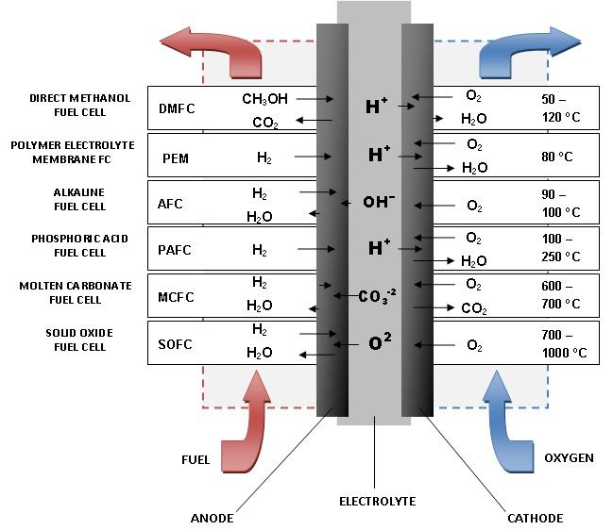
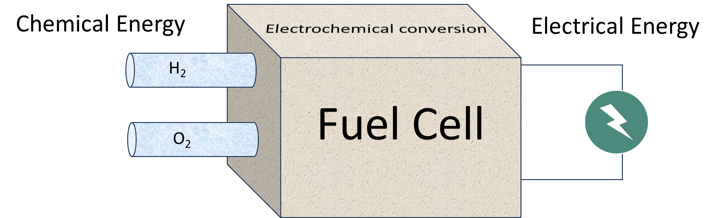
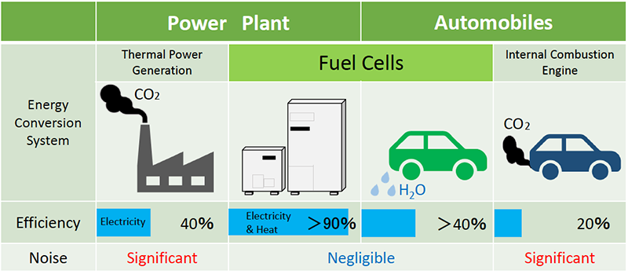
1. Introduction: Fuel Cell
http://www.fcgroup.yamanashi.ac.jp/en/fuel-cell/index.html
DOI:10.13140/RG.2.1.2579.0482

Slide 4
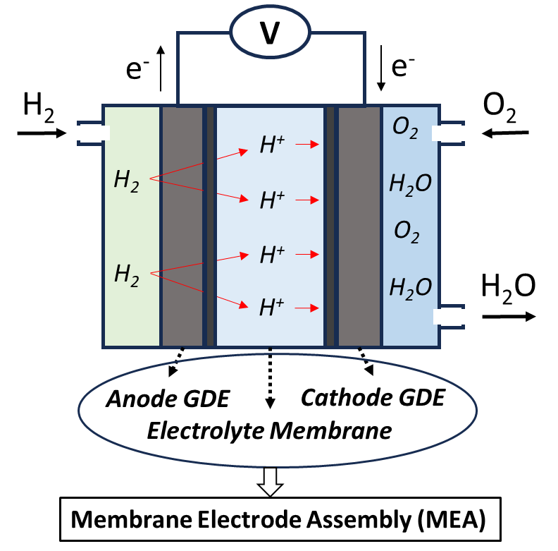
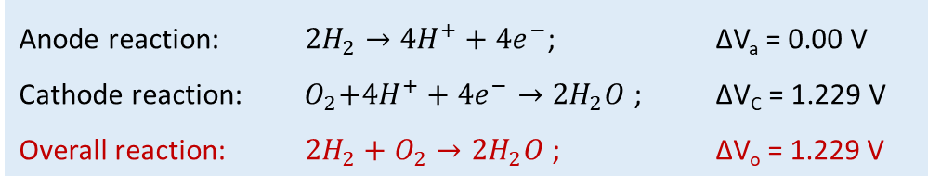
1. Introduction: Proton Exchange Membrane Fuel Cell (PEMFC)
Proton Exchange Membrane Fuel Cell (PEMFC)
Anode reaction: ${2H}_{2}→{4H}^{+}+{4e}^{−}$; ∆V_{a} = 0.00 V
Cathode reaction: ${ O}_{2}+{4H}^{+}+{4e}^{−}→{2H}_{2}O$ ; ∆V_{C} = 1.229 V
Overall reaction: ${2H}_{2}+O_{2}→{2H}_{2}O$ ; ∆V_{o} = 1.229 V

Slide 5
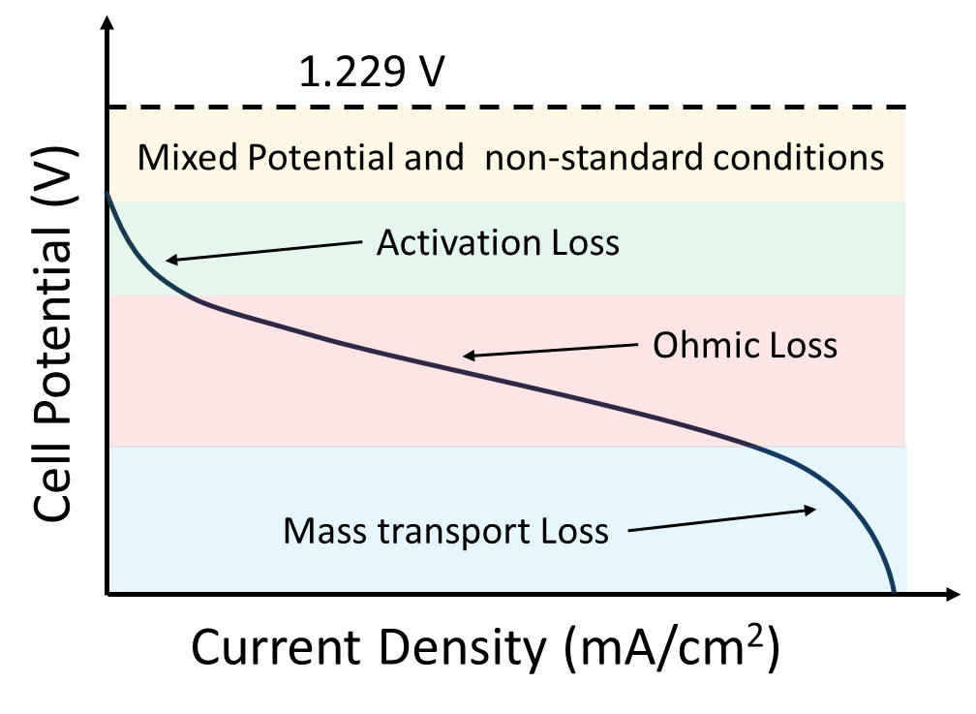


1. Introduction: Proton Exchange Membrane Fuel Cell (PEMFC)
Proton Exchange Membrane Fuel Cell (PEMFC)
Over potential $(η) = η_{act}+η_{ohm}+η_{con}$
Anode reaction: ${2H}_{2}→{4H}^{+}+{4e}^{−}$; ∆V_{a} = 0.00 V
Cathode reaction: ${ O}_{2}+{4H}^{+}+{4e}^{−}→{2H}_{2}O$ ; ∆V_{C} = 1.229 V
Overall reaction: ${2H}_{2}+O_{2}→{2H}_{2}O$ ; ∆V_{o} = 1.229 V
$$η_{ohm}={iR}_{internal}$$

Slide 6
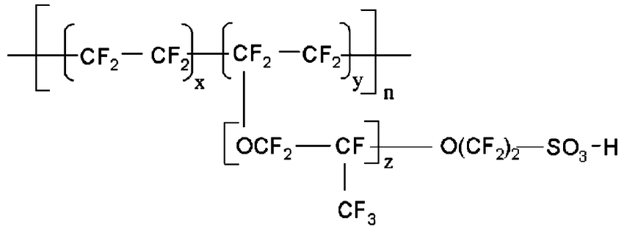
1. Introduction: Proton Exchange Membrane (PEM)
General properties of PEM
Excellent proton conductivity
High electric resistivity
Barrier to gas crossover
Mechanically strong
Higher chemical stability
Chemical structure of state-of-the-art Nafion® monomer

Slide 7
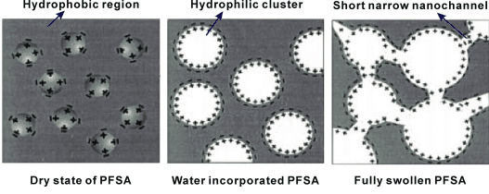
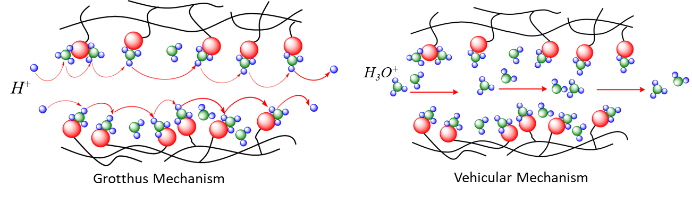
1. Introduction: Proton Exchange Membrane (PEM)
General properties of PEM
Excellent proton conductivity
High electric resistivity
Barrier to gas crossover
Mechanically strong
Higher chemical stability
Chemical structure of state-of-the-art Nafion® monomer
Proton Transport Mechanisms
EnergyTechnol.2015,3,675–691

Slide 8
1. Introduction: Proton Exchange Membrane (PEM)
General properties of PEM
Nafion® Membrane
Excellent proton conductivity
High electric resistivity
Barrier to gas crossover
Mechanically strong
Higher chemical stability
Pros:
Excellent proton conductivity
Good chemical stability
Thermally stable up to 160 ºC
Chemical structure of state-of-the-art Nafion® monomer
Cons:
Excessive swelling
Gas permeability
Low mechanical strength
Expensive (~ 1000 $/m²)
Proton Transport Mechanisms
EnergyTechnol.2015,3,675–691

Slide 9
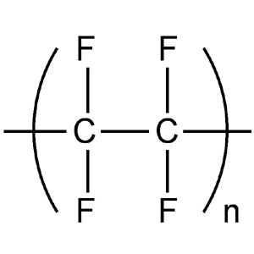
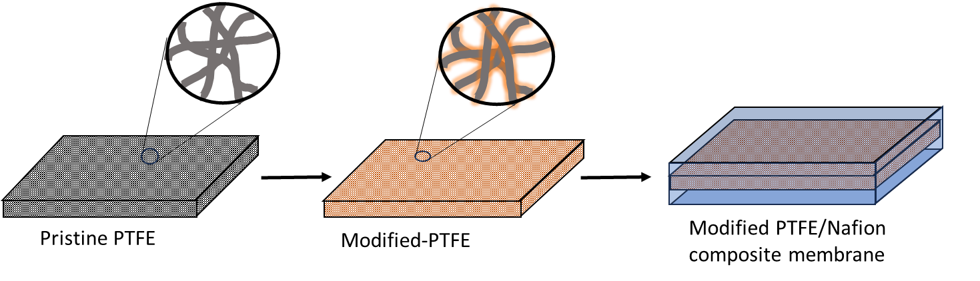
2. Experiment
PTFE reinforced Nafion composite membrane:
Polytetrafluoroethylene (PTFE) chemical structure
Casting Nafion solution directly on porous PTFE Substrate (PTFE/Nafion)
Casting Nafion solution on modified-PTFE substrate (modified-PTFE/Nafion)

Slide 10
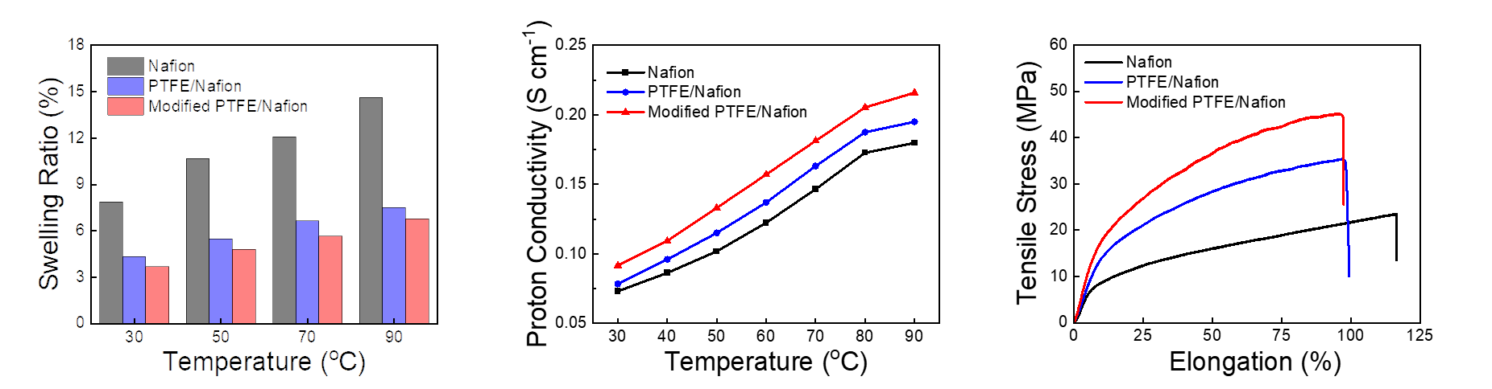
3. Result and Discussion: General Properties
Reduced swelling ratio
  Constrained by PTFE network
Increased proton conductivity
  Packed-acid mechanism
Enhanced mechanical strength
  PTFE support

Slide 11
3. Result and Discussion: PEMFC performance
(a)
(b)
Single cell PEMFC performance in (a) H₂/O₂ and (b) H₂/air

Slide 12
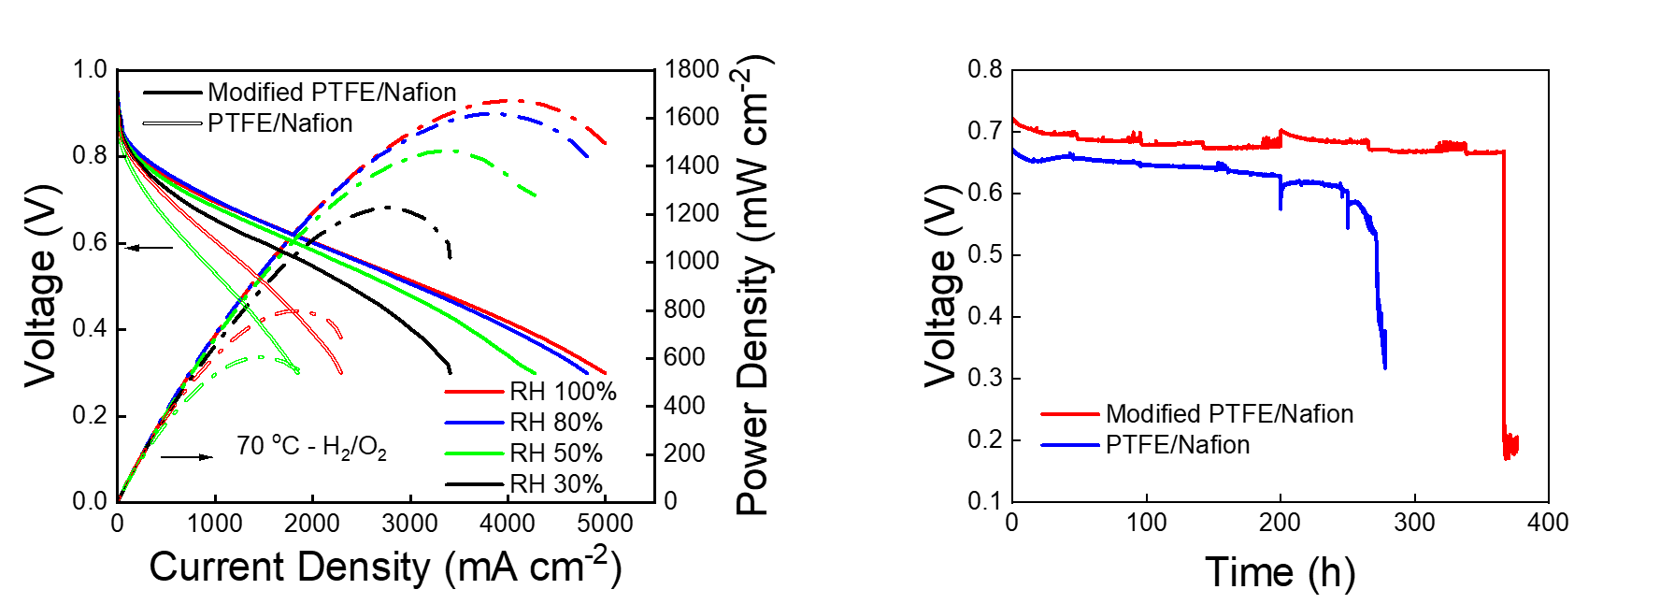
3. Result and Discussion: PEMFC performance and Durability
Single cell PEMFC performance at various RH
Membrane durability test at constant current of 0.2 A with cell temperature of 90 ºC and 30% RH

Slide 13
4. Conclusion
Compared to the state-of-the-art Nafion® membrane, modified PTFE/Nafion electrolyte membrane demonstrates;
More than 57% lower swelling ratio
Improved mechanical strength by 1.8-fold
Improved PEMFC performance by 52% in O₂ and 35% in air
Long term stability in harsh operating conditions of PEMFC

Slide 14
Acknowledgement
Current Lab Members
Dr. Anima Bose : Research Advisor
Dr. Dinh Cong Tinh Vo : Postdoctoral Researcher
Subash Bhandari :Graduate Student
Paul Byaruhanga : Joint Graduate Student

Slide 15
Thank you for your Attention !

Slide 17
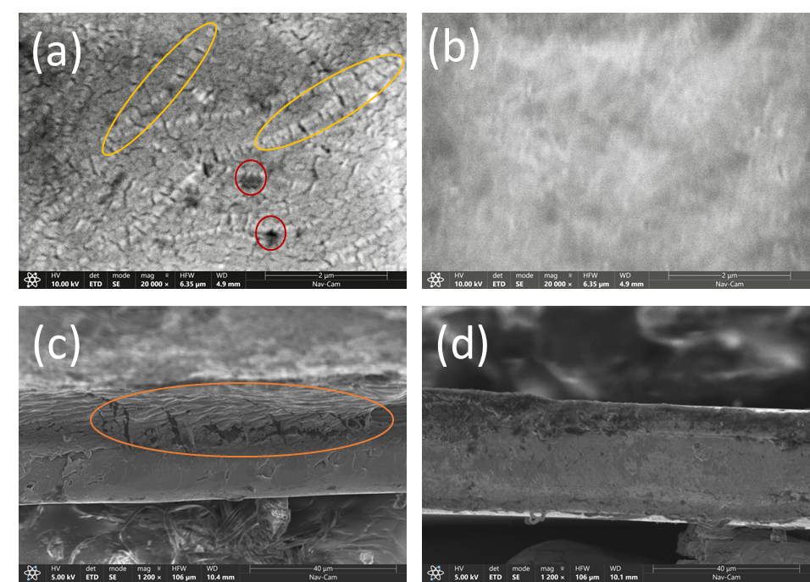
PTFE/Nafion
Modified PTFE/Nafion
Surface SEM
Cross-section SEM

Slide 18

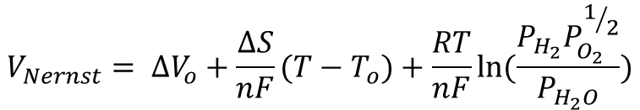
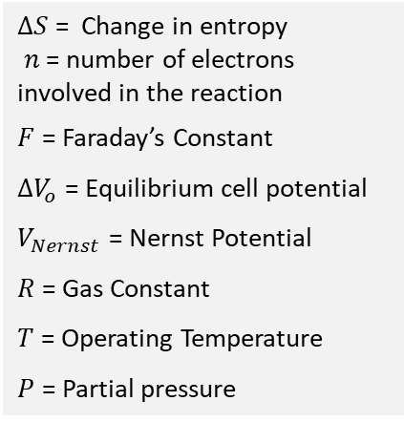


Thermodynamic potential:
$$V_{Nernst}= {∆V}_{o}+\frac{∆S}{nF}(T−T_{o})+\frac{RT}{nF}\ln{(\frac{P_{H_{2}}P_{O_{2}}^{1/2}}{P_{H_{2}O}})}$$
$∆S$ = Change in entropy
$n$ = number of electrons involved in the reaction
$F$ = Faraday’s Constant
${∆V}_{o}$ = Equilibrium cell potential
$V_{Nernst}$ = Nernst Potential
$R$ = Gas Constant
$T$ = Operating Temperature
$P$ = Partial pressure
Fuel Cell Potential $\left(V\right)= V_{Nernst}−η$
Over potential $(η) = η_{act}+η_{ohm}+η_{con}$
$$η_{ohm}={iR}_{internal}$$

