Slide 1
Kneading Theory for Gene Splicing
Ethan Speakman

Slide 2
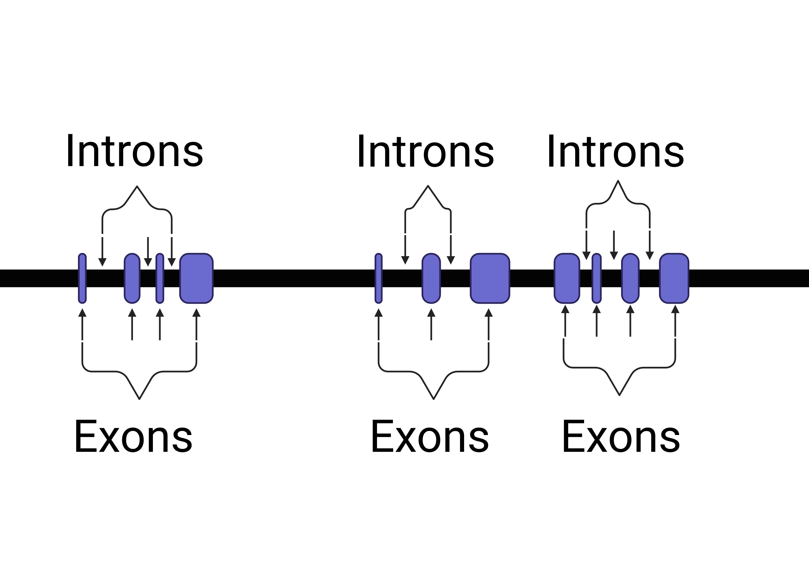
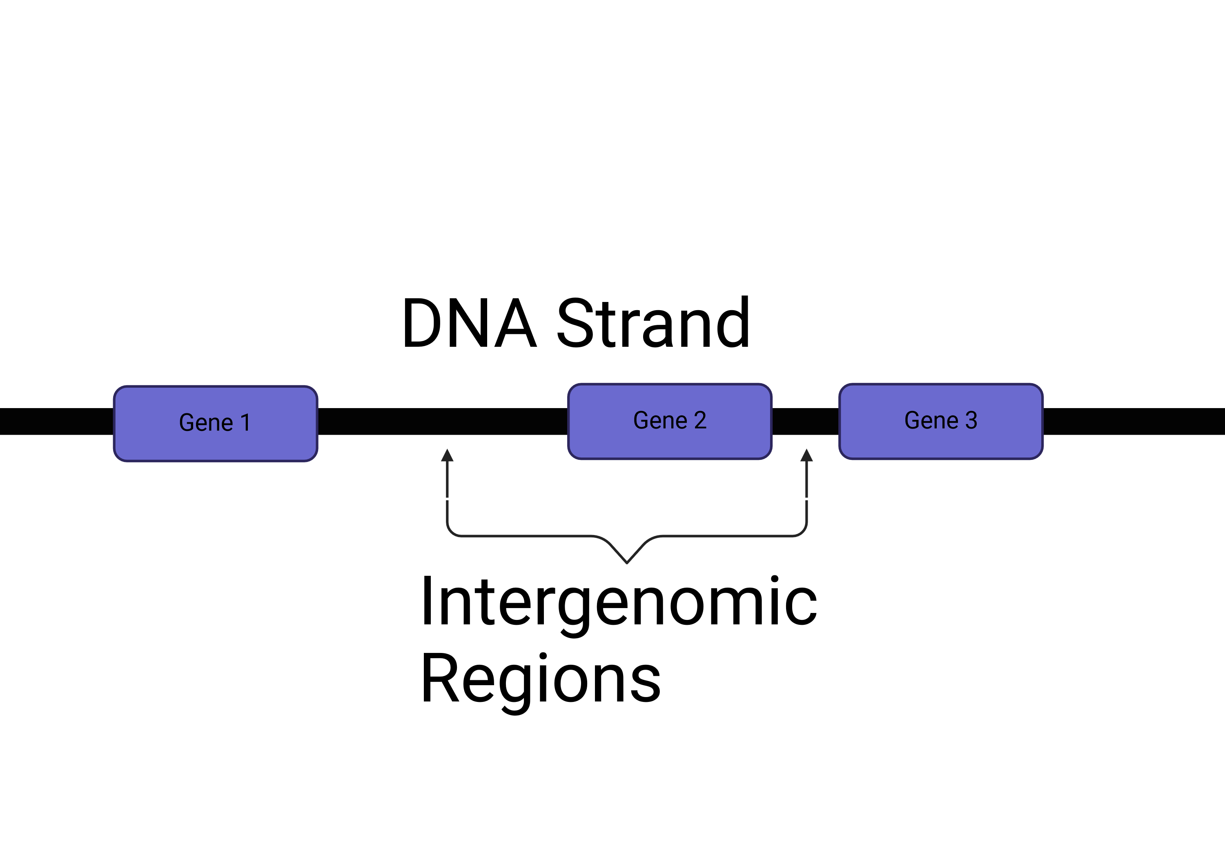
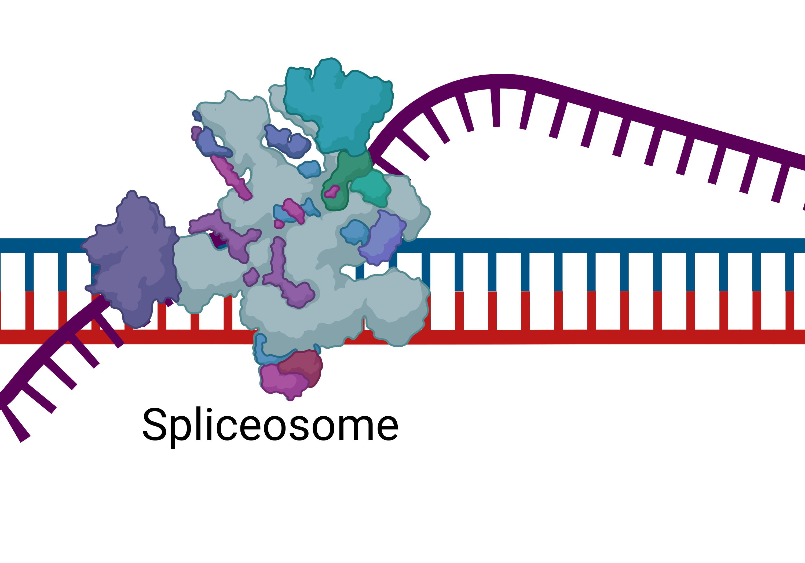
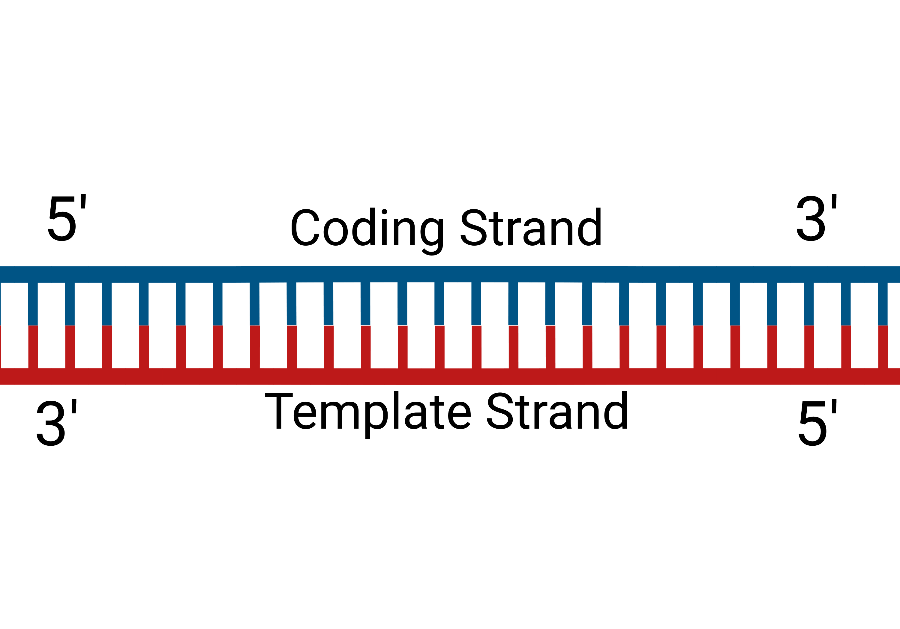
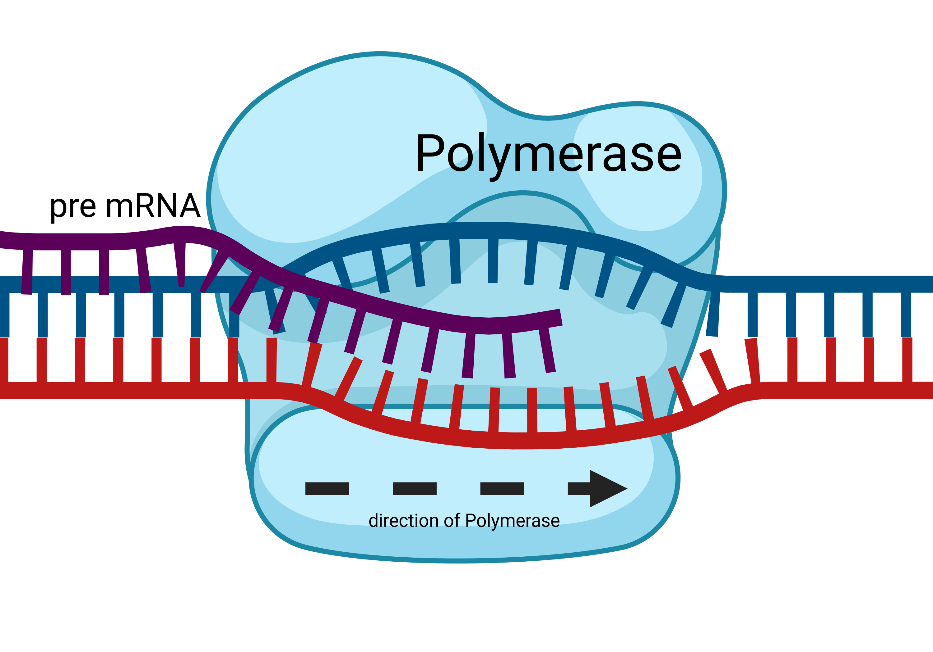

Slide 3
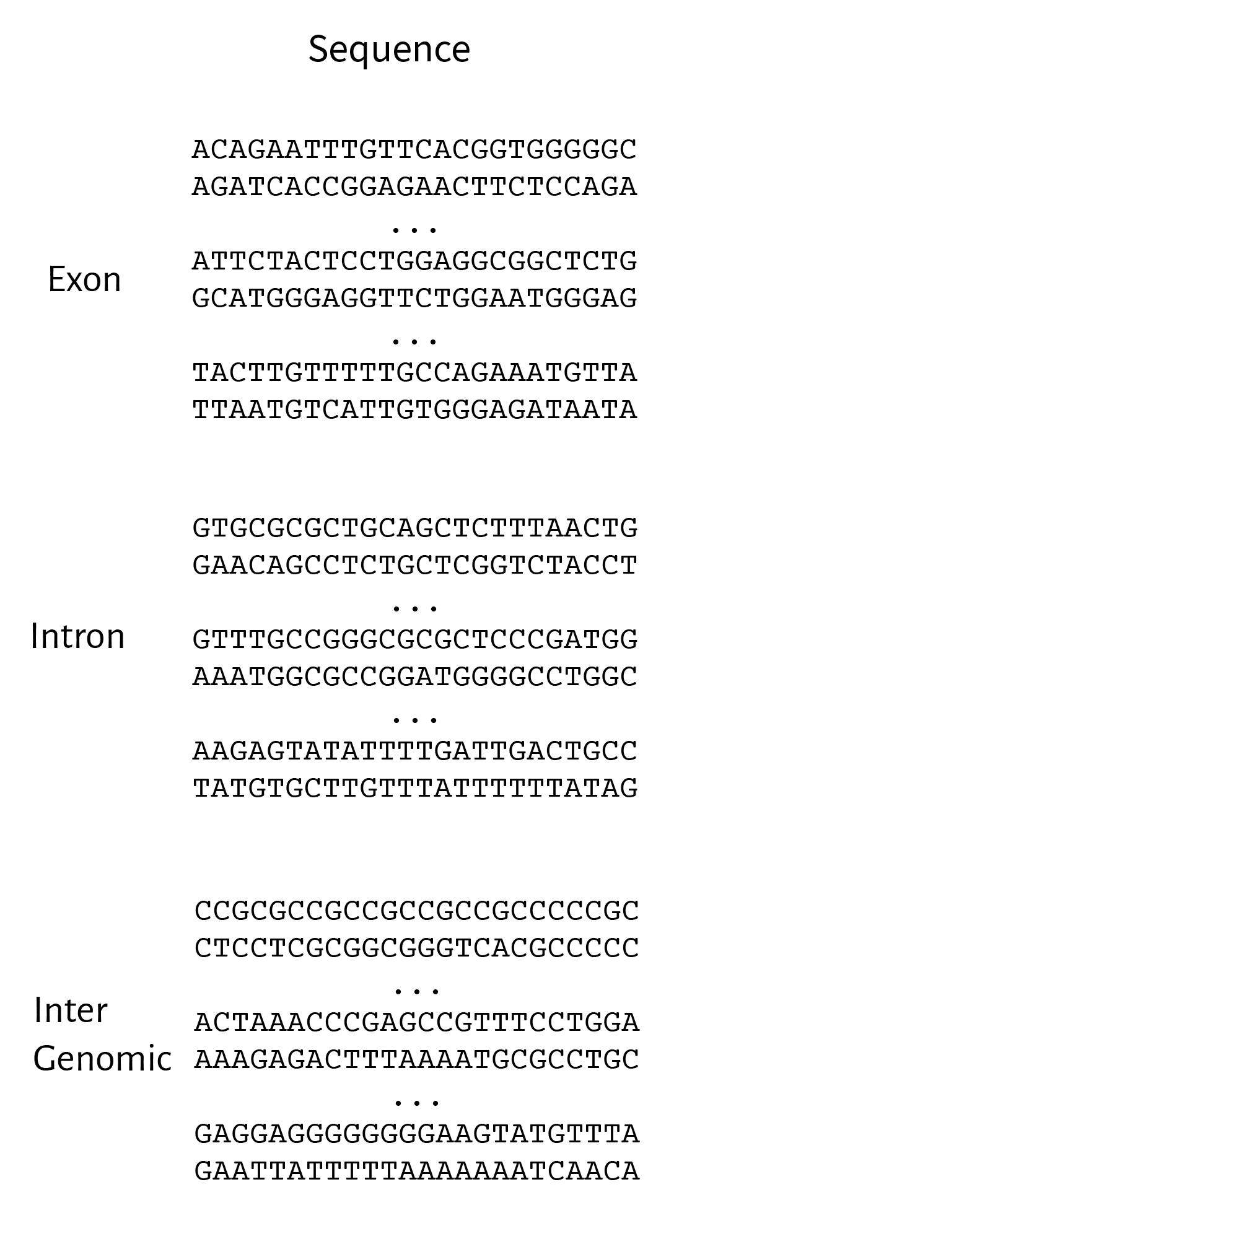
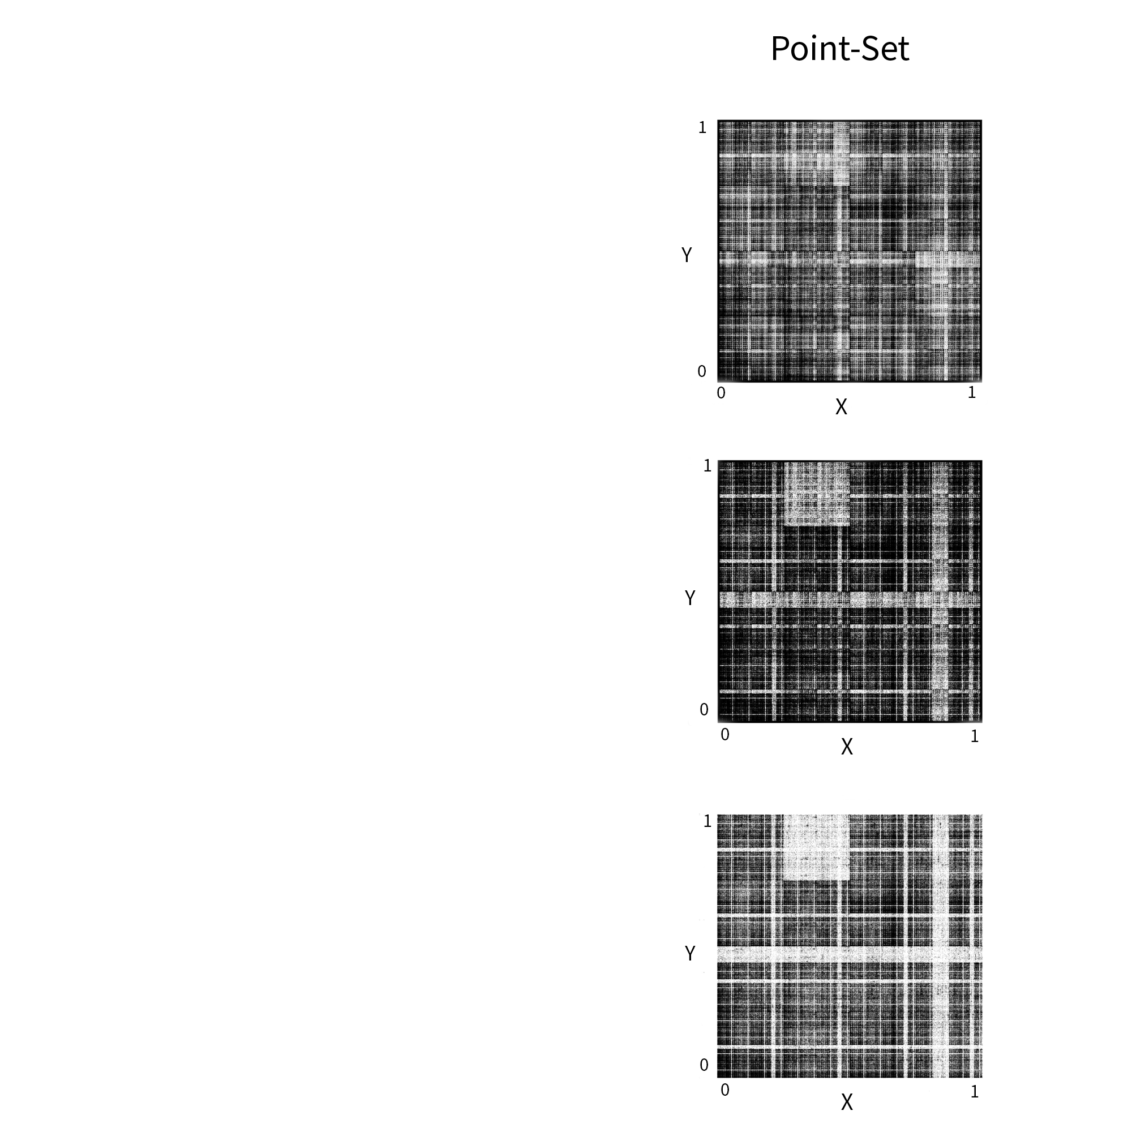
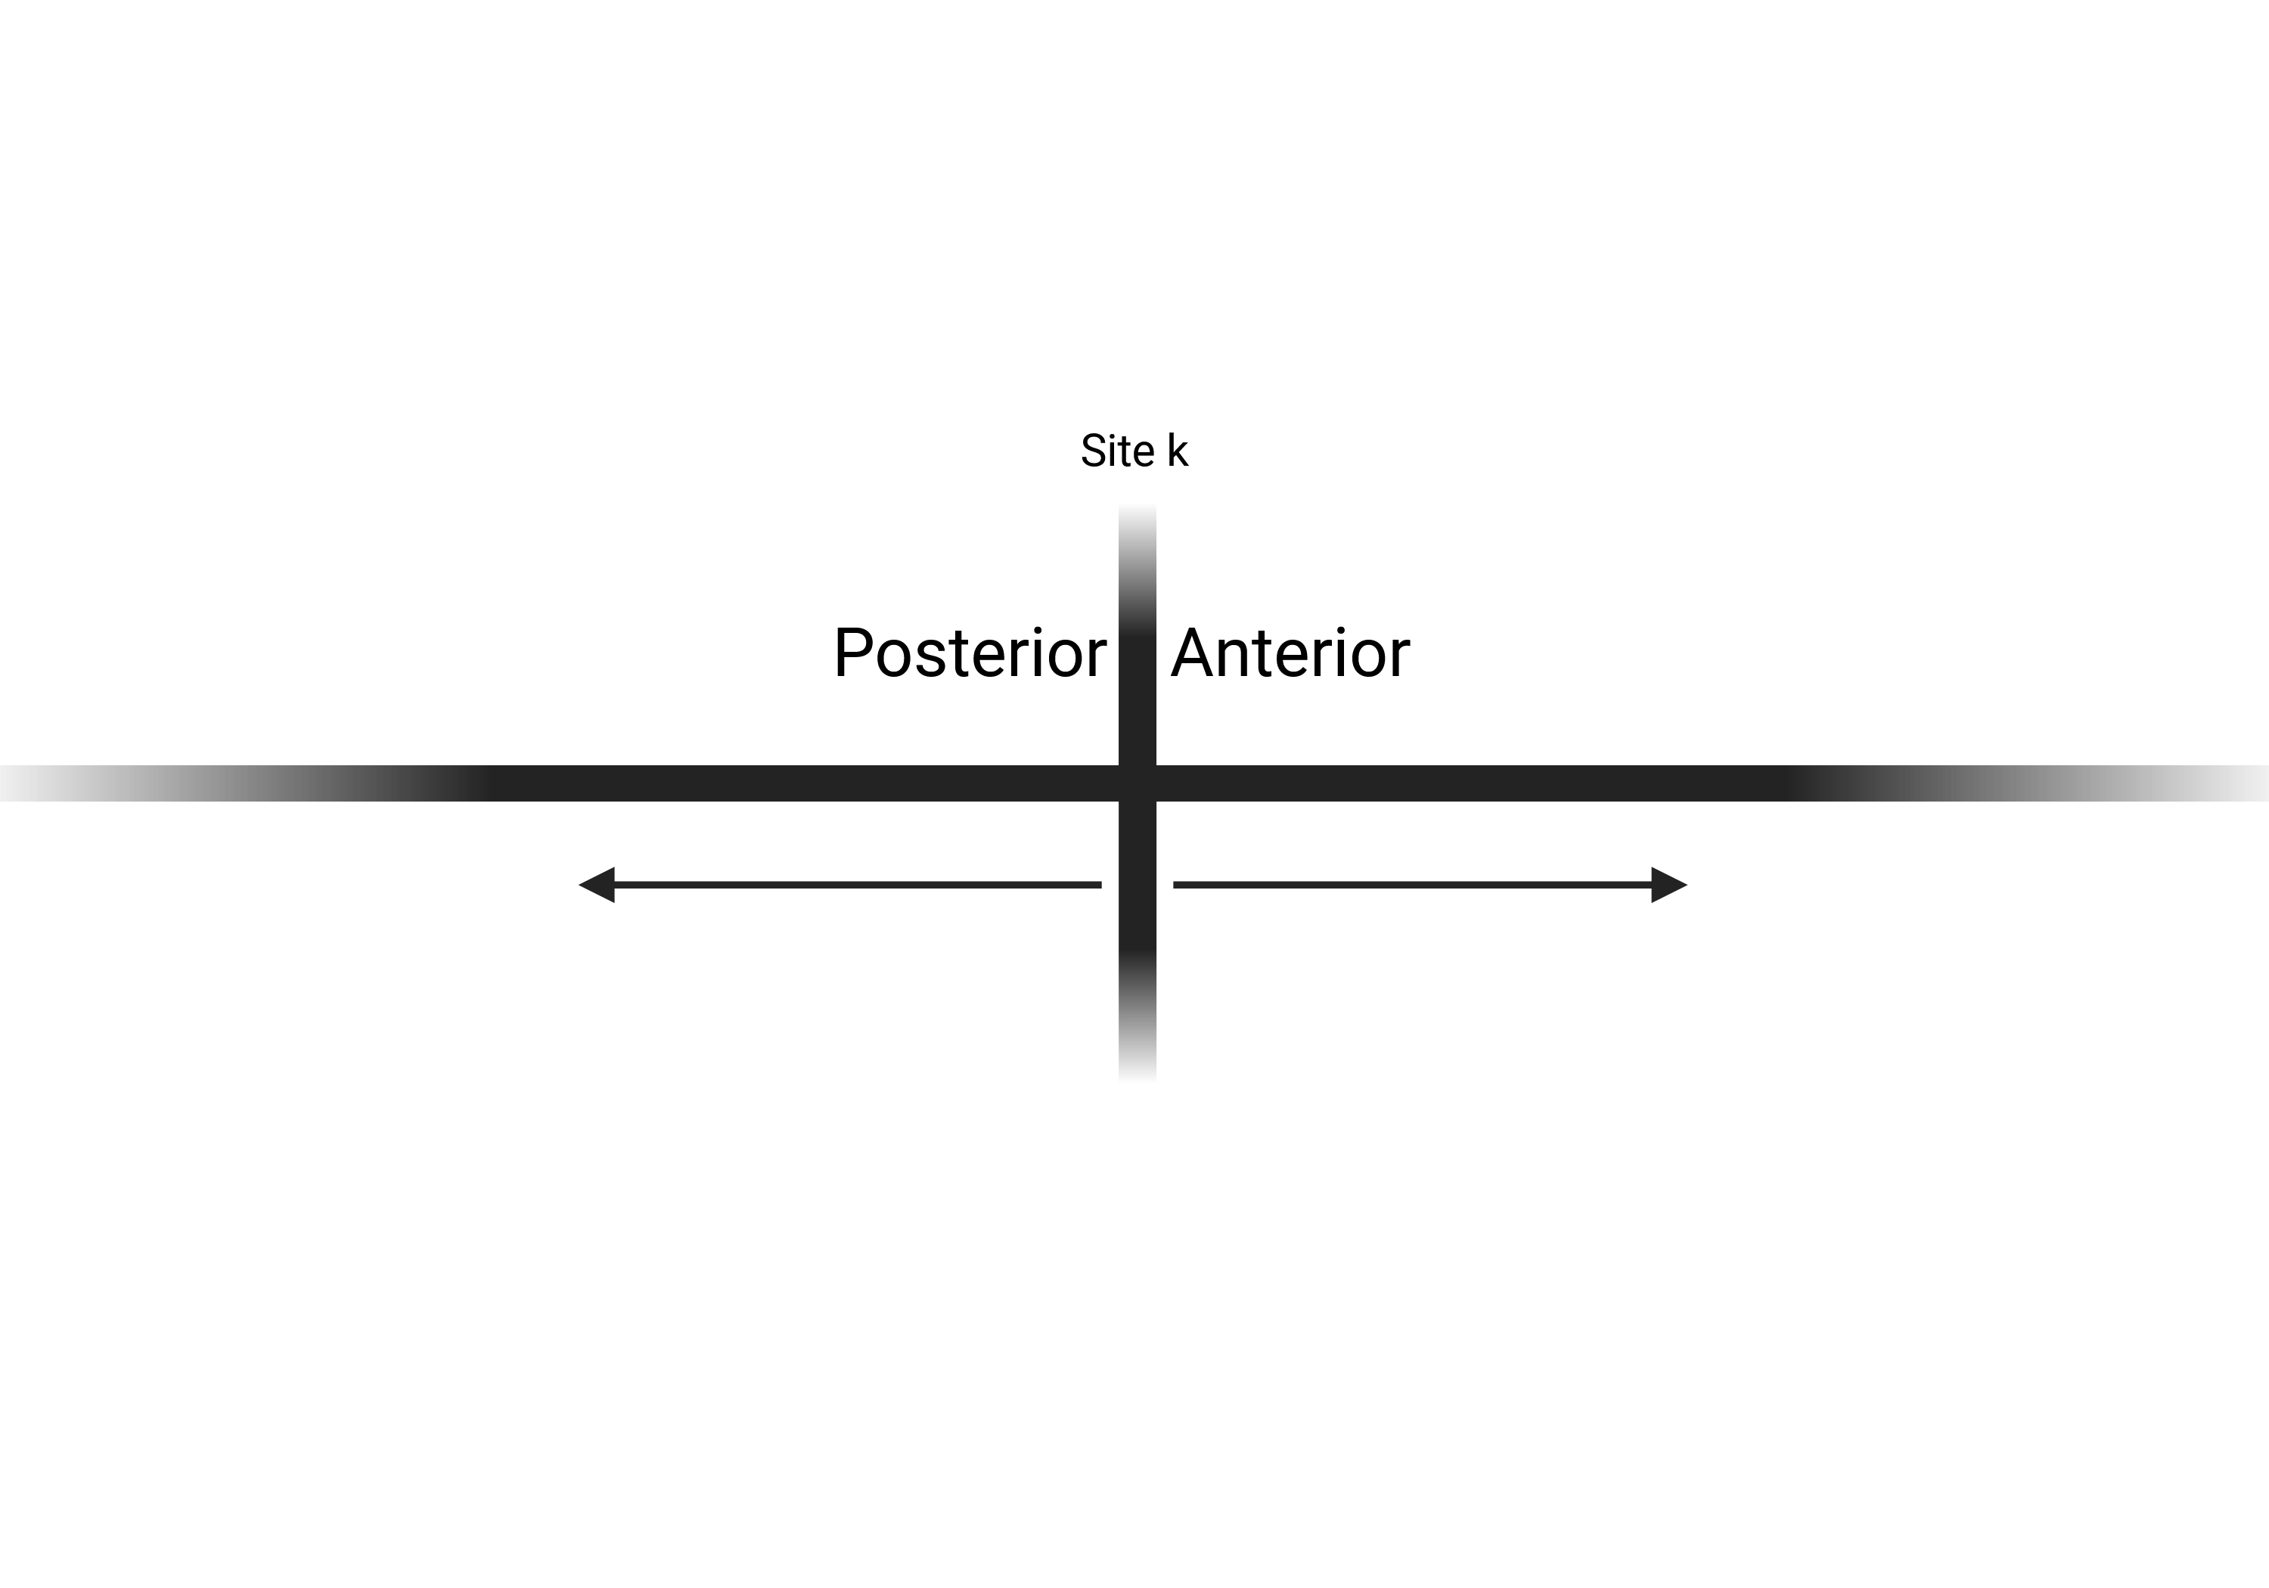


$$y=\sum_{i = 1}^{∞}{\frac{n_{k−i}}{4^{i}}}$$
$$x=\sum_{i =0}^{∞}{\frac{n_{k+1}}{4^{i}}}$$
$$n_{k}=\left\{A:0, G:1, T:2, C:3\right\}$$

Slide 4
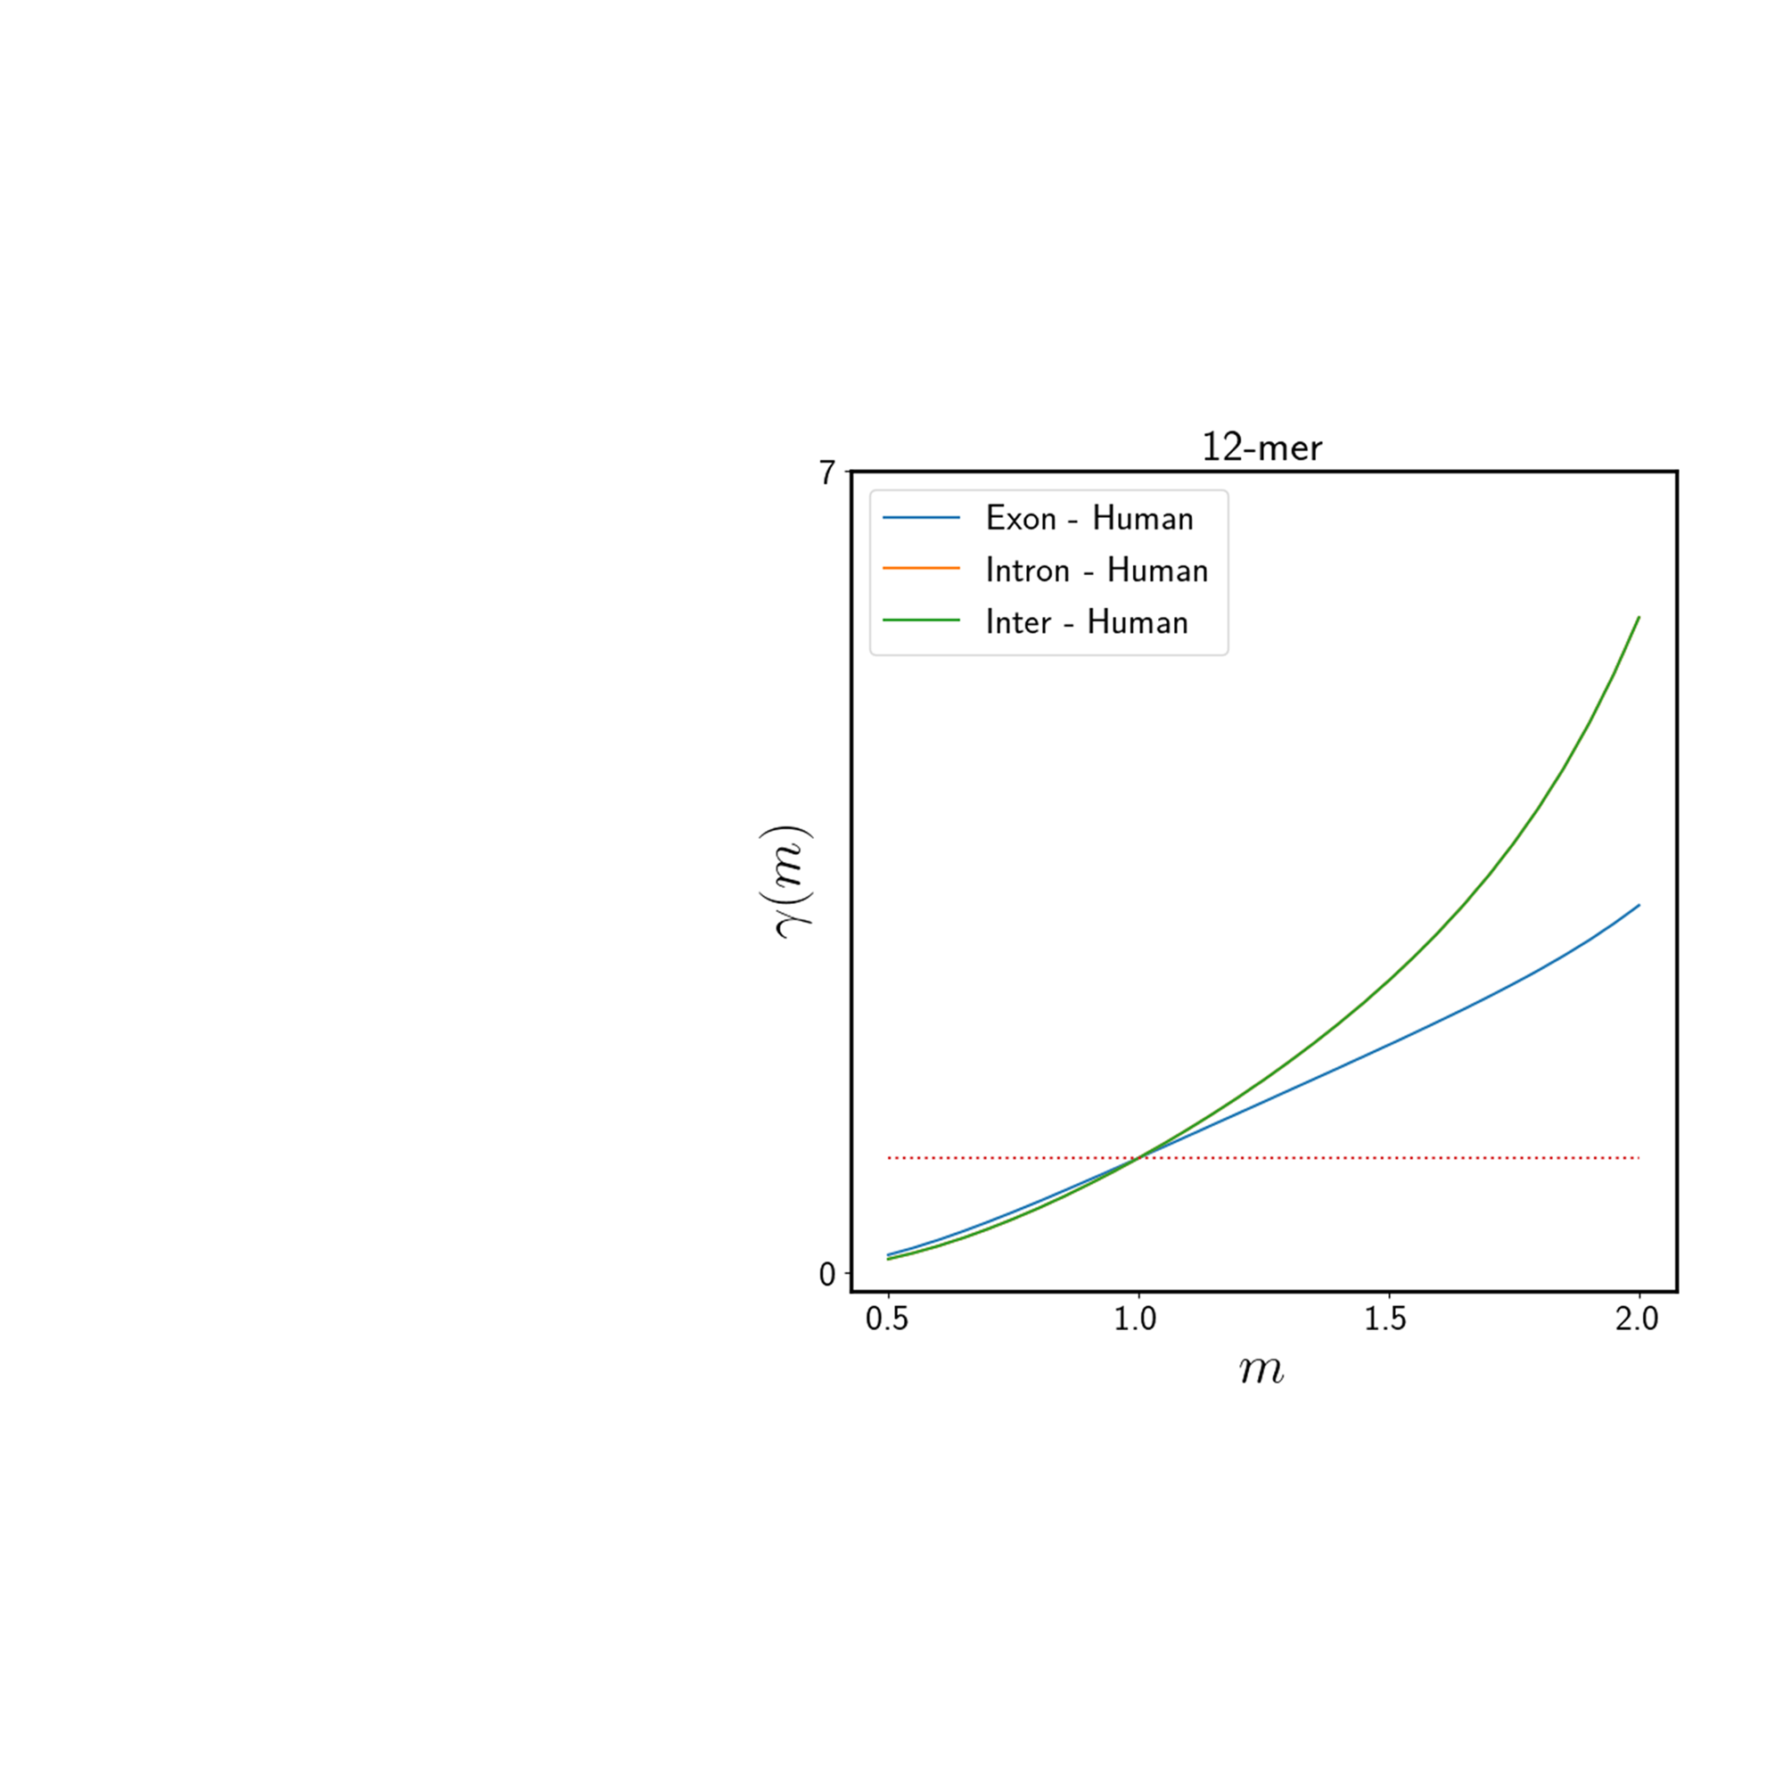
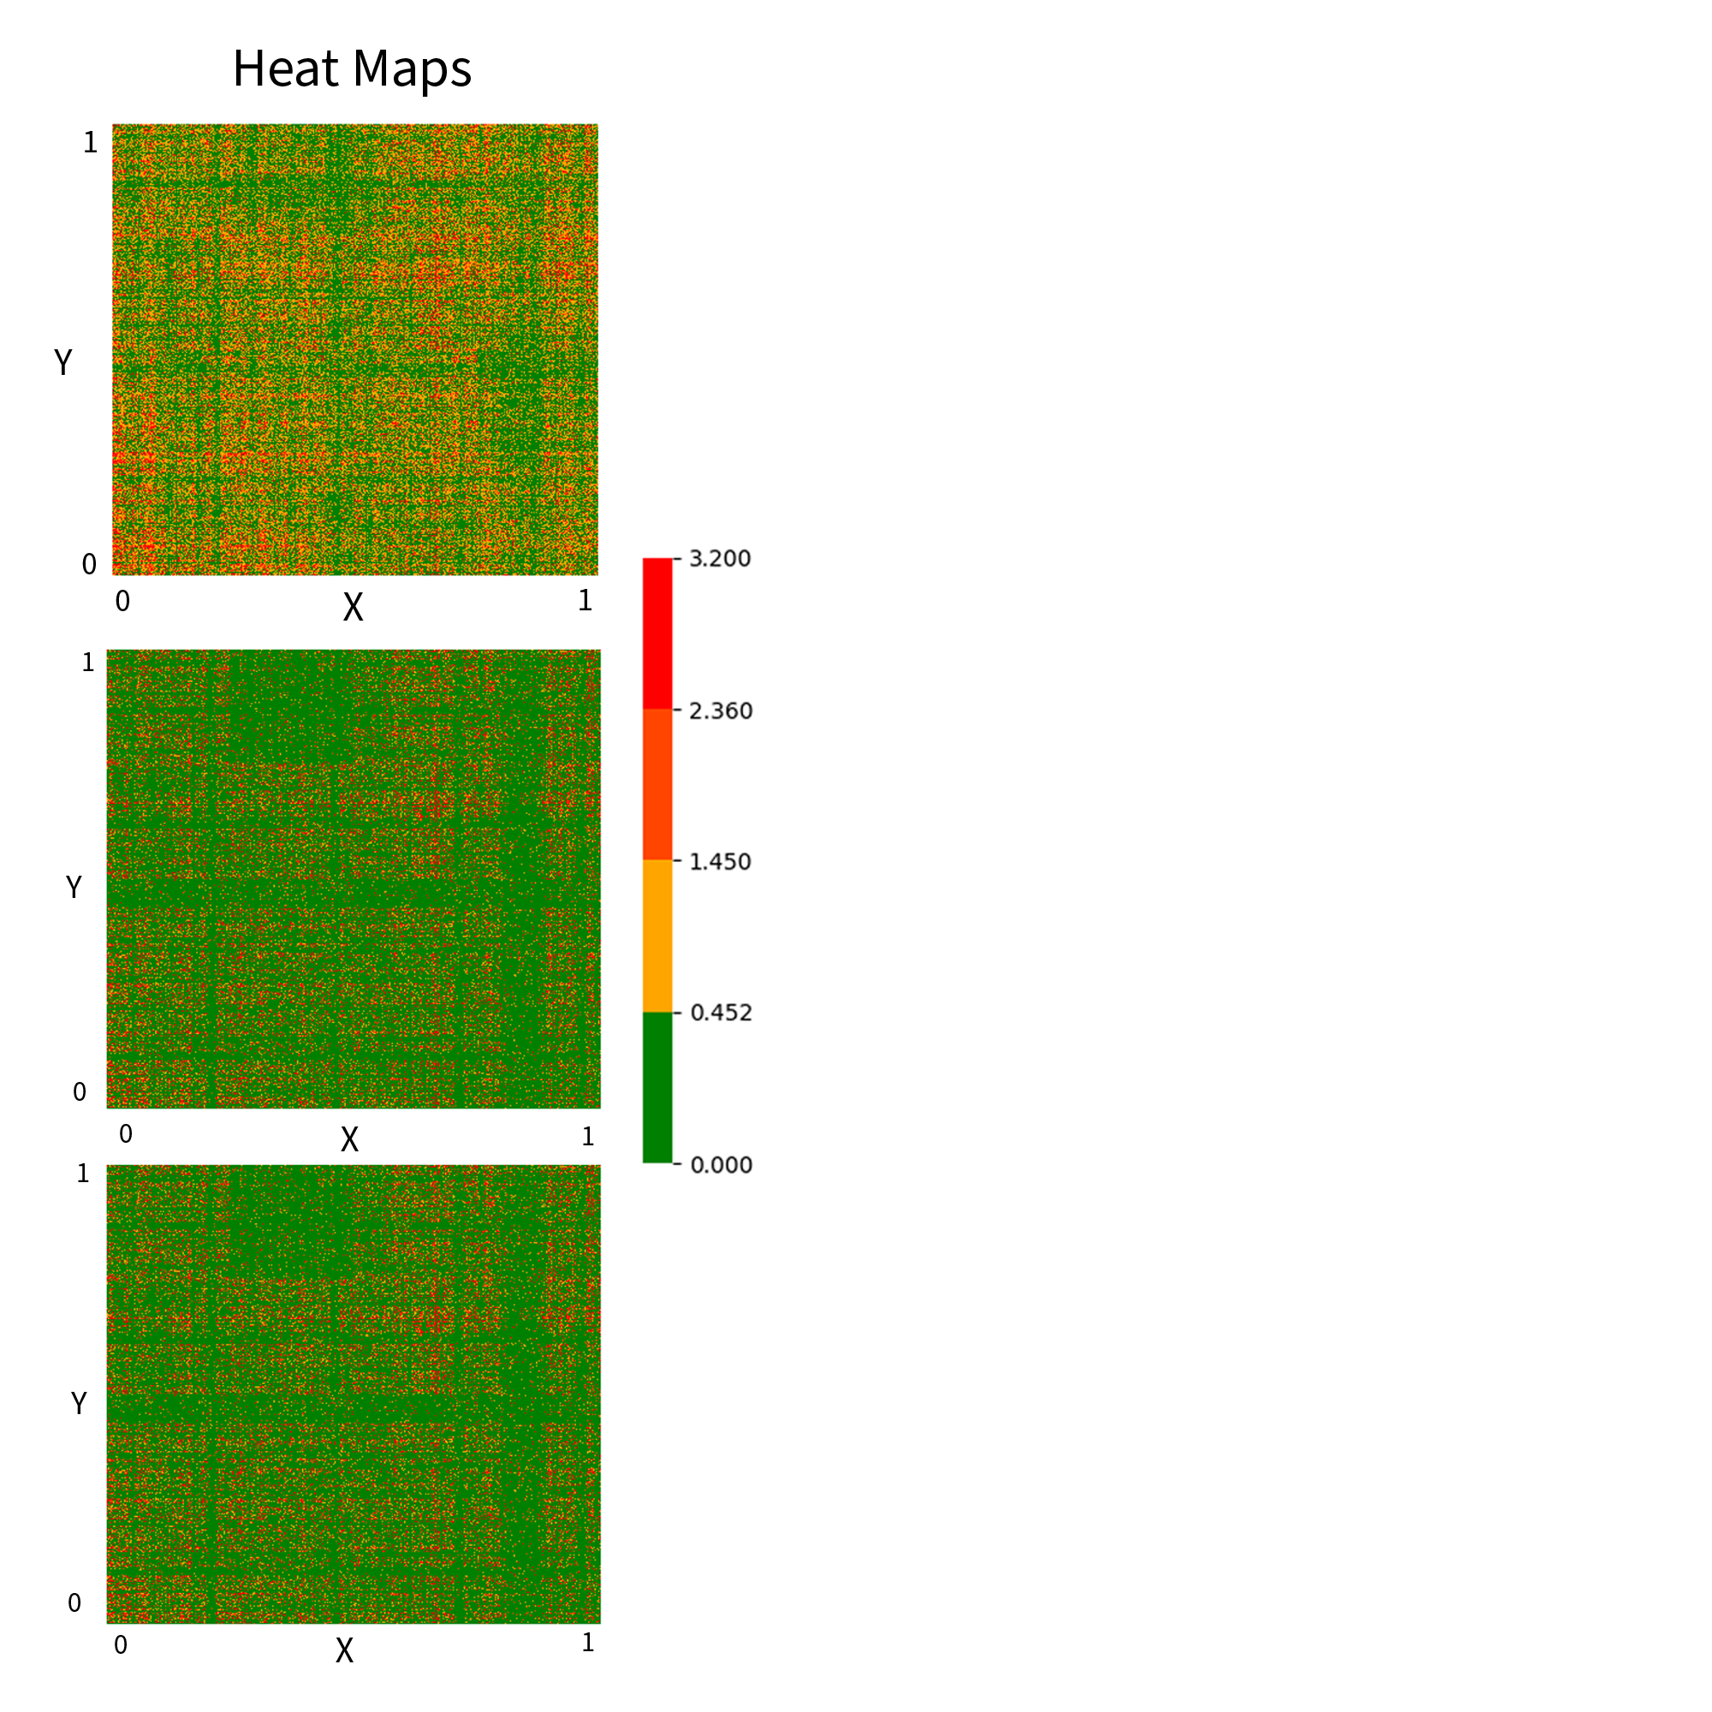
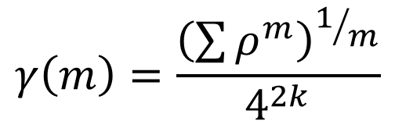
$$γ\left(m\right)=\frac{{\left(\sum{ρ^{m}}\right)}^{1/m}}{4^{2k}}$$

Slide 5
