Slide 1
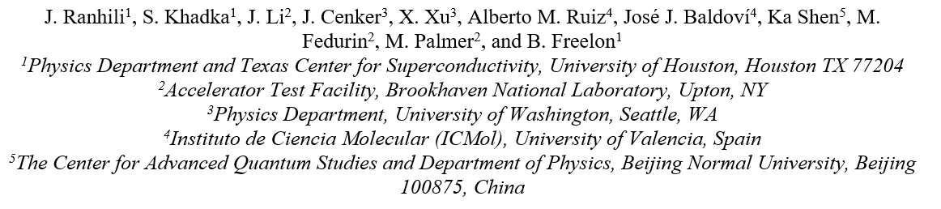


Ultrafast Electron Diffraction Studies in the Two-Dimensional Magnet CrSBr
Physics Research Day 2024

Slide 2

Outline of the talk
Novel 2D magnet CrSBr
UED studies of CrSBr at BNL
  BNL MeV UED Features
  Sample preparations
  UED data analysis
  Fitting UED data using dynamic diffraction theory
Conclusions
Acknowledgements
Physics Research Day 2024

Slide 3
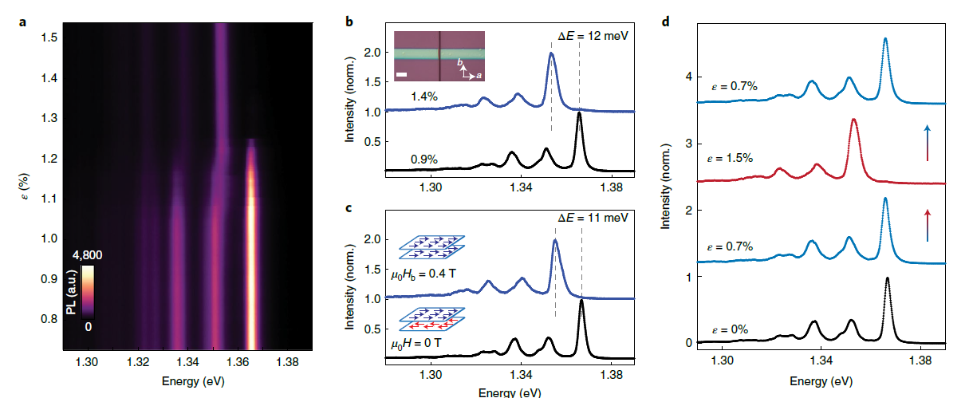
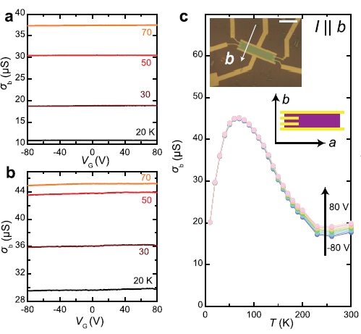
CrSBr: A Novel 2D Magnet
Air stable T_{N} =132 K easy axis of magnetization is along b
Strain induced magnetic phase transition properties
Quasi 1D electronic transport properties along b
1. Cenker, et al. Nat. Nanotechnol. 17, 256 (2022)
1. Fan Wu, et al. Adv. Mater. 34, 2109759 (2022)
Strong magnetoelastic coupling
External mechanical strain can be used as a switch to control the magnetic phases.
σ_{b}/σ_{a} (conductivity) ≈ 3 × 10^2 to 10^5
Photocurrent detected only along b axis.
Quasi 1D electronic transport behavior occurs along the b direction and 1D chains are aligned along b.
Physics Research Day 2024
Notes:
The material CrSBr is an air stable 2D VdW magnetic material that received research interest recently. Many studies have been performed on this material so far and Here I have added some of the interesting results out of them.

Slide 4
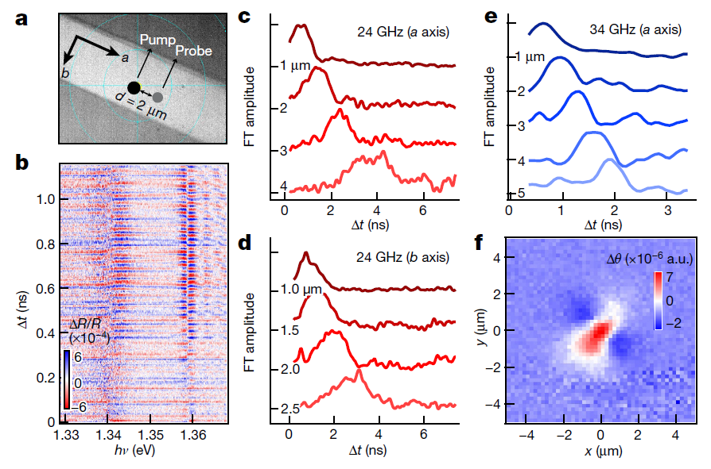
Ultrafast studies of CrSBr
CrSBr shows strong magnon- Wannier exciton coupling.
A well known mechanism for fast propagation of magnons at small momentum vectors is attributed to hybridization between magnon and acoustic phonons through magneto-elastic coupling
In this mechanism, the above-gap pump pulse creates thermally induced strain in magnetic materials and launches the hybridized magnon and phonon modes.
1. Y.J. Bae, et al. Nature 609, 282 (2022)
Physics Research Day 2024
Notes:
Here I have added one of the recent pump-probe measurements on this material. This work shows fast propagation of coherent magnons coupled with excitons through the material. They have detected two magnon frequencies along a axis and one frequency along b axis. As the authors explained, the fast propagation of magnons is a result of coupling magnons with the phonons. Therefore, this study demonstrate ultrafast induced coupling of excitons magnons and phonons in this material. This work motivated us to study the phonon dynamics of this material further, and for that we choose ultrafast electron diffraction technique. Because UED is one of the most accurate and efficient technique to study phonon dynamics.

Slide 5
UED experiments on CrSBr at BNL
Physics Research Day 2024
Notes:
From now on, I am going to discuss about the results and outcome of our UED study that we performed at BNL

Slide 6
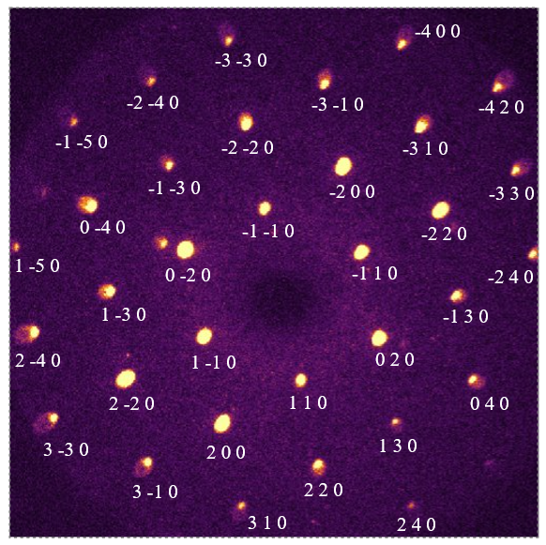
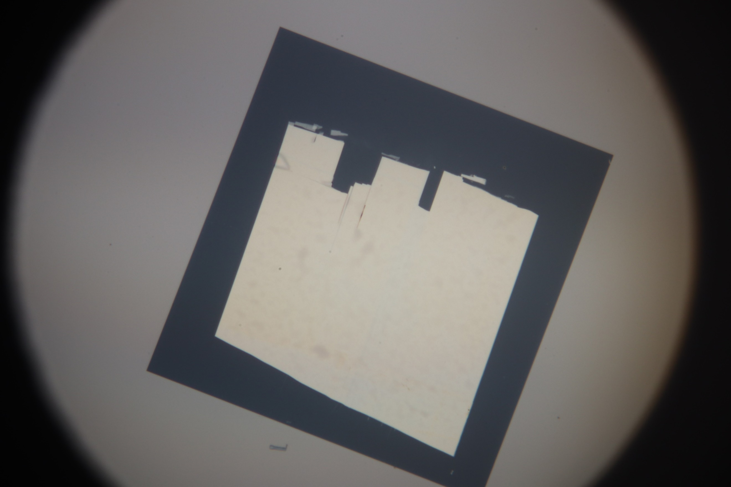
Samples and collected diffraction patterns
Figure 1. Optical image of the CrSBr mounted on a square Si₃N₄ window (250 um X 250 um)
Figure 3. Static diffraction pattern of data with miller indices
Physics Research Day 2024

Slide 7
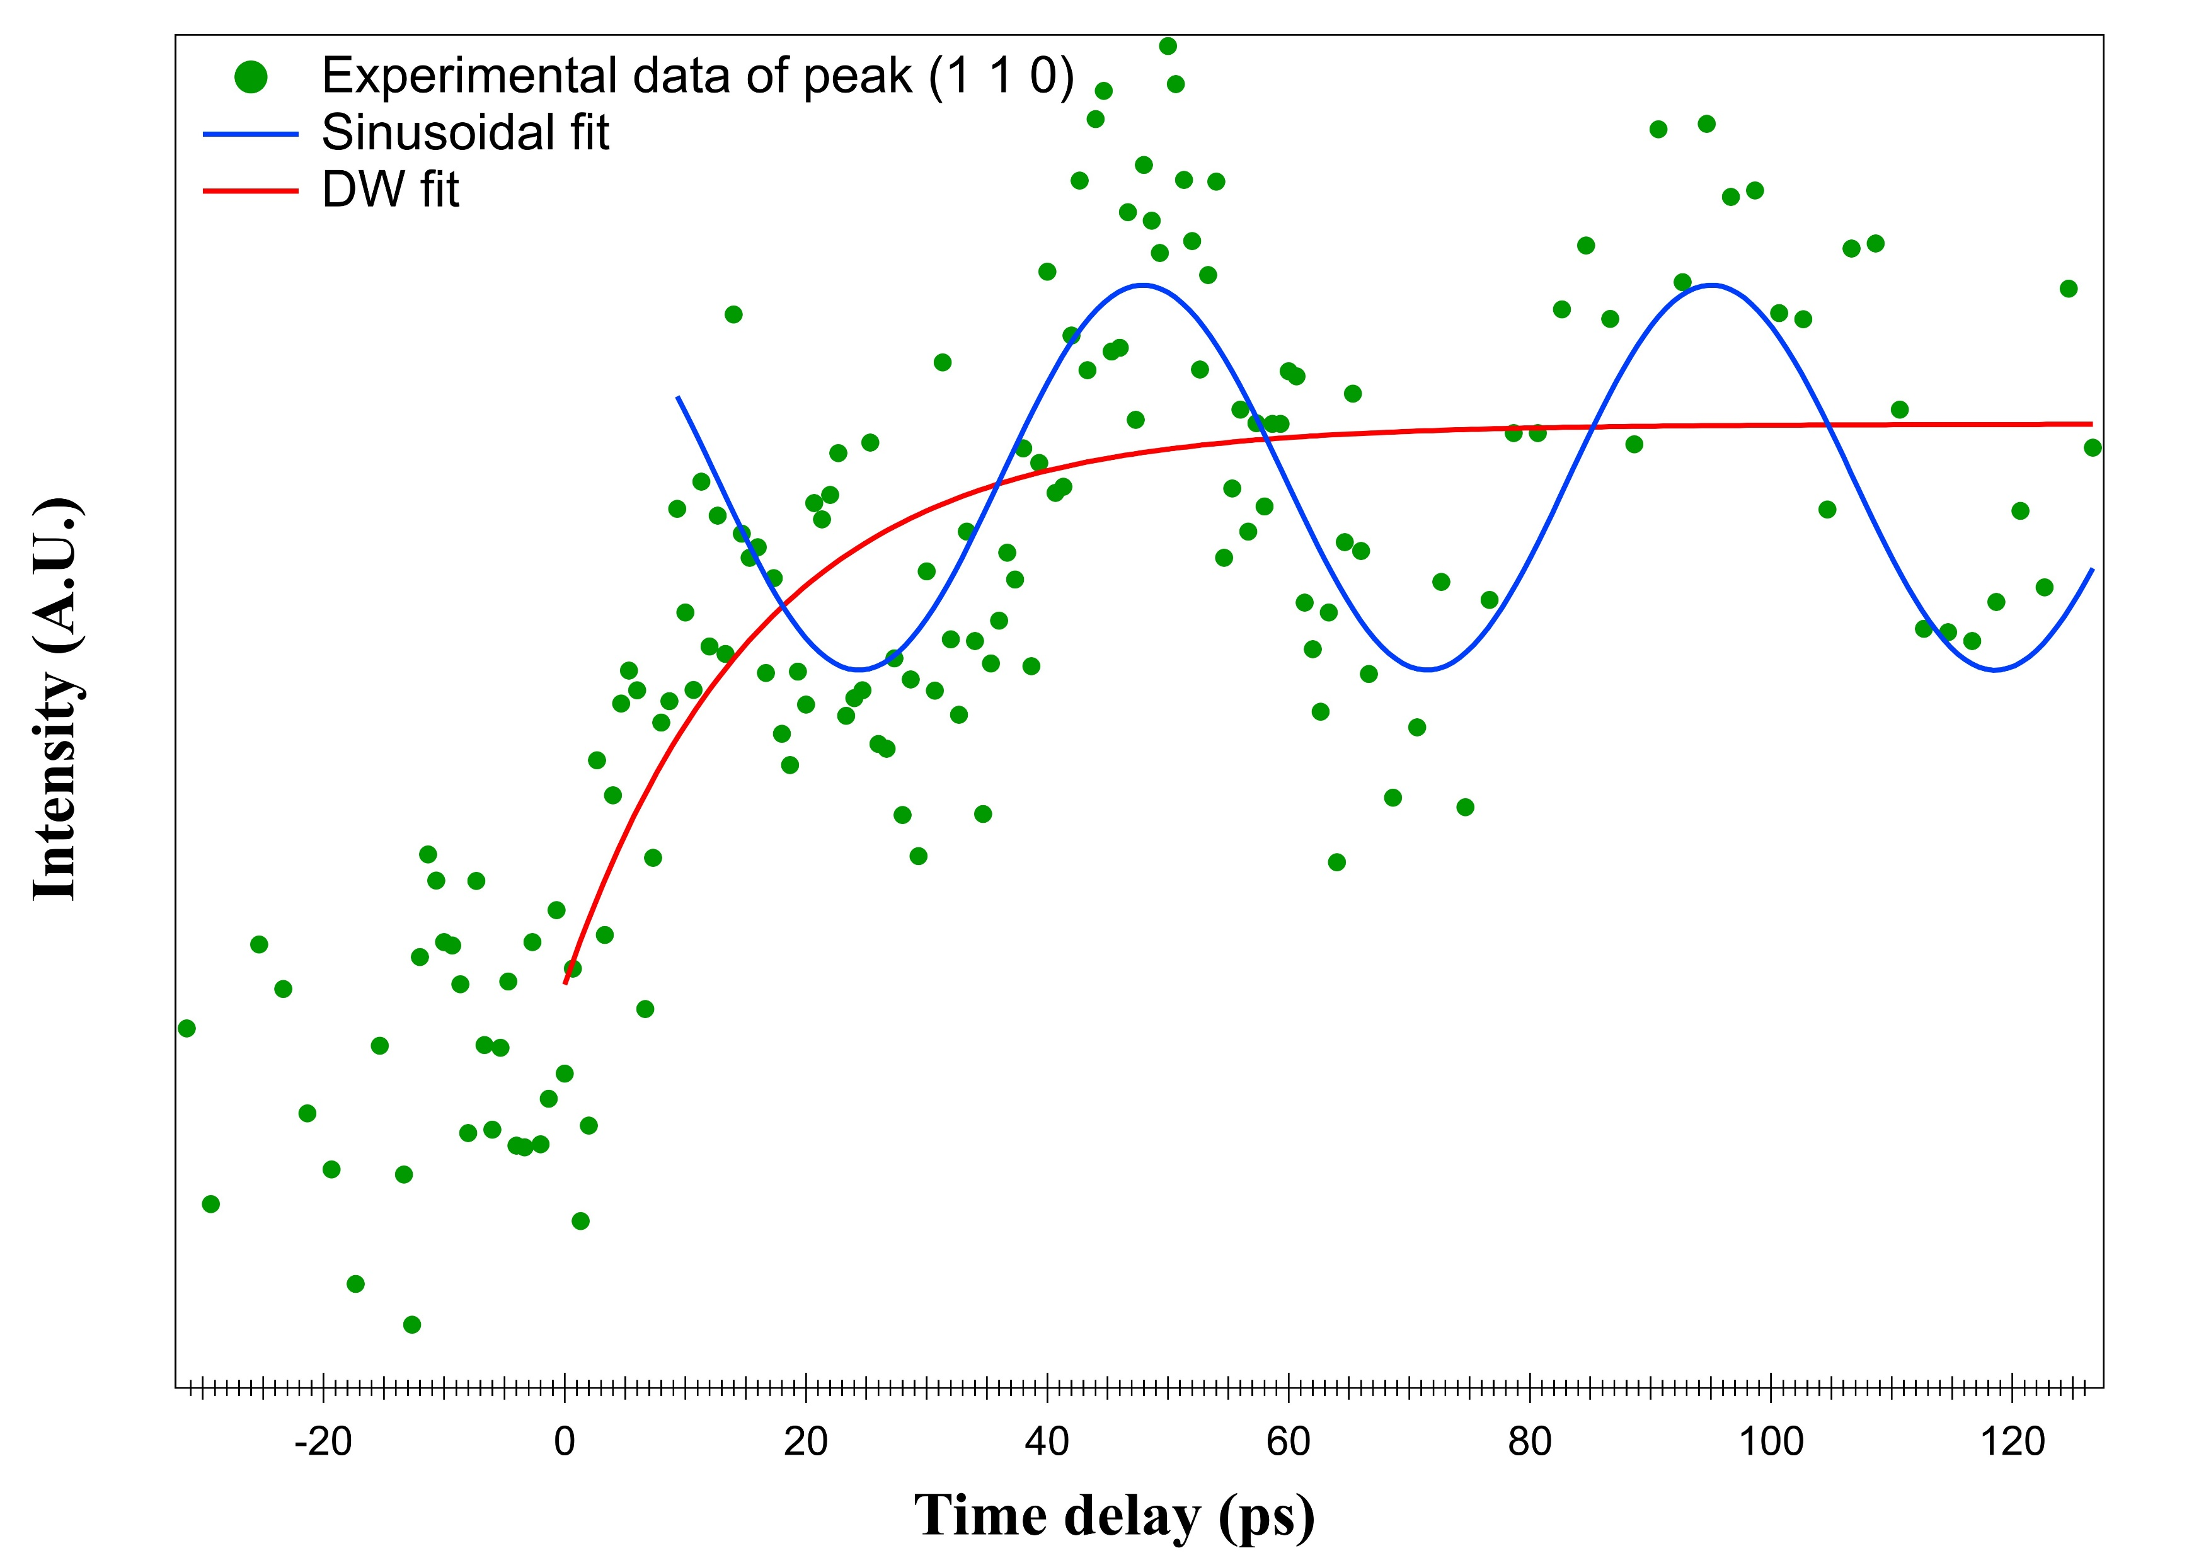
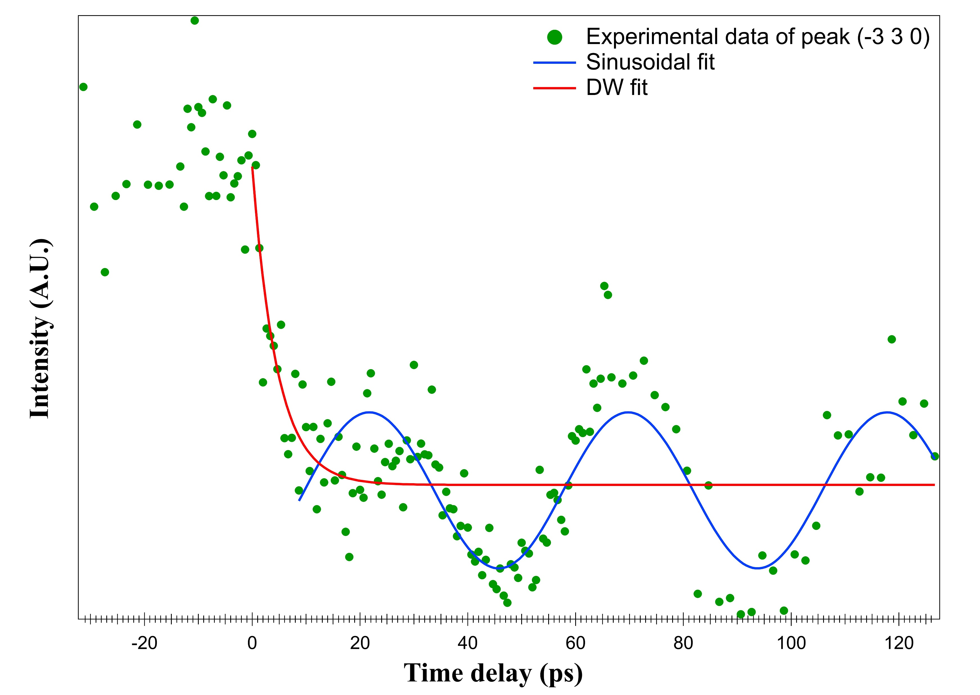
Debye Waller effect and oscillatory behavior of normalized intensity data at LT
The normalized intensity behavior can simply fit using two parameters:
  DW exponential factor
  Simple cosine factor
The frequency of the cosine oscillations ~ 23 GHz (Acoustic Phonons region)

Slide 8
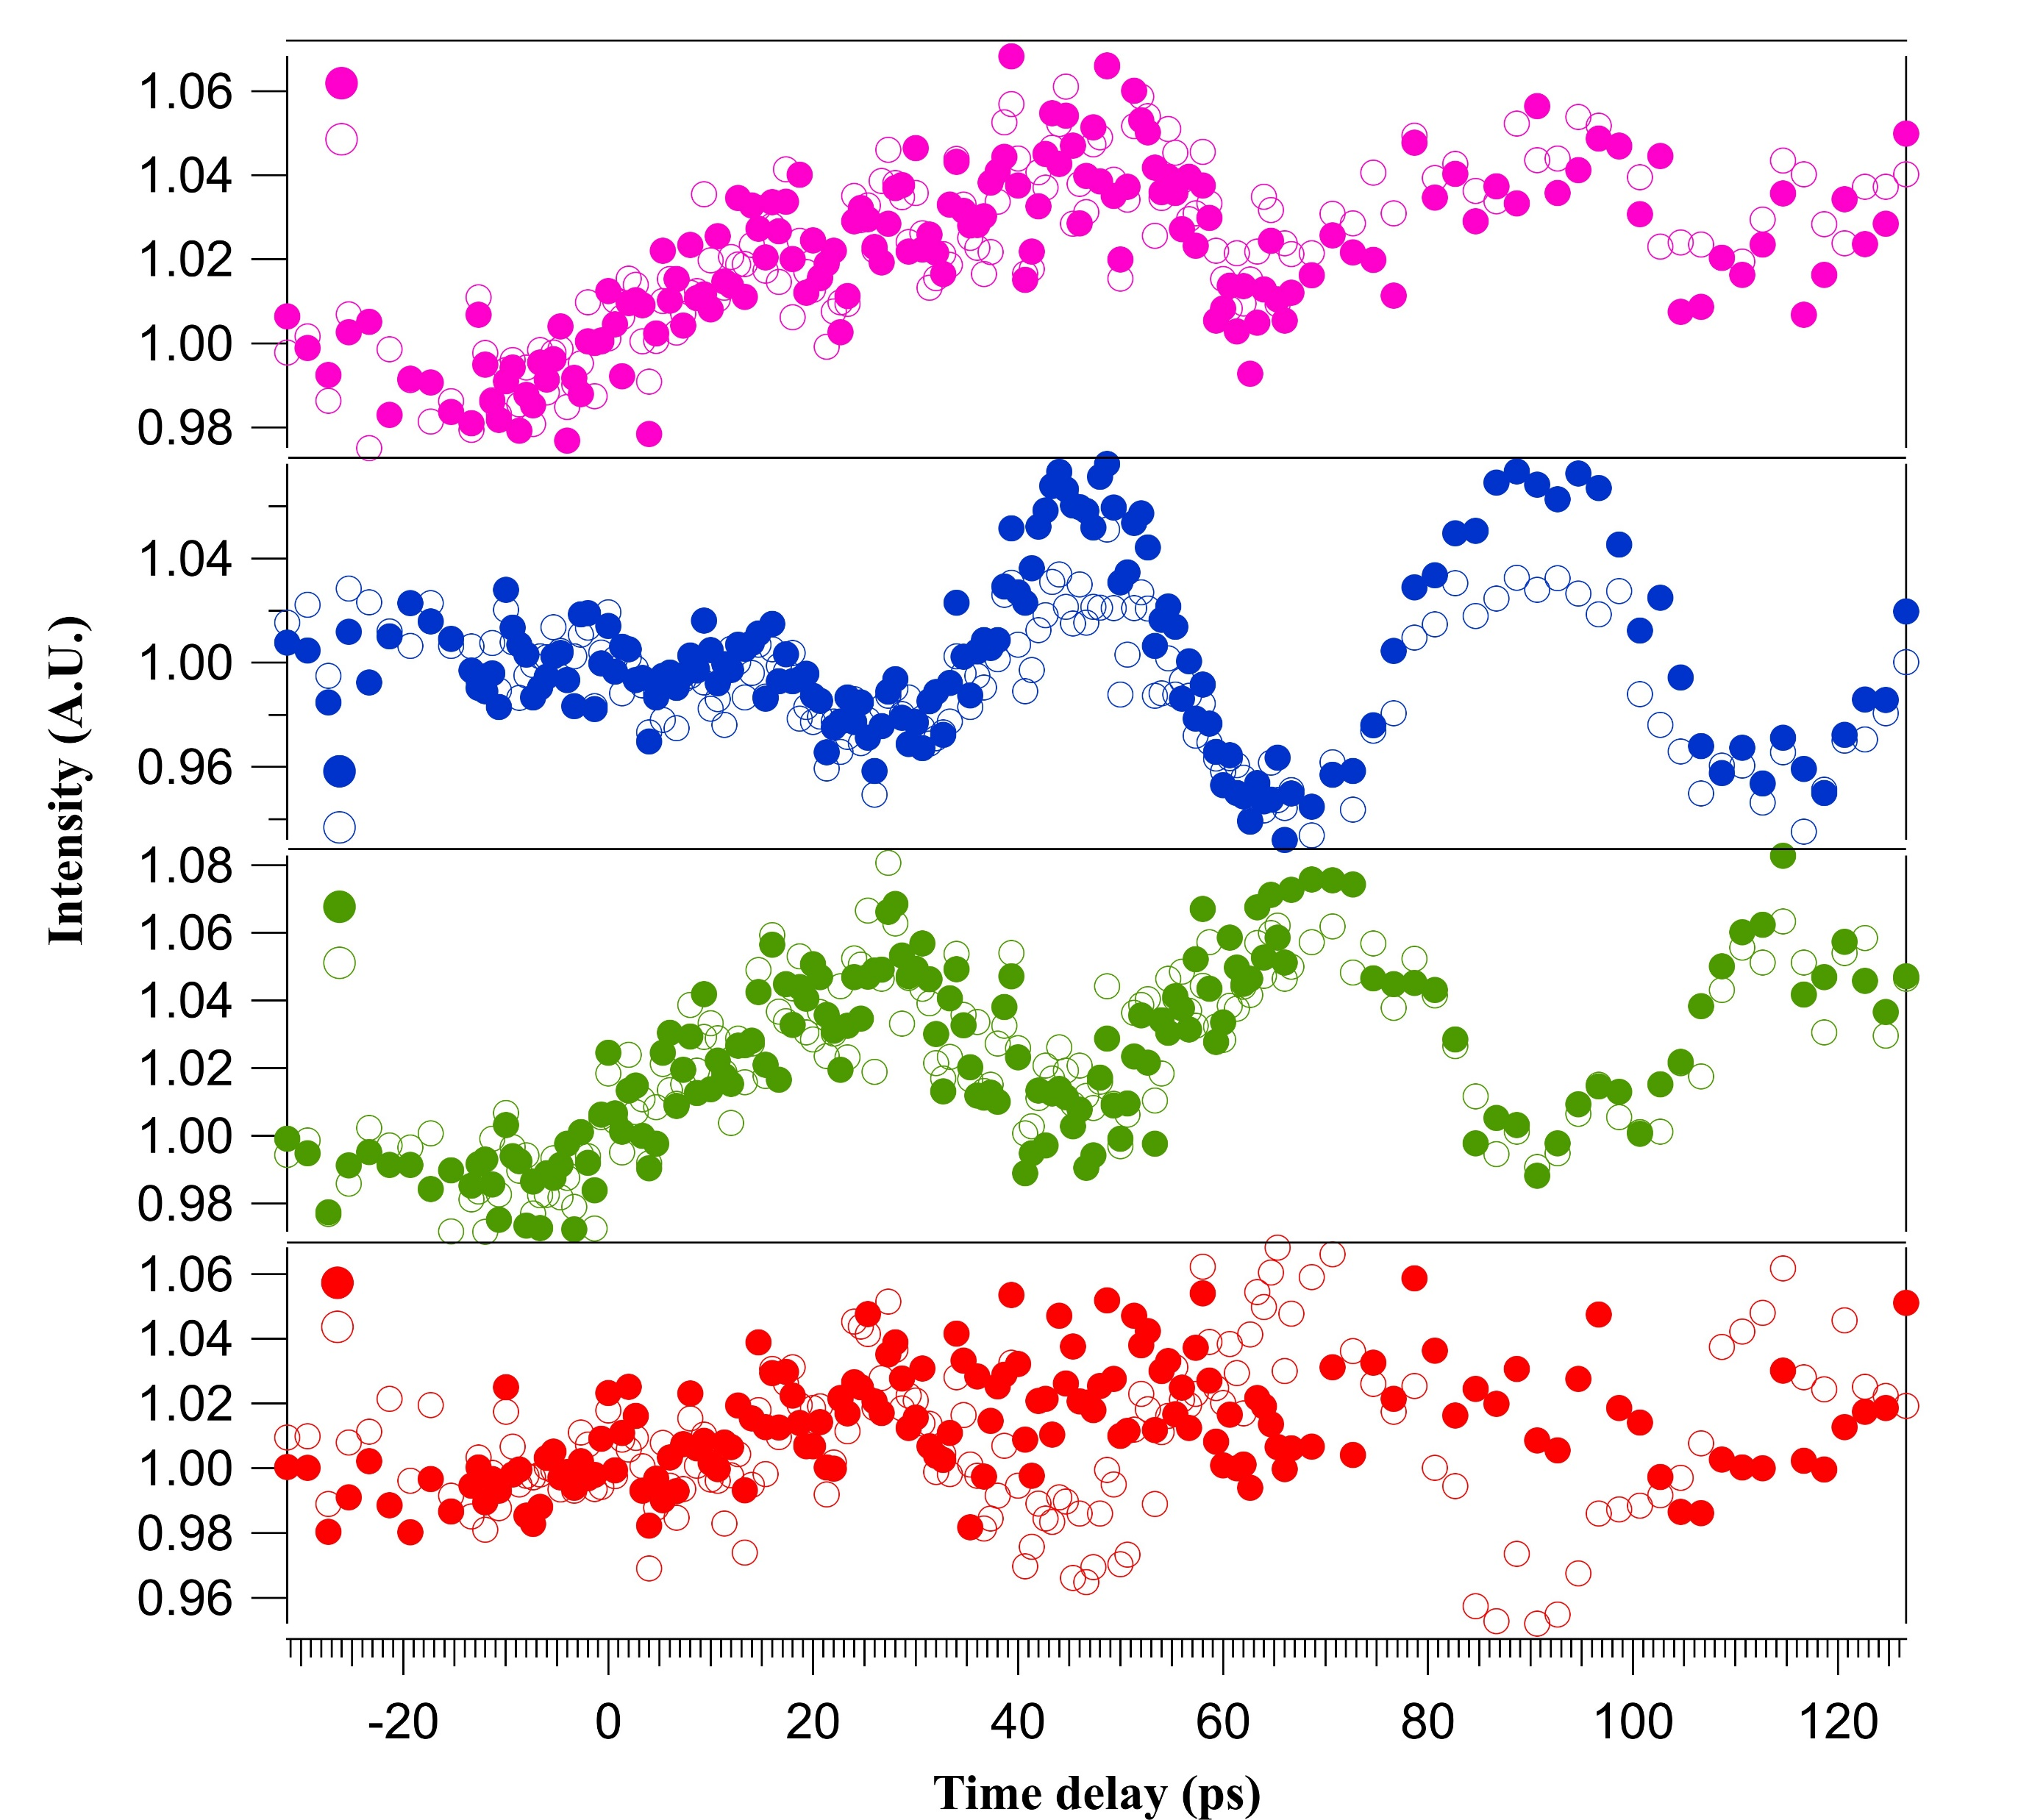
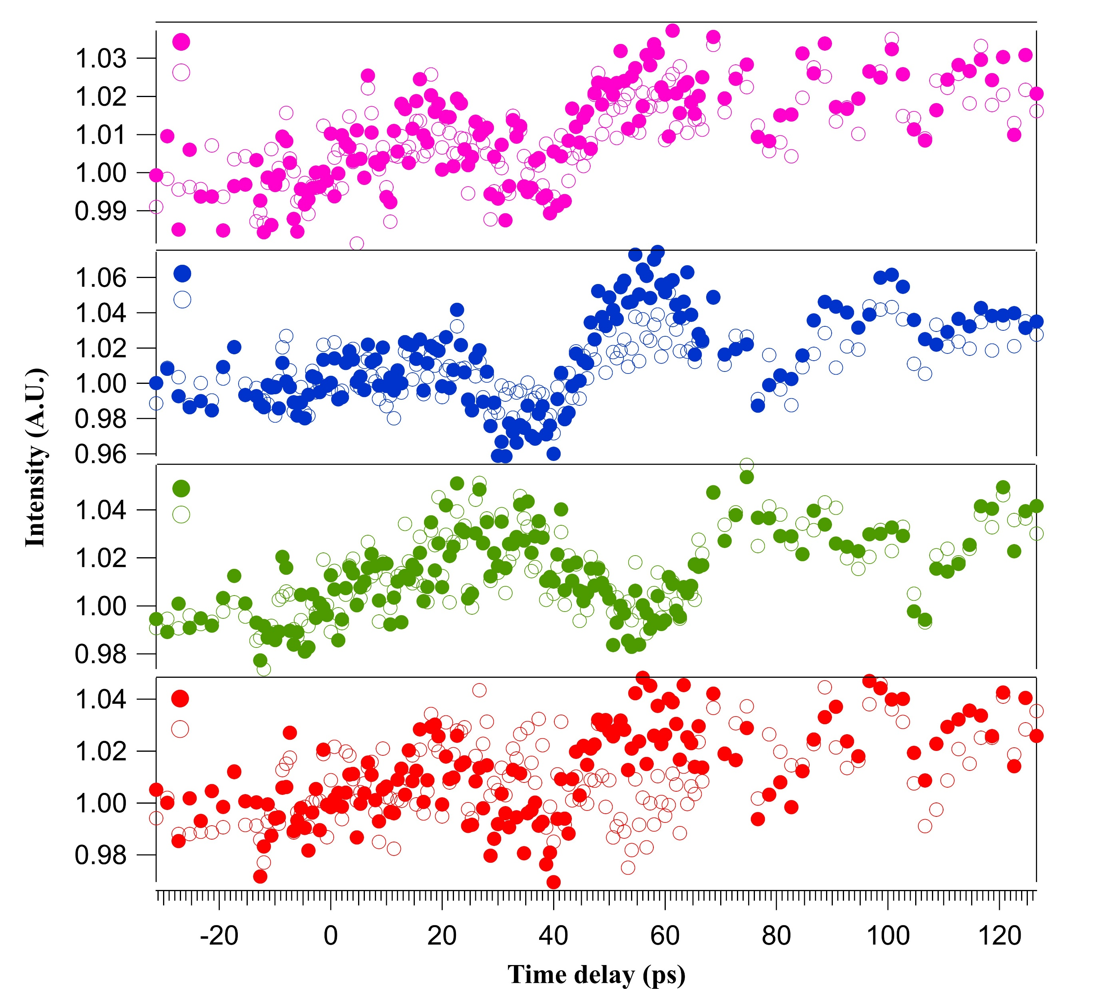








a
Time evolution and temperature dependency of Friedel pairs’ intensities
LT (77 K)
RT (300 K)
11$0$
11$0$
$\overline{1}$ $\overline{1} 0$
$\overline{1}$ $\overline{1} 0$
$$020$$
$$0\overline{2}0$$
$$020$$
$$0\overline{2}0$$
$$1\overline{1}0$$
$$1\overline{1}0$$
$$\overline{1}10$$
$$\overline{1}10$$
2$00$
2$00$
$$\overline{2}00$$
$$\overline{2}00$$
Time evolution of Friedel’s pairs Bragg peak intensities before and after the laser pulse excitation at 77 K (left) and 300 K (right).
Notes:
We checked the time evolution of Friedel pair intensities. Because we wanted to check if our data satisfy Friedel’s law. Most of the Friedel pairs at both LT and RT satisfy Friedel’s law, having nearly equal intensities of oscillations. When we compared the oscillations at two temperatures, you can see, at RT, oscillations are weak and have shorter lifetime compared to the LT. And we check the frequency of oscillations at two temperatures. This is in agreement with the ultrafast paper results that I discussed earlier. This temperature dependency motivated us to study further about the intensity oscillations.
[(3-10), (-310)] and [(3-30), (-330)] pairs don’t follow the Friedel law.
Obeying the Friedel’s law satisfy the condition that the beam is normal to the sample surface.

Slide 9
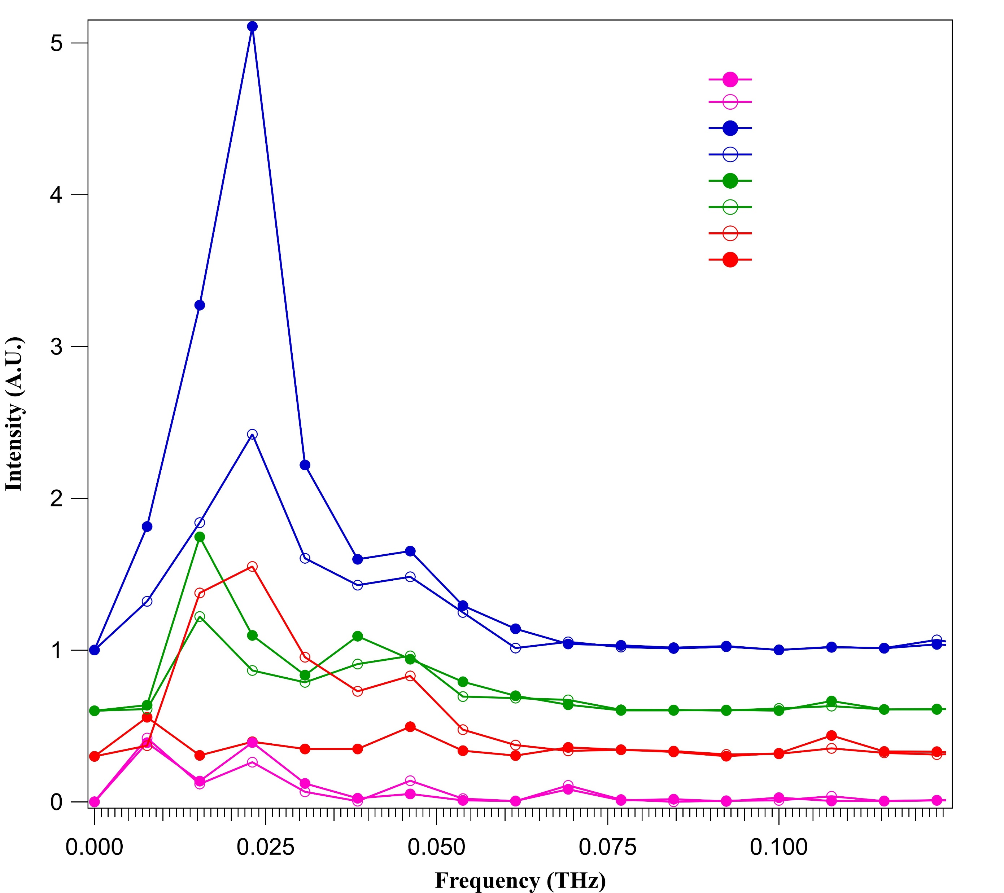
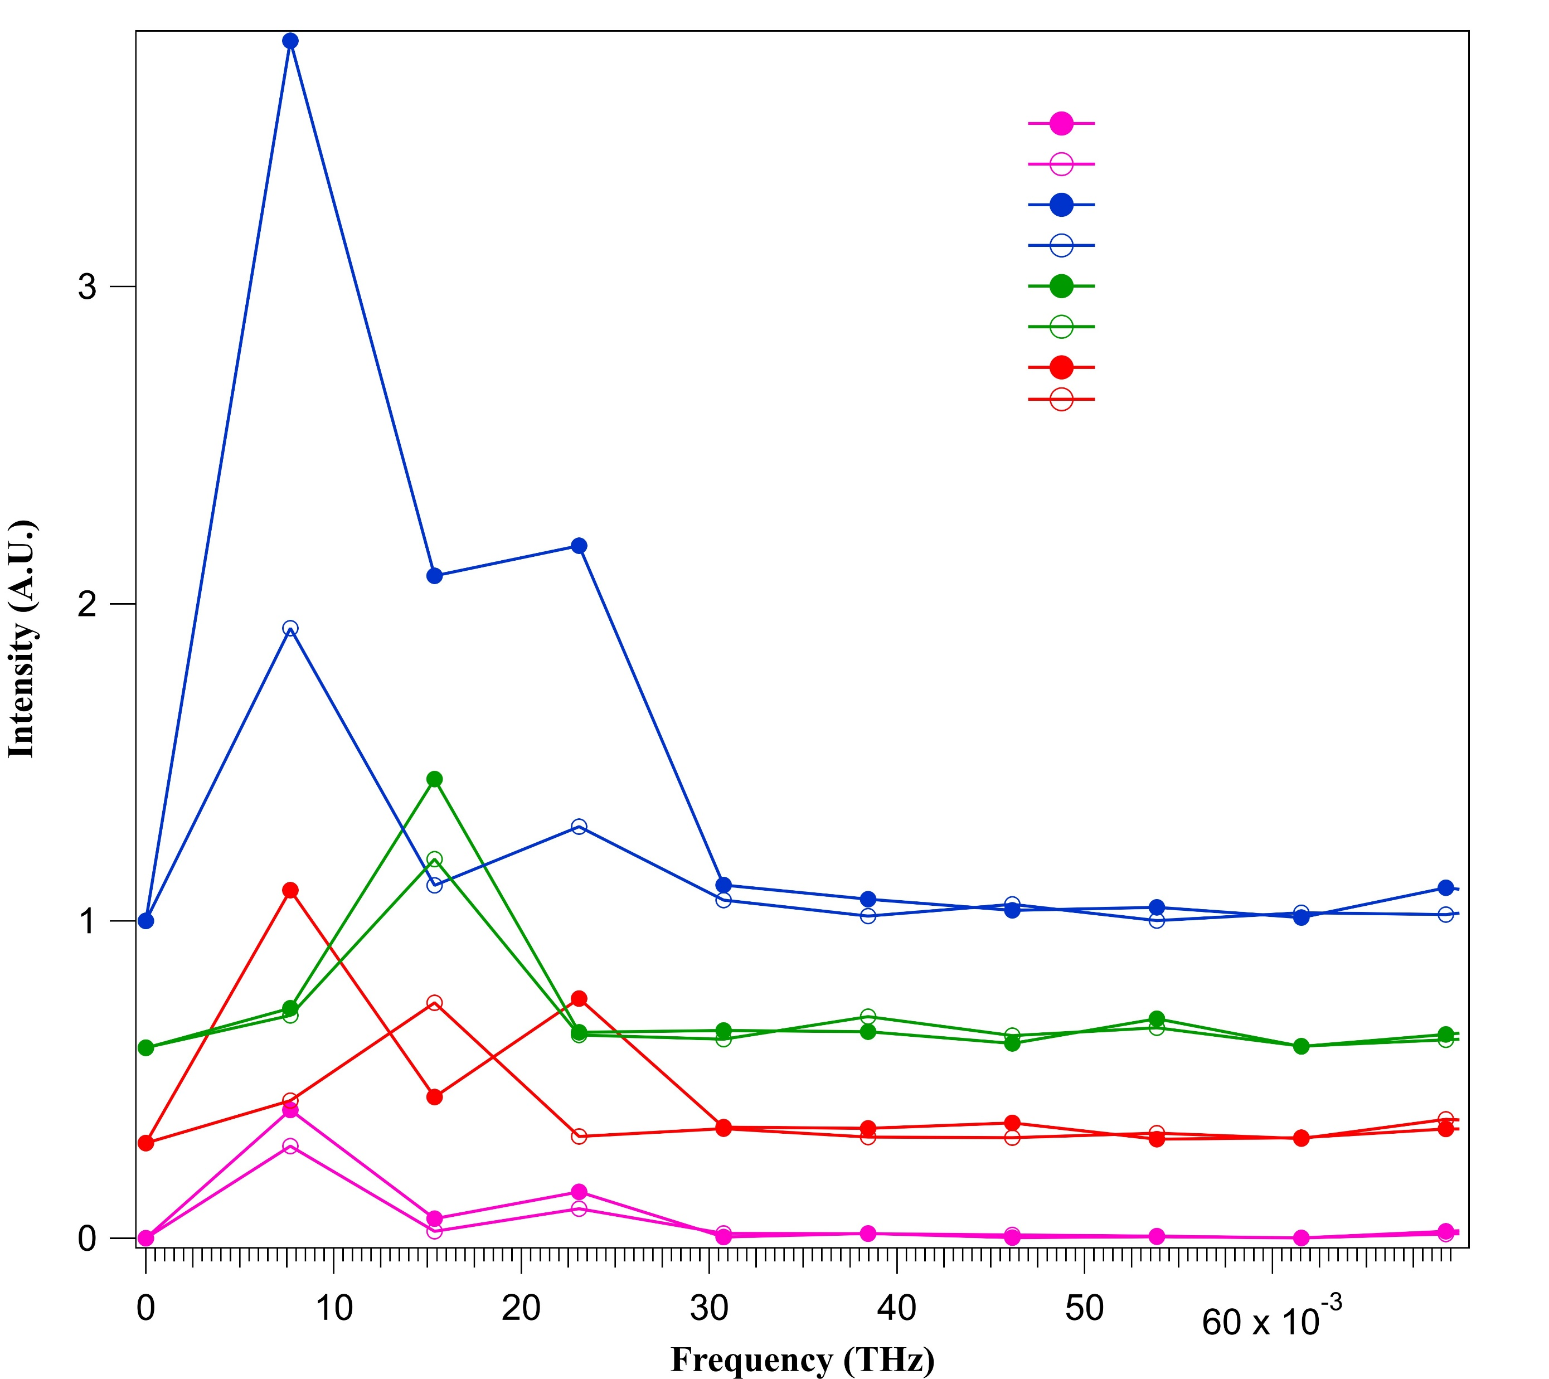



a
Frequency of oscillations at two temperatures
FFTs at LT (77 K)
FFTs at RT (300 K)
11$0$
$\overline{1}$ $\overline{1} 0$
$$020$$
$$0\overline{2}0$$
$$1\overline{1}0$$
$$\overline{1}10$$
2$00$
$$\overline{2}00$$
Frequency of oscillations decrease with the temperature.
Frequency of oscillations are do not depend on the pump beam energy.
This behavior is in agreement with the published results of coupled coherent magnon phonon propagation.
Notes:
We checked the time evolution of Friedel pair intensities. Because we wanted to check if our data satisfy Friedel’s law. Most of the Friedel pairs at both LT and RT satisfy Friedel’s law, having nearly equal intensities of oscillations. When we compared the oscillations at two temperatures, you can see, at RT, oscillations are weak and have shorter lifetime compared to the LT. And we check the frequency of oscillations at two temperatures. This is in agreement with the ultrafast paper results that I discussed earlier. This temperature dependency motivated us to study further about the intensity oscillations.
[(3-10), (-310)] and [(3-30), (-330)] pairs don’t follow the Friedel law.
Obeying the Friedel’s law satisfy the condition that the beam is normal to the sample surface.

Slide 10
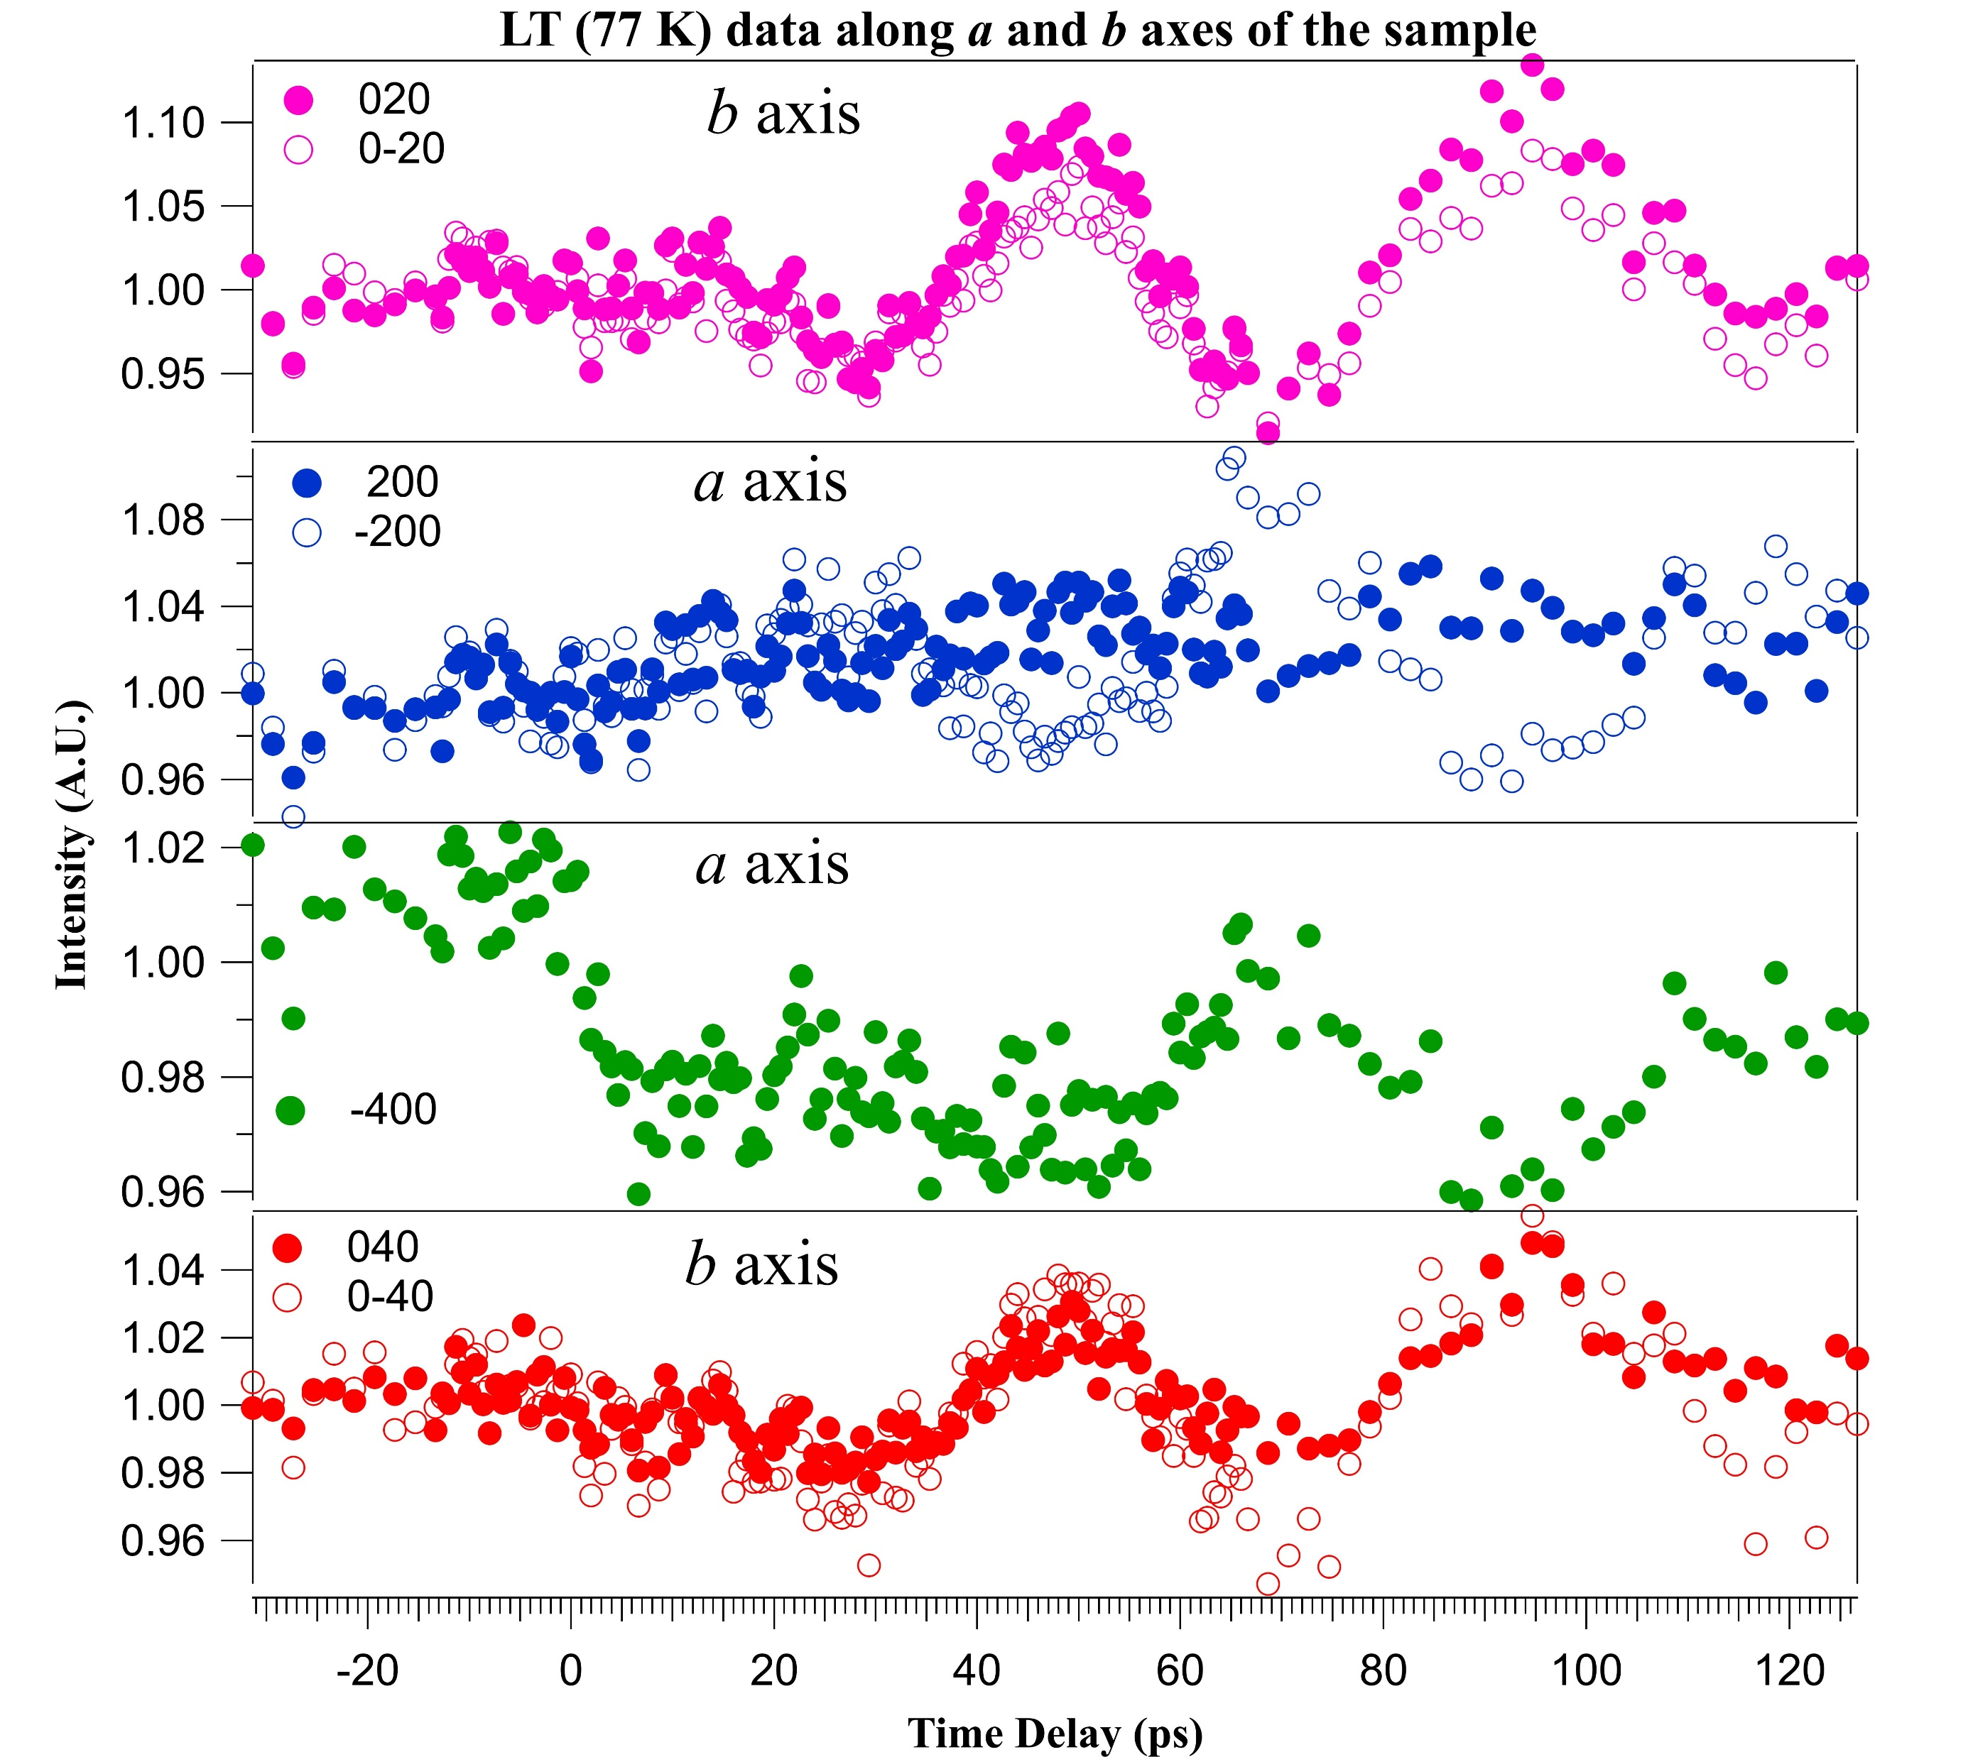




a
Time evolution of Friedel pairs along a and b axes at LT
$$020$$
Peaks along the b axis show clear oscillations with long lifetime.
Interestingly, the easy axis of magnetization is along the b axis.
This leads to the idea that we could observe magnon-phonon coupling in our data as well (we are still working on this).
$$0\overline{2}0$$
2$00$
$$\overline{2}00$$
$$\overline{4}00$$
$$040$$
$$0\overline{4}0$$
Notes:
Then we did analyze the intensities along a and b axes of the sample. We observed clear oscillations along the b axis and weak oscillations along the a axis.

Slide 11
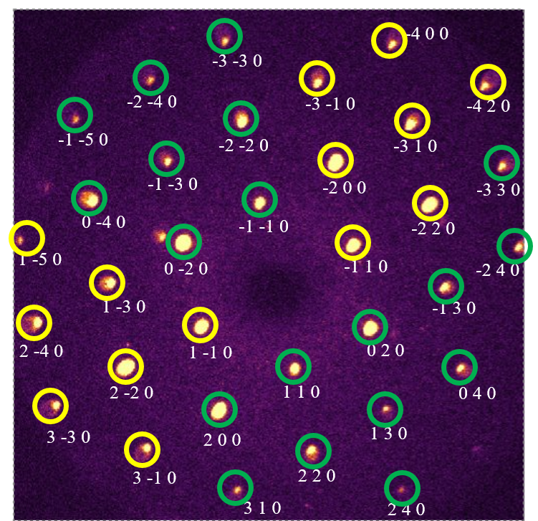
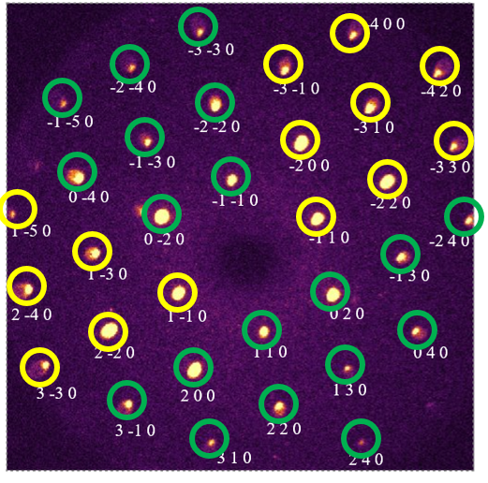
Phase of oscillations at two temperatures
LT (77 K)
RT (300 K)
Green circles are 180º out of phase to the yellow circles.
No clear pattern of phase oscillations.

Slide 12
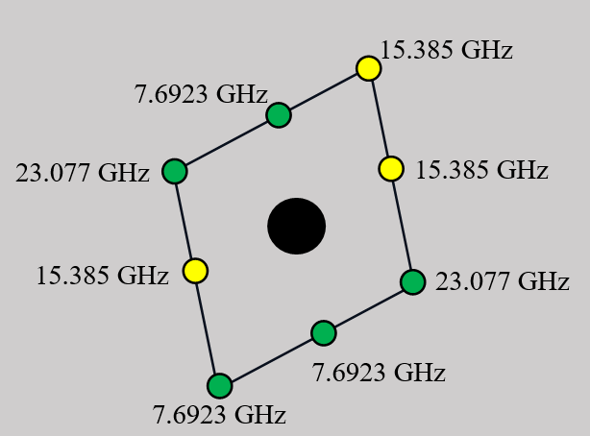
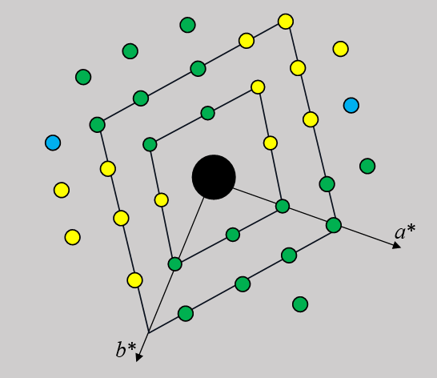
The relationship between phase and frequency of oscillations
7.692 GHz and 23.077 GHz frequencies are in-phase oscillations. The intermediate frequency component (15.385 GHz) is out of phase to the above oscillations.
The rest of the Bragg peaks parallel to each of the above BPs follow the same phase as them.
Along the b axis (i.e. a* in reciprocal space), we observed only one oscillation (23.08 GHz), but along a, three frequency components obtained (7.69, 15.39 and 23.08 GHz). This result is also in agreement with the earlier mentioned published results.
Physics Research Day 2024

Slide 13
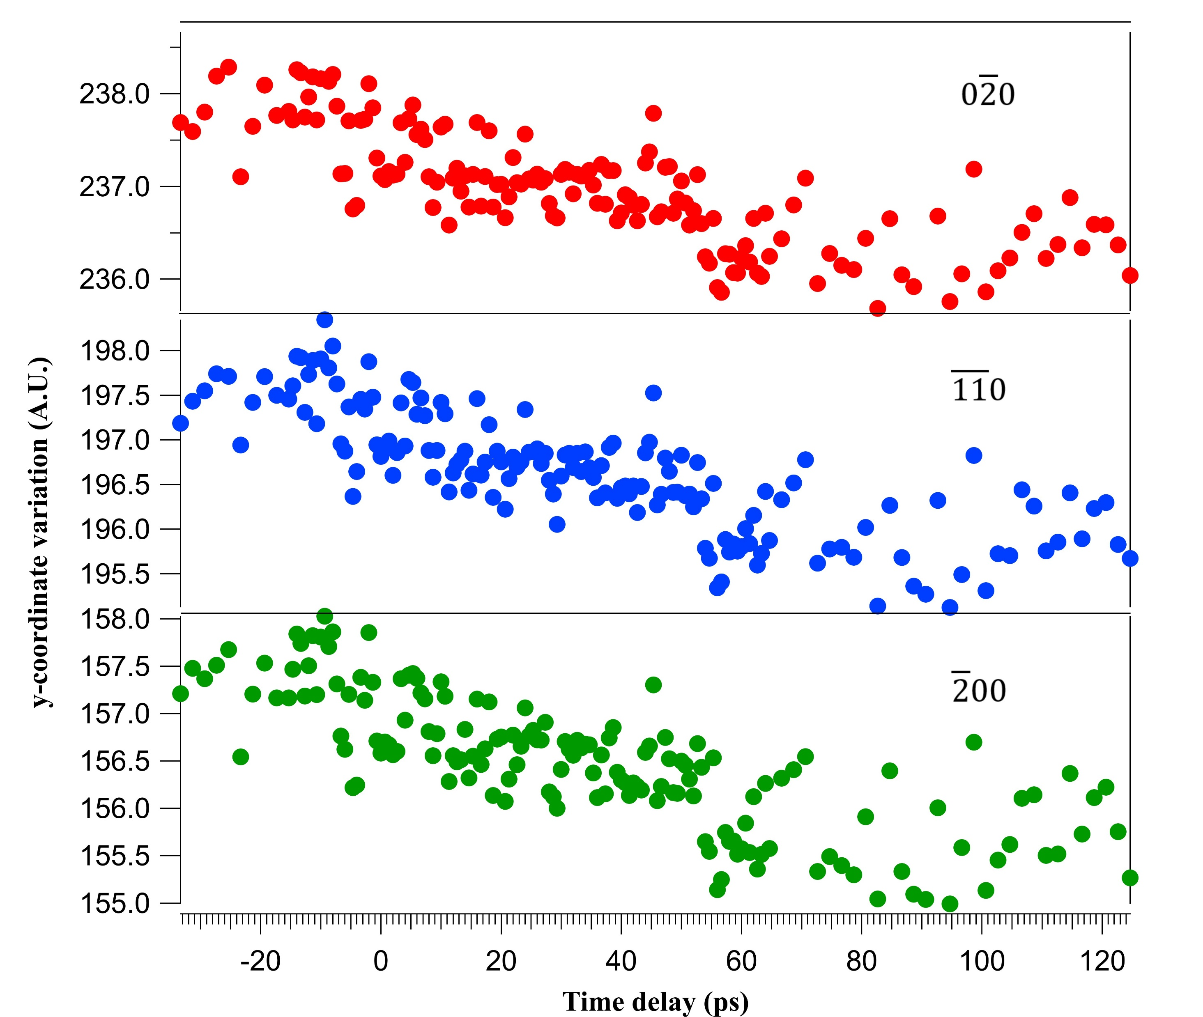
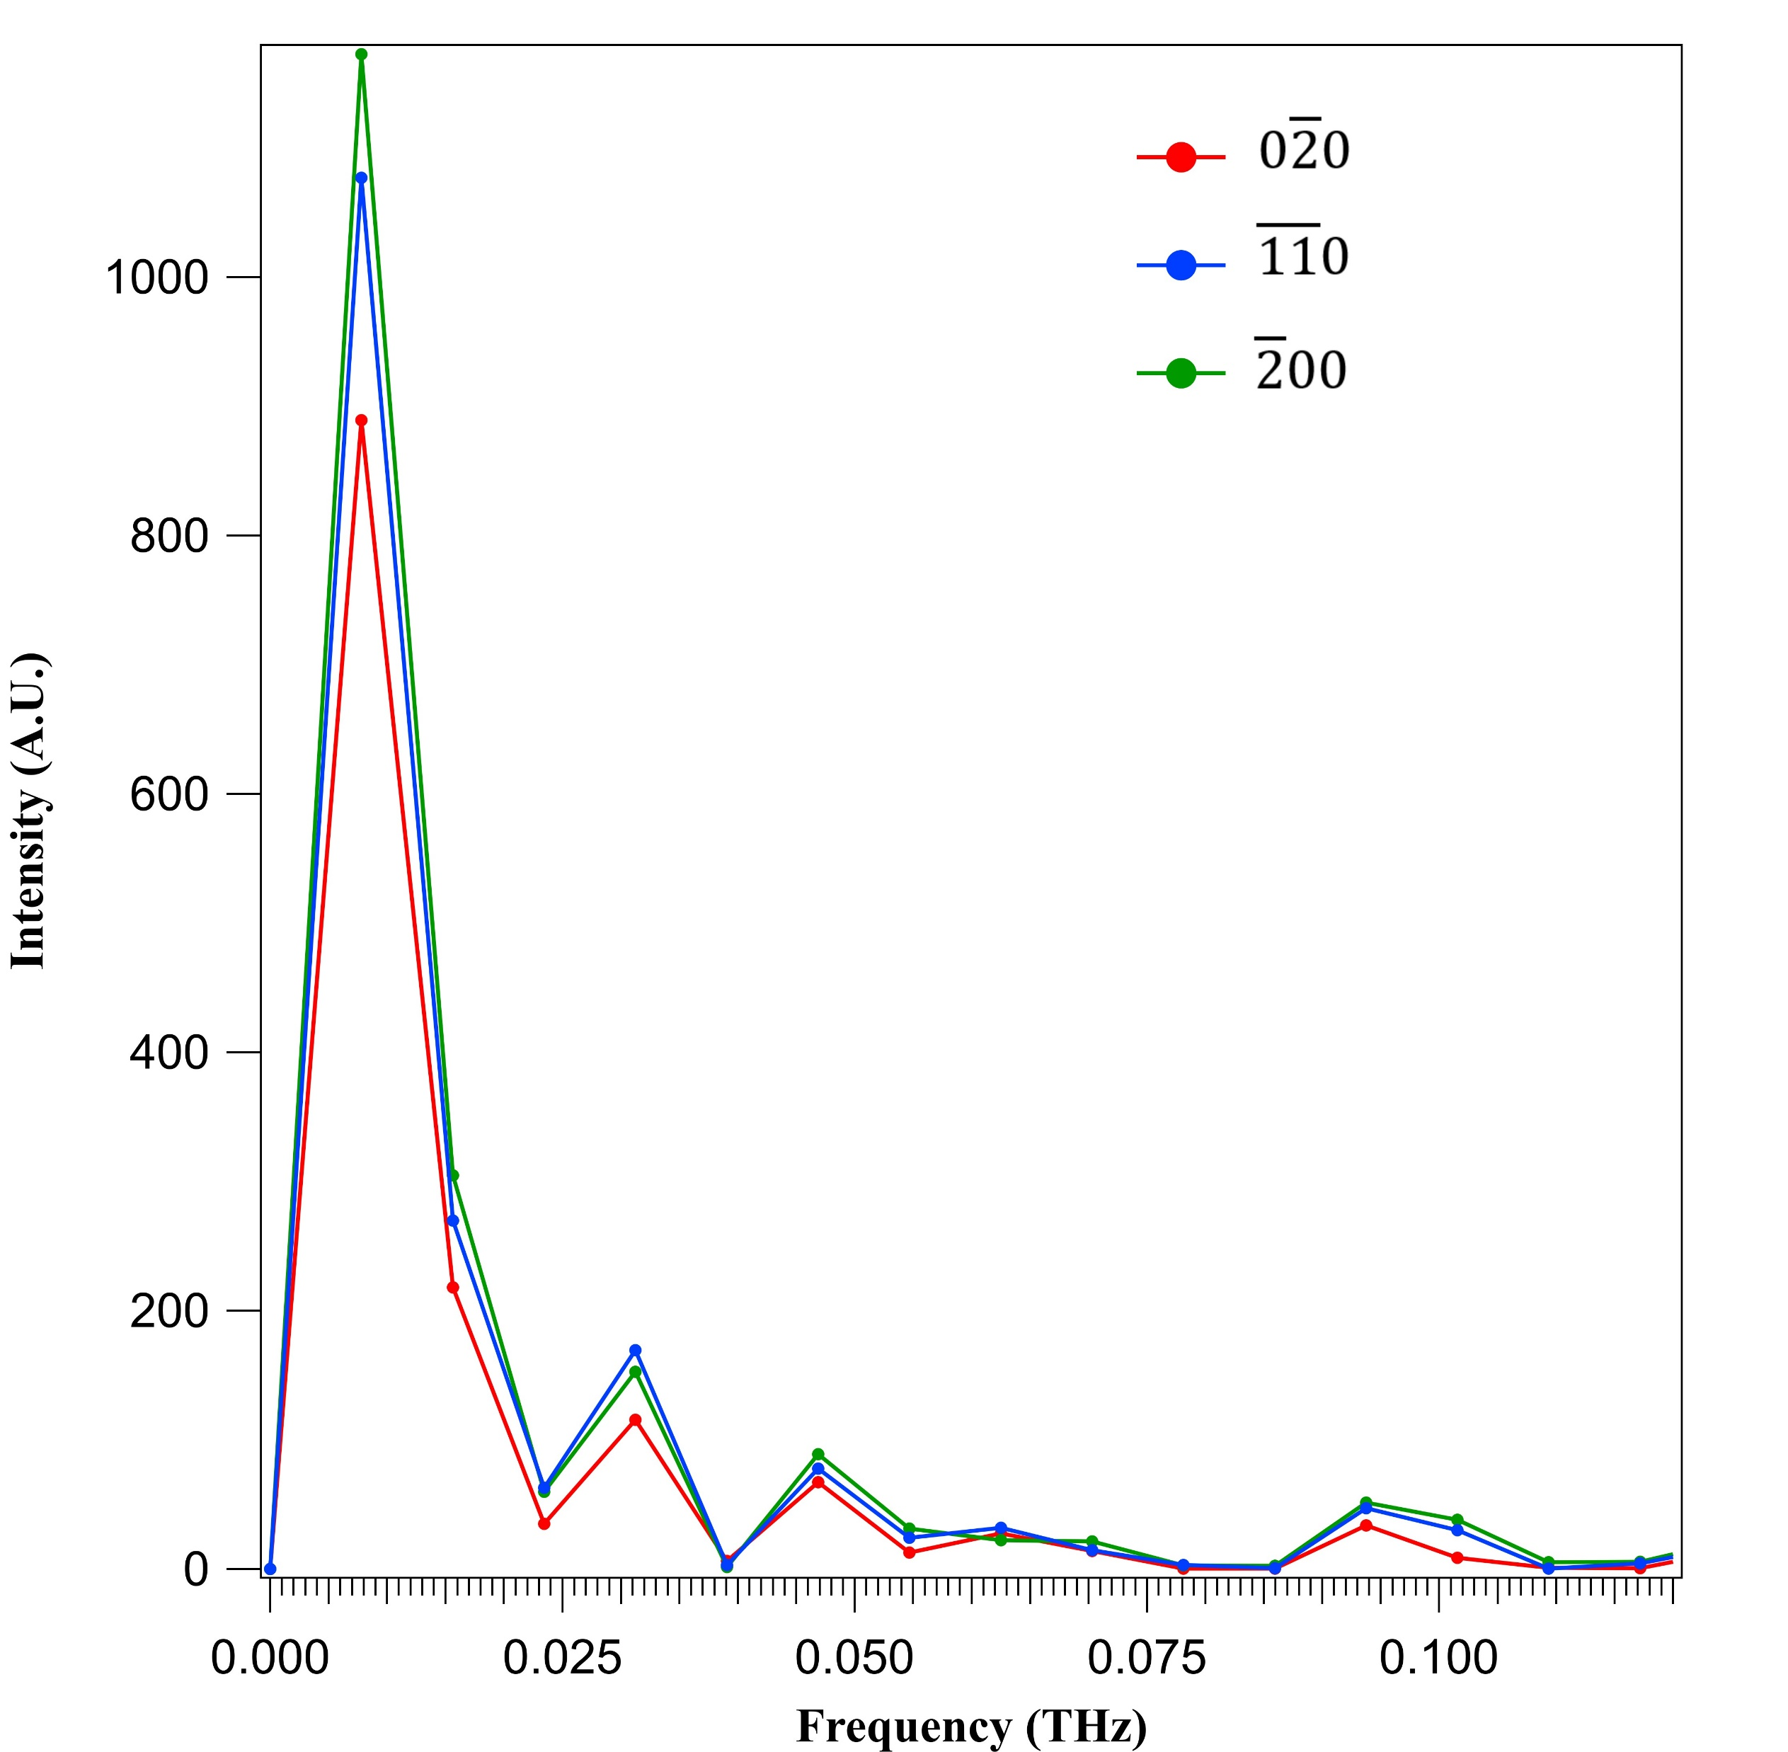
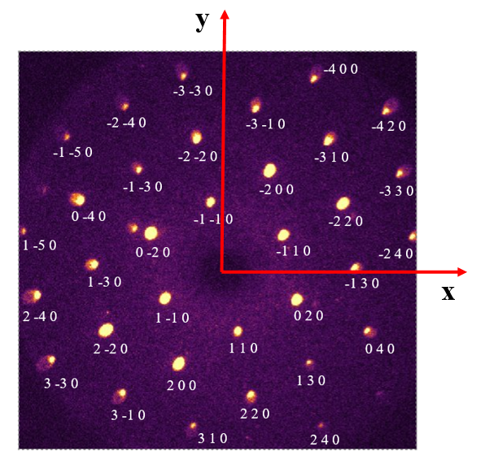
The detection of Bragg peaks position change
LT (77 K)
RT (300 K)
The variation of Bragg peaks position with delay time is measured by using scikit-ued python package.
The plots show that variation for some of the selected Bragg peaks.
The frequency of the above variations that found from FFT gives 7.81 GHz fundamental frequency. This is in good agreement to the fundamental frequency of intensity oscillations (7.69 GHz).
Physics Research Day 2024
Notes:
Then I would like to share the information about the Bragg peak position variation with the delay time. For this, I checked the x and y coordinates variations wrt to the time delay.

Slide 14
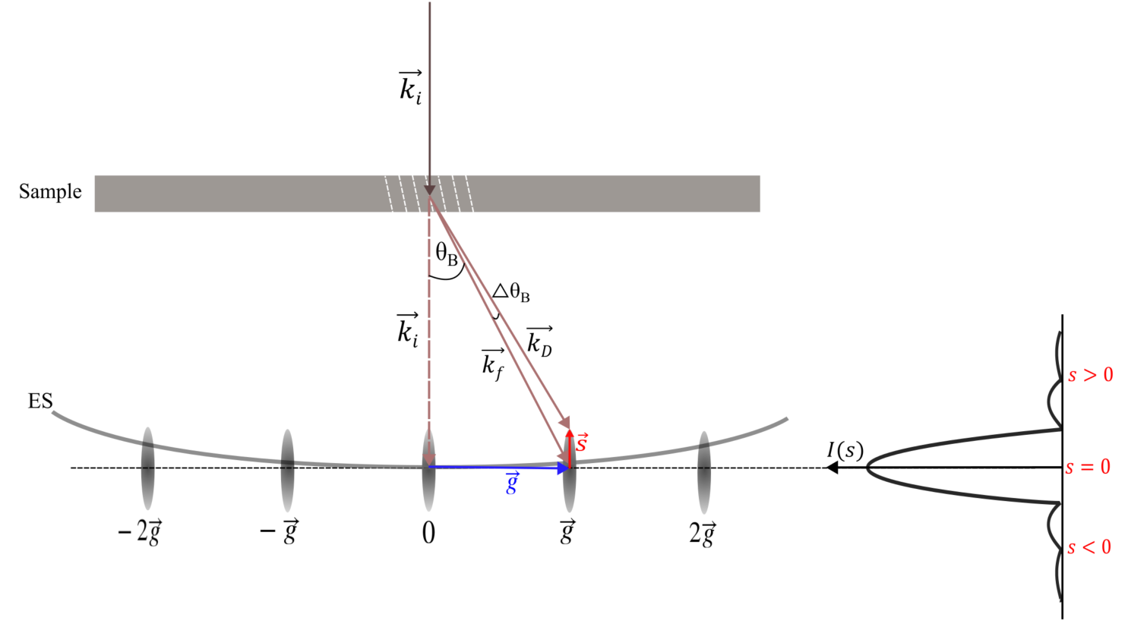
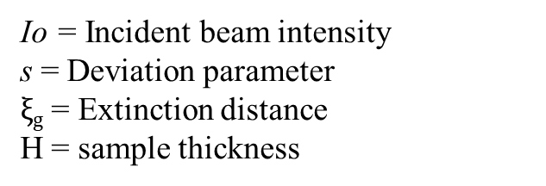
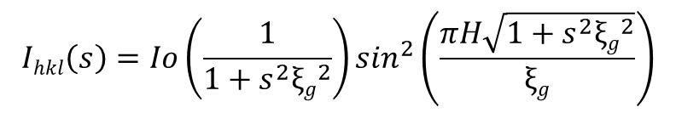
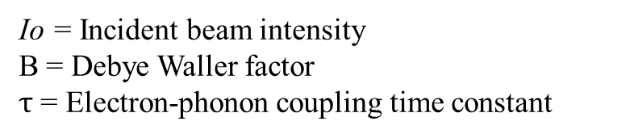
a
Fit results of the BPs intensity behavior with time
1. Debye Waller contribution
Io = Incident beam intensity
B = Debye Waller factor
$τ$ = Electron-phonon coupling time constant
$$I\left(t\right)=Io \{\left(1−B\right)+B∗exp⁡(−t/τ)\}$$
2. Dynamic diffraction contribution¹⁻³
$$Ihkl\left(s\right)=Io\left(\frac{1}{1+s^{2}{ξg}^{2}}\right)\sin^{2}\left(\frac{πH\sqrt{1+s^{2}{ξg}^{2}}}{ξg}\right)$$
Io = Incident beam intensity
s = Deviation parameter
$ξg$ = Extinction distance
H = sample thickness
Reimer, L. Transmission electron Microscopy (2013)
Cowley, J.M. Electron Diffraction Techniques (1992)
Williams, D.B; Carter C.B. Transmission Electron Microscopy (1996)
Figure 7 Ewald construction of transmission mode electron diffraction with the deviation parameter.
Physics Research Day 2024
Notes:
Debye Waller contribution explains the intensity drop or increment right after the time zero. The laser beam transfer heat energy to the sample, and lattice points absorb that energy and start to oscillate. This causes for the intensity to drop or increase and this intensity variation explain using Debye Waller factor.
To explain the oscillatory motion of our data, we used dynamic diffraction theory. According to the DD theory, the intensity of a Bragg peak can be explained by using deviation parameter. The deviation parameter, s draws from the center of the lattice point to the Ewald’s sphere. As the lattice planes oscillate, deviation parameter will be varied and so the intensity will be varied. That behavior explains in this equation.

Slide 15
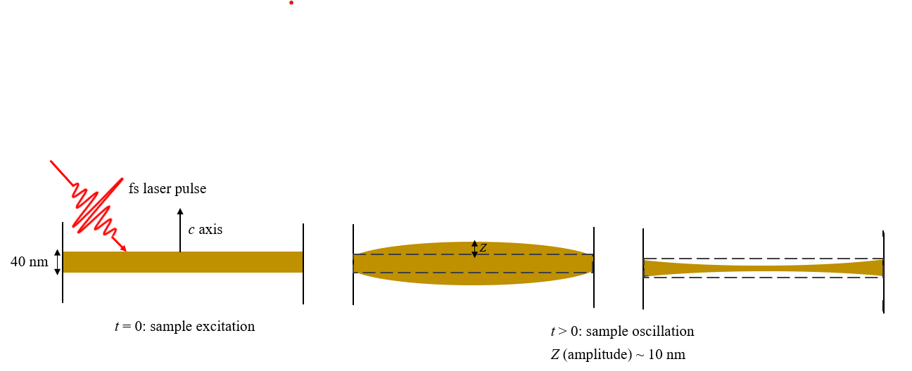
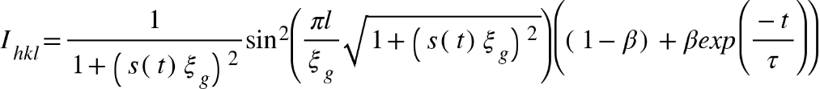
a
Fit results of the BPs intensity behavior with time (ctd.)
In order to model the BP intensity time-series data, we constructed a quantifiable time-dependent deviation parameter that results from the crystal’s excitation by the fs pump beam.
We hypothesized that (i) the bulk sample motion modulates the deviation parameter and (ii) s can be represented as sinusoidal time-varying function as follows.
s(t) = Acos(Ωt + φ) + k
A = Reciprocal space amplitude of the deviation parameter
Ω = The oscillation frequency of the deviation parameter
φ = Phase
t = Time for which t > t₀
k = constant
Then the full fit function can be written as:
Schematic representation of sample deformations when the pump beam been introduced
Physics Research Day 2024
Notes:
Now in order to fit our data, if we assume there are small oscillation of the sample that induced by the pump beam, like showing in the schematic, we hypothesized that the deviation parameter should be varied as a simple harmonic oscillator. Therefore, we introduced sinusoidal function to s, and plugged it in the original equation. By doing so we came up with this final equation to fit our data.

Slide 16
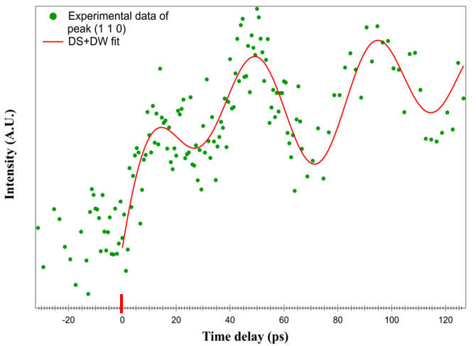
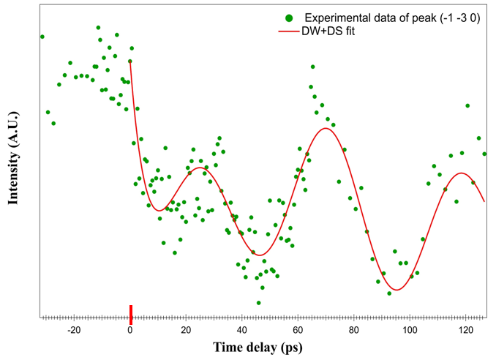
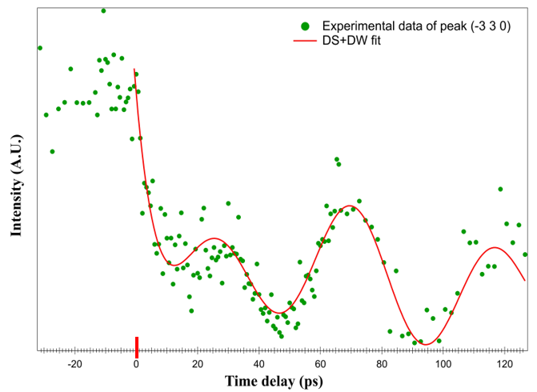
a
Fit results of the BPs intensity behavior with time (ctd.)
Figure UED time-series data fitted by dynamical scattering (DS) and Debye-Waller (DW) factor.
Physics Research Day 2024

Slide 17
a
Calculation of sample thickness using sound velocity
By assuming that the deformations of the sample is carried out by the acoustic phonons:
  We did calculate the sample thickness using the sound velocity.
  The time period of the oscillations was calculated by using the frequency of intensity oscillations (23 GHz).
  By doing so, we obtained sample thickness of 41. 87 nm.
  The AFM measurements give the sample thickness of ~ 40 nm.
Therefore, we concluded our analysis that the deformations of the sample is mediated by coherent acoustic phonons of 23 GHz.
Physics Research Day 2024

Slide 18
Conclusions
Femtosecond (fs) pump pulses excited small anisotropic lattice deformations of the sample.
These deformations are mediated by coherent acoustic phonons (CAPs) that are longitudinal breathing modes.
The frequency of these CAPs are extracted by analyzing the intensity oscillations of Bragg peaks, and the corresponding frequency was, ~ 23 GHz for most of the Bragg peaks. The detected lowest frequency was 7.692 GHz and this frequency was well matched with the frequency of Bragg peaks position change.
The anomalous intensity behavior of the Bragg peaks (BPs) intensities was simulated by incorporating an oscillating electron deviation parameter ansatz into well-developed dynamical scattering intensity expressions.
Doing so allowed excellent modeling of the ultrafast time dynamics of the photo-excited 2D crystalline samples.
Physics Research Day 2024
Notes:
The ultrafast beam induced small deformations on the sample that are carried out by CAPs. The frequency of the coherent phonons were calculated by analyzing the intensity oscillations of the BPs. We found 23 GHz is the dominant frequency component. At LT, the oscillations are more clear leading to the idea of phonon and magnon coupling in our data, but this analysis is not finished yet. The data was fitted by DW and DS theories, we changed the deviation parameter to be vary as a sinusoidal function.

Slide 19

Acknowledgments
My research group members:
Dr. Byron Freelon (PI)
Sumit Khadka
Chamini Shammi
Ubeh Uchenna
Beamline staff scientists:
Dr. Junjie Li (BNL)
Dr. Mark Palmer (BNL)
Dr. Mikhail Fedurin (BNL)
Sample preparations:
Dr. Xiaodong Xu (University of Washington)
John Cenker (University of Washington)
Theoretical support:
Dr. Jose J. Baldovi (University of Valencia)
Alberto M. Ruiz (University of Valencia)
Dr. Ka Shen (Beijing Normal University)
Physics Research Day 2024

Slide 20
Thank you!
Physics Research Day 2024

Slide 21
Auxiliary section
Physics Research Day 2024

Slide 22
2D Magnetic Materials
2D magnetic materials are easily exfoliated into mono layer or few layers forms. They exhibit weak van der Waal forces.
The magnetic properties of these materials exhibit in two-dimensional plane.
First 2D material discovered is Graphene in 2004 (figure).
The magnetism in these 2D materials first discovered for CrI₃ and Cr₂Ge₂Te₆ in 2017.
2D magnetic materials are highly applicable in spintronics and magnetic storage devices.
Physics Research Day 2024

Slide 23
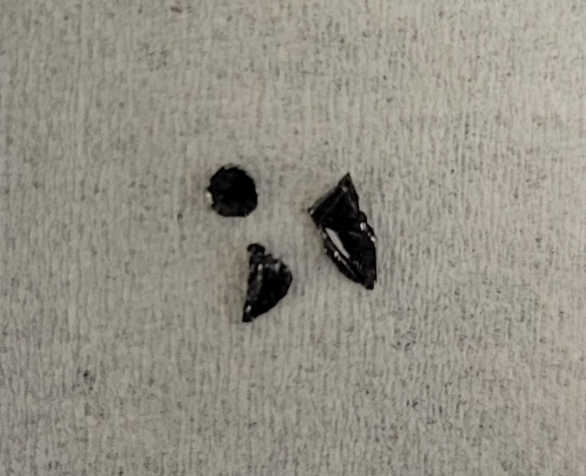
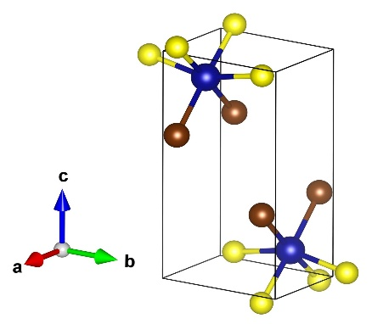
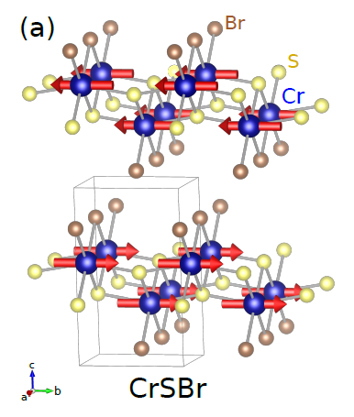
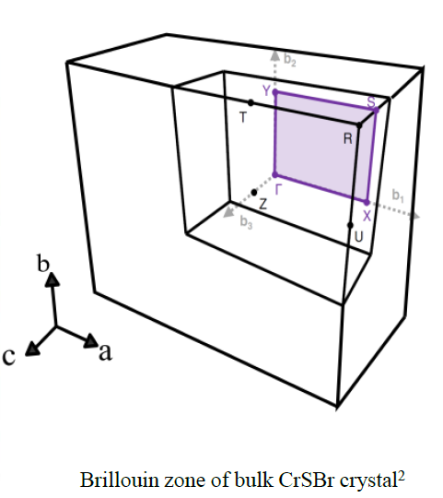
CrSBr
Air stable
Long axis of the crystal is b, short axis is a
Large direct band gap semiconductor (~1.5 eV)
A-type AFM semiconductor with an in-plane FM easy axis along b.
Paramagnetic at room temperature
Curie temperature: T_{c} = 146 K, Neel temperature: T_{N} =132 K
8 mm
CrSBr crystals (left) and its orthorhombic crystal structure¹ (right) (Cr, S and Br atoms represent by blue, yellow and brown colors respectively).
A type AFM ordering in CrSBr³
Yang et al., Phys. Rev. B 104 144416 (2021)
Klein, et al. Nat. Comm. 13 5420 (2022)
Scheie et al., Adv. Sci. 9 2202467 (2022)
Physics Research Day 2024

Slide 24
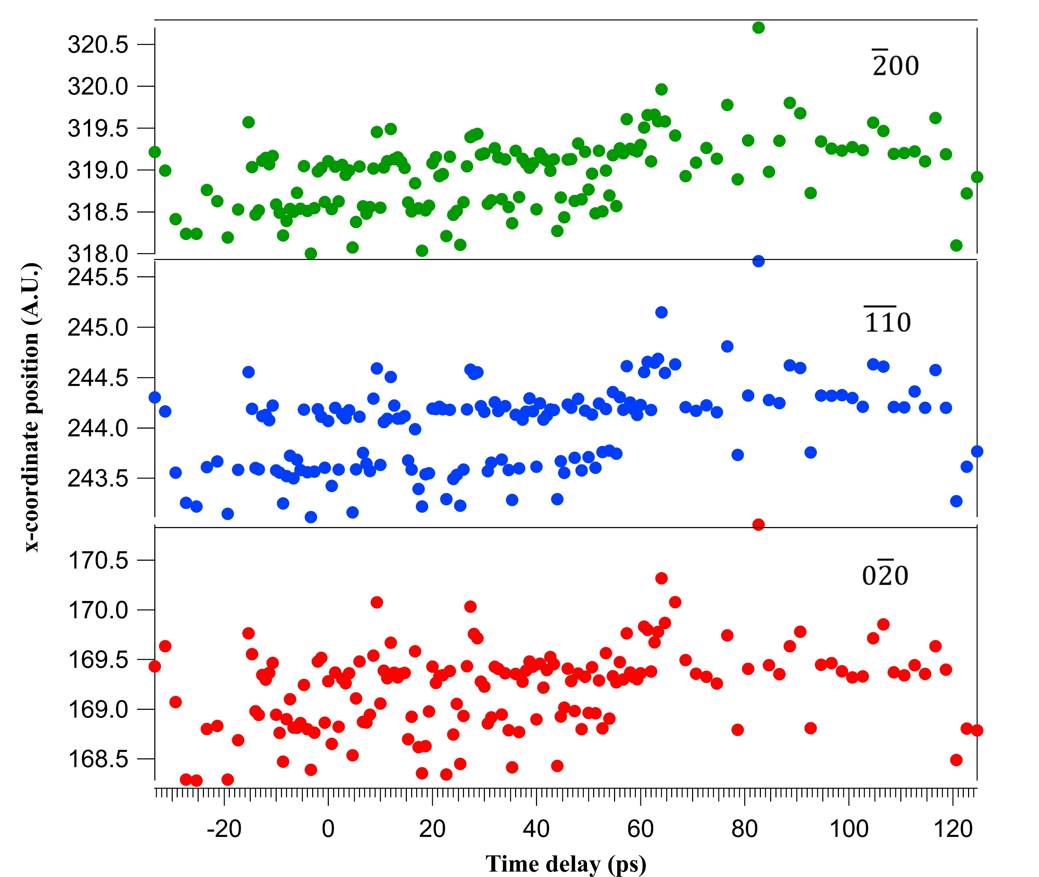
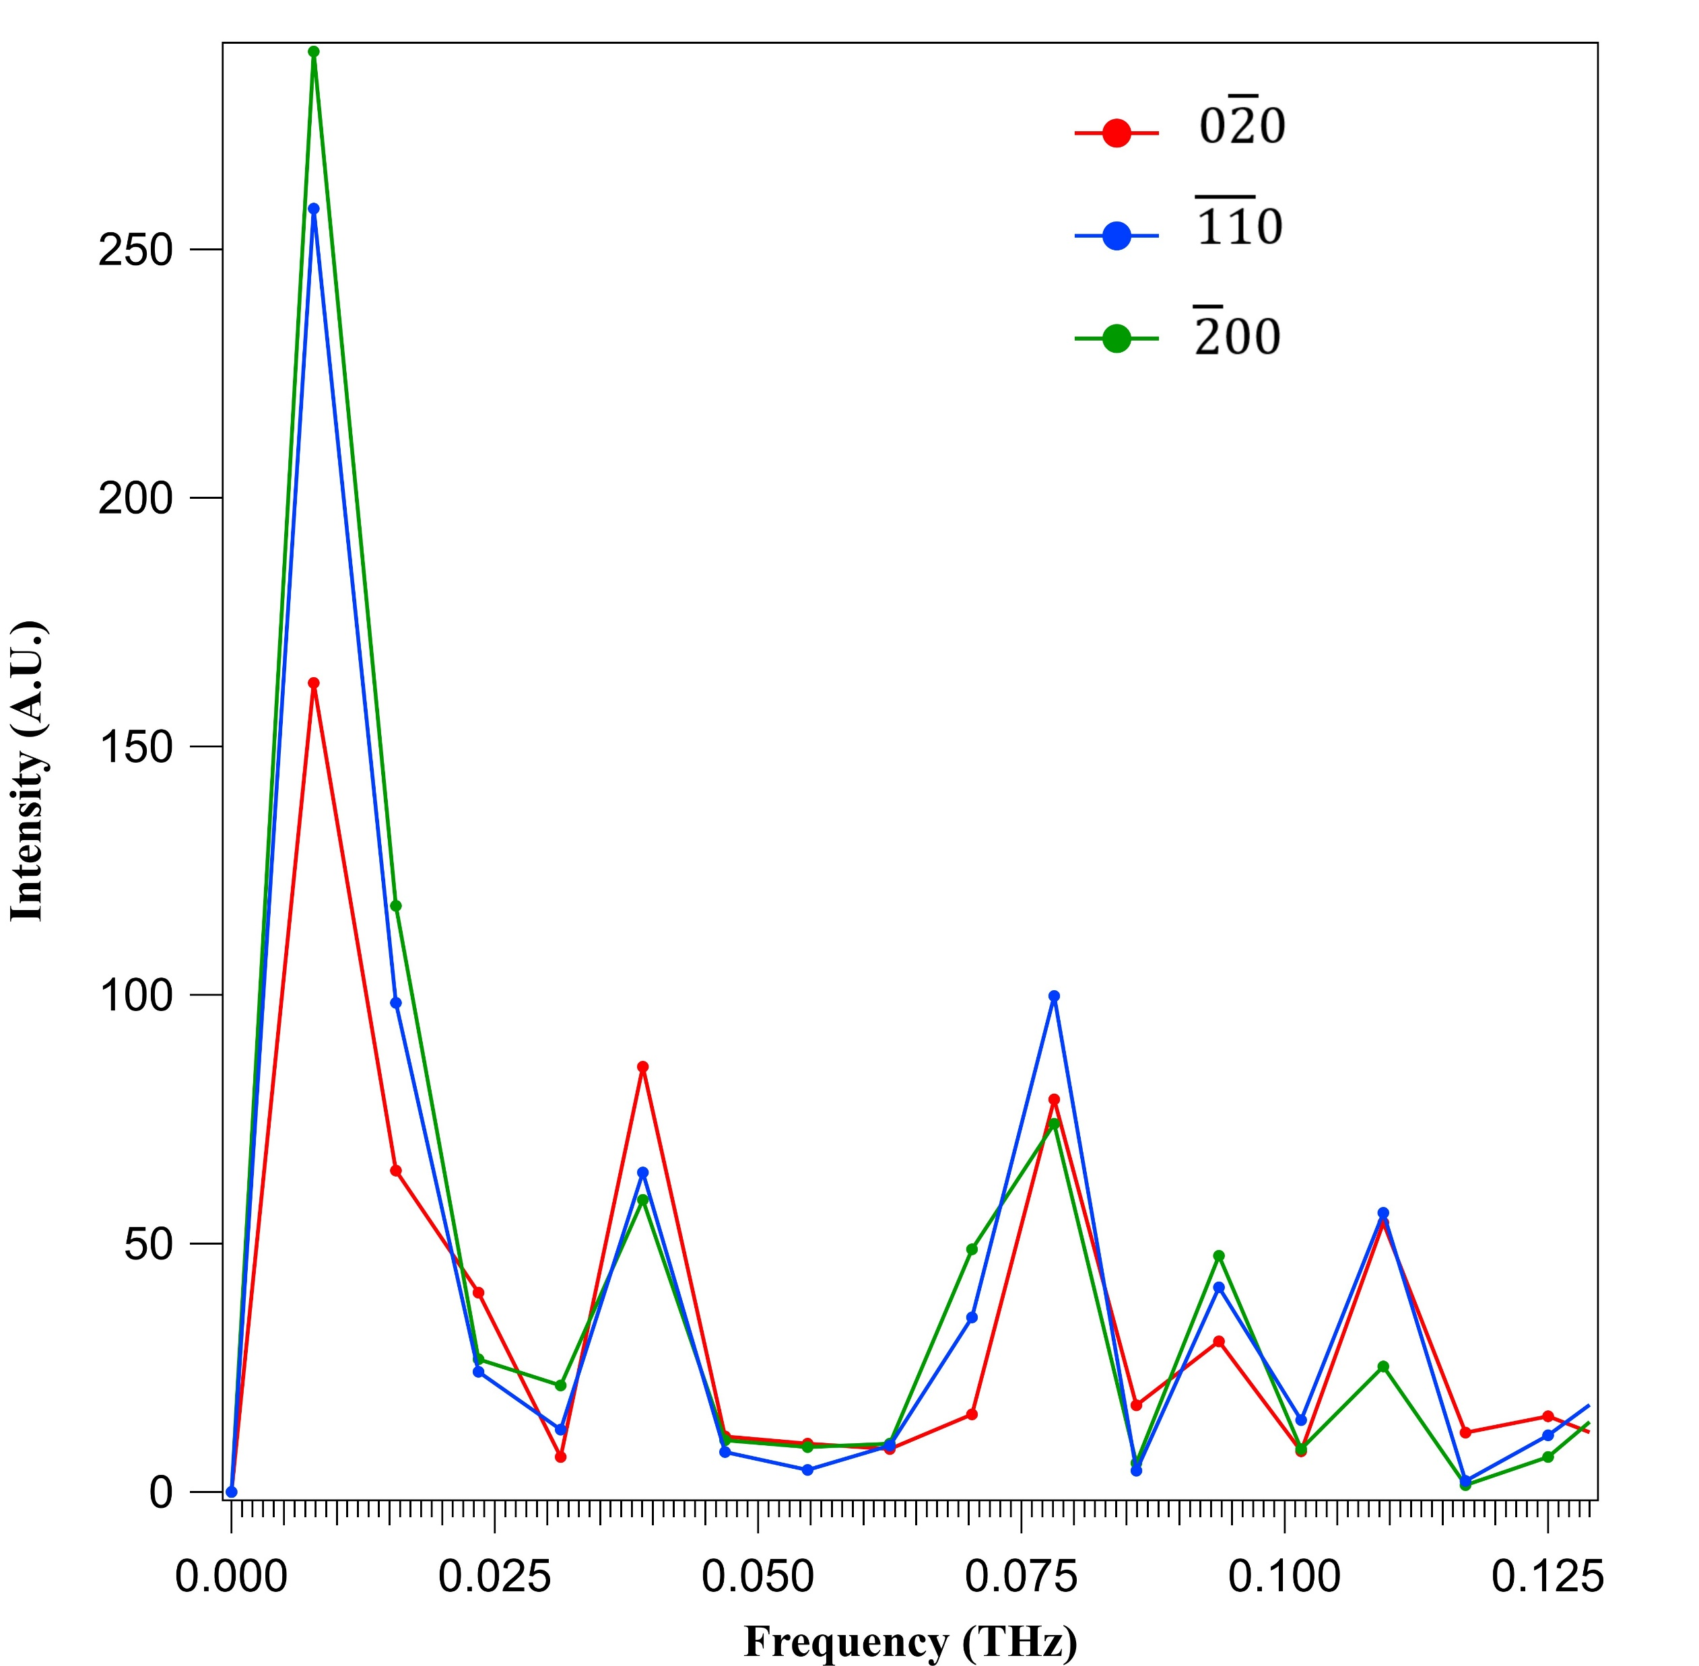
The detection of Bragg peaks position change: x coordinate
LT (77 K)
RT (300 K)
The frequency of the above variations gives 7.9365 GHz fundamental frequency. This is in good agreement to the fundamental frequency of intensity oscillations.
Physics Research Day 2024

Slide 25
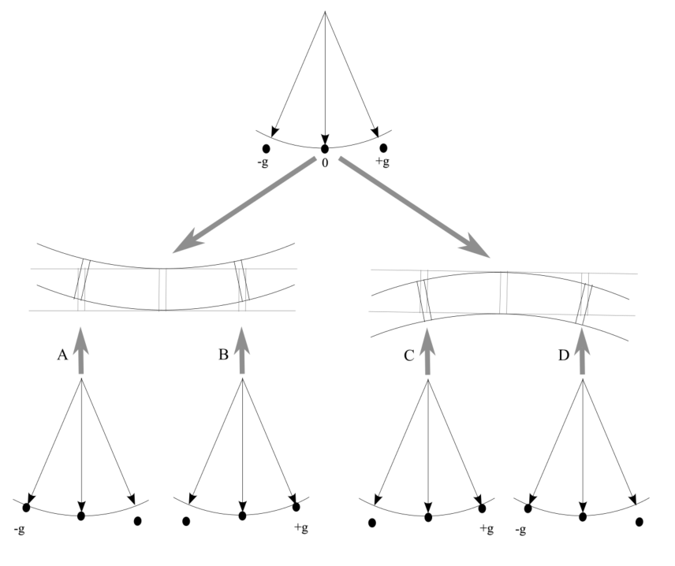
a
Fit results of the BPs intensity behavior with time (ctd.)
In order to model the BP intensity time-series data, we constructed a quantifiable time-dependent deviation parameter that results from the crystal’s excitation by the fs pump beam (Figure 8).
We hypothesized that (i) the bulk sample motion modulates the deviation parameter and (ii) s can be represented as sinusoidal time-varying function as follows.
s(t) = Acos(Ωt + φ) + k
A = Reciprocal space amplitude of the deviation parameter
Ω = The oscillation frequency of the deviation parameter
φ = Phase
t = Time for which t > t₀
k = constant
Then the full fit function can be written as:
a
b
c
Figure a The diffraction condition for an unbent sample. (b and c) Bend contours are shown for concave up and concave down sample deformations respectively. A and C (B and D) are to the left (right) of the bend contours. The diffraction conditions are same for the A, D and B, C. The deviation parameter s = 0 at the center of the bend contour i.e., the unbent region of the sample. The s becomes positive or negative based on the sample oscillation.
Physics Research Day 2024

Slide 26
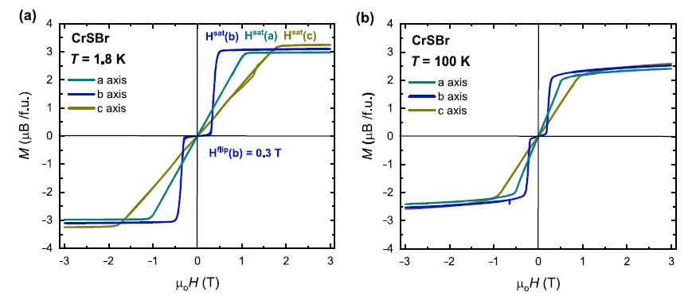
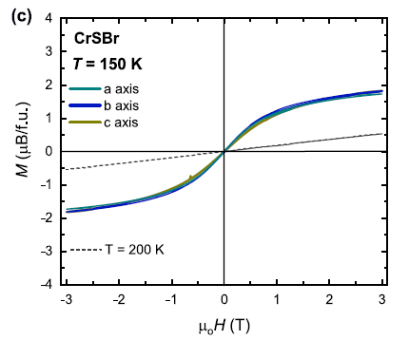
Saturation magnetic fields of CrSBr at different temperatures
H_{sat} a = 1 T
H_{sat} b = 0.4 T
H_{sat} c = 2 T
H_{sat} a = 0.5 T
H_{sat} b = 0.3 T
H_{sat} c = 1 T
Temperature and field dependent magnetization of CrSBr along the three axes and the corresponding saturation fields¹
1. Sara et al., Nat. comm. 13 4745 (2022)
Physics Research Day 2024
Notes:
M=isothermal magnetization

Slide 27
MeV UED Experiments at BNL
BNL MeV UED Experiments info:
Laser pulses of 800 nm wavelength, and a pulse duration of 180 fs provided a pump beam to the CrSBr samples.
Synchronized 130 fs pulses of 2.8 MeV electrons served to probe the CrSBr crystals with a total area of ∼100 × 100 μm² at various time delays.
Repetition rate was 20 Hz.
Room (300 K) and low-T (77 K) data collected.
Data collected for five different pump fluences.
(hk0) Bragg peaks detected.
Physics Research Day 2024

