Slide 1


Entanglement Entropy in p-p Collisions at LHC Energies
Alek Hutson
University of Houston Physics Research Day 2024
Advisor: Dr. Rene Bellwied
February 24, 2024

Slide 2
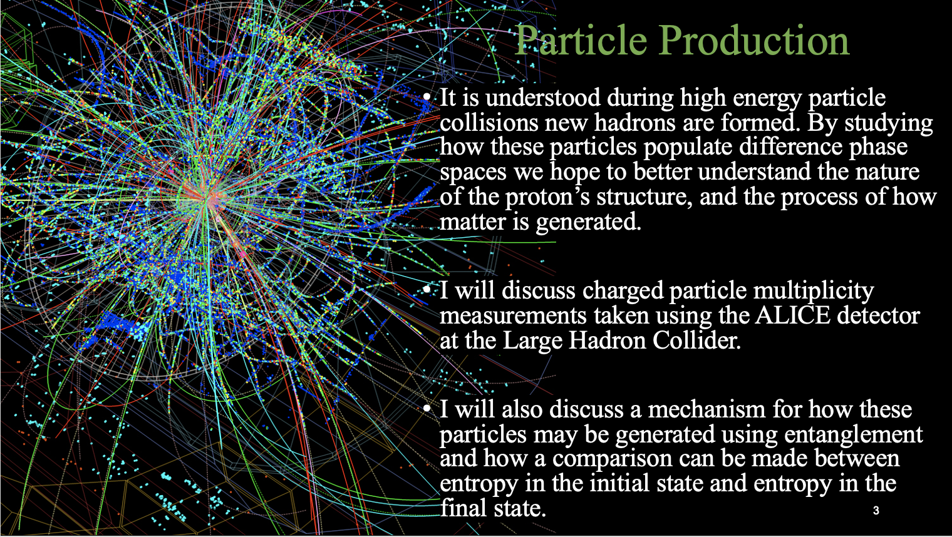
Introduction

Slide 3
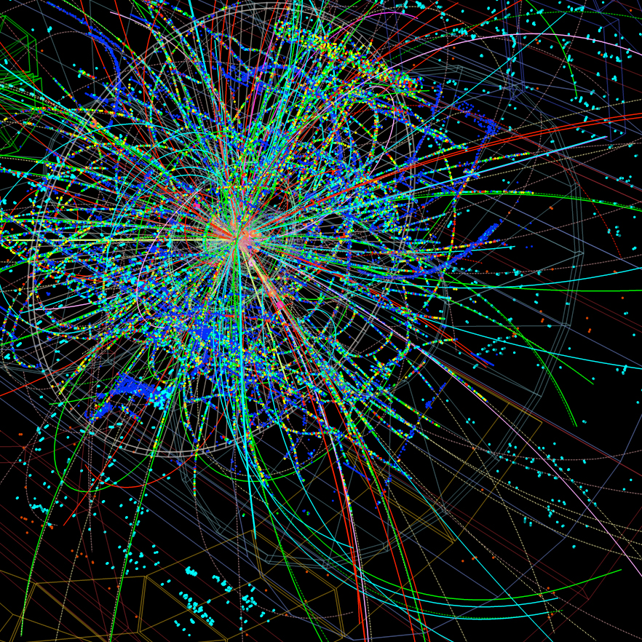
Particle Production
It is understood during high energy particle collisions new hadrons are formed. By studying how these particles populate difference phase spaces we hope to better understand the nature of the proton’s structure, and the process of how matter is generated.
I will discuss charged particle multiplicity measurements taken using the ALICE detector at the Large Hadron Collider.
I will also discuss a mechanism for how these particles may be generated using entanglement and how a comparison can be made between entropy in the initial state and entropy in the final state.
Entanglement in the initial state may be what gives rise to the thermal like behavior of larger systems.

Slide 4


Gibbs Entropy (final-state)
Gibbs entropy is a thermodynamic quantity that measures the degree of disorder, or randomness, in a system.
This is calculated using a probability distribution of the number of microstates. In this case the number of hadrons
The more hadrons produced the higher the entropy.
While the Gibbs entropy is defined under different context than entanglement entropy, each of these definitions attempts to quantify the disorder of the system. And each is proportional to the number of particles.
A
B
B
Entanglement Entropy (initial-state)
Entanglement entropy is a metric for understanding the level of entanglement between two or more quantum systems.
It quantifies the amount of information that is shared between particles (partons) and can be used to characterize their degree of correlation.
A proton represents a pure state; meaning the partons are fully correlated and maximally entangled.
The interacting proton can be segmented into an interaction region (A) and a region that remains unprobed (B). Entanglement entropy arises between these two regions.
The goal of this analysis is to show that entanglement survives the system evolution and these two entropies can be related, even to the extent that their values should be equal. This would demonstrate that we are not dealing with a thermal system but rather a quantum many body system that appears thermal.

Slide 5
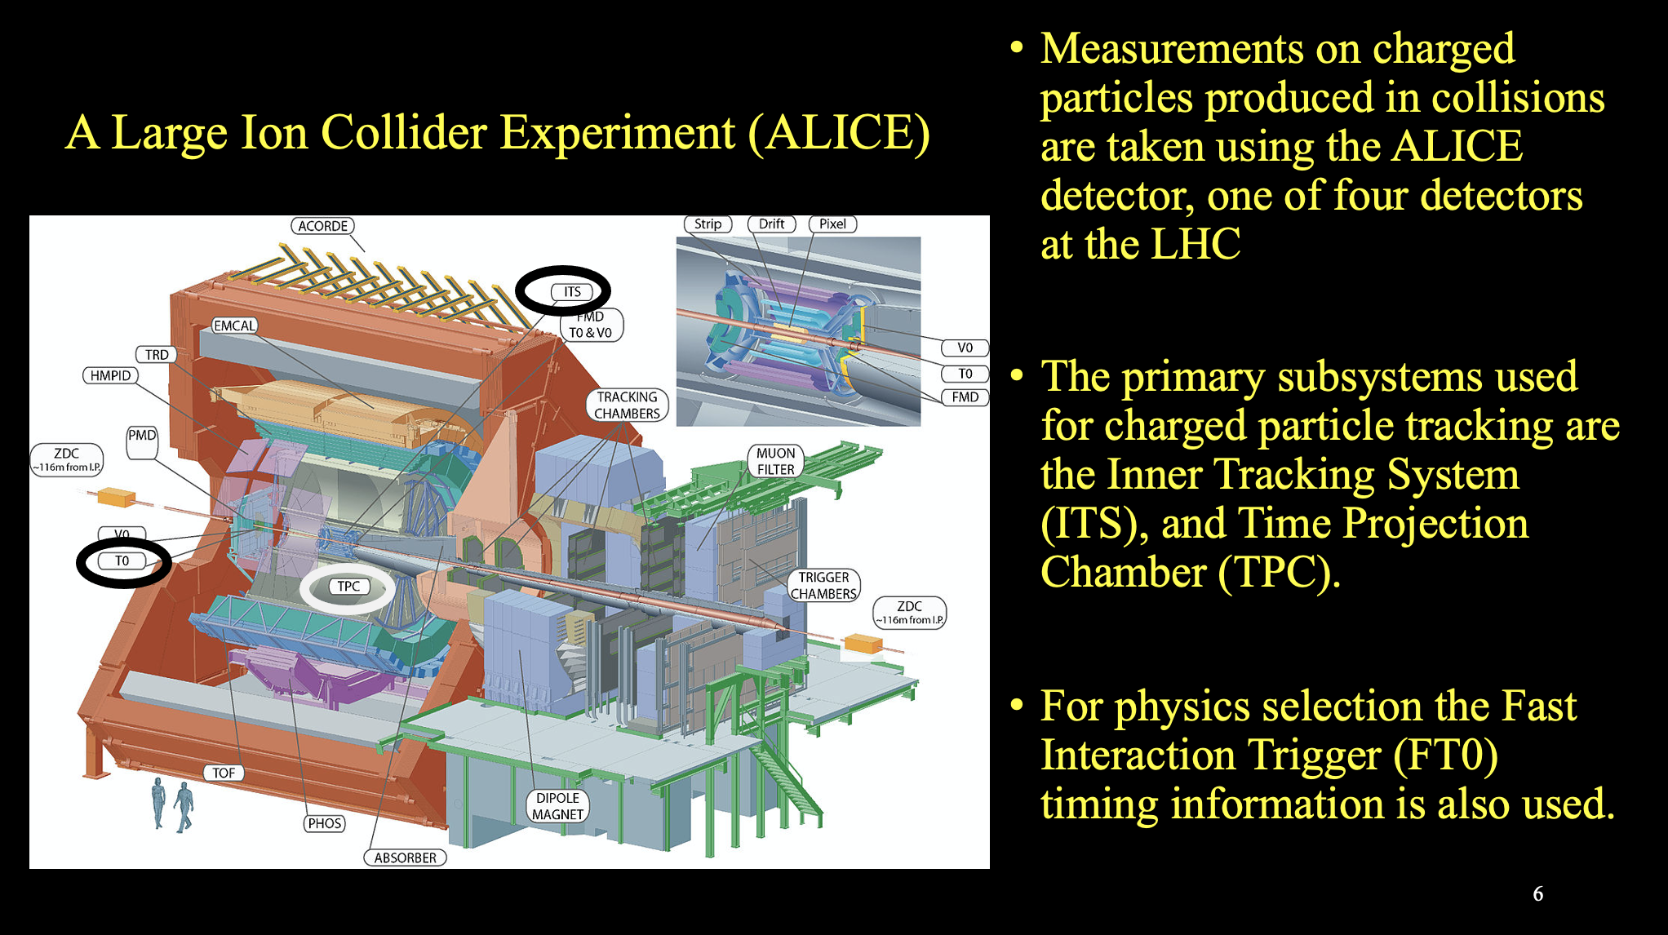
Final State

Slide 6
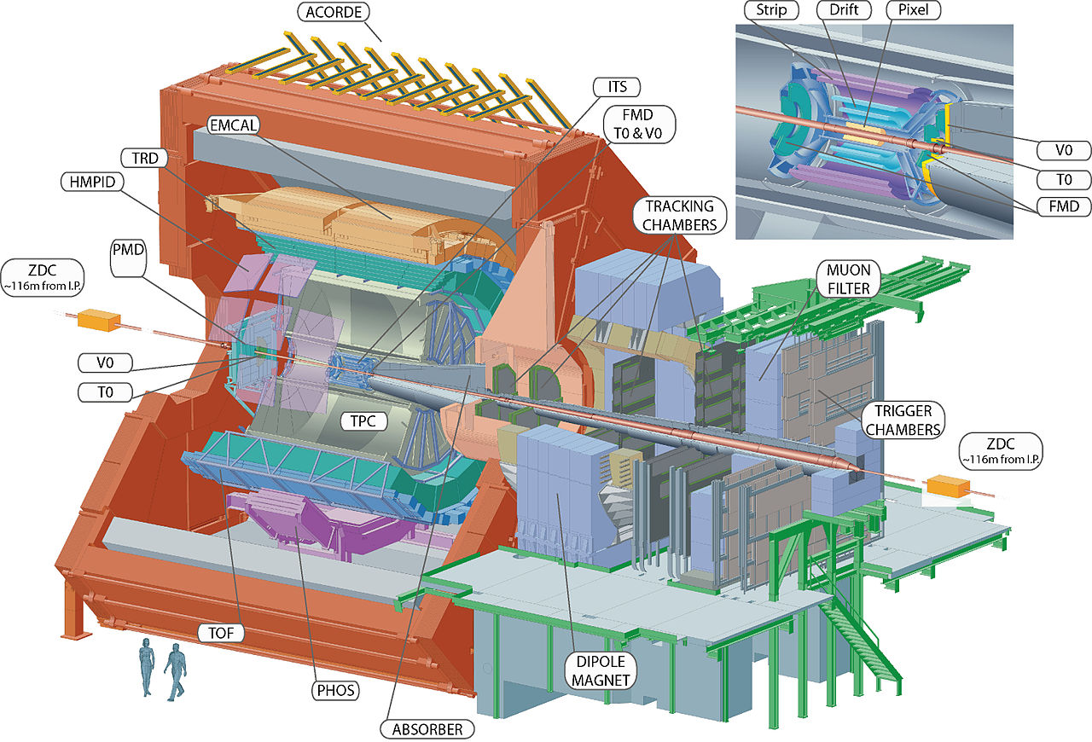
A Large Ion Collider Experiment (ALICE)
Measurements on charged particles produced in collisions are taken using the ALICE detector, one of four detectors at the LHC
The primary subsystems used for charged particle tracking are the Inner Tracking System (ITS), and Time Projection Chamber (TPC).
For physics selection the Fast Interaction Trigger (FT0) timing information is also used.
TPC

Slide 7
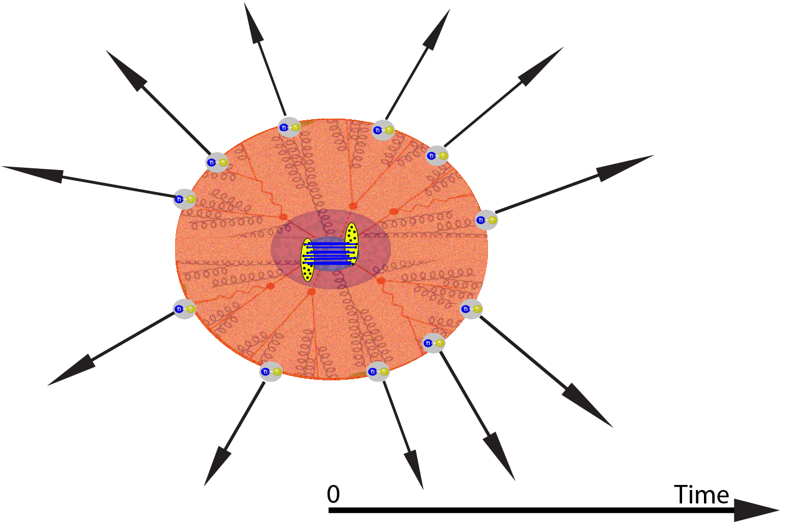
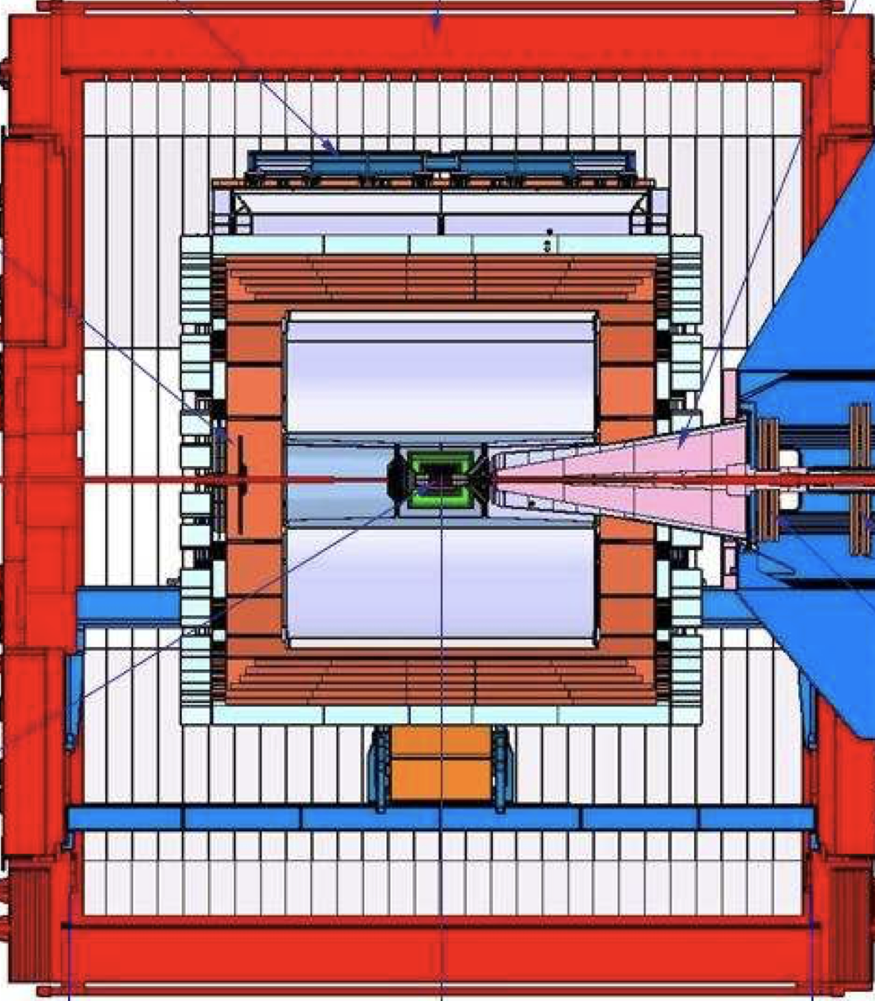
ALICE DETECTOR
η = 0
Provided there is sufficient energy in the initial state the protons will fragment into many hadrons.
Pseudorapidity (η) is a Lorentz invariant spacial coordinate which quantifies an angle relative the beam axis.
As the newly produced charged hadrons traverse and deposit energy into the various subsystems of the detector their positions can be resolved.
At high energies it is possible that between the initial state and the hadronized final state a QGP may form. This has been demonstrated in larger systems.

Slide 8
ALICE DETECTOR
η = 0
2
3
1
4
Multiplicity is defined as the number of produced hadrons in a given geometric region. It is convenient to express multiplicity as a function of pseudorapidity.
A multiplicity distribution (P(N_{h})) represents the probability of N_{h} hadrons being produced in the chosen region.
6
5
N_{h} = 7
7

Slide 9
ALICE DETECTOR
η = 0
2
3
1
4
Multiplicity is defined as the number of produced hadrons in a given geometric region. It is convenient to express multiplicity as a function of pseudorapidity.
To find P(N):
Populate a histogram with N_{h}
A multiplicity distribution (P(N_{h})) represents the probability of N_{h} hadrons being produced in the chosen region.
6
5
N_{h} = 7
7

Slide 10
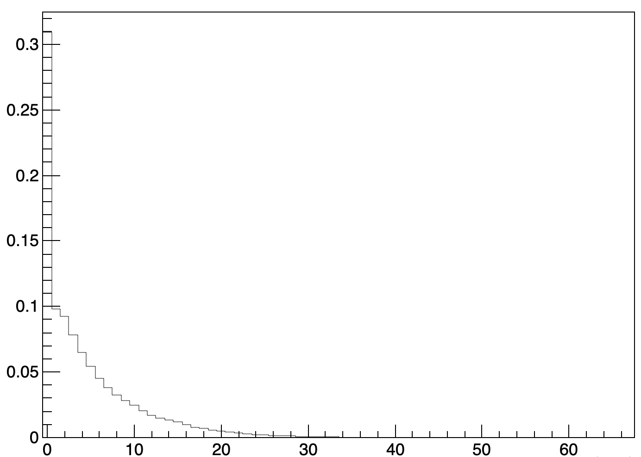
ALICE DETECTOR
η = 0
2
3
1
4
P(N_{h}).
Multiplicity is defined as the number of produced hadrons in a given geometric region. It is convenient to express multiplicity as a function of pseudorapidity.
To find P(N):
Populate a histogram with N_{h}
Over many events
Then normalize to unity
√s = 7 TeV
|η| < .5
A multiplicity distribution (P(N_{h})) represents the probability of N_{h} hadrons being produced in the chosen region.
N_{h}
6
5
N_{h} = 7
7

Slide 11
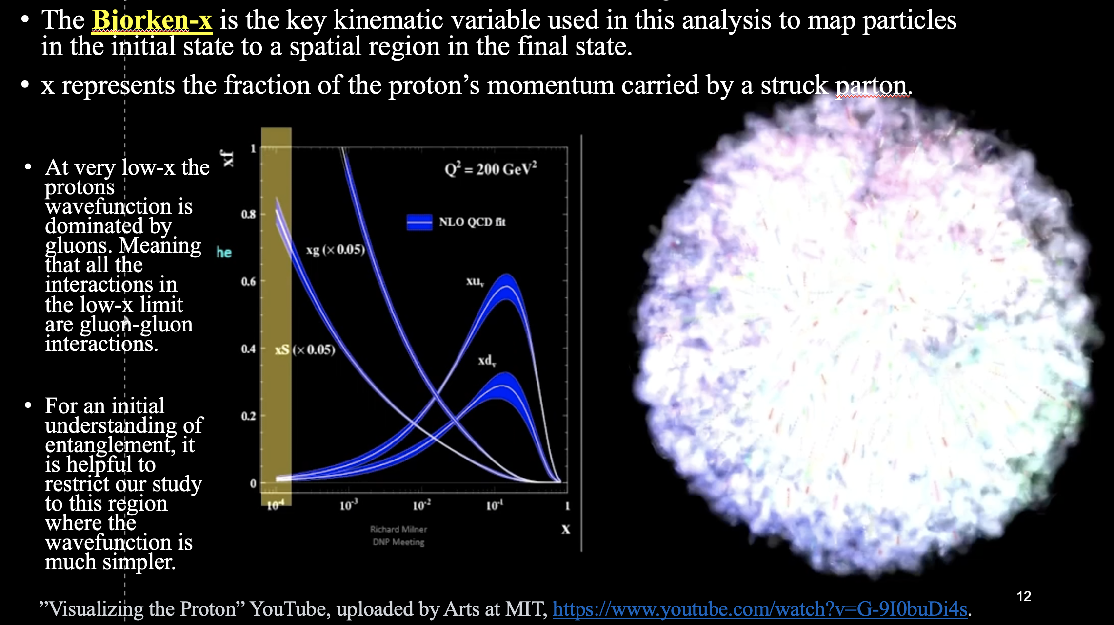
Kinematics

Slide 12
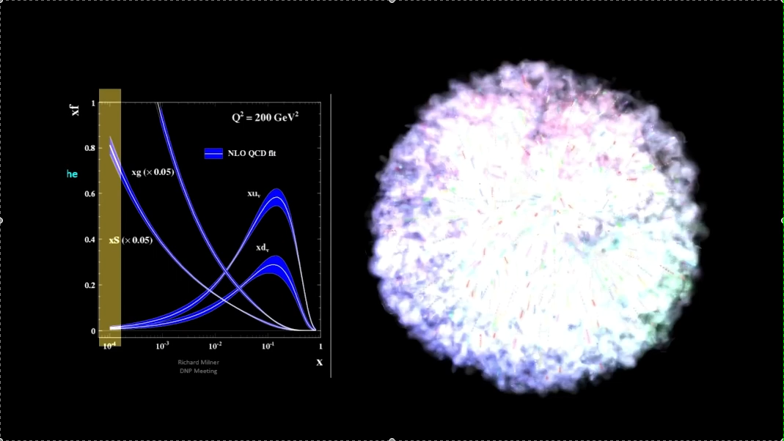
The Bjorken-x is the key kinematic variable used in this analysis to map particles in the initial state to a spatial region in the final state.
x represents the fraction of the proton’s momentum carried by a struck parton.
At very low-x the protons wavefunction is dominated by gluons. Meaning that all the interactions in the low-x limit are gluon-gluon interactions.
For an initial understanding of entanglement, it is helpful to restrict our study to this region where the wavefunction is much simpler.
”Visualizing the Proton” YouTube, uploaded by Arts at MIT, https://www.youtube.com/watch?v=G-9I0buDi4s.

Slide 13
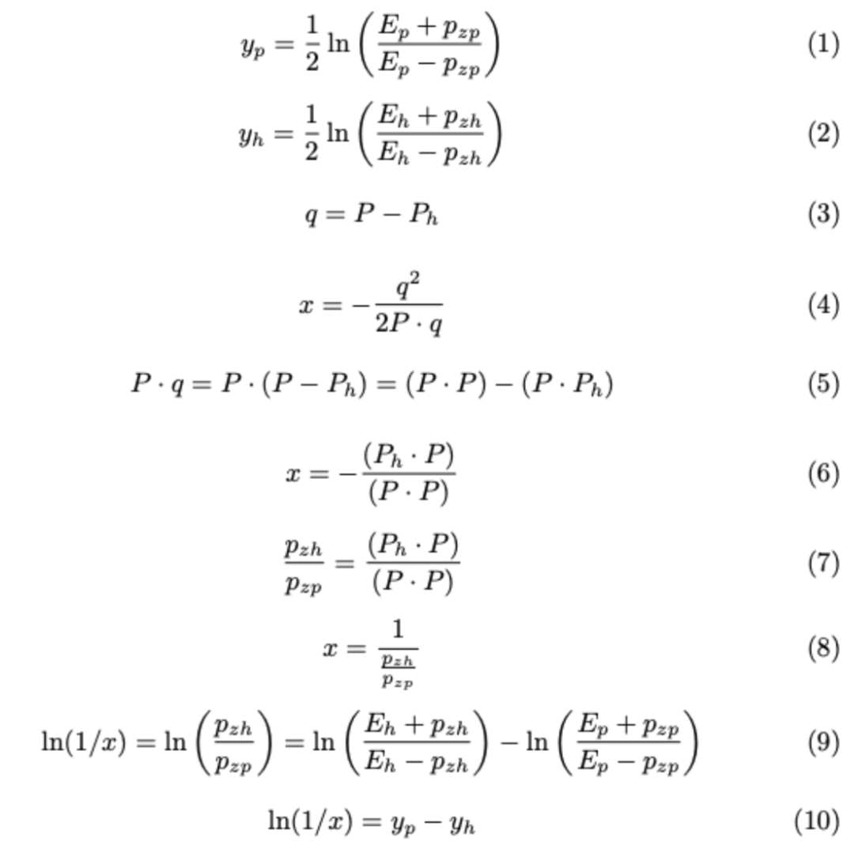
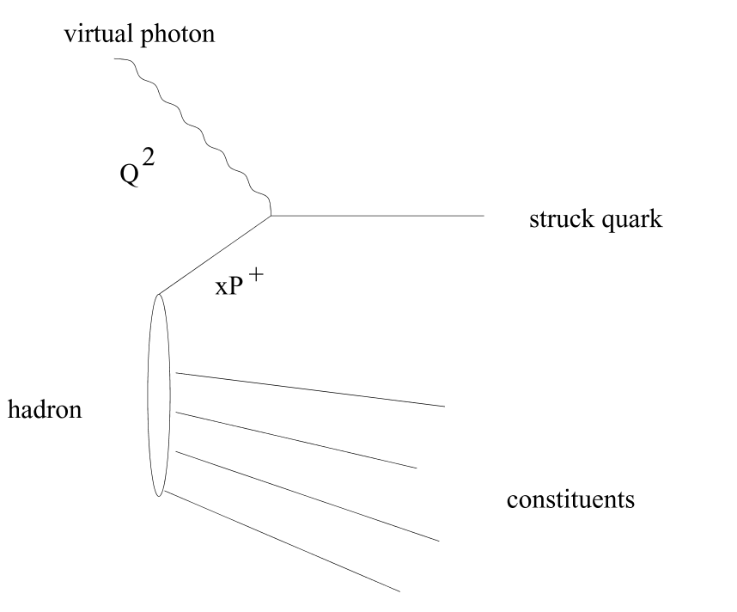

The formalism that allows us to relate x (not measurable in our system) to pseudorapidity (a measurable quantity) we will borrow the formalism of DIS.
P_{h}
q²
P
DIS uses an e-p system where the quantity x and the energy exchange q² can be measured.
x = e^{-y} e^{η}
h
p
h
h

Slide 14
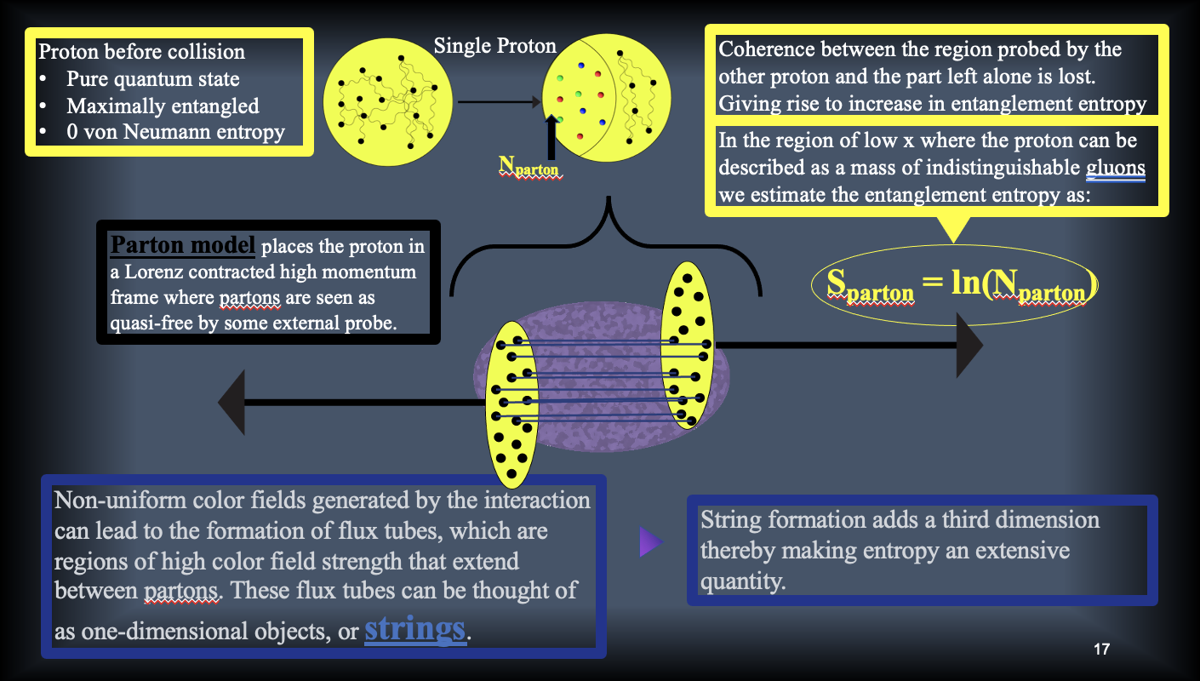
Initial State

Slide 15
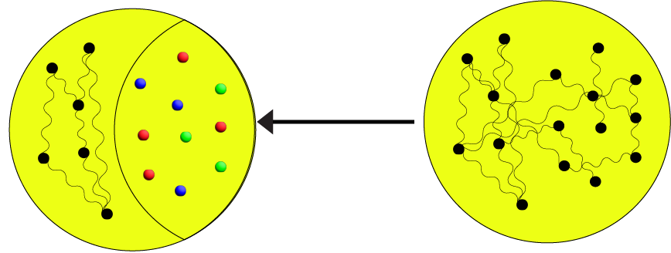
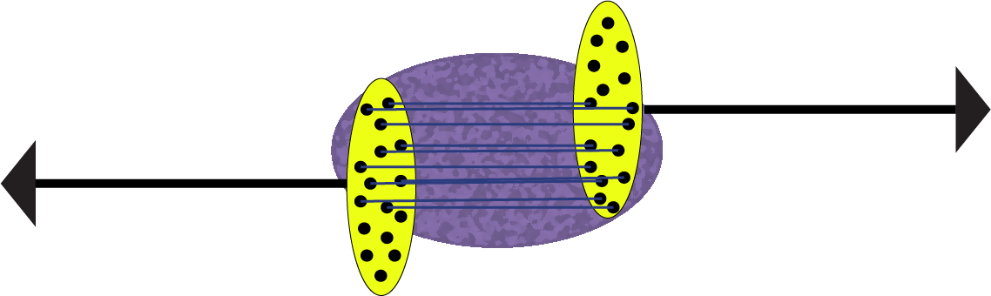
Proton before collision
Pure quantum state
Maximally entangled
0 von Neumann entropy
Single Proton
Coherence between the region probed by the other proton and the part left alone is lost. Giving rise to increase in entanglement entropy
In the region of low x where the proton can be described as a mass of indistinguishable gluons we estimate the entanglement entropy as:
N_{parton}
Parton model places the proton in a Lorenz contracted high momentum frame where partons are seen as quasi-free by some external probe.
S_{parton} = ln(N_{parton})
Non-uniform color fields generated by the interaction can lead to the formation of flux tubes, which are regions of high color field strength that extend between partons. These flux tubes can be thought of as one-dimensional objects, or strings.
String formation adds a third dimension thereby making entropy an extensive quantity.

Slide 16
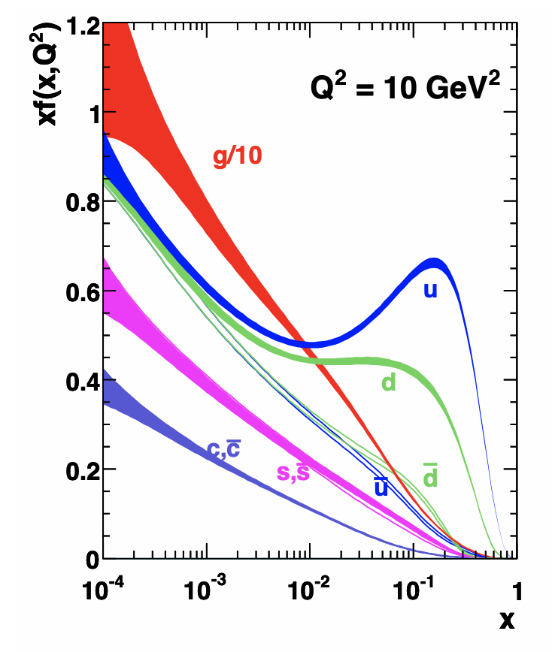
Parton Distribution Functions
Parton distribution functions f(x) describe the probability to find a particular parton with some fraction of the protons momentum characterized by x.
PDF’s are dependent on the scale at which the proton is probed Q² called the factorization scale.
Found using pQCD by fitting DIS cross sections from data.
Pdf’s are fit using a third order polynomial and integrated over to find the number of particles.
A. D. Martin, W. J. Stirling, R. S. Thorne, and G. Watt, Eur. Phys. J. C63, 189 (2009), arXiv:0901.0002 [hep-ph].

Slide 17

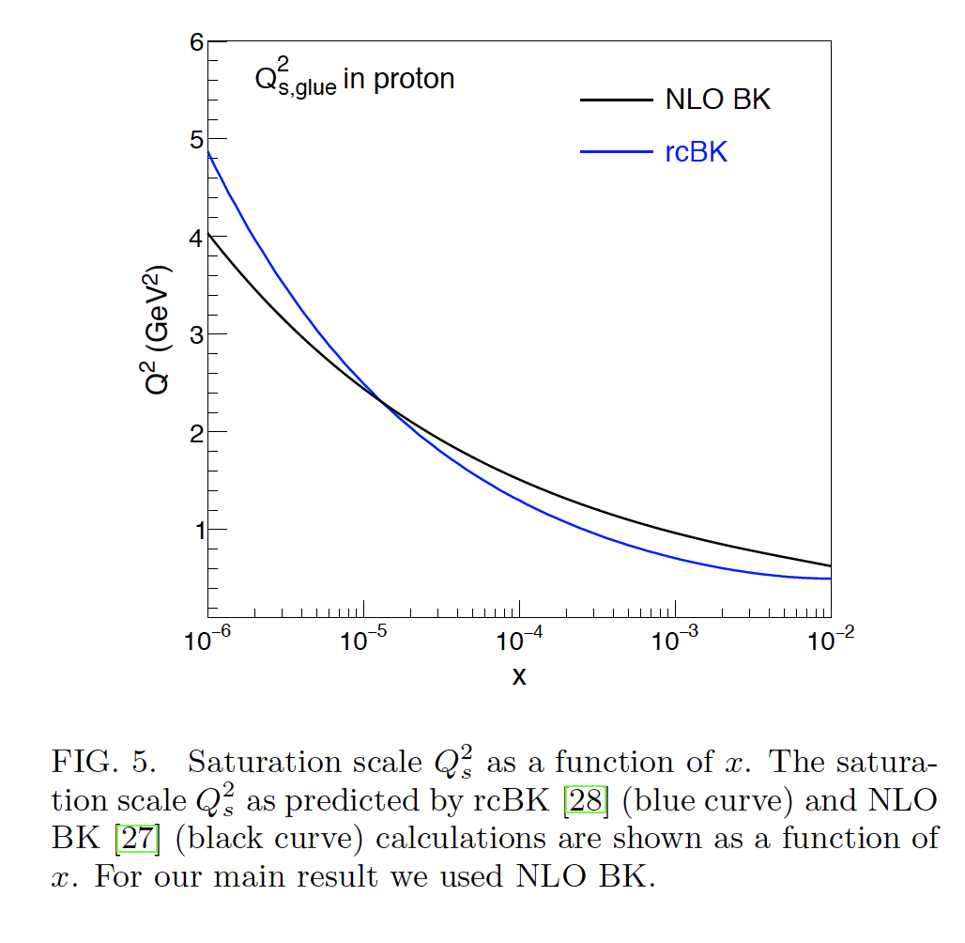
To calculate the number of partons in the initial state we integrate over the appropriate range in x.
.9 TeV
MSTW LO at Q_{s}² = 0.89
-1 < η < 1
13 TeV
MSTW LO at Q_{s}² = 1.51
-1 < η < 1
x
LHAPDF is an open-source library from which one can extract and extrapolate published PDF sets.
These PDF sets are fitted to data by various collaborations (e.g. HERAPDF).
Errors are calculated using a Hessian approach
Factorization Scale
For average p-p collisions this scale is characterized by the transverse momentum of partons, which is dependent on the density of partons. Parton density is said to saturate at low x so the corresponding scale is called the saturation scale Q_{s}².

Slide 18
To calculate the number of partons in the initial state we integrate over the appropriate range in x.
.9 TeV
MSTW LO at Q_{s}² = 0.89
-1 < η < 1
13 TeV
MSTW LO at Q_{s}² = 1.51
-1 < η < 1
x
S_{parton} = ln(N_{parton})

Slide 19
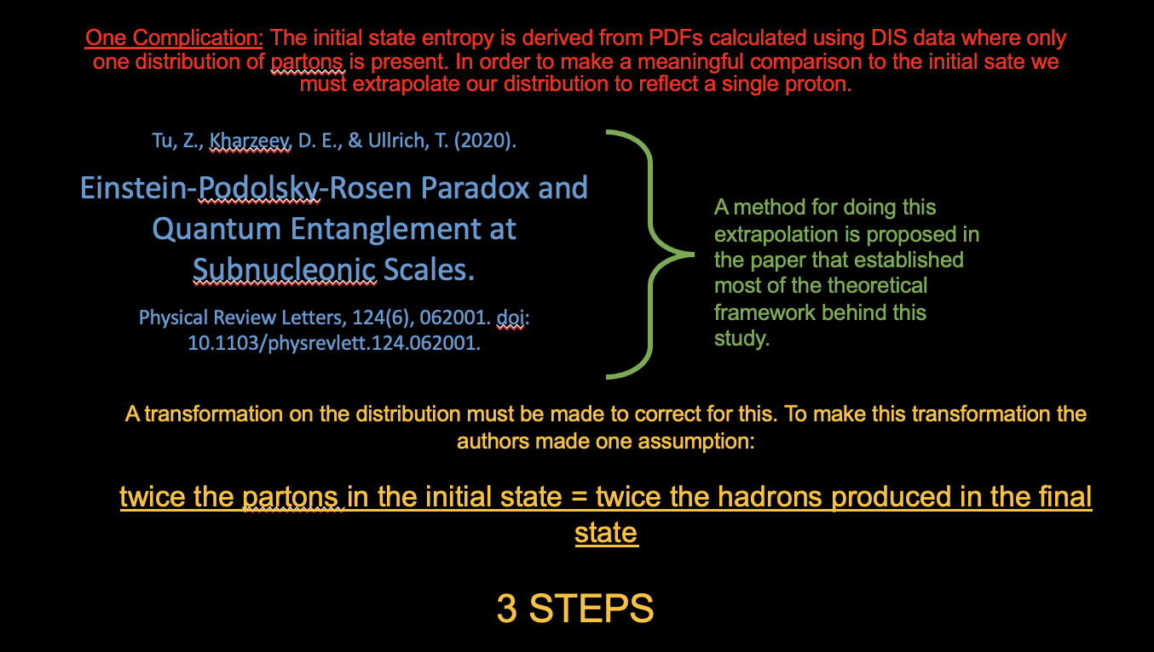
Final vs. Initial Entropy

Slide 20
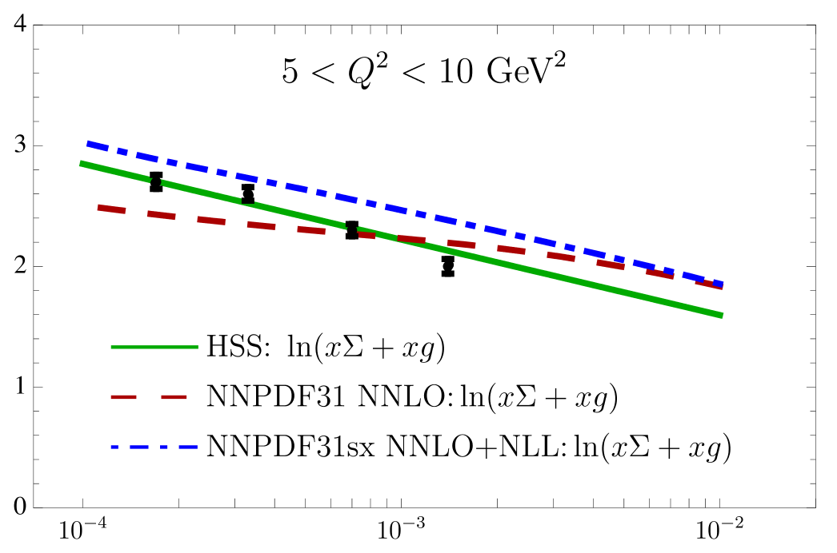
Equivalence shown in e-p systems
e-p using H1 data
Hentschinski, M., & Kutak, K. (2022). Evidence for the maximally entangled low x proton in Deep Inelastic Scattering from H1 data. The European Physical Journal C, 82(2), 56. doi: 10.1140/epjc/s10052-022-10056-y.

Slide 21
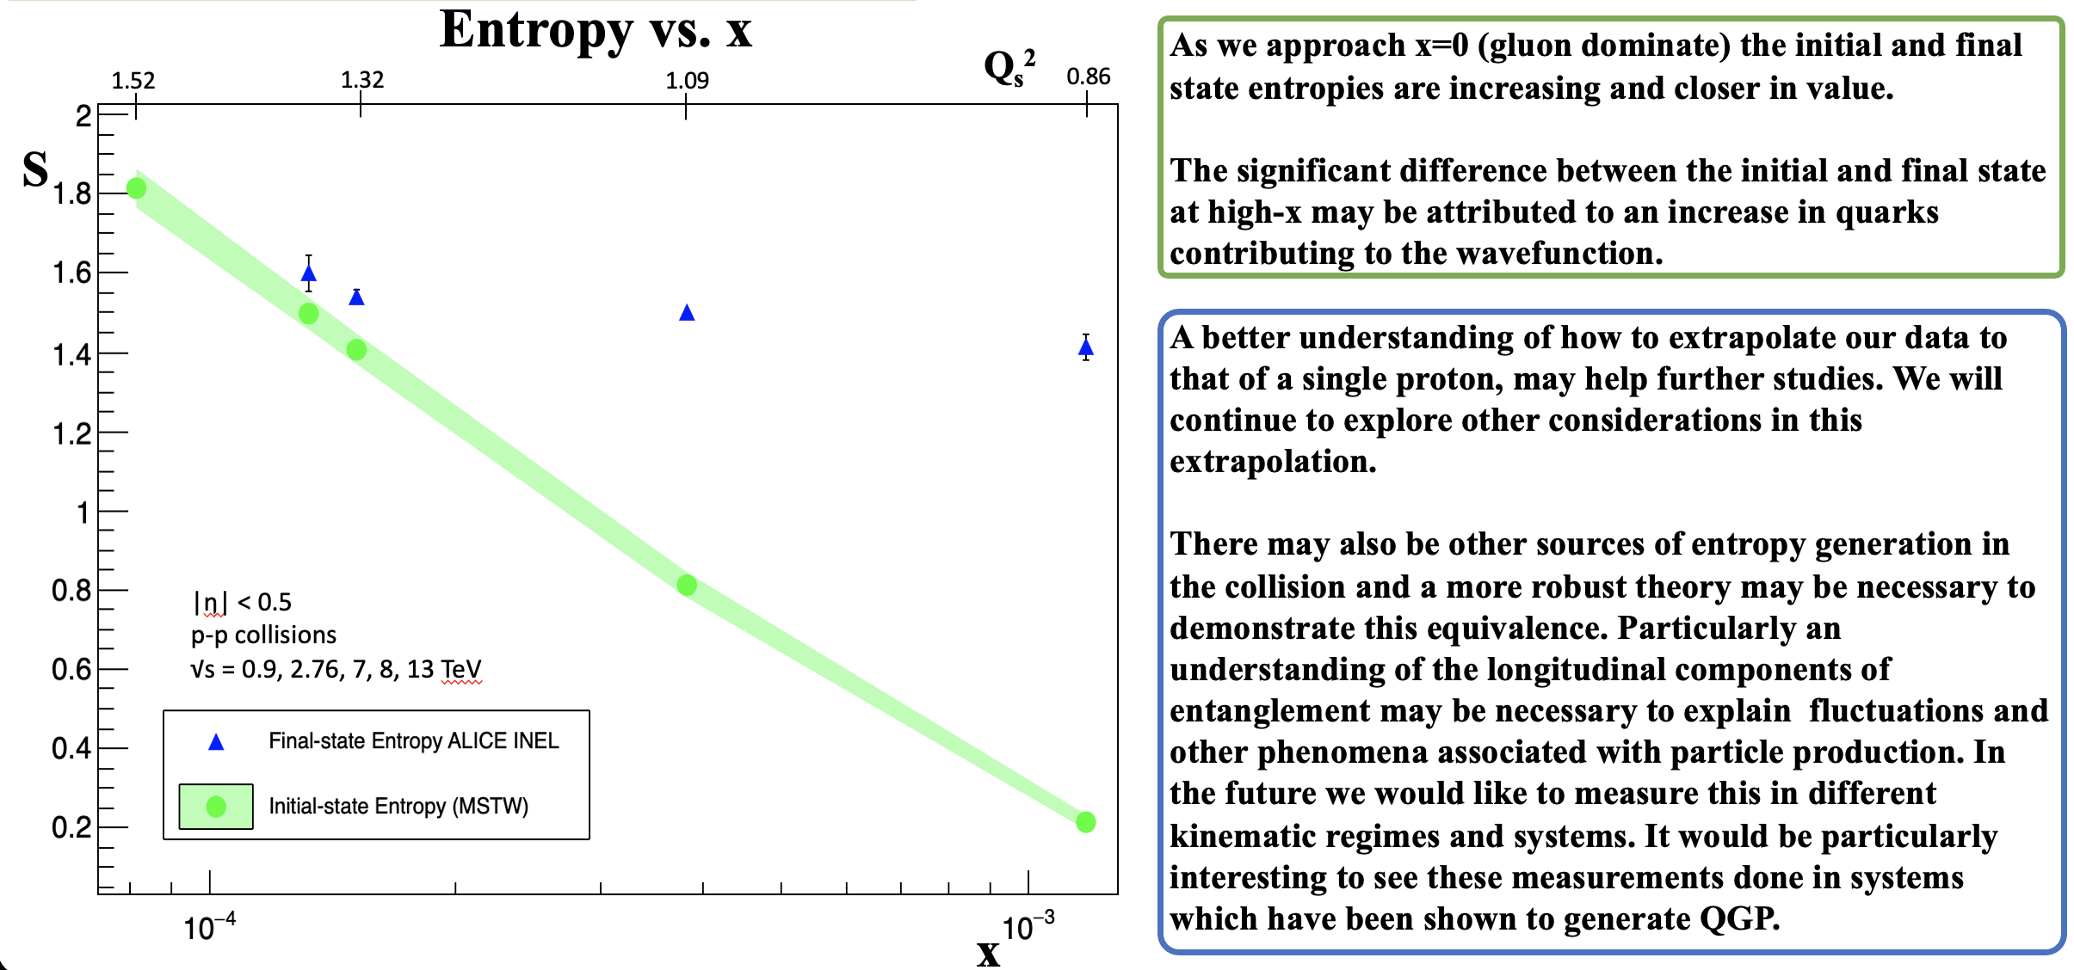

Slide 22
Conclusion and Future Steps
While it seems evident that there is a relation between entanglement entropy in the initial state and thermodynamic entropy in the final state in e-p systems.
It is not yet clear whether this holds true in hadron collisions.
A better understanding of how to extrapolate our data to that of a single proton, may help further studies. We will continue to explore other considerations in this extrapolation.
There may also be other sources of entropy generation in the collision and a more robust theory may be necessary to demonstrate this equivalence.
Furthermore, we would like to measure this in different kinematic regimes and systems.

Slide 23
