Slide 1


Superconducter vortex spectrum in type-2 WSM
Swadeepan Nanda, Pavan Hosur
University of Houston, Houston, TX
Physics Research Day, 02-24-2024

Slide 2
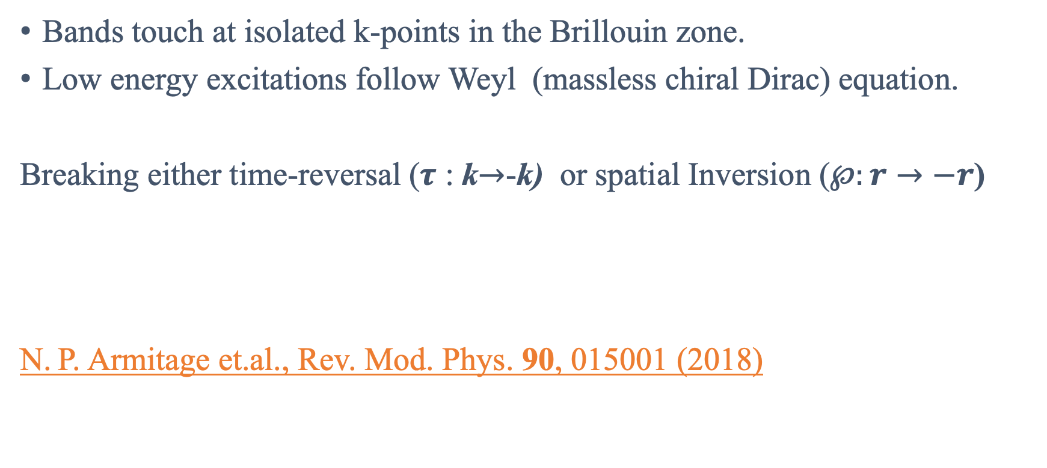
Weyl semimetal:
Bands touch at isolated k-points in the Brillouin zone.
Low energy excitations follow Weyl (massless chiral Dirac) equation.
Breaking either time-reversal ($τ$ : k$→$-k) or spatial Inversion ($℘:r→−r$)
N. P. Armitage et.al., Rev. Mod. Phys. 90, 015001 (2018)

Slide 3
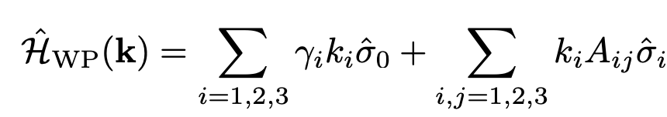
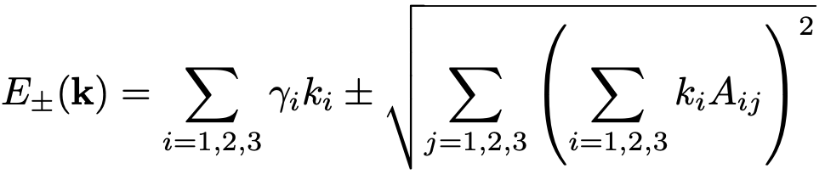

Linear Model:
Timothy M. McCormick, Itamar Kimchi, and Nandini Trivedi; Phys. Rev. B 95, 075133(2017)

Slide 4

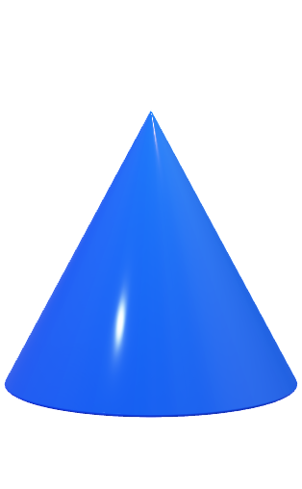



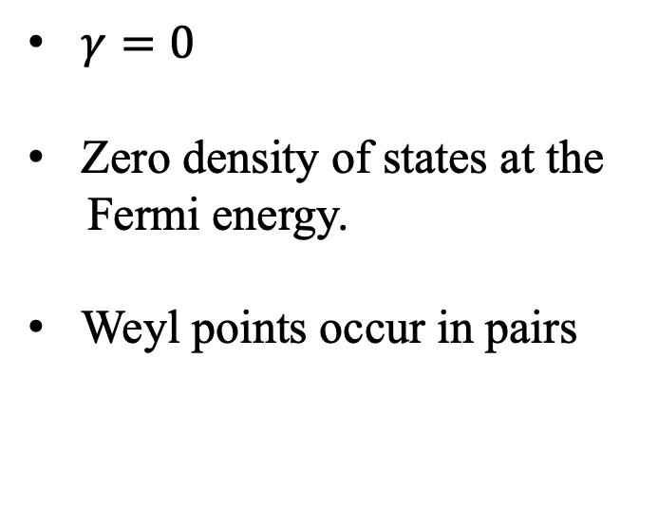

Type I WSM:
$γ=0$
Zero density of states at the
Fermi energy.
Weyl points occur in pairs
Const $k_{z}plane$
$$E(k)$$
$$k_{y}$$
Weyl points
$$k_{x}$$

Slide 5
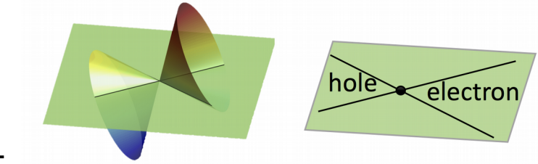
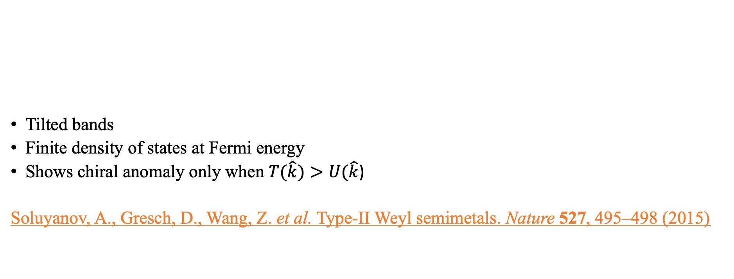
Type II WSM:
Tilted bands
Finite density of states at Fermi energy
Shows chiral anomaly only when $T(\hat{k})>U(\hat{k}$)
Soluyanov, A., Gresch, D., Wang, Z. et al. Type-II Weyl semimetals. Nature 527, 495–498 (2015)

Slide 6
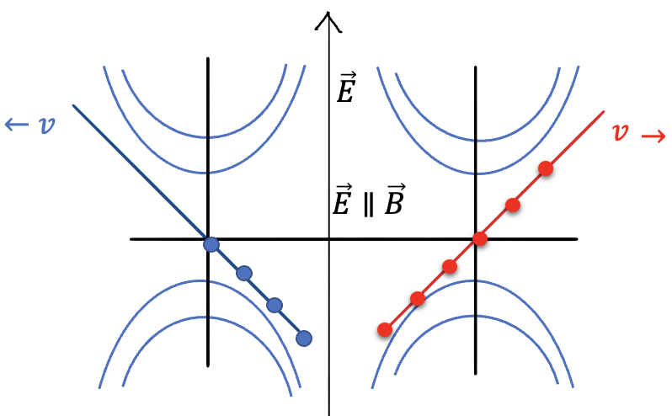
Chiral Magnetic effect:
External magnetic field creates Landau levels
Chiral zeroth Landau level
External electric field facilitates axial
current via chirality imbalance
k_{z}
E
Type I | Type II
CME happens for any direction of B | CME is shown only when B is in direction where |T(k)| >|U(k)|

Slide 7
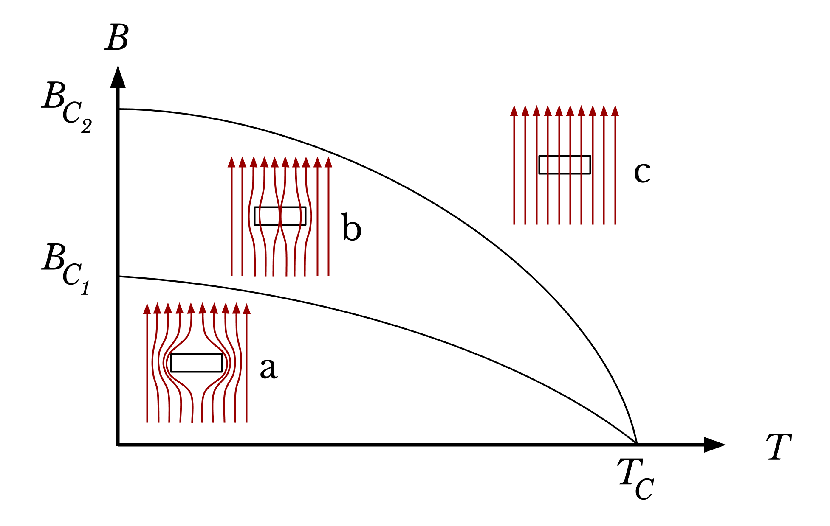
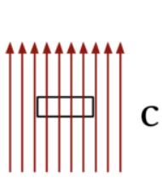
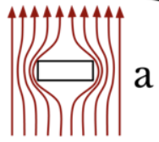

Superconductors:
$$B_{C}$$
$$T_{C}$$
Type I
Type II
Topological superconductor: Superconductor with non-zero Topological invariant

Slide 8
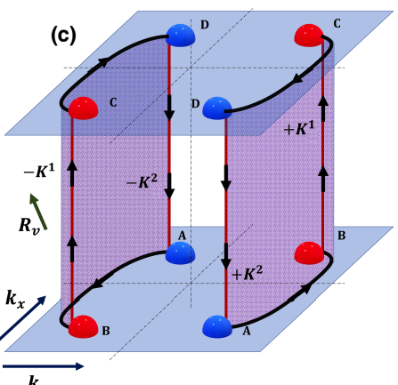

Previous works:
For type-1 WSM
$E_{n}^{±}=±ε\left(n+\frac{1}{2}+\frac{φ}{2π}\right); ε=\frac{∆}{ξl_{FA}}$
R. Giwa and P. Hosur, Phys. Rev. Lett. 130,156402(2023)

Slide 9
Material to realize bulk topological superconductor
Transition metal dichalcogenides(TMDs)
Semi-metallic TMD: WTe₂, MoTe₂
WTe₂ , MoTe₂ : Type-2 WSM
Qi, Y., Naumov, P., Ali, M. et al., Nat Commun 7, 11038 (2016)

Slide 10
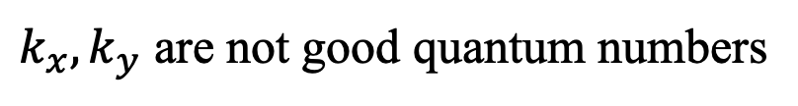
Problems:
Non-zero density of states at zero energy
Broken translational invariance in the plane perpendicular to the vortex
z
$k_{x}, k_{y}$ are not good quantum numbers

Slide 11



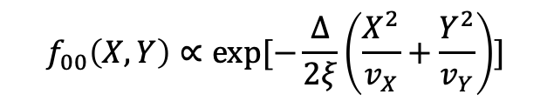
For a single node:
For type-I : $HBdG=τ_{z}\hat{k}$.σ $+ (τ_{x}\hat{x}−τ_{y}\hat{y}$)$\frac{Δ}{ξ}$
$$E\left(n_{X},n_{Y}\right)=±\sqrt{\frac{2Δ}{ξ}(n_{X}v_{X}+n_{Y}v_{Y})}$$
R. Giwa and P. Hosur; Phys. Rev. Lett. 127, 187002, 2021
For type-II: $HBdG={λkx+τ}_{z}\hat{k}$.σ $+ (τ_{x}\hat{x}−τ_{y}\hat{y}$)$\frac{Δ}{ξ}$
$$f_{00}\left(X,Y\right)∝exp⁡[−\frac{∆}{2ξ}\left(\frac{X^{2}}{v_{X}}+\frac{Y^{2}}{v_{Y}}\right)]$$
$\left\langle X,Y | GS\right\rangle$=

Slide 12
NEXT..
Include surface Fermi arc contribution.
Construct semi-classical orbits for type-2 WSM.

Slide 13
Thank You!
This work was funded by Department of Energy, via
DE-SC0022264

