Slide 1



Physics Research Day 2024
STAR-FXT Program @ RHIC
Rutik Manikandhan
02/24/2024

Slide 2
Relativistic Heavy-Ion Collisions
Heavy Atoms like Pb/Au/Cu.
Stripped off of their electrons Ions (Heavy-Ion).
Accelerated to speed of light.
Collide them with each other to form “Little Bangs”.
Study the aftermath by specialized detector systems around the collision.
m₁
m₂
m₁
m₂
t =10⁻²⁰ s !!!

Slide 3
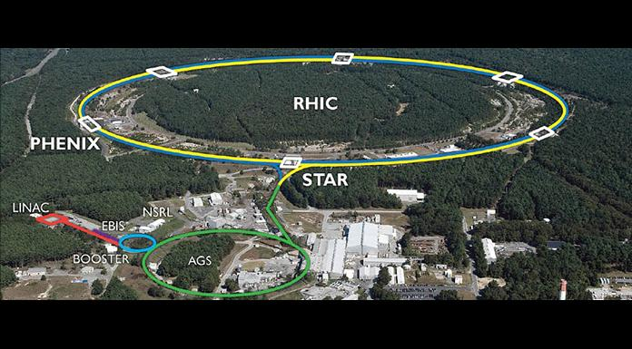
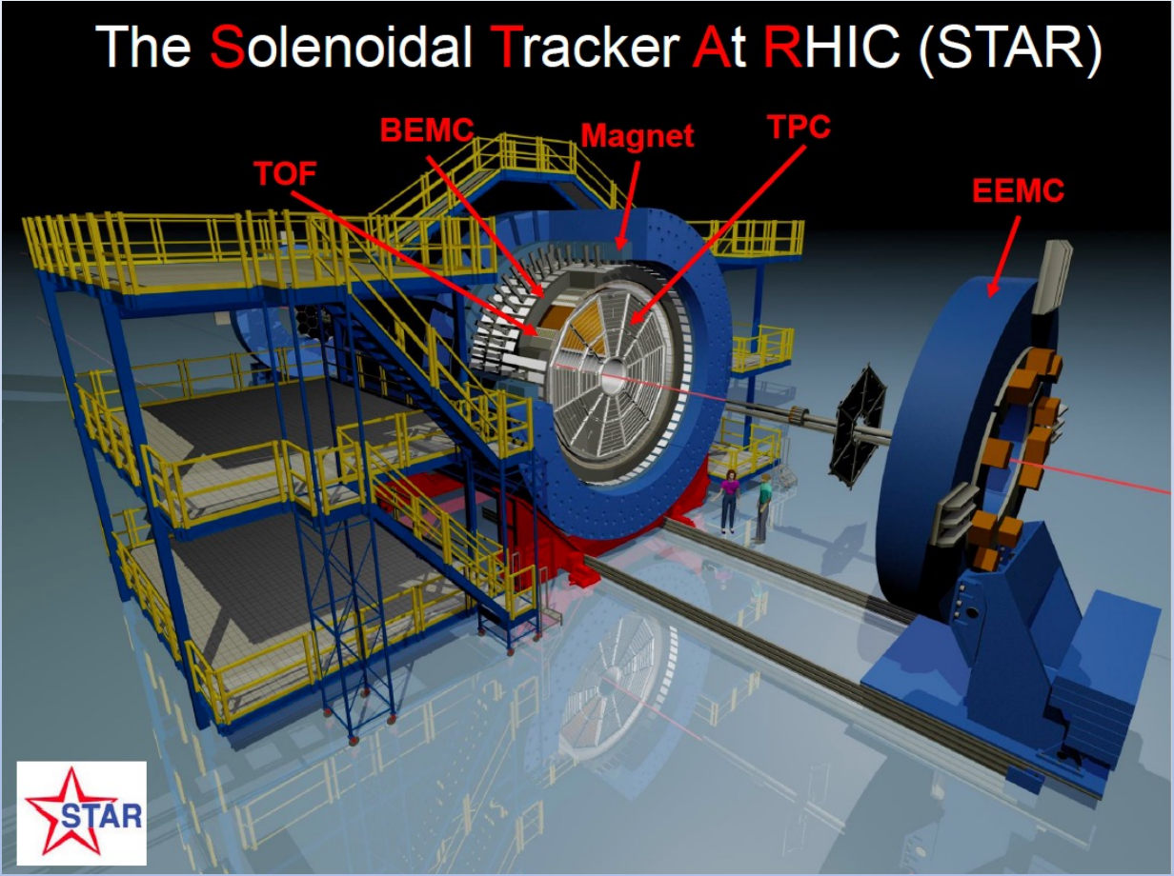
RHIC: STAR Experiment
STAR: Solenoidal Tracker At RHIC.
Heavy ion collisions of Au,Cu,Zr,Ru and d.
Energy range from 3 GeV - 200 GeV (√s_{NN}).
Relativistic Heavy-Ion Collider
https://www.star.bnl.gov
Located at Brookhaven National Laboratory (BNL).
Long Island, New York, USA.
STAR Detector
https://www.star.bnl.gov

Slide 4
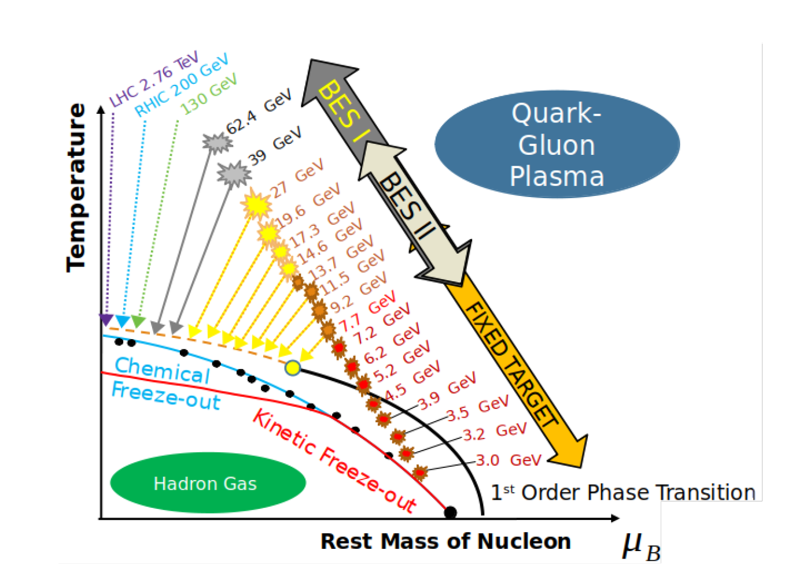
QCD Phase Transition
Lattice QCD calculations show that the QCD transition is an analytical crossover at 𝝻_{B}≅0 , involves a rapid change as opposed to a discontinuous jump .
QCD inspired phenomenological models predict a first order phase transition at high 𝝻_{B}.
The point where the doping of matter over antimatter becomes large enough to instigate a first order phase transition is referred to as the QCD critical point.
❓
Baryon Chemical Potential
arXiv:2108.13867
‹#›/11

Slide 5
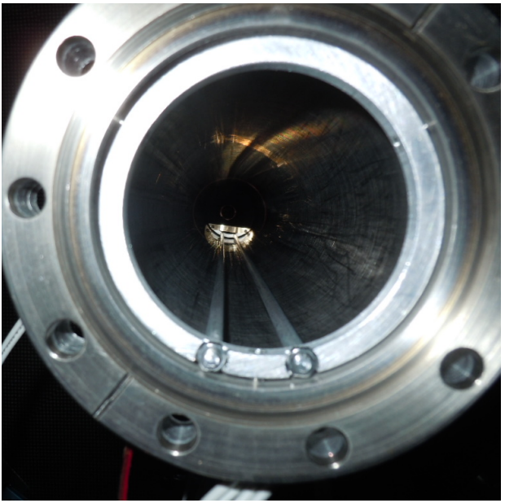

STAR-FXT
STAR Beam Energy Scan (BES-I) results suggested a softening of the equation of state (EOS) and hinted at critical fluctuations.
At these lower energies the luminosity of RHIC is too low, making it impractical to take data in collider mode.

Slide 6
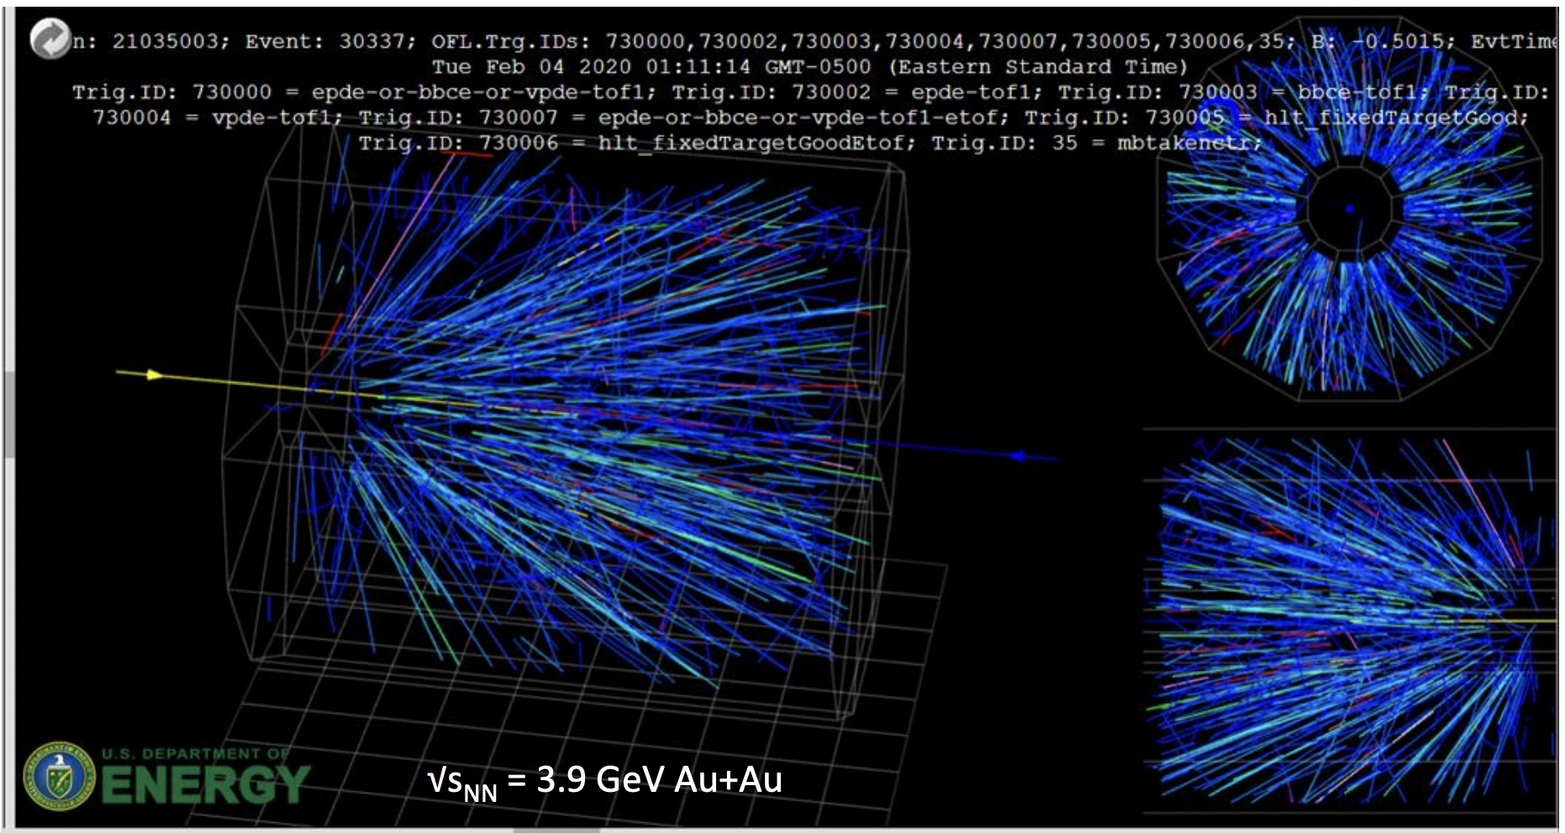
Event Display

Slide 7
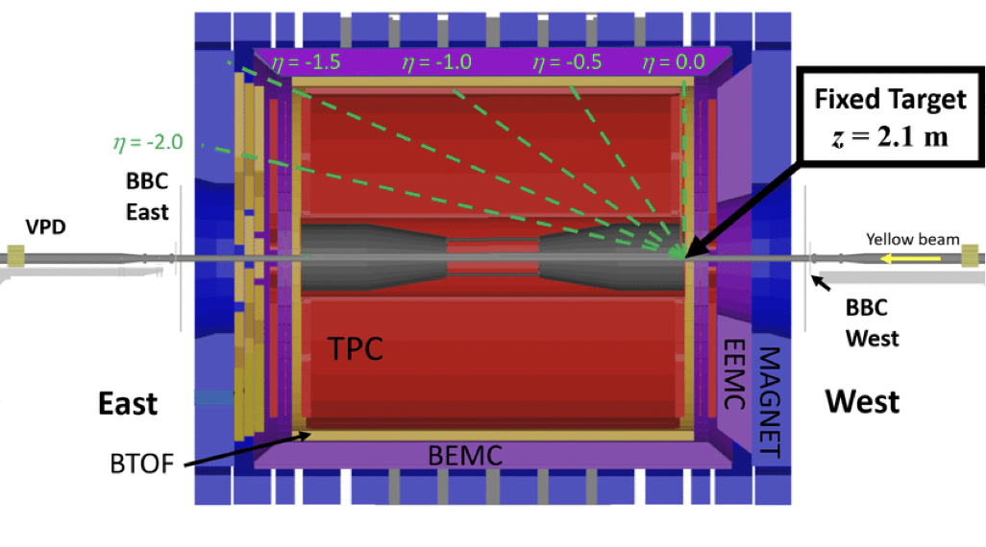
STAR-FXT Setup
Gold Target fixed at west end of the detector
TPC Acceptance ➤ 𝞰 : [-2,0] (lab frame)
PID Acceptance ➤ 𝞰 : [-1.4,0]
(lab frame)
Mid rapidity ➤ 𝞰 ≅ -1.05
Majority of particle production

Slide 8
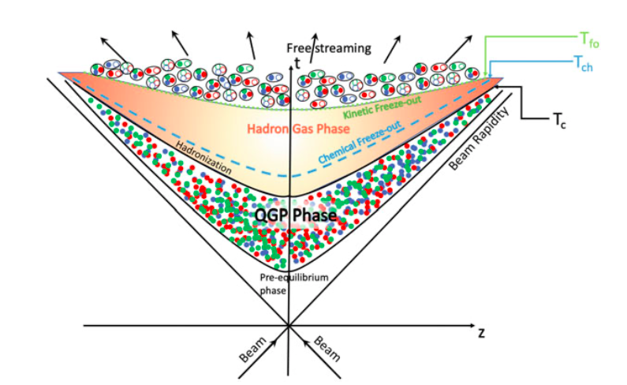
What do we measure in these Experiments?
Spectra : Distribution of particle momenta.
Yield: Count of particle numbers. (Multiplicity)
After the chemical freeze-out (T_{ch}), the yield is fixed.
After the kinetic freeze-out (T_{kin}), the spectra are fixed.
Space-time evolution of RHIC
https://doi.org/10.1007/978-3-030-67235-5_6

Slide 9
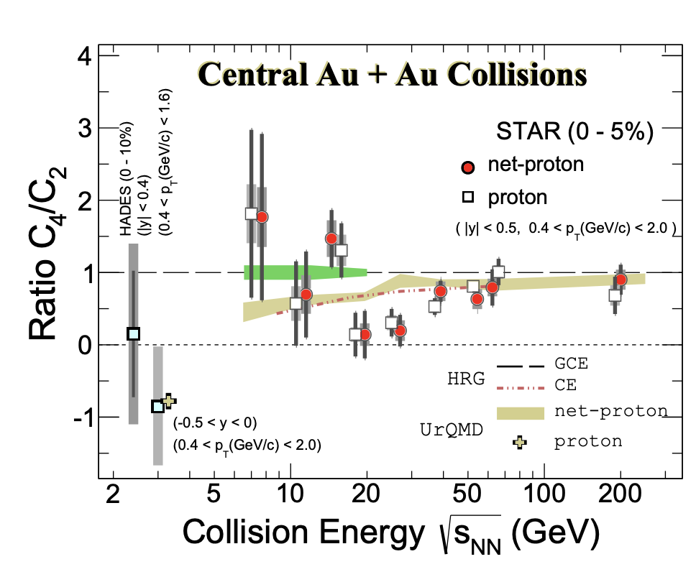
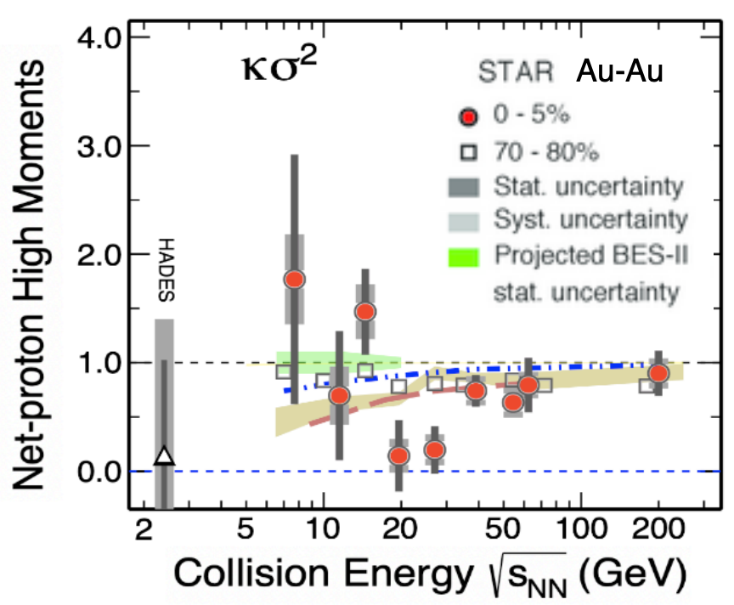
Multiplicity Fluctuations
Multiplicity fluctuations are associated to conserved charges :
  Electric Charge
  Baryon Number
  Strangeness
Non-monotonicity could be associated with critical fluctuations
If a critical point exists it is above √s_{NN} =3.0 GeV
Control Parameter
Phys. Rev. Lett. 128, 202303

Slide 10
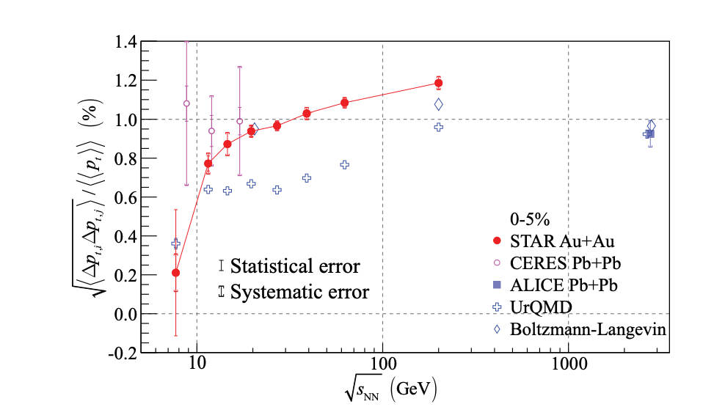
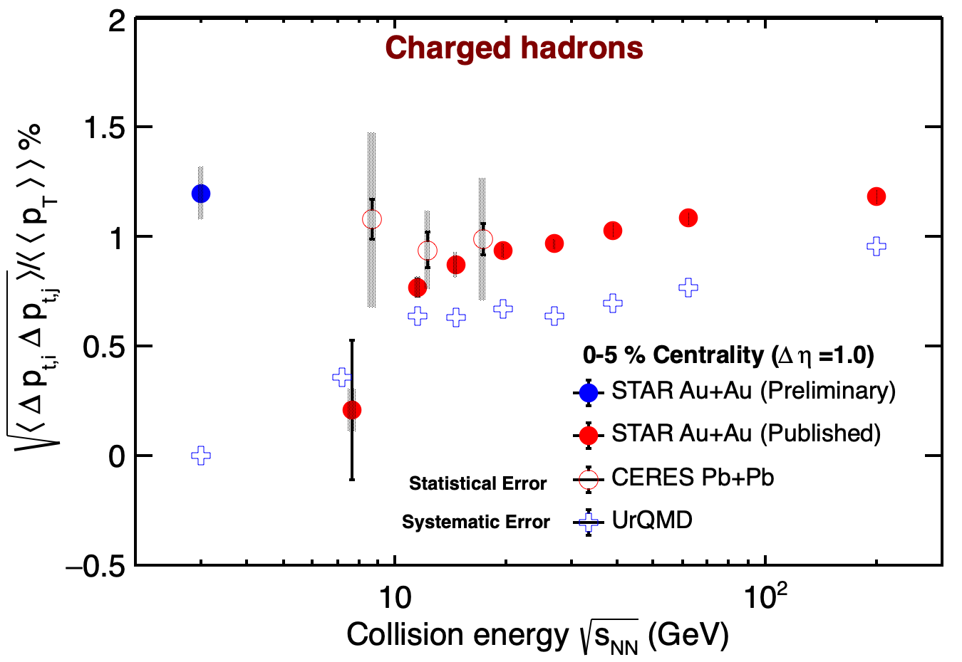



Momentum Fluctuations
Transverse Momentum p_{T} is defined as
√(p_{x}² + p_{y}² ).
Fluctuations in temperature are obtained from the fluctuations in transverse momentum.
Correlators have a finer resolution for fluctuations in temperature.
3
10
30
100
<p_{T}> T_{eff}
(GeV)
STAR,Phys.Rev.C 99, 2019

Slide 11

Conclusions/Outlook
We discussed the importance of the Fixed Target program at STAR.
Possible signals of critical points
  Fluctuations of conserved quantum numbers ↔ Multiplicity Fluctuations
  Fluctuations of Temperature ↔ p_{T} Fluctuations

Slide 12
References
Basu, Sumit, Sandeep Chatterjee, Rupa Chatterjee, Tapan K. Nayak, and Basanta K. Nandi. "Specific heat of matter formed in relativistic nuclear collisions." Physical Review C 94, no. 4 (2016): 044901.
Mukherjee, Maitreyee, Sumit Basu, Arghya Chatterjee, Sandeep Chatterjee, Souvik Priyam Adhya, Sanchari Thakur, and Tapan K. Nayak. "Isothermal compressibility of hadronic matter formed in relativistic nuclear collisions." Physics Letters B 784 (2018): 1-5.
Schnedermann, Ekkard, Josef Sollfrank, and Ulrich Heinz. "Thermal phenomenology of hadrons from 200A GeV S+ S collisions." Physical Review C 48, no. 5 (1993): 2462.
Sahoo, Raghunath. "Relativistic kinematics." arXiv preprint arXiv:1604.02651 (2016).
Torrieri, Giorgio, Rene Bellwied, Christina Markert, and Gary Westfall. "Statistical hadronization phenomenology in K/π fluctuations at ultra-relativistic energies." Journal of Physics G: Nuclear and Particle Physics 37, no. 9 (2010): 094016.
Kliemant, Michael, Raghunath Sahoo, Tim Schuster, and Reinhard Stock. "Global properties of nucleus–nucleus collisions." In The Physics of the Quark-Gluon Plasma, pp. 23-103. Springer, Berlin, Heidelberg, 2009.

Slide 13
Questions???

Slide 14
Backup Slides

Slide 15
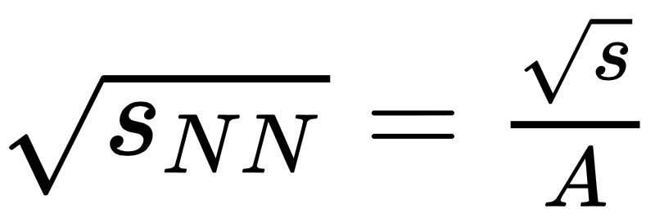
Collision Energy (√s_{NN} )
√s is the total energy in the Center of Mass Frame (CM), invariant mass of the CM.
Natural units, ħ = c = 1.
1eV = 1.60218x10⁻¹⁹ J.
The Collision Energy enables us to reach the desired energy density and temperatures for the system.
Energy of the collision expressed in terms of nucleon- nucleon center of mass energy.
In the nucleon-nucleon CM frame, two nuclei approach each other with the same velocity.
The nucleon-nucleon CM energy is denoted by √s_{NN} and is related to the total CM energy by:
A : Number of Nucleons in the Heavy-Ion

