Slide 1

Ce-doped NiFe-LDH electrocatalysts for oxygen evolution reaction
Paul Byaruhanga
pbyaruha@cougarnet.uh.edu
Advisor : Dr. Shuo Chen
Department of Physics, College of Natural Science and Mathematics
University of Houston

Slide 2
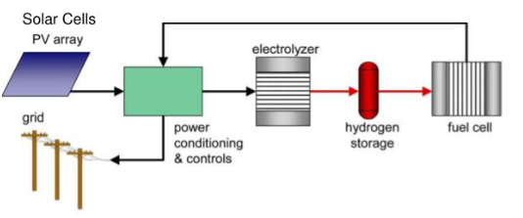
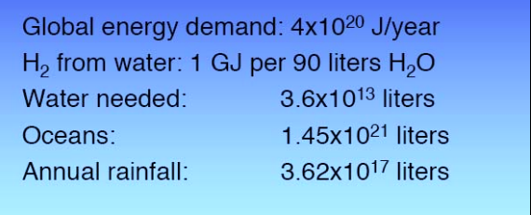
Why do we need hydrogen?
Energy source | Energy density (MJ/kg)
Li-ion battery | 0.54
Gasoline | 46.90
Hydrogen | 120.00
~ 220 times more energy density than batteries
~ 54 times more energy density than gasoline
Department of Energy target
$2/kg H₂ by 2025
$1/kg H₂ by 2030
https://www.bp.com/en/global/corporate/energy-economics/statistical-review-of-world-energy.html

Slide 3
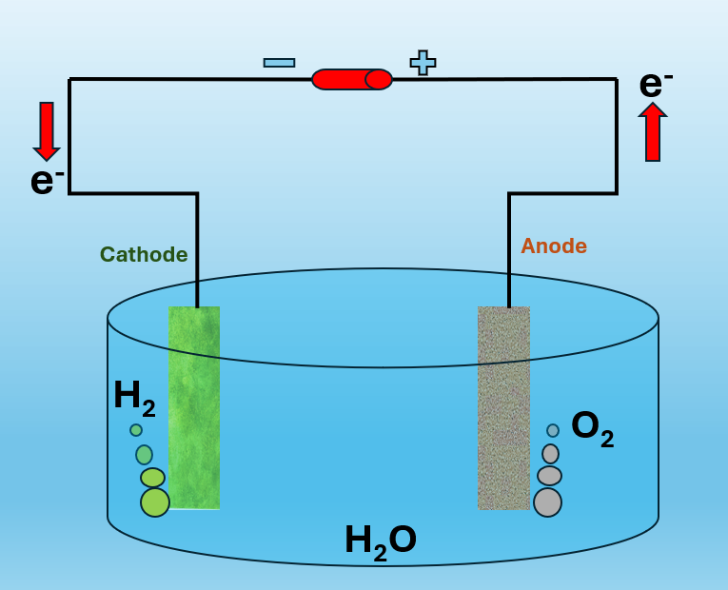
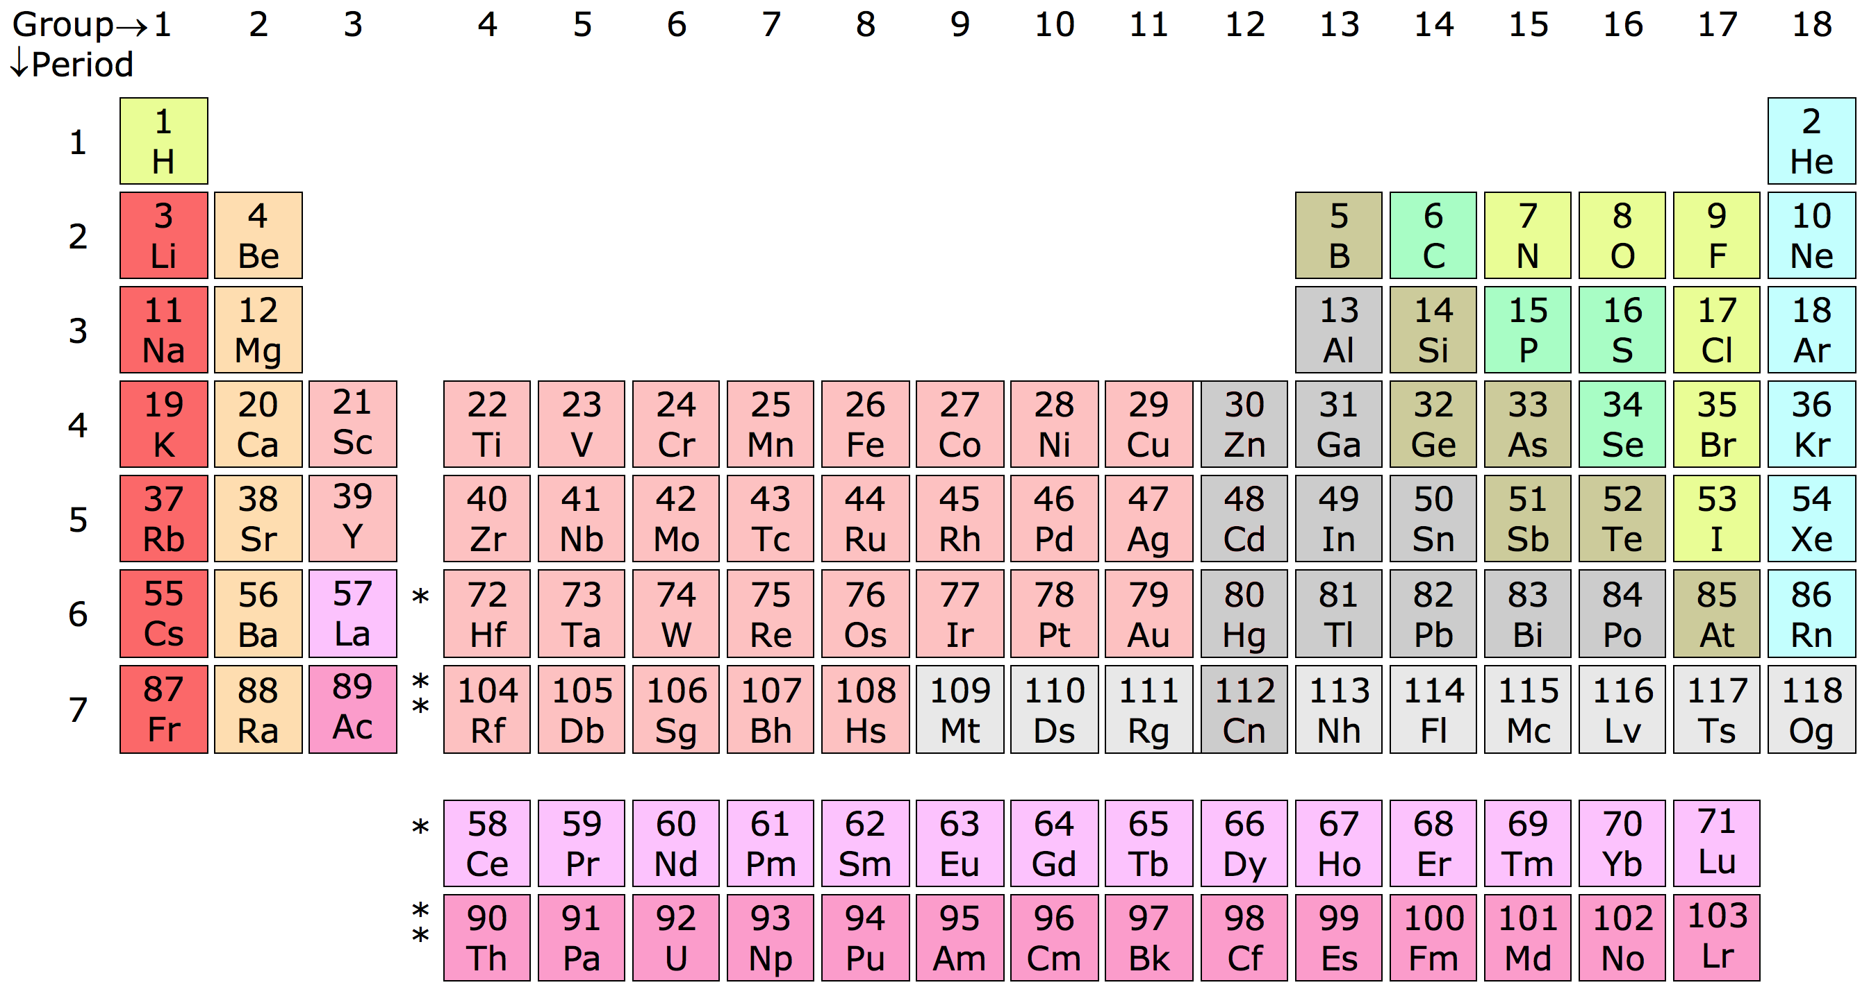
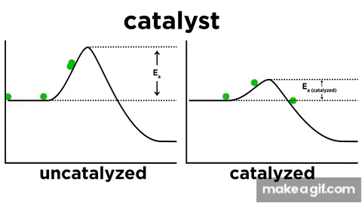

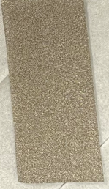
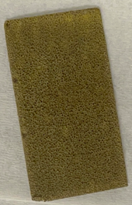

How to produce green H₂?
H₂O → H₂ + ½ O₂
Cathode : 2H₂O + 2e⁻ → H₂ + 2OH⁻
Anode : 4OH⁻ → O₂ + 2H₂O + 4e⁻
periodic table - Search Images (bing.com)
Ni foam
+
catalyst layer
Ni foam
Uncatalyzed
Catalyzed
Energy Diagrams, Catalysts, and Reaction Mechanisms on Make a GIF

Slide 4
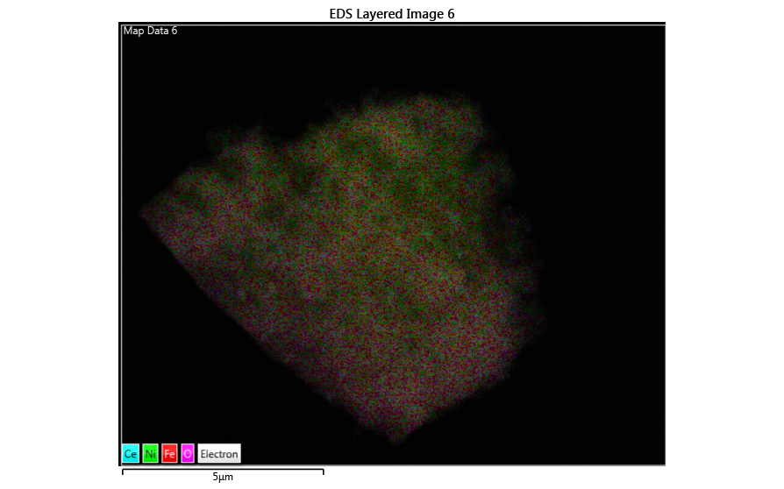
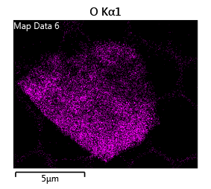
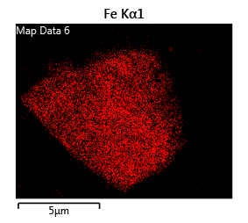
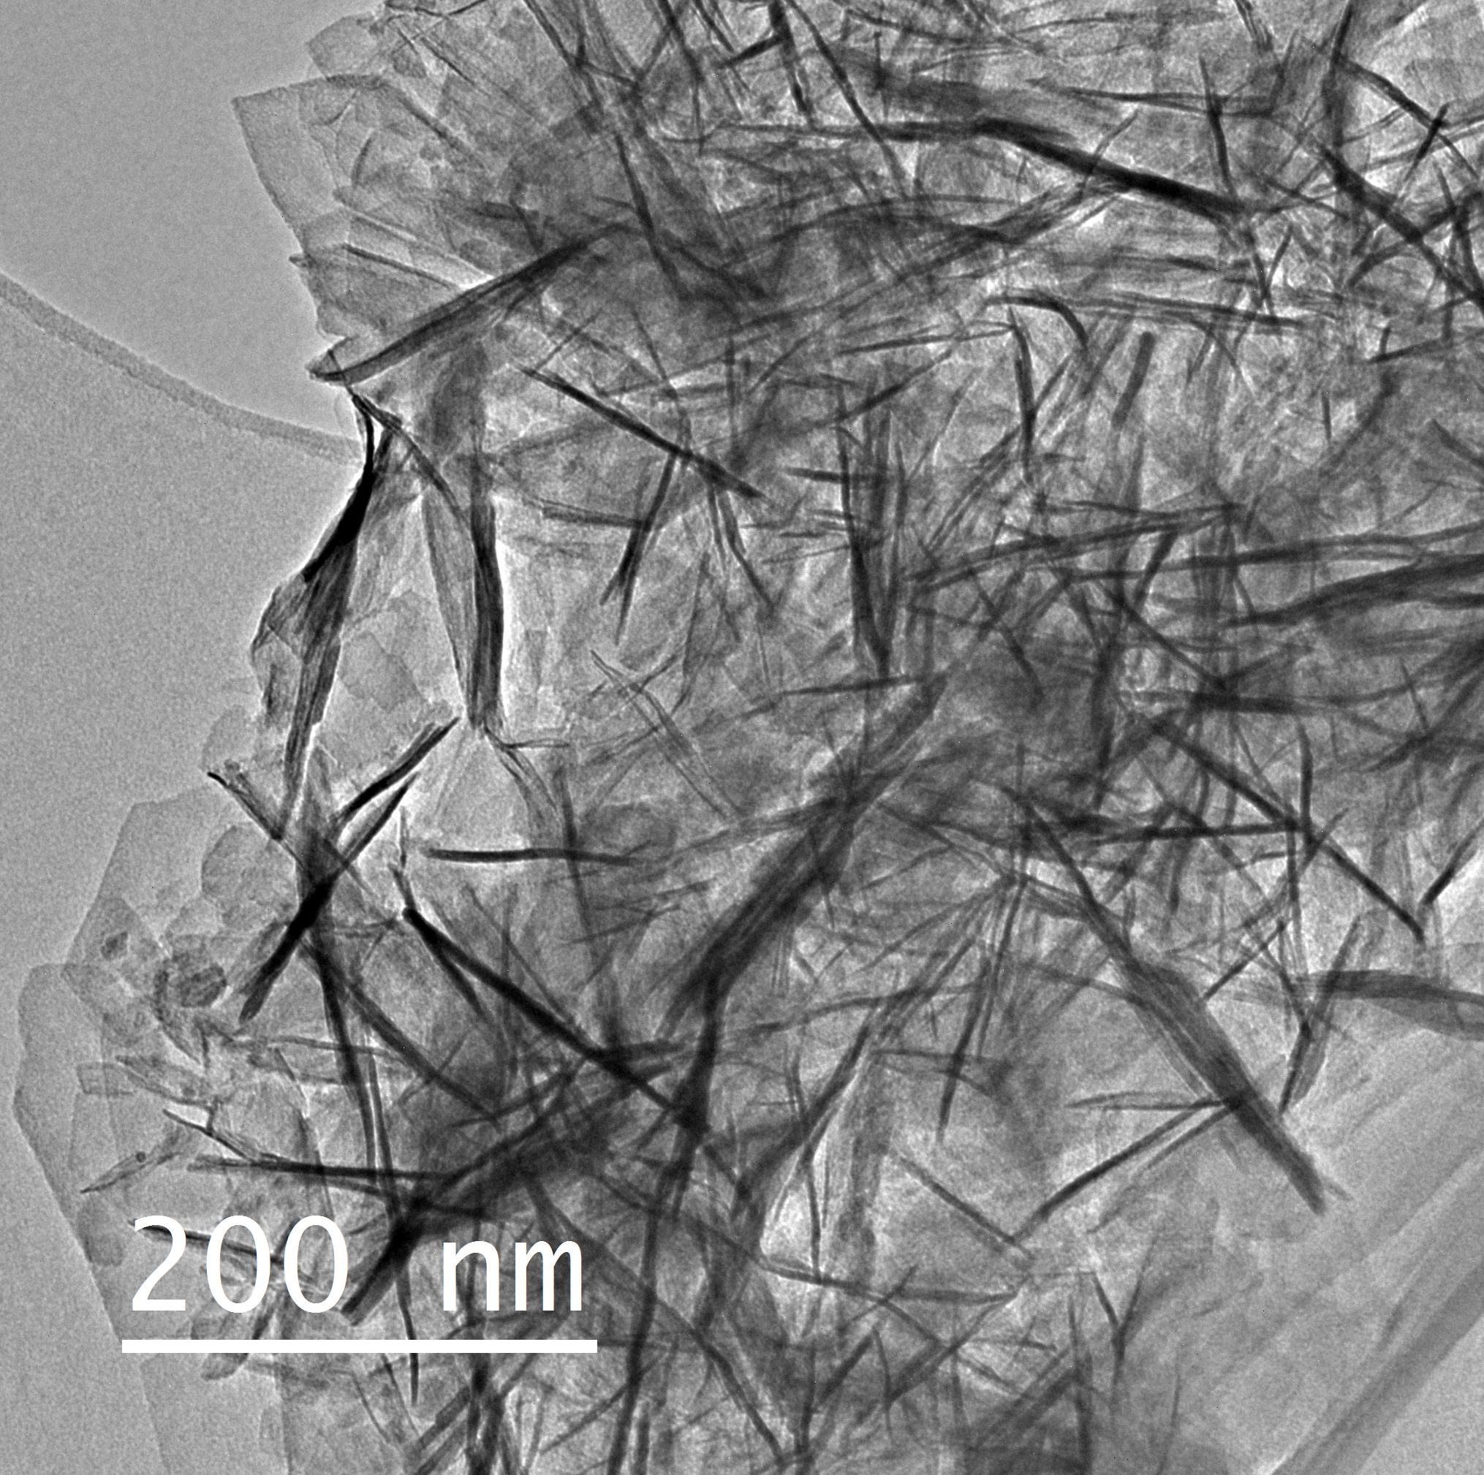
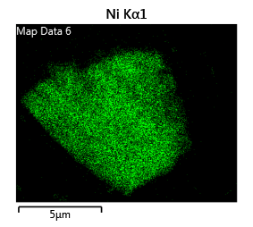
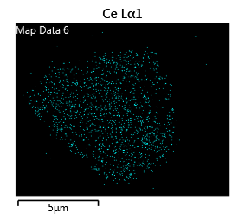
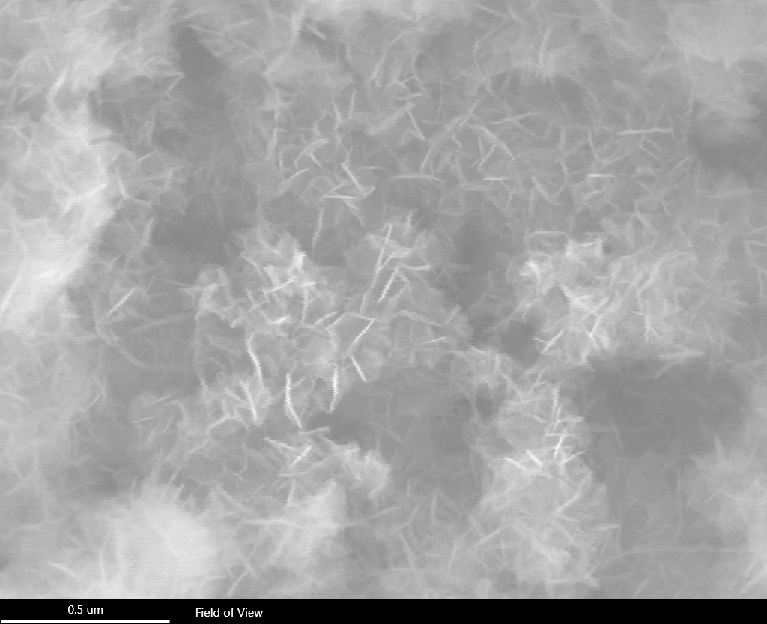
What does our electrocatalyst look like?
5µm

Slide 5
How does the electrocatalyst perform?
in 1 M KOH

Slide 6
Is our electrocatalyst stable?

Slide 7

Conclusion

Slide 8


Acknowledgement
Mr. Yu Wang
Ms. FNU Vidhi
Mr. Haroon Muhammad Khan
Mr. Minghui Ning
Dr. Song Shawei
Dr. Dezhi Wang
Prof. Zhifeng Ren
Sometimes I shake my head to see if I still have my brain because you in Physics anything can happen
My meme of the year so far…
Thank you

Slide 9
Additional slides

Slide 10
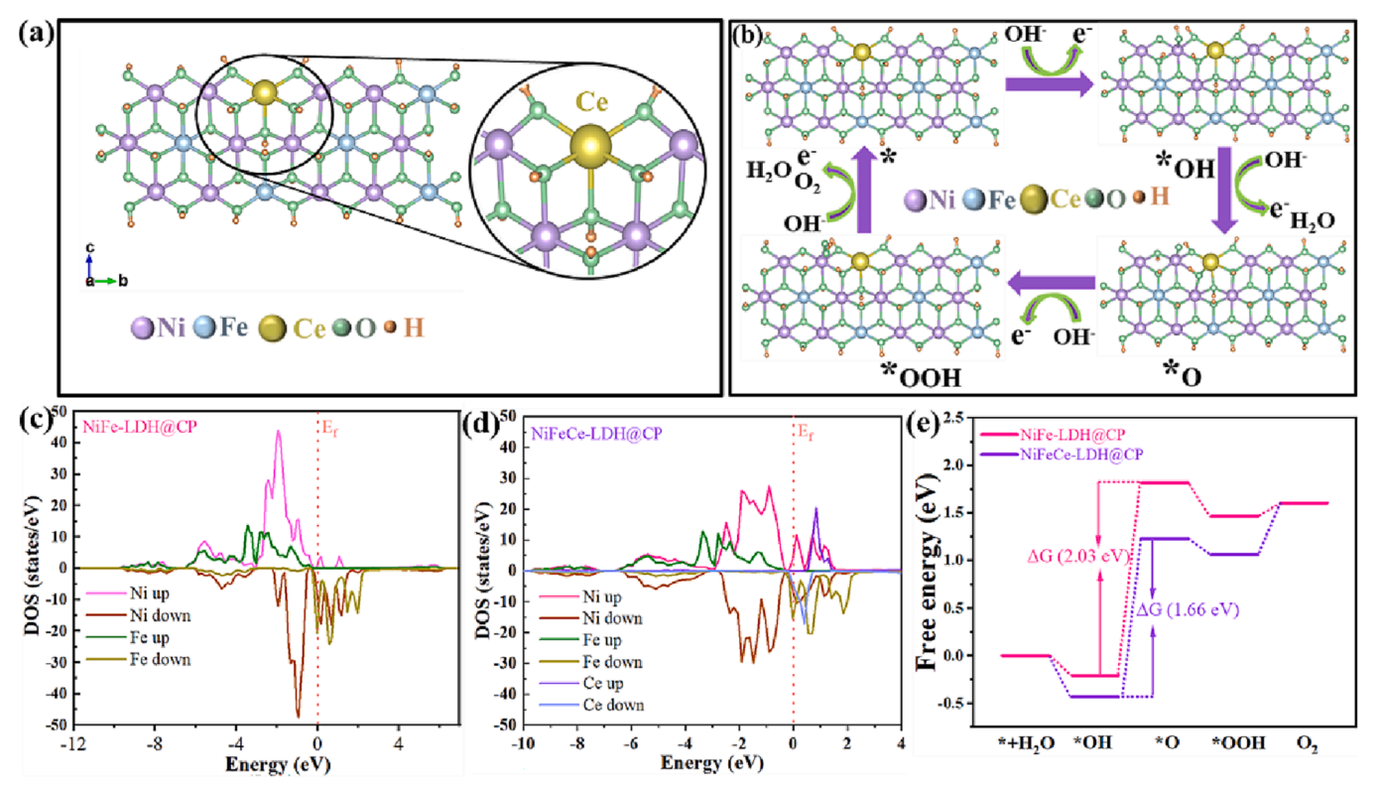
Effect of Ce doping
Liao, Yuanyuan, et al. (2023)

Slide 11
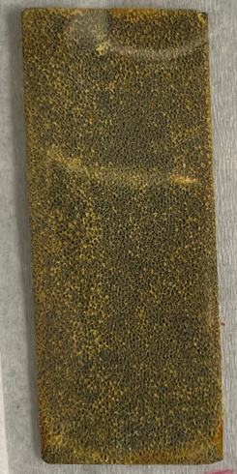
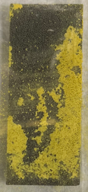
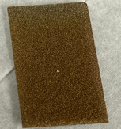
Challenges
Ce doped layer with NH₄F
Difficult to synthesize.
Poor performance
Ce doped layer without NH₄F
Synthesis possible
Poor perfprmance
Ce doped layer with NH₄Cl
Synthesis possible
Good perfprmance
Pure Ni foam

Slide 12
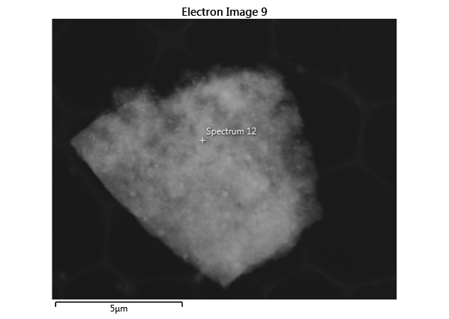
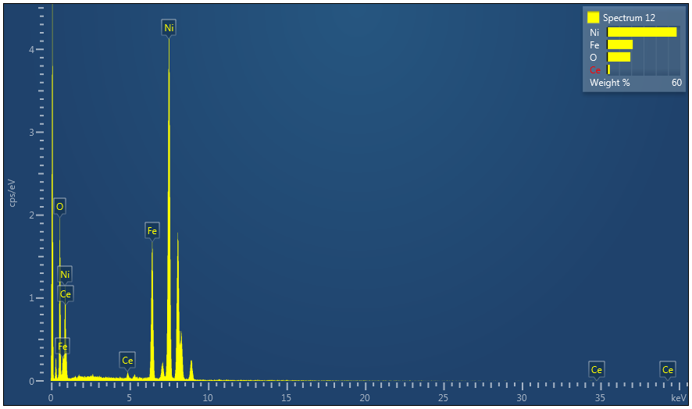
Composition analysis
Element | Line Type | k Factor | k Factor type | Absorption Correction | Wt% | Wt% Sigma | Atomic %
O | K series | 1.032 | Theoretical | 1.00 | 19.28 | 0.36 | 46.82
Fe | K series | 0.602 | Theoretical | 1.00 | 21.15 | 0.29 | 14.72
Ni | K series | 0.621 | Theoretical | 1.00 | 57.07 | 0.40 | 37.77
Ce | L series | 1.059 | Theoretical | 1.00 | 2.51 | 0.26 | 0.70
Total: |  |  |  |  | 100.00 |  | 100.00

Slide 13
Performance results of our catalysts

Slide 14
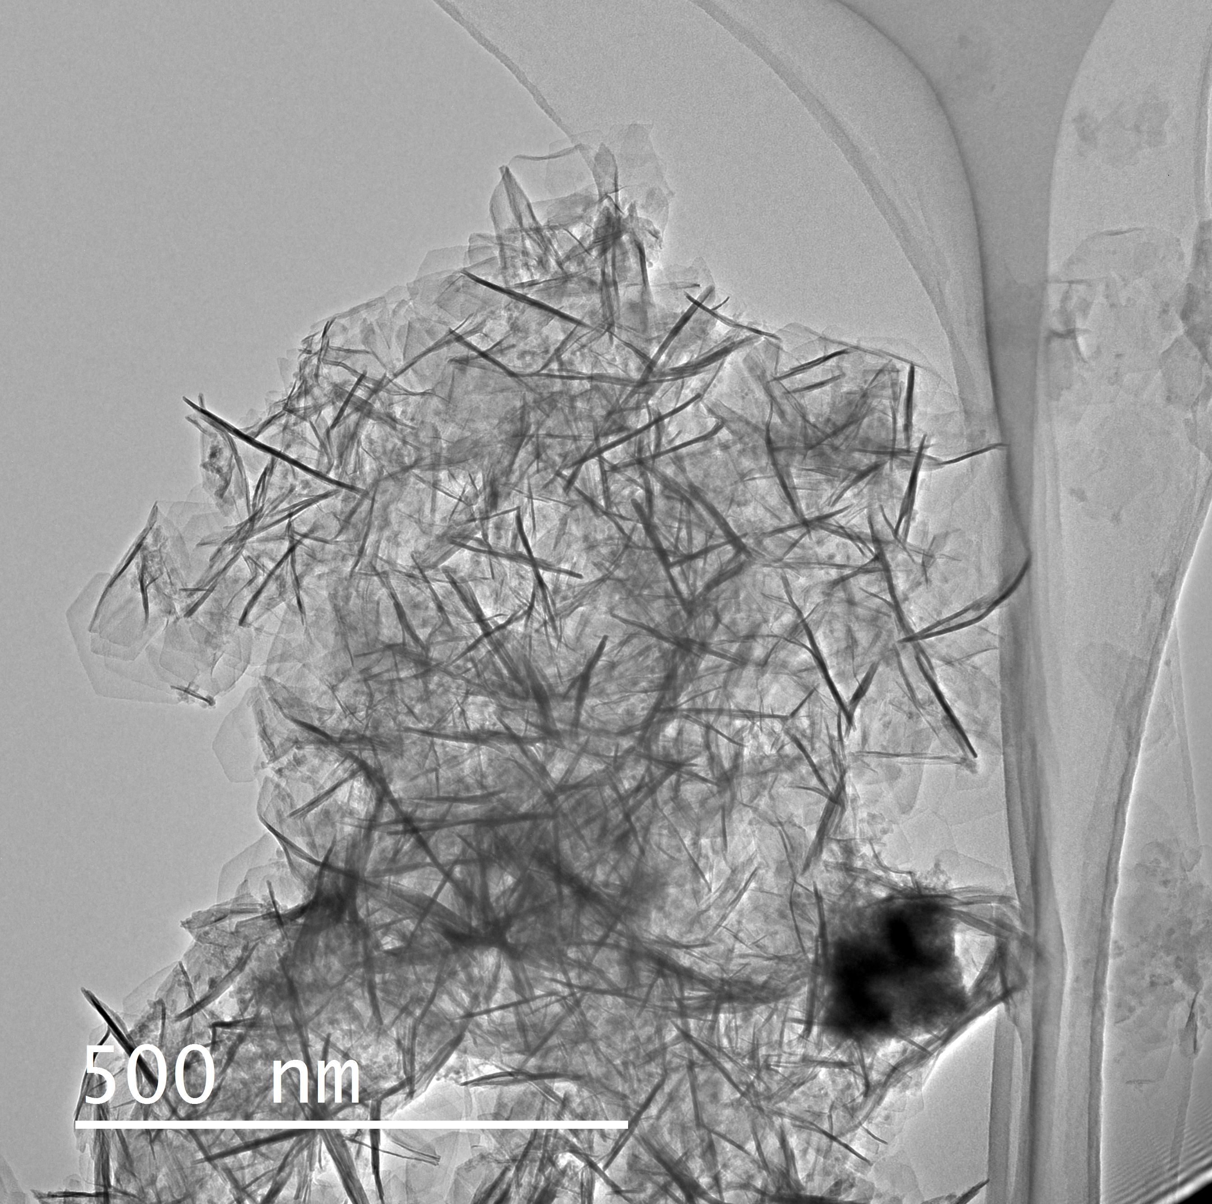
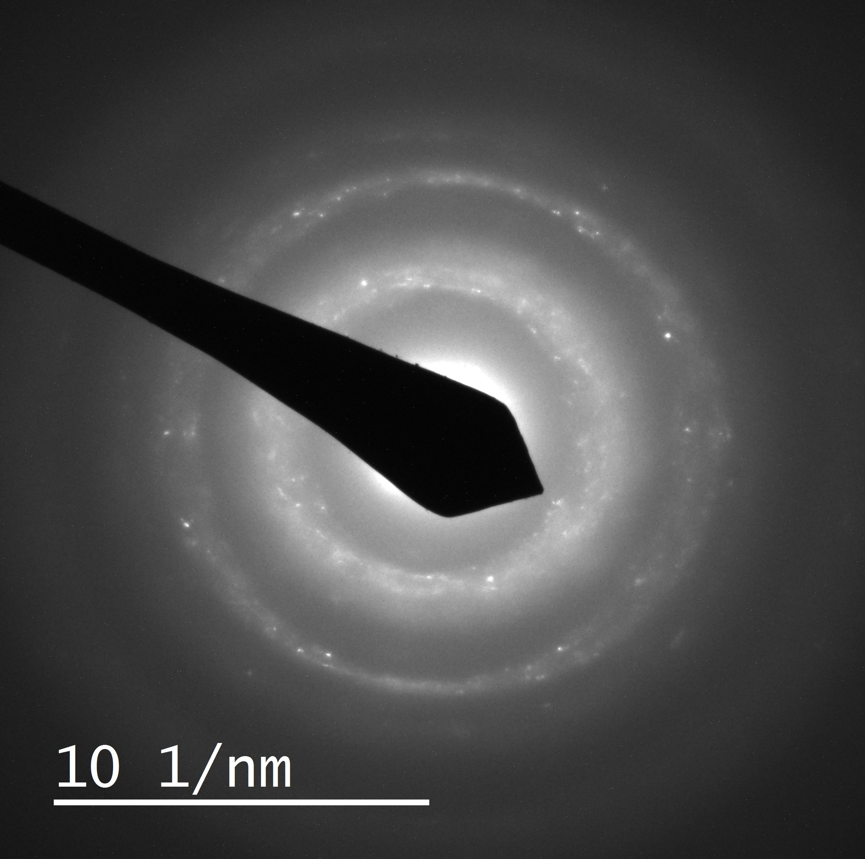
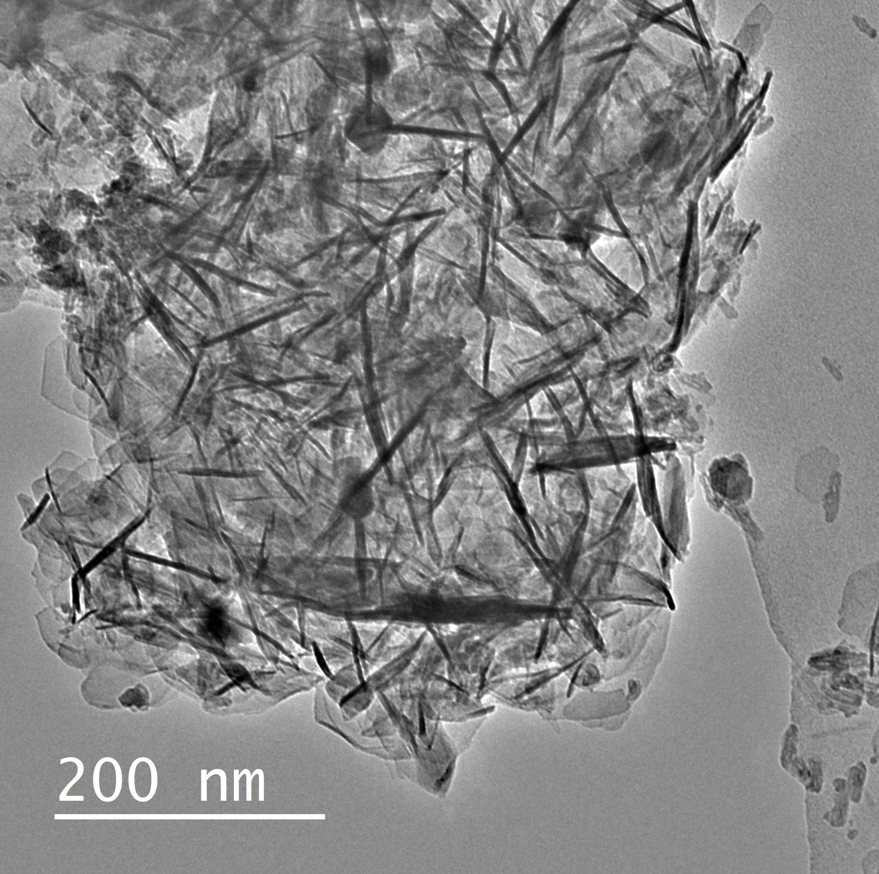
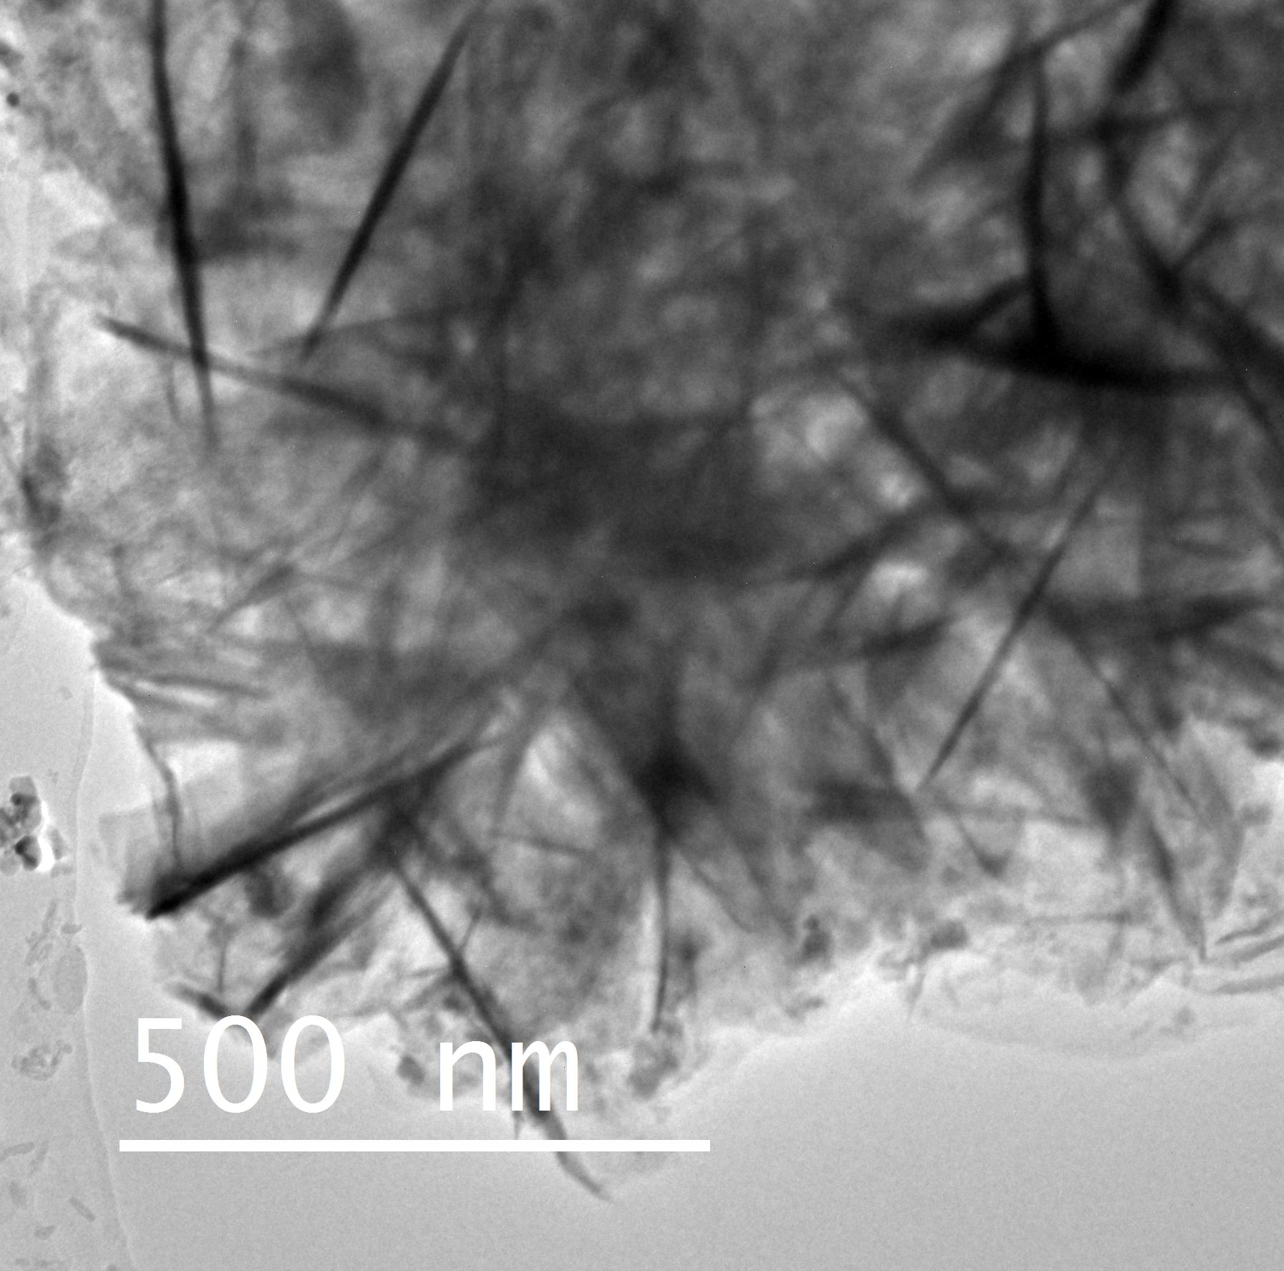
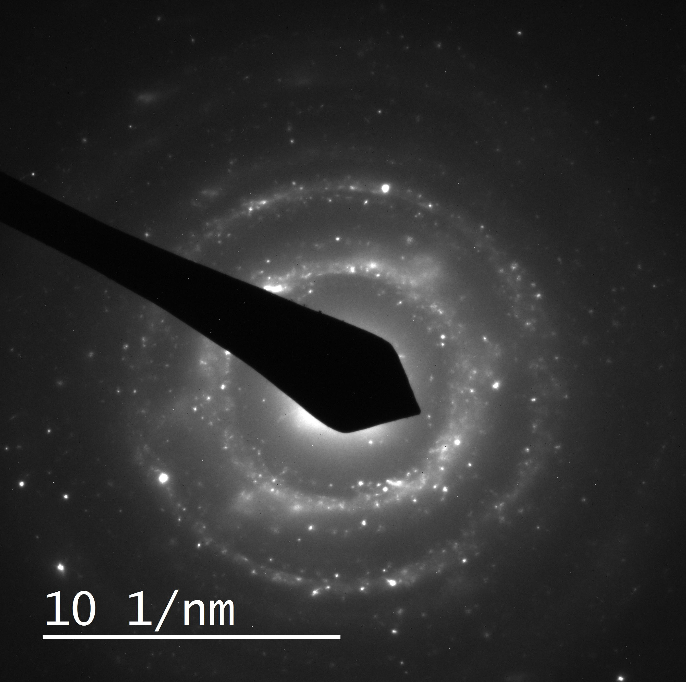
NiFe0.95Ce0.05
NiFe-LDH

