Slide 1






Contour Extrapolation of baryon density in search of the QCD critical point
Hitansh Shah
ADVISOR: Dr. Claudia Ratti
COLLABORATORS: VOLODYMYR VOVCHENKO, MAURICIO HIPPERT, JORGE NORONHA
Physics Research Day - 2024
1 / 12

Slide 2
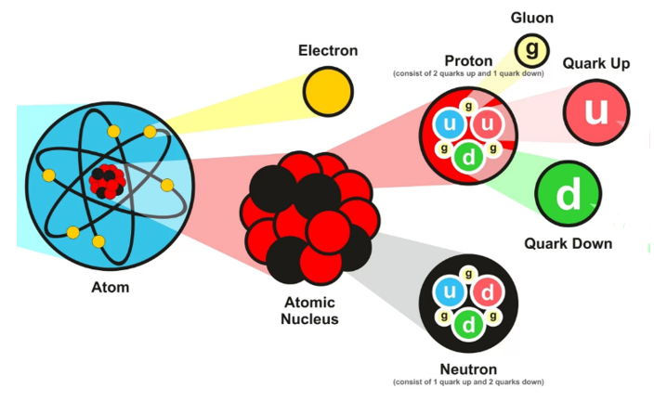
Introduction
Quarks and Gluons
Color charge
Hadron :- Baryons and Mesons
Baryons: consists of 3 quarks
(Protons and neutrons)
Mesons: consists of quark- antiquark
(Pions and Kaons)
2 / 12

Slide 3
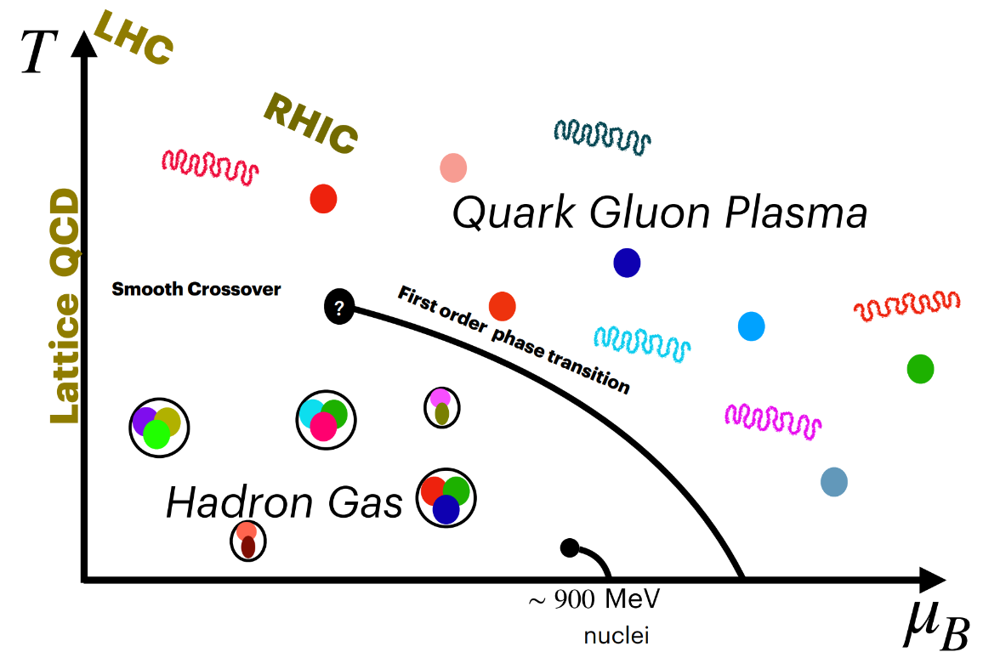
QCD Phase Diagram
Deconfined Quark Gluon Plasma
Analytic Crossover at
Vanishing chemical potential
Nuclear Liquid - gas phase transition
Is there a critical point and a first order
phase transition? If yes, where?
Neutron Stars
3 / 12

Slide 4
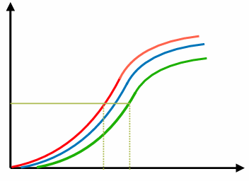
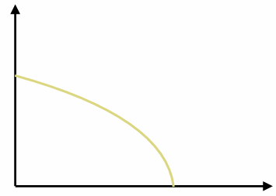












Using Contours to understand the phase transitions
No phase transition
$$n_{B}$$
$$μ_{1}<μ_{2}<μ_{3}$$
$$T$$
$$μ_{3}$$
$$μ_{2}$$
$$μ_{1}$$
$$n_{1}$$
$$T_{1}′$$
$$T_{1}$$
$$T$$
$$μ_{B}$$
$$T_{1}′<T_{1}$$
Contours of constant baryon chemical potential
Contours of constant baryon density
4 / 12

Slide 5
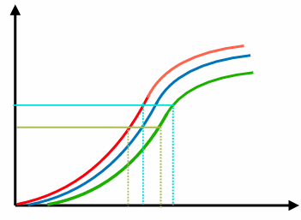
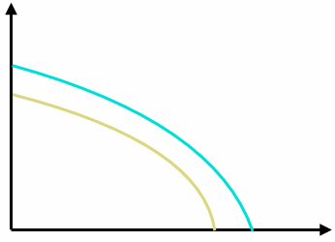










Using Contours to understand the phase transitions
No phase transition
$$n_{B}$$
$$T$$
$$n_{2}$$
$$n_{1}$$
$$T_{2}′$$
$$T_{1}′$$
$$T_{2}$$
$$T_{1}$$
$$μ_{B}$$
$$T$$
Contours of constant baryon chemical potential
Contours of constant baryon density
4 / 12

Slide 6
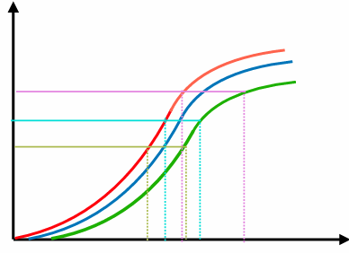
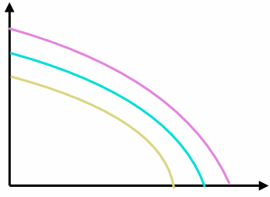














Using Contours to understand the phase transitions
No phase transition
$$n_{B}$$
$$T$$
$$n_{1}<n_{2}<n_{3}$$
$$n_{3}$$
$$n_{2}$$
$$n_{1}$$
$$T_{3}′$$
$$T_{2}′$$
$$T_{1}′$$
$$T_{2}$$
$$T_{1}$$
$$μ_{B}$$
$$T_{3}$$
$$T$$
Contours of constant baryon chemical potential
Contours of constant baryon density
4 / 12

Slide 7
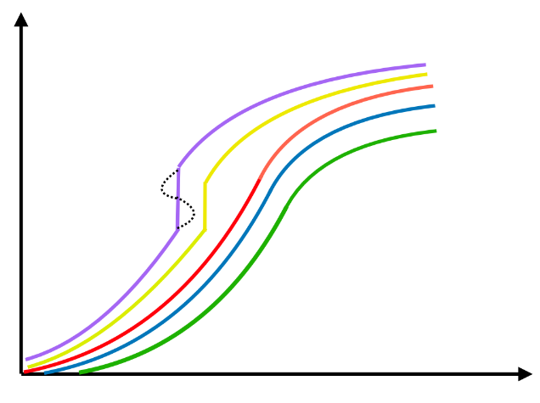
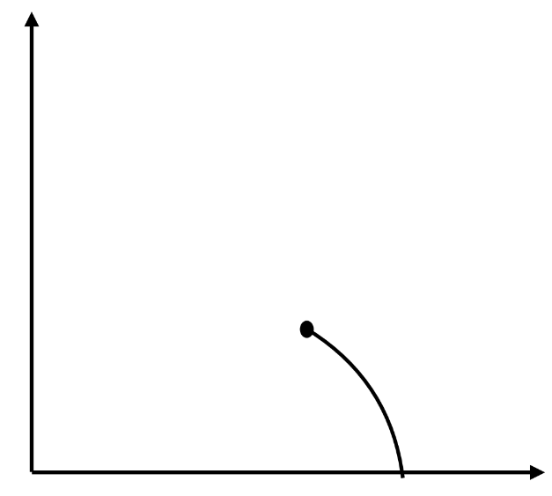


Using Contours to understand the phase transitions
$$n_{B}$$
$$T$$
$$T$$
$$μ_{B}$$
Contours of constant baryon chemical potential
Contours of constant baryon density
5 / 12

Slide 8
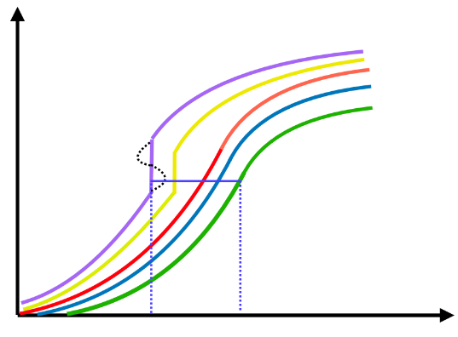
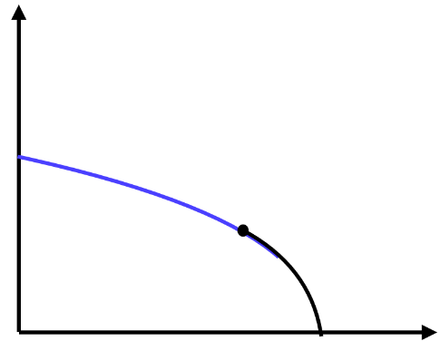



Using Contours to understand the phase transitions
$$n_{B}$$
$$T$$
$T_{1}$’
$$T_{1}$$
$$T$$
$$μ_{B}$$
Contours of constant baryon chemical potential
Contours of constant baryon density
5 / 12

Slide 9
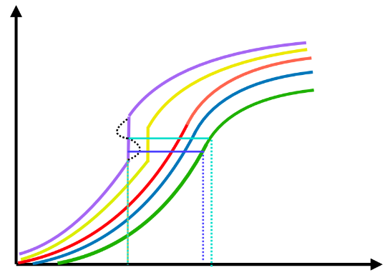
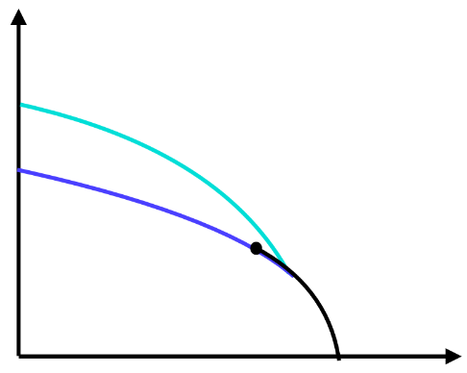




Using Contours to understand the phase transitions
$$n_{B}$$
$$T$$
$$T_{f}$$
$$T_{2}$$
$$T_{1}$$
$$T$$
$$μ_{B}$$
Contours of constant baryon chemical potential
Contours of constant baryon density
5 / 12

Slide 10
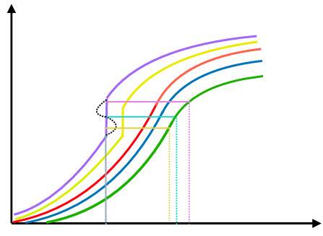
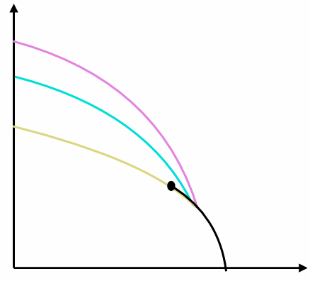






Using Contours to understand the phase transitions
First Order Phase Transition
$$n_{B}$$
$$T$$
$$n_{3}$$
$$n_{2}$$
$$n_{1}$$
$$T_{f}$$
$$T_{3}$$
$$T_{2}$$
$$T_{1}$$
$$T$$
$$μ_{B}$$
Contours of constant baryon chemical potential
Contours of constant baryon density
5 / 12

Slide 11
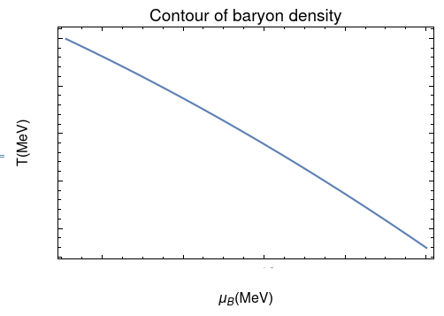
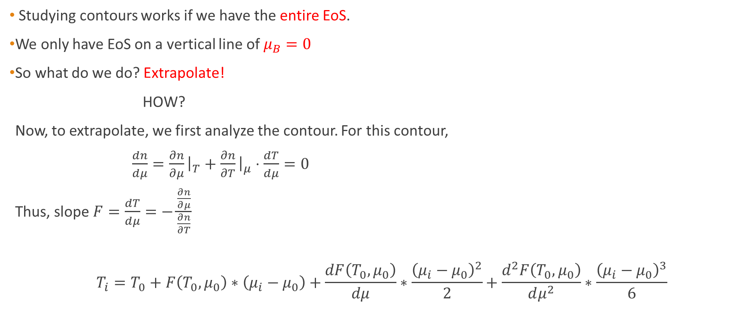
Extrapolation
Studying contours works if we have the entire EoS.
We only have EoS on a vertical line of $μ_{B}=0$
So what do we do? Extrapolate!
HOW?
Now, to extrapolate, we first analyze the contour. For this contour,
$\frac{dn}{dμ}=\frac{∂n}{∂μ}{\left.​\right|}_{T}+\frac{∂n}{∂T}{\left.​\right|}_{μ}⋅\frac{dT}{dμ}=0$
Thus, slope $F=\frac{dT}{dμ}=−\frac{\frac{∂n}{∂μ}}{\frac{∂n}{∂T}}$
$$T_{i}=T_{0}+F\left(T_{0}, μ_{0}\right)∗\left(μ_{i}−μ_{0}\right)+\frac{dF\left(T_{0}, μ_{0}\right)}{dμ}∗\frac{{\left(μ_{i}−μ_{0}\right)}^{2}}{2}+\frac{d^{2}F\left(T_{0},μ_{0}\right)}{dμ^{2}}∗\frac{{\left(μ_{i}−μ_{0}\right)}^{3}}{6}$$
6 / 12

Slide 12
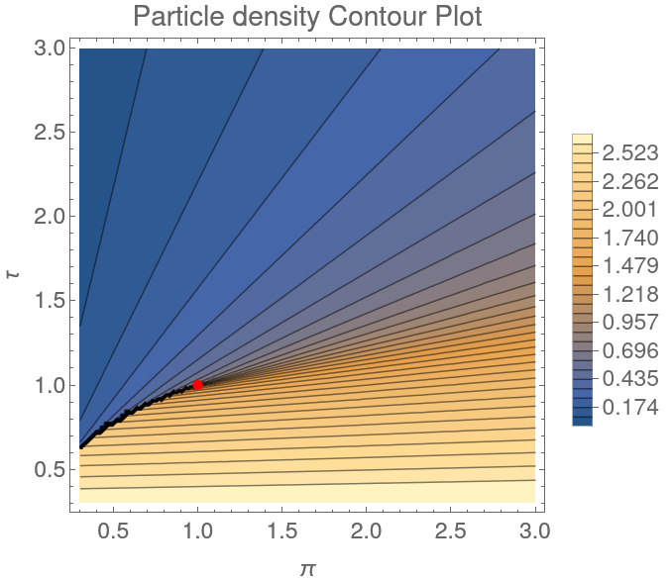

Van der Waals model in CE (Single particle)
Particles are treated as hard spheres.
Repulsive and attractive interactions are present between
the particles.
VdW EoS has a liquid gas phase transition in the EoS.
The equation of state is given as follows:
$(P+\frac{a}{v^{2}})\left(v−b\right)=T$ where $v=\frac{V}{N}$
In dimensionless variables, where $τ=\frac{T}{T_{c}},π=\frac{P}{P_{c}} , η=\frac{n}{n_{c}}$
The critical point is at $\left(π,τ\right)=(1,1)$.
7 / 12

Slide 13
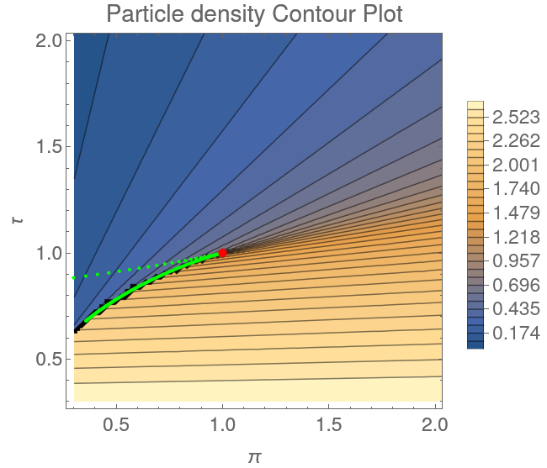
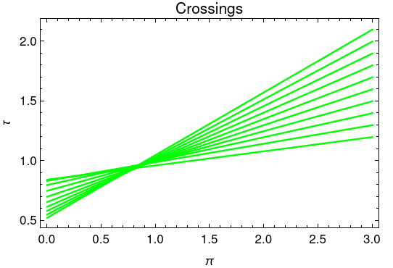
Crossings
8 / 12

Slide 14
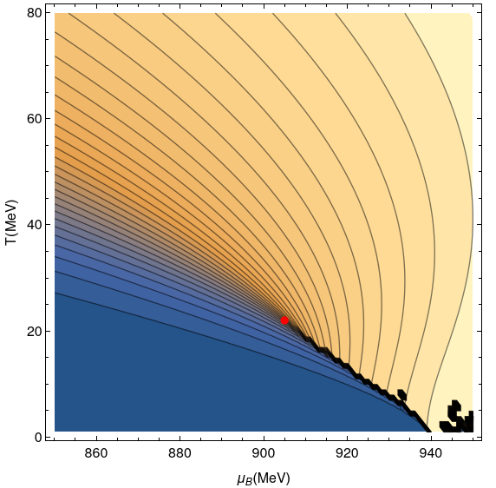
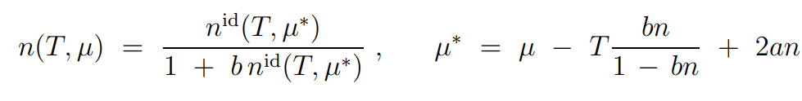

Quantum VdW in GCE
We switch from Canonical Ensemble to Grand canonical ensemble
Baryon chemical potential $μ_{B}$ becomes a control parameter
instead of pressure.
Equation of state can be now solved using
the transcendental equation below:
We only have a proton and neutron in the system currently.
a = 329 MeV fm³ b=3.42 fm³
V. Vovchenko et.al., D. V. Anchishkin et. al and M. I. Gorenstein et. al. (2015)
9 / 12

Slide 15
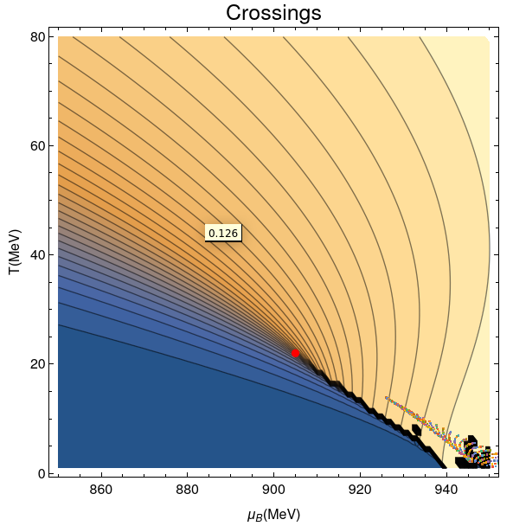
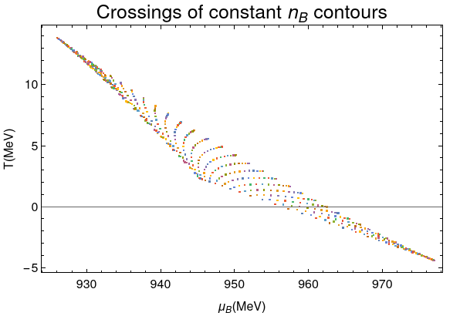


Crossings $μ_{0}=851MeV$
Actual Critical point :- ($μ_{Bc}=903 MeV, T_{c}=21 MeV$)
Estimated Critical Point:-$(μ_{Bc}=925MeV,T_{c}=15 MeV)$
V. Vovchenko, H. Stoecker, Thermal-FIST:, Comput. Phys. Commun. 244, 295 (2019)
10 / 12

Slide 16
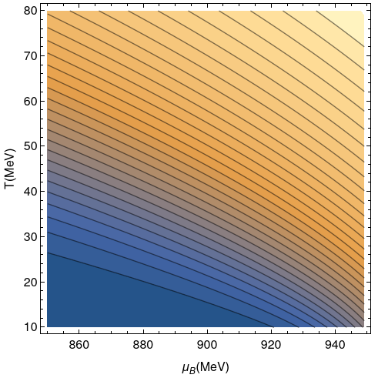
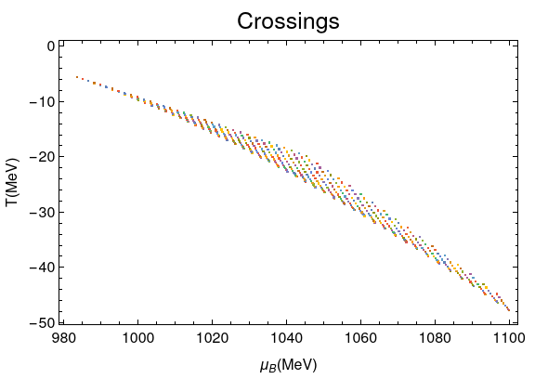
Excluded Volume model
a = 0 MeV fm³ b=3.42 fm³
No attractive interactions, no phase transition
11 / 12

Slide 17
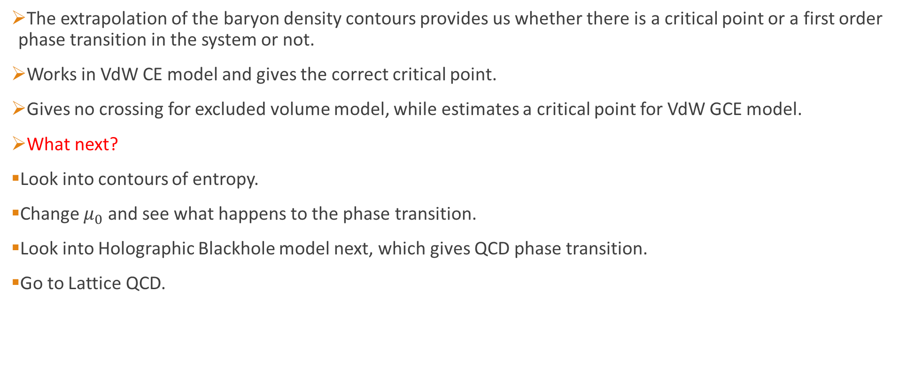
Outlook
The extrapolation of the baryon density contours provides us whether there is a critical point or a first order phase transition in the system or not.
Works in VdW CE model and gives the correct critical point.
Gives no crossing for excluded volume model, while estimates a critical point for VdW GCE model.
What next?
Look into contours of entropy.
Change $μ_{0}$ and see what happens to the phase transition.
Look into Holographic Blackhole model next, which gives QCD phase transition.
Go to Lattice QCD.
12 / 12

Slide 18
BACKUP SLIDES

Slide 19


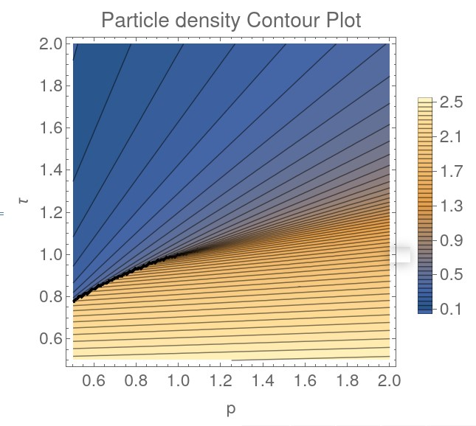

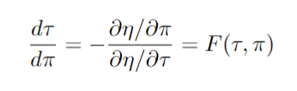

Extrapolation technique
Show theory of extrapolation, crossings and lensing criterion.

Slide 20


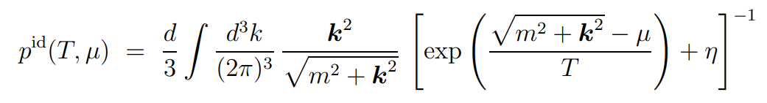
Ideal Hadron Resonance Gas Model
Nucleons and Resonances are considered as point particles
No interactions between the particles
The partition function for an ideal HRG is shown as:
In the GCE, the pressure is given as follows:
Ratti, C., & Belwied, R. (2020). The Deconfinement Transition of QCD.
/ 35

Slide 21
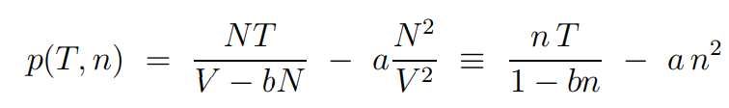
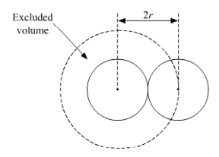
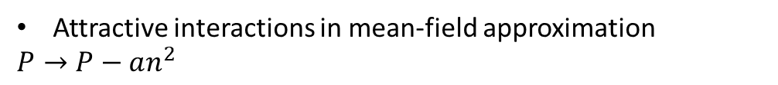
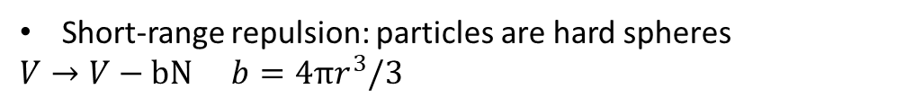
Van der Waals HRG Model
Instead of point particles, we consider nucleons and resonances as hard spheres
Describes the pressure function in equilibrium systems of particles with both repulsive and attractive interactions.
Equation predicts the existence of a first-order phase transition and contains a critical point.
VdW equation in
Canonical Ensemble
Short-range repulsion: particles are hard spheres
$V→V−bN$ $b=4πr^{3}/3$
Attractive interactions in mean-field approximation
$$P→P−an^{2}$$
V. Vovchenko et.al., D. V. Anchishkin et. al and M. I. Gorenstein et. al. (2015)
/ 35

Slide 22

Quantum Van der Waals HRG
η equals +1 for Fermi statistics, -1 for Bose statistics, and 0 for the Boltzmann approximation
The VdW equation of state in the GCE is obtained in the form of a transcendental equation for particle number density n ≡ n(T, µ) as a function of T and µ
where n_{id} is a particle number density in the ideal Boltzmann gas
for T< T_{c} gives multiple solutions , T>T_{c} gives unique solution
V. Vovchenko et.al., D. V. Anchishkin et. al and M. I. Gorenstein et. al. (2015)
a = 329 MeV fm³ b=3.42 fm³
For baryons
/ 35

Slide 23
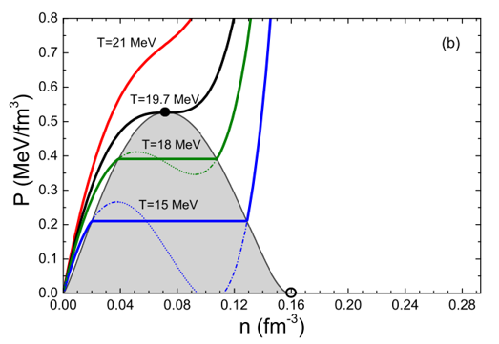
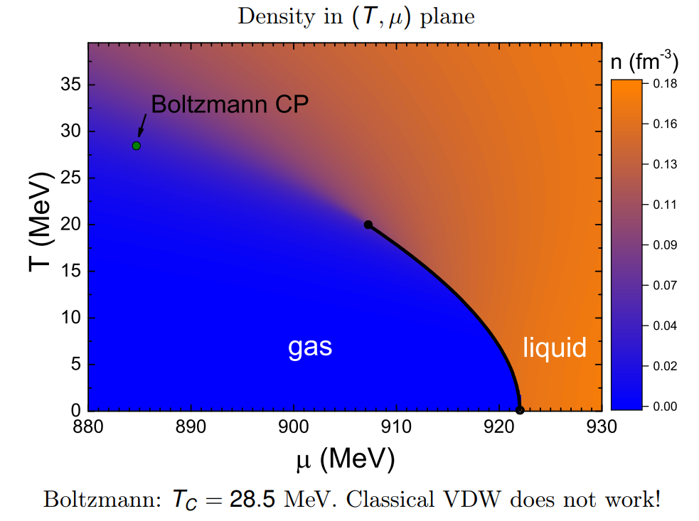
Liquid Gas Phase Transition
/ 35

Slide 24
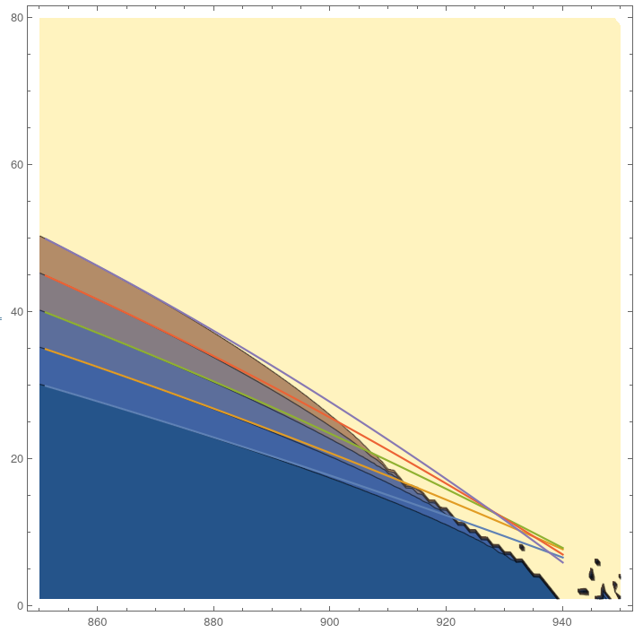
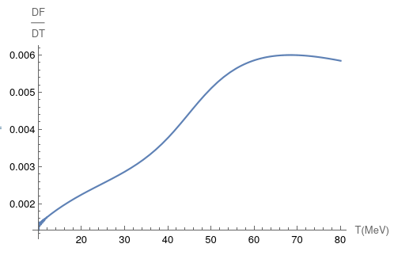

Lensing Criterion and Contours $μ_{0}=851MeV$

Slide 25
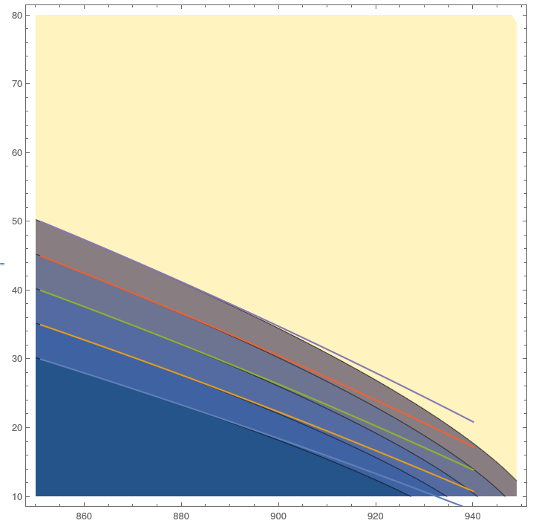

Slide 26
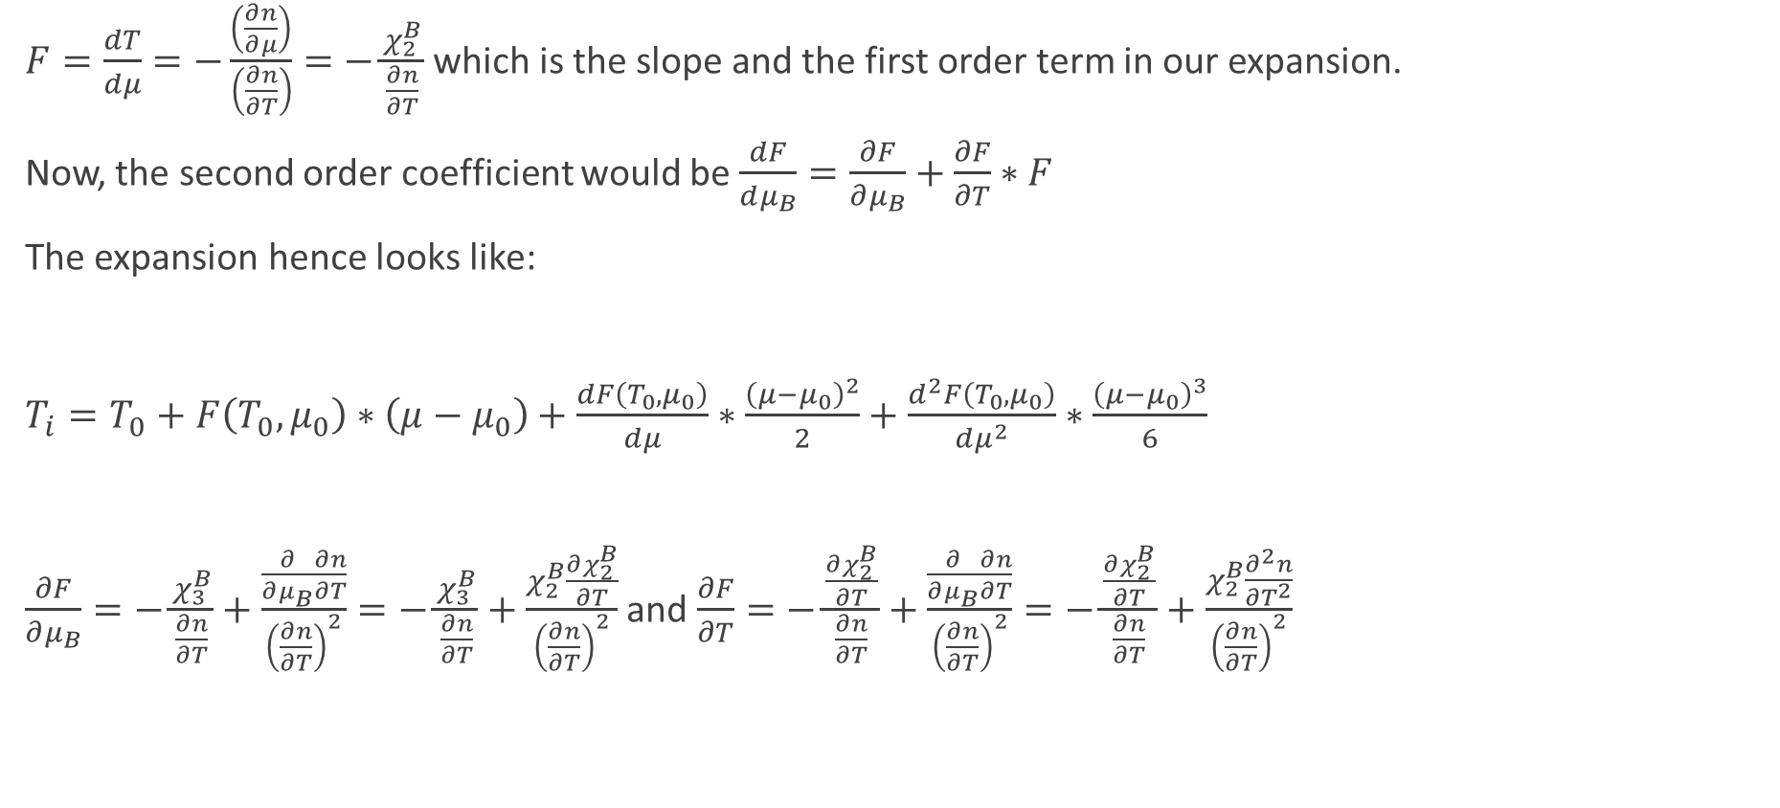
New scheme to do 2nd order derivatives
$F=\frac{dT}{dμ}=−\frac{\left(\frac{∂n}{∂μ}\right)}{\left(\frac{∂n}{∂T}\right)}=−\frac{χ_{2}^{B}}{\frac{∂n}{∂T}}$ which is the slope and the first order term in our expansion.
Now, the second order coefficient would be $\frac{dF}{dμ_{B}}=\frac{∂F}{∂μ_{B}}+\frac{∂F}{∂T}∗F$
The expansion hence looks like:
$T_{i}=T_{0}+F\left(T_{0}, μ_{0}\right)∗\left(μ−μ_{0}\right)+\frac{dF\left(T_{0}, μ_{0}\right)}{dμ}∗\frac{{\left(μ−μ_{0}\right)}^{2}}{2}+\frac{d^{2}F\left(T_{0},μ_{0}\right)}{dμ^{2}}∗\frac{{\left(μ−μ_{0}\right)}^{3}}{6}$
$\frac{∂F}{∂μ_{B}}=−\frac{χ_{3}^{B}}{\frac{∂n}{∂T}}+\frac{\frac{∂}{∂μ_{B}}\frac{∂n}{∂T}}{{\left(\frac{∂n}{∂T}\right)}^{2}}=−\frac{χ_{3}^{B}}{\frac{∂n}{∂T}}+\frac{χ_{2}^{B}\frac{∂χ_{2}^{B}}{∂T}}{{\left(\frac{∂n}{∂T}\right)}^{2}}$ and $\frac{∂F}{∂T}=−\frac{\frac{∂χ_{2}^{B}}{∂T}}{\frac{∂n}{∂T}}+\frac{\frac{∂}{∂μ_{B}}\frac{∂n}{∂T}}{{\left(\frac{∂n}{∂T}\right)}^{2}}=−\frac{\frac{∂χ_{2}^{B}}{∂T}}{\frac{∂n}{∂T}}+\frac{χ_{2}^{B}\frac{∂^{2}n}{∂T^{2}}}{{\left(\frac{∂n}{∂T}\right)}^{2}}$

Slide 27
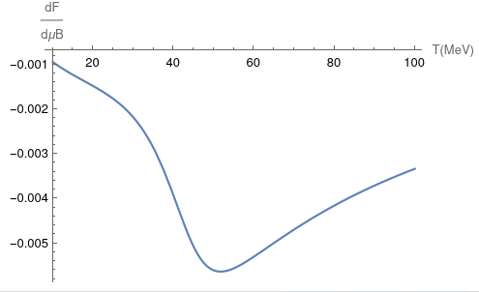
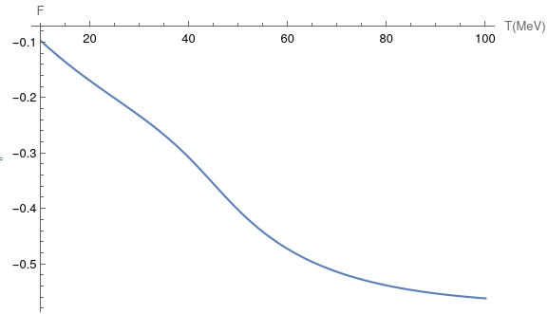
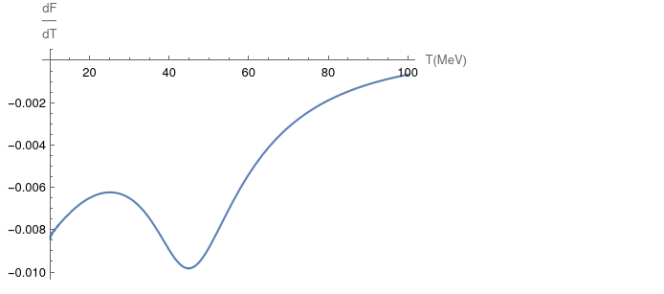
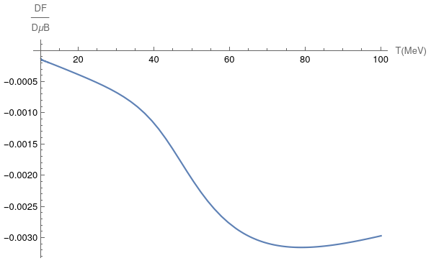
Increasing Precision VdW

Slide 28
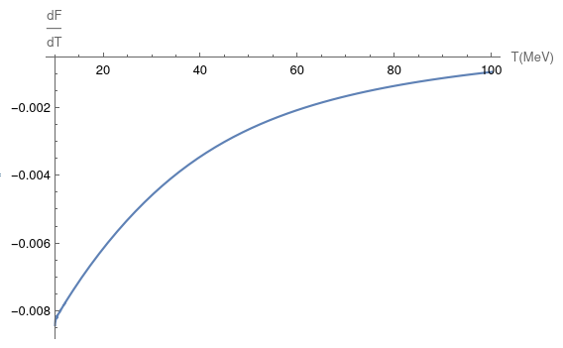
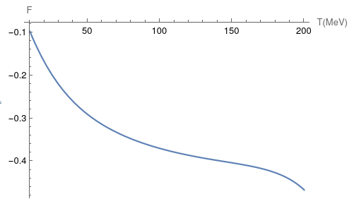


EV p&n

Slide 29




But, is there a critical point and if yes, where?

Slide 30


Slide 31
Outline
Introduction
Quantum Chromodynamics
QCD Phase Diagram
Concept
Contours
Extrapolation scheme
Toy Models
Van der Waals Classical CE
VdW model GCE (p and n)
Excluded Volume GCE
Summary
1 / x

