Slide 1





ALICE Experiment In LHC Run 3
Iris Likmeta
Physics Research Day 2024

Slide 2
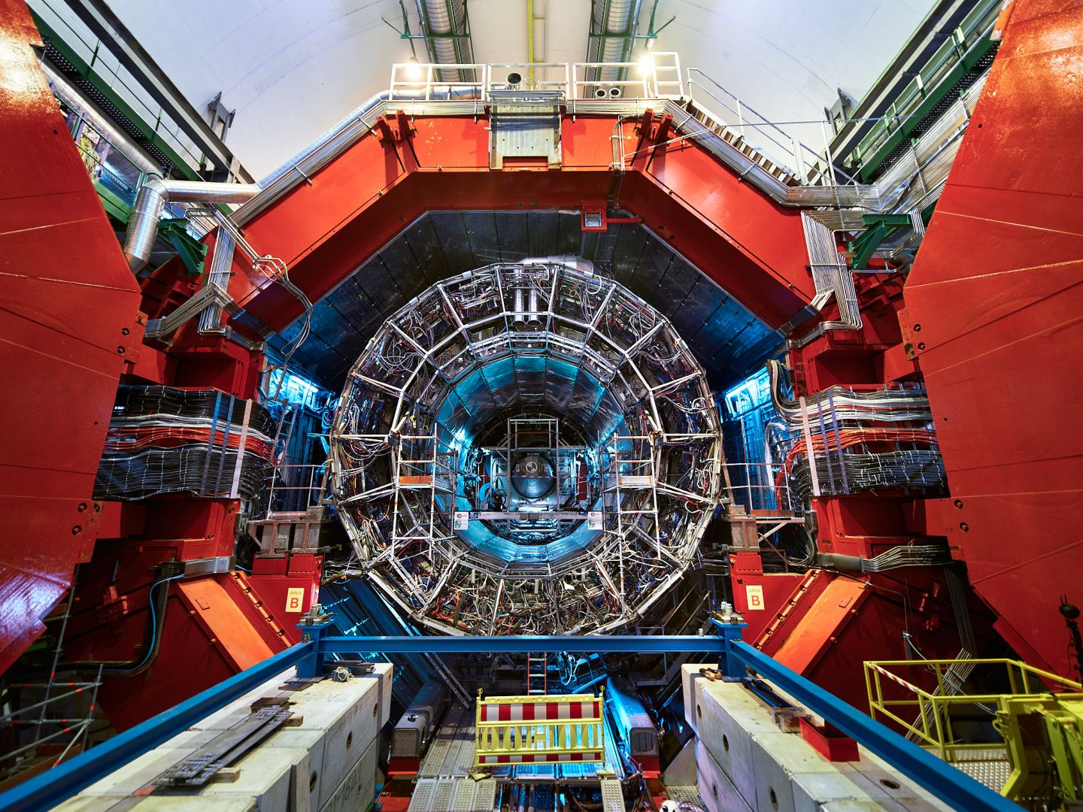

Outline
Hardware upgrades
New computing system
2

Slide 3
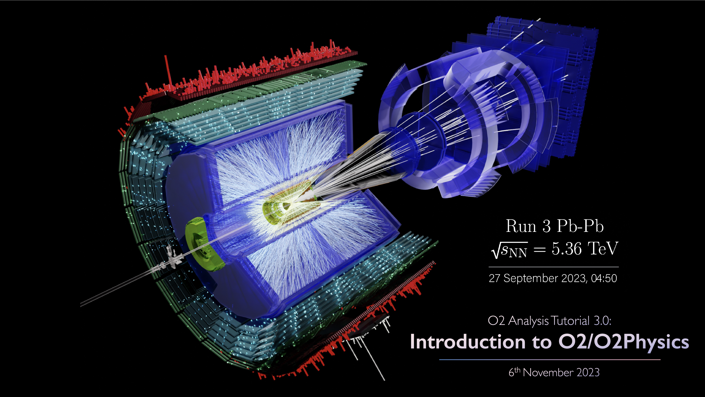
Event Plane Pb-Pb
3

Slide 4
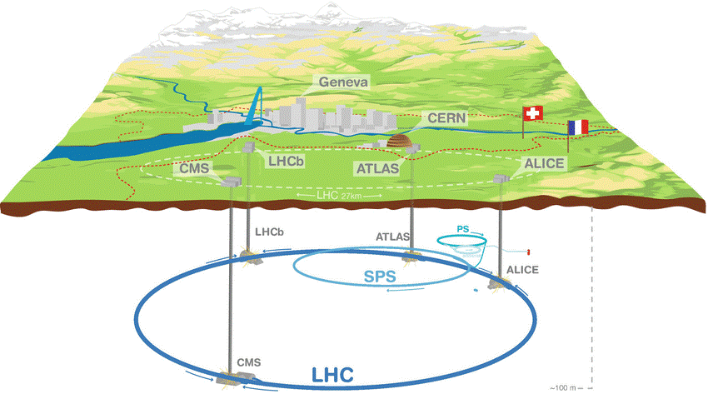
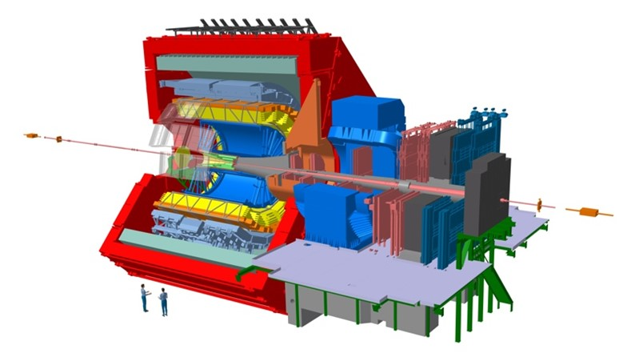
ALICE Detector
Weight: 10000 tones
Length: 26m
Width: 16m
Height: 16m
56m
Inner Tracking System (ITS): vertex and track reco.
Time Projection Chamber (TPC): track reco. & particle ID
Transition Radiation Detector (TRD): particle ID
Time Of Flight (TOF): Particle ID
Electromagnetic Calorimeter (EMCal): Energy deposition
Solenoid (L3 magnet): 0.5 T
4

Slide 5
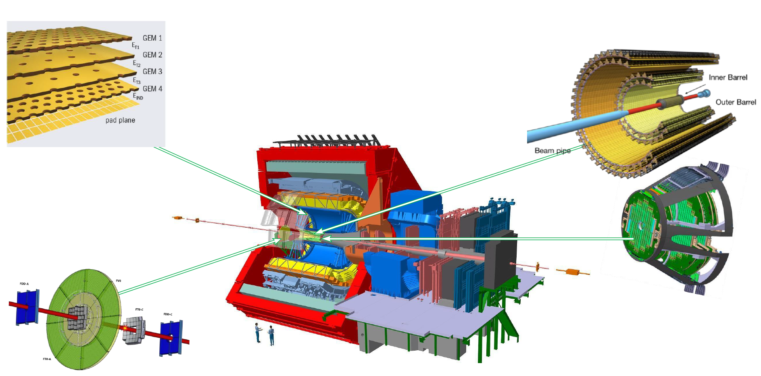
ALICE Run 3 Hardware Upgrades
TPC: Gas Electron Multipliers (GEM) replaced old wire chambers.
ITS: 7 layers of Si pixel sensors builds a 10m² area (12.5B Si sensors).
New beam pipe with smaller diameter (36.4mm)
MFT: 5 disks of Si pixel sensors. Match muons before and after the absorber.
FIT: Serves as interaction trigger, luminometer, indicator of vertex position and forward multiplicity counter
New readout system:
Continuous readout through 13B electronic sensors
3.4 TB/s
5

Slide 6
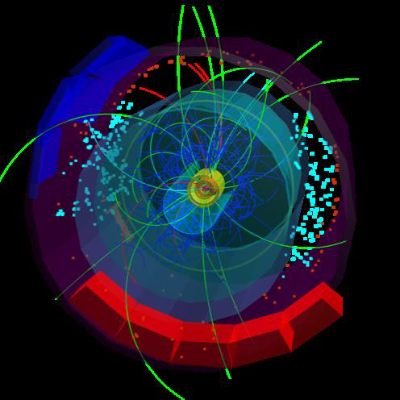
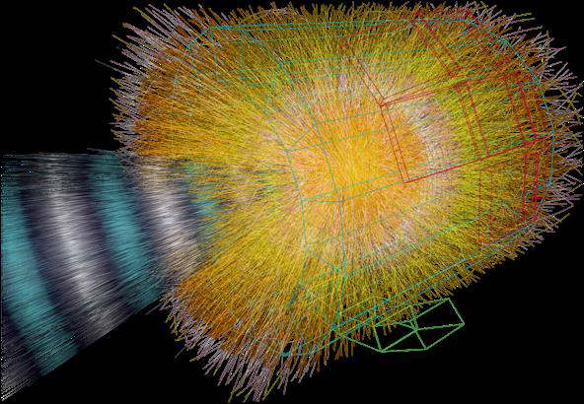
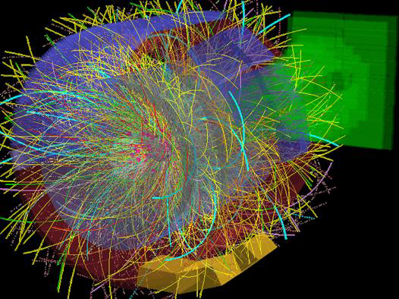
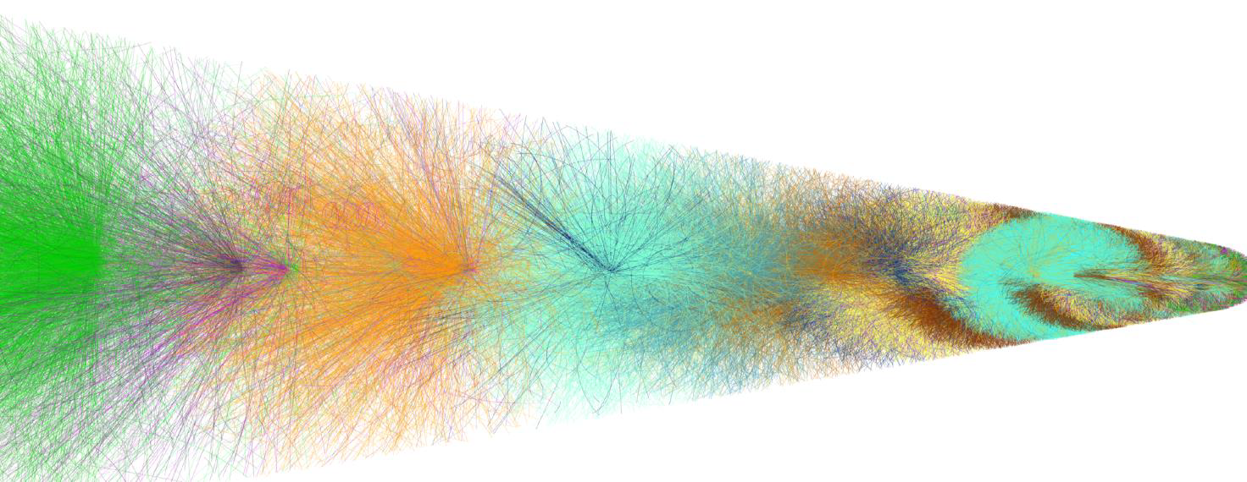
Benefits
p-p
p-Pb
Pb-Pb
Completely new detector readout 3.4 ΤΒ/s
Reconstruct 100 times more events online than Run 1
Store 100 times more events than Run 1
50kHz interaction rate (1event/10μs)
Overlapping events in TPC with realistic bunch structure @ 50 kHz Pb-Pb
Tracks of different collisions shown in different color
As of today, we have:
5 weeks of Pb-Pb collisions at 50 kHz interaction rate: 12B reco. events
500B reco. events of p-p collisions during 2022-2023
6

Slide 7
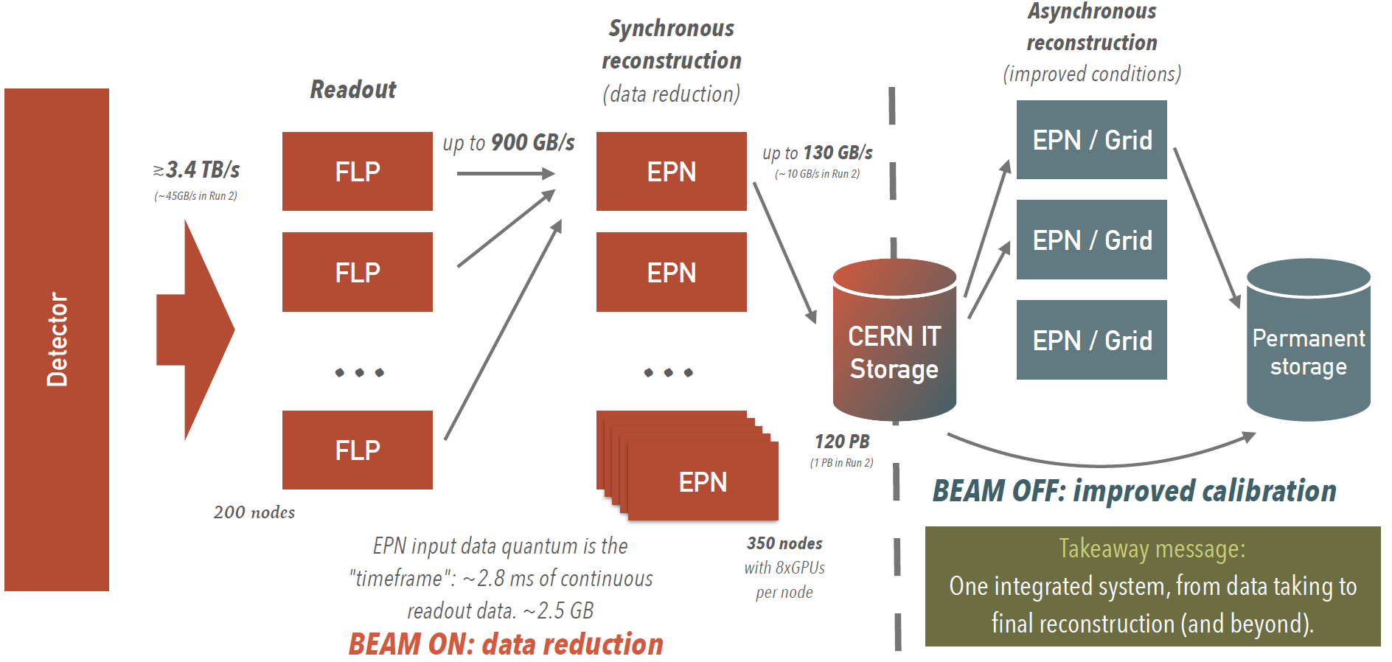
O² Framework
7

Slide 8
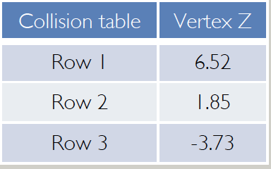

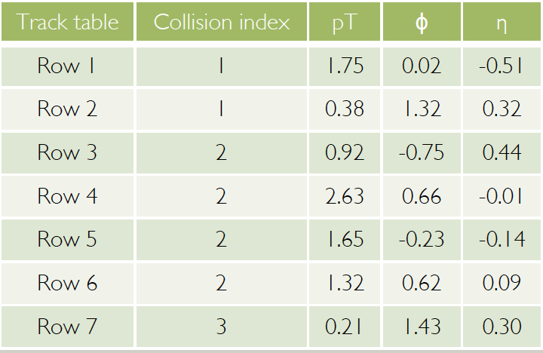
O² Layout
AliPhysics: object-oriented, arrays of structures-based
– ultimately: restrictive for analysis speed!
Major switch to arrow tables
– structures of arrays-based, enormous processing speed unlocked!
Root files are still the I/O backend of the new framework!
Data is stored in multiple TTrees in TFiles
O2 AODs (AO2Ds) can be inspected with the browser
Tables are read from columnar trees during the analysis
Connection between Collision Table and Track Table is done via index!
Reversed access hierarchy: Tracks refer to Collisions
Previously: Collisions contained Tracks
8

Slide 9
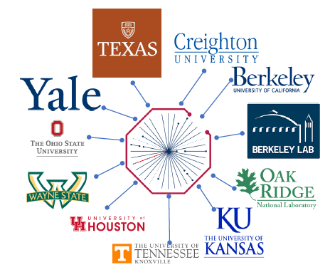

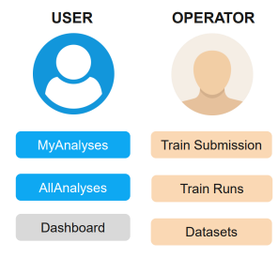
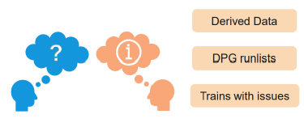
Hyperloop
Organized job submission and monitoring system
Train system for O² , replacing the LEGO train system
Allows organized analysis on the GRID and Analysis Facilities
Fully integrated with O², allowing task configuration
Individual workflows - known as wagons - are combined into trains
Skimmed / Derived data stored for further processing in subsequent trains
Data available: converted Run 2 data, Run 3 data and MC, Derived data
Dedicated views for regular users and operators
24/5 Operation (3 different timezones)
Institutes: multiple ALICE-USA institutions, 2 in Europe, 1 in Asia
Shift-type support during working hours
Organized feedback sessions
9

Slide 10
Conclusions
Hardware and software upgrades led to a single bottom line: 50 kHz interaction rate!
Newly hardware components (FT0 with 7ps resolution) ranks among the fastest detectors in high energy physics experiment
O² Framework speeds up significantly particle’s reconstruction processes
10

Slide 11

11

