Slide 1



Generalized Free Cumulants for Quantum Chaotic Systems
Siddharth Jindal
Department of Physics and Texas Center for Superconductivity, University of Houston
siddharth@sidjindal.dev
Pavan Hosur

Slide 2
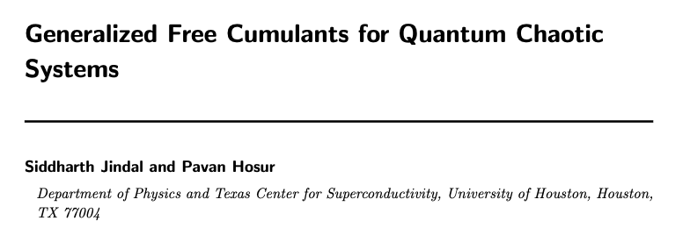
Generalized Free Cumulants for Quantum Chaotic Systems
arXiv:2401.13829

Slide 3
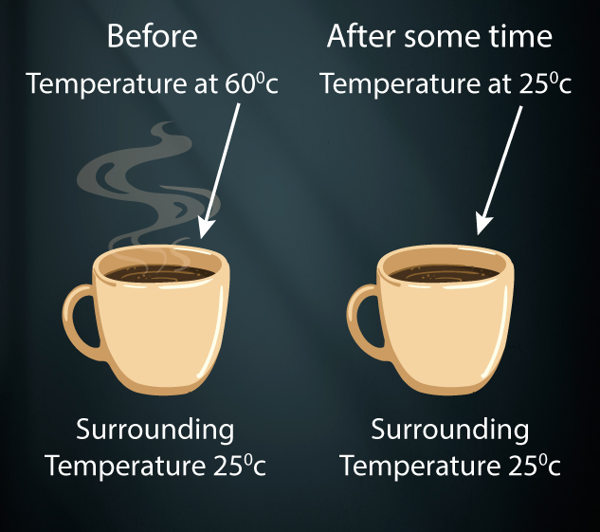

Thermodynamics Quantum Mechanics
Irreversible Reversible

Slide 4
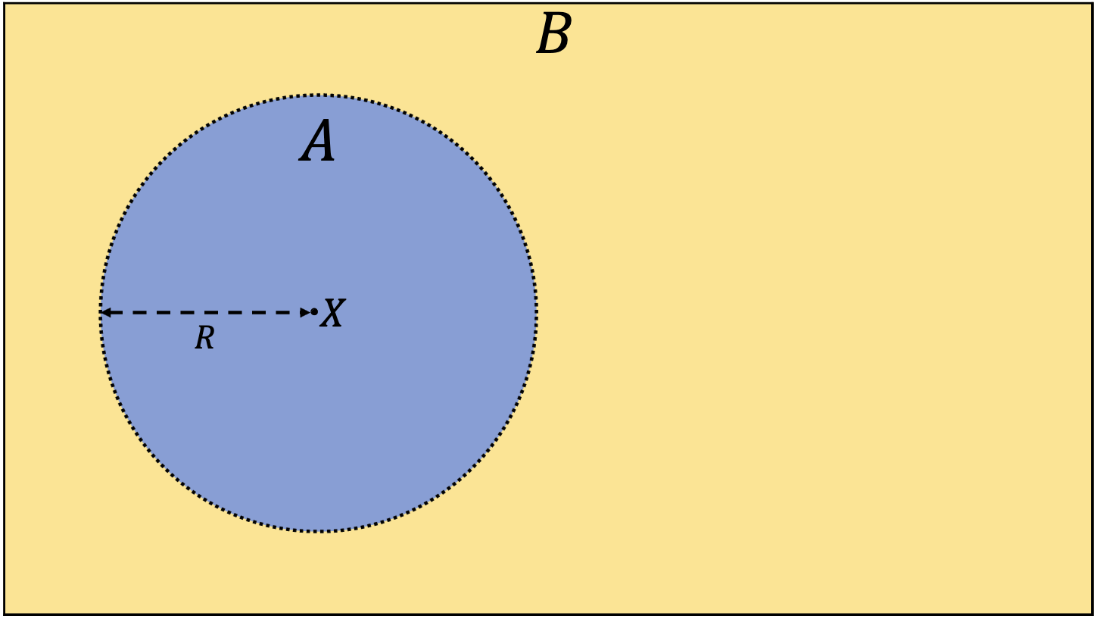

Does the coffee cup thermalize?

Slide 5

Postulate: Many-body Berry’s conjecture
Eigenstates are (pseudo-)random vectors up to the symmetry constraints of the system
Physical properties of the system should be robust to microscopic perturbations (Deutsch 1991)

Slide 6



Eigenstate thermalization (ETH)
Assuming Berry’s conjecture:
(Feingold & Peres 1986, Deutsch 1991, Srednicki 1994)
microcanonical average
uncorrelated gaussian random numbers
Describes the emergence of equilibrium ensembles but not the thermalization process

Slide 7
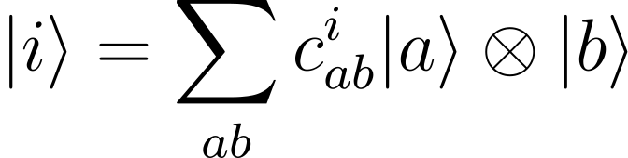
Ergodic bipartition (EB)
Recovers the Page curve for entanglement entropy (Deutsch 2010, Lu & Grover 2018, Murthy & Srednicki 2019)
Analogous to MBBC/ETH but computes distinct quantities
Previously only used to compute static quantities

Slide 8
Non-commutative probability
Classical Probability Theory
Non-commutative Probability Theory
Free Probability Theory
maximal
non-commutativity
commutativity
Observables
+
States
classical independence
(independence)
free independence
(freeness)
Notes:
Classical probability theory is formulated using a sample space of events and a rule for assigning probabilities to subsets of events (i.e. a probability distribution). Observables are measurable functions of the sample space.
Quantum mechanics is not a theory of classical probability!
Non-commutative probability is formulated using an algebra of observables and a state. Non-commutative probability generalizes quantum mechanics.

Slide 9


Eigenstate thermalization
( distinct) (Foini & Kurchan 2018)
planar connected n-point correlators a.k.a free cumulants (Pappalardi, Foini, & Kurchan 2022)
Can be applied to distinct operators

Slide 10
Distinguishability of eigenstates
Using a free probability-inspired analysis,
(Kudler-Flam, Narovlansky, Ryu 2021)
EB => subsystems are indistinguishable when < ½ size => diagonal ETH
interpreted as matrix on lower indices, upper index is a sample

Slide 11
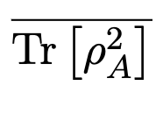








Diagrammatic Approach
$$=$$
$$a_{2}$$
$$i$$
$$a_{1}$$
$$=$$
$$+$$
$$+…$$
$$b_{2}$$

Slide 12
Q: Does the coffee cup thermalize?

Slide 13
Does the coffee cup thermalize? Yes!

Slide 14
Some other technical results
Criteria for validity of ensemble averaging
Calculation of Page curve for entanglement entropy
Arguments for gaussianity of random matrix terms
Eigenstate correlations encode entanglement velocities
Operator-eigenstate correlations encode butterfly velocities

Slide 15
Summary and future work
The fundamental postulate of the ETH is that eigenstates are random vectors How much of quantum chaos does the MBBC encompass?
Ideas from free probability and random matrix theory are central to quantum chaos Can further techniques be drawn?
Ergodic bipartition enables strong statements about chaotic systems Can this be extended to higher-order correlators?
The ETH and EB are unified into a powerful calculational tool

Slide 16
Generalized Free Cumulants for Quantum Chaotic Systems
Siddharth Jindal
Department of Physics and Texas Center for Superconductivity, University of Houston
siddharth@sidjindal.dev
Pavan Hosur

