Slide 1
Physics Research Day 2024
Correlated Quantum Transport of Charge Density Waves
Johnathan O. Sanderson
Advisor: Dr. John H. Miller

Slide 2

Contents
Charge Density Wave theory.
Bardeen-Zener Tunneling Characteristic.
Time-Correlated Soliton Tunneling Model.
Charge Density Wave research at UH and TcSUH.

Slide 3
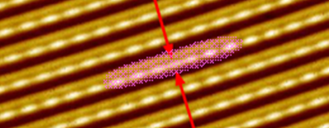


Charge Density Waves (CDWs)
The Charge Density Wave (CDW) is an electron-phonon condensate within which electrons flow coherently at the highest known temperatures at ambient pressure.
CDW mechanics is of fundamental importance to both condensed matter physics and quantum physics.
Research is showing evidence that CDW transport is a coherent, Josephson-like tunneling process at temperatures up to 474K. [1]
NbSe3 CDW (Soliton Highlighted) Brun and Wang, 2006

Slide 4
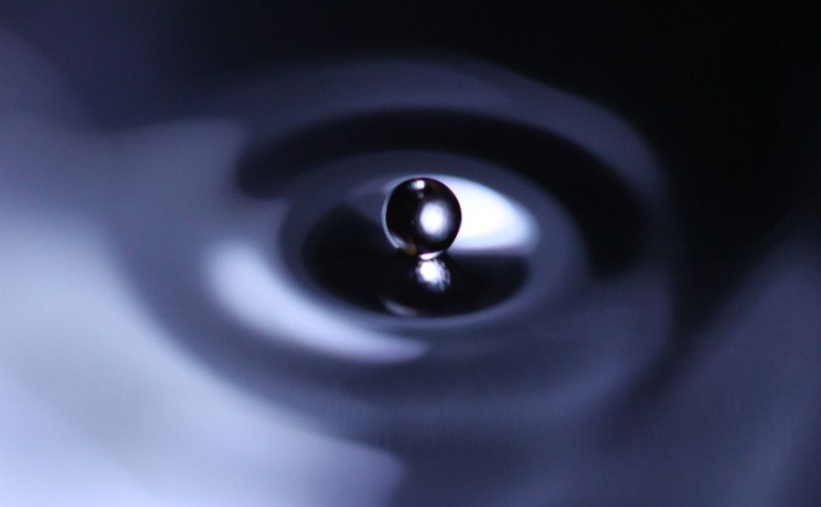
Correlated Quantum Transport of Charge Density Waves
Current-Voltage (I-V) characteristic data for NbS3, TaS3, and NbSe3 at temperatures up to 474 K [2-6] show nearly precise agreement with two methods:
Dr. John Bardeen’s (B.C.S. Theory) modified Zener-tunneling characteristic [7].
Time-correlated soliton tunneling (ST) model [8-9].
Treats the CDW system as a quantum fluid that flows drip-like as microscopic entities tunnel coherently from one charging energy microstate to the next [8].
Quantum Fluid, Larry Hardesty, MIT, 2013

Slide 5
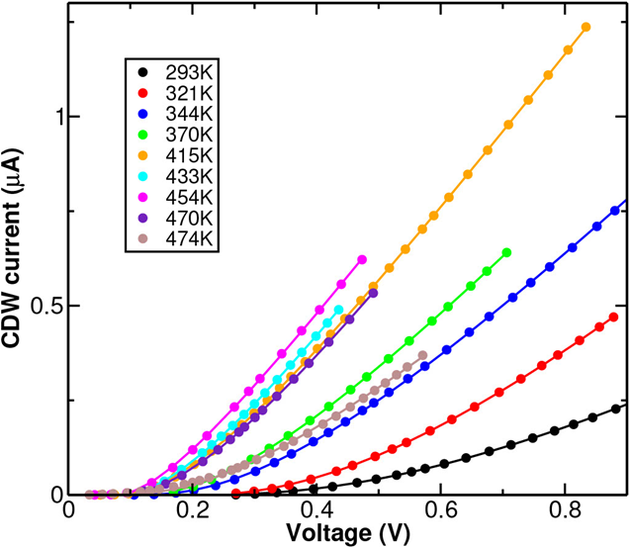
Bardeen-Zener Tunneling Characteristic
Narrow band noise and voltage oscillations in the Soliton tunneling (ST) model result from time-correlated, Josephson-like tunneling between successive charging energy macrostates [10].
The model’s simulations showed unparalleled agreement between experiment and theory [8-10].
Current-Voltage characteristics were computed by averaging over several cycles and also exhibited precise agreement with experiments using NbSe3 [8-10].
For a wide range of parameters, the computed I-V curves were found to match Dr. Bardeen’s modified Zener-tunneling curve [11].

Slide 6

Time-Correlated Soliton Tunneling Model
Here we use Dr. Bardeen’s modified Zener-tunneling curve [11] to analyze CDW transport data [1] on NbS3 for temperatures ranging from 293 K to 474 K.
We extracted reported differential conductance data and subtracted the normal conductance.
We then integrated to obtain I-V curves, which were compared to the Bardeen-Zener tunneling curve.
The I-V figures show nearly precise agreement between the Bardeen-Zener tunneling curve and the experimental data [1-6], strongly supporting a quantum mechanism of CDW transport.
$I_{CDW}=G_{max}\left[V−V_{Tm}\right]exp⁡\left[−\frac{V_{0}}{V}\right]$ (Eqn. 1)
Experimental (Solid Circles)
Quantum Theoretical Bardeen-Zener I-V curve (Solid Lines)

Slide 7
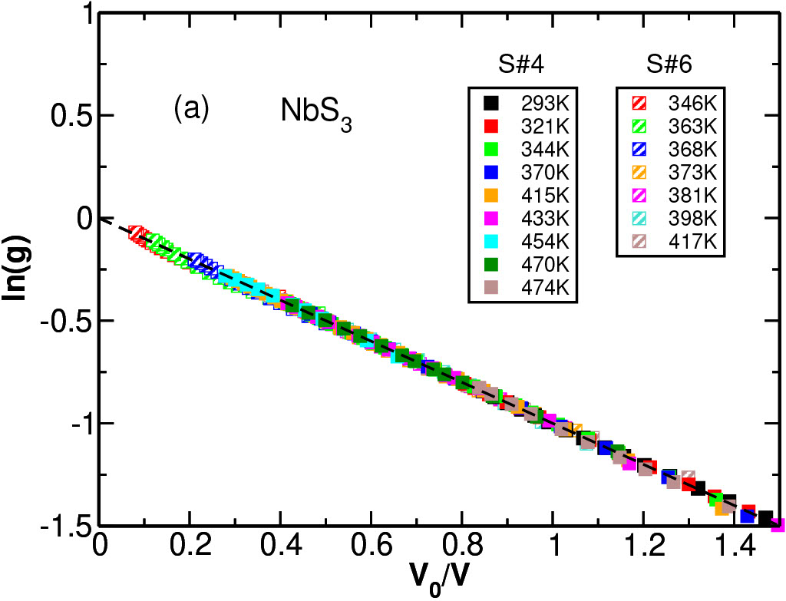
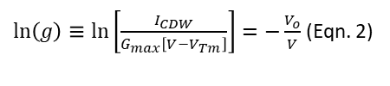
Time-Correlated Soliton Tunneling Model
One can collapse the experimental data onto a single line using equation 2 [1].
This was carried out with data for NbS3, TaS3, and NbSe3 crystals.
The plots show strongly that the points collapse to a single straight line for the temperature range 293 K to 474 K.
The data converging to a single straight line is consistent with the Bardeen-Zener tunneling curve and strongly supports quantum transport in all three crystal systems [11].
$\ln\left(g\right)≡\ln\left[\frac{I_{CDW}}{G_{max}\left[V−V_{Tm}\right]}\right]=−\frac{V_{o}}{V}$ (Eqn. 2)

Slide 8
Time-Correlated Soliton Tunneling Model
NbS3

Slide 9
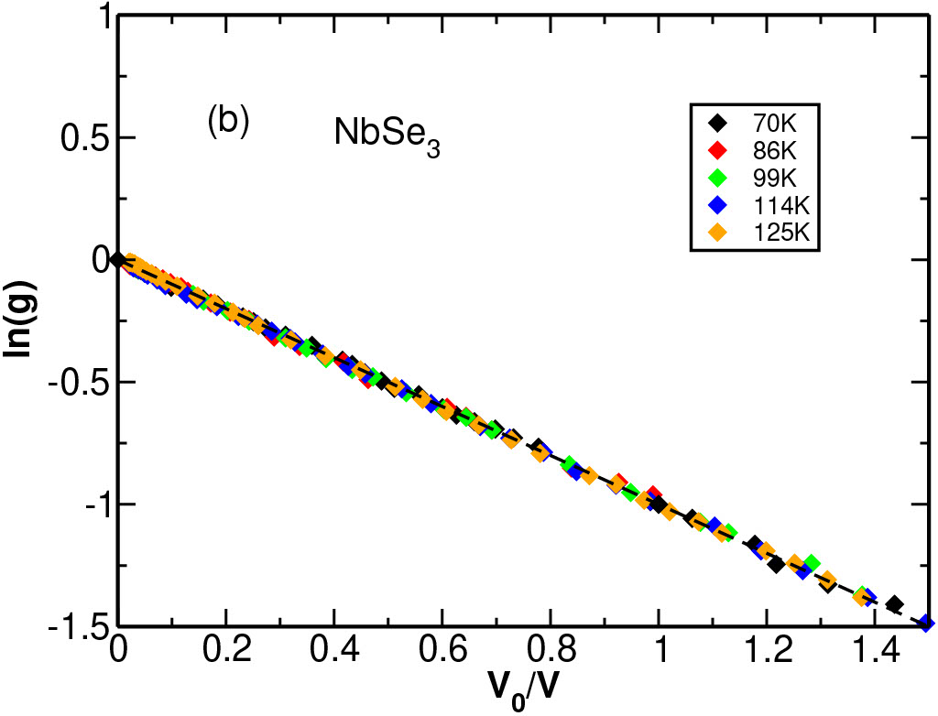
Time-Correlated Soliton Tunneling Model
NbSe3

Slide 10
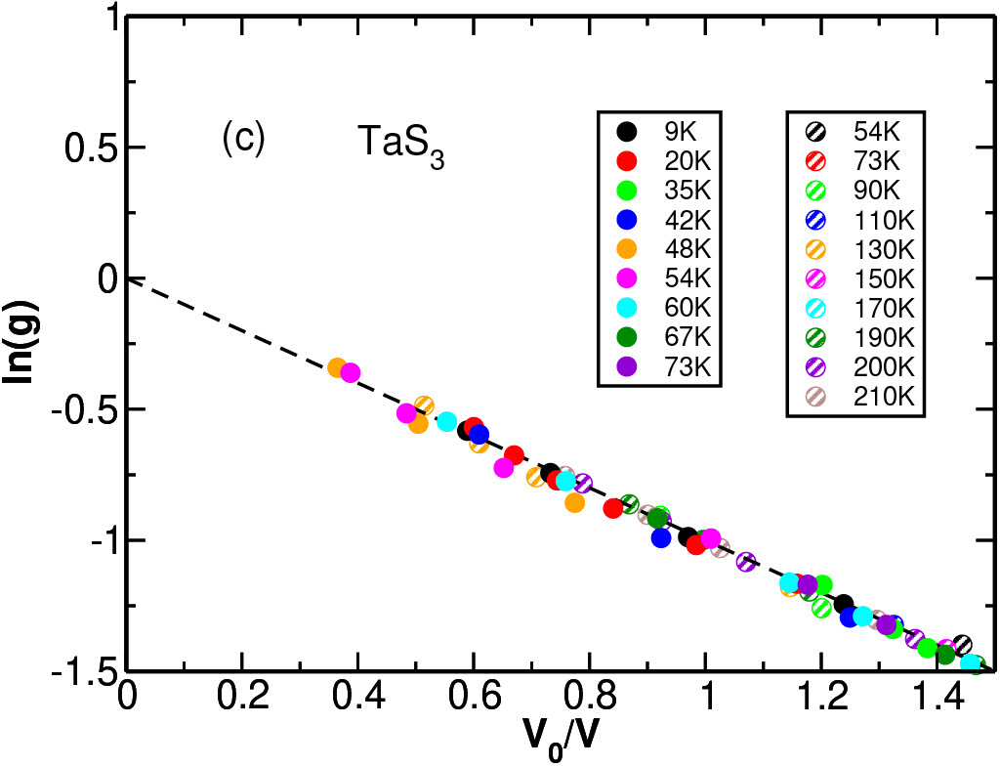
Time-Correlated Soliton Tunneling Model
TaS3

Slide 11
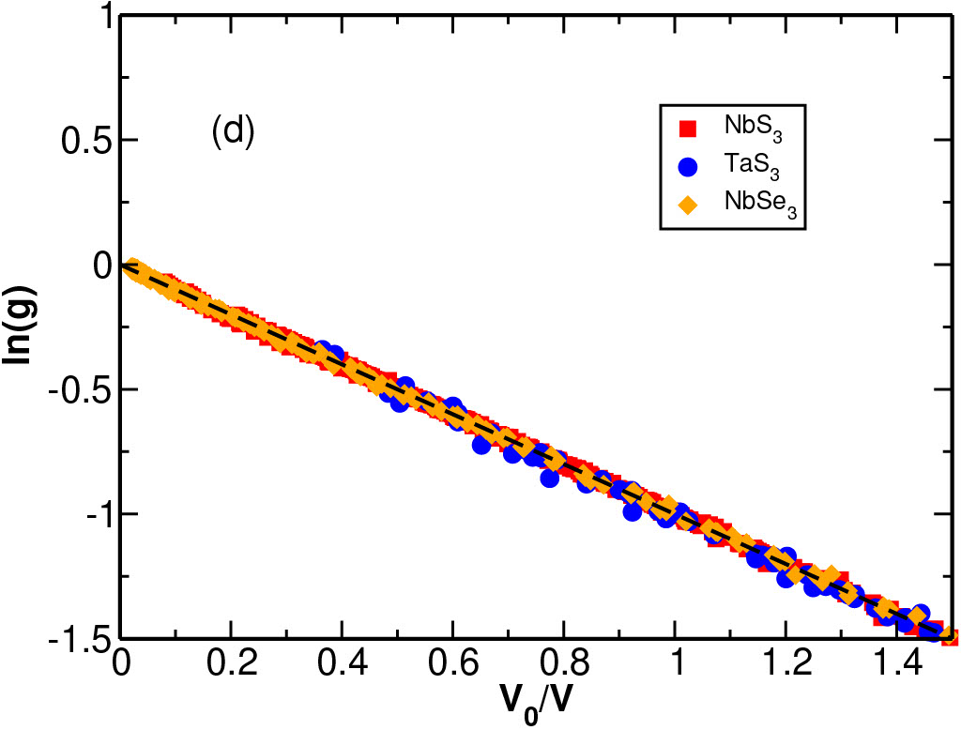
Time-Correlated Soliton Tunneling Model
Global (NbS3, NbSe3, and TaS3)

Slide 12



Charge Density Wave Research at UH
There are many experimental methods that can be applied to observe and support quantum transport of CDWs.
Nonlinear I-V characterization and differential conductance measurements.
Nonlinear direct and harmonic mixing responses.
X-Ray and Neutron diffraction experiments.
Vapor transport methods for crystal growth.
Materials Characterization (microscopy etc).

Slide 13
Thank You!
Thank you to the organizers of the Physics Research Day.
Thank you all for participating.

Slide 14
References
[1] S. G. Zybtsev, V. Y. Pokrovskii, V. F. Nasretdinova, S. V. Zaitsev-Zotov, E. Zupanic, M. A. van Midden, and W. W. Pai, Journal of Alloys and Compounds 854, 157098 (2021).
[2] P. Monceau, N. P. Ong, A. M. Portis, A. Meerschaut, and J. Rouxel, Physical Review Letters 37, 602 (1976).
[3] T. Takoshima, M. Ido, K. Tsutsumi, T. Sambongi, S. Honma, K. Yamaya, and Y. Abe, Solid State Communications 35, 911(1980).
[4] A. H. Thompson, A. Zettl, and G. Grüner, Physical ReviewLetters 47, 64 (1981).
[5] J. Dumas, C. Schlenker, J. Marcus, and R. Buder, Physical Review Letters 50, 757 (1983).
[6] Z. Z. Wang, M. C. Saint-Lager, P. Monceau, M. Renard, P. Gressier, A. Meerschaut, L. Guemas, and J. Rouxel, Solid State Communications 46, 325 (1983).
[7] J. Bardeen, L. N. Cooper, and J. R. Schrieffer, Physical Review108, 1175 (1957).
[8] J. H. Miller, A. I. Wijesinghe, Z. Tang, and A. M. Guloy, Physical Review Letters 108, 036404 (2012).
[9] J. H. Miller, A. I. Wijesinghe, Z. Tang, and A. M. Guloy, Physical Review B 87, 115127 (2013).
[10] J. John H. Miller and M. Y. Suárez-Villagrán, Applied Physics Letters 118, 184002 (2021).
[11] J. Bardeen, Physical Review Letters 45, 1978 (1980).

