Slide 1
NiMo based bifunctional catalysts for water electrolysis
Navmi Naik
Research Day
February 24, 2024

Slide 2
Outline
Water electrolysis
Bifunctional catalyst
Performance
Morphology study
Conclusion

Slide 3

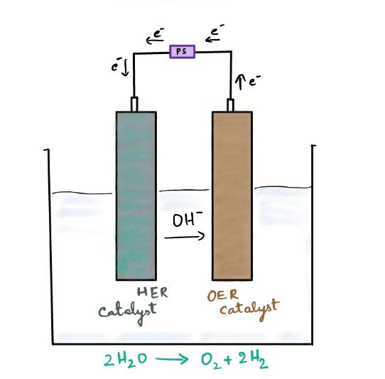
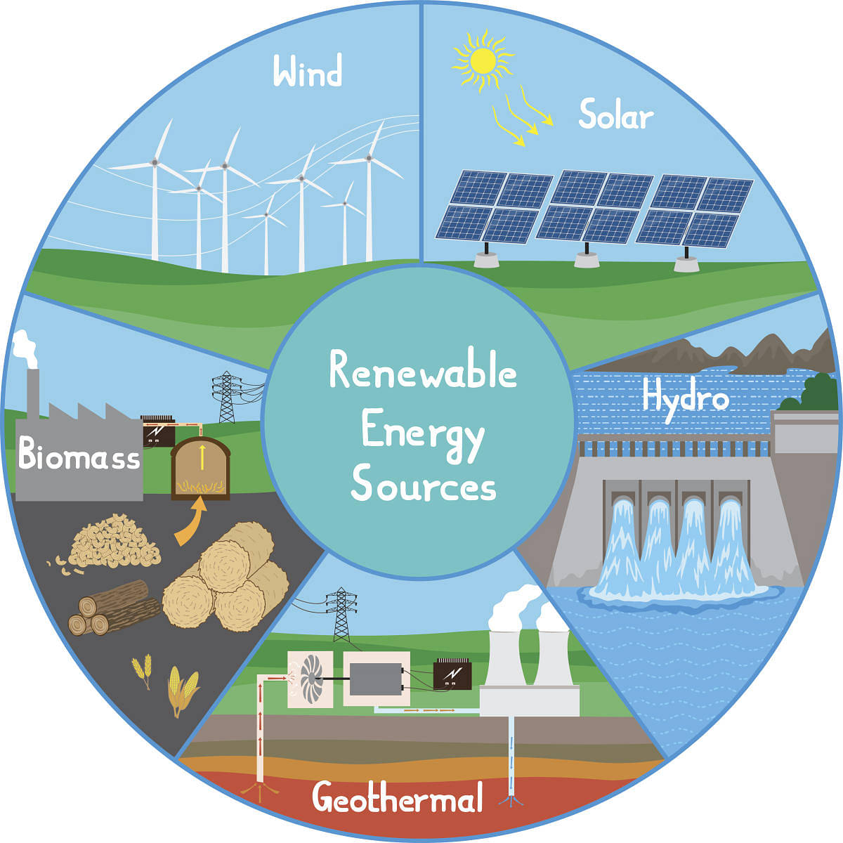
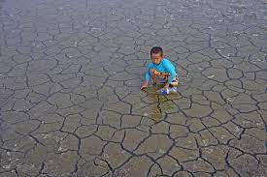
Water electrolysis
https://earth.org/countries-with-water-scarcity/

Slide 4
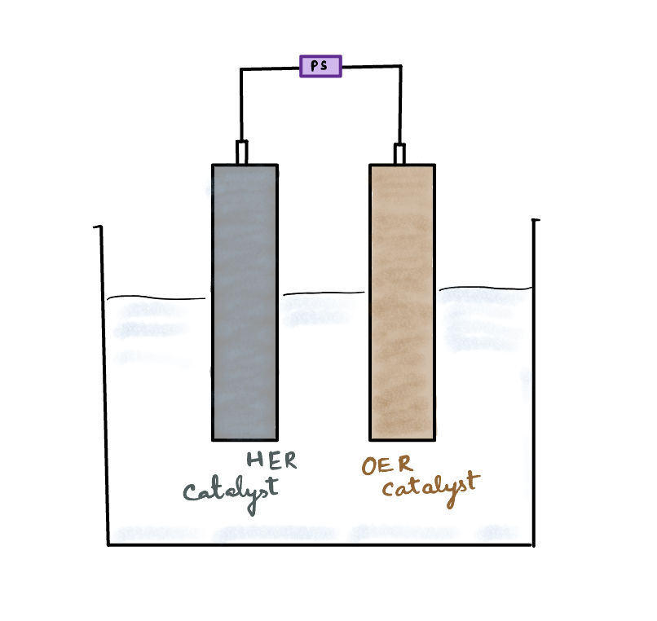
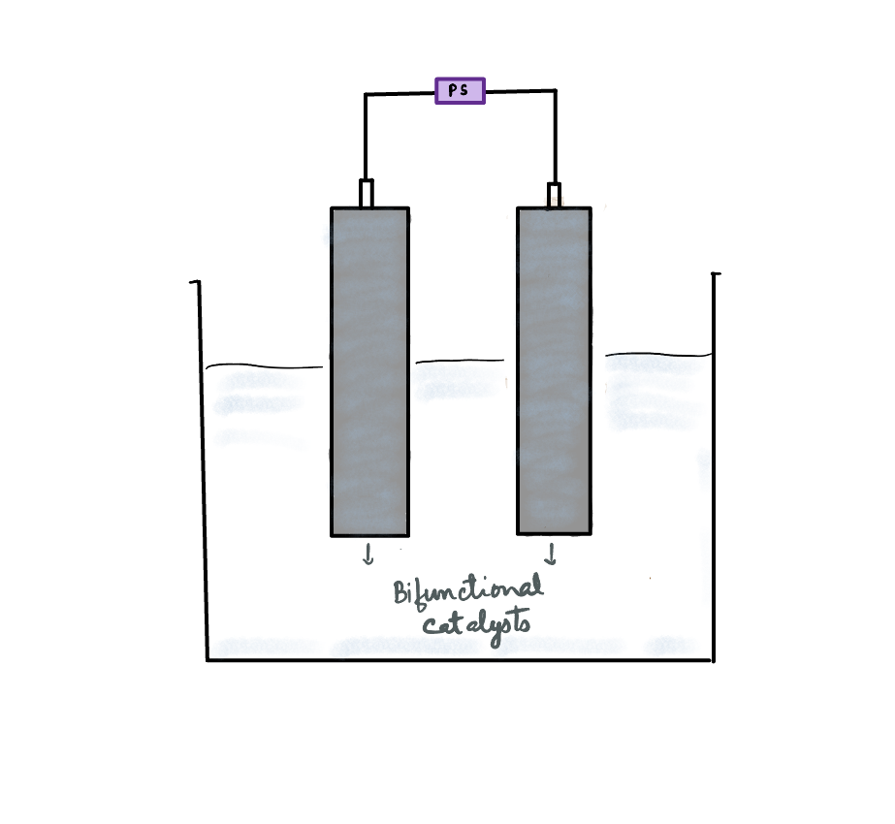
Bifunctional catalyst
HER – Hydrogen evolution reaction
OER – Oxygen evolution reaction
Bifunctional – Performs HER and OER simultaneously
Reduces cost of the technology
Simplifies the setup

Slide 5
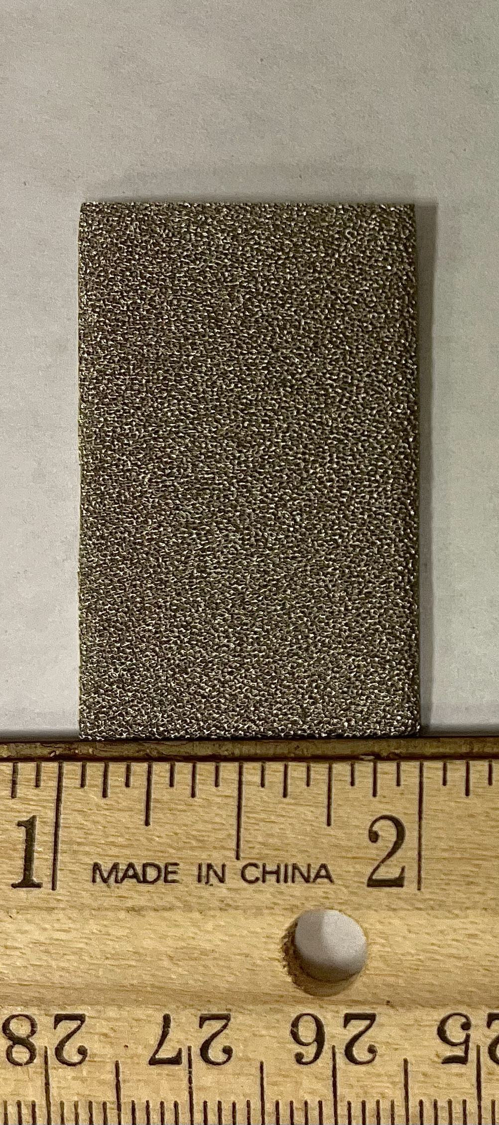
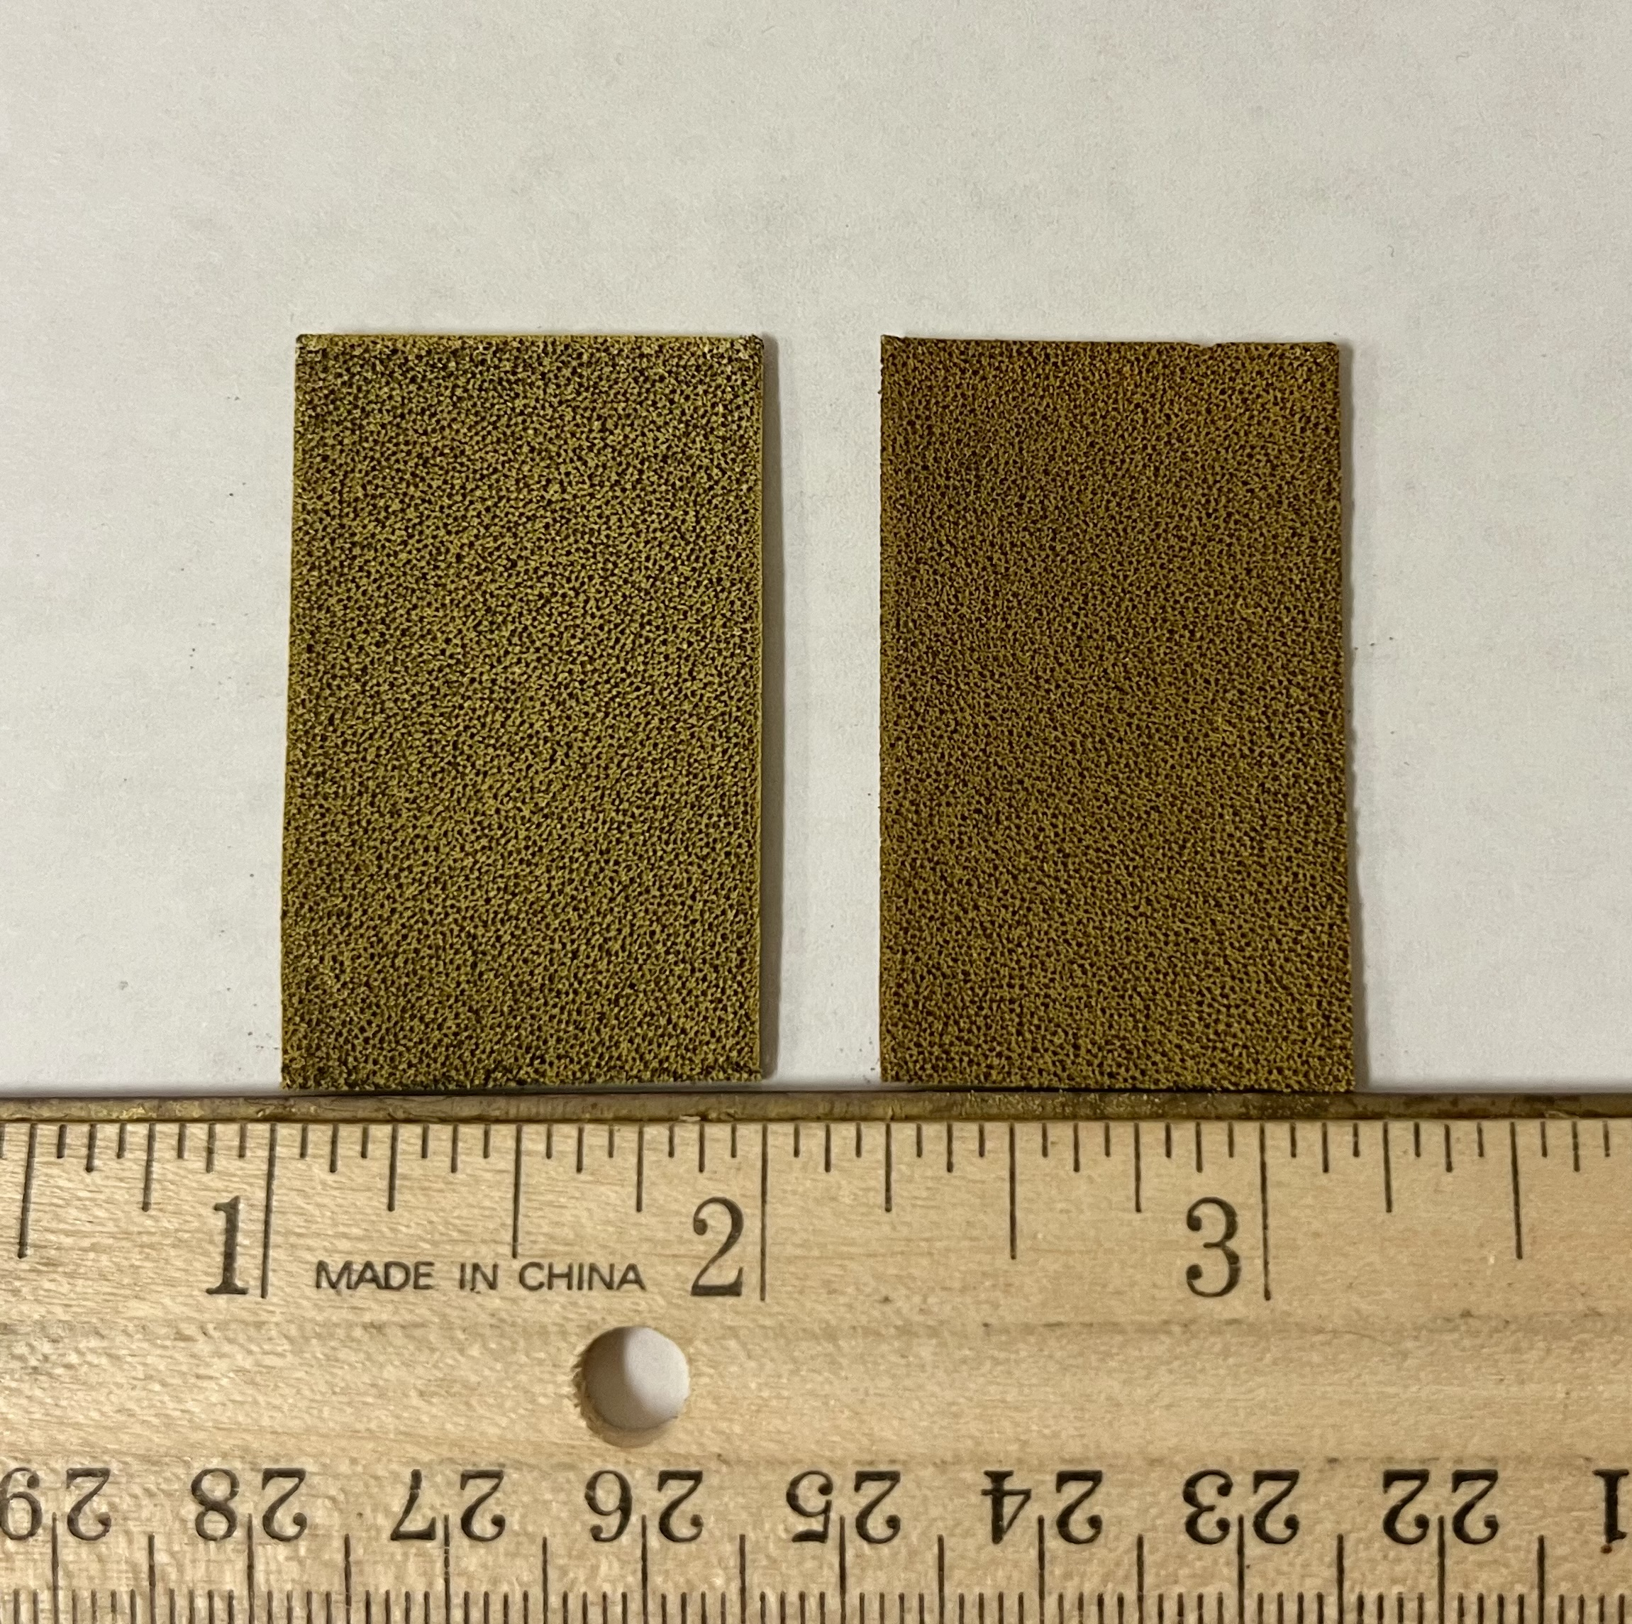
Synthesis
Substrate
Step 1
Step 2
Hydrothermal
Deposition
Annealed
NiFe/MoNi₄/MoO₂/NF
NiMo
NiFe LDH
In H₂/Ar
Immersed in a solution of Ni(NO₃)₂ and FeSO₄
for 1-5h.
Nickel Foam (NF)
NiMoO₄/NF
NiFe LDH/NiMoO₄/NF
precursor
OER
10.1016/j.mtphys.2021.100419, 2021 MTP

Slide 6
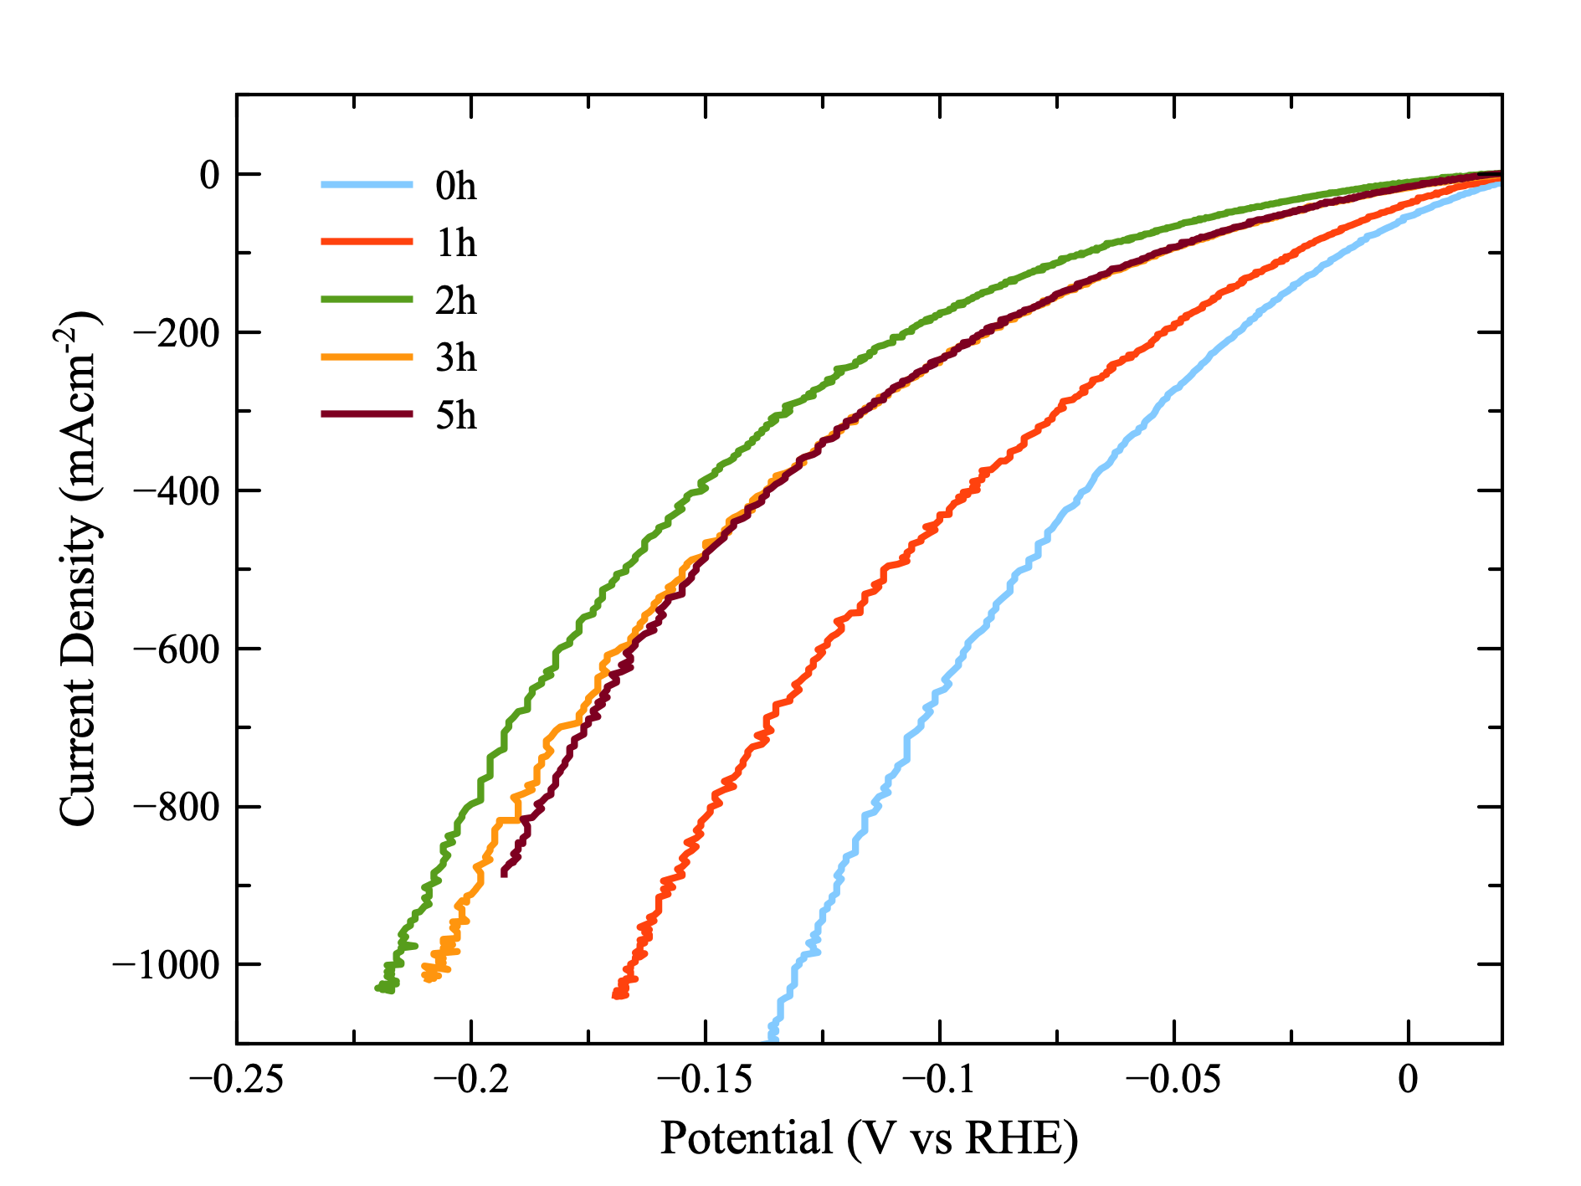
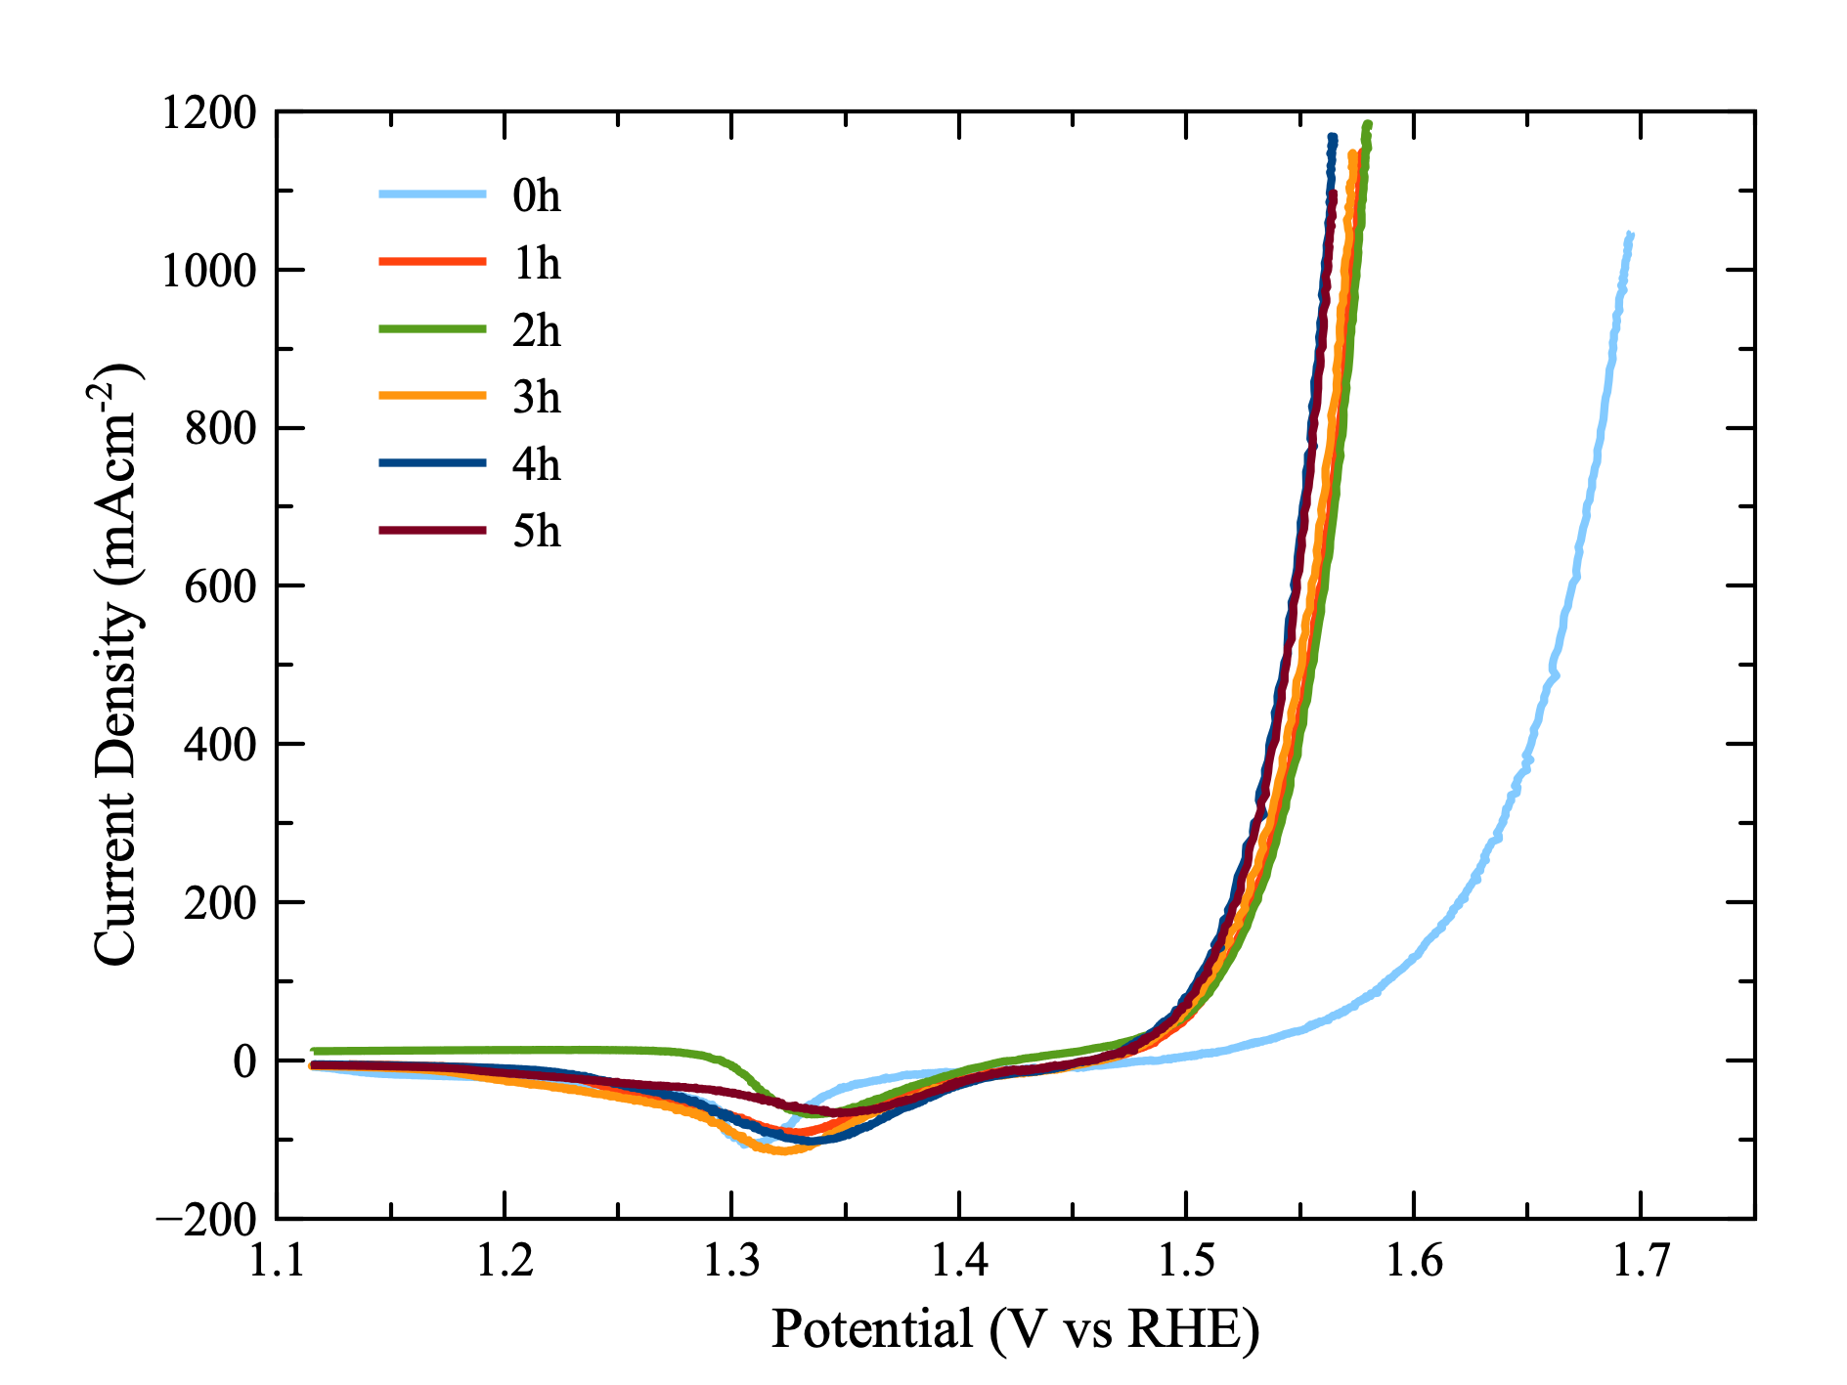
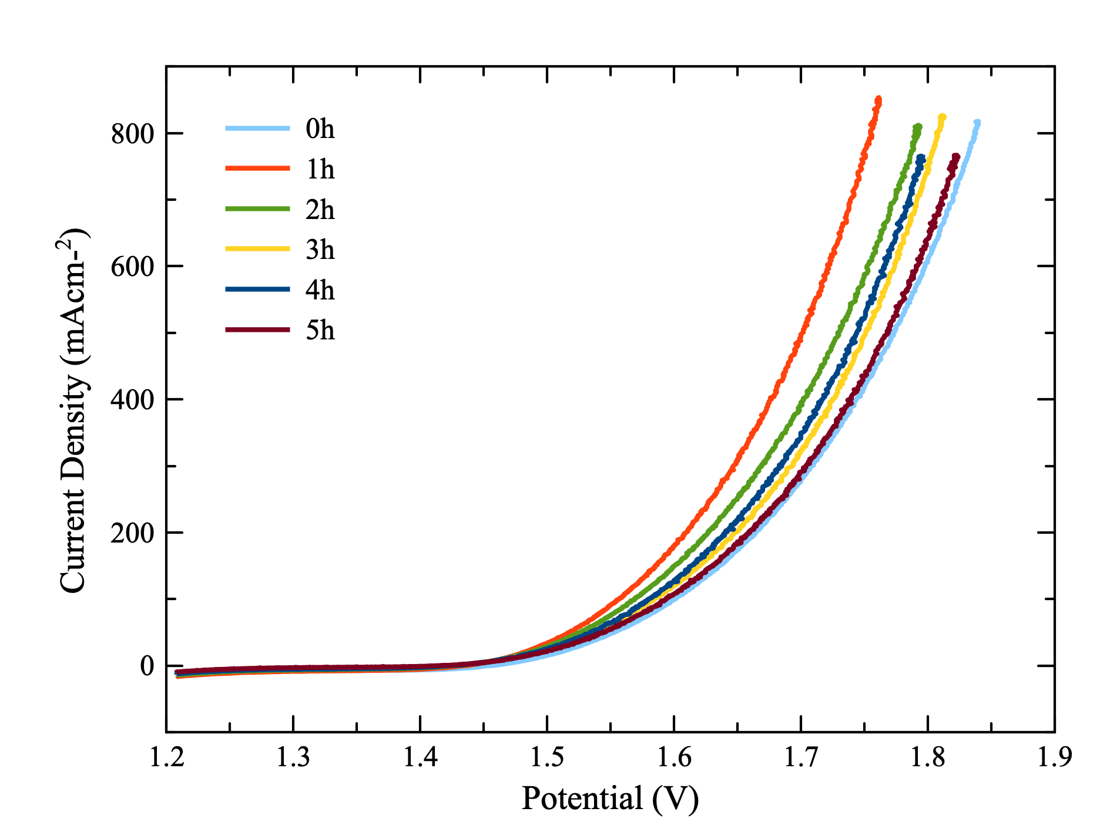
Optimizing Step 2 – OER layer
112mV
81mV
323mV
431mV
Voltage (V)
Notes:
Add Overpot for 0h and 1h. All figures on same level …resize

Slide 7
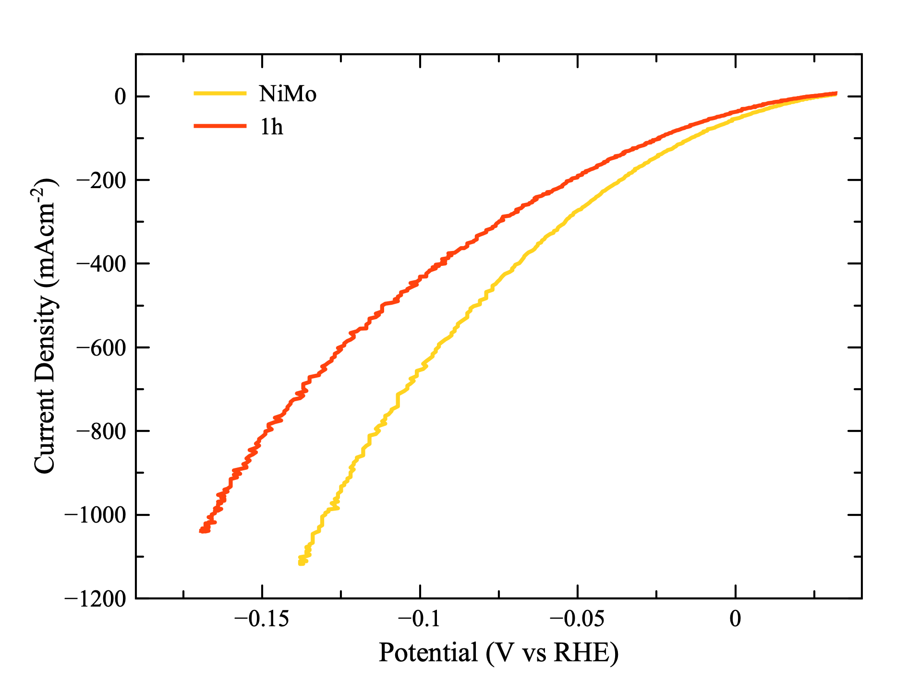
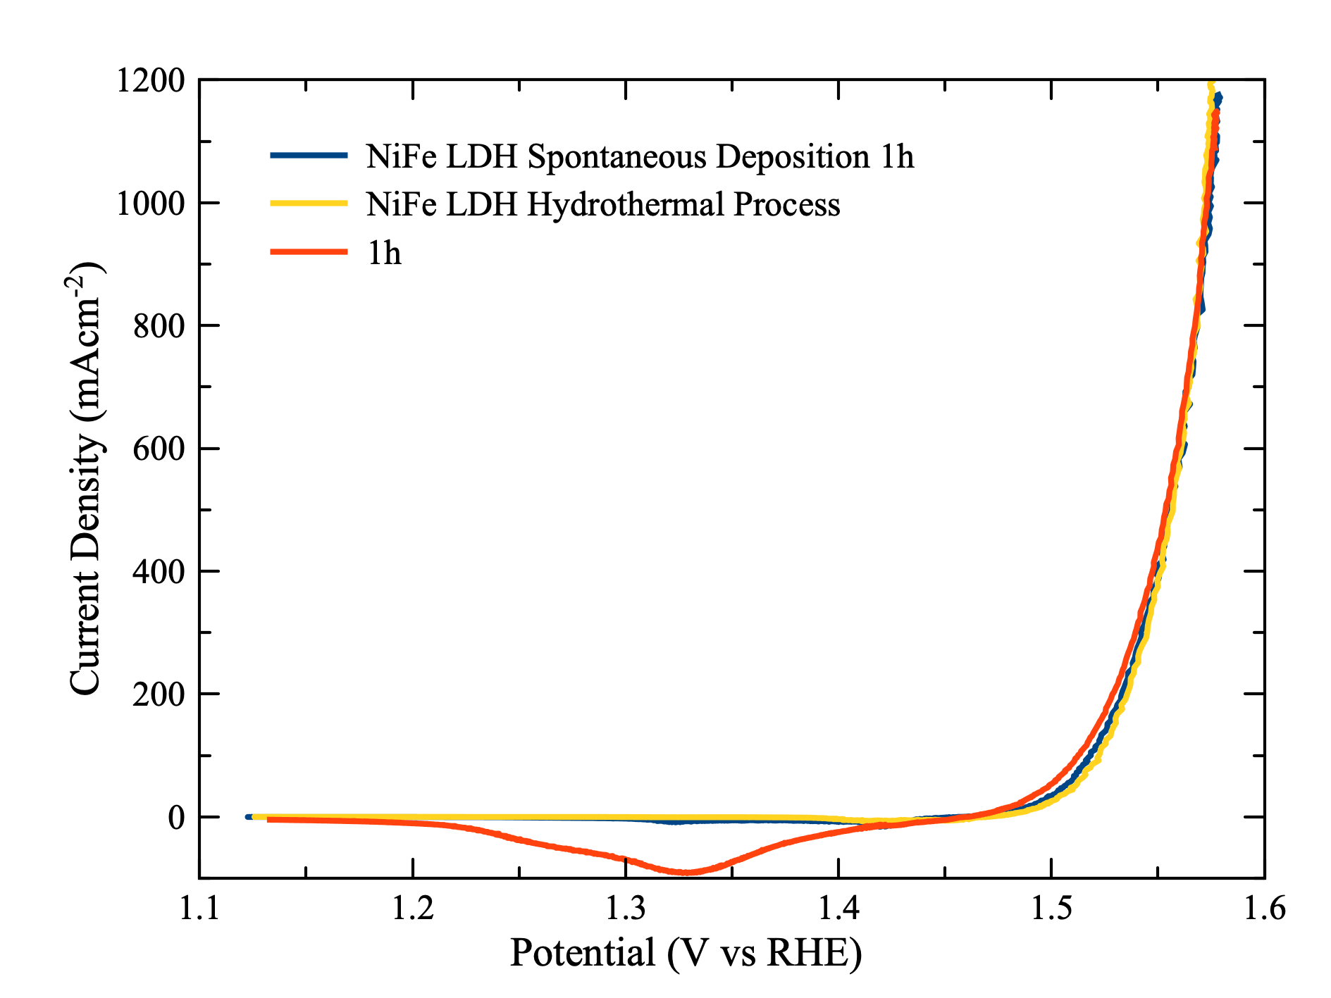
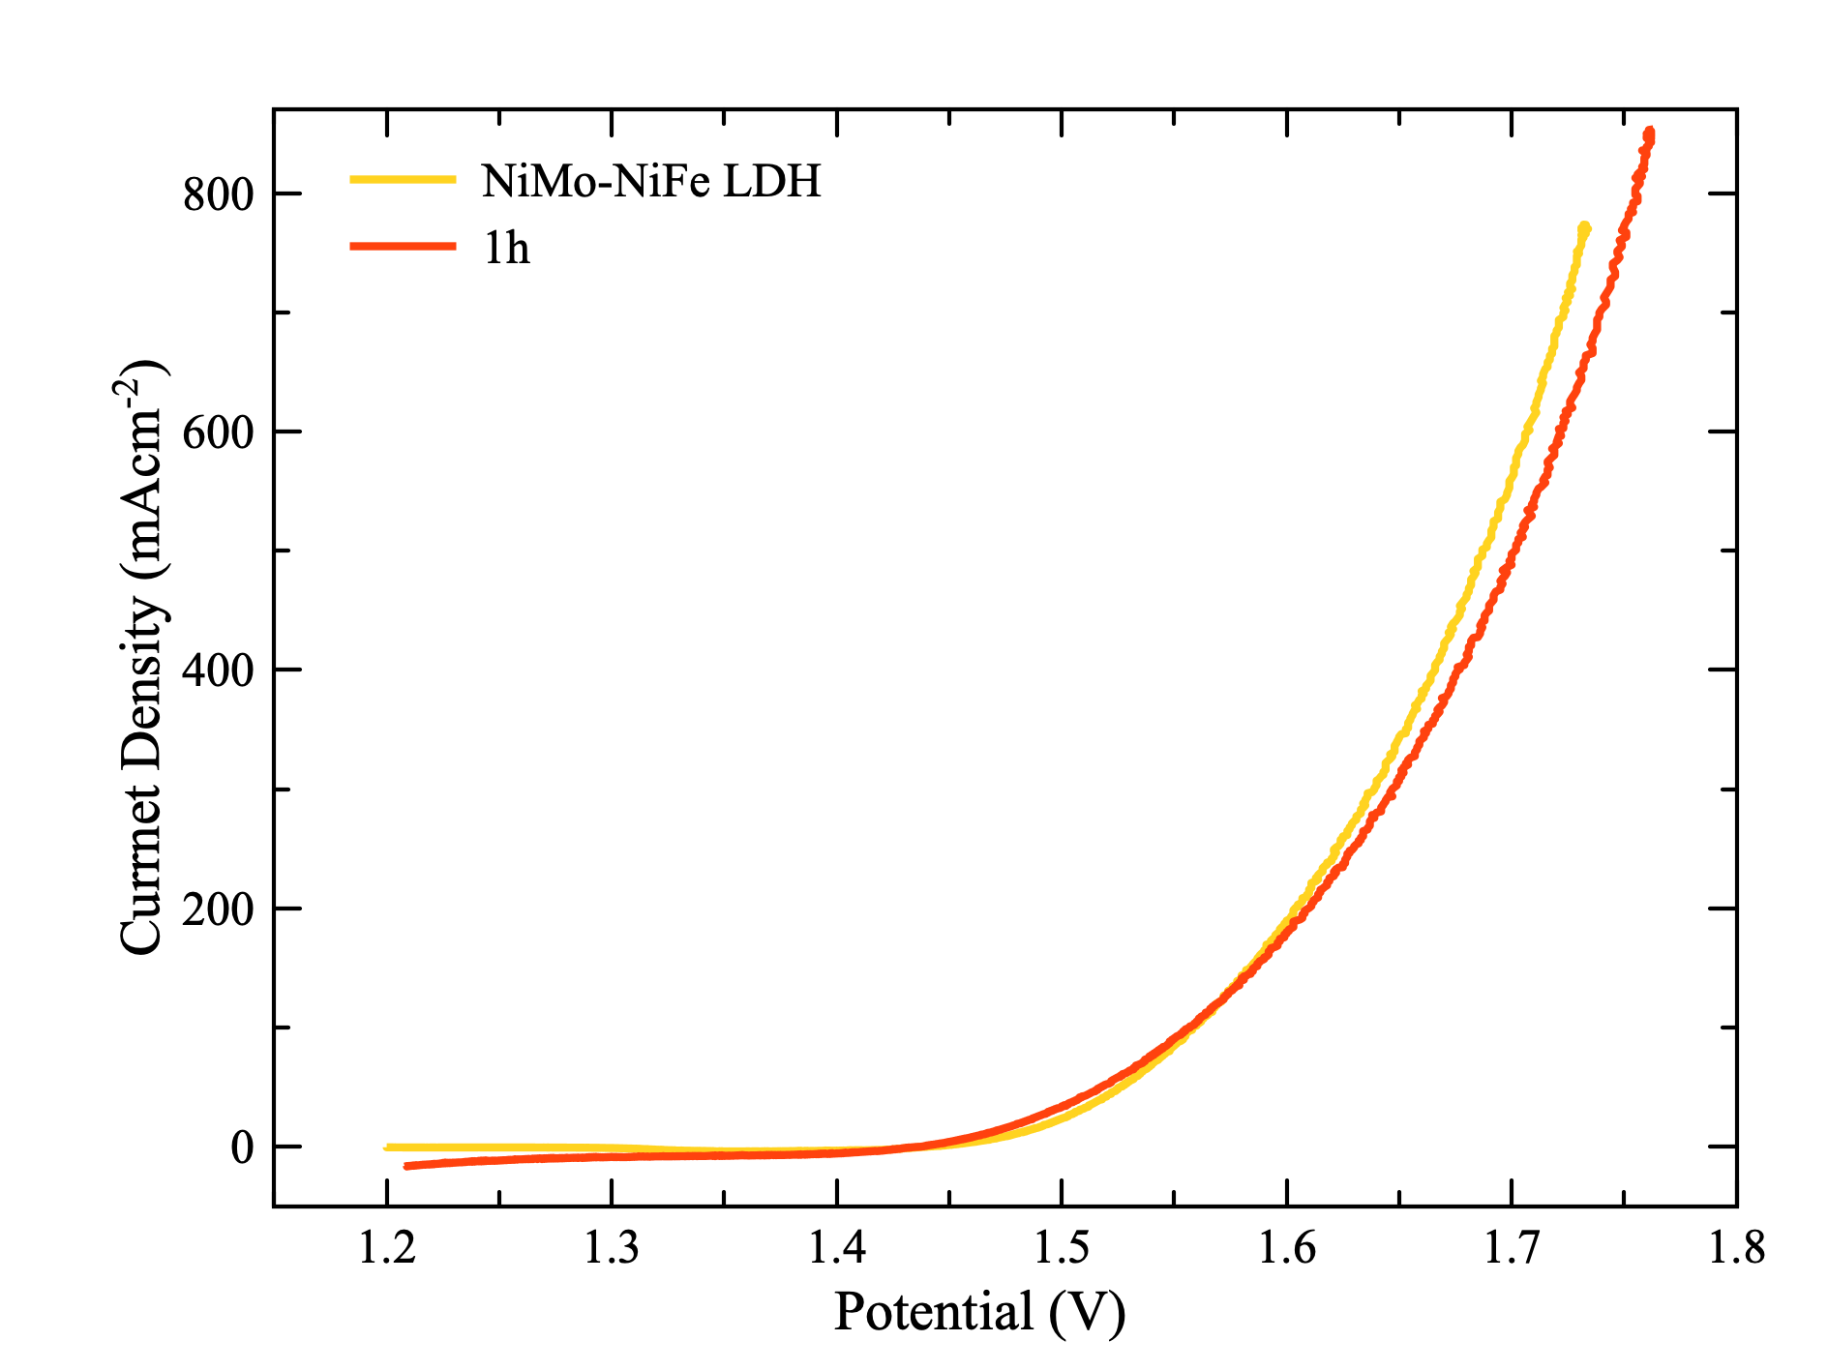
Comparison with benchmarks
Voltage (V)
Notes:
Every thing must be inside.

Slide 8
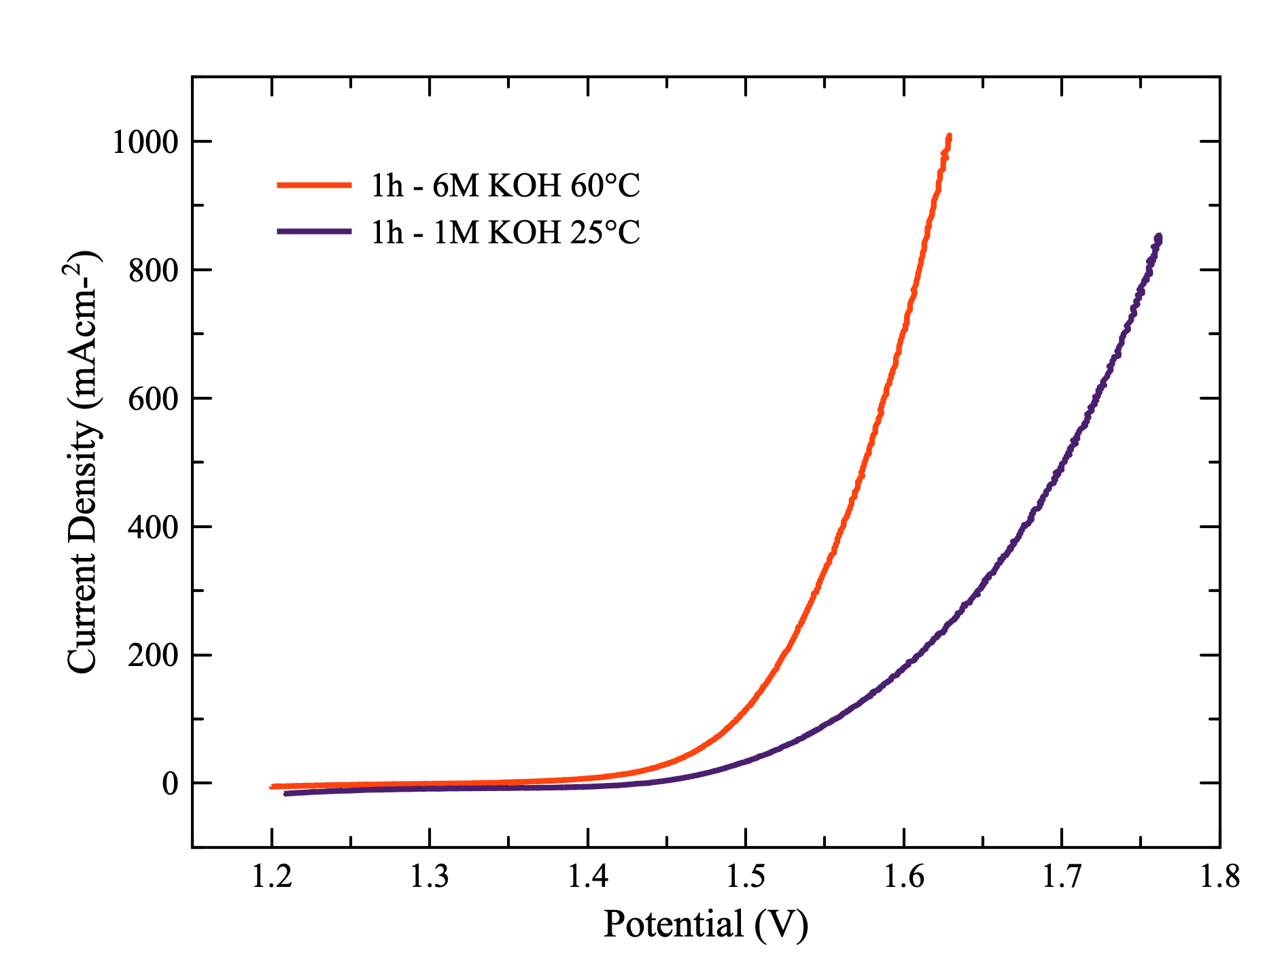
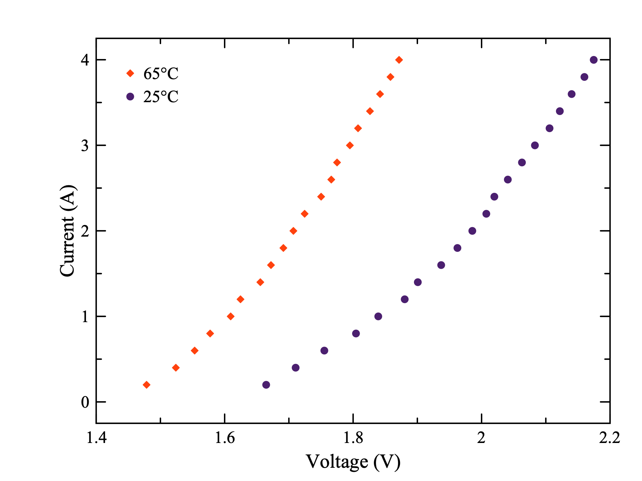
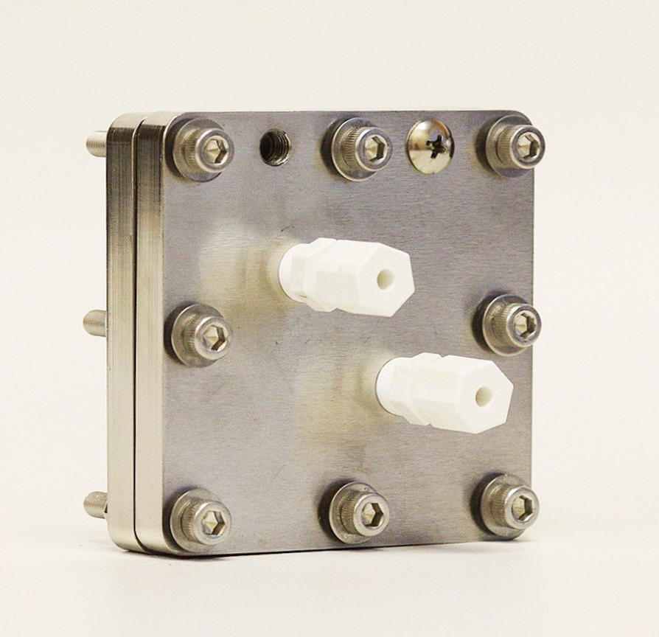
Tests under industrial conditions
1.63V
1.87V
0.5x0.5cm²
2x2cm²
Voltage (V)
Beaker electrolyzer
AEM electrolyzer
With IR compensation
Without IR compensation
Notes:
IR compensation with and without.
Why left better than right … IR compensation. Wtrite it out
Mention working area left panel
Substrate NF
Beaker electrolyzer, AEM electrolyzer

Slide 9
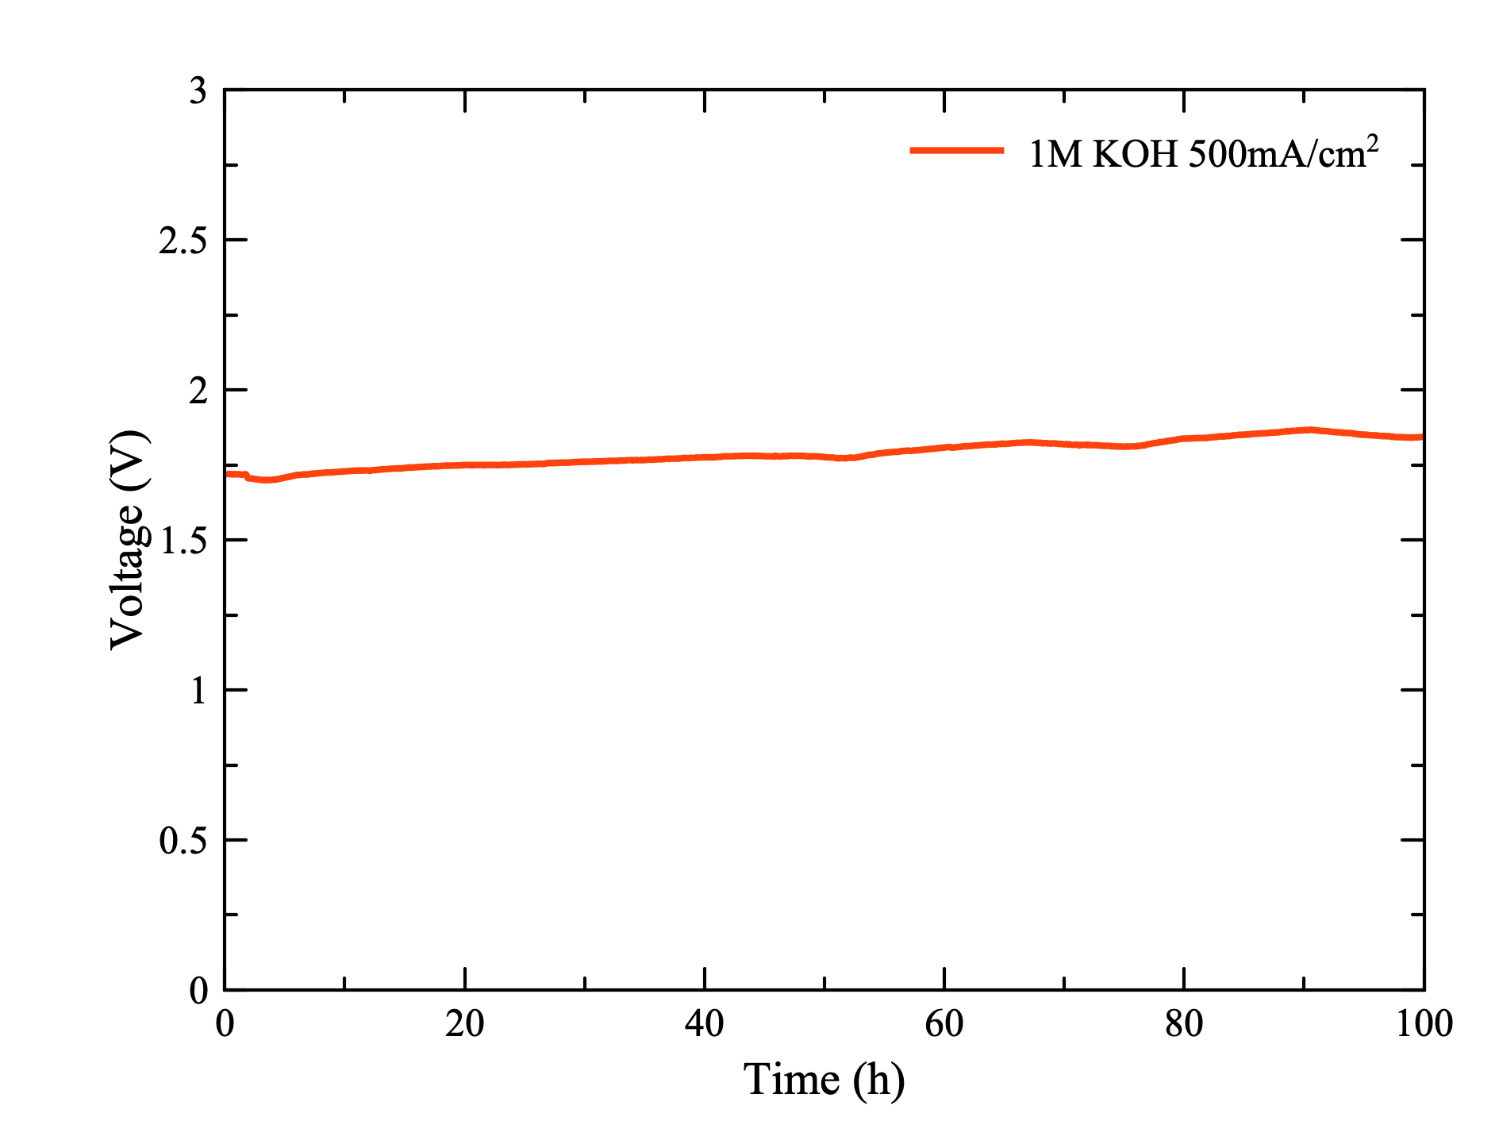
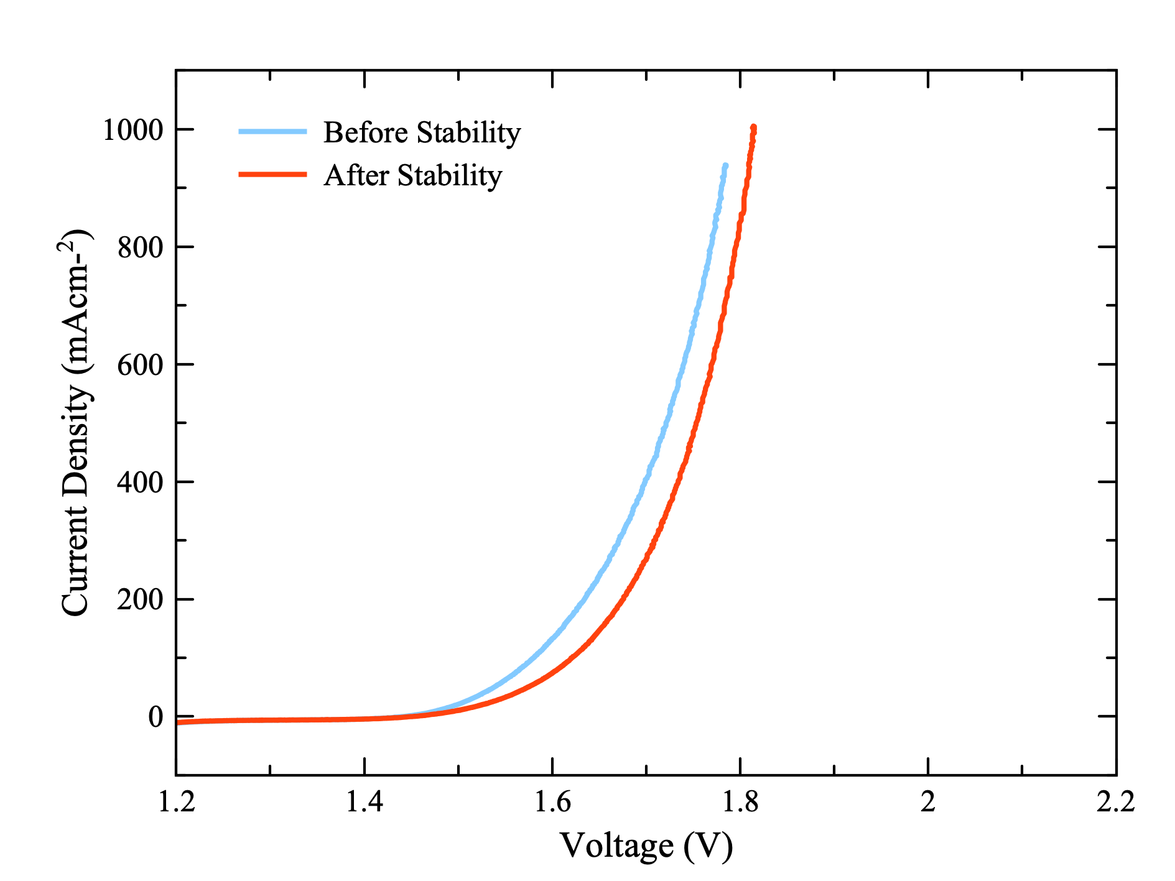
Stability
∆ = 30mV
Notes:
Dashed line to show difference on left panel.. Differnece 123mV…….. Remove dashed line

Slide 10
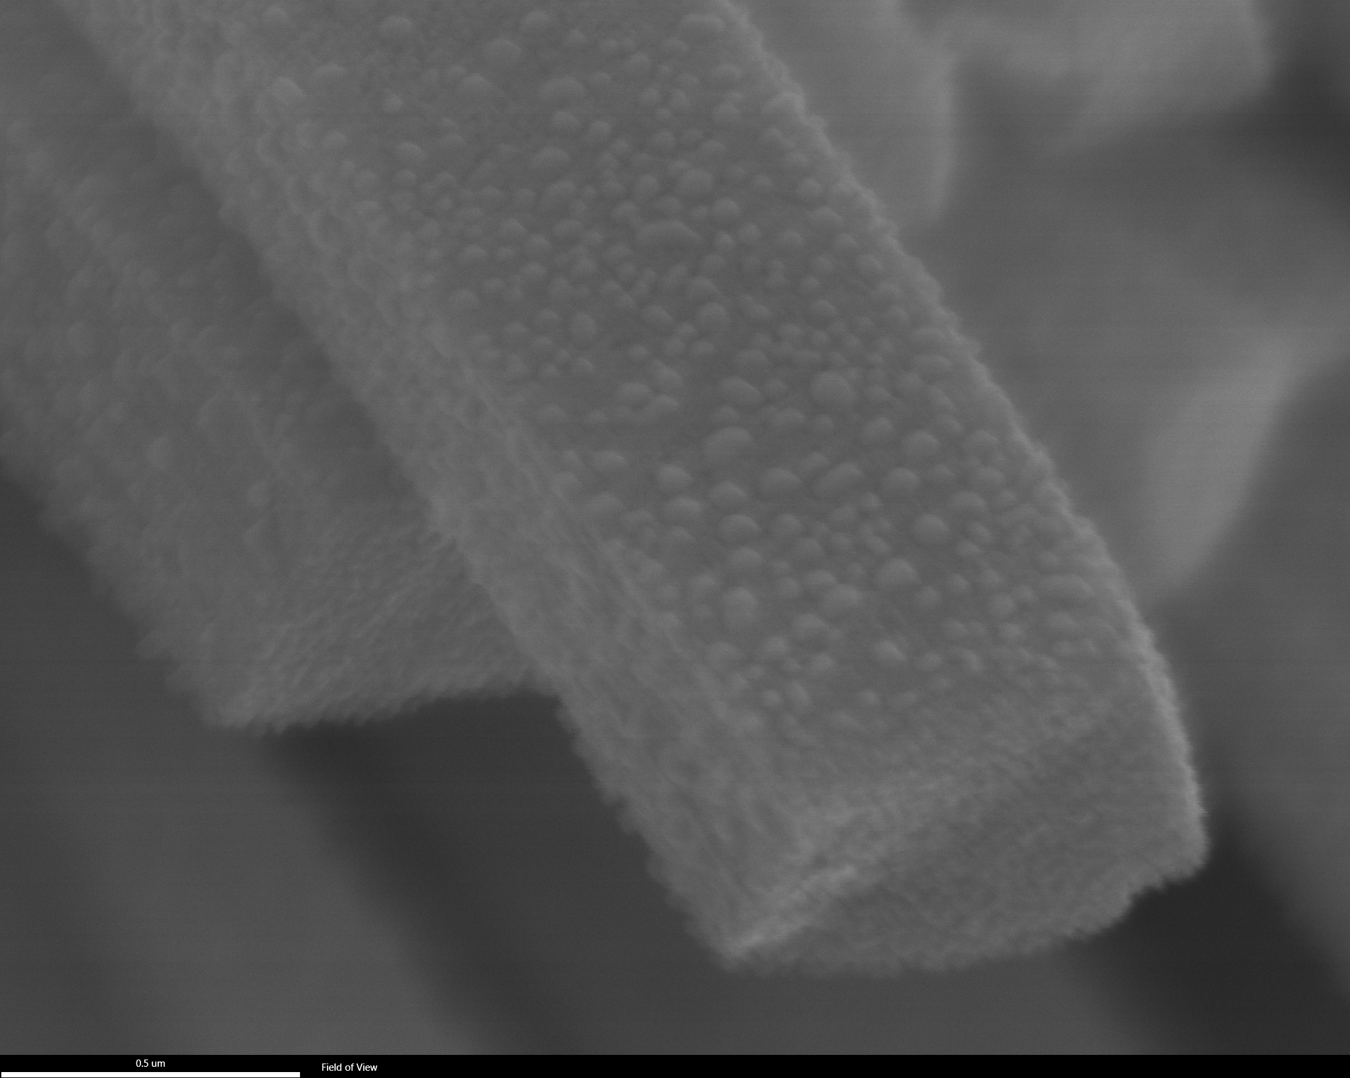
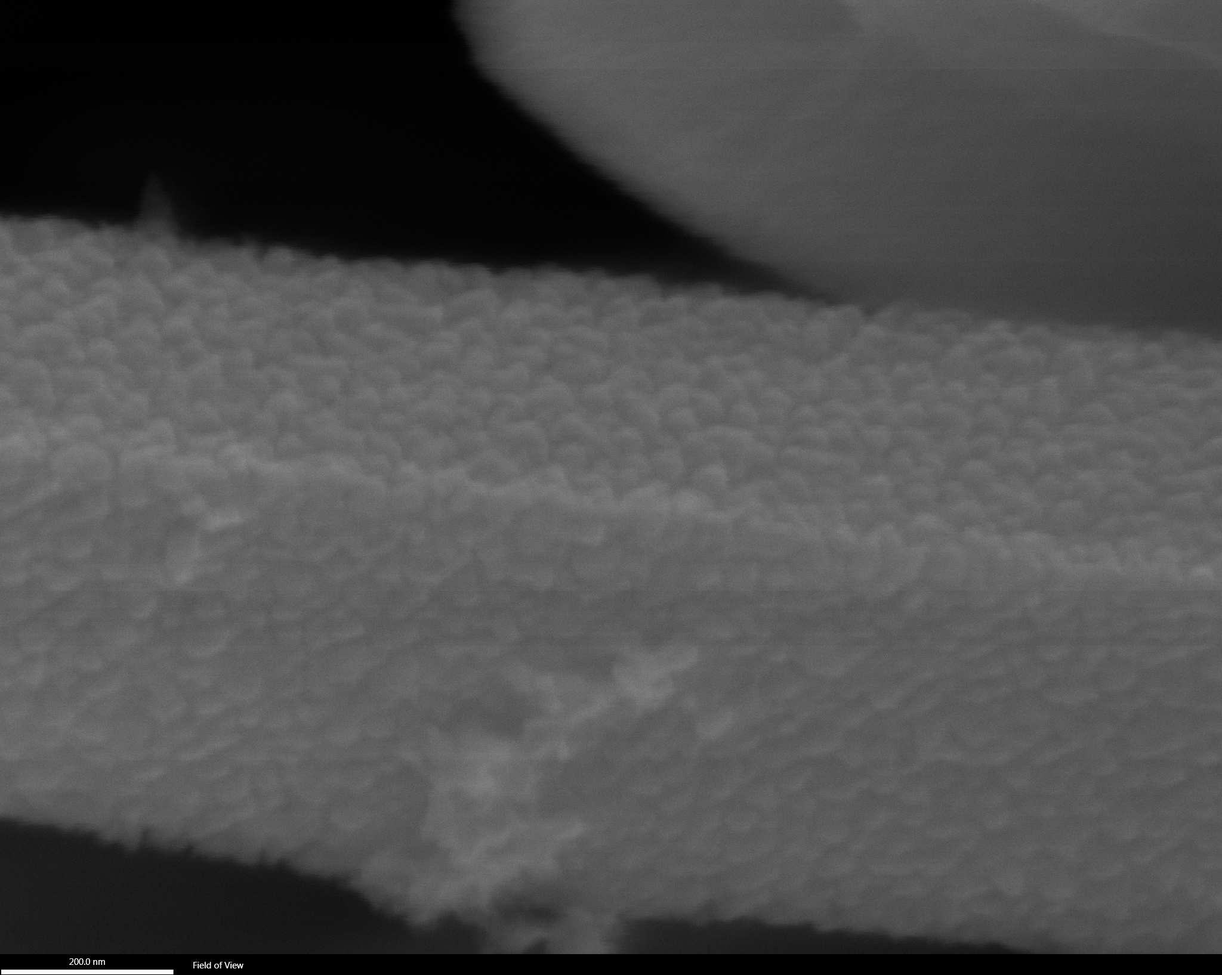
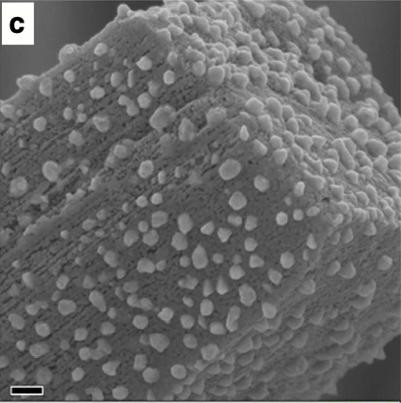
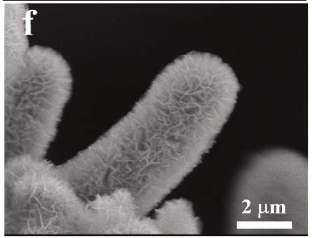
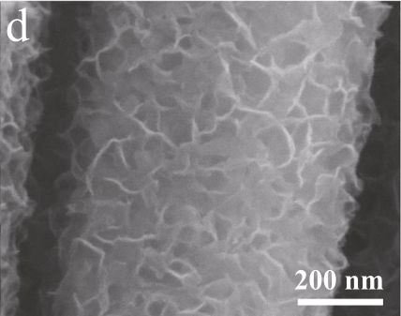
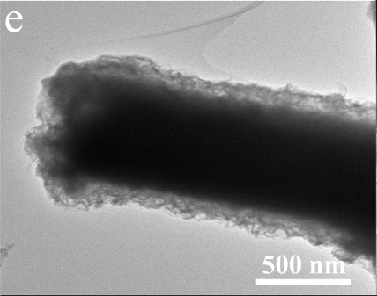
Morphology
0h
1h
0.5 µm
200 nm
10.1038/ncomms15437 Jian Zhang, 2017
Panlong Zhai, 2023
https://doi.org/10.1016/j.mtphys.2022.100841
Fanghao Zhang, 2022
https://doi.org/10.1038/s41467-023-37091-x

Slide 11
Conclusions and further research
A bifunctional catalyst with performance comparable to benchmarks was synthesized.
An industrial AEM electrolyzer was built.
The catalyst was found to be stable for over 100h.
Future work will focus on improving the performance further using different methods, especially with electrodeposition to build a core shell structure.

Slide 12
Acknowledgements
Dr. Zhifeng Ren
Dr. Dezhi Wang
Minghui Ning
Yu Wang
Dr. Luo Yu
Thank you!

Slide 13
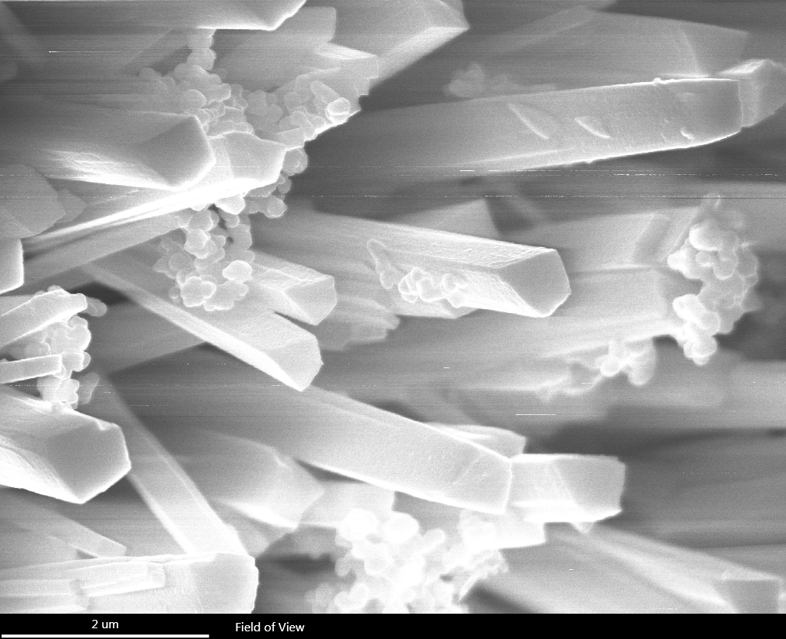
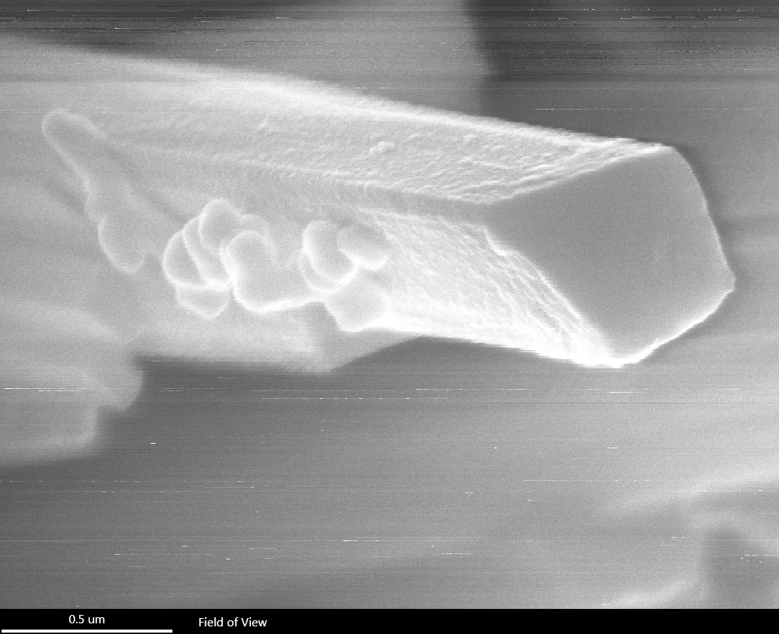
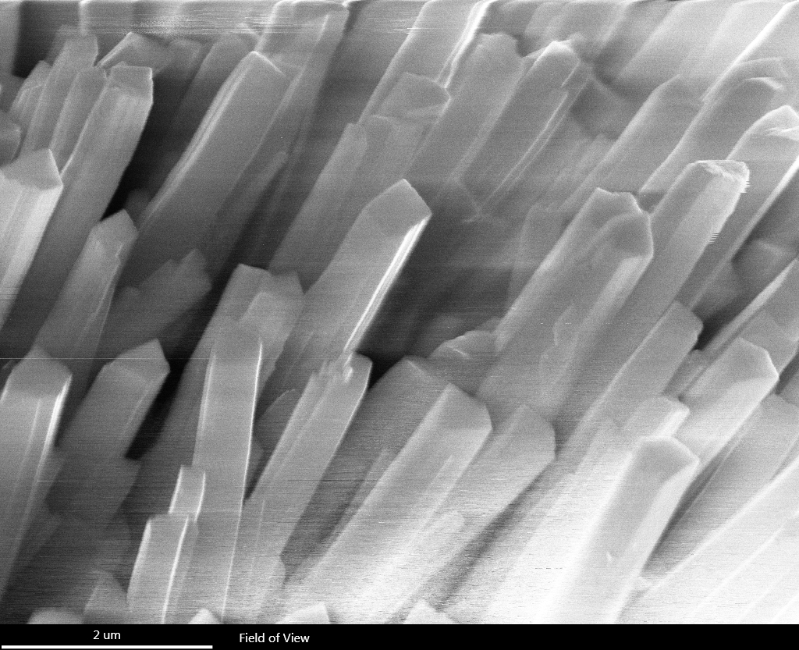
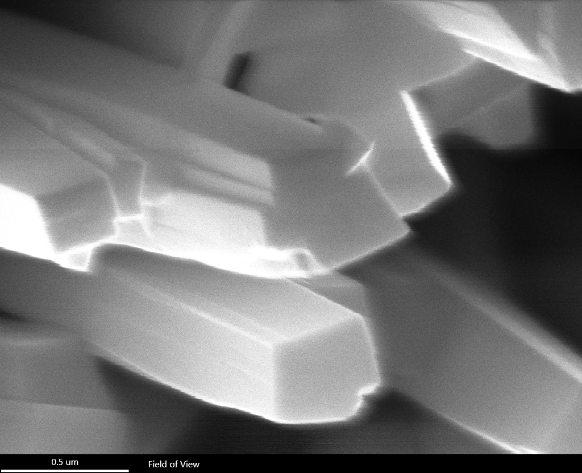
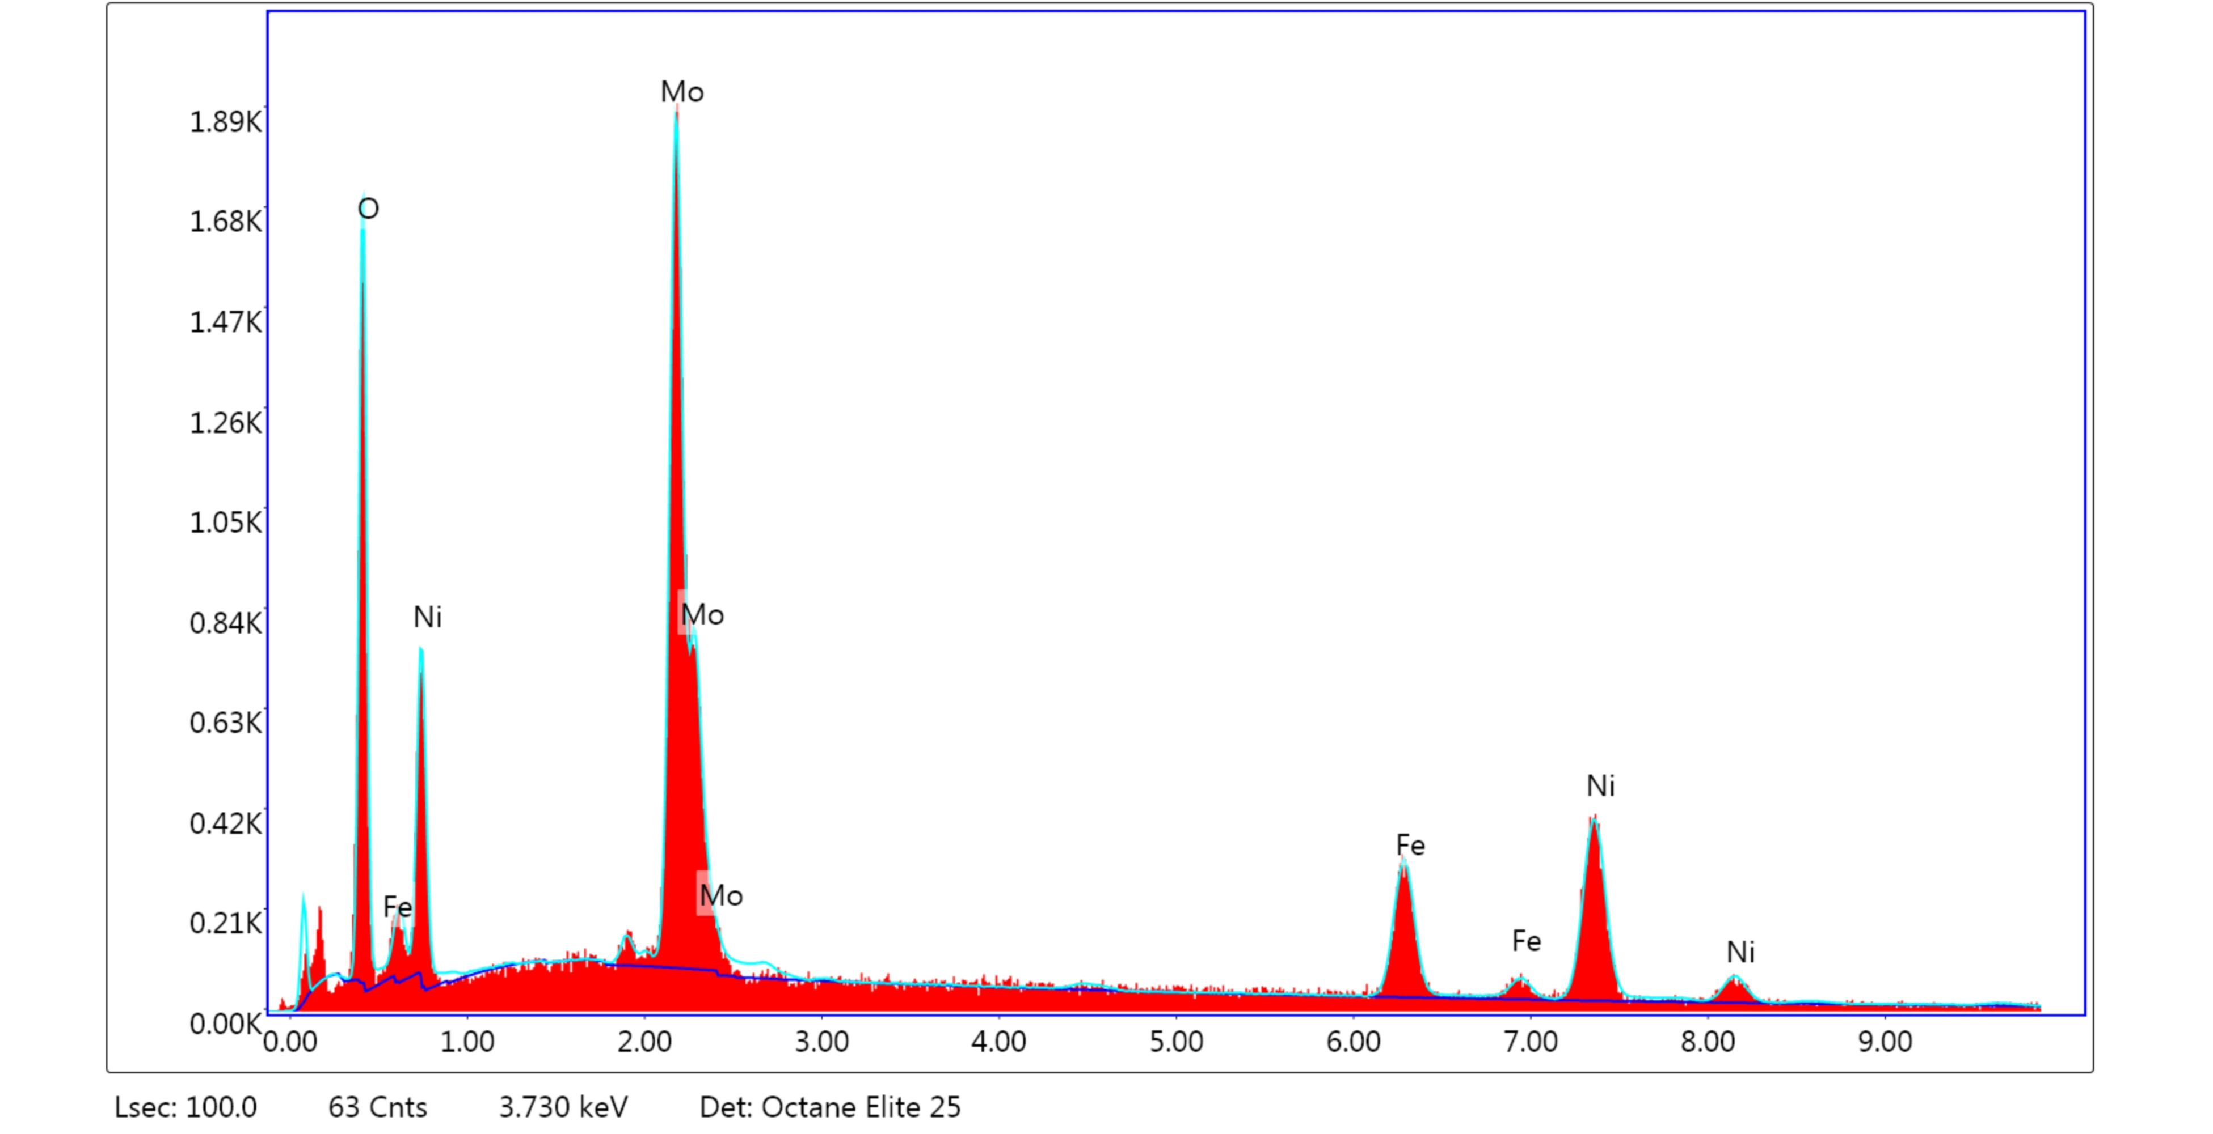
Supplementary information
1a
1b
NiMoO₄
^{NiFe LDF/NiMoO}₄
0a
0b
 | O | Mo | Fe | Ni
At. % | 19.2 | 33.1 | 14.9 | 32.9
Wt. % | 50.5 | 14.5 | 11.2 | 23.6
Electrodeposition?
Notes:
Remove figure 2x5

