Slide 1
Thermoelectric Properties of N type Mg₃Bi₂-N type Bi₂Te₃ Composites
Junaid Ur Rehman

Slide 2

Outlines
Introduction
Applications
Characterization and Results
Conclusion

Slide 3
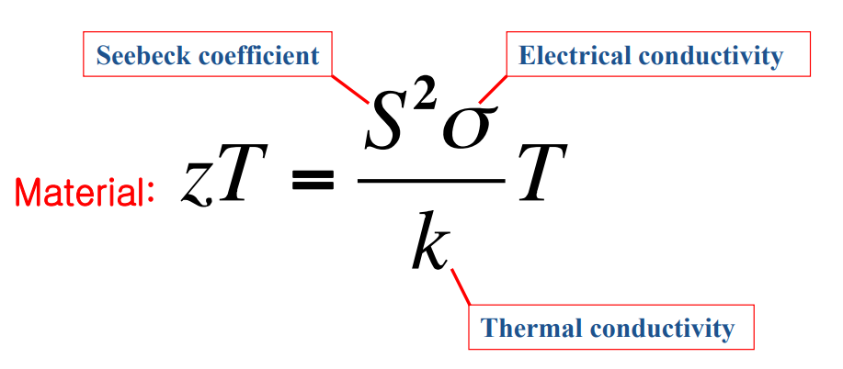
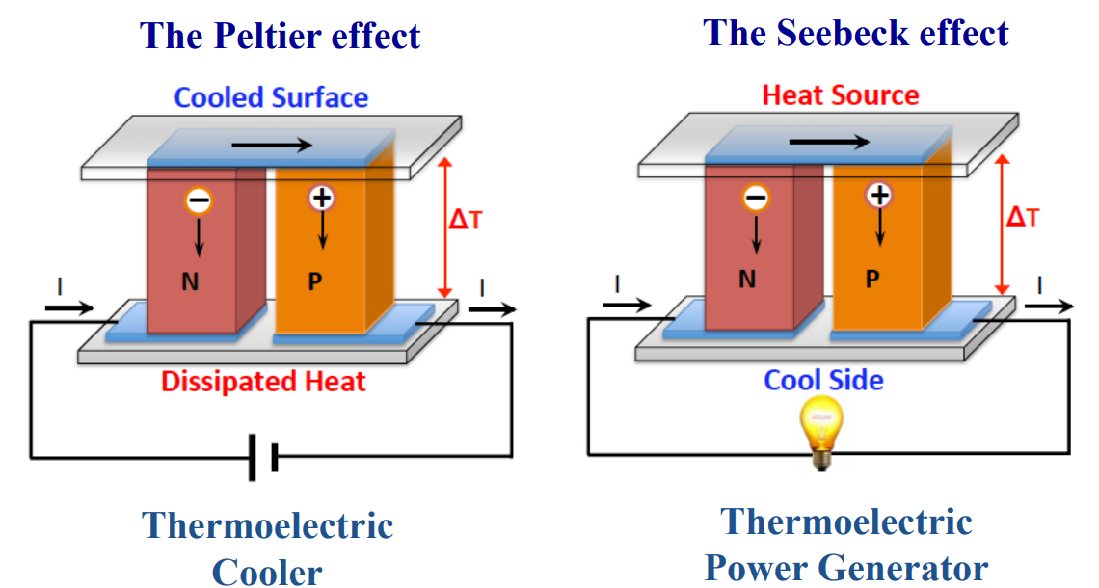
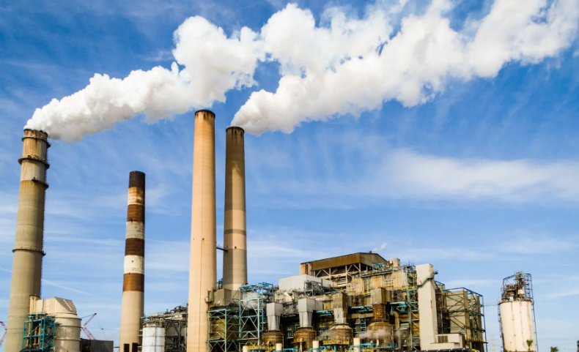

Introduction
1. Basic Principles
2. Figure of Merit
3. Motivation
Power stations
65% of energy wasted to environment
Green house effect

Slide 4

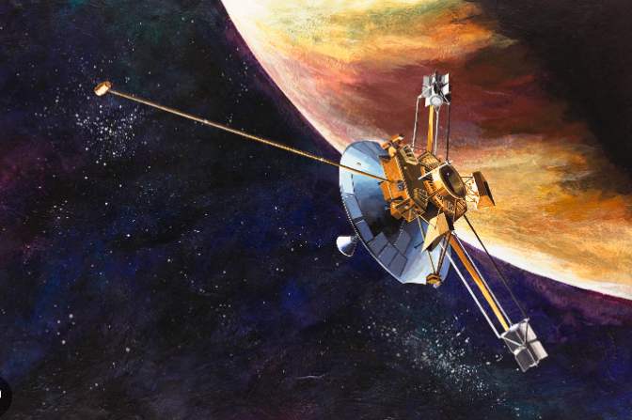
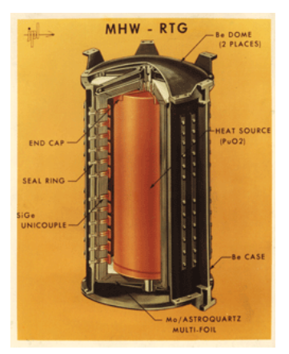
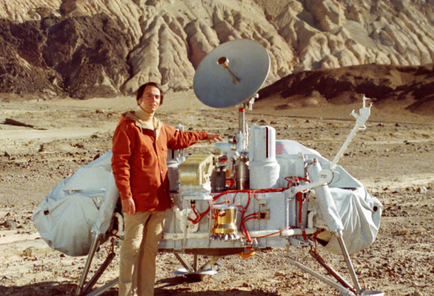
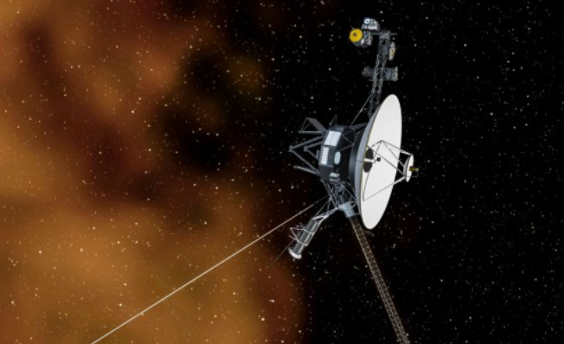
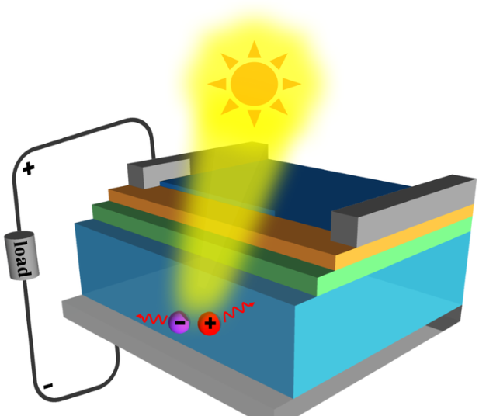
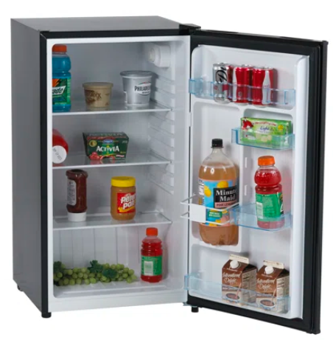
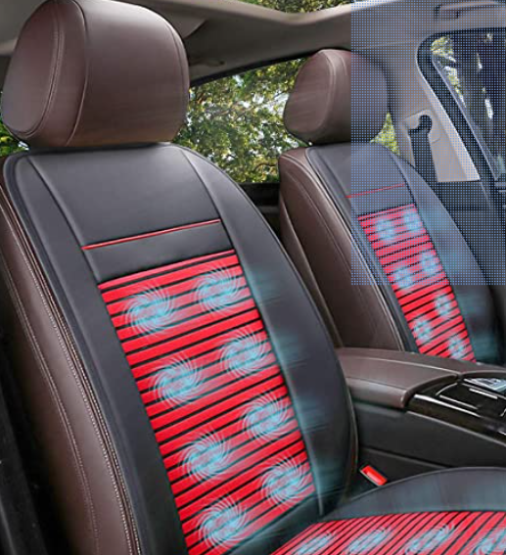
Applications
Apollo-I
Pioneer
1. Radioisotope Thermoelectric Generator(RTG)
Used by NASA
Viking
Voyager-I
2. Niche applications for solid state Technology
Peltier coolers based on Bi₂Te₃-Sb₂Te₃ used for
Optoelectronic devices
Small refrigerators
Seat heat and cooling system

Slide 5
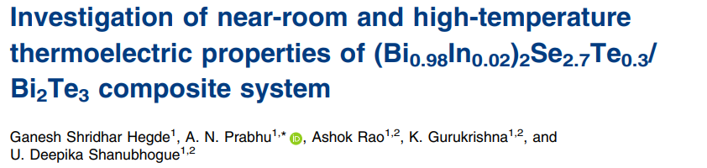
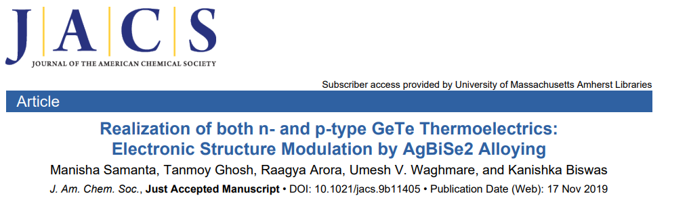
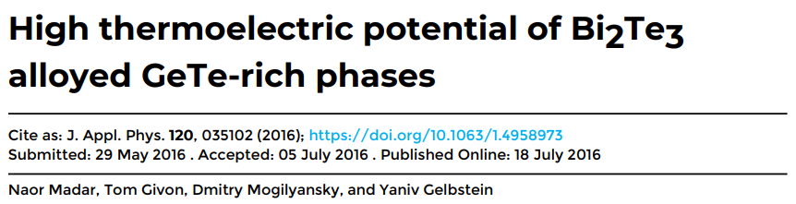
Why I choose Composite?

Slide 6
N type-N type makes N-type Composites
N type
N type
Mg_{3.2}Bi_{1.498}Sb_{0.5} Te_{0.002}
Bi₂Te_{2.7}Se_{0.3}
(1-x)(Mg_{3.2}Bi_{1.498}Sb_{0.5} Te_{0.002} + x(Bi₂Te_{2.7}Se_{0.3}) Composite
N type Composite
Mixing after Hot Pressing
Direct Mixing Method

Slide 7
Mixing after Hot Pressing
Step 1
Step 2
Bi₂Te_{2.7}Se_{0.3}
Mg_{3.2}Bi_{1.498}Sb_{0.5} Te_{0.002}
Powder 1
Powder 2
The Tube in furnace for 12hrs at 750⁰C
Ball milling for 8 hrs
Mixing in mortar for 5 mins
Ball Milling for 6 mins
Hot Pressing at 750⁰C for 5 mins
Hot Pressing at 700⁰C for 5 mins
Hot Pressing at 450⁰C for 3 mins
Measurements
Ball milling for 6 mins

Slide 8
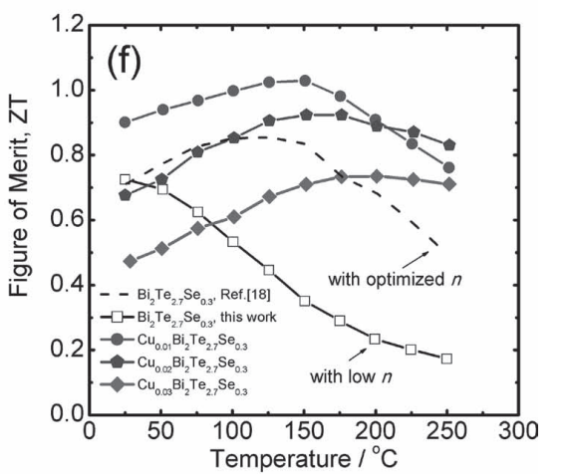
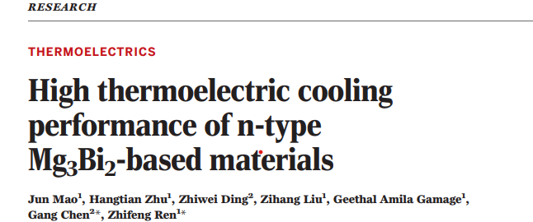
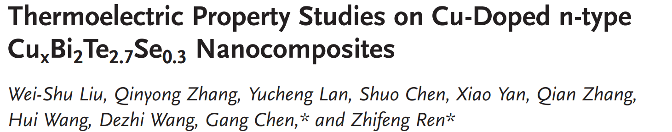
Mg_{3.2}Bi_{1.498}Sb_{0.5} Te_{0.002}
Results
Bi₂Te_{2.7}Se_{0.3}

Slide 9
(1-x)(Mg_{3.2}Bi_{1.498}Sb_{0.5} Te_{0.002}+x(Bi₂Te_{2.7}Se_{0.3})
1% Bi₂Te_{2.7}Se_{0.3}
Got p type
ZT at 300K is 0.1 and at 500K is 0.3

Slide 10
Composite Direct Mixing
Step 1
Step 2
Bi₂Te_{2.7}Se_{0.3}
Mg_{3.2}Bi_{1.498}Sb_{0.5} Te_{0.002}
Powder 1
Powder 2
The Tube in furnace for 12hrs at 750⁰C
Ball milling for 8 hrs
Mixing in mortar for 5 mins
Ball Milling for 6 mins
Hot Pressing at 750⁰C/800⁰C for 5 mins
Measurements

Slide 11
(1-x)(Mg_{3.2}Bi_{1.498}Sb_{0.5} Te_{0.002}+x(Bi₂Te_{2.7}Se_{0.3})
Higher ZT at 300K is 0.54 and 500K is 1.1
N type composite

Slide 12
(1-x)(Mg_{3.2}Bi_{1.499}Sb_{0.5} Te_{0.001}+x(Bi₂Te_{2.7}Se_{0.3})
Reduce the Te amount and increase Bi
ZT at 300K is 0.81 for 0.25% BTS and at 525K is 1.34 for 1% BTS

Slide 13
(1-x)(Mg_{3.2}Bi_{1.499}Sb_{0.5} Te_{0.001}+x(Bi₂Te_{2.7}Se_{0.3})
Higher ZT is 0.73 at 300K and 1.25 at 500K
Reproducible

Slide 14
Conclusion
Successfully synthesized the Pure Compounds and reproduced the composites
Got the N type composite by changing the synthesis process
Increase the performance by reducing the extra dopant Te by 0.001 for medium range temperature

Slide 15
Work In Progress
For Bi₂Te_{2.7}Se_{0.3} confirmation I will check best composites at different temperature.
SEM to check the morphology of composite with temperature and composition and EDS to confirm the wt%

Slide 16
Thanks for your Attention

Slide 17
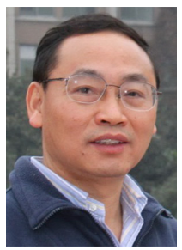

Acknowledgment
Advisor: Pro Zhifeng Ren
Dr Shaowei Song
Xin Xi
Suraj Pardan
Navmi Naik
Haroon Khan
Rui Shu

Slide 18
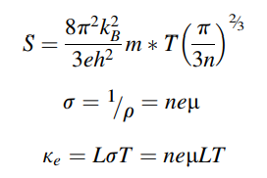
STRATEGIES TO ACHIEVE A HIGH FIGURE-OF-MERIT (ZT)
To improve the electrical transport properties via optimizing n.
To optimizing band engineering which cause higher power factor
Yang, Lei (2018). Emerging Materials for Energy Conversion and Storage

Slide 19
Outline
Introduction
Seebeck effect and Peltier effect
Thermoelectric Efficiency
Types of Thermoelectric Materials(TEMs)
Problems to enhance the efficiency of TE materials
Applications of TE materials
Synthesis to make high quality TE materials
Conclusion and discussion

Slide 20
Thermoelectric Effect
Used for harvesting and recovering heat which is directly converted into electrical energy using thermoelectric generators (TEGs) Conversely,
Peltier coolers and heaters are utilized to convert electrical energy into heat energy for cooling and heating purposes
[Ssennoga Twaha, 2016]

Slide 21
Thermoelectric Performance
Dimensionless figure of merit zT
Where S, σ, T, and κ are the Seebeck coefficient, electrical conductivity, absolute temperature, and total thermal conductivity
Where k= k(electron) + k(lattice)
[Fujiwara, R, 2023]

Slide 22
Types of Thermoelectric Materials
Inorganic TE materials (N and P type)
Organic TE materials (N and P type)
Inorganic-organic TE composites(N and P type)
Bismuth telluride (Bi₂Te₃) and its alloys
Lead telluride (PbTe) and its alloys
Silicon-germanium (SiGe) alloys,
Antimony telluride (Sb2Te3)
Tin selenide (SnSe)
The abundancy of tellurium (Te) in the earth’s crust is only around 0.001 ppm which is less than gold 0.004ppm
MgAgSb
Organic TE materials, including polymers, carbon nanotubes (CNTs), and graphene
Low zT values
Advantages of being inexpensive and recyclable
The intrinsic flexibility of organic TE materials
In general, organic TE materials possess low thermal conductivity
ZT value depends on the power factor
Organic TE materials contain lower electrical conductivity and Seebeck coefficient
Organic TE materials benefits from low thermal conductivity, low density, low cost, low environmental impacts, and good mechanical flexibility
Achieving all these requirements in one TE material is of importance

Slide 23
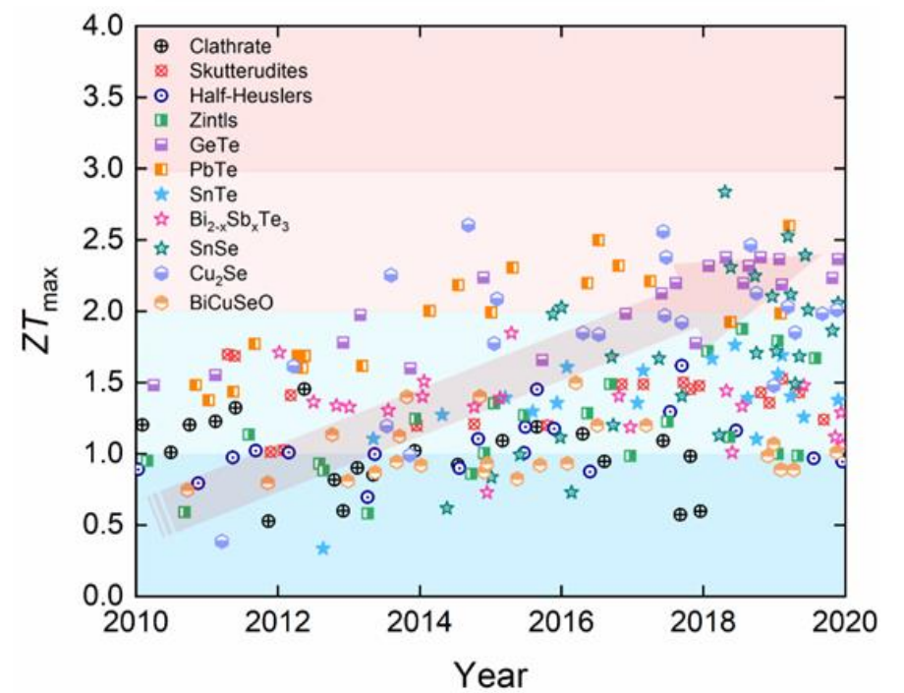
Groups of TE materials and Performance
TE properties at 300K
Present Thermoelectric material for Commercial Use
Bismuth Telluride (Bi2Te3), 1950s
Lead Telluride (PbTe), 1970s
Silicon Germanium (SiGe), 1970s
Skutterudittes, 1990s

Slide 24
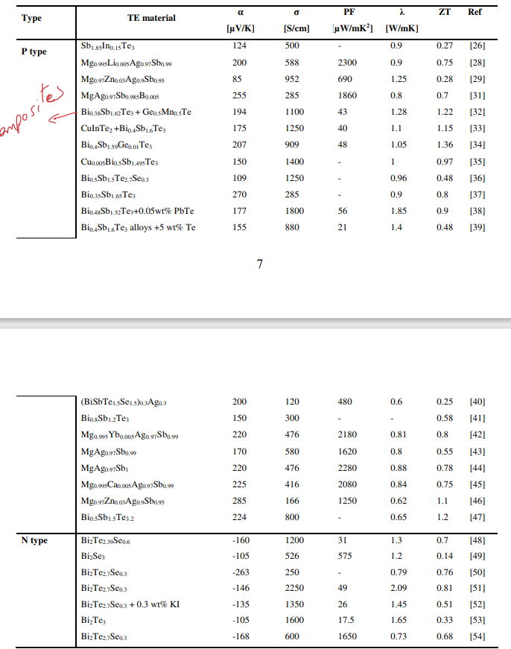
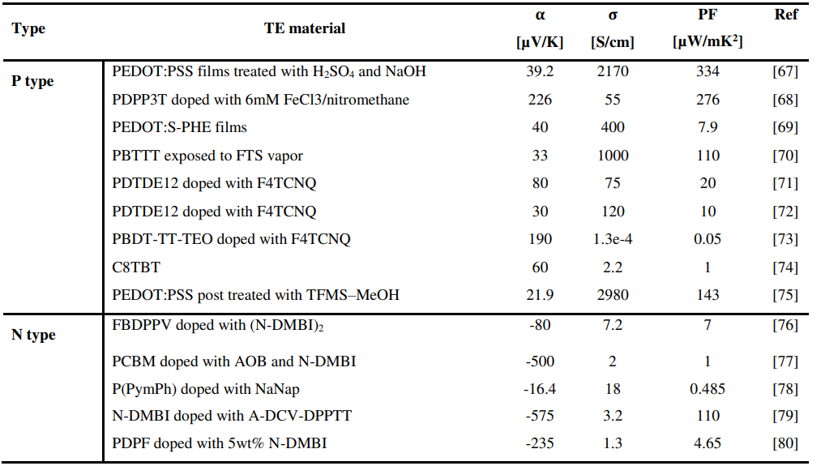
zT values Inorganic and organic TE materials
Inorganic TE materials (N and P type)
Organic TE materials (N and P type)
TE properties of some typical polymer based TE materials at 300K

Slide 25
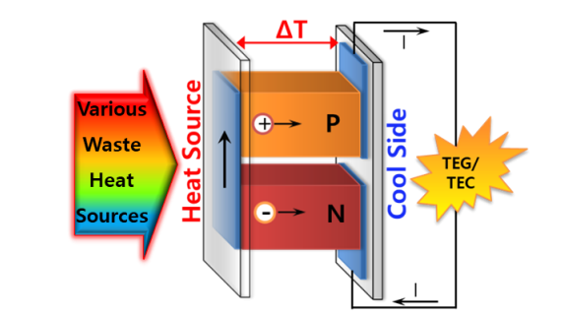

Slide 26

Types of Thermoelctric Materials(TE)
There are three types of TE materials
Inorganic TE materials (N and P type)
Organic-Inorganic TE materials (N and P type)
Organic TE materials (N and P type)

Slide 27
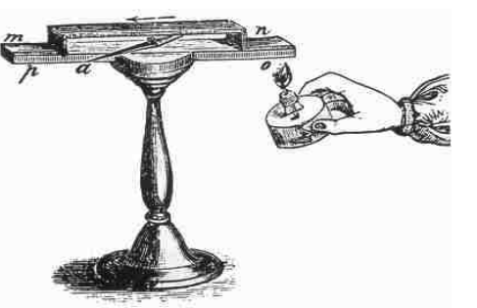
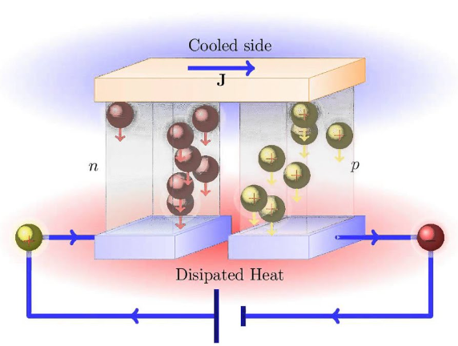
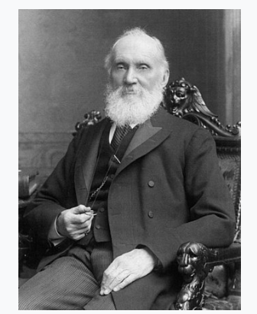
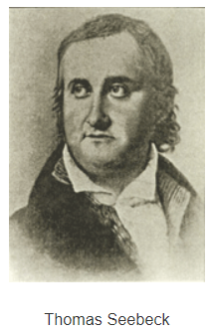
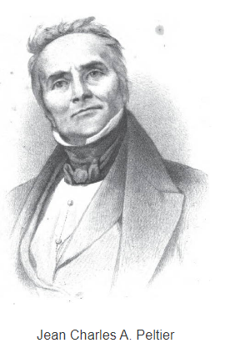
History of Thermoelectric (TE)
Thermoelectric(TE) materials and devices, convert the direct energy between heat and electricity.
First TE effect in 1821-3 by Thomas seebeck
1834 J A. Peltier
20 years later 1854 Willium Thomson(Kelvin Relationship)
?
Thermoelectrics.matsci.northwestern.edu/thermoelectrics/history.html

