Slide 1
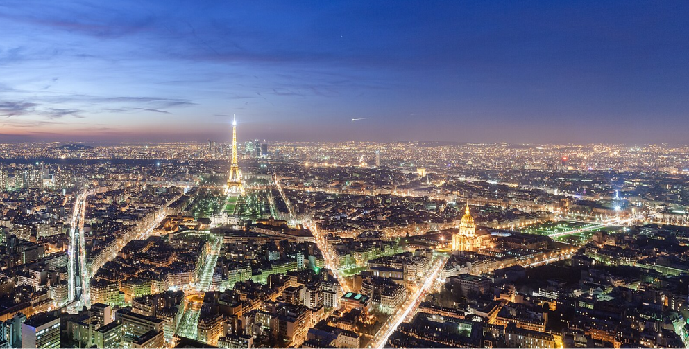



Welcome
HEPIX Spring 2024
Ce travail bénéficie d'une aide de l'État au titre de France 2030 P2I - Graduate School Physique portant la référence ANR-11-IDEX-0003
Notes:
Caroline Auge de Fleury,
Céline Jully,
Joël Surget,
Imed Magroune
Sarodia Vydelingum
Suyan Dong
Philippe Malbranque

Slide 2
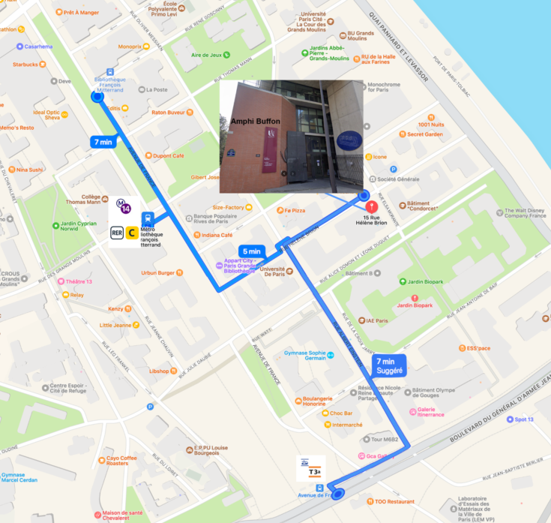


Amphi Buffon
15 rue Hélène Brion, 13e
Lunches and coffee breaks in the lobby
location information
on the back of your badge
Welcome reception from 5:30 p.m. in the lobby
The two closest metro lines 6 and 14 will be closed every evening at 10 p.m.

Slide 3
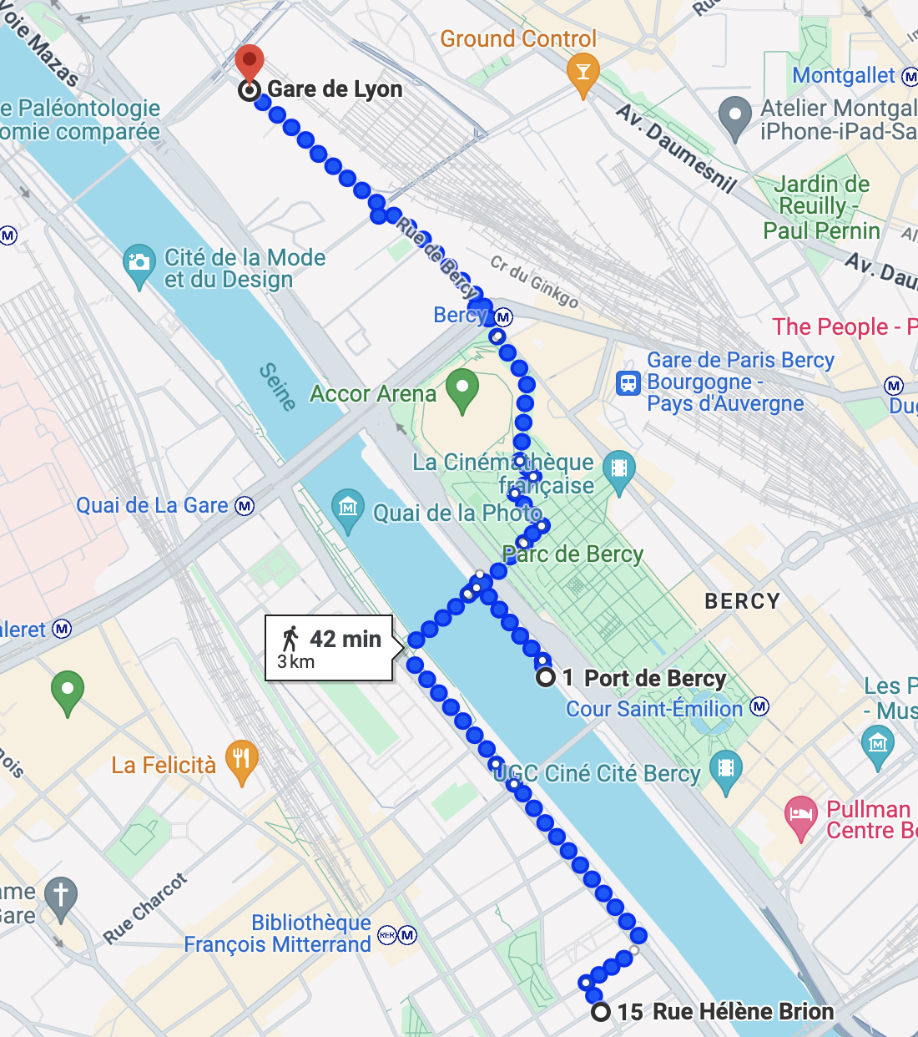
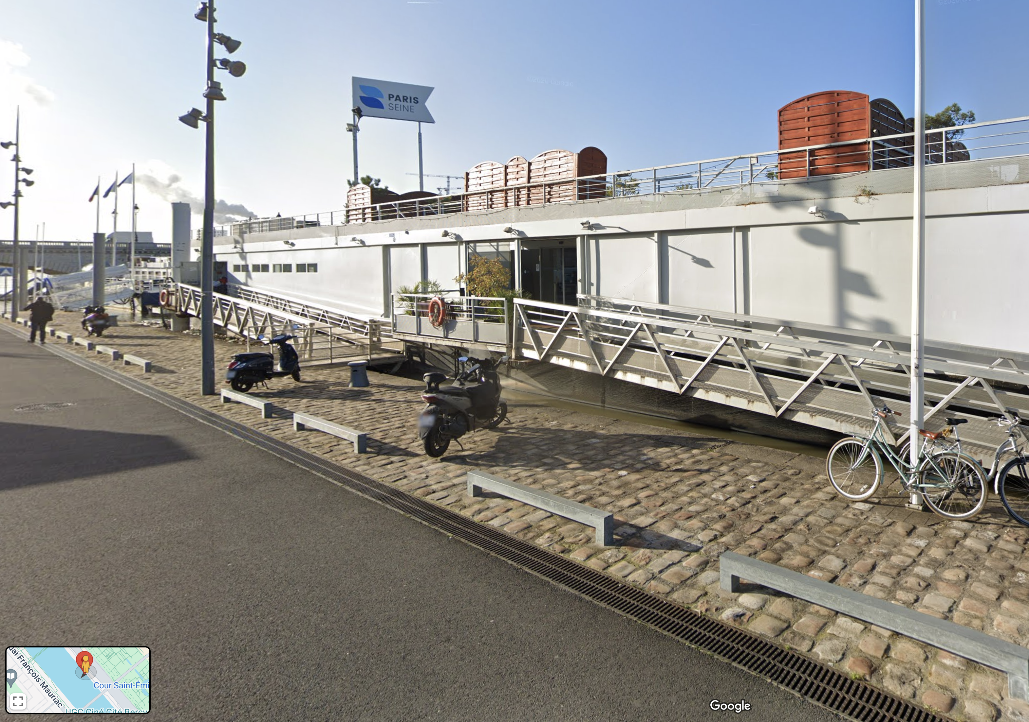


Wednesday workshop dinner
20 min
1.5 km
Saphir péniche
Paris Seine
1 port de Bercy Aval
Saphir péniche
Paris Seine
1 port de Bercy, 12e
20 min
1.5 km
Boarding 19 p.m.
Don’t be late
The two closest metro lines 6 and 14 will be closed every evening at 10 p.m.

Slide 4


eduroam
login: hepix-cmpwifi@guest
password: 4mXbfjnJ
up7d

Slide 5

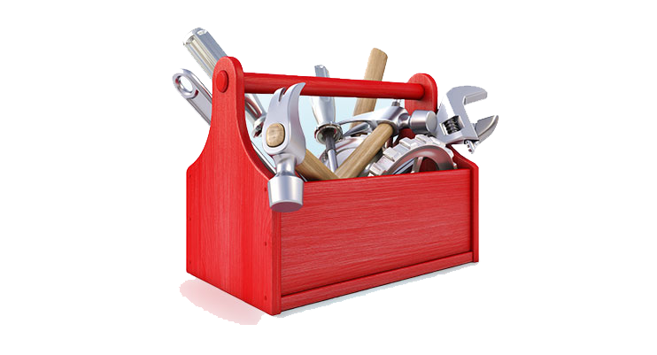
Linux Future session this afternoon
- upcoming end-of-life of CentOS 7
- contribute to discussion
“Show us your toolbox” on Wednesday afternoon
- Share whatever tool you find useful in your daily work life
- Slides or live demo welcomed
- Send ideas to Peter van der Reest or Mattias Wadenstein

Slide 6
Notes:
I wish you an excellent workshop with enriching exchanges and nourishing discussions.

