Slide 1
Hyperconverged Cloud Infrastructure at CSCS
Dino Conciatore – System Engineer
Thursday, April 18th, 2024
HEPiX – Paris, France

Slide 2
Background
Operating a multi-tenant Kubernetes cluster can be very complex
  Based on past experience with a large multi-tenant cluster, with multiple VLANs and users with varying requirements and workflows
Improvements were necessary to ensure a greater user experience
Simplify the deployment of CSCS internal services
Security and Isolation:
  network isolation should be implemented per cluster or purpose
Notes:
Around 2018 we started our journey with kubernetes
The first requirement was to have a big multi-tenat cluster to serve all users needs.
We had a lot of challenges:
Multiple vlans isolation
Complex Ingress/egress based on istio
Different workflows
Namespaces isolations
We quickly discovered that this is not sustainable and very difficult to scale and maintain

Slide 3
Introducing Key Components

Slide 4

Introduction to Harvester
Harvester is an open-source hyperconverged infrastructure solution
Kubernetes as orchestration engine
Based on KVM and KubeVirt, which enable virtualization and orchestration of VMs
Storage management through Longhorn to provide a persistent storage
Networking based on Multus enables isolation on multiple VLANs
Notes:
That uses Kubernetes as an orchestrator engine for kubeVIRT

Slide 5

Introduction to Rancher
Rancher is an open-source Kubernetes clusters manager.
Centrally manage multiple Kubernetes clusters
Simplified provisioning and scaling of clusters, node management, and upgrades.
Strong security features, including role-based access control (RBAC), network policies and integration with identity providers to enhance security and compliance.
Rancher has its own Kubernetes distribution called RKE2
Notes:
It allows you to manage easily multiple kubernetes clusters
It helps you in provisioning and scaling
And also have very nice security features, like role-based access control

Slide 6
Introduction to ArgoCD
Argo CD is an open-source continuous delivery tool specifically designed for Kubernetes that follows the GitOps methodology.
Application deployments are declared using Kubernetes manifests or Helm charts stored in Git repositories.
  Argo CD then ensures that the actual cluster state matches the desired configuration
Graphical UI for visualizing and managing application deployments status. Additionally, it offers a command-line interface (CLI) for scripting and automation.

Slide 7
Hyperconverged Cloud Infrastructure at CSCS

Slide 8
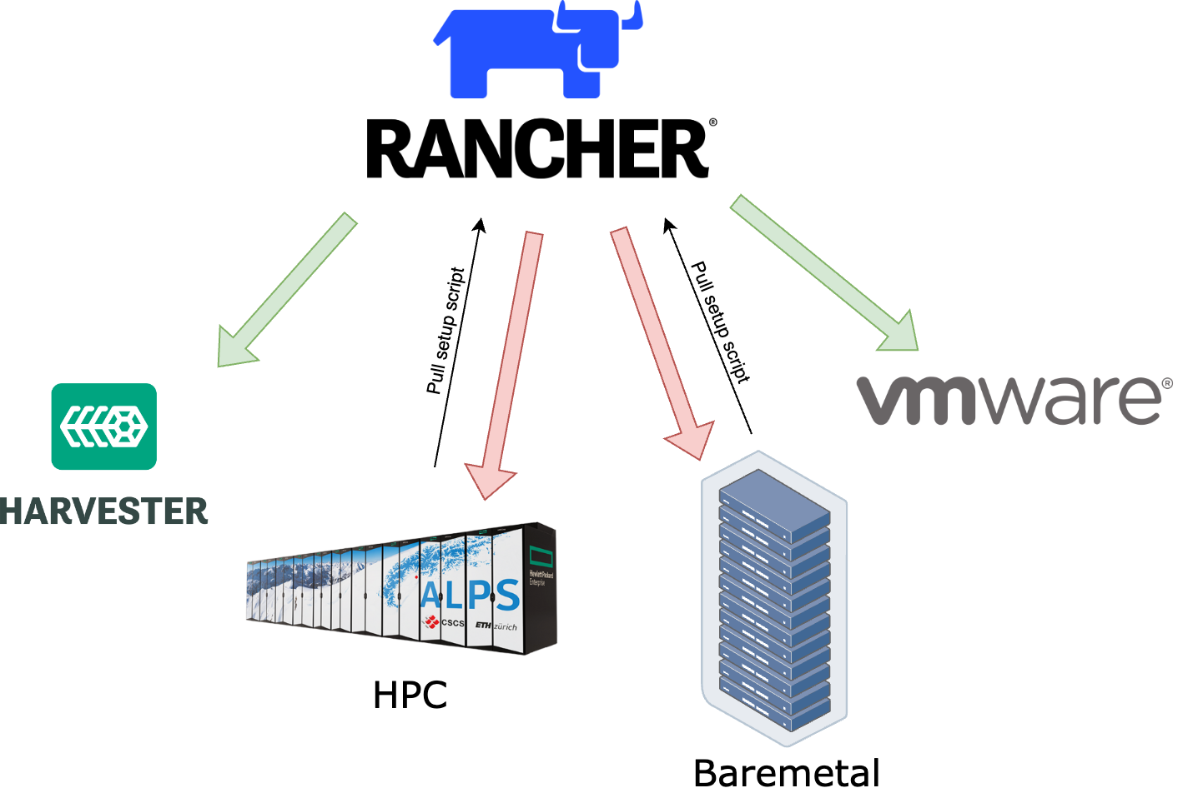
Where we run kubernetes
Kubernetes clusters deployed on:
Harvester
VMware
Bare metal
  Commodity Hardware
  HPC (CSCS Alps)
Notes:
Direct deployment on Harvester and VMware, meaning Kubernetes nodes are spownedirectly when cluster creation is triggered.
Deployment on Baremetal and HPC, nodes must already be running.

Slide 9
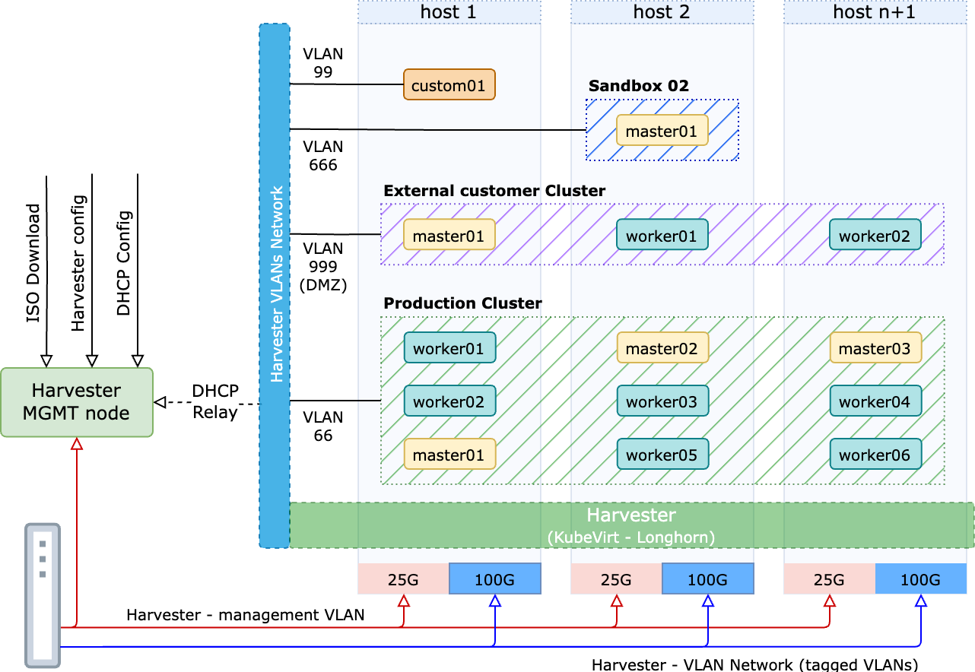
Harvester architecture
Harvester host:
  Management (25G)
    Kubernetes overlay
    VMs Live migration
    Harvester StorageClass
  VLANs (100G)
    Downstream clusters
  Local NVMEs
  512G ram
  64 Cores
Management node:
  DHCP Relay for VMs
  Hosts setup
    iPXE Boot
    ISO Repository
    Hosts config
Notes:
So, now… lets talk about the Harvester architecture:
harvester is a cluster of nodes (in our case, each nodes with… )
On top of those nodes we have a kubernetes cluster
With longorn and kubevirt
Kubevirt to spinup VMs
CSCS SETUP:
8 nodes + 11 new
25G for management net
100G for VLAN Network

Slide 10
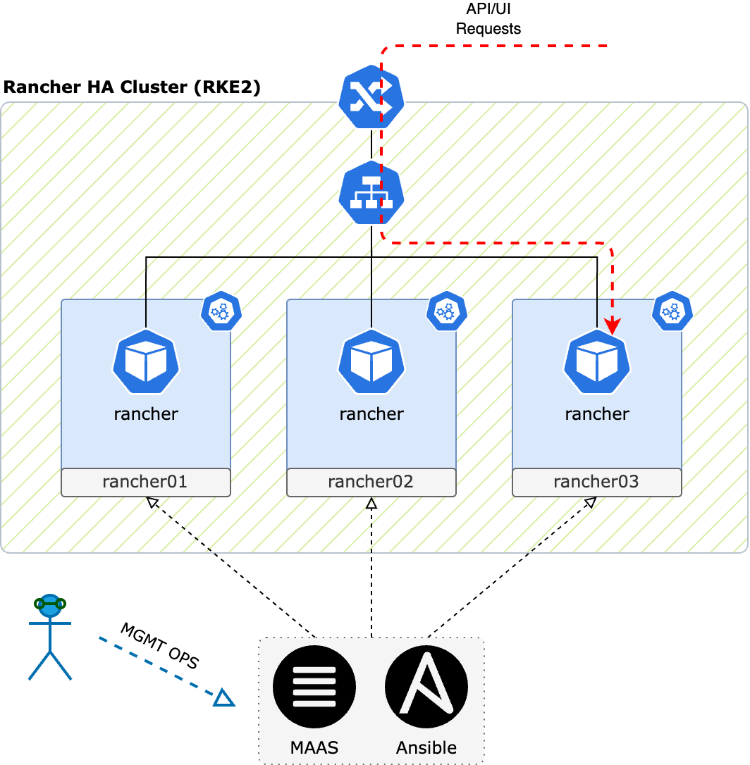
Rancher cluster architecture
RKE2 Cluster
3 nodes both master and worker
Each node is expected to have a Rancher pod
kube-vip enables external access to the UI/API
Node management:
Node lifecycle through MAAS
RKE2 installed and managed with Ansible
Rancher deployment managed with Helm

Slide 11
Infrastructure as a code and GitOps

Slide 12
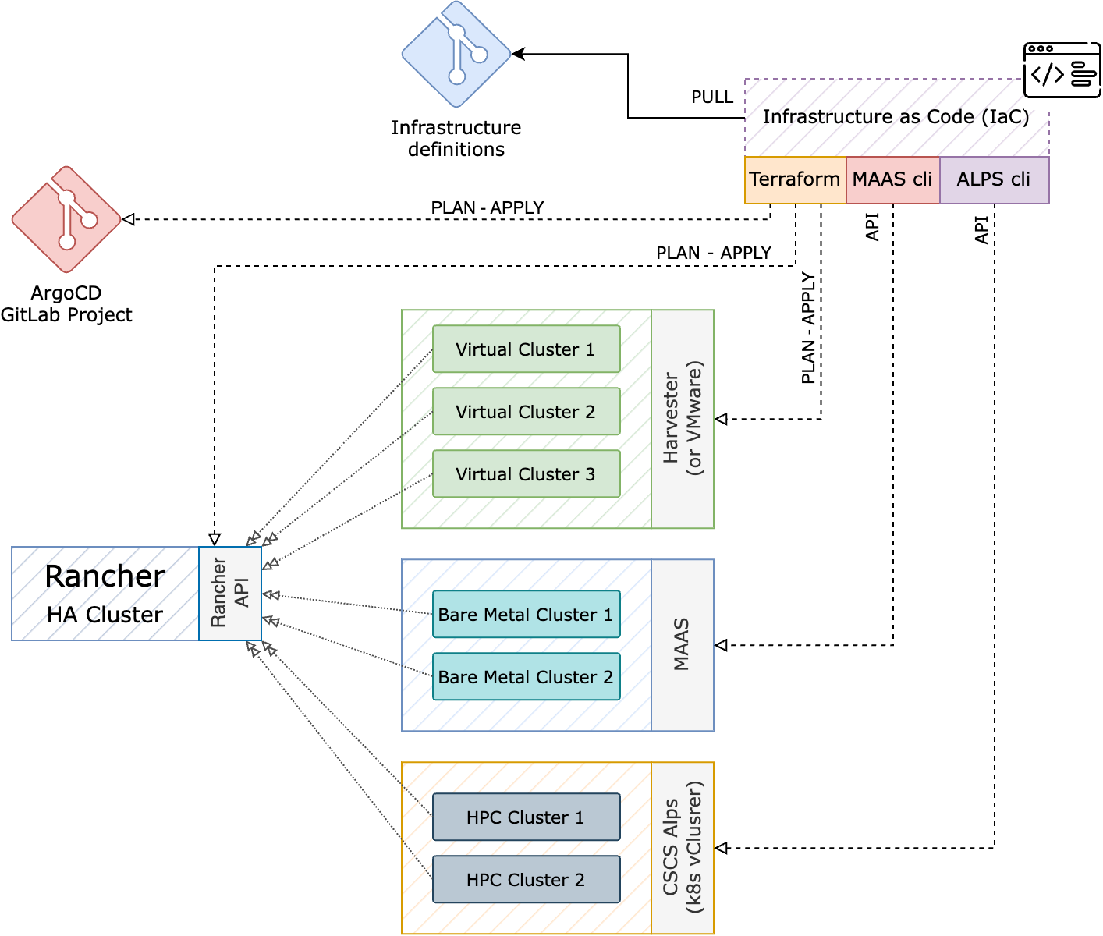
Infrastructure as a code
Harvester (or VMware)
  Define the cluster and git push:
    CPUs, Ram, Nodes, VLAN
  $ terraform apply
  Triggers the VMs creation (masters/workes)
  Rancher will run the cluster join command on the newly created VMs
MAAS (Bare Metal nodes)
  Define the cluster and git push:
  $ terraform apply
  $ ansible-playbook deploy-rke2.yml
  Nodes will join the cluster
CSCS Alps (HPC)
  $ terraform apply
  Master nodes creation on Harvester
    And join
  $ ./rancher-agent-install.sh
  Worker nodes will join the cluster
Notes:
First of all we have to decide where to deploy.

Slide 13
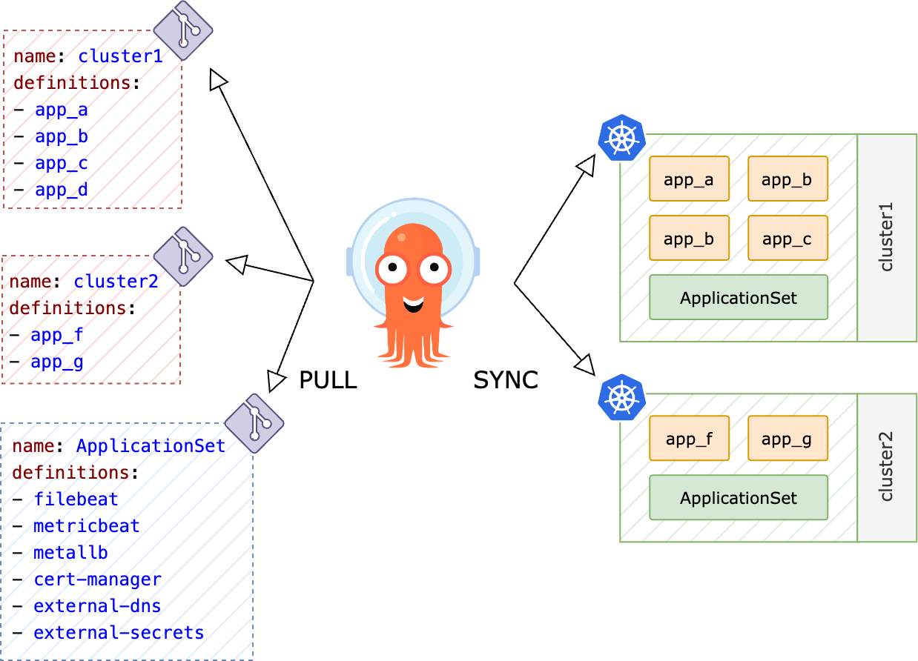
GitOps with ArgoCD
Application definitions
  Each cluster has its own Git repo with all application manifests (HELM or pure k8s manifests)
ApplicationSet
  Using ArgoCD Generators common applications can be deployed on all clusters or on clusters with specific labels
Argo CD ensures that the state of apps matches the desired configuration.

Slide 14
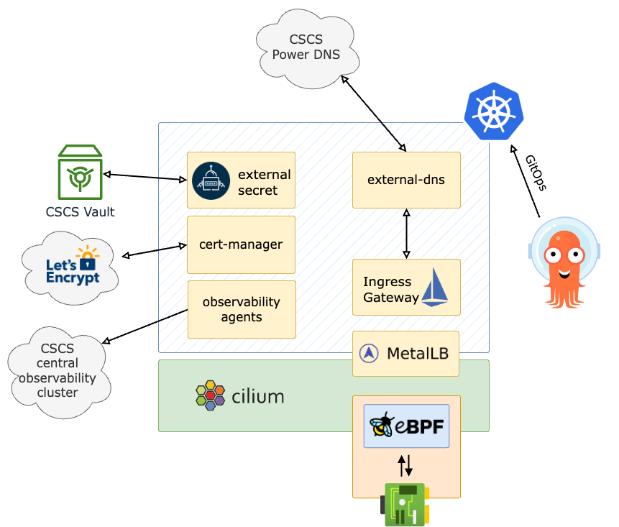
Kubernetes clusters common features
All clusters deployed have the following common services preconfigured:
CNI: Cilium
  Service mesh (eBPF)
  Hubble (observability UI)
CSI:
  cephfs
  ceph rbd
Istio (only Ingress Controller)
  No sidecars
  Started migration to new API Gateway
MetalLB
  Currently still via ARP
  BGP in the future
Automated DNS and Certs
External Secret
  For all Vault secrets
Observability agents
  Filebeat and Metricbeat
Notes:
With cilium service mesh enabled
Cilium is based on eBPF
all the networking is done at kernel level without the need of sidecars
Cilium also come with a nice observability UI
Istio only for ingress gateway and in the future API gateway
IP assignment, DNS entry and Let’s Encrypt Certificates are automated
Triggered when a new association Istio GW ←→ k8s Service is made
Using ArgoCD for GitOps automation. All new changes are pushed to a git repo and ArgoCD will apply them
External secret to interface HashiCorp Vault

Slide 15
Observability
All clusters come with automatically deployed logs and metrics collectors (ArgoCD ApplicationSet), which send everything to our central Observability Infrastructure.
Currently we are using Elastic Beats
Autodiscovery
  Triggered on New, Modified and Deleted pod
Hint based
  Configure Beat modules via pod Annotations:
annotations:
  co.elastic.metrics/hosts: '"${data.host}:9404"'
  co.elastic.metrics/metrics_path: /metrics
  co.elastic.metrics/metricsets: collector
  co.elastic.metrics/module: prometheus
  co.elastic.metrics/processors.1.add_fields.fields.namespace: kafka
  co.elastic.metrics/processors.1.add_fields.target: data_stream

Slide 16
Operations

Slide 17
Infrastructure upgrade
Harvester
  Upgrade triggered automatically via the user interface.
    RKE2 upgrade
    Draining one host at a time
      VMs are live migrated
    OS Image replacement
Rancher
  Ansible managed nodes:
    Drain Kubernetes nodes one by one.
    Reinstall or upgrade the OS
  Rancher
    Upgrade done via Ansible (same playbook used for the installation)
      rke2_version: v1.26.9+rke2r1
      NOTE: Don't skip intermediate minor versions when upgrading, eg. : v1.28.x → 1.29.x
ArgoCD
  via Helm

Slide 18
Downstream clusters upgrade
Kubernetes
  Required RKE2 version can be changed using Terraform
    kubernetes_version = "v1.29.2+rke2r1"
    $ terraform apply
      NOTE: Don't skip intermediate minor versions when upgrading, eg. : v1.28.x → 1.29.x
    Rancher will handle draining nodes and upgrading
OS Upgrades
  Harvester nodes (VMs):
    Required OS can be changed using Terraform
      image = "default/ubuntu-jammy”
      $ terraform apply
  Ansible managed nodes:
    Drain Kubernetes nodes one by one.
    Reinstall or upgrade the OS based on your requirements

Slide 19
Use cases

Slide 20
Conclusion and Usecases
We are running a total of ~35 downstream clusters, with ~200 VMs and ~100 bare metal nodes
Here are some of the Kubernetes clusters:
dCahce (presented at next HEPiX)
  16 bare metal nodes
  ~250 pools
  48TiB of PVCs via Ceph RBD (Total 12PB WLCG + CTA)
WLCG Services
  Frontier Squid
    With multus and whereabouts (IPAM)
  Nordugrid ARC CEs
  site-bdii
Observability cluster
  92 bare metal nodes
  Local NVMe storage
    Local Path for Elasticsearch data nodes
    Longhorn for all other persistent services
Central CSCS services
  Vault
  Jfrog
  Gitlab-runners
HCP Test
  3 master on Harvester
  4 worker on ALPS (1024 cores)

Slide 21
Questions?

Slide 22
Thank you for your attention.

Slide 23
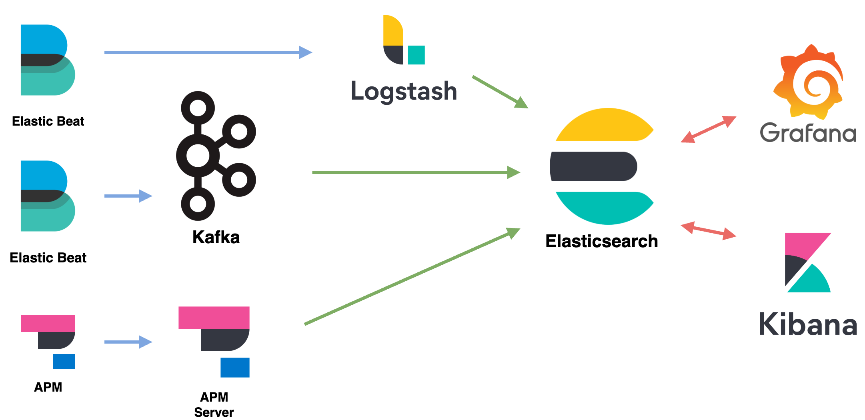
Backup slide: Elastic Stack flow
Notes:
How the data is sent to Elasticsearch
Almos everything via Elastic Beats:
Clients are
Metricbeat
Filebeat
Auditbeat
The clients ingestion options:
Kafka (Preferred)
Logstash (depending on the requirements)
Application performance monitoring (APM) → APM Server → ES
Once everything is on ES we cand do analysis with Grafana or Kibana

Slide 24
Cilium tuning
Notes:
How the data is sent to Elasticsearch
Almos everything via Elastic Beats:
Clients are
Metricbeat
Filebeat
Auditbeat
The clients ingestion options:
Kafka (Preferred)
Logstash (depending on the requirements)
Application performance monitoring (APM) → APM Server → ES
Once everything is on ES we cand do analysis with Grafana or Kibana

