Slide 1
Lessons learnt from large scale data processing with CVMFS
HEPIX, April 2024

Slide 2
Matt Harvey
HPC Production Engineer

Slide 3
JUMP TRADING
Privately-owned proprietary trading firm, established 1999
Focus on algorithmic and high-frequency trading
World-wide operations
  12 offices across US, EU, Asia, Pacific
>700 employees

Slide 4
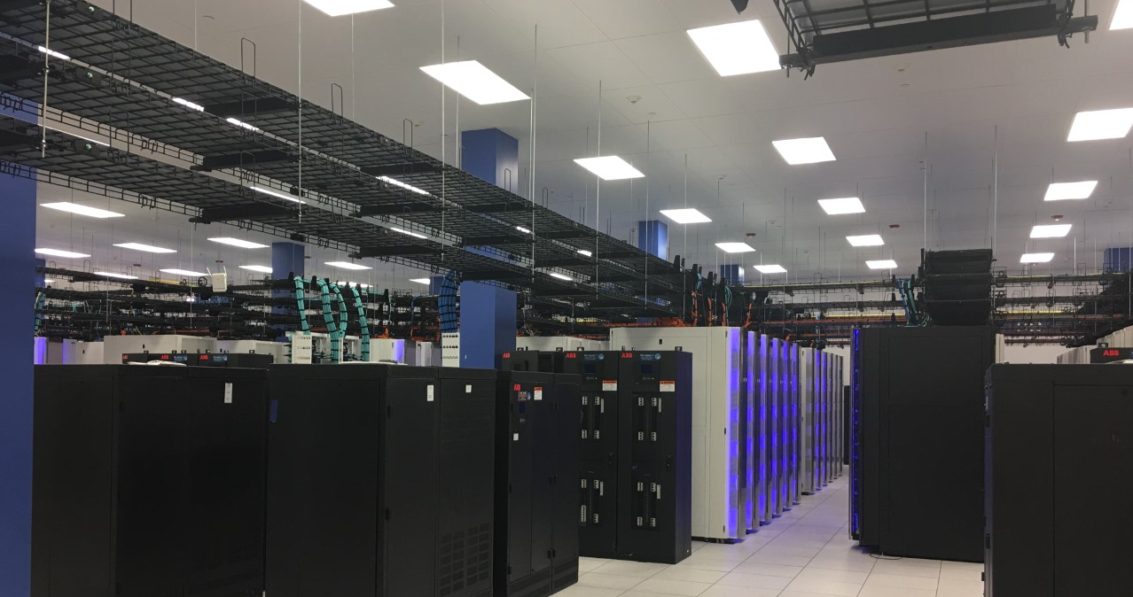
HPC at Jump

Slide 5

Jump’s Research Environment
(HPC / “The Grid”)
The platform where we develop and optimize trading strategies
Sophisticated data-intensive and compute-intensive research workflows
Technologically competitive with some of the largest publicly known research systems in the world
  Thousands of servers
  Hundreds of petabytes of storage
  Fast network interconnects
  Keeps growing: more hardware every year
Fabric logical diagram
Image Credit: Olli-Pekka Lehto

Slide 6
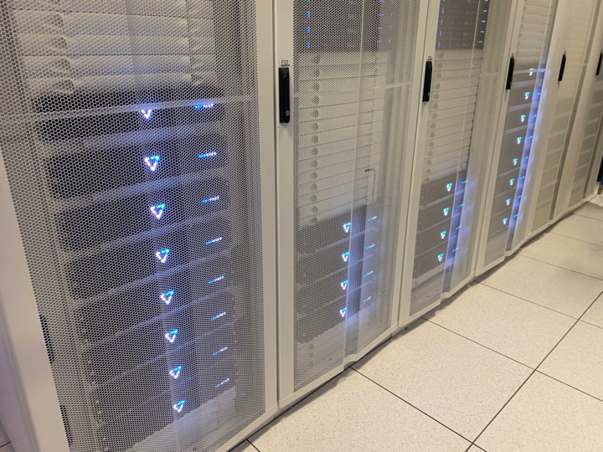
Data Archive
Realtime-updated repository of all market data
Data captured from exchanges around the globe
Derivative products for end-users

Slide 7
Ten Years of Archive Growth
Doubling ~2 years, currently growing at ~1.5PB/week
substantial day-on-day volatility

Slide 8
Archive infrastructure
Before 2022, stored on conventional on-prem GPFS filesystem
  Continual capacity management issues
  Cost-inefficient
  Could not scale to multiple colos
  The Legacy Archive was an obstacle to growth
  Re-architect to use commercial object storage
Notes:
Paying for hard drives for data we never access (e.g., second copies)
Very difficult to handle HPC pods scaling – choices are multihoming or more rsyncs.
Massive rsyncs hard to manage
Complex symlink and mount management to present 4+ GPFS/NFS filesystems as "/jump/archive"
Hard to provide archive access in "non-grid" areas (e.g., dev hosts and hosts with experimental hardware)
Hard to add new datasets: more hard drives, servers, and rsyncs
GPFS is not the ideal place to store zero-bitrot data for decades

Slide 9
A New Design: Tiered Archive
  Able to run existing work-loads unmodified
    POSIX filesystem presentation
  Decoupled from HPC fabric / filesystems
    Accessible outside of HPC environment
  Able to accommodate >10x growth in capability
    capacity, bandwidth
  Non-requirements:
    Read-write mounts on compute nodes
    Concurrent writes on the same file
    Global consistency and file locking
Notes:
Allow

Slide 10
The Tiered Archive
Three puzzle pieces:
Filesystem presentation: POSIX-like to allow existing apps to keep working
Read Path: Cloud storage backed by many layers of cache
Write Path: Pipeline to add new data to the system at scale

Slide 11
The Tiered Archive
Three puzzle pieces: CVMFS?
✅ Filesystem presentation: POSIX-like to allow existing apps to keep working
✅ Read Path: Object storage backed by many layers of cache
❌ Write Path: Pipeline to add new data to the system at scale

Slide 12
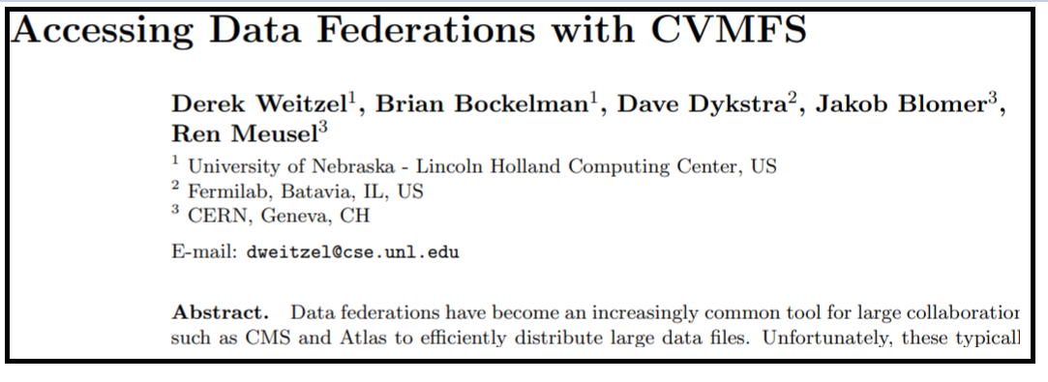
Tiered Archive: CVMFS
Describes how to use CVMFS with “external” data ie not stored in content-addressable form
Notes:
This paper: proposed an extension to CVMFS to handle “external” data – files whose content not managed by CVMFS in it’s content-addressable-storage

Slide 13
High performance write path
CVMFS “grafting” to separate data and metadata write paths
  Data is uploaded directly to cloud storage
  Doesn’t use CVMFS content-addressable storage
cvmfs-rsync
  diff src and dest, upload changes to object store
  Capture file metadata
cvmfs_swissknife ingestsql
  Send metadata to gateway for addition to repo

Slide 14
Problems and Solutions

Slide 15
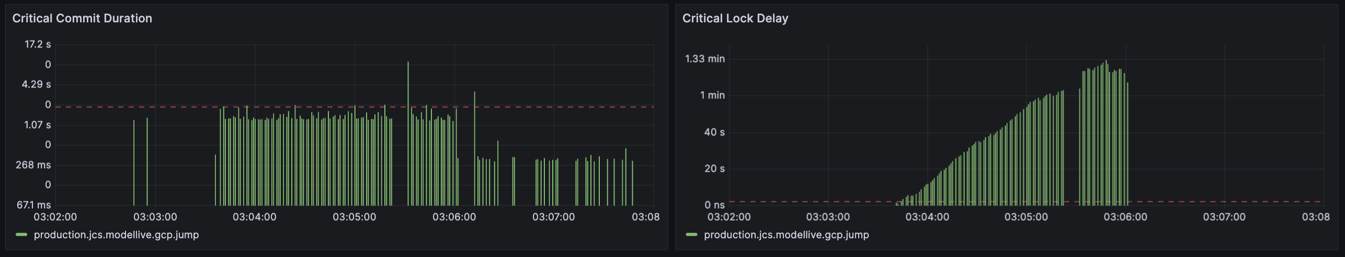
Grafting throughput
Grafting is a point of serialization
  Need to optimise critical path performance
  Can now achieve a floor time of < 300ms, down from 2+ sec.
  Fixed scenarios leading to grafts of minutes duration
Notes:
Also: reduce default lease lifetime and add lease extensions – allows quick recovery from crashes of graft jobs

Slide 16
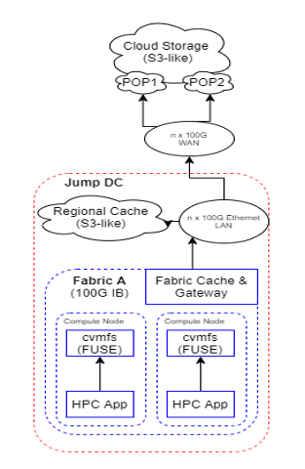
Read cache hierarchy
Use Varnish HTTP cache https://varnish-cache.org/
  NVME caches in each HPC cluster
    Bridges cluster network and DC ethernet
    Measured 30GiB/s per server
  NVME+HDD caches in each DC
  Cache tiers horizontally scalable as required
Colo varnish
Cluster varnish

Slide 17
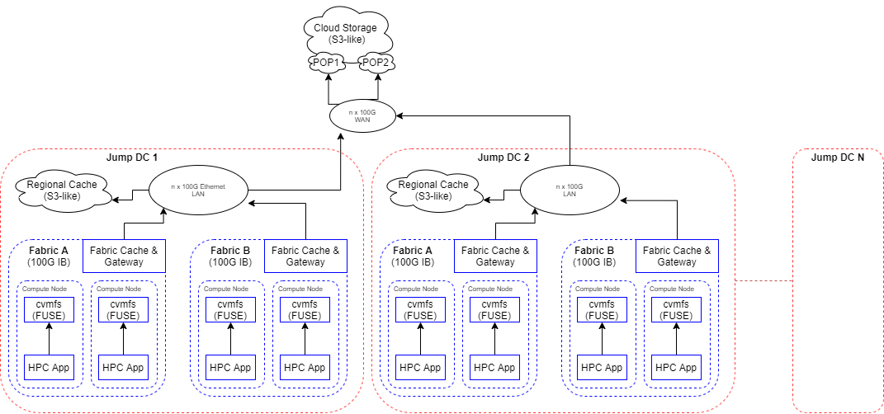
Scaling out
Colo varnish
Colo varnish
Cluster varnish
Cluster varnish
Cluster varnish
Cluster varnish

Slide 18
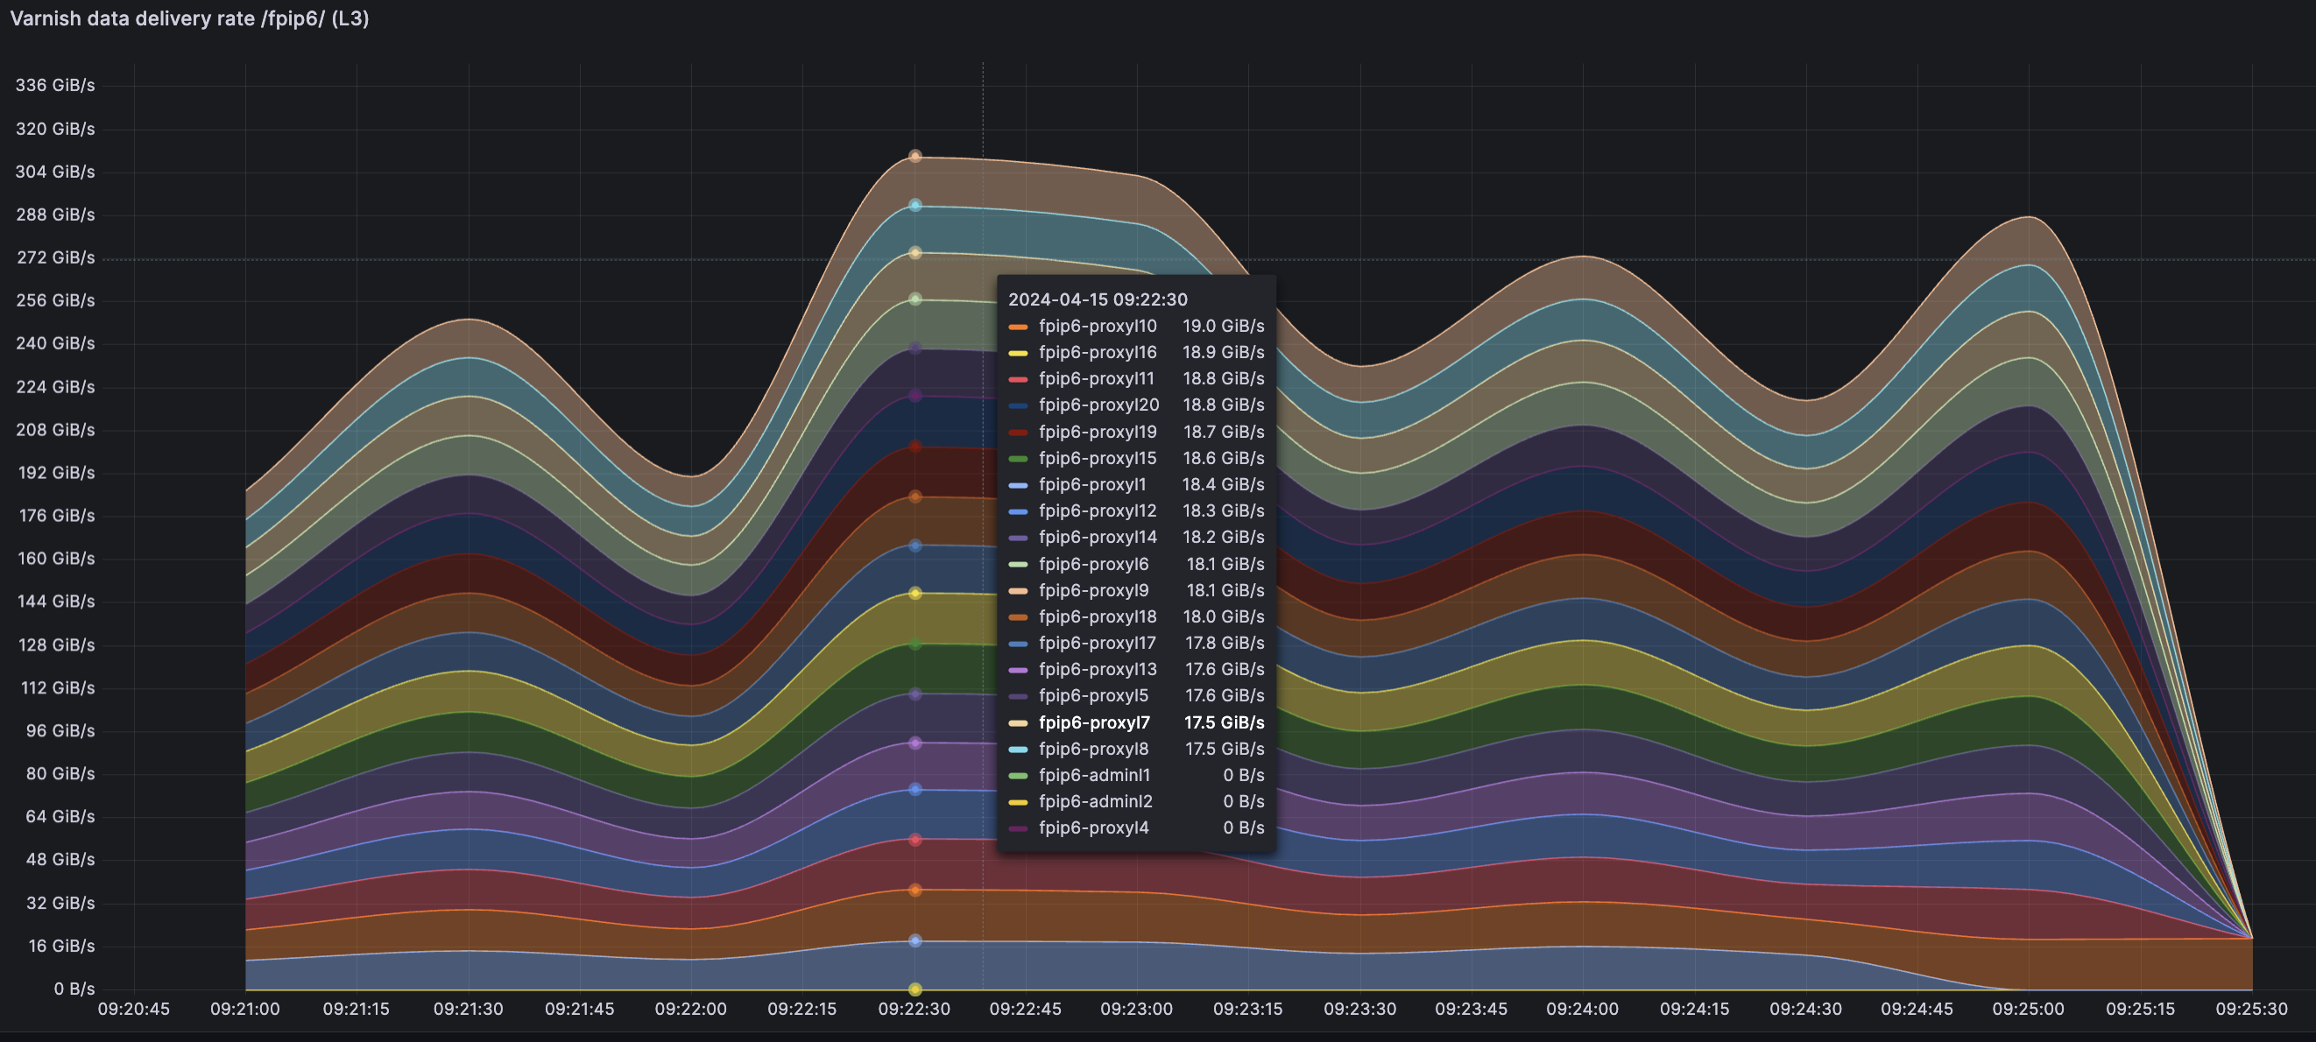
Read cache efficiency
Shard data across all caches
  Use rendezvous hashing https://en.wikipedia.org/wiki/Rendezvous_hashing
  Failure of a cache causes traffic to be equally redistributed
  Shard at 24MiB chunks, not whole object
  * Supported in CVMFS as compile time addition
Added health-checking code to accommodate cache instance failures

Slide 19
Object immutability
CVMFS has direct mapping from filepath -> object key
Changing a file requires cache invalidation
  Expensive, race-prone
Solution:
  Object key = path/.filename.<content shasum>
  Add file path/filename to CVMFS as:
    File: path/.filename.<content shasum>
    Symlink: path/filename -> .filename.<content shasum>
Changing a file -> new dot file, flipped symlink (atomic)

Slide 20
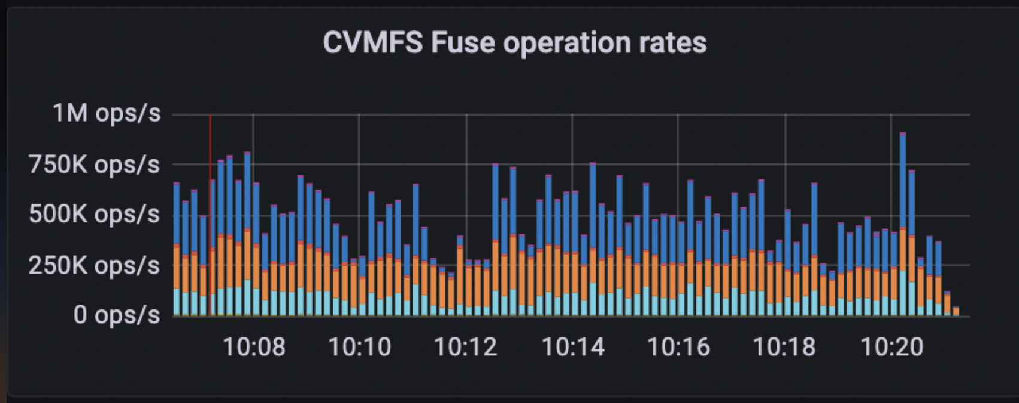
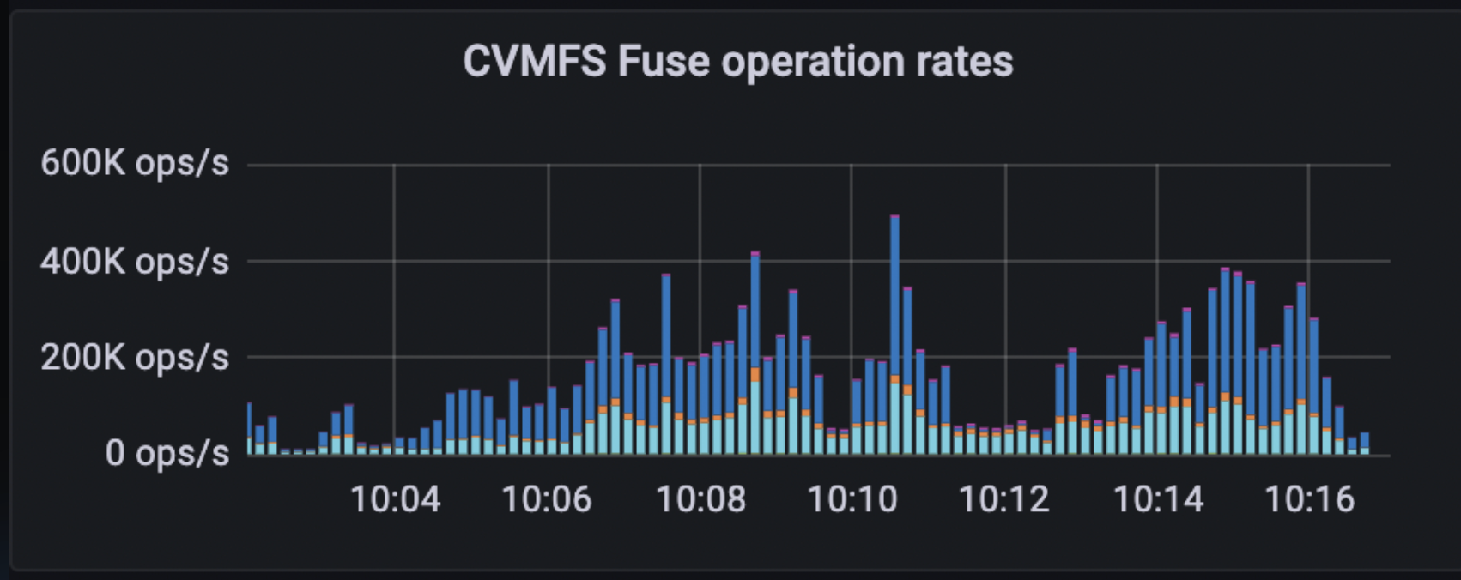
Symlink lookups
  * Dot-scheme is symlink heavy
  FUSE does not cache symlink lookups by default
  Enabling it exposed bug when symlink target changes – kernel cached value not expired
  Fixed with CVMFS, libfuse, kernel fuse patches

Slide 21
Low read performance
Reads are slow: ~500MB/s
Reads in chunks of 24MiB
Downloads, sha1sums multiplexed onto a single thread
Local disk cache must be populated before returning read
  Write-limited on local disk
Data ends up in page cache twice
In our case, hit rate of local caching very low

Slide 22
Cache bypass “direct” read
Completely bypass CVMFS download path
Map each fuse_read() to an HTTP GET
  Multithreaded
  No sha1summing
No local cache
  rely on page cache, fast network and varnish
Tune kernel readahead and increase fuse message size
  128 kiB ->1MiB
  Requires minor kernel patches (RHEL8)

Slide 23
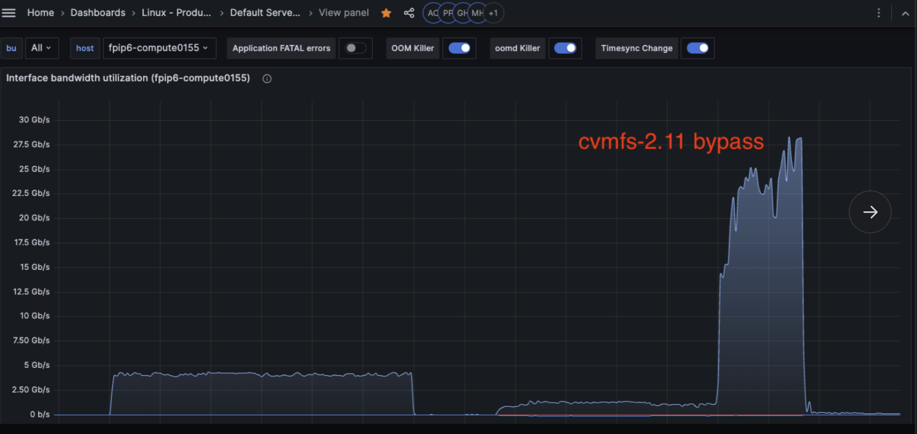
Cache bypass “direct” read
8x parallel reads, randomly selected files between 0 and 2GiB, 1MiB reads
CVMFS cache in shmem
500MiB -> > 3GiB/s

Slide 24
Catalogue load inefficiencies
Every directory is represented by a sqlite database stored in an object.
Catalog loads could stall all fuse operations
  Very bad if historical data where catalog not in cache
  Wide compute nodes very likely to encounter the issue
Single-threaded catalog decompression could peg a core

Slide 25
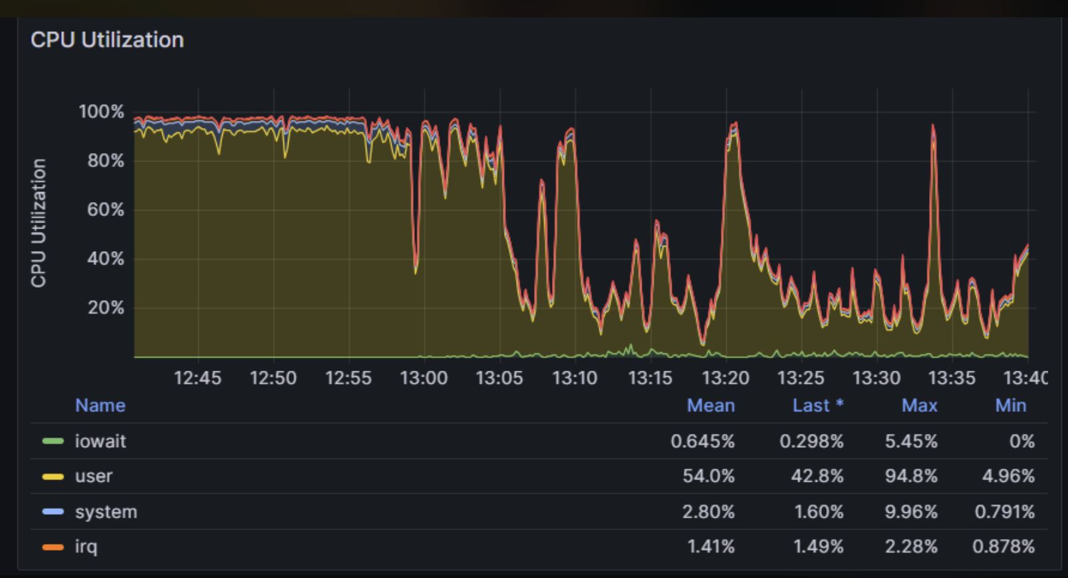
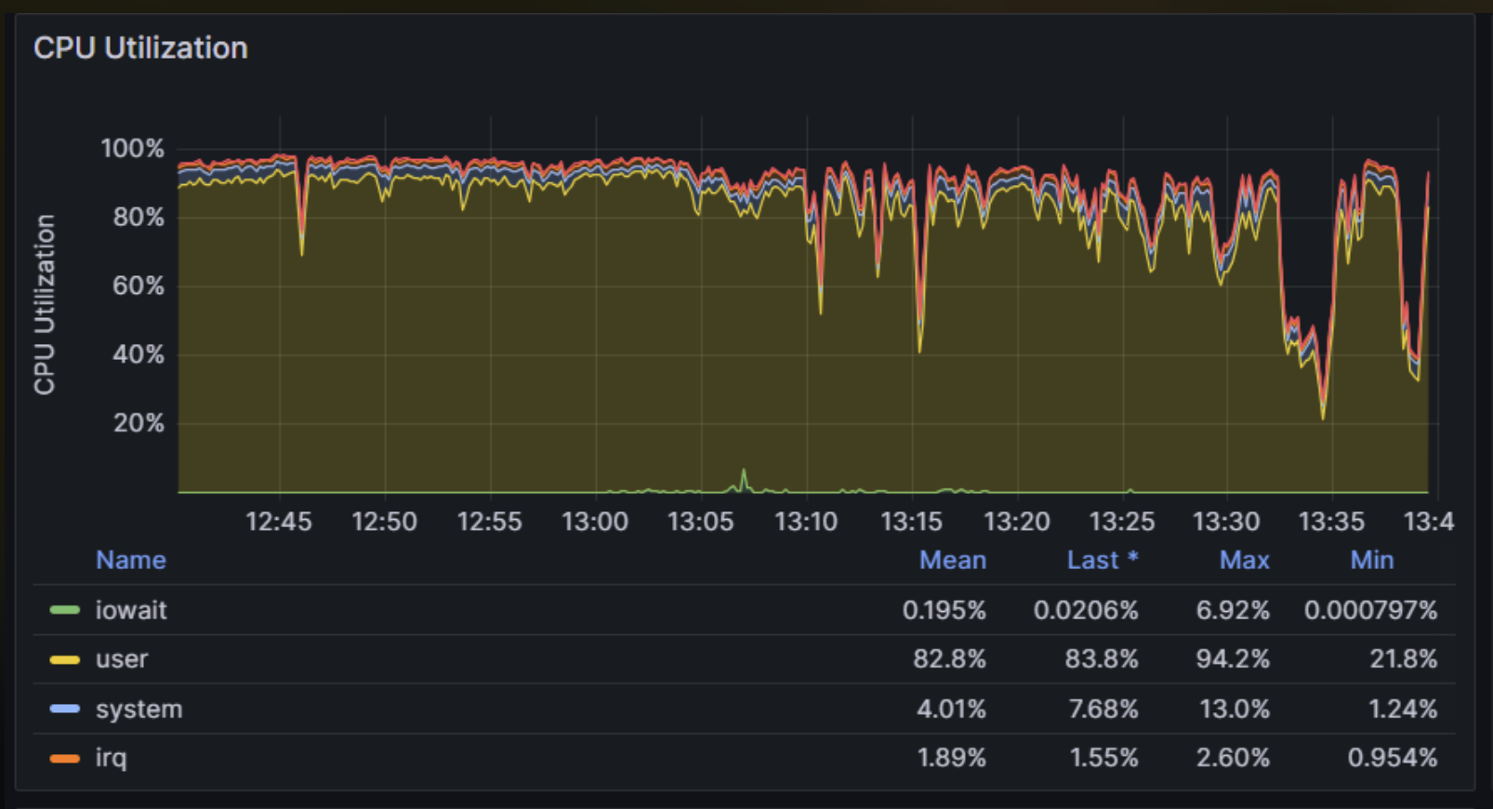
Catalogue load improvements
128 core AMD system
Fixed locking, multithreaded decompression
Startup time down from ~90s to ~5s

Slide 26
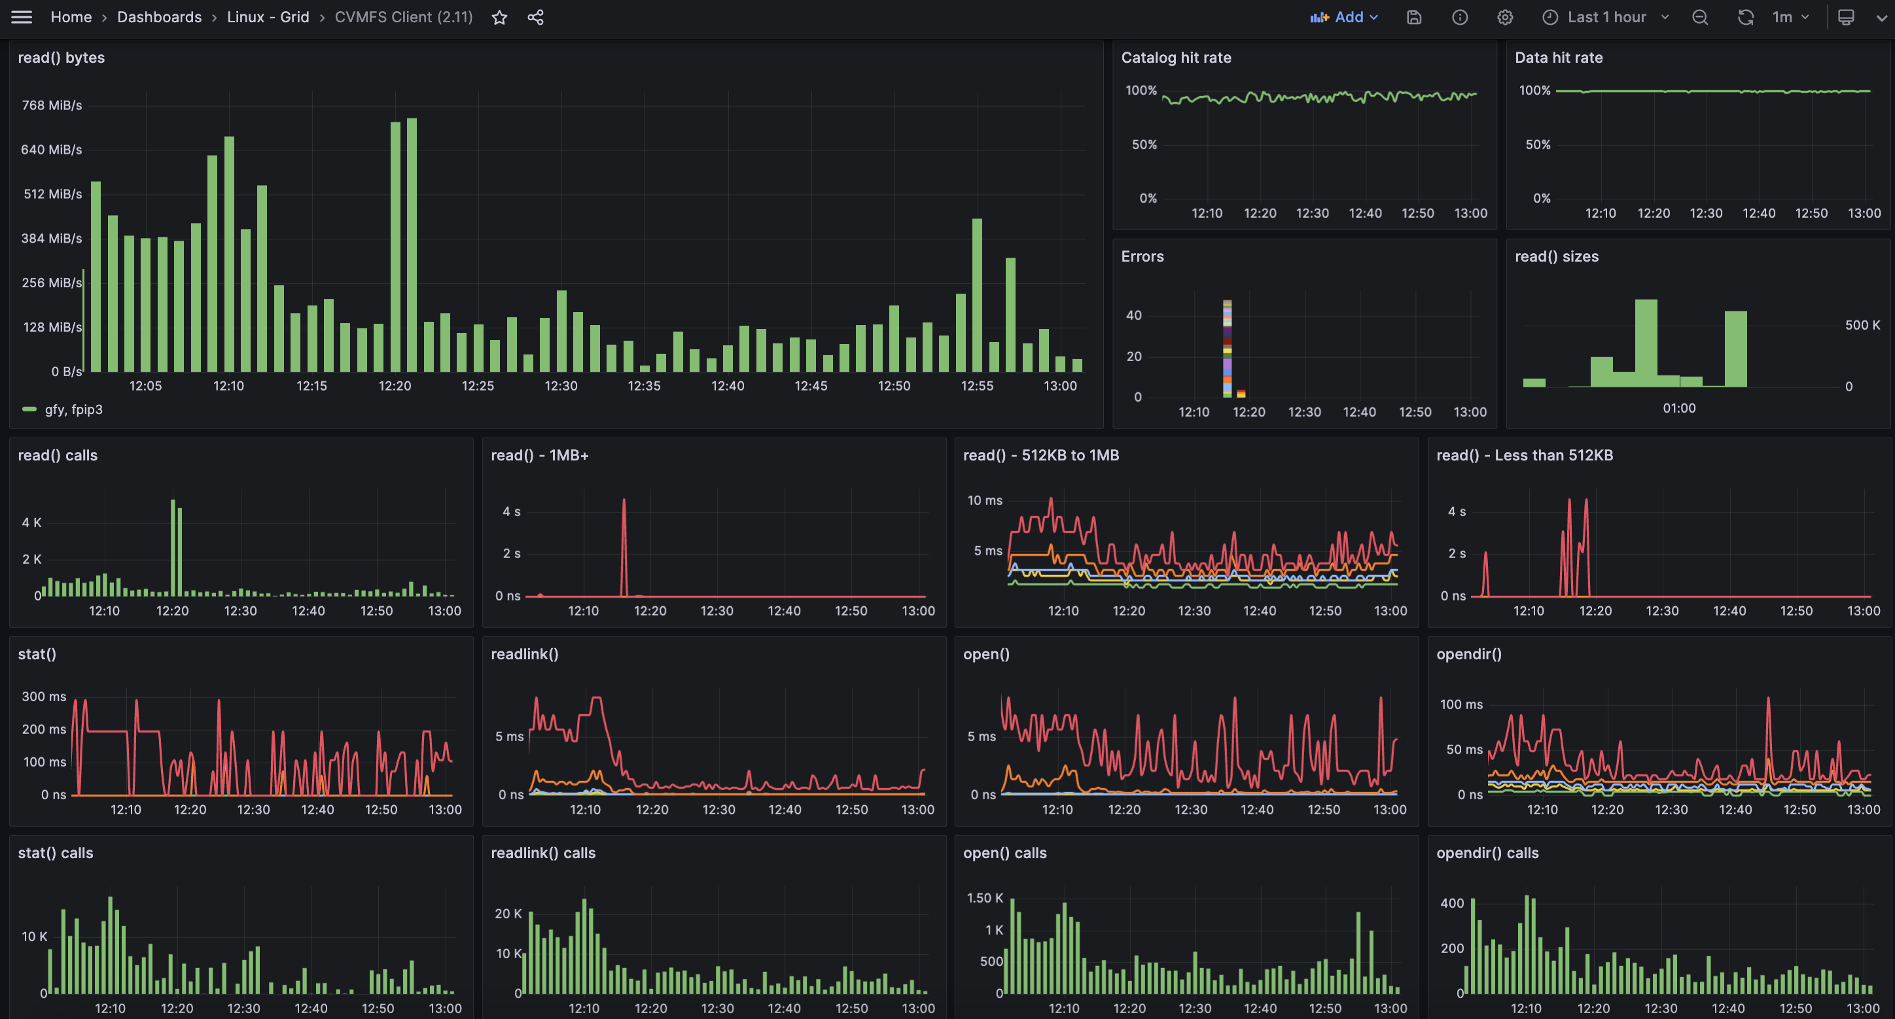
Observability
Export internal counters, operation latencies via telegraf
Notes:
Dig into the performance of individual nodes
Combined with varnish logs can track read operations through the cache read stack

Slide 27
Thank you
Questions?
mharvey@jumptrading.com

Slide 28
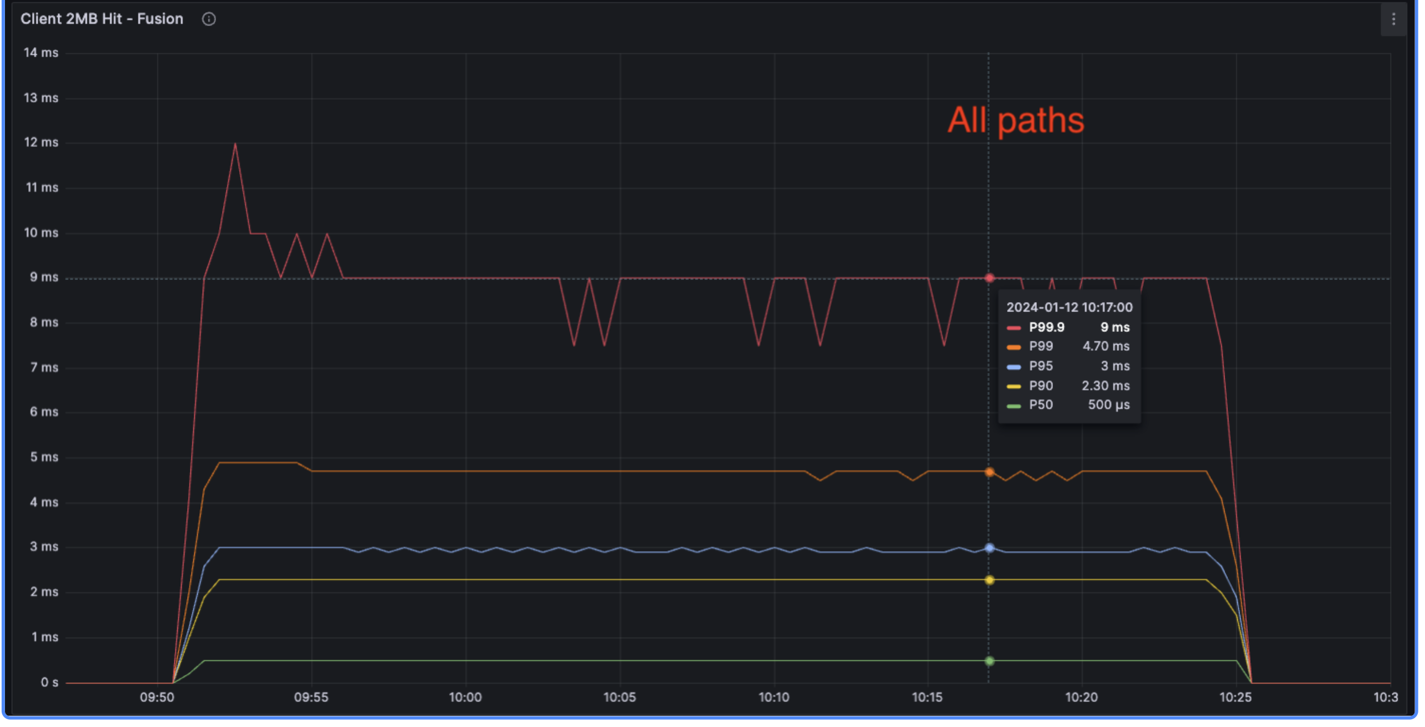
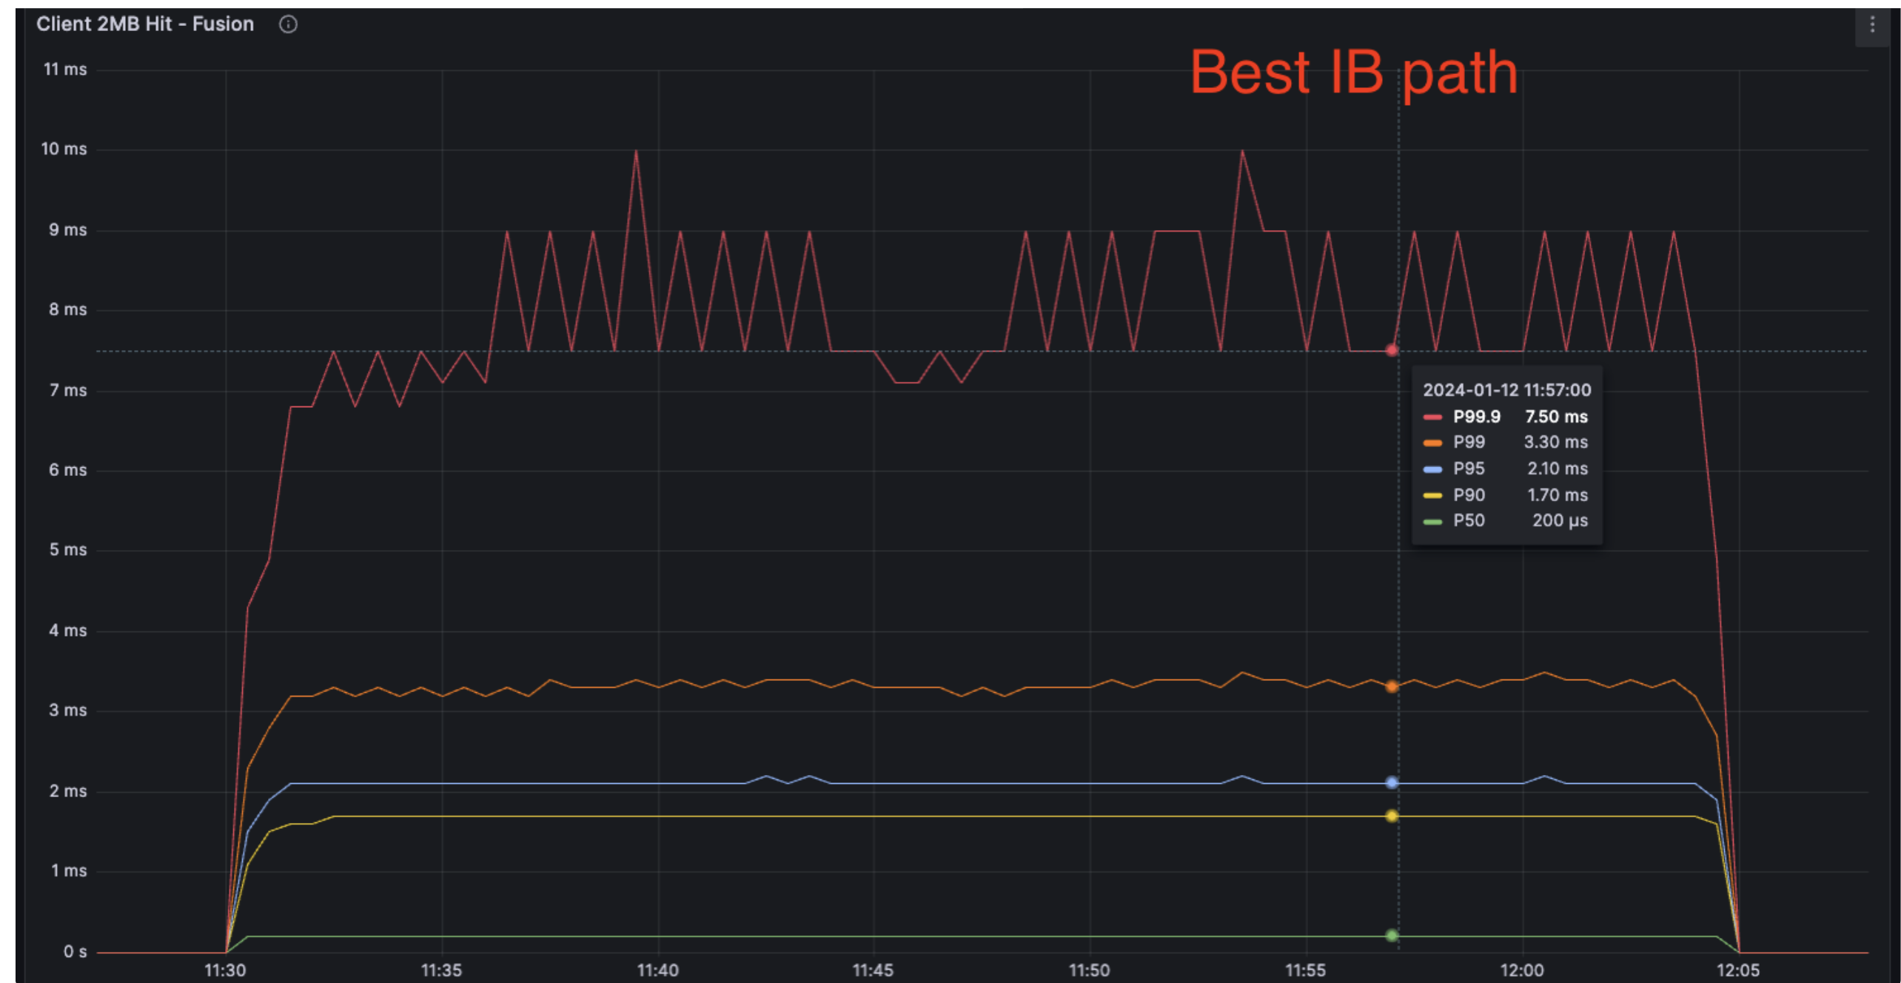
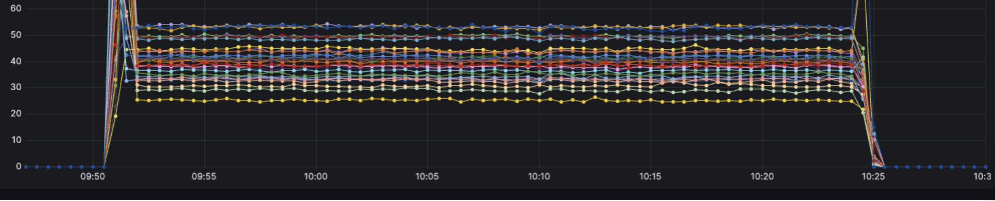
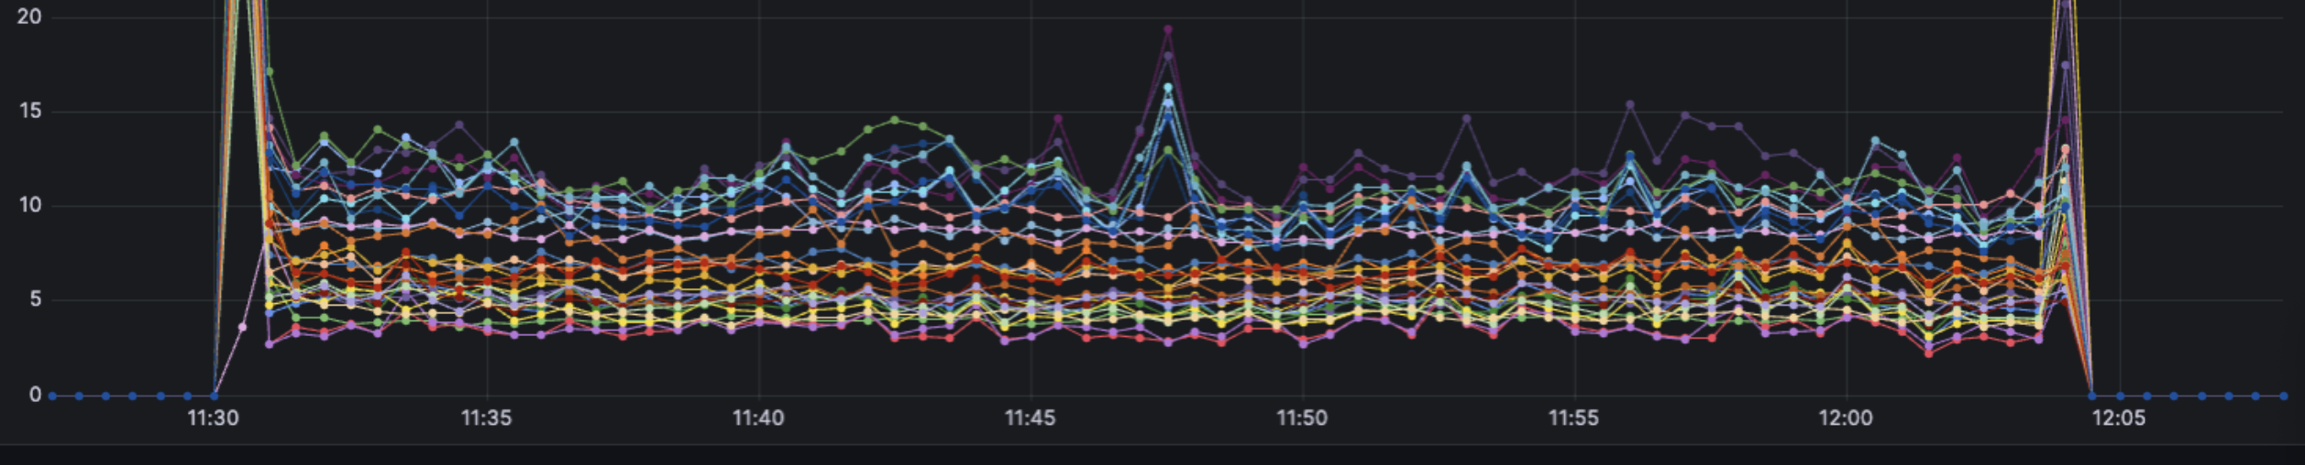
Infiniband fabric-aware routing
Varnish caches have multiple HBAs
Shard over all caches, but client routes via the best interface
Reduces P-values, fabric congestion

