Slide 1



RAL Site Report
HEPiX Spring 2024, Paris
Martin Bly et al.
April 2024

Slide 2
Outline
DC24
Batch/Tape/Echo
Procurement
Time series data
Space
Thanks to colleagues for their input

Slide 3
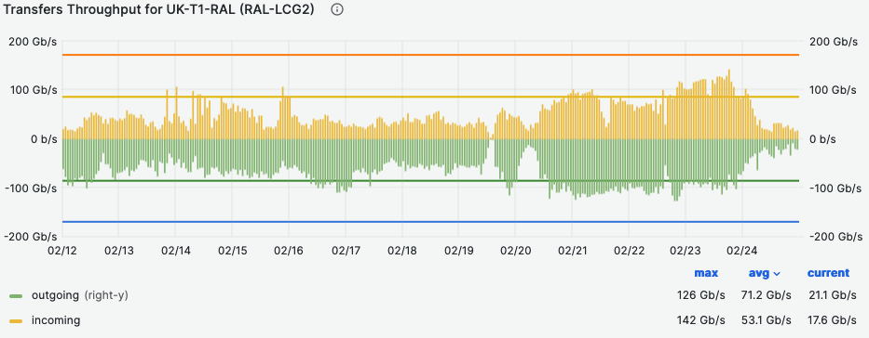
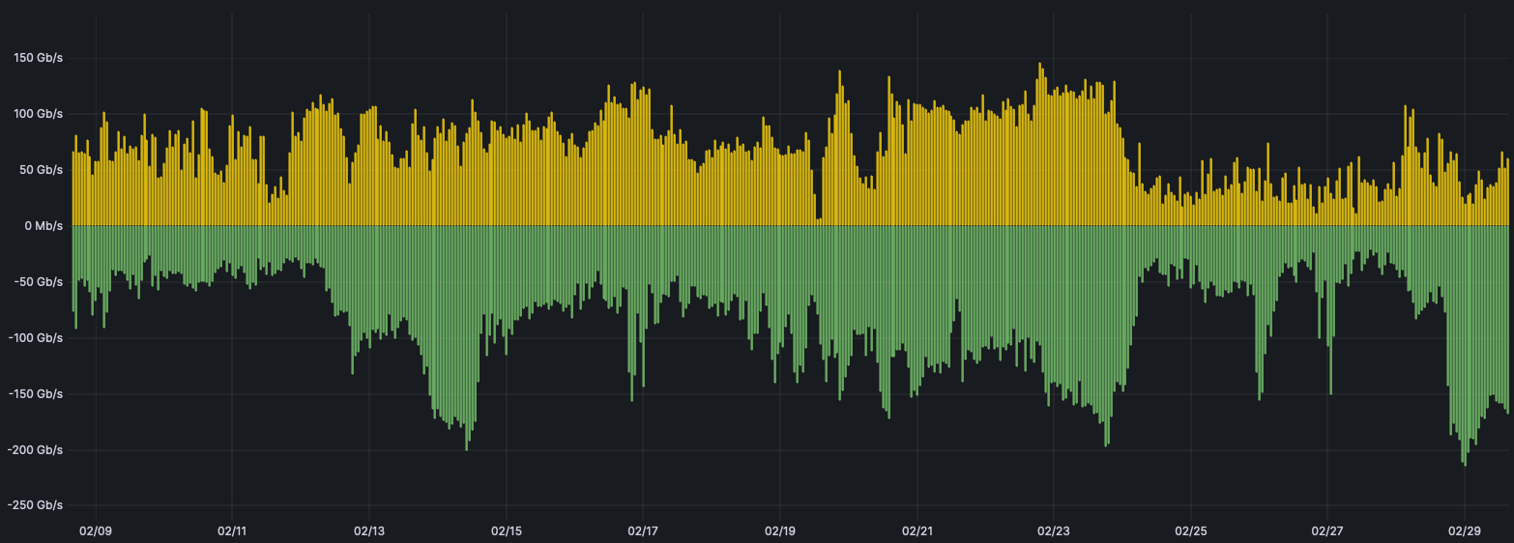

DC24 - Overview
Overall DC24 was very successful for RAL.
  Significant network problems at the start of challenge resulted in low initial throughput.
At the end, throughput was 2 – 3 times higher than we ever saw before:
  We found a new set of bottlenecks well above Run 3 normal load that can be worked on over the next few years.
  Fantastic effort from the Tier-1 to debug, fix/optimize in real time.
WLCG DC24 Monitoring
Site Link Monitoring

Slide 4
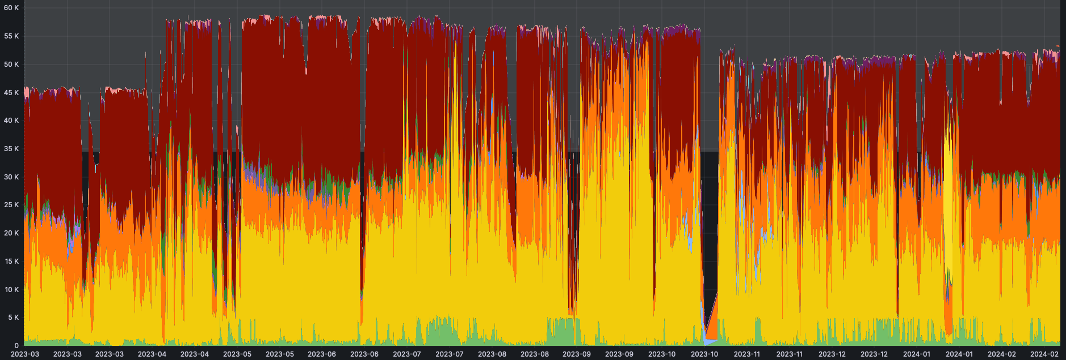
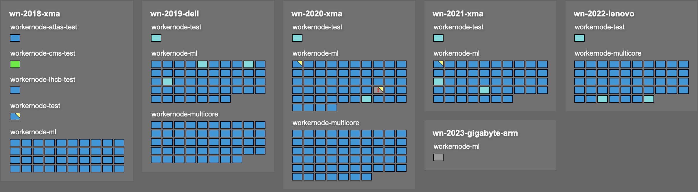
Batch Farm
HTCondor and ARC CEs continue to perform very well for the Tier-1.
  The utilization of the resources very impressive when compared to other science areas.
The most frequent operational problem is with VOs not always receiving their desired fairshare.
  This problem will become more complex as we add different architectures.
Tom Birkett has setup a pre-prod cluster (which runs actual work and is accounted, and can be used to test the latest patches).
  We have a single node dual stack which is being tested.

Slide 5

Tape Libraries
DMF service now migrated to new server/storage hardware
  RHEL 8.8
  Service using Obelix Library
  Data on tape migrating From Oracle library to Obelix as service runs
2 x SpectraLogic tFinity libraries
  Asterix (WLCG) – 15 Frames
  Obelix (Others) - 13 Frames
1 x Oracle SL8500
  System backups
  To be phased out when system backups replacement solution identified.
Notes:
Asterix is possibly still the longest in Europe

Slide 6
Echo status and plans
Echo recently exceed 100PiB of raw capacity.
Backend storage working very well.
  Many operational changes can be done transparently, and the team is trying to automate them where possible.
2024 Q2:
  SL7 → Rocky 8
  Decommission 2017/18 generations of hardware
  Continue deployment/weighting up of 2022 hardware
Q3
  Complete deployment and decommissioning
  Upgrade Ceph from Nautilus to Pacific
  Start deployment of 2023 Storage
Longer term:
  implement rack-level failure domains
  Plan to upgrade Ceph Pacific -> Reef in ~ April 2025

Slide 7
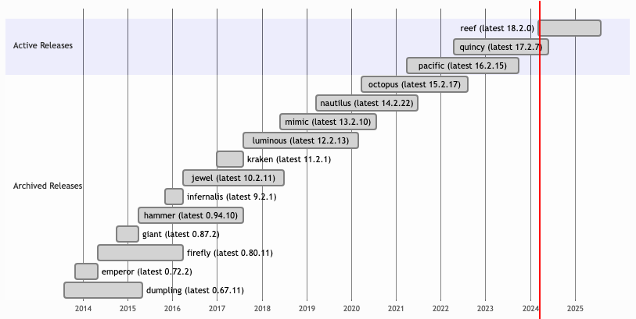
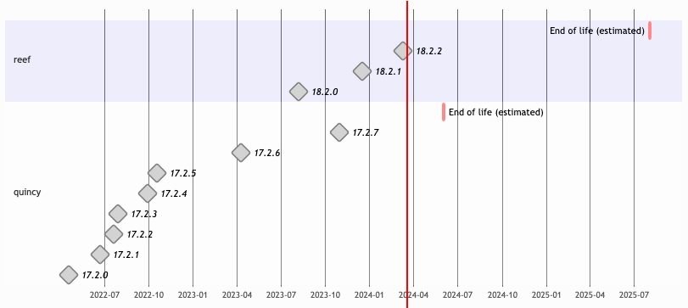
Ceph release schedule
Our last major Ceph upgrade was in May 2020!
Currently we are on Nautilus.
Double upgrade to Pacific by September 2024.
Double upgrade to Reef for April 2025.
In GridPP7 want to aim to be looking to upgrade to latest release once it has been out for 6+ months.

Slide 8
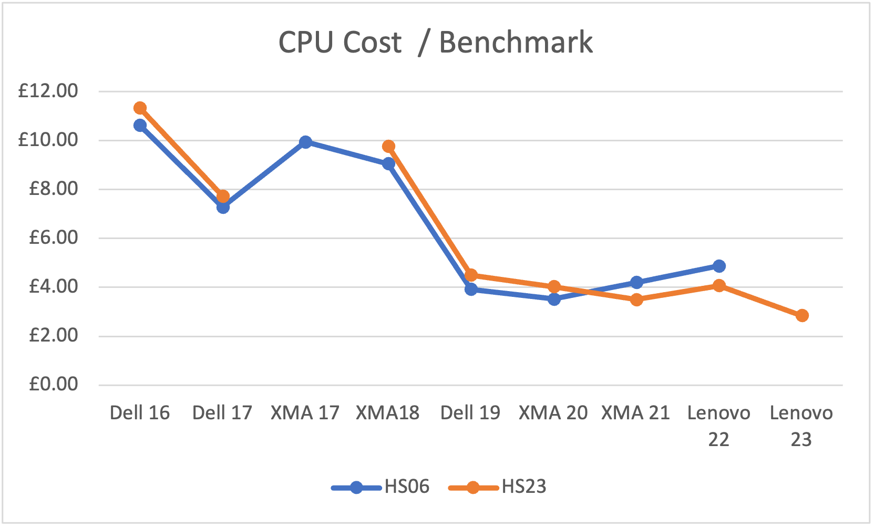
CPU procurement
This year SCD did a joint CPU procurement for JASMIN, SCARF, Tier-1 and the STFC Cloud.
  Compute, Memory and OS Disk were identical, differences in networking and local storage.
407 servers in total, 36 for Tier-1, with:
  Dual AMD EPYC 9654
    ~ 6000 HS23 each).
  24 x 64GB memory (= 1.5TiB memory).
    JASMIN purchased some with 6TiB memory.
  480GB SSD OS drive.
  Mellanox ConnectX-6 25Gb/s NICs.
    Bluefield version for the Cloud

Slide 9
Disk and other procurement
We purchased 32 Dell Storage nodes for Echo T1 storage
  28 x 22TB drives.
  2 x 16C/32T CPUs
  480GB SSD OS Disk
  256GB memory
  25Gb/s Mellanox NIC.
  Installed, almost ready for handover to Storage Team
Echo gateways
  4 with 25Gb/s NICs
  1 with 100Gb/s NICs

Slide 10
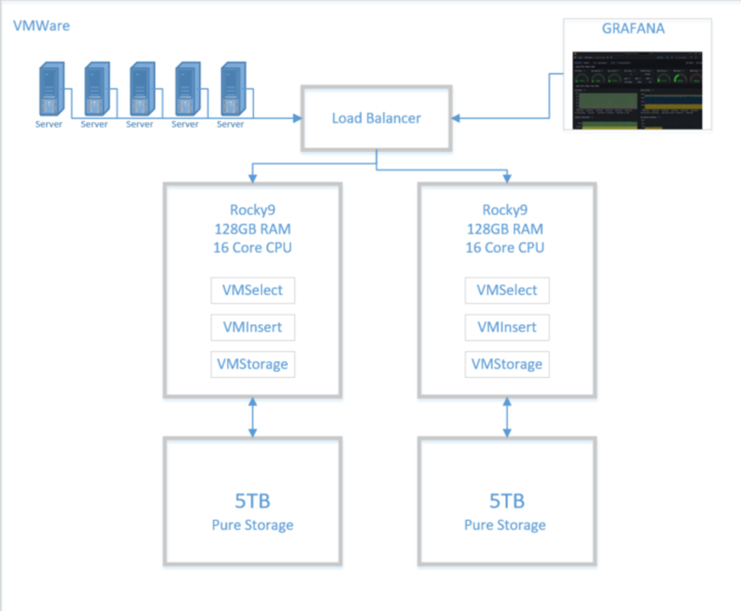
Victoria Metrics
We currently use InfluxDB for our time series monitoring.
  Very old version – Security is OK because not publicly accessible.
We are running a (joint) project to replace it.
  New service will be called Timon = TIme MONitor
We currently plan to move to Victoria Metrics.
  I am negotiating to get the Enterprise version for a 3 year contract at ~£20k per year for 0.5 million data points per second ingest.

Slide 11
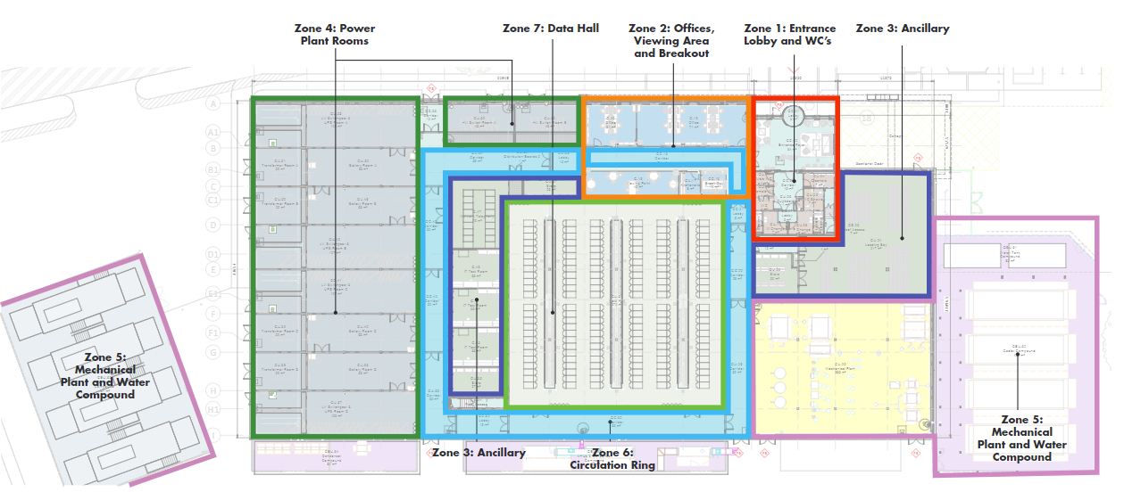
RCC – R130
On Hold

Slide 12
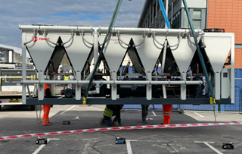
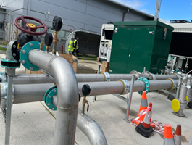
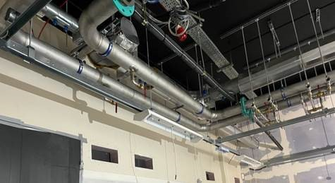
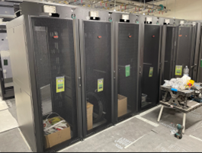
While we wait… New DC Update
Converting one of the operations areas in the existing DC
  Progressing…
  16 x 750mm wide racks, water cooled doors, rack power depends on size of coolers (~37kW rack)
  Services, power etc., - top feed
  No UPS, compute only

Slide 13



Notes:
The abstract pattern can be removed or repositioned if required. Be careful to ‘Send to Back’ so that it does not obscure any important information.

Slide 14

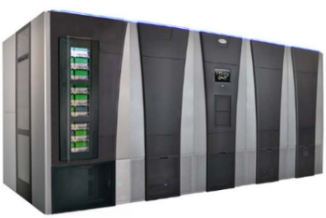
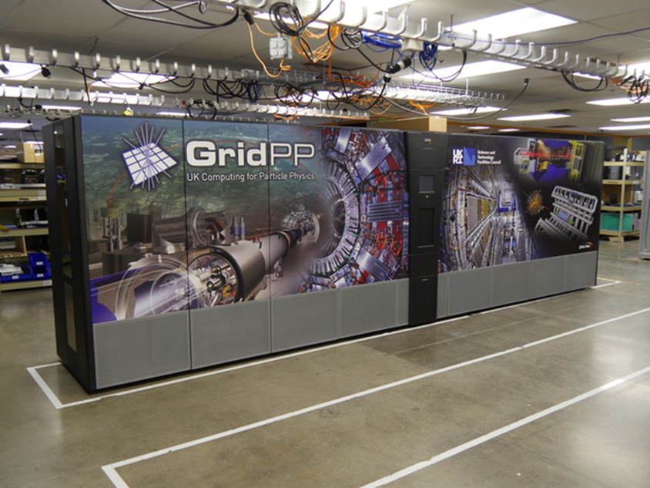
XRootD Client
XRootD Client
Antares:
Current setup
TPC proxies
Data
Metadata
x8
Facilities EOS cluster
Tier-1 EOS cluster
CTA Frontend/CTA CLI
x1
x9
x13
CTA Catalogue
TS1160
Tape Drives
Facilities CTA Tape Servers
Tier-1 CTA Tape Servers
CTA object store
Facilities SpectraTfinity tape library
x28
x17
x17
x4
LT08
Tape Drives
LT09
Tape Drives
TS1160 Tape Drives
LT09
Tape Drives
Tier-1 Spectra Logic
Tfinity tape library
x12
x4
x20
x14

Slide 15
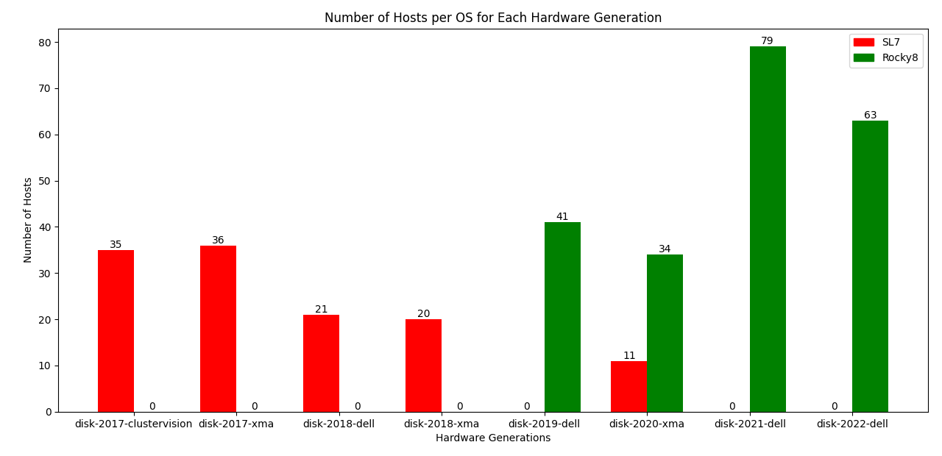
Rocky 8 Upgrade Progress – Echo Storage
OS upgrades to Echo storage nodes are automated
  Working hours only
Each storage generation has its own foibles
  Development needed each time
  We intend to decommission 2017 before the SL7 EOL
  If we can decommission 2018 as well, we will.
Credit to Maksim for the graph and much of the work.

Slide 16
Tier1 Batch Service
Running HTCondor
  Condor 10 beginning of November
    This will give us continued LTS support for Condor
Working on:
  Continued testing of Tokens through ARC-CE, most notably the testing of ARC-CE7 when available.
  xrootd container optimisation and architectural “re-imagining” of how the Docker xrootd containers will interact.
  Rocky 8 for the ARc-CE’s
    Likely will take the longest, lots of continued testing

Slide 17
CTA Tape service (Antares)
2 EOS clusters, Tier-1 and Facilities, against a single CTA instance
EOS: 4.8.105-1, CTA: 4.8.7-1
Tier-1 EOS cluster: 13 x 1.5TB SSD nodes
  Ingest space: 200TB, Retrieve space: 172TB
Facilities EOS cluster: 2 x 3.5TB + 7 x 1.5TB SSD nodes
  Ingest space: 190TB, Retrieve space: 265TB
Migration of the last CASTOR instance completed in early June
Notes:
EOS data caches
RIP CASTOR

Slide 18
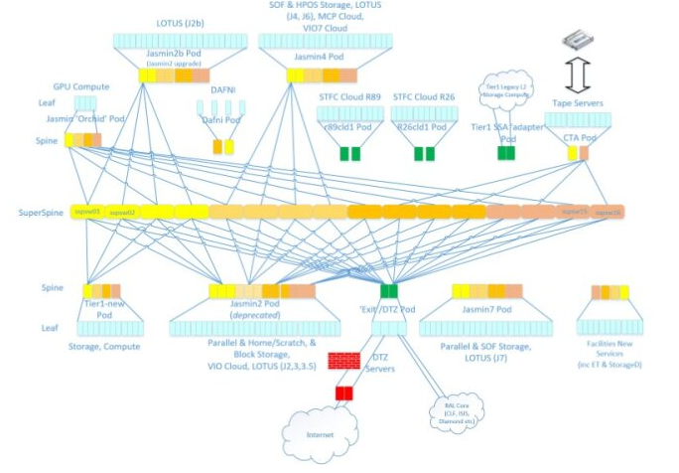
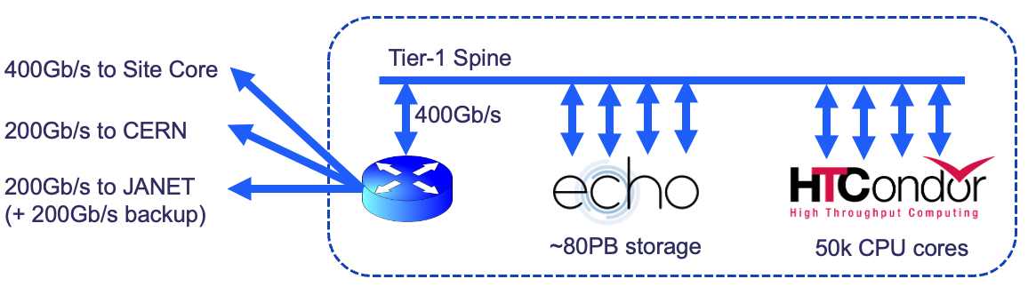
Tier-1 Network
For the last 3 years there has been significant working within RAL to upgrade the network.
  Completely replace the Tier-1 network
  Build a network Super Spine to link the various HPC projects.
RAL Tier-1 is on LHCONE
  Recently announced 2001:630:54::/52
  WN have been for several months (IPv4 only), storage (dual stack) is being migrated now.
Routing preference:
  LHCOPN
  LHCONE
  JANET link

