Slide 1
Ready for Windows 11 in your endpoint device park?
Sébastien Dellabella, Siavas Firoozbakht, Michał Kwiatek
HEPiX 2024 (Spring)

Slide 2
In this talk :
    CERN-Managed device park overview
    Past experiences with major Windows upgrades
    Challenges of migration to Windows 11
      Establishing device compatibility
      Migration mechanics
      Software compatibility
      Data Privacy with Microsoft Copilot
      Migration planning
    And what if you cannot migrate?

Slide 3
CERN-managed device park overview
Engineering + Accelerators and Technology sector
Experimental Physics
Administrative sector
IT
Theorical Physics, Beams and smaller sectors
10000 CERN managed Windows endpoints
  Deployment is staged in 5 rings which progressively include all CERN sectors
  For a tailored schedule,
  we use different tools:
    Windows Update (GPOs)
    CMF

Slide 4

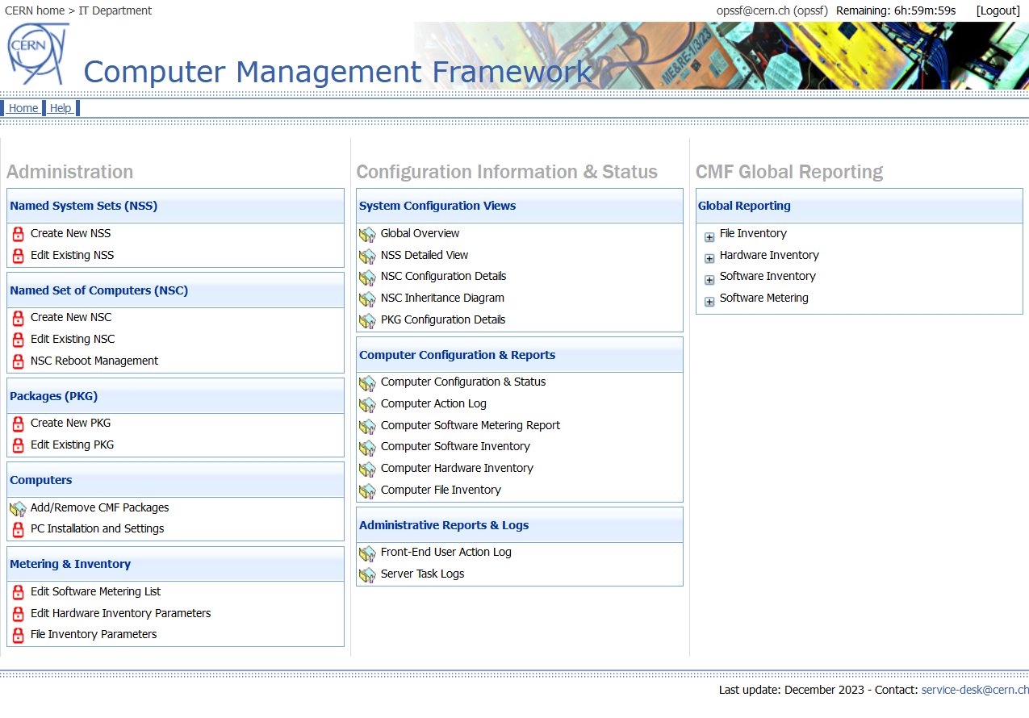
Past experiences with major Windows upgrades
Tools we use
  CMF is a CERN proprietary software deployment tool (similar to System Center Configuration Manager from Microsoft)
    Used mainly to deploy software and feature updates with a tailored schedule

Slide 5
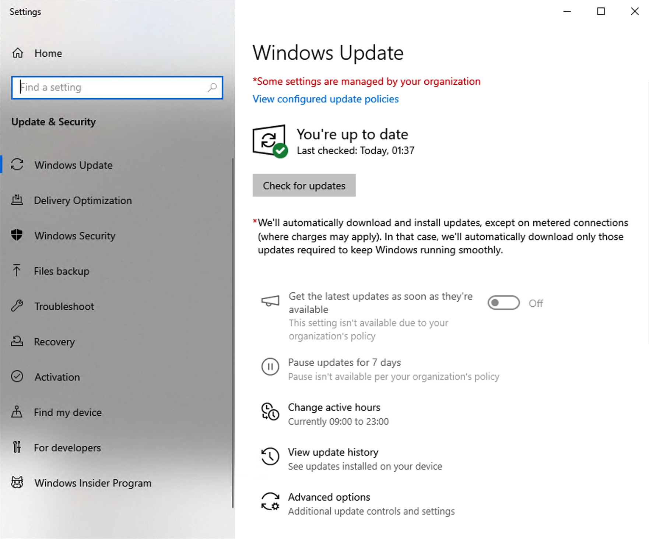
Past experiences with major Windows upgrades
  Tools we use
    Windows Update is a built-in update mechanism provided by Microsoft
    on Windows.
      Used by default CERN-wide to deploy quality updates and feature updates with a flexible schedule
      Very useful when devices are not connected to the CERN Network; scheduling capabilities more limited than in CMF

Slide 6
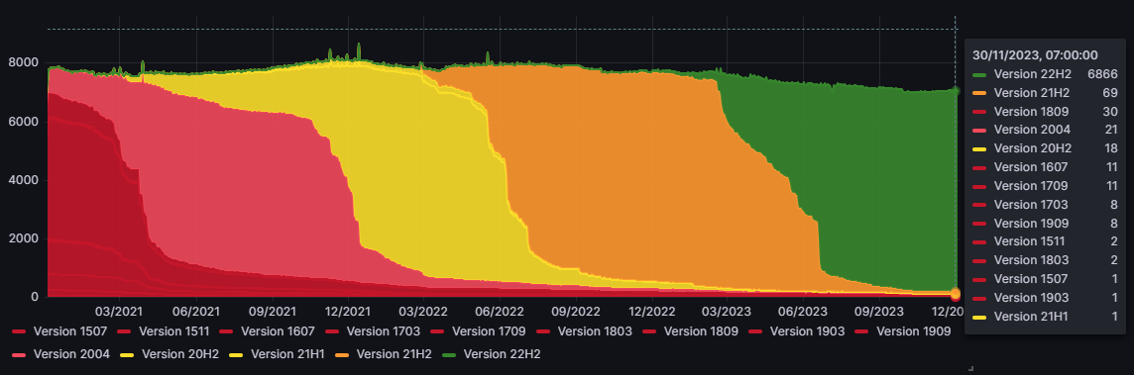
Past experiences with major Windows upgrades
  Previous migrations
    Upgrading from Windows 7 to Windows 10 was easier
      Windows 10 require a processor running at 1GHz minimum
      The first 1GHz Intel processor was the Pentium III released already in 1999, 15 years before Windows 10.
    Migrating from one Windows build to another was almost flawless using the tools mentioned before as requirements didn’t change over time.

Slide 7
Challenges of migration to Windows 11
  Windows 11 hardware requirements are more restrictive:
 | Windows 10 | Windows 11
Processor Minimum | 1GHz CPU or SOC | 1GHz on a CPU that is not older than 2017 (8th Gen) with at least 2 cores
TPM 2.0 and UEFI | Not Required | Required
Storage for upgrade installation | 20Gb | 64Gb
RAM requirements for 32bits system | 1Gb | Not Supported
RAM requirements for 64bits system | 2Gb | 4Gb
Display Minimum | Direct X 9 , WDDM 1.0 driver, 800x600 resolution | Direct X 12, WDDM 2.0 driver, 8bits / colour channel, HD support

Slide 8
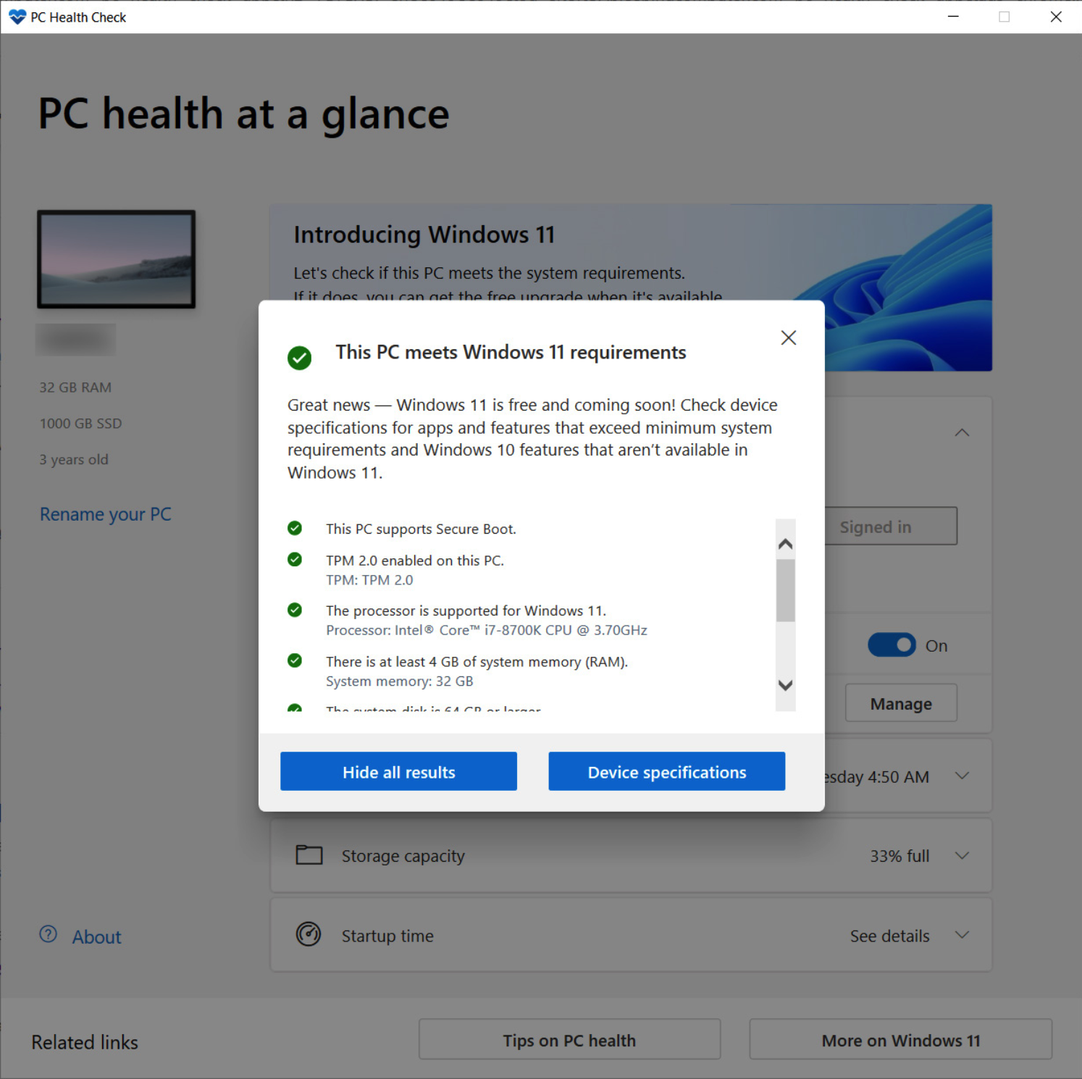
  Establishing device compatibility 1/4
  PC Health Check
    Recommended by Microsoft
    Only works with individual PCs
    Impossible to centralise results
    Not working on domain-joined devices

Slide 9
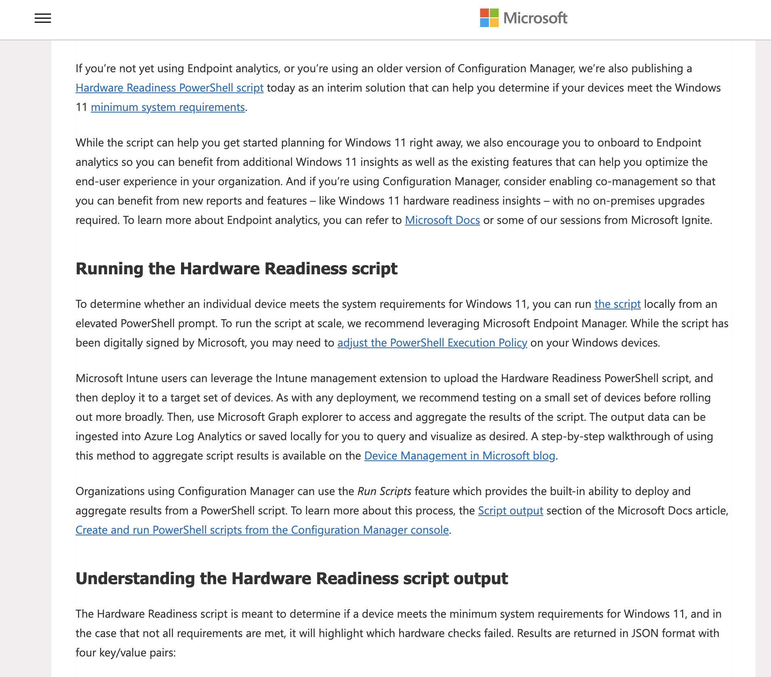
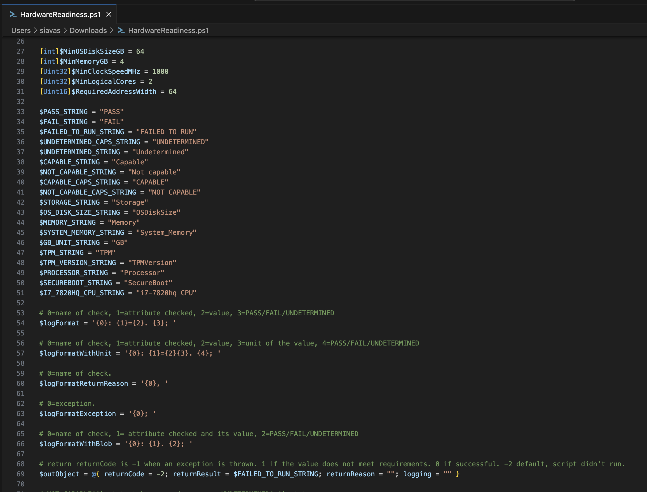
Establishing devices compatibility 2/4
  Microsoft’s PowerShell readiness script
    Useful at first but became outdated quickly as Microsoft changed the list of supported CPUs over time.
    Impossible to keep the supported list of CPUs updated automatically, the script is not dynamic

Slide 10
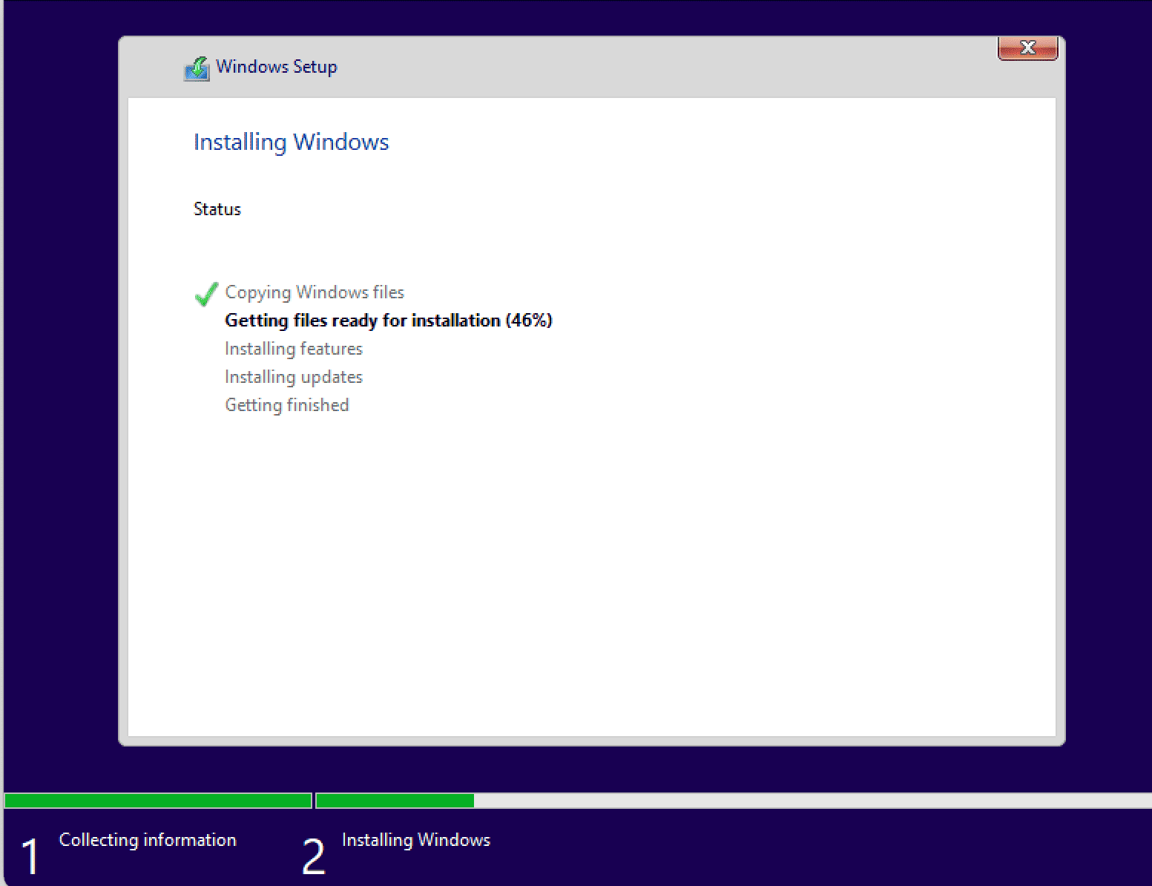
Establishing devices compatibility 3/4
  Windows Setup as a compatibility checker
    The Windows Setup executable has a special parameter for that (/compat)
    Advantage: Obsolescence of the PowerShell script is solved
    Cons: Process hanging and not yielding any results from time to time

Slide 11
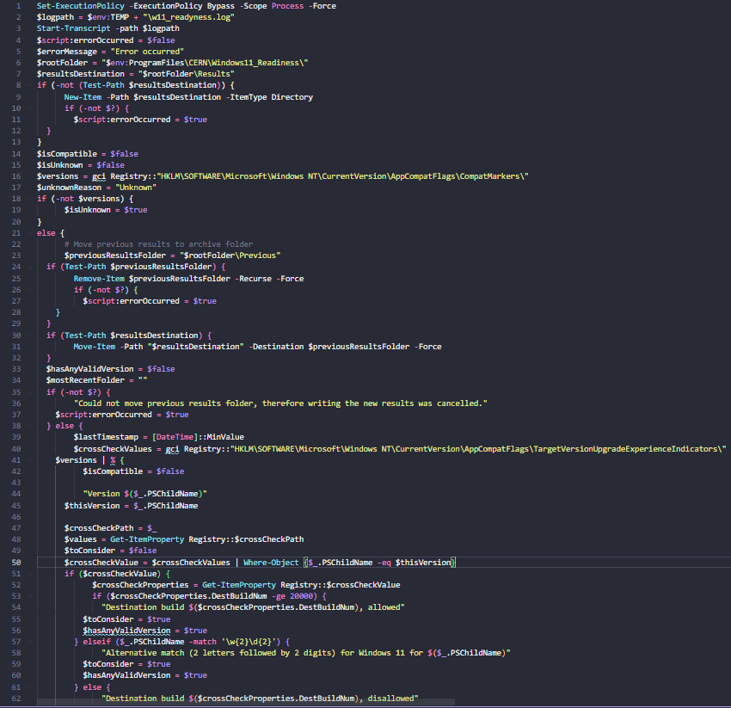
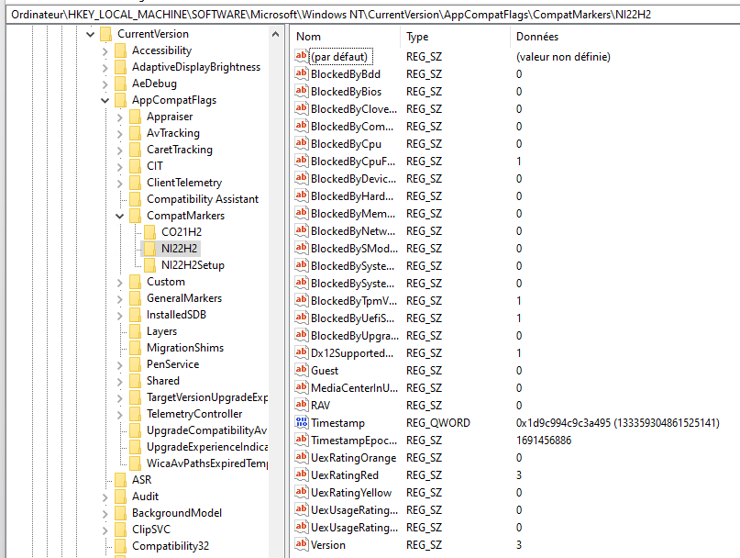
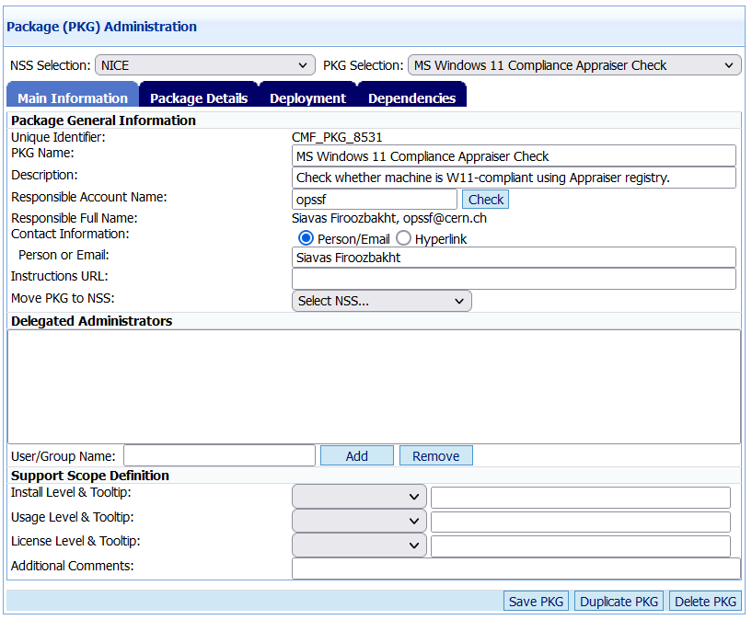
Establishing device compatibility 4/4
  Windows internal checker (Appraiser)
    Advantage: dynamically updated by Windows
    Cons: not officially documented by Microsoft
    Final choice: reliable results for 94%
    of our Windows device park

Slide 12
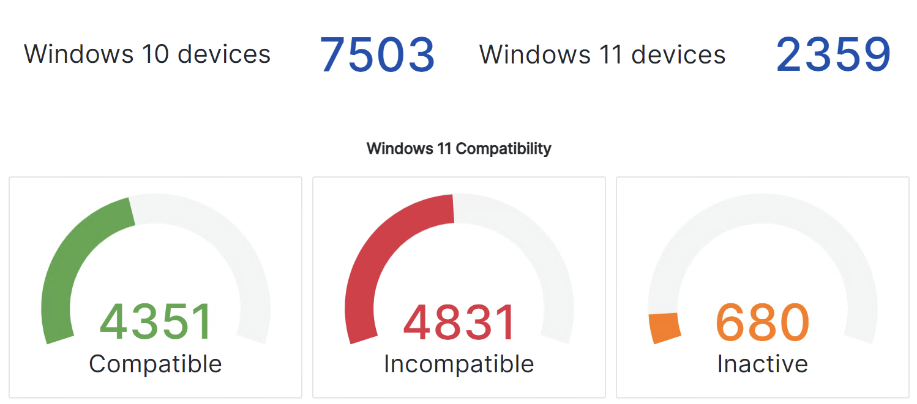
Device compatibility
Approximately 10000 desktops in total are CERN-managed
  4831 of which are not compatible with Windows 11
    3906 are physical devices, 925 are OpenStack VMs in the CERN Cloud

Slide 13
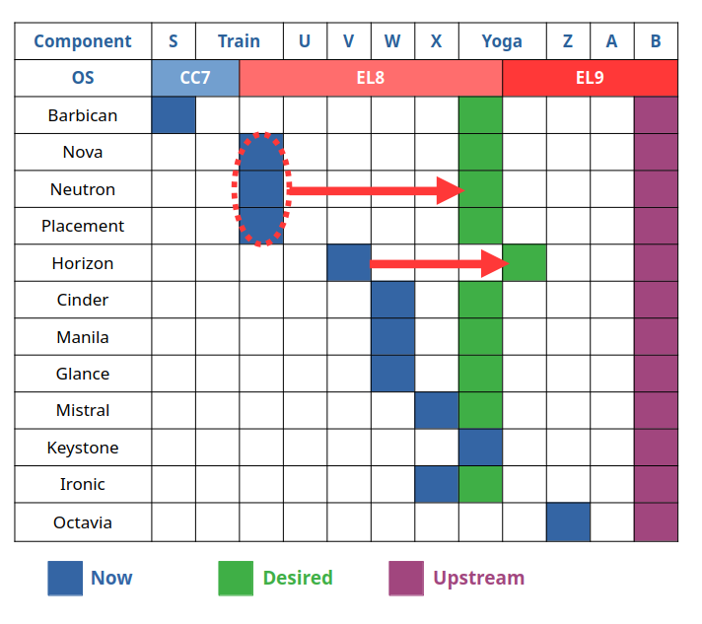
Migration mechanics – OpenStack VMs
  Windows 11 requires TPM 2.0
  and a compatible CPU (>= Intel Cascade Lake)
  which in CERN OpenStack translates to:
      Upgrading from Train (T) to Yoga (Y)
      to enable vTPM support on compatible hardware
      Hypervisor upgrade (cc7 to el8)
  Windows 11 VMs can now be installed in CERN OpenStack
  Limitation: vTPM cannot be added on existing VMs
      As a physical device attached to a VM, it prevents some operations like live-migrations and rebuild
      Existing Windows 10 instances cannot be upgraded in-place to Windows 11

Slide 14
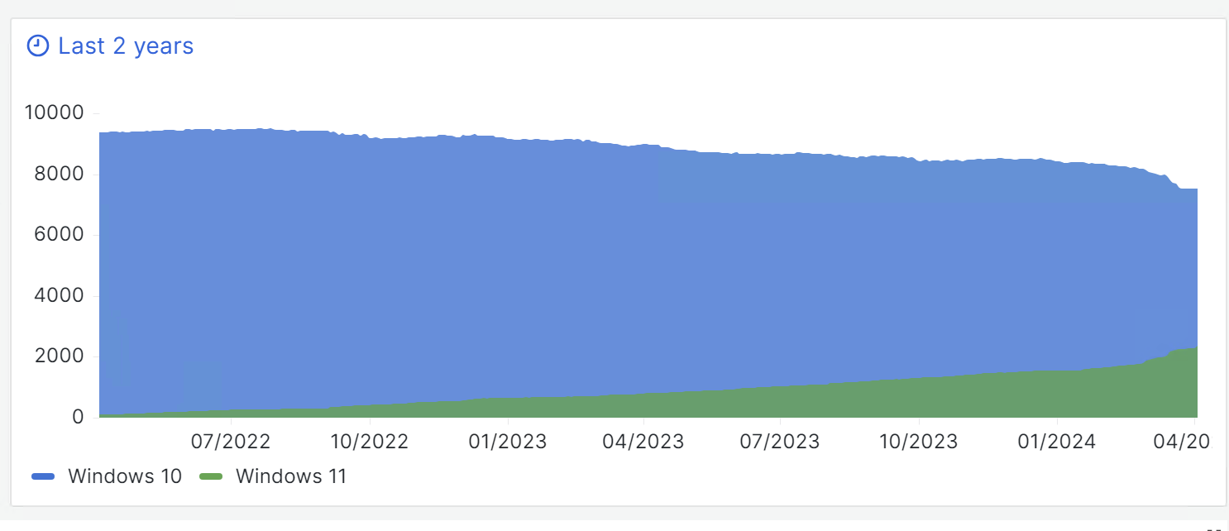
Migration mechanics – Physical devices
    Deployment via an in-place upgrade package in CMF with a tailored schedule over the first 6 months of 2024
    Windows 11 has been proposed by Windows Updates automatically but would not be forced by MS until Windows 10 reach EOL (October 2025)

Slide 15
Migration mechanics – Physical devices
    An in-place upgrade is not possible when the original OS language is different from the OS language of the upgrade package.
      Impossible to install our proposed English International (UK) version on English US systems.
      Solution: We remotely deployed and installed the language pack and changed the OS language on concerned systems prior to Windows 11 upgrade.
    An in-place upgrade is not possible even with more than 20 GB of free disk
      Microsoft recommend at least 20 GB of free disk space in the official specifications, but sometimes up to 37 GB is requested.
      Solution: We implemented additional checks in the Windows package to ensure the system will have enough disk space to perform the upgrade after the setup is launched

Slide 16
Software compatibility
  The version of one of our main CAD software is currently not compatible with Windows 11
    Impossible to migrate to Windows 11 until a compatible version has been deployed
    Mitigation: Additional dependencies in the CMF package to ensure migration is on hold until required version of the given software has been deployed
    Solution: engage with the CAD software support to establish a feasible migration timeline
  New Windows 11 security features interfere with software widely used at CERN
    Concretely: Credential delegation in PuTTY and StarNet X-Win32 does not work with Credentials Guard (a feature of Virtual Based Security on Windows 11), which allows isolation of secrets such that only privileged system software can access them.
    Workaround for Putty: disable credential delegation
    Solution for X-Win32: in preparation, feature request has been accepted by StarNet
    More information on Credential Guard and Virtual Based Security:
    https://learn.microsoft.com/en-us/windows/security/identity-protection/credential-guard/

Slide 17
Data Privacy with Microsoft Copilot
Copilot brand is used for a dynamic family of ChatGPT-like products that leverage the same LLM models (GPT-3, GPT-4 Turbo)
Microsoft is aggressively extending the Copilot brand to a wide range of products, both old and new
Previous “Bing Chat Enterprise” (free of charge) is now ”Microsoft Copilot”
    Offers new feature for enterprise data privacy called ”Commercial data protection”
    Is a likely replacement for Cortana, the previous Windows assistant, whose standalone app was discontinued in June 2023.
    Is increasingly integrated with the operating system
  Not to be confused with:
    Copilot Pro
    Copilot for Microsoft 365
    GitHub Copilot, Copilot Studio, etc.

Slide 18

Clarifying Copilot confusion
Personal account | Work account
What is Copilot…for us
    Copilot is the ChatGPT-like AI assistant by Microsoft released in February 2023.
Uses thePersonal account
Work account
      same models as ChatGPT: GPT-3, GPT-4 Turbo.
      In addition, it can perform searches in Bing and in workplace files
    Launched initially as Bing Chat Enterprise, renamed in November 2023 to Microsoft Copilot
    It is intended as a replacement for Cortana, the Windows assistant, whose standalone app was discontinued in June 2023.
    Multiple editions are available with different licensing conditions.
      Available at https://copilot.microsoft.com and in various other places such as Windows, Edge browser, Office 365 apps depending to the edition.
Copilot
Free of charge
Can also be used anonymously (limited)
Copilot
optionally with Commercial data protection
Included in A1/A5
(previously Bing Chat)
Out of scope
Copilot
$22/user/month
Copilot for Microsoft 365
A5 + $30/user/month
PRO

Slide 19
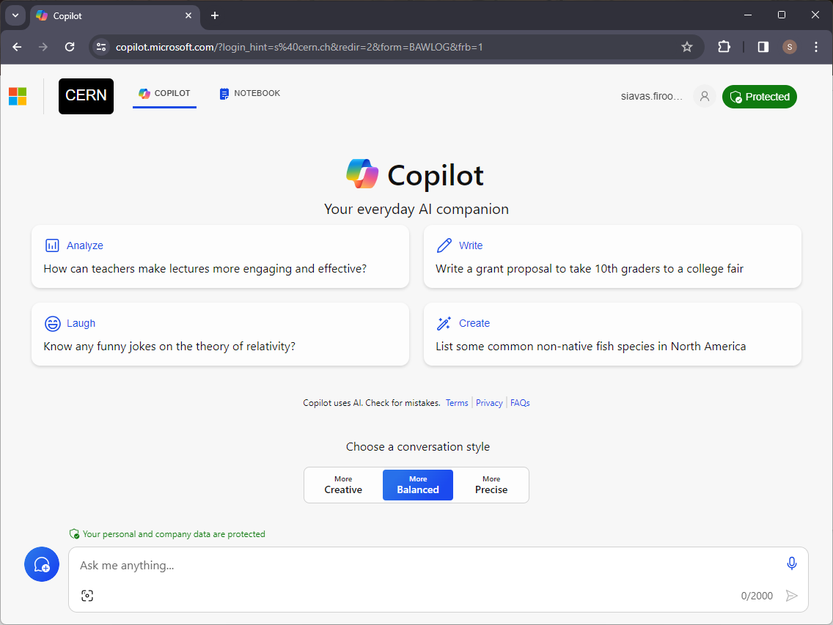
Data Privacy with Microsoft Copilot
  When the user is logged on with an account that has an A1/A5 licence item “Commercial data protection for Microsoft Copilot” enabled:
  The free of charge Microsoft Copilot^{*)} does not access or use any organisational data other than the one directly provided in the chat as prompts. Organisation and user information is removed from the chat data at the start of a session.
  None of the data provided is used to train the underlying LLM model
  Sessions are temporary and cannot be saved. The session is closed when the browser tab is closed or when the current login times out. Chat history is not available.
  Advertising in Entra ID is not based on chat history. In Copilot, however, advertisements pertinent to the chat session may be shown.
  No usage reports and auditing are available to administrators of the Organisation
  The data that is collected from prompts and responses lives as long as the session.
  To provide chat responses, Copilot uses global data centres for processing and may process data in the United States. Optional Bing-backed connected experiences don't fall under Microsoft's EU Data Boundary (EUDB) commitment.
No enterprise data protection if Microsoft Copilot is used anonymously
or with a private
account
^{*)} Other Copilot flavours have different data privacy challanges, out of scope of this talk

Slide 20
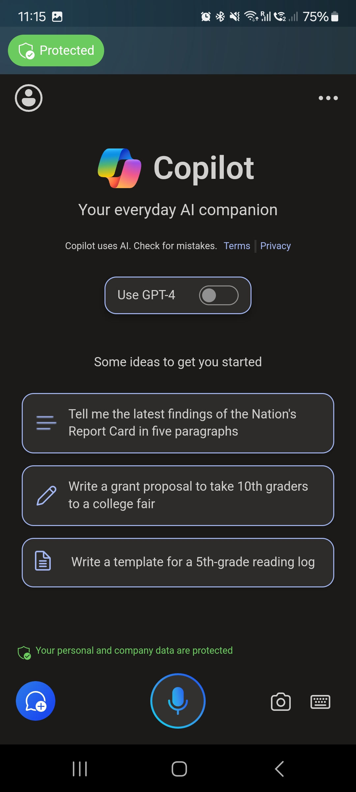
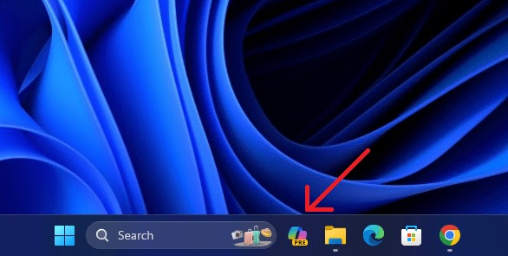
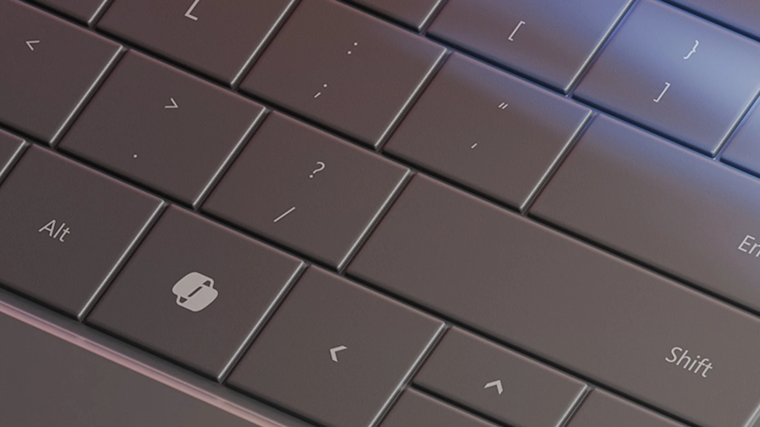
Data Privacy with Microsoft Copilot
We expect Copilot to be integrated in Windows OS
in the future
    Foreseen for Windows 11 24H2 in Fall 2024
Also, in PC hardware (dedicated key on the keyboard)
Our intention is to enable it in a way
that ensures appropriate
data privacy
    M365 A1/A5 licences
    GPOs

Slide 21
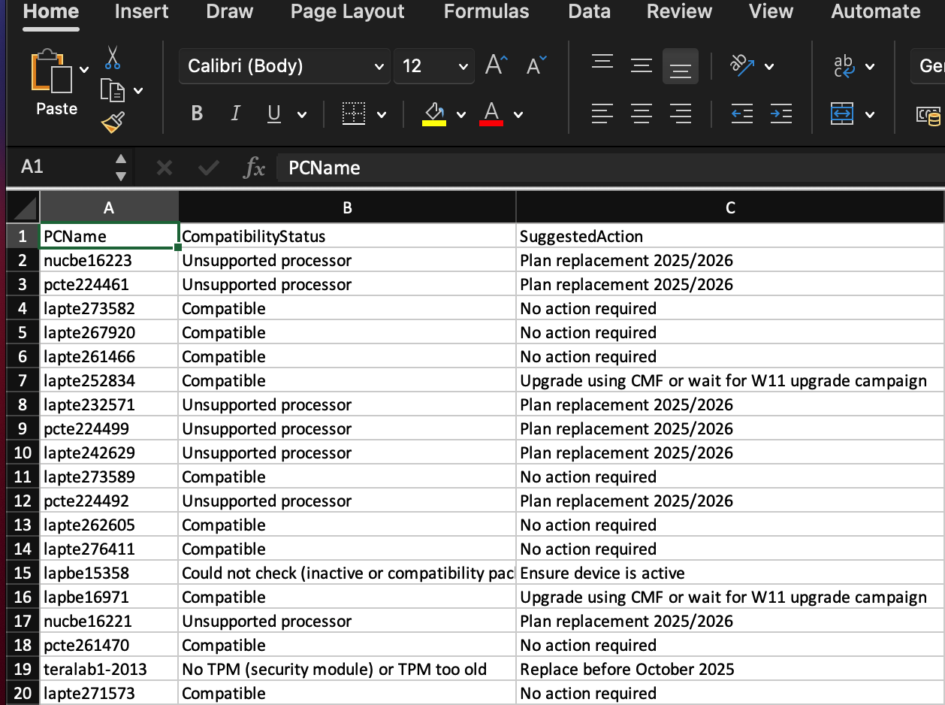
Migration planning
  At CERN, endpoint device purchasing is done per administrative units/experiments and there is no central purchasing plan
  Communication around the migration started
  2 years before the end-of-support date and includes:
    Presentations to the IT representatives
    of user communities
    Providing of up-to-date data regarding device compatibility in each department
    Technical help to dedicated support teams
    Monitoring the evolution of the migration across CERN user communities and follow-up
    with their representatives

Slide 22

And what if you cannot migrate?
Extensive discussions with Microsoft have not been promising so far
    Microsoft would not change hardware compatibility criteria
    8th Generation processor remains the minimum
    Proposed alternative was to move end-user devices to the (Microsoft) cloud
    and replace current devices with thin clients
Possible alternatives
  Consolidation: workloads from multiple devices combined into small number
  of newer devices ^{COST—}
  Recycling: devices could be used with another OS, ex.: Alma Linux or RHEL9
    Devices produced after 2014 support x86_64-v2 architecture which is the requirement for RHEL9 ^{COST—}
    The cost of user training may be higher than the cost of replacing the hardware ^{COST++}
  Switching to Windows Server OS for specific workstations where supported ^{COST+}
    For engineering workstations where hardware is planned to be replaced in 2-3 years
  In specific scenarios, switching to Windows 10 Ent. LTSC or IoT LTSC (supported until 2027/29) ^{COST++}
    Only to be considered for computers where licenced software requires running Windows 10
    (e.g., workstations with engineering software or control equipment).
  Migrating to the latest build of Windows 11 late in 2025 overriding HW requirements ^{COST—}
    To extend HW lifetime by up to 12 months, assuming possible with W11b24H2 (TBC when released)

Slide 23


To conclude :
  Windows 10 end-of-life is 23 October 2025
  Plan and communicate early
    despite uncertainty caused by evolving HW requirements
    it makes budget planning easier
  Identifying (in)compatible devices may be a challenge
  Consider data-privacy impact of Copilot
  All alternatives to replacing old hardware come with its own cost
  It is an opportunity to consolidate your device park

Slide 24
Questions? Thoughts? Your own experience?
Thank you for your attention !
Sébastien Dellabella, Siavas Firoozbakht, Michał Kwiatek
HEPiX 2024 (Spring)

