Slide 1
The intelligent operation and maintenance system of the IHEP computing platform
Yaosong Cheng, IHEP
HEPIX 2024 Spring
Paris, 19.4.2024
Notes:
I’m yaosong , come from IHEP. I will talk about a

Slide 2

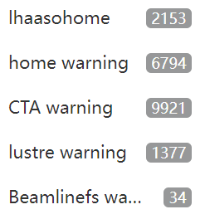

Background
IHEP HTC cluster: ~35k cpu cores, ~300 active users, ~500k completed jobs/day
Problems encountered during the operation
  High IO latency
  Read-write failure
  Server crash
  Performance bottlenecks
  Resource contention
What issues are occurring with the server ?
Which process is consuming resources ?
Whose jobs caused the exception ?
How to recover the service?
Notes:
A large HTC cluster at IHEP includes about 35k cpu cores , 300 active users, aboult 500k jobs completed per day
But Problems encountered during the operation, like High IO latency，Read-write failure, Resource contention and so on
When the administrator get alerts, we need to judge and analyze …
And then How to restore the service?
it’s a time consuming and boring task

Slide 3
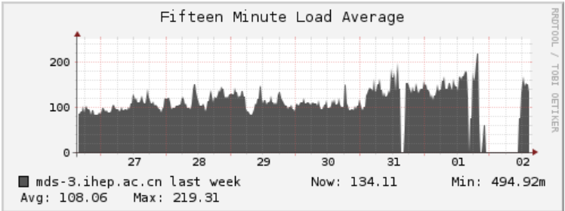
‘Abnormal’ job
Apart from hardware issues, most problems are caused by ‘abnormal’ jobs
What is the ‘abnormal’ jobs？
  Storage resource misusing by user
    massive access in short time
    The disk on the worker node has been exhausted
  Normal jobs: no problem for small number, but a large number can cause heavy I/O burden
The impact of abnormal jobs on the cluster file system
  Server Crashed
  Everyone's access is very slow
For cluster administrators
  Difficult to locate the source of abnormal jobs
CPU_Load
File server crashed!
Notes:
So，in a word…
But What is the ‘abnormal’ jobs here？
We defined two kind of jobs are abnormal, the first type is that Storage resource misusing by user, include …
Second is Normal jobs which is no problem for small number, but a large number can cause heavy I/O burden
When abnormal jobs occurd, the server may crash, and slow down everyone's access.
For administrators，the biggest problem is

Slide 4


Traditional solutions
Depend on the experience of the administrator
Take a long time to solve problems
  Big MTTR (Mean Time to Restoration ), typically in unit of hours
Probably mis-kill normal jobs
Primary cause of the problem may ultimately not be found
Received an alert or user feedback
manual operation
Check the status of the storage
Query the time of occurrence of the anomaly
Filter jobs submitted before this point in time
Analyze programs based on experience
Limit potentially abnormal jobs
Notes:
The Traditional solution is very Depend on the experience of the administrator
When
It do need a long time to fix problems
Occasionally.it might Faild to identify the real cause or mis-kill normal jobs

Slide 5
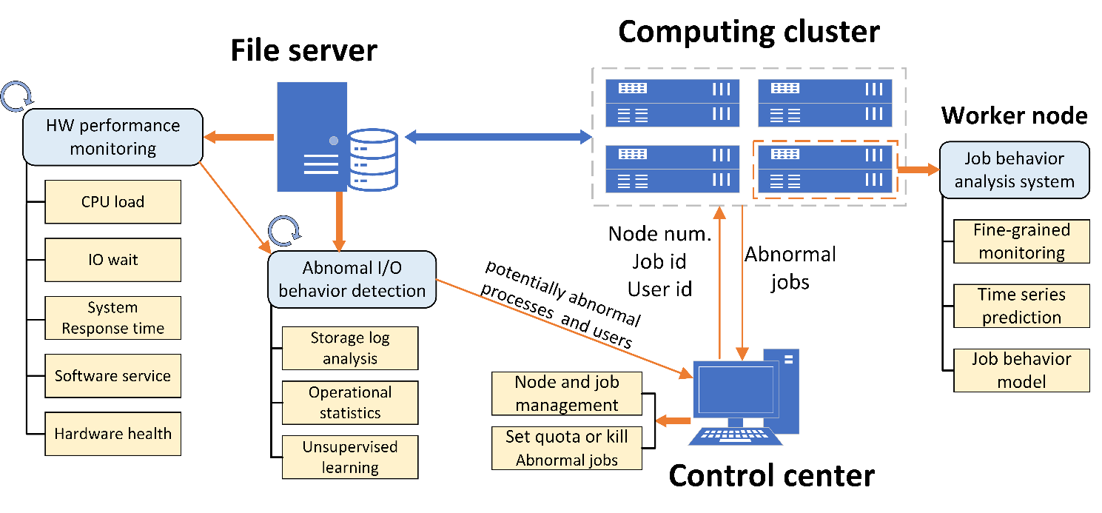
The intelligent operation and maintenance system
Adjust the available resource scale for each user dynamically
The system running on three parts
  Abnormal detection at file servers
    Find potentially abnormal processes & users
  Control Center
    Identify the potentially abnormal worker nodes
    Limit resource usage of abnormal user
  Abnormal detection at worker node
    Identify the abnormal job inside potentially abnormal worker nodes
Notes:
So ,we design and develop the …
Focusing on the adjustment of the available resource scale for each user dynamically
The first,
Second is Control Center, which identify …
The third,
Finally we return to the Control Center to …s
Next is the details

Slide 6
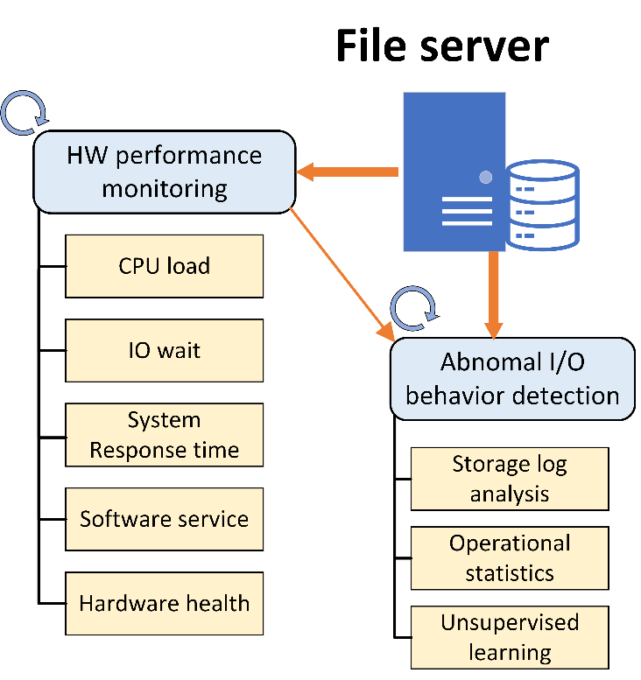
Abnormal detection at file servers (1/4)
Two types of detection running in the background
1st: Detect abnormal I/O behavior of user processes in the file system
  Near real-time statistics of the file system resources consumed by user processes
  Score and rank the user’s I/O behaviors
    Using unsupervised machine learning algorithm
Reduce the suspected scope
  Conducive to further inspection
Notes:
Abnormal detection at file servers
There are…
The first is about abnormal…
It works by
It
This detection is helpful to Reduce the suspected scope of the cause of the anomaly

Slide 7
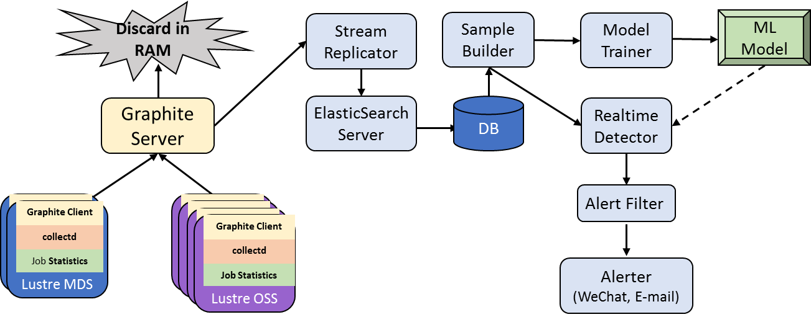
Abnormal detection at file servers (2/4)
  GitHub - LiXi-storage/barreleye: Lustre Monitoring System
( Control center)
Data collection
  Lustre provides an open sourced collectD plugin for collection of performance metrics, which include those jobstats
These metrics are saved on ElasticSearch
Notes:
Now we running it with lustre
Lustre provides an open sourced collectD plugin for collection of performance metrics, which include those jobstats
These metrics are stored on ElasticSearch Database

Slide 8
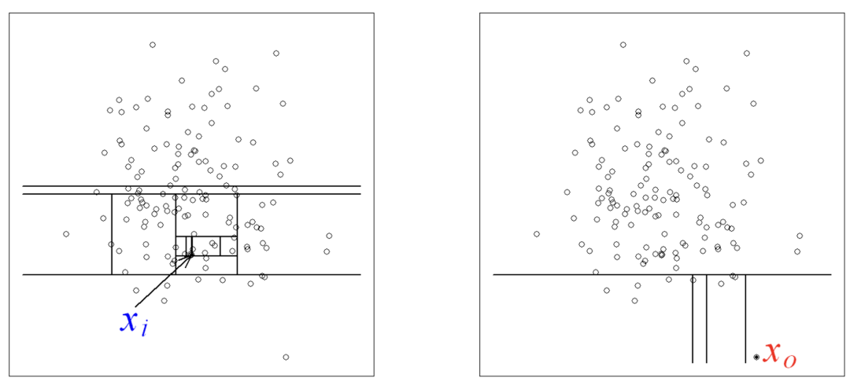
Abnormal detection at file servers (3/4)
Using Isolation Forest algorithm
  The more isolated a sample is , the higher anomaly score it will get
  The sample data is aggregated from the operations of filesystem by a user process within 10 minute
  Two models: last day and last week
  New samples will be scored separately by the two models
  The scores from the model of last day will be sorted, and the scores from the model of last week will be used as a reference
Very effective on large, high dimensional data
Recommended by scikit-learn package
Notes:
Then we use the Isolation Forest algorithm for abnomal detection,
Isolation Forest is very effective on large, high dimensional data
In a data set, the more isolated a sample is, the higher score it will get .
That means, the feature of a process if very different from others, It's more likely to be considered an anomaly.
Then we design the sample data
We traind two ,,by the data of

Slide 9
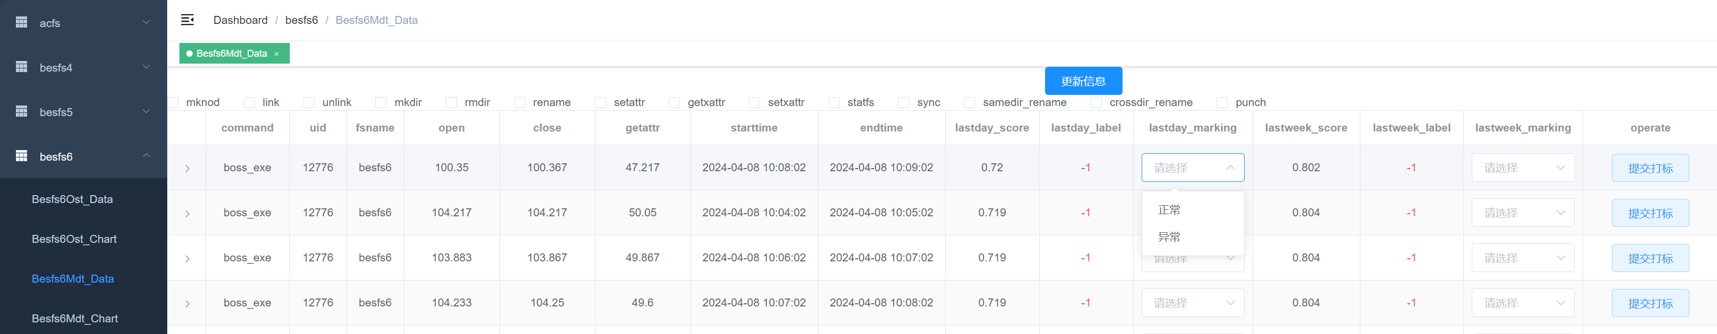
Interactive interface
Support for multiple file system instances
Sort by the abnormal scores of the processes
Support viewing various metadata operation statistics (Lustre MDTs)
Support for manual marking
File system instance
Metadata operation anomaly detection
More metadata operations
update
please select
please select
submit
Normal
please select
submit
Abnormal
please select
submit
please select
please select
submit
Users and job processes
Metadata operations & frequency
Abnormal value and manual marking
Notes:
This is the Interactive interface
Web page
optimize

Slide 10
Abnormal detection at file servers (4/4)
2nd: Hardware performance monitoring
  Metrics: CPU_load / IO_wait, etc.
  A shell script that runs periodically in the background
Once a certain metrics is abnormal, the top scoring processes and their owners will be sent to the control center
Notes:
Then this is the second part, which names Hardware performance monitoring
In the first part ,we only score the user’s process when the file system is healthy
But , Once a certain metrics in here is abnormal

Slide 11
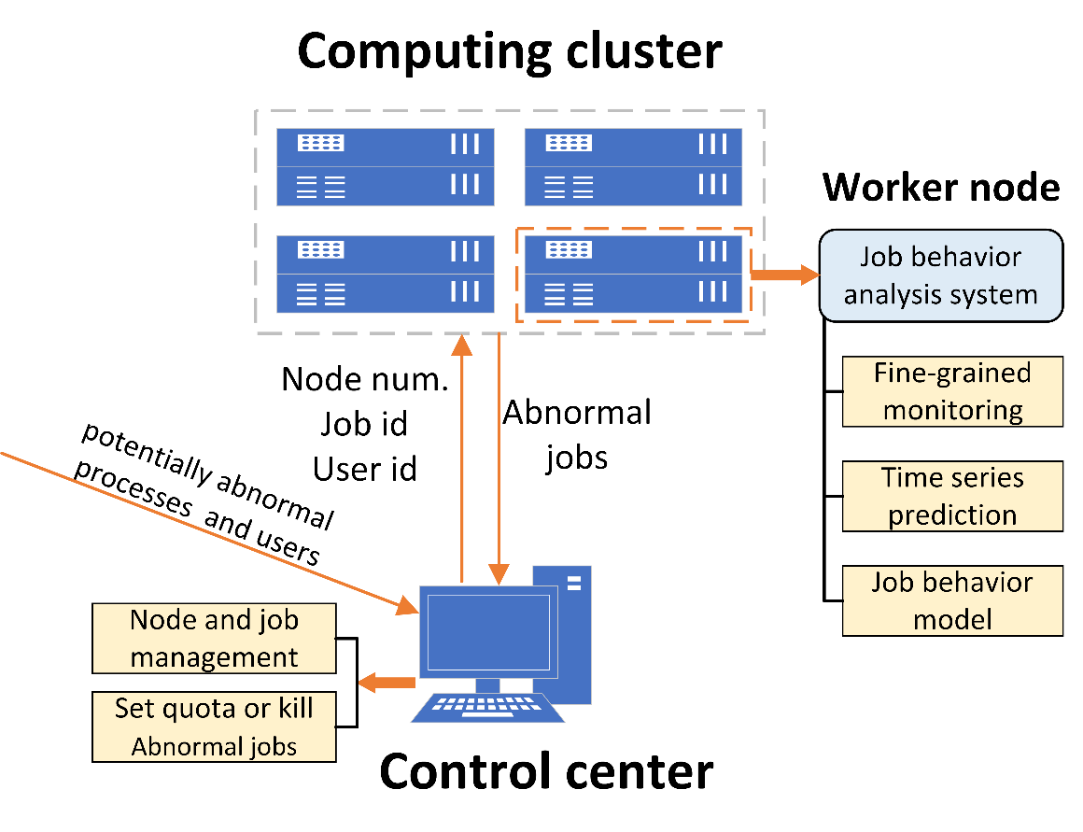
Control Center
Node and Job Management
Receive file system anomaly detection alerts
  Current load, user usage
Control the Job behavior analysis tool start up on the worker node
  Find the running worker nodes by processes & UIDs
  Remotely start the tool with root privileges
Notes:
Next is control center，it manages all of nodes and jobs in our computing cluster
It will launch the analysis tool, When it receive the alert from filesystem,
First,

Slide 12
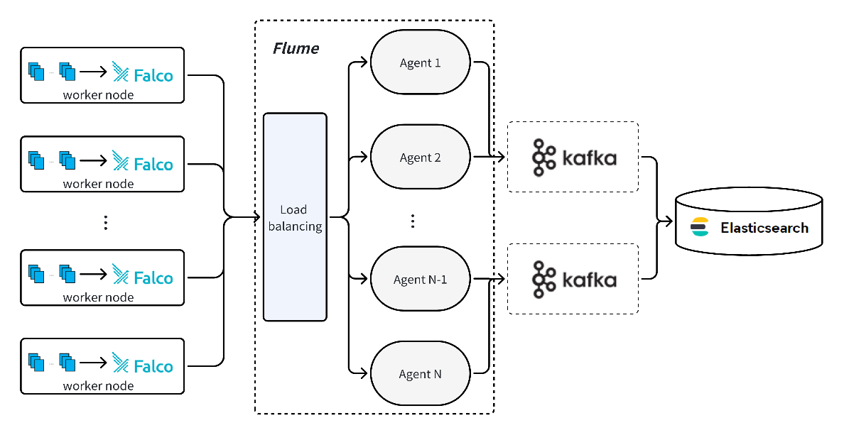
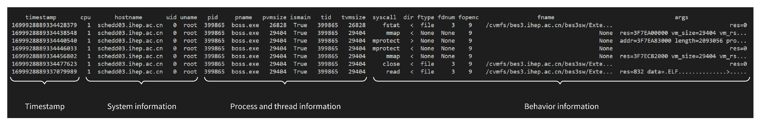
Abnormal detection at worker node (1/2)
Scraping job’s system calling by ‘Falco’
  Filter by username and jobname
  Upload to Elasticsearch
Falco is a lightweight tool to scrap the system calling based on the Linux kernel
Data preprocessing
  Combination of Embedding and Encoding handles the system calling
  The data is based on a time series
Notes:
Here is the third part
It aims to confirm whether the job is abnormal or not.
We use Falco to scrap job’s system calling and Filter by username and jobname, and also Upload to Elasticsearch
The sys calling is handled by the combination of Embedding and Encoding

Slide 13
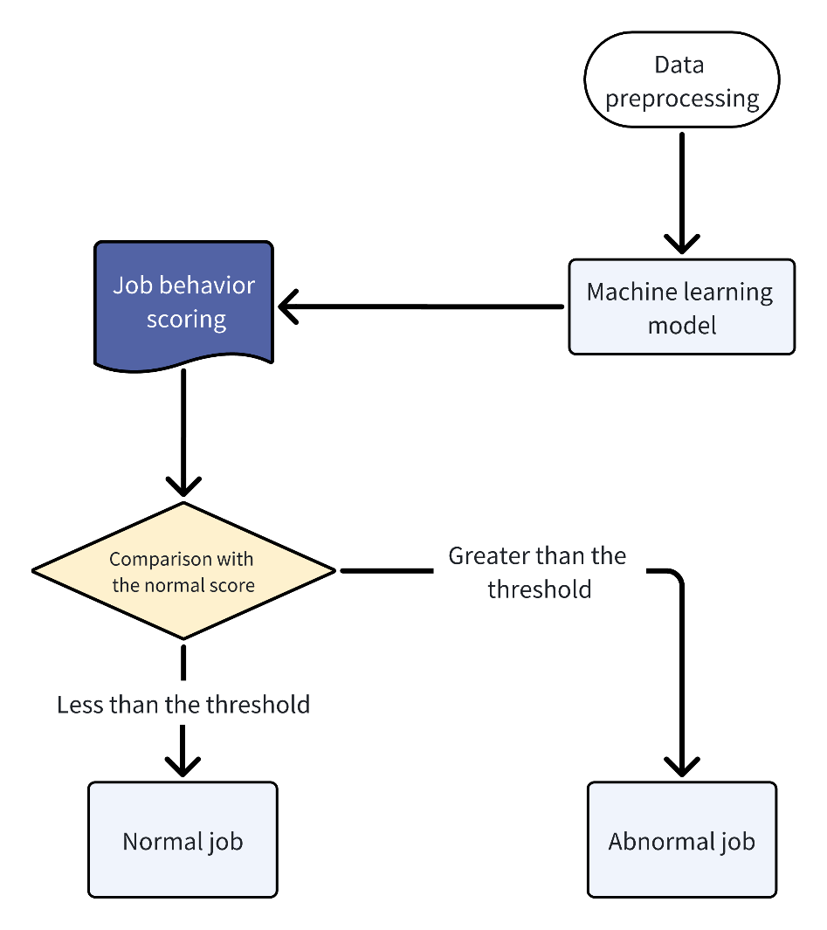
Abnormal detection at worker node (2/2)
Job behavior analysis
Using Autoformer model to learn normal job system calling relationships
Using Perplexity metric to evaluate the system calling of jobs
  Obtain Perplexity metric based on normal job systems calling , as a threshold
  Obtain Perplexity metric based on target job systems calling
  Evaluate anomaly
Notes:
After the preparation, there is Job behavior analysis
We use Autoformer model to learn normal job system calling relationships
We firstly
Which are used to Evaluate anomaly

Slide 14
Control Center
Node and Job Management
Receive file system anomaly detection alerts
  Current load, user usage
Control the Job behavior analysis tool start up on the worker node
  Find the running worker nodes by processes & UIDs
  Remote start the tool with super root privileges
Limit the maximum number of abnormal user job
  HepJob tool set
    hep_rm username

Slide 15
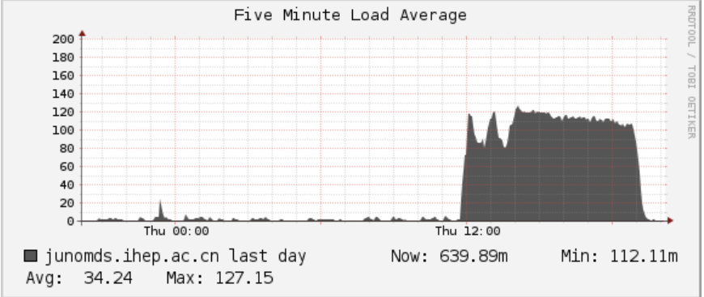
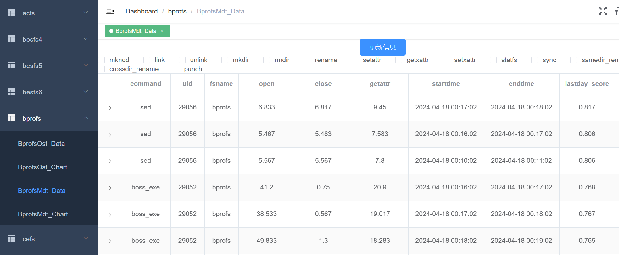
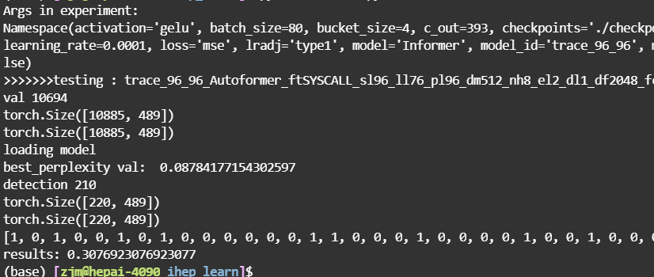
Control Center
Example: the abnormal user was limited
Notes:
Here is the example to show the abnormal user was limited
A file server suffer a heavy CPU load
Abnormal detection system identify the abnormal user and his job, control center limited the running job like this

Slide 16
Conclusion and Future work
An intelligent operation and maintenance system is still an ongoing project
  The Isolation Forest algorithm is used to score user processes
  The Autoformer model is used to detect job behavior anomaly
  Control center enables system automation
Future work
  The storage hardware performance monitor will be developed
  Optimization on the accuracy of the ML algorithm will be done
  Other file systems, like EOS, will be supported
Notes:
Now
In theFuture work

Slide 17
Thanks!
Questions?
chengys@ihep.ac.cn

