Slide 1

Exascale challenges
Christophe CALVIN
CEA/DRF
Deputy to the Director of Fundamental Research at the CEA in charge of HPC and simulation

Slide 2
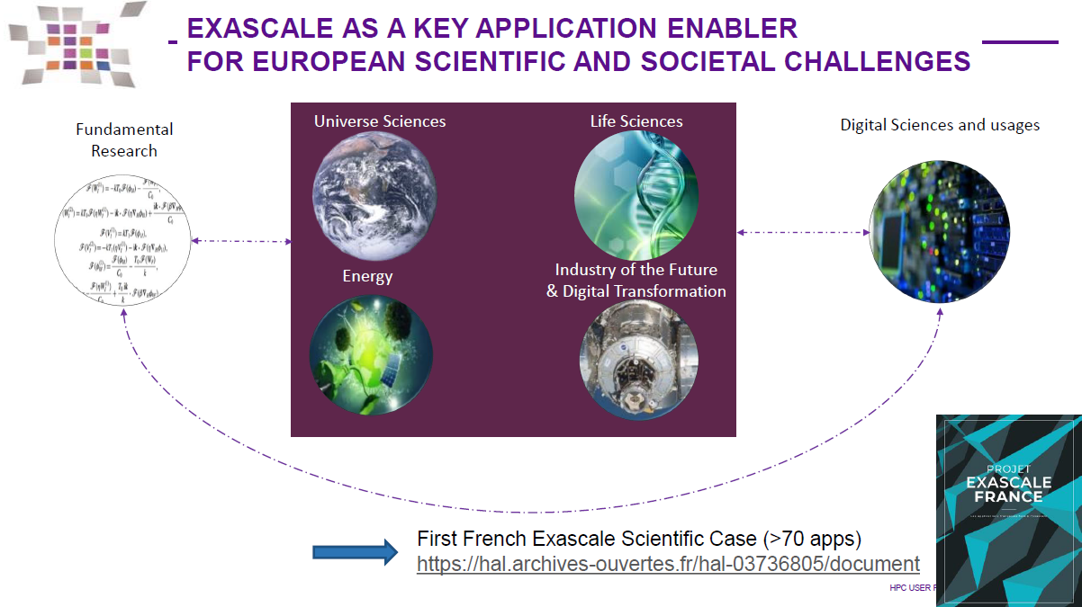


What exascale? And for what?
Prefix (symbol E) which, placed in front of a unit, multiplies it by 10¹⁸.
Compute: Exaflops → 10¹⁸ floating points operations per seconds Eflops/s
Storage: Exabyte → 10¹⁸ bytes

Slide 3

Technological challenges
How to design and operate such a machine within a sustainable energy envelope?
 | 2010 | 2018 | Factor Change
System peak | 2 Pf/s | 1 Ef/s | 500
Power | 6 MW | 20 MW | 3
System Memory | 0.3 PB | 10 PB | 33
Node Performance | 0.125 Gf/s | 10 Tf/s | 80
Node Memory BW | 25 GB/s | 400 GB/s | 16
Node Concurrency | 12 cpus | 1,000 cpus | 83
Interconnect BW | 1.5 | 50 GB/s | 33
System Size (nodes) | 20 K nodes | 1 M nodes | 50
Total Concurrency | 225 K | 1 B | 4,444
Storage | 15 PB | 300 PB | 20
Input/Output bandwidth | 0.2 TB/s | 20 TB/s | 100

Slide 4

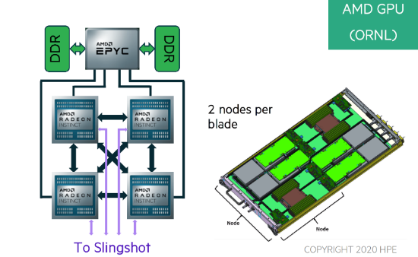
Technological challenges
 | 2010 | 2018 | 2022 (FRONTIER)
System peak | 2 Pf/s | 1 Ef/s | 1.5 Ef/s
Power | 6 MW | 20 MW | 22.7 MW
System Memory | 0.3 PB | 10 PB | 37 PB
Node Performance | 0.125 Gf/s | 10 Tf/s | 166 Tf/s
Node Memory BW | 25 GB/s | 400 GB/s
Node Concurrency | 12 cpus | 1,000 cpus | 64 CPU cores + 880 GPU cores
Interconnect BW | 1.5 | 50 GB/s | 100 GB/s
System Size (nodes) | 20 K nodes | 1 M nodes | 9,472 nodes
Total Concurrency | 225 K | 1 B | 9 B
Storage | 15 PB | 300 PB | 500 / 1,000 PB
Input/Output bandwidth | 0.2 TB/s | 20 TB/s | 5 / 10 TB/s
How to design and operate such a machine within a sustainable energy envelope? → GPU

Slide 5
TOP 500 List – Nov 2023
Rank | System | Cores | Rmax (PFlop/s) | Rpeak (PFlop/s) | Power (kW)
1 | Frontier - HPE Cray EX235a, AMD Optimized 3rd Generation EPYC 64C 2GHz, AMD Instinct MI250X, Slingshot-11, HPE | 8,699,904 | 1,194.00 | 1,679.82 | 22,703
2 | Aurora - HPE Cray EX - Intel Exascale Compute Blade, Xeon CPU Max 9470 52C 2.4GHz, Intel Data Center GPU Max, Slingshot-11, Intel | 4,742,808 | 585.34 | 1,059.33 | 24,687
3 | Eagle - Microsoft NDv5, Xeon Platinum 8480C 48C 2GHz, NVIDIA H100, NVIDIA Infiniband NDR, Microsoft | 1,123,200 | 561.20 | 846.84
4 | Supercomputer Fugaku - Supercomputer Fugaku, A64FX 48C 2.2GHz, Tofu interconnect D, Fujitsu | 7,630,848 | 442.01 | 537.21 | 29,899
5 | LUMI - HPE Cray EX235a, AMD Optimized 3rd Generation EPYC 64C 2GHz, AMD Instinct MI250X, Slingshot-11, HPE | 2,752,704 | 379.70 | 531.51 | 7,107
6 | Leonardo - BullSequana XH2000, Xeon Platinum 8358 32C 2.6GHz, NVIDIA A100 SXM4 64 GB, Quad-rail NVIDIA HDR100 Infiniband, EVIDEN | 1,824,768 | 238.70 | 304.47 | 7,404
7 | Summit - IBM Power System AC922, IBM POWER9 22C 3.07GHz, NVIDIA Volta GV100, Dual-rail Mellanox EDR Infiniband, IBM | 2,414,592 | 148.60 | 200.79 | 10,096
8 | MareNostrum 5 ACC - BullSequana XH3000, Xeon Platinum 8460Y+ 40C 2.3GHz, NVIDIA H100 64GB, Infiniband NDR200, EVIDEN | 680,960 | 138.20 | 265.57 | 2,560
9 | Eos NVIDIA DGX SuperPOD - NVIDIA DGX H100, Xeon Platinum 8480C 56C 3.8GHz, NVIDIA H100, Infiniband NDR400, Nvidia | 485,888 | 121.40 | 188.65
10 | Sierra - IBM Power System AC922, IBM POWER9 22C 3.1GHz, NVIDIA Volta GV100, Dual-rail Mellanox EDR Infiniband, IBM / NVIDIA / Mellanox | 1,572,480 | 94.64 | 125.71 | 7,438
100% CPU
>90% of total performance is based on GPUs (NVIDIA and AMD)
We talk about Peak and HPL perf. Not on real scientific applications

Slide 6
GPU from video games to AI
Initially GPU have been designed for video games! → graphics
Used for HPC (CUDA): excellent ratio Gflops/Watt
Now GPU market: AI (and Gen AI) – FP64 is quite useless for AI workloads (Learning and inference)
GPU: not especially designed for numerical simulation
Not really easy to program – CUDA/OpenCL – explicit transfer from host→device
Increase FP32/FP16/FP8/FP4 performances for AI and stagnation of FP64 perf

Slide 7



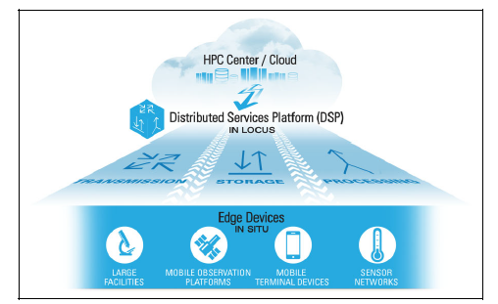
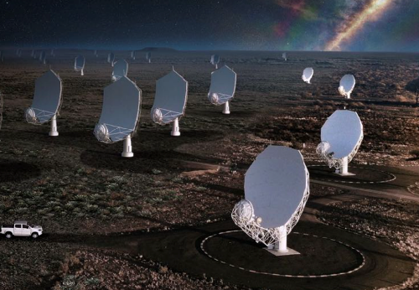


And what about usages?
Not only pure HPC (numerical simulation)
More and more HPDA: treatment and analysis coming from large facilities and IoT
Explosion of AI (and especially GenAI)
ChatGPT-3: 175 Billions of parameters - 3 months - 8 000 GPU Hopper – 15 MW mégawatts
Chat GPT-4: 1 Trillion of parameters
Dataset | # tokens | Proportion within training
Common Crawl | 410 billion | 60%
WebText2 | 19 billion | 22%
Books1 | 12 billion | 8%
Books2 | 55 billion | 8%
Wikipedia | 3 billion | 3%
# DataSets
Size of DataSets
35 ExaBytes

Slide 8
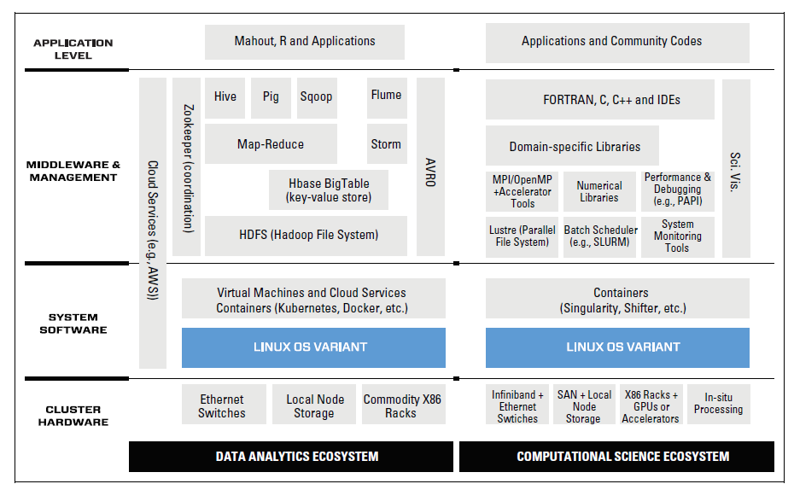
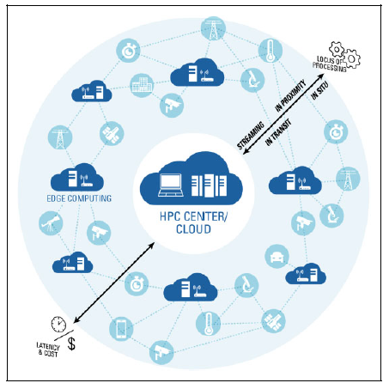
What impact?
SW stack: both for data and HPC
FS: large data sets / small files / high performance (LUSTRE is not the only solution)
Cloud access – HPC center is not “fortress” anymore
HPC center not anymore in the center! A link in the chain
Exascale is not only a HW concern but need to rethink the usage of supercomputers, datacenter architecture and access to supercomputers

Slide 9
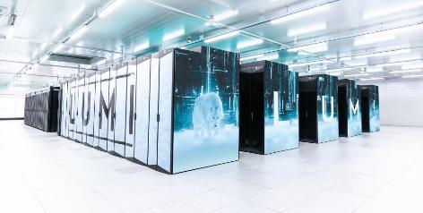
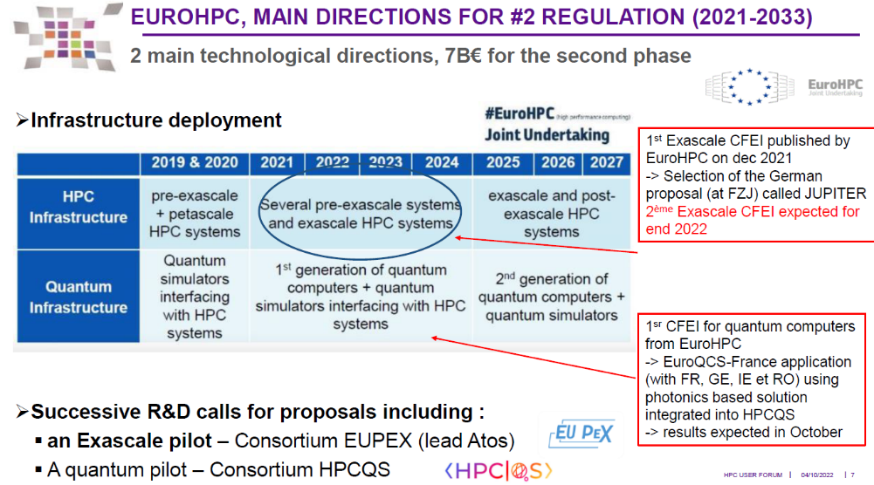
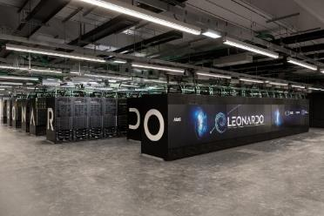
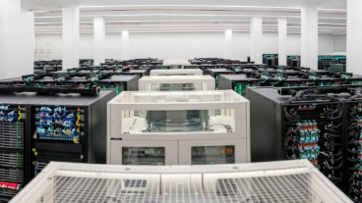
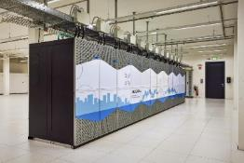
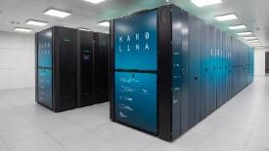


Exascale in Europe
LUMI: 540 Pflops
LEONARDO: 314 Pflops
MareNostrum5: 312 Pflops
PreExa
1st Exasale System → JUPITER
Meluxina: 18Pflops
Karolina: 13Pflops
Discoverer: 6Pflops
Peta

Slide 10
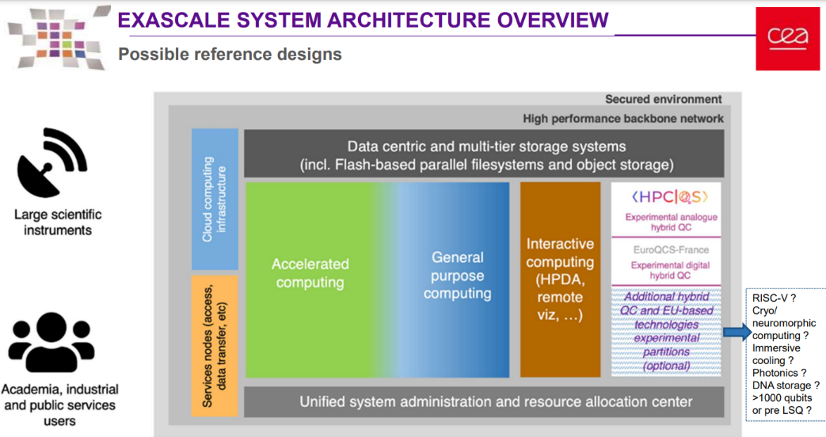
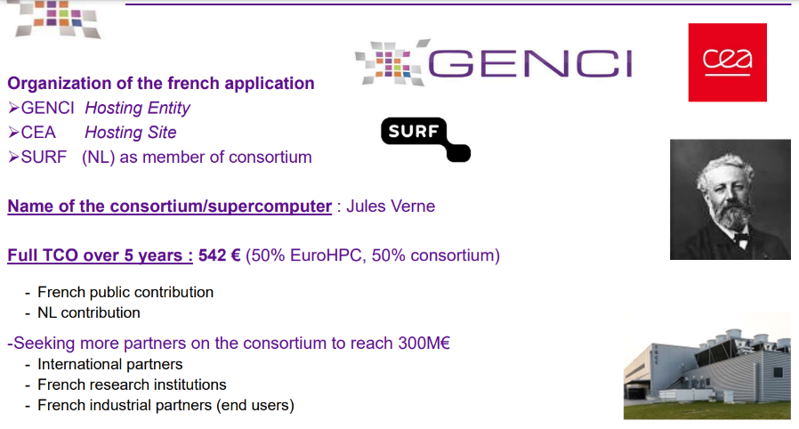
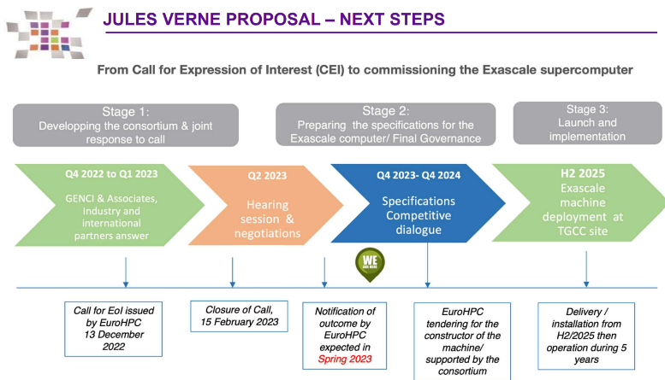
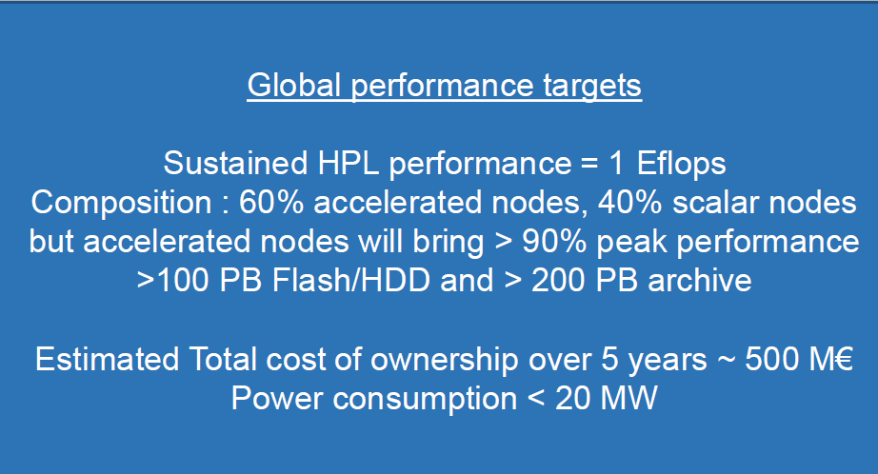
Exascale in France: Jules Verne project

Slide 11
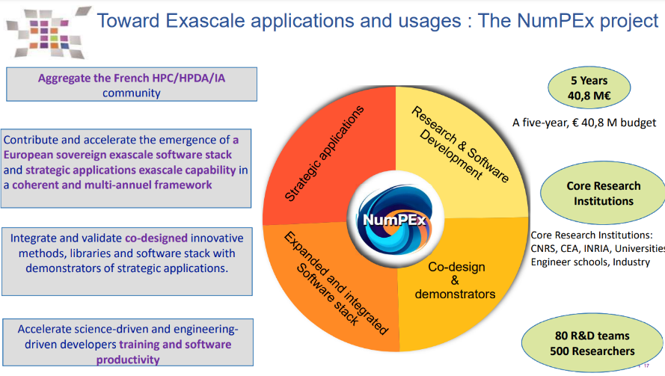


Exascale in France: support for application communities
12 PY for 5 years L3/L4 support funded by the project

Slide 12















Collaborations – National → International ecosystem
Int. collaboration on HPC/AI/HPDA/QC
EU/JPN Collaboration
HPC/AI – Climate/Material/Biomedical
PEPR – Software Stack
Collaboration on HPC/AI/HPDA/QC
European Lab for exascale
HPC/HPDA/AI/QC

Slide 13
Thanks !
Questions?

