Slide 1
Computer Security Update
Roman Sumailov roman.sumailov[@]cern.ch
CERN Computer Security Team
HEPiX Spring 2024, 17.04.2024

Slide 2
Content
Supply-chain problems
Phishing for 2FA Less secure & more secure 2FA
Email security
R&E community security

Slide 3
Content
Supply-chain problems
Phishing for 2FA Less secure & more secure 2FA
Email security
R&E community security

Slide 4
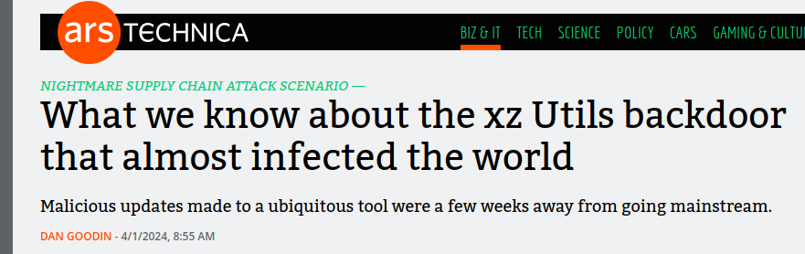
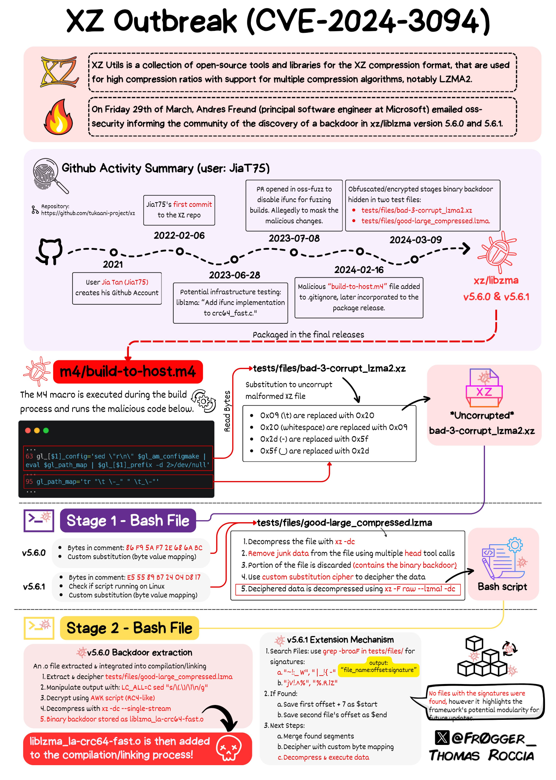
xz-utils (CVE-2024-3094)
Is an open source data-compression utility available almost in every Linux distro (.deb, .rpm…)
Exploitable under certain conditions:
  Sophistically backdoored versions 5.6.0 & 5.6.1
  Distro needs to run glibc
  More conditions for backdoor to run
  Rolling-release distros are vulnerable
Backdoor discovered on the March 29th
Took at least 3 years to prepare with social engineering
“In a nutshell, it allows someone with the right private key to hijack sshd, the executable file responsible for making SSH connections, and from there to execute malicious commands.”
https://arstechnica.com/security/2024/04/what-we-know-about-the-xz-utils-backdoor-that-almost-infected-the-world/
https://gist.github.com/thesamesam/223949d5a074ebc3dce9ee78baad9e27
https://www.sentinelone.com/blog/xz-utils-backdoor-threat-actor-planned-to-inject-further-vulnerabilities/
https://tukaani.org/xz-backdoor/
Notes:
Very recent (end of March) discovery compromise of xz-utils. xz-utils is an open source data compression utility available on almost all installations of Linux and other Unix-like operating systems. Package is commonly used for compressing release tarballs, software packages, kernel images, and initramfs images. It is very widely distributed.
xz-utils is an open source project and has been for a long time maintained by one person. Few years ago another user started contributing to this project, among other open source projects. It can also be said that he social engineered his way into getting commit rights. Other accounts also pressured main developer into giving maintaining rights to at least one more user. This user programmed a backdoor into this library.
This backdoor is complex and very indirect, only versions 5.6.0 & 5.6.1 are affected. It is only exploitable when a few _known_ specific criteria are met. However, this backdoor is _at least_ triggerable by remote unprivileged systems connecting to public SSH ports. The backdoor manipulated sshd, the executable file used to make remote SSH connections. Anyone in possession of a predetermined encryption key could stash any code of their choice in an SSH login certificate, upload it, and execute it on the backdoored device.
Thanks to the discovery, only people vulnerable would realistically be the ones that have rolling versions of OS. This particular attack was sophisticated and we got lucky that it got discovered before it was merged into stable releases.
There are scripts available that let you check if your device is vulnerable, but long story short - if you run one of the affected library versions, upgrade immediately.

Slide 5
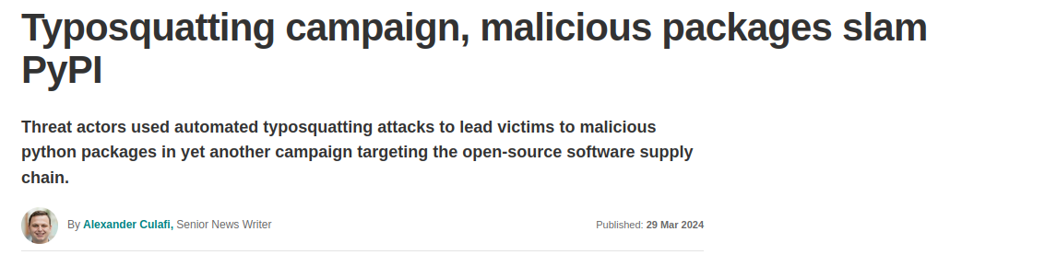
PyPI and typosquatting – still a thing
Always had problems with malicious packages
In the last campaign 500 malicious packages uploaded to PyPI posing as legitimate popular tools (March 2024)
One account per one malicious package
https://blog.dachary.org/2020/08/29/pypi-is-responsible-for-distributing-malware/
https://www.techtarget.com/searchsecurity/news/366577455/Typosquatting-campaign-malicious-packages-slam-PyPi
Notes:
PyPiIhas more than 800,000 users, yet it always had supply chain attack type security issues.
Typosquatting still very actual with freshest malicious packages upload campaign happened at the end of March 2024. 500 malicious packages were uploaded to PyPI posing as legitimate tools. Moreover, during this campaign there was one malicious package per one account, not one account spamming many malicious packages.

Slide 6
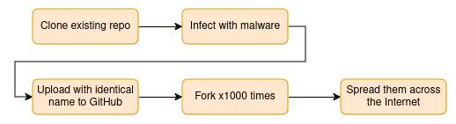
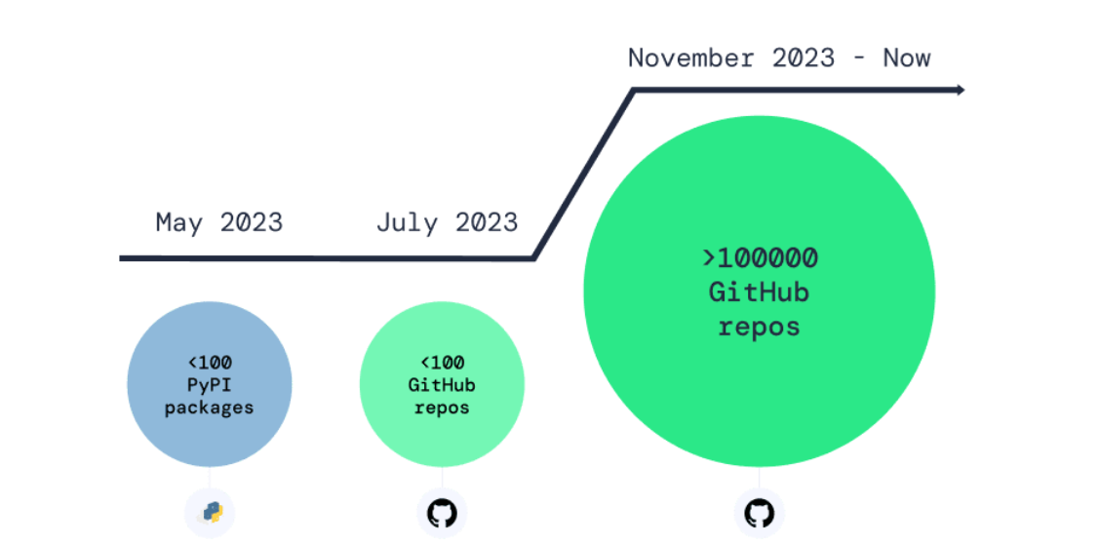
Malicious GitHub repositories
Over 100k infected repositories (discovered Feb 2024)
Repository confusion attack that relies on human error
https://www.developer-tech.com/news/2024/feb/29/github-suffers-over-100k-infected-repos/
Notes:
GitHub can also be risky, according to recent discoveries by security researchers, it contains over 100 thousand infected repositories while even a year ago there were many less. Amount of malicious repos grows exponentially. What malicious actors did in this case... (follow the chart).
This supply chain attack relies on human error, that instead of a legitimate repo, developers will download the malicious one. Although, to their defense, GitHub tries to remove malicious repositories fast, but their systems are not perfect.

Slide 7

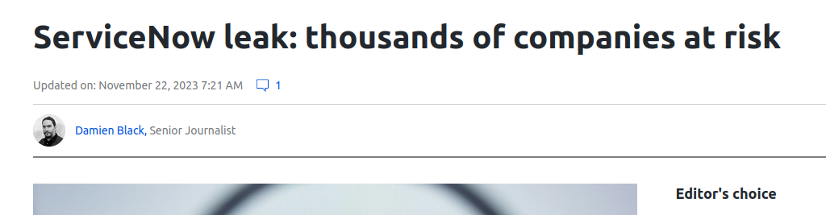
Commercial suppliers
Vulnerability existing since 2015
Allows unauthenticated users to access confidential records
ServiceNow was given by researcher 6 months to react
Vulnerability published in Oct 2023
ServiceNow did not deny/confirm or warn customers (CERN was not warned either)
https://www.enumerated.ie/index/servicenow-data-exposure
https://cybernews.com/news/servicenow-leak-thousands-companies-risk/
Notes:
ServiceNow, a big digital platform supplier had vulnerability for years that allowed unauthenticated users to extract internal data. Problem lies in the misconfiguration of a widget in ServiceNow's system.
According to the security researcher who discovered the vulnerability last year, he gave the company 6 months to react before publishing the info. ServiceNow didn't do anything. And even after publishing, ServiceNow neither denied nor confirmed the vulnerability. And they didn't warn their clients. We, at CERN, as clients of ServiceNow did not get any warning or advisory from them, we did our own patch.

Slide 8

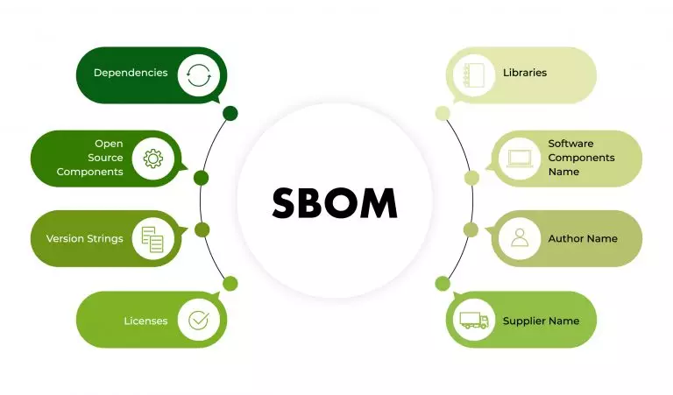
Solutions
As usual – no silver bullet, but things like SBOM (Software Bill of Materials) can help
SBOM is a document providing list of libraries and dependencies used in a project
https://media.defense.gov/2022/Sep/01/2003068942/-1/-1/0/ESF_SECURING_THE_SOFTWARE_SUPPLY_CHAIN_DEVELOPERS.PDF?utm_source=the+new+stack&utm_medium=referral&utm_content=inline-mention&utm_campaign=tns+platform
https://scribesecurity.com/fr/sbom/#definition-of-software-bill-of-materials
Notes:
There is no silver bullet for supply chain of attacks, but there are combination of approaches you can use to become more secure. SBOM is definitely one of them. The document, which creation should be automated has list of all the libraries and dependencies used in a project.

Slide 9
Content
Supply-chain problems
Phishing for 2FA Less secure & more secure 2FA
Email security
R&E community security
Notes:
Now let's talk about 2FA for a bit, precisely about different approaches to 2FA

Slide 10
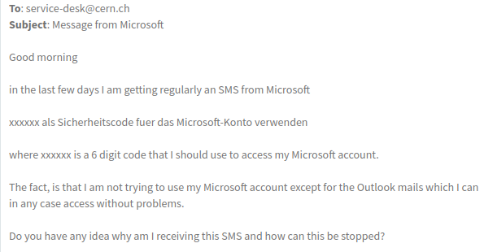
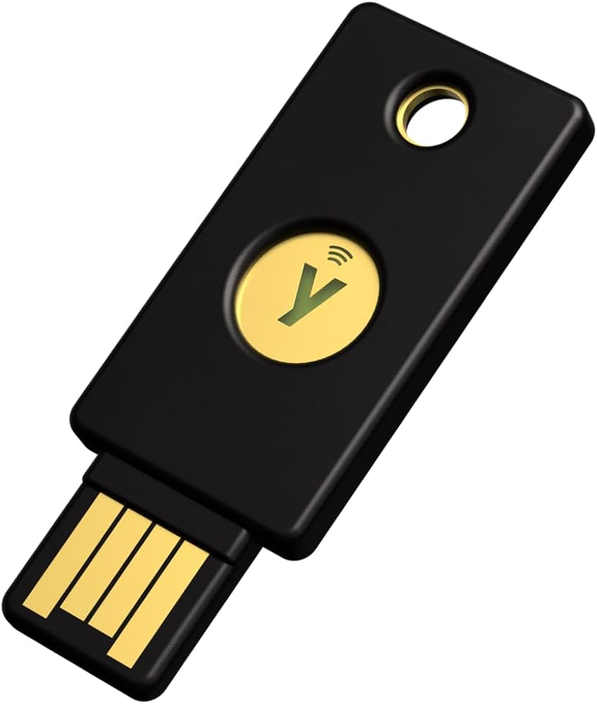
Two-Factor Authentication – SMS confirmation phishing
If possible, better to have 2FA as something tied to device, something you HAVE (TOTP, WebAuthn like Yubikey)
SMS codes are phished for
CERN users were phished for WhatsApp confirmation 2FA SMS codes
Notes:
Multifactor authentication means having multiple steps for authenticating and something extra than just a password. You can have five-factor authentication too, but we will stick to two-factor.
There are different ways to implement 2FA, and when picking, we recommend going for something that is tied to a device directly, like a Yubikey or other WebAuthn enabled solution. For example, Macbook fingerprint.
2FA SMS confirmations are phished for. In this example is depicted case we had at CERN where someone tried to get the confirmation code for user's Microsoft account.

Slide 11
Content
Supply-chain problems
Phishing for 2FA Less secure & more secure 2FA
Email security
R&E community security
Notes:
mail security, especially relevant starting from February this year for everyone.

Slide 12
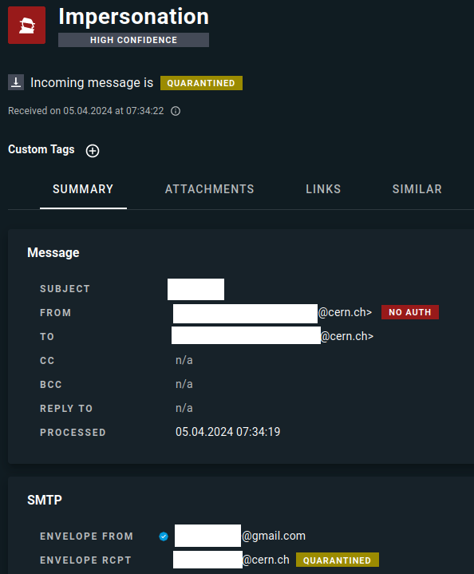
Email security DMARC/DKIM/SPF
DMARC – Domain-based Message Authentication, Reporting & Conformance - Policy that ties together two emails authentication protocols SPF and DKIM
CERN enforced DMARC in 2023
Google & Yahoo enforcing DMARC since Feb 2024 so most admins must adjust
DMARC enforcement caused lots of problems for users mostly due to spoofing:
  Users spoofing themselves via 3rd party, i.e gmail
  Many problems come due to personal use of professional emails
  Forwarding sometimes makes email auth impossible (breaking DKIM signature, failing SPF)
  Mailing lists spoofing senders
https://www.proofpoint.com/us/blog/email-and-cloud-threats/google-and-yahoo-set-new-email-authentication-requirements
Notes:
DMARC - Domain-based Message Authentication, Reporting & Conformance - Policy that ties together two authentication protocols for emails SPF and DKIM.
SPF - Sender Policy Framework. SPF can prevent domain spoofing. It enables your mail server to determine when a message came from the domain that it uses.
DKIM - DomainKeys Identified Mail. This ensures that the content of your emails remains trusted and hasn’t been tampered with or compromised. DKIM employs digital signatures to validate email.
CERN enforced DMARC last year.
This created noticeable problems for end-users due to quarantining legit, but badly configured emails, mostly coming down to spoofing problem:
- Users sending emails on behalf on @cern.ch, but from GMAIL, Yahoo or other 3rd party infrastructure.
- Many university mailing lists impersonate senders when distributing emails.
- A lot of forwarding set up from university email accounts to CERN. Some of them during forwarding modify emails header/footer which breaks DKIM.
- Some email configuration just badly set up (non-functioning SPF i.e).
- CERN allows to use emails for personal business and there are all sorts of DMARC non-compliance.
An example
But from February this year, DMARC is also enforced by Google and Yahoo and wider audience must adapt too. So email security is becoming stronger overall and it is a good thing.

Slide 13
Content
Supply-chain problems
Phishing for 2FA Less secure & more secure 2FA
Email security
R&E community security

Slide 14
Tier-3 compromise in Asia (summer 2023)
Account was discovered scanning CERN servers
Turned out compromised account at Tier-3 site
Attacker performed lateral movement infecting other servers in Tier-3

Slide 15
Tier-3 compromise in Asia (summer 2023)
MULTI-FACTOR AUTHENTICATION
Servers were lacking updates due to ‘yum update’ failing to run
‘pkexec’ exploit was used to escalate privileges to ‘root’
Site had to reinstall all servers involved
PREVENTION?
Notes:
... it all started with stolen credentials. What could have prevented it? You won't believe it, 2FA!

Slide 16
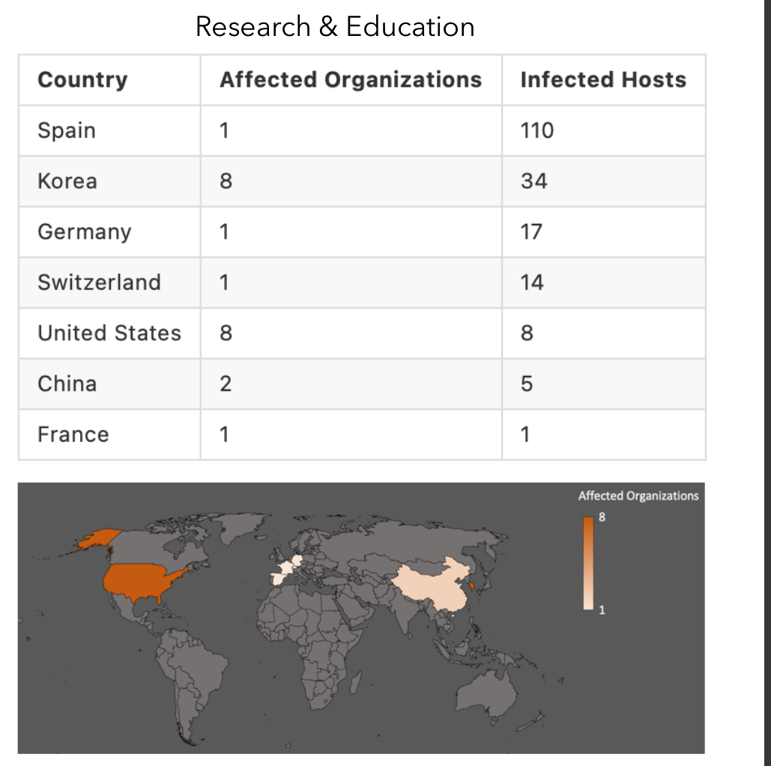
MICI-BICA case (summer 2023)
MULTI-FACTOR AUTHENTICATION
200+ servers compromised/25+ impacted organisations
Infected hosts botnetted/used for cryptomining
Operating for 3 years
Directed at Research & Education!
Initial access:
  Password spraying: Using a list of passwords against different accounts
  Credential stuffing: Reusing credentials from one account to another one
TTP old & not sophisticated:
  IRC for bot control, bash scripting for malware orchestration
  Vanilla bruteforce SSH scanners, open source cryptominers…
PREVENTION?
Notes:
MICI-BICA incident. Considerable attack against R&E industry. It also started with a compromised account.
This criminal group deliberately targeted R&E sector. They managed to operate for at least 3 years before they were noticed.
TTP or tactics, techniques & procedures are old

Slide 17
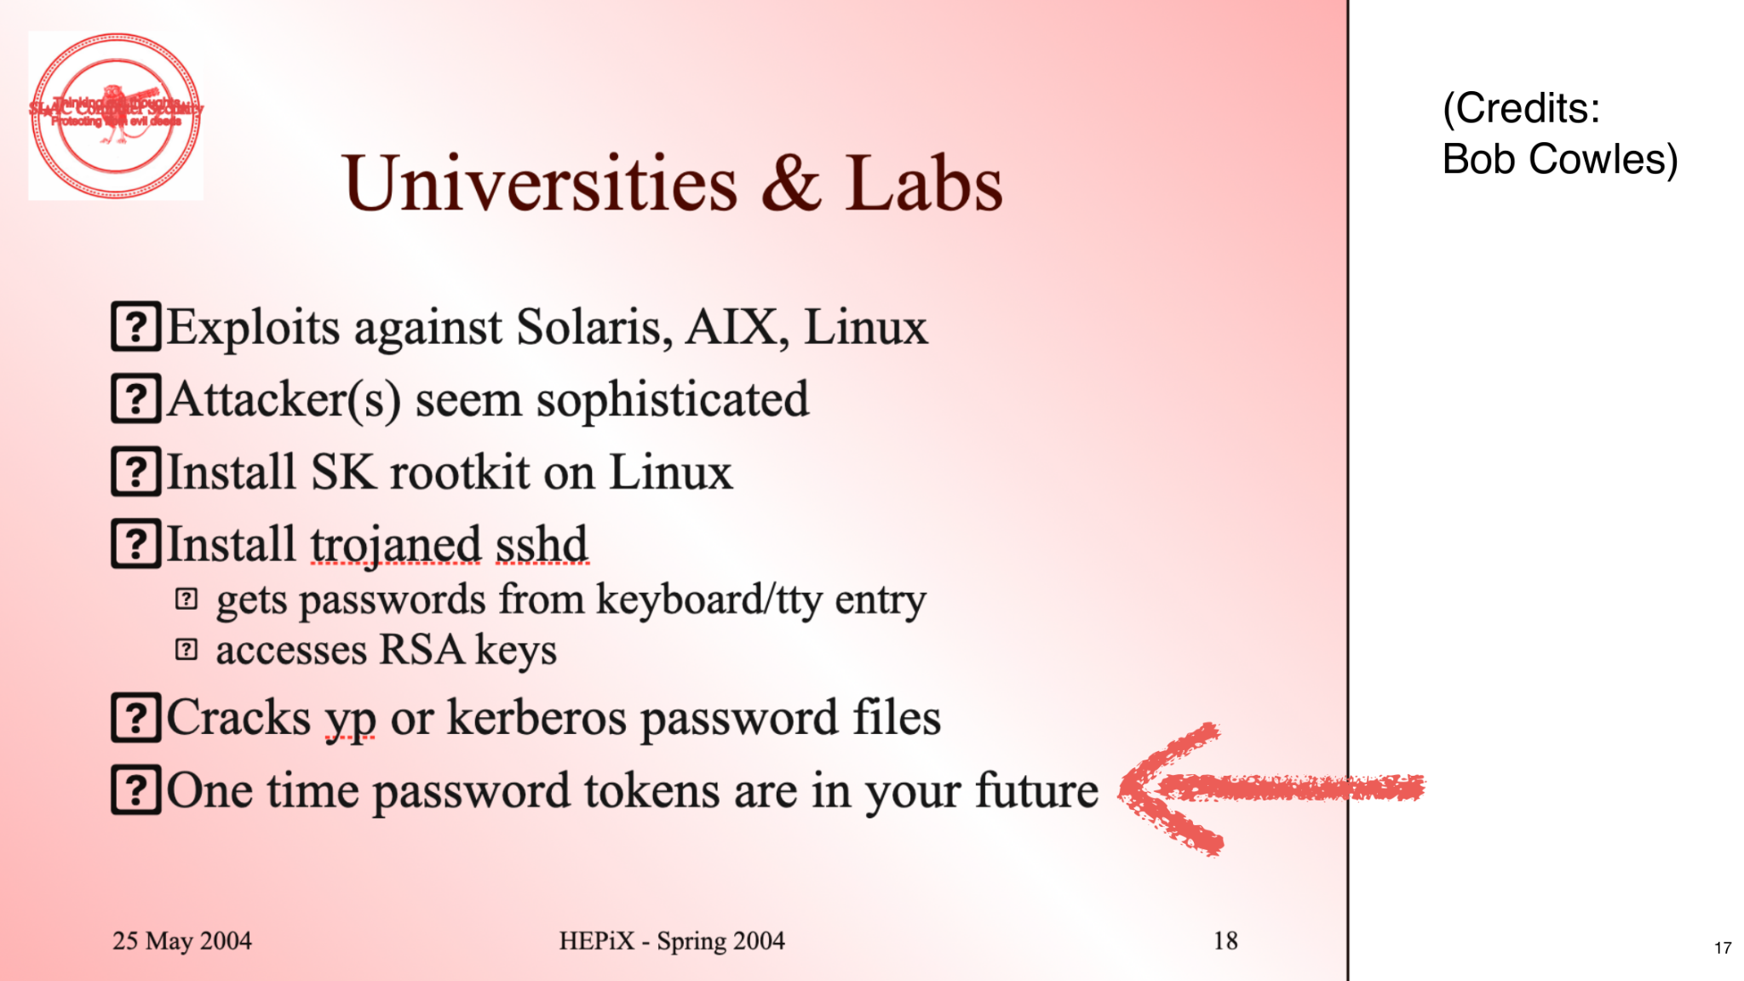
20 years later we talk about 2FA…
Notes:
I would like us all to time travel for a second back into 2004. HEPiX presentation by Bob Cowles. Twenty years ago we were told that multifactor authentication is our future... and in 2024 here we are, saying that it would have prevented the type of cybercrime that was already existing in 2000s.

Slide 18

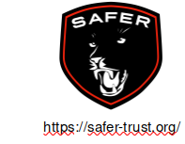
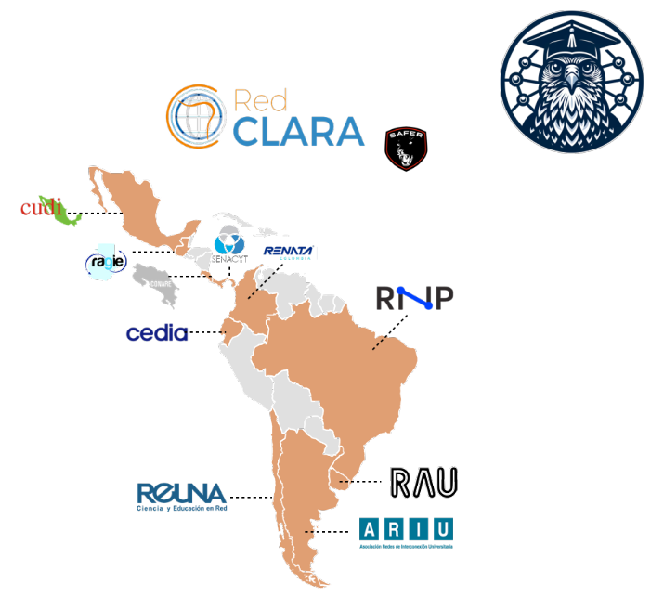
Collaboration in R&E
SAFER – Security Assistance For Education & Research Trust Group
SICURA-LAC – Collaboration with 2000+ South American universities for cybersecurity initiatives
WLCG SOC Working Group – Cooperation to establish SOC building guidelines for WLCG sites
REN-ISAC – Cybersecurity collaboration for five-eyes
EGI – Computing security for EGI infrastructure (Europe)
China IHEP security
pDNSSOC
Cooperation with French hospitals cybersecurity teams
Notes:
I would like to wrap up this presentation by stressing that we are a community. We do not have financial capabilities of commercial companies to buy expensive professional security solutions. But we have each other, we must share knowledge, expertise, threat intelligence.
At CERN Computer Security Team we are involved in multiple collaborations, some of them are listed here, not all:
- SAFER - Community of security experts to help universities in need
- Project "SICURA-LAC" under orchestration of RedCLARA (https://www.redclara.net). A project aimed at enhancing cooperation between R&E networks in Latin America and the Caribbean with CERN bringing expertise and coordination.
- WLCG sites willing to collaborate on creating helpful materials on establishing SOC at your own site. Also exchanging standards and experience to share threat intelligence with each other to protect our infrastructures from possible threats.
- REN-ISAC, five eyes - five eyes are Australia, Canada, New Zealand, the UK and the US
- EGI CSIRT (Computer Security Incident Response Team)
- pDNSSOC - Community driven project, so called poor man's SOC
- Collaboration with French health sector in fight against cybercrimes
If you would like to know more, some of these initiatives have their own website that are linked in this presentation. Criminal groups also have tendency to target specific sectors, us included. As research institutions we can only efficiently protect ourselves if we timely share information. Building trust groups, relationships, and cooperation are the keys. Thank you.

Slide 19

Merci beaucoup !

