Slide 1
IPv4 to IPv6(-only) in the German Tier-1 Data Center of the CERN Large Hadron Collider
Bruno Hoeft, Matthias Schnepf, Max Fischer, Andreas Petzold
Karlsruhe Institute of Technology, Hermann-von-Helmholtz-Platz 1, 76344 Eggenstein-Leopoldshafen, {first-.familyname}@kit.edu

Slide 2
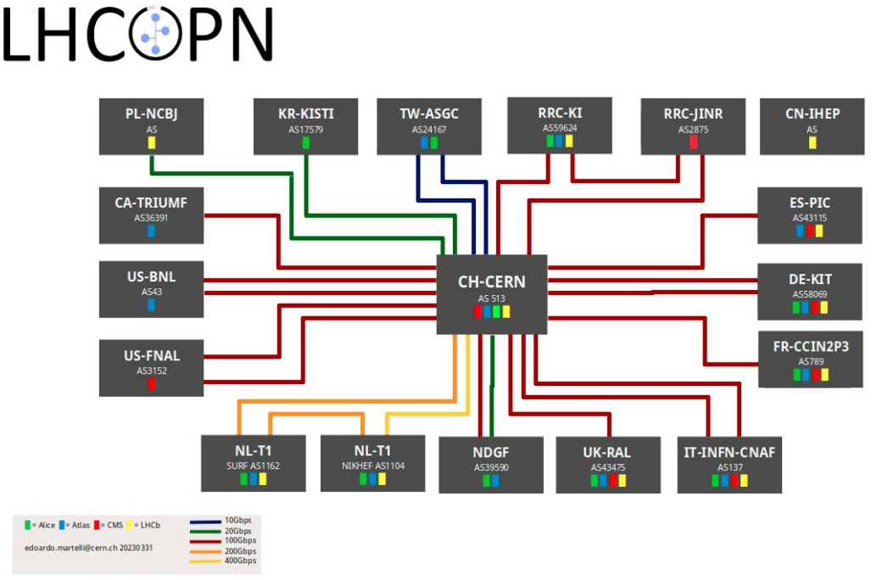
raw data calculation and tape storage centres
Tier0 to Tier1s network
  Dedicated 10/100/400Gbps links
  16 Tier1s + 1 Tier0
  12 countries in 3 continents
  2.1 Tbps to the Tier0

Slide 3
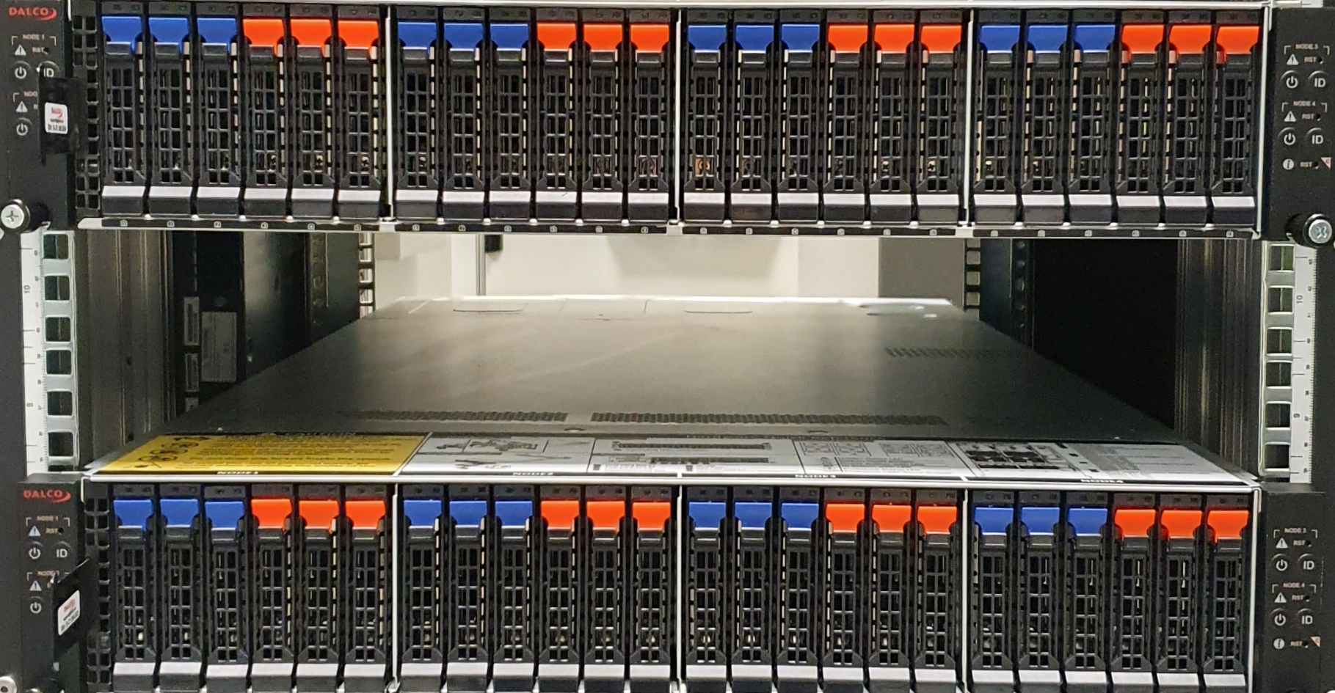
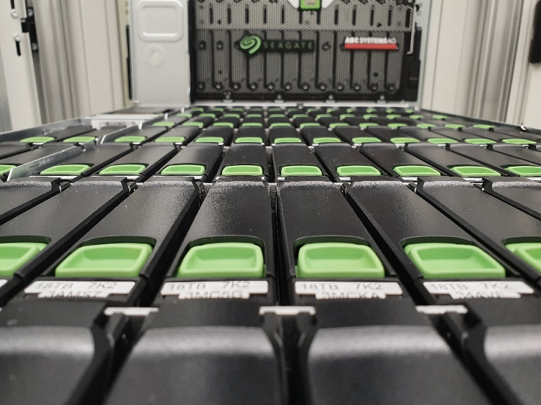
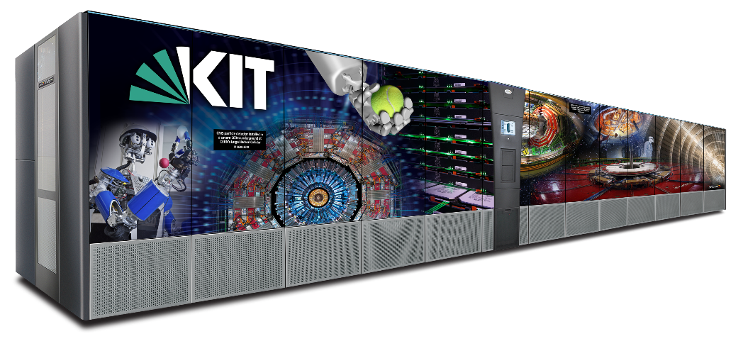
GridKa
worker node farm
  217 aktive hardware systems
  42500 compute cores
online-storage
  99 PB effectiv storage capacity
  6824 HDDs
  100 Server
nearline-storage
  85 PB saved on tapes
  135PB available capacity on tapes
wan network
  2 x 100Gb/s direct to CERN (LHCOPN)
  2 x 100Gb/s to DFN (LHCONE overley)
  2 x 100Gb/s to Belwue

Slide 4
Building IPv6 Textbed
HEPiX- IPv6 working group asking for IPv6 only testbed
PXE boot
DHCPv6
WorkerNode
installation process
DNS
IPv6 only testbed
Squids
LRMS batch processing
CVMFS
Monitoring (Ganglia)

Slide 5
DE-KIT – workernode migration towards IPv6
Pro-active IPv6 Monitoring at DE-KIT

Slide 6
detailed monitoring at DE-KIT (GridKa)
Monitor all comunications between WorkerNodes and
  administration
  job submission
  Storage
  …

Slide 7
monitoring of process intercomunication at DE-KIT (GridKa)
  - with packetbeat collecting network data
  - logstash pushing the data to opensearch (former elastic search)
  for storing the data
  - kibana for visualizing
  (no opensearch – only easy search requests)
  started with a small set of workernodes (storing the data „longterm“ → ~ 6 days)
  while enlarging the set of workernodes graduately
  data keeping time had to be limited to less than one week only
  (for not exceeding the storage size of 0,5 Tbyte)
Identify IPv4 protocol usage

Slide 8
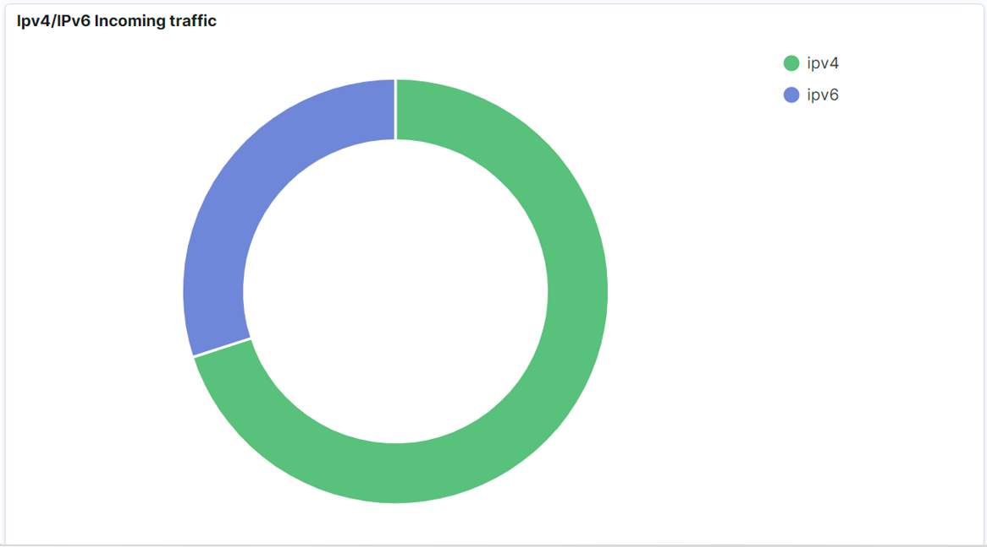

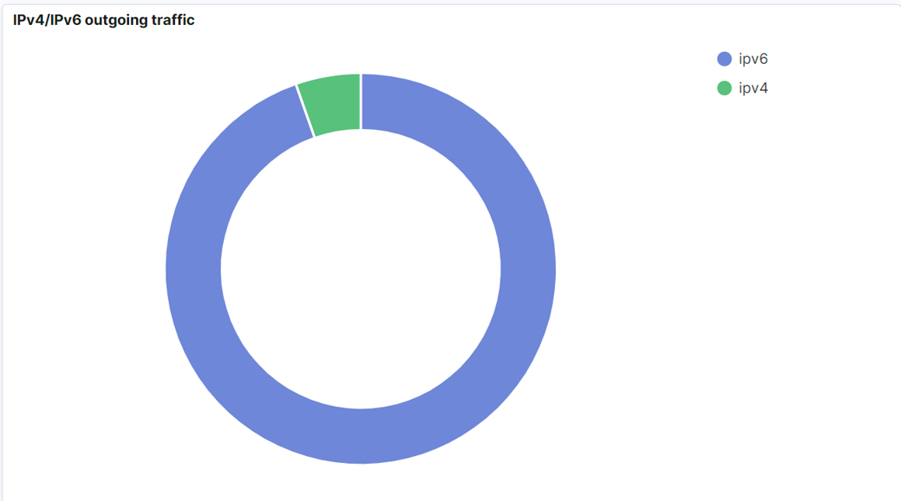
snapshot of a dashbord
IPv4/IPv6 incoming traffic
at 08.09.22
all worker nodes already dual-stack deployed
IPv4/IPv6 Packages
IPv4/IPv6 outgoing traffic

Slide 9
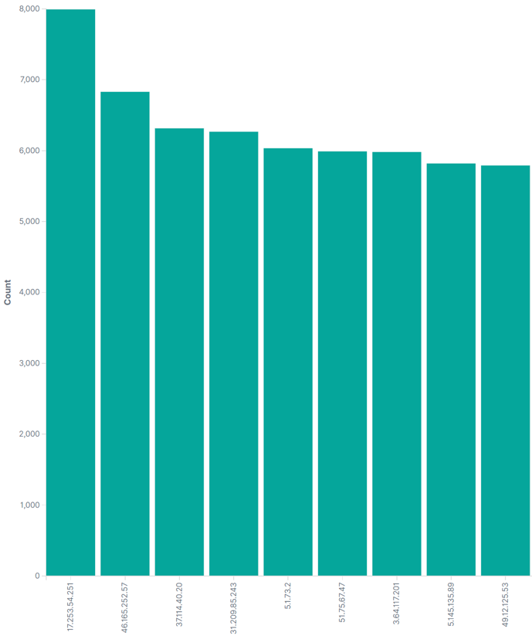
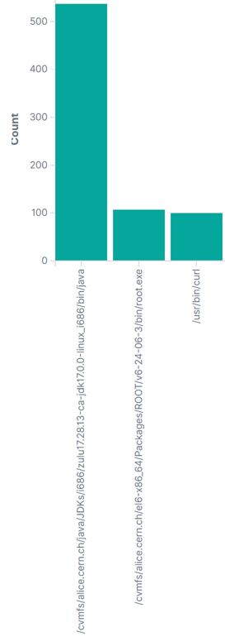
NTP ?
java
Many NTP / port 123 connections
  During 24 hours approx. 210.000
  NTP → IPv4 only (depending on dualstack enabling of rack-manager (40.000 internal))
  Monitoring was first pointing especially 10.1.12 and 10.1.18 → checking later showed that much more racks running ntp check via private addr. (NAT)
  160.000 external communications → some of the destination server have quite dubious „names“
root
curl
process-tracking
  The numbers of NTP communication process and matched process is not matching yet
5.199.135.170
S O L V E D
pmg.jonasled.de.
ntp.creoline.net.
srv102.gosix.net.
radio-sunshine.org.
47.ip-51-75-67.eu.
telesto.hot-chilli.net.
defra1-ntp-004.aaplimg.com.
ve1124.venus.
servdiscount-customer.com.
ec2-3-64-117-201.eu-central-1.
compute.amazonaws.com.
NTP.ORG
  → returns sometimes funny addresses

Slide 10
Logstash → is now IPv6
Logstash (port 5047) → dual-stack deeployed
statistic:
28-07-2022 → IPv4 385k – IPv6 1,41 M
23-10-2022 → IPv4 476k – IPv6 1,39 M
23-12-2022 → IPv4 227k – IPv6 450k
30-10-2023 → IPv4 906k – IPv6 864k
04-04-2024 → IPv4 1,0 M – IPv6 1,0 M

Slide 11
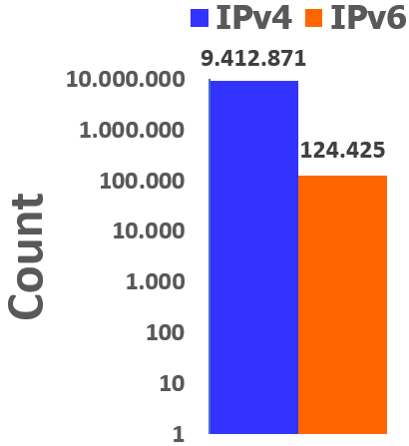

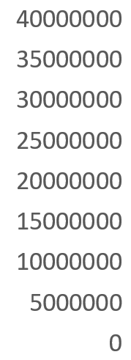

Closer look at DNS
GridKa DNS:
  IPv4 only count : 9,412,871 (24 hours)
  DNS (Bind) Server and WN is already dual-stack
40 Mio.
  at WN resolve.conf first lines IPv4
    Make sure IPv6 DNS server addresses listed and
    place it before IPv4
Count
every new deployed host:
the first lines are IPv6 resolver addresses of the resolve.conf file followed by the IPv4 addresses
  nameserver 2a00:139c:address
  nameserver 2a00:139c:address
  nameserver 10.privat-address
  nameserver 10.privat-address
6,4 Mio.
→ Resolve.conf update: reprovisioning required
53
53

Slide 12
WN – deployment process
Redhat Satellite Server (foreman)
  Used for management of most GridKa hosts:
    Manages redhat Subscriptions
    Controlls kickstart installations (DHCP / PXE)
    Provides yum repos
    Provides CA (certificate authority) and ENC (encryptor) functionalities for puppet
  Uses modular architecture. Additional functionalities can be added via so called capsules
    TFTP server (IPv6 ready - dual-stack)
    Puppetmaster (IPv6 ready - dual-stack)
    Pulp (software repository management (IPv6 ready - dual-stack))
    DNS (IPv6 ready - dual-stack)
    DHCP (currently DHCPv6 capsule not available)

Slide 13
Details of Squid
SQUIDS (Proxyserver and Web-Cache):
  some SQUIDS still IPv4 only (migration to dualstack in proccess)
  Significant part of connections via public IPv4
  => to check: if CVMFS can prefer IPv6?
  (CVMFS → CernVM-File-System)
    CVMFS sending via http request to squid
    CVMFS has DN configuriert that needs to be resolved
    → default chooses IPv4 address
    Solution => cvmfs_ipfamily_prefer=6

Slide 14

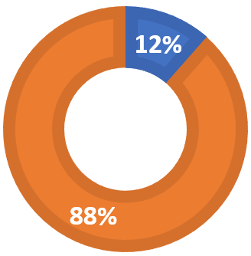
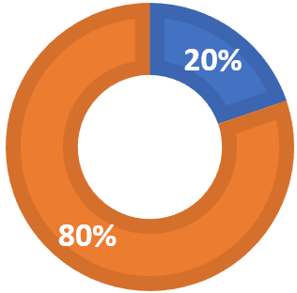
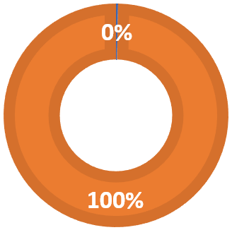
SQUIDS migrated all to dual-stack
  During the second half of 2022 all SQUIDS migrated to dual-stack deployment
  CVMFS now
  - manly IPv6 but:
    - on WorkerNodes uses IPv6 (with deployed flag: CVMFS_IPFAMILY_PREFER=6 )
    - CVMFS frontier uses still IPv4 even while both systems dual-stack
- but switching of IPv4 → froniters will operate over IPv6
  - the CMS CVMFS frontiers offers in site-local-config.xml the Option:
<frontier-connect>
...
<prefer ipfamily="6"/>
...
</frontier-connect>
26-07-2022
23-10-2022
25-10-2023
IPv4 : 1,25 mio. IPv6: 9,6 mio.
IPv4 : 4,44 mio. IPv6: 18 mio.
IPv4 : 64 k IPv6: 22 mio.

Slide 15
Batch-Processing -- LRMS
(HT-Condor) all dual-stack
  LRMS (Local Resource Management System)
  HTCondor at GridKa (all dual-stack and set to prefer the protocoll IPv6 (Port 9618/9)
    percentage increased toward IPv6 at 28-06-2022→ IPv4: 895k to IPv6: 255k
    1,2% IPv4 28-07-2022 → IPv4: 27k, IPv6: 2,17 mio.
    11% IPv4 02-01-2023 → IPv4: 287k, IPv6: 2,28 mio.
    4,3% IPv4 04-40-2023 → IPv4: 767k, IPv6: 17,8 mio.
  Less then 50% of IPv4 is internal traffic
  (communication with home → the LRMS demons uses protocol of Home-Institution)

Slide 16
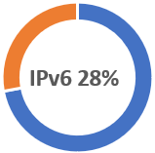
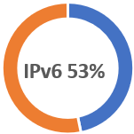
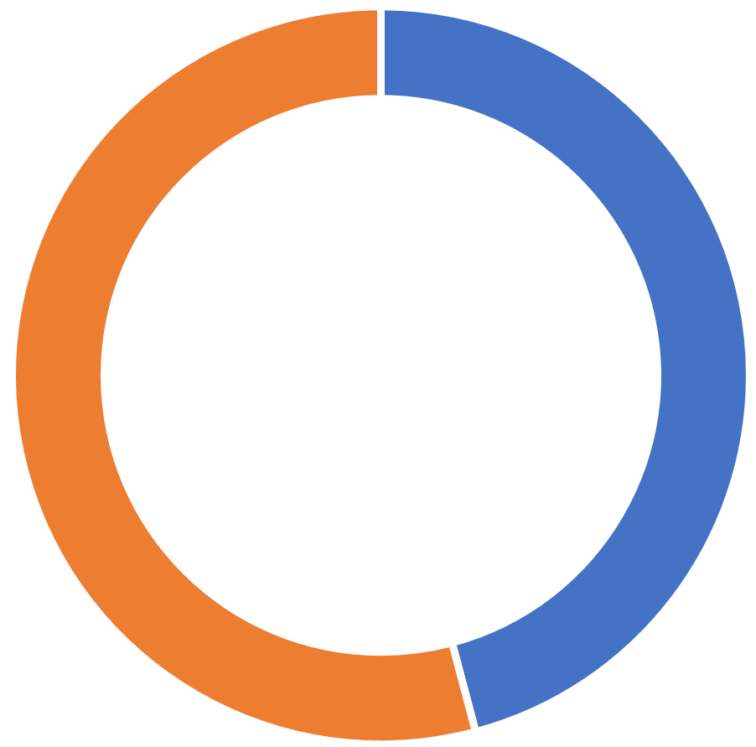
A view statistics
04-04-2024:
  IPv4: → 99,4 mio.
  IPv6: → 210,6 mio.
15-04-2022:
  IPv4: → 80 mio.
  IPv6: → 31 mio.
26-07-2022:
  Ipv4 → 44 mio.
  Ipv6 → 50 mio.
23-10-2023:
  IPv4 → 122 mio.
  IPv6 → 144 mio.
IPv6 67%
(packets in 24 hours)
# of WorkerNodes included in the statistic expanded
IPv6 54%

Slide 17
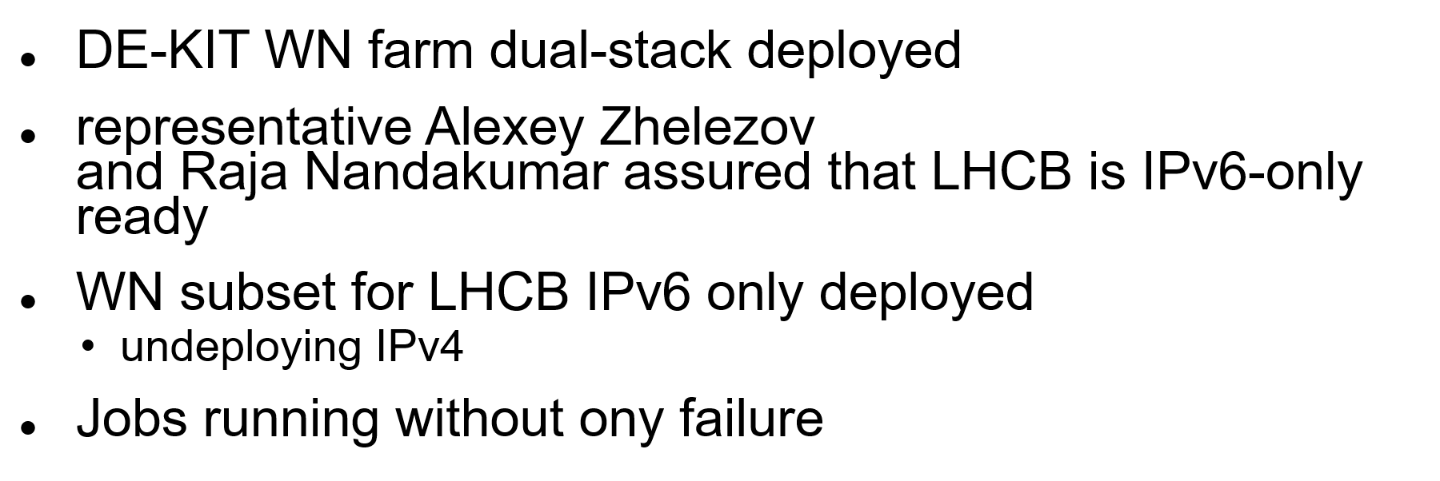
IPv6 @ LHCB

Slide 18
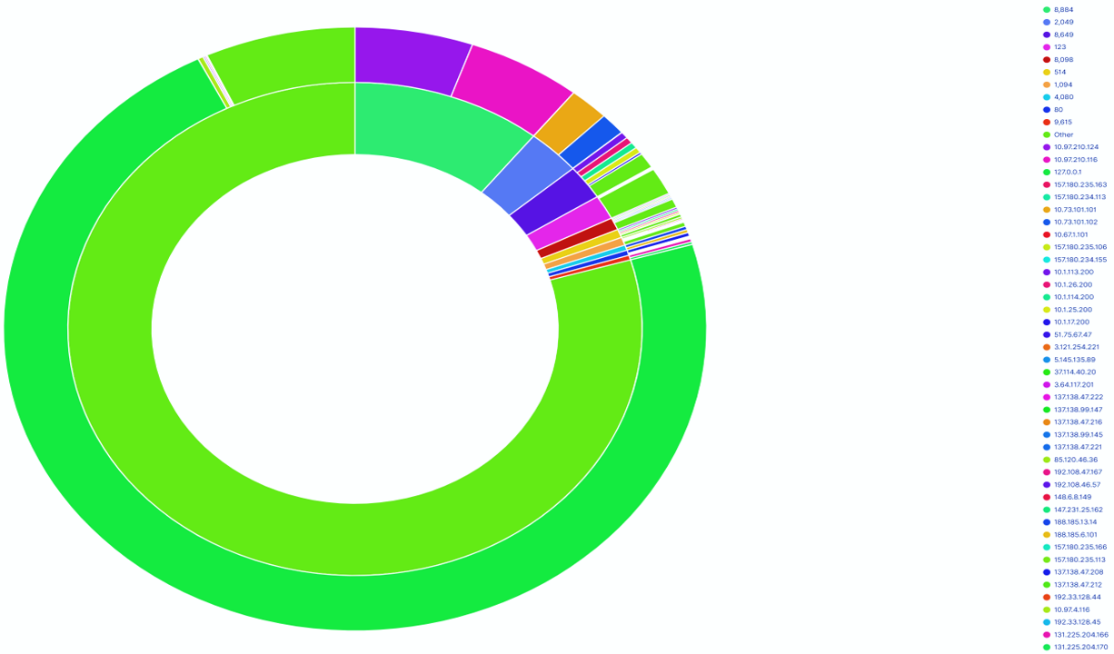
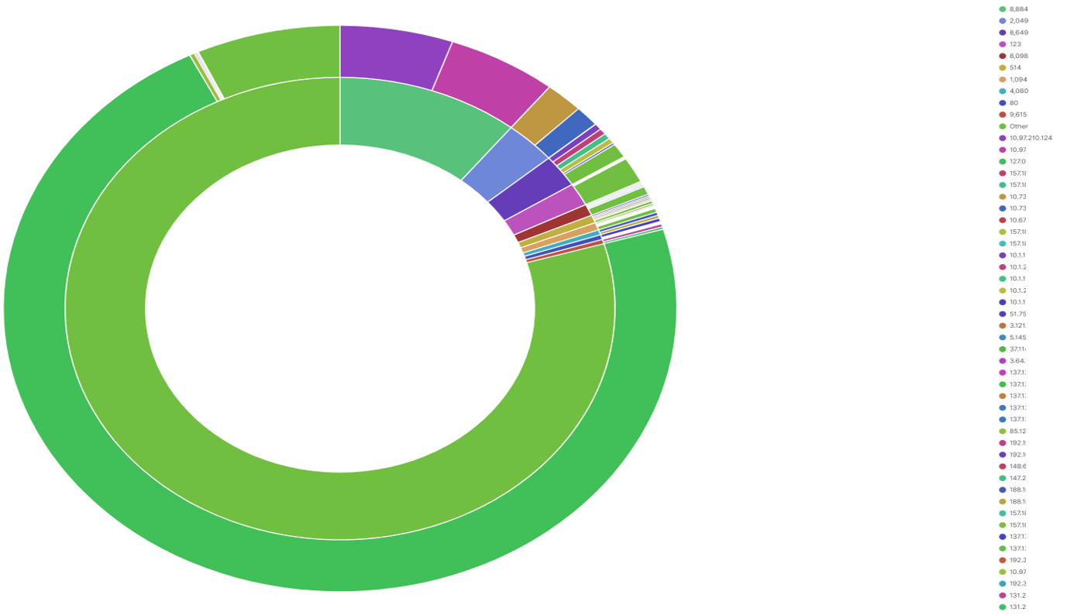
Conclusion
Ports
migration of Rackmanager – work in progress
Narrow down the still IPv4 communication
IPv4
Adresses
  packet monitoring configured
    to list all unhandled IPv4 packets
      8884 – Alice: operation report
      2049 – NFS
      1094 – XrootD
      961[89] – LRMS (less than 50% only internal to WN-Farm)
      be aware → dependency on other sites
  IPv6 linux internals (resolve.conf, cvmfs + cvmfs-frontier, …)
  PXE – Boot + DHCPv6 (first boot addr. Distribution)
Identify the next service for IPv6 migration tasks

Slide 19
Thx for your attention

Slide 20
backup Slides

Slide 21
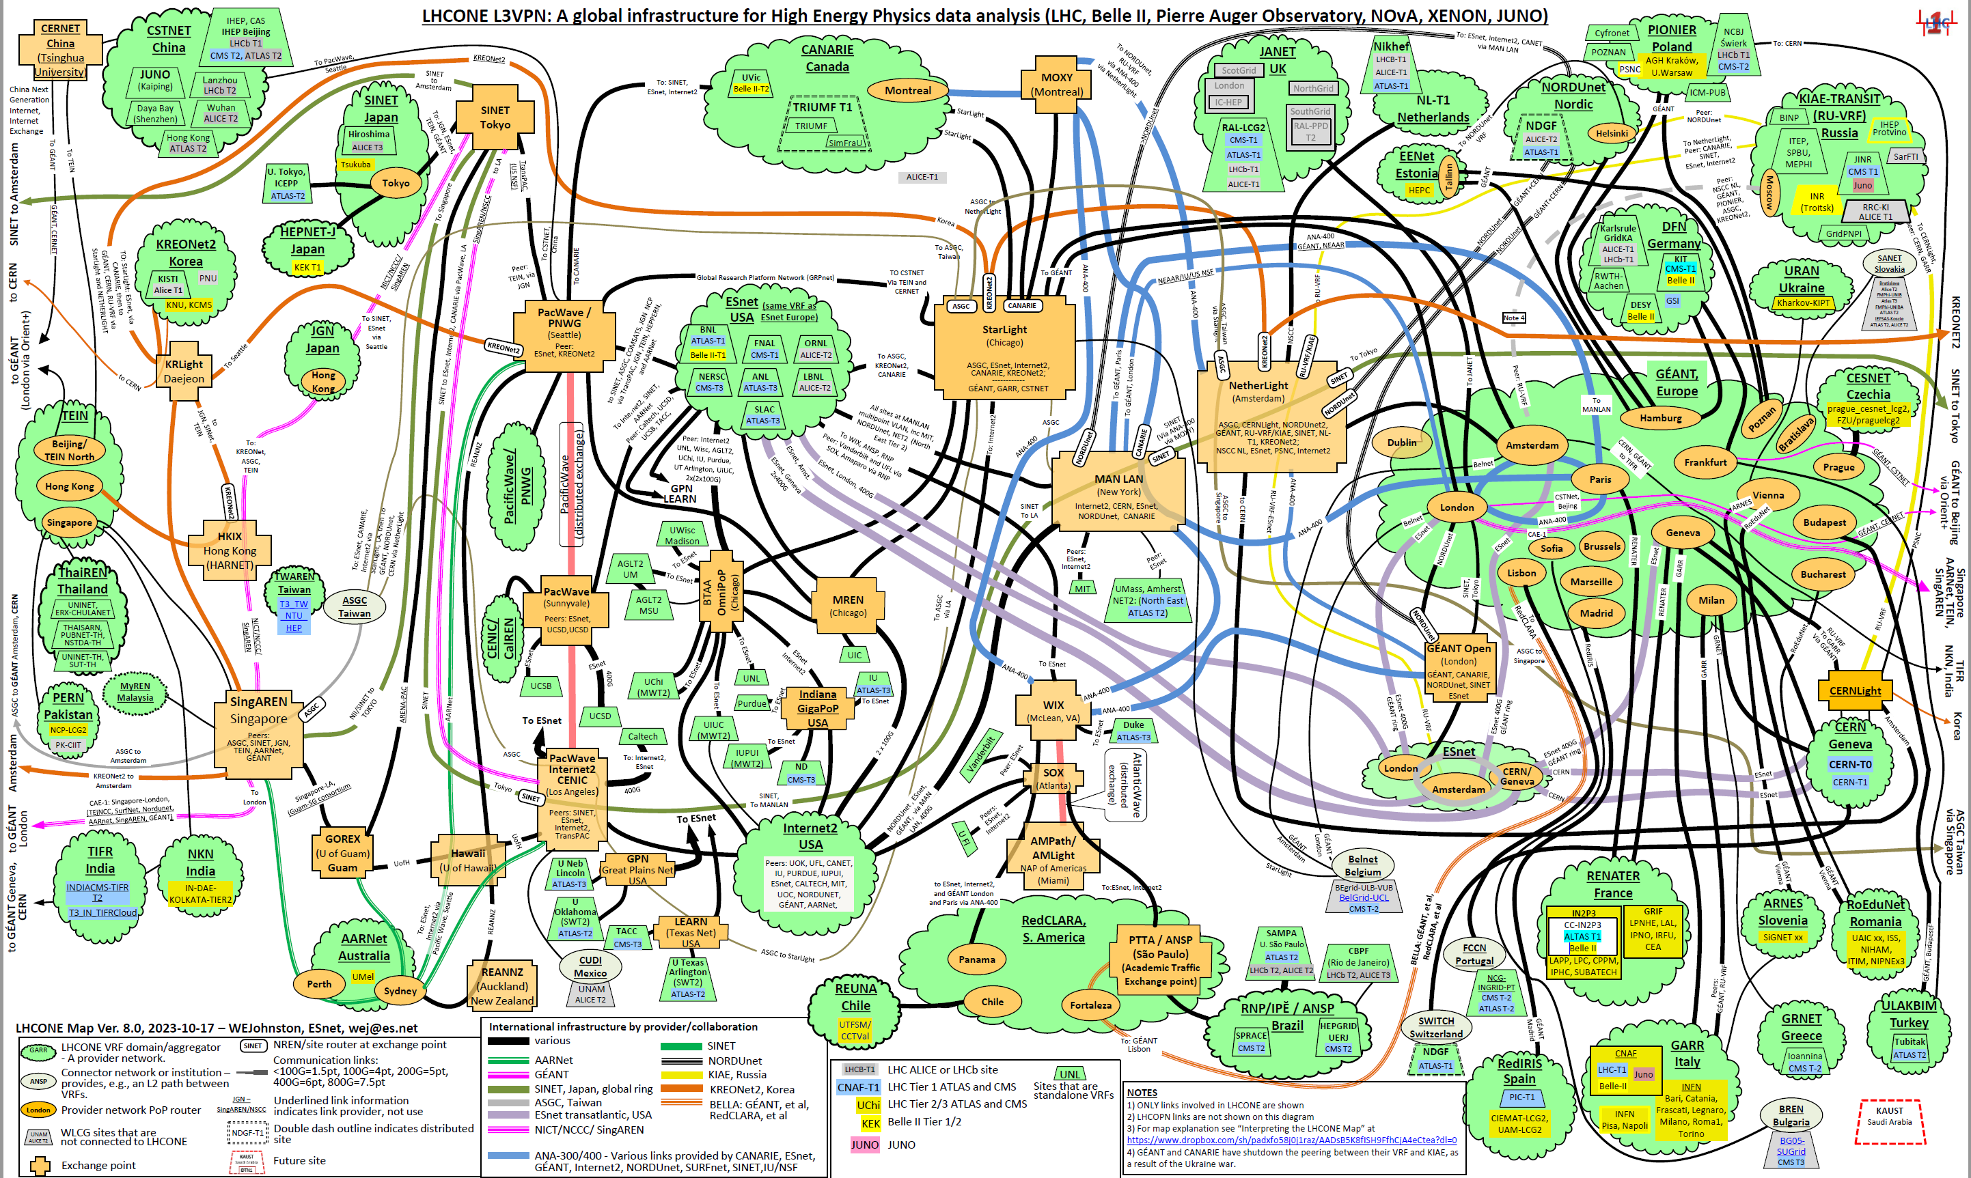
LHCONE
William E Johnston <johnstonwe@gmail.com>

Slide 22
Details of Alice VOBoxes:
ALICE VOBoxes:
  Client to VOBox prefers IPv4 (ALICE Monitoring (UDP))
  => to check the possibility of IPv6 migration with ALICE (still ongoing)
    dual-stack enabling works and
    if Preference towards IPv6 is possible
    ALICE is constrained by IPv6 unavailability on other sites
  → advice of Alice : switch of IPv4 at VO-BOX (the none monitoring VO-BOX)
    Timing still under discussion
  Monitoring (port 8884 / IPv4 only) → 11 Mio. (/24 hours)
XRootD:
  via public IPv4 (ALICE)
  All ALICE XRootD SE are dual-stack deployed
  older version of XRootD → upgrade to current XRootD should improve, is still pending
  → advice of Alice : get IPv6 ready – but wait for switching it on till complete Alice is IPv6 ready
Dest port 1094 –Ipv4/ipv6 → XRootD (alice, belle2, atlas, cms)

Slide 23
dCache upgrade to 7.2.15
Upgrade from dCache version 6.2.34 to 7.2.15
  Two day downtime at June 20th and 21st 2022
HTTP-TPC transfers now prefer IPv6 address,
if both endpoints support it.
fixed handling of Storage Resource Reporting (SRR)
requests over IPv6
Handle IPv6 address when running HTTP(s)
Third Party Copy (TPC) with gridsite delegation
Storage Resource Manager (SRM) : Fix IPV6 logging for SRM

Slide 24
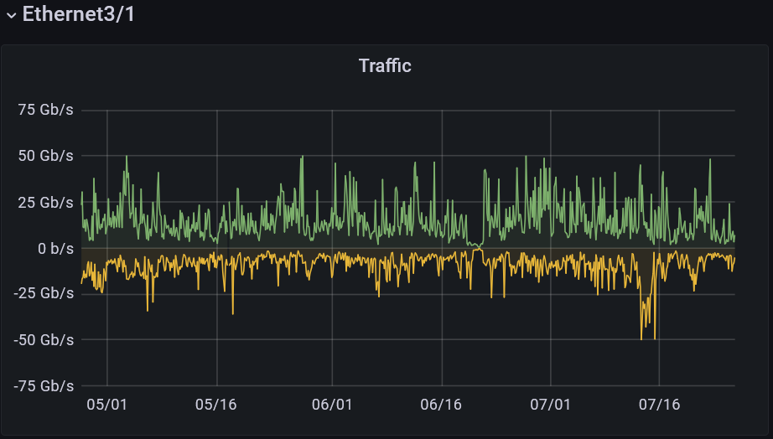
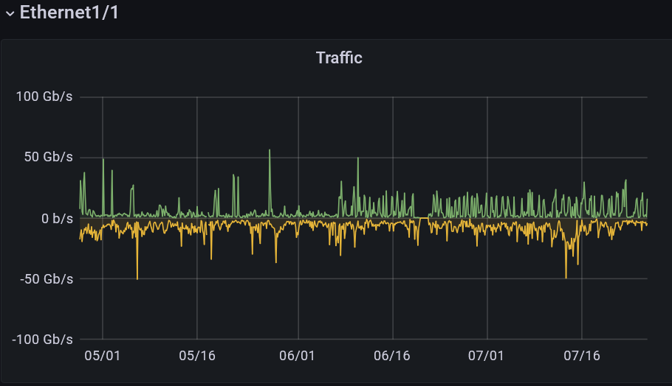
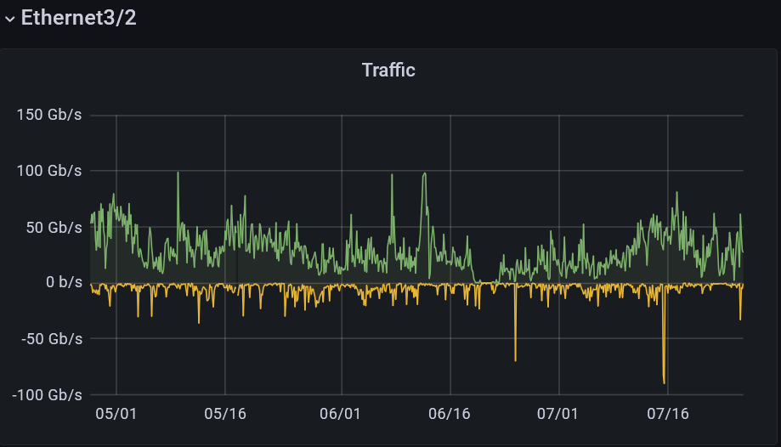
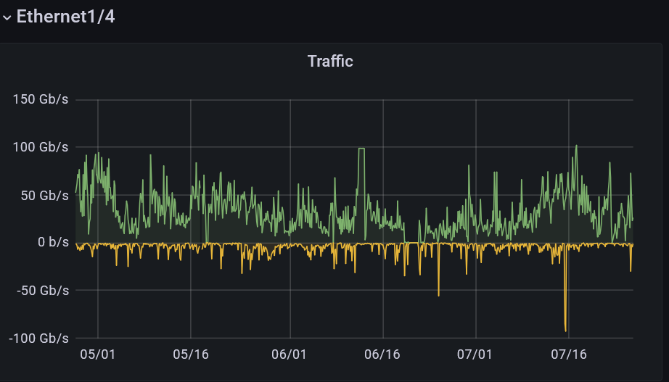
WAN Interfaces
D o w n t i m e
r-ig-I
L H C O N E
r-ig-II
r-ig-I (DE-KIT Border Router):
left two Interfaces
Ethernet 3/1 (Internet + LHCONE) +
Ethernet 3/2 (LHCOPN)
L H C O P N
r-ig-II (DE-KIT second Border Router):
right two Interfaces
Ethernet 1/1 (Internet + LHCONE) +
Ethernet 1/4 (LHCOPN)

Slide 25
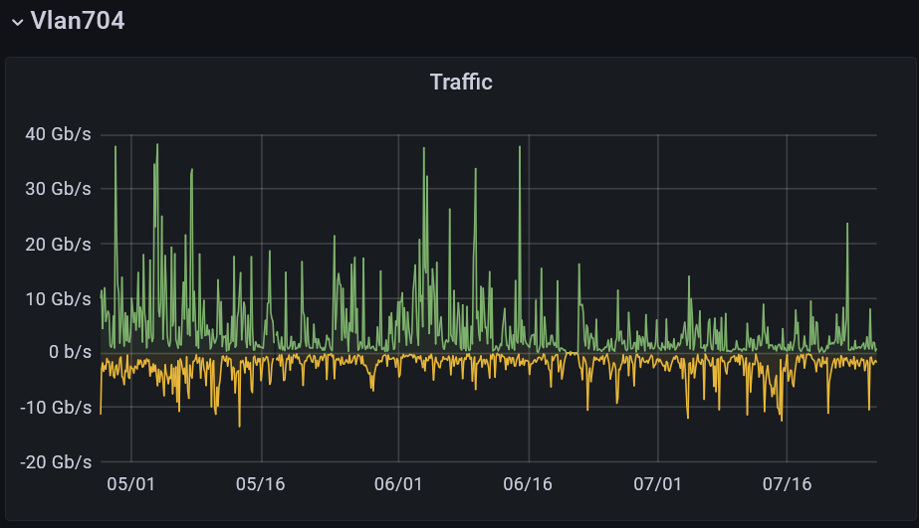
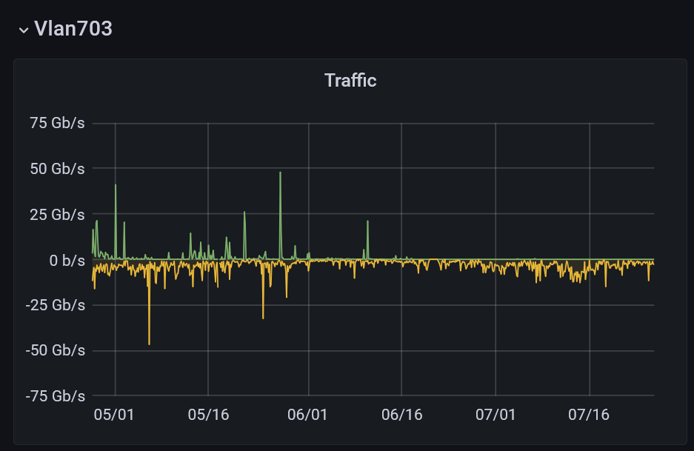
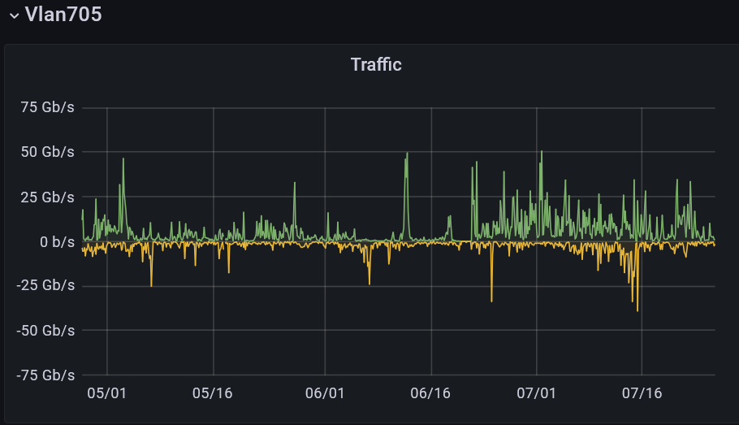
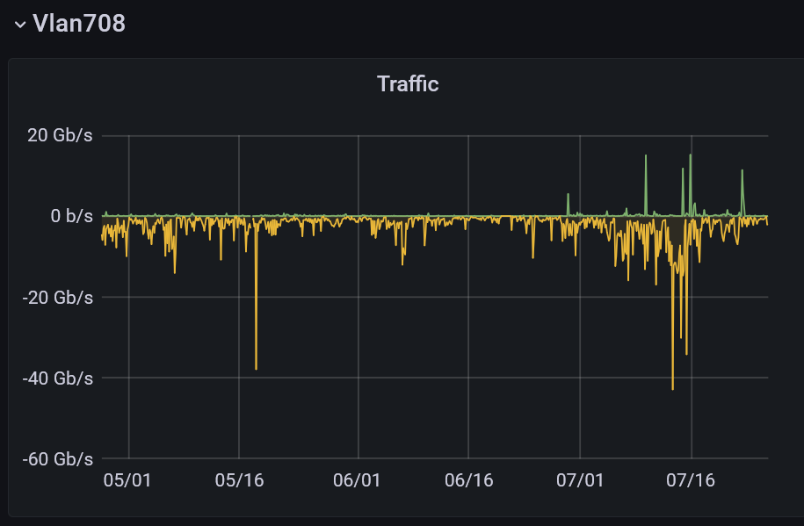
LHCONE IPv4 / IPv6
transfer pattern after downtime
D o w n t i m e
r-ig-I
r-ig-II
IPv4
IPv4
Graph over 90 days
Traffic of LHCONE
moved partioly from the IPv4 vlans
after the downtime to the IPv6 Vlans
IPv6
IPv6

Slide 26
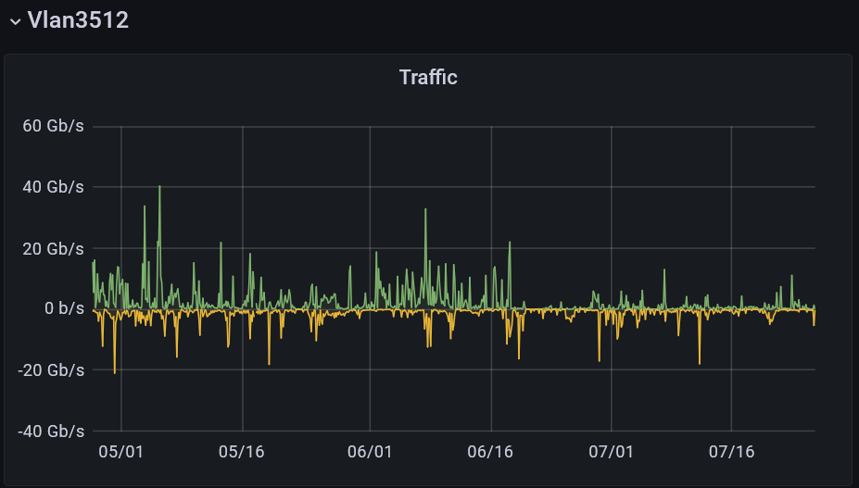
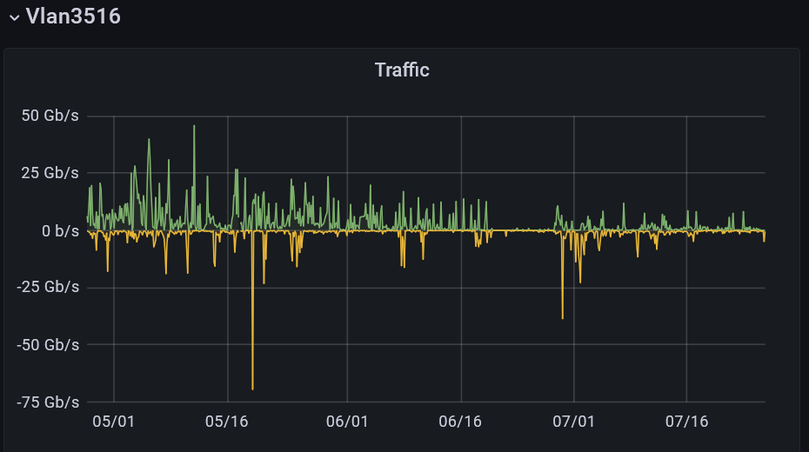
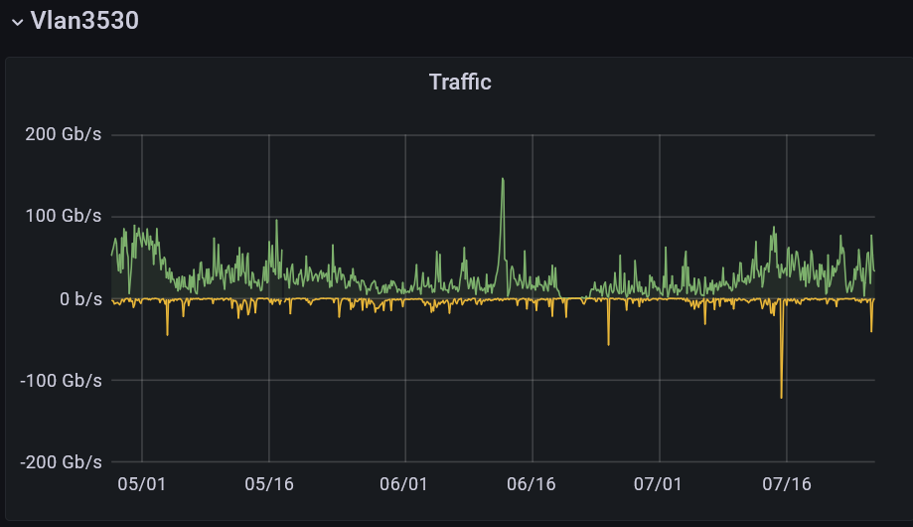
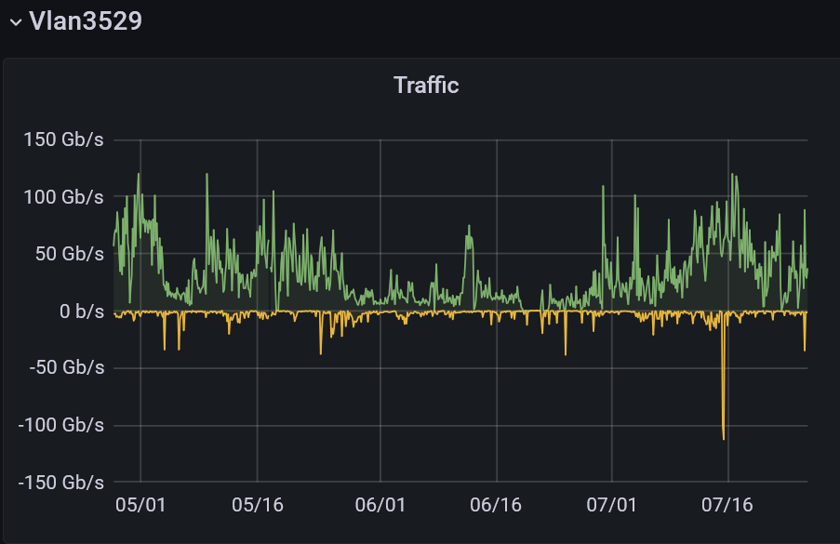
LHCOPN IPv4 / IPv6
transfer pattern after downtime
D o w n t i m e
r-ig-I
r-ig-II
IPv4
IPv4
Graph over 90 days
Traffic of LHCOPN
moved from the IPv4 vlans
after the downtime to the IPv6 Vlans
IPv6
IPv6

Slide 27
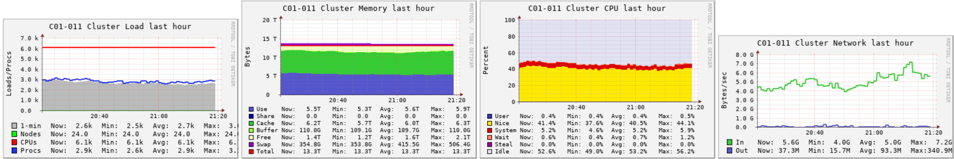
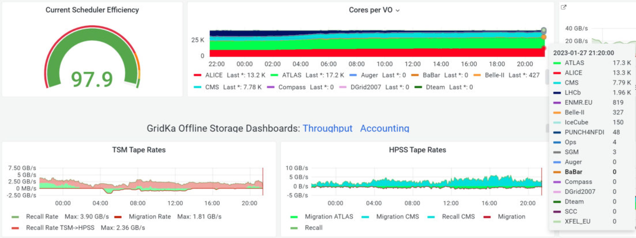
Monitoring
G A N G L I A
- Migration of Ganglia to IPv6 will not persuit
- Ganglia will be replaced by opensearch, kibana and grafana

Slide 28
administatrative Services
  at each rack is a Rack Manager deployed:
    Starting in 2001 with private IPv4 only
    Migration process initiated (but still in progress)
    → enable dual-stack (AAAA)
      NTP
      rsyslog (→ migration → still pending (port 514))
      Monitoring (GmonD → Ganglia Client)
      DHCP (→ migration to DHCPv6 pending)

