Slide 1
IPv6 deployment on WLCG compute services
A. Sciabà
HEPiX Spring Workshop, Paris, 15-19 April 2024

Slide 2
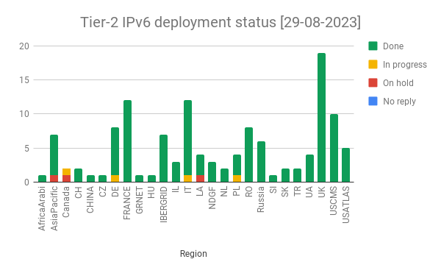
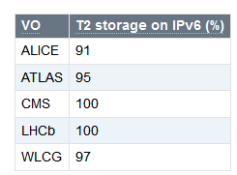
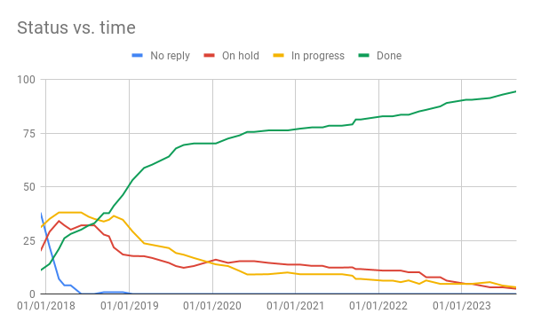
Status of IPv6 in WLCG
WLCG’s agreed end-point is to have IPv6-only sites and services
  Removes the complexity of operating dual stacks and improves security
  Few IPv6-only clusters already there, e.g., at CERN
  Dual stack is just a necessary step along this path
The campaign to deploy IPv6 on storage services has practically ended
  Its goal was to support IPv6-only WNs
  Took very long mainly due to difficulties convincing the hosting institute to deploy IPv6
Today, almost all WLCG sites have IPv6 on site

Slide 3
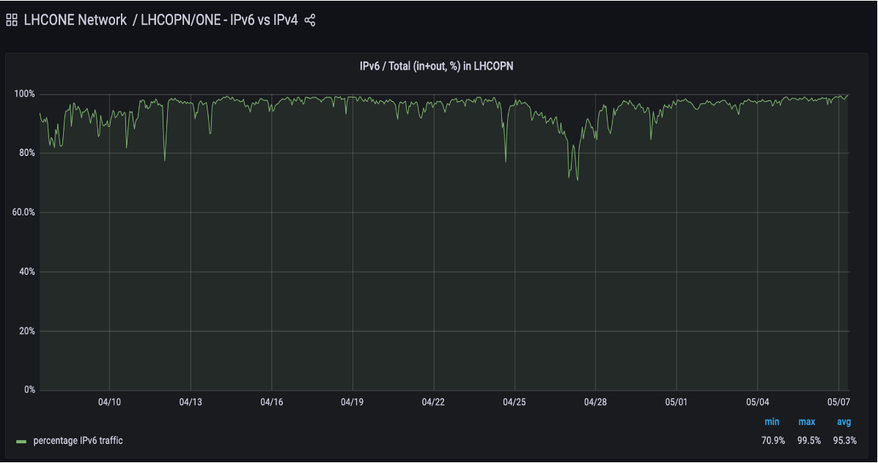
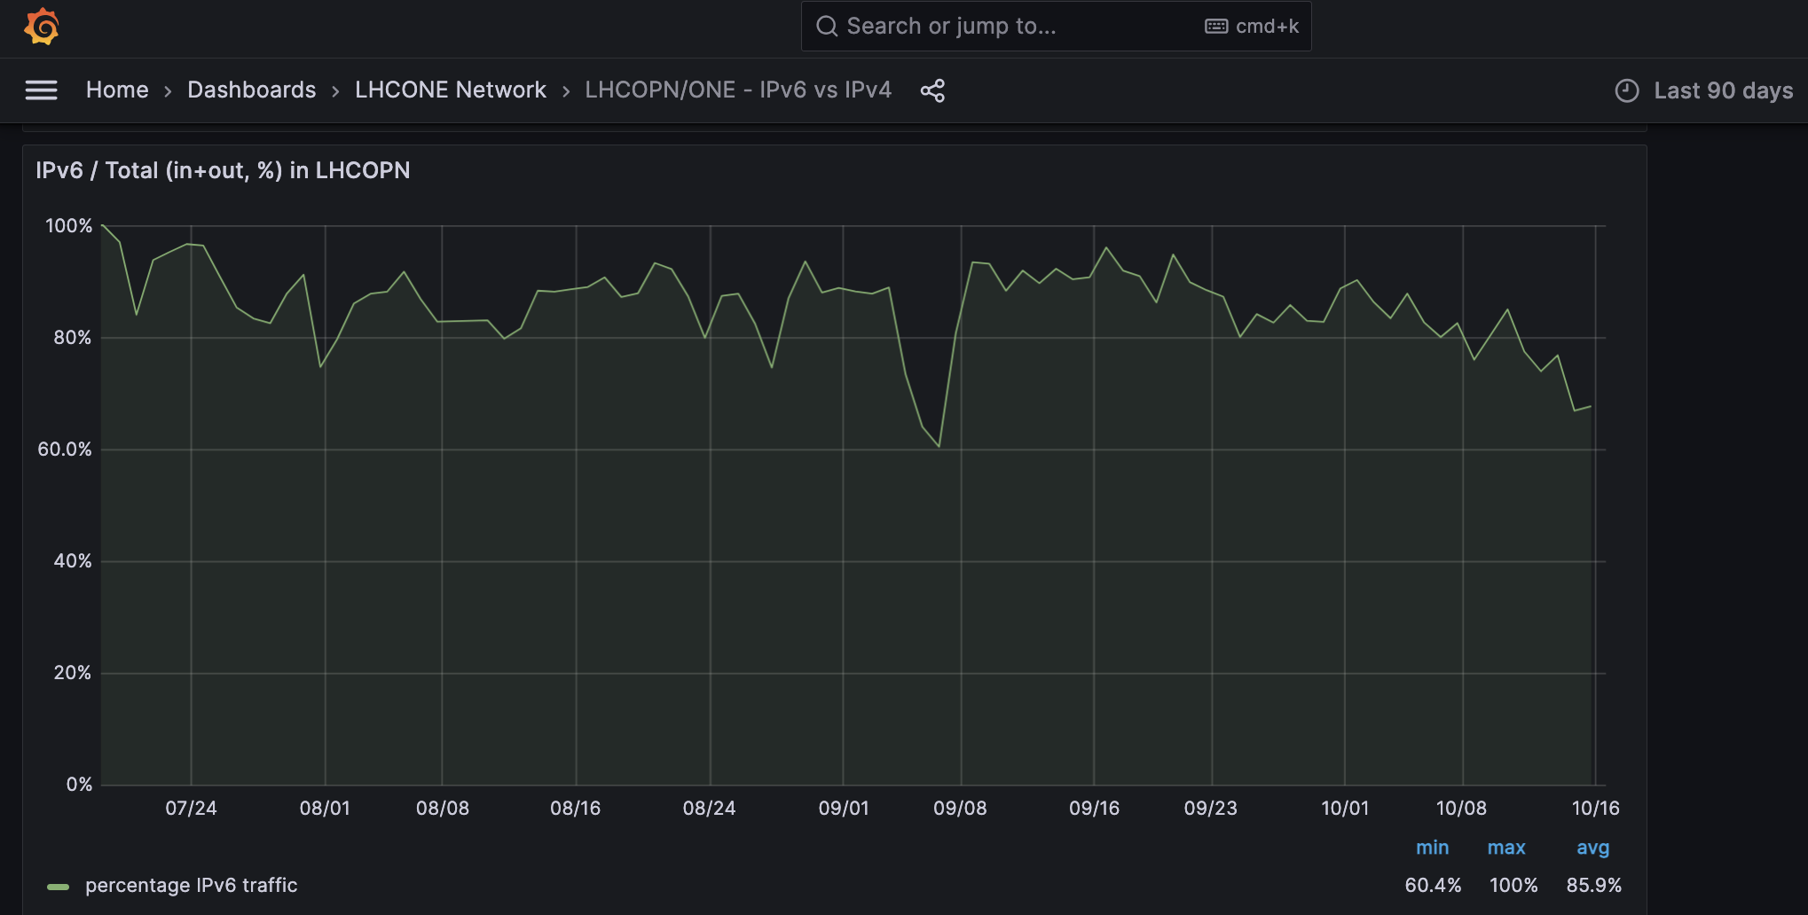
IPv6 on Compute Services: general motivations
IPv4 addresses are a very scarce resource
  May limit site expansion and creation of new sites
  Want to avoid use of NAT
Strong push by some governments to fully embrace IPv6
  The US government mandates 50% of systems IPv6-only in 2024 and 80% in 2025, affecting FNAL and BNL
Packet marking works only for IPv6
All LHC experiments and Grid middleware fully support IPv6 in production
  Has been the case for quite some time
Almost all sites have IPv6 in their intranet
  The biggest obstacle has been already removed
  A large fraction of CEs and WNs has IPv6 now
Eliminate the biggest remaining source of IPv4 traffic
  Data transfers between WNs and storage systems
LHCOPN traffic to/from CERN

Slide 4
Proposal submitted for approval to the MB
All WLCG sites should offer IPv6 connectivity on their compute services (CEs and WNs) by June 30, 2024
  Switching off IPv4 is not requested nor recommended: sites wishing do to it must discuss it with the supported experiments
Progress would be tracked by launching a GGUS ticketing campaign, exactly as it happened for the storage services and perfSONAR
  ETF could be used to test full functionality of the job management system over IPv6
The proposal was accepted in October 2023

Slide 5
ALICE
Status at the start of the campaign
  Storage
    95% of the distributed disk space is dual stacked (only a handful of T2 endpoints still IPv4-only)
  Worker nodes
    49% of the job slots (150k jobs running) connected to the ALICE central services over IPv6 (preferred by default)
    45% of the machines pass an explicit ‘curl -6’ test
Requirements
  ALICE is asking all remaining sites to dual stack their resources to enable sites that run out of IPv4 addresses to run jobs efficiently (by direct connection to data sources without NAT boxes or proxies)
  For the same reason sites are encouraged to dual stack their entire infrastructure

Slide 6
ATLAS
Status at the start of the campaign
  IPv6 support for storage already a requirement, mostly met
    The long tail has proved troublesome
  However, 50 % of the requests to the data-management service (Rucio) are done over IPv4
Requirements
  ATLAS recommends that all Grid-facing services and resources be requested to deploy IPv6

Slide 7
CMS
Status at the start of the campaign
  The CMS submission infrastructure is using IPv6 when available
  About 52% of the CEs already dual stack
  About 25% of the WNs in the global pool and 74% in the CERN pool have IPv6
Requirements
  Need to meet the US government mandate
    The CMS pilot factories in the US have to become IPv6-only!
  Proposing deadline on 30 June 2024
    Chosen to coincide with the CentOS 7 end-of-life

Slide 8
LHCb
Status at the start of the campaign
  100% of services and storage already dual stacked
  Pure IPv6 nodes thoroughly tested with no loss of performance or capability
Requirements
  Support full scale deployment on CEs and WNs

Slide 9
DUNE
Requirements
  No objections to IPv6 (even only) on WNs
    Fulfils the US government requirement
  Move to IPv6-supported hardware Rucio services (FTS)
  opensciencegrid.org lacks IPv6!
  Some sites (e.g., BNL) will need to dual stack internal services (Puppet, Condor) to dual stack
  Likely timescale to be comfortable with pure ipv6 on WNs: ∼12 - 18 months

Slide 10
Ticketing campaign
Launched on 28 November 2023 on all WLCG sites
  Tier-3 sites not included
“Please deploy dual-stack connectivity (IPv4+IPv6) on your computing services (computing elements and worker nodes) as soon as possible and by 30 June 2024 at the latest”
Provide estimates for timescale and some details on the necessary steps
It cannot meet the deadline, explain why

Slide 11
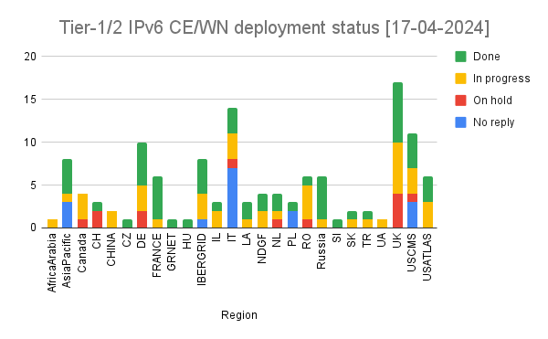
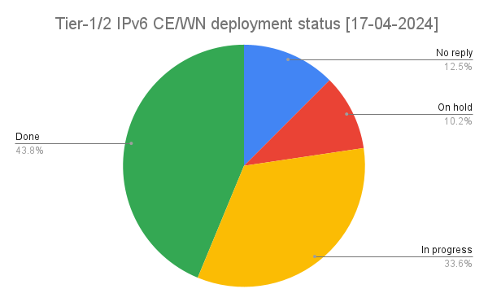
Current status
Around 44% of sites completed IPv6 deployment
A few regions (France included) have (almost) all sites on IPv6
  And a few ones stand out for the opposite reason
Status always visible from a twiki page

Slide 12
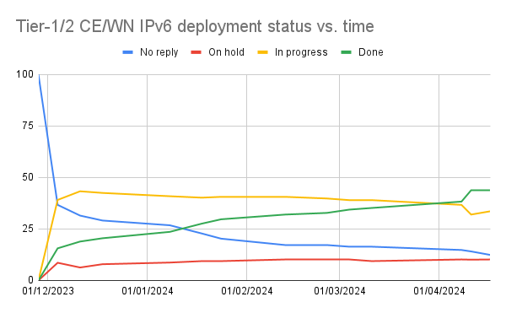
Time evolution
About 20% of sites already had IPv6 on compute services at the start of the campaign
2.5 months left until the deadline
A linear extrapolation would have 62% of sites done by the deadline
  Need to pick up the speed!
  Not to be too worried, several sites will take their time but still meet the deadline

Slide 13
Analysis of the site replies
Type of answer | Sites
The site already had IPv6 | 33
The site is silent | 25
The site acknowledges the request and adds it to their planning | 17
The site promptly reacts and takes necessary action, deployment is completed quickly | 15
The site needs to figure out how to do it or planning is not trivial | 9
The site promptly reacts and takes necessary action, but deployment takes some time | 6
The site needs to wait for some other upgrade | 6
The site is silent and suddenly announces that deployment is completed or almost completed | 6
The site did something but then went silent | 2

Slide 14
Special concerns, problems or requests
Some sites will couple it to other changes (e.g. new OS, new nodes, change internal routing, etc.)
Some sites admit that they will not meet the deadline
  Manpower issues, very complex or special site setup, other constraints, …
A few sites asked if they can go IPv6-only or at least test it!
  Possible but must be arranged with their experiments
A couple of sites are afraid that WNs (now behind NAT) will become more “exposed”
A site needed some expert help but eventually managed
Overall, sites tend to take the request seriously and act on it

Slide 15
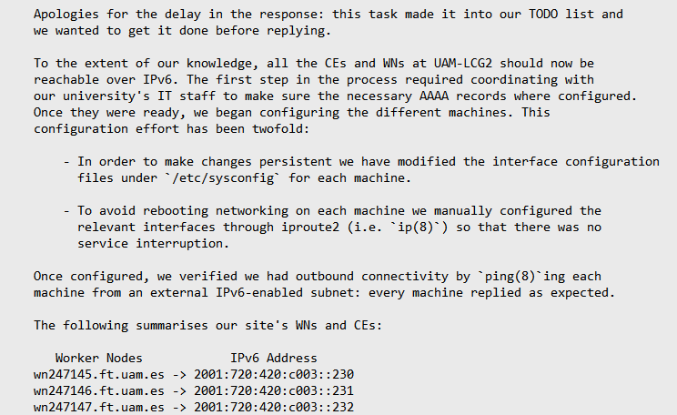
An example: UAM-LCG2
The only site which explained in detail what was done to deploy IPv6!
  https://ggus.eu/index.php?mode=ticket_info&ticket_id=164411

Slide 16
Conclusions
Almost all WLCG sites had already adopted IPv6 for storage and a large fraction also provided it on compute
All LHC experiments fully support IPv6 in their computing operations
The next logical step for the WLCG network strategy is to reach 100% adoption
  Low risk, relatively short completion time expected in most cases
  Leverage the resources of the HEPiX IPv6 working group and WLCG operations
Deployment on compute services is proceeding reasonably well
  Sites very rarely ask for help, they figure it out by themselves!
  Few sites are pessimistic about their ability to meet the deadline
  Too many sites (15%) still did not react to the ticket, though
  44% of sites have finished!

Slide 17
Discussion
Desire to still retain NAT for WNs? Discuss
Are there any sites in the audience which have not yet replied to the ticket? If so, can you comment why?
  Are you struggling with a technical challenge?
Anyone in the room who wants to share experiences? Or challenges? Already solved or still to be solved?
Other issues?

