Slide 1

Nonconformities HL-UK / CERN WP4
Handling, sharing and approval
EDMS 2894857
H. Garcia Gavela on behalf of the HL-LHC PDQR Office
16/05/2023

Slide 2
Outline
HL-LHC Nonconformities
Handling of NCRs
Content
Conclusions

Slide 3
Outline
HL-LHC Nonconformities
Handling of NCRs
Content
Conclusions

Slide 4


HL-LHC Nonconformities
Nonconformity → Non fulfilling of a requirement (of any kind)
Requirements for Cryomodules are specified in the Engineering Specifications, including their annexes (Drawings, Procedures) or are coming from the normative (standards, rules, etc)
HL Nonconformity Process for Collaborations EDMS 2149457
Full process on Launching a Nonconformity using EDMS is explained in EDMS 1908145
NCRs will follow the HL-LHC Template to communicate with CERN in order to comply with HL-LHC NC Policy (class, criticality, decision, corrective/preventive actions…)
CERN will provide support in the preparation of the NCRs as well with the evaluation. Nevertheless, we expect Collaborations
pre-filled the template with the related info as well as with a first assessment

Slide 5
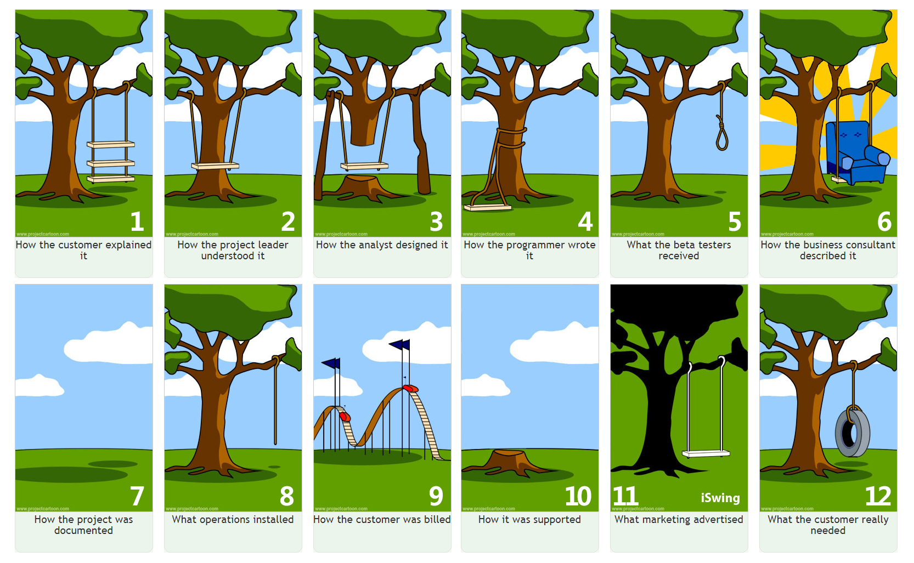
Requirements
Without requirements there are not nonconformities

Slide 6
Requirements
Without requirements we cannot talk about quality
Requirements only “exist” if there is a verification method : Each requirement shall be stated in such a way that an objective verification can be defined for it
Only requirements that are necessary, measurable, achievable, and verifiable shall be included in the specifications
Requirements are to worded to provide a definitive basis for acceptance or rejection. If no requirements, no nonconformities
(to be treated accordingly and to be used for lessons learned and improvement)
Reviewers allow you to understand how others understand your requirements. Experts will help on defining requirements
Main goal of the documentation review process is to ensure that requirements (including applicable normative) are clearly defined, revised, agreed and propagated among the different stakeholders. Coordination at Project Level

Slide 7
Project Documentation
Documentation is a key player for any project:
  It provides provision of objective evidence;
  It proves the conformity of the requirements established by a customer;
  It enables repeatability and traceability of the work done;
  It provides provision of appropriate training;
  In the event of a nonconformity, it allows tracing the info back and searching for the root cause.
  In projects at large scale, with high personnel turnover (temporary contracts, students, etc) proper documentation (handling, storage, accessibility) becomes critical for an adequate knowledge transfer
  Communication (internal and external)

Slide 8
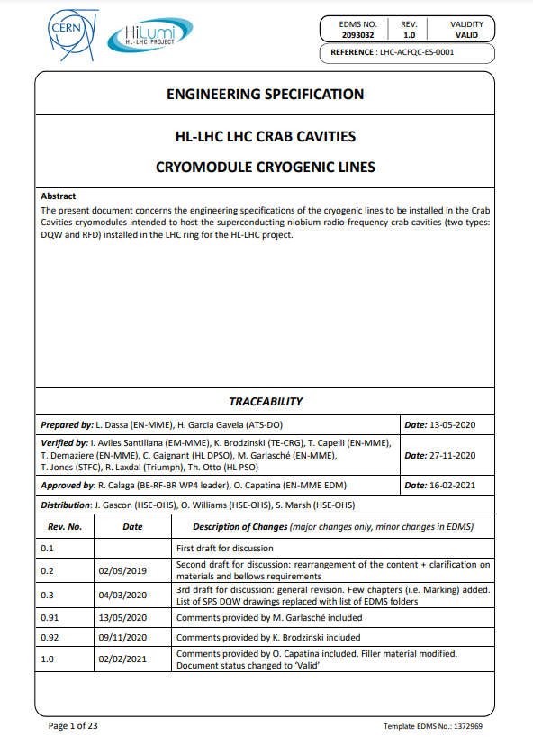
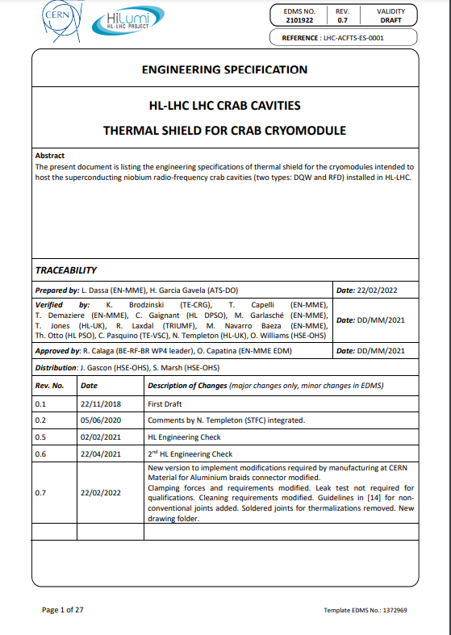
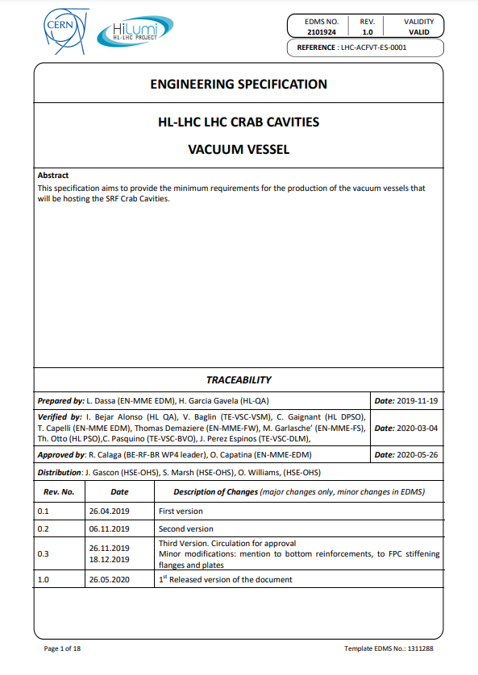
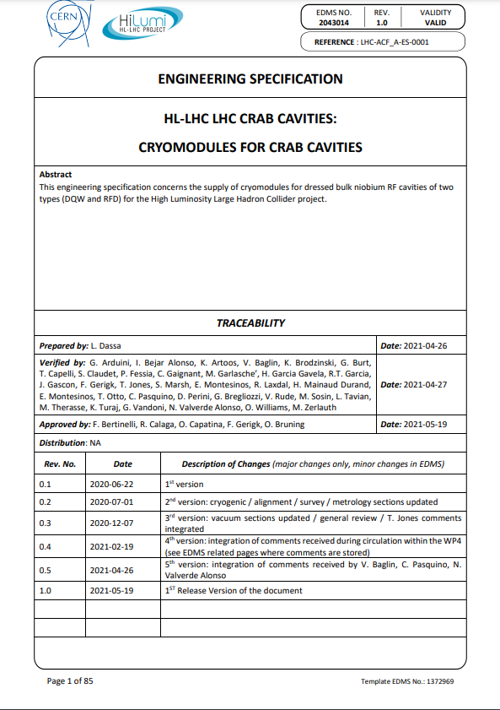
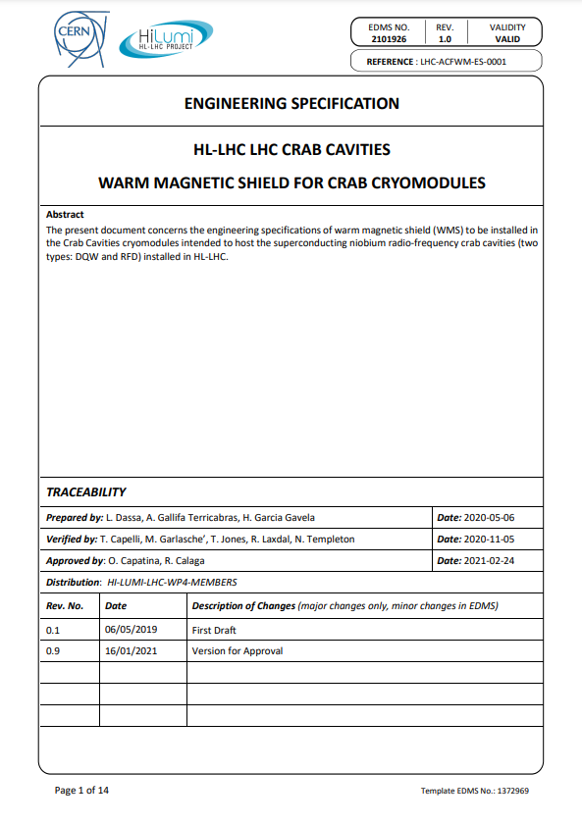
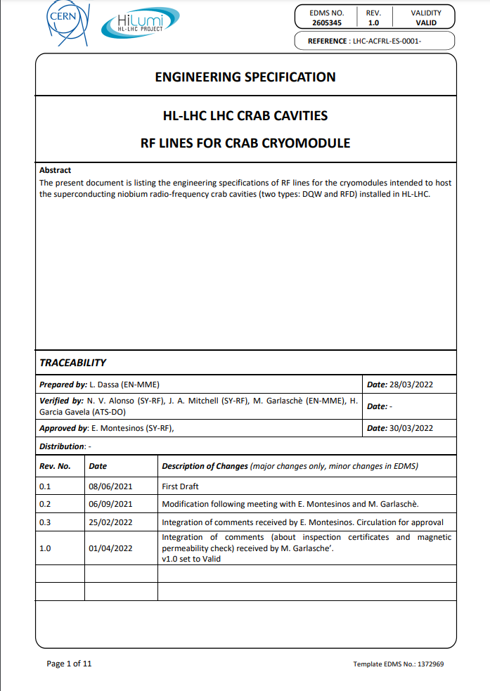
Requirements
WP4 Engineering Specifications issued for Cryomodule and Cryomodule components They are the main basis to check applicable requirements

Slide 9
HL-LHC Nonconformities
Nonconformities are part of the any kind of production and it does not mean the equipment cannot be used
Nonconformities ≠ Deviation Requests
  Nonconformity – A deviation from an established requirement is detected
  Deviation Request – Request to do something different from an established requirement
We are NOT here to search for guilties but to learn from these issues and improve.
Root cause and corrective/preventive actions are of utmost importance (solve the issues found and avoid recurrence so the process is optimized).
NCRs can lead to overcosts or delays so it is mandatory to trace them properly and apply the lessons learned in the future

Slide 10
Outline
HL-LHC Nonconformities
Handling of NCRs
Content
Conclusions

Slide 11
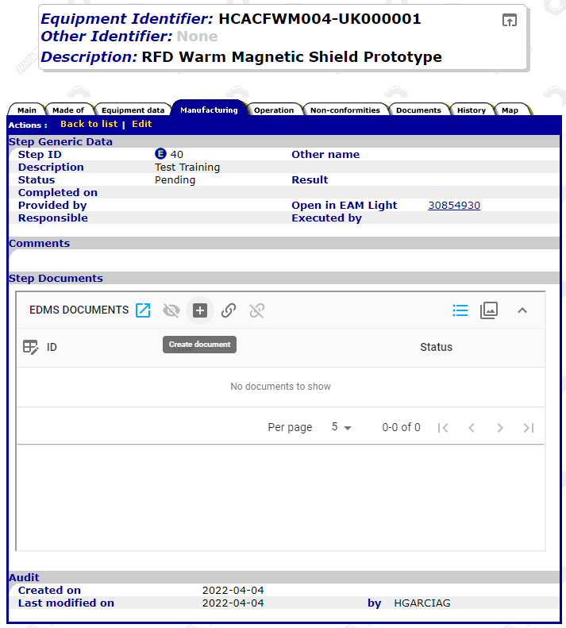
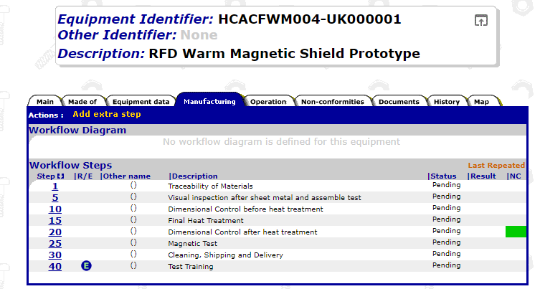
Create EDMS Document via MTF

Slide 12
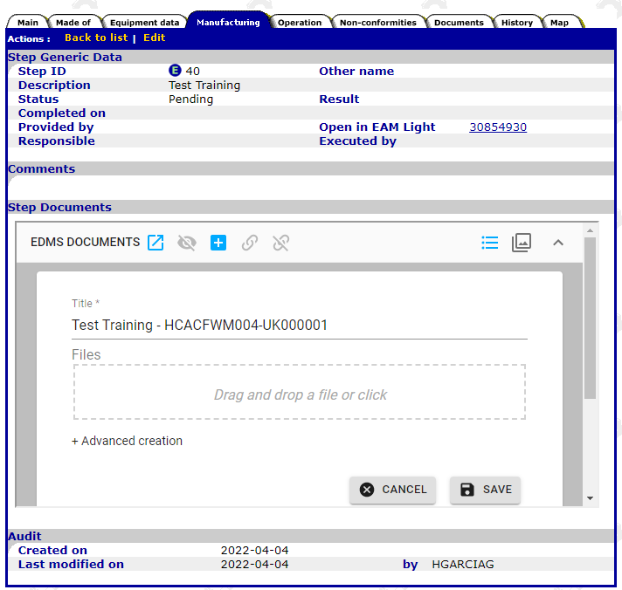
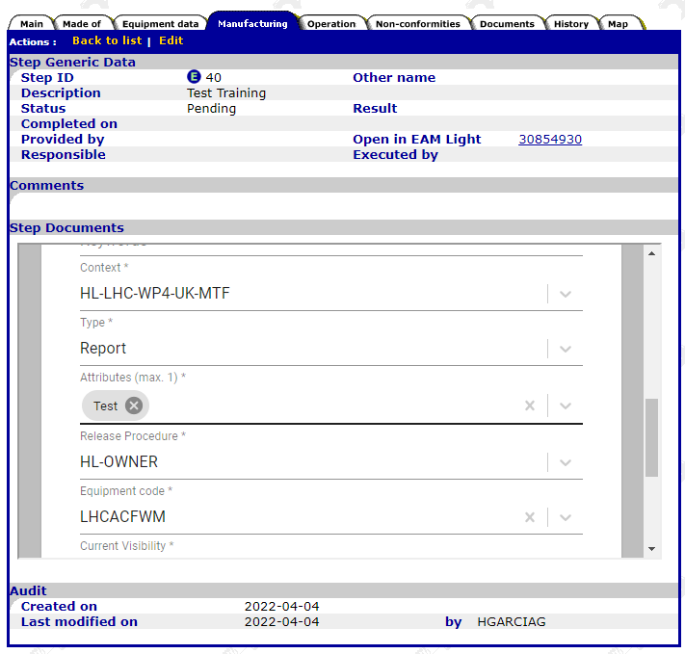
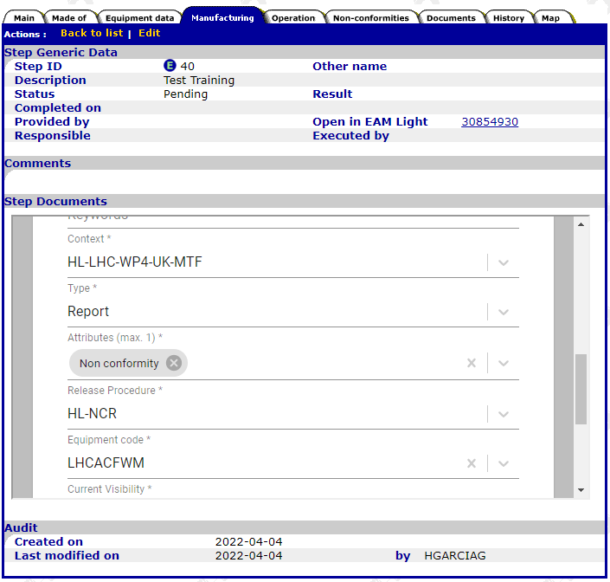
Create EDMS Document via MTF
Nonconformities are reports as well.
You just need to change in the attributes Test by Non conformity

Slide 13
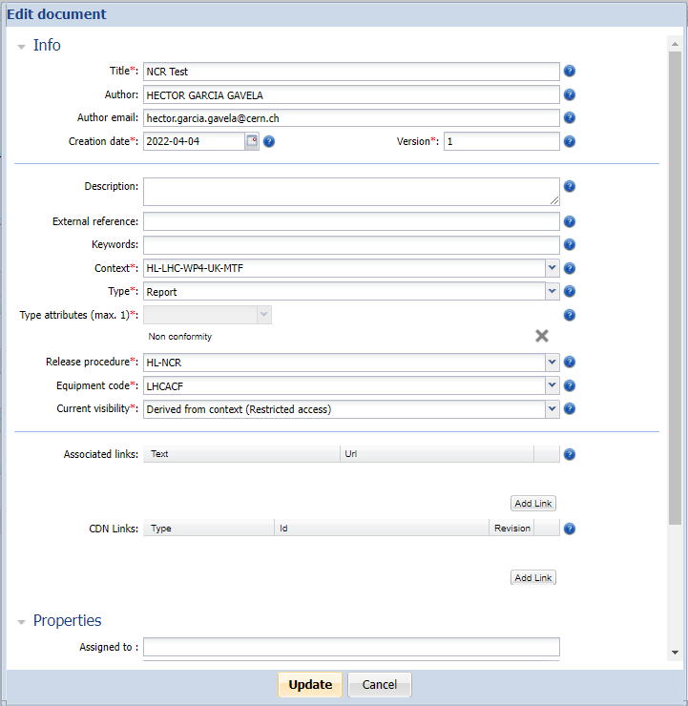
Create EDMS Document
If you create the NCR directly in MTF, the context by default is already set
(HL-LHC-WP4-CANADA-MTF).
If you create the file in EDMS, choose the context – HL-LHC-WP4-CANADA-MTF
Type of Document – Report and Type Attribute Non conformity
Release Procedure HL-NCR (important!!)
Equipment Codes (See next Slide)
Once you issue the document, please fill in all the associated EDMS metadata (Info and Properties). Same info that will appear in the Template
Always start with the version 0.1
The HL-LHC NCR Template correctly filled in shall be added to the EDMS document

Slide 14
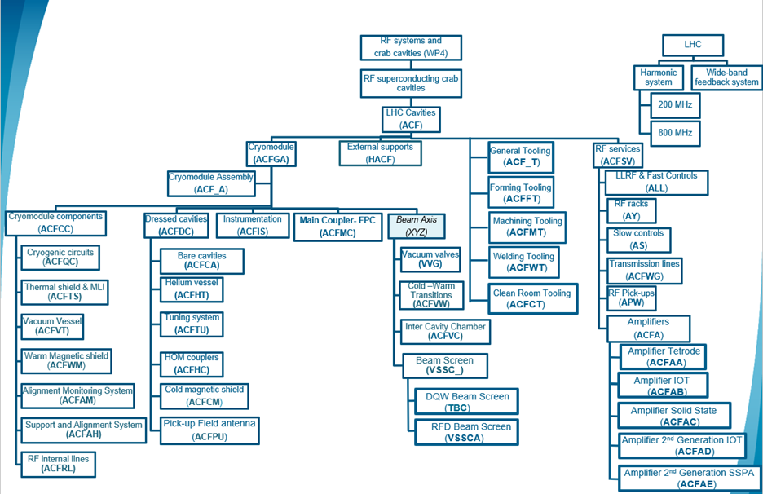
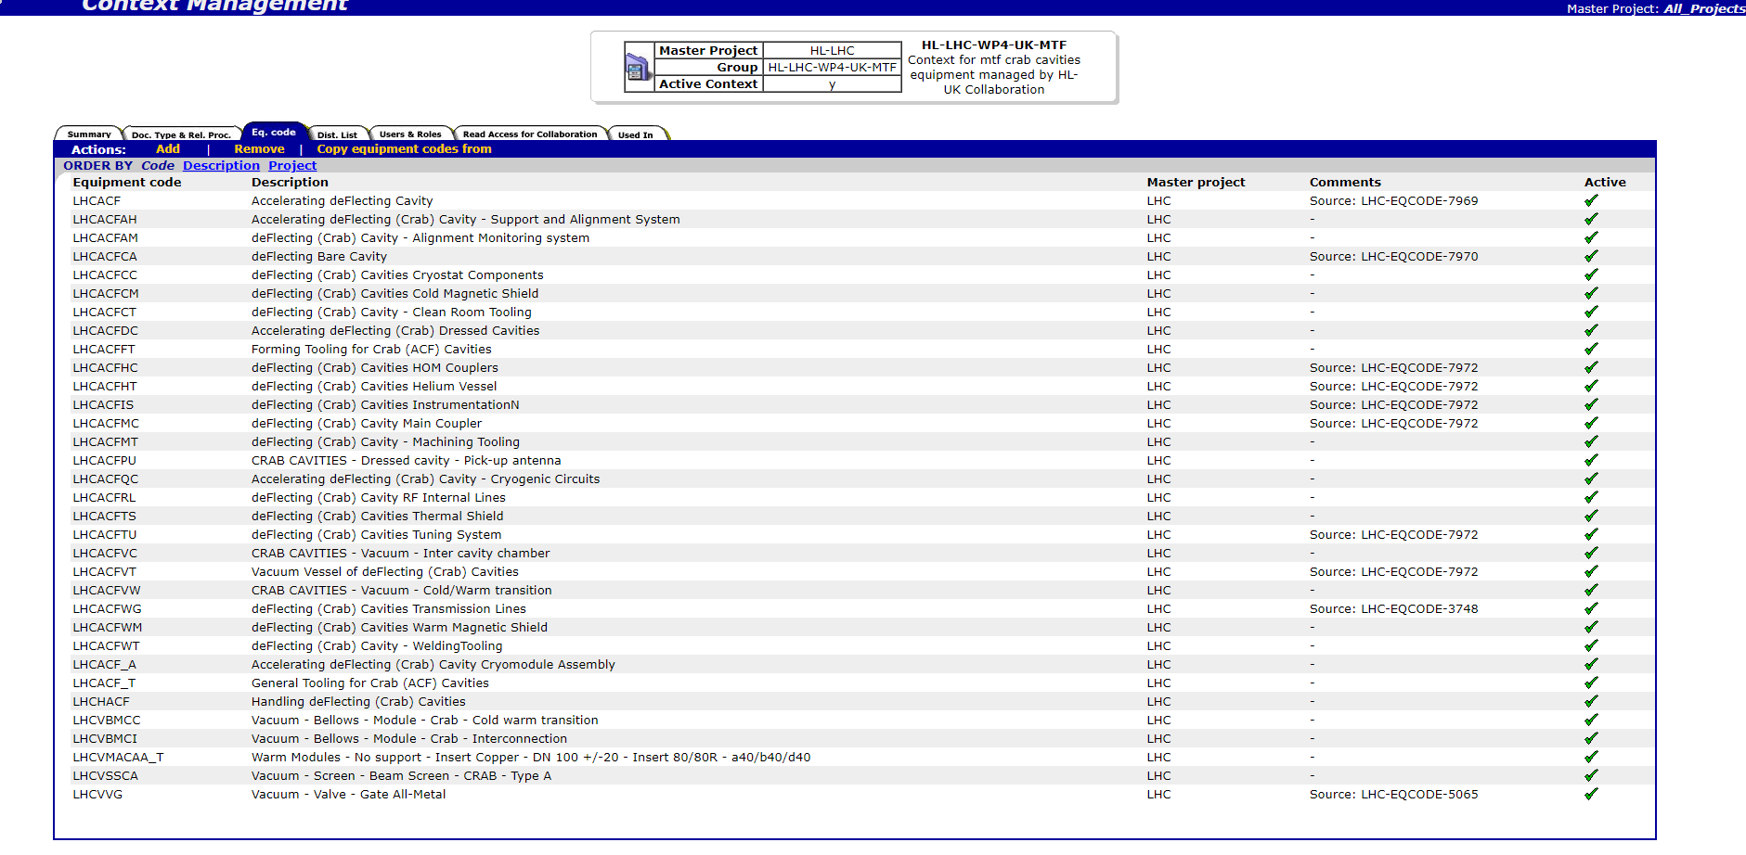
Create EDMS Document via MTF

Slide 15
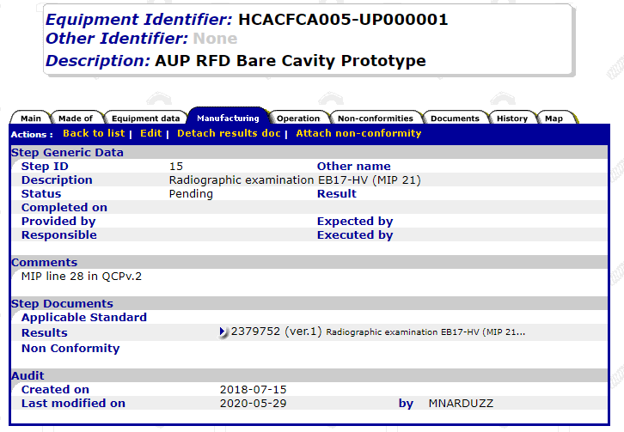
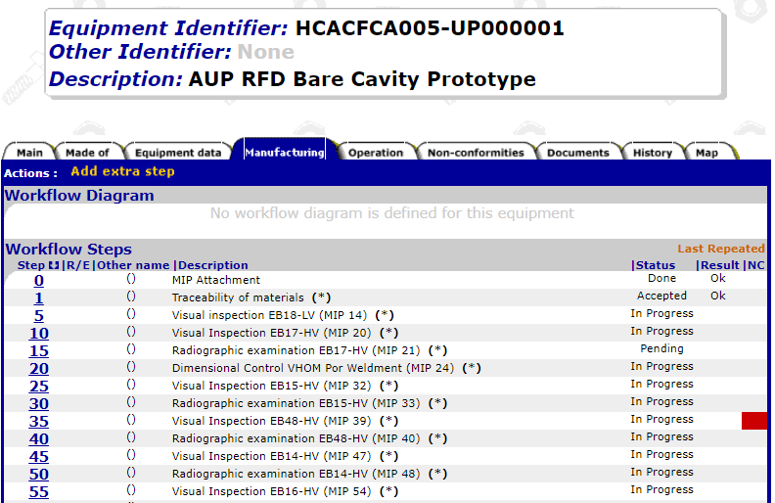
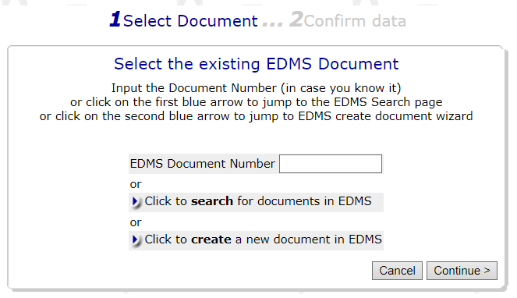
Attach NCR in EDMS Document to MTF
The NCR shall be attached to the applicable MTF Step (where the deviation is found)
If the document is already created in EDMS then we can attach it to MTF
If it is not created in EDMS yet, the document can be created directly in EDMS by using MTF

Slide 16
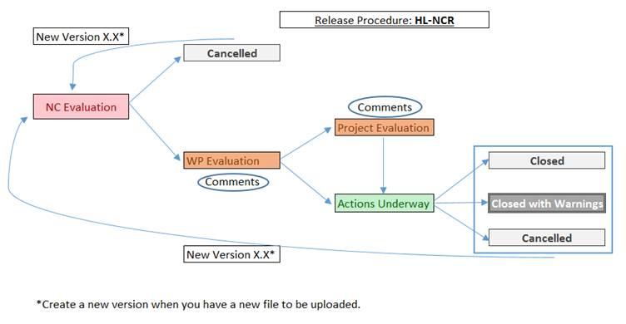
Document life-cycle

Slide 17
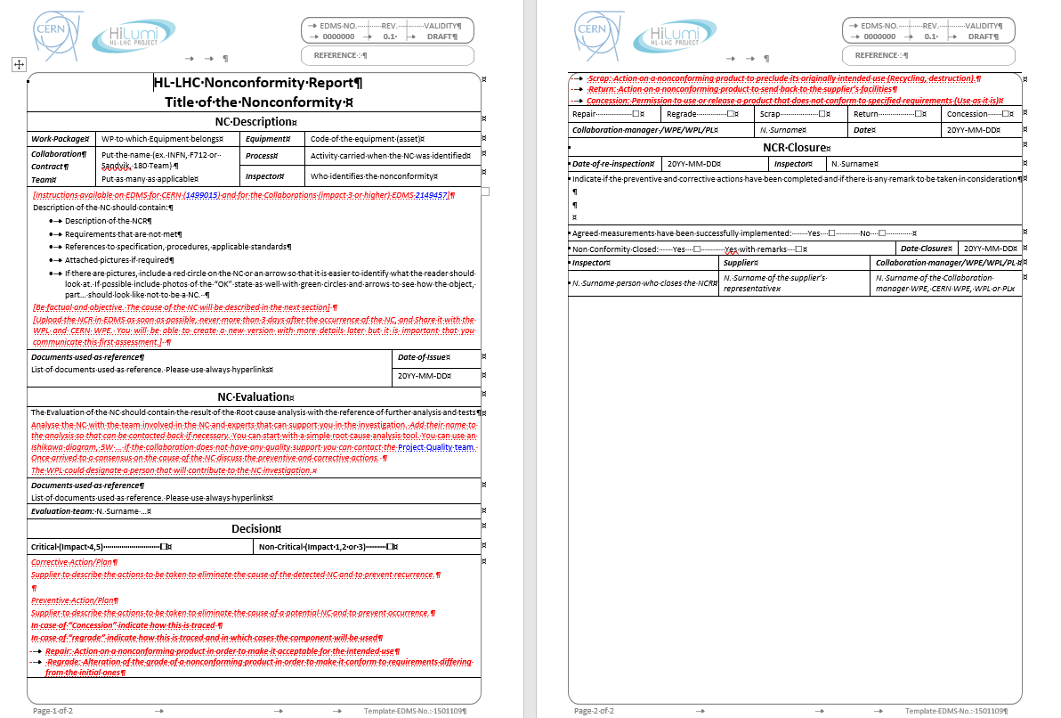
Document life-cycle
These inputs can be provided by HL-UK. CERN can help with the preparation

Slide 18
Outline
HL-LHC Nonconformities
Handling of NCRs
Content
Conclusions

Slide 19

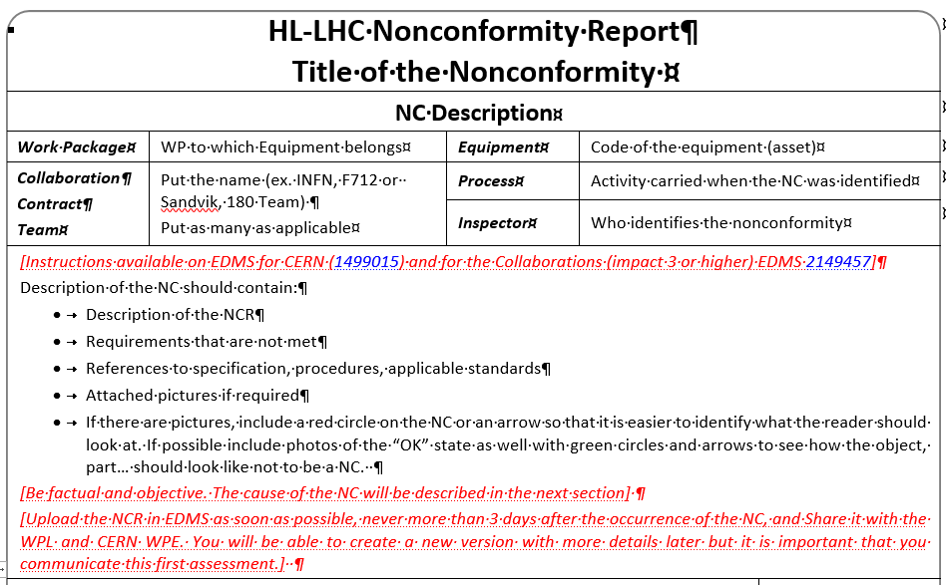
NC Description
Provide all the available information about the Nonconformity (Description, requirement/s not met, etc.) – What, Where, When, Who
Be factual and objective. We are not assessing the causes and the impact yet. First we need to know what went wrong. The root cause of the NC as well as the consequences will be described in the next section (NC Evaluation)
Add references to reports and other documentation to be used as reference and supportive documentation of the Nonconformity
Provide pictures and/or any other relevant material that can be useful for the analysis

Slide 20
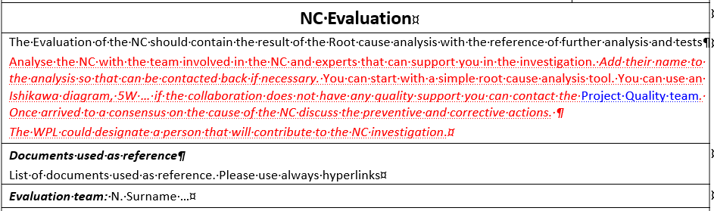
NC Evaluation
The root cause of the Nonconformity is herein detailed – Why, How
A method statement can be proposed to the evaluation team (if Repair is required)
The impact of the Nonconformity is to be explained (technical and project level)
Corrective actions to close this NC and Preventive actions to avoid recurrence are herein proposed. These actions shall be assessed and confirmed during the follow step (WP Evaluation). A new version of the document might be required depending on the decision (more information is requested for completeness, different method statement…)

Slide 21
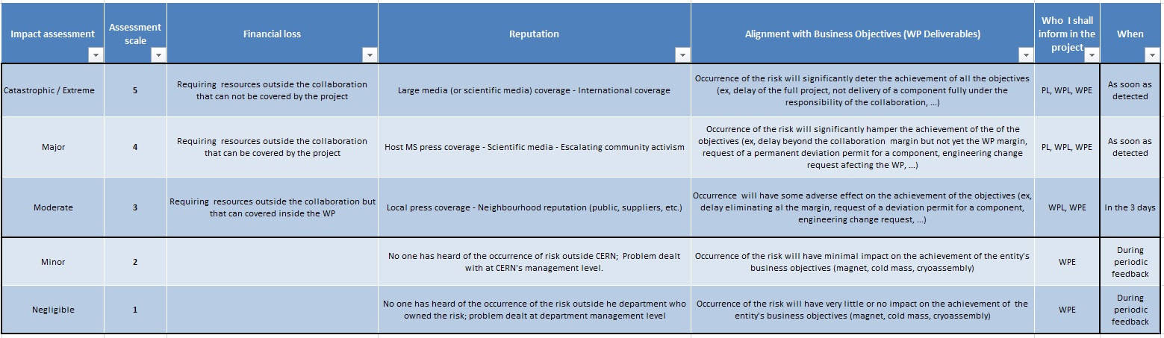
Handling and Sharing of Nonconformities
The NC Class triggers how it is to be communicated -> Marco is your entry point
The NC will be assessed by the Collaboration with the team involved in the NC (Production, inspection ...). The first check shall be how this NC affects the project (Impact). If the NC has a relevant impact on the project (delays beyond the margin, additional means beyond the collaboration, damage to the image of the project, etc.), then the WPL shall be informed.
The Collaborations Impact matrix (EDMS 1863763) can be used to evaluate the NC but, in case of doubt, the NC shall be always escalated to the next project level (Share with us!)

Slide 22
Handling and Sharing of Nonconformities
 | Technical impact | Schedule impact | Financial impact | Others
Class 5 | Major implications for the project It requires a clearance from CERN to move fwd. Out of specified performance Potential loss of one full item | > 2 months of Delay Time window not respected, and project schedule needs to be updated |  | Same issue happens more than times Potential change in the specification
Class 4 | Major implications for the project It requires a clearance from CERN to move fwd. Potential loss of one partial item Repair to be performed, which requires CERN approval | 1 month < Delay < 2 months Time window not respected, and project schedule needs to be updated |  | Same issue happens up to three times Potential change in the specification
Class 3 | It requires a clearance from CERN to move fwd. Potential loss of one partial item Repair to be performed, which requires CERN approval | 1 week < Delay < 1 month Time window not respected but project schedule does not need to be updated |  | First time it happens Potential change in the specification
Class 2 | Minor implications | < 1 week of Delay
Class 1 | Minor implications | No delays are accounted
Time Reference – Delivery of the equipment to CERN
In case of doubts, inform us! – Minor issues may have a later major impact, if they are not properly addressed upon occurrence!
Of course, a potential regrade (change in the specification) needs CERN Approval (…and proper discussion between HL-UK and CERN-WP4). Regrades will most likely lead to Deviation Requests
Class 1, Class 2 up to WPE to approve it, Class 3 WPL and Class 4 and 5 to be shared with the PL

Slide 23
Document life-cycle (Share with CERN)
If the NC is critical (impact 4,5), it will also be shared with the Project Management (up to us to escalate)
The document is shared with the EDMS Distribution List: WP4_COORD_CRYOMODULE

Slide 24

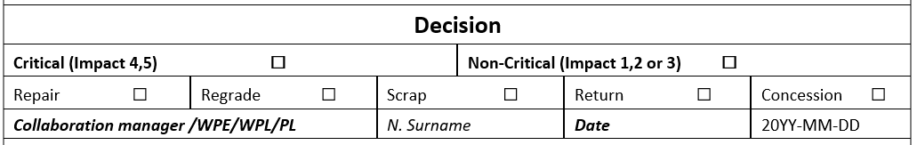
WP Evaluation (CERN Assessment and feedback)
Once the document is shared with WP4_COORD_CRYOMODULE, we will provide Feedback via EDMS
Based on the previous income CERN will assess the information and provide a decision (Full process is traced through EDMS).
The decision about the Nonconformity shall be integrated in the document
  Repair: Action on a nonconforming product in order to make it acceptable for the intended use
  Regrade: Alteration of the grade of a nonconforming product in order to make it conform to requirements differing from the initial ones
  Scrap: Action on a nonconforming product to preclude its originally intended use (Recycling, destruction).
  Return: Action on a nonconforming product to send back to the supplier’s facilities
  Concession: Permission to use or release a product that does not conform to specified requirements (Use as it is)

Slide 25
Document life-cycle
The status of the NC will remain in Actions Underway until it is proven that the NC has been solved

Slide 26
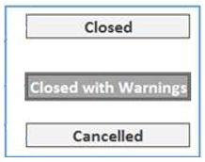
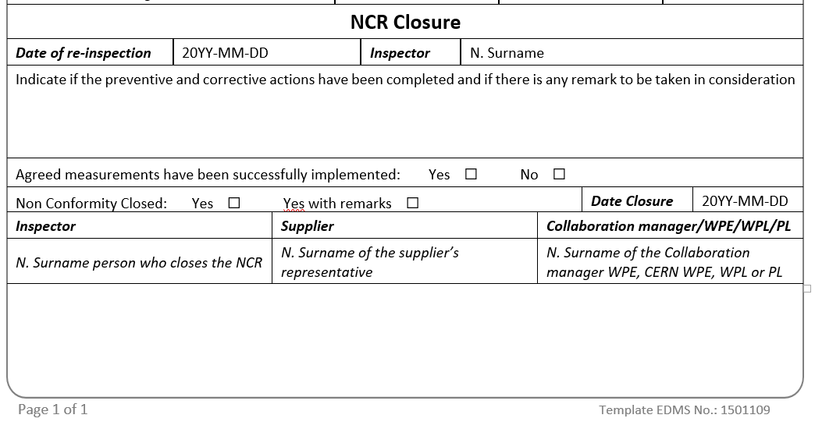
NC Closure
Once the Nonconformity is solved, the document shall be updated (new version to be issued). The reference to the report(s) that proves the Nonconformity is closed is to be added in MTF (additional MTF Step if needed) and the Status of the Nonconformity is changed to Closed or Closed with Warnings
No measurable actions = No closure of the NC

Slide 27
Outline
HL-LHC Nonconformities
Handling of NCRs
Content
Conclusions

Slide 28
Some reasons a problem-solving process often fails
Jumping from analysis to a solution too quickly
Using data that are inaccurate or biased
Failing to include the right people in the problem-solving process
Mistaking a symptom for the root cause of the problem
Failing to test a solution before implementing it
Failing to evaluate the potential beneﬁts and costs of the chosen solution

Slide 29
Conclusions
Nonconformities are part of the production of any component. When a specified requirement is not fulfilled a Nonconformity is to be issued
The metadata as well as the information of the NC is to be provided by the Collaboration with support from CERN
CERN will assess the NCR and provide the feedback (assessment of the proposal and decision)
Actions are to be implemented (if any) before closing the Nonconformity
NCR to be attached to the corresponding MTF Step and when necessary the step shall be repeated to prove that the Nonconformity is closed (if repair)
Every NCR should answer to the 5W-1H (Who, When, Where, What, Why, How) – Otherwise it is most likely incomplete

Slide 30
Q&A

Slide 31
Closing the NC- pre-steps
Who will verify the actions? (internal auditors or similar)
Once the actions are implemented, how long until they are verified as effective?
Where will the verification activities be recorded?
What verification indicators will be used (reduced scrap rates, reduced nonconformances, reduced customer complaints, trained personnel, and so on)?
Do the indicators provide evidence that the actions solved the problem and didn’t create any new ones?
Will the actions require ongoing monitoring? If so, what is the frequency of the monitoring?
Who will the verification results be reported to? How? When?

Slide 32
Closing the NC
The independent person’s role is to perform a check and balance at the end of the problem-solving process. However, there is nothing wrong with the person(s) who implemented the action being present when the actions are being reviewed. In fact, that is suggested, because that person should be able to clearly describe, as well as show, confirmation of effectiveness of the actions taken.
The closure dates should be recorded, as it provides the evidence that the problem is now resolved and all steps have been completed. Without completing the verification step, actions will appear in a perpetual state of “openness” and their status difficult to determine. If we bypass the verification step we will never be sure that the solution fixed the problem so it doesn’t come back.
Long-term monitoring of implemented actions ensures that the solutions are working the way they were intended. It also determines whether or not the actions taken were the best long-term solution so that the problem will not occur again

Slide 33
Finding solutions – In the context
Your solutions/actions
How will the actions affect the customer?
Will the actions negatively affect other processes within the organization?
How much will it cost to implement the actions?
Do we have the necessary resources?
How long will it take?
Who is going to do it?
Due to limited resources, will we need to implement a short-term solution while planning for a more permanent one?

Slide 34
Finding the solution - The Why not principles
Nalebuff and Ayres created four approaches that act as catalysts for developing solutions to problems. Each is represented by a question:
What would an “unconstrained” person do? Be a bit bolder and more outrageous than you might otherwise be. Typically, solutions prompted by this question will not be feasible in real life, but might represent a core idea that can be expanded upon.
Why don’t you feel my pain? Individual and corporate actions have consequences to others that are not priced in the market. Looking for inefficient behaviour by buyers or sellers is a systematic way both to identify problems and to solve them. Some problems create an external harm that is greater than the internal benefit.
Where else would it work? Great solution exists for a different problem, one similar enough to your problem that the solution can be an inspiration. This normally requires some translation to fit the context and institutions of the new setting.
Would flipping it work? There are symmetries all around us and sometimes flipping things around provides a powerful new solution. This is done by breaking down the existing practice into its component parts and writing a description in simple, declarative sentences.

Slide 35
Corrective versus Preventive action
Corrective action
occurs as a result of a reported problem and is considered a reactive approach.
should be taken to eliminate the cause of existing problems, thus preventing them from recurring.
should not be considered disciplinary action or a means in itself, but rather, part of the problem-solving process that analyzes issues with the intent of improving. It is important to note that the mere act of correcting a problem is different than taking corrective action. When correcting a problem, immediate action is taken which may or may not involve the additional steps of determining the root cause of the problem or following up for effectiveness. Correcting alone may not result in resolving the issue.
Preventive action
Is the response to information or knowledge that indicates that a potential problem might occur. This information or knowledge could come from trend analysis, risk analysis, market analysis, or previous experience. Using this information allows the organization to prevent the problem from happening in the first place.
Prevention of potential problems may require different thinking, since a preventive approach requires us to ask the “what-ifs.” One way to start thinking about preventive action is to brainstorm the kinds of preventive actions that are experienced every day.

Slide 36
Preventive actions
Action to eliminate the cause of a potential nonconformity or other potential undesirable situation.
In general is the weakest point of the analysis because requires to go beyond the NC. You should ask yourselves
There is any similar component where the same NC could happen?
There is any similar process where the same NC could happen?
If happened here why did not happen in the similar object/process?
Did I communicate the NC to colleagues that could be interested?

Slide 37
For all actions
State clearly:
  What you want to do,
  When you want to do it,
  How long the action will take to be implemented
  Who will do it,
  How much will cost
  Which is the result expected and how you will measure the success of the action
Obtain endorsement of the stakeholders
Trace the action and obtain the endorsement on writing

Slide 38
I keep six honest serving men
(They taught me all I know);
Their names are What and Why and When
And How and Where and Who.
Rudyard Kipling

