Slide 1
HL Quality Plan and EDMS Insights
Hector Garcia Gavela on behalf of the PDQR Office
CERN – 2nd Feb 2024 – EDMS 3027418

Slide 2
Introduction and Goals
Introduction and information for Newcomers
Refresh about HL Quality Plan
Procedures in place for preparing, sharing and releasing documentation
Guidelines for documentation and use of Tools (EDMS, MTF)
Information Workflow – E-Groups/Distribution Lists
Nonconformities

Slide 3
Goal of HL-LHC
From EC-FP7 HiLumi LHC Design Study application of 2010
The main objective of HiLumi LHC Design Study is to determine a hardware configuration and a set of beam parameters that will allow the LHC to reach the following targets:
A peak luminosity of L_{peak} = 5×10³⁴ cm⁻²s⁻¹ with levelling, allowing:
An integrated luminosity of 250 fb⁻¹ per year, enabling the goal of L_{int} = 3000 fb⁻¹ twelve years after the upgrade.
This luminosity is more than ten times the luminosity reach of the first 10 years of the LHC lifetime.
Ultimate performance established 2015-2016: with same hardware
and same beam parameters: use of engineering margins:
L_{peak ult} ≅ 7.5 10³⁴ cm⁻²s⁻¹ and Ultimate Integrated L_{int ult} ∼ 4000 fb⁻¹

Slide 4
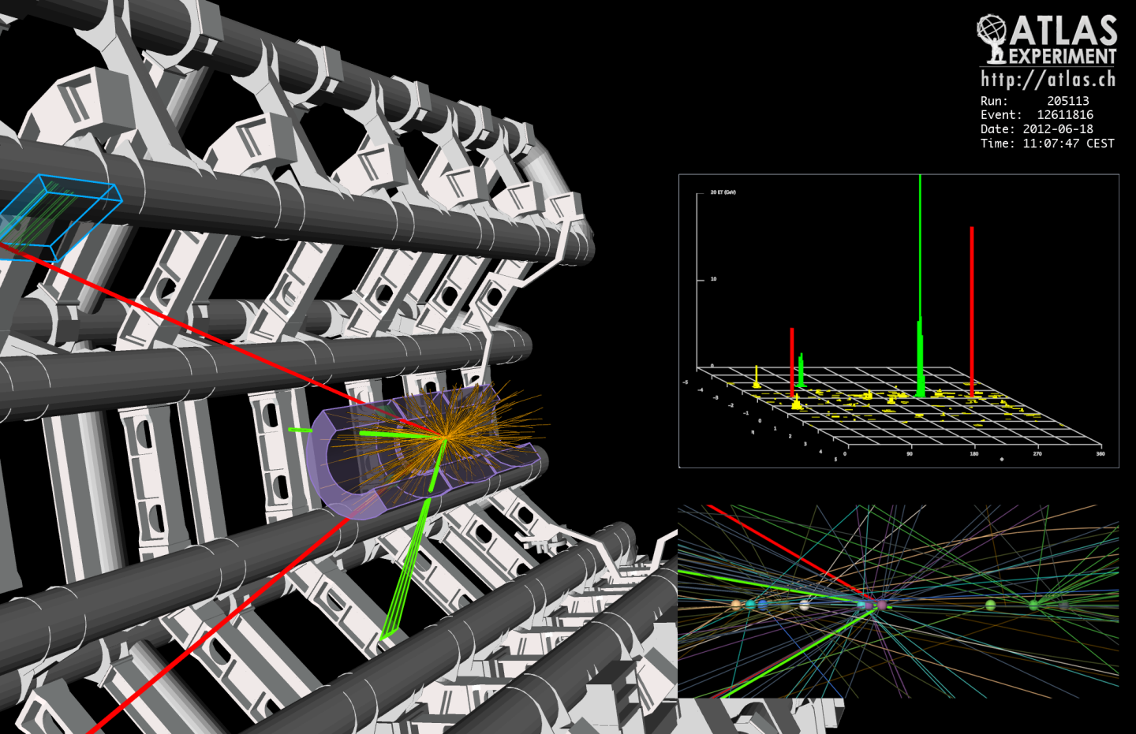
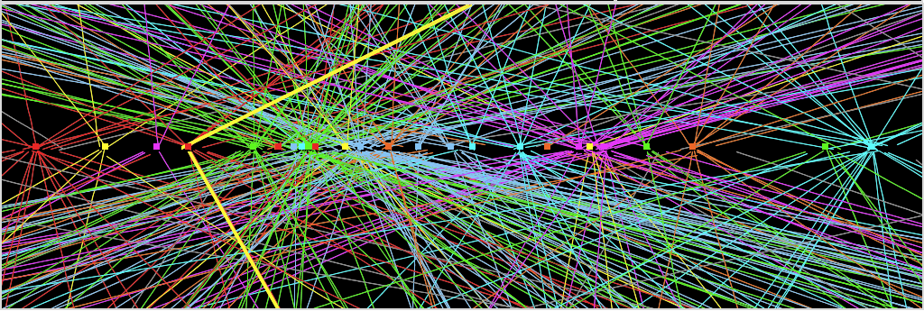
More luminosity
⇒ increased collision rate
Higgs: the needle in the haystack
Picture repeated 40 millions times each second
Z→ μμ
Z→ μμ event from 2012 data with 25 reconstructed vertices

Slide 5
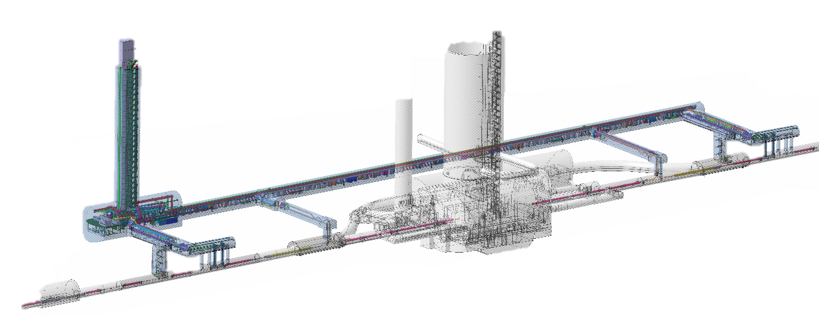
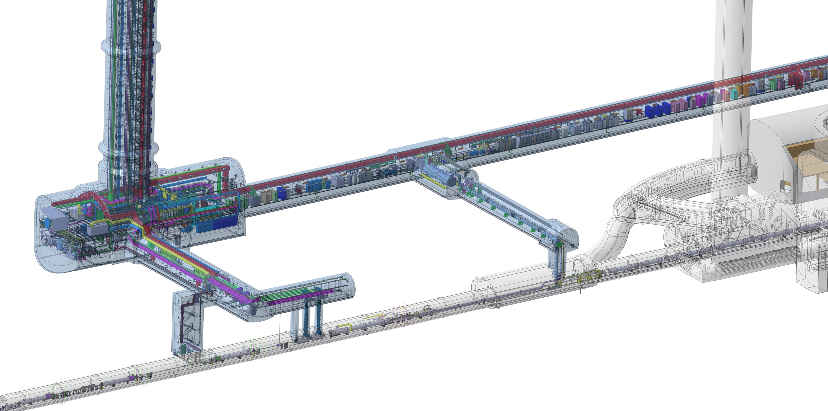
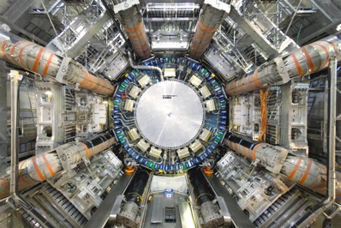
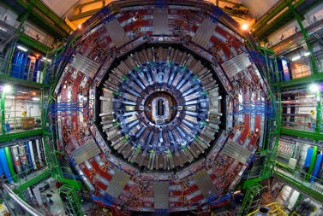
HL-LHC Scope in 1R and 5R
QDS
UR55
Warm Diodes
CLIQ
PIC,BIS
CDBs
OC EE
Valve box
DFHX
D2 OC PCs
DFHM
US57
D2 PC
D1 PC
OC PCs
UW57
PC IT
PCs IT Trims
CDBs
DSHX
D2 OC EE
UL57
Cold box
DSHM
UA57
D1
CP
Q3
Q2B
Q2A
Q1
RF Powering
DFM
DCM
Cooling and Ventilation
DFX
UPR57
Cold Diodes
TAXN
D2
DQHDS
Crab
Cavities
M. Modena and M. Mendes
Q4
Q5
Q6

Slide 6
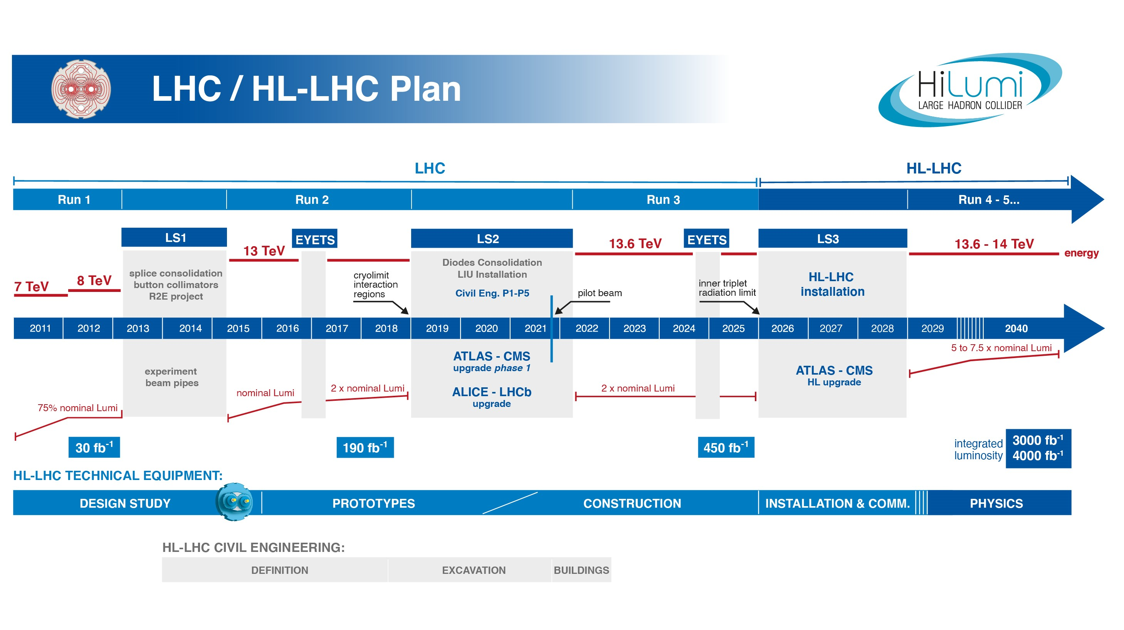
EU funded HiLumi
Design Study
Approval of
HL-LHC Project
We are here
HL-LHC Operation
Run3 operation
Over Half Way!
7 years since project approval
Less than 5 years until start Run4
Series production is well underway for all components!

Slide 7
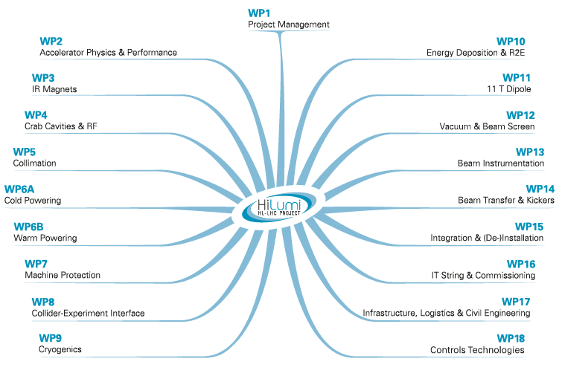
HL-LHC Project

Slide 8
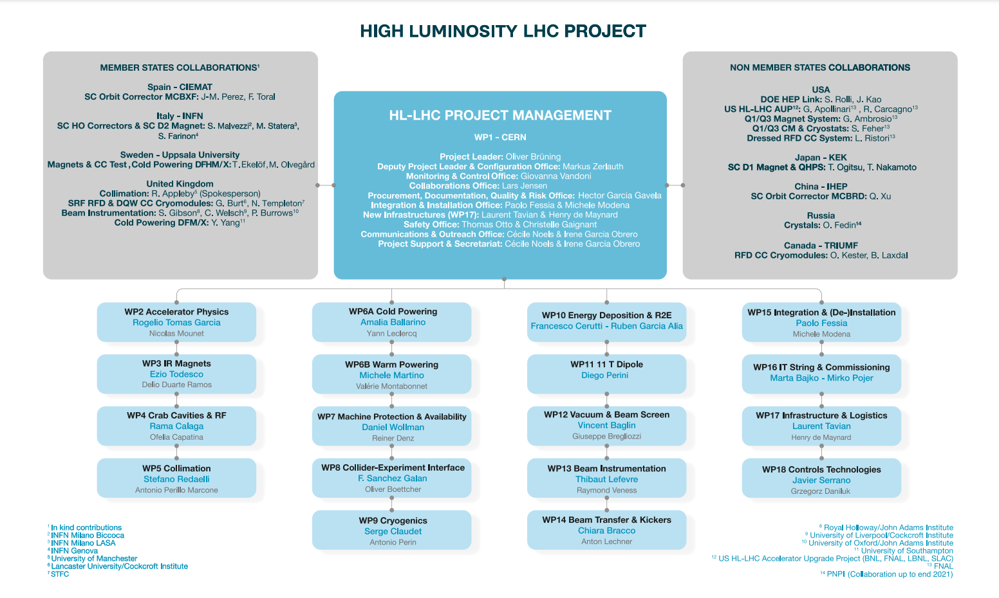
Project Structure

Slide 9
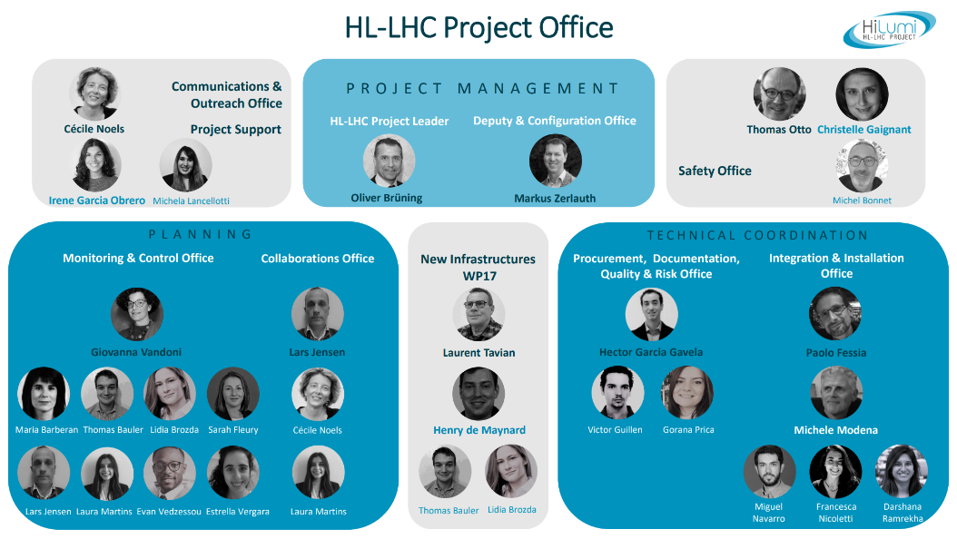

Slide 10
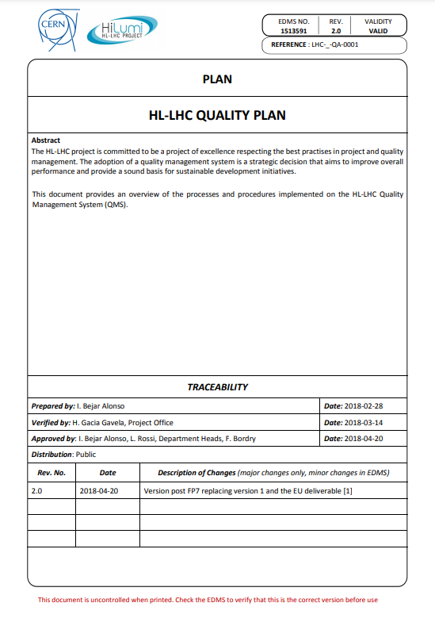
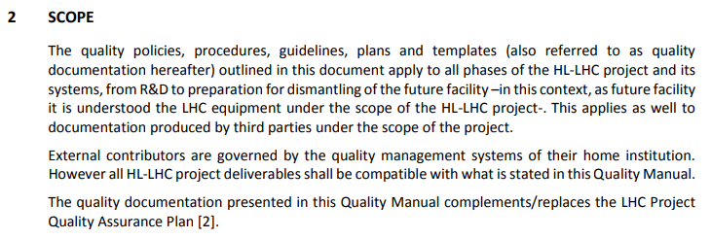
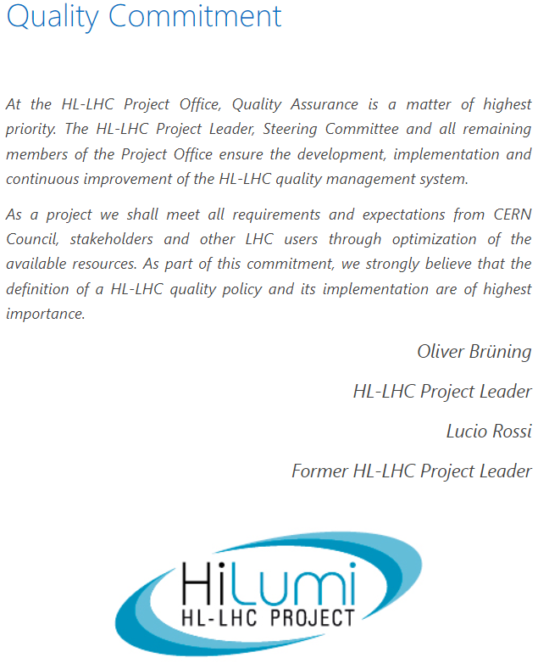
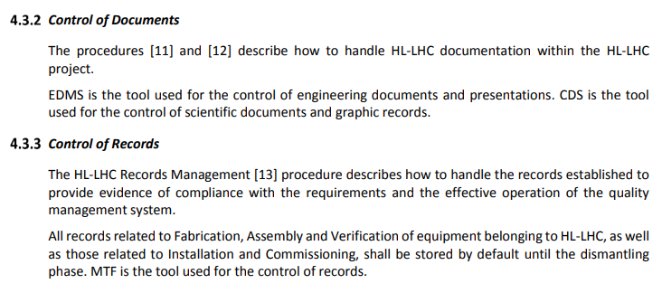
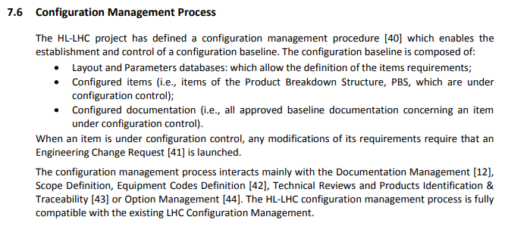
HL-LHC Quality Plan
https://edms.cern.ch/document/1513591/2.0

Slide 11
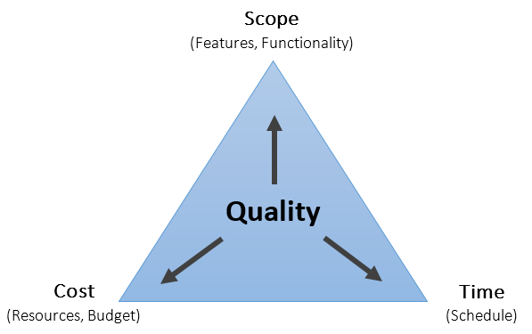
Pragmatic approach
External contributors are governed by the quality management plans of their home institute, however all HL-LHC deliverables shall be compatible with the HL-LHC Quality plan
Hardware baseline documentation stored in EDMS (primary tool for documentation at CERN)
Fabrication records in MTF (Asset management)
Project technical information accessible to all “Hilumiers”
Corporate image when representing the project

Slide 12
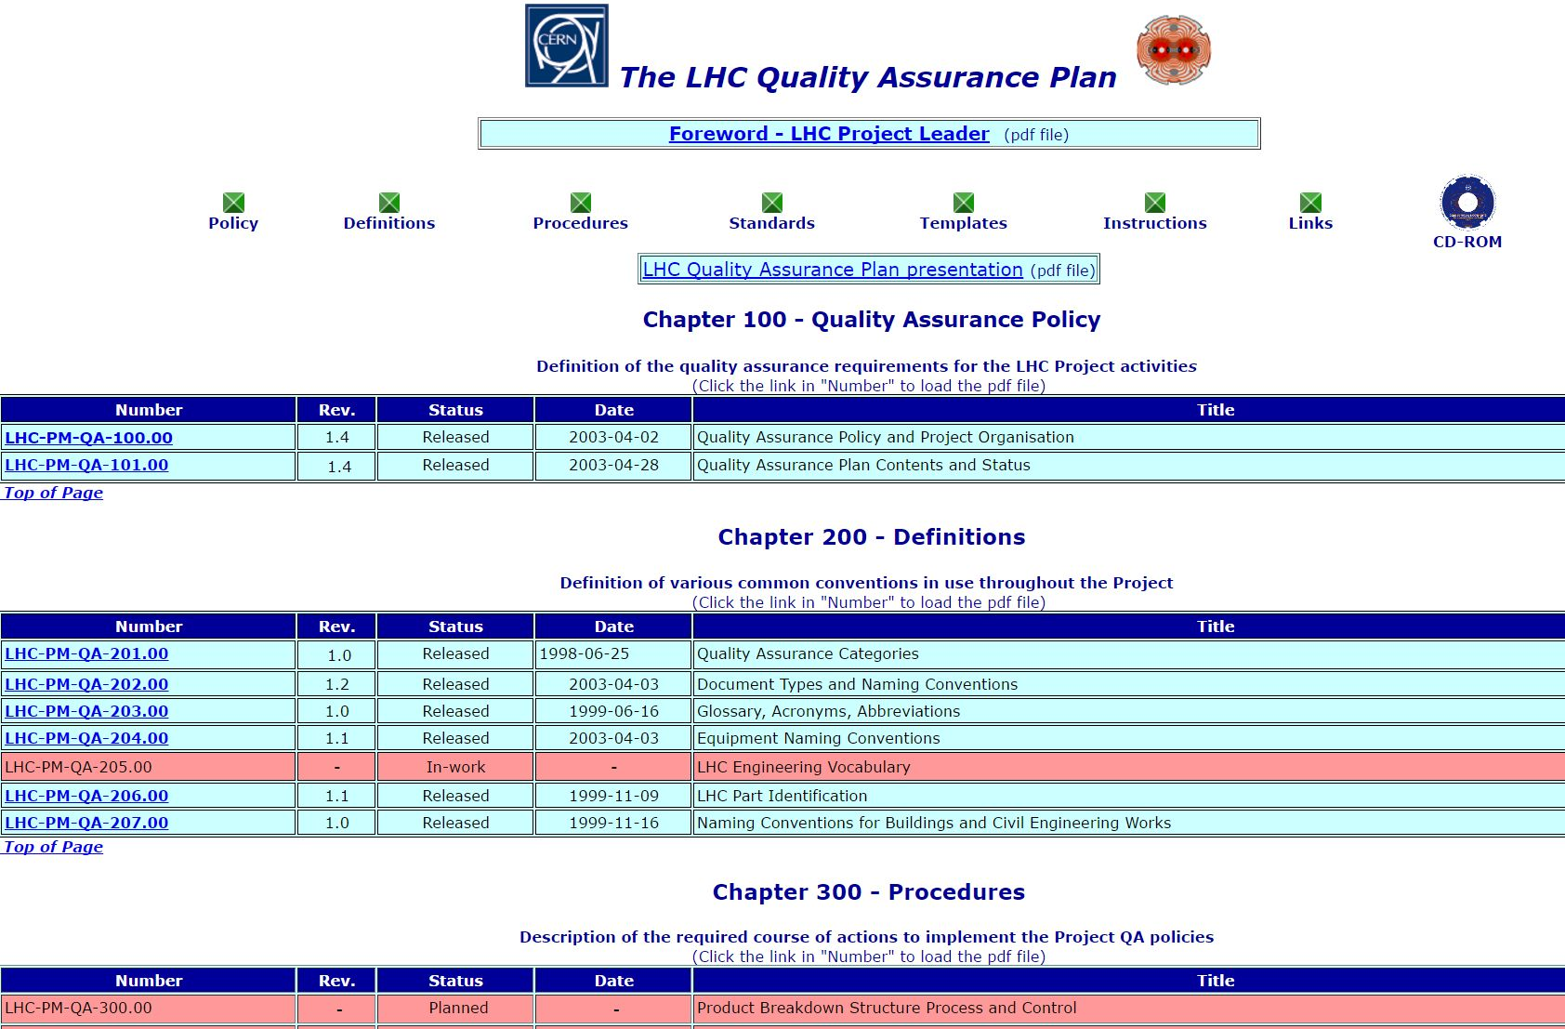
HL-LHC is an upgrade of an existing machine

Slide 13
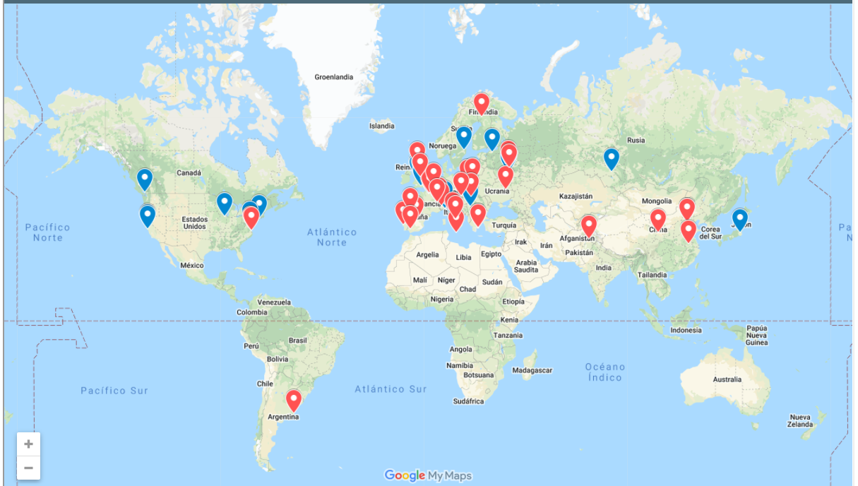
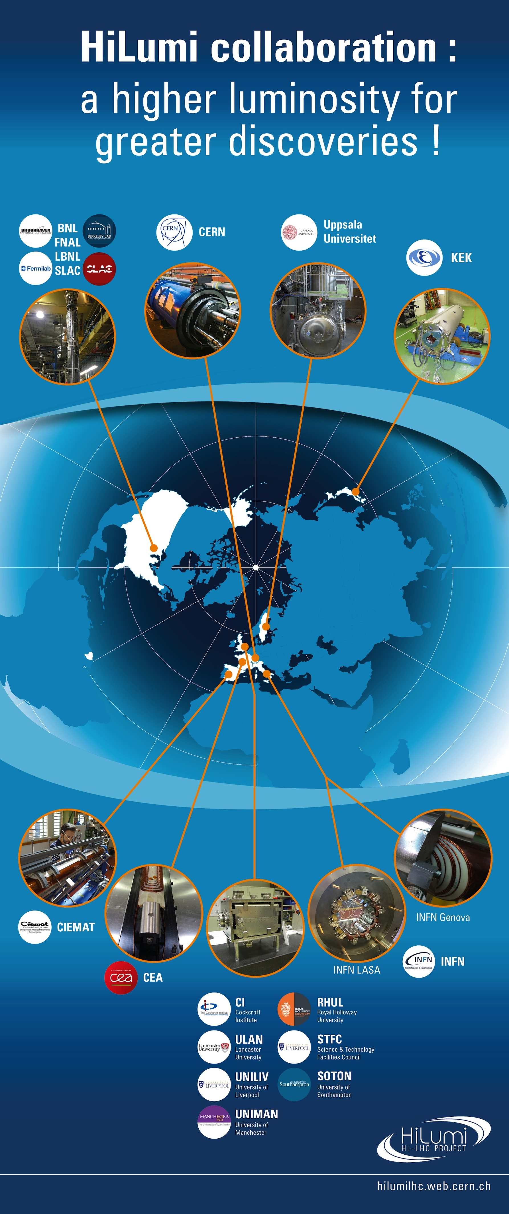
HL-LHC - A truly collaboration project

Slide 14
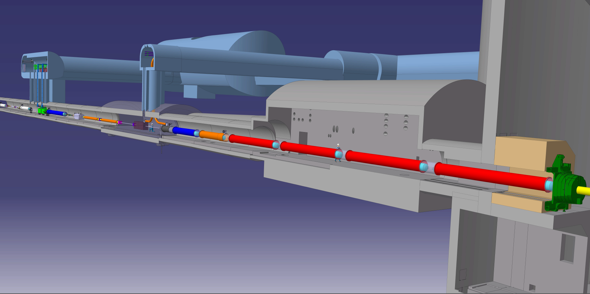




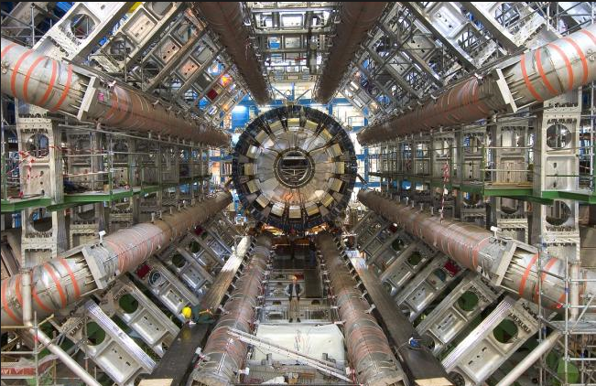


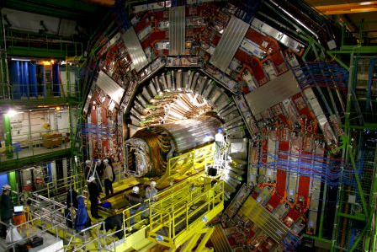
The Insertion Region (up to Q4)
Connection to LHC (UL)
Service gallery (UR)
UA Gallery
Service cavern
Q4
Collimators
SC Links
D2
Crab cavities
D1
CP
Q3
TAXN
DFM
DFX
Q2b
Q2a
Q1
TAXS
HL-LHC Introduction to hilumi newcomers

Slide 15
The MS region with in-kind contributions
UA gallery
Service cavern
(BBLR)
Q4
Crab cavities
D2
Collimators
TAXN

Slide 16
Pragmatic approach
External contributors are governed by the quality management plans of their home institute, however all HL-LHC deliverables shall be compatible with the HL-LHC Quality plan
Hardware baseline documentation stored in EDMS (primary tool for documentation at CERN)
Fabrication records in MTF (Asset management)
Project technical information accessible to all “Hilumiers”
Corporate image when representing the project

Slide 17
HL-LHC Quality Plan
HL-LHC Quality Plan: https://edms.cern.ch/document/1513591

Slide 18
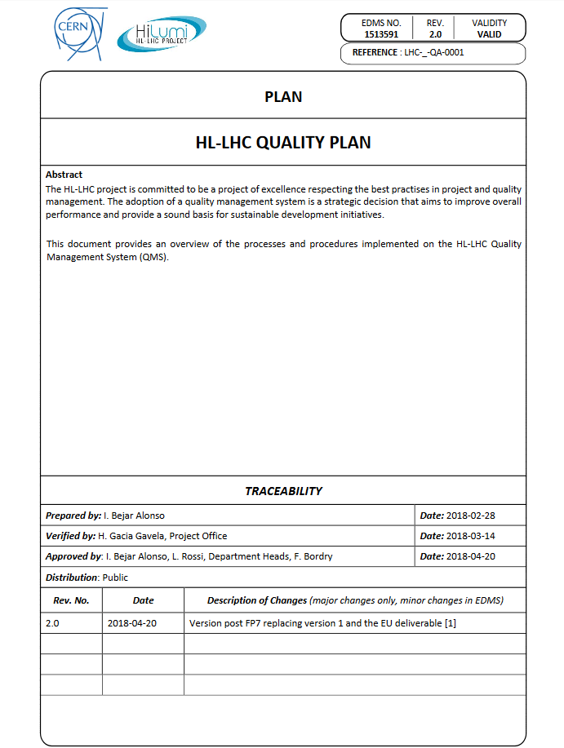
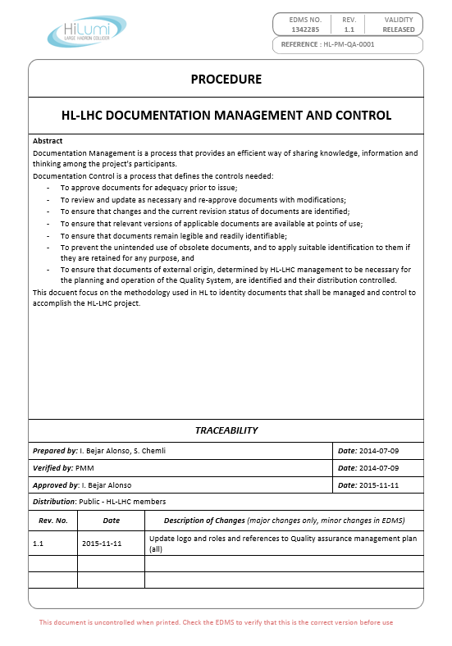
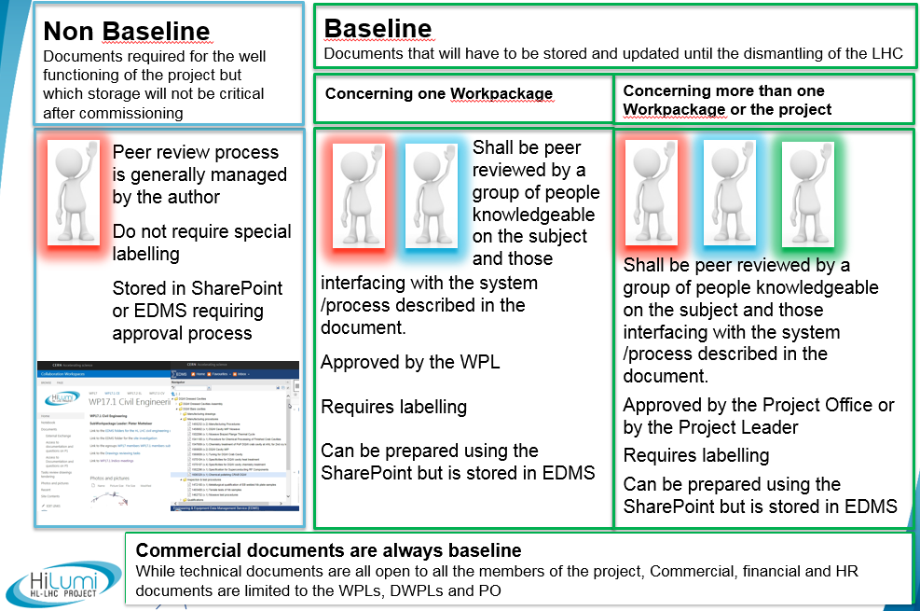
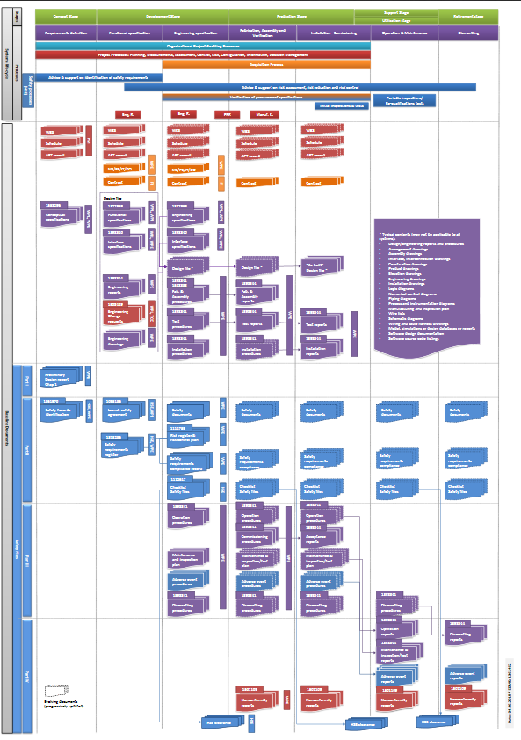







HL-LHC Quality – Some pillars
HL Quality Plan
Doc. Management & Control
It provides the procedures to be used and it explains how quality is managed for HL-LHC
Reference document for the Handling and storing of documentation
EDMS 1513591
EDMS 1342285
On top of the Quality Plan, guidelines, procedures and tools, the most important is the commitment and engagement of the people for these activities
Baseline Documentation
Tools for HL
Baseline documents that need to be issued and stored up to the dismantling of the machine
Tools available at CERN to manage documentation
EDMS 1361462

Slide 19
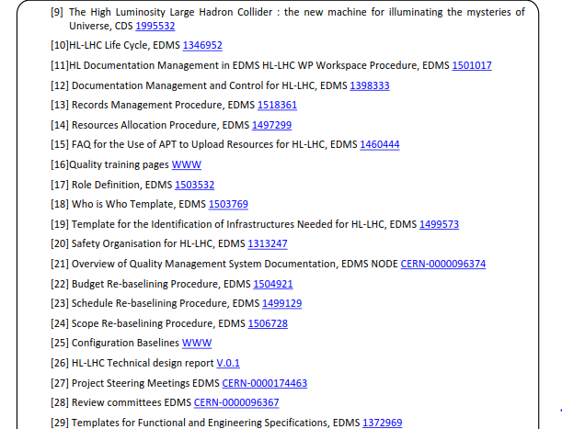
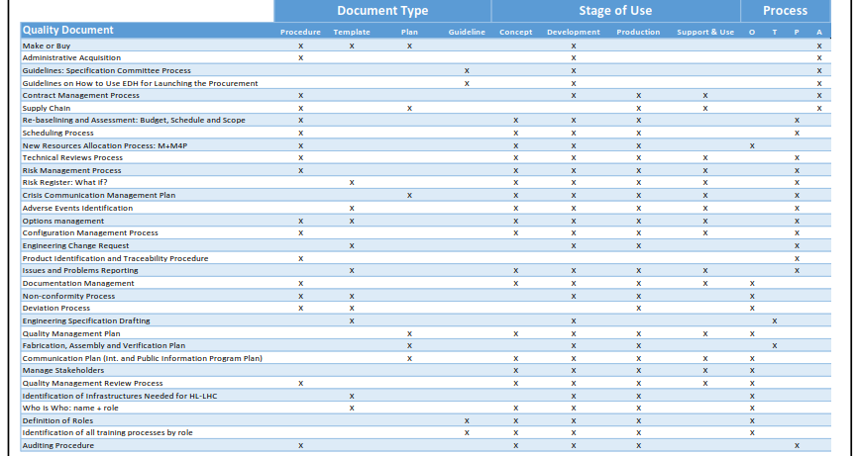
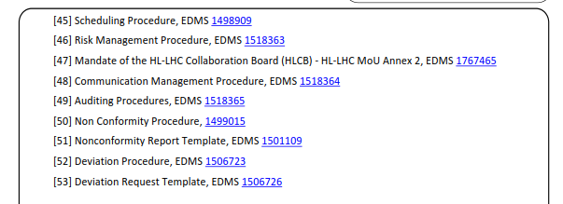
All processes documented

Slide 20
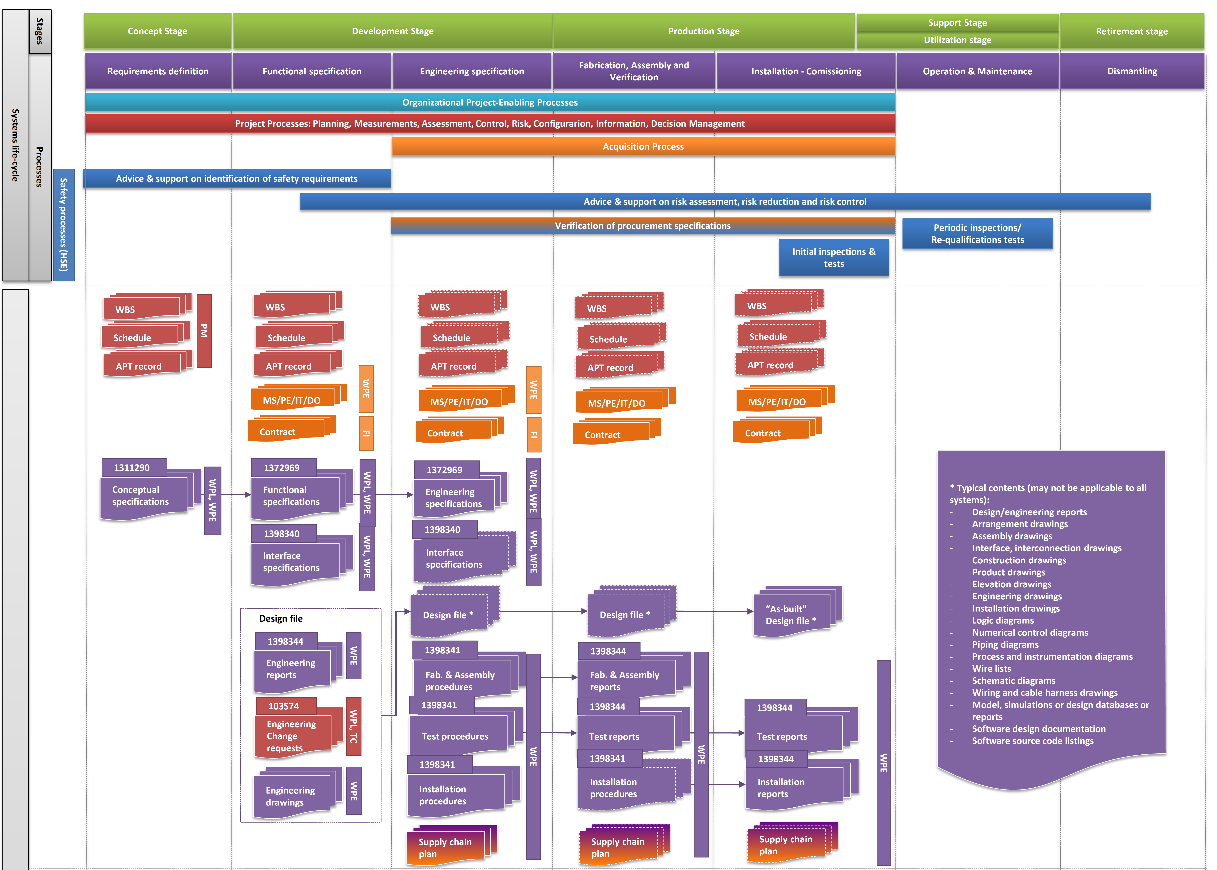
Long term documentation (1/2)
EDMS #1361462
From system requirements to technical solutions and products
Project management
Acquisition
Technical
Safety

Slide 21
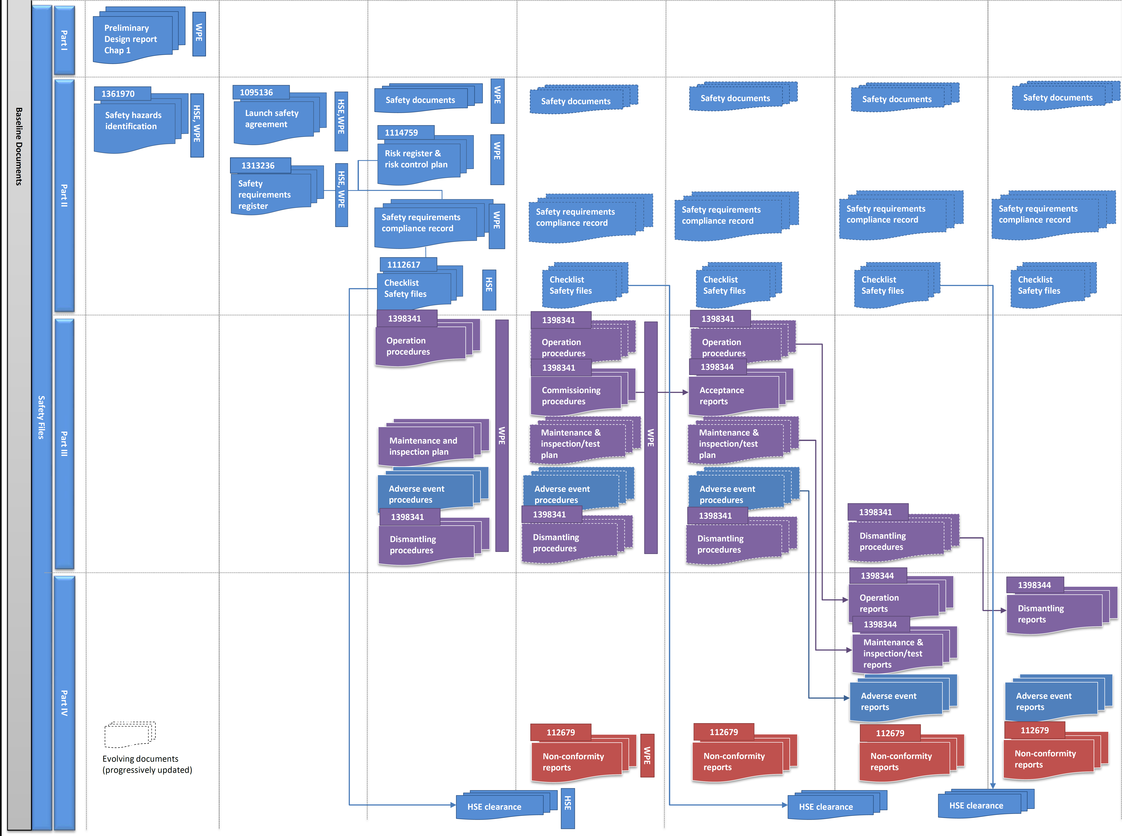
Long term documentation (2/2)
EDMS #1361462
Safety File
Links to already
existing documentation
will be made,
whenever required
Project management
Acquisition
Technical
Safety

Slide 22
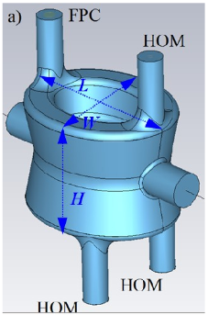
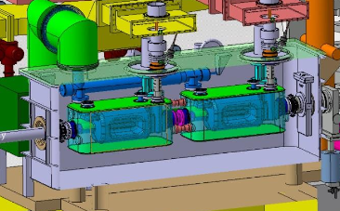
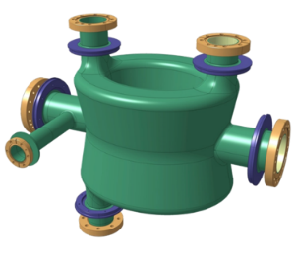
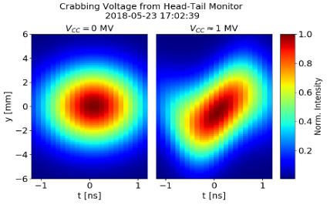
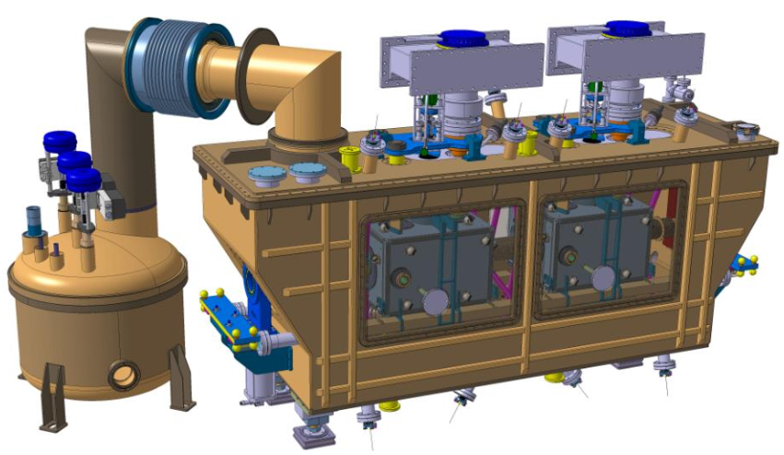
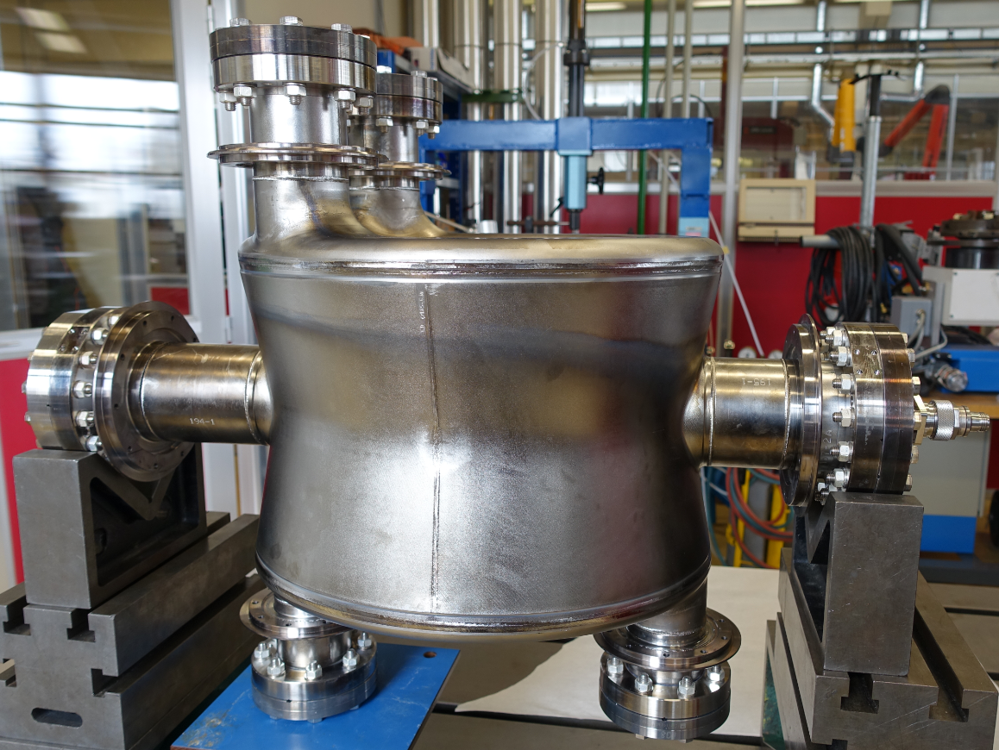
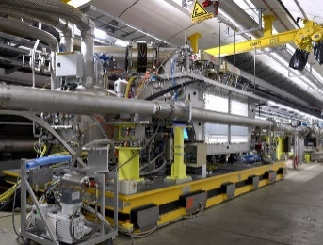
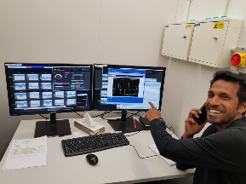
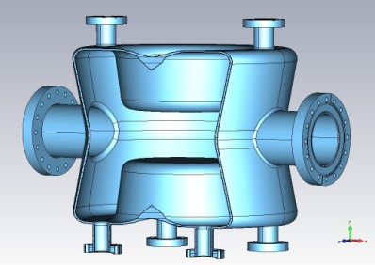
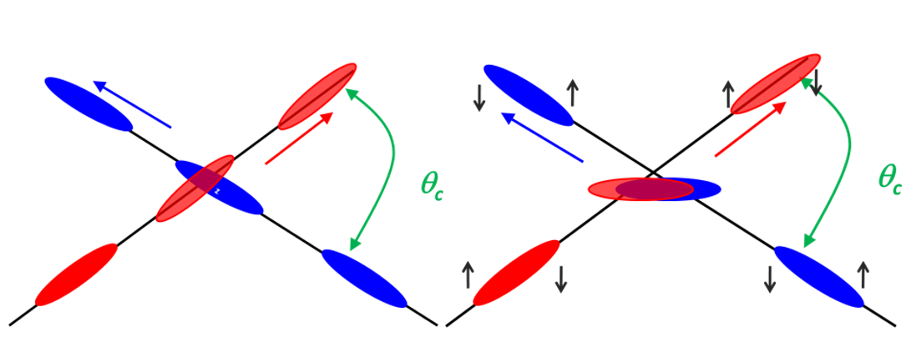
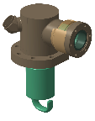
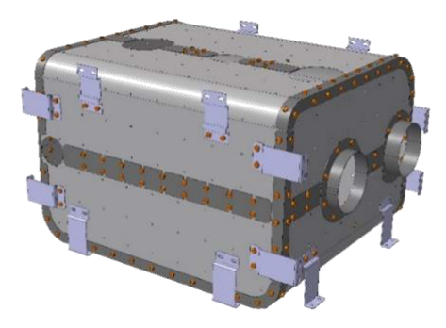
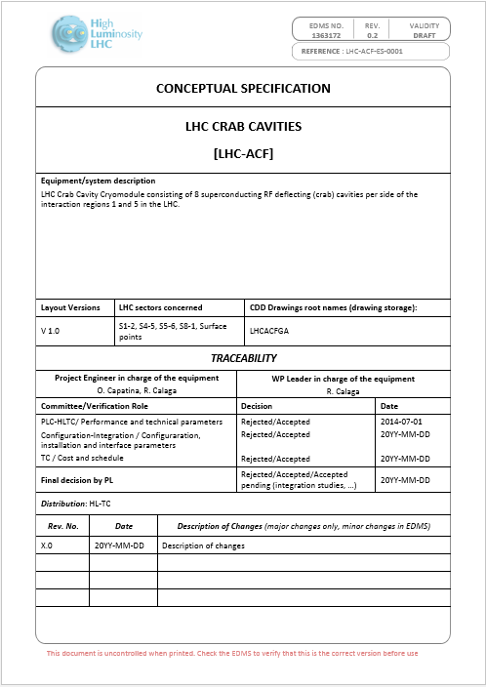
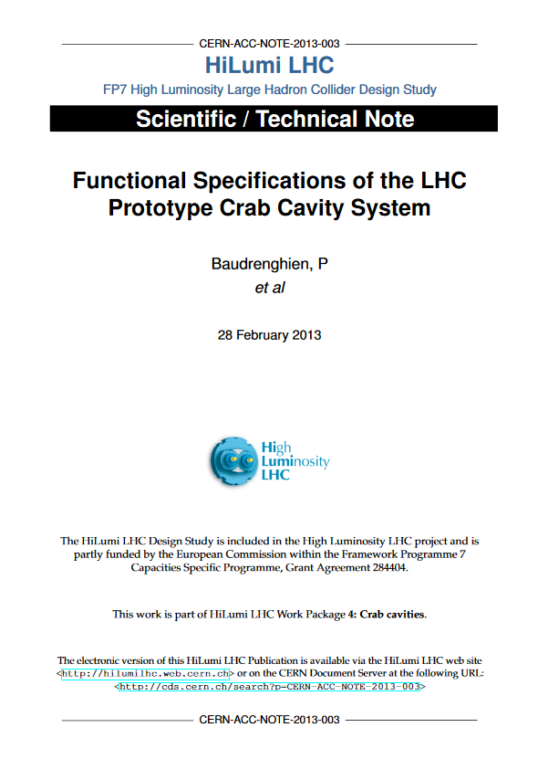
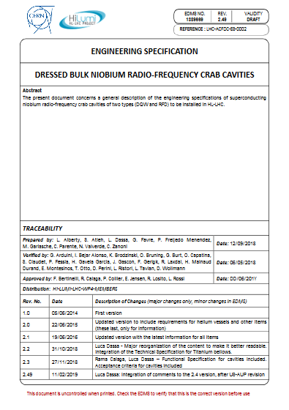
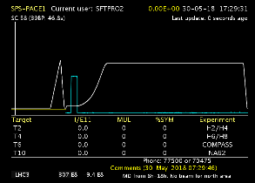
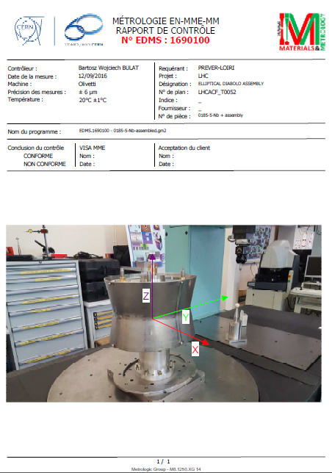
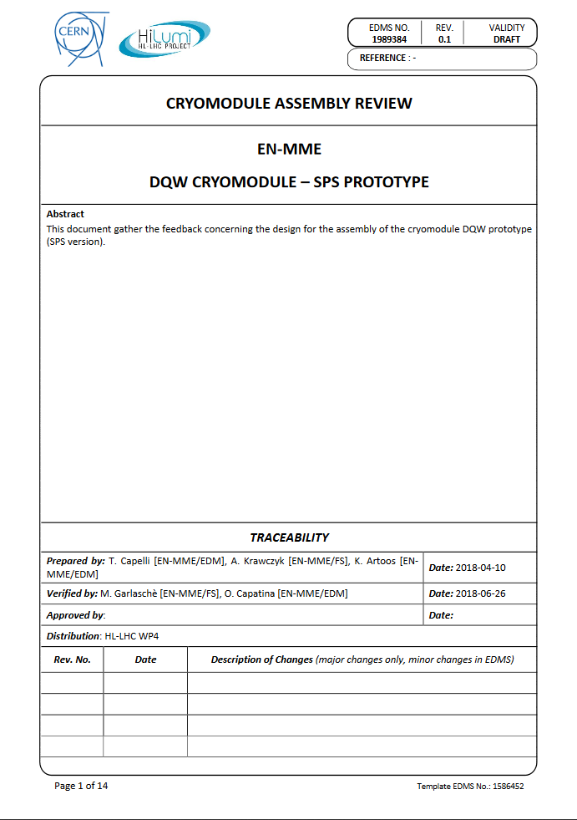
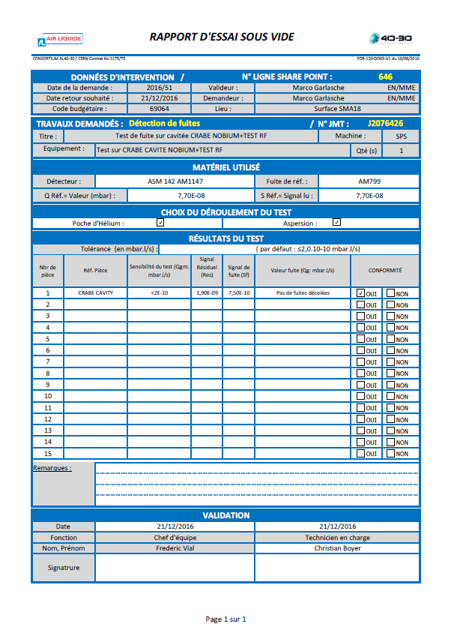







When – The full HL-LHC life-cycle
From Systems Requirements to Technical Solutions & Products

Slide 23
HL Quality Plan and EDMS Insights
Hector Garcia Gavela on behalf of the PDQR Office
CERN – 2nd Feb 2024 – EDMS 3027418

Slide 24
How – CERN Tools integrated and supported
SmarTeam/CATIA
Used to extract BOMs and check some assemblies by the QA
CDD
Used for all internal drawings and for drawing control
MTF/Infor
Used for upload and control of external drawings (collaborations and companies) w/ LHC Stamp, by import
Used for assets (equipment or batch) and EDMS documents links
EDMS
Used for items
Used for storage, approval, traceability and management of documentation (engineering, manufacturing, installation,..)
Used thoroughly by the designers that make the 3D and 2D models
Used to access CDD as the drawings are also EDMS documents
Used for equipment production follow-up and their traceability
Used for storage (KIOSK)
Used for Layout links
Used to structure the Project in the different folders following the PBS [Configuration]
Used for manufacturing data storage
Used to access assets linked to an item

Slide 25



EDMS – Requirements to access
CERN Lightweight account is required (Link to create one) to access to EDMS (Engineering & Equipment Data Management Service)Engineering & Equipment Data Management Service
1. Follow the link to register your account
2. Go to EDMS and Log in with this account
3. You will then have access to the Documentation of the Project
Notes:
Ultimate : the pink box must substitute/overlap the blue one

Slide 26

EDMS – Requirements to access
If you are going to use MTF (Equipment Management Folder), then a CERN Nice Account is required
Please contact HL-LHC.Secretariat@cern.ch
(Michela Lancellotti) in order to proceed
She will send you the details, the application form
to be filled in and the documentation to be provided
Notes:
Ultimate : the pink box must substitute/overlap the blue one

Slide 27




From system architecture to EDMS Structure

Slide 28


Specific Nodes for Collaborations
Dedicated node for each Collaboration within the main WP4 Structure
To access to CERN tools, colleagues from Collaborations need to set a lightweight account (only for EDMS access) or Nice Account (EDMS and MTF access required)
All members of HL will have the rights to create/edit documents in EDMS (under the corresponding Context)

Slide 29
Documentation - Key concepts
Baseline / Non Baseline
In my Work package / In several Work packages
Confidential (Cost, Resources, …)
Storage
Visibility
Approval

Slide 30




Documentation in one page (EDMS 1398333)
Non Baseline
Documents required for the well functioning of the project but
which storage will not be critical after commissioning
Baseline
Documents that will have to be stored and updated until the dismantling of the LHC
Concerning one Workpackage
Concerning more than one Workpackage or the project
Peer review process is generally managed by the author
Do not require special labelling
Stored in SharePoint or EDMS requiring approval process
Shall be peer reviewed by a group of people knowledgeable
on the subject and those
Shall be peer reviewed by a group of people knowledgeable
on the subject and those interfacing with the system /process described in the document.
Approved by the Project Office or by the Project Leader
Requires labelling
Can be prepared using the SharePoint but is stored in EDMS
interfacing with the system /process described in the document.
Approved by the WPL
Requires labelling
Can be prepared using the SharePoint but is stored in EDMS
Commercial documents are always baseline
While technical documents are all open to all the members of the project, Commercial, financial and HR documents are limited to the WPLs, DWPLs and PO

Slide 31



EDMS Engineering node
Documentation during this phase
Specifications
Drawings
Calculations
Simulations
Engineering notes
Bill of Materials, List of Materials

Slide 32


EDMS Fabrication, Assembly, Verification node
Documentation during this phase
Manufacturing Procedures
Test Procedures
Assembly Procedures
Manufacturing and Inspection Plans
Qualifications
Manufacturing Records – MTF
https://edms-service.web.cern.ch/faq/EDMS/pages/tutorials.html
EDMS Tutorials

Slide 33












CC for SPS – The full HL-LHC life-cycle
MTF

Slide 34


EDMS Release Procedures
EDMS Documents (specifications, MIPs, procedures) issued by the Collaboration will be issued under the Context: HL-LHC-WP4-CANADA
MTF Documents (production reports/certificates/nonconformities) issued by the Collaboration will be issued under the Context: HL-LHC-WP4-CANADA-MTF

Slide 35

EDMS Release Procedures

Slide 36

EDMS Release Procedures

Slide 37

EDMS Release Procedures

Slide 38
Documentation
Type of Document | Examples | Context to be used | Release Procedure
Procedures | Assembly Procedures, MIPs | HL-LHC-WP4-CANADA | HL-AL
Procurement Specifications | Specifications used for the procurement of cryomodule components | HL-LHC-WP4-CANADA | HL-OWNER
Calculations |  | HL-LHC-WP4-CANADA | HL-OWNER
Manufacturing Records | Material certificates, dimensional reports, leak check reports, NDTs reports, etc. | HL-LHC-WP4-CANADA -MTF | HL-OWNER
Nonconformities | NCRs arisen during production | HL-LHC-WP4-CANADA -MTF | HL-NCR
If Deviation Requests need to be issued, then contact WP4 (Marco, Luca) and HLPO (PDQR Office). We will take care of the formal approval (HL-BASELINE with HL-AL release procedure)

Slide 39
HL-LHC Quality Plan – Traceability of Changes
Document | Purpose | Reference | EDMS Docs
Engineering Change Request | Modification of the current Project Baseline: There is a modification on the scope defined in the technical baseline (TDR) There is a need of extra funds to pay for an object that was in the baseline and can not be funded by internal reorganization of the budget for the same equipment (Budget ECR) If the modification affects the present LHC machine an ECR is submitted using the normal LHC ECR circuit | TDR – Scope Baseline PBS – Project Breakdown Structure MTP – Cost Baseline | Process 2429904 Template HL-LHC ECRs 1508429 LHC ECRs Link
Schedule Change Request | Trace and record relevant variances in the Master Schedule wrt. the one endorsed and approved in the last Cost & Schedule Review (CSR). For deliverables related to LHC installation or IT String installation: - If the shift is > 2 months (LHC installation) : An SCR shall be issued. - If the shift is > 1 months (IT String): An SCR shall be issued. | MS – Master Schedule | Process 2735444 Template 2725175
Decision Management Reports | Trace managerial decisions without modifying the Project Baseline. Formalize a technical decision between several options or sharing of managerial decisions Internal re-scheduling w/o affecting the baseline Revaluation of the cost |  | Template 1501719
Deviation Requests | Request to do something different from an established requirement for a limited number of components, for a brief period, or for a specific use | Engineering Specifications Design/Manufacturing files Technical Specifications | Process 1506723 Template 1506726
Safety Request | In case the deviation concerns exclusively a safety requirement. If so, it is not necessary to create a deviation request on the top of the Safety request. | Safety Requirements Technical Specifications Engineering Specifications | Template 1770077
Nonconformity | Non fulfilment of an established requirement (they are more production oriented) | Engineering Specifications Design/Manufacturing files Technical Specifications | Process 1499015 Template 1501109
Notes:
Ultimate : the pink box must substitute/overlap the blue one

Slide 40


Manufacturing Records in MTF
MTF is an integral part of EDMS.
This tool is used to store the manufacturing data during production and grant traceability (what goes where)
Workflow (more or less complex) shall be integrated following the Manufacturing & Inspection Plan (MIP)
Manufacturing reports shall be provided to CERN along the production (including Nonconformities)
For reference – MTF Training given in June 2020 to the UK Colleagues: https://edms.cern.ch/document/2385803/1.0

Slide 41
(Some) Conclusions
Everybody should feel responsible for Quality and not just the people that are more devoted to this activity
Documentation is a key part of any project
  It provides provision of objective evidence;
  It proves the conformity of the requirements established by a customer;
  It enables repeatability and traceability of the work done
HL-LHC is an upgrade of an existing machine (LHC). Existing rules are to be followed Pragmatic Approach with our Collaborations
HL-LHC tried to implement an industrial approach within the boundary conditions of the Research centers: Traceability, documentation, control of changes etc. are ‘a must’ for any project at large scale
Important to keep traceability (what goes where) along the full life-cycle
The correct use of EDMS/MTF is of paramount importance in order to store, handle and retrieve information in later stages
Standardization for all the CERN members and Collaborations
Continuous improvement as a quality principle and support from PDQR Office

Slide 42

What use to happen at the end of the projects
other

Slide 43

Thank you for your attention
Link to EDMS

Slide 44
Why the office was created
SUPPORT: Rules without support are just papers
OPTIMIZATION: Engineers had to concentrate on the technical solutions
HARMONIZATION: We have 20 institutes working for the project and tens of CERN groups
RULES: The LHC quality plan was obsolete

