Slide 1
SM18 Bench upgrade meeting
30 Jan 2024

Slide 2
Structure
Entering new phase to operation and commissioning. Bench upgrade coordination combined with test coordination by Gerard. Many thanks to Marco for getting us this far.
Main tasks for 2024 (simplified):
Bench A2:
Shuffling module – Fréderic S.
Electrical modifications – Gaëlle
Commissioning – Gaëlle + Remi
Test Q3 - Gaëlle
Additional modifications for CP - Gaëlle
Test CP - Gaëlle
Bench B2
Finish test D1 proto direct connection - Gaëlle
Shuffling module – Fréderic S.
Commissioning – Gaëlle + Remi
Test D1 – Gaëlle
Bench C2
Shuffling module – Hervé
Commissioning – Gaëlle + Remi
Test D2 series - Gaëlle
Supporting tasks (same importance 😉)
Shaft storage and trolley in bench E – Marco
Anti-cryostats – Carlos
PLC – Olivier D.
CRG, including cryo sensors – Olivier P.
uQDS – Jelena -> Daniel
Mechanical modifications (yellow structures) – Gaëlle
Power converters – Frédéric D.
DQHDS & Energy Extraction – TE-MPE
Safety documentation – Gerard/Marco/everyone
Budgets/budgets codes - Gerard
No longer discussed as upgrade has been completed (exceptions apply when we need to learn from it)
Bench F1: First magnet tested. (4.5 K cryo commissioning to complete, quench recovery time to be optimized).
Bench F2: First link is connected, electrical checks ongoing, final warm cables placed, next week ready for cool down.
uQDS – In use for cluster F1 and F2. Minor debugging ongoing and part of operational process.
Software and GUI for uQDS, data conversion and analysis – In use, well advanced and debugging ongoing.

Slide 3
Bench A2
Following the inputs from from tasks and mpp tool
Done
Shuffling module - Design - All pieces available
CFB - 2 and 20 kA leads installed and tested
Powering and protection - 2 kA EE installed - DHQDS installed - DC cabling? - AC cabling?
Demineralized water?
Measurement electronics: - DMM - uQDS - PotAim
PLC, interlocks and Cryo-OK - Wiring OK - CRG Logic defined and implemented? - PLC for Anti-Cryostat temperature control
Anti-Cryostat short and long segments ready
Ongoing
Shuffling module - Installation (Frédéric) - support frame + Phase separator - Brazing SC splice to CFB+Vtaps+insulation - Extension of N,XY lines - Other cryo lines + cantilever support - Final support frame + Thermal screen = vacuum vessel
Shuffling module instrumentation - Cryo instrumentation pinout definition - Cabling of cryo sensor (internal) - Cabling of cryo sensor (external) Instrumentation box (Vtaps) installation and cabling
Electrical circuit - Cleanup electrical cabling (Gaëlle) - Wiring IFS to bench? -
To be done/To be decided/Future action points
Shuffling module before Q3 - Commissioning
Commissioning with Q3 - All systems
Preparation for CP (after Q3 test) - 2 uQDS to be ordered and installed
Safety and co-activity
Note: D1 magnet in test on bench B2 until 16 February.
Reporting during the meeting by Frederic:
- X-line is installed, N-line with sous-marine valve is installed.
- M-line pressure test in SMI2 failed due to non-conform welding. Spare bellow placed and ready next week.
- To be efficient, CRG advanced the intervention on compressed air system piping in the time needed for the M-line bellow repair.
- Additional connector needed for pressure sensors on the connector box. To be acquired.

Slide 4
Bench B2
Done
Shuffling module - Design - All pieces available?
Ongoing
D1-proto test in direct connection
To be done/To be decided/Future action points
Shuffling module installation
For discussion in a next meeting
Safety and co-activity

Slide 5
Bench C2
Done
Shuffling module - Design - All pieces available?
uQDS in use for D1 test.
Short anti-cryostats finished.
Ongoing
First Long anticryostat almost completed.
Geometric survey done – integration of anti-cryostat in CFB to be updated.
To be done/To be decided/Future action points
Shuffling module installation
For discussion in a next meeting
Safety and co-activity

Slide 6
Other items
F1 polarity switch in one 2 kA circuit - Guillaume - DC cabling - AC cabling Foreseen for 6-week shutdown around June/July 2024

Slide 7
Documents - Plans
Q3 integration in Bench A2:LHCMMQQXFS0001 (Draft) CP integration in Bench A2: ???
Risk analysis A2 - Olivier
Safety files and clearance for F2 powering – ongoing.
Validation of design drawings and safety documentation are important
Table is an early draft, I would like to fill it in in the next two weeks.

Slide 8
Meetings strategy 2024:
General meetings through zoom (I think bi-weekly is OK, but suggestions welcome)
Some topical discussions
- F1 Shuffling module lessons learnt
  Which changes have been propagated from F1 to A2?
  Are there still cryo (hardware) optimizations to be done?
Technical meetings where needed, in person. Organized by me, Hervé or Frederic.
- C2 CFB + shuffling module + Anti cryostat integration
- A2 CFB + shuffling module advancement
Etc.
Focus on test capabilities for deliverables of WP6, WP7 and WP8, but also o diagnostics and measurements for feedback to WP5.

Slide 9
Priorities
Priority 1: Shuffling module A2 -> Test Q3 - > Test CP
Priority 2, in parallel: Shuffling module C2 designs and plans
Shuffling module B2: lower priority

Slide 10
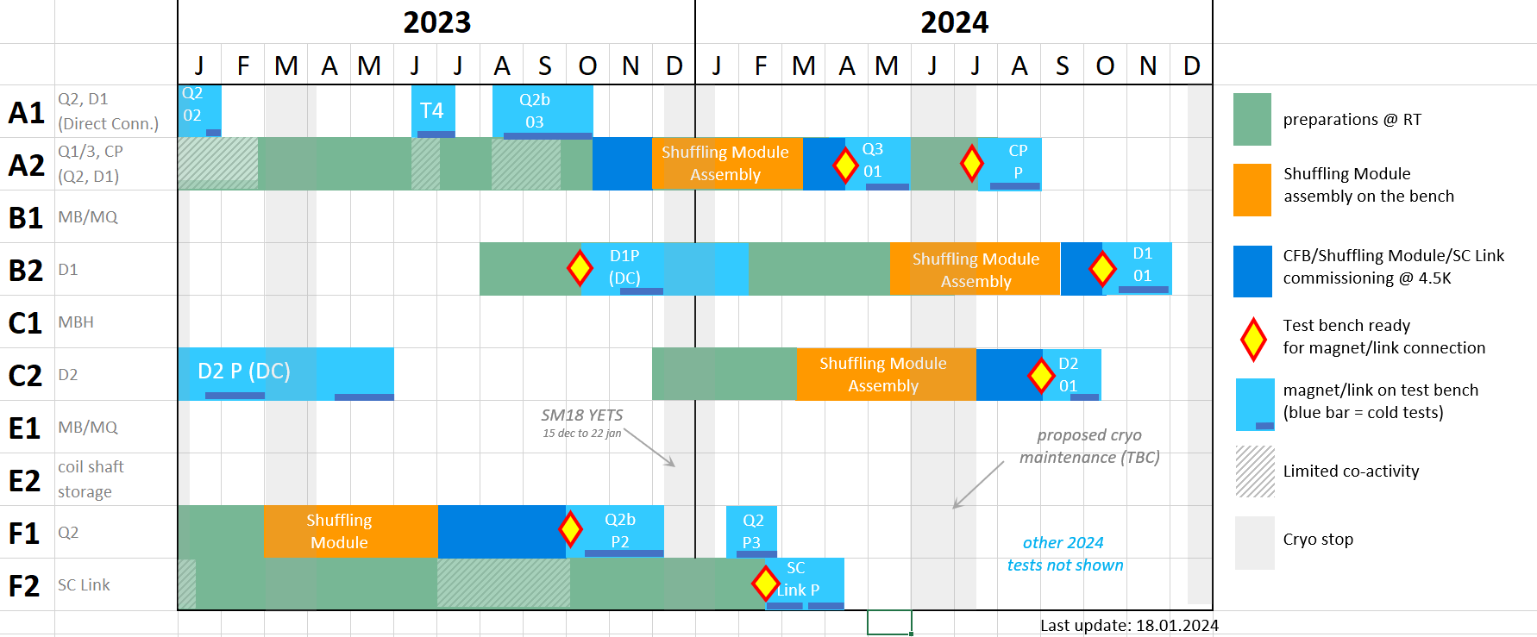
General discussion, suggestion, comments/Tour du Table
Usefull links
Indico site (minutes)
Horizontal test benches upgrade schedule (detailed, MPP + PDF files)
Horizontal test benches upgrade summary (Excel file)

